Slide 1
ITRF - LhARA
General Facility Infrastructure and Integration
ITRF WP2 & LhARA WP1.6
1272-pa1-wp2-prs-0010-v1.0-ITRF-24-month-design-review-WP6-infrastructure-2024-09-02
24 Month Design Review
2nd September 2024
Clive Hill, UKRI-STFC-Daresbury Laboratory, On behalf of the team
Notes:
The abstract pattern can be removed or repositioned if required. Be careful to ‘Send to Back’ so that it does not obscure any important information.

Slide 2
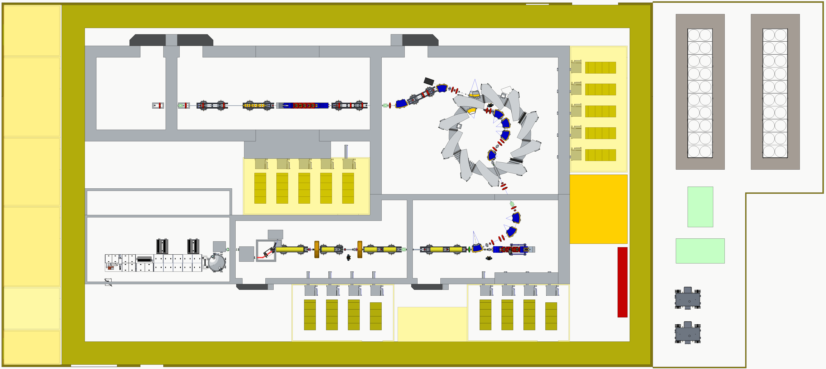
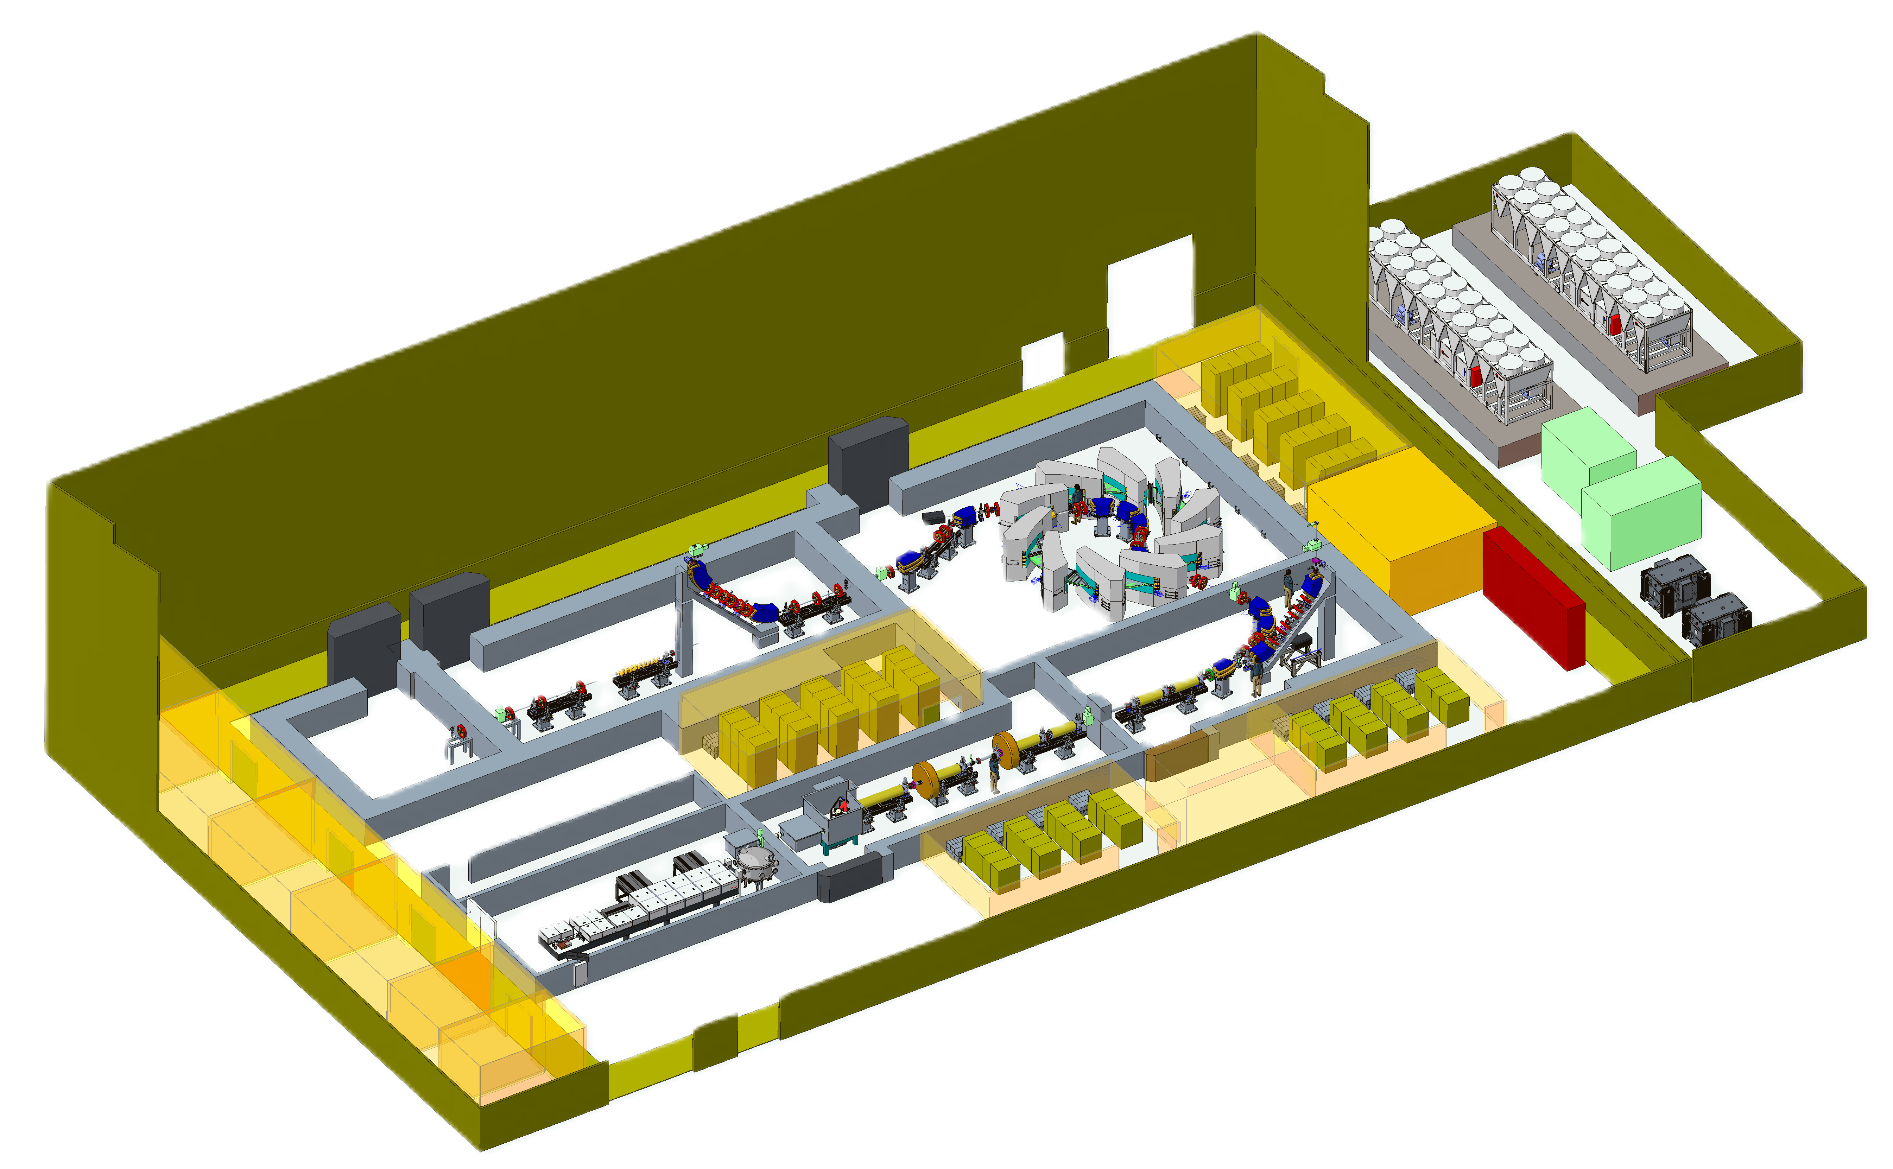
71m
Facility Layout Ground Floor
In Vivo Control Room
Access
Rack Room 4
Fixed Field Accelerator
In Vivo Prep Room
Area 6
Area 5
High Energy Line
Water chiller
Water chiller
In Vivo User
Station
Rack Room 3
Assembly and Clean Room
Concrete Shielding
Area 4
Outside Pen
32m
15-127 MeV Protons
5-34 MeV/u Ions
Access
Laser Room Technical Corridor
Rack Room 4
Water Plant Room Heat Exchangers
Water
Tank
Acc Control Room
Laser Room
Target & Capture Room
Low Energy Line
Area 1
Pumps
Fenced Area
Area 2
Area 3
15 MeV Protons
Switchboard
Meeting Room
Transformers
Rack Room 1
RF Room
Rack Room 2
Office

Slide 3
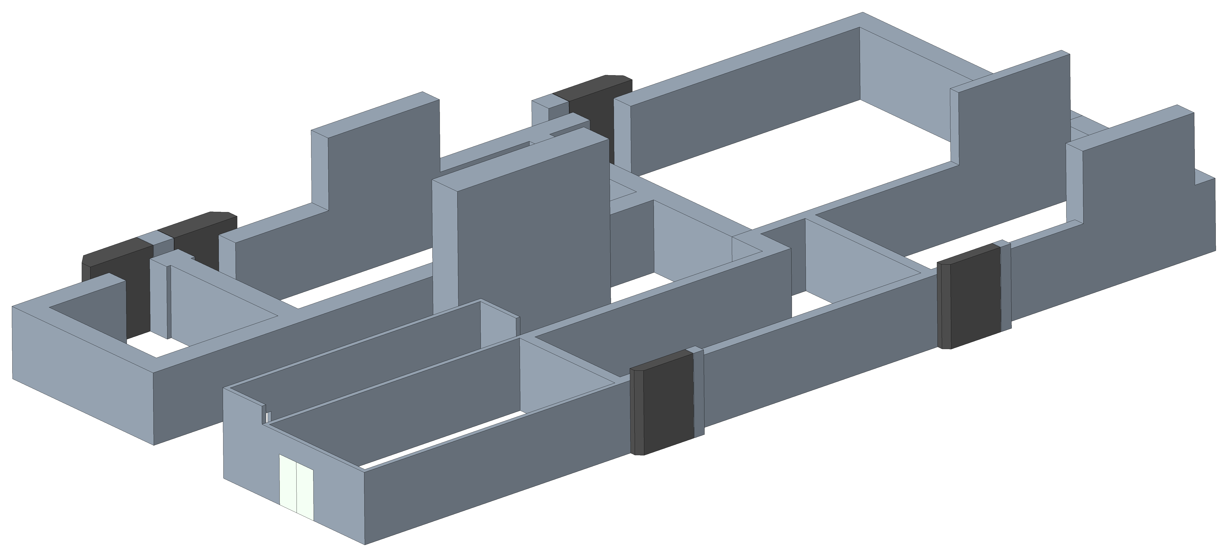
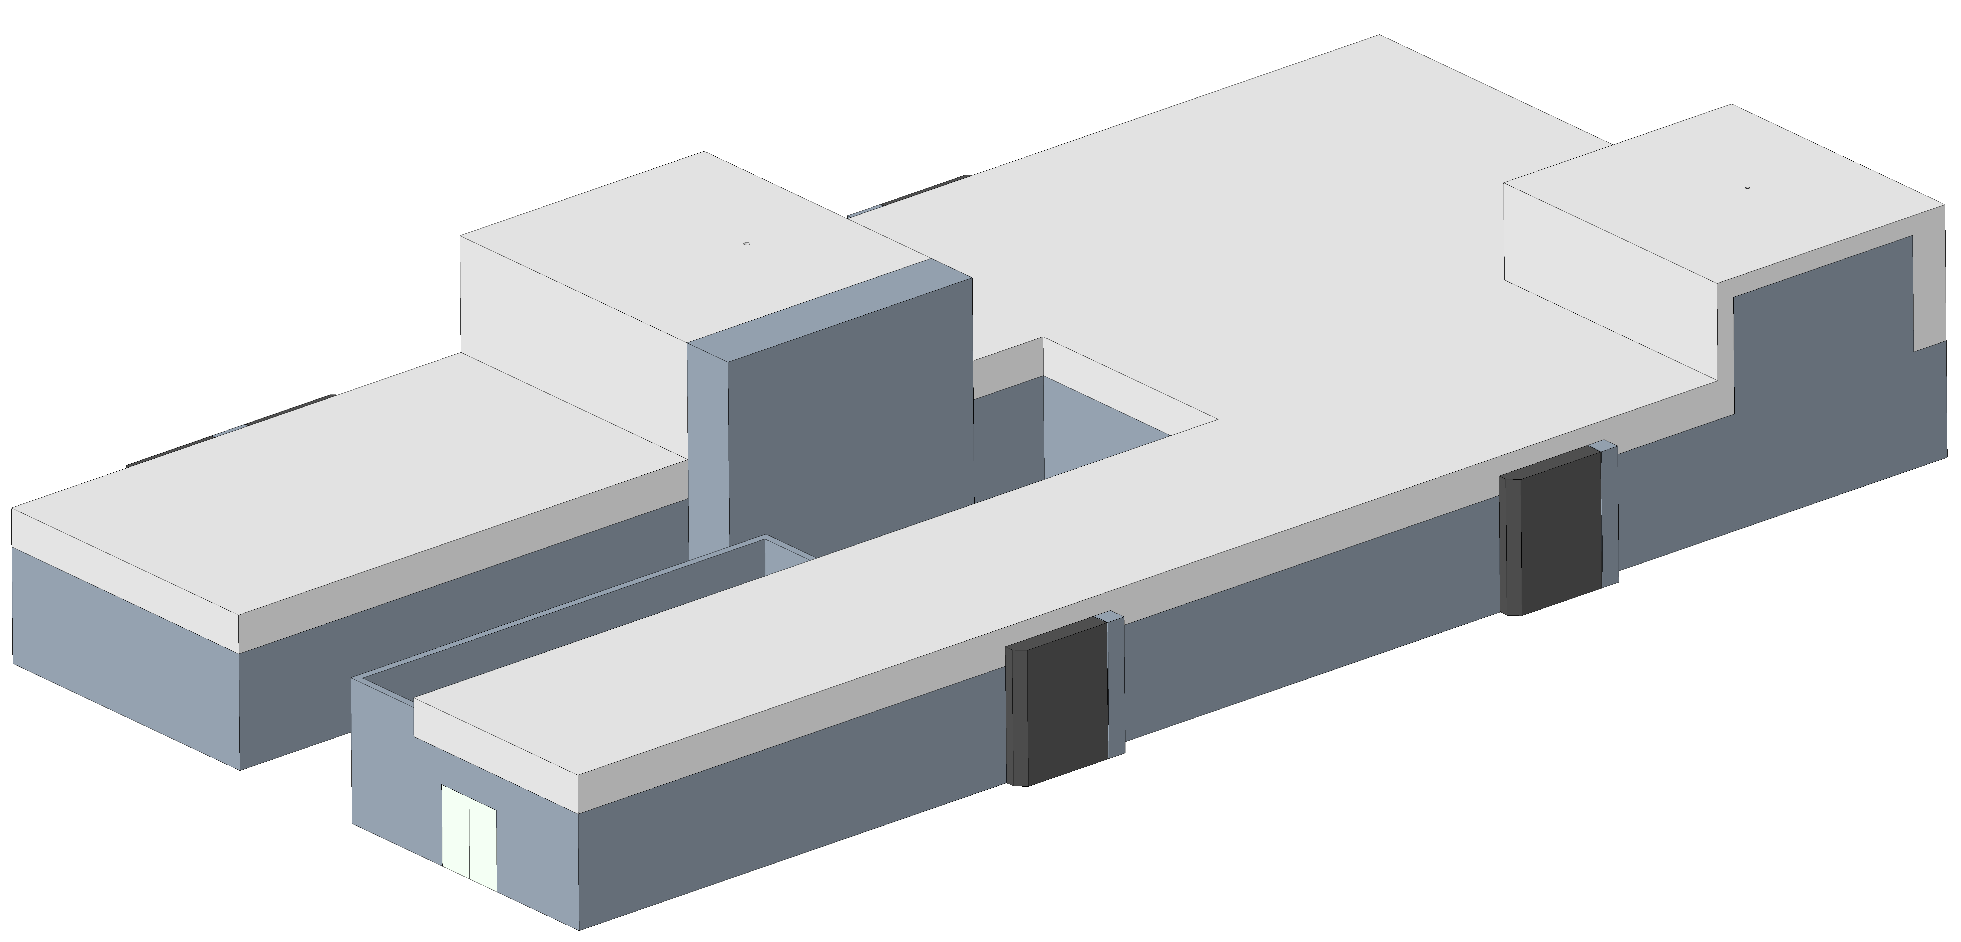
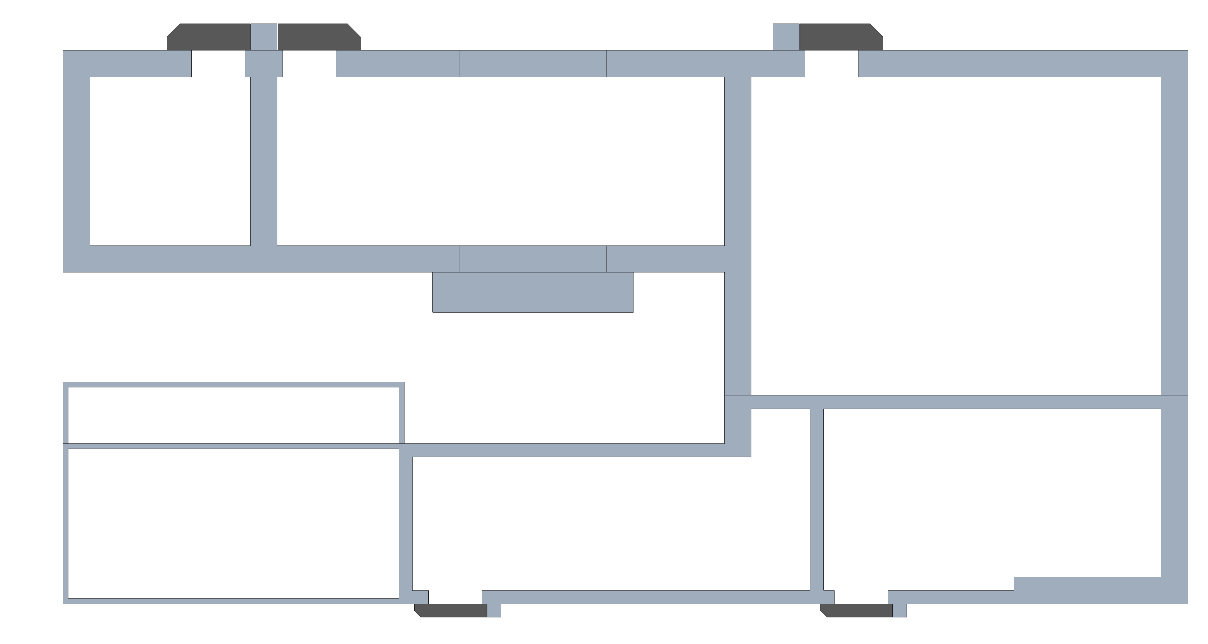
Concrete Bunker Shielding
Low Energy In Vitro Station
High Energy In Vitro Station
Access doors
6.3m
In Vivo Station
High Energy Line
6m
16.7m
12m
Concrete Shielding Thickness (Assumptions)
Target and Capture 0.5m
Low Energy Line 0.5m
FFA Area 1.0m
High Energy Line 1.0m
In Vivo Station 1.0m
FFA
15.3m
5.6m
Laser Room
Target and Capture
Low Energy Line
12.3m
14.8m
12.6m

Slide 4
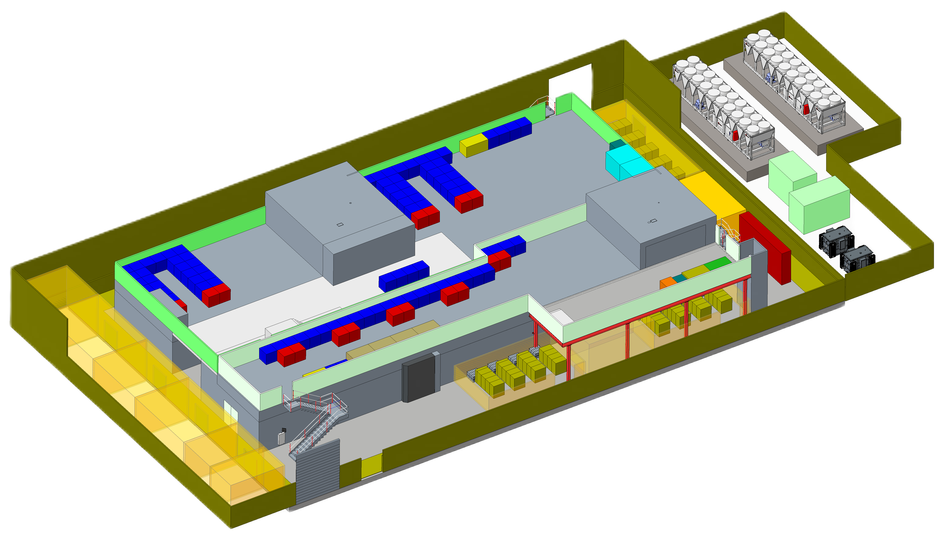
Facility Layout First Floor
High Energy In Vitro Station
High Energy Line
Low Energy Line
Low Energy In Vitro Station

Slide 5
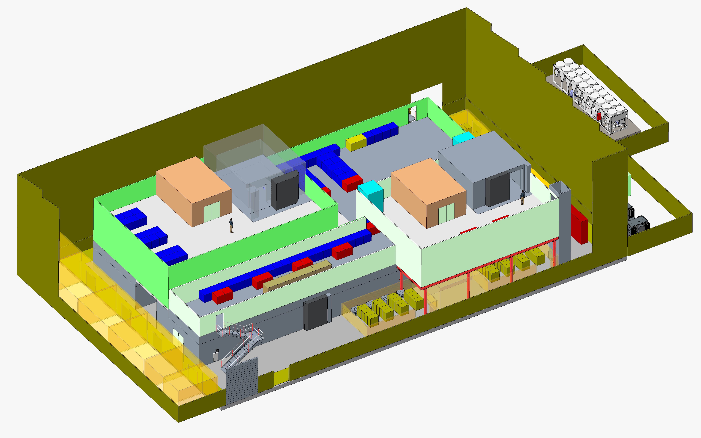
Facility Layout Second Floor
High Energy In Vitro Station
Low Energy In Vitro Station
Control Station
Control Station

Slide 6
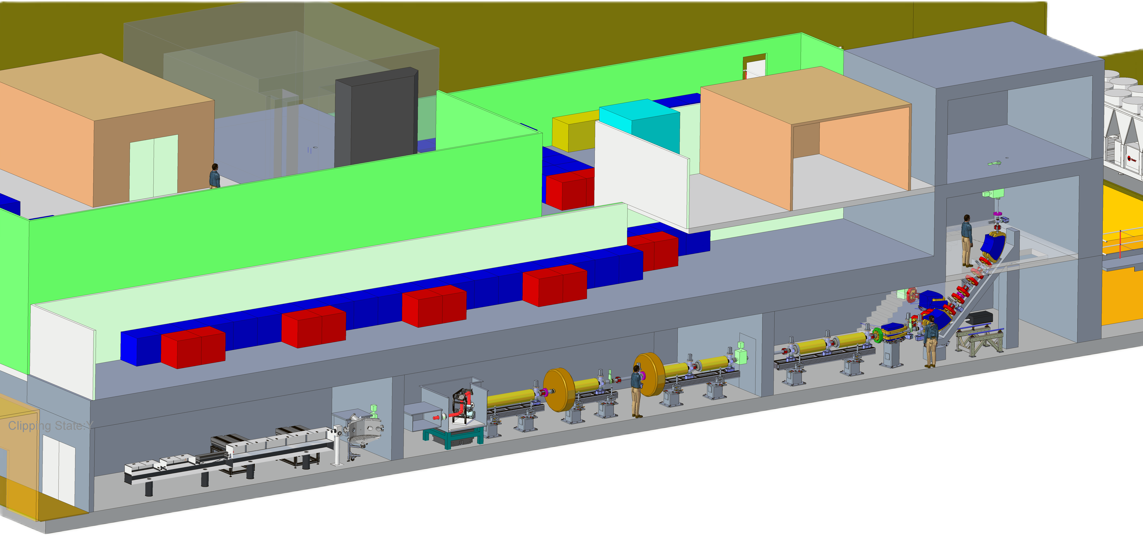
Low Energy Line
Low Energy In Vitro End Station
3m
Low Energy In Vitro End Station
Low Energy Line
Capture
100 TW Ti:Sapphire Laser
Target System

Slide 7
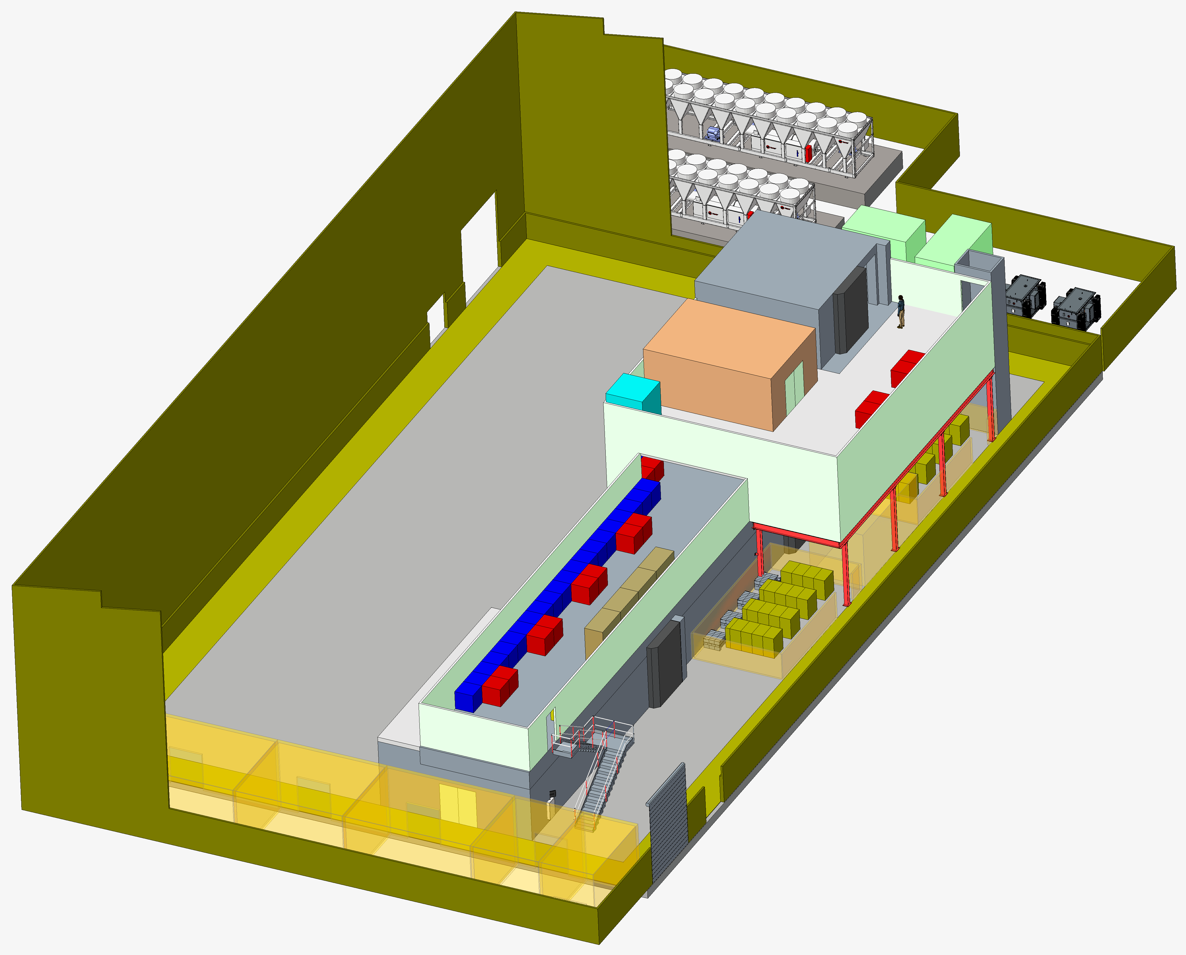
Stage 1 Low Energy Line
Low Energy In Vitro End Station

Slide 8
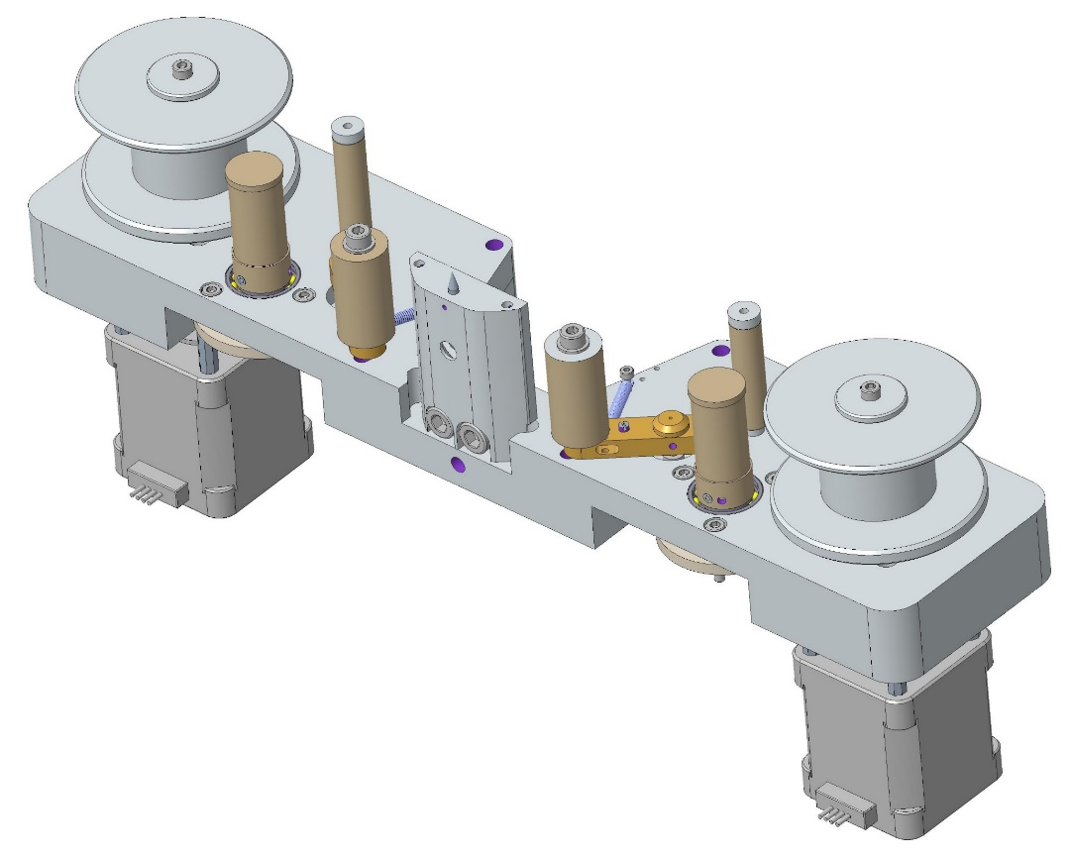
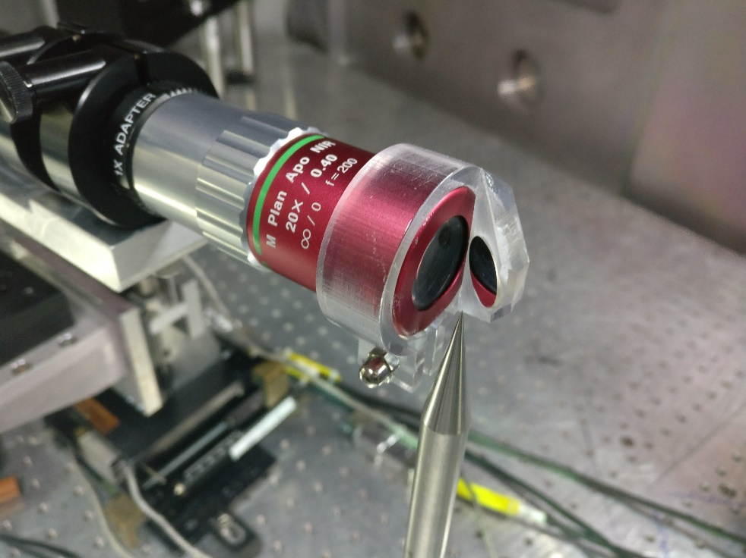
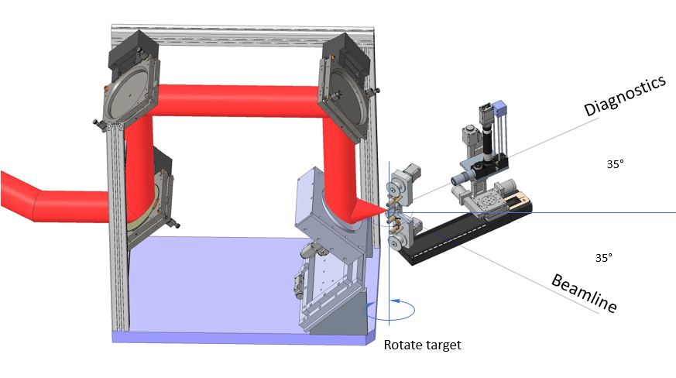
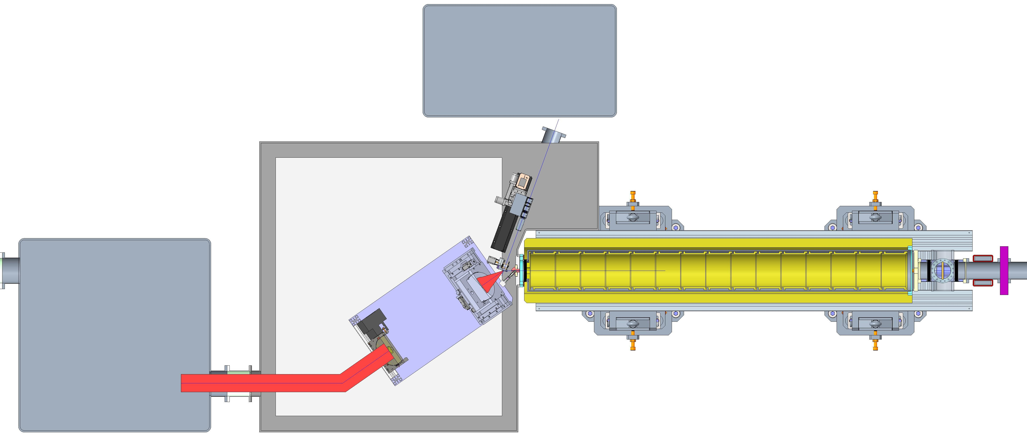
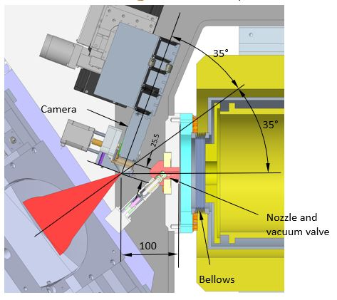
Tape Target
Camera
Tape Target
Diagnostics chamber
Diagnostics Camera
Tape target
35°
35°
Gabor Lens 01 & 02

Slide 9
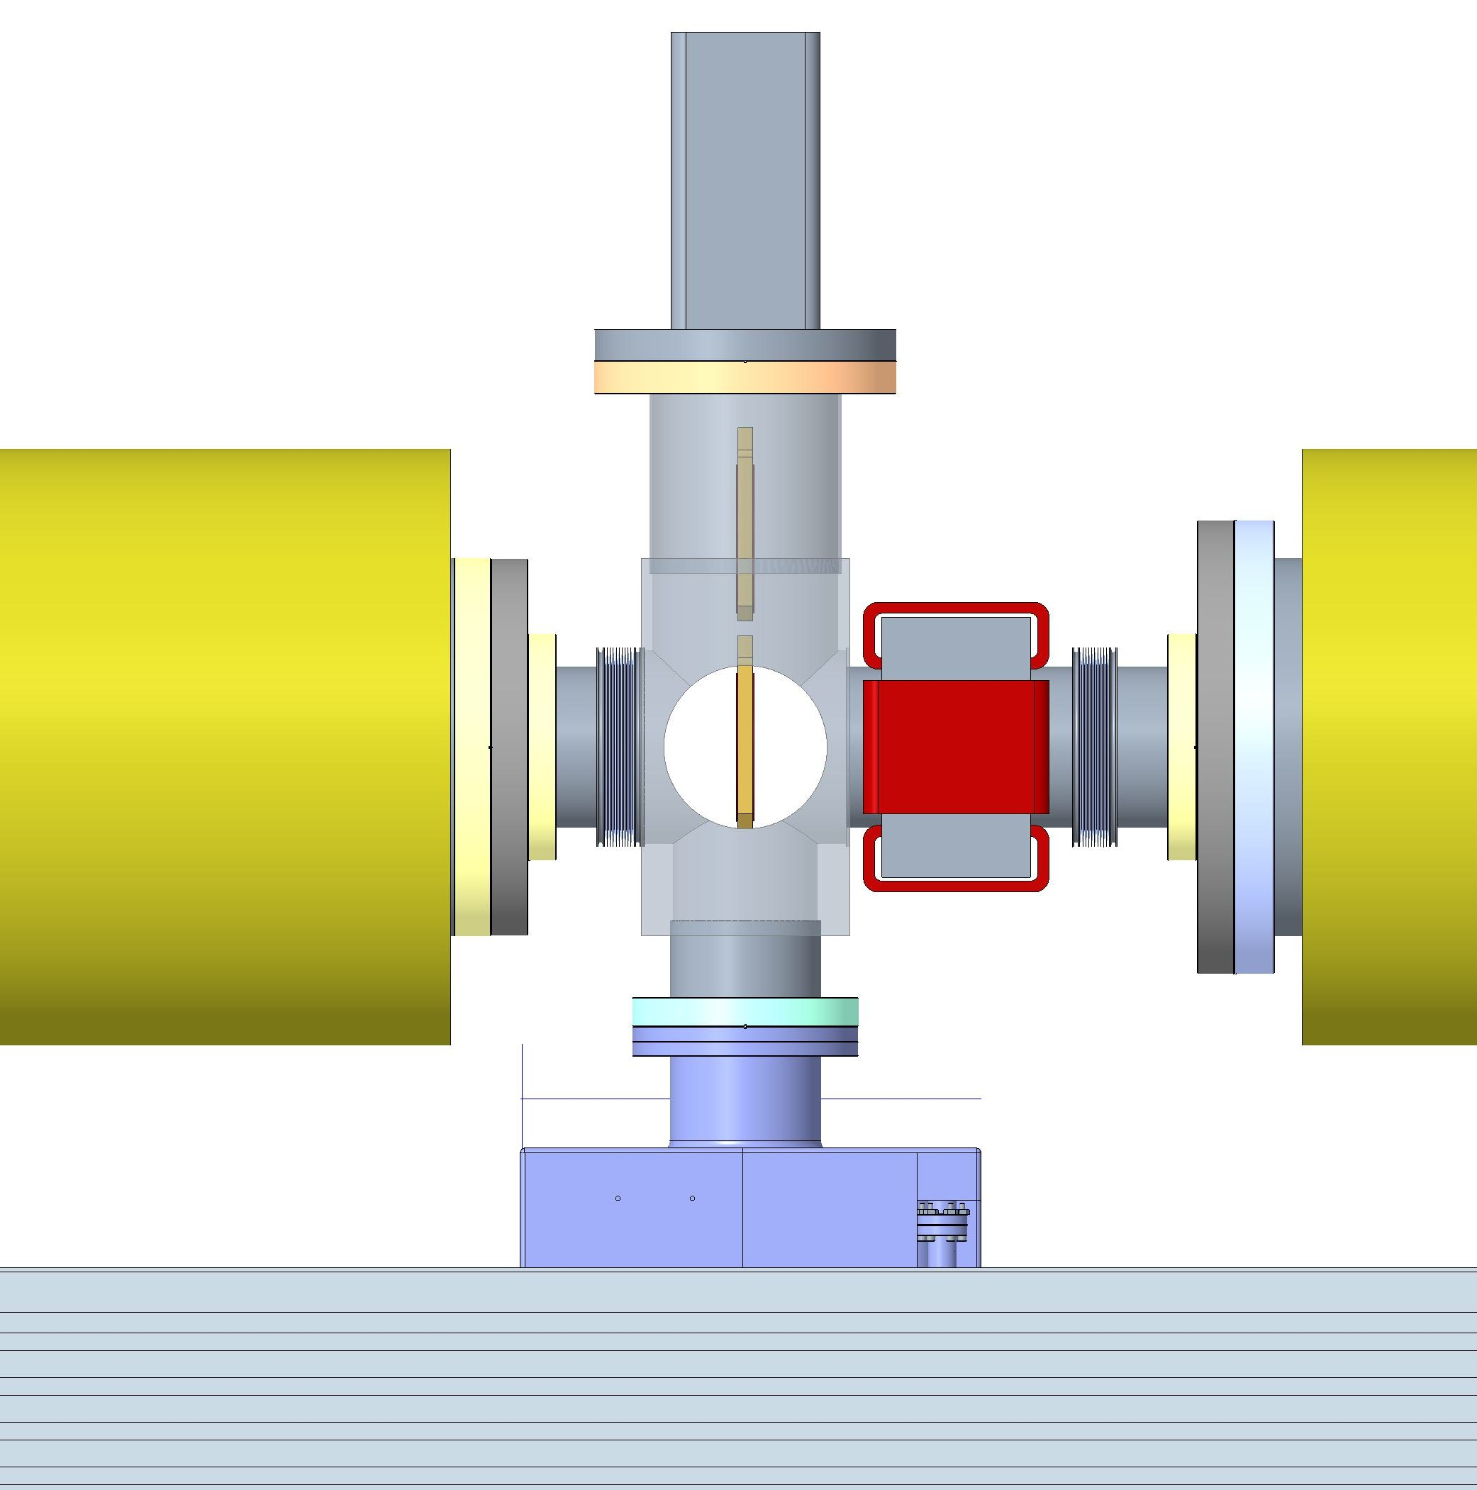
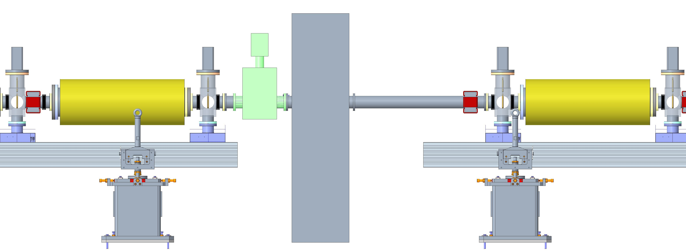
Low Energy Line
+200mm
+400mm
Beam Profile Monitor
100mm Corrector Magnet
Corrector Magnet
500mm
For contingency
05
06
Beam Stop
Shield Wall
Corrector Magnet
+1157mm
+3959mm
+7666mm
+9323mm
+13380mm
+15037mm
+17140mm
0m
+0mm
+200mm
+400mm
+200mm
+546mm
+1145mm
Target Chamber
RF Cavity
01
02
RF Cavity
03
04
05
06
07
Shield Wall
Beam Stop

Slide 10
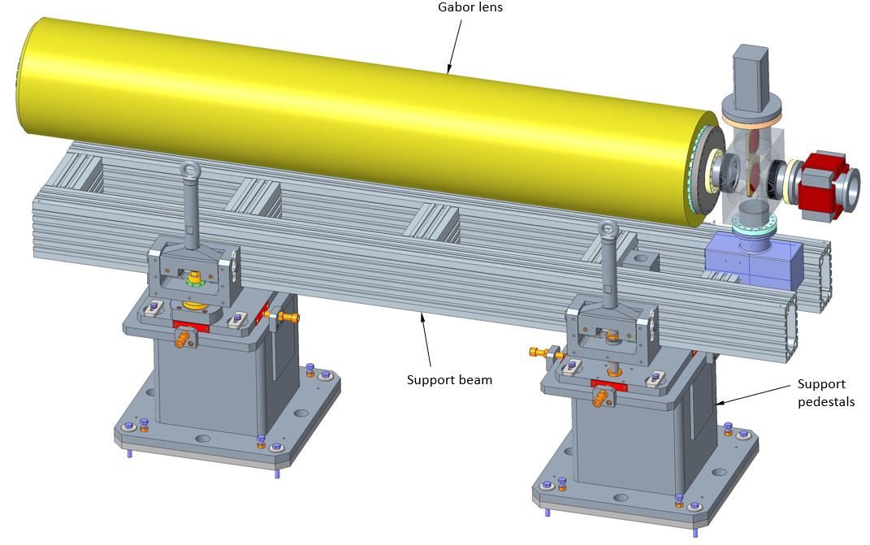
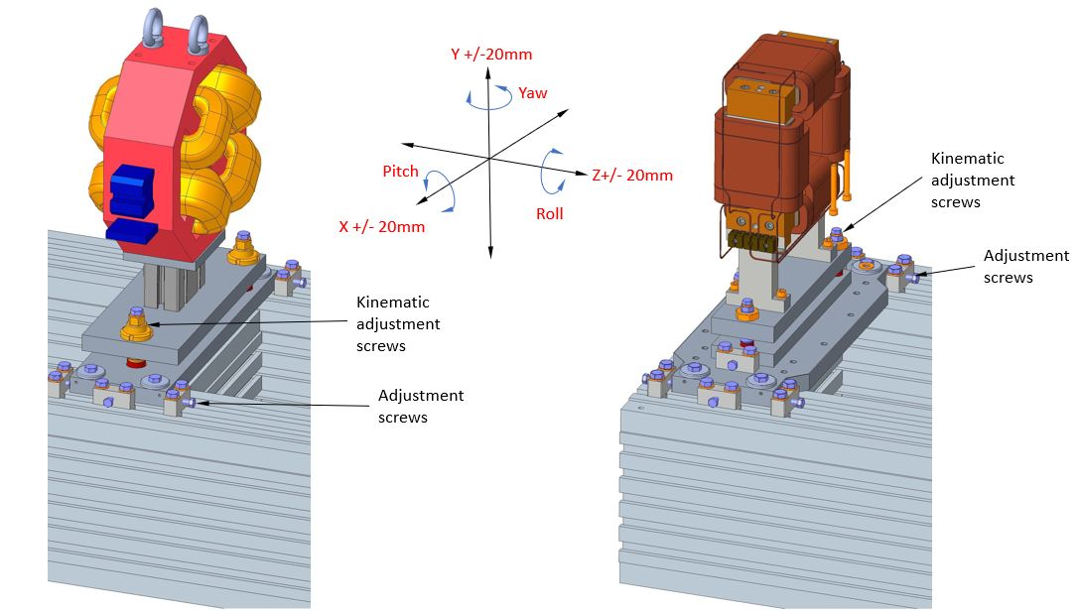
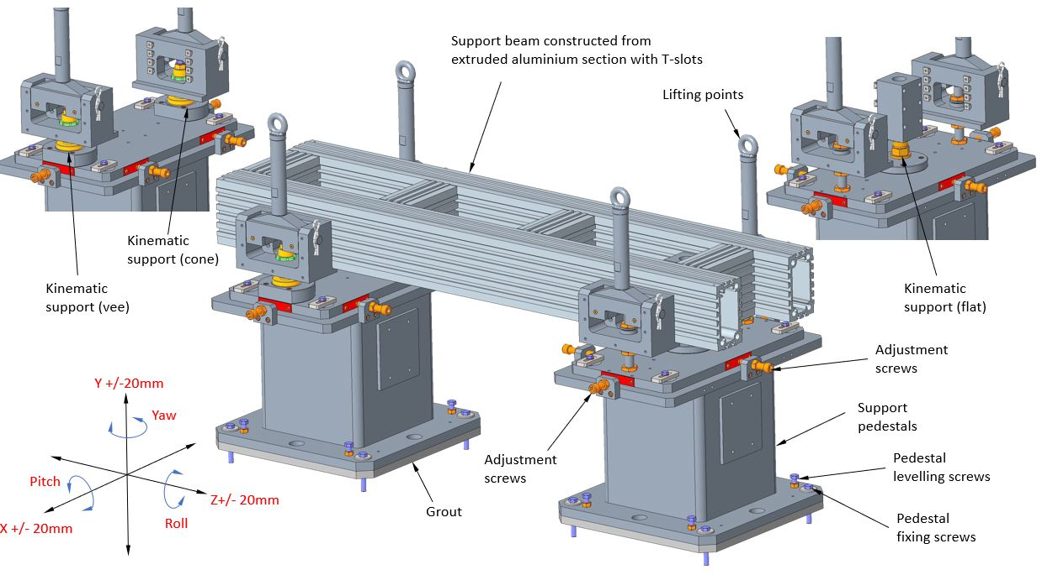
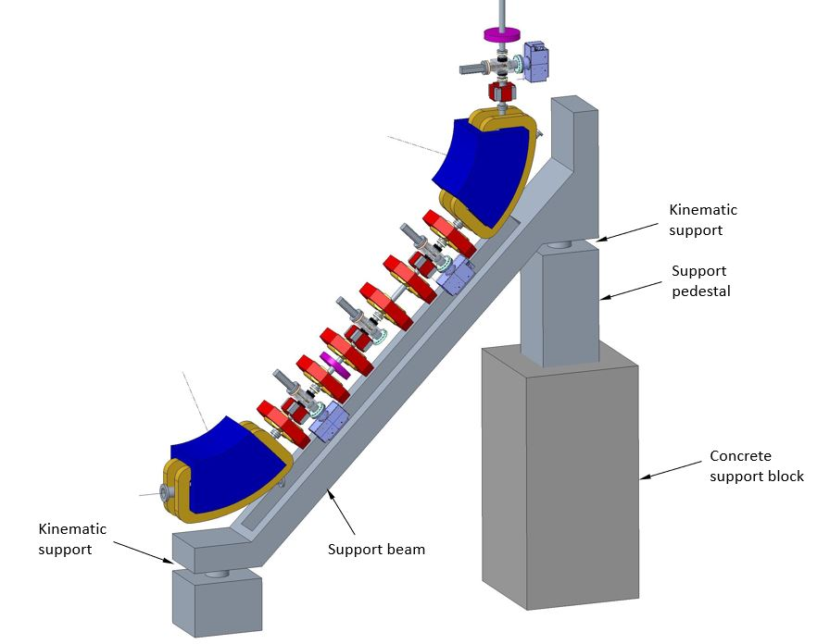
Low Energy Line Support Systems

Slide 11
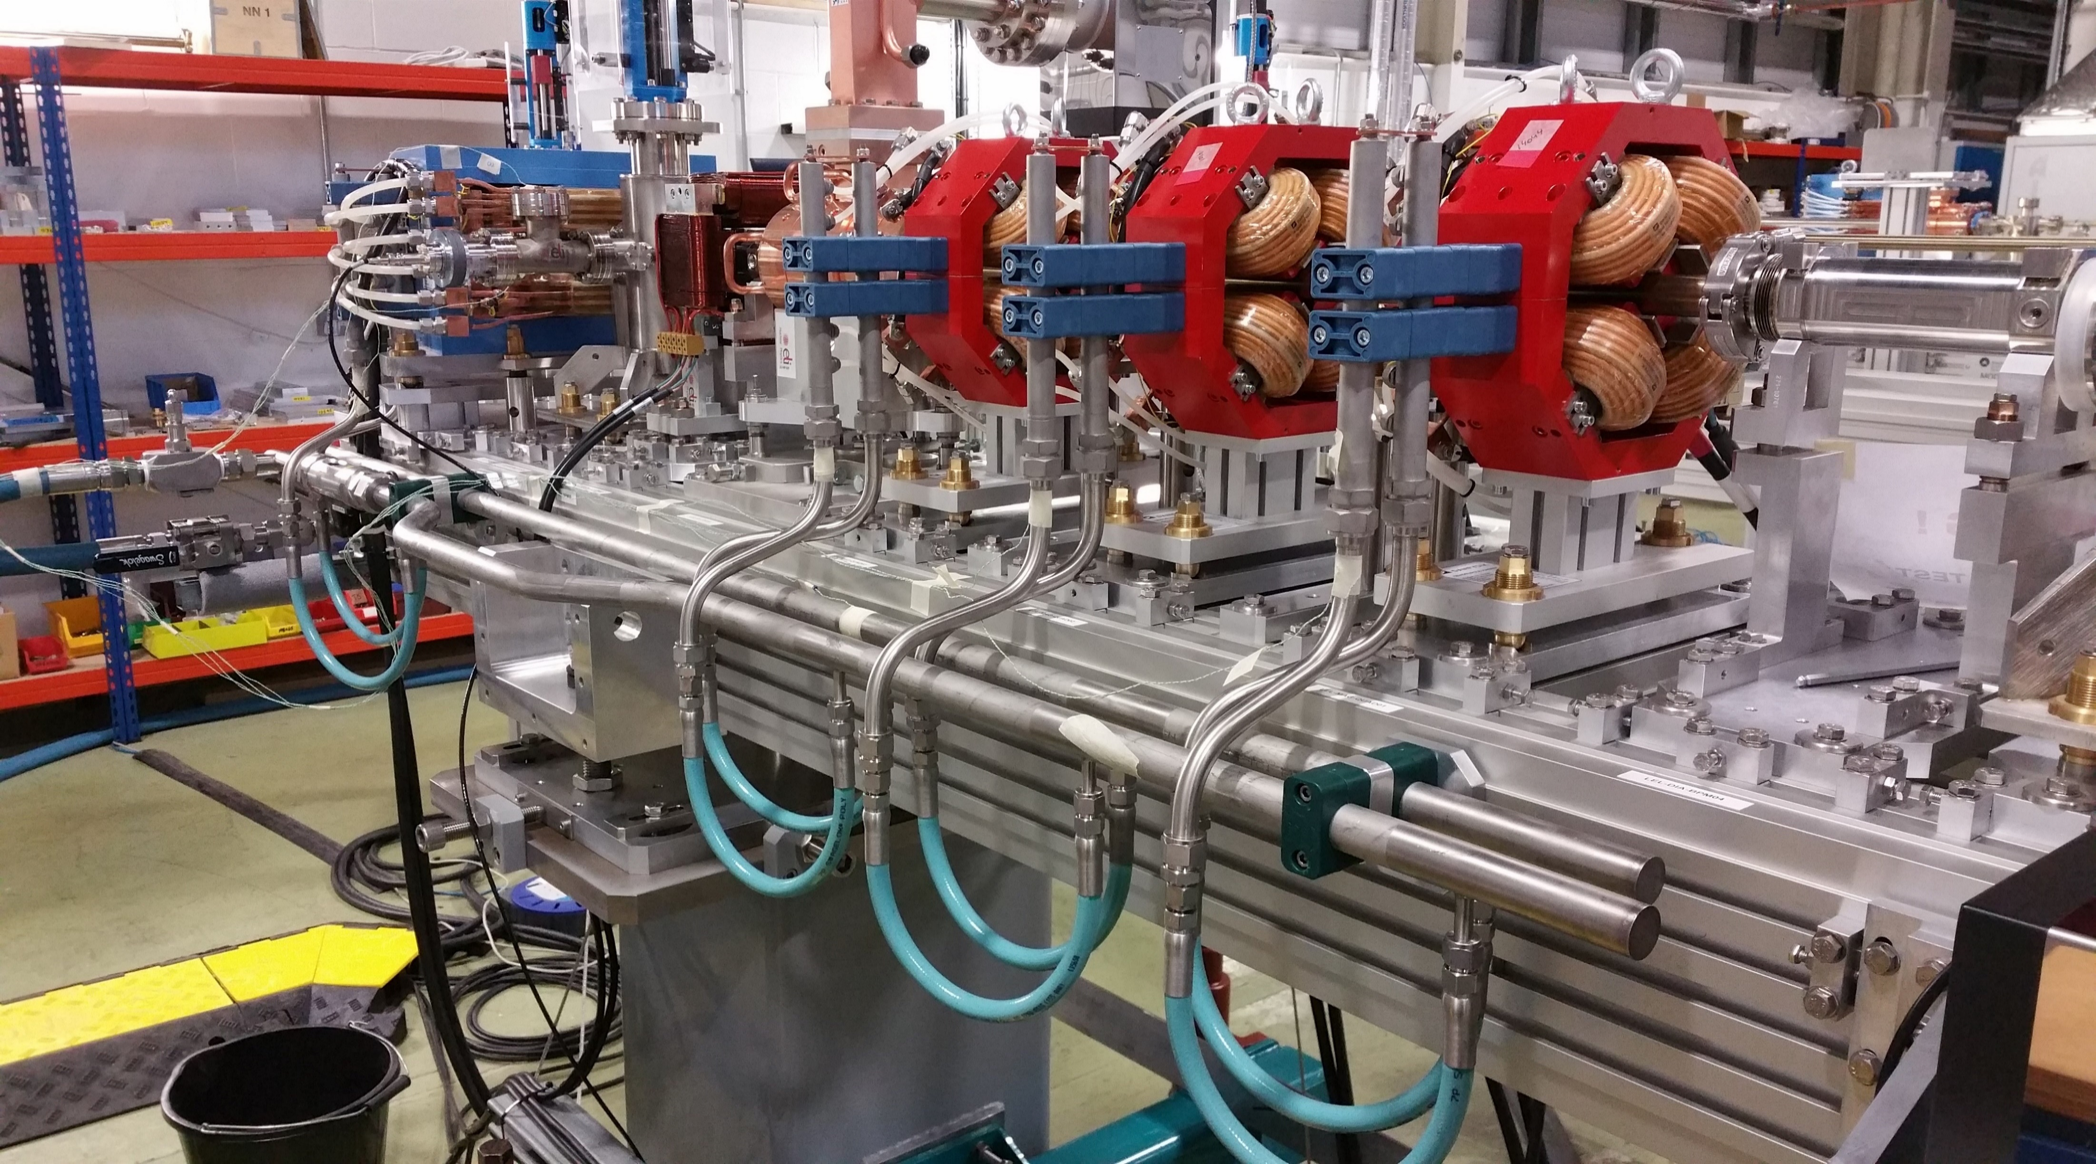
Low Energy Line Support Systems Example
Kinematic supports
Lifting points
Support Beam
Support Pedestal

Slide 12
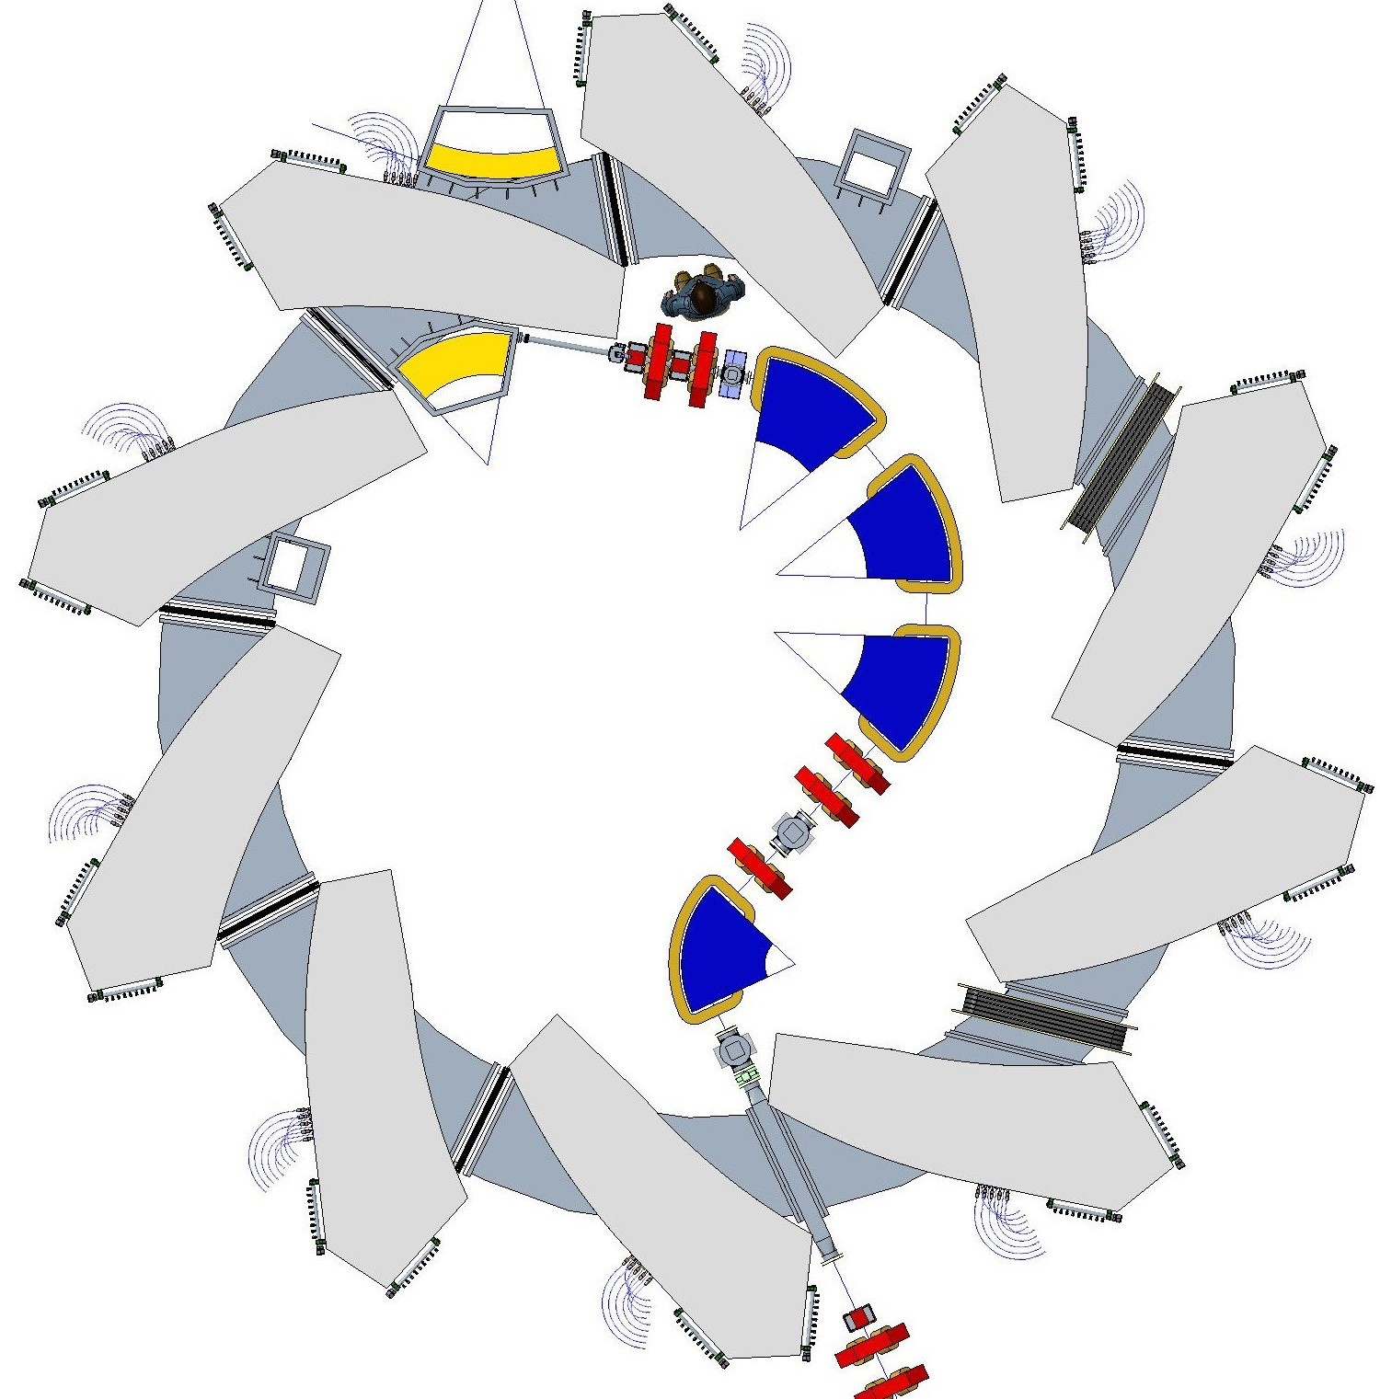
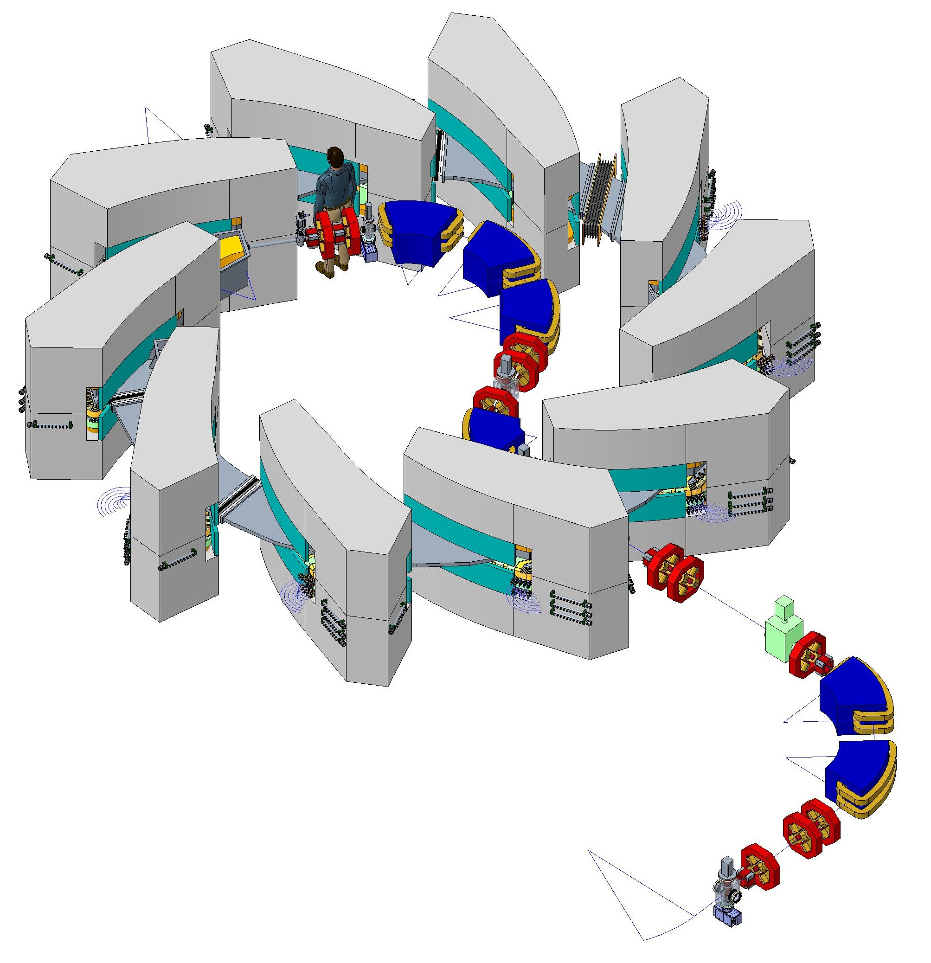
FFA Injection Line & Ring Magnet Yoke
Extraction septum magnet
Extraction kicker magnet
Ring Magnet
Injection septum magnet
RF MA Cavity
Injection kicker magnet
Injection Line
Preliminary LhARA FFA magnet specification:
lattice : spiral scaling singlet,
N: 10,
ksi: 48.7 degree,
R0: 3.477m,
Rmax: 3.53m,
Rmin: 2.88m,
Gap: 9.5cm.
RF MA Cavity

Slide 13
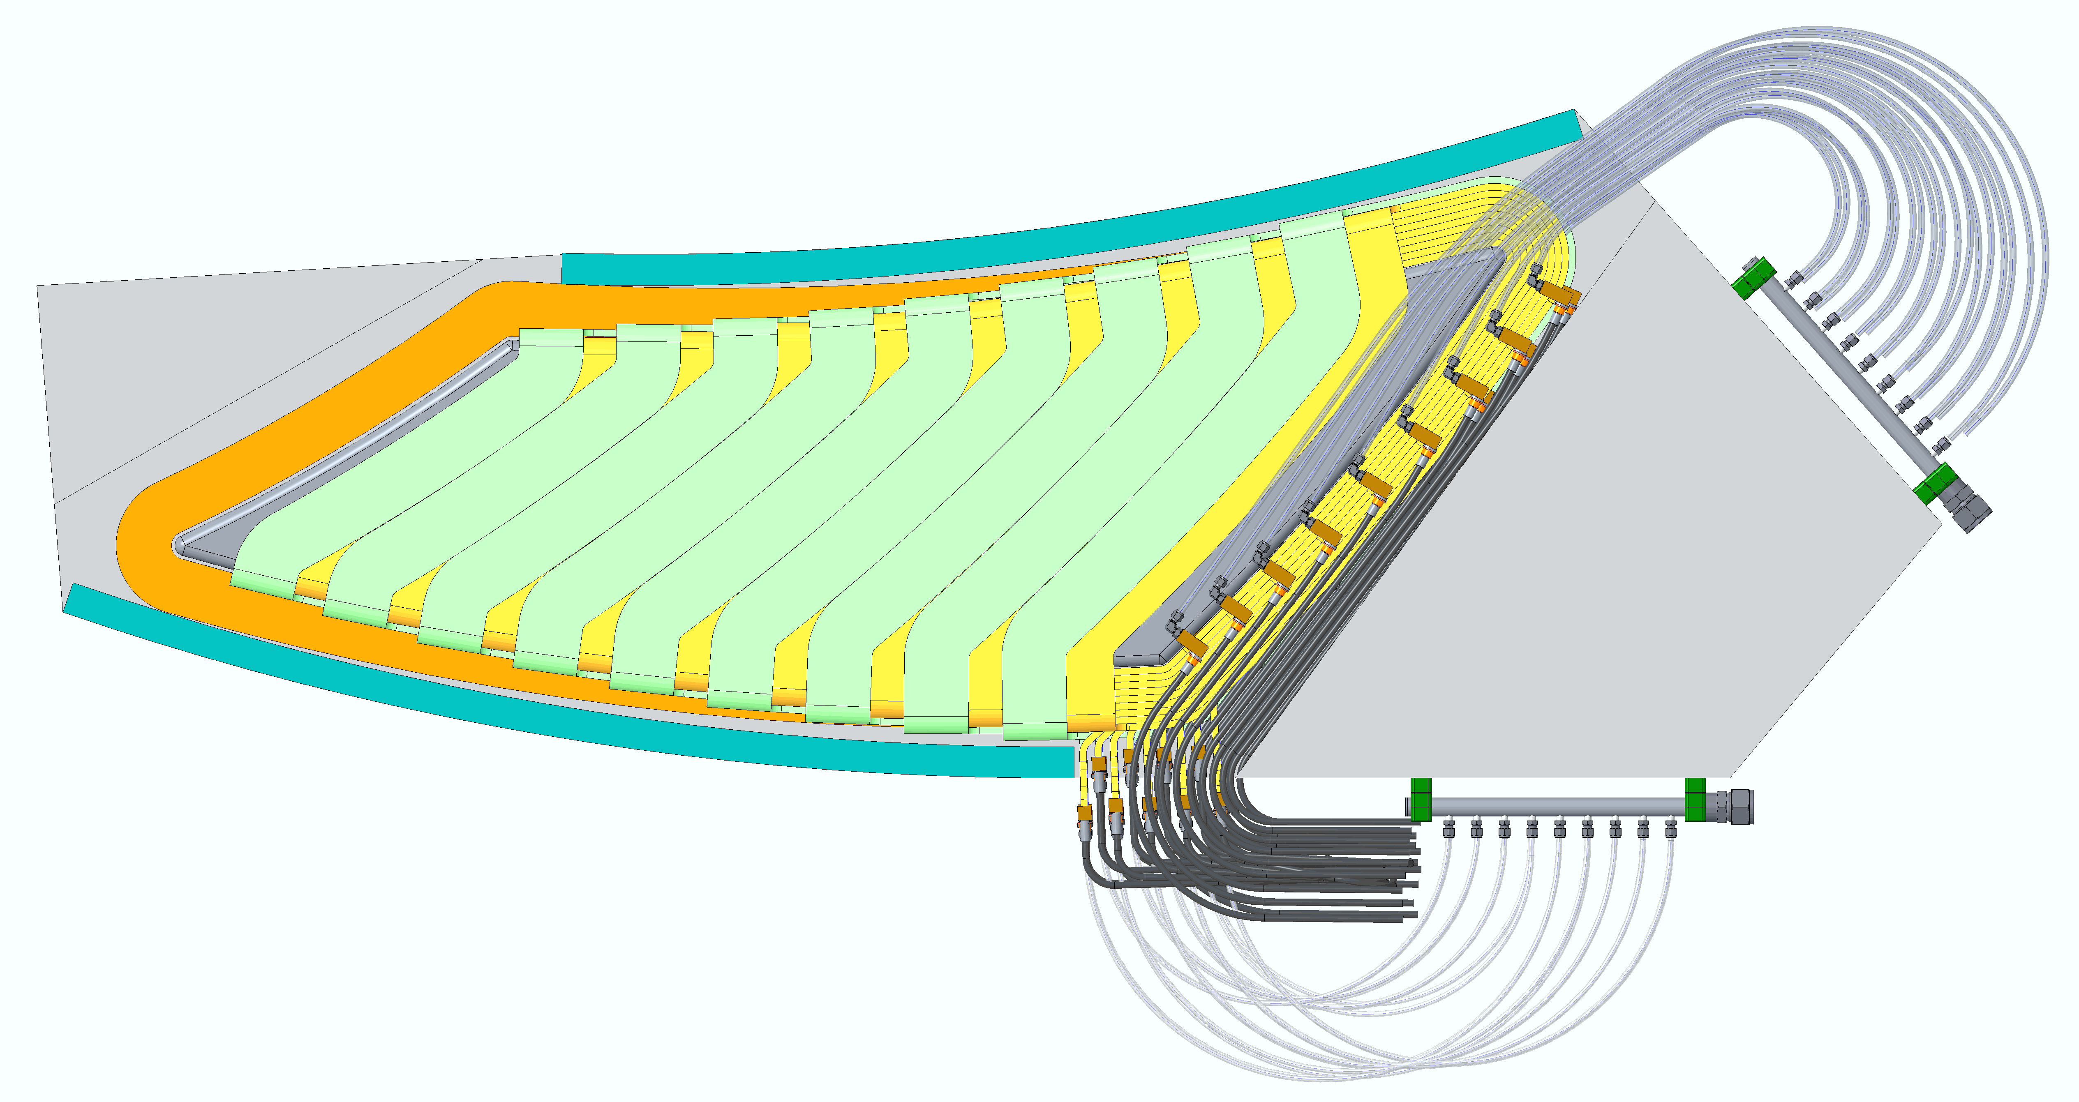
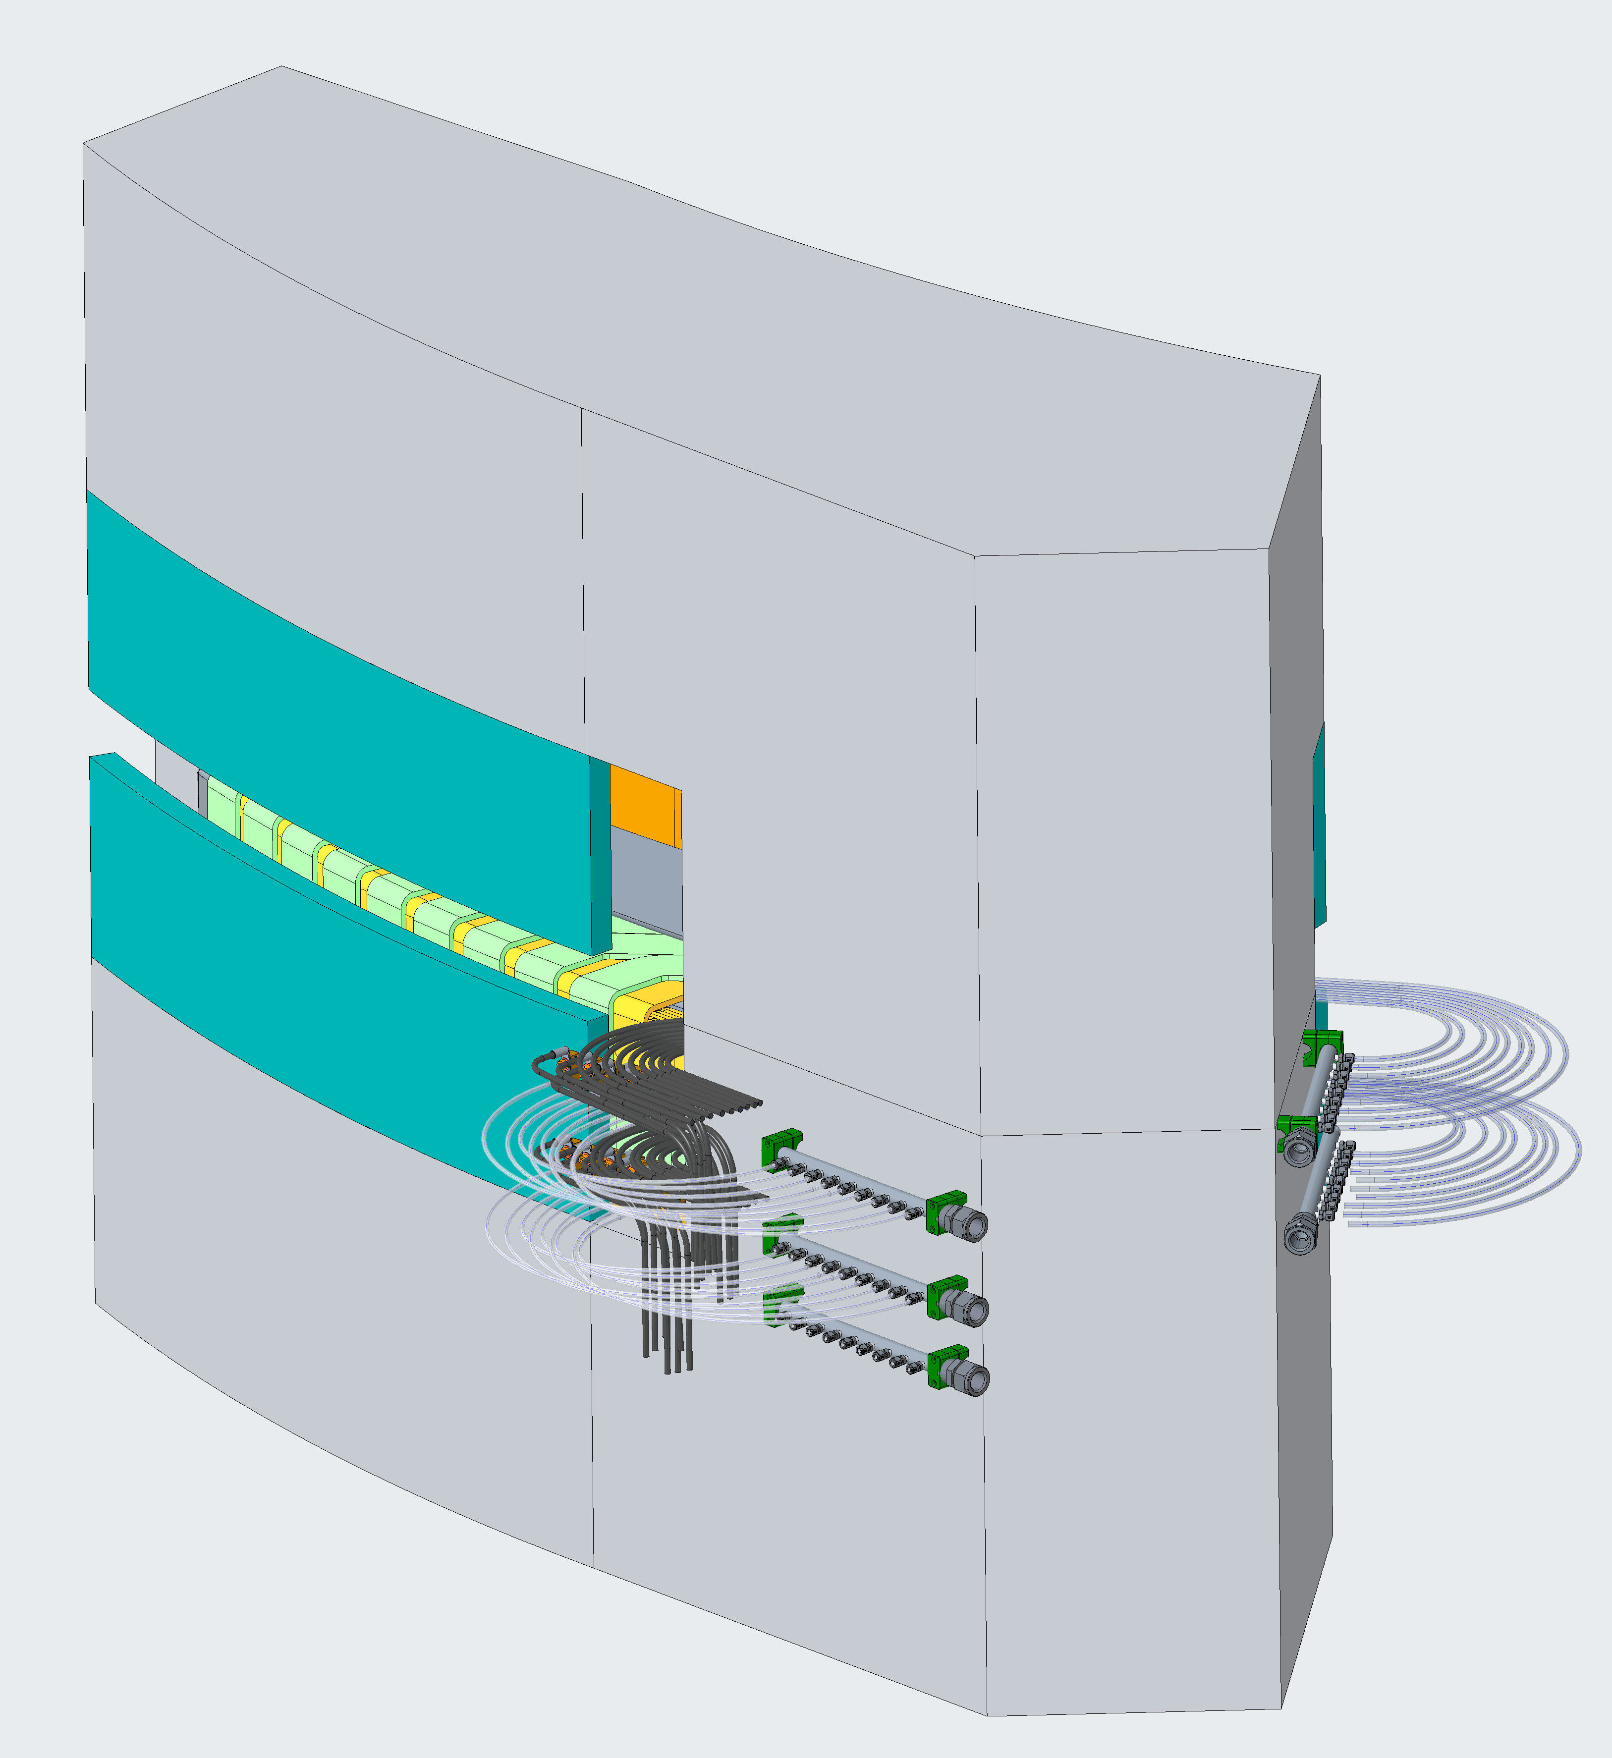
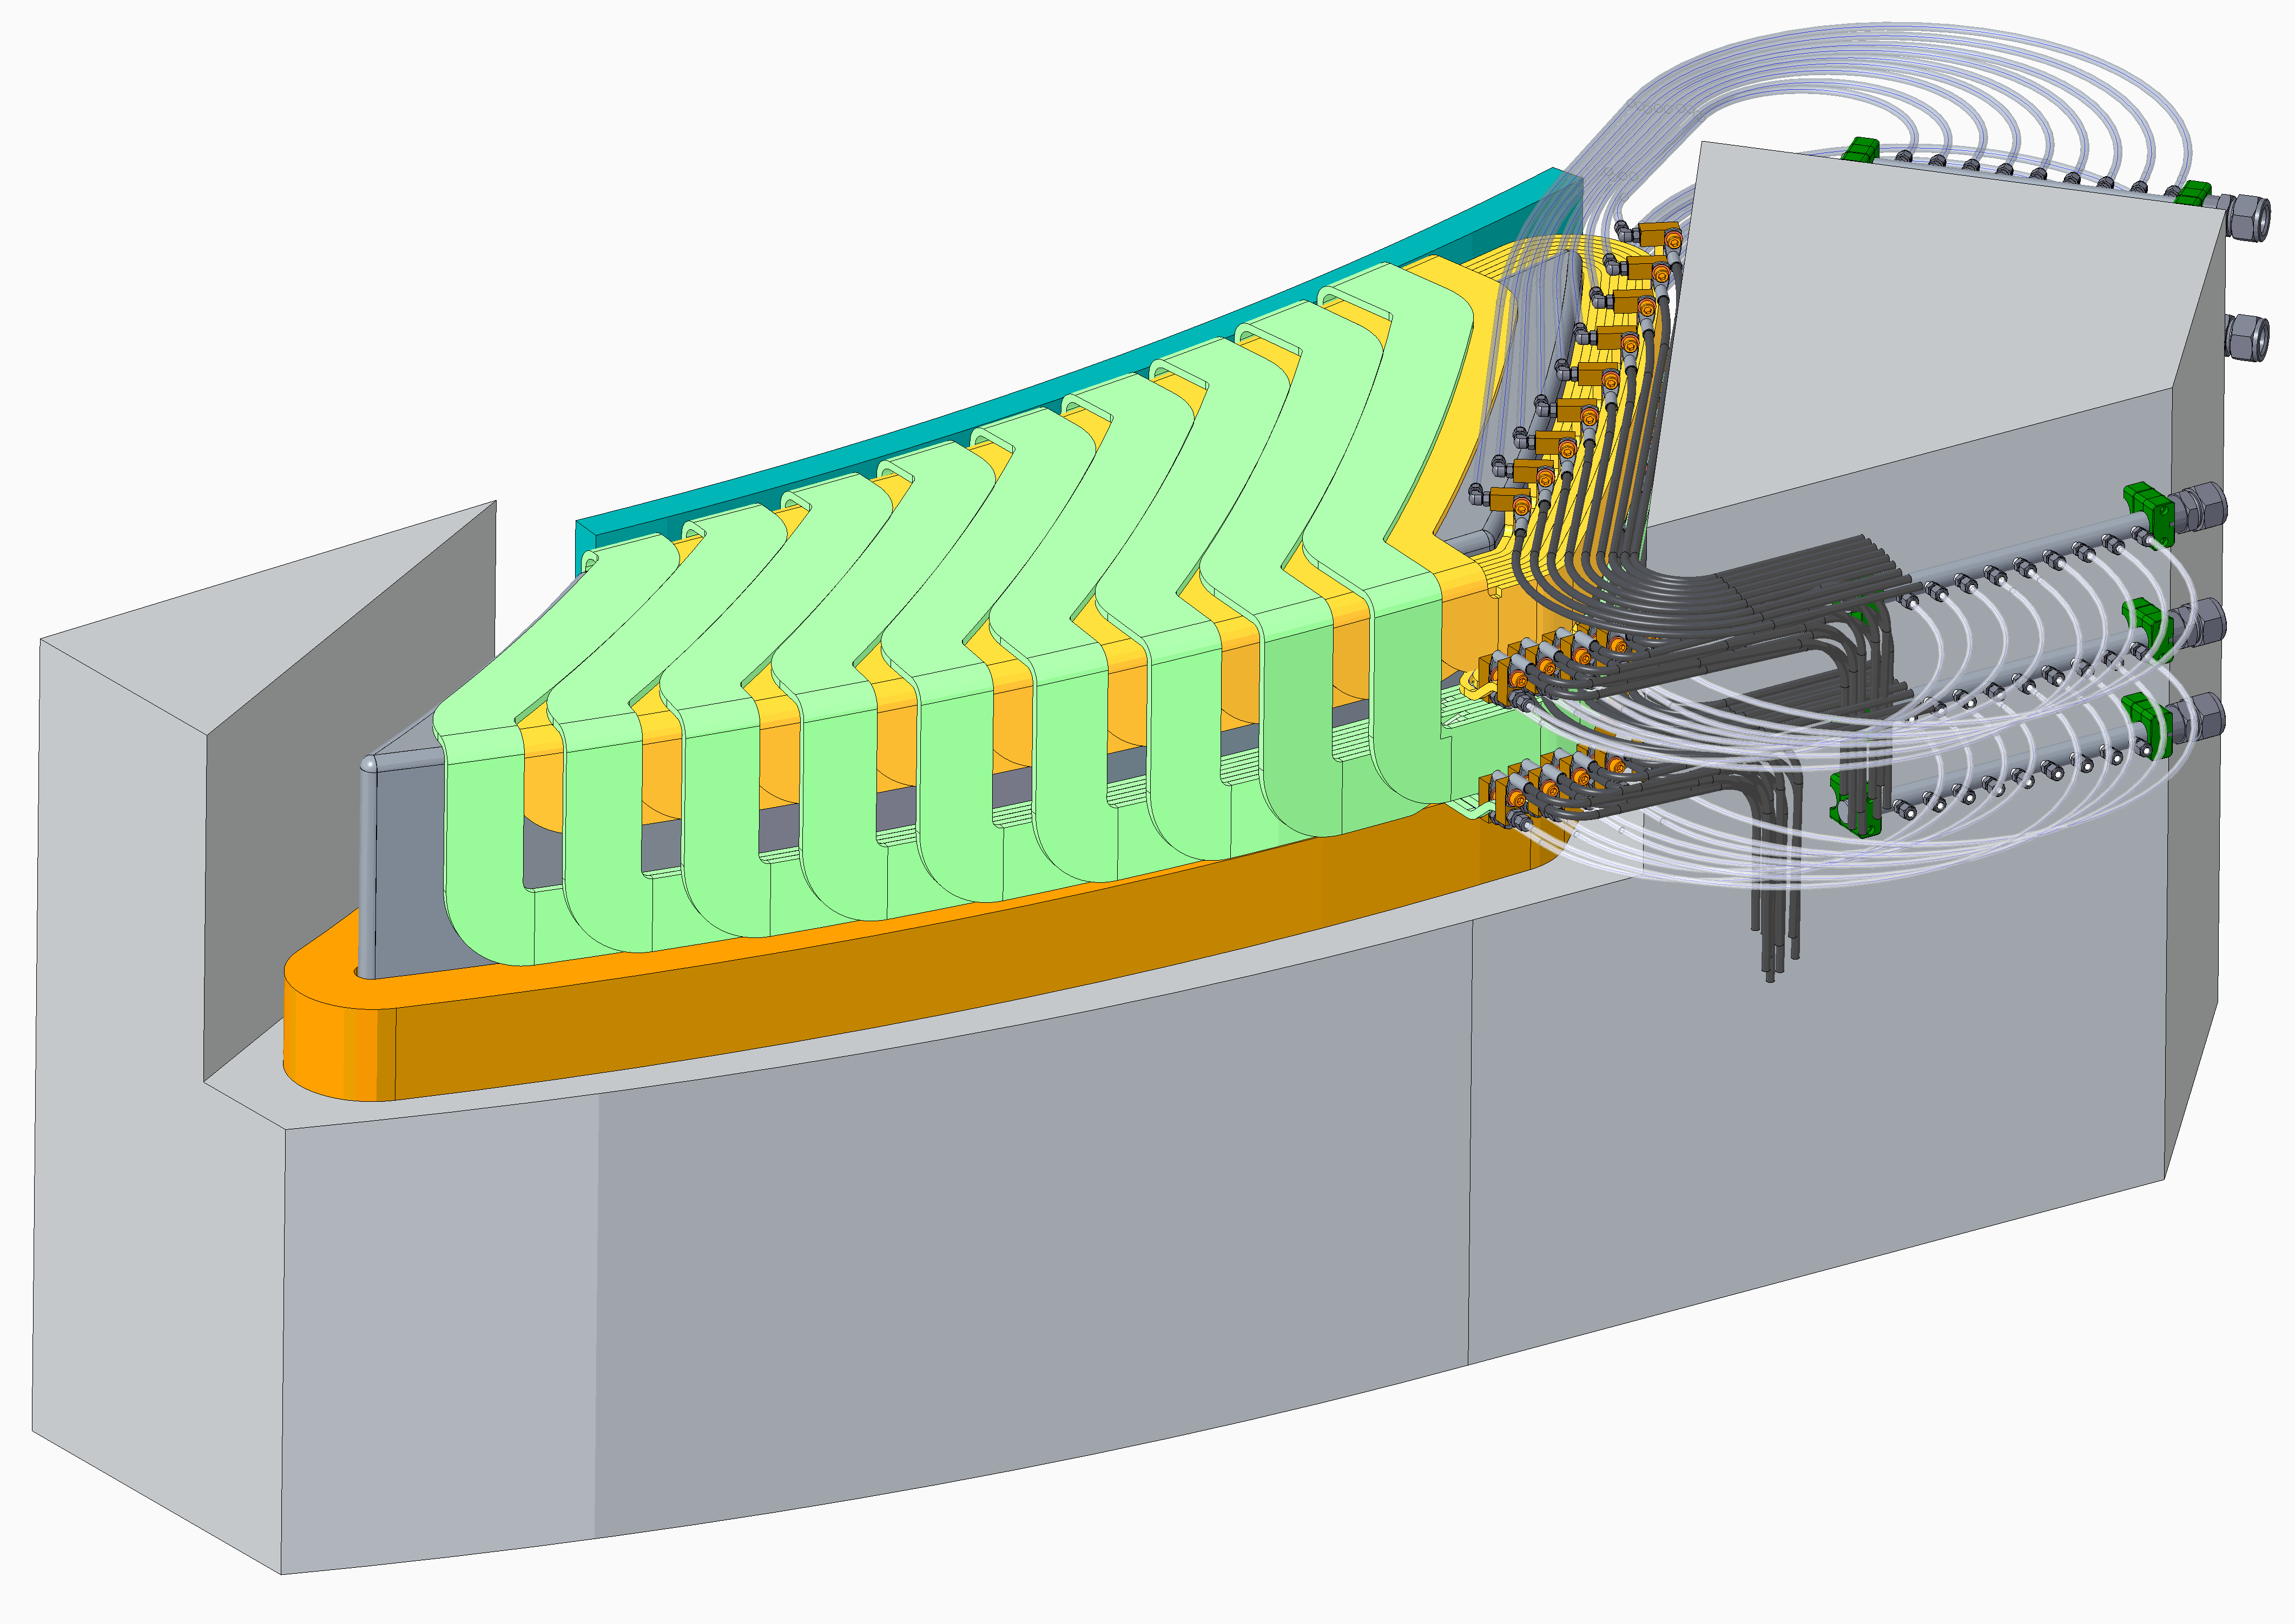
FFA Magnet
2710mm
Steel yoke
Weight 22 t
965mm
2000mm
Trim coils only shown on lower pole
18 Trim coils (2 layers)
Water return
Pole
Water feed
Field clamp plates
Electrical power cables
Water cooling manifold
Main coil

Slide 14
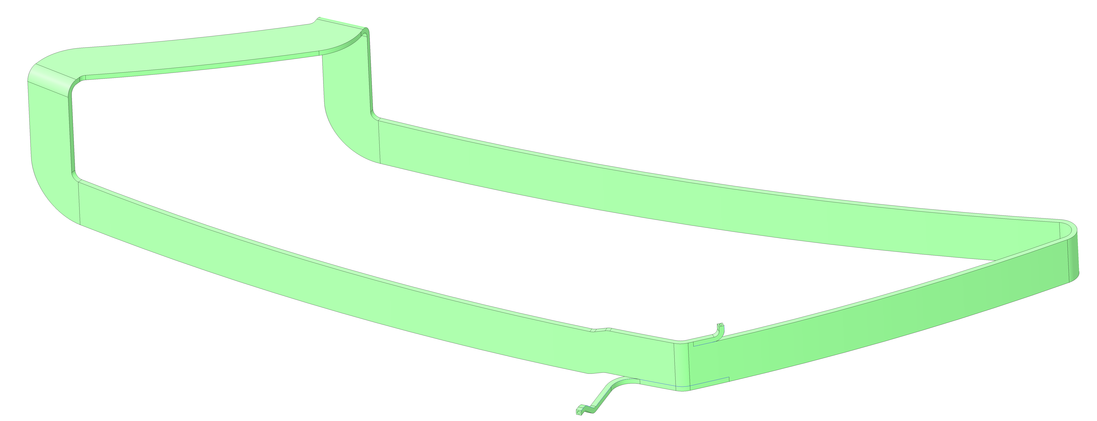
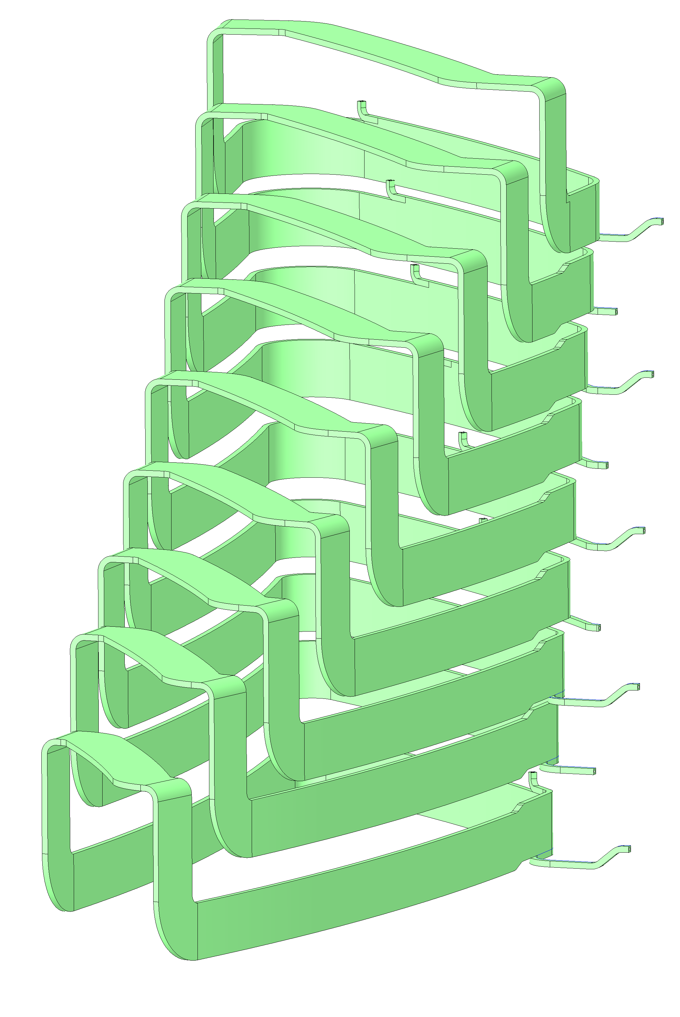
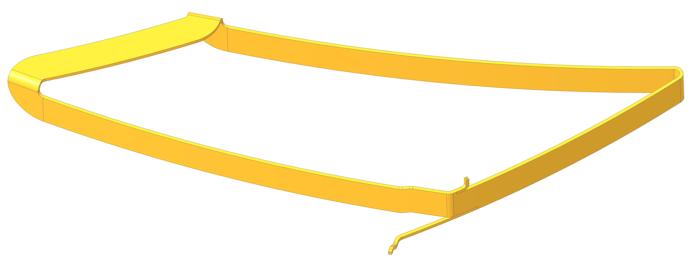
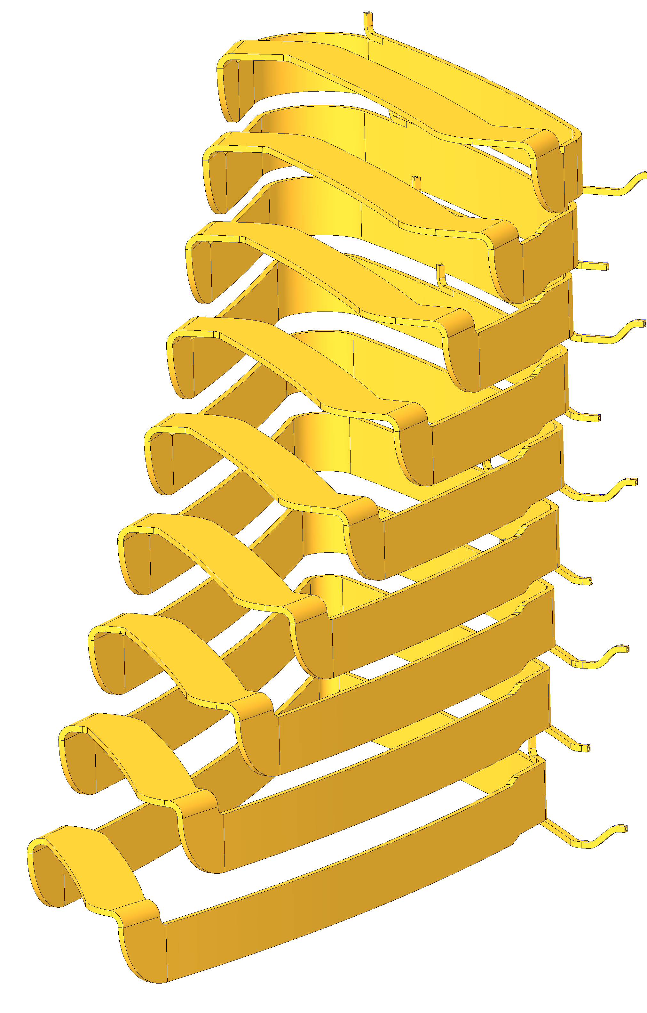
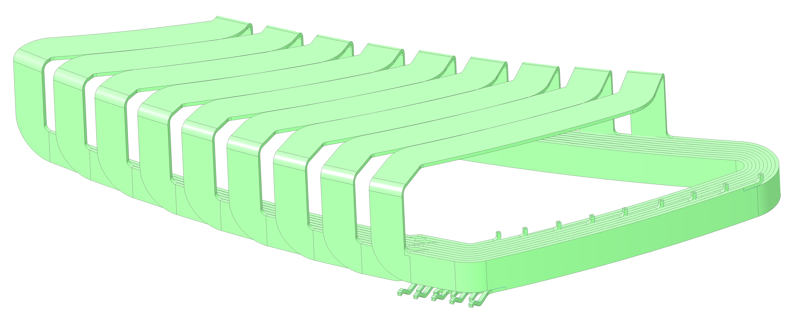
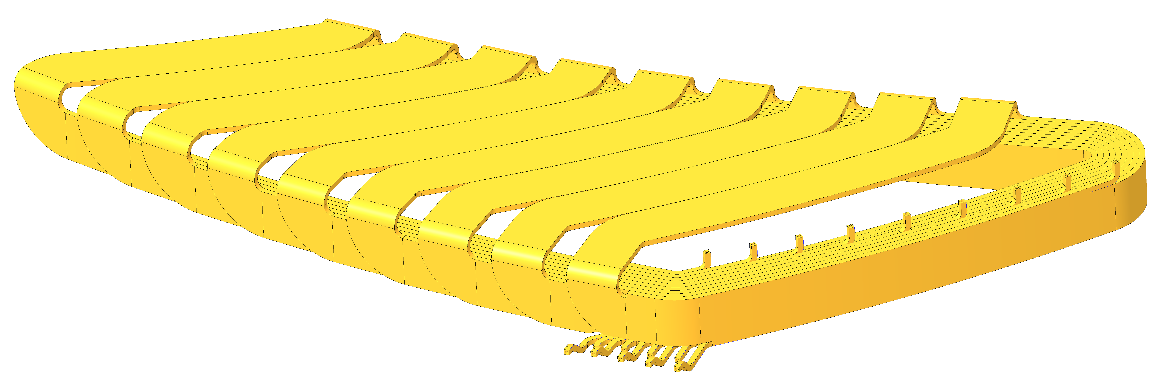
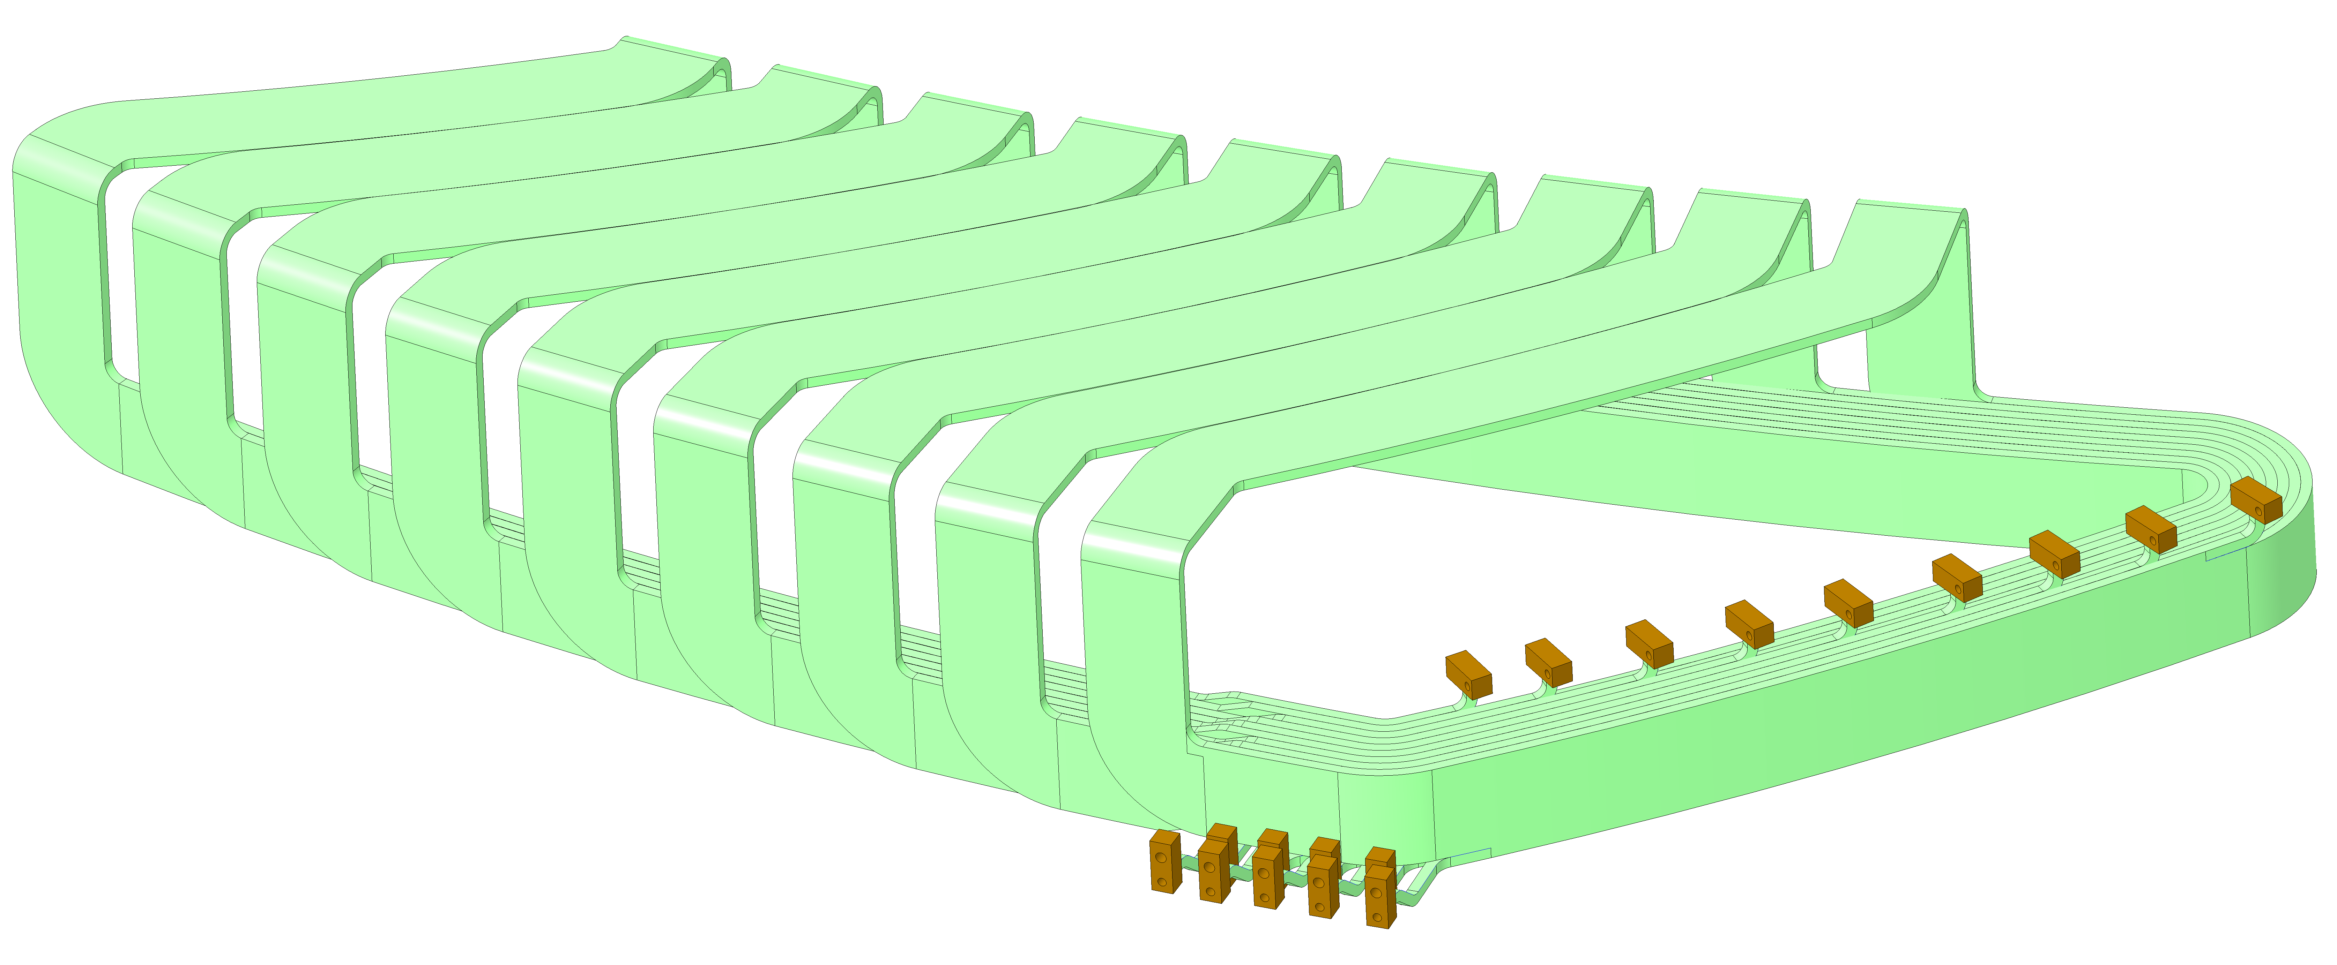
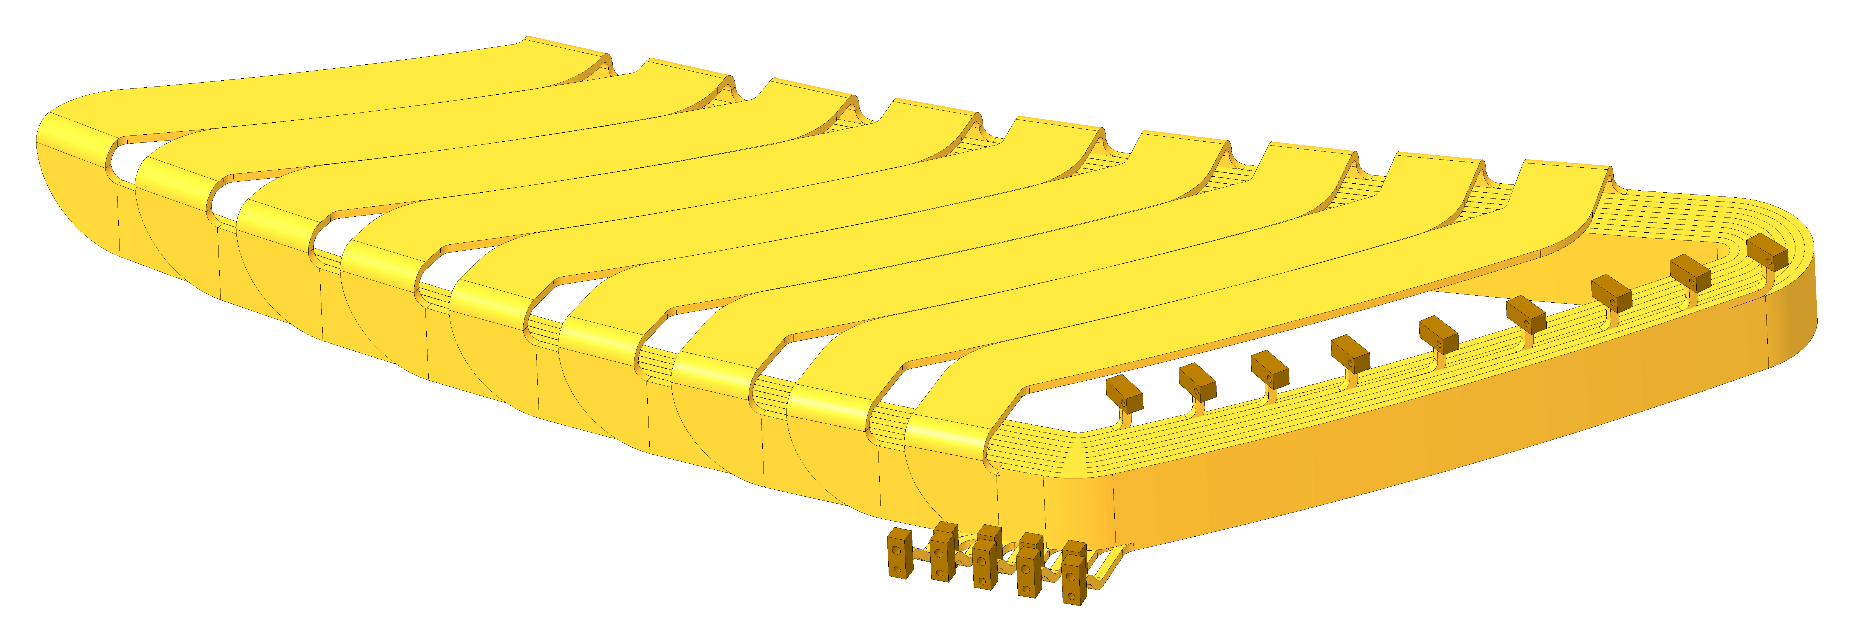
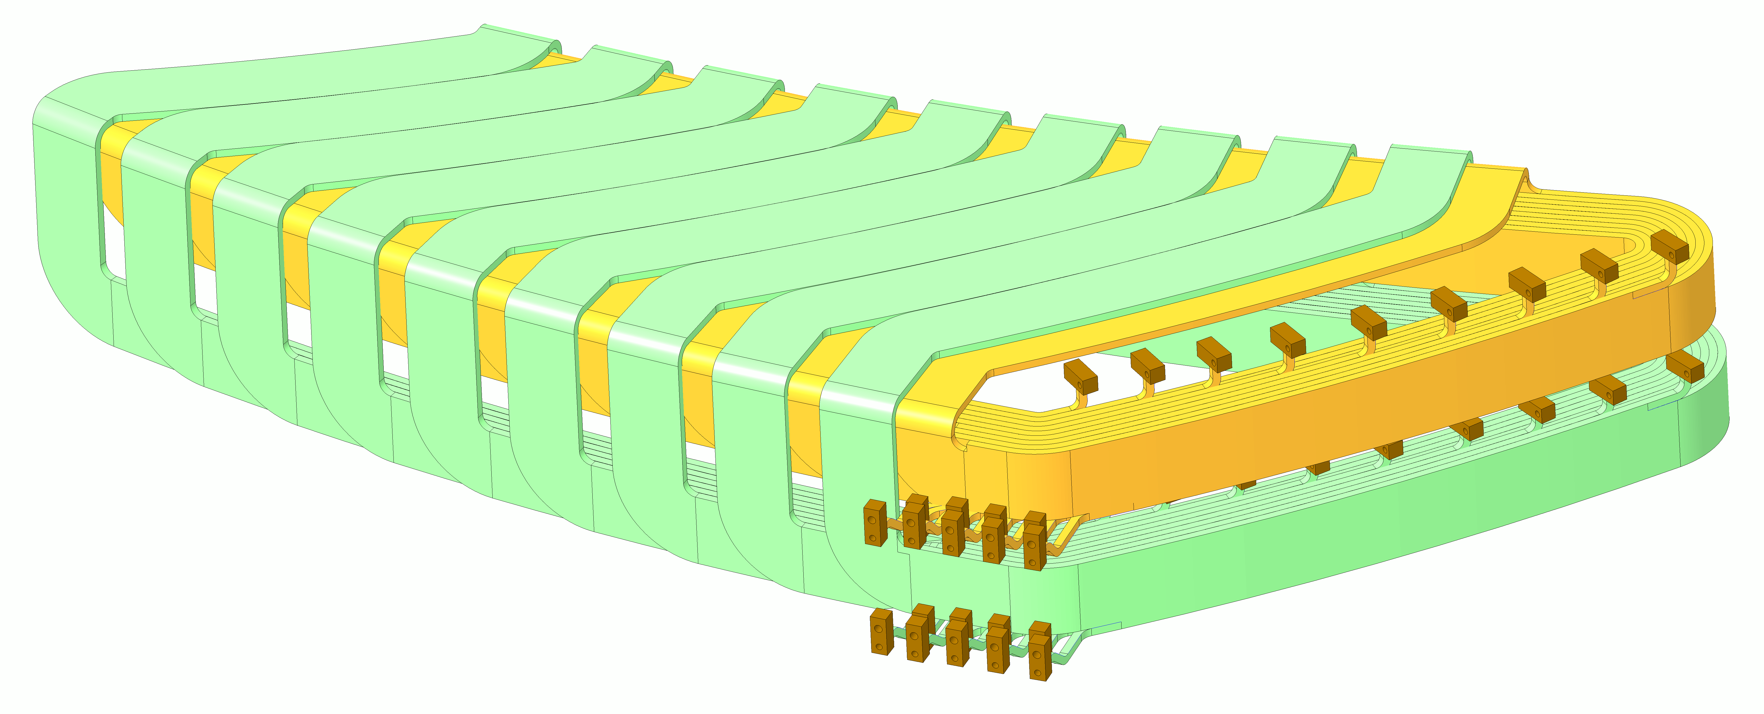
Trim Coils
Single trim coil wound with □10mm conductor with Ø6mm hole
Single trim coil wound with □10mm conductor with Ø6mm hole
9 coils in each layer
9 coils in each layer
Braze connector blocks for water and electrical connections
Braze connector blocks for water and electrical connections
9 coils in each layer

Slide 15
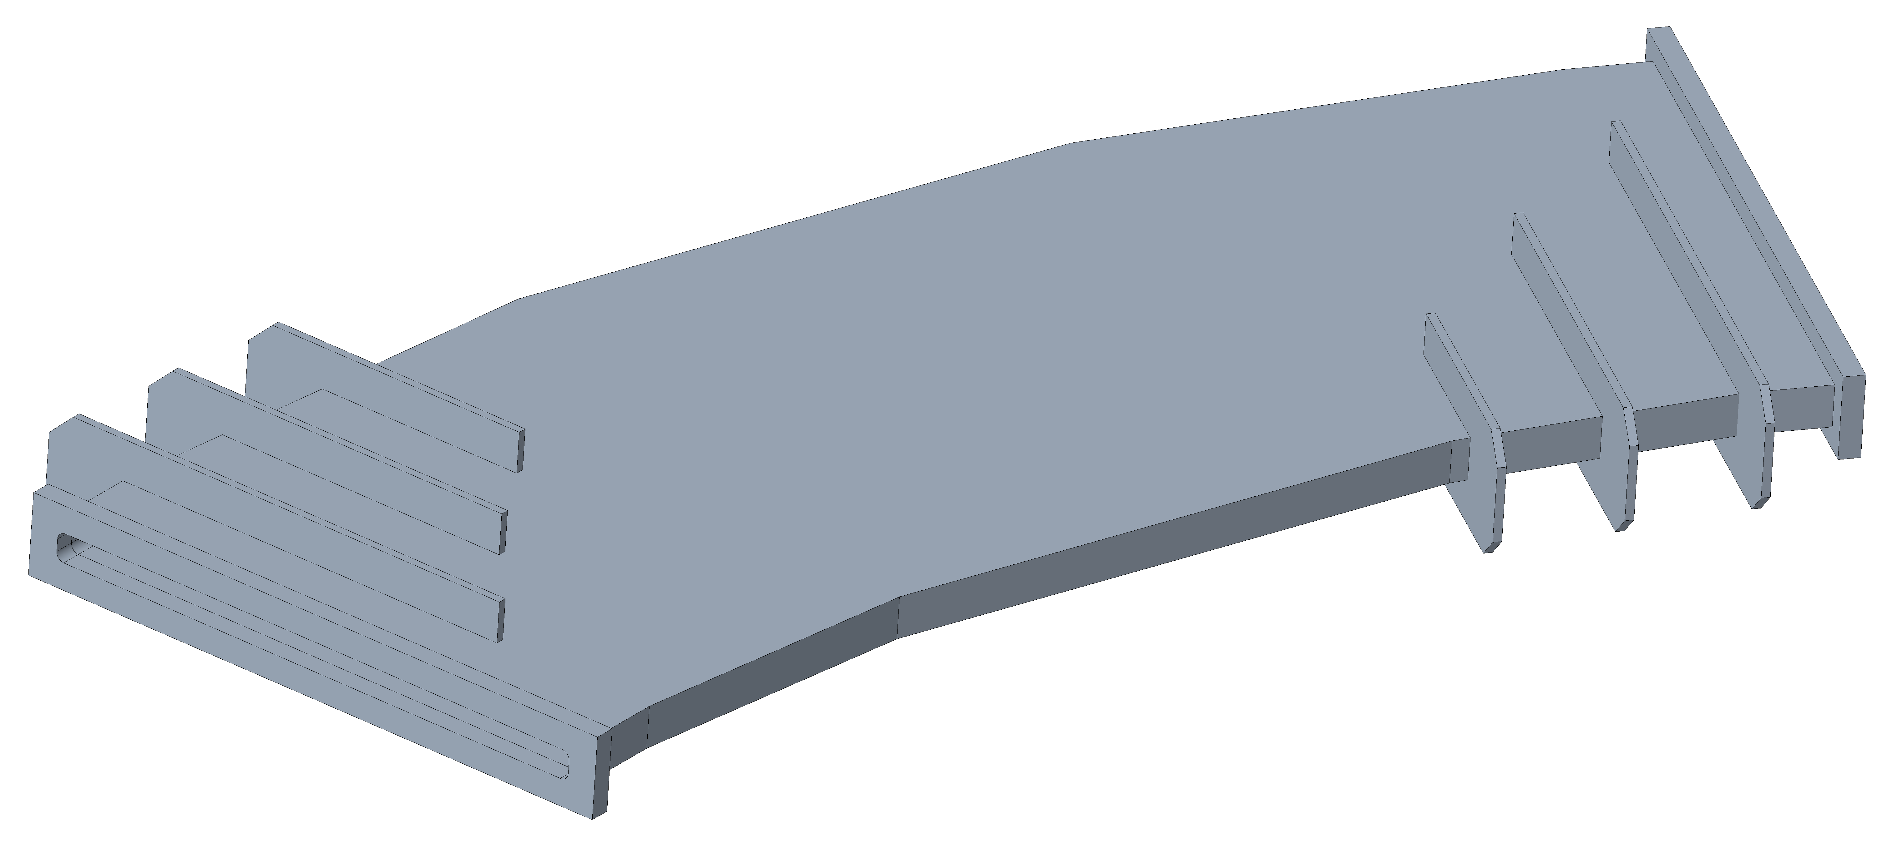
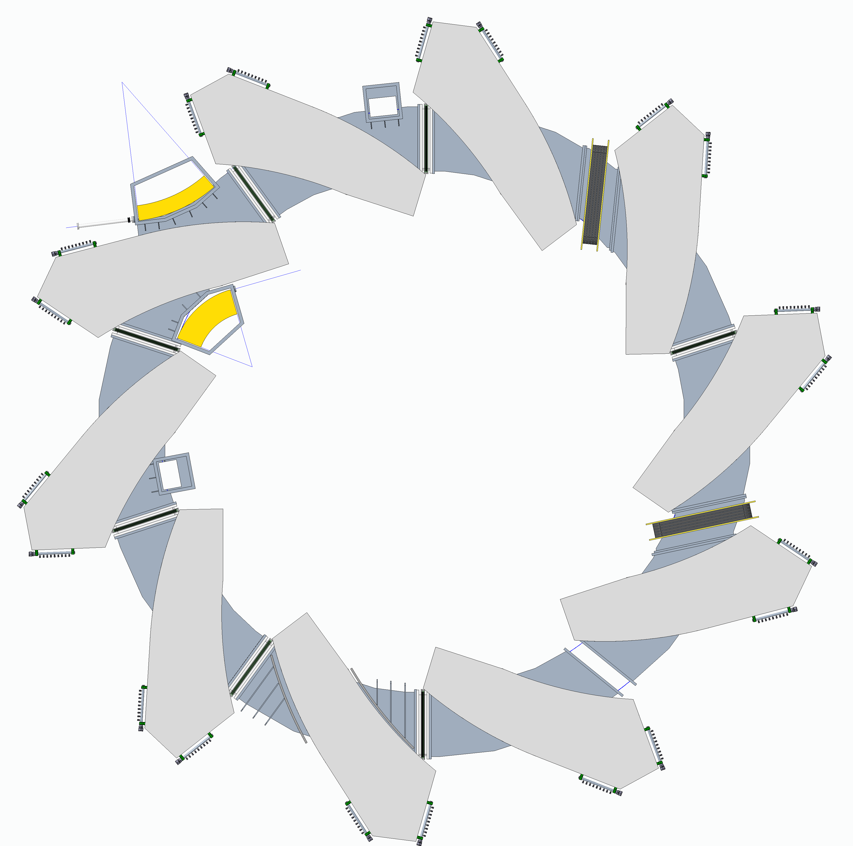
Ring Vacuum Chamber – Stainless Steel
Pole region
36°
Stengthening ribs
35mm vertical aperture
51mm chamber
2710mm
10mm Trim coil
95mm pole gap
Upper pole
Trim coil layer 2
Trim coil layer 1
Trim coil layer 1
Trim coil layer 2
Lower pole
2mm clearance for deflection due to vacuum load and geometric flatness
Vacuum chamber 8mm wall thickness

Slide 16
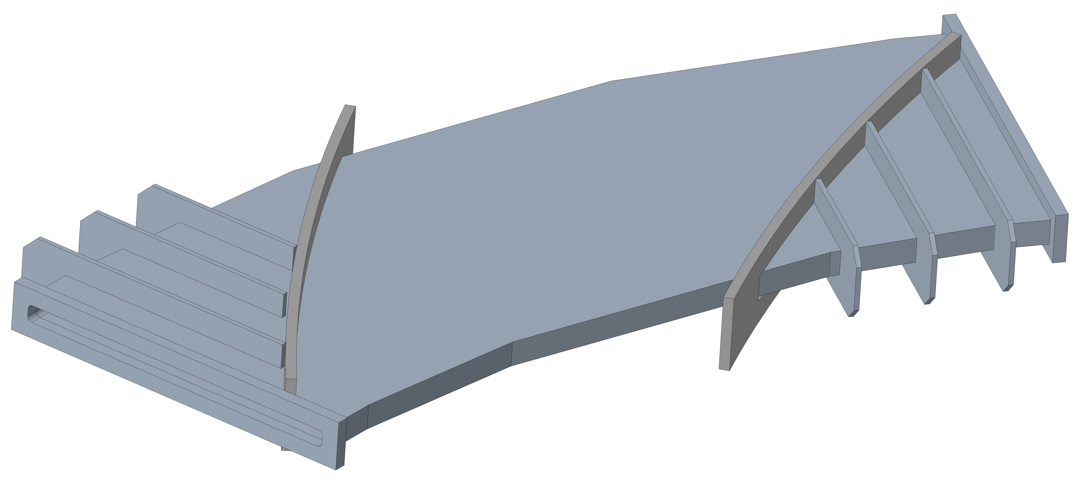
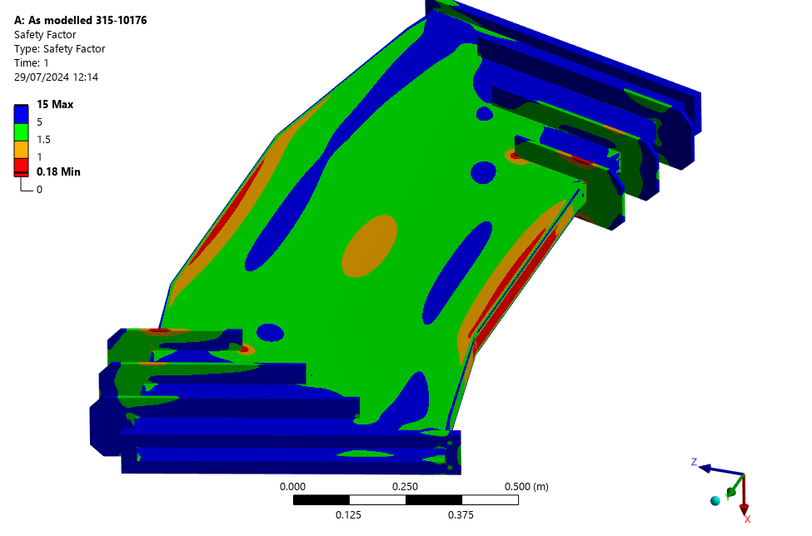
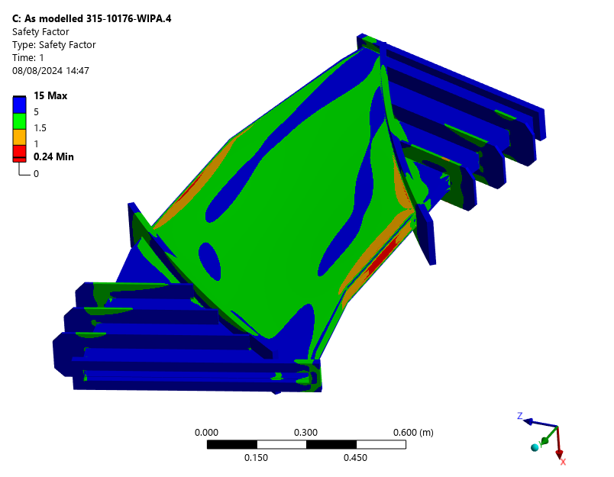
Ring Vacuum Chamber – Finite Element Analyses by Mitchell Kane
Pole region
Pole region

Slide 17
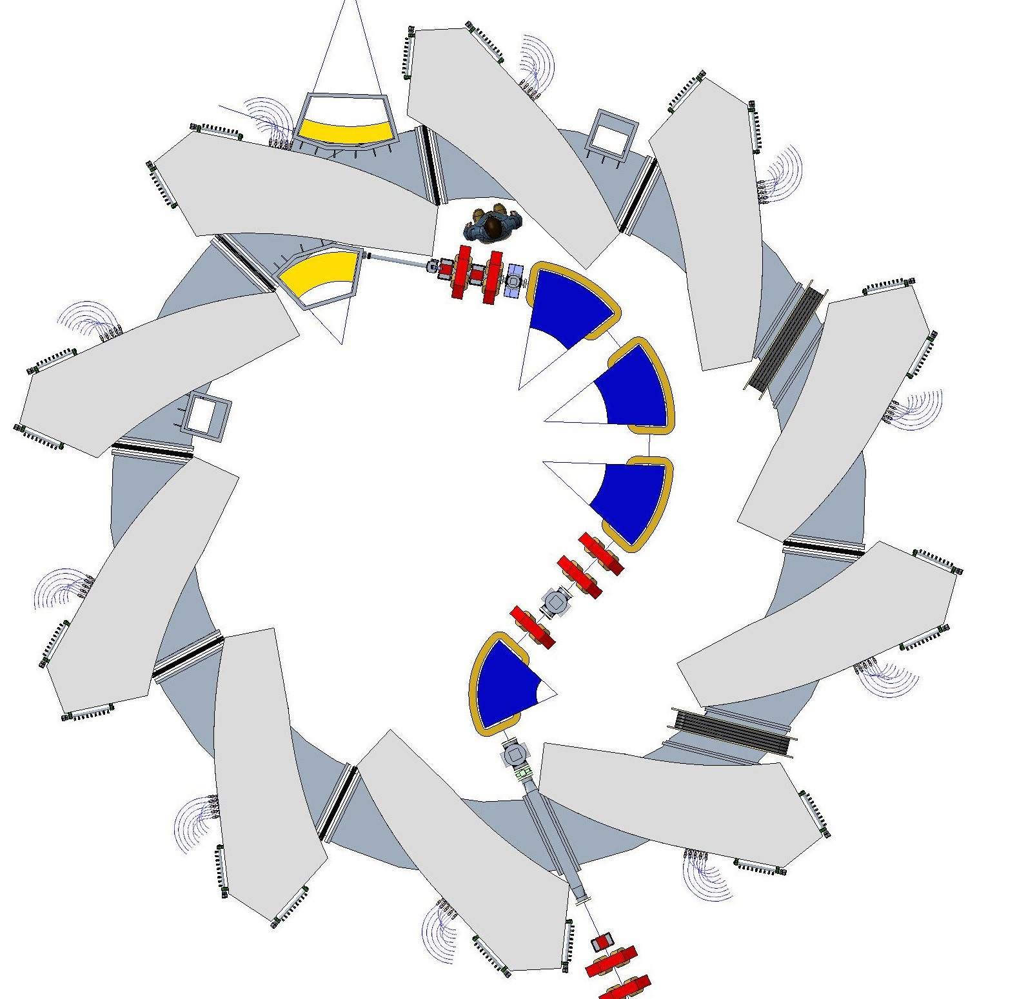
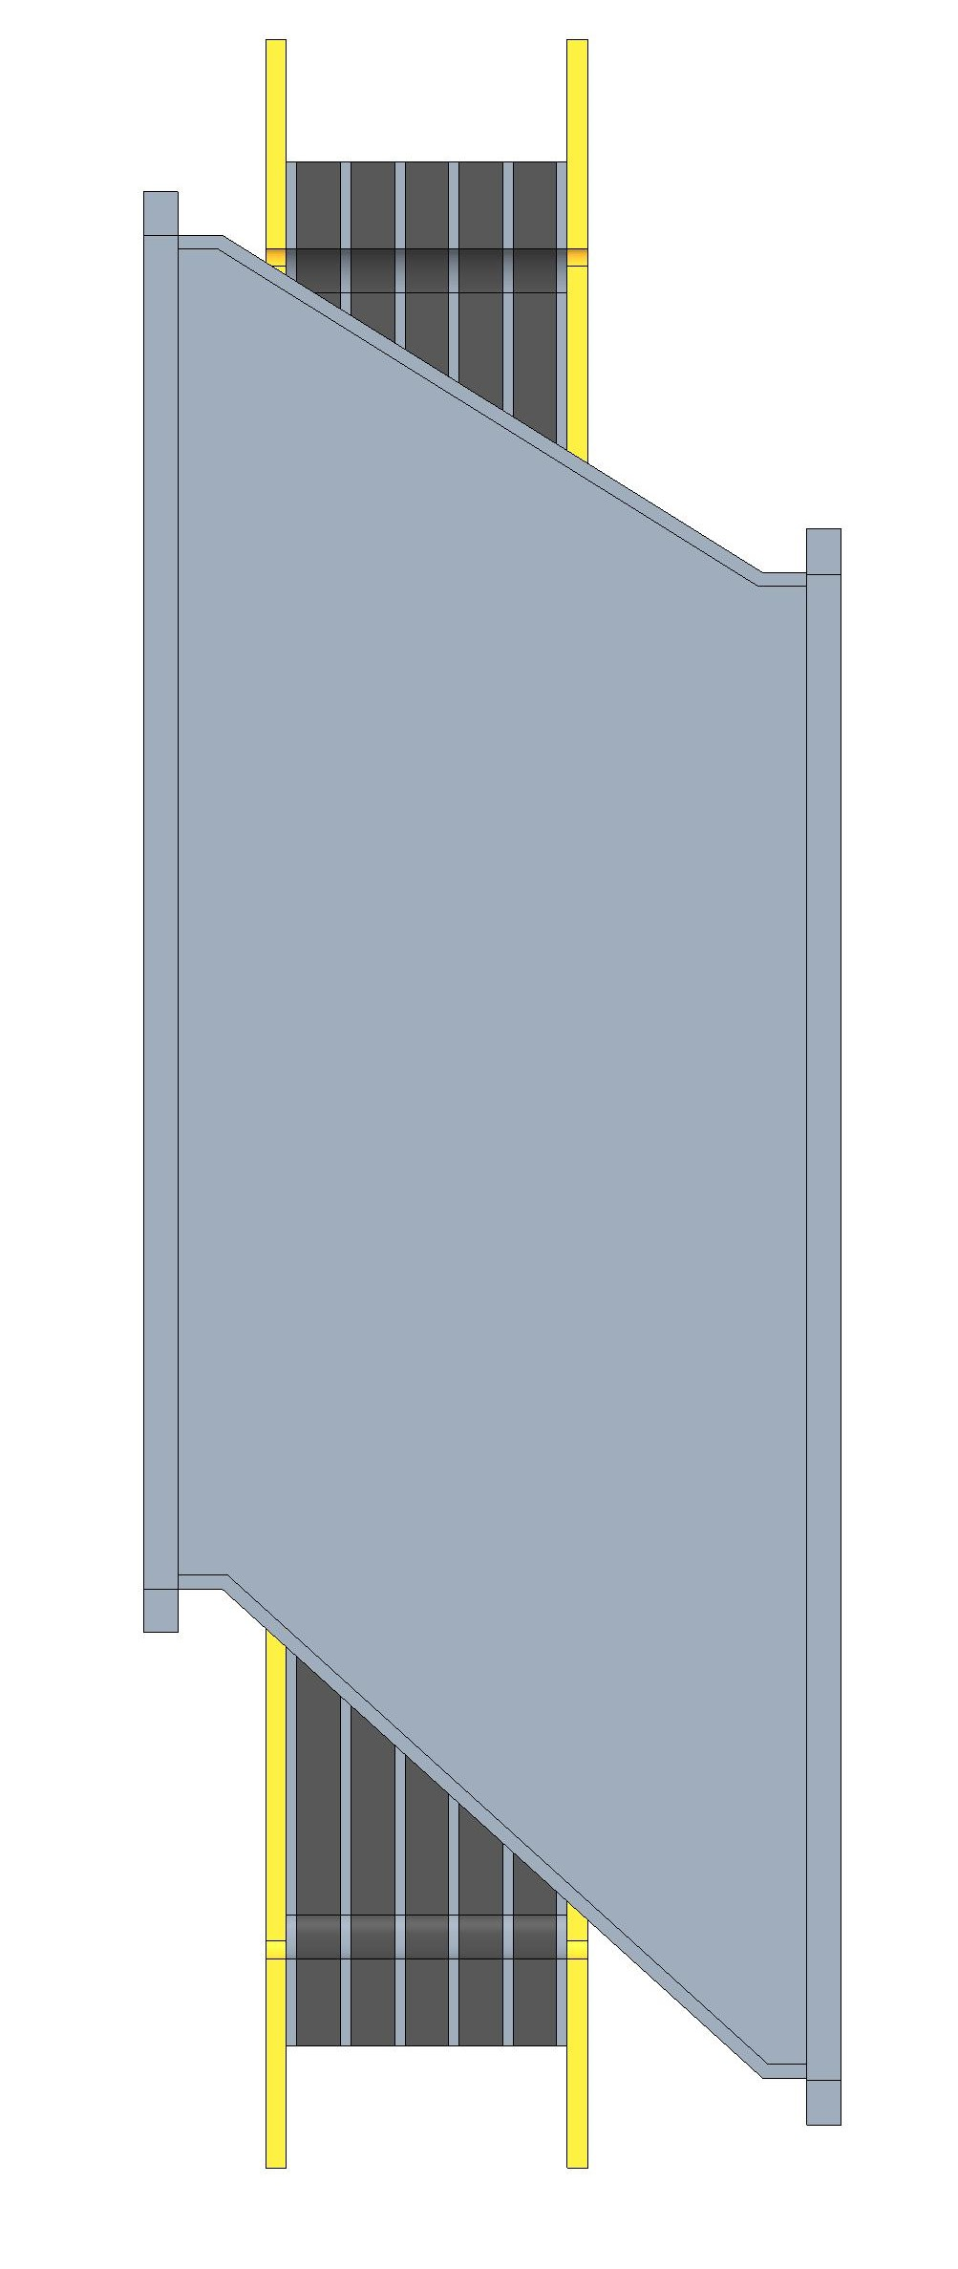
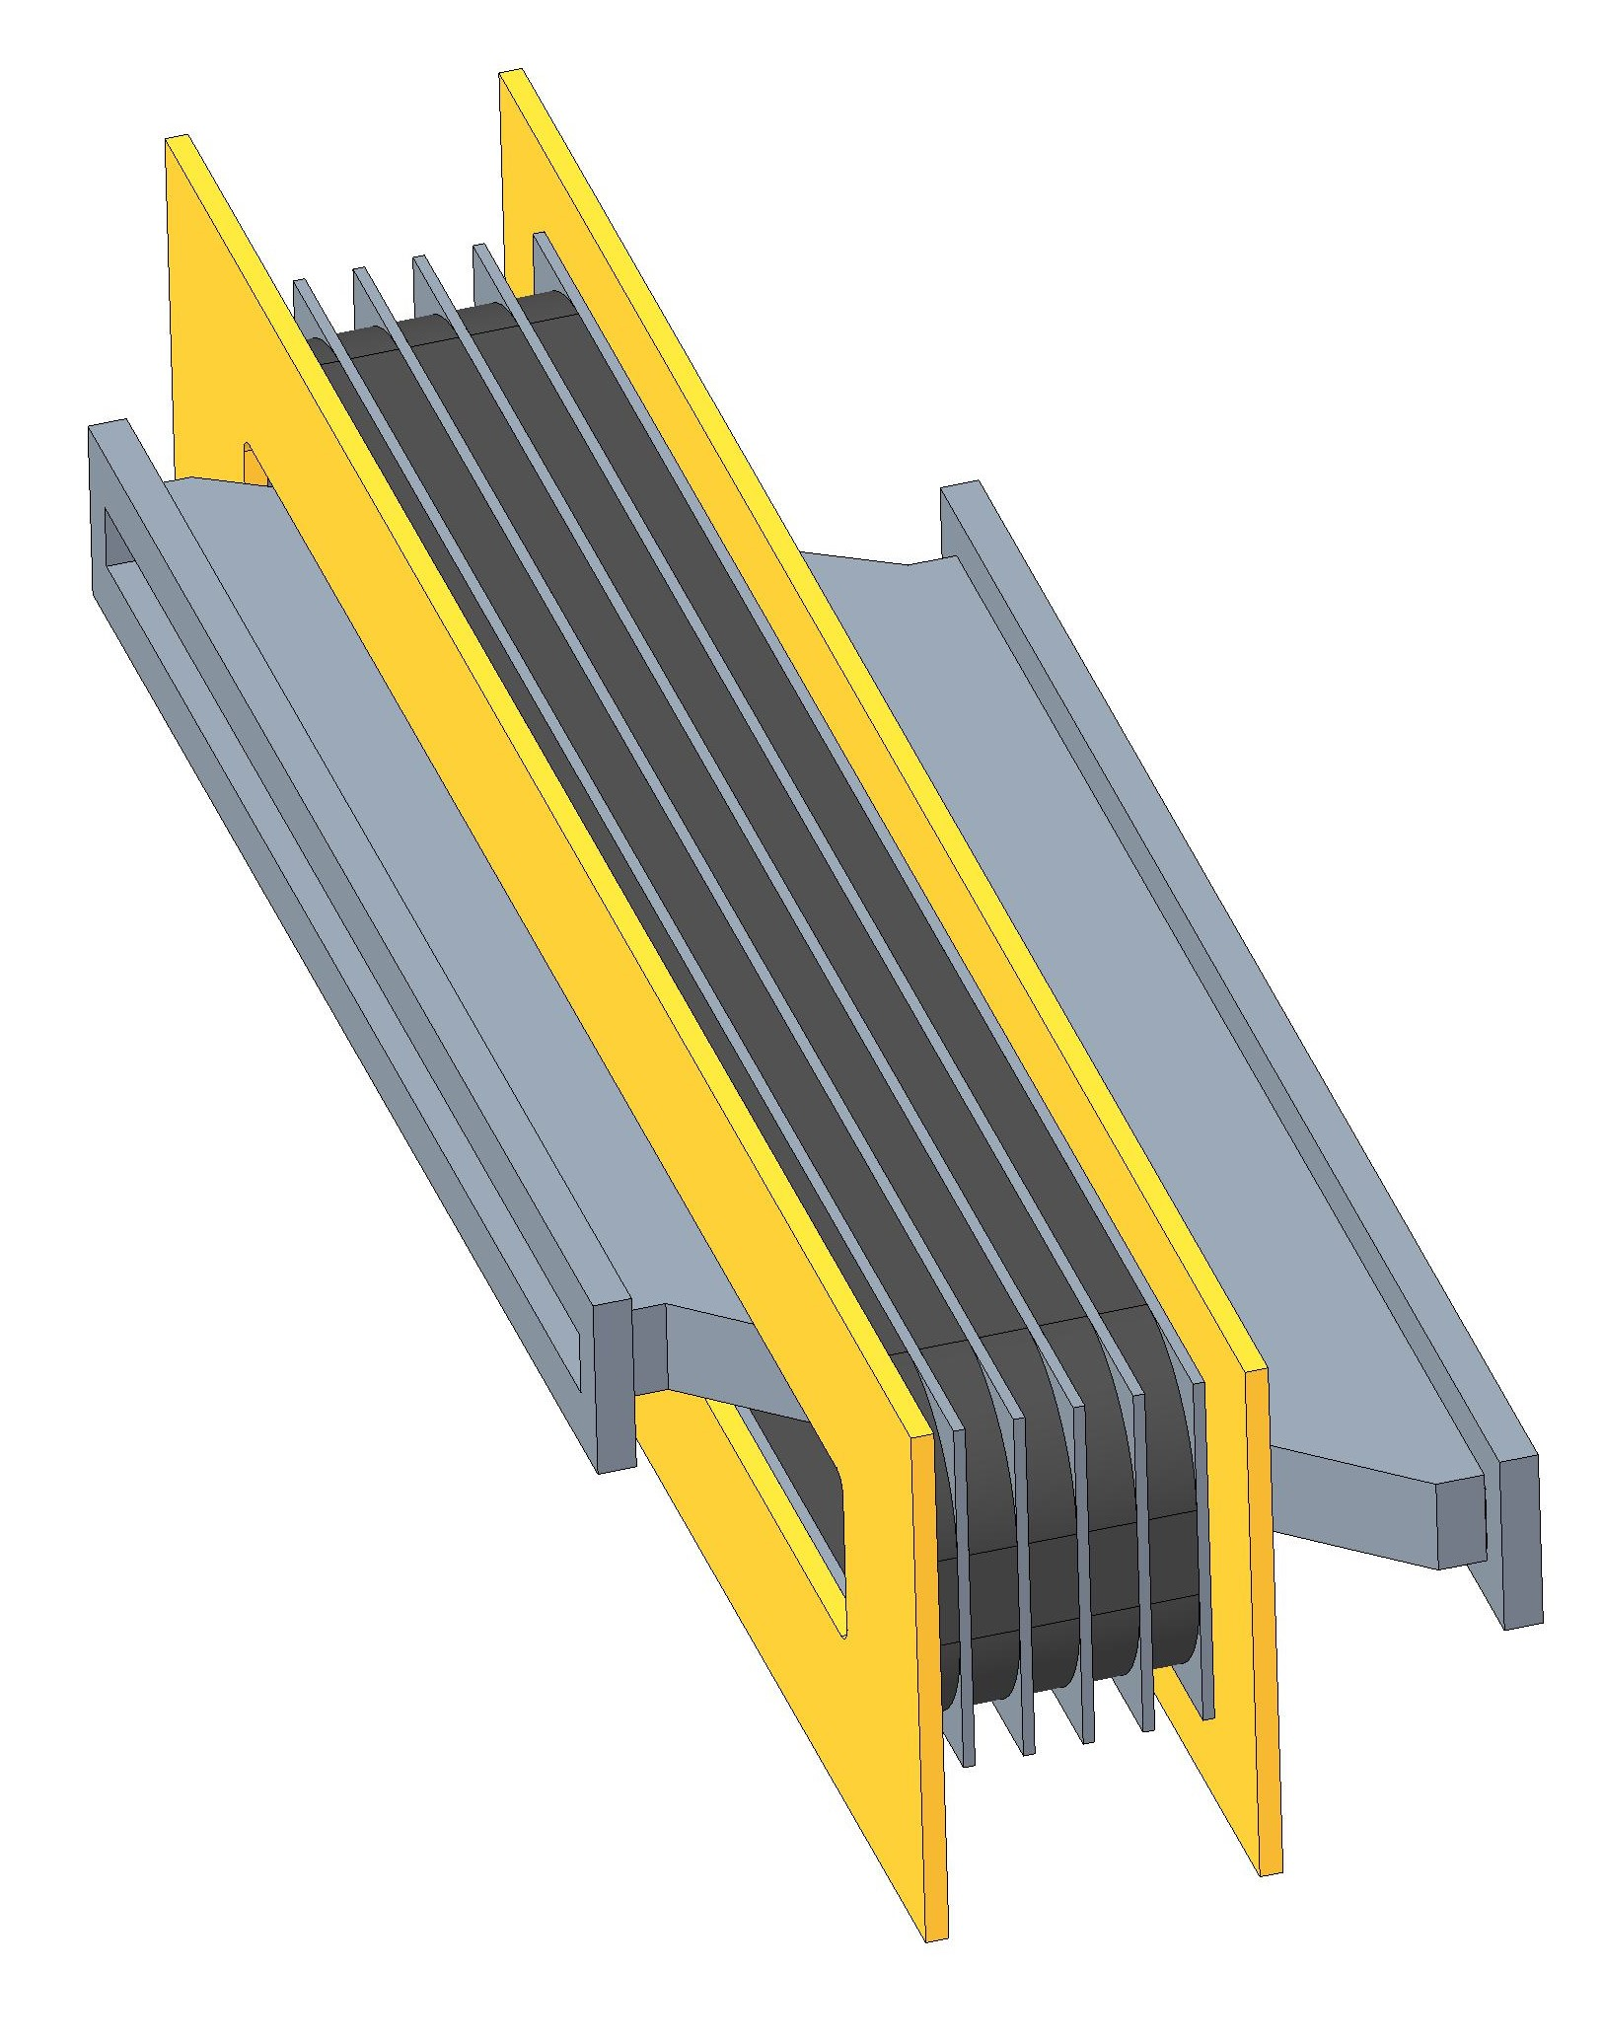
RF Cavity
400mm
BPM
5 cores 25mm thick
BPM
BPM
BPM
Cavity
BPM
BPM
WS
915mm
WS
BPM
BPM
Cavity
WCM
BPM
BPM
FFA MA Cavity

Slide 18
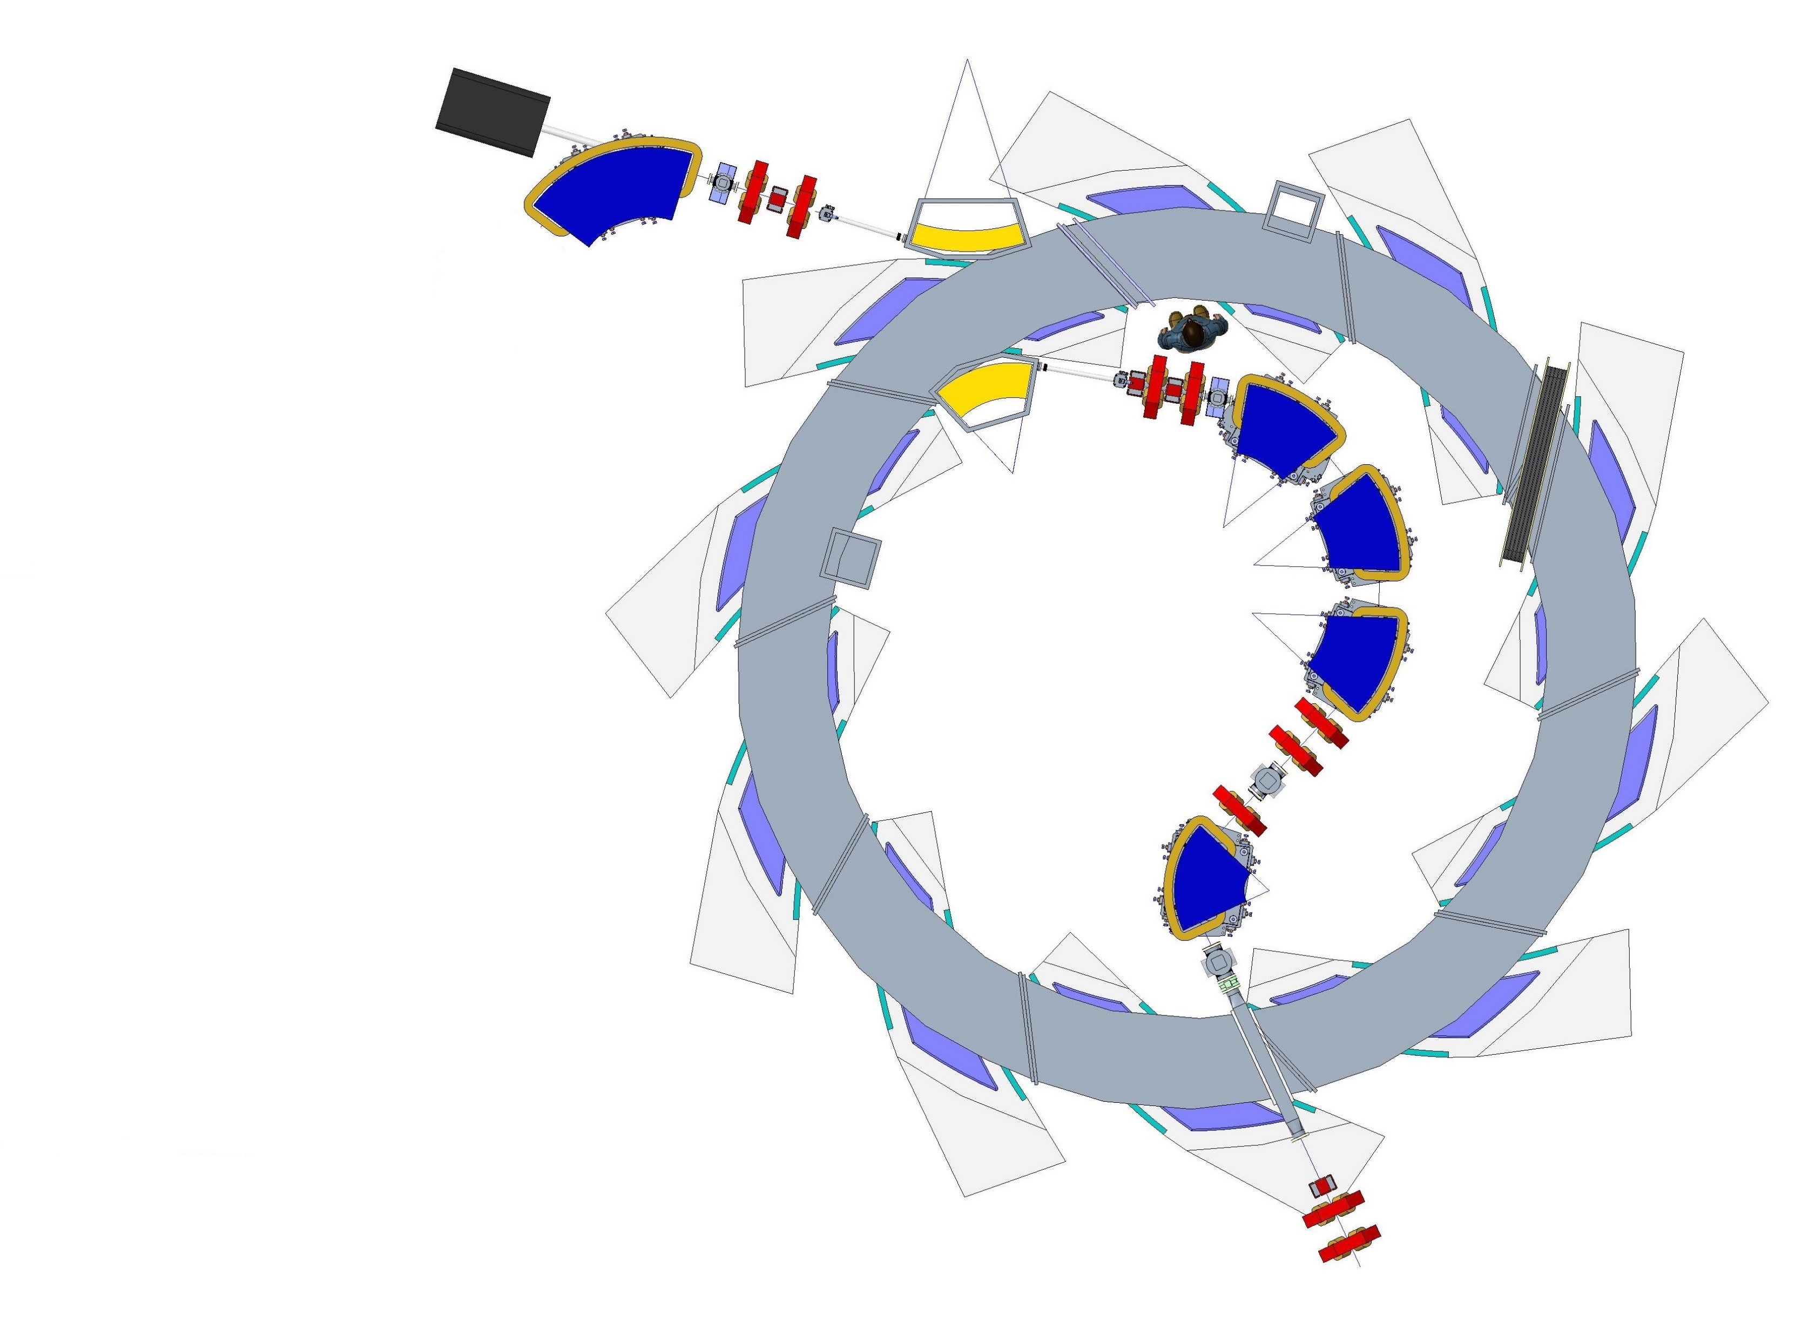
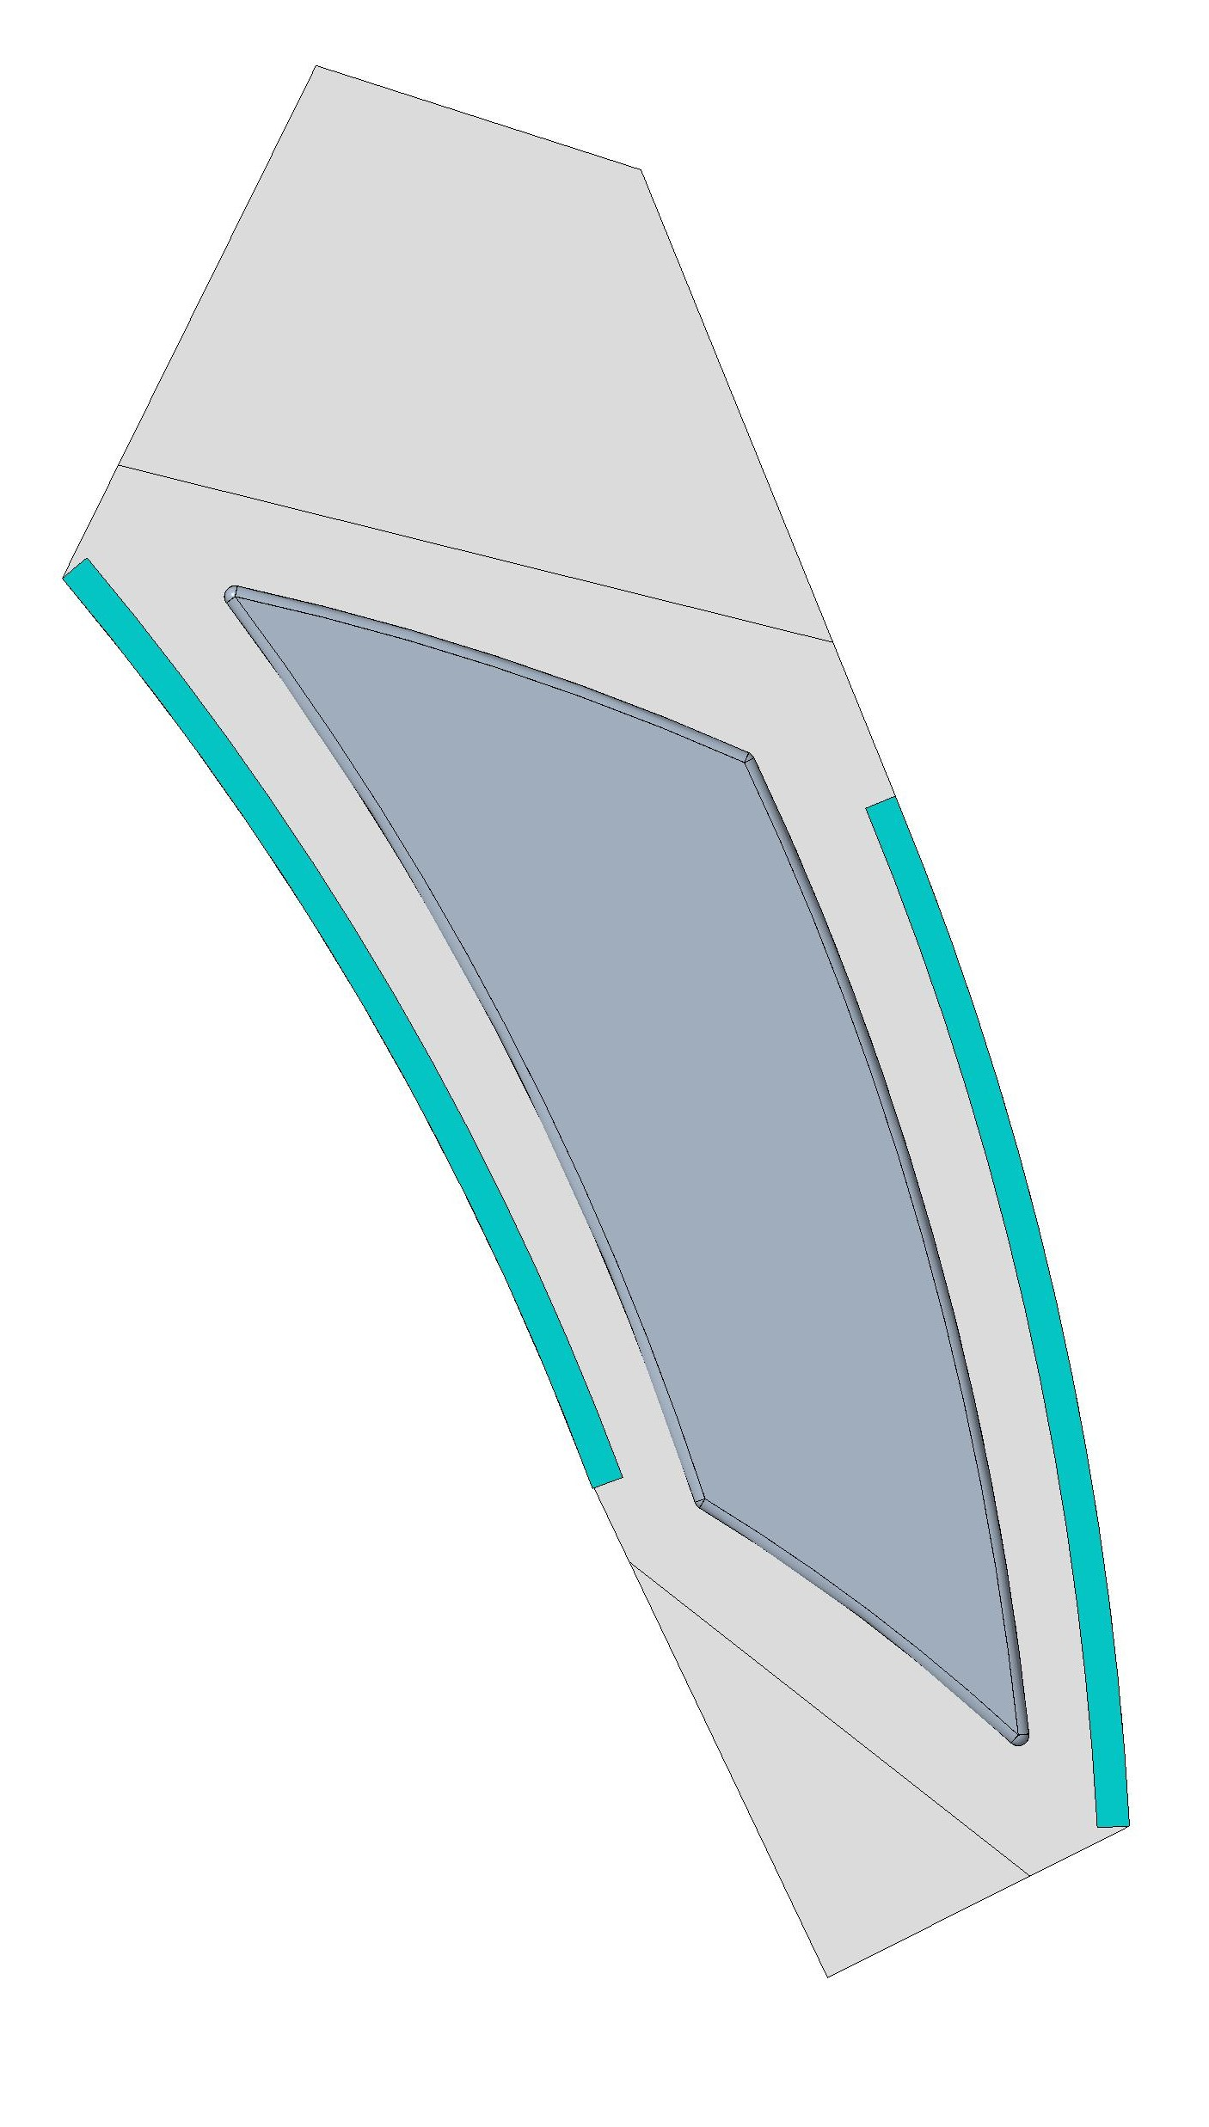
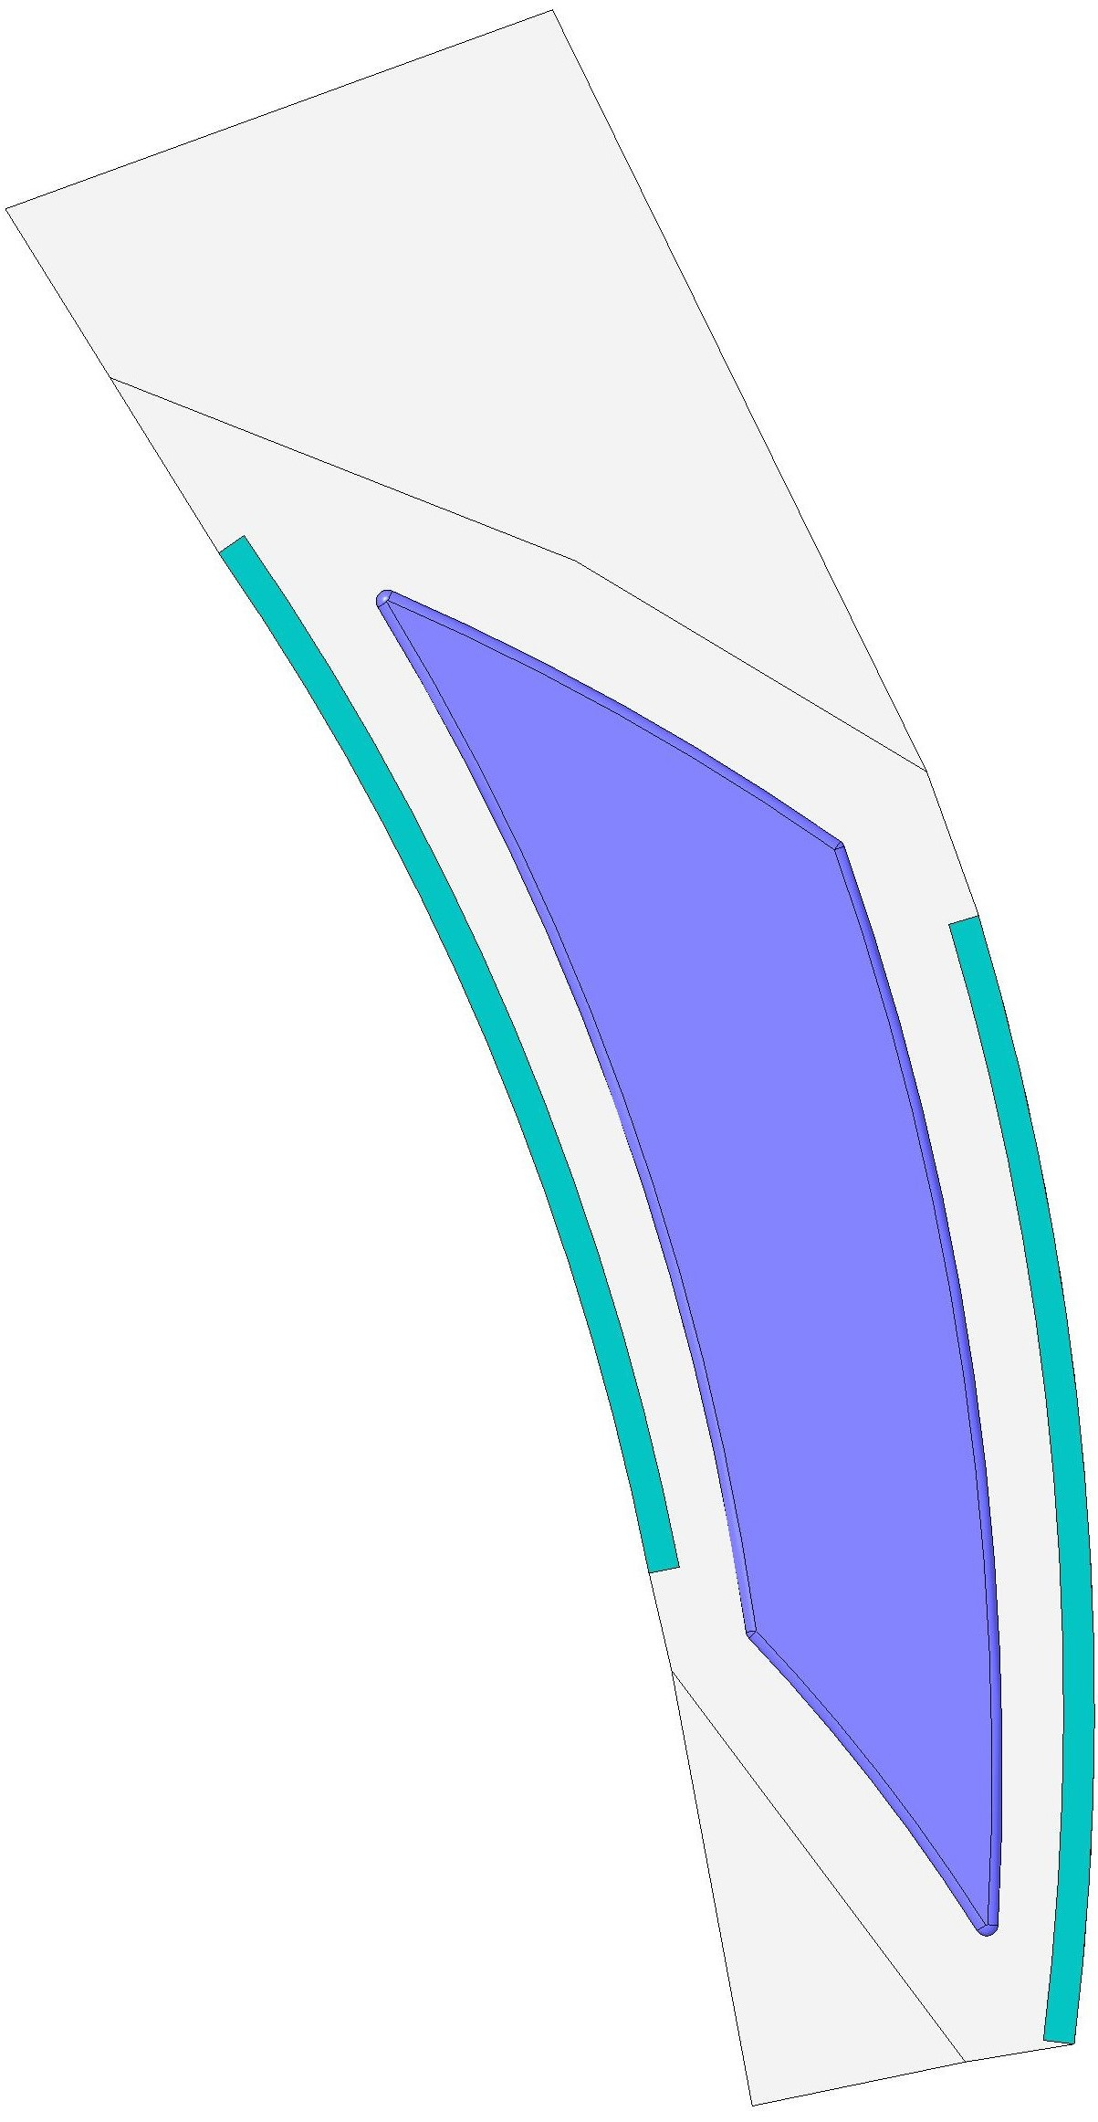
FFA Ring - spiral angle 53.9 degrees
RF cavity size increase
Pole
Pole
Spiral angle 48.7 degree
Spiral angle 53.9 degree
Reduced space between magnets
Injection line requires change in angle

Slide 19
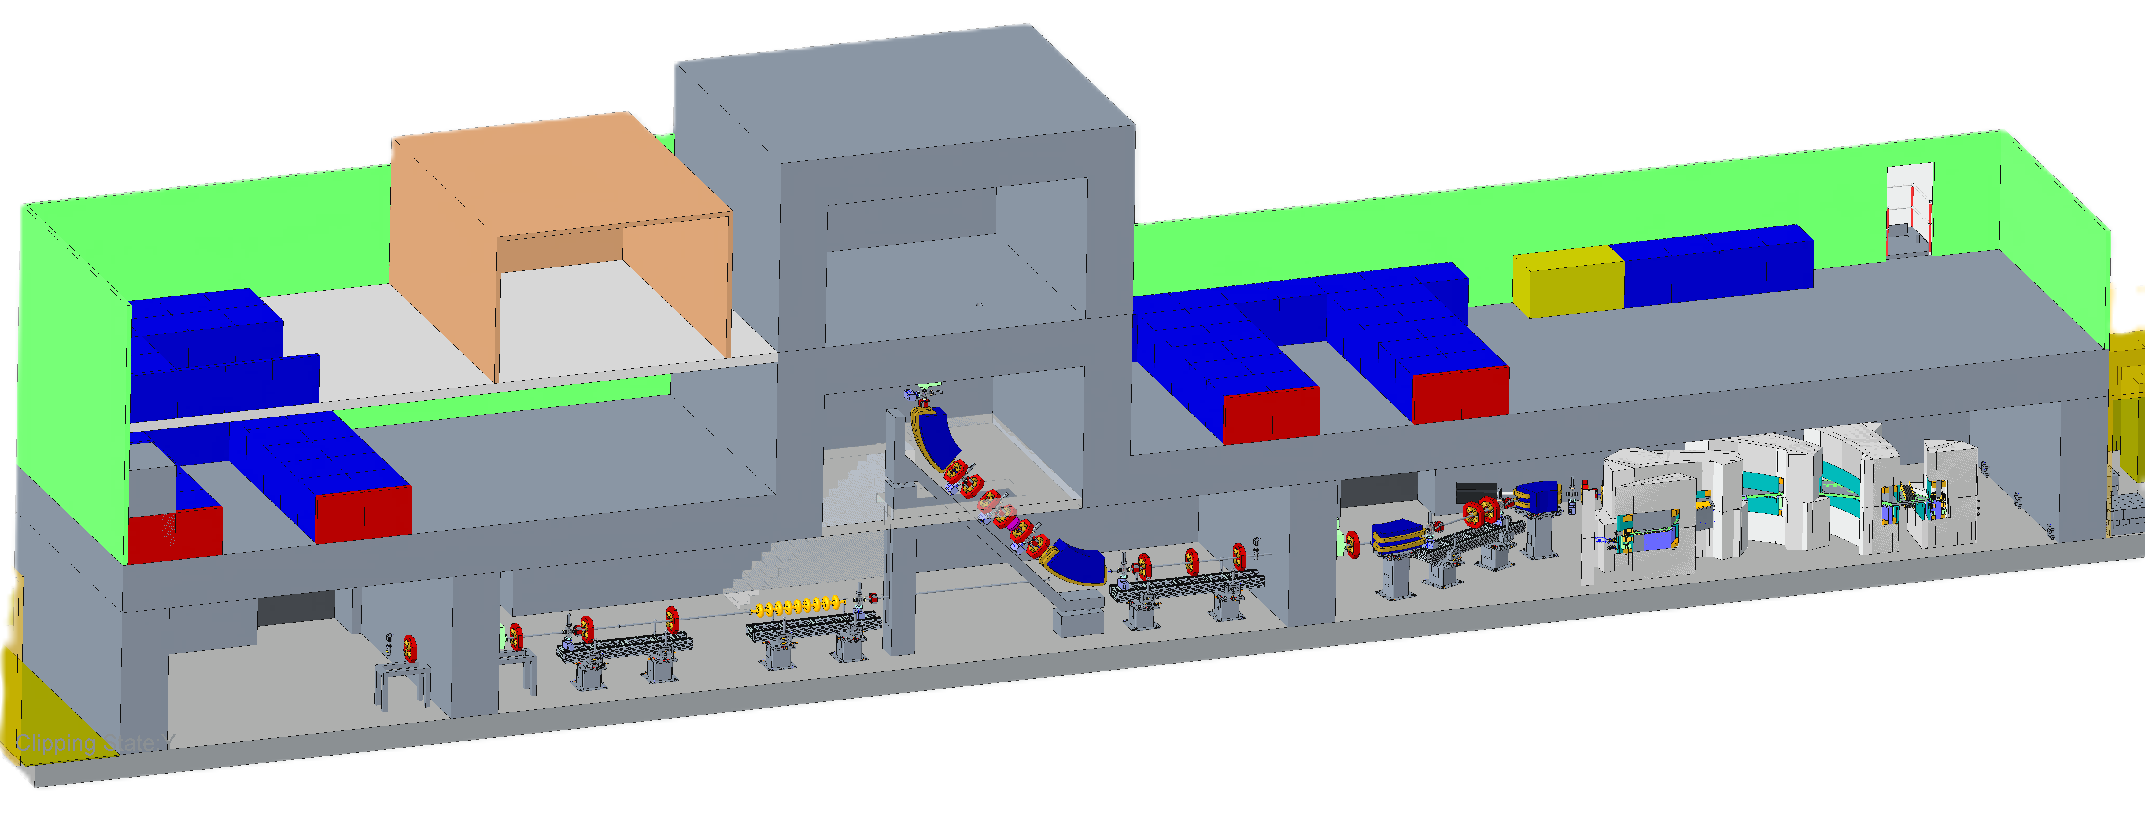
High Energy Line
High Energy In Vitro Station
High Energy In Vivo Station
High Energy In Vitro Station

Slide 20
Questions
Any questions that cannot be answered by the team in attendance can be sent to myself at
clive.hill@stfc.ac.uk
Thank you

