Slide 1



WP6 - Design & Integration: Status
William Shields
(william.shields@rhul.ac.uk)
LhARA Collaboration Meeting
2nd September 2024

Slide 2

Outline
Stage 1 update (me)
Stage 2 FFA design update (Ta-Jen)
Engineering & Integration (Clive)

Slide 3
Overview: Layout
Locations and key dimensions defined :
  Gabor lens
  Arc magnets
  RF cavities
  Collimators
  Corrector magnets
  Vacuum valves
  Wall current monitors
Locations and key dimensions defined :
  Profile monitors
  Shielding walls
  Radiation shutters
  Octupole
  Beam dump
  Stage 2 switching magnet

Slide 4
Overview: Key Parameters
Parameter | Value/Range | Unit
Laser Parameters Power Energy Pulse length Rep. rate Proton Energy Ion Energy | 100 2.5 25 10 15 3.77 | TW J fs Hz MeV MeV/u
Proton & Ion Capture Beam Divergence at design energy Gabor Lens effective length Gabor Lens physical length* Cathode Radius Maximum Voltage Number of Gabor Lenses* Alternative technology: solenoid length Alternative technology: solenoid max field | 11 0.857 1.157 0.0365 65 2 1.157 1.4 | degrees m m m kV m T
Stage 1 Beam Transport Number of Gabor lenses Number of re-bunching cavities Number of collimators Arc bending angle Number of bending magnets Maximum dipole field Number of quadrupoles Maximum quadrupole field Number of octupoles Beam pipe radius | 5 2 2 90 2 0.55 6 0.65 1 0.0365 | Degrees T T m

Slide 5
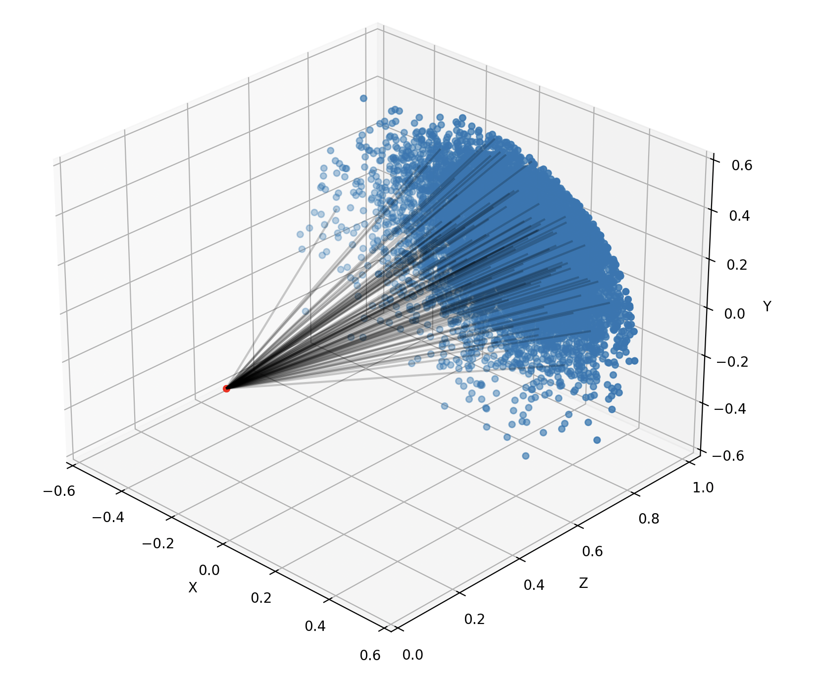
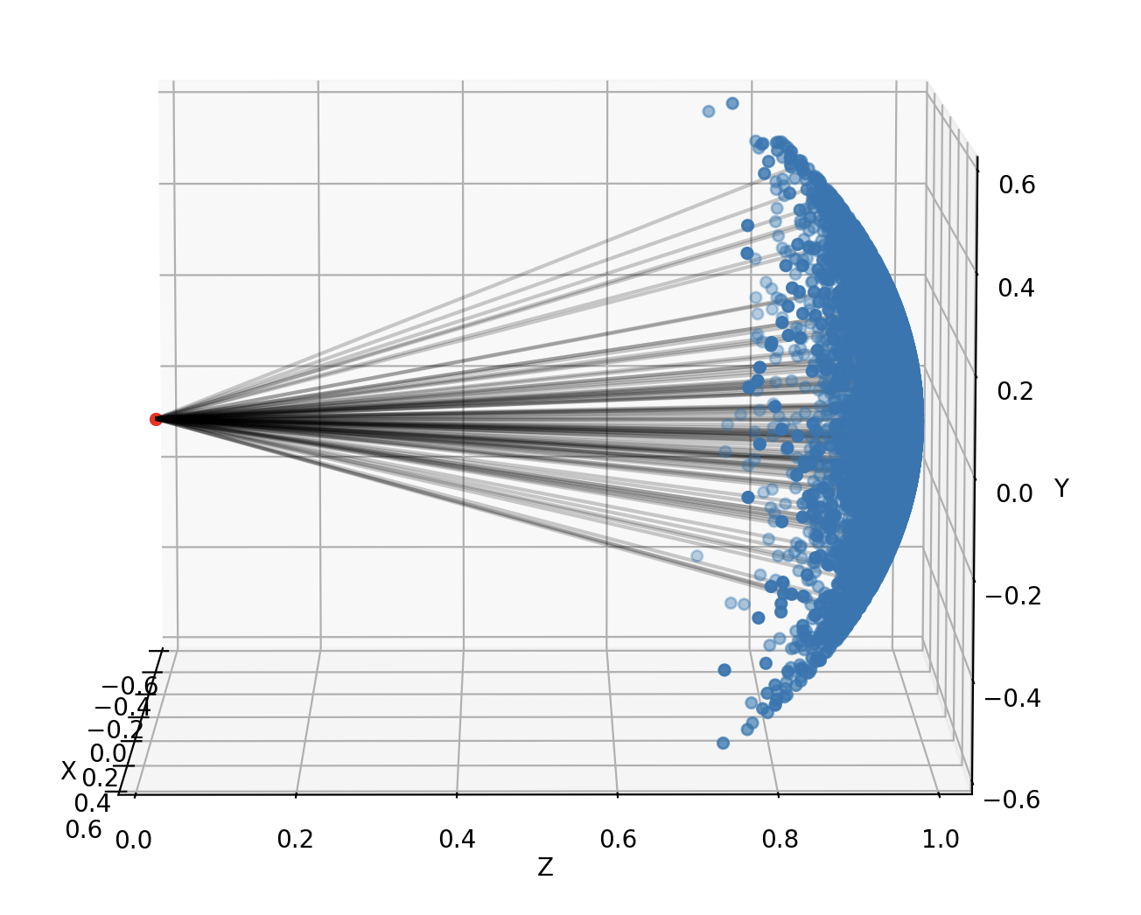
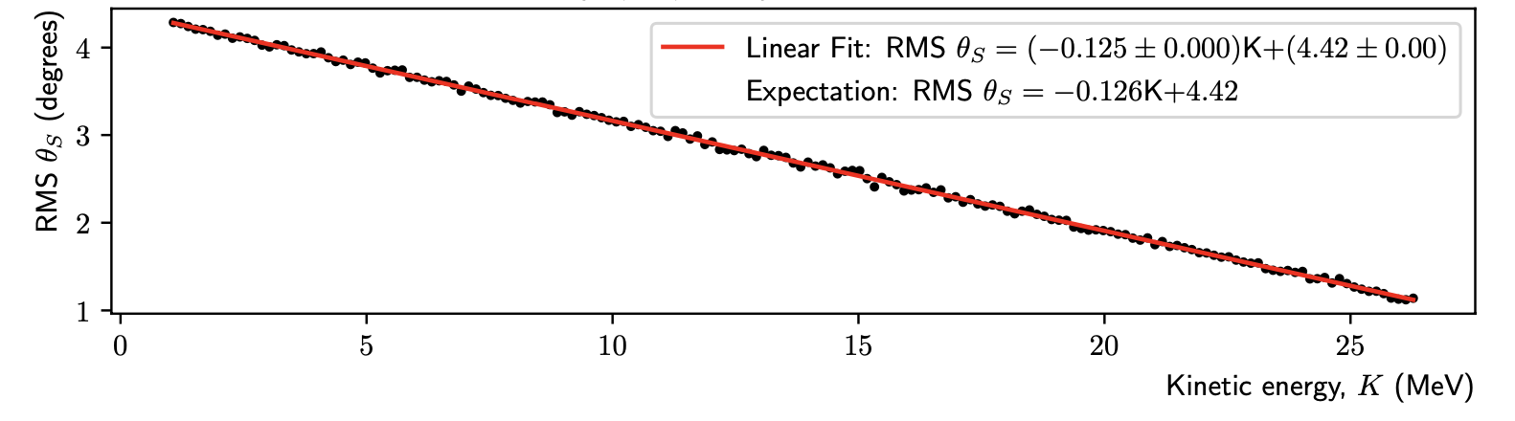

Parameterised Source Distribution
LhARALinearOptics
  K. Long, M. Maxouti, N. Dover
  Code for modelling LhARA beam lines
  Optics, losses, particle source
Angular distribution generated as a cone centred on the normal to the foil surface.
  The opening angle of the cone taken from:
  Low KE angle taken to be 20°, linearly decreases such that angle at E_{max} is 5° (based on [1]).
  The distribution of the polar angle, θ_{s}, approximated as Gaussian
  11° at 15 MeV (25 MeV E_{max})
$$σ_{θ_{S}}\left(E\right)=20°−15° \frac{E}{E_{max}}$$
[1] F. Nurnberg, M. Schollmeier, et al., Review of
Scientific Instruments 80 no. 3, (03, 2009) 033301

Slide 6
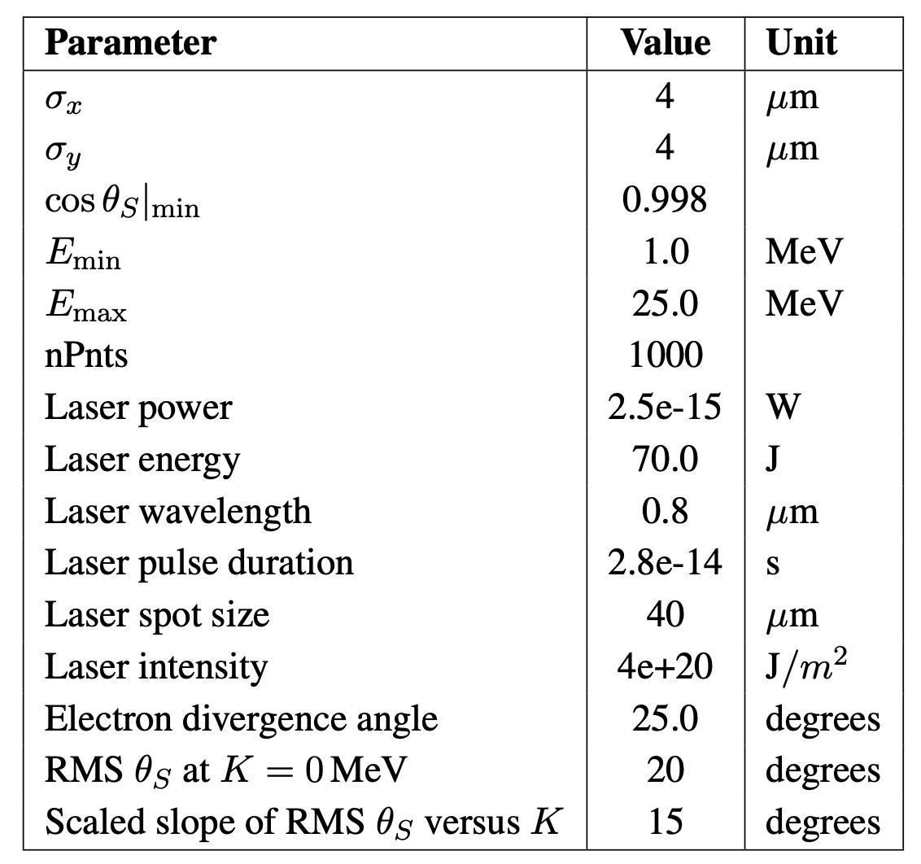
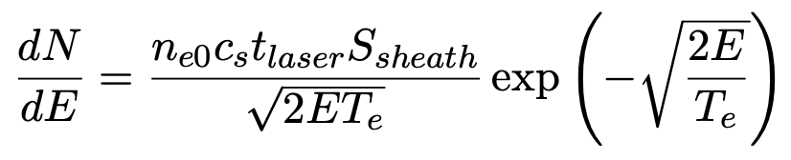

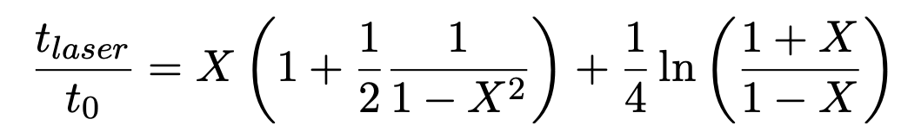

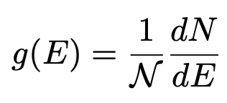
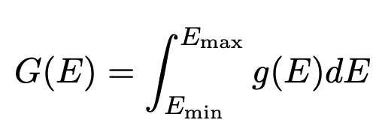
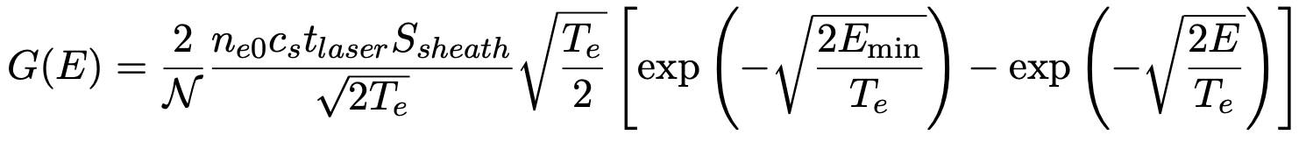
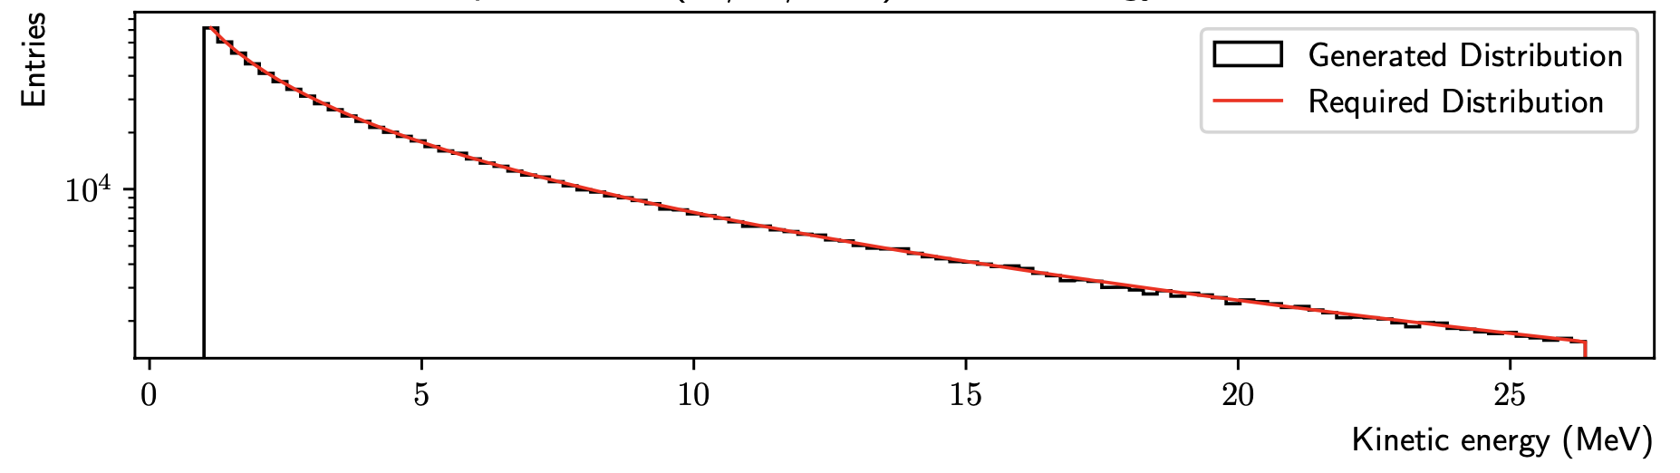
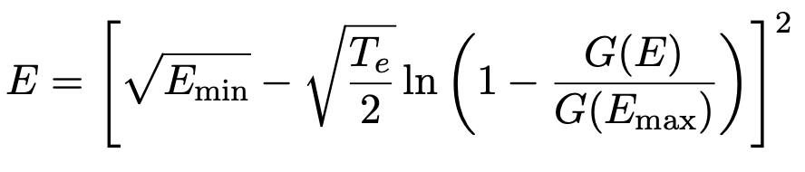
Parameterised Source Distribution
KE spectrum from [2], unable to predict cut-off KE:
Model in [3] has cut off given by:
Probability of particle generated in E -> E+dE:
[2] J. Fuchs, P. Antici, et al.,” Nature Physics 2 (01, 2006)
[3] J. Schreiber, F. Bell, et al., Physical review letters 97 (08, 2006) 045005

Slide 7
LhARA Linear Optics

Slide 8
Beam Comparison To SCAPA Simulation

Slide 9
Reduced Divergence Comparison
Test: theta distribution reduced by factor 4

Slide 10
Stage 1 Nozzle
Methodology
  Generate beam (LLO)
  Track 5cm
  2mm radial filter
  Track 5cm with space charge
  2.87mm radial filter
Transmission (%) | Nozzle Entrance | Nozzle Exit
OSIRIS SCAPA Simulation, | 88.7 | 68.0
Parameterised Beam, θ_{s} = 11° | 7.9 | 4.1
Parameterised Beam, θ_{s} = 2.75° | 87.5 | 55.9
Beam Property | OSIRIS SCAPA Simulation |  | Parameterised Beam, θ_{s} = 11° |  | Parameterised Beam, θ_{s} = 2.75°
 | Horizontal | Vertical | Horizontal | Vertical | Horizontal | Vertical
TWISS ⍺ | -199 | -209 | -355 | -357 | -341 | -342
TWISS β (m) | 19.65 | 20.60 | 35.35 | 35.51 | 33.89 | 33.93
Emittance (m rad) | 8.53e-08 | 8.11e-08 | 5.91e-8 | 5.87e-8 | 5.77e-8 | 5.75e-8
Beam Size (m) | 1.28e-03 | 1.28e-03 | 1.43e-3 | 1.43e-3 | 1.39e-3 | 1.40e-3

Slide 11
Stage 1 Beam at the Nozzle Exit
Final 15 MeV ± 2% beam for particle tracking simulations
Small differences in beam properties depending on particle count (% level)
  Good agreement at nozzle entrance – likely a space charge effect.

Slide 12
Stage 1: Capture and Energy Selection
Solenoid (%) | SCAPA OSIRIS Simulation |  | Theta S = 11 |  | Theta S = 2.75
 | KS (m⁻¹) | B (T) | KS (m⁻¹) | B (T) | KS (m⁻¹) | B (T)
GL1 | 2.4917 | 1.4 | 2.4917 | 1.4 | 2.4917 | 1.4
GL2 | 1.0187 | 0.5724 | 1.0168 | 0.5713 | 1.0175 | 0.5717
GL3 | 1.4485 | 0.8138 | 1.4486 | 0.8139 | 1.4486 | 0.8139

Slide 13
Stage 1 Optics Flexibility
Flexibility preserved for delivering 1-3 cm spot sizes.

Slide 14
Gabor Lens Strengths
Beam Size , 2 σ diameter (cm) | Solenoid 4 B Field (T) | Solenoid 5 B Field (T) | Solenoid 6 B Field (T) | Solenoid 7 B Field (T)
1.0 | 0.7727 | 0.8222 | 4.466e-03 | 1.3746
1.5 | 1.0893 | 0.7576 | 1.1466 | 0.0382
2.0 | 1.1654 | 0.7032 | 0.9633 | 0.2220
2.5 | 1.1491 | 0.7637 | 0.8972 | 0.2634
3.0 | 1.2804 | 0.6017 | 0.7816 | 0.2048

Slide 15
Stage 1 Optics for Stage 2 Operation
Challenges meeting baseline injection line beam parameters
  Emittance ~4.3e-6, beta of 50m = 1 sigma beam radius of 1.46 cm.
Solutions prioritising alpha = 0
Solution 1:
Alpha x: -0.09
Alpha y: -0.11
Beta x: 17.92
Beta y: 18.01
Emit x: 4.30e-06
Emit y: 4.29e-06
Solution 2:
Alpha x: -0.112
Alpha y: -0.169
Beta x: 17.49
Beta y: 17.37
Emit x: 3.22e-06
Emit y: 3.235e-06
Solution | Solenoid 4 B Field (T) | Solenoid 5 B Field (T) | Solenoid 6 B Field (T) | Solenoid 7 B Field (T)
1 | 1.0719 | 0.8482 | 0.7448 | 0.4998
2 | 1.0976 | 0 | 0 | 0.1176

Slide 16
Beam at the Stage 1 End Station
Symmetric, circular, parallel beam.
  3.6cm spot size
Small growth in energy spread due to space charge
Uniform spectrum and temporal profile

Slide 17
Summary
Standard parameterised source developed
Stage 1 performance unaffected
No other stage 1 changes
Ready for CDR write-up.

Slide 18


Thank you
William Shields
william.shields@rhul.ac.uk

