Slide 1
Modelling laser ion beam interactions
Stephen McMahon
LhARA collaboration meeting
2nd September 2024

Slide 2
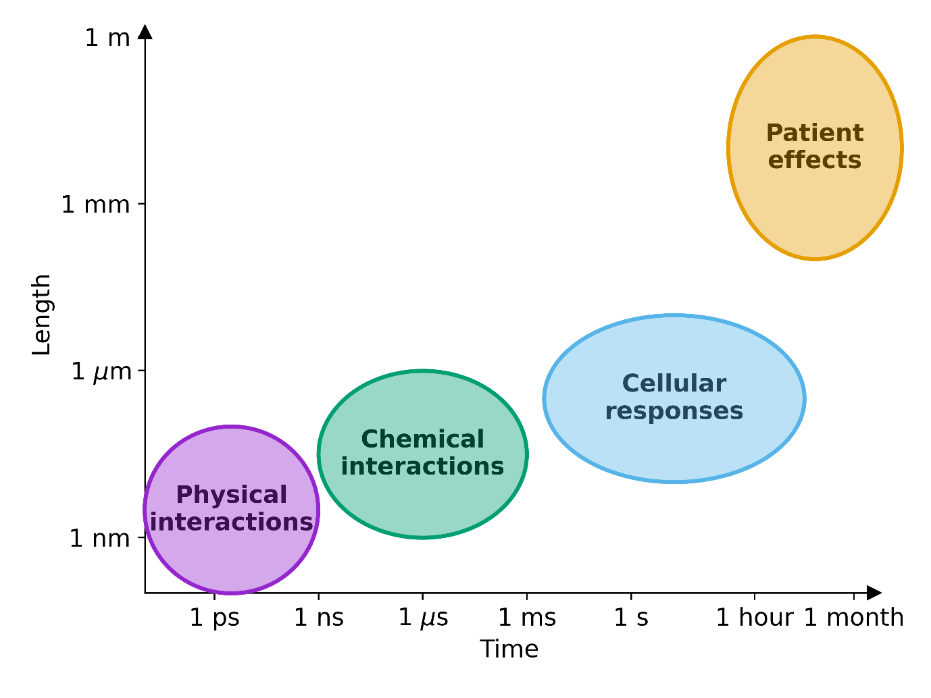
Key outstanding questions
Conventional radiotherapy is delivered over a timescale of minutes, where physico-chemical interactions happen largely in isolation. FLASH has suggested some cellular effects can be modulated at timescales of <1 s, whereas laser-accelerated beams can deliver irradiations entirely within the physical stage of interaction.
It’s unclear how this may affect both physical and chemical effects of radiation.
Conventional RT
Laser-accelerated beams
FLASH
Schematic illustration of time- and length-scales associated with different aspects of radiation responses.

Slide 3
Modelling inter-track interactions
We used Geant4/Topas-nBio to simulate interactions of proton beams in small target samples.
To explore potential for interactions between tracks, we calculated both the distribution of physical energy deposition around the track, as well as the generated radical species as a function of time.
Left: Schematic illustration of proton beam incident on small water phantom. Right: Illustration of energy deposition by a pencil beam of fifty 100 MeV protons, and evolution of generated radical species (solvated electron (green), hydroxyl radical (orange), hydrogen (magenta), hydronium (sky blue), dihydrogen (purple), hydrogen peroxide (grey) and hydroxide (yellow) ).

Slide 4
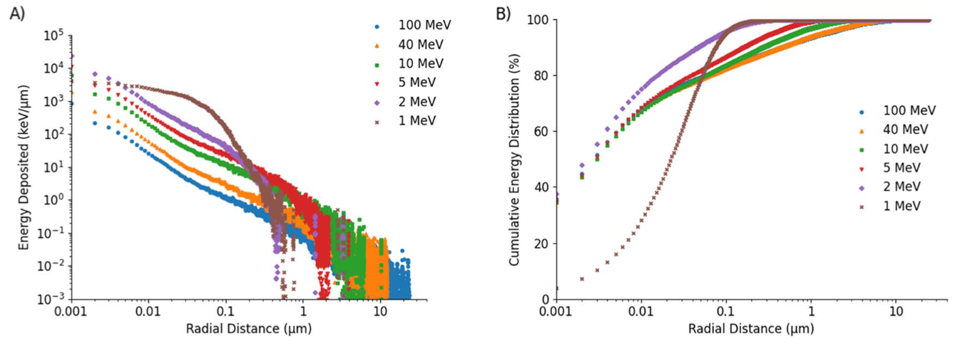
Radial track distributions
These data can be used to define the effective ‘width’ of proton tracks as a function of energy and time.
Figures to the right show the radial deposition of energy around proton tracks (top) and cumulative distributions of energy (bottom).

Slide 5
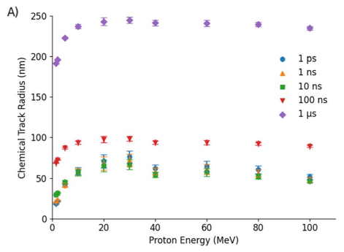
Radial track evolution
Tracks can also be quantified as a function of their distribution of reactive chemical species. At early timepoints (1 ps) this closely resembles the physical energy deposition, but as time progresses the tracks become broader.
Right: Illustration of 100 MeV track width at different times (top); and illustration of ‘track radius’ containing 80% of chemical species at different timepoints for different energies.

Slide 6
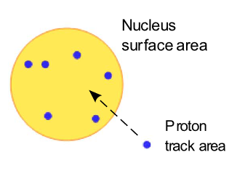
Track overlap rates
We can then distribute these tracks on a biological ‘target’ and calculate the probability of overlap.
For simplicity here, we call an ‘overlap’ if a track core passes within 1 track radius of another track.

Slide 7
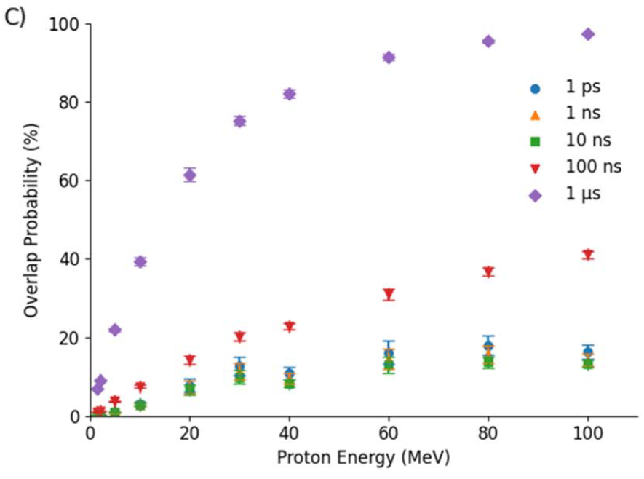
Track overlap rates
We can then distribute these tracks on a biological ‘target’ and calculate the probability of overlap.
For simplicity here, we call an ‘overlap’ if a track core passes within 1 track radius of another track.
Probability closely mirrors that of track radius, but with an additional reduction at low energies due to higher tracks and fewer particles per Gray.
Probability of a given track overlapping with at least one other, for 2 Gy proton irradiation at different energies.

Slide 8
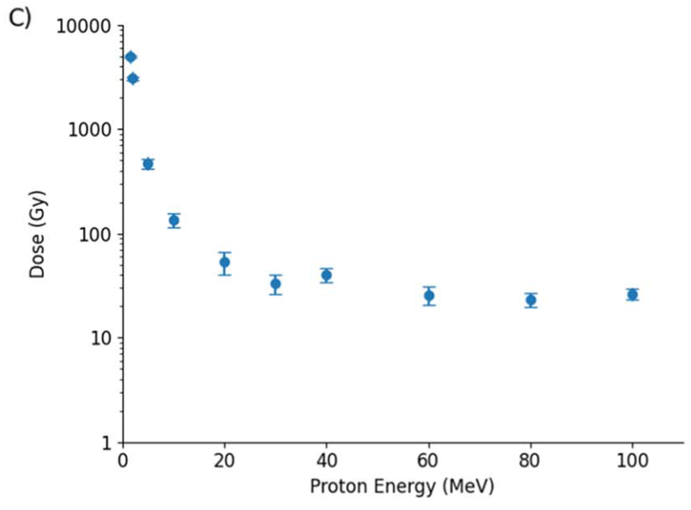
Track overlap rates
We can then distribute these tracks on a biological ‘target’ and calculate the probability of overlap.
For simplicity here, we call an ‘overlap’ if a track core passes within 1 track radius of another track.
Probability closely mirrors that of track radius, but with an additional reduction at low energies due to higher tracks and fewer particles per Gray.
Dose required for the average number of overlaps per track to be equal to 1, for t=1 ns. Even for low LETs, this number is much higher than clinically relevant.

Slide 9
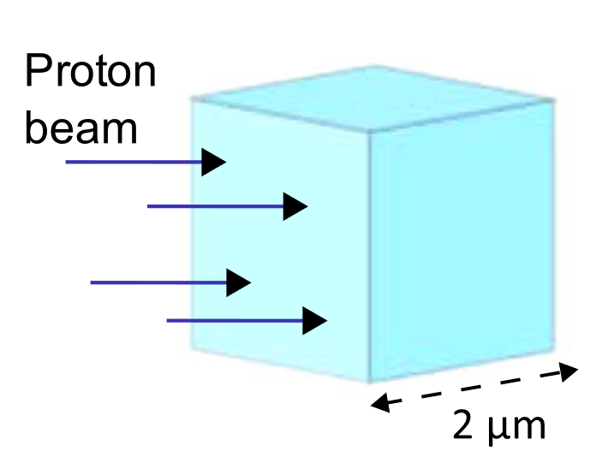
Radiochemical impact
Track overlaps do not actually guarantee interaction, however.
To investigate this, we also simulated radiochemical yields in a water phantom volume, for different delivered doses either temporally independently, or as single pulses.

Slide 10
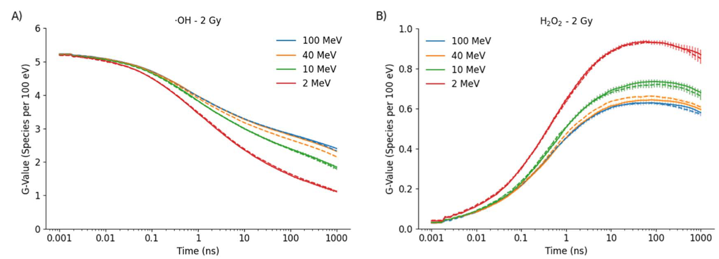
Radiochemical impact
We investigated temporal evolution of yields of different radical species in water, as a function of proton energy and dose.
Clear LET-dependent effects were seen, but differences between low dose-rate (solid lines) and instantaneous delivery (dashed lines) were minor.
Statistically significant OH depletion was seen at 8 Gy of 100 MeV protons at 10 µs, but on the order of a few percent.

Slide 11
Track Overlap Summary
Track overlap is relatively uncommon, up to doses much greater than that used clinically.
Overlaps are more common for higher energies (lower LETs), and later radical diffusion timepoints.
However, scavenging in cells limits radical diffusion to a few nanoseconds, significantly reducing overlap probabilities.
Even in simple water volumes, the actual rate of radical interaction remains low, even at energies and timepoints where overlaps begin to occur.

Slide 12
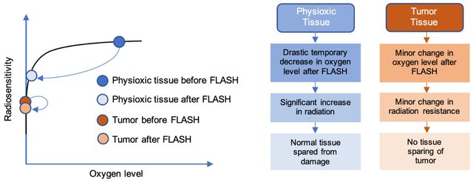
Oxygen depletion
There is significant interest in oxygen depletion as a mechanism of FLASH sparing.
Here, high dose-rate delivery reacts with oxygen more quickly than it can be replenished, preventing its role in generating indirect DNA damage.
Right: Schematic FLASH effect diagram, from Okoro et al, Cancers, 2022

Slide 13
Modelling oxygen depletion
Depletion
Recovery
We developed a simple analytic model of oxygen depletion in FLASH RT, modelling competition between environmental reoxygenation and radiation-induced depletion.
Gives a dose-rate and time dependent model for target oxygenation.

Slide 14
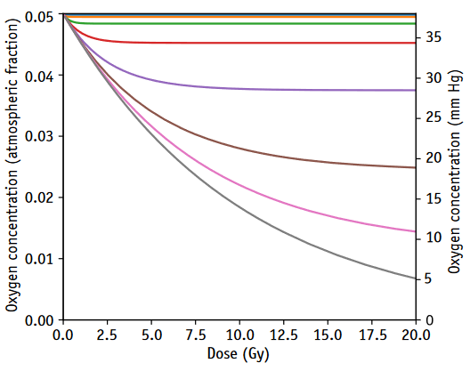
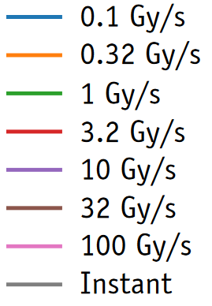
Modelling oxygen depletion
We developed a simple analytic model of oxygen depletion in FLASH RT, modelling competition between environmental reoxygenation and radiation-induced depletion.
Gives a dose-rate and time dependent model for target oxygenation.
Oxygen levels as a function of dose delivered, using different dose rates.

Slide 15
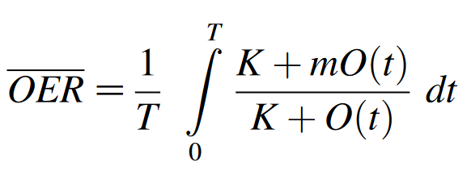
Impact on OER
This model can then be used to calculate the time-varying Oxygen Enhancement Ratio (OER) during exposure taking into account oxygen depletion.

Slide 16
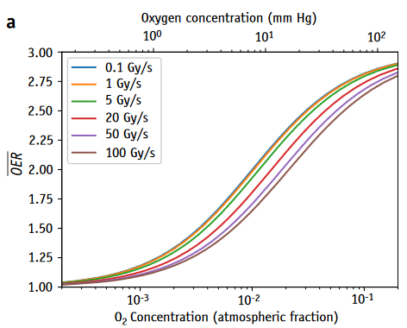
Impact on OER
This model can then be used to calculate the time-varying Oxygen Enhancement Ratio (OER) during exposure taking into account oxygen depletion.
This predicts changes in average OER as a function of initial Oxygen, dose, and dose-rate.
Right: Illustration of average OER curves for 15 Gy delivered at different dose rates.

Slide 17
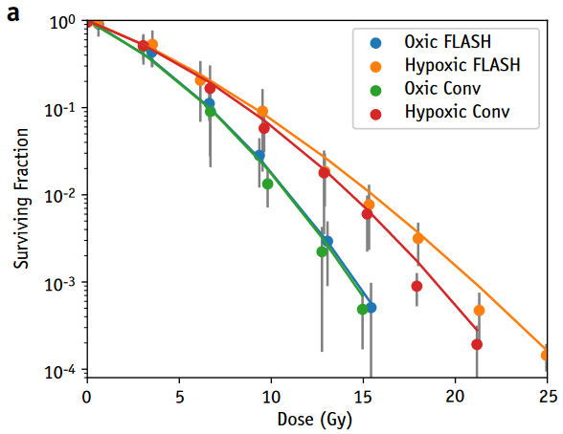
Survival prediction
These models effectively reproduce FLASH dose-response curves for different radiation conditions, highlighting significant impact in moderately hypoxic conditions, but negligible effect in oxic conditions.
Right: Comparison of model and experiment predictions for DU-145 cells irradiated at conventional and FLASH (600 Gy/s) dose rates with electrons.

Slide 18
Oxygen depletion summary
An Oxygen depletion based model performs well at predicting FLASH effects, in our data and that of other groups.
Can in principle be applied directly to laser-accelerated irradiations, with possibly a small correction for kinetics of O2-DNA reactions.
However, magnitude of oxygen depletion remains an open question in the field, as experimental measurements suggest rate of depletion is much lower than that model fits predict is needed to drive observed effects.

Slide 19
Conclusions & future areas for investigation
Classical ‘inter-track’ interactions are unlikely to significantly affect responses in laser irradiations, but FLASH radiochemistry-like effects may be important.
However, much physics remains unexplored in this area. Laser-accelerated irradiation pulses would put systems into a highly non-equilibrium state, with many ionised atoms and electrons carrying significant energy. The impact of this on biological systems remains unknown, as there have been limited studies of these effects.

Slide 20
Acknowledgements
QUB
Kevin Prise
Karl Butterworth
Computational radiobiology group
Francisco Liberal
Shannon Thompson
Lydia Gardner
Moh Dakheel
Lund University
Kristoffer Petersson
Gabriel Adrian
Thompson, S.J.; Prise, K.M.; McMahon, S.J. Investigating the Potential Contribution of Inter-Track Interactions within Ultra-High Dose-Rate Proton Therapy. Physics in Medicine & Biology 2023, 68, 055006, doi:10.1088/1361-6560/acb88a.
Petersson, K.; Adrian, G.; Butterworth, K.; McMahon, S.J. A Quantitative Analysis of the Role of Oxygen Tension in FLASH Radiation Therapy. International Journal of Radiation Oncology Biology Physics 2020, 1–9, doi:10.1016/j.ijrobp.2020.02.634.

