Slide 1

Narrow-band, GeV gold ion acceleration from ultra-thin foils
Philip Martin
p.martin@qub.ac.uk

Slide 2







Acknowledgements
P. Martin, H. Ahmed, D. Doria,
M. Cerchez, F. Hanton, D. Gwynne,
A. Alejo, J. Fernandez-Tobias,
J. Green, A. Macchi, D. A. Maclellan,
P. McKenna, J. Ruiz, M. Swantusch,
O. Willi, S. Zhai, M. Borghesi, S. Kar

Slide 3
Outline
Acceleration of super heavy ions to date – motivations and techniques
Acceleration mechanisms
Experimental results
PIC simulations
Summary

Slide 4
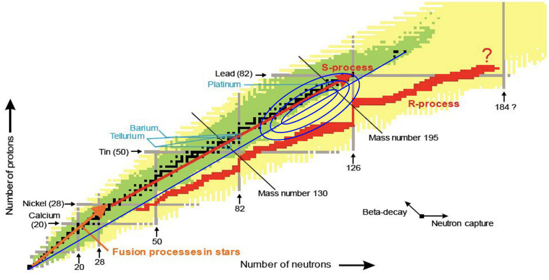
Why accelerate Au ions with lasers
Useful in nuclear physics studies, such as exotic nuclei production via the R-process (fission-fusion reaction)
Injection into conventional accelerators
Very heavy ions notoriously difficult to accelerate to high energies, and in high particle number via conventional means
Habs et al., Appl. Phys. B: Lasers and Optics 103, 471 (2011)
Notes:
7 MeV/n minimum energy for fission barrier + enough energy to fuse
Plus need v high particle number to be efficient

Slide 5
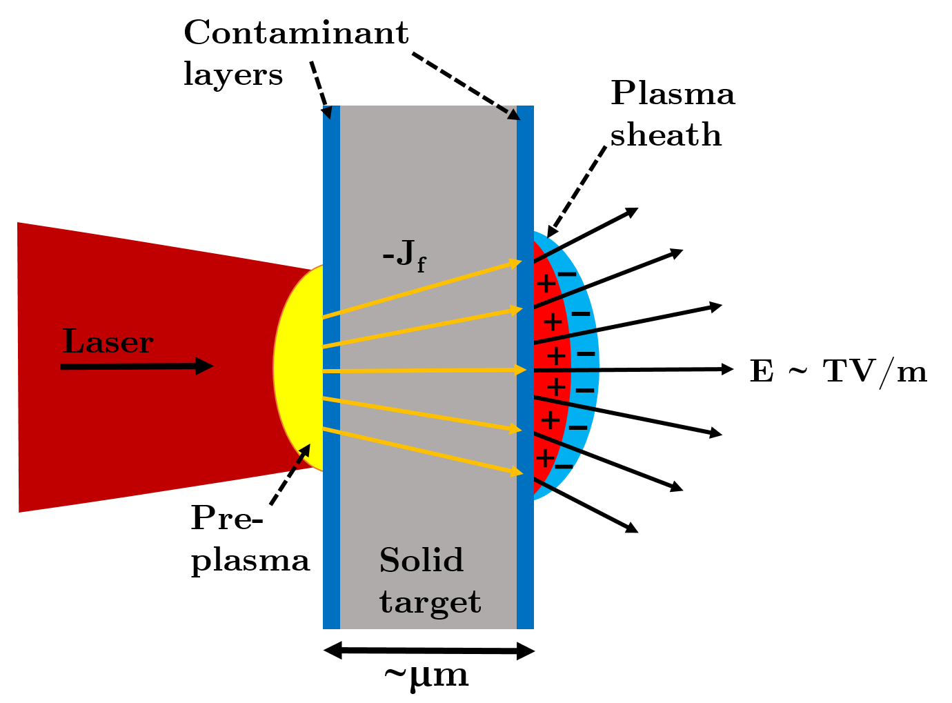
Ion acceleration mechanisms - TNSA
Hot electron sheath formed on target rear side sets up space charge field
High Z/A ions are favoured – proton acceleration dominates
Notes:
Thick solid density target regime
Contaminant layers on rear surface provide light ions
Accelerated according to Z/A in broadband, Boltzmann-like spectra
Difficult for heavy ions to be accelerated by this means due to shielding of field by P/C

Slide 6
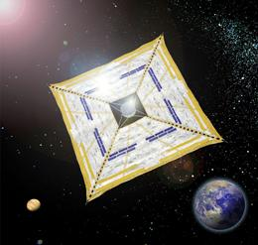
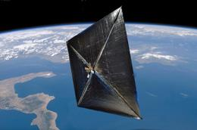
Radiation pressure acceleration (RPA)
Light can exert pressure on surfaces
Reflecting surface
Pressure = Force per unit area
= Momentum transferred to the surface
f
v
IKAROS (Japan)
May 2010
Nanosail D2, (US)
Jan 2011
f '
Acceleration ~ 0.3 µm/s²
G. Marx, “Interstellar vehicle propelled by terrestrial laser beam”, Nature 211 (1966) 22
Notes:
-At sufficiently high intensities, radiation pressure can accelerate target

Slide 7
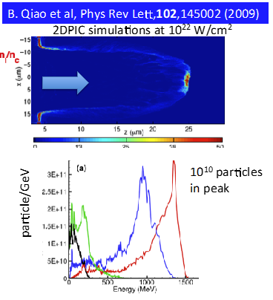
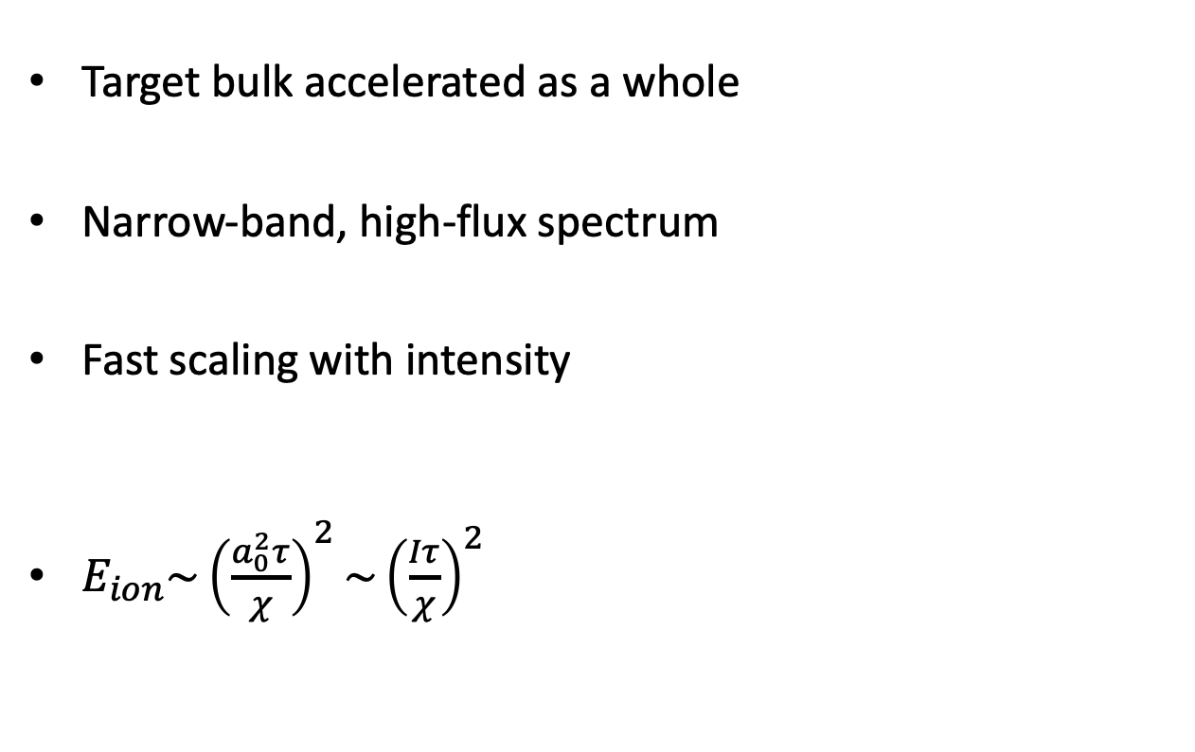
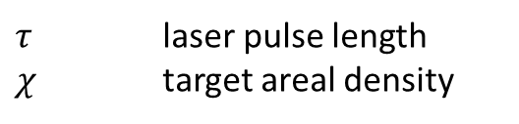
Light sail RPA
Target bulk accelerated as a whole
Narrow-band, high-flux spectrum
Fast scaling with intensity
$E_{ion}\sim {\left(\frac{a_{0}^{2}τ}{χ}\right)}^{2}\sim {\left(\frac{Iτ}{χ}\right)}^{2}$
$τ$ laser pulse length
$χ$ target areal density
Target must stay opaque:
Electron heating
Target disassembly
Transverse instabilities
Kar et al. PRL, 109, 185006 (2012)
Notes:
- When target is < skin depth of laser, light sail is mechanism

Slide 8
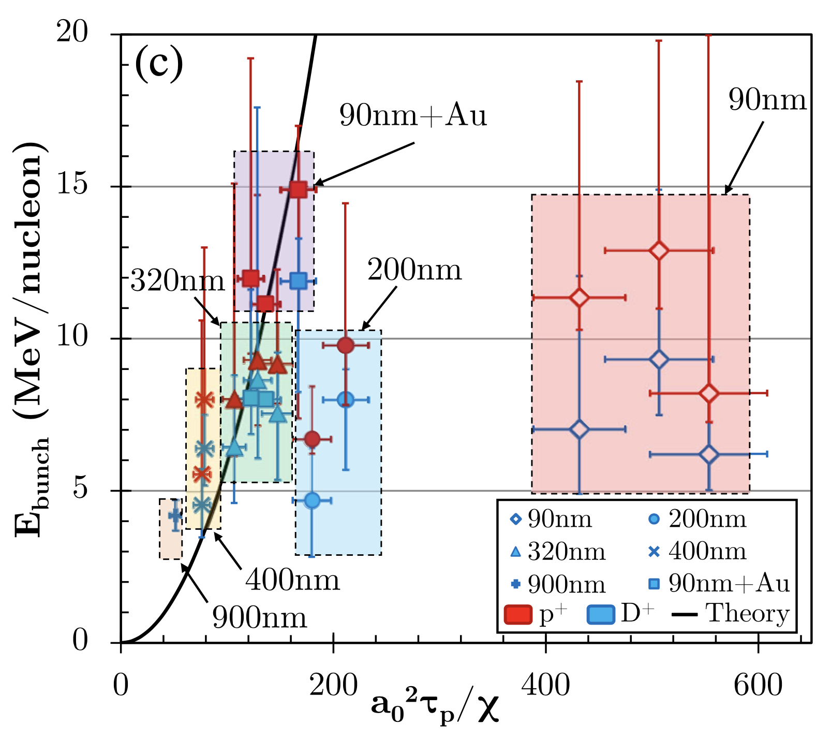
Relativistically induced transparency (RIT)
Light sail theory predicts highest energies for thinnest targets
BUT - Thinner targets go transparent earlier - shutting off RPA
Volumetric electron heating by laser pulse can enhance accelerating fields, at cost of potentially destroying spectral bunching from LS-RPA
Alejo et al. PRL 129, 114801 (2022)
Notes:
Have to balance between thin targets and suppressing transparency
RIT can enhance energies, but can destroy bunching if onset too early

Slide 9
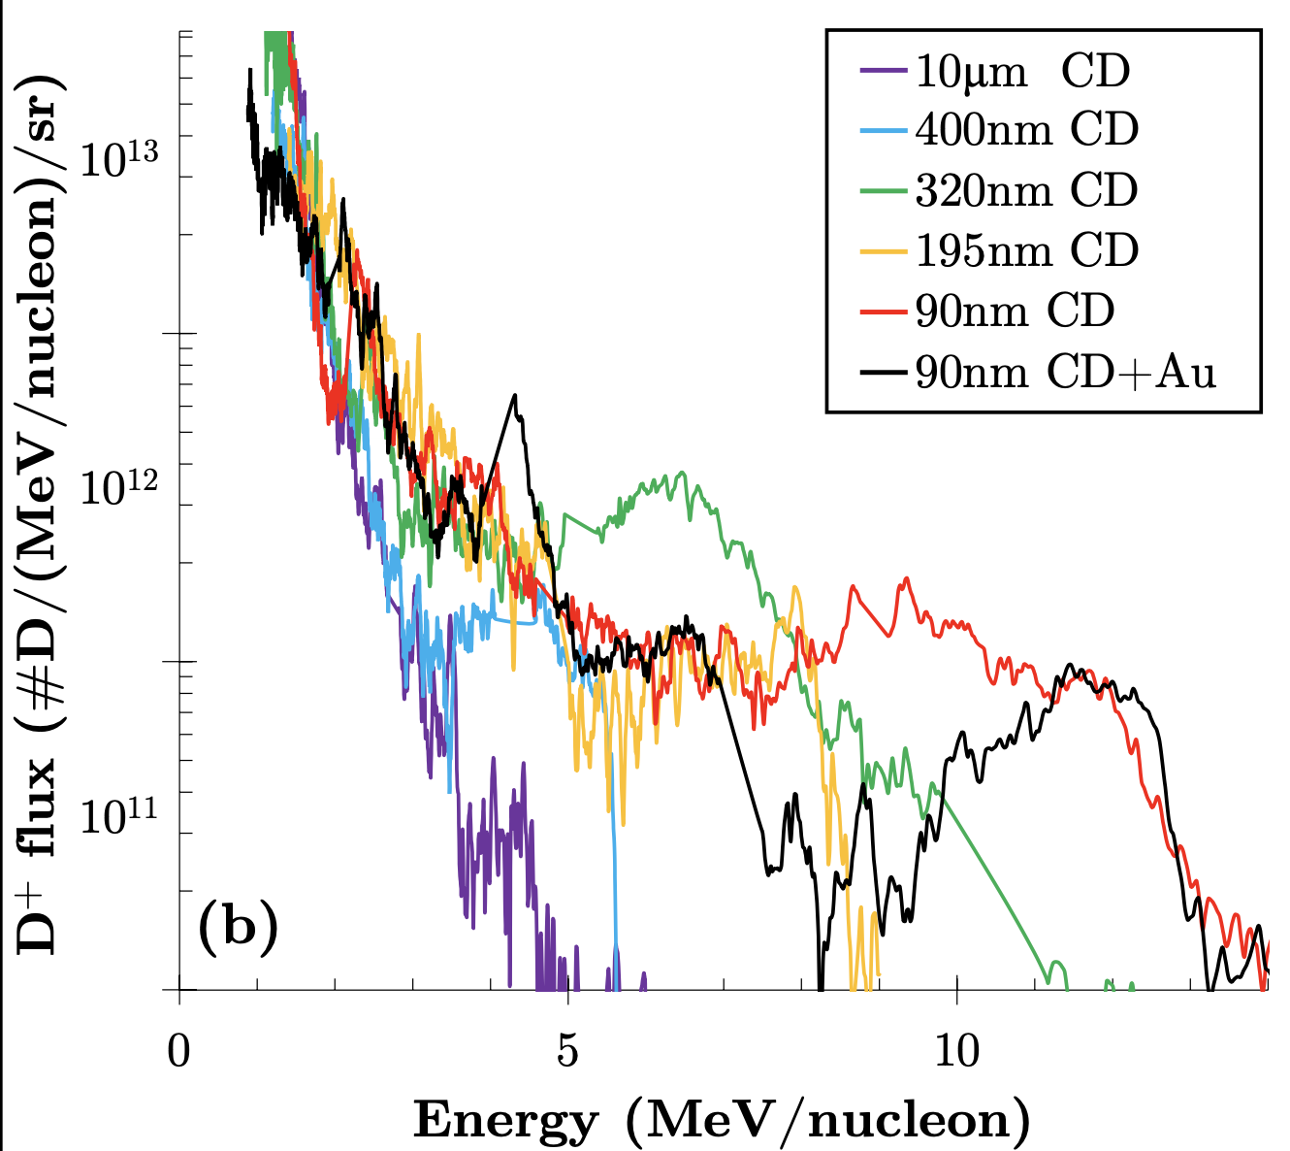
Relativistically induced transparency (RIT)
Light sail theory predicts highest energies for thinnest targets
BUT - Thinner targets go transparent earlier - shutting off RPA
Delaying of onset of RIT can favour spectral bunching e.g. thin Au layer acting as reservoir to continually replenish electron density
Alejo et al. PRL 129, 114801 (2022)
Notes:
- Ways to mitigate RIT include, using CP to reduce electron heating, Reducing intensity by stretching pulse, Au layer over CH foil

Slide 10
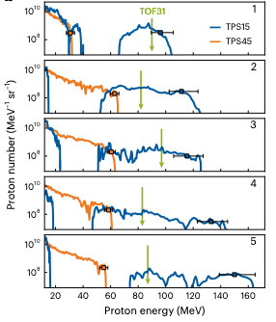
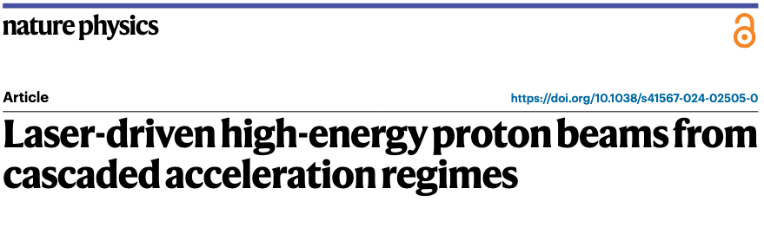
Hybrid acceleration
Most thin-foil interactions a combination of these mechanisms
Highest proton energies of up to 150 MeV achieved so far via a hybrid or “cascaded” acceleration mechanism

Slide 11
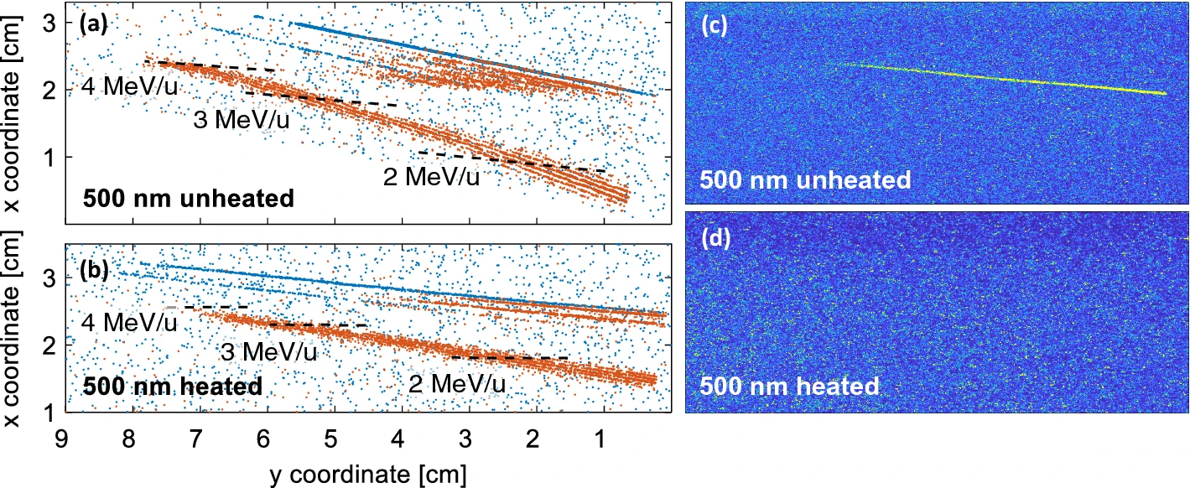
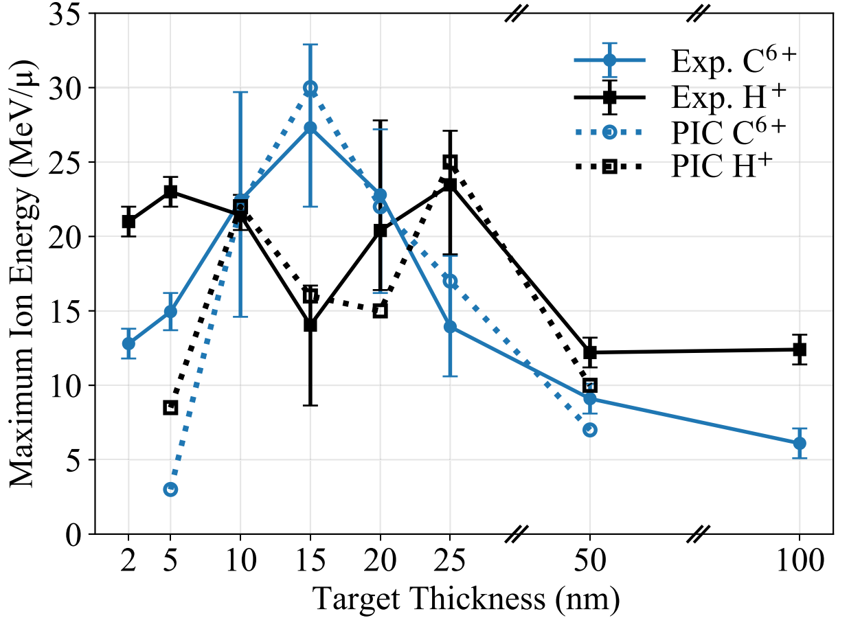
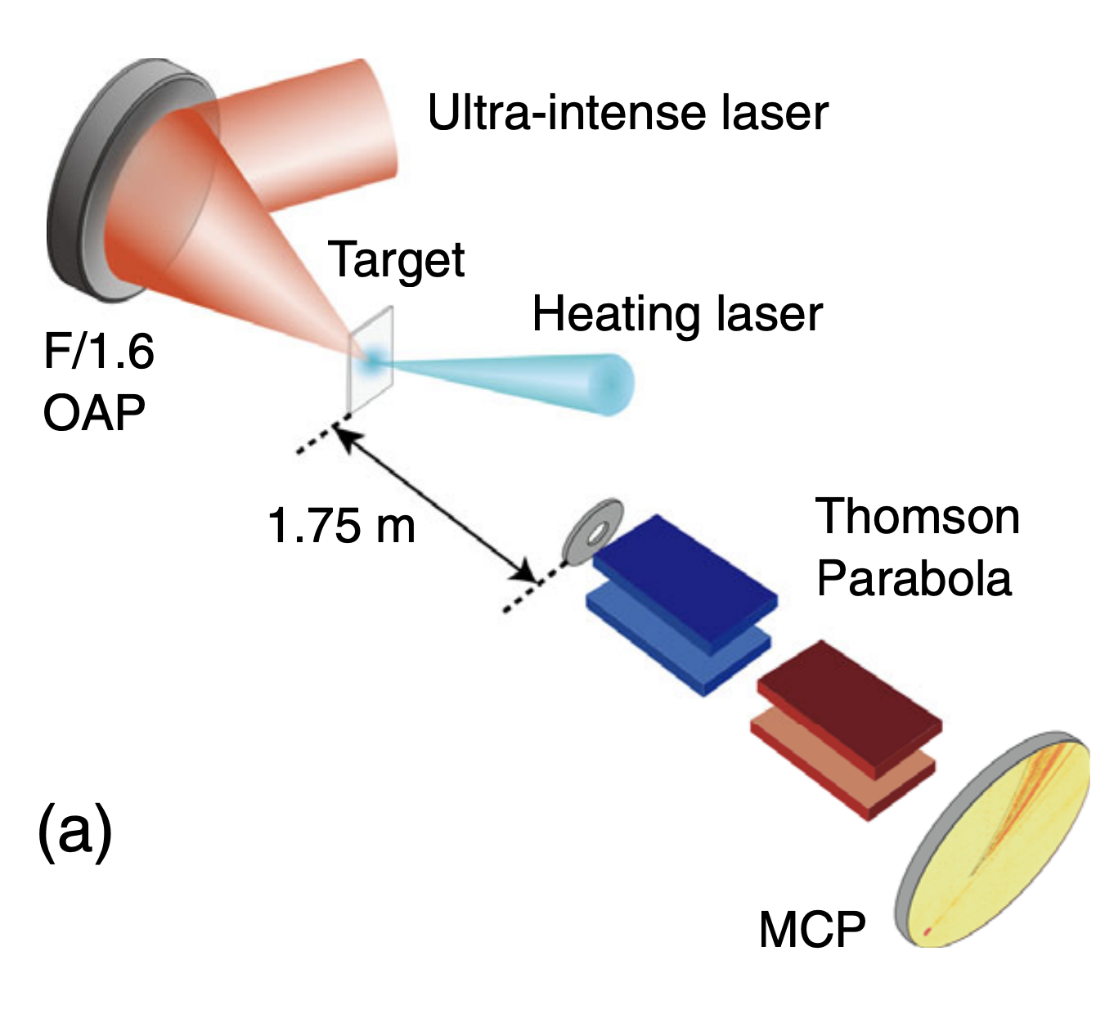
How can we select heavier ions over protons?
Lindner et al. Sci. Rep. 12, 4784 (2022)
Proton contaminant removal by laser pedestal
Rear contaminant removal by target heating
McIlvenny et al. PRL 127, 194801 (2021)
Wang et al. PRX 11, 021049 (2021)

Slide 12
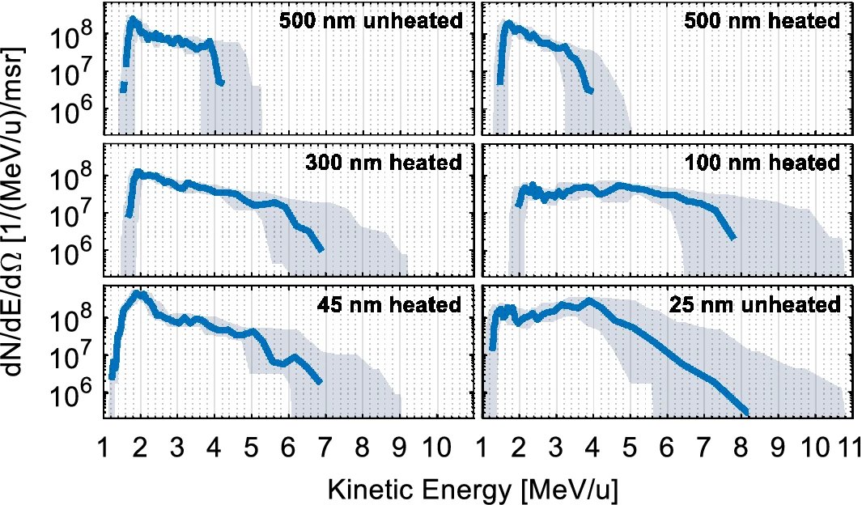
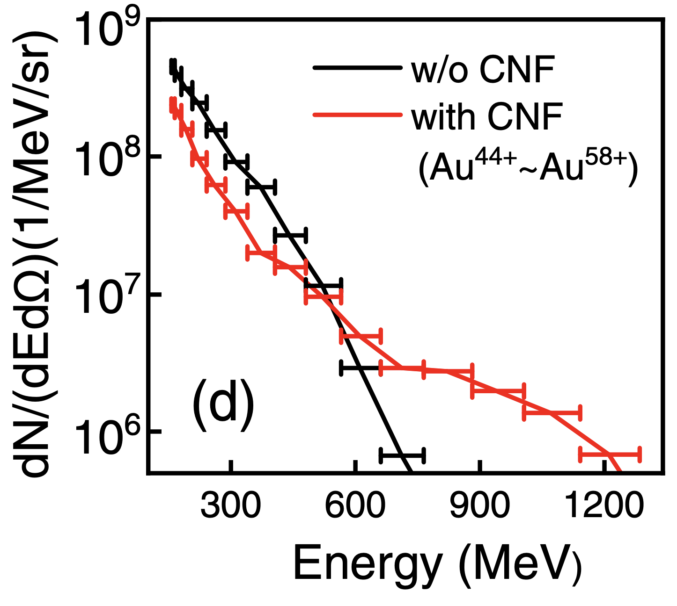
Previous efforts on Au ion acceleration
Lindner et al. Sci. Rep. 12, 4784 (2022)
Wang et al. PRX 11, 021049 (2021)
Best energies achieved were ~7 MeV/n (1.4 GeV), in broadband spectra
Particle flux at these energies ~ 10⁸-10⁹ ions/(MeV/n)/sr

Slide 13
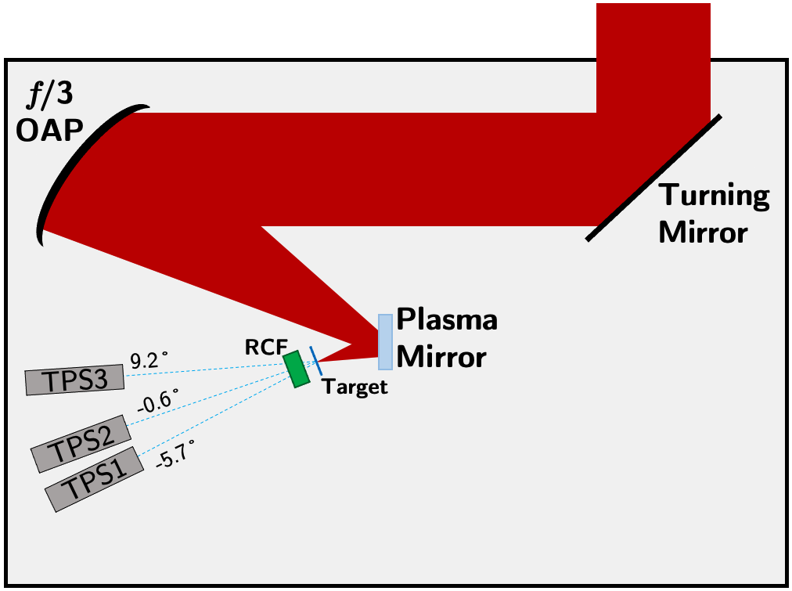
Experiment at Vulcan PW
Targets:
Au foils 15-30 nm thick (±5 nm)
Normal incidence
λ=1053 nm 𝜏≃(800±100) fs
⌀=5-6 μm E_{total}≃600 J
I₀=(3±2)⨉10²⁰ W/cm²
Thomson parabola spectrometers coupled with BAS-TR image plate detectors*
*Doria et al. RSI 93, 033304 (2022)

Slide 14
Au ion spectra
TPS1
TPS2
TPS3
Ion flux at peak 4x10¹¹ ions/(MeV/n)/sr for 15 nm target
Spectral bunch energy 7.5±2.5 MeV/n
(1.5±0.5 GeV), cutoff > 2 GeV

Slide 15

3D PIC simulations
Both 15 nm and 30 nm targets simulated, with 10 nm CH₂ contaminant layers on front and rear
𝜏=700 fs, I₀= 2x10²⁰ W/cm², 5.5 μm FWHM focal spot
Au ion bunch isosurface at +50 fs, relative to the pulse peak

Slide 16
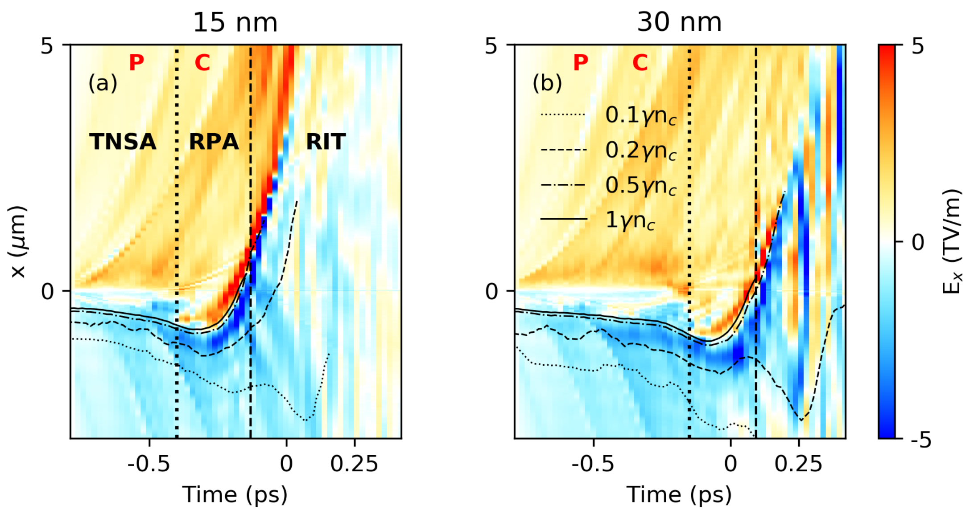
2D PIC simulations
3 stage hybrid acceleration mechanism
Proton/carbon ion fronts
Stage 1: ‘Cleaning’ phase
Low intensity rising edge causes thermal expansion, ion separation according to Z/A
Density profile shaping
Notes:
- TNSA dominated process accelerates high Z/A contaminant ions away from critical density surface
- At same time, density of target is decreasing and radiation pressure of laser rising edge keeps critical surface close to density peak

Slide 17
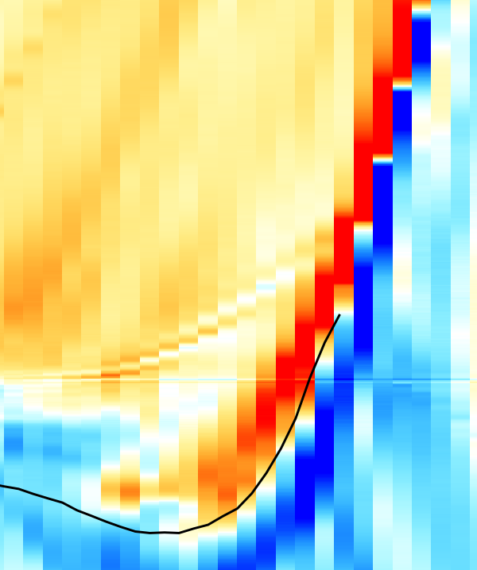
2D PIC simulations
3 stage hybrid acceleration mechanism
Stage 2: ‘Bunching’ phase
Peak RPA field ~13 TV/m
Close to pulse peak, RPA now dominates
High RPA fields act on Au ion dominated plasma
RPA phase begins
Notes:
Intensity has risen, and density lowered to the point where RPA takes over from TNSA, and critical surface is accelerated forward
The RPA is now acting on a plasma dominated by Au ions, causing the Au bunching

Slide 18
2D PIC simulations
Well-defined transitions between the phases of RPA/RIT dominated acceleration
Stage 2 begins when laser radiation pressure overcomes thermal expansion - acceleration of critical density surface becomes positive
Notes:
- This time also coincides with moment the RPA field is set up as seen in previous slide

Slide 19
2D PIC simulations
3 stage hybrid acceleration mechanism
Stage 3: ‘Acceleration’ phase
Plasma goes relativistically transparent close to pulse peak
Au ion bunch is post-accelerated by RIT-enhanced mechanisms
Au ion spectrum at +300 fs
Notes:
The Au ion bunch at start of RIT has an energy of ~2 MeV/n
RIT close to peak of pulse, Au ions are post-accelerated to GeV energies

Slide 20
2D PIC simulations
Bunching is sensitive to target thickness
Thicker target undergoes 3 stage mechanism, but RPA phase is shorter, weaker
Transparency is delayed, acceleration phase less effective
Au ion spectrum at +300 fs
Notes:
- Bunching phase has to be maximum efficiency in order for it to be preserved until end of laser pulse
- 15 nm target is most optimal thickness for this laser pulse, 30 nm target does not have an effective RPA phase, and RIT post-acceleration less effective too

Slide 21
Scalability to multi-PW systems
Taking 10PW (25fs, 250J) system, and stretching the pulse, keeping fluence constant
Shortest pulse/highest intensity not necessarily best for very heavy ion acceleration
Fraction of laser fluence that contributes to RPA phase for each pulse duration

Slide 22
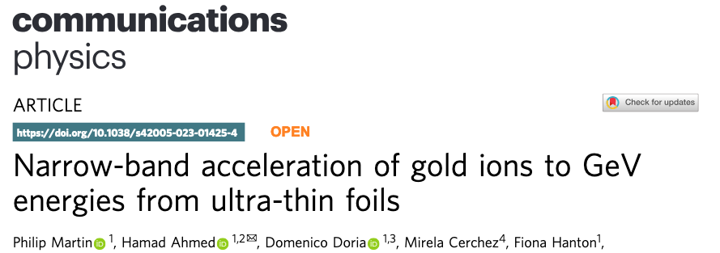
Summary
Au ions have been accelerated to GeV energies in a high-flux, narrowband spectral bunch for the first time.
Ion flux in the bunch exceeds previous works by orders of magnitude.
Bunching can be scaled up to multi-PW systems, but is sensitive to initial laser/target parameters.

Slide 23
Supplementary slides

Slide 24
2D and 3D energy difference
Exaggerated longitudinal expansion and energy gain in lower dimensionality must be compensated for by e.g. lowering intensity, or reducing pulse duration

Slide 25
Proton/Carbon 6+ spectra

Slide 26
Bunched Au spectra in follow-up experiment
Follow-up experiment at Vulcan also exhibited Au bunching:
-6°
-2°
+6°
10±5 nm
10±5 nm

Slide 27
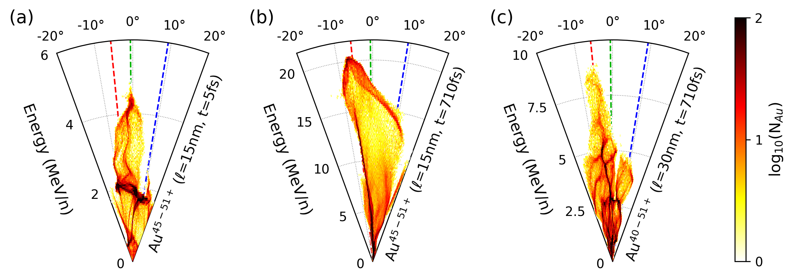
Au angular distribution
--- TPS1 ---TPS2 ---TPS3

Slide 28
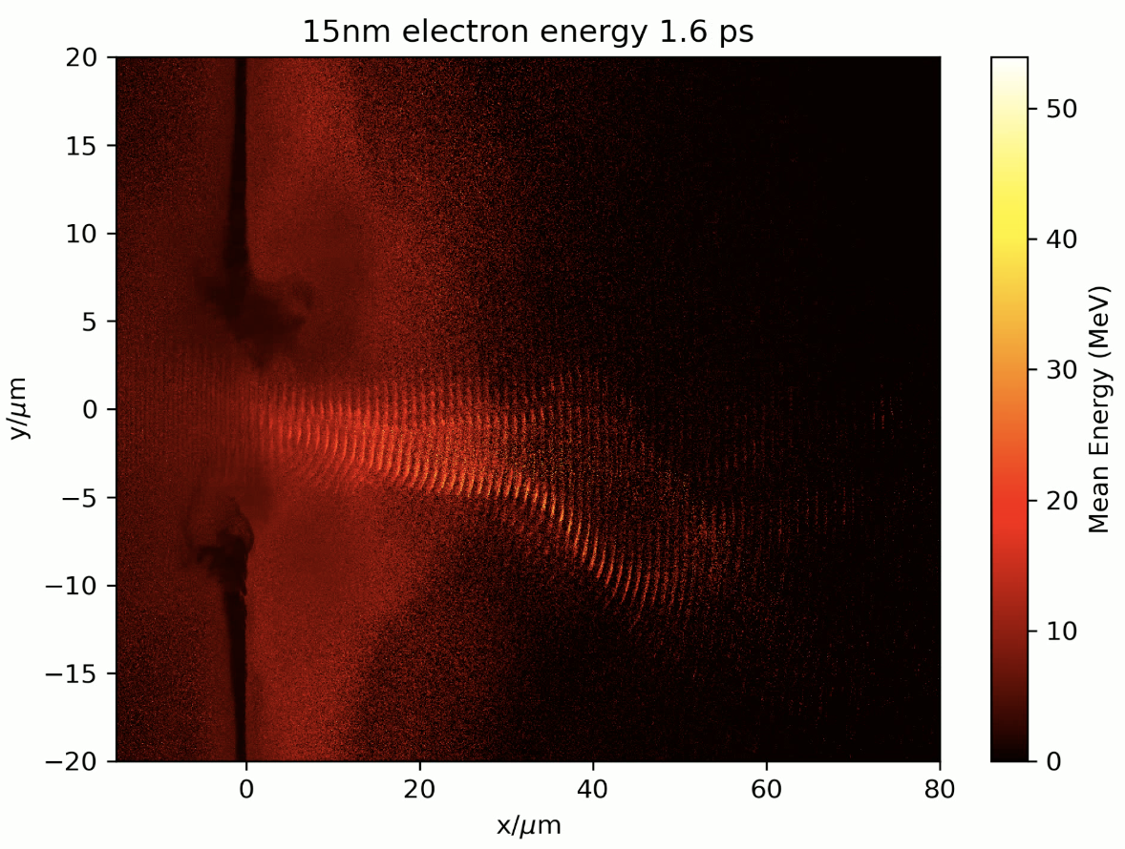
Hot electron jet in RIT stage
High current hot electron jet forms quasistatic B field that can deflect ions off-centre.
Au ions mostly affected, as proton/carbon ions have cleared the region close to the jet

