Slide 1

Lessons from laser electron studies
Conor McAnespie
LhARA, September 2024

Slide 2
Contents
Introduction to electrons in radiobiology
Very High Energy Electrons (VHEE)
Laser-driven sources of electrons for radiobiology research
  Direct laser acceleration
  Laser-wakefield acceleration
Cell irradiations with laser-driven sources
Conor McAnespie
LhARA, September 2024

Slide 3
Introduction
Conor McAnespie
LhARA, September 2024

Slide 4
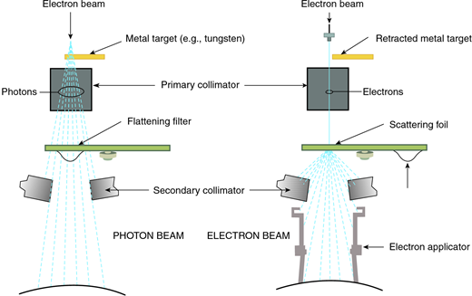
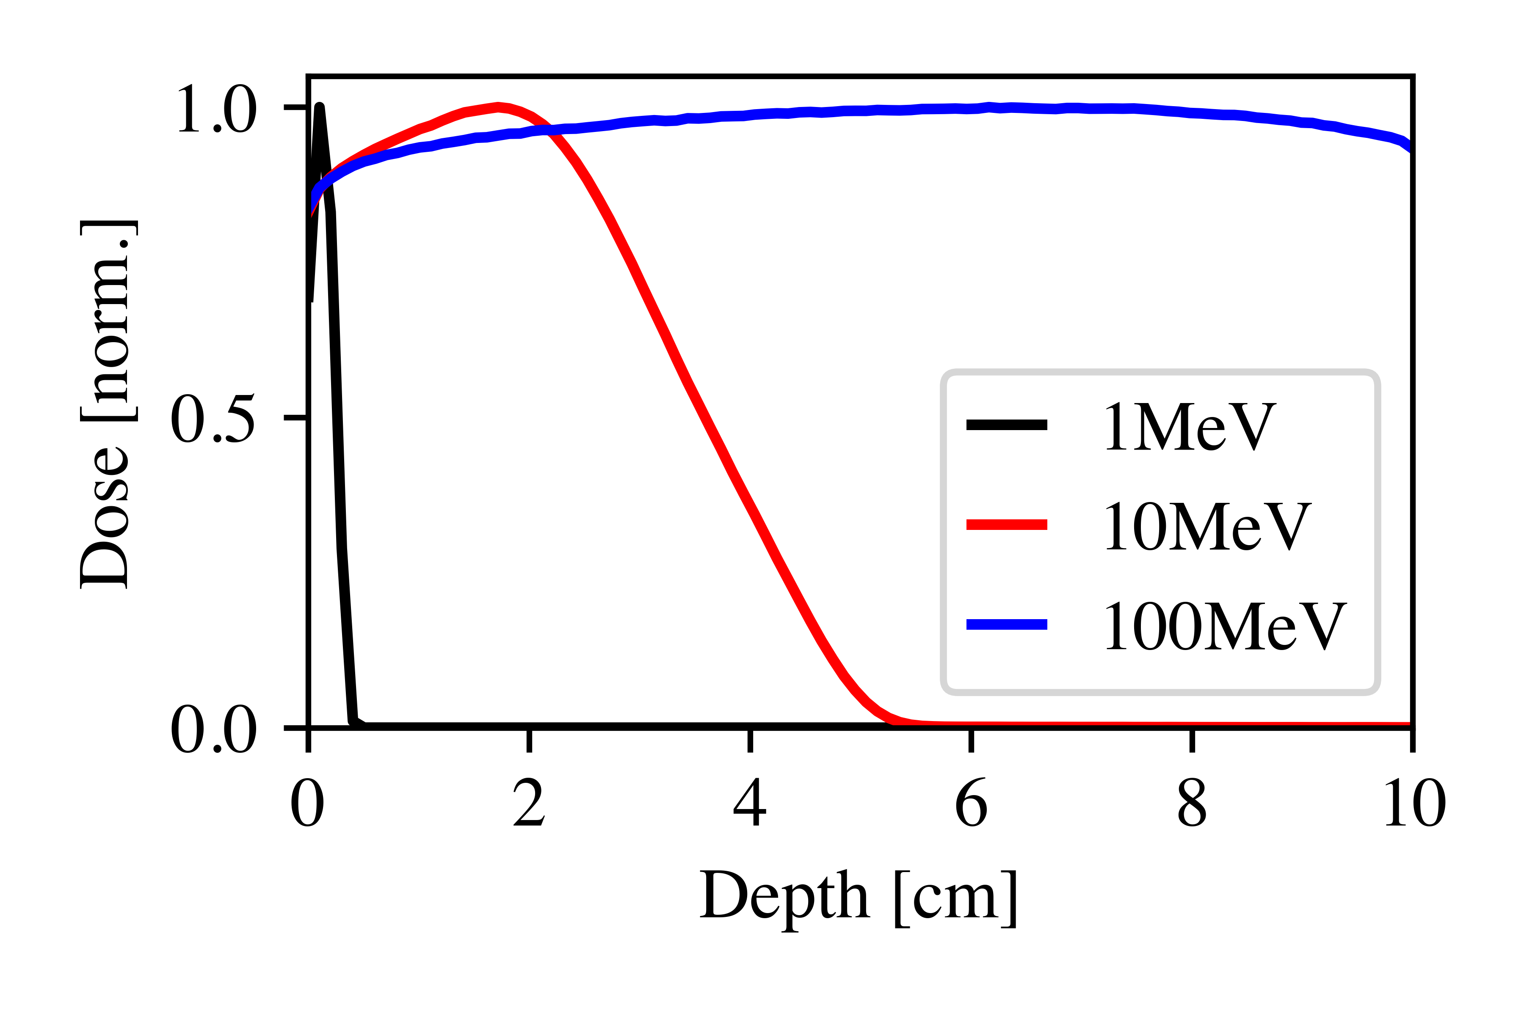
Electrons sources for radiobiology
Current electron beam energies in clinical settings are limited to a few MeV.
Used to treat surface or near-surface tumours.
∽fs
Physical step
Ionisations and excitations
Laser-Driven
fs-ps
Physio-chemical step
Molecular dissociations
Flash
Conventional
ps-s
Chemical step
Reactions and diffusions
s-hr
Biochemical step
DNA repair Enzymatic
Proposed to increase the energy to 100’s of MeV to target deep-seated tumours.
hr-d
Biological step
Cellular and tissue response
Conor McAnespie
LhARA, September 2024

Slide 5
Very High Energy Electron RT
First proposed in the early 2000’s VHEE describes the use of 100-250MeV electrons to reach deep-seated tumours.
Relatively low cost to develop accelerators to reach these high energies.
Possible to reach high-dose per pulse and ultra-short pulse durations for the studies of dose-rate effects (FLASH and beyond).
Source | Electron energy [MeV] | Change [pc] | Duration [ps]
CLEAR [1] | 60-220 | 10-1500 | 0.1-10
CLARA [2] | 250 | 250 | 2-10
[1] https://clear.cern/content/welcome-clear
[2] D. Angal-Kalinin et al. Phys. Rev. Accel. Beams 23, 044801
Conor McAnespie
LhARA, September 2024

Slide 6
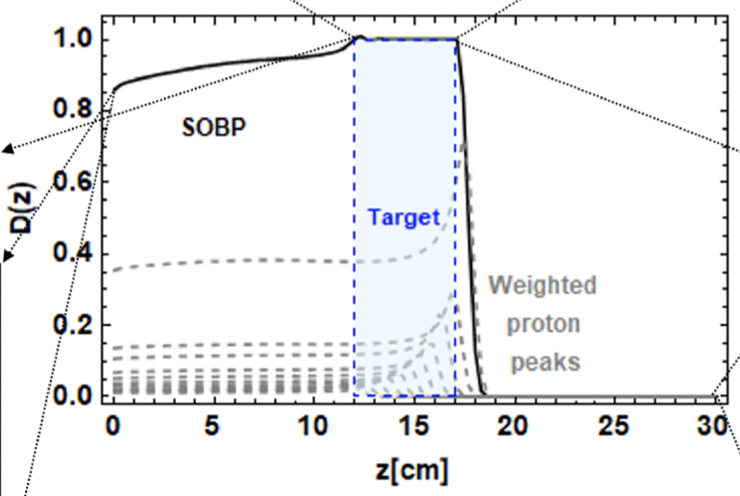
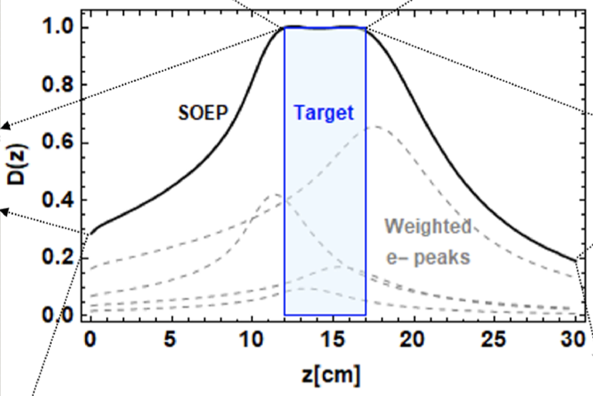
Advanced techniques
Current x-ray based RT techniques include shaping the beam and multiple irradiation angles to reduce normal tissue dose.
Due to their charge, it is possible to manipulate electron bunches to produce Bragg-like peaks, comparable to that proposed with ion sources.
Whitmore, L. et. al. Scientific Reports, 11(1), p.14013.
Conor McAnespie
LhARA, September 2024
Notes:
Here only the final quadrupole strength was changed to vary the dose distribution: Electron energy 250MeV

Slide 7
Laser driven electron sources
Conor McAnespie
LhARA, September 2024

Slide 8
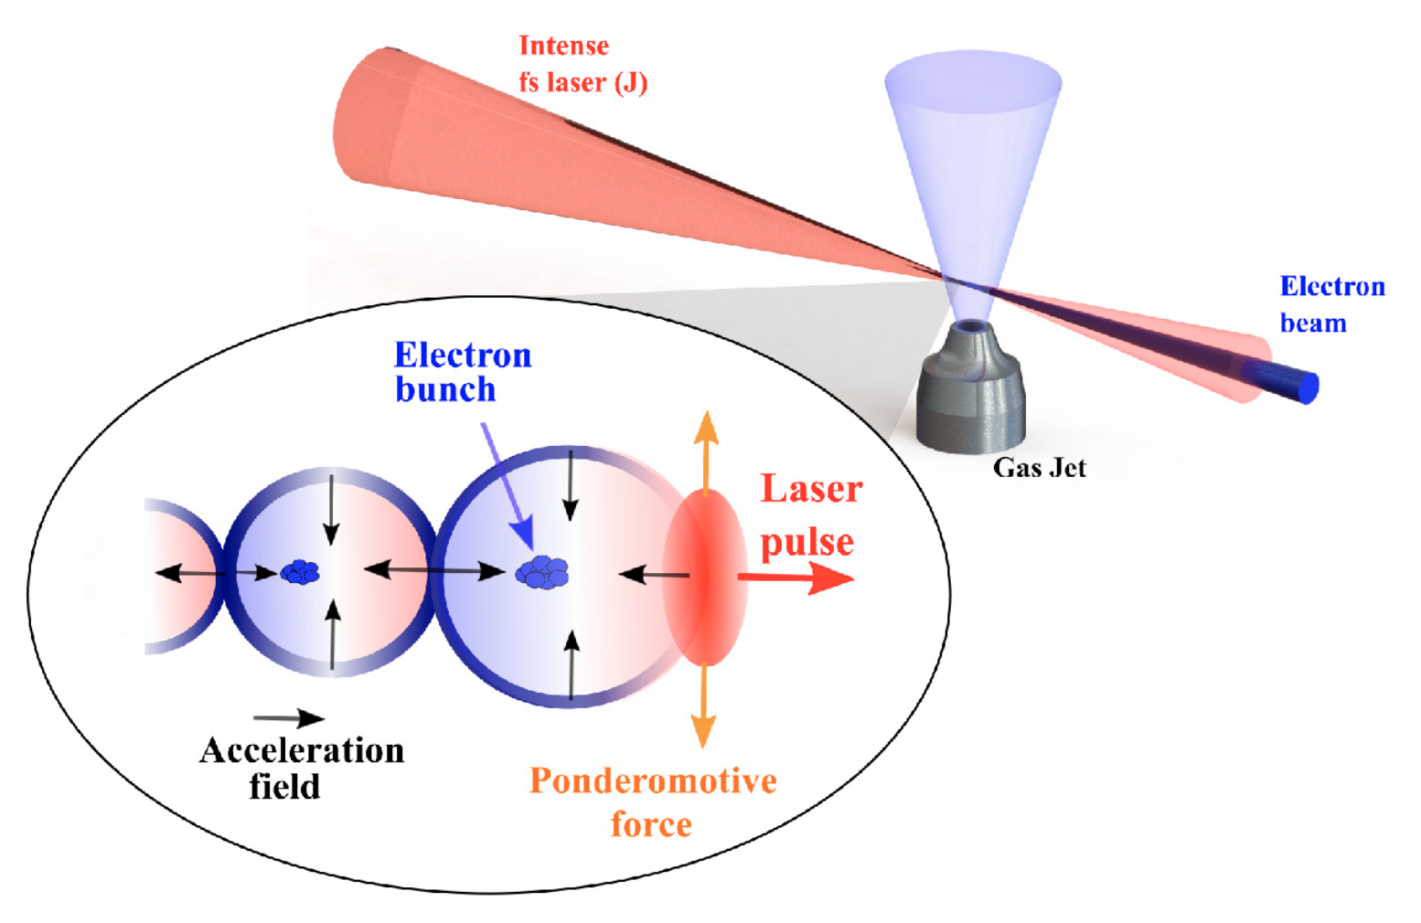
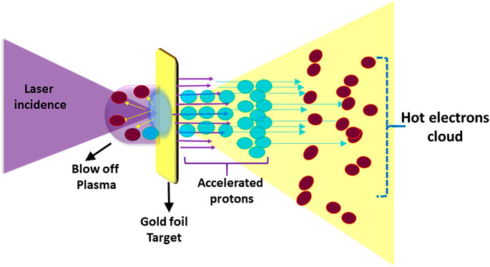
Laser-driven electron sources
Laser wakefield acceleration (LWFA)
Electron acceleration from the interaction of a laser pulse with an under-dense plasma (gas targets).
Direct laser acceleration (DLA)
Electron and proton acceleration from the interaction of a laser pulse with an over-dense plasma (solid targets).
Conor McAnespie
LhARA, September 2024

Slide 9
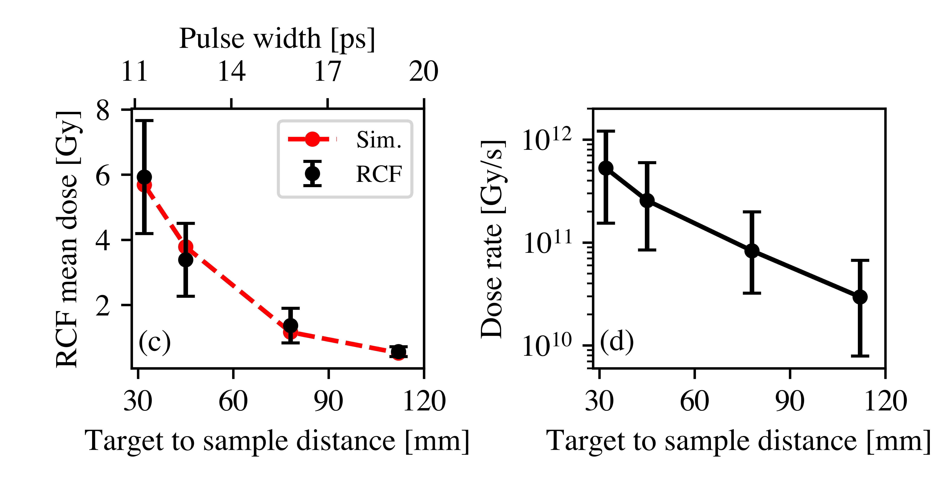
Beam properties from DLA
1.5cm
2cm
Electron energies in the range of few – 10MeV, scaling up to <100MeV
High divergence (~30 degrees)
2.5cm
3cm
Simulated electron duration ~10’s of picoseconds.
Dose-rates on the order of 10¹¹ Gy/s
C.A. McAnespie, et. al.- arXiv:2309.06870, 2023
Conor McAnespie
LhARA, September 2024

Slide 10
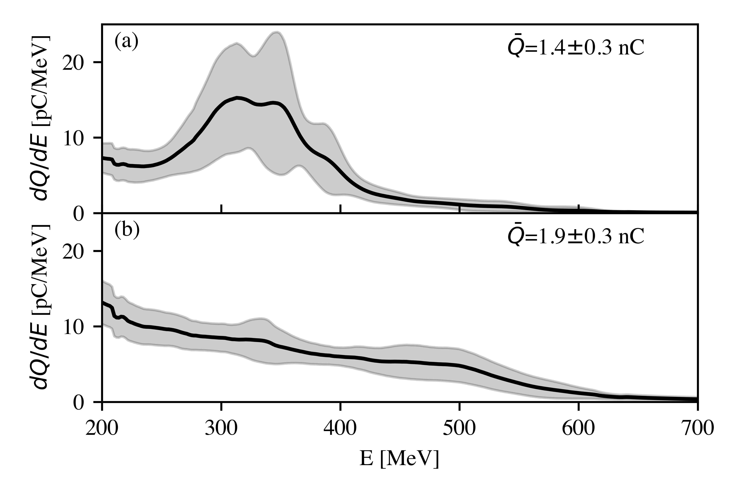
Beam properties from LWFA
Electron energies >100MeV
Low divergence (<0.1 degrees)
Expected duration <50 femtoseconds
Electron profile at the cell plane, reaching >1Gy over cm-scales areas
C.A. McAnespie, et. al.- Submitted 2024
Conor McAnespie
LhARA, September 2024

Slide 11
Electron experiments at QUB
(With help from many others)
Conor McAnespie
LhARA, September 2024

Slide 12
Laser-driven electron sources
TARANIS – DLA
Gemini – LWFA
Parameter | TARANIS | Gemini
e- energy [MeV] | 0 - 12 | 100-1000
e- divergence [mrad] | 0.49 | 0.002
e- duration [ps] | 10 - 20 | 0.045
dose [Gy] | 0.5 – 6 | 0.5 - 3
Conor McAnespie
LhARA, September 2024

Slide 13
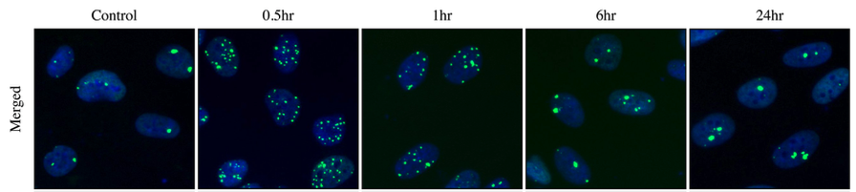
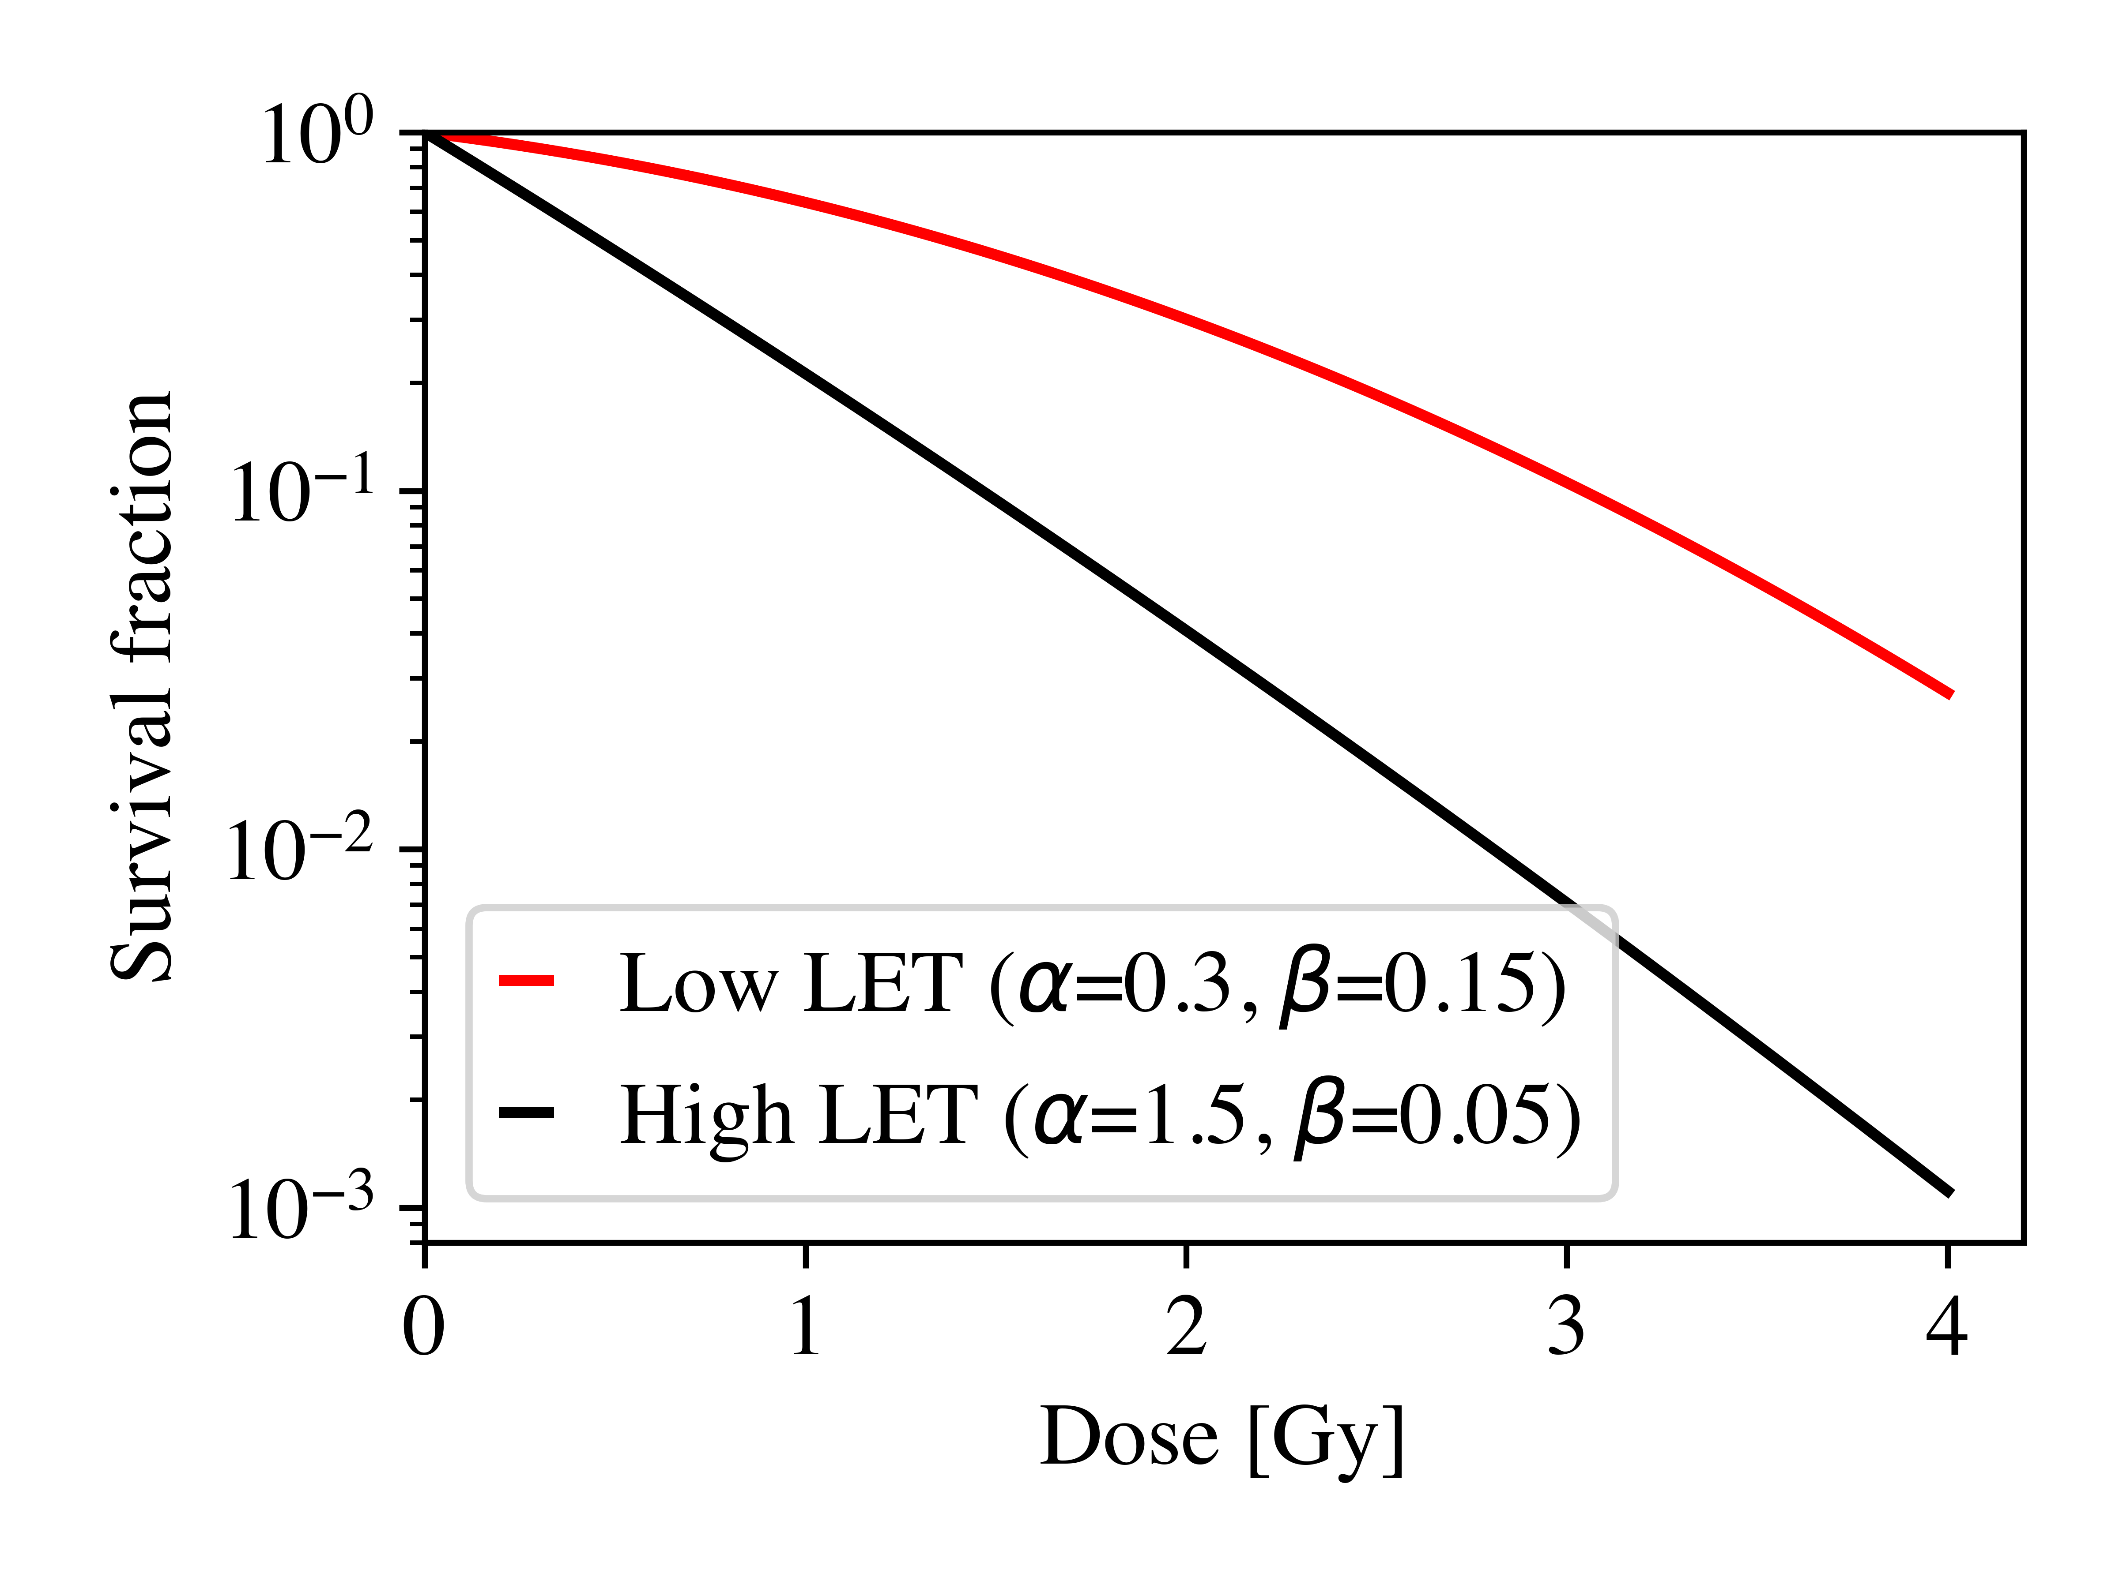
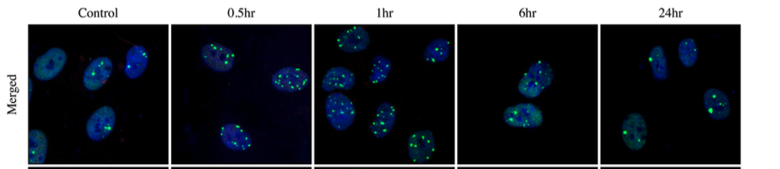

Studying biological effectiveness
DNA DSB repair kinetics
Cell survival assay
0.5hr
24hr
$$SF\left(D\right)=exp⁡(−αD −βD^{2})$$
20% O²
<0.5% O²
Conor McAnespie
LhARA, September 2024

Slide 14
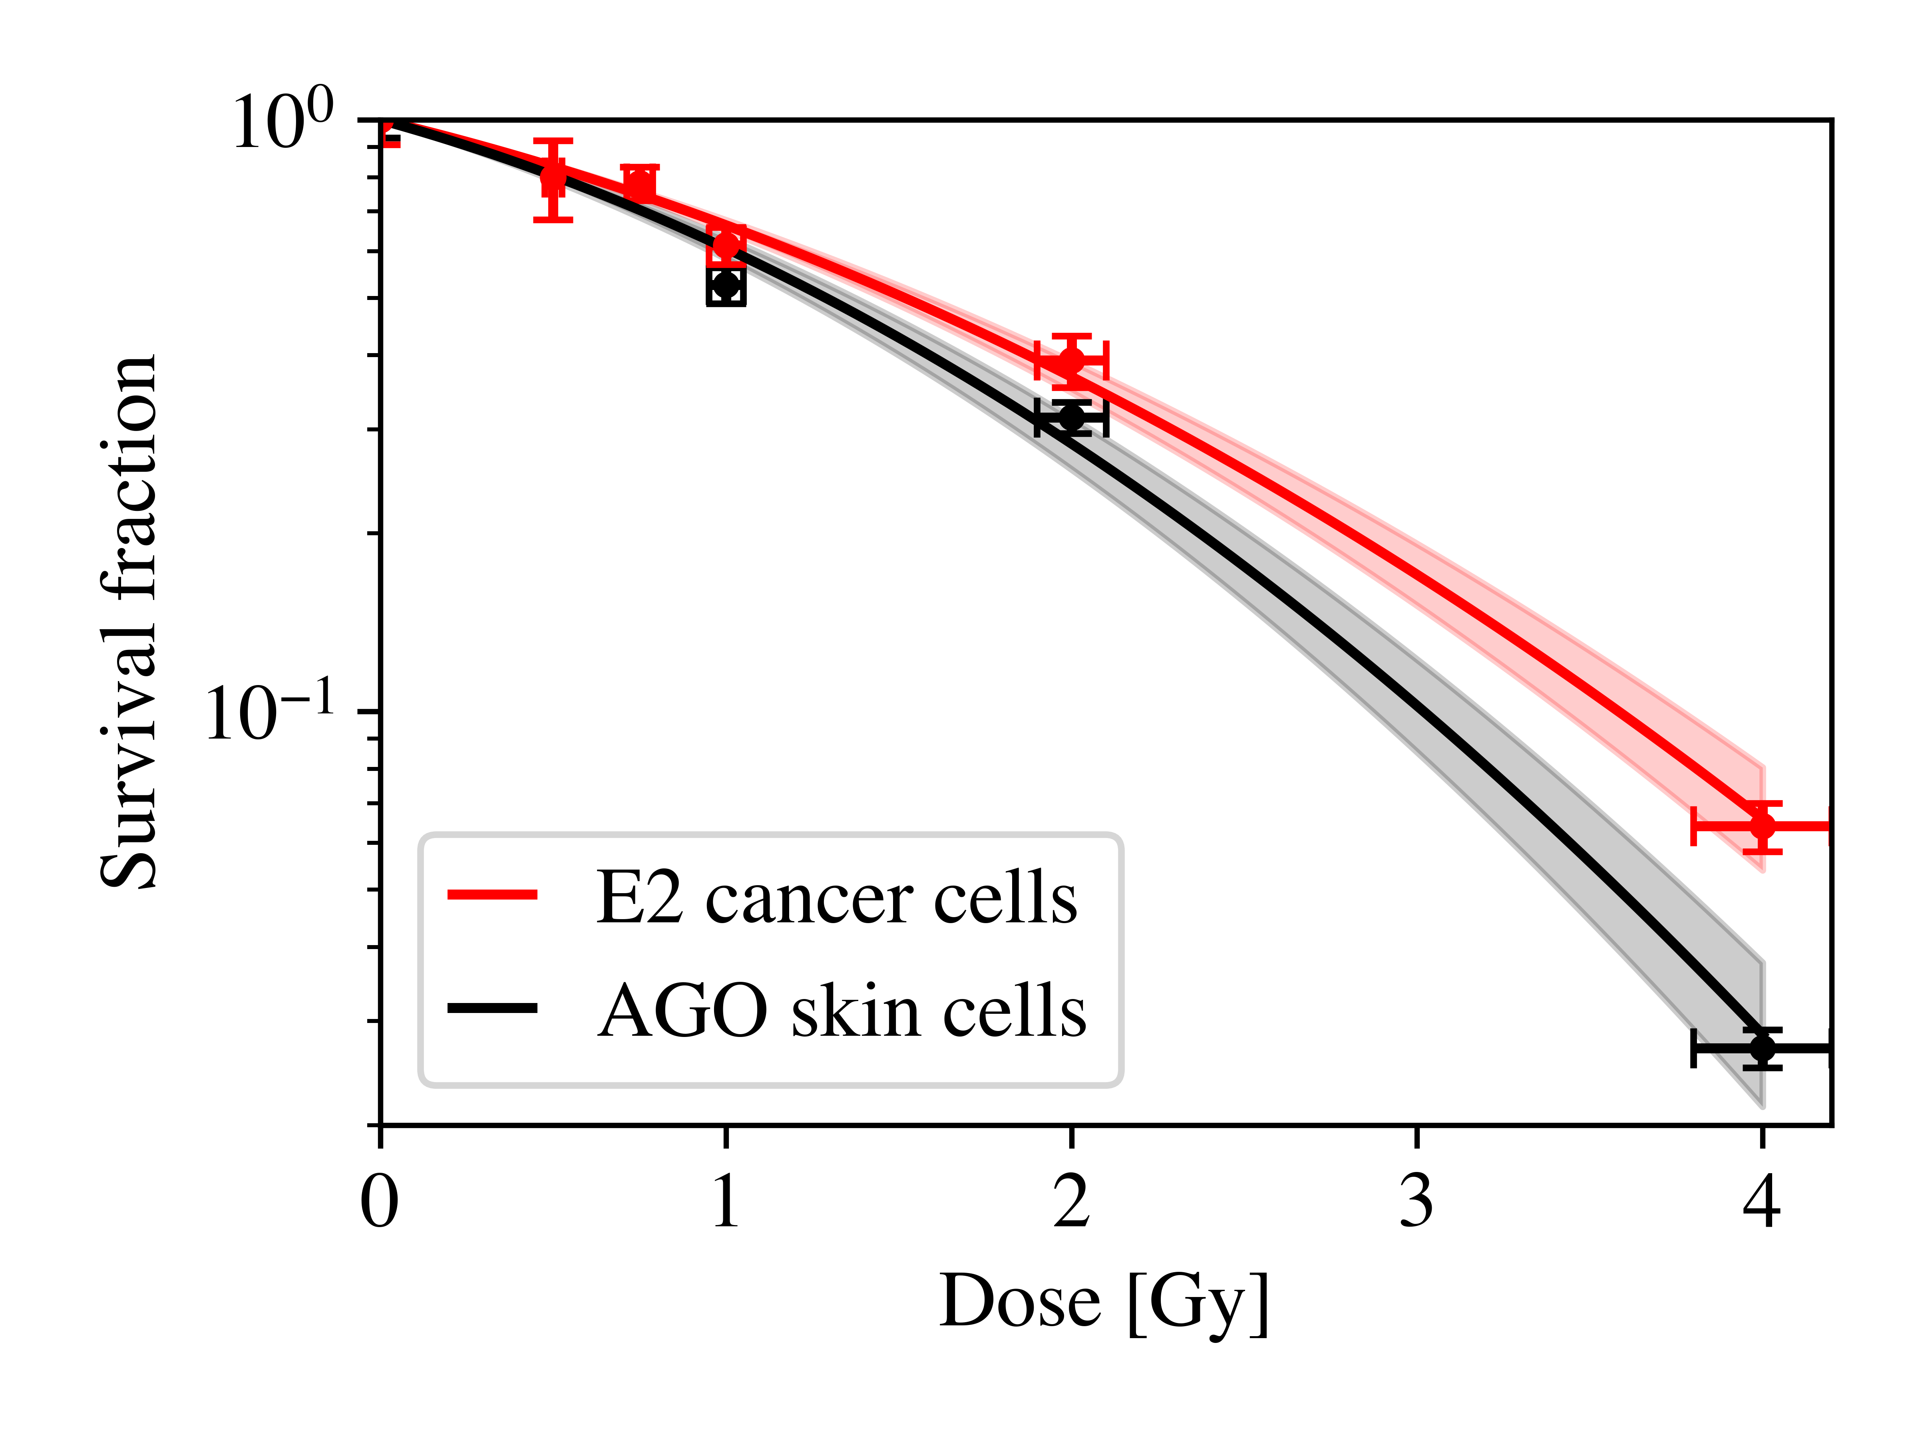
Cell lines used
Performed reference x-ray irradiations at 0.49 Gy/min dose-rate (PGJCCR).
AG01522 D Human skin fibroblast cells (Coriell Institute).
E2 Patient-derived glioblastoma stem-like cells.
Used for comparison with laser-driven studies.
Conor McAnespie
LhARA, September 2024

Slide 15
Taranis – Picosecond scale irradiations
Conor McAnespie
LhARA, September 2024

Slide 16
Picosecond-scale irradiations
24hrs after irradiation, no significant difference measured between picosecond-scale and conventional irradiations.
Conor McAnespie
LhARA, September 2024

Slide 17
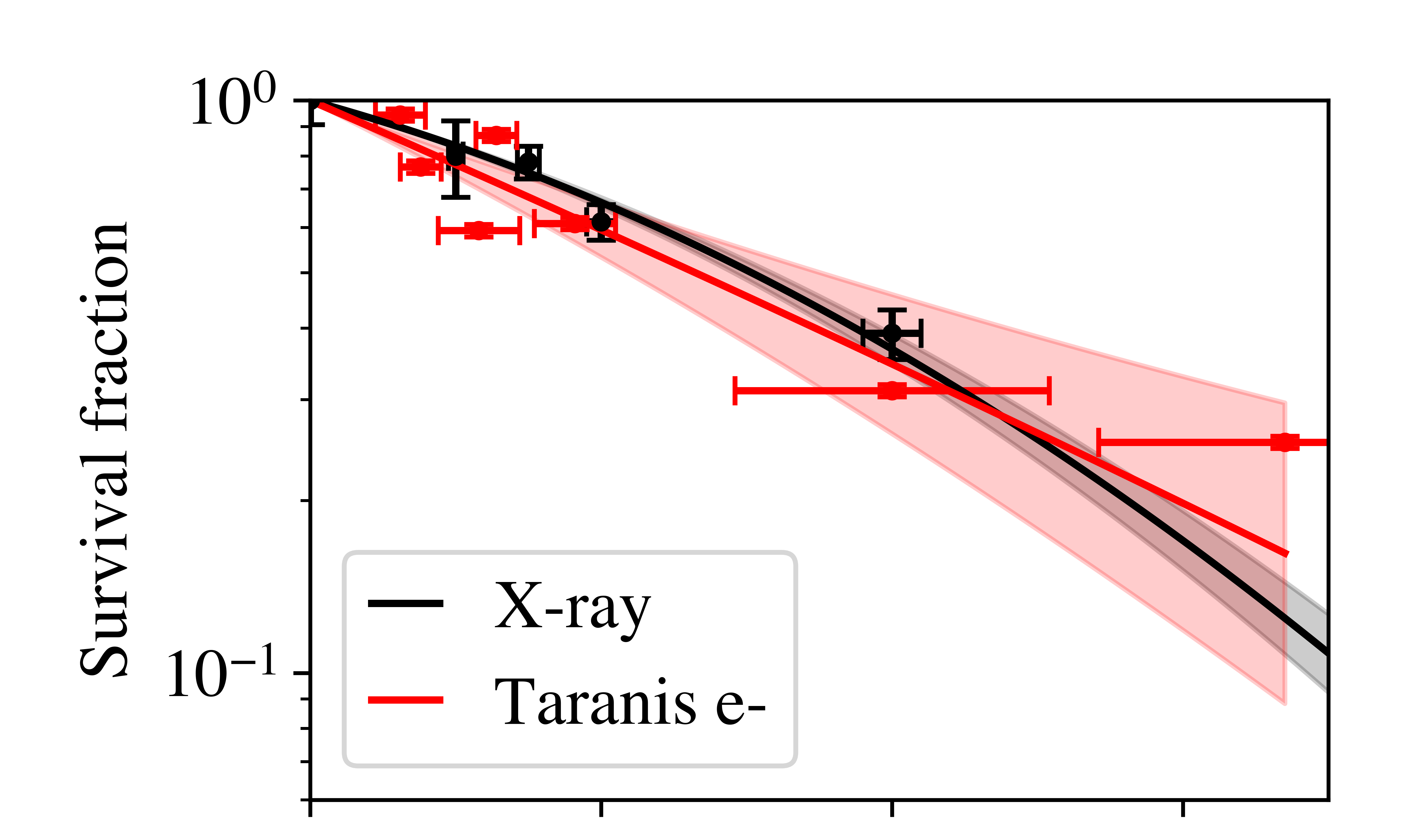
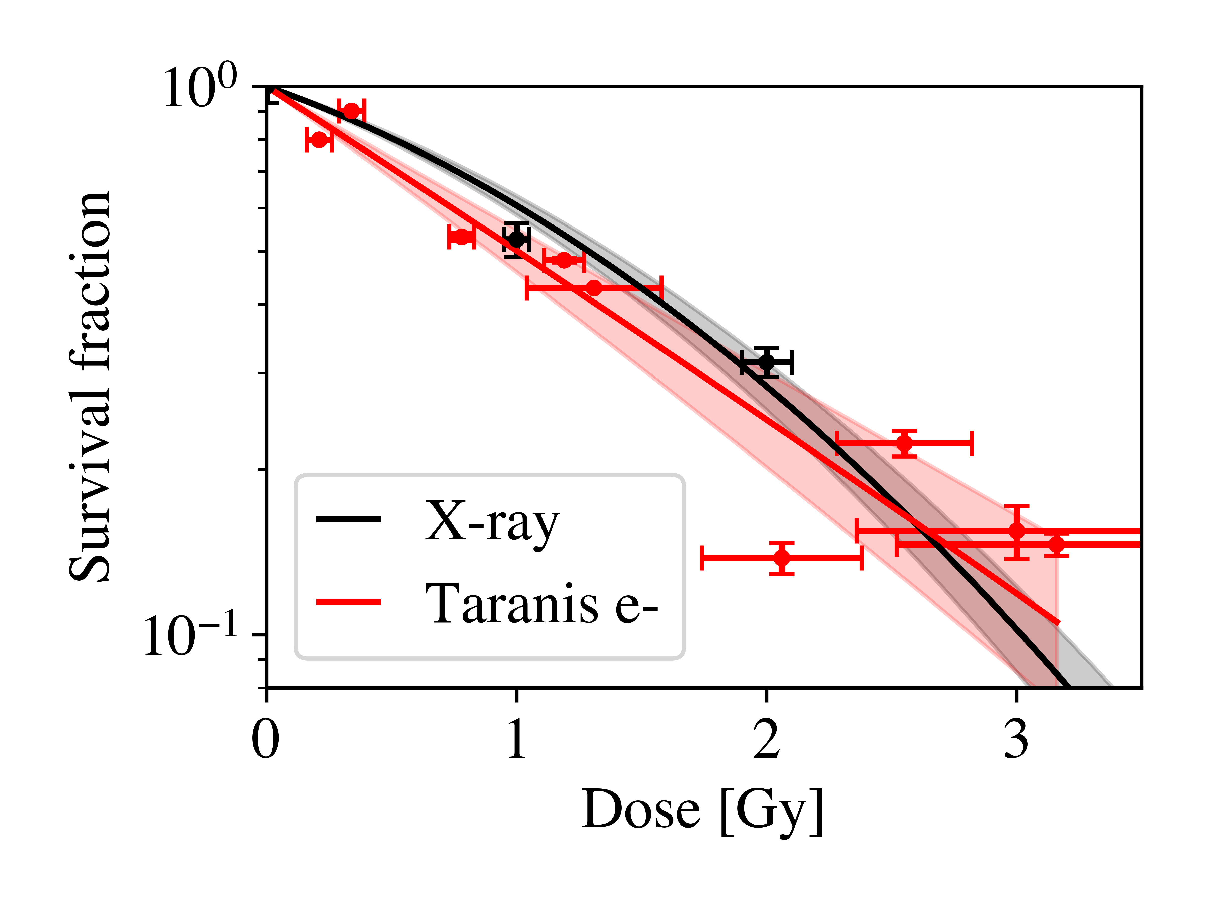
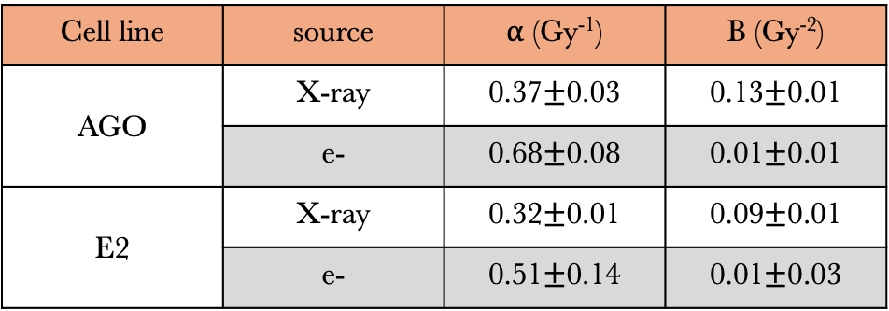
Picosecond-scale irradiations
AGO - Skin
Cell line | source | ⍺ (Gy⁻¹) | Β (Gy⁻²)
AGO | X-ray | 0.37$±$0.03 | 0.13$±$0.01
 | e- | 0.68$±$0.08 | 0.01$±$0.01
E2 | X-ray | 0.32$±$0.01 | 0.09$±$0.01
 | e- | 0.51$±$0.14 | 0.01$±$0.03
E2 - Cancerous
High alpha, low beta!
Conor McAnespie
LhARA, September 2024

Slide 18
Gemini – Femtosecond scale irradiations
Conor McAnespie
LhARA, September 2024

Slide 19
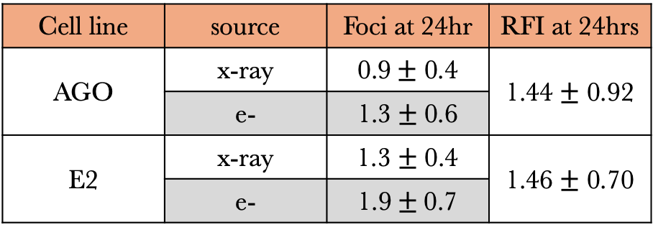
Femtosecond-scale irradiations
Cell line | source | Foci at 24hr | RFI at 24hrs
AGO | x-ray | 0.9$±$ 0.4 | 1.44 $±$ 0.92
 | e- | 1.3 $±$0.6
E2 | x-ray | 1.3 $±$ 0.4 | 1.46 $±$ 0.70
 | e- | 1.9$±$0.7
Conor McAnespie
LhARA, September 2024

Slide 20
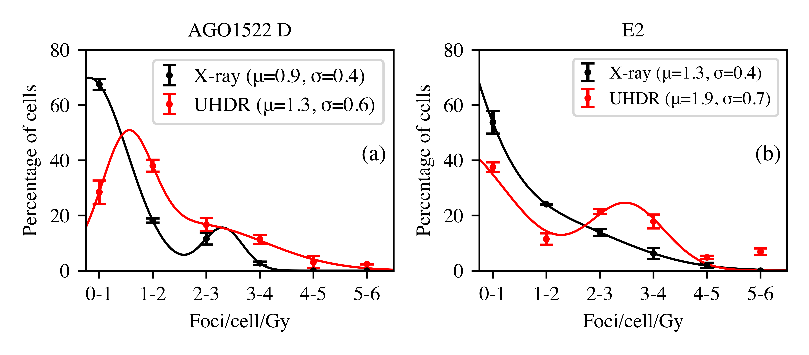
Further foci analysis
Subpopulation of 53BP1 foci at 24 hours after irradiation highlight a trend for more damages from VHEE electrons.
Size of the induced foci also indicated a more complex damage site.
Conor McAnespie
LhARA, September 2024

Slide 21
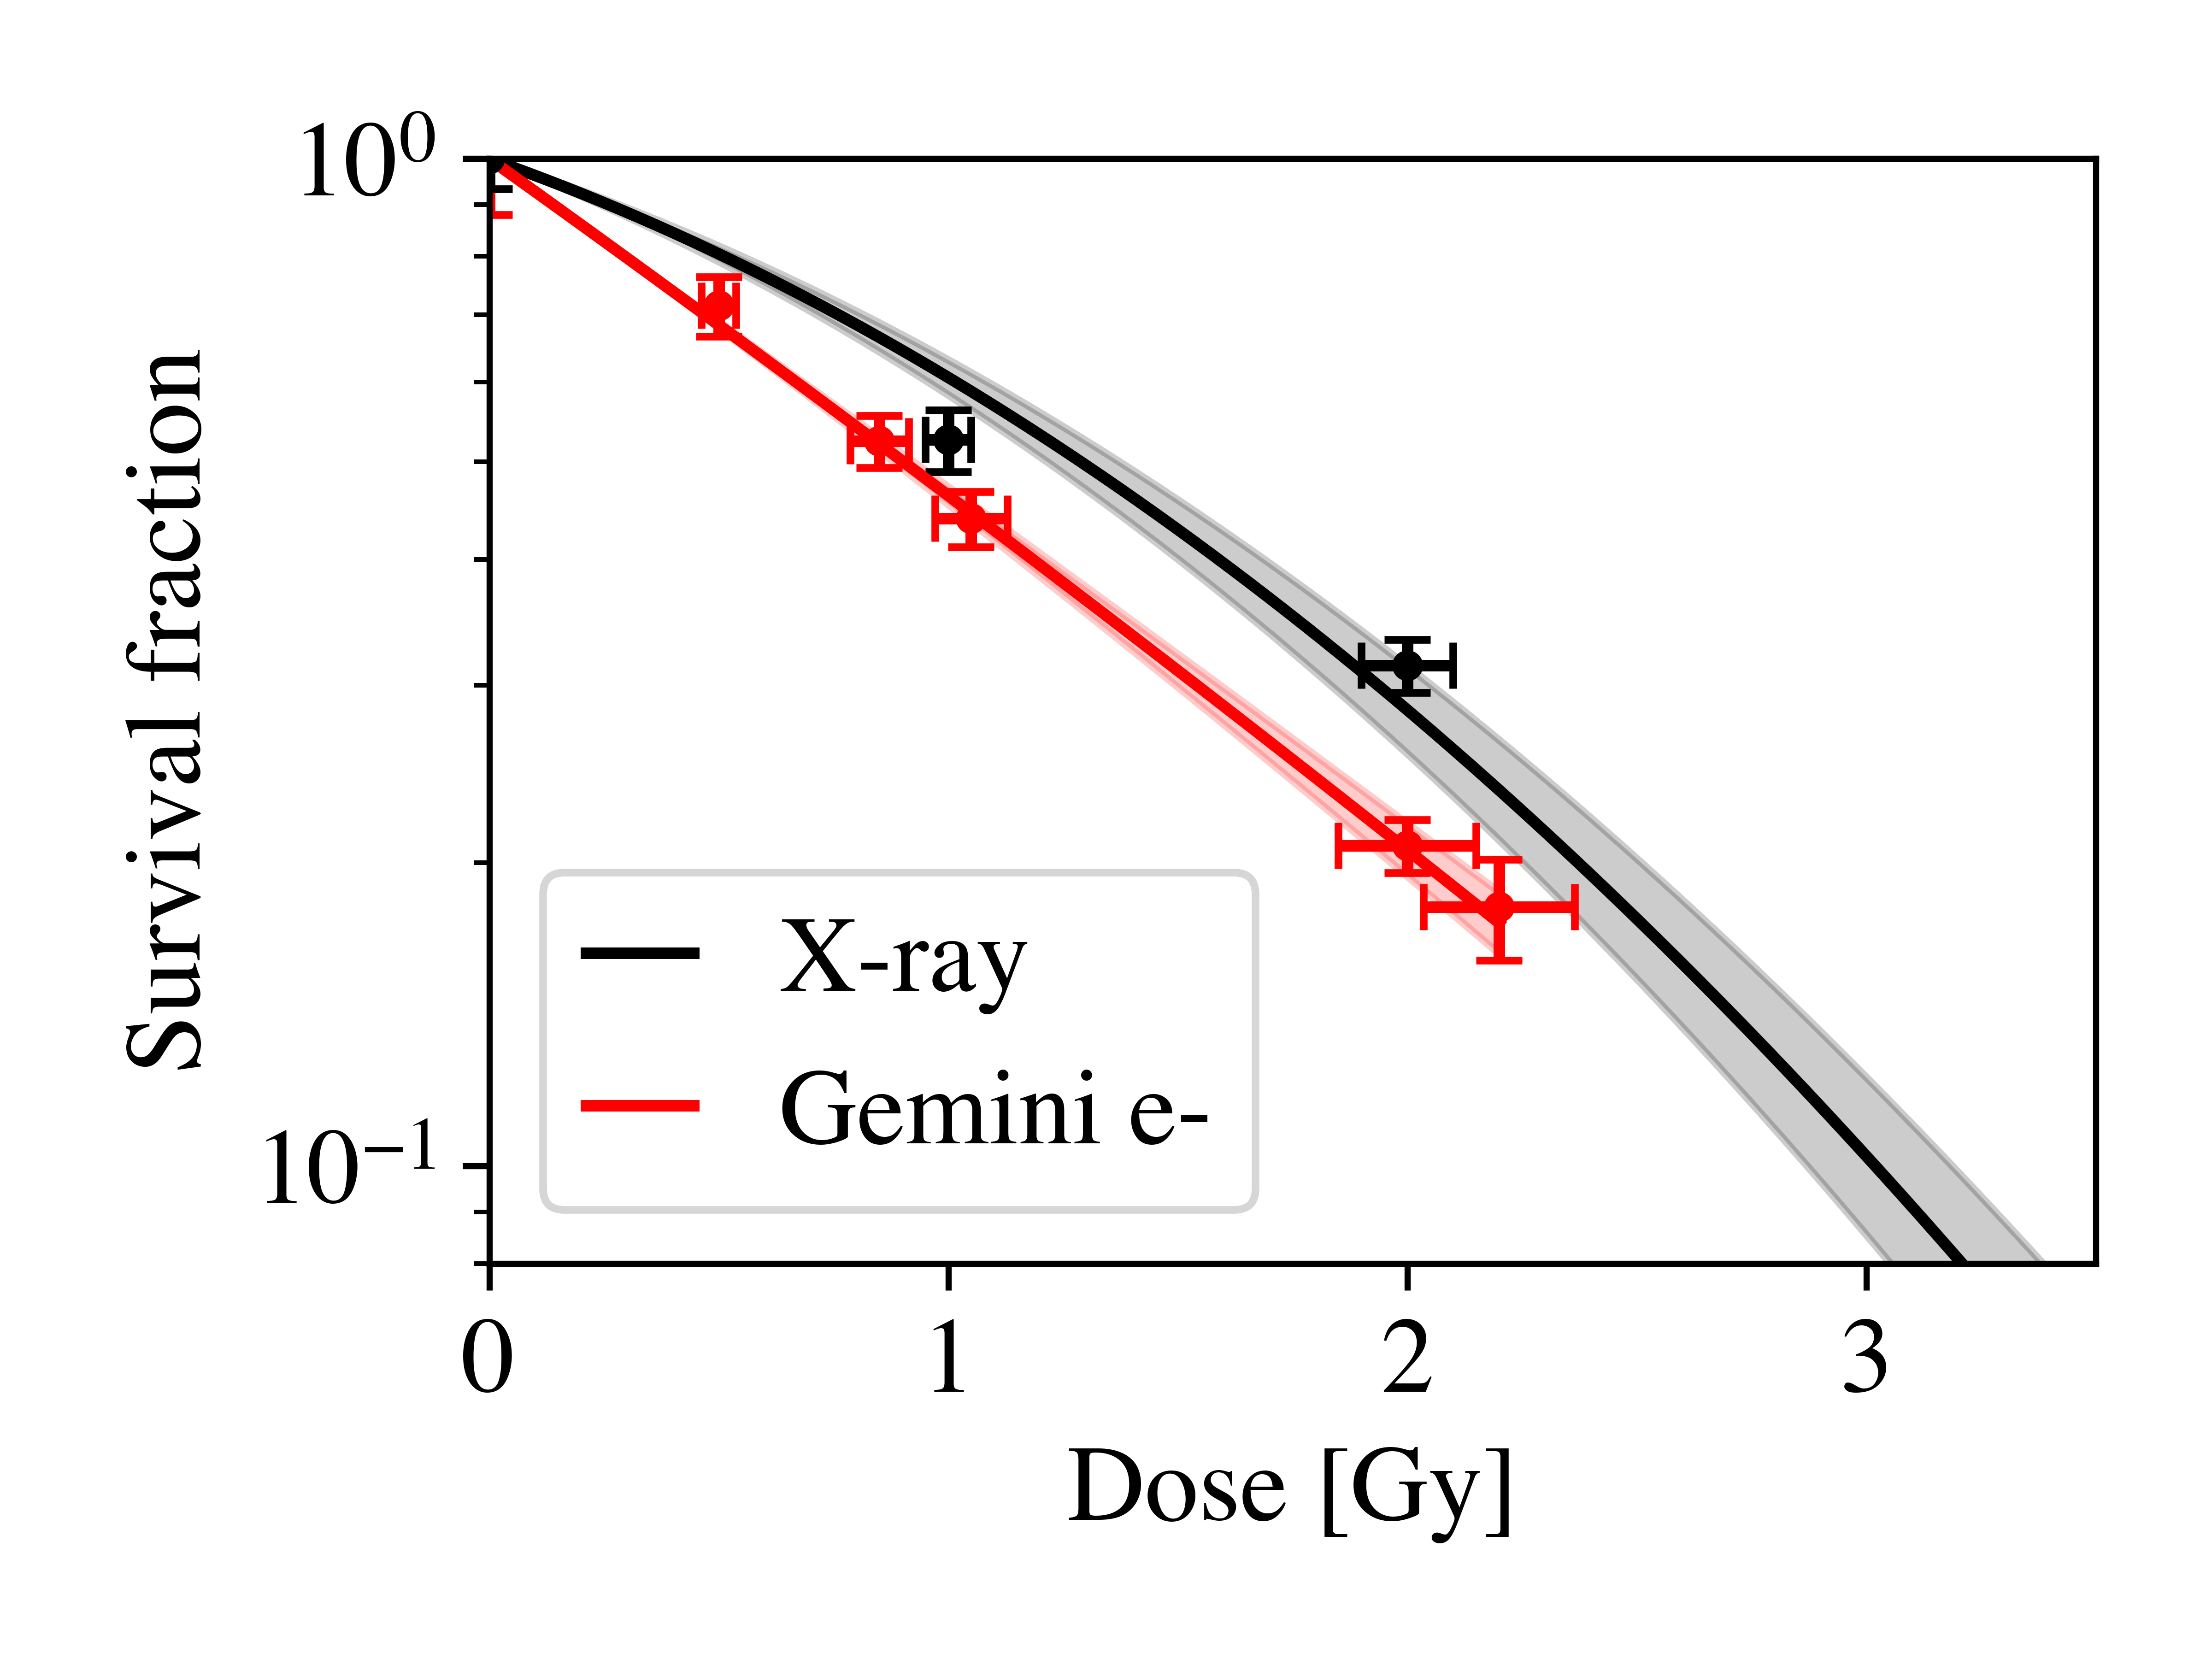
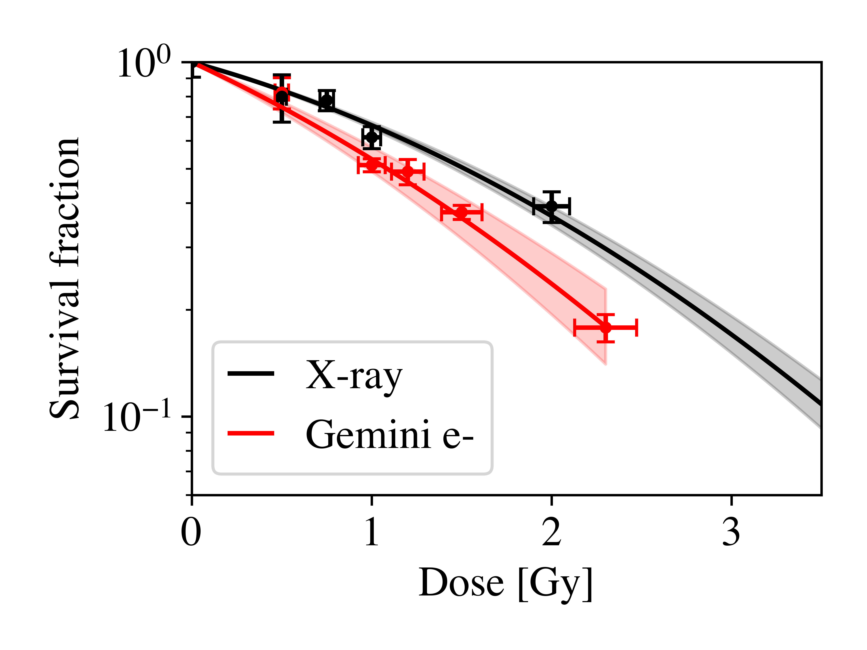
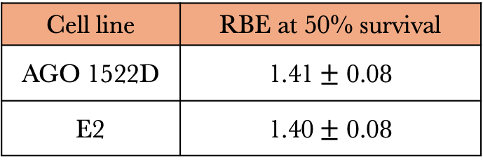
Femtosecond-scale irradiations
AGO - Skin
E2 - Cancerous
Cell line | RBE at 50% survival
AGO 1522D | 1.41$±$ 0.08
E2 | 1.40$±$ 0.08
C.A. McAnespie, et. al.- Submitted 2024
Conor McAnespie
LhARA, September 2024

Slide 22
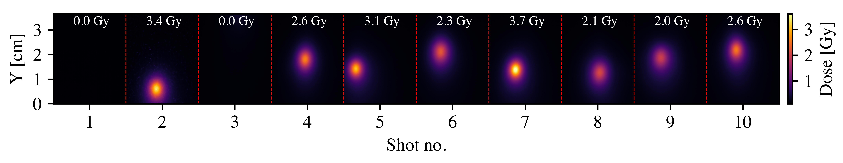
Limitations
Shot-to-shot fluctuations in position and level of dose
  Laser energy / pointing
  Target misalignment / imperfections
Regimented access to facilities to perform detailed experiments with multiple repeats.
Conor McAnespie
LhARA, September 2024

Slide 23
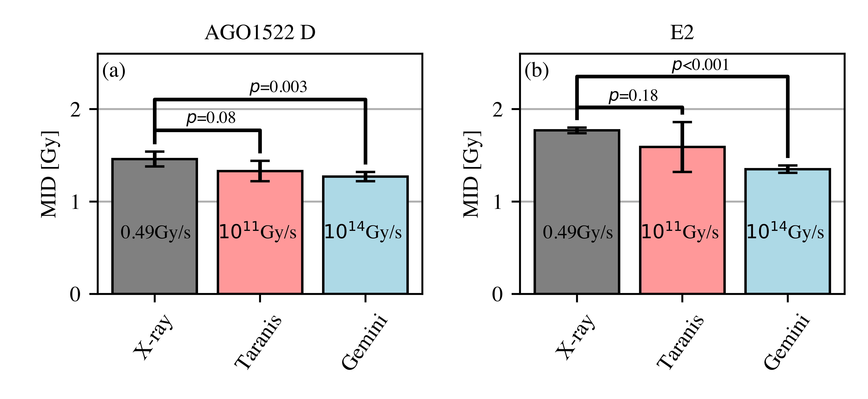
Conclusions
Performed successful irradiations of biological samples at picosecond and femtosecond level with laser driven sources.
Measured increased biological effectiveness at the femtosecond level in both healthy and cancerous tissue.
Conor McAnespie
LhARA, September 2024

Slide 24




Collaborators
CLMI
H. Maguire
L. Calvin
K. Fleck
M. Streeter
E. Gerstmayr
J. Sarma
G. Sarri
PGJCCR
C. McDonnell
S. McMahon
K. Prise
N. Bourgeois
O. Finlay
S. Needham
S. Botchway
P. Chaudhary
G. Schettino
B. Kettle
S. Mangles
J. Mill
D. Jaroszynski
Conor McAnespie
LhARA, September 2024

Slide 25
Thanks for your attention!
Conor McAnespie
LhARA, September 2024

