Slide 1
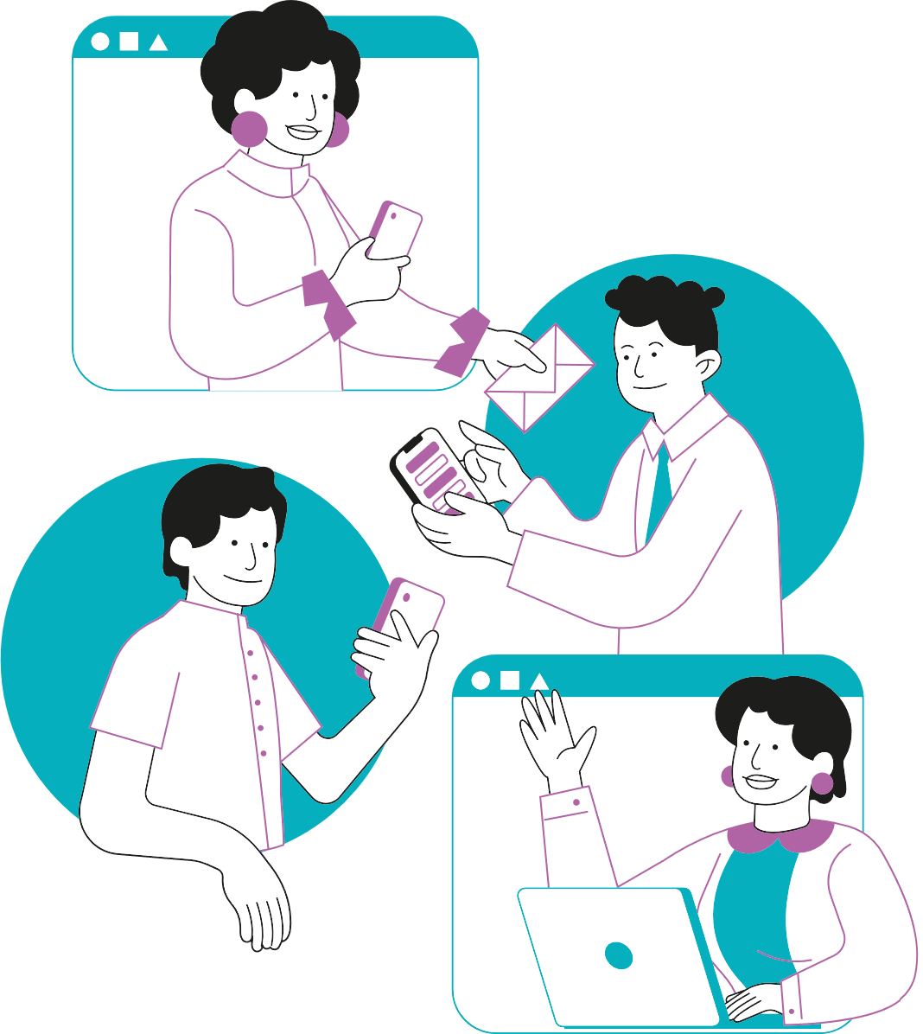
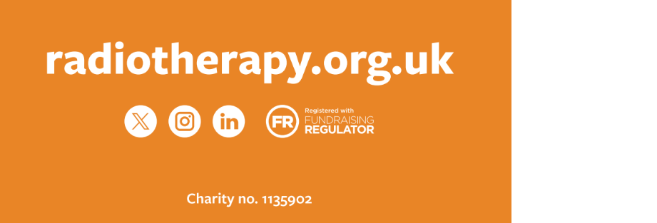
COMMUNICATION & CO-DESIGN FOR RESEARCH
SARAH QUINLAN MBE
DIRECTOR RADIOTHERAPY UK

Slide 2
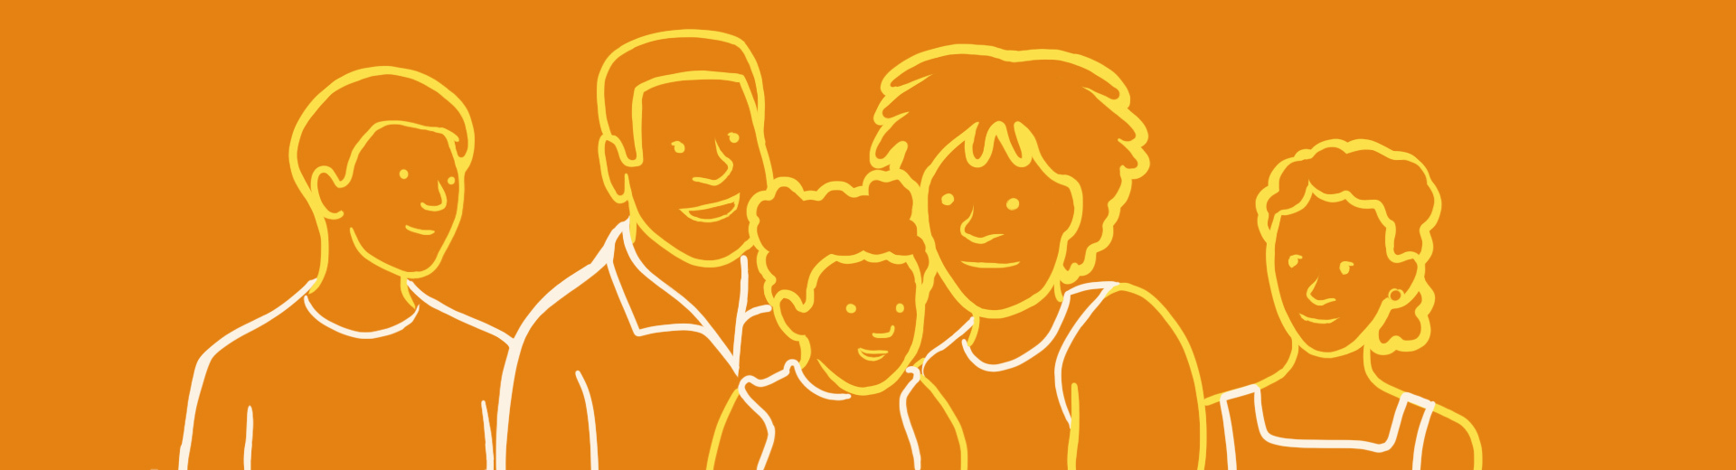


2
Our Work
Patient Information Resources
Advocacy and Campaigning for equality of access to modern radiotherapy
Workforce Services

Slide 3




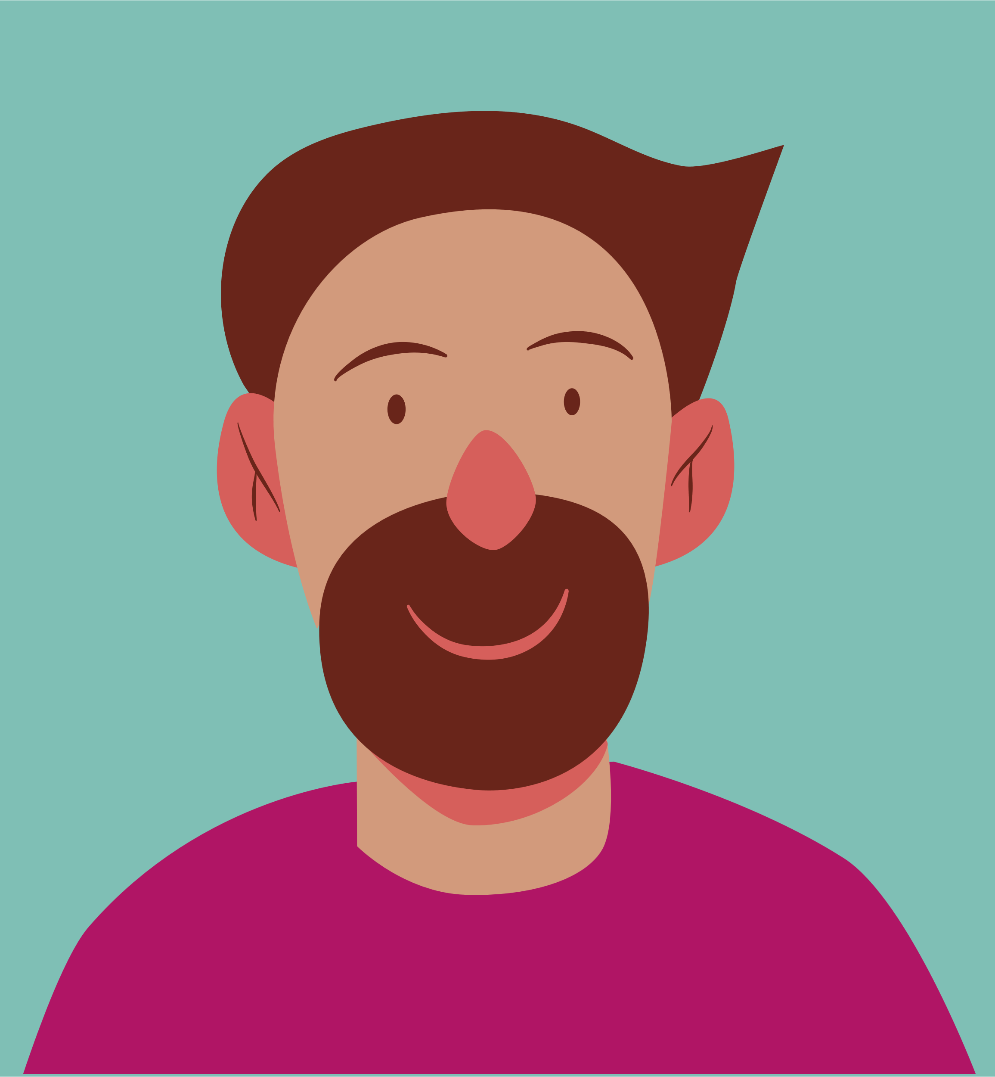


Why is communication and co-design important?
Encourages informed decision making and helps secure funding by demonstrating value and potential impact
Bridges the gap between scientists and the public
Promotes understanding and appreciation of your work
Improves your research
04
05
Notes:
involving those who ultimately use or affected by research - means that your methods and outcomes are relevant and applicate
co-design fosters a collaborative envt where diverse perspectives can lead to innovative solutions and creative approaches
more likely to champion and adopt research findings and recommendations
empowers patients
improves quality of the research.

Slide 4

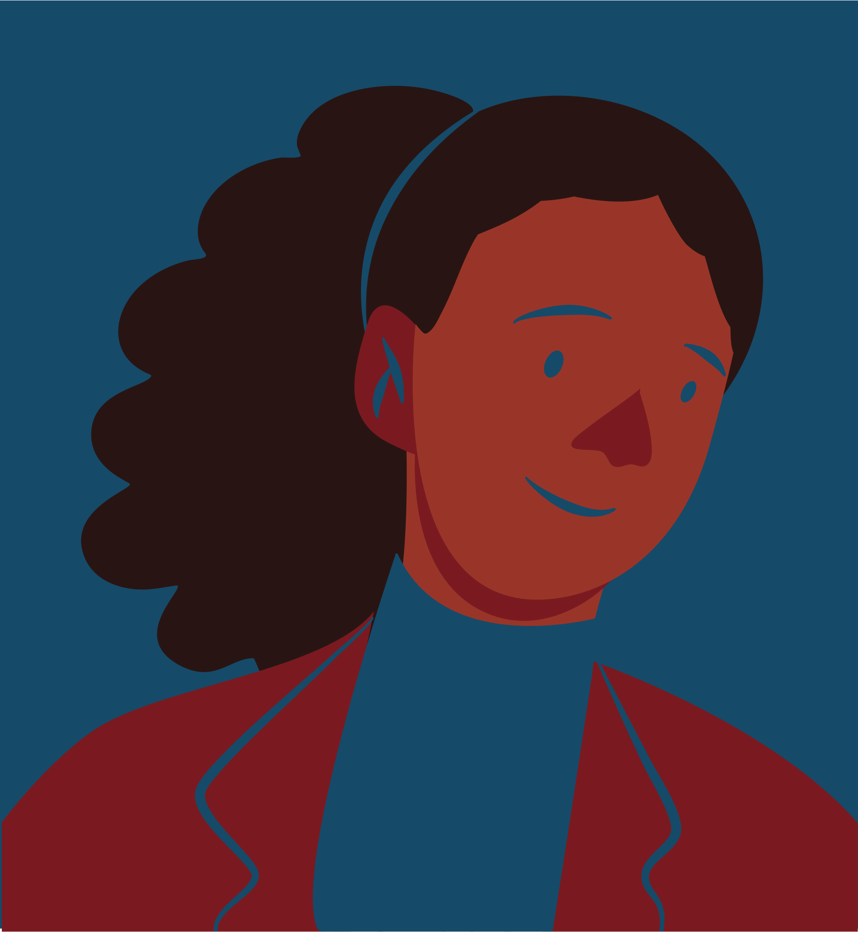
Who is your audience
  General public,
  Beneficiaries of your work
  Peers
  Policymakers,
  Funders.
Tailored messaging

Slide 5
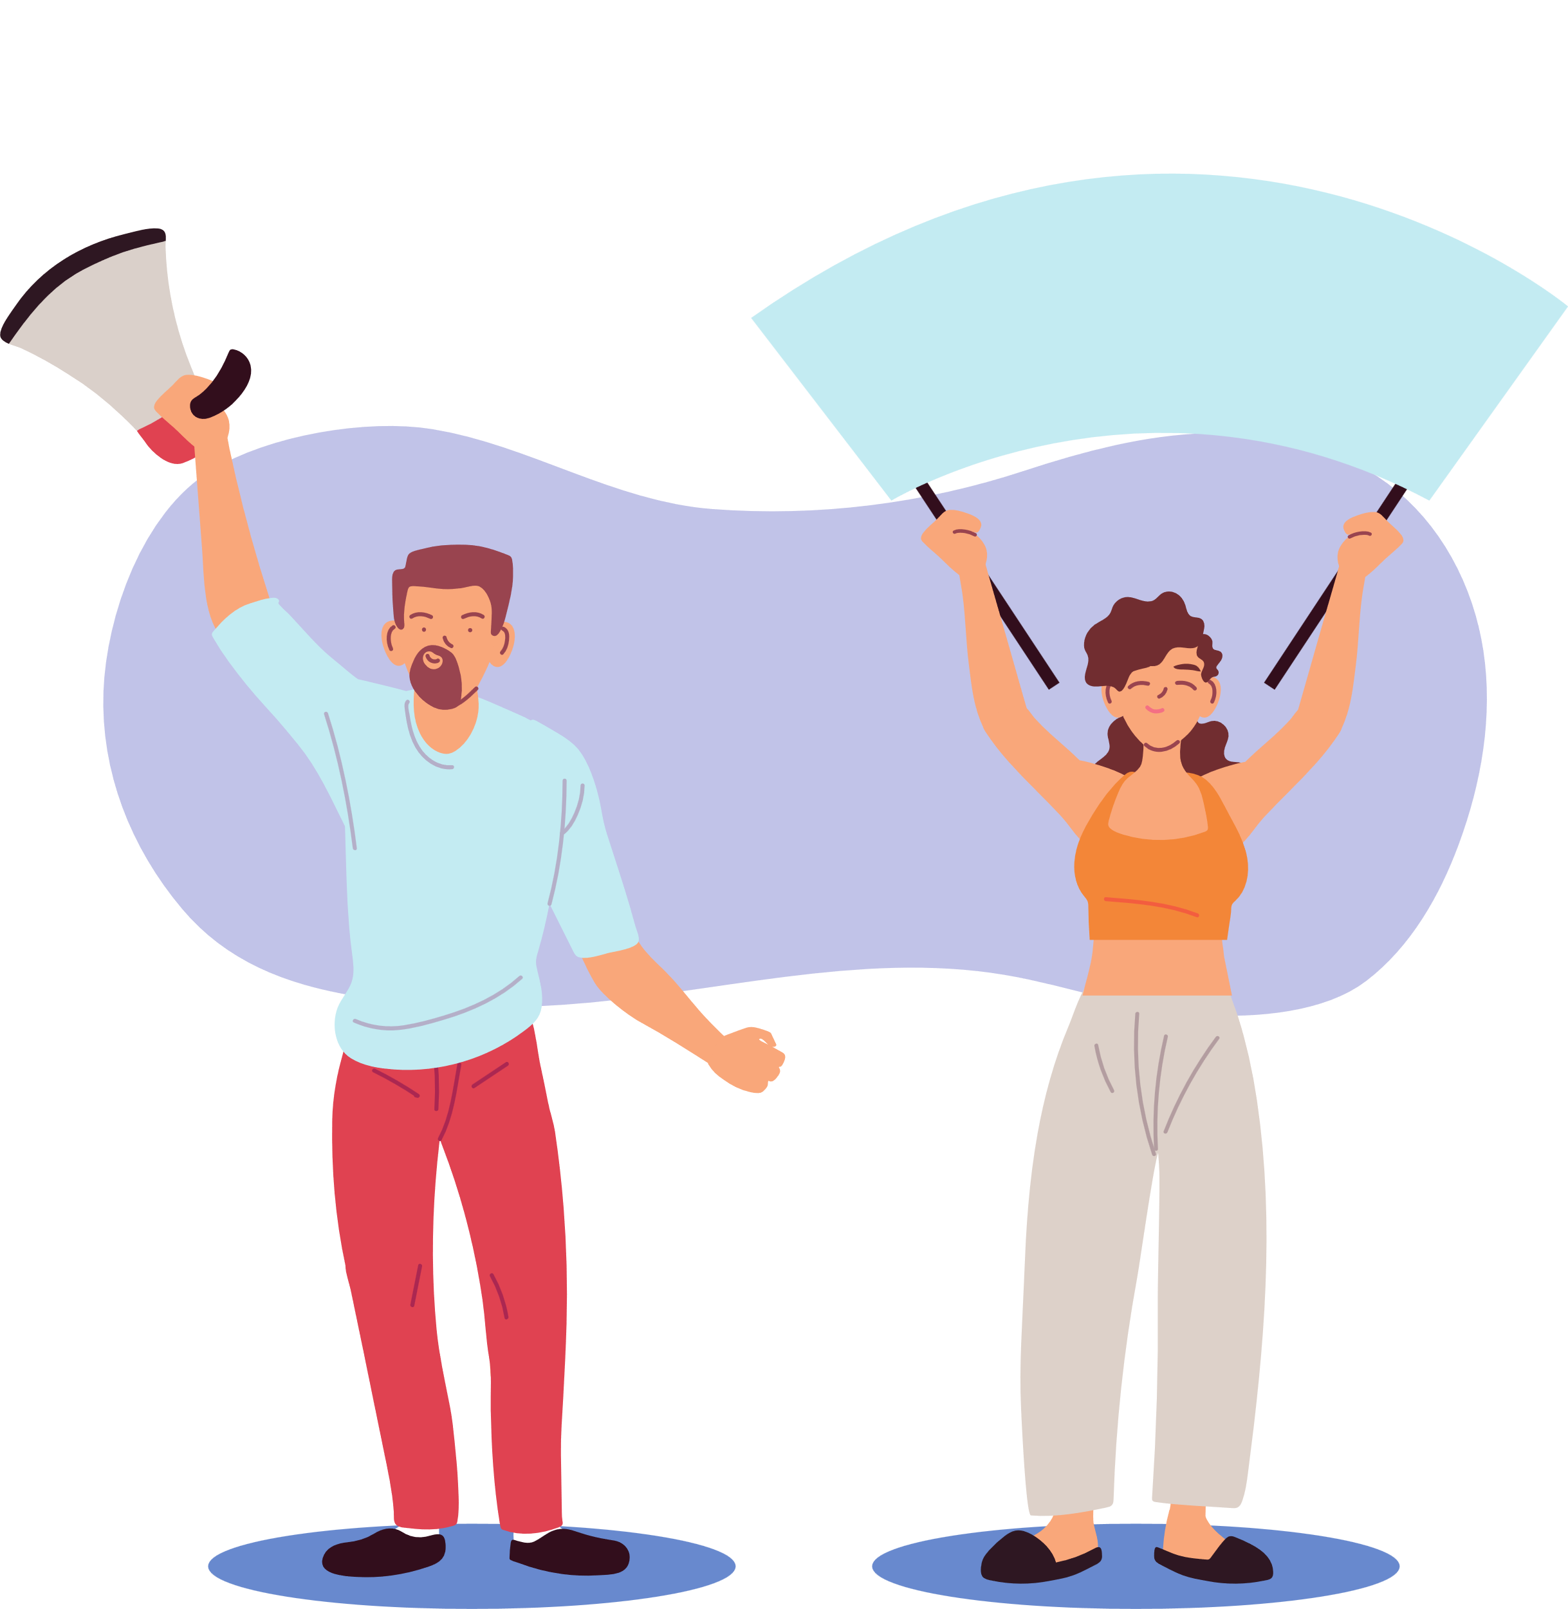
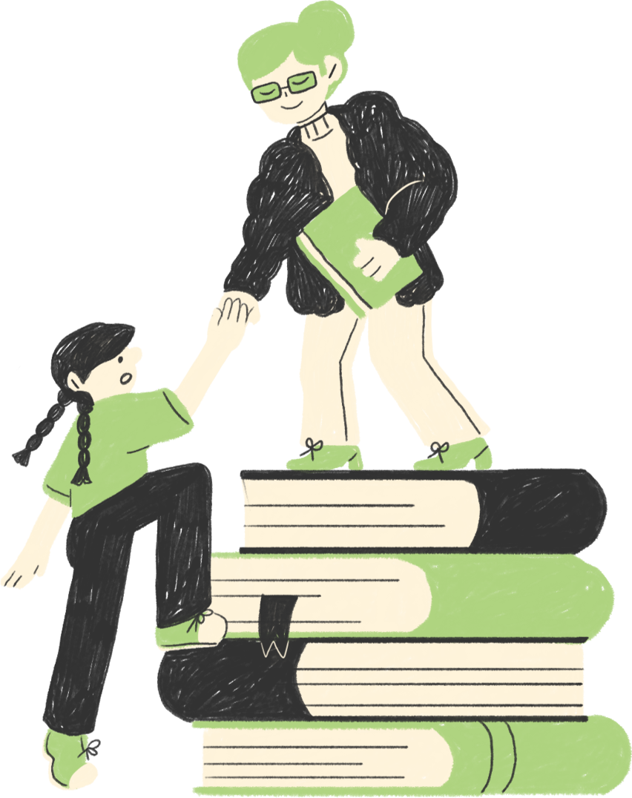
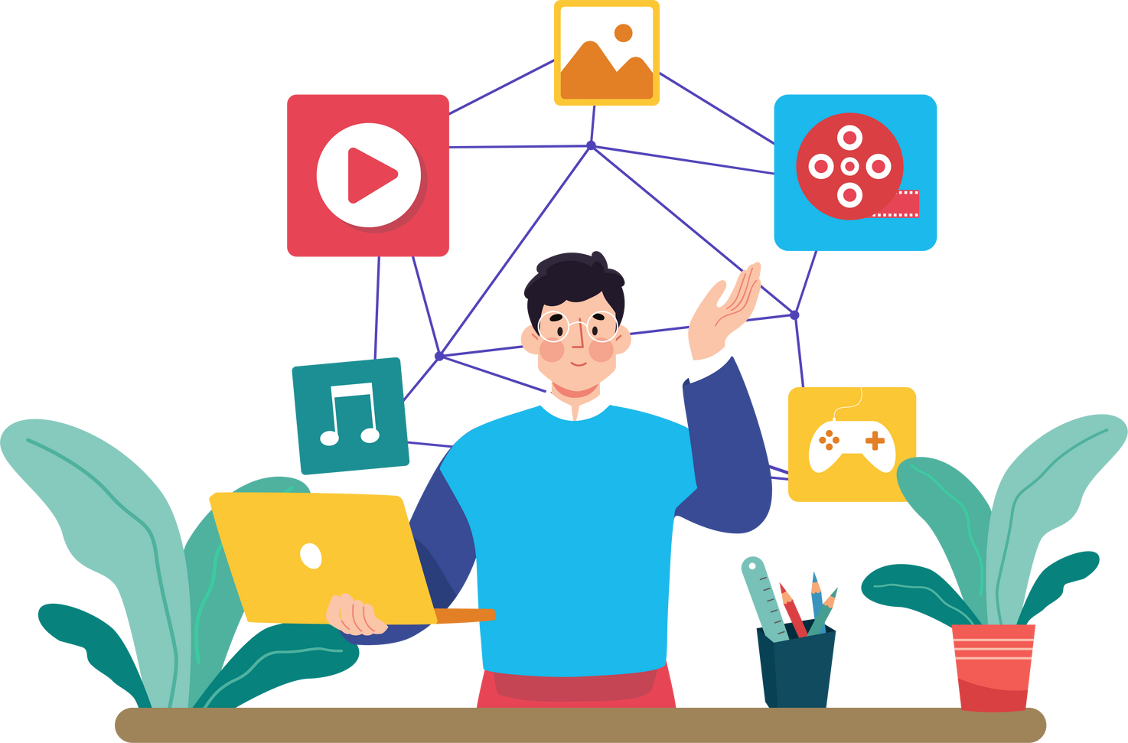
What are your goals?
  Educate AND Learn
  Advocate
  Raise awareness
  Improve your research - innovative solutions integrate diverse perspectives and expertise.

Slide 6

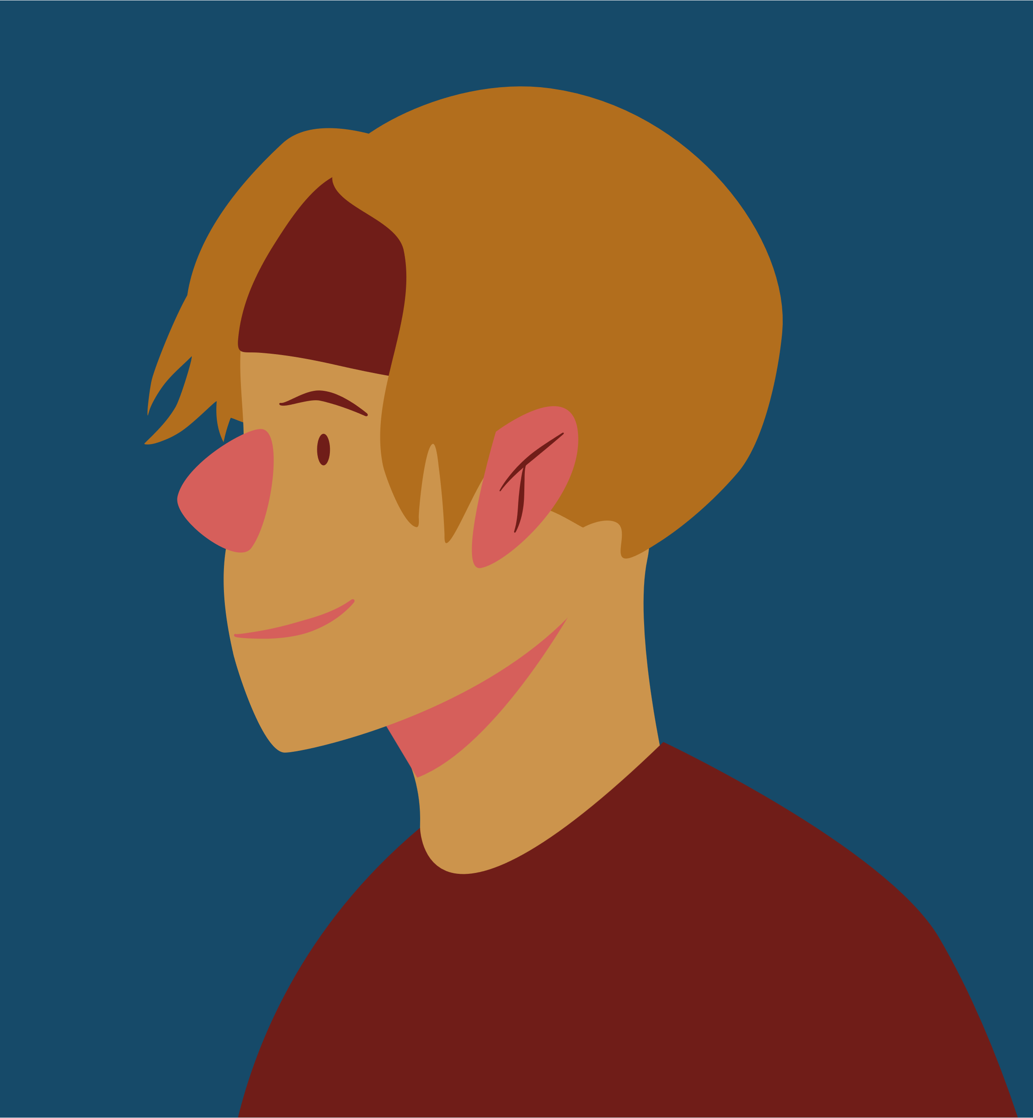
Simplify complex ideas
  Avoid Jargon
  Use analogies and metaphors
  Break down the information into manageable chunks.
  Co-design. Work with your audience to create and review
  Be relatable and authentic

Slide 7
This makes your work accessible
According to the National Literacy Trust,
the average reading age for adults in the UK is around 9 years old.
This means that many adults read at a level similar to that of a 9-year-old child.

Slide 8


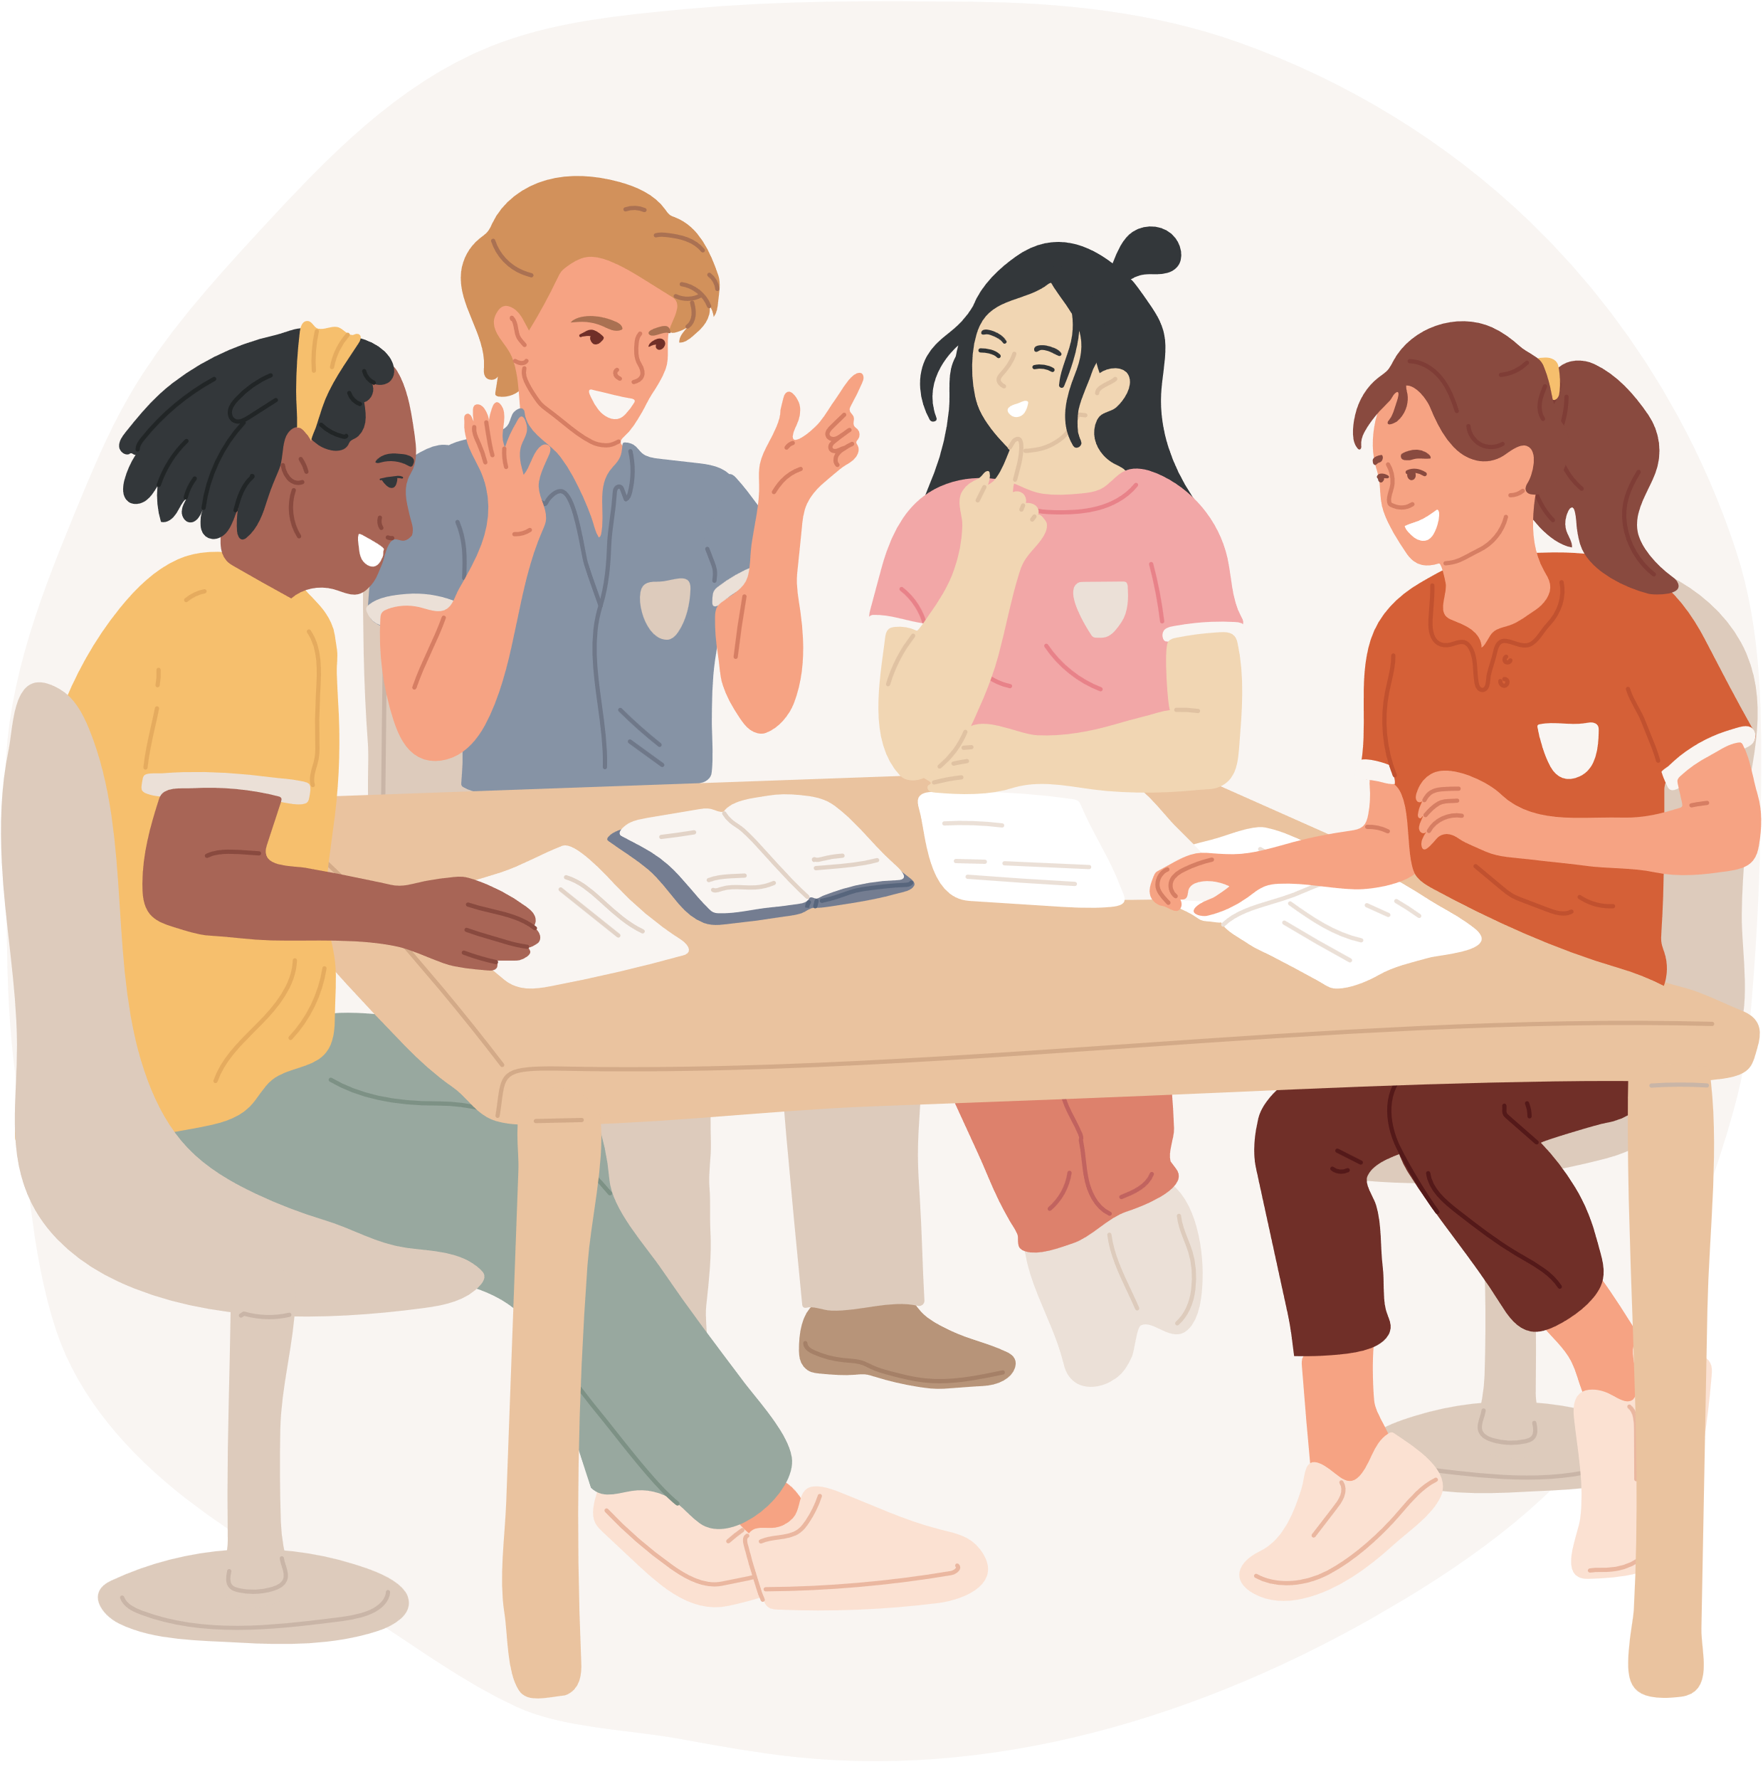



Engage your audience
TELL THE STORY
COMMUNICATION CHANNELS
Make it relatable.
It’s about people and
why you do what you do.
What is the
bigger picture?
Socials
Website
Public - open up/ invite in
Outreach - patient groups, policy makers
.
CO-DESIGN
Co-Design with your beneficiaries from the start - what works for them?
Interactive elements - Q&A sessions, polls, videos
Feedback loop
Notes:
scntifically creative can also communicate creativelhy.
examples: public lectures (think Brian COx/ Neil deGrasse Tyson - make complex concepts accessible
Socials - use images, videos and updates

Slide 9
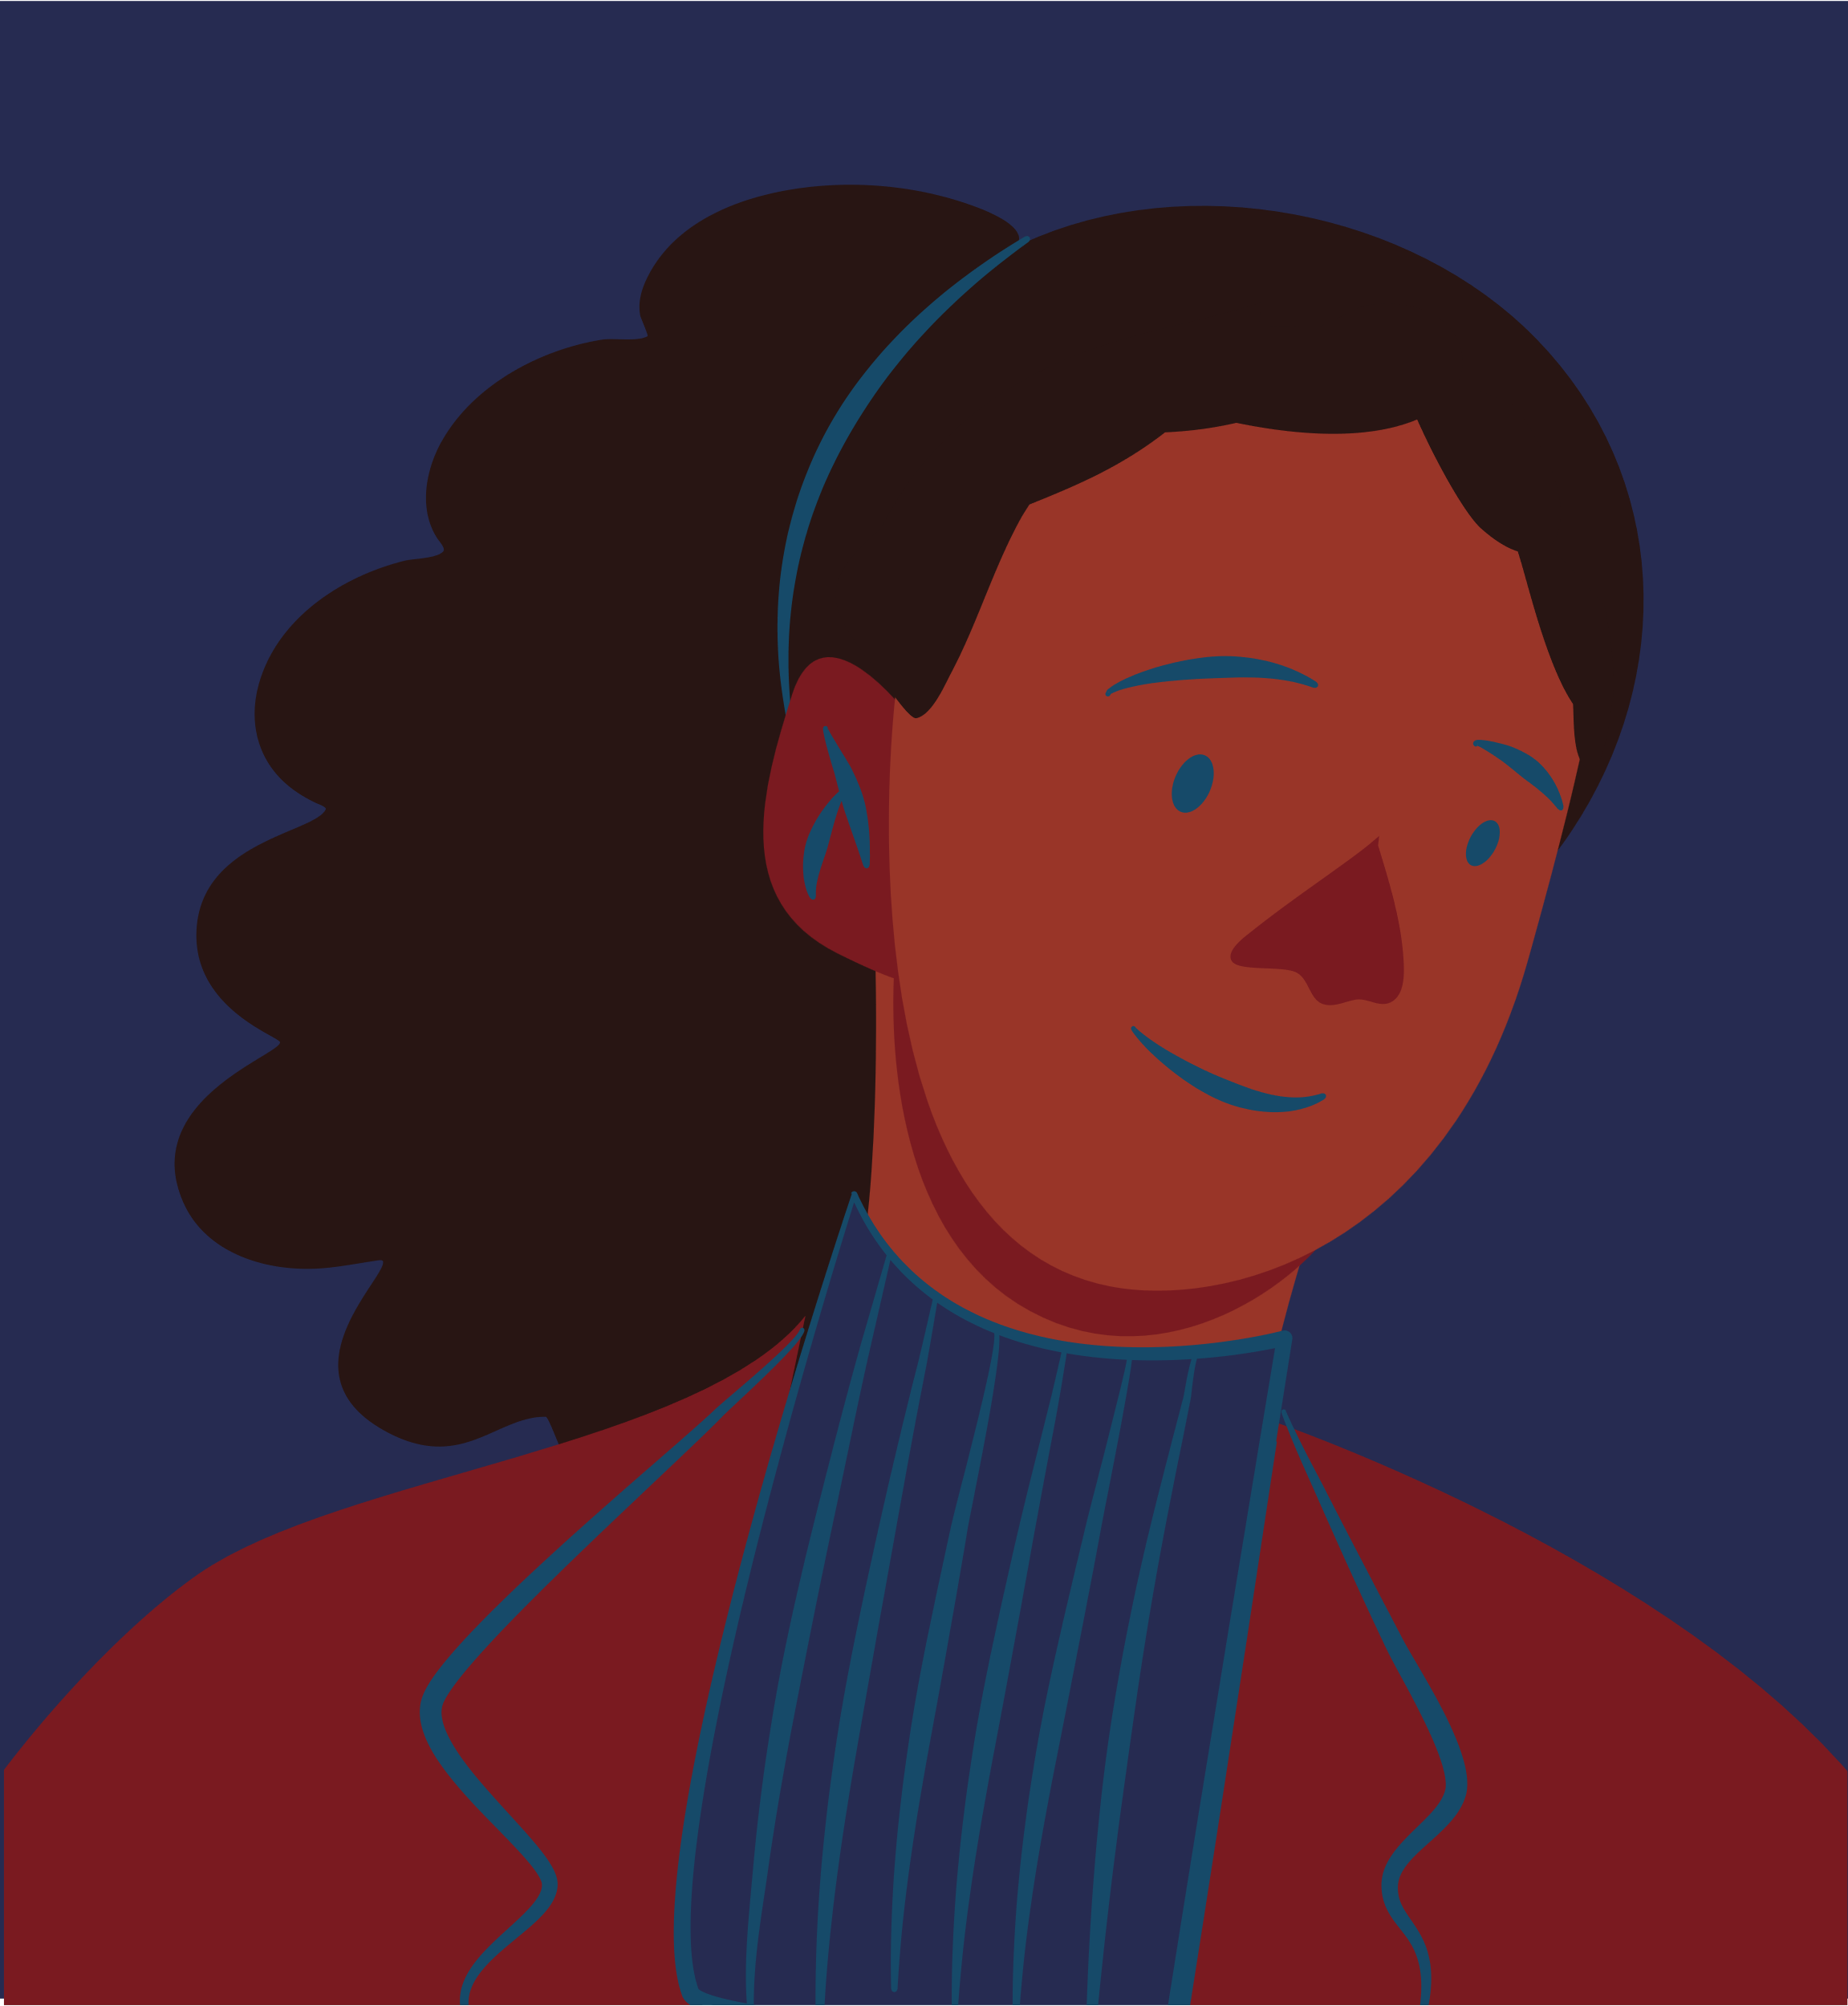
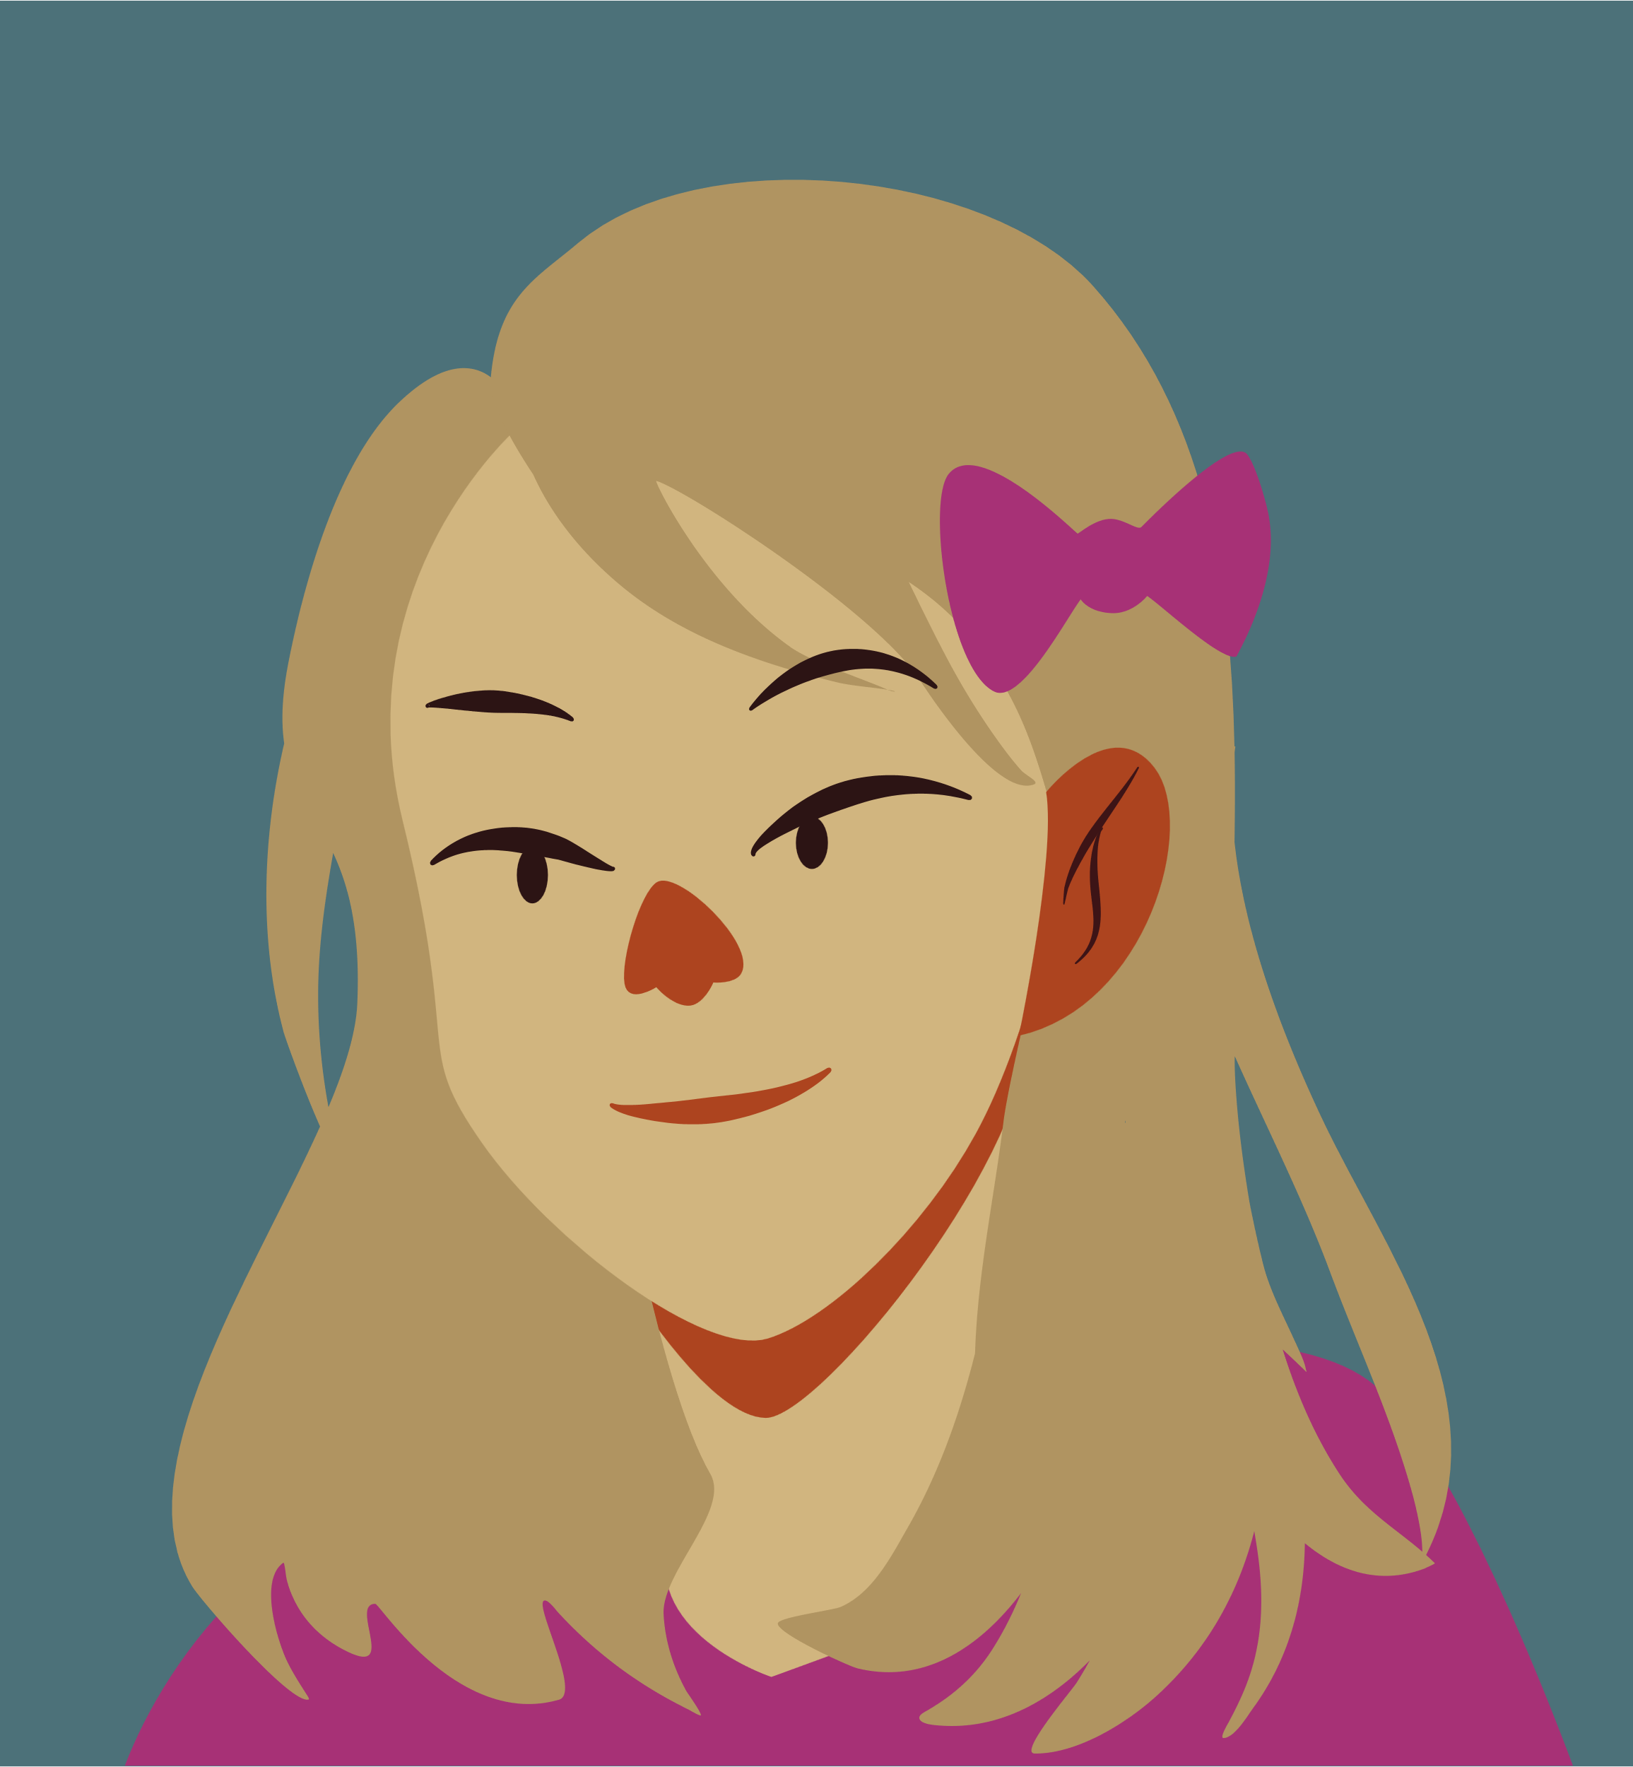
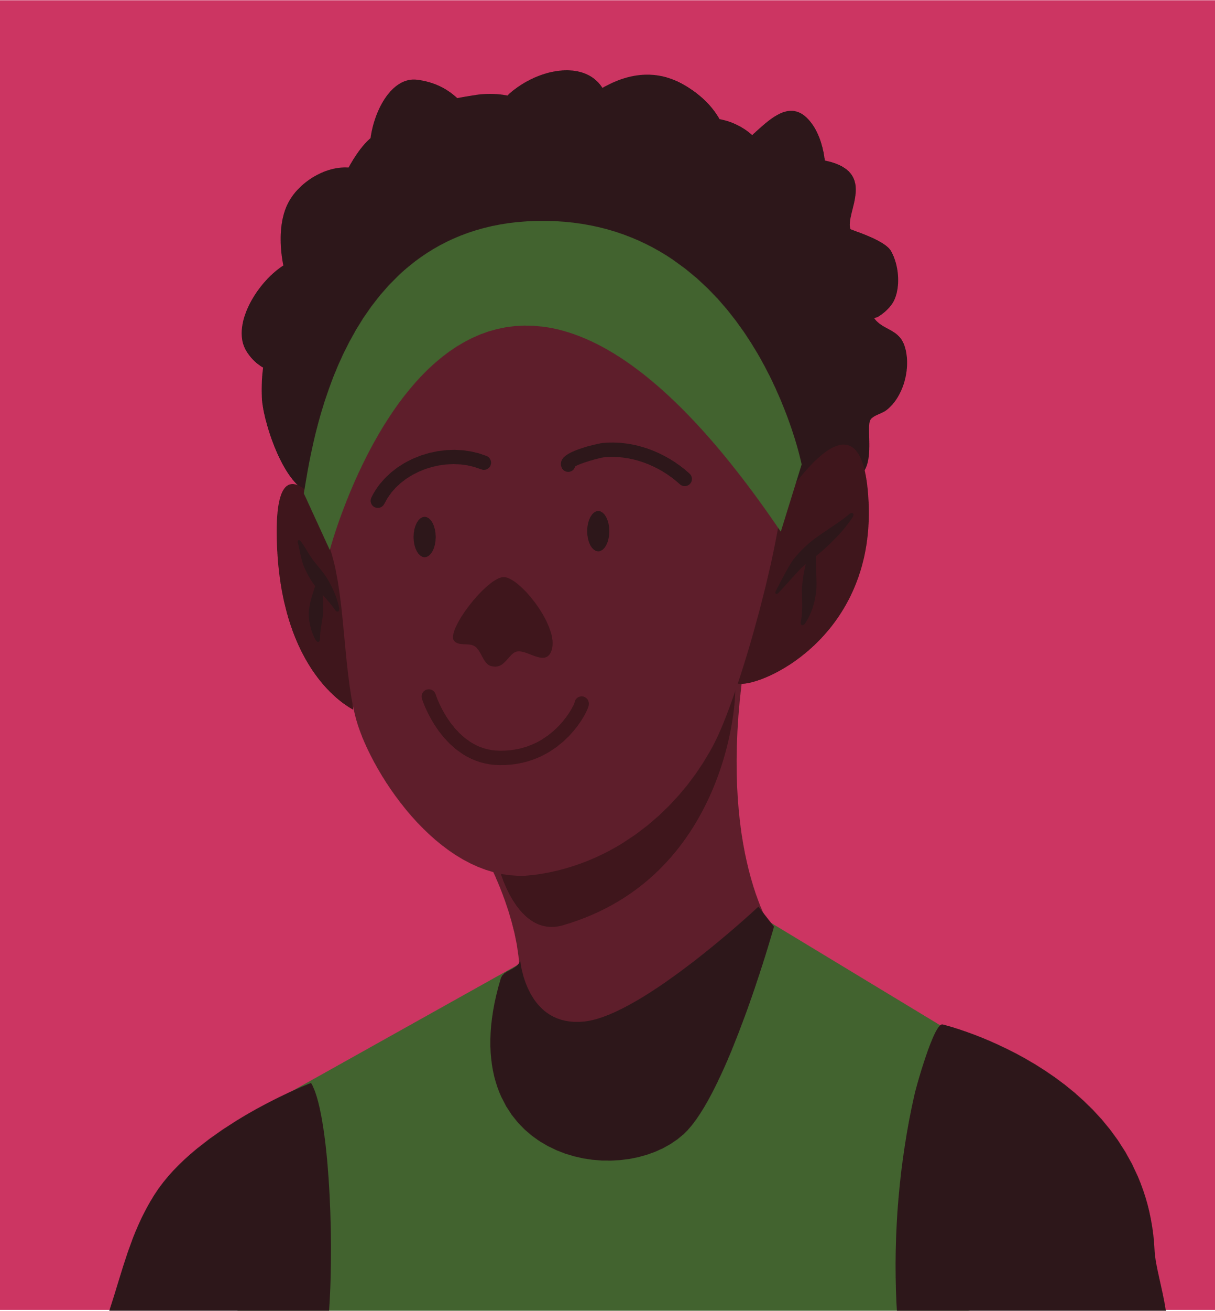

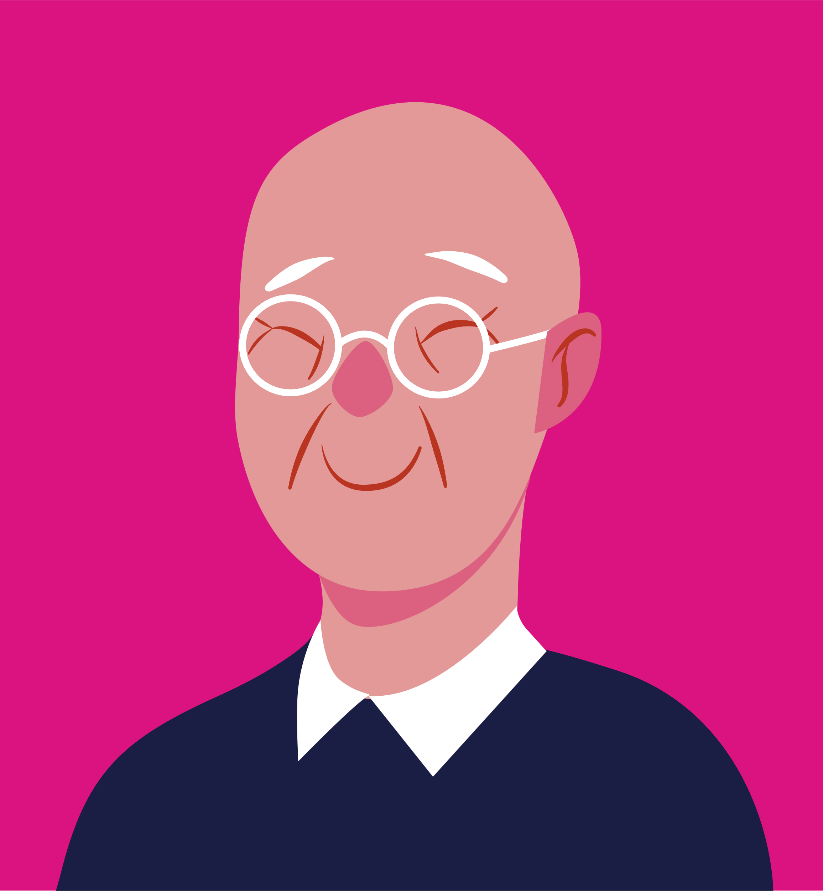


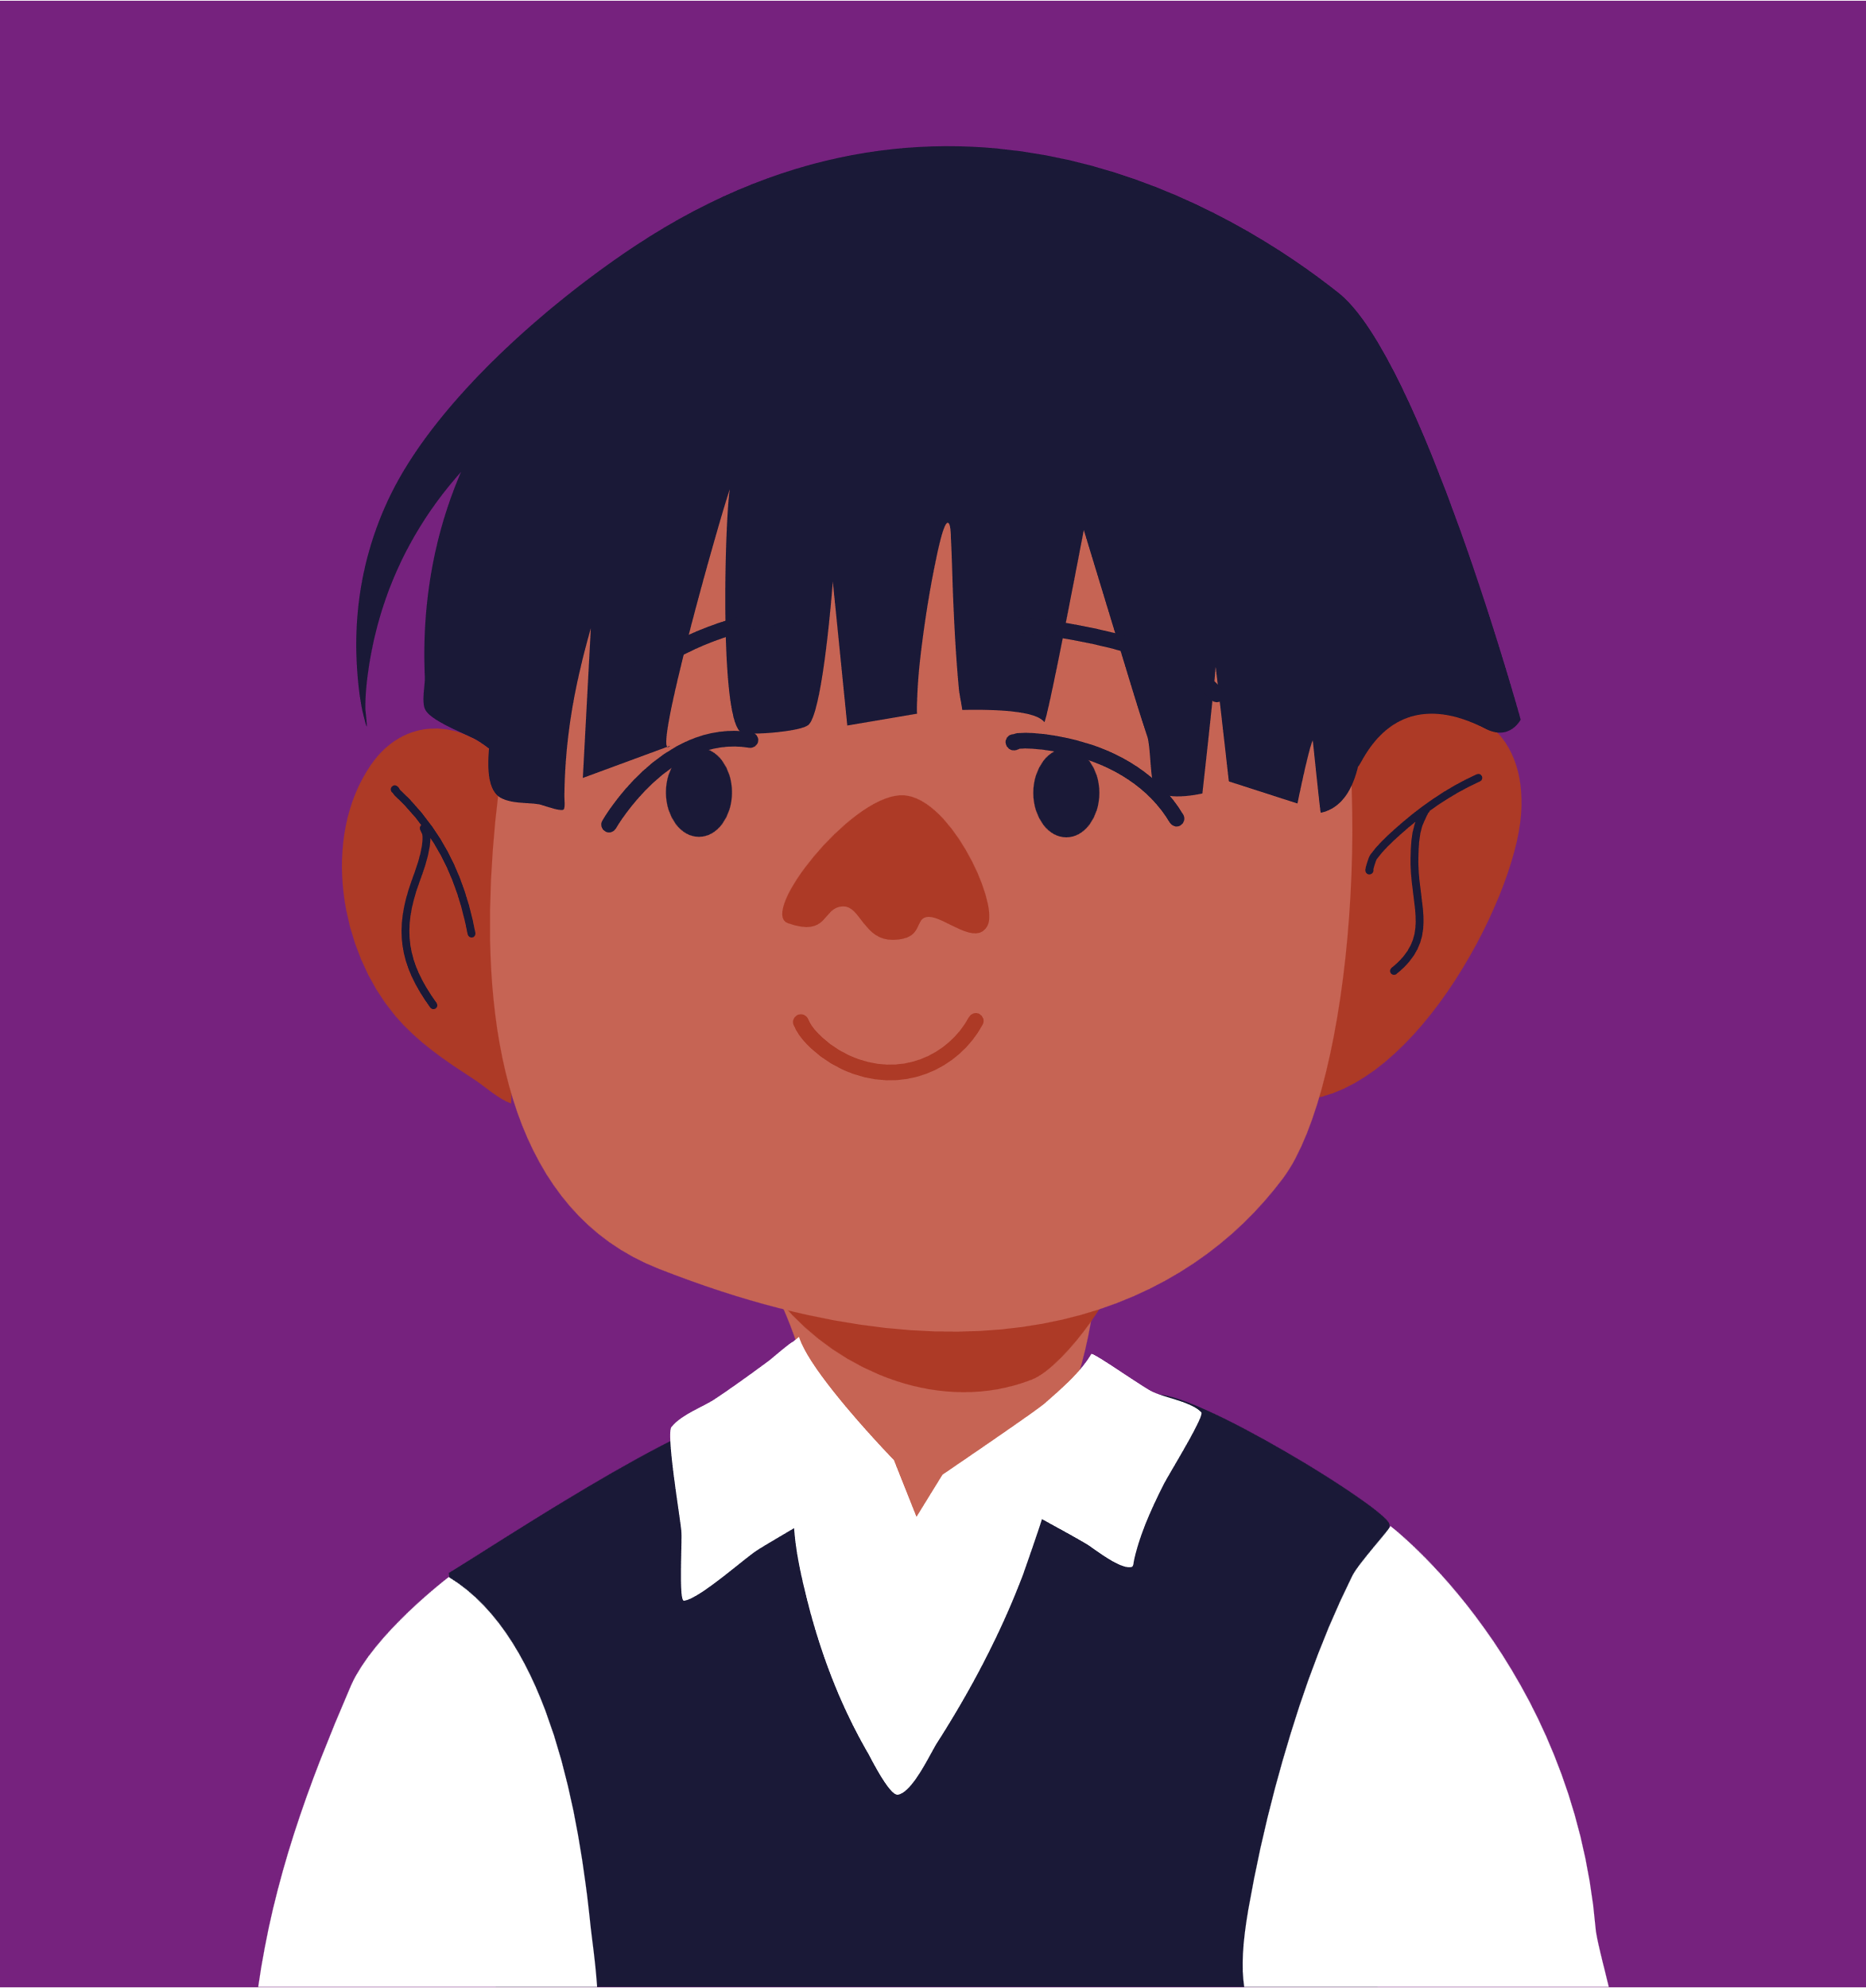


What is the impact of your
research on society?
Connect your work to broader issues
and real world application.
Tailor your message, engage your audience, be positive and continuously improve

Slide 10


