Slide 1
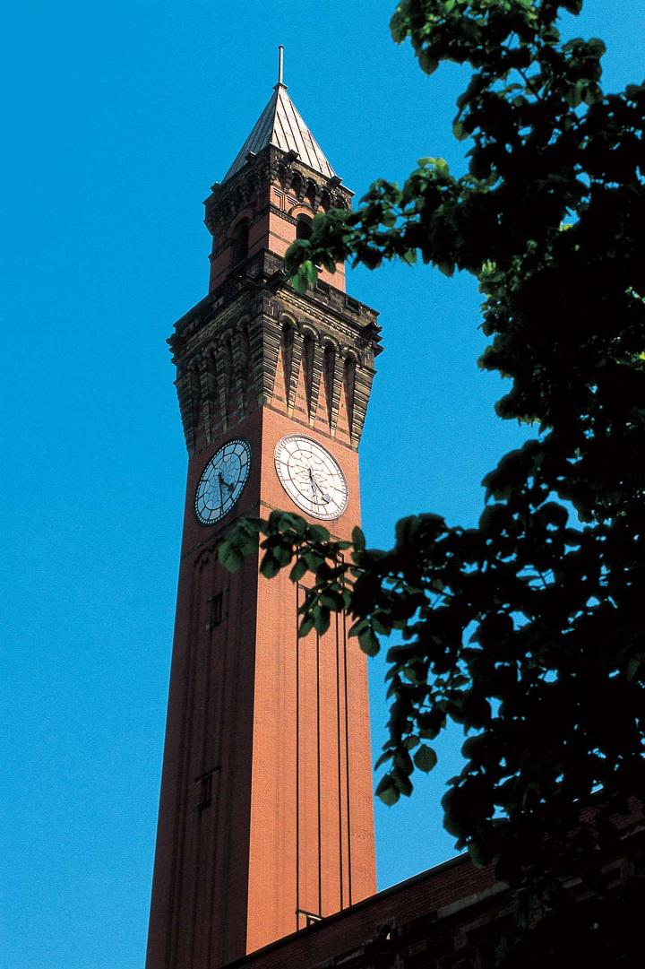
Radiobiology research at SCAPA - PoPLaR
Professor Jason Parsons
Institute of Cancer and Genomic Sciences
School of Physics and Astronomy

Slide 2
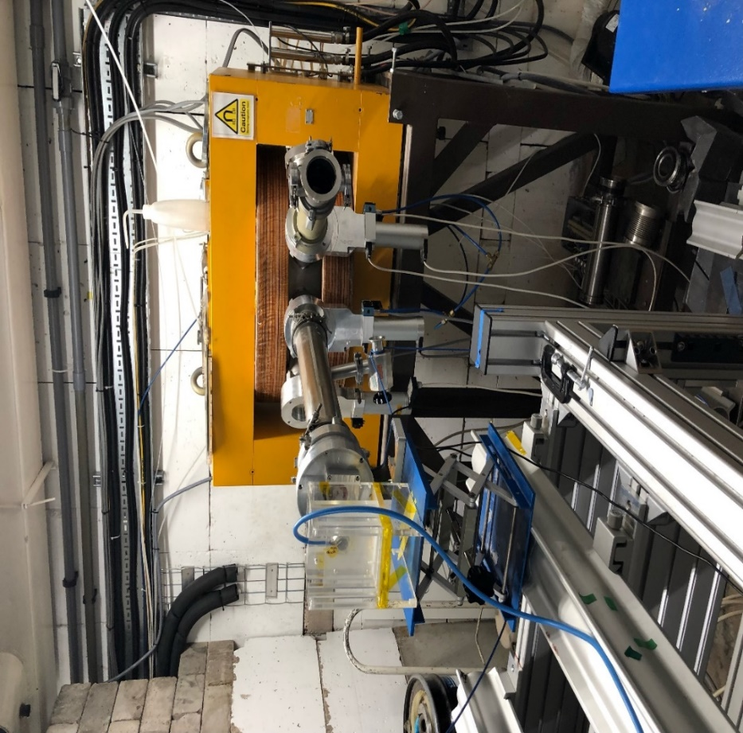
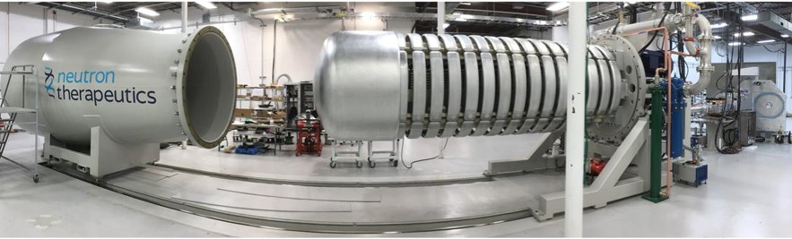
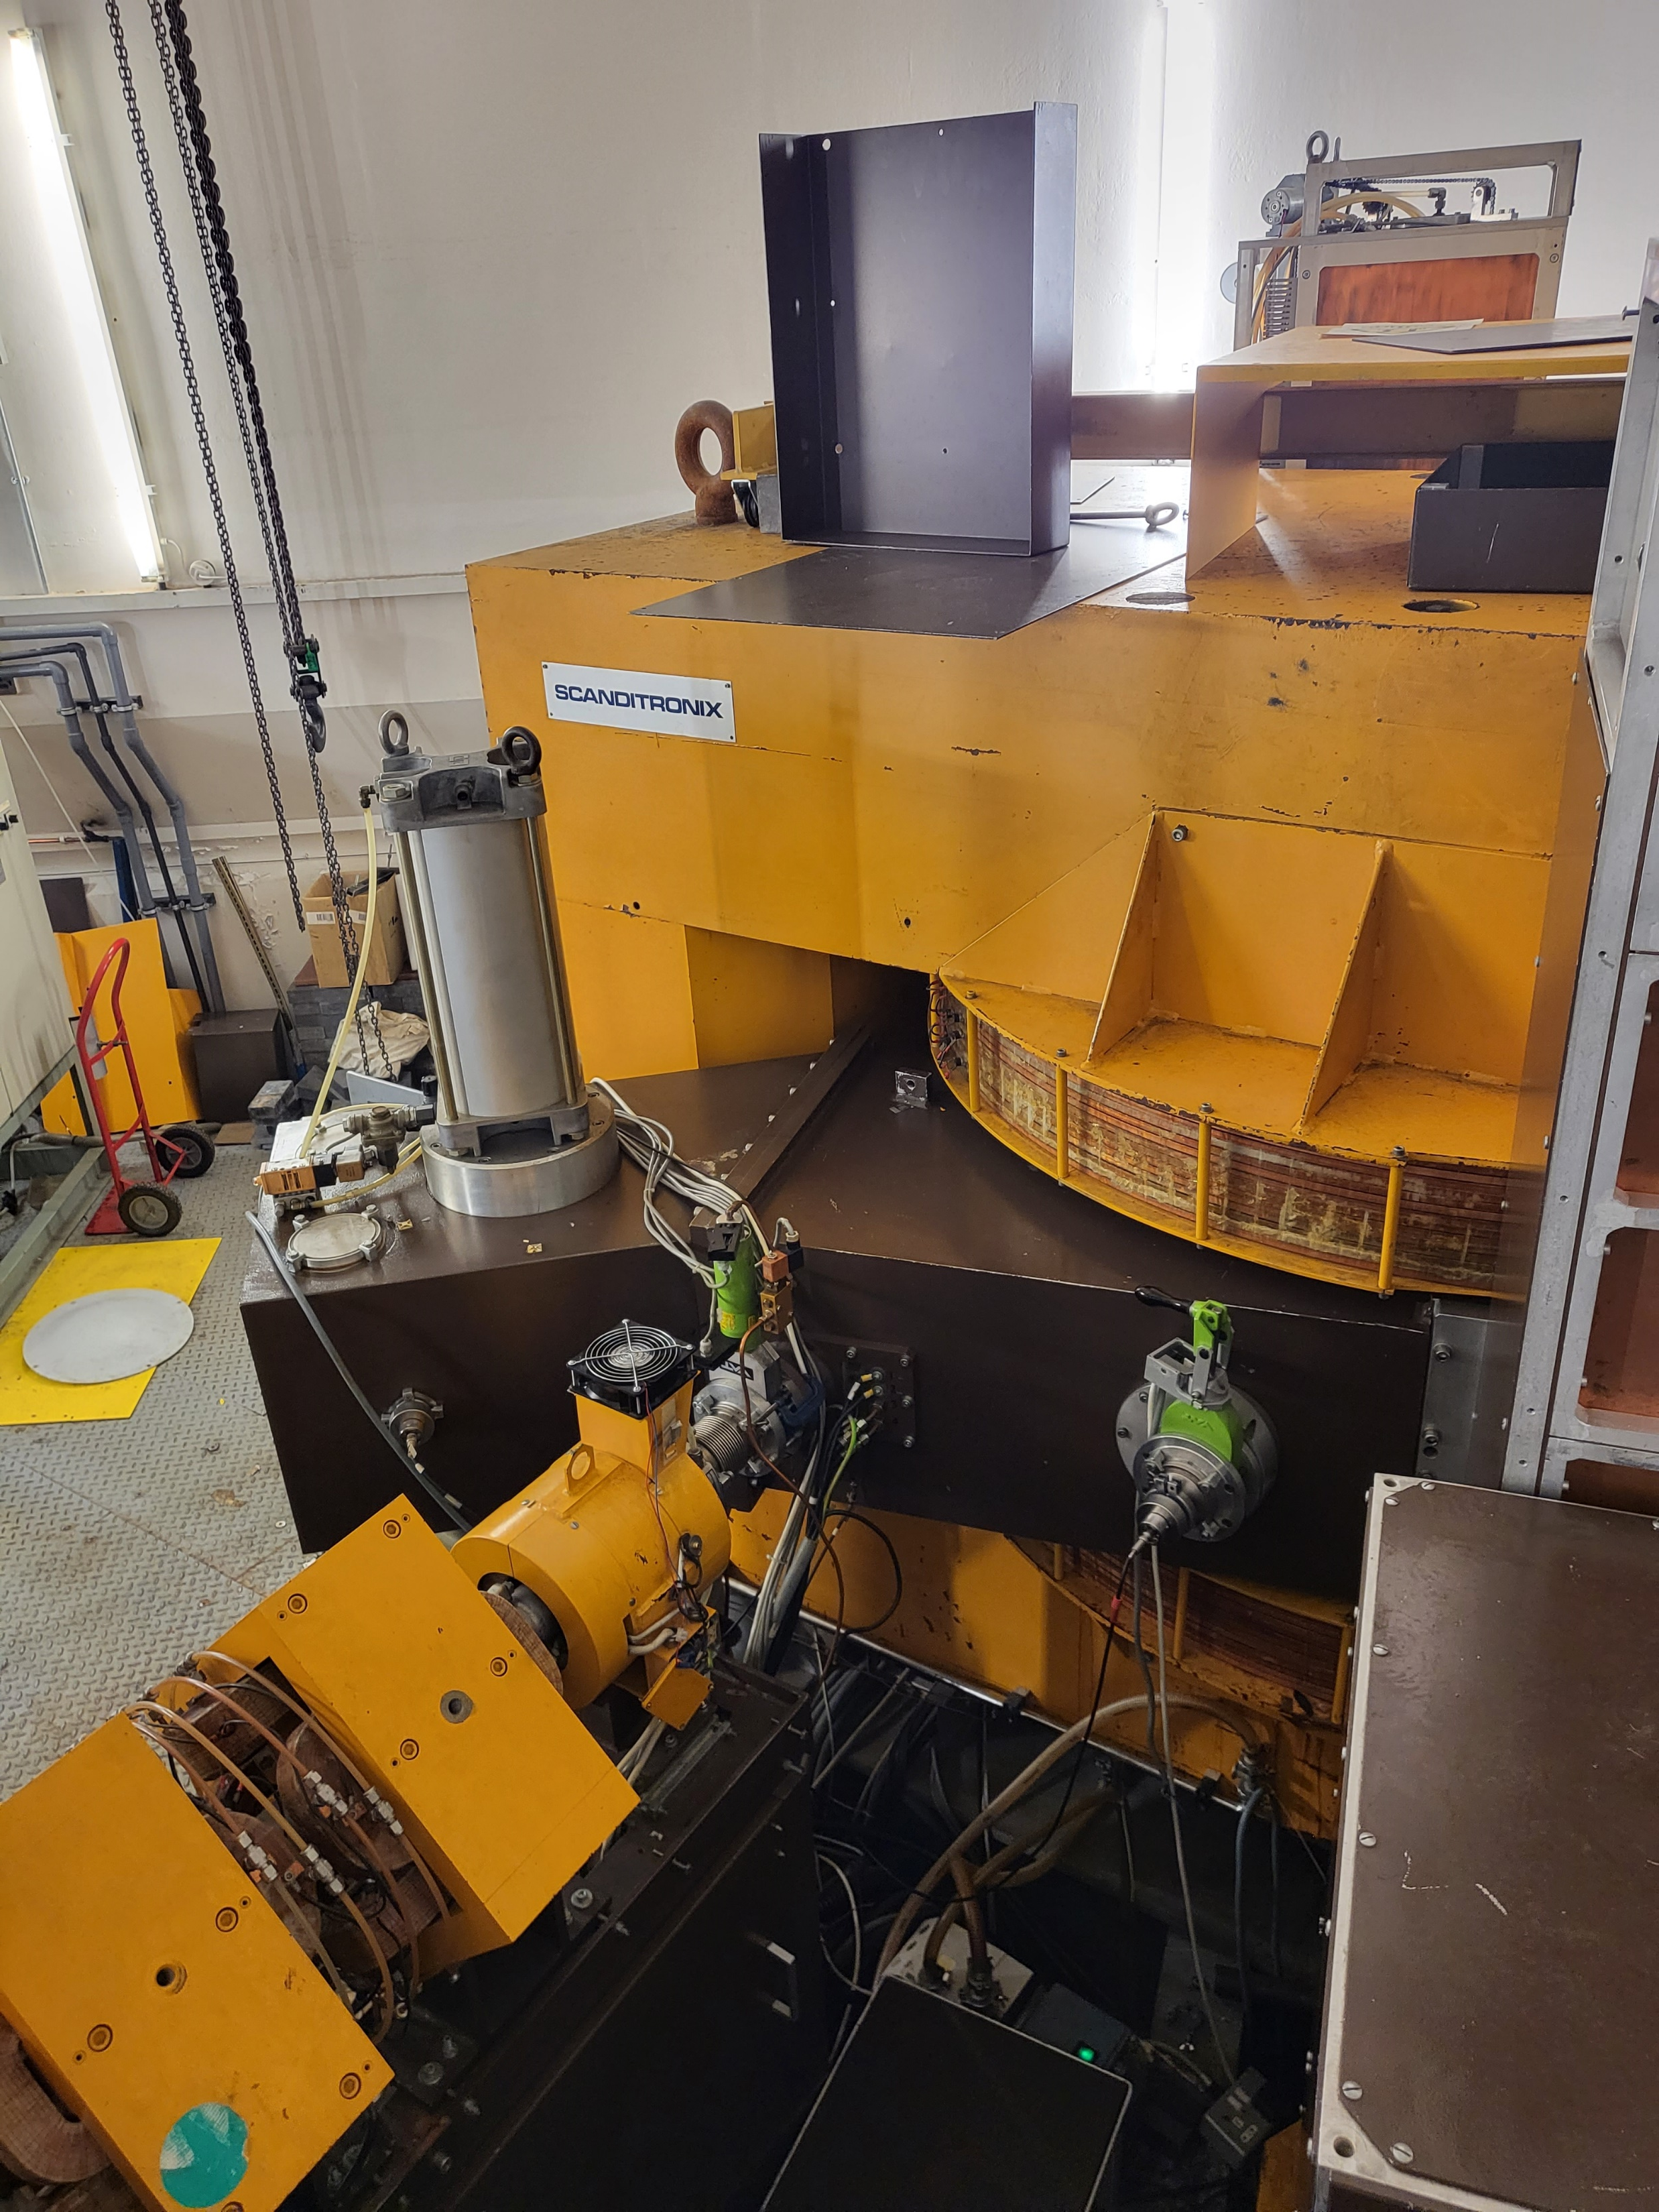
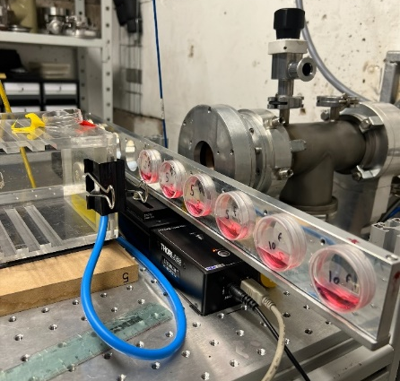
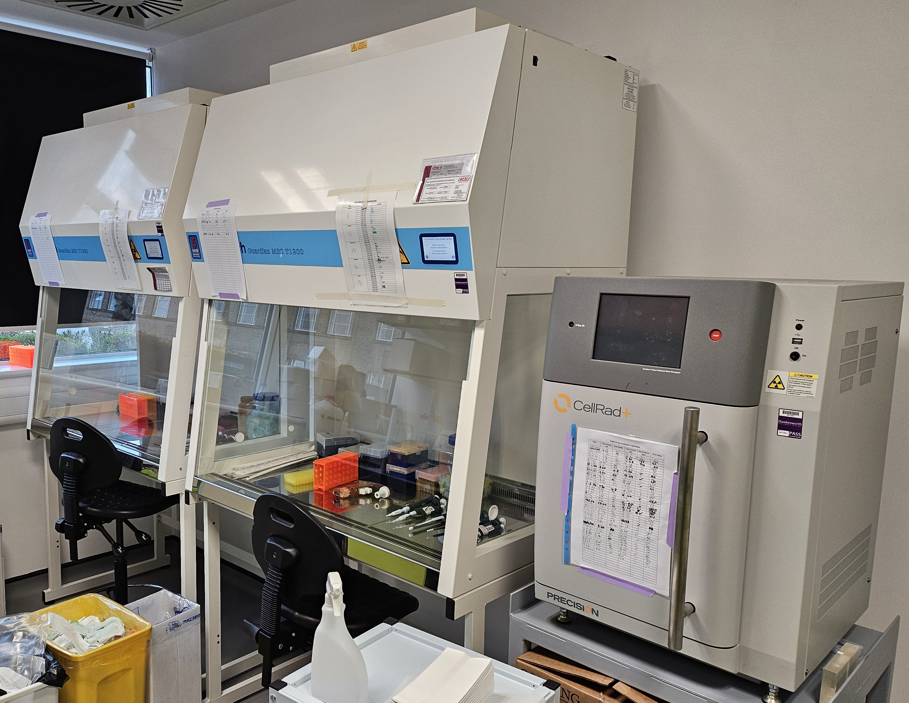
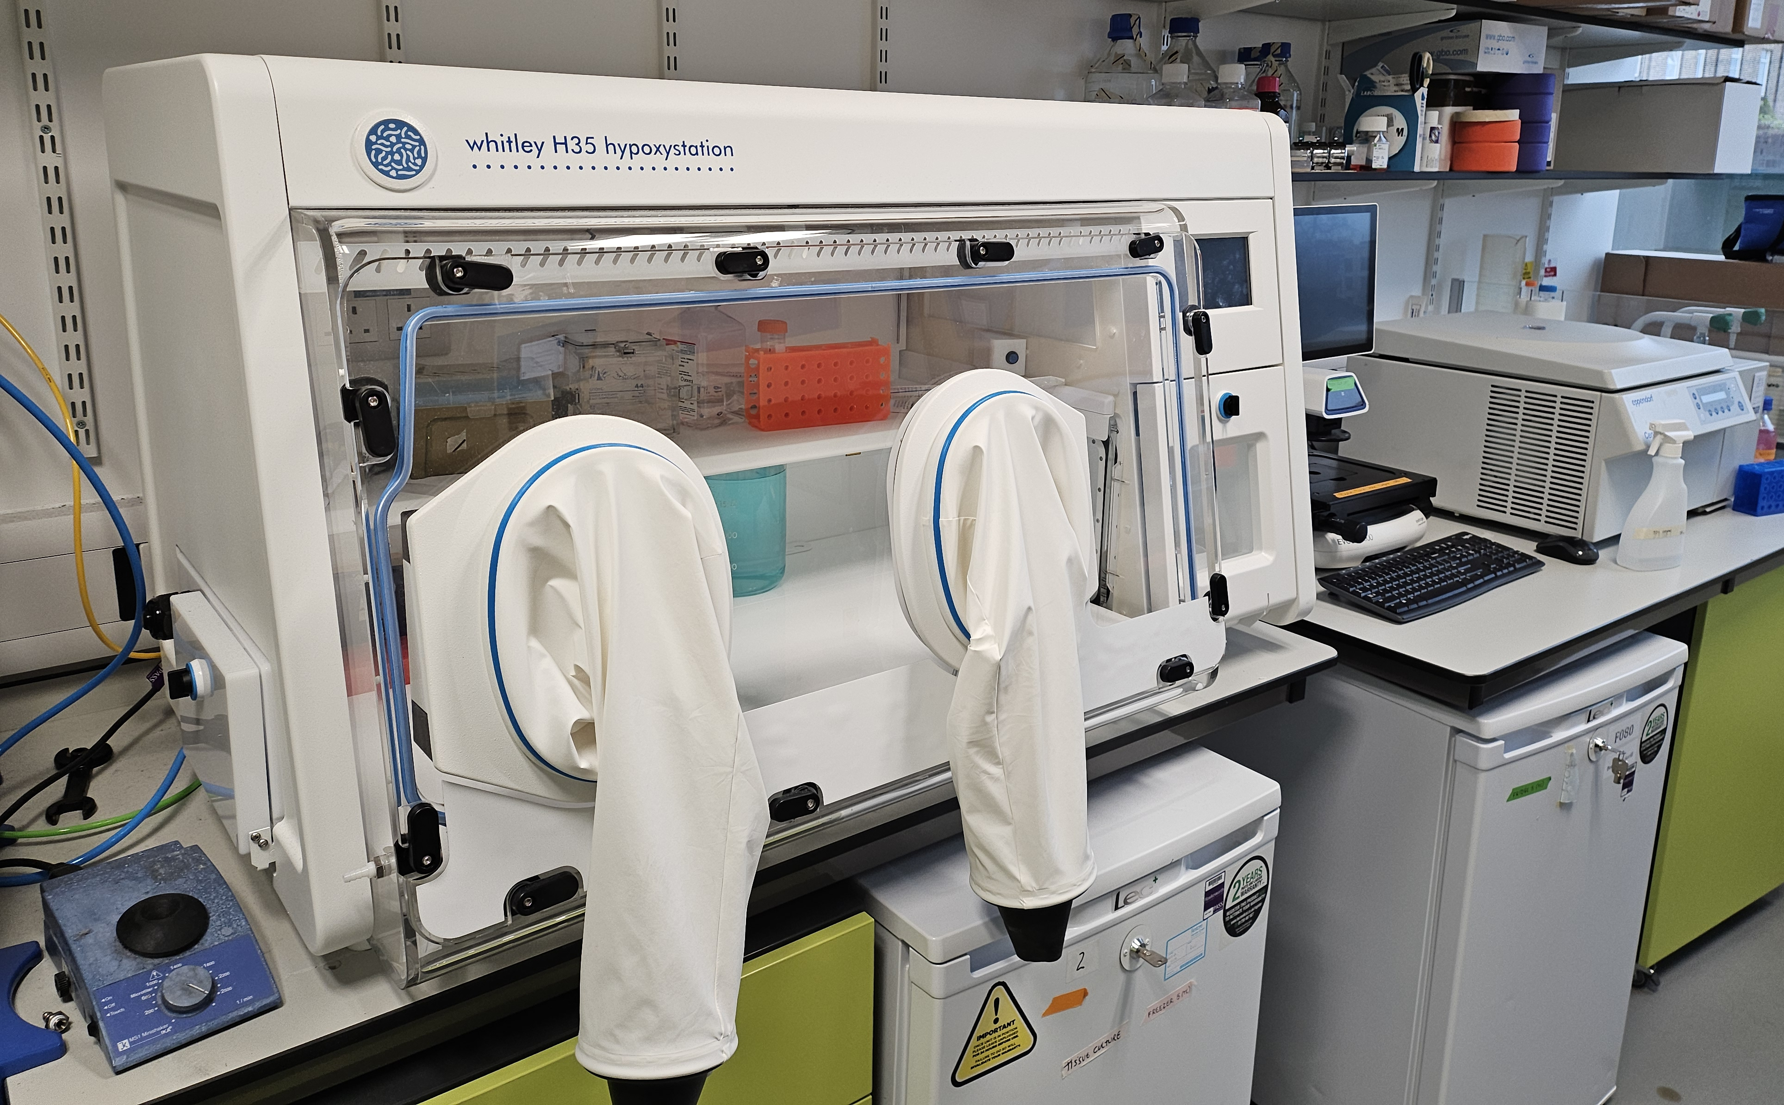
Unique national resources in Birmingham for radiobiology research
High flux accelerator-driven neutron source
Boron neutron capture therapy (BNCT)
MC-40 cyclotron
Protons and particle ions in different spatial (SFRT) and temporal (FLASH) configurations
Routinely accessible.
Dedicated for research.
High throughput and flexible.
  Radiobiology facilities in ICGS and EPS
  150 kV X-ray irradiator, 2x hypoxia workstations, cell and molecular biology capabilities

Slide 3
  Radiobiological characterisation of the MC-40 cyclotron at the University of Birmingham
  Fabbrizi et al., (in preparation)

Slide 4
  Radiobiological characterisation of the 60 MeV cyclotron at the Clatterbridge Cancer Centre
  UMSCC74A
  p<0.02; RBE=1.7
Alkaline (SSB)
  UMSCC74A
160
Enzyme-modified (DSB+CDD)
140
*
****
*
120
100
***
CDD
80
**
*
  UMSCC6
60
***
**
  p<0.01; RBE=1.9
40
20
0
  *p<0.005, **p<0.002, ***p<0.001
  *p<0.02, **p<0.01, ***p<0.005, ****p<0.001
  58 MeV (1 keV/μm); 11 MeV (12 keV/μm)
  Carter et al., (2018) Int J Rad Oncol Biol Phys
  Carter et al., (2019) Int J Rad Oncol Biol Phys
  Fabbrizi et al., (2021) Methods Protoc

Slide 5
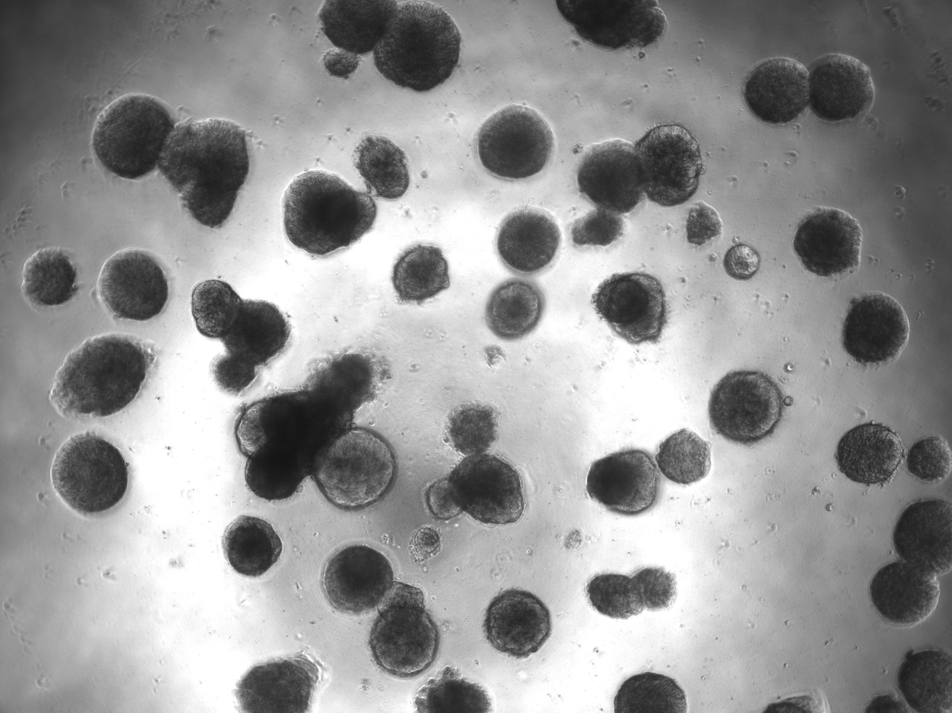
FLASH protons produce cell sparing effects
FLASH
CONV
*
Normoxia
Hypoxia (1 %)
FLASH
21 % O₂
CONV
21 % O₂
FLASH
1 % O₂
CONV
1 % O₂
C
*
Cont
21 % O₂
Cont
1 % O₂
FLASH
21 % O₂
FLASH
1 % O₂
CONV
21 % O₂
CONV
1 % O₂
Cont
21 % O₂
Cont
1 % O₂
FLASH
21 % O₂
FLASH
1 % O₂
CONV
21 % O₂
CONV
1 % O₂
  Hughes et al., (in preparation)

Slide 6
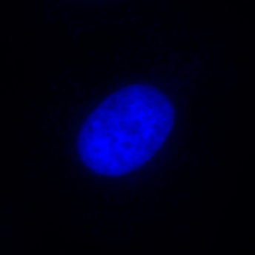
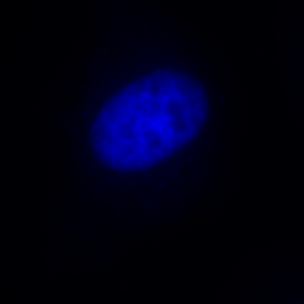
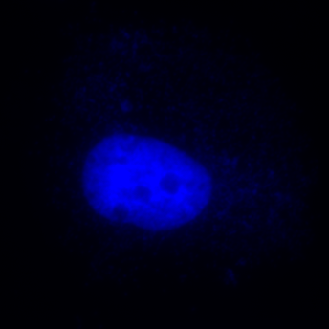
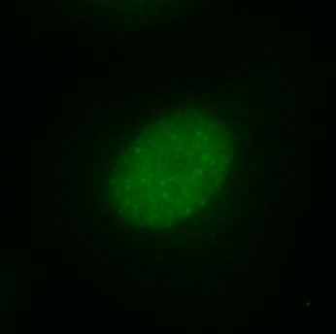
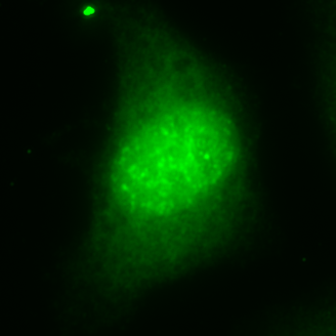
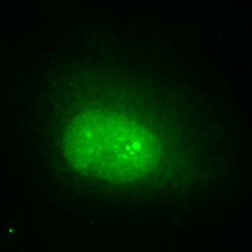
Identifying novel targets for radiosensitisation in combination with PBT
FaDu
A253
11 MeV
11 MeV
*
***
11 MeV
11 MeV
DMSO
DMSO
****
ATMi
DNA-Pkcsi+IR
**
DMSO+IR
DMSO
FaDu
ATMi+IR
DNA-Pkcsi+IR
  Carter et al., (2019) Int J Rad Oncol Biol Phys
  Vitti et al., (2020) Cancers
  Nickson et al., (2021) Front Oncol
  Zhou et al., (2022) Front Oncol
  Fabbrizi et al., (2024) Cell Death Dis
  Fabbrizi et al., (2024) Cell Death Discov
PDD00017273
Control
11 MeV
58 MeV

Slide 7
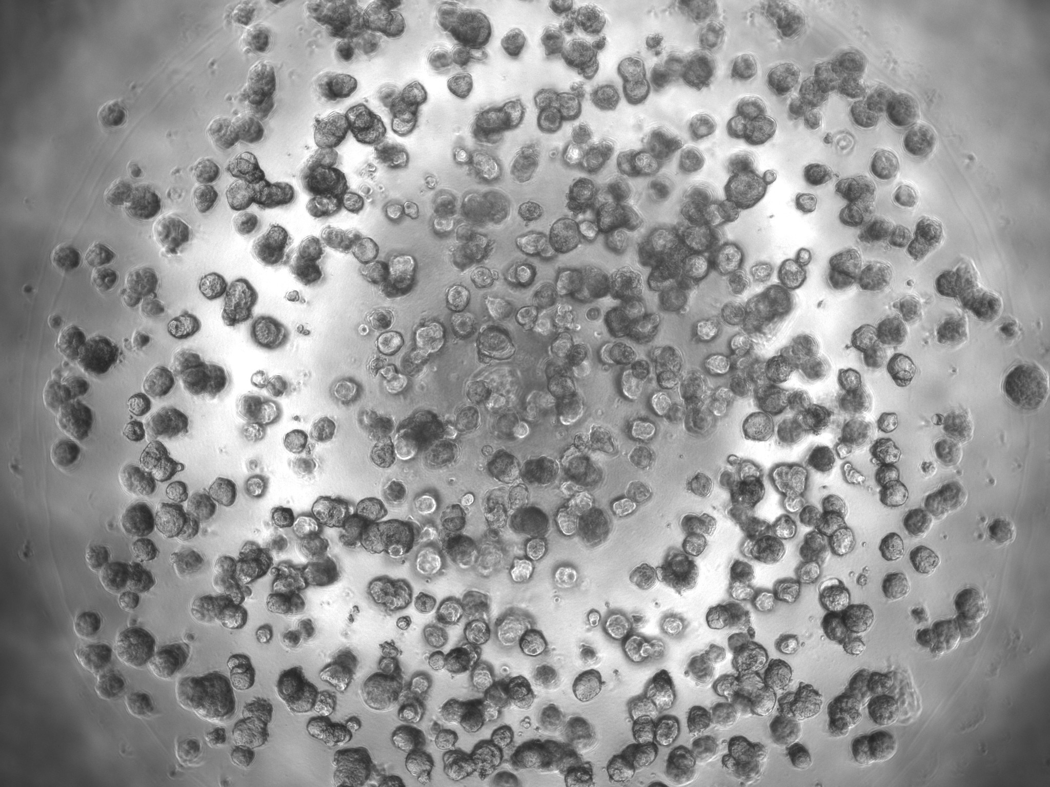
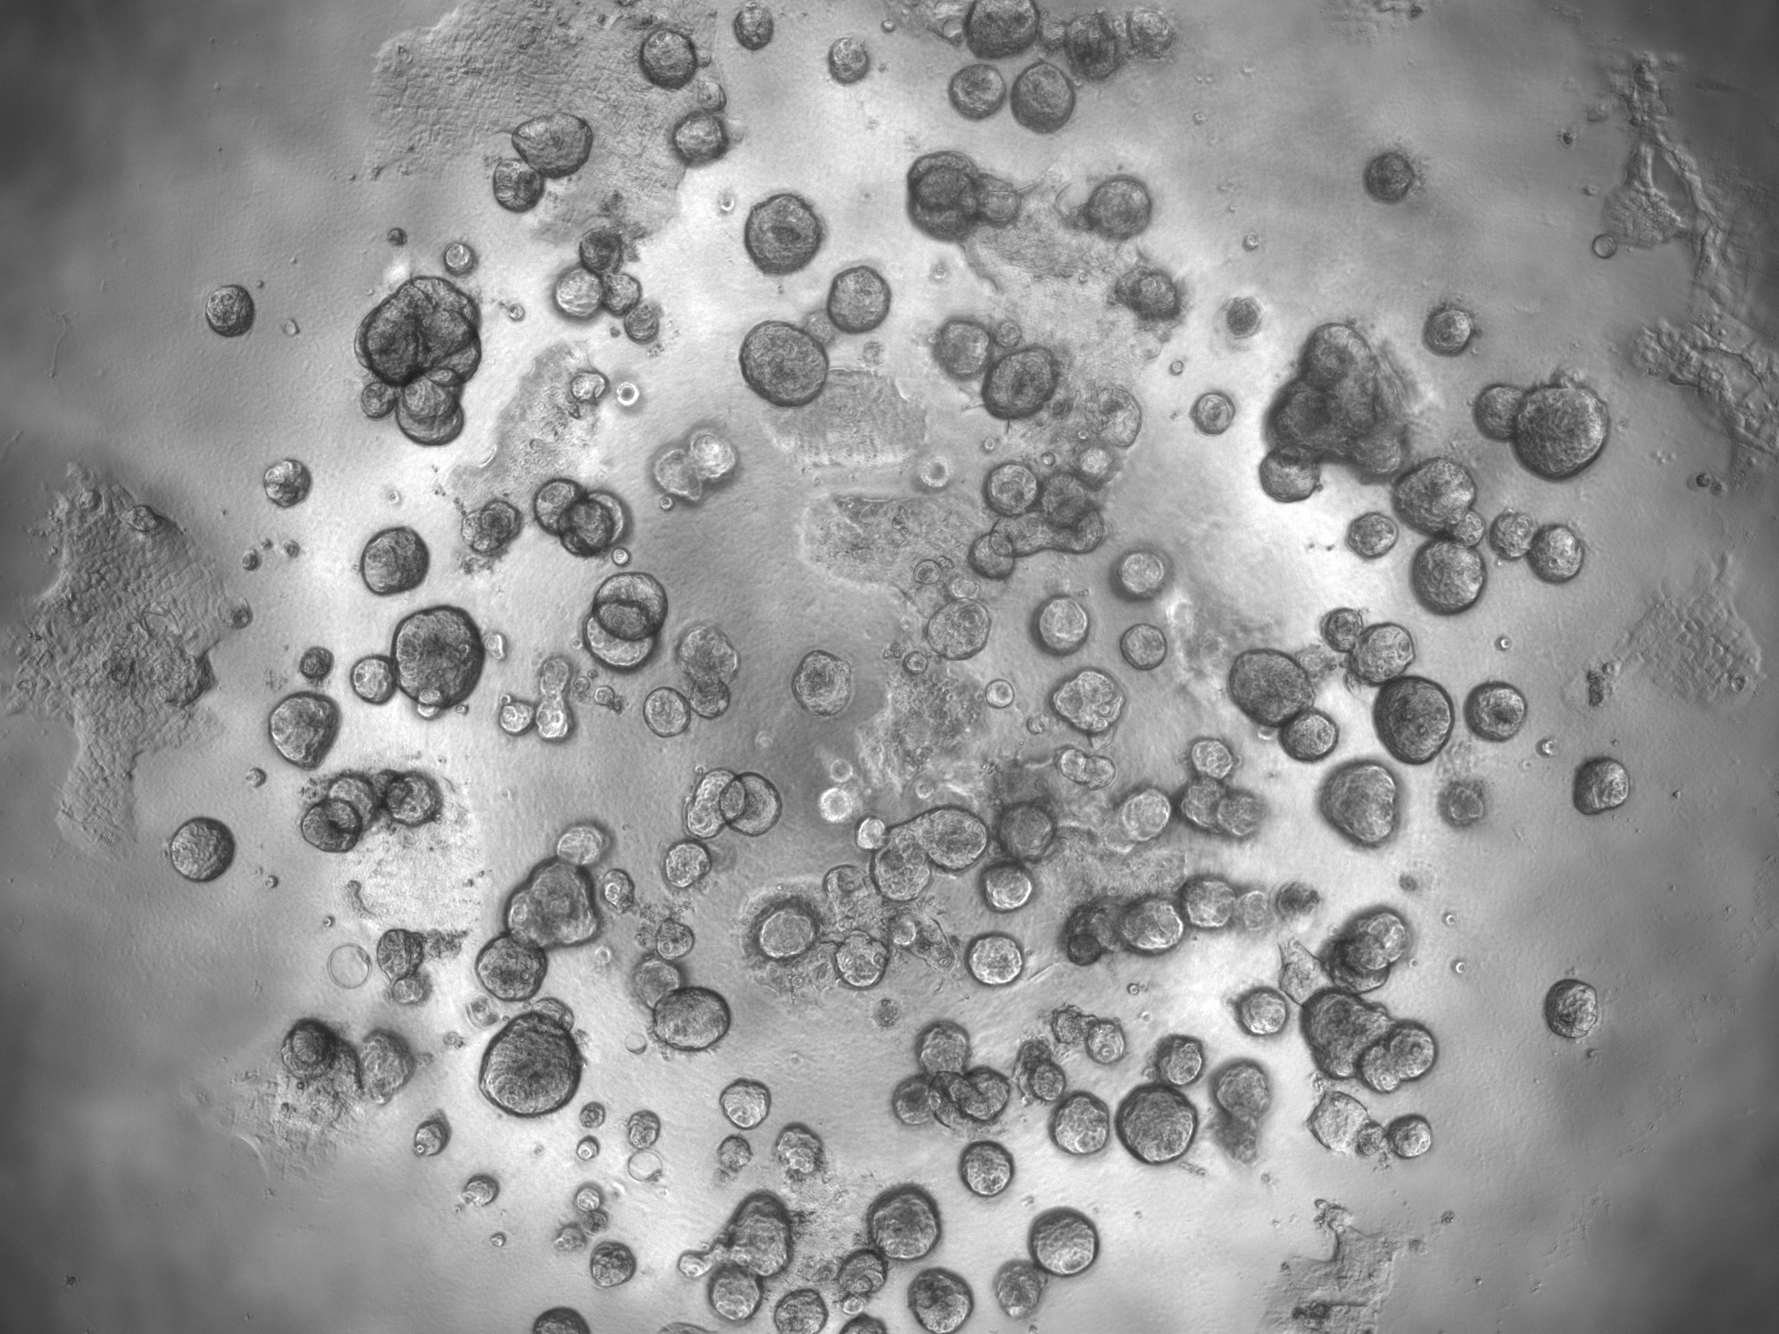
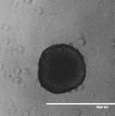
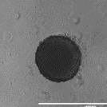
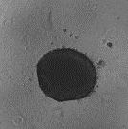
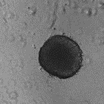
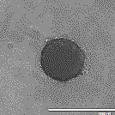
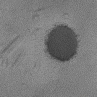
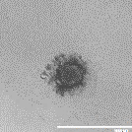
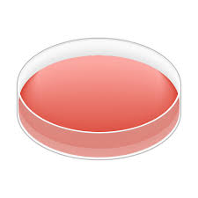
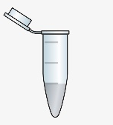
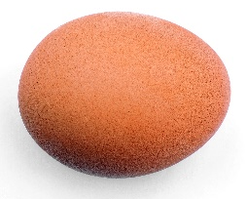
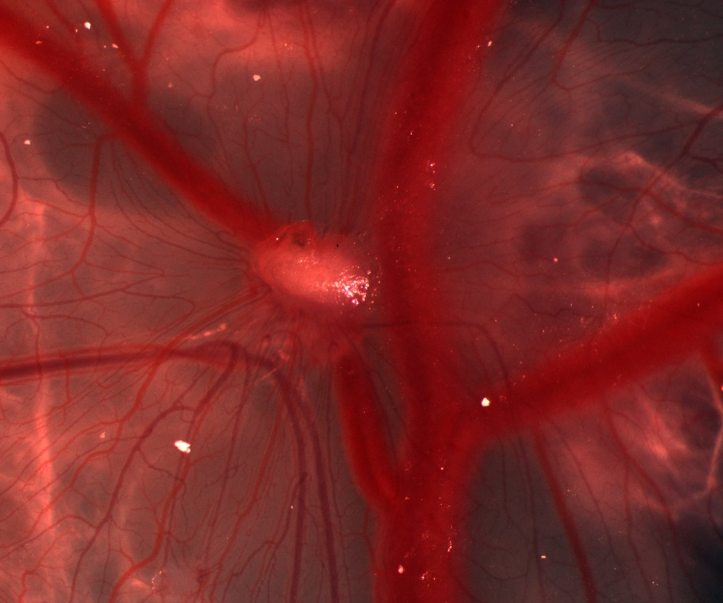
Models for radiobiology research
  Cell lines grown in 2D and 3D (spheroids)
  Patient-derived organoids
HNC-1
HNC-2
DMSO
ATMi
ATRi
DNA-Pkcsi
Inhibitor only
DMSO
Inhibitor-1
Inhibitor-2
Inhibi+IR
Day 0
Day 3
Day 7
Day 10
Day 11
Day 14
Window
Implant cells
Drug
Irradiate
Dissect
  Chick embryo tumour model

Slide 8
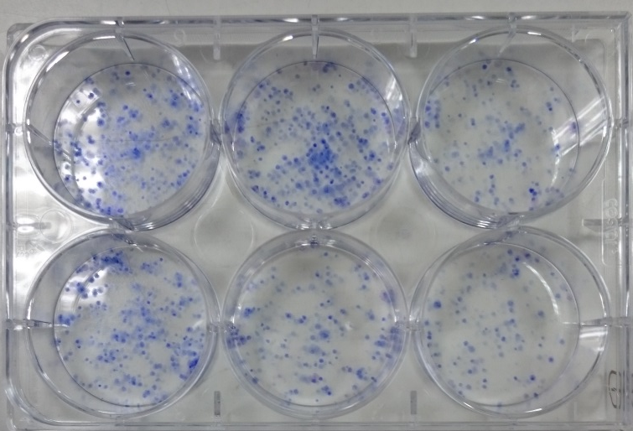
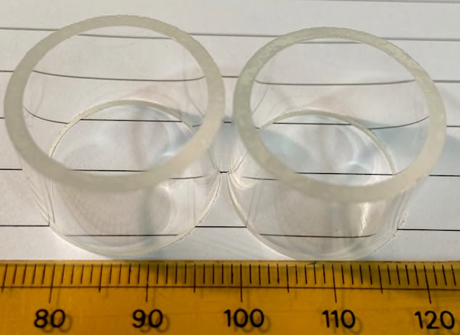
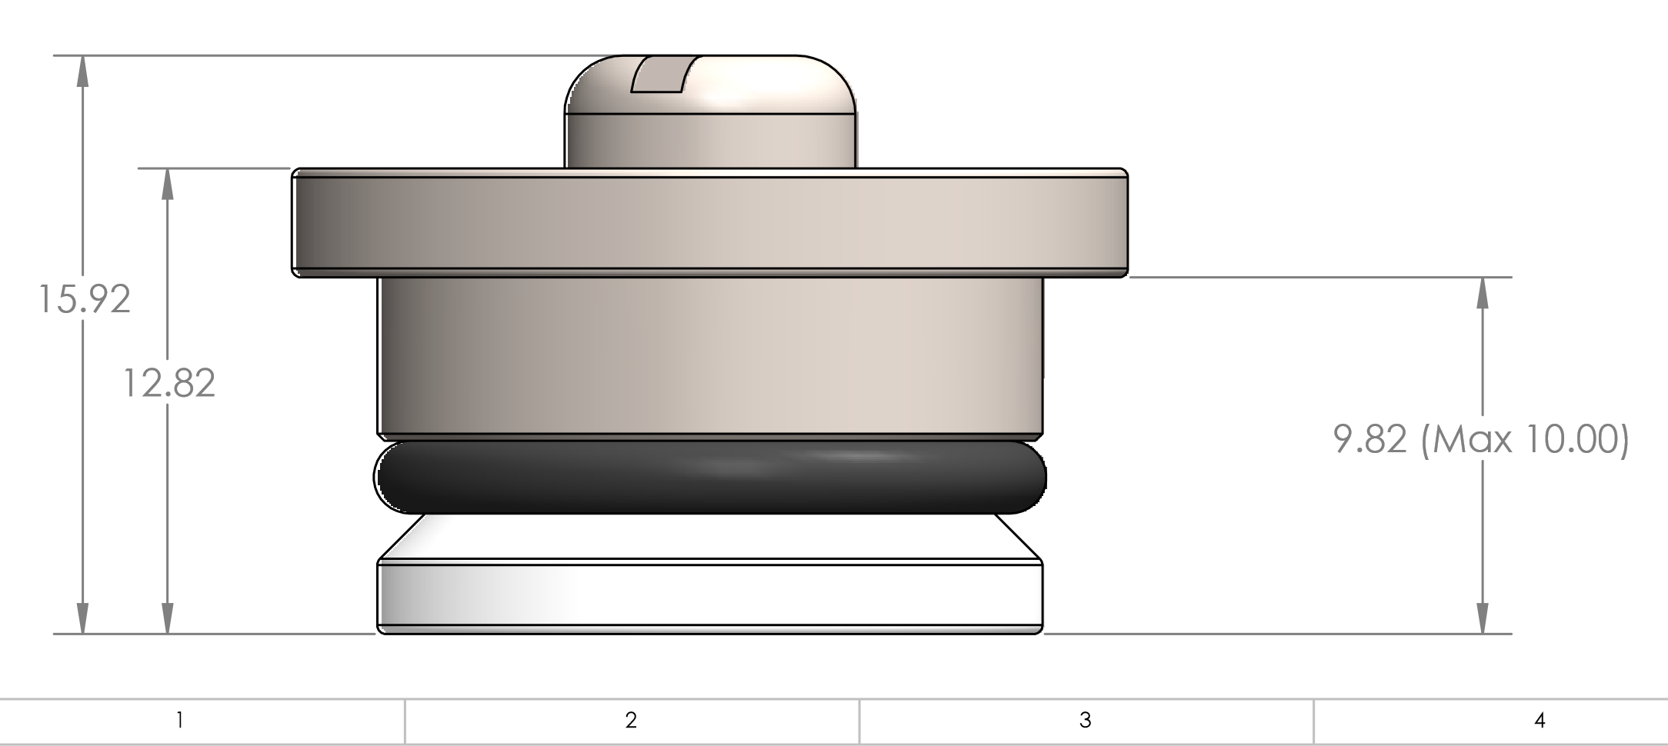
Initial radiobiology experiments at SCAPA
Clonogenic assays (gold standard in radiobiology)
~10 MeV – grow cells on 2.5 µM Mylar in glass rings
Internal diameter – 18.5 mm
Outer diameter – 22.5 mm
Utilise several cancer (HeLa and HNSCC/GBM) and normal cell lines.
Irradiate at multiple doses (0-8 Gy, plus 15 Gy), most likely at a single shot (to achieve highest dose rate; ~10⁹ Gy/s).
Need at least 3 independent biological repeats.

Slide 9
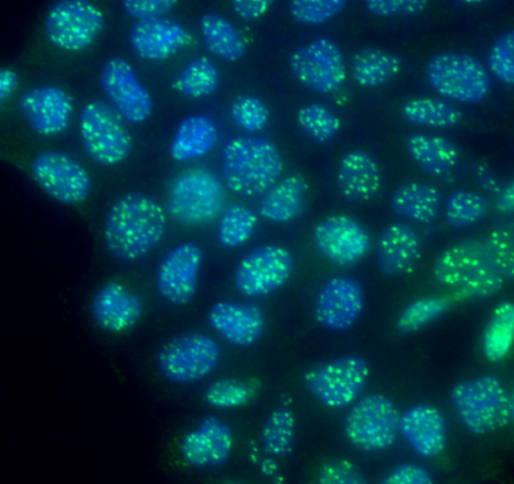
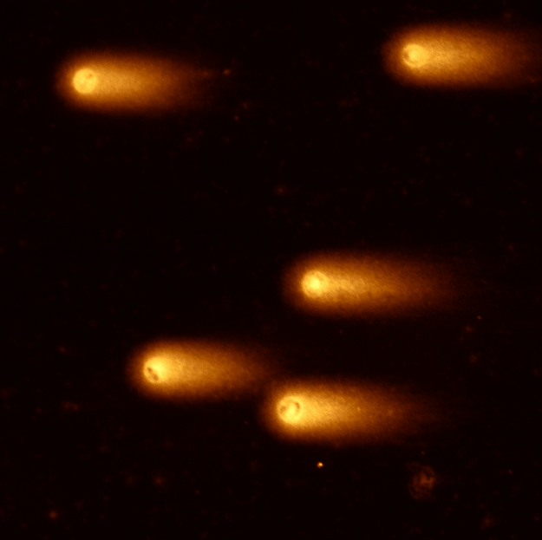
Initial radiobiology experiments at SCAPA
DNA repair foci analysis (usually done on 0.1 mm glass coverslips within dishes/plates).
Likely can grow and stain cells on Mylar.
Again, need to utilise several cancer and normal cell lines, irradiating at multiple doses and at least 3 independent biological repeats.
Need to analyse foci at several different time points (1-24 h) but samples can be fixed and processed off site.
DNA repair analysis using comet assays.
Lot of sample processing required – cells placed on microscope slides, lysed, and electrophoresed post-irradiation (after 1-24 h repair time).

Slide 10
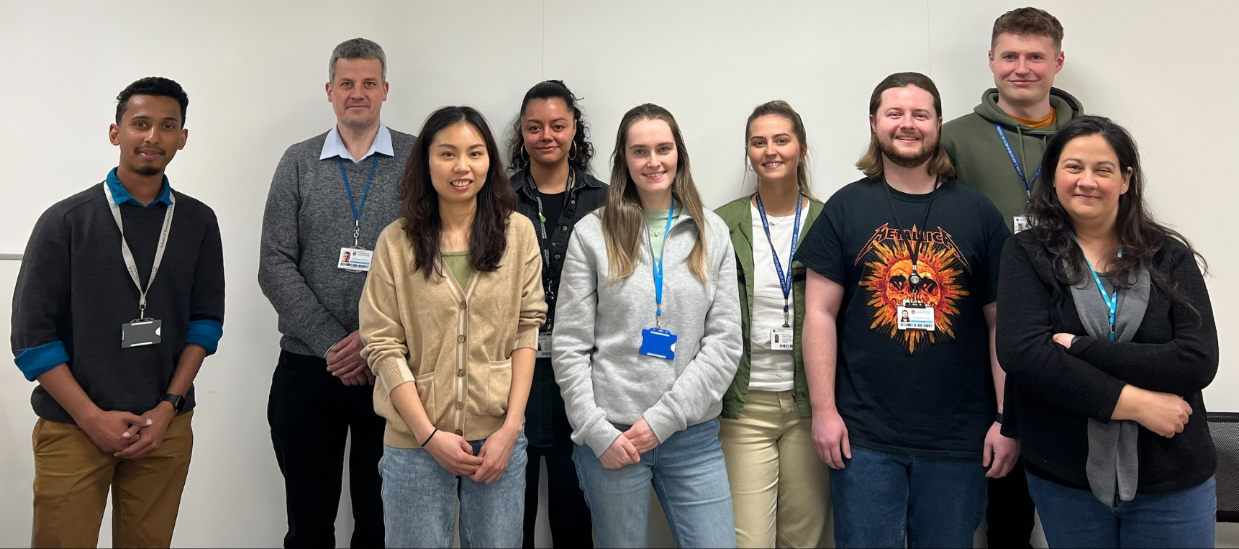




Acknowledgements
Parsons Group
Rachel Carter
Katie Nickson
Terpsi Vitti
Maria Rita Fabbrizi
Jonathan Hughes
Alice Ormrod
Chun Li
Lizzie Dufficy
Amalia Goula
Karthik Vaidya
Fouzia Zayou
George Duffield
Emma Melia
Leah Punshon
Laura Hawkins
Alex Bembridge
University of Birmingham
Stuart Green
Tzany Kokalova-Wheldon
Ben Phoenix
Tony Price
Hisham Mehanna
Colin Watts
Oxford Institute for Radiation Oncology
Imperial College London
Ken Long
Mark Hill
James Thompson
Kristoffer Petersson
AstraZeneca
Clatterbridge Cancer Centre
Stephen Durant
Alan Lau
Andrzej Kacperek
University of Liverpool
Thanks to
University of Glasgow
Anthony Chalmers
Mike Clague, Sylvie Urbe
Sonia Rocha, Terry Jones
Helen Bryant
Thomas Helleday

