Slide 1


LhARA bulk shielding assessment
James Bebbington, STFC
Notes:
This is a short summary of LhARA bulk shielding assessment, completed as part of WP6 to estimate the requirements for the shield wall thicknesses of the facility. This culminated in the publishing of the shielding design basis (which contains all of the key data, assumptions and acceptable criteria used in the assessment), the two bulk shielding assessments for stage 1 and 2 and my interpretation of these assessments, including identification of further work.

Slide 2
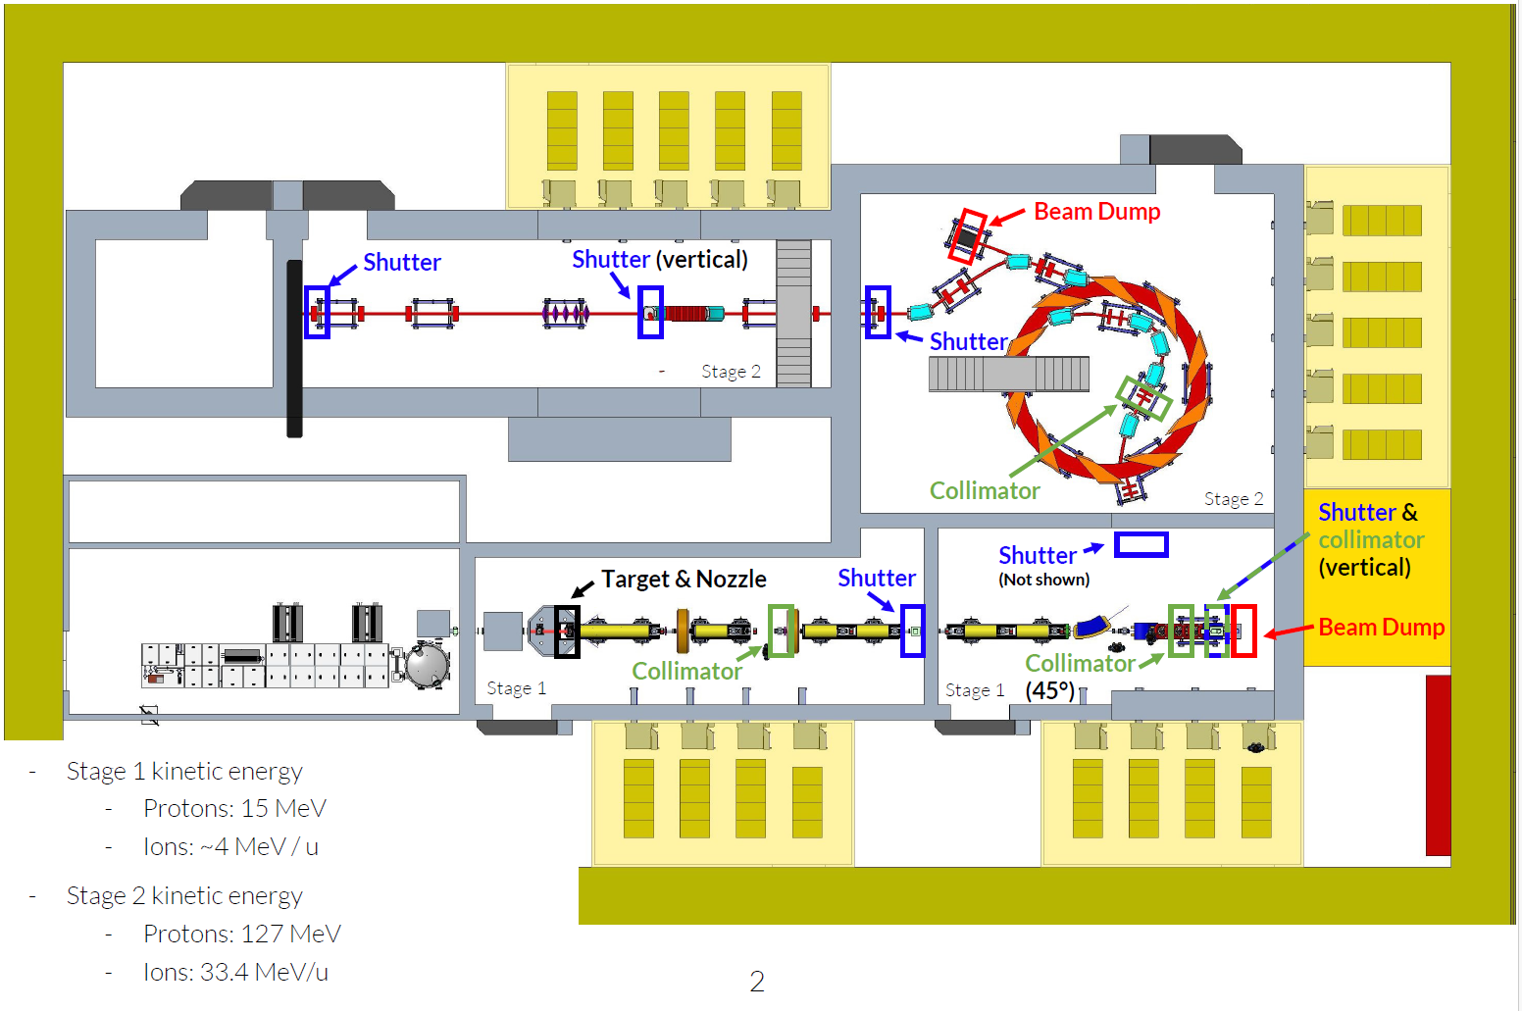
Stage 1
Stage 2
L
I
H
N
G
M
K
J
F
Source term
A
B
C
D
E
Next steps
Notes:
Firstly, we’ll look at the source term that was used for the assessments.
We’ll then look at the shielding requirements for Stage 1 and Stage 2 that have been calculated to satisfy acceptable dose rate criteria.
I’ll then conclude with some suggestions for future work to be taken forward into the next phase of design.

Slide 3
 | Proton beam energy (MeV) | Frequency (Hz) | Particles incident in final station (p/s)
Stage 1 (p) | 15 | 100 | 1E10
Stage 1 (C6+) | 48 |  | 1E9
Stage 2 (p) | 127 |  | 1E10
Stage 2(C6+) | 400 |  | 1E9
L
I
H
N
G
M
K
J
Source | Description
A | Proton/ion plasma source
B | Gabor lenses and collimator (source term exhibited by losses during this first stage of beam acceleration)
C | Source shutter (the shutter between the source stage and the stage 1 experiment)
D | In-vitro Stage 1 delivery (beam bending vertically up to delivery area)
E | Stage 1 beam dump
F | Injection line into FFA
G | FFA acceleration (source term exhibited by the acceleration mechanism of the FFA)
H | FFA extraction (the term attributed to the accelerated beam leaving the FFA)
I | FFA beam dump
J | FFA shutter
K | In-vitro Stage 2 delivery (beam diverted vertically upwards to the Stage 2 delivery area)
L | Stage 2 dump
M | Stage 2 shutter
N | In-vivo line (utilised for treatment in the final evolution of the accelerator)
F
A
B
C
D
E
Source term
Notes:
The assessment was divided up into the two operational stages, with Stage 2 incorporating the FFA onwards. The beam source term and source locations are displayed on the slide. The assessment then subdivided these stages into the individual rooms, since the plan is to commission equipment in individual rooms whilst the adjacent, subsequent room is being built.
Although the intention is to initially operate at 10 Hz repetition rate, the assessment used the 100 Hz figure, which is the ambition for LhARA in the future.
The energy spectrum of the source was conservatively simplified; understanding this in greater detail could reduce shielding thicknesses. However, the omission of the electron component of the source could act to increase the shielding requirement; these should both be addressed.

Slide 4
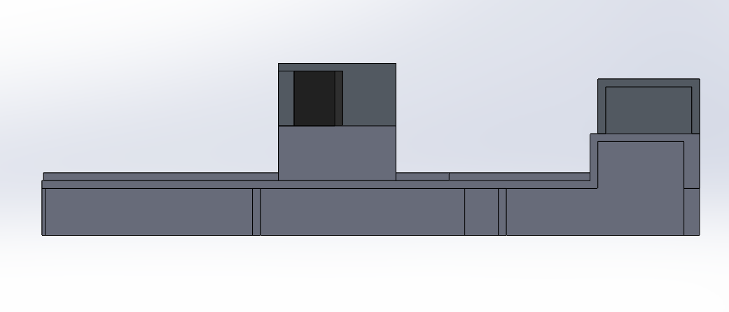
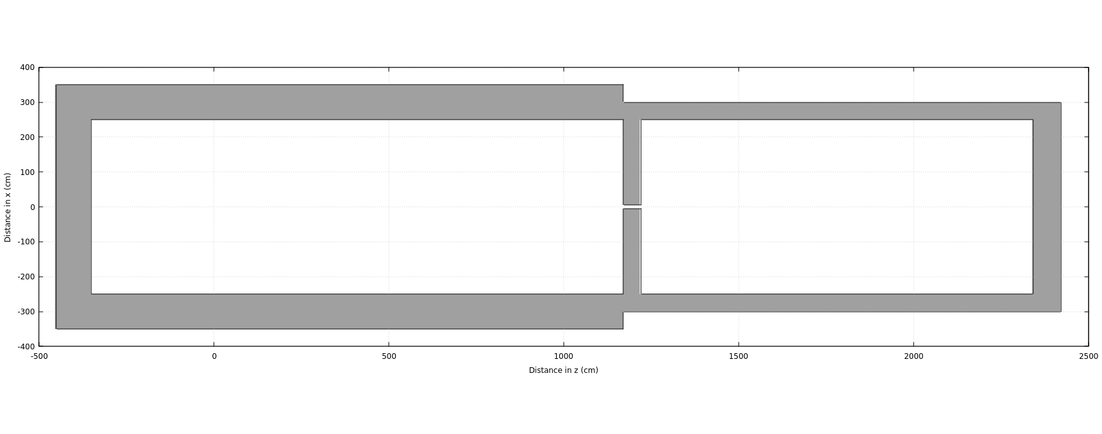
Stage 1
1 m
50 cm
A
Stage 1a
B
C
D
E
Stage 1b
2.5 m
Target A
Target B
50 cm
1 m
Target D
10 cm diameter (opening for beam)
80 cm
7 m
11.7 m
9.4 m
1.8 m
Notes:
Stage 1 is defined as the sources up to the FFA, displayed in the slide here. It incorporates the initial source, the acceleration provided by the Gabor lens and includes the first stage in-vitro beam dump.
Here, the requirements are driven mainly by the source, in Stage 1a, with 1 m of concrete surrounding this substage and 50/80 cm around Stage 1b. A refinement of the source spectrum and an understanding of the electron term have competing influences over this initial requirement; it is expected that the spectrum will lessen the shielding thicknesses, but the electron term could increase this.
However, the outcome of the assessment is not too dissimilar to the initial prediction of 50 cm.

Slide 5
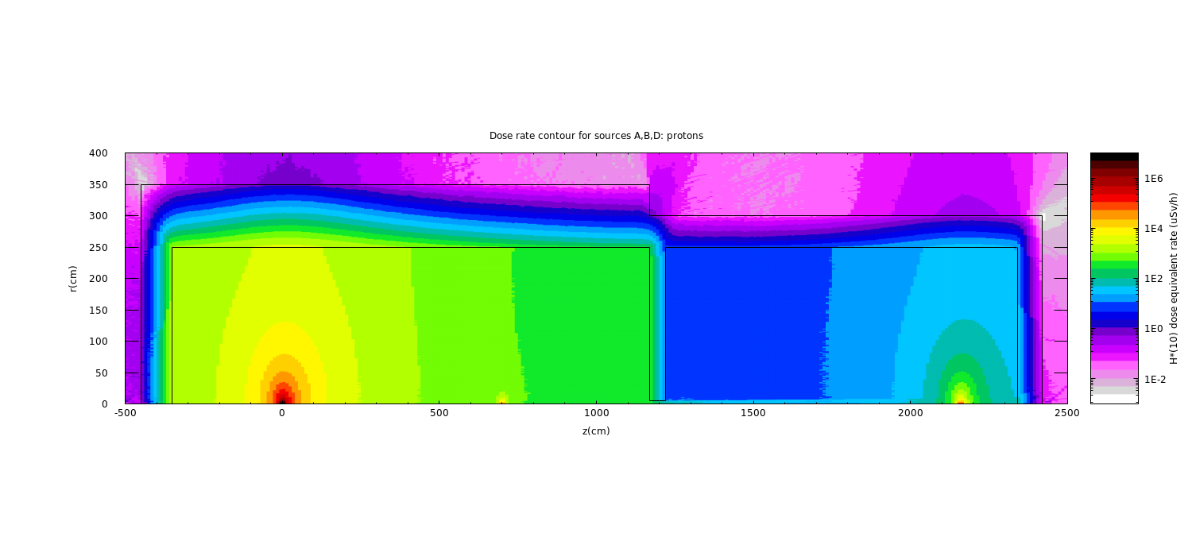
Stage 1
Notes:
Dose rate contour maps are also available.
This demonstrates the influence of all three ground floor sources within Stage 1 – clearly showing that the initial source is the overriding factor on the shielding requirements.

Slide 6
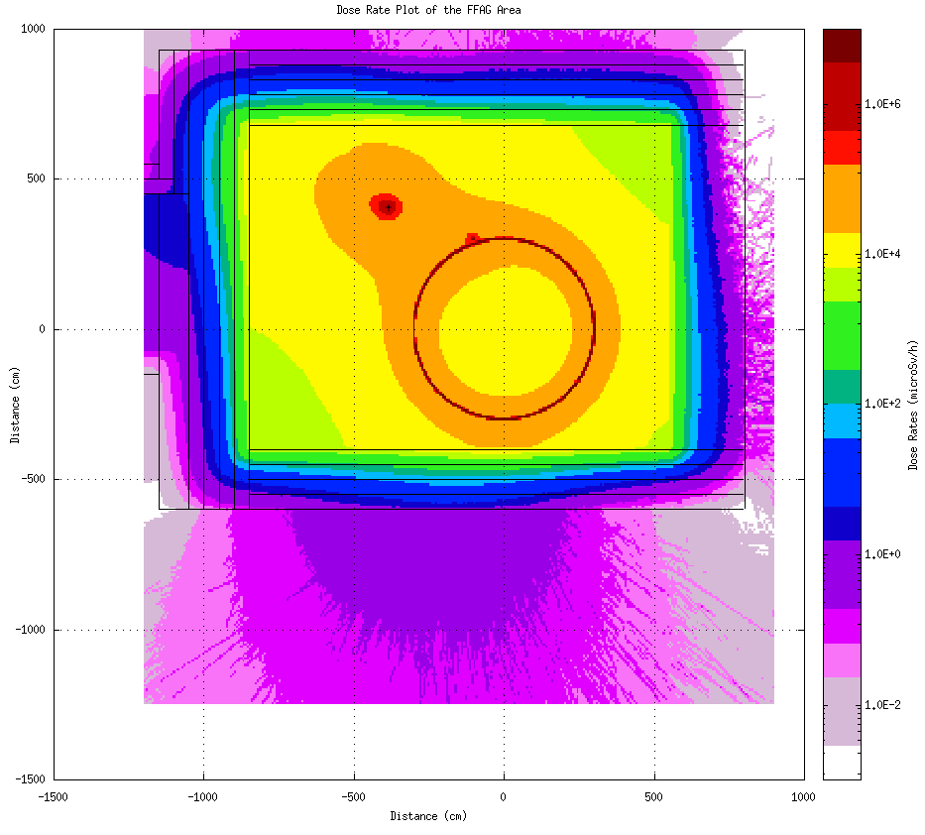
Stage 2
L
I
H
N
G
M
K
J
Notes:
Stage 2 incorporates the acceleration provided by the FFA – the shielding requirements are therefore much more demanding and in the current stage of design, are much more demanding than initially predicted.
Within the area housing the FFA, concrete wall thicknesses range from 200-300 cm. These are largely driven by the FFA beam dump, which was modelled as a copper target for the purpose of this early design stage assessment. However, as can be seen from the contour plot, the FFA itself is also driving the E/S walls of the facility.
Simplistic, conservative modelling of the FFA (surrounded by a copper target) and its beam dump (as a copper target) can be refined in the next stage of design to assist in reducing bulk shield wall thicknesses, e.g. a layered, more complex beam dump design could be capable of taking the pressure of the bulk shield wall.
To maintain an occupied lab space on the roof above the FFA, the roof is also required to be 250 cm thick. This can obviously be reduced if the roof space is not accessible.

Slide 7
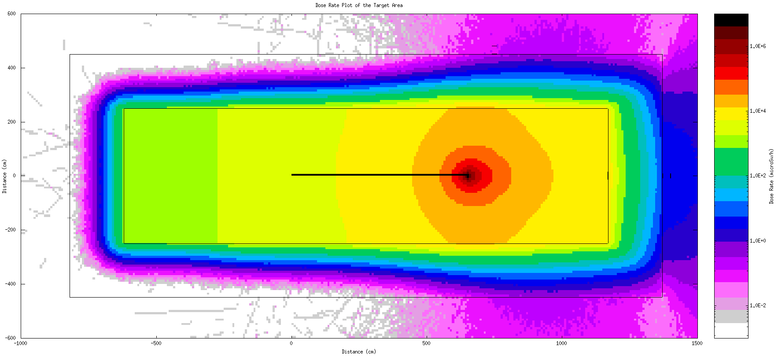
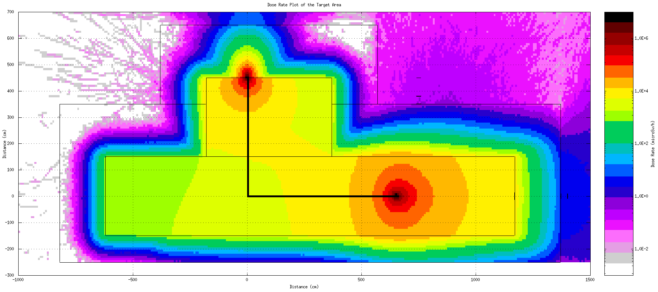
Stage 2
L
I
H
N
G
M
K
J
Notes:
An elevation and plan view of the next operational room of the facility, with sources K and L active, where, again, shielding thicknesses of between 200-300 cm are required to keep accessible dose rates within the acceptable criteria. Note this is not an accurate representation of the beam path, but both sources acting simultaneously. (A minor conservatism given that the additive effect of the dose rates does not appear to be influencing any shield wall thickness, they are driven by the sources independently).
Again, a review of accessible areas would help to reduce the shielding requirements here.

Slide 8
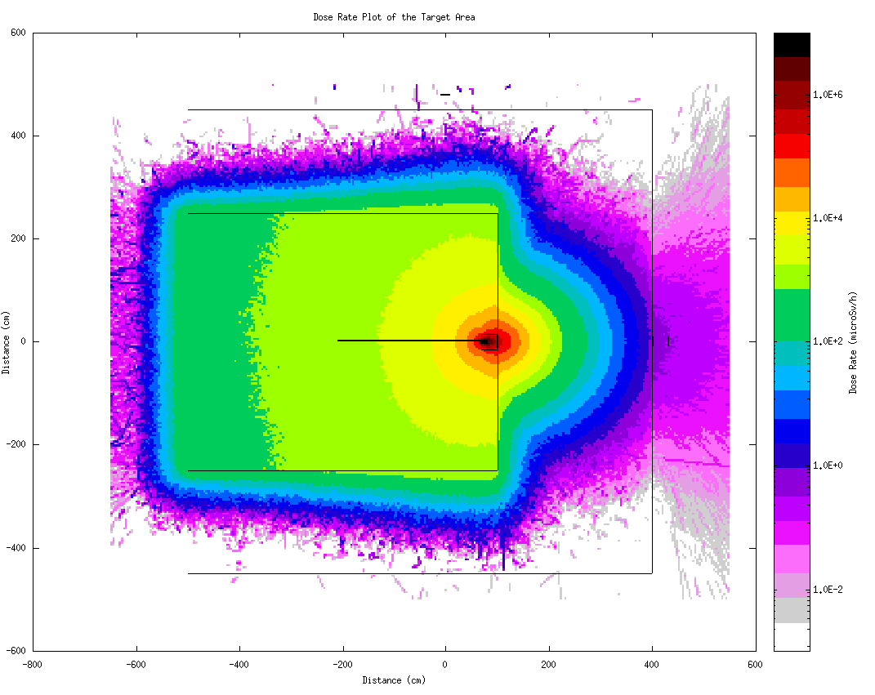
Stage 2
L
I
H
N
G
M
K
J
Notes:
The shielding requirements for the end station (location N) are also representative of the in-vitro station on the roof.
150 cm walls either side do not have much room for reduction, however, the 300 cm wall behind the source will benefit greatly from a properly designed beam dump.

Slide 9
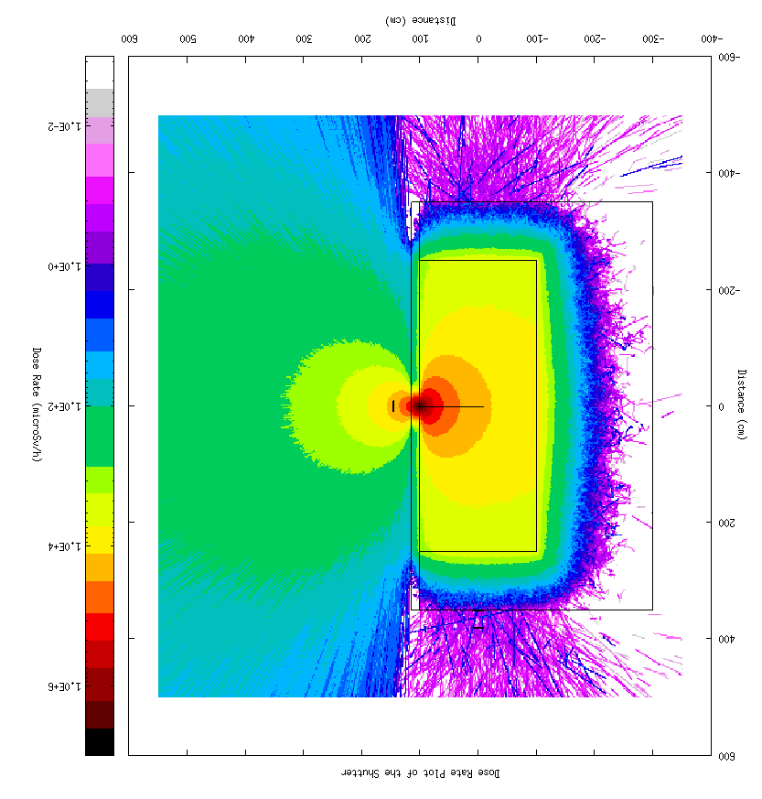
Stage 2
L
I
H
N
G
M
K
J
Notes:
Finally, an assessment of a reduced 10 Hz beam incident on a tungsten shutter has led to attenuated dose rates of ~ 100 mSv/h; clearly unacceptable. This introduces difficulties in the flexible method of construction/operation, where access into adjacent areas is desirable whilst beam is being received in the prior room.
If this is still desired, a shielded hutch for the shutter should be designed to reduce these dose rates to within the acceptable dose rate criteria.

Slide 10
Refine source data (electron source not currently accounted for and spectrum may be pessimistic).
Focus the design of dedicated beam dumps and local shielding to reduce some concrete thicknesses (300 cm in some areas).
Review access requirements on roof of Stage 2.
Design shielded shutters; the tungsten shutter alone is not enough to attenuate a 10 Hz beam to allow access into adjacent areas.
Still need to carry out fault scenario and activation analysis.
L
I
H
N
G
M
K
J
F
A
B
C
D
E
Next steps
Notes:
Pointers for further work in the next phase of facility design.

