Slide 1

Radiation from a plasma undulator based on a plasma wakefield
Claudia Cobo, Louis Forrester, Adam Hughes, Runfeng Luo and Zulfikar Najmudin
CLARA User Meeting
3rd December 2024

Slide 2
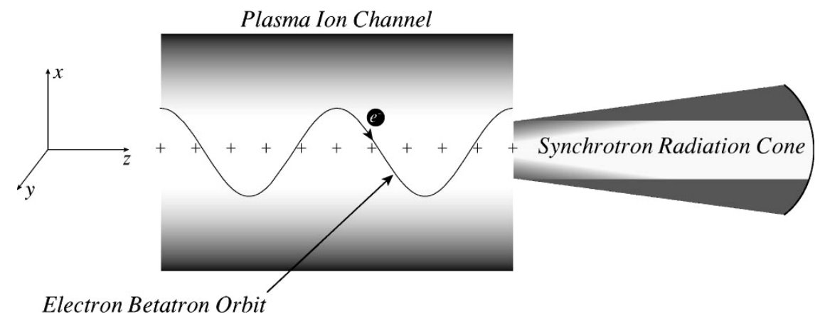
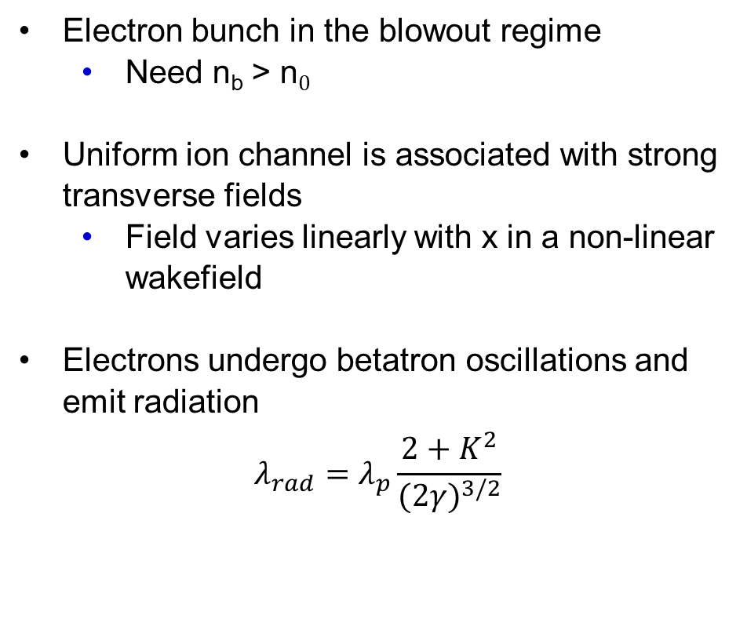
Introduction
Electron bunch in the blowout regime
        Need n_{b} > n$0$
Uniform ion channel is associated with strong transverse fields
        Field varies linearly with x in a non-linear wakefield
Electrons undergo betatron oscillations and emit radiation
$$λ_{rad}=λ_{p}\frac{2+K^{2}}{{(2γ)}^{3/2}}$$
E. Esarey et al. Phys. Rev. E 65 056505 (2002)
Claudia Cobo c.cobo@imperial.ac.uk 4th CLARA User Meeting
Notes:
NL regime – field varies linearly with x

Slide 3
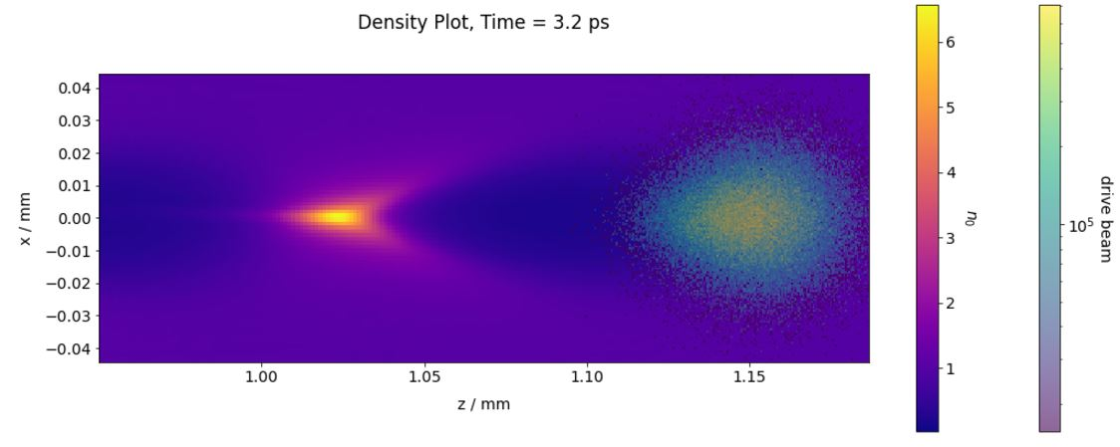
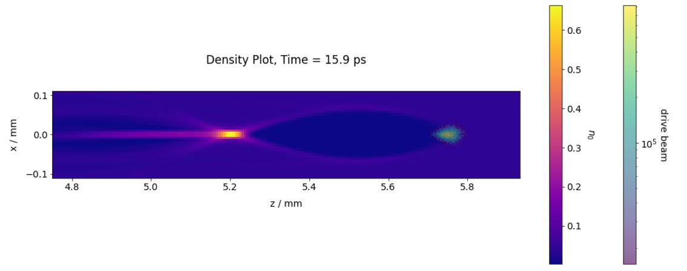
Plasma Undulator
Simulations by R. Luo
n₀ = 5×10²² m⁻³ at 3.2 ps
Wakefield generation
FBPIC simulations of wakefield driven by the CLARA beam
Beam density= 2 × 10²² m ⁻³
Bubble size is appropriate for the CLARA beam size at plasma electron density 2×10²¹ m⁻³
Drive Beam Parameter | Value
Energy (MeV) | 250
Charge (pC) | 250
RMS duration (fs) | 50
n₀ = 2×10²¹ m⁻³ at 15.9 ps
Claudia Cobo c.cobo@imperial.ac.uk 4th CLARA User Meeting
Notes:
Linear field needs full cavitation (strongly driven regime) --> exploring if CLARA can drive this.
Coherent? Looking into that (Genesis + pIC) but challenging

Slide 4
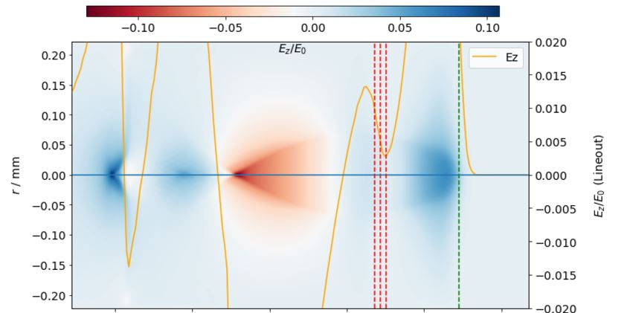
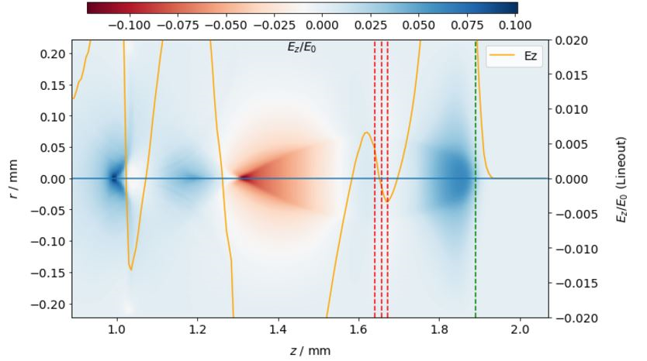
Plasma Undulator
145 µm separation
Simulations by R. Luo
Witness beam timing
Witness beam at position of zero accelerating field produces a nonevolving-energy beam over a long interaction distance
Energy change of witness beam minimised at 175 µm separation
ekrgerhkj
Witness Beam Parameter | Value
Energy (MeV) | 250
Charge (pC) | 150
Duration (fs) | 50
Focal spot size (µm) | 13
Equilibrium spot size (µm) | 6
Drive beam position
Witness beam position
175 µm separation
Claudia Cobo c.cobo@imperial.ac.uk 4th CLARA User Meeting
Notes:
alpha_twiss2=1.7482124925208413
beta_twiss2=0.01566260984793899
Zero accelerating field to make beam stable, extend interaction distance, minimise energy gain or lose

Slide 5
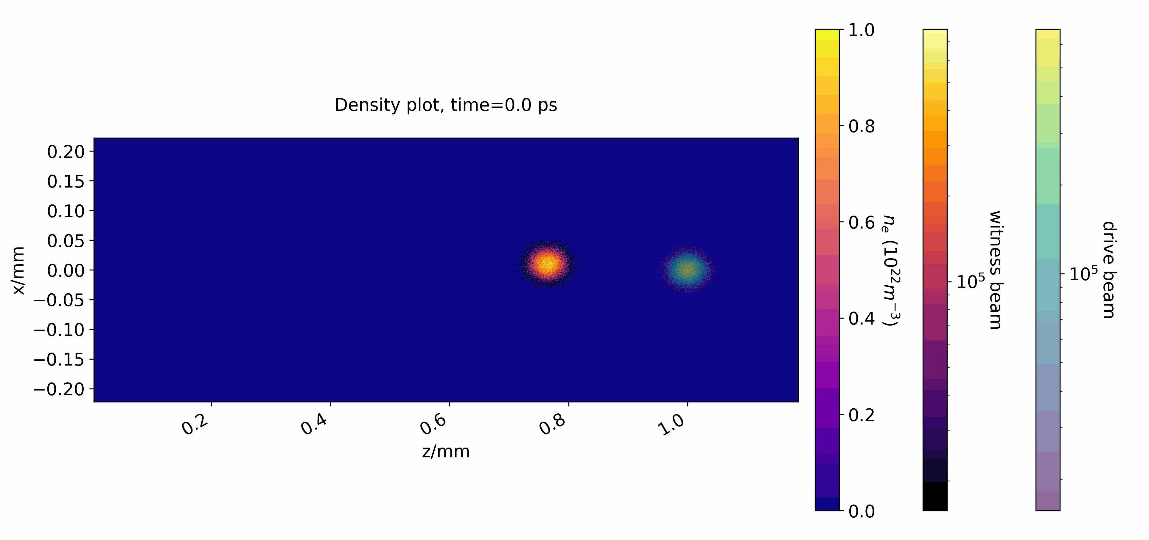
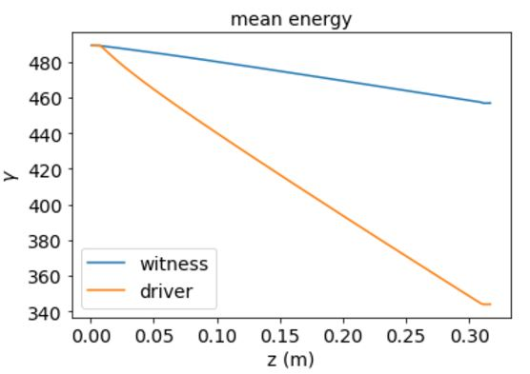
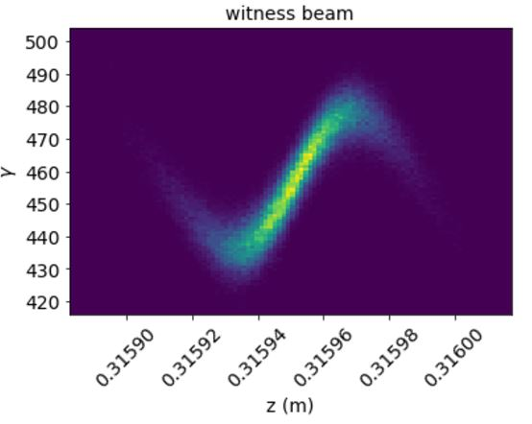
Plasma Undulator
Simulations by R. Luo
Full Simulation Results
Simulation Parameter | Value
Plasma density (10²¹ m⁻³) | 2
Interaction length (mm) | 300
Drive – witness separation (µm) | 175
Initial witness transverse offset (µm) | 10
Energy gain/loss of witness beam could be improved by tailoring the beam current profile
Claudia Cobo c.cobo@imperial.ac.uk 4th CLARA User Meeting

Slide 6
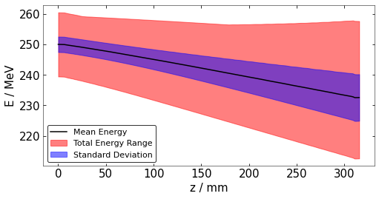
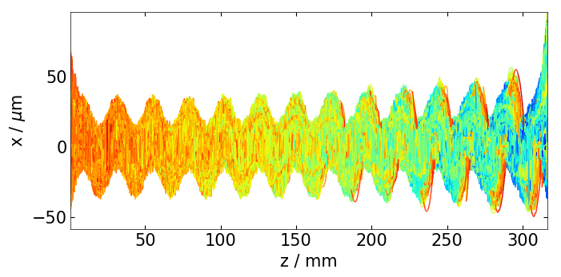
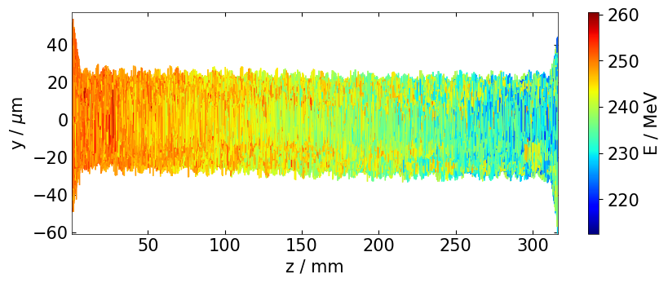
Plasma Undulator
Particle Trajectories and Energy Progression
Plasma Properties
n_{e}= 2x10²¹ m⁻³
L_{plasma} = 0.3 m
K = 1.316 for 10 µm offset
λ = 91 nm
Claudia Cobo c.cobo@imperial.ac.uk 4th CLARA User Meeting
Notes:
Drive 250pC

Slide 7
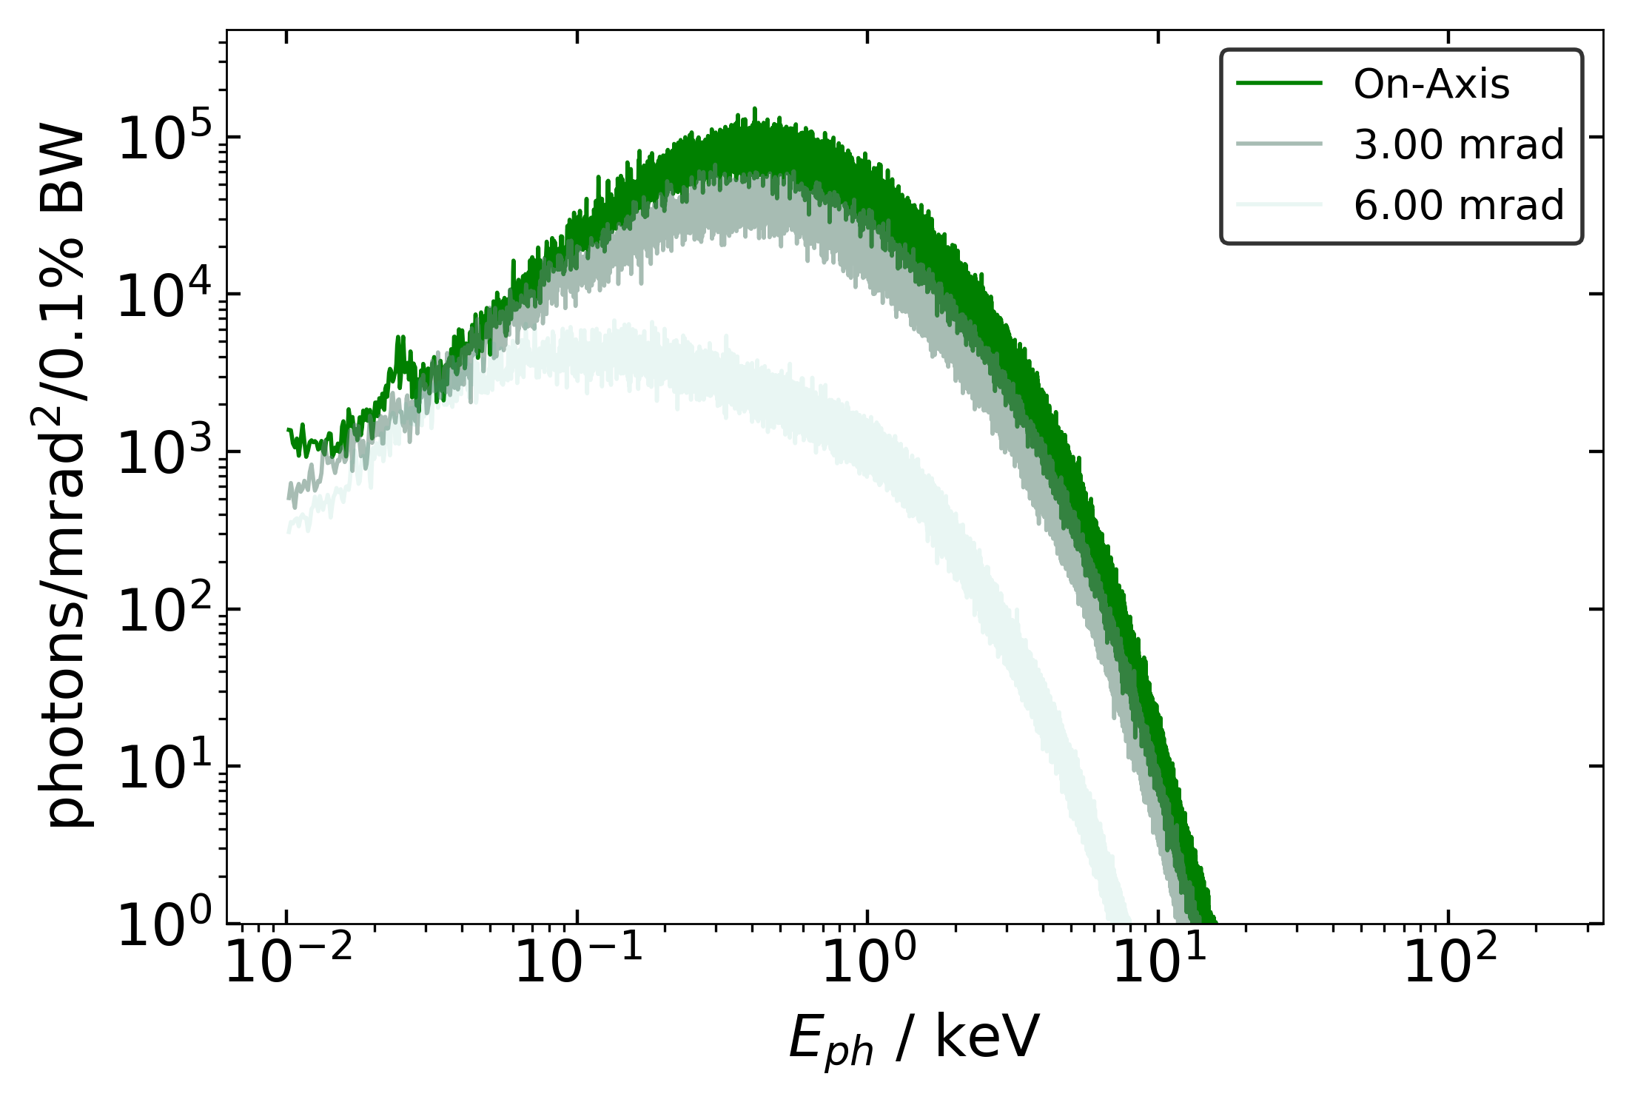
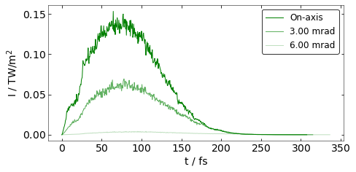
Plasma Undulator
Analysis by A. Hughes
Radiation Outputs (Radiation Computation Code)
Radiation Spectrum
Peak photon fluence of 10⁵ photons/mrad²/0.1% BW
Broad synchrotron-like spectrum with critical energy of ~ 1keV
Total yield of 4x10¹¹ photons above 0.01 keV in modelled radiation beam
Temporal Intensity Profiles
FWHM duration of 100 fs
Beam has a FWHM divergence of approximately 6 mrad along x-axis
The modelled x-ray beam has a peak brightness of 10²¹-10²² photons/s/mrad²/mm²/0.1% BW
Claudia Cobo c.cobo@imperial.ac.uk 4th CLARA User Meeting

Slide 8
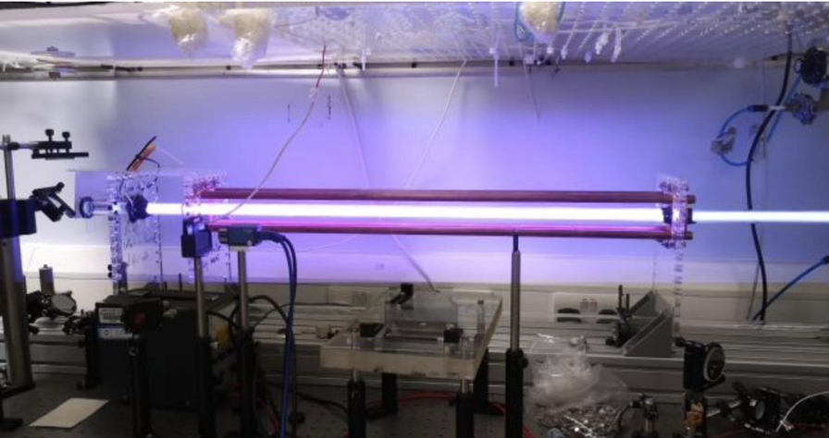
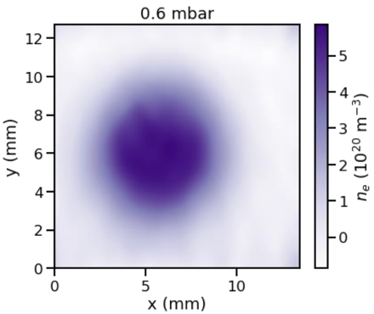
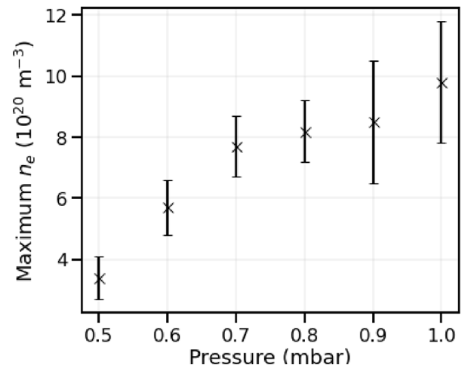
Plasma Formation in Experiment
Discharge Plasma Source
Plasma Properties
n_{e}= 2×10²¹ m⁻³
L_{plasma} = 0.3 m
Simulated plasma parameters can be achieved with a discharge plasma source
Parameter | Value
Tube length (m) | 1
Diameter (mm) | 19.5
Gas pressure (mbar) | 0.01 – 1.5
Discharge current (A) | ~ 400
Discharge time (us) | 1 - 100
Plasma electron density (10²⁰ m⁻³⁾ | 1 – 20
Claudia Cobo c.cobo@imperial.ac.uk 4th CLARA User Meeting

Slide 9
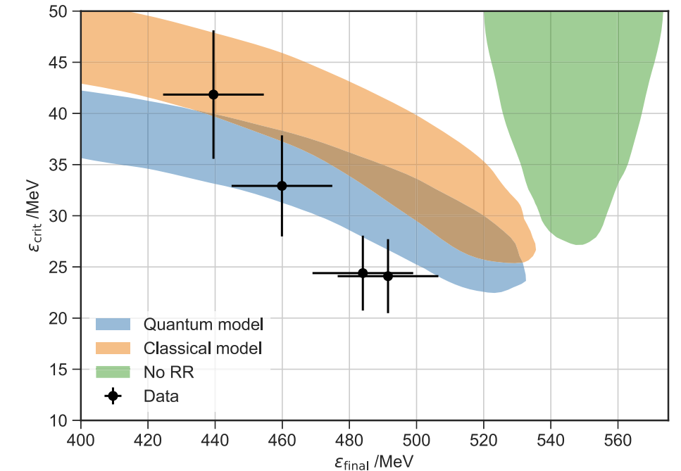

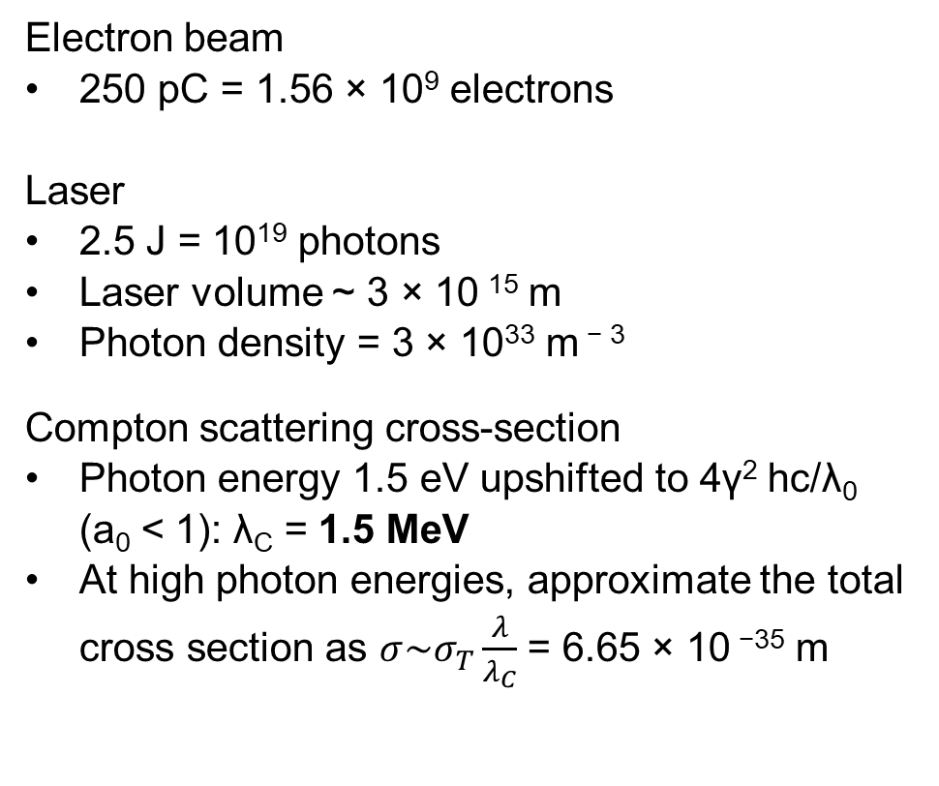
Compton Scattering
Electron – photon collisions
Electron MFP = 1/photon density x $σ$ = 5 m
Probability of collision in ~10 μm interaction length = 0.000002
Number of interactions = 3120 photons
Useful to probe radiation reaction
Preliminary Calculations
Electron beam
250 pC = 1.56 × 10⁹ electrons
Laser
2.5 J = 10¹⁹ photons
Laser volume ~ 3 × 10 ¹⁵ m
Photon density = 3 × 10³³ m ⁻ ³
Compton scattering cross-section
Photon energy 1.5 eV upshifted to 4γ² hc/λ₀ (a₀ < 1): λ_{C} = 1.5 MeV
At high photon energies, approximate the total cross section as $σ\sim σ_{T}\frac{λ}{λ_{C}}$ = 6.65 × 10 ⁻³⁵ m
J. Cole et al. Phys. Rev. X 8 011020 (2018)
Claudia Cobo c.cobo@imperial.ac.uk 4th CLARA User Meeting

Slide 10
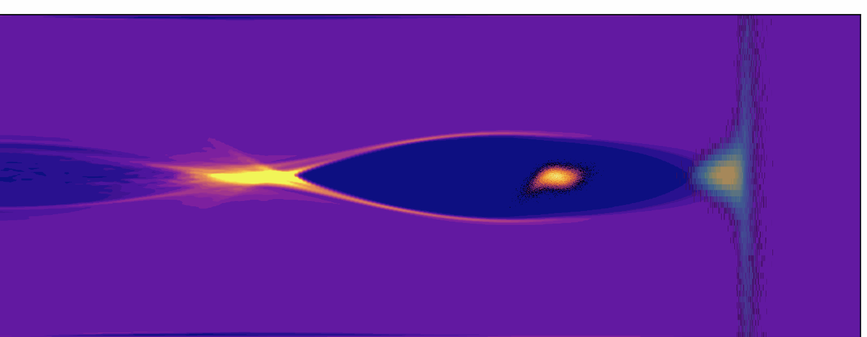
Conclusions
We have modelled possible configurations of the CLARA electron beam propagating in a plasma channel, forming a plasma undulator
We offset the witness beam’s axis of propagation from that of the drive beam by 10 µm for enhanced radiation generation
We can produce a collimated, ultrashort, high brightness, broadband radiation beam comprising photon energies up to 10 keV
        100 fs FWHM duration
        6mrad FWHM divergence
        10²¹-10²² photons/s/mrad²/mm²/0.1% BW peak brightness
Claudia Cobo c.cobo@imperial.ac.uk 4th CLARA User Meeting

Slide 11
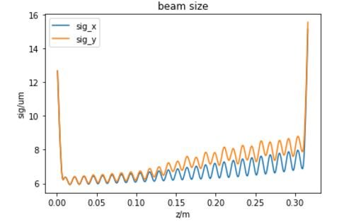
Plasma Undulator
Witness beam matching

