Slide 1




VHEE and FLASH Radiotherapy at CLARA
Dr Kristina Small
MEW Group, PRECISE Group
University of Manchester, Cockcroft Institute

Slide 2
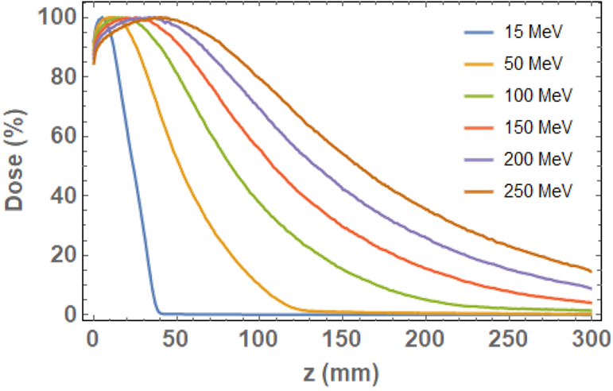
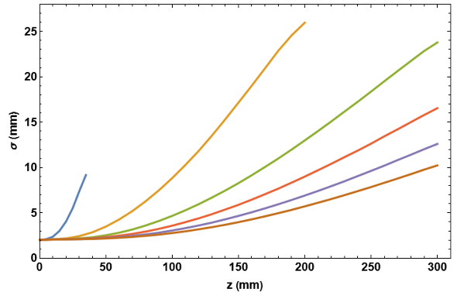
Novel Radiotherapy - VHEE
a
15
MeV
250
MeV
Very High Energy Electron radiotherapy will use 100-250 MeV electrons to treat cancer. Key advantages:
Increased range in tissue – can treat deep-seated tumours
Reduced lateral beam spread – lower dose delivered to healthy tissue surrounding a tumour
Insensitivity to inhomogeneities (A. Lagzda, MEW)¹ – changes in tissue density do not affect dose delivery in contrast to protons
15
MeV
250
MeV

Slide 3

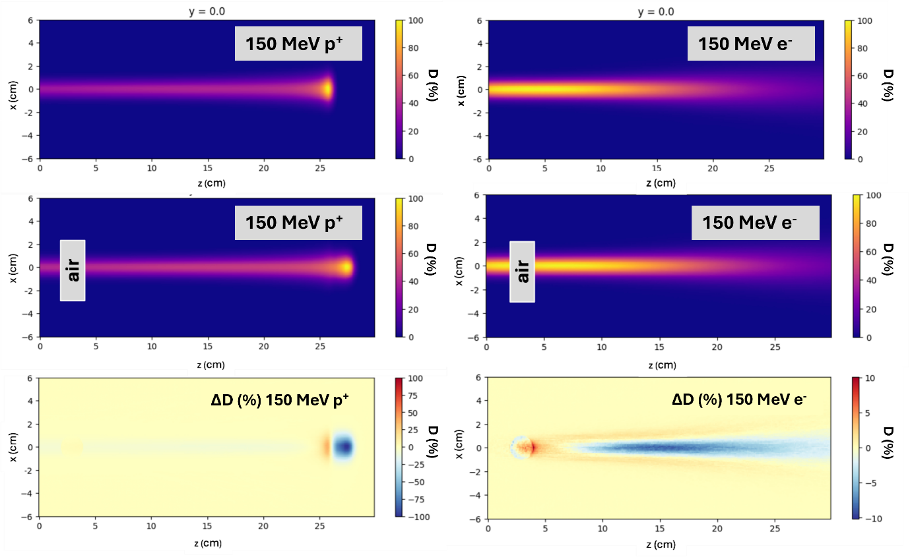
Novel Radiotherapy - VHEE
Proton sensitivity to air pocket²
Proton sensitivity to air pocket²
Very High Energy Electron radiotherapy will use 100-250 MeV electrons to treat cancer. Key advantages:
Increased range in tissue – can treat deep-seated tumours
Reduced lateral beam spread – lower dose delivered to healthy tissue surrounding a tumour
Insensitivity to inhomogeneities (A. Lagzda, MEW)¹ – changes in tissue density do not affect dose delivery in contrast to protons
[1] Lagzda, A. et al. Influence of heterogeneous media on Very High Energy Electron (VHEE) dose penetration and a Monte Carlo-based comparison with existing radiotherapy modalities. Nucl. Instruments Methods Phys. Res. Sect. B. 482 70-81 (2020)
[2] Small, K. et al. VHEE facilities in Europe with the potential for FLASH dose irradiation: Conspectus and dose rate parameterisation. To be submitted to Nuclear Instruments and Methods in Physics Research B

Slide 4

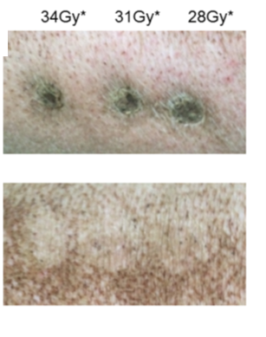
Novel Radiotherapy - FLASH
FLASH-RT – Radiotherapy dose delivered in ms/us/ns timescales, rather than minute timescales for conventional radiotherapy
Consistently shown to significantly reduce radiation-induced side effects in healthy tissue
Electrons are light and charged – ideal for FLASH delivery
Combining VHEE and FLASH could mean an effective, patient-friendly cancer treatment
Conventional
48 weeks PI
FLASH
48 weeks PI
Vozenin, M. C. et al. The advantage of FLASH radiotherapy confirmed in mini-pig and cat-cancer patients. Clin. Cancer Res. 25, 35–42 (2018).

Slide 5

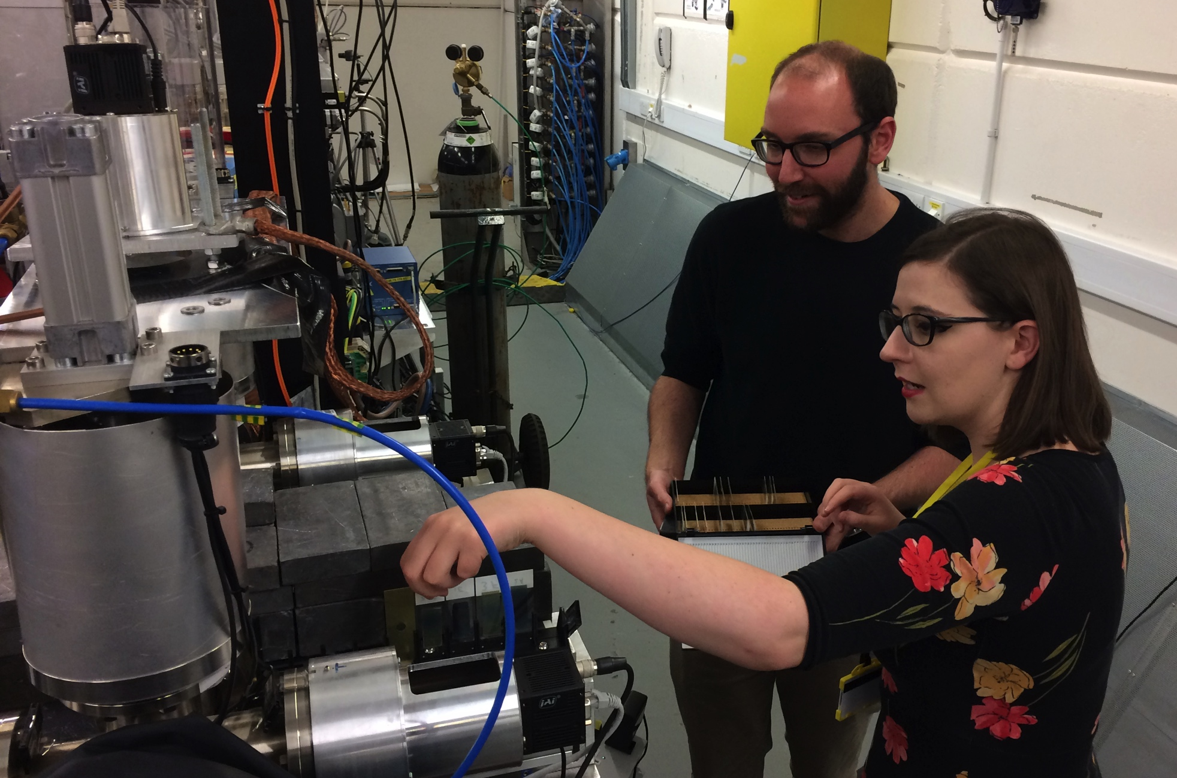
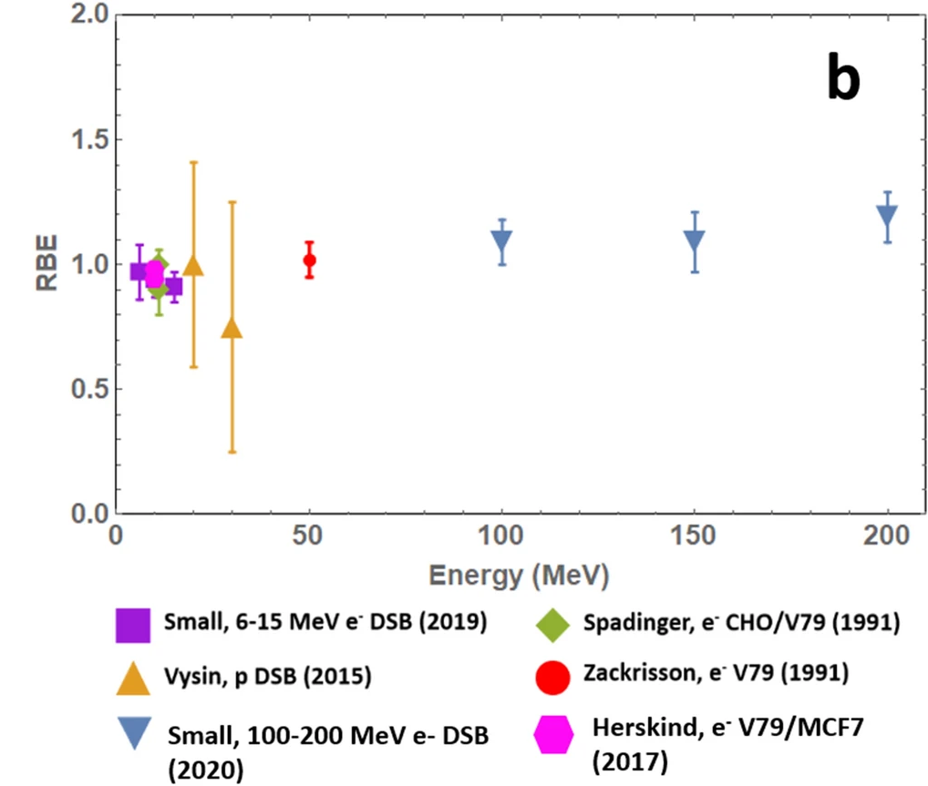
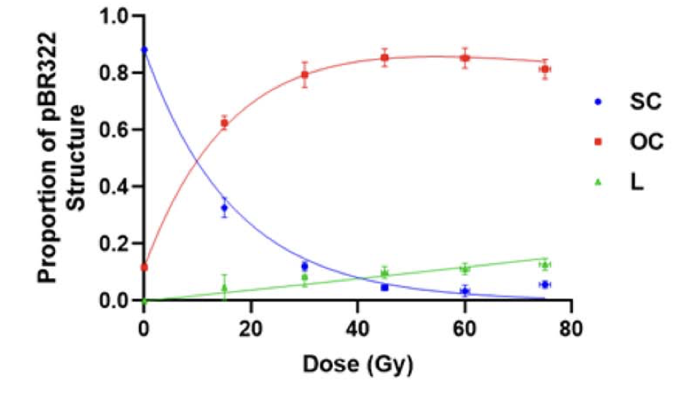
VHEE at CLEAR and CLARA
Plasmid irradiation experiments with varying scavenging capacities performed in 2021/2022 (H. Wanstall, MEW/PRECISE).
Good VHEE RBE agreement with earlier experiments!
2018/2019 – pBR322 plasmid irradiation studies with 35 MeV electrons
  Assessed feasibility of VHEE plasmid studies
  Focus on experimental development – sample preparation and installation, sample holder design
Formed the basis for successful CLEAR experiments at 200 MeV
  World-first VHEE RBE calculations!
Wanstall, H. et al. Quantification of damage to plasmid DNA from 35 MeV electrons, 228 MeV protons and 300 kVp X-rays in varying hydroxyl radical scavenging environments. Journal of Radiation Research 64(3) 547-557 (2023)
Small, K. et al. Evaluating very high energy electron RBE from nanodosimetric pBR322 plasmid DNA damage. Sci. Rep. 11, 3341 (2021)

Slide 6
Radiotherapy and CLARA Phase 2
Upper limit specified for clinical VHEE radiotherapy
Beam Parameter | CLARA
Energy Range | 250 MeV
Bunch Charge | 5-250 pC
Repetition Rate | 100 Hz
Relative Energy Spread | 0.01% (low charge) 0.1% (high charge)
Can irradiate at both conventional and FLASH dose rates (> 40 Gy/s)
Low energy spread = reliable and repeatable beam – key for clinical VHEE machine design
Easy access to FEBE experimental chambers – rapid sample setup and throughput

Slide 7
VHEE at CLARA – Moving Forward
What makes a FLASH beam FLASH?
Beam focusing with quadrupoles
Radiobiology

Slide 8

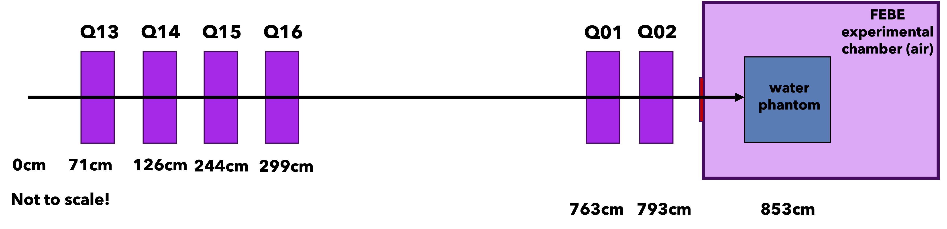
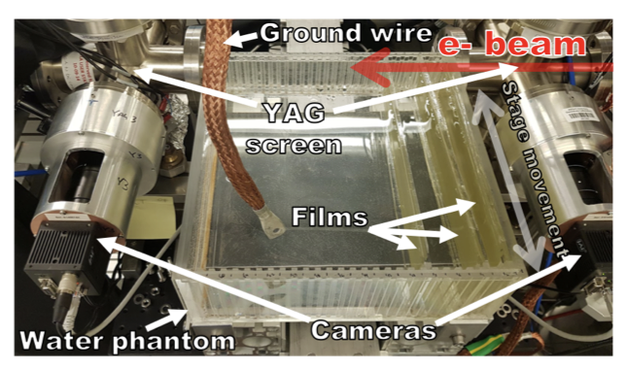
Beam Characterisation and Focusing
Aim – To produce reliable, repeatable, high dose-rate electron beams capable of reaching patient relevant depths in a water phantom
Basic experiment setup:
  PMMA phantom in in-air chamber (30 x 10 x 30 cm³?) containing water
  Gafchromic film situated at regular intervals through phantom
  Doses measured and used to calculate dose rates and generate PDD curves
What makes a FLASH beam FLASH?
  Variation study to establish beamline and experimental setup parameters required for FLASH dose rate threshold of 40 Gy/s
Lagzda, A. VHEE Radiotherapy Studies at CLARA and CLEAR Facilities. Student thesis (PhD), University of Manchester. (2019)

Slide 9
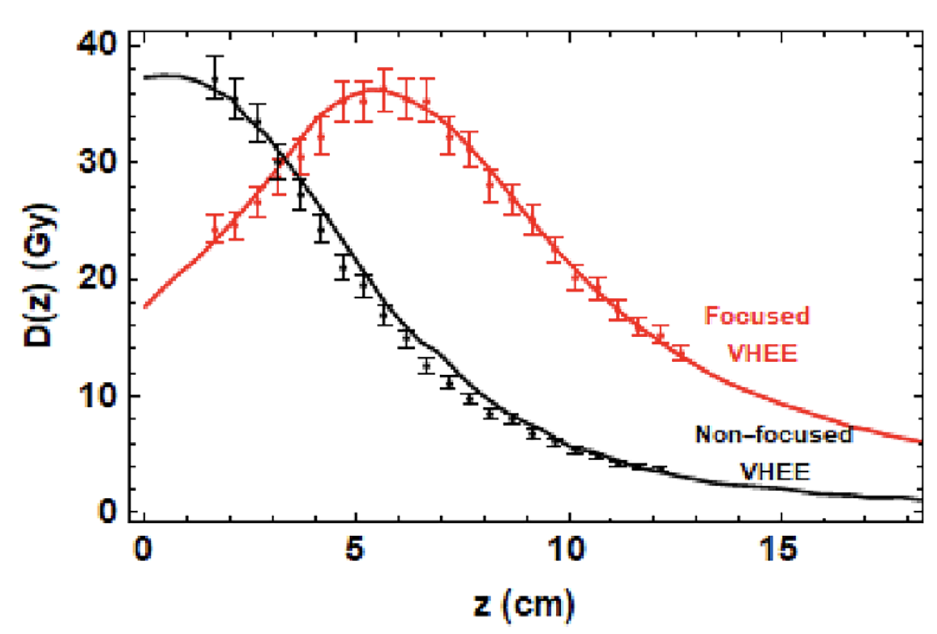
Beam Characterisation and Focusing
Aim – To produce reliable, repeatable, high dose-rate electron beams capable of reaching patient relevant depths in a water phantom
Basic experiment setup:
  PMMA phantom in in-air chamber (30 x 10 x 30 cm³?) containing water
  Gafchromic film situated at regular intervals through phantom
  Doses measured and used to calculate dose rates and generate PDD curves
Electron beam focusing by varying quadrupole strengths
  Successful focusing has been achieved at depths up to 5 cm (L, Whitmore, MEW), initially investigated by A. Lazda
  Aiming for focusing at 10-15 cm – more relevant for patient treatment!
  Initial simulation work underway in ELEGANT and TOPAS
Whitmore, L. et al. CERN-based experiments and Monte Carlo studies on focused dose delivery with very high energy electron (VHEE) beams for radiotherapy applications. Sci. Rep. 14 (2024)

Slide 10

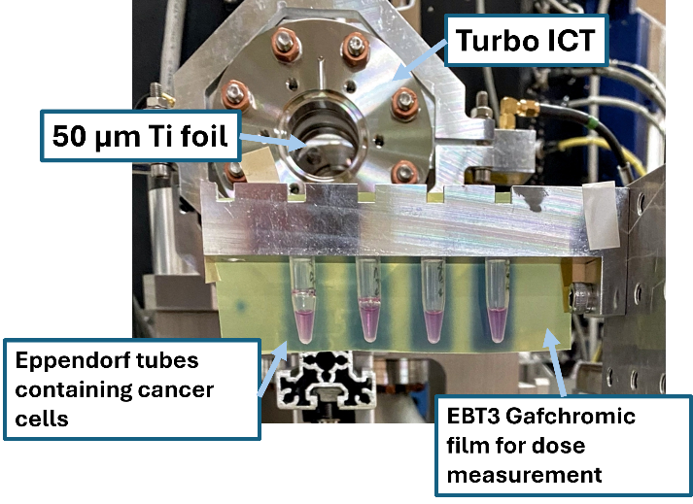
Radiobiology at CLARA – Cell Survival
Aim – observe how cancer cells and normal cells respond to in-air VHEE irradiation at conventional/FLASH dose rates
Experimental setup:
  Samples held in Eppendorf tubes on movable stage in in-air chamber
  Cells irradiated with doses from 0-10 Gy
  Survival rate calculated through clonogenic assay
  Initial focus on lung and pancreatic cancer cell lines
Currently in discussions to fit out a small biological lab space for preparation/analysis of cellular samples
Wanstall, H. C. et al. First in vitro measurement of VHEE relative biological effectiveness (RBE) in lung and prostate cancer cells using the ARES linac at DESY. Sci Rep 14 (2024)

Slide 11
Conclusions
VHEE and FLASH radiotherapy have the potential to revolutionise cancer treatment, particularly lung and pancreatic cancers
The CLARA beamline is ideal for research into VHEE-FLASH radiotherapy due to wide energy range, high bunch charge/dose rate and efficient experimental area design
Short-term focus at CLARA– reliably delivering VHEE-FLASH beamlines and establishing biological viability of VHEE-FLASH as a lung/pancreatic cancer treatment
Long-term potential – expanding to treatment planning using the MARVIN phantom, complex radiobiological studies (spheroids, organoids)

Slide 12

Acknowledgements
Roger Jones
Deepa Angal-Kalinin
James Jones
Stewart Boogert
Nicholas Henthorn
Michael Merchant
Karen Kirkby
Amy Chadwick
Elham Santina
Adam Aitkenhead
Wilfrid Farabolini
Roberto Corsini
Davide Gamba
Antonio Gilardi

