Slide 1


omroneip
An EPICS asyn driver for communicating with omronNJ/NX PLCs using EtherNet/IP
Phil Smith
pts@observatorysciences.co.uk

Slide 2
What is omroneip?
An EPICS asyn driver created by Observatory Sciences for Graham Cox and his team at STFC Daresbury.
Allows the user to configure PVs to send and receive data over EtherNet/IP.
Ethernet/IP communications are implemented using the open source libplctag library.

Slide 3
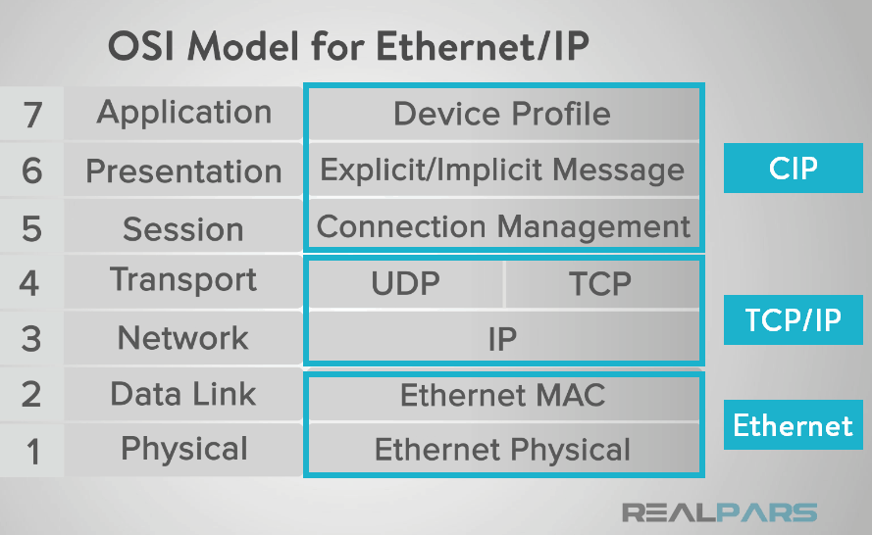
EtherNet/IP
EtherNet/IP (IP = Industrial Protocol) is an industrial networking protocol that adapts the Common Industrial Protocol (CIP) to standard Ethernet.

Slide 4
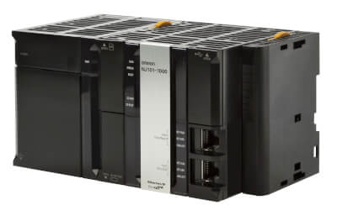
What is omroneip?
Intended for use with OmronNJ/NX PLCs.
  Potentially supports other EtherNet/IP PLCs (Alan-Bradley/Rockwell) .
Alternative to the current EPICS ether_ip driver
Supports some of the newer EtherNet/IP features that are available on OmronNJ/NX.
Code repository is open source and available on github.

Slide 5
Key features
Supports the large forward open CIP specification which allows single CIP messages of up to 1994 bytes to OmronNJ.
Supports packing of CIP read requests. Allowing hundreds of small reads to be packed into a single message for improved performance.
Supports reading of UDTs (user defined types) up to the maximum message size

Slide 6
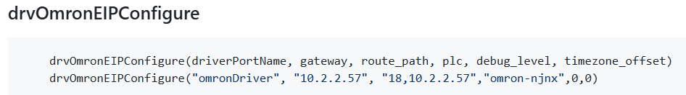
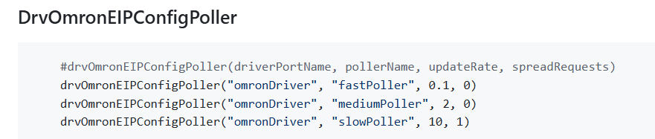
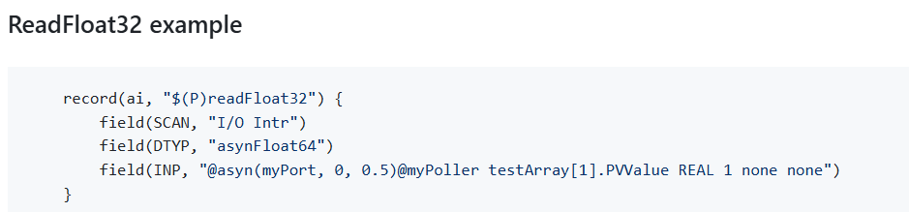
Using the driver

Slide 7
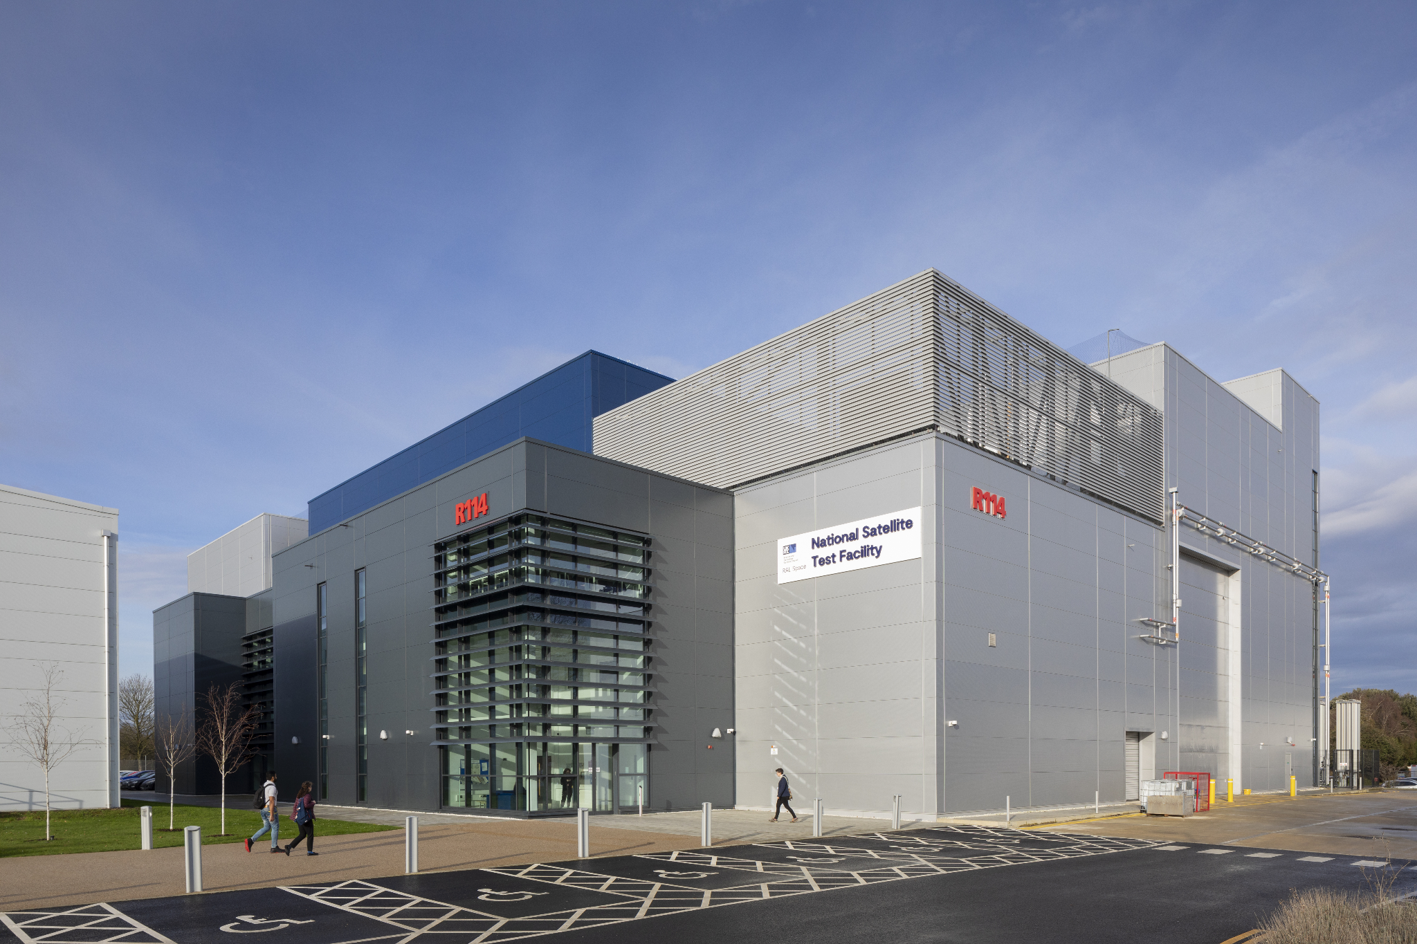
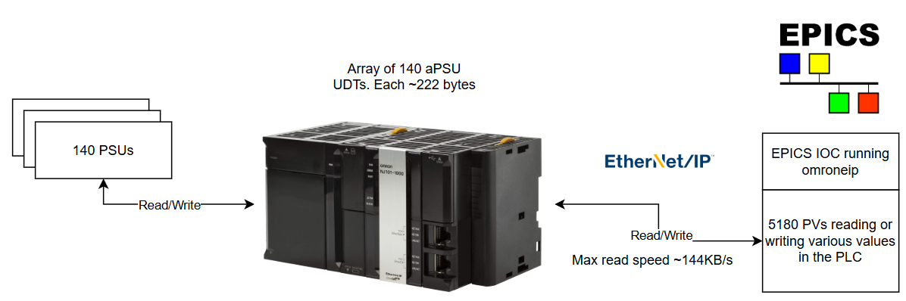
Case study
RAL Space Large Satellite Test Chamber
  Driver currently being commissioned on site.
  1 OmronNJ PLC connected to 140 PSUs
  Each PSU sends its data to a 222 byte UDT within an array in the PLC.
  Driver automatically optimises to look for multiple PVs which read data from the same UDT and downloads entire UDTs rather than individual items.

Slide 8
Future
Improved support for Alan-Bradley/Rockwell PLCs if there is EPICS community interest and someone to support it.
Libplctag does not currently support fragmented reads on OmronNJ/NX (reading data > 1994 bytes in multiple fragmented reads), but this is being worked on.
Libplctag does not currently support interrogating the PLC for information about available data. This is being worked on and will remove the need to manually describe UDT structures which is currently needed for doing optimisations.

