Slide 1
Using compress records in the real world
Steve Hunt ALS

Slide 2
EPICS is not just for I/O
It is tempting for people new to EPICS to use it just for I/O
And do data processing at the client level …….

Slide 3
And why not you ask ….
IOCs are designed to run continuously
Client programs often are at risk of being terminated
Calculated values are not saved in the archiver
Not seen by the alarm handler
Neither trend plots
And these values can’t be easily shared with other applications

Slide 4
What is the alternative
Client programs and scripts are often good for developing algorithms
But when stable and are needed to run the facility
Consider moving to the IOC

Slide 5
One useful tool for simple processing….. the compress record
Has two main, and complementary functions …
  Reading values over time into an array
  Processing of data in arrays

Slide 6
Very useful to put these together
One compress record to use as circular buffer
Another to read and process that buffer

Slide 7
Example – at reading serial data from a radiation monitor
Example data arrives every 4 secs in units of uSv/hr
longin
DoseRate4sec
INP @gamma.proto counts$(P)
DTYP stream
SCAN I/O Intr
EGU uSv/hr
FLNK History
compress
History
INP RadMon
ALG Circular Buffer
NSAM 900
SCAN I/O Intr
FLNK AvgDoseRate
compress
AvgDoseRate
INP History
ALG N to 1 Average
N 900
NSAM 1
EGU uSv/hr
FLNK Dose
calc
Dose
INPA AvgDoseRate
CALC A*900
EGU uSv

Slide 8
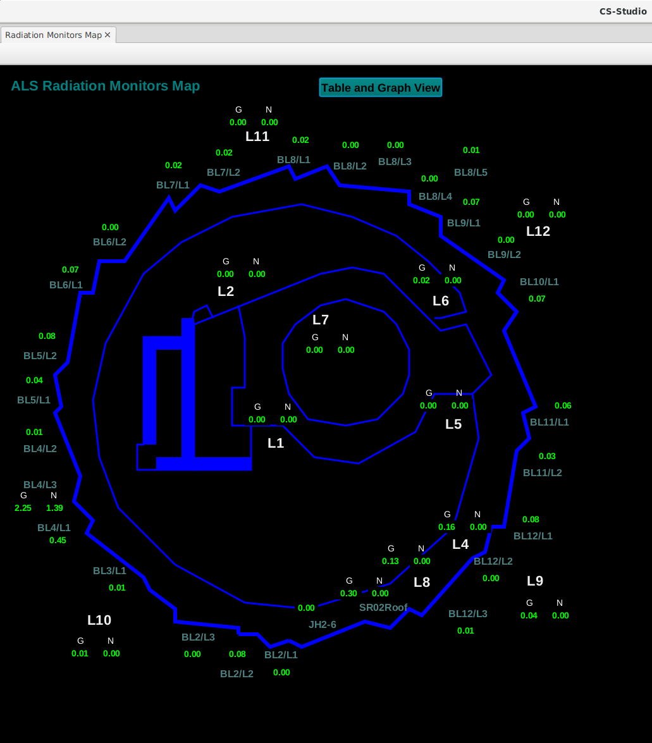
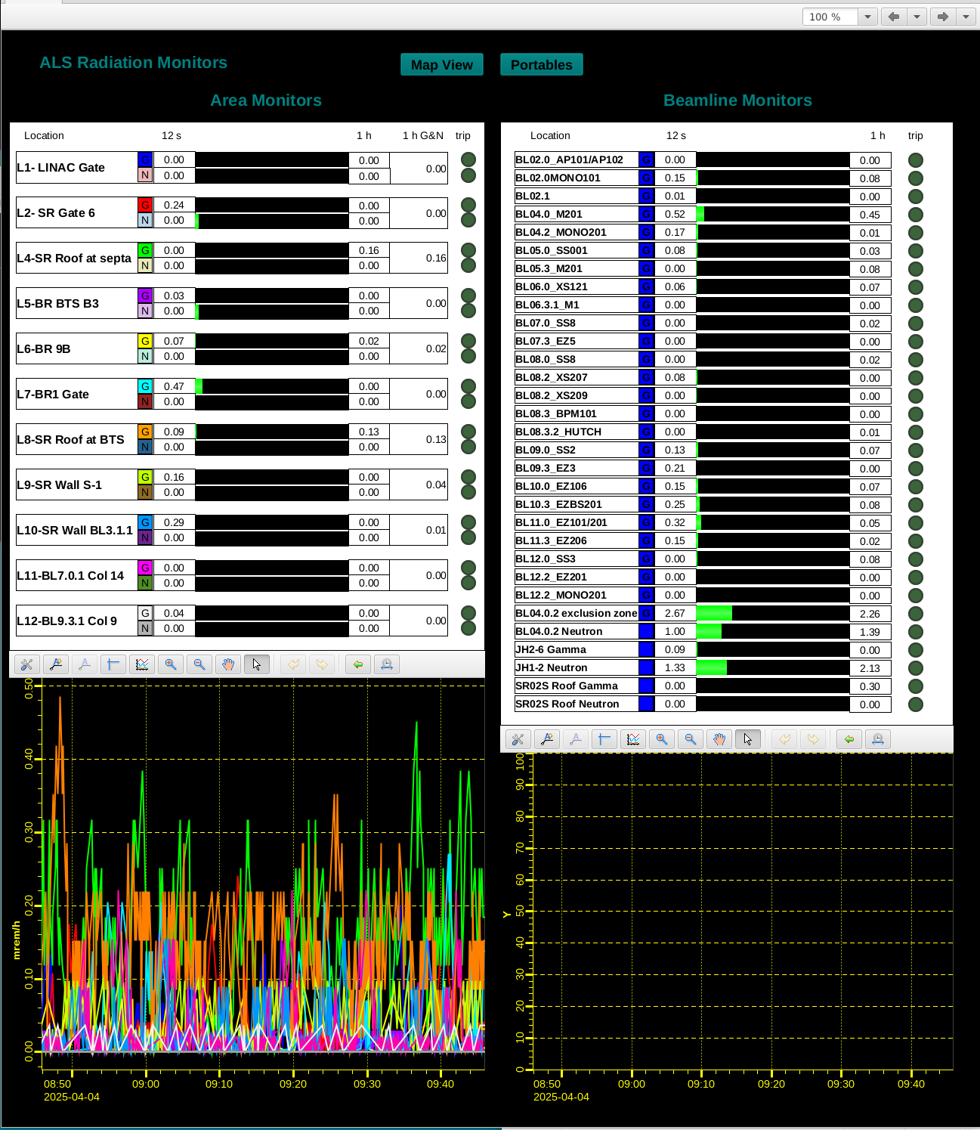
Operator Screens

