Slide 1




Introduction to the software and hardware platforms for the Pre-Project of the ICONE Accelerator
Alexis Gaget
CEA / IRFU (Saclay)

Slide 2


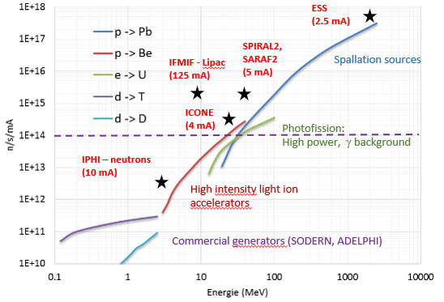
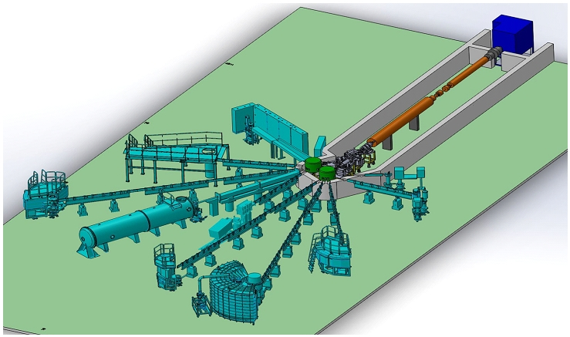

ICONE : an accelerator-driven neutron source
(ICONE stands for Installation COmpacte de NEutrons in french
or Innovative COmpact NEutron facility in english)
ICONE an HICANS (High Current Accelerator-based Neutron Sources)
High current (current peak ~80mA) - Low energy accelerator – 25 Mev
  Compact
  Reduced cost
  Great operational flexibility
  There is no production of high-energy secondary particles (fast neutrons and gamma rays)

Slide 3

ICONE : an accelerator-driven neutron source
CEA IRFU is in charge of the development of the LINAC and its control system.
The design is Based on our extensive experience with various accelerators such as SPIRAL2, ESS, IPHI upgrade, and SARAF
Ion
Source
LEBT
MEBT
DTL
HEBT
RFQ
80 mA
75keV
3.62 MeV
25 MeV

Slide 4

Control system hardware platform

Slide 5
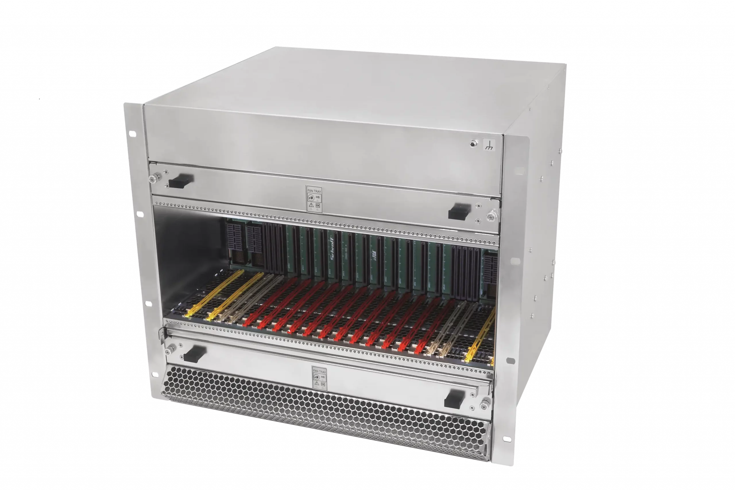
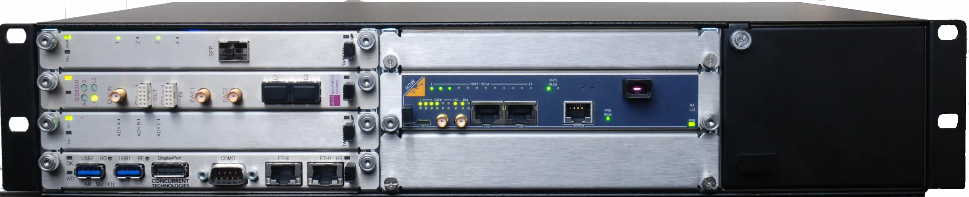
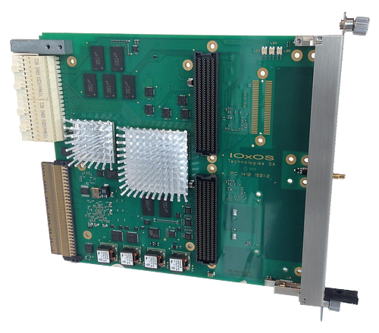
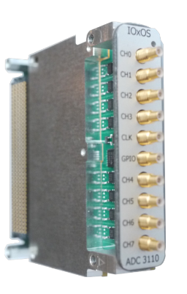
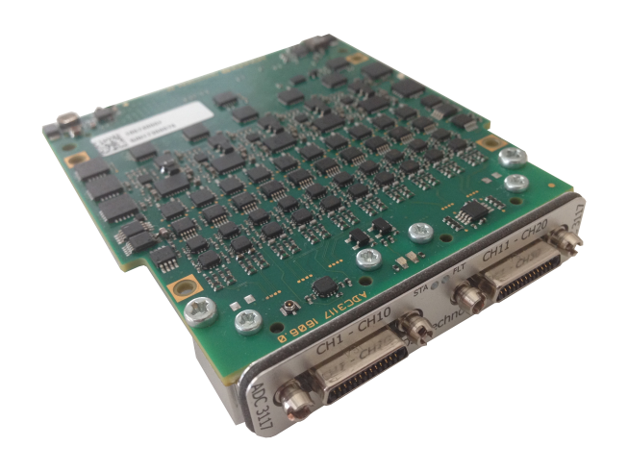
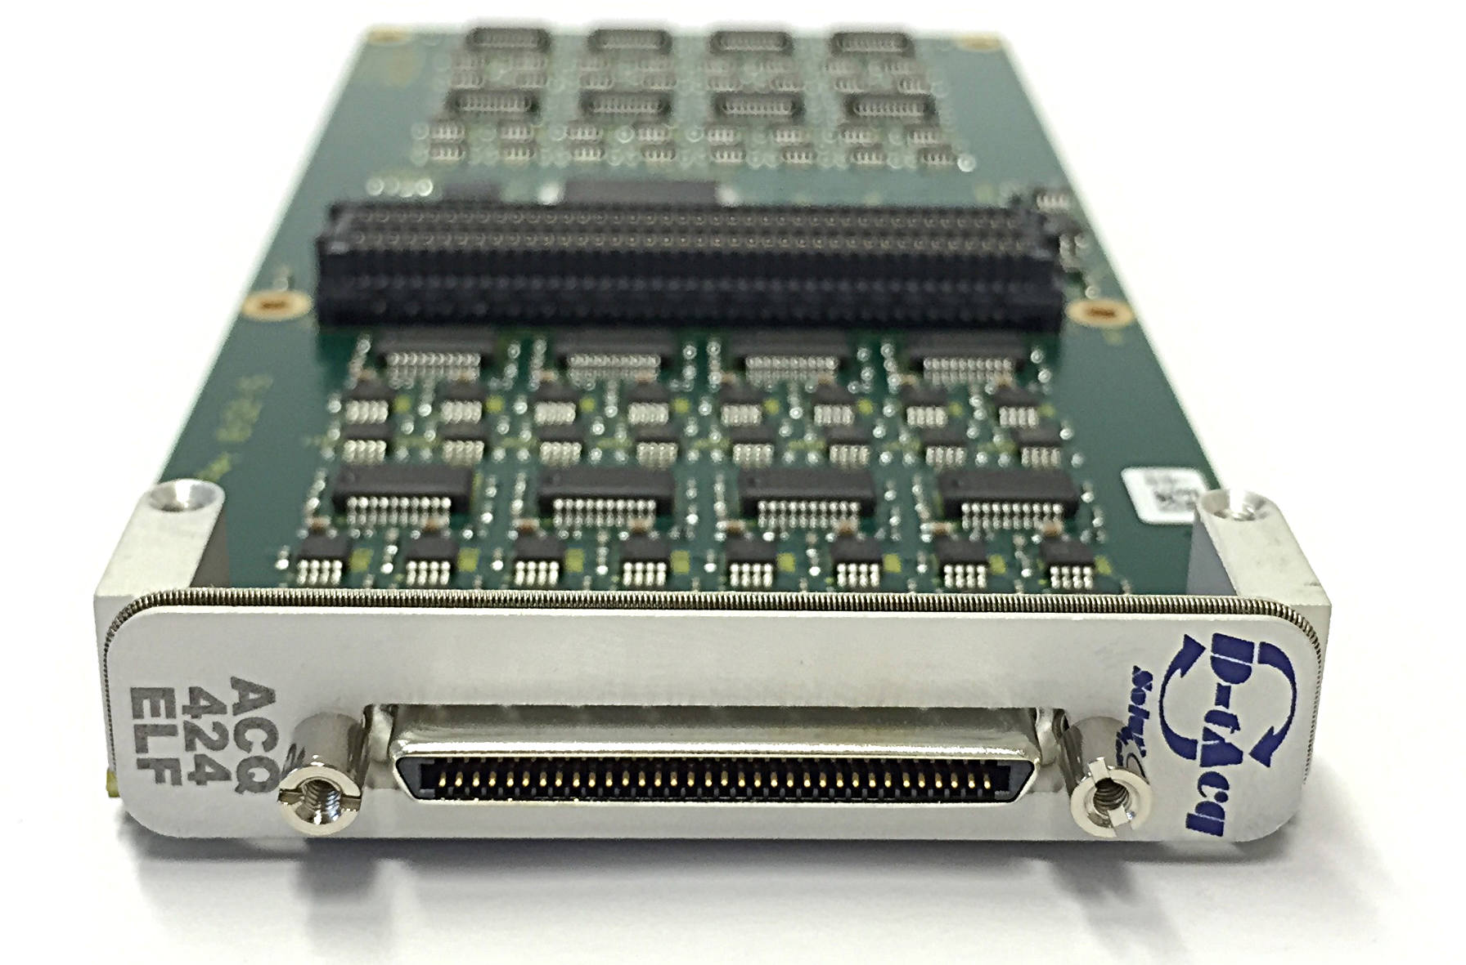
Hardware platform (based on SARAF and IPHI upgrade)
Standardized platform based on SARAF and IPHI upgrade
Fast/Semi Fast Acquisition based MTCA.4 :
  Crate MTCA.4 NAT NATIVE-R2 (6 cards) or NATIVE-R9 (12 cards) (mostly for profiler like Harps)
  Fast Acquisition (5MSmp/s -> 250MSmp/s) : CPU IOxOS IFC1410 & IOxOS ADC3111
  Semi Fast Acquisition (50KSmp/s -> 5MSmp/s)
    CPU IOxOS IFC1410 and IOxOS ADC3117 (5MSmp/s, 20 channels)
      ACCT, Faraday Cup, current measurement, RF...
      FPGA development kit available for IFC1410
    CPU DAMC-FMC1Z7IO and RTM D-tacq acq424elf (1MSmp/s, 32 channels)
      Profiler (Harps)
      64 channels at 1Msps up to 50Hz
Native R2
Native R9
adc3111
IFC1410
Acq424ELF
ADC3117

Slide 6
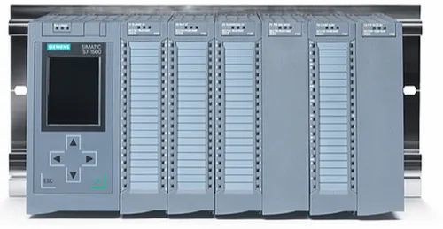
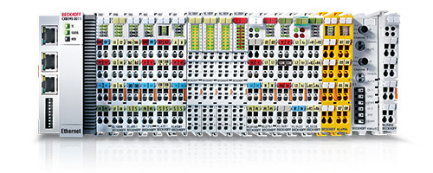
Hardware platform
Standardized platform
Remote IOs:
  vacuum , interlocks process … : Siemens 1500 PLC & remote I/O modules (OPC UA)
  Non-critical slow acquisitions: Beckhoff (OPC UA) : EK9160 & remote I/O modules
Thanks to THE Ralph and THE Dirk for the OPC UA driver

Slide 7
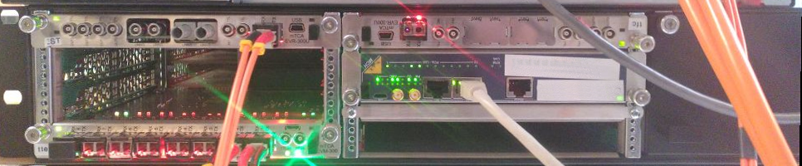

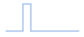
Hardware platform
Standardized platform
Timing System: Micro Research Finland (MRF) on MTCA.4
  Event Generator Master and Fanout/concentrator : MTCA EVM 300
  Event Receiver : MTCA EVR 300U
MTCA EVR300U
RF Master Oscillator
F_{rf}
_{I.e:88MHz}
Master Event Generator
Fanout/
concentrator
Crate NAT R2
MTCA EVM300
Event
receiver
Event
receiver
fanout
Event
receiver
Event
receiver
Synchronisation trigger
Event
receiver
Event
receiver
Event
receiver
Event
receiver

Slide 8
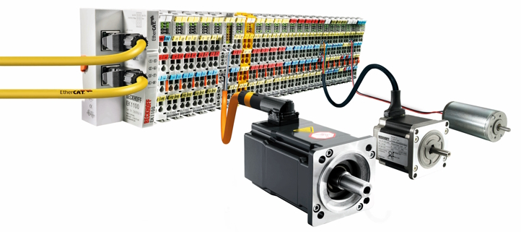
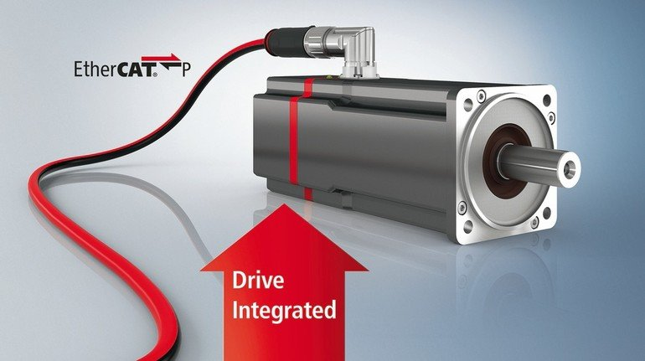
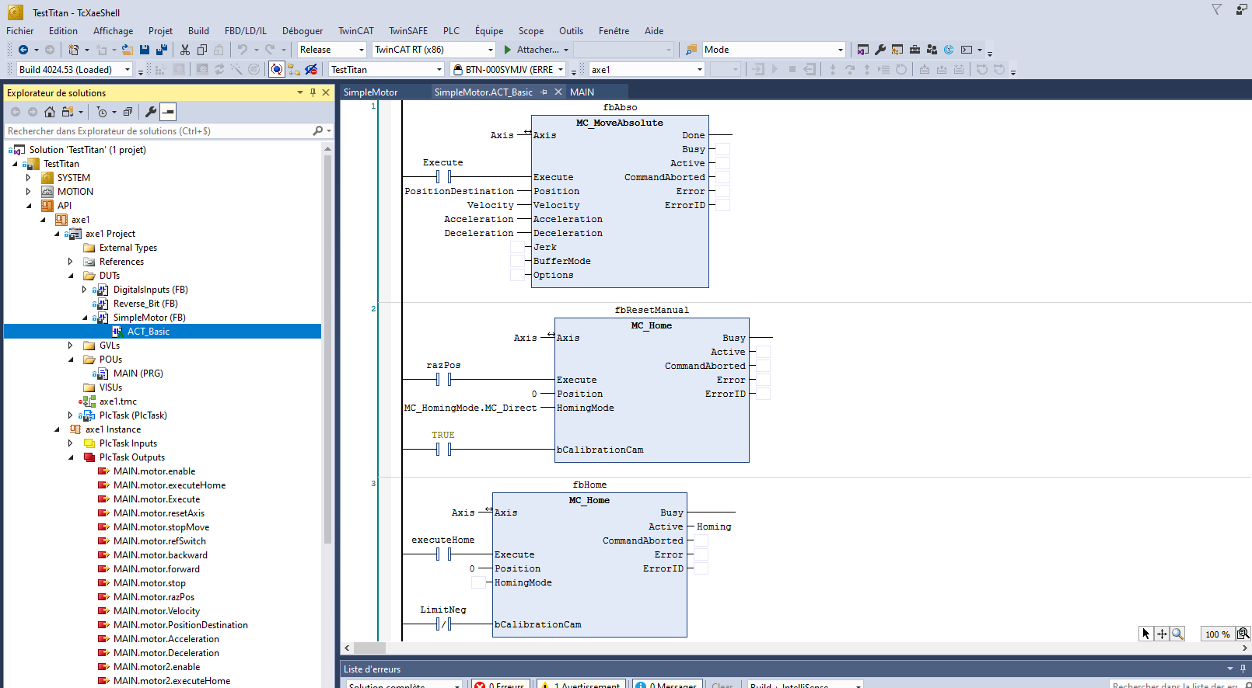
Hardware platform
Standardized platform
Motorization: Beckhoff (the whole chain: CPU,Driver, wires, motors and development environment TwinCAT)
  IPC Beckhoff CX5110-9020+ Driver ServoMotor EL7221-9014 + Motor AL8121-0F21
  IPC C6930 + driver AX5201 + Motor AL8011

Slide 9
Control system software platform

Slide 10

Software platform
EPICS V7
PVAccess protocol
Phoebus
  Phoebus-alarm
  Phoebus save-and-restore
  Phoebus Olog
  ChannelFinder
Archive appliance
Custom made software:
  Gengiscan (Genius Generic Scan): purpose is to run a "scanning procedure" (or "scan")
  ssh-monitor: monitor devices through ssh and CA (soon PVA ?)
  …

Slide 11

Software platform
EPNix is an EPICS development and deployment framework
  Based on Nix. Nix is a package manager and deployment tool for producing reproducible and reliable software, with a very active online community (including one at CEA/IRFU).
  Decentralized production architecture. The development environment heavily relies on our git instance.
  Highly reproducible and easily reversible.

Slide 12
Software platform
EPNix packages the standard EPICS support modules:
    Asyn
    mrfioc2
    opcua
    Streamdevice
    Etc…
EPNix also packages other EPICS-related tools, such as procServ, Phoebus, and so on. You can build them by using Nix, while having a strong guarantee that they work as-is.
  Existing Packages :
    Phoebus (and its services such as Alarm, save-and-restore etc..)
    Archive appliance
    Ca-gateway
    ChannelFinderService
    Etc …
  Already available EPICS modules: https://epics-extensions.github.io/EPNix/
  (and for more questions, Rémi is in the room)

Slide 13
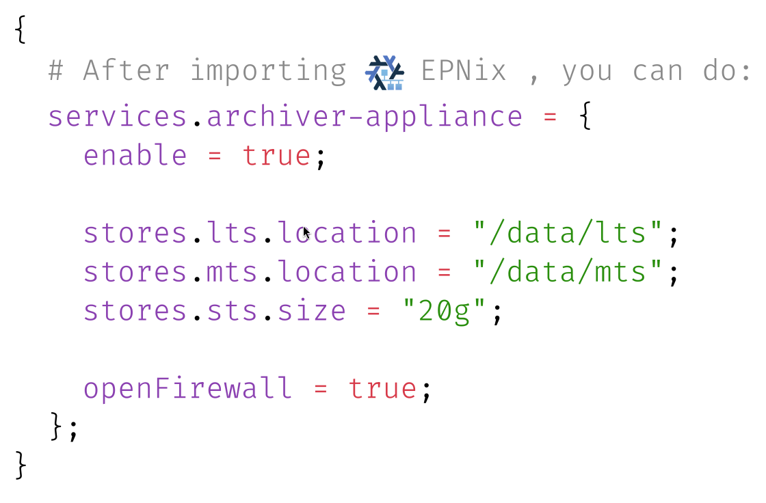
Software platform
Short example with the archiver-appliance

Slide 14
Machine Protection System
  Machine Protection System at SARAF (A. Gaget): https://accelconf.web.cern.ch/icalepcs2023/posters/thpdp102_poster.pdf
  MRF Timing System Design at SARAF (A. Gaget): https://accelconf.web.cern.ch/icalepcs2021/posters/thpv022_poster.pdf

Slide 15
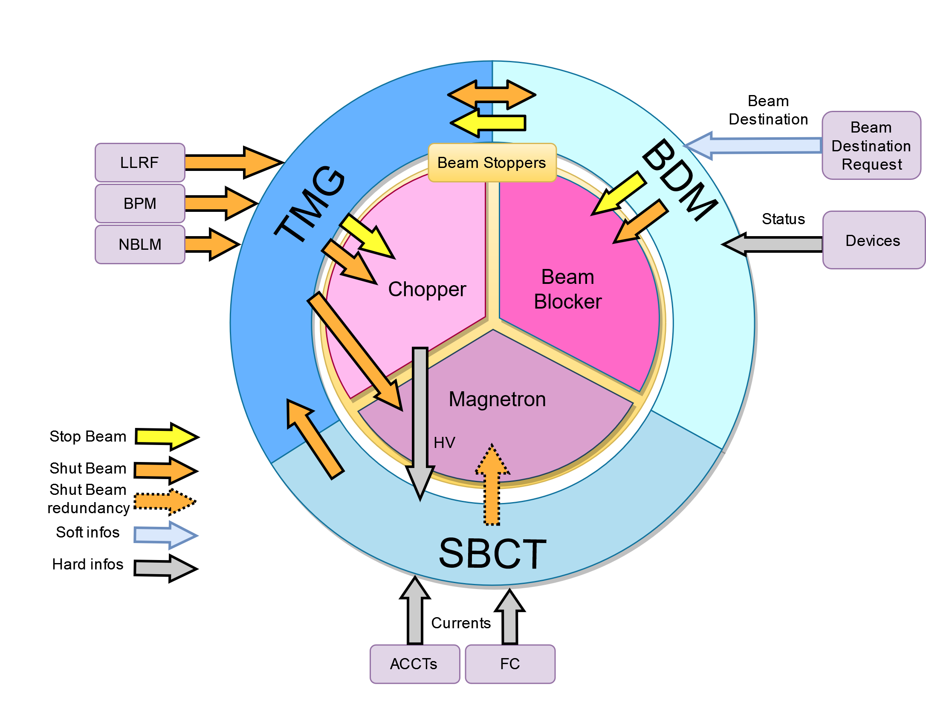
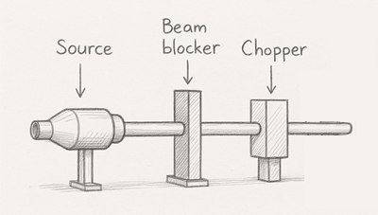
MPS Overview
Beam destination master (BDM) controls that conditions to get the beam to a destination are checked. Linked to all PLC all along the accelerator through Profinet
Timing (TMG) is the heart of the MPS creating or shutting the beam pulse through chopper and magnetron and being the messenger of the shutbeam event
Section Beam Current Transportation is checking current of the beam all along the accelerator and compare them.

Slide 16
Other FPGA development based on IOxOS MTCA card
RF Fast Interlock : Stop the RF in case of RF incident. Comparison of RF signals with threshold.
Neutron Beam Loss monitor: count neutron lost in the pipe all along the accelerators.
  FPGA development on MTCA.4 at CEA (V. Nadot), talk for MTCA workshop at this meeting.

Slide 17
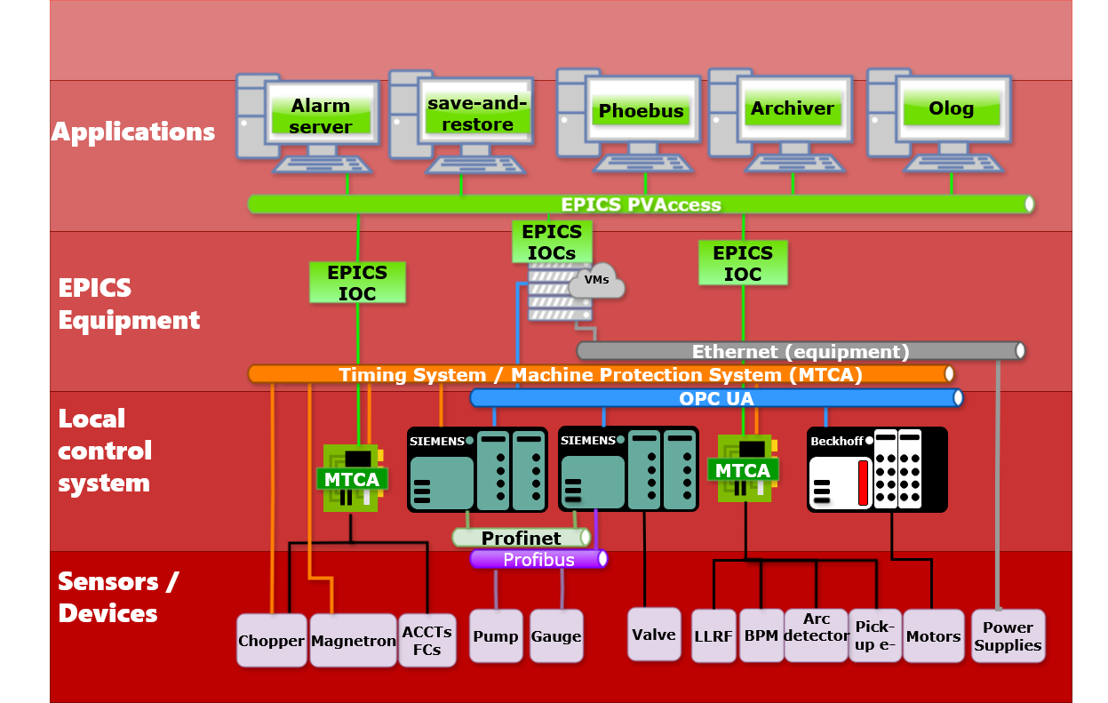
Main synoptic architecture

Slide 18
Main synoptic architecture
Deploy
EPNix
Build
Test
Deploy
Deploy
Deploy

Slide 19

Thanks for your attention
Any questions ?
  ICONE : https://www.icone-neutron.fr/
  Nix : https://nixos.org/
  EPNix : https://epics-extensions.github.io/EPNix/
  Machine Protection System at SARAF (A. Gaget): https://accelconf.web.cern.ch/icalepcs2023/posters/thpdp102_poster.pdf
  MRF Timing System Design at SARAF (A. Gaget): https://accelconf.web.cern.ch/icalepcs2021/posters/thpv022_poster.pdf
  FPGA development on MTCA.4 at CEA (V. Nadot), talk for MTCA workshop of this meeting.

Slide 20
Annex

Slide 21
Hardware platform
Requirements of the devices | Sampling/monitoring frequency range | COTS solutions
Fast acquisition | 5 MS/s 250 MS/s | MTCA.4 IOxOS IFC 1410 & FMC ADC-3111
Semi-fast acquisition | 50 KS/s up to 5 MS/s | MTCA.4 - IOxOS IFC 1410 & IOxOS FMC ADC-3117 MTCA.4 - Desy Z7IO && D-Tacq ELF24
Remote I/Os control LAN | 100 ms up to 1s | Industrial PC / Virtual Machines on a dedicated server Beckhoff
Process for vacuum/ cryogenics & Remote I/Os & Interlock | 100 ms up to 1s | Siemens 1500 PLC & I/O boards/ Profinet/Profibus Fieldbuses & remote I/Os

Slide 22
BDM – Beam Destination Master
BDM PLC
Injector Interlock PLC
Injector Vacuum PLC
Cryomodule 3 PLC
Cryomodule 4 PLC
MEBT vacuum and water PLC
Cryomodule 1 PLC
Cryomodule 2 PLC
MEBT diagnostics PLC
Beam Blocker PLC
BDM based on PLC Siemens
BDM gets data from low level PLC and compare it to conditions for a beam destination.
If an error occurs, the beam stopper is inserted and a signal is sent to the Timing.

Slide 23
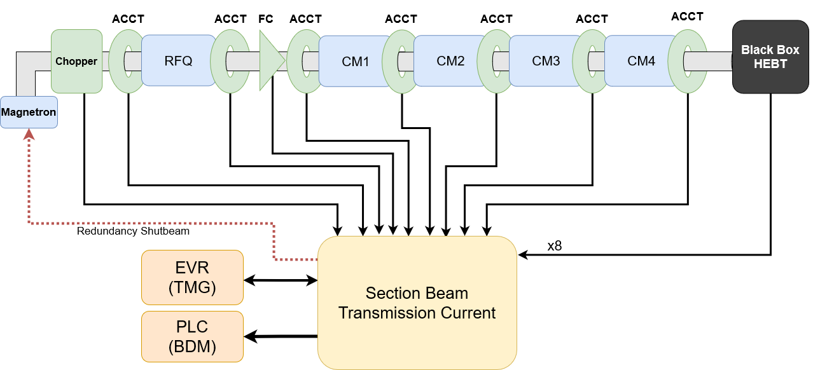
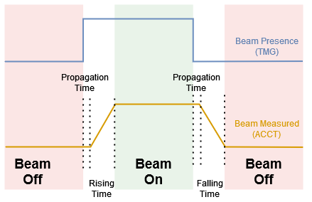
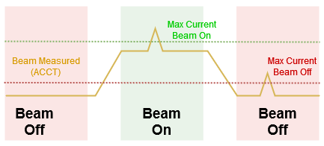
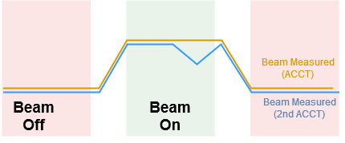
Section Beam Current Transmission - SBCT
ShutBeam Redundancy
Beam Amplitude Checking
Beam On/Off management
Current differences

Slide 24
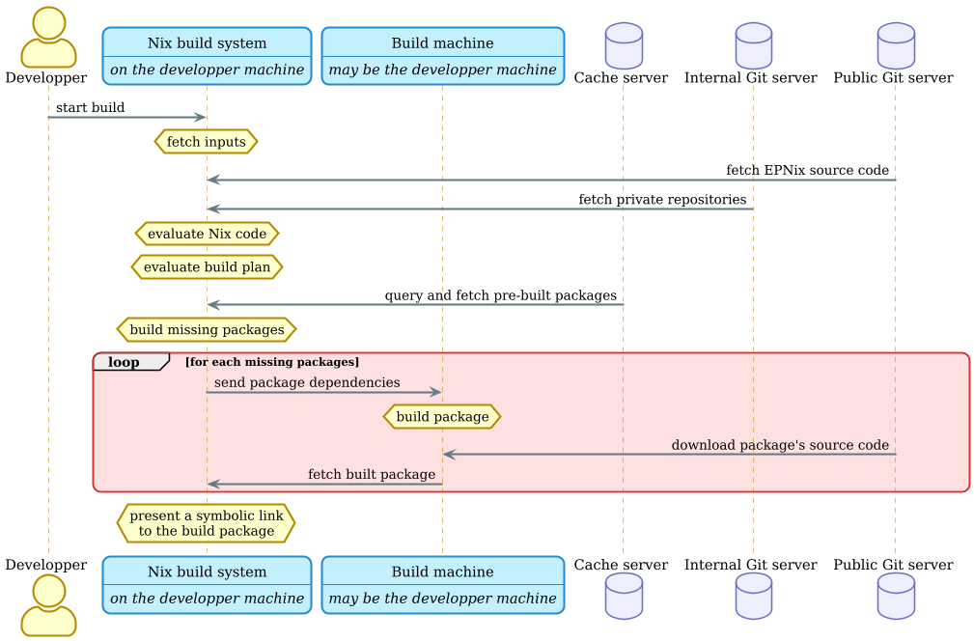
EPNix – sequence diagram

