Slide 1
ISIS Source
Site Report
Ivan Finch
Aqeel AlShafei, Kathryn Baker, Raunakk Banerjee, Gareth Howells, Ajit Kurup, Mateusz Leputa, Paul Ray, Mihnea Romanovschi
EPICS Collaboration Meeting Spring 2025, Rutherford Appleton Laboratory
Monday 7 April
Notes:
Make very clear that I'm talking about the accelerators. We don't have a unified controls team at ISIS. Freddie Akeroyd's team has finished their transition to EPICS and it looks very different to ours!

Slide 2





A Brief Recap of Our EPICS
Every site does EPICS differently. This is how ISIS Source is built:
PVAccess protocol (not CA)
Hardware Interfaces:
  Python / p4p for in-house developed, e.g. Moxa, MQTT, CIP
  "Conventional" IOCs developed by the EPICS community
  Vsystem through pvecho (bridge between control systems)
Servers and services:
  Deployed into container environment (Docker Swarm)
  Using Phoebus middleware for archiving, save-and-restore, etc.
User interfaces
  Using Phoebus and its infrastructure for HMIs and other user interfaces
  Exploring other web technologies, e.g. streamlet for ML
Notes:
This is a version of a slide I give at every talk about our transition from Vsystem to EPICS
Not much has changed significantly in our overall design. Key changes:
we have now deployed conventional IOCs
our server and middleware setup is more mature
We are confident we won't need to implement CA (more likely that ISIS Experiment Controls will meet us, they are beginning to experiment with pva)
Normally I emphasise what we have learned from the EPICS community

Slide 3
What we've done since the last Meeting
Deployed our first "conventional" IOCs (community developed):
  Modbus
  FINS (~25% of our Vsystem channels)
  CPS / PXI – in-house hardware using XML protocol (~50% of our Vsystem channels)
  Exploring OPC-UA as our preference for the future
Developed a CI/CD pipeline to deploy our IOCs in containers
  On db change, only that container is restarted with new config
  On IOC change, all containers may be restarted
PV Naming Convention
  Improved standard with feedback from equipment owners. Standardising of suffixes.
  Begun work on validator website, inspired by SNS example
SnowSignal (UDP Broadcast Relay) – fixed issues with IP fragmentation
Notes:
Modbus was straightforward, with some deep-rooted caveats I'll address later
FINS is more complex – with the assistance of our contractors from Mobiis we (Gareth) are converting the existing Vsystem databases to EPICS. Without belittling the work, the databases are relatively straightforward, all the logic embedded inside and outside the databases is far from it.
CPS / PXI waiting on p4p for ISIS tools to be discussed later. Will have the same problems as FINS
Attribute CI/CD work to Aqeel
PV Naming (led by Ajit, with Gareth and Sarah Fisher)
SnowSignal here mostly because I gave a talk at the last Collab Meeting and there have been some important bug fixes we're almost finished testing

Slide 4
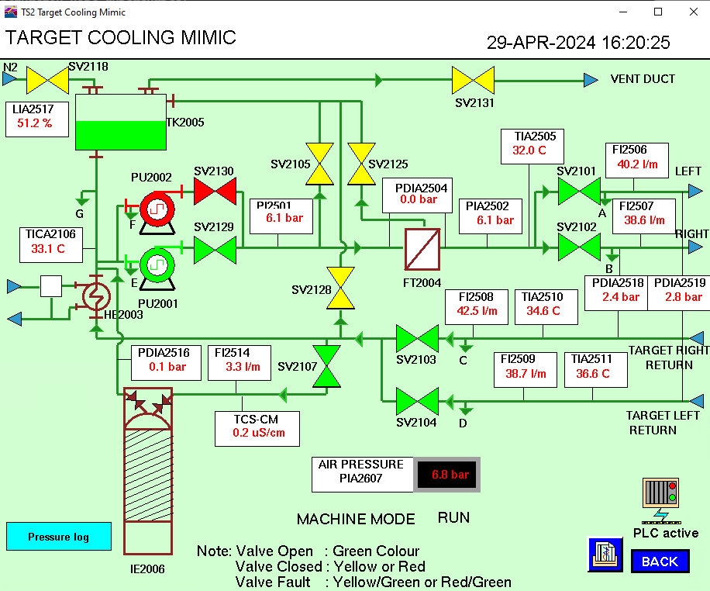
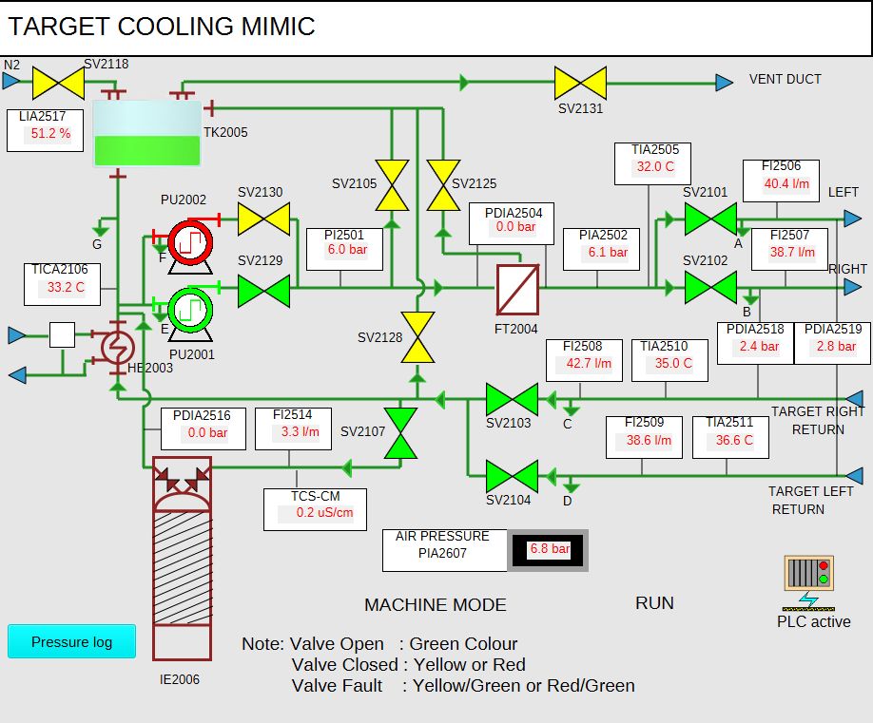
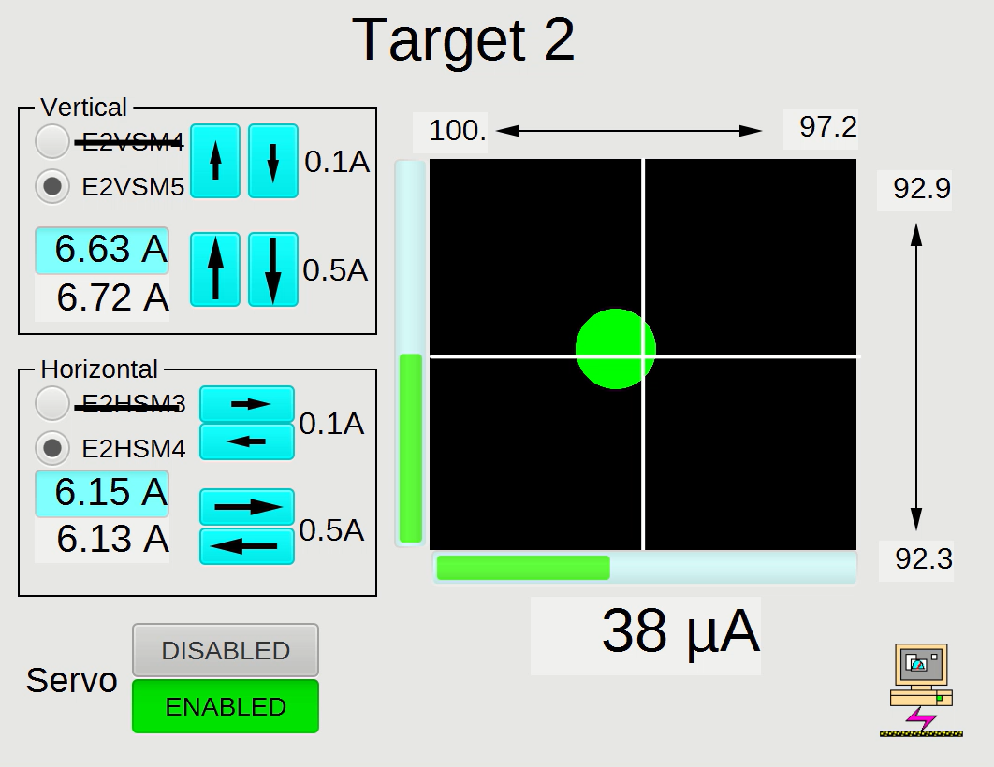
Our Path to EPICS
We started with and still use Vsystem, a "cousin" of EPICS.
Built pvecho (v2e and e2v) to bridge between the two control systems:
Built on-top of systems originally intended to monitor Vsystem for improved archiving
MQTT, CouchDB (NoSQL database)
Built using pvapy, many parts by analogy with Vsystem
Our first "IOC" was an interface to Omron PLCs using the CIP protocol:
Developed using p4p and existing Python code
The PLC fully configures the PVs, including the PV name and alarm triggers
We now have a complex control system! For example, our target steering reads thermocouples in EPICS, pvecho sends the data to Vsystem so that code written in Basic and running on OpenVMS can adjust steering magnets currents, and the new values are sent back to EPICS. There is no "conventional" IOC in this PID loop.
Notes:
Previously these talks have always emphasised how we're doing EPICS the same as other sites, maybe a little ahead with the pva part. This time I want to speak to how and why we're different
Don't go into the complex history of Vsystem and EPICS, the short version is they came out of the same work in '80s at Los Alamos and were rivals/competitors in the '90s. Shortest vesion is that EPICS is OSS and Vsystem is commercial.
Attribute pvecho to Kathryn, note that she and the rest of our ML team are at the 5th ICFA Beam Dynamics Mini-Workshop on Machine Learning for Particle Accelerators at CERN
Emphasise that not every development decision is made with careful planning, we built our system out of what was available
Pvapy was a considered decision, we wanted to be able to fall back on CA. In hindsight it was the wrong decision!
The chief point here is that we built a kind-of complete EPICS system without "conventional" IOCs. They're still new for us!

Slide 5
Development to Support Our Approach
PV Naming:
In Vsystem all channel names were guaranteed unique (centralised), in EPICS uniqueness must be enforced
Developed tools for automated renaming of PVs across multiple systems (screens, alarms, S&R, etc.). Still problems with tracking changes to name.
P4p for ISIS:
We keep reinventing the wheel when using p4p, we decided to standardise.
P4p supplies the structure of pva Normative Types but not their logic
Need additional features, e.g. analogues of calc records and forward links
RecCaster / pyRecCaster
Mandate that all IOCs or equivalents must use RecCaster to report on existence of PVs, and IOCstats.
In the case of p4p for this required the development of a new tool pyRecCaster. Expected enhancement to pvecho.
Will allow us to identify, verify PV names, and automatically archive new PVs, etc.
ChannelFinder
Plan to use approach from other sites of automatically triggering archiving, etc.
With PV Naming, role in automatically generating engineering screens
Notes:
Community has emphasised importance of naming convention. For our operators and managers this should make it much easier to identify data.
All of our channels in Vsystem fail to conform with our naming convention. We find that we often get names wrong (and "we" is a wider range due to our support of PLCs determining PV names). We need to be able to be able to correct our mistakes easily so we have developed a suite of PV renaming tools.
We plan to make p4p for ISIS available to our developers through a pip install and use it to make best practice easy, e.g. automatically validate names. P4p for ISIS isn't just used for hardware interfaces, it's also used by our ML team to make interfaces to their surrogate models available through Phoebus screens. P4p for ISIS is a mixture of features that we hope will be of interest to the community and configuration which is specific to ISIS. A version was presented at the previous EPICS Collaboration Meeting, Ajit will be giving a more detailed presentation on
PyRecCaster one of our two software development projects open-sourced since last meeting. (Other is SnowSignal)

Slide 6
Problems with Our Approach & "conventional" IOCs
Starting from Vsystem experience and pure Normative Types implementations to IOCs has exposed some assumptions that we made:
We set long alarm messages (>20 characters) and channel descriptions.
Up until Friday, alarm.message strings were displayed by Valarm unaltered via v2e
PV length limits affect us during testing, as our previous method was to prefix DEV:
PV, configuration from PLC (via MQTT)
RNG:WTR:EXTRACTSEPTUM1_PLC:DW4_LT01_LEVEL
value double = 78.45
alarm.severity int32_t = 1
alarm.status int32_t = 4
▶ alarm.message string = "ST12 Header Tank level DW4_LT01 Low Alarm"
▶ display.description string = "ST12 Header tank level(DW4_LT01)"
valueAlarm.active bool = true
valueAlarm.lowAlarmLimit double = 10
valueAlarm.lowWarningLimit double = 80
valueAlarm.highWarningLimit double = 100
valueAlarm.highAlarmLimit double = 150
valueAlarm.lowAlarmSeverity int64_t = 2
valueAlarm.lowWarningSeverity int64_t = 1
valueAlarm.highWarningSeverity int64_t = 1
valueAlarm.highAlarmSeverity int64_t = 2
hyst bool = true
channelName string = "RNG:WTR:EXTRACTSEPTUM1_PLC:DW4_LT01_LEVEL"
PV, from IOC
EPB1:MAG:ESEPTUM1:PSU:CURRENT
struct "epics:nt/NTScalar:1.0"
value double = 0
alarm.severity int32_t = 3
alarm.status int32_t = 2
▶ alarm.message string = "COMM"
valueAlarm.active bool = false
valueAlarm.lowAlarmLimit double = nan
valueAlarm.lowWarningLimit double = nan
valueAlarm.highWarningLimit double = nan
valueAlarm.highAlarmLimit double = nan
valueAlarm.lowAlarmSeverity int32_t = 0
valueAlarm.lowWarningSeverity int32_t = 0
valueAlarm.highWarningSeverity int32_t = 0
valueAlarm.highAlarmSeverity int32_t = 0
valueAlarm.hysteresis int8_t = 0
Notes:
Example on the left is an example of a PV we're going to have to work on renaming as it doesn't meet our revised naming standard. Non-standard suffix and includes

Slide 7
Other work
Vsystem to EPICS migration, supporting other institutions:
Visit by PARTREC from the Netherlands – radiation therapy research
In contact with Helmholtz-Zentrum Berlin – proton therapy
Machine learning:
Automated tuning of the LEBT, working towards deployment through Phoebus
Virtual Injector PLP will extend this to the rest of the injector
Notes:
Give a shout out to Klaas Winter at Partrec

