Slide 1
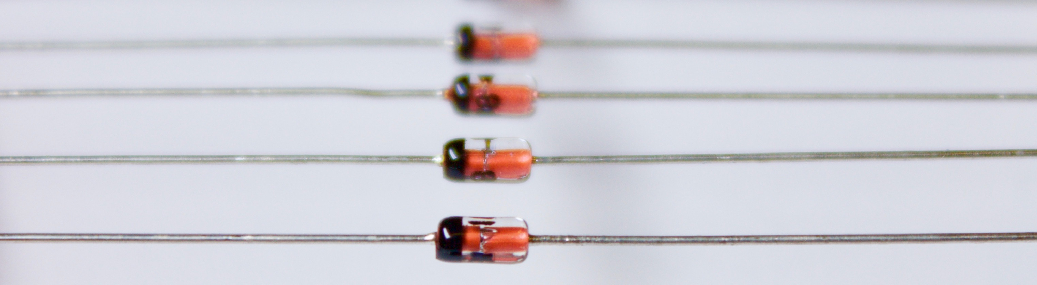

EPICS Diode
One-Way Data for ITER Remote Participation
Ralph Lange, ITER Organization
EPICS Collaboration Meeting, 07-11 April 2025

Slide 2
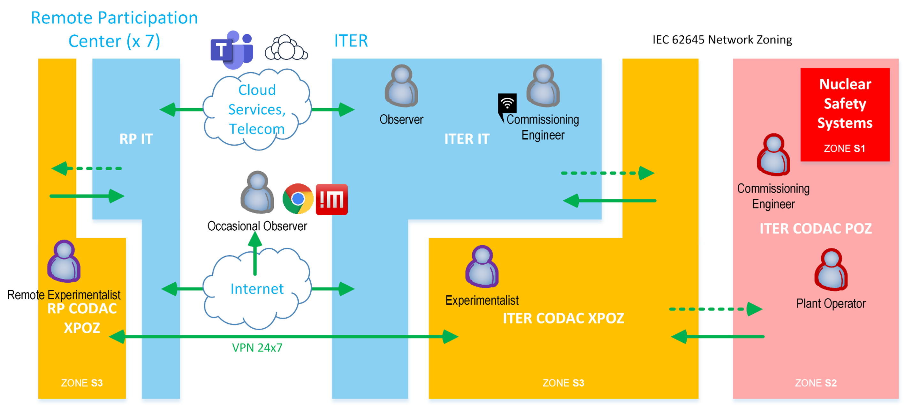
ITER Remote Participation Scope
Plant Operators: local access from plant network (POZ, IEC 62645 S2) using control system (CODAC) tools
Experimentalists: access from experiment preparation and analysis network (XPOZ, S3) using CODAC tools in read-only mode. Could be both local and remote
Occasional Users: remote access from office network / internet (S4) using web / remote desktop tools
Network zone extension to a remote site is done using a VPN (zones S1 / S2 require on-site presence)
Focus in this talk on uni-directional live data extraction

Slide 3
Background
F4E (Giuseppe Ferro et al.) developed an EPICS Data Diode (presented at the EPICS Collaboration Meeting in 2020). Their implementation uses HTTP on the long distance.
I&C security audit by Thales in 2020 recommended getting rid of EPICS gateways on plant network boundary in favor of indirect access via live databases or archives. If propagation delay would be too high, a diode-like solution was recommended.
ITER (Leonid Lobes) has tested CA working fine over long distance (presented at the EPICS Collaboration Meeting in 2022), meaning propagation of EPICS traffic could be a viable option for ITER remote centers.
Nuclear licensing in France could result in severe limitations on live data exposure, so ITER decided to make another implementation of a diode using a strictly uni-directional protocol (one-way UDP). This would also mean freedom from vendor-lock, as most commercial diodes support UDP out of the box (but none support EPICS).
Don’t reinvent
the wheel,
just realign it.
Anthony D’Angelo

Slide 4
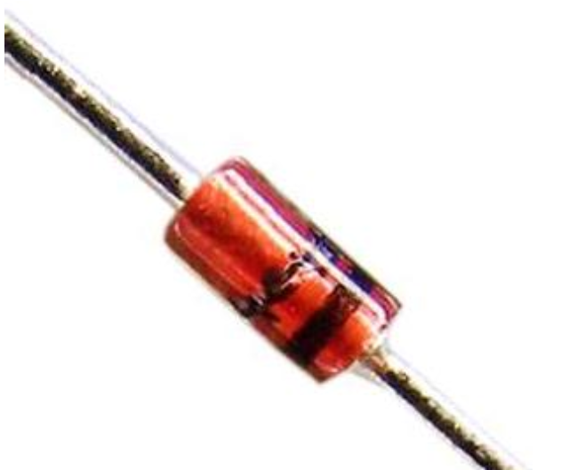
Requirements
One-way UDP
50.000 simple PVs per instance @ 10 Hz update
Support of CA (V1) and PVA (V2)
Propagation delay ≤ 100 ms
Detection of stale connection (dead sender)
Only value updates are transferred; DB (re-)configuration is considered as maintenance action not in scope
No modification of source IOCs and servers (if possible)
Can be turned on / off without impact on plant controls
High integrity coding for sender (plant) side

Slide 5
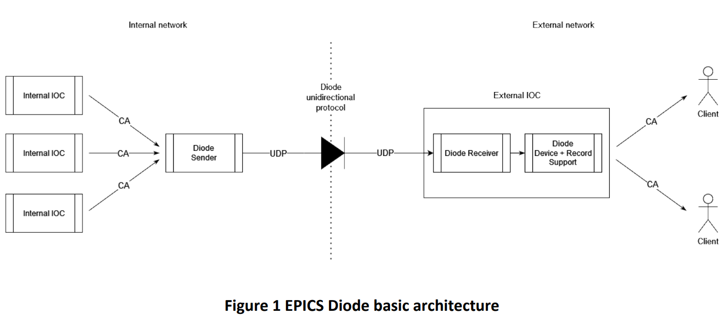

text
text
text
Replicating an IOC Using a UDP Stream (version 0)
Both sides (sender and receiver) are fully configured.
Sender has CA subscriptions and sends updates (value/time/status) through a mostly binary UDP streaming protocol.
Receiver Device Support reads data into the EPICS Database.
The setup is local, with CA being used locally or across the long distance.
Replicating an IOC Using a UDP Stream (version 0)
Both sides (sender and receiver) are fully configured.
Sender has CA subscriptions and sends updates (value/time/status) through a mostly binary UDP streaming protocol.
Receiver Device Support reads data into the EPICS Database.
The setup is local, with CA being used locally or across the long distance.
text

Slide 6
text
Replicated Records
text
text
Replicating an IOC Using a UDP Stream (version 1)
Both sides (sender and receiver) are fully configured.
Sender has CA subscriptions and sends updates (value/time/status) through a mostly binary UDP streaming protocol.
Receiver pushes data into the EPICS Database and sends out CA updates.
The setup is local, with CA being used locally or across the long distance.
Replicating an IOC Using a UDP Stream (version 1)
Both sides (sender and receiver) are fully configured.
Sender has CA subscriptions and sends updates (value/time/status) through a mostly binary UDP streaming protocol.
Receiver pushes data into the EPICS Database and sends out CA updates.
The setup is local, with CA being used locally or across the long distance.
text

Slide 7
Configuration and Startup
Both sender and receiver are configured using the same JSON file.
{
// Minimum sender update period in seconds. (min = 0.025)
"min_update_period": 0.025,
// Polled fields update period in seconds. (min = 3.0)
"polled_fields_update_period": 5.0,
// Heartbeat period in seconds. (min = 0.1)
"heartbeat_period": 15.0,
// Maximum sender sent rate in MB/s, 0 for no limit.
"rate_limit_mbs": 64,
// Array of channels to export (order matters!).
"channel_names": {
"MSC:T-0":{},
"MSC:T-1":{},
...
}
}
IOC shell integration (receiver):
# Configure records read-only
asSetFilename("$(DIODE_ROOT)/cfg/readOnly.acf")
# Load DBD
dbLoadDatabase("$(DIODE_ROOT)/dbd/testDiode.dbd")
testDiode_registerRecordDeviceDriver(pdbbase)
# Trace = 0, Debug = 1, Config = 2, Info = 3 (default),
# Warning = 4, Error = 5
diodeLogLevel(3)
# Load DB
dbLoadRecords("$(DIODE_ROOT)/db/db_test_2000.db")
# Start the receiver thread with the listening port & IP
diodeReceiverStart("$(DIODE_ROOT)/cfg/diode.json", 5080, "10.130.1.102")
# Start the IOC
diodeIocInit()

Slide 8
IOC Databases
Inside (no modification of existing records):
record(calc, "MSC:T-0") {
field(CALC, "B?0:val+1")
field(SCAN, "0")
field(FLNK, "MSC:T-1")
field(INPB, "MSC:RESET")
}
record(calc, "MSC:T-1") {
field(CALC, "B?0:val+1")
field(SCAN, "Passive")
field(FLNK, "MSC:T-2")
field(INPB, "MSC:RESET")
}
...
Outside (optional markup of records with a non-standard sequence number):
record(calc, "MSC:T-0") {
field(CALC, "B?0:val+1")
field(SCAN, "0")
field(FLNK, "MSC:T-1")
field(INPB, "MSC:RESET")
}
record(calc, "MSC:T-1") {
info(diode_cix, "1")
field(CALC, "B?0:val+1")
field(SCAN, "Passive")
field(FLNK, "MSC:T-2")
field(INPB, "MSC:RESET")
}
...
A diode_dbgen tool could be used to query the IOC on the inside and produce a DB file for the IOC on the outside. The info field “diode_cix” is only required if the name of the PV on the outside is different from the one inside / in the config.

Slide 9
Sender Integration in ITER CODAC Environment
$ sudo systemctl start codac-7.1-epics-diode-poz@10.130.1.102
$ sudo systemctl status codac-7.1-epics-diode-poz@10.130.1.102
● codac-7.1-epics-diode-poz@10.130.1.102.service
Loaded: loaded (/usr/lib/systemd/system/codac-7.1-epics-diode-poz@.service; disabled; vendor preset: enabled)
Active: active (running) since Wed 2024-09-11 06:58:03 UTC; 9s ago
Main PID: 120690 (diode_sender)
Tasks: 6 (limit: 49463)
Memory: 2.3M
CGroup: /system.slice/system-codac\x2d7.1\x2depics\x2ddiode\x2dpoz.slice/codac-7.1-epics-diode-poz@10.130.1.102.service
└─120690 /opt/codac-7.1/apps/epics-diode/bin/diode_sender -c /opt/codac-7.1/apps/epics-diode/cfg/diode.json 10.130.1.102
Sep 11 06:58:03 4504ds-srv-0029.codac.iter.org systemd[1]: Started codac-7.1-epics-diode-poz@10.130.1.102.service.
Sep 11 06:58:03 4504ds-srv-0029.codac.iter.org diode_sender[120690]: 2024-09-11T06:58:03.398 [config] Loading configuration from '/opt/codac-7.1/apps/epics-diode/cfg/diode.json'.
Sep 11 06:58:03 4504ds-srv-0029.codac.iter.org diode_sender[120690]: 2024-09-11T06:58:03.399 [sender] Initializing transport, send list: [10.130.1.102:5080].
Sep 11 06:58:03 4504ds-srv-0029.codac.iter.org diode_sender[120690]: 2024-09-11T06:58:03.399 [sender] Initializing CA.
Sep 11 06:58:03 4504ds-srv-0029.codac.iter.org diode_sender[120690]: 2024-09-11T06:58:03.399 [sender] Creating 2000 channels.

Slide 10
Network Tuning
Best performance requires significantly increasing network buffers and packet sides on both parts of the diode:
# Receiver side
$ sudo sysctl -w net.core.rmem_default=26214400
$ sudo sysctl -w net.core.rmem_max=26214400
# Sender side
$ sudo sysctl -w net.core.wmem_default=26214400
$ sudo sysctl -w net.core.wmem_max=26214400
# Both sides
$ sudo ifconfig eth0 mtu 9000

Slide 11
Performance Test Configuration
Reference:
Software Diode:
Hardware Diode:

Slide 12


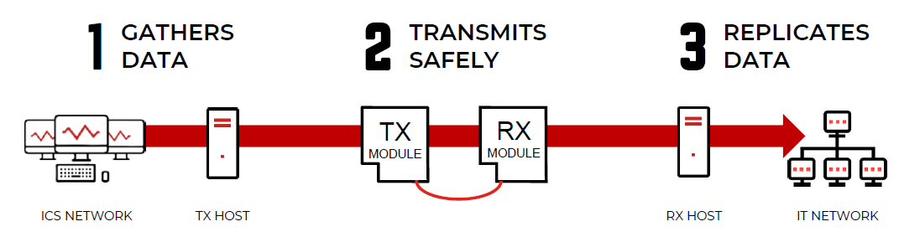
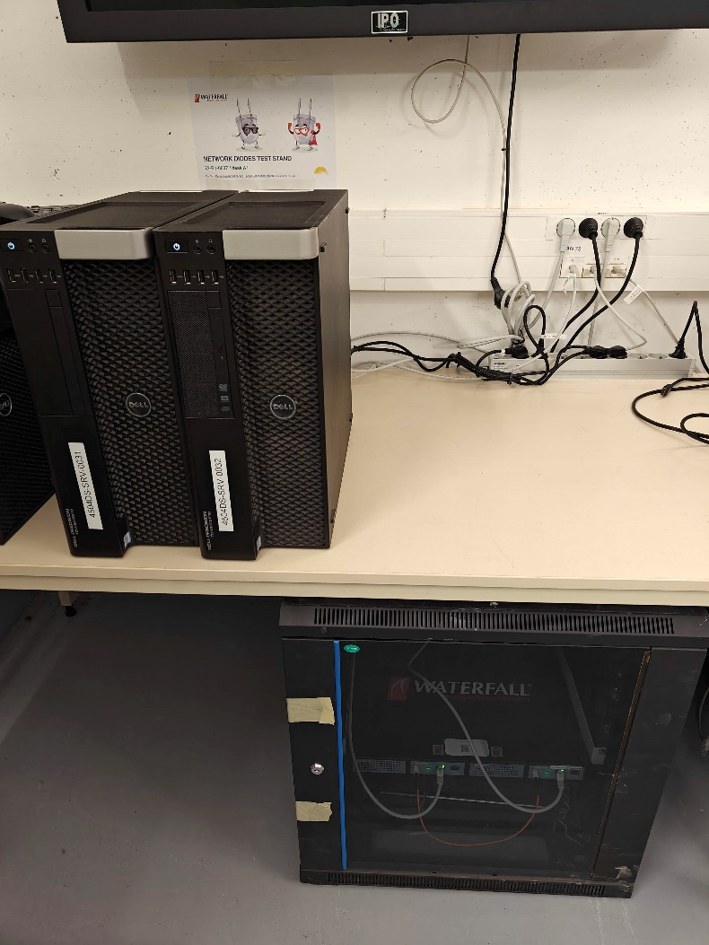
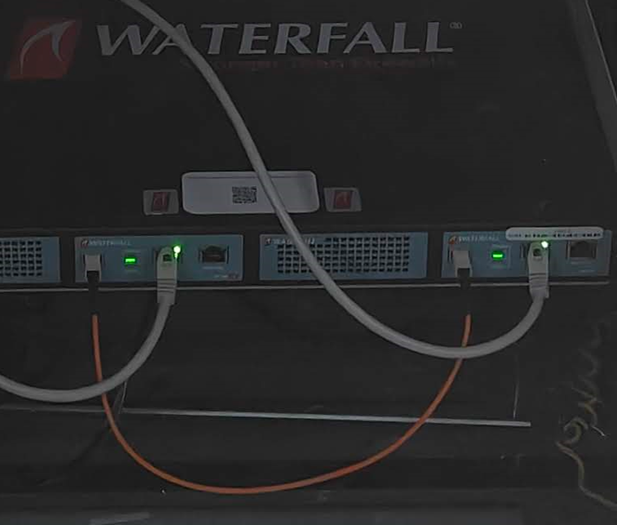
Hardware Diode Test Stand
+ two client virtual machines with EPICS software diode (not shown)
Internal network (TX)
External network (RX)
Diode host INT
Diode host EXT
Uni-directional fiber connection
Waterfall WF-500. 1 Gbps UDP. Embedded hosts available as option
Hardware Diode

Slide 13
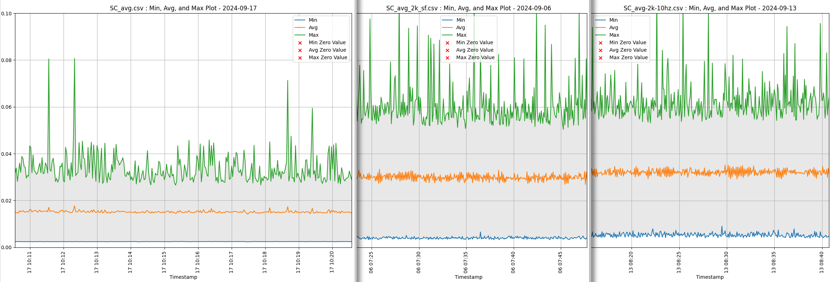
Propagation Delay Test: 2.000 PV at 10 Hz (Graph)
Time (s)
Direct reading:
With a software diode:
With a hardware diode:

Slide 14
Propagation Delay Test: 2.000 PV at 10 Hz (Tabular) – Software Diode
Direct reading:
With a software diode:
Time , min , Avg , max
2024-09-09 07:30:35.006, 0.00222794, 0.0147023, 0.028491
2024-09-09 07:30:40.009, 0.00225168, 0.0156245, 0.0433001
2024-09-09 07:30:45.012, 0.00226114, 0.0148075, 0.0335019
2024-09-09 07:30:50.016, 0.00224274, 0.0153224, 0.0549977
2024-09-09 07:30:55.029, 0.00224464, 0.0148566, 0.0317156
2024-09-09 07:31:00.037, 0.00223602, 0.0149802, 0.0363677
2024-09-09 07:31:05.044, 0.00219899, 0.0148636, 0.0307716
2024-09-09 07:31:10.056, 0.00225856, 0.0150708, 0.0370319
2024-09-09 07:31:15.065, 0.0022554, 0.0150547, 0.039358
2024-09-09 07:31:20.071, 0.00224622, 0.0151776, 0.0396417
2024-09-09 07:31:25.077, 0.00225115, 0.0150516, 0.036602
2024-09-09 07:31:30.084, 0.00226824, 0.0151594, 0.0429711
2024-09-09 07:31:35.090, 0.00224812, 0.0148512, 0.0294496
2024-09-09 07:31:40.095, 0.00223143, 0.0148588, 0.0363419
2024-09-09 07:31:45.101, 0.00225451, 0.0153008, 0.04302
2024-09-09 07:31:50.105, 0.00225747, 0.0153995, 0.0392186
2024-09-09 07:31:55.110, 0.00227762, 0.0149405, 0.0326959
2024-09-09 07:32:00.116, 0.00224443, 0.0153642, 0.0444384
2024-09-09 07:32:05.125, 0.00224313, 0.0149166, 0.0394424
2024-09-09 07:32:10.133, 0.00228578, 0.0153907, 0.0412106
2024-09-09 07:32:15.138, 0.00230542, 0.0152157, 0.0410428
2024-09-09 07:32:20.143, 0.00228728, 0.014978, 0.0369561
2024-09-09 07:32:25.149, 0.00228458, 0.0153488, 0.0322483
Time , min , Avg , max
2024-09-06 07:23:08.958, 0.00523455, 0.0291069, 0.0563685
2024-09-06 07:23:13.962, 0.00329676, 0.0304606, 0.0552727
2024-09-06 07:23:18.965, 0.00398524, 0.029149, 0.0702227
2024-09-06 07:23:23.969, 0.00452183, 0.0290567, 0.0611334
2024-09-06 07:23:28.974, 0.00464556, 0.0299505, 0.0539586
2024-09-06 07:23:33.977, 0.00454899, 0.0307251, 0.0610959
2024-09-06 07:23:38.980, 0.00396552, 0.0329809, 0.0668529
2024-09-06 07:23:43.984, 0.00385853, 0.0299367, 0.0778222
2024-09-06 07:23:48.987, 0.00357364, 0.0316497, 0.0646217
2024-09-06 07:23:53.993, 0.00360718, 0.0293324, 0.0529508
2024-09-06 07:23:58.996, 0.00402128, 0.0294285, 0.0548909
2024-09-06 07:24:04.000, 0.00401748, 0.0296965, 0.0547798
2024-09-06 07:24:09.012, 0.0038931, 0.0311468, 0.0755579
2024-09-06 07:24:14.019, 0.00433052, 0.0296455, 0.0576727
2024-09-06 07:24:19.022, 0.00357776, 0.0296013, 0.0561386
2024-09-06 07:24:24.026, 0.00382108, 0.0301167, 0.0580669
2024-09-06 07:24:29.031, 0.00401149, 0.0290561, 0.0591794
2024-09-06 07:24:34.037, 0.00471695, 0.0314323, 0.0618587
2024-09-06 07:24:39.046, 0.00329788, 0.0288512, 0.0552057
2024-09-06 07:24:44.050, 0.00455049, 0.0318294, 0.0596405
2024-09-06 07:24:49.054, 0.00343947, 0.0289353, 0.0975649
2024-09-06 07:24:54.058, 0.00383182, 0.0308581, 0.0673679
2024-09-06 07:24:59.062, 0.00405254, 0.0300098, 0.0547065
Avg
Difference
Avg
0.002339
0.015223
0.039427
0.001704
0.014688
0.021054
0.004042
0.029911
0.060481
(seconds)
Latency ~ 15 ms = Requirement met.
2024-09-09 08:29:28.234, 0.0023682, 0.0155377, 0.0367443
2024-09-06 08:21:57.066, 0.00340158, 0.0253352, 0.0548381

Slide 15
Propagation Delay Test: 2.000 PV at 10 Hz (Tabular) – Hardware Diode
Direct reading:
In 5 s window
With a hardware diode:
Time , min , Avg , max
2024-09-09 07:30:35.006, 0.00222794, 0.0147023, 0.028491
2024-09-09 07:30:40.009, 0.00225168, 0.0156245, 0.0433001
2024-09-09 07:30:45.012, 0.00226114, 0.0148075, 0.0335019
2024-09-09 07:30:50.016, 0.00224274, 0.0153224, 0.0549977
2024-09-09 07:30:55.029, 0.00224464, 0.0148566, 0.0317156
2024-09-09 07:31:00.037, 0.00223602, 0.0149802, 0.0363677
2024-09-09 07:31:05.044, 0.00219899, 0.0148636, 0.0307716
2024-09-09 07:31:10.056, 0.00225856, 0.0150708, 0.0370319
2024-09-09 07:31:15.065, 0.0022554, 0.0150547, 0.039358
2024-09-09 07:31:20.071, 0.00224622, 0.0151776, 0.0396417
2024-09-09 07:31:25.077, 0.00225115, 0.0150516, 0.036602
2024-09-09 07:31:30.084, 0.00226824, 0.0151594, 0.0429711
2024-09-09 07:31:35.090, 0.00224812, 0.0148512, 0.0294496
2024-09-09 07:31:40.095, 0.00223143, 0.0148588, 0.0363419
2024-09-09 07:31:45.101, 0.00225451, 0.0153008, 0.04302
2024-09-09 07:31:50.105, 0.00225747, 0.0153995, 0.0392186
2024-09-09 07:31:55.110, 0.00227762, 0.0149405, 0.0326959
2024-09-09 07:32:00.116, 0.00224443, 0.0153642, 0.0444384
2024-09-09 07:32:05.125, 0.00224313, 0.0149166, 0.0394424
2024-09-09 07:32:10.133, 0.00228578, 0.0153907, 0.0412106
2024-09-09 07:32:15.138, 0.00230542, 0.0152157, 0.0410428
2024-09-09 07:32:20.143, 0.00228728, 0.014978, 0.0369561
2024-09-09 07:32:25.149, 0.00228458, 0.0153488, 0.0322483
Time , min , Avg , max
2024-09-13 08:15:03.128, 0.00490939, 0.0313841, 0.0538449
2024-09-13 08:15:08.131, 0.00425254, 0.0320064, 0.0862429
2024-09-13 08:15:13.135, 0.00559753, 0.0318712, 0.0642206
2024-09-13 08:15:18.139, 0.00548258, 0.0318799, 0.0598045
2024-09-13 08:15:23.142, 0.00568218, 0.0325599, 0.0746377
2024-09-13 08:15:28.146, 0.00423283, 0.0335971, 0.0636418
2024-09-13 08:15:33.149, 0.00636099, 0.0299653, 0.0644183
2024-09-13 08:15:38.153, 0.00472146, 0.0333809, 0.0601963
2024-09-13 08:15:43.156, 0.00473473, 0.031251, 0.0635979
2024-09-13 08:15:48.160, 0.00470414, 0.0337608, 0.0581836
2024-09-13 08:15:53.163, 0.00664546, 0.0308281, 0.0940041
2024-09-13 08:15:58.167, 0.00433338, 0.0331315, 0.0591587
2024-09-13 08:16:03.170, 0.00487864, 0.0305319, 0.062216
2024-09-13 08:16:08.173, 0.00479006, 0.0335254, 0.057082
2024-09-13 08:16:13.177, 0.00603843, 0.0300104, 0.0598382
2024-09-13 08:16:18.181, 0.00476638, 0.033446, 0.0622389
2024-09-13 08:16:23.184, 0.00504441, 0.0302326, 0.0665274
2024-09-13 08:16:28.187, 0.0043991, 0.031836, 0.0594936
2024-09-13 08:16:33.191, 0.0053994, 0.0318103, 0.0547522
2024-09-13 08:16:38.195, 0.00459638, 0.0316021, 0.0592841
2024-09-13 08:16:43.201, 0.00556159, 0.0319331, 0.0685137
2024-09-13 08:16:48.204, 0.00418333, 0.0322342, 0.0559437
avg
Difference
avg
0.002339
0.015223
0.039427
0.002882
0.016797
0.023306
0.00522
0.03202
0.06273
(seconds)
Latency ~ 17 ms = Requirement met.
2024-09-09 08:29:28.234, 0.0023682, 0.0155377, 0.0367443
2024-09-13 09:14:55.779, 0.00499899, 0.0299252, 0.0539671

Slide 16
PV Loss Test: 10 Hz Updates over 24 h – Software Diode
Losses above 2.000 PV @ 10 Hz = Requirement not met.
Datetime
N of PV lost in the event
4.000 PV @ 10Hz
3.000 PV @ 10Hz
2.000 PV @ 10Hz
2024-08-28 14:34:20, START
2024-08-28 16:26:27, 2046
2024-08-28 20:41:29, 2046
2024-08-29 00:12:20, 2046
2024-08-29 01:31:12, 2046
2024-08-29 13:17:18, 2046
2024-08-29 14:34:21, END
2024-09-04 12:45:27, START
2024-09-04 19:52:37, 2046
2024-09-05 00:56:50, 2046
2024-09-05 01:17:21, 2046
2024-09-05 02:45:36, 2046
2024-09-05 11:05:50, 3000
2024-09-05 12:08:28, 2046
2024-09-05 12:45:28, END
2024-09-05 15:18:26, START
2024-09-06 15:18:27, END
Few losses
Few losses
No losses
Moderate losses (≤ 5%) between 5.000 and 10.000 PVs, severe losses (> 15%) above 10.000 PVs. The rare glitch around 2046 PVs to be understood – UDP configuration issue or diode software issue?
Reason found: 2046 PVs = 1 UDP packet, we experience packet reordering in our virtualization platform, fix in progress

Slide 17
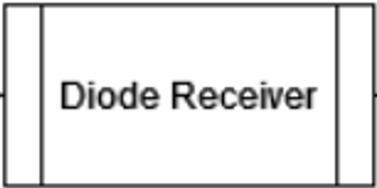
text
Internal
PVA Server
PVA
PVA
Internal
PVA Server
PVA
PVA
PVXS
PVXS
PVA
Internal
PVA Server
text
text
Replicating PVA Using a UDP Stream (prototype of version 2)
Both sides (sender and receiver) are fully configured.
Sender has PVA subscriptions and sends updates through a mostly binary UDP streaming protocol.
Receiver sends out PVA updates.
The setup is local, with PVA being used locally and across the long distance.
text

Slide 18
Status and Roadmap
Requirements and Design Documents are approved.
V1.0 supporting CA (record) PVs delivered by our contractor (Cosylab) in April 2024 and independently verified. User manual prepared.
Operation over hardware diode confirmed.
Prototype of V2.0 supporting PVA (structured) PVs has been delivered.
No production use is foreseen yet because ITER plant commissioning does not require this level of security.
There are no ITER specifics in the code.
It will be made available to the EPICS collaboration. (The ITER “Publication of Software” process has been started.)
Stay tuned for future reports on this.
Credits
Denis Stepanov, Leonid Lobes (ITER)
Matej Sekoranja (Cosylab)
Thank you!

