Slide 1


PLC PARSER TOOL EPICS Database generator
Katy SAINTIN
IRFU, CEA Saclay, France
EPICS Collaboration Meeting - April 7th - 11th 2025
ISIS Neutron and Muon Source

Slide 2


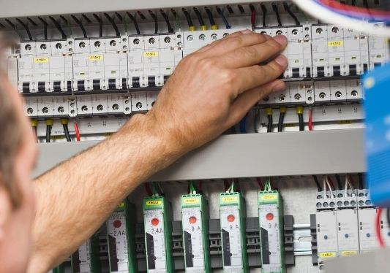

Technical context
“Limited” skills and available human resource
The laboratory was divided into 2 groups :
IT and Automation
IT developer without expertise in automation
Automation engineer without development skills
Notes:
Oversimplify the situation
Automaticien hate command line and love Windows Desktop / Drap and Drop tool
Developers hate Windows Deskop and love command line

Slide 3



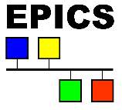




The needs in 1996
Mainly driven by the automation engineer
EPICS developers focused on ADAS VME Board drivers
Solution to generate the communication between automation and supervision easily
Initial release January 19 1999
Ground test 1988 Bob Dalesio, Jeff Hill, Marty Kraimer
ICALEPCS 1991,Tsukuba JAPAN hosted by KEK Inter-University
Accelerators in US : LANL , ANL …
Initial released April 19, 2001
POC demo 2000 Andy Götz, Jean-Michel Chaize, Emmanuel Taurel
ICALEPCS 1999, Trieste ITALY hosted by Elettra synchrotron
Synchrotrons in Europe : ESRF, SOLEIL …

Slide 4





MUSCADE : µ Embedded SCADA
Embedded in one device (including services)
Robust and compact industrial PC (extreme conditions )
In-house solution @CEA
Only 2 developers
Full pure java solution
Windows OS
SIEMENS PLC S7 drivers
Optimized archiving system
Advanced alarms management system
Secured remote access with certificates
Notes:
But French people all love food => Micro SCADA

Slide 5
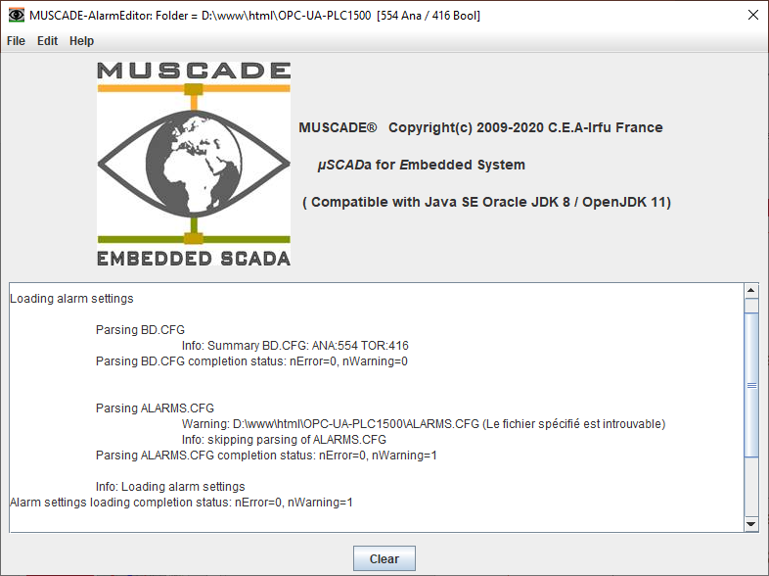
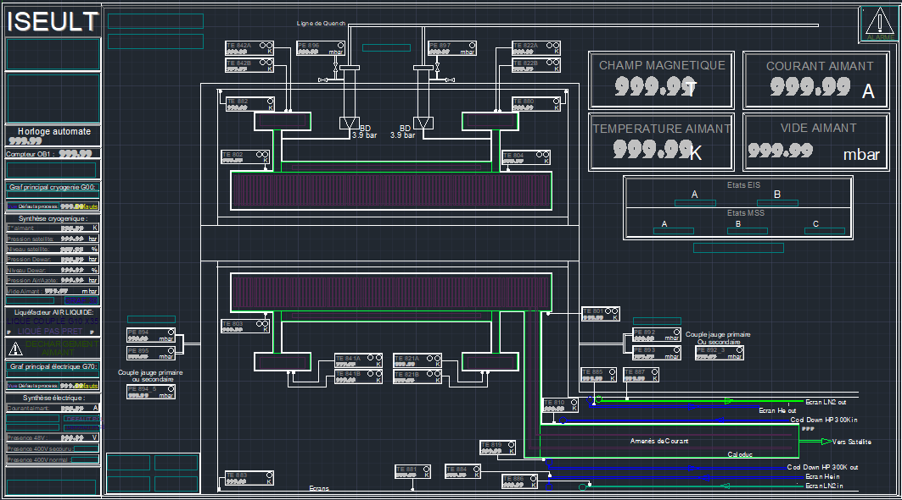

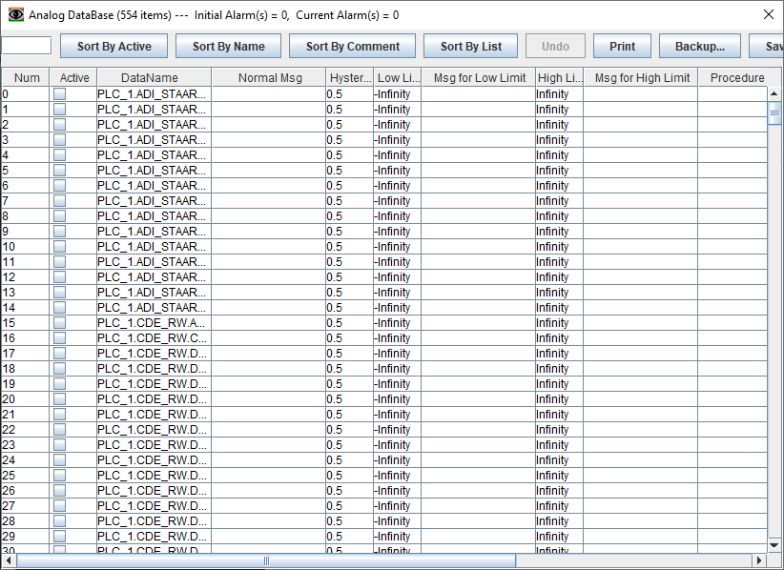
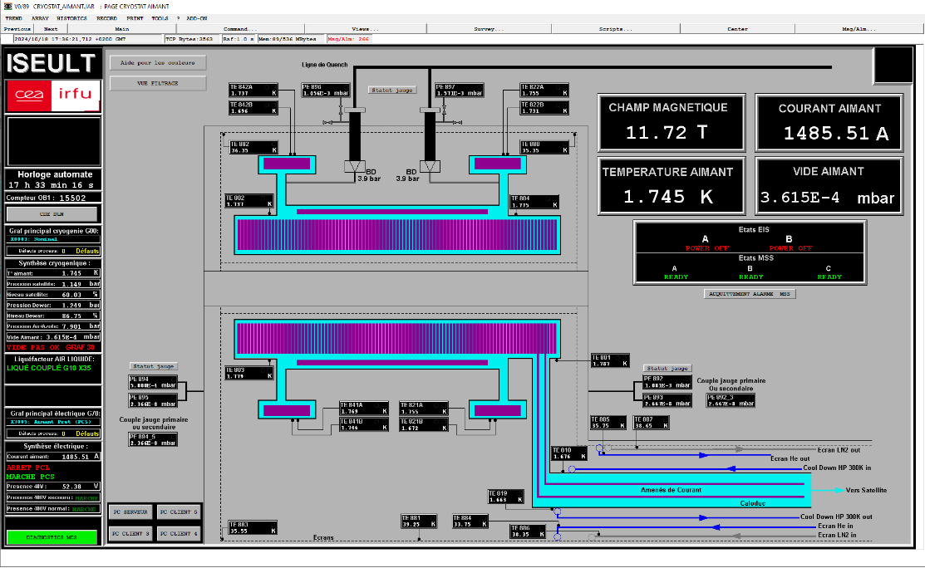
TOOLKITS to build server and supervision gui
Notes:
Cliquez sur Insertion puis En-tête/Pied pour saisir les champs « Evènement – Date » et « Service » ; puis cliquer sur Appliquer partout.

Slide 6
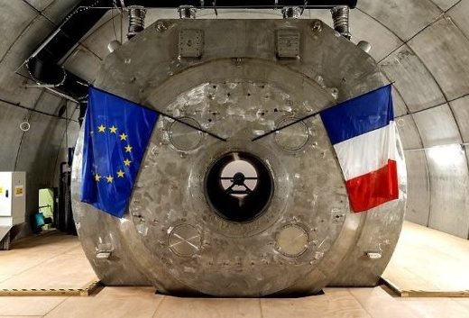

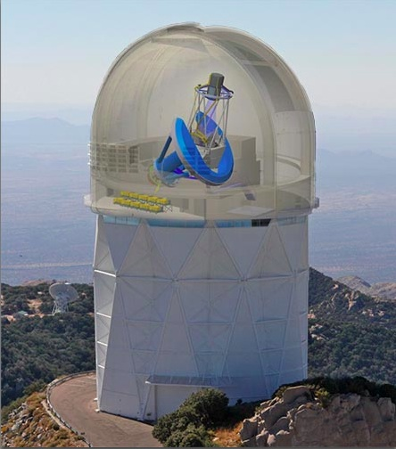

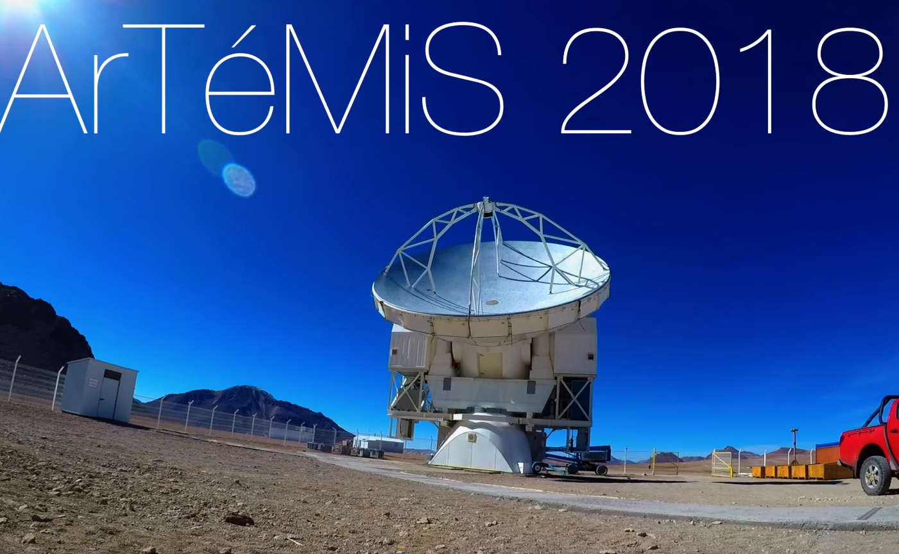
MUSCADE KEY FIGURES
Product team : 2022 the 2 experts have retired
1 developer
3 people in charge of operational support
Maintenance to keep operational until 2032
Installations :
90 servers
20 projects on CEA site
18 facilities off site
4 facilities supervised with EPICS
Support tracking for 2024 :
185 services tickets opened
62 service requests
17 issues
75 issues on site
46 outside the site (certificate expirations)
On site
ARIELIX
ATLAS
CHYMENE
CLAS12
EUCLID
IPHI*
ISEULT
JT60
LIQUE 4003
LIQUE 4008
LIQUE 4012
LOTUS
MAQUETTE
MGB2
MINOS
MIRIM
SCHEMA
SOPHI
STAARQ
LILIT
Off site
AGATA*
ARTEMIS
CMS-CDS
COCOTIER
COMPASS
DESI
ESS*
GBAR
IFMIF*
ISEULT
MEGACAM
NFS
R3B
SARAF
S3
SPIRAL2*
TAR
W7X-C1
ISEULT
DESI – Kitt Peak
Arizona
* On
ArTémis camera APEX
Chili
Notes:
Since 2022 on the 2 experts retirments, I took over the management and the development of the product

Slide 7


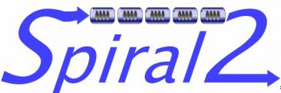






developments @ IRFU CEA
1993 TESLA test facility injector - Desy - GERMANY
2011 SPIRAL 2 Heavy-ion sources - Ganil - FRANCE
2013 IFMIF Lipac Accelerator - Rokkasho JAPAN
2014 ESS spallation source – Lund SUEDEN
2017 SARAF Accelerator - Soreq - ISRAEL
2021 AGATA detector - Fermilab - ITALY
2024 PIP II accelerator - Fermilab - ITALY
2025 SEASON detector – Igisol FINLAND
Notes:
In the same time …

Slide 8

Mains goals
Provide an intuitive tool to generate COM without requiring IT skills
Reduce human errors and accelerate development
Empower the user with autonomy
TO RELY on a TEAM
Eliminate the need for unique expertise
“Because alone we go faster but together we go further”

Slide 9





Supported drivers in both SCADA
Modbus Mark Rivers (Based on Asyn)
S7PLC Dirk Zimoch
S7 CEA support 2020 in house dev CEA
OPCUA support 2023 dev ITER Ralph Lange
S7 CEA
Notes:
Cliquez sur Insertion puis En-tête/Pied pour saisir les champs « Evènement – Date » et « Service » ; puis cliquer sur Appliquer partout.

Slide 10


Strong points
Interoperability : communication regardless of manufacturer or platform
Security : Encryption and authentication
Data Modeling : Flexible and with simple addressing via paths “Node Id”
Standardized Protocol : Open standard widely adopted and supported
PIP II (Proton Improvement Plan-II) :
EPICS OPCUA as main control command system
MUSCADE OPCUA for cryogenic cold box system

Slide 11



PLC PARSER TOOL General principle
User friendly GUI : Windows and Linux support
1 Protocol selection
2 Siemens TIA Portal file parsing
3 Parameters settings
4 Generates EPICS database and protocol configuration
5 EPICS deployment on server
Done by Automation engineer
Done by EPICS developer
Notes:
Cliquez sur Insertion puis En-tête/Pied pour saisir les champs « Evènement – Date » et « Service » ; puis cliquer sur Appliquer partout.

Slide 12
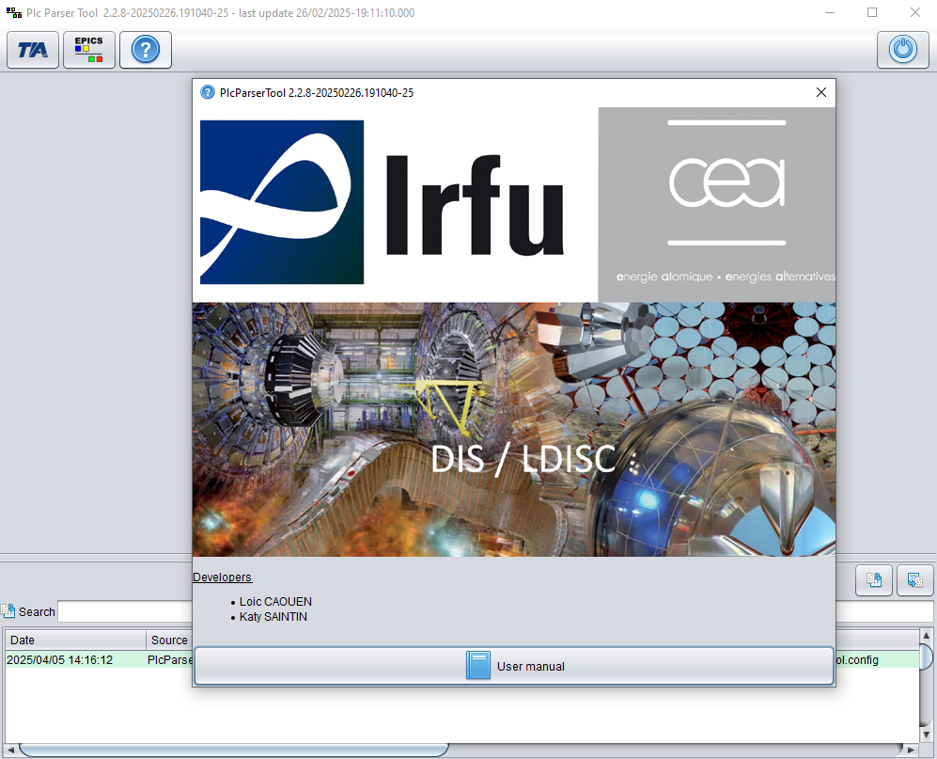
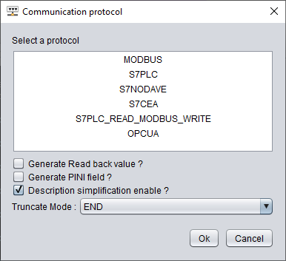
PLC ParserTool GUI
1 protocol selection
Pure Java swing application
Based on Visual DCT
Protocols options dialog

Slide 13
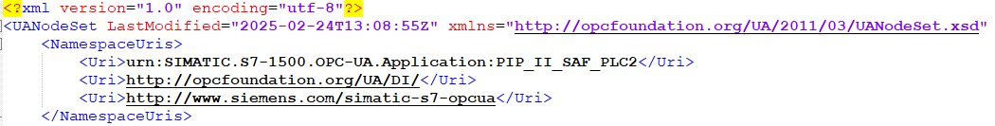

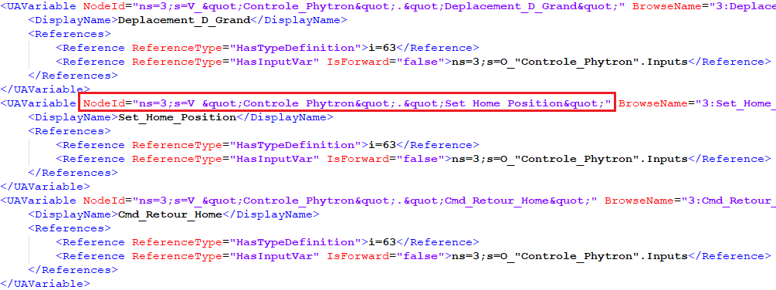
2 OPCUA TIA Portal XML File
~ 7000 variables
13 / 16

Slide 14
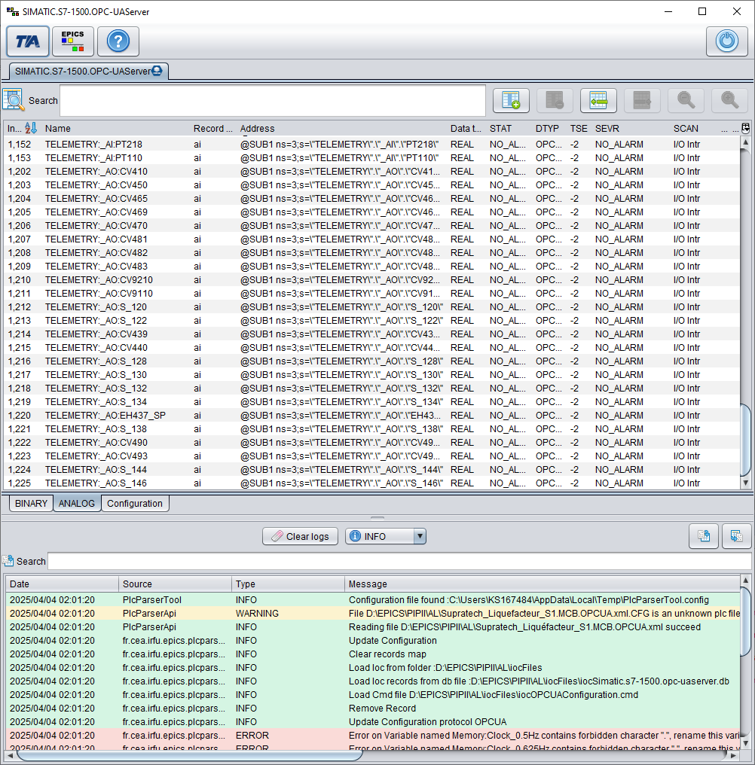
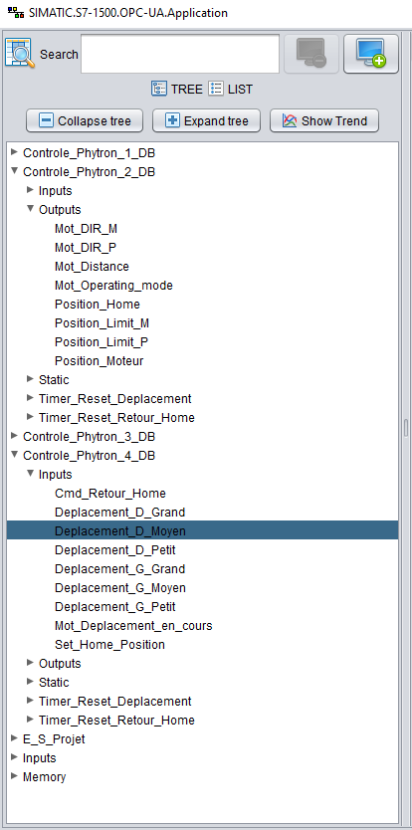
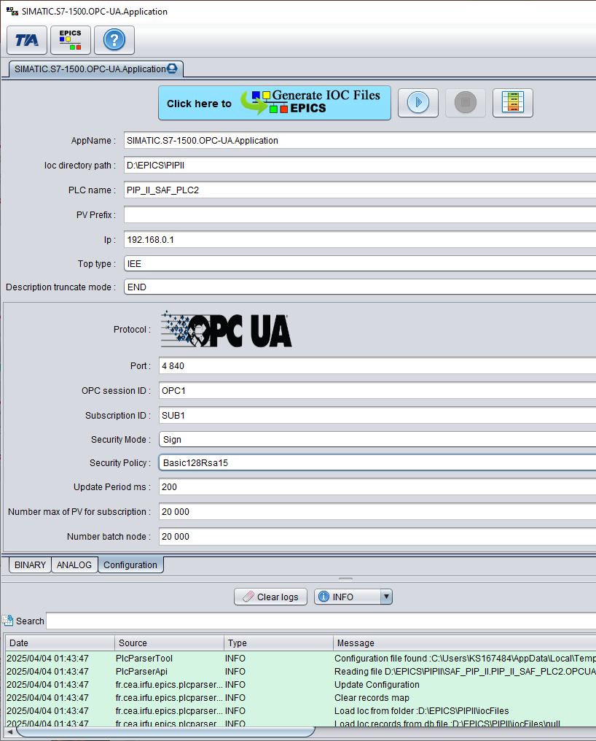
3 Parameters settings
Database table based on Visual DCT
EPICS PV Tree
EPICS & OPCUA parameters

Slide 15
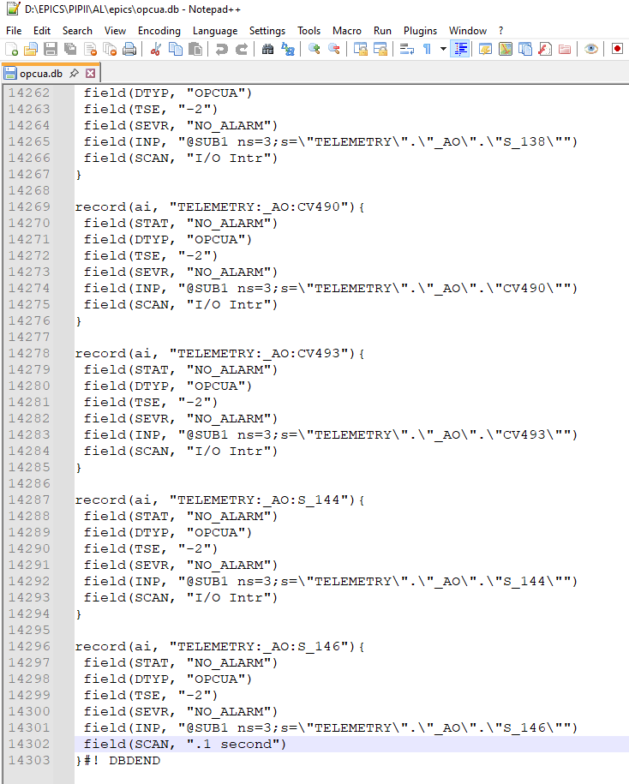

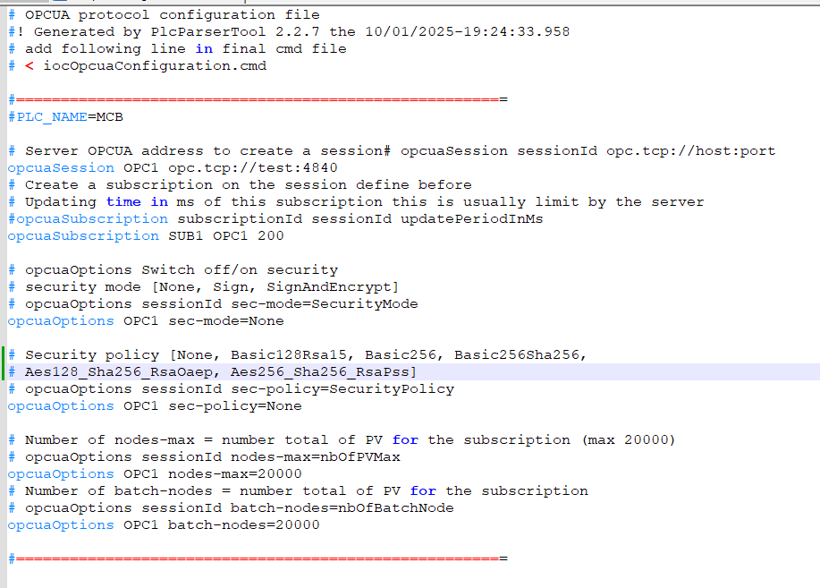
4 EPICS database and configuration generation
Notes:
Cliquez sur Insertion puis En-tête/Pied pour saisir les champs « Evènement – Date » et « Service » ; puis cliquer sur Appliquer partout.

Slide 16


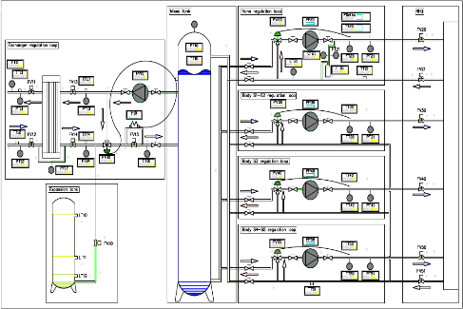
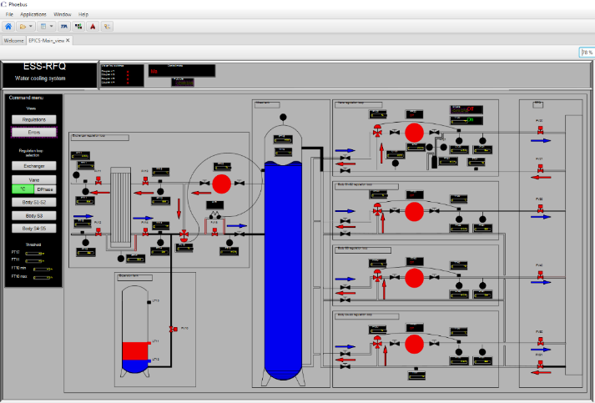
Next steps for GUI developments
DXF2BOB and DXF2BOB convertors
Presentation in lightning talk “Control System Studio for MUSCADE”

Slide 17
Any questions ?
Thank you for your attention
katy.saintin@cea.fr
Vivien LORIOT
Paul LOTRUS
EPICS Collaboration Meeting - April 7th - 11th 2025
ISIS Neutron and Muon Source

