Slide 1
web-pvtools - PV client tools for web
Lin Wang
wanglin@ihep.ac.cn
Controls Group, Accelerator System Division, CSNS
Dongguan Campus of IHEP (Institute of High Energy Physics)
Spring 2025 EPICS Collaboration Meeting
Apr 7 – 11, 2025, held at ISIS

Slide 2
Content
（1）Scenario
（2）Design
（3）Implementation
（4）Deployment
（5）Use cases
（6）Summary

Slide 3
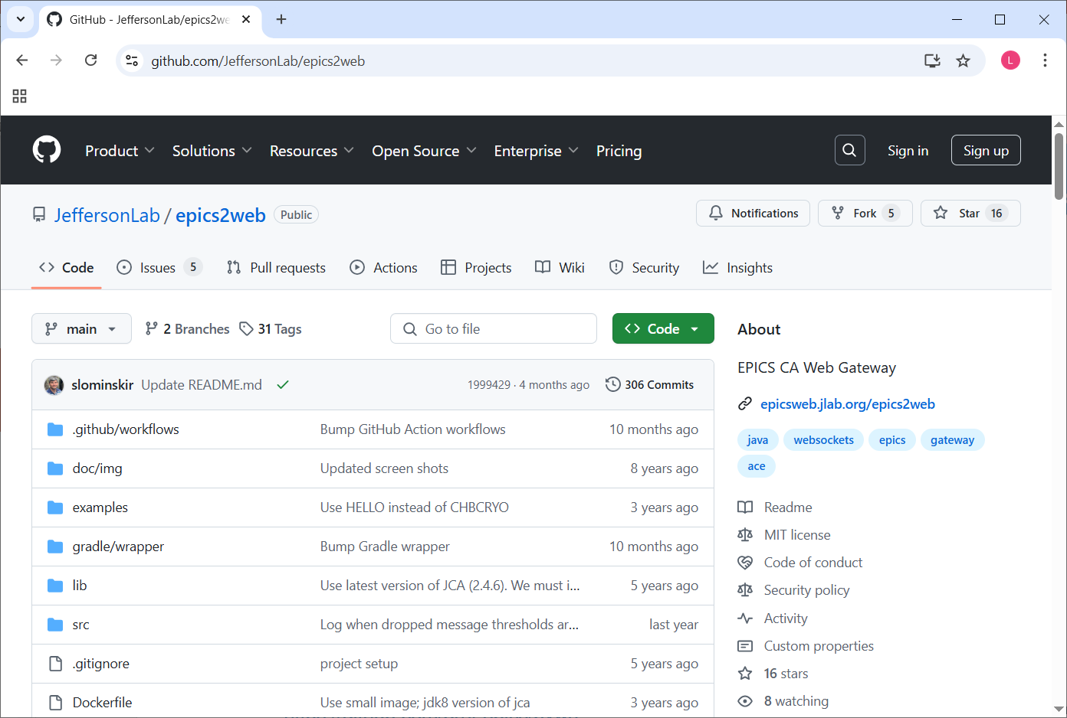
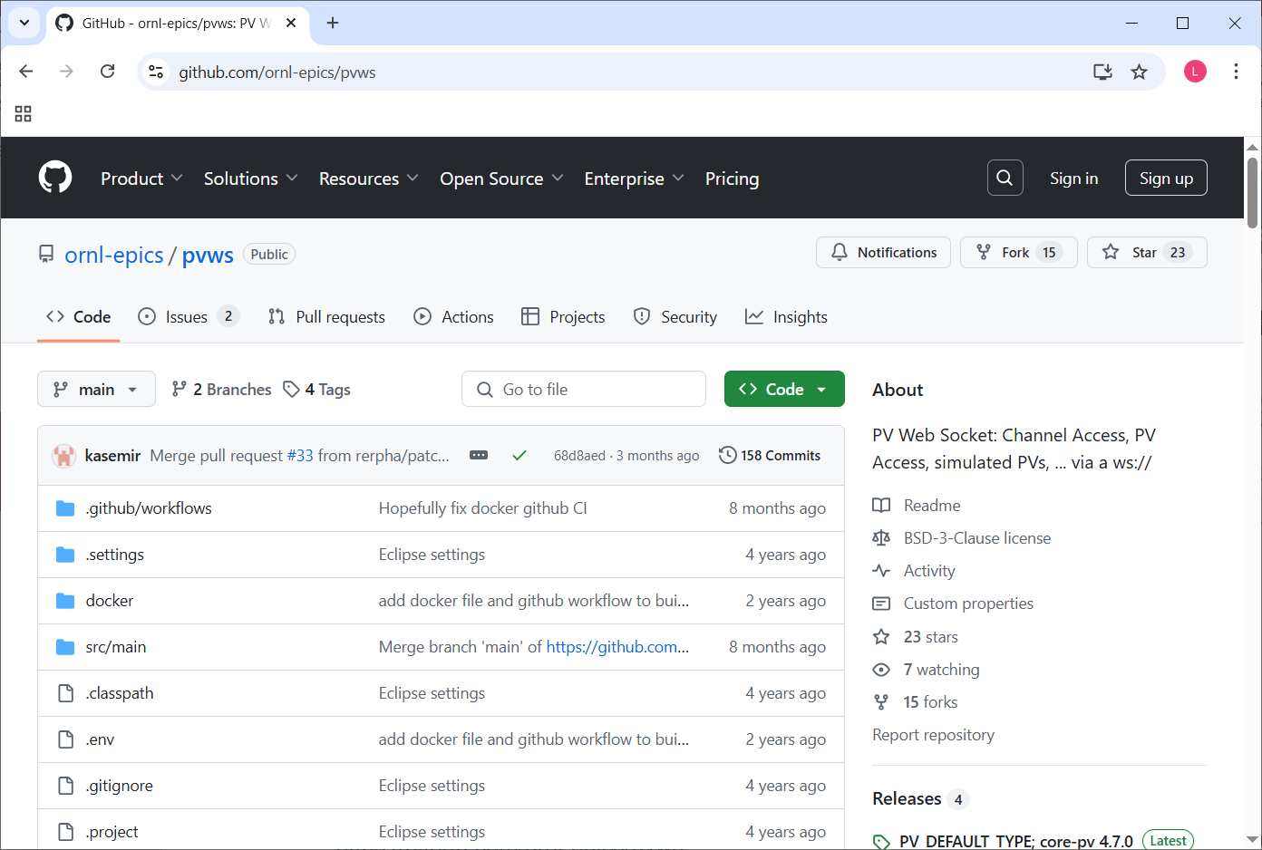
Scenario
Motivation
  Interested in developing web-based EPICS tools
  Based on web development experience
  Based on EPICS usage experience
  But not easy to develop from scratch
Inspiration
  epics2web
    Monitors EPICS Channel Access over the web
    https://github.com/JeffersonLab/epics2web
  pvws
    Web Socket for PVs
    https://github.com/ornl-epics/pvws
GitHub page for epics2web
GitHub page for pvws

Slide 4
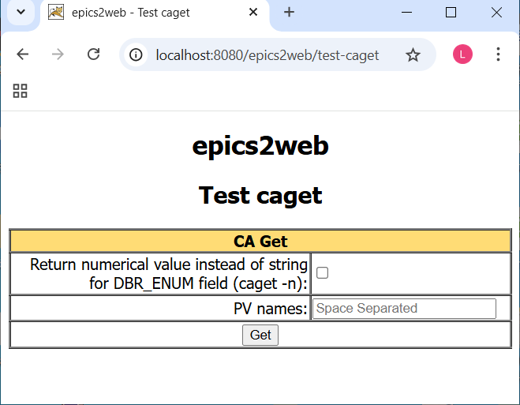
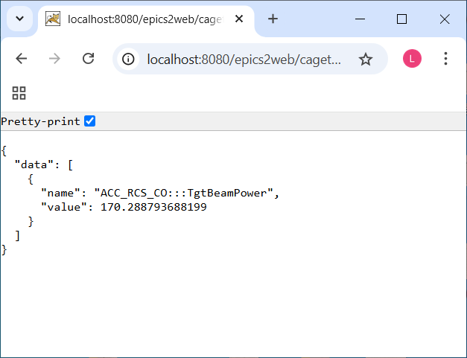
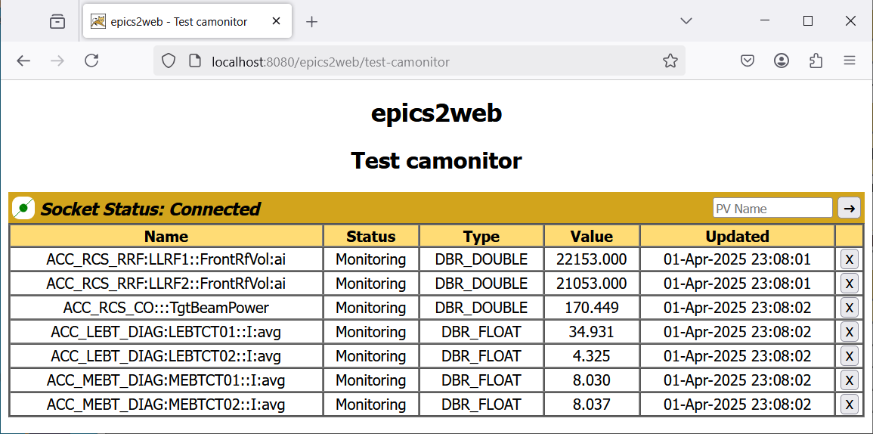
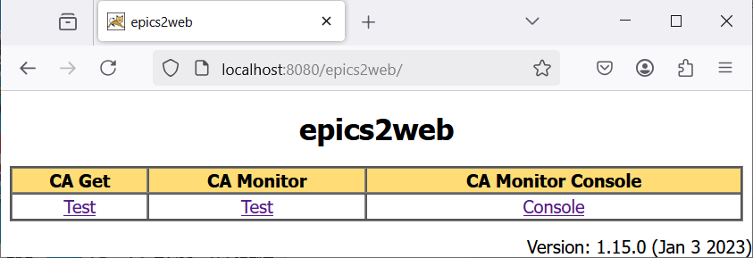
epics2web
Runs on Apache Tomcat
Supports Channel Access using JCA library
  import com.cosylab.epics.caj.CAJContext;
  import gov.aps.jca.CAException;
Provides camonitor using WebSocket
Provides caget using REST service
Provides JSP web pages to perform caget and camonitor
caget page
caget response
Home page
camonitor page

Slide 5
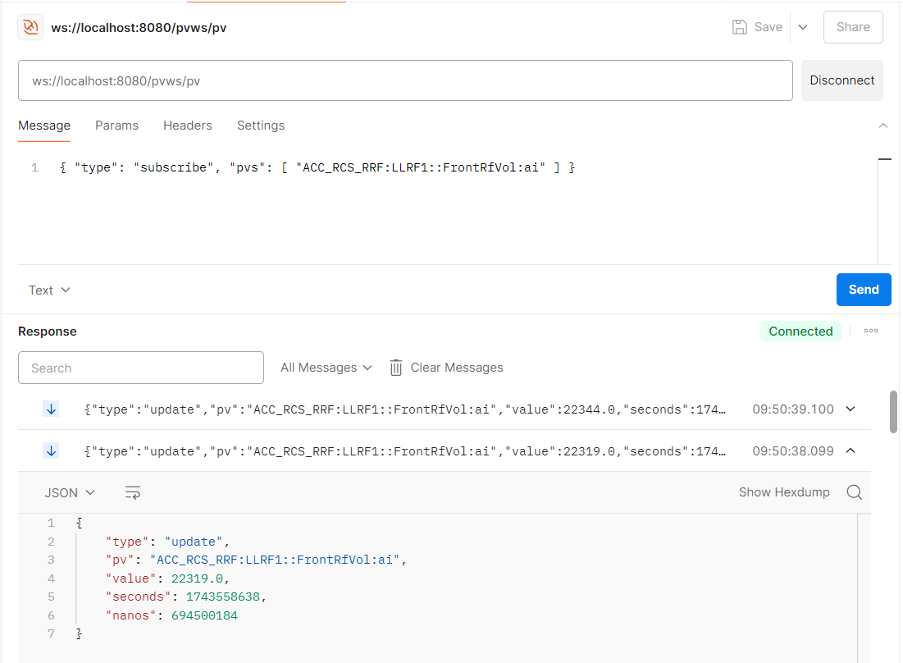
pvws
Runs on Apache Tomcat
Supports CA and PVA using Phoebus core-pv
  import org.phoebus.pv.PV;
  import org.phoebus.pv.PVPool;
Supports both scalar and array data
Provides camonitor using WebSocket
Provides caput using WebSocket
Provides pvws summary using REST service
Provides JSP web pages to demonstrate usage
Accessing pvws using Postman

Slide 6
What are the goals of web-pvtools?
Provide camonitor using WebSocket in backend
  Both epics2web and pvws feature
Provide caget and caput using REST service in backend
  epics2web feature
Support both Channel Access and PV Access in backend
  pvws feature
Support both Scalar and Waveform PVs in backend
  pvws feature
Provide web tool for PV Status Monitor in frontend
  Epics2web feature
Provide other web tools: caget, caput, camonitor, cainfo, probe, StripTool, X/Y Plot in frontend
  New feature

Slide 7
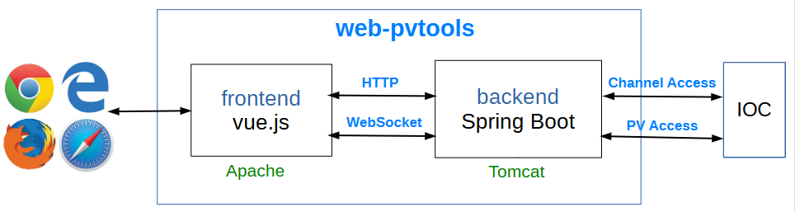
Design
web-pvtools uses a frontend and backend separation architecture
Backend
  Interacts with IOC using CA and PVA
  Provides WebSocket server and REST service to frontend
Frontend
  Interact with backend using HTTP and WebSocket
  Provides web pages for different PV tools
Architecture

Slide 8
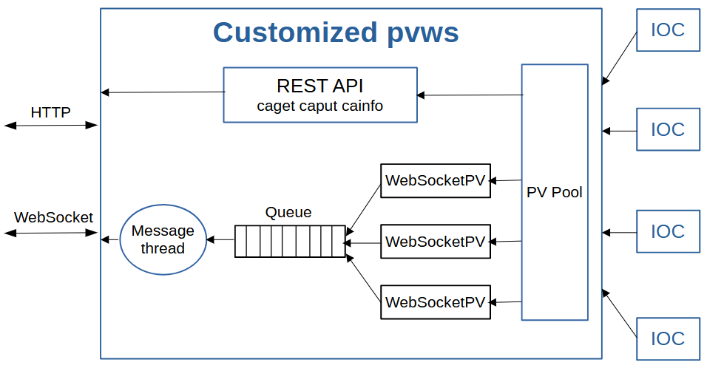
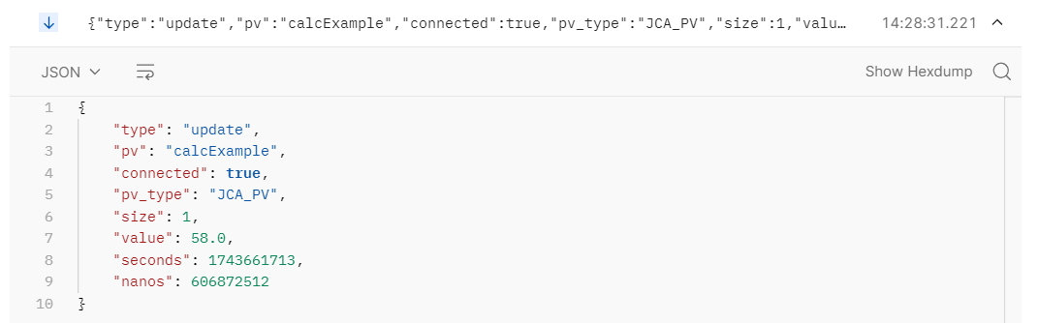
Design of backend
Customized version of pvws
Refactor using Spring Boot framework
  Simplify REST service implementation
  Include embedded Tomcat server
  Run as standalone JAR file
Add caget / caput in REST service
Replace the Base64 encoding of array value with raw data
Add more fields in WebSocket data
  connected, pv_type, size
Block diagram for backend
Update from backend

Slide 9




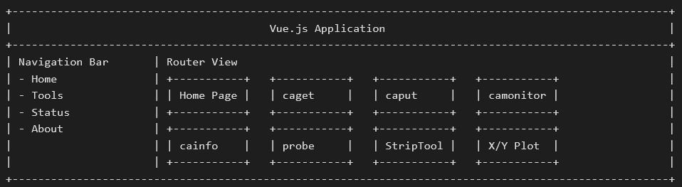
Design of frontend
Single Page Applications framework: Vue.js
  Two-way data binding
  Various component libraries available to choose from
Component library: PrimeVue
HTTP client library: Axios
Charting library: ApexCharts
Textual block diagram for frontend

Slide 10
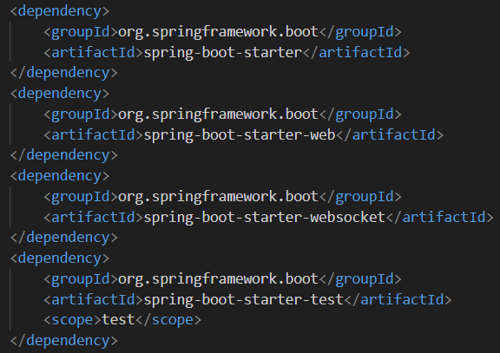


Backend customization: Spring Boot
Refactor using Spring Boot framework
  Add Spring Boot related dependencies and plugins to pom.xml
  Add Spring Boot application entry point
  Add @Component annotation to WebSocket.java to enable Java WebSocket API in Spring Boot
  Replace Servlet with Spring Boot REST API
JAR file instead of WAR is generated when building
The JAR file can be run using the java -jar command
  $ java -jar pvwa-0.0.1-SNAPSHOT.jar
Spring Boot dependencies in pom.xml

Slide 11
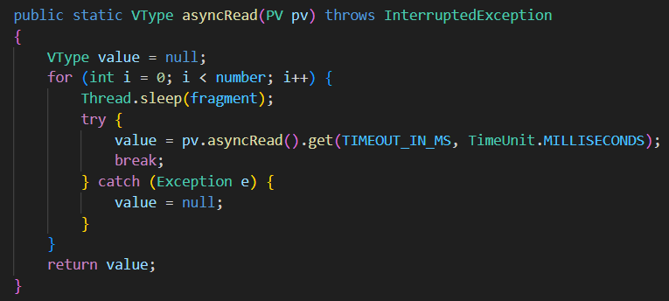
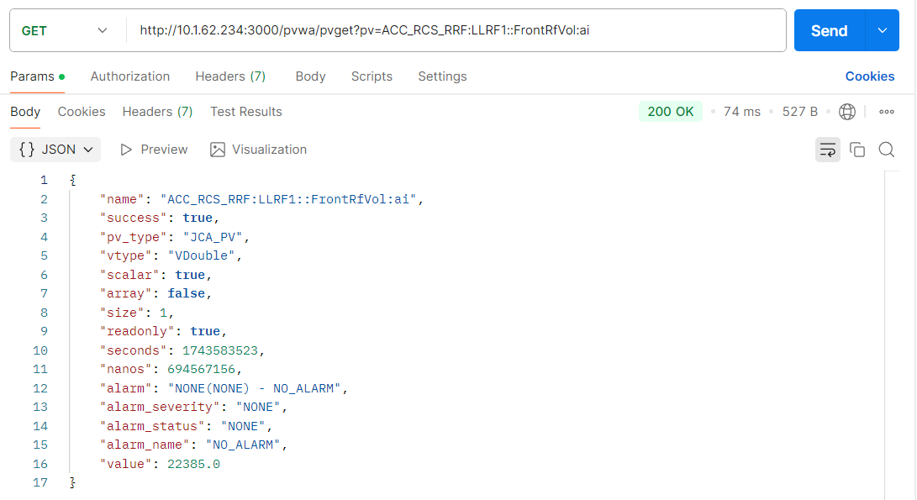
Backend customization: caget
Critical problem after org.phoebus.pv.PVPool.getPV(name)
  org.phoebus.pv.PV.read() returns null if connection is not established
  org.phoebus.pv.PV.asyncRead() throws an exception if connection is not established
Solution
  Split the timeout into time slices and iterate to make multiple attempts
  https://github.com/wanglin86769/web-pvtools/blob/master/pvwa/src/main/java/pvwa/controller/PVReadController.java
asyncRead() iteration
Data format for caget

Slide 12
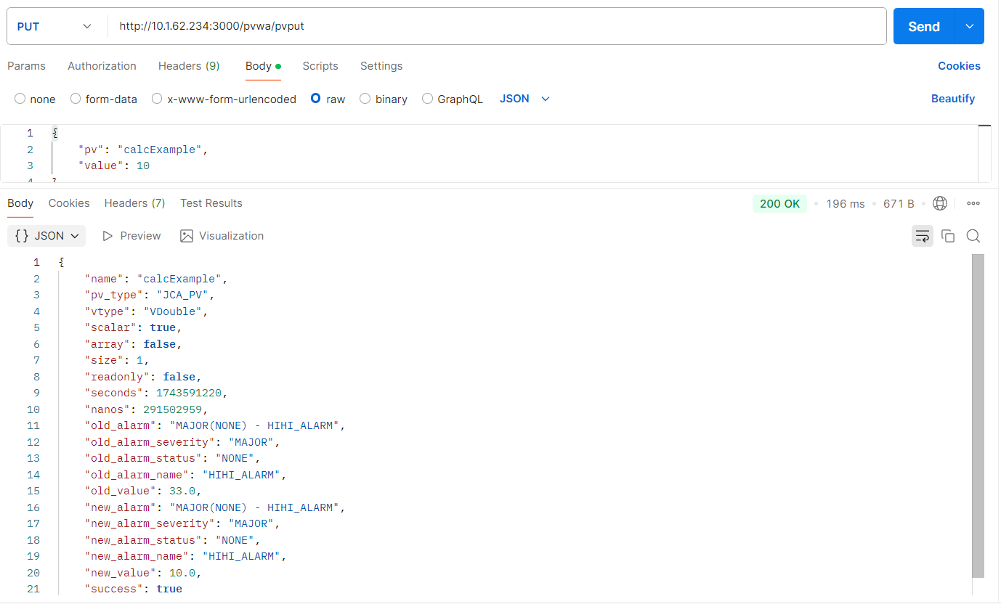
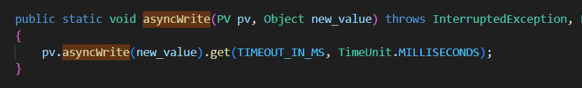
Backend customization: caput
Critical problem
  pv.read() after pv.write() may return old value instead of new value using org.phoebus.pv.PV
Solution
  Use “async” variant of write() to await completion of the write
  https://github.com/wanglin86769/web-pvtools/blob/master/pvwa/src/main/java/pvwa/controller/PVWriteController.java
caput returns both old value and new value
The execution order of read and write operations
  1. asyncRead(): read old value
  2. asyncWrite(): write new value
  3. read(): readback new value
asyncWrite() invocation
Data format for caput

Slide 13
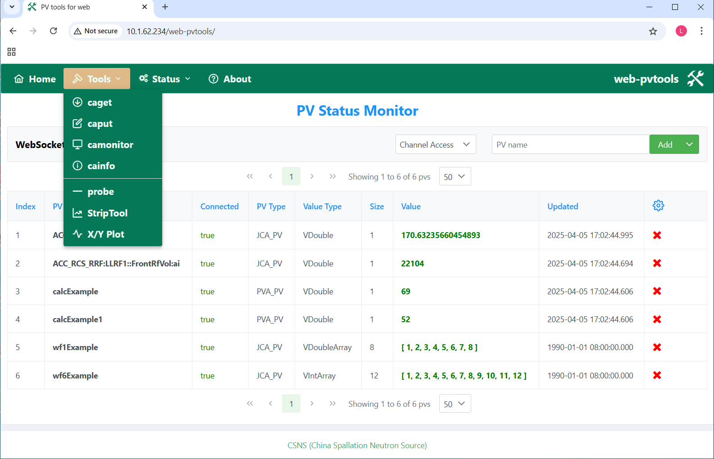
Frontend implementation
Web pages for PV tools
  Home (PV Status Monitor)
  caget
  caput
  camonitor
  cainfo
  probe
  StripTool
  X/Y Plot
Web pages in frontend

Slide 14
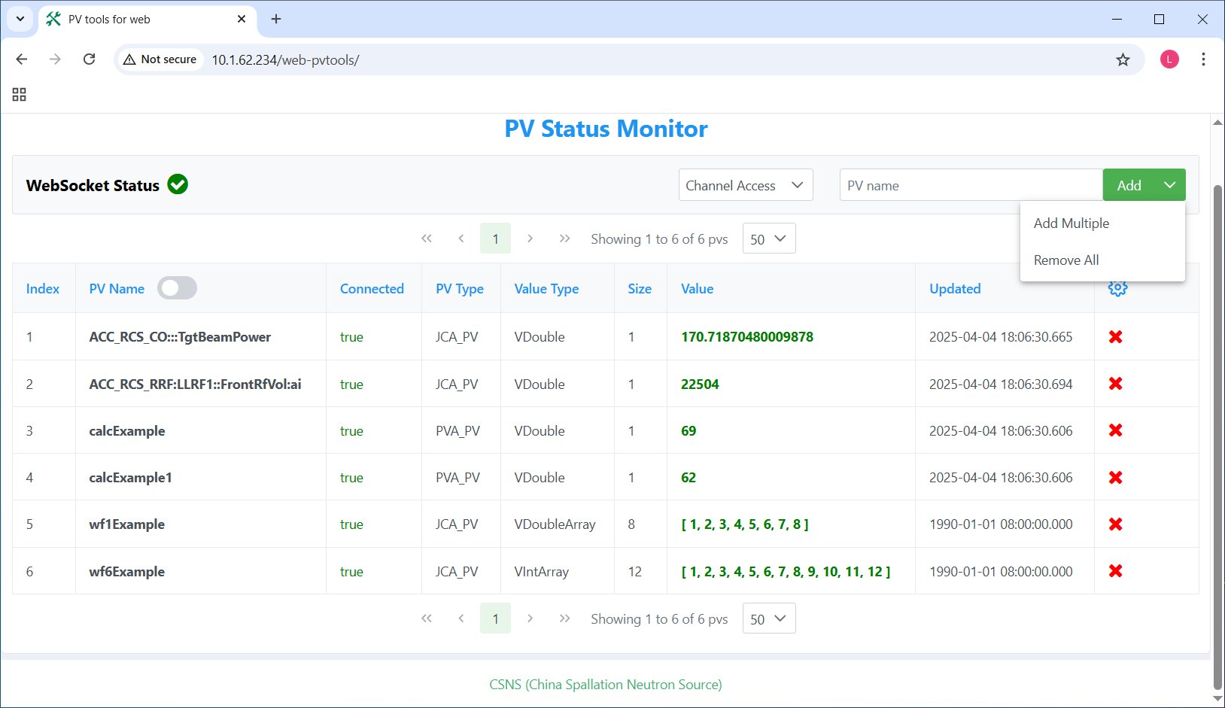
Frontend implementation: PV Status Monitor
Implementation
  Monitors PV status using WebSocket
  Supports both CA and PVA
  Supports both scalar and waveform
  PV list are stored in LocalStorage and can be loaded when refreshing
Usage
  CA and PVA can be selected
  PVs can be added or deleted
  Type, value and timestamp of PVs are displayed

Slide 15
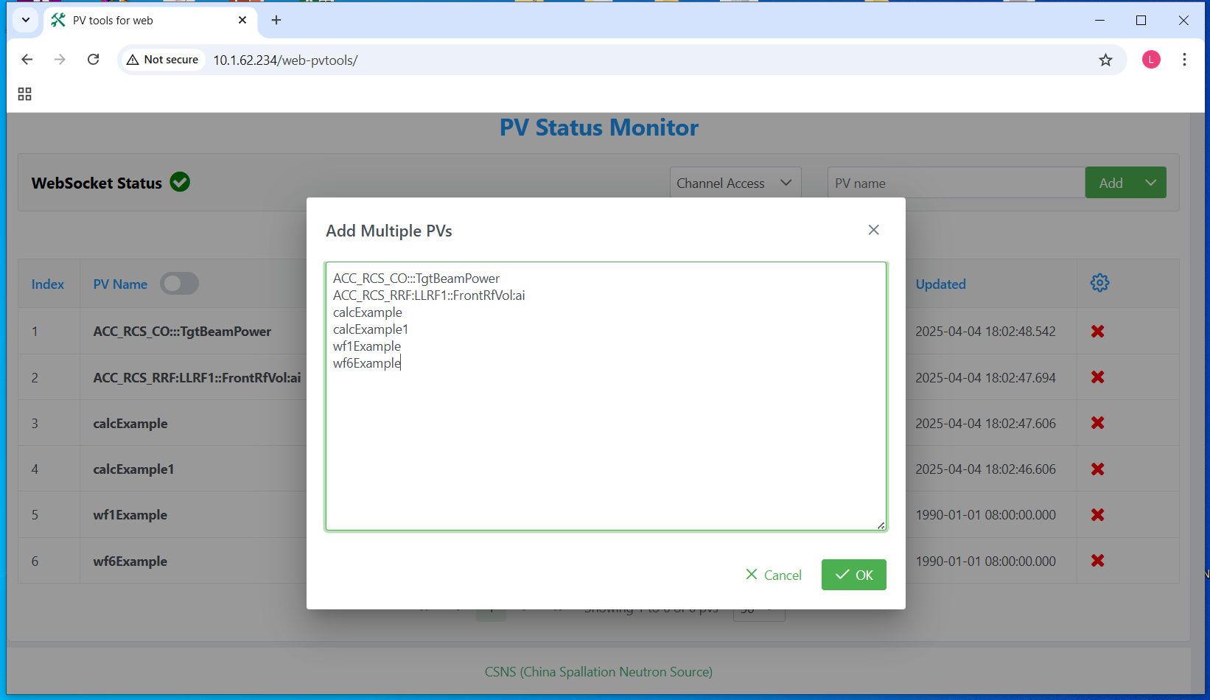
Frontend implementation: PV Status Monitor
Multiple PVs can be added at once

Slide 16
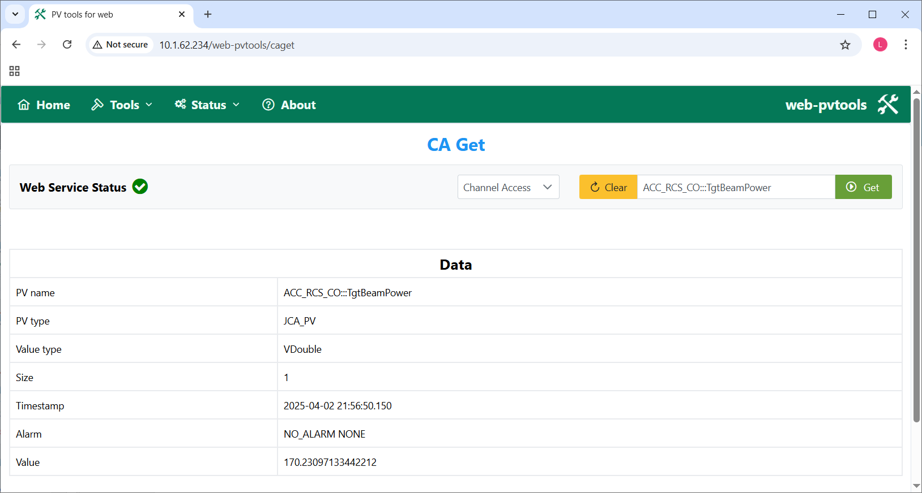
Frontend implementation: caget
Fetch PV value using REST API

Slide 17
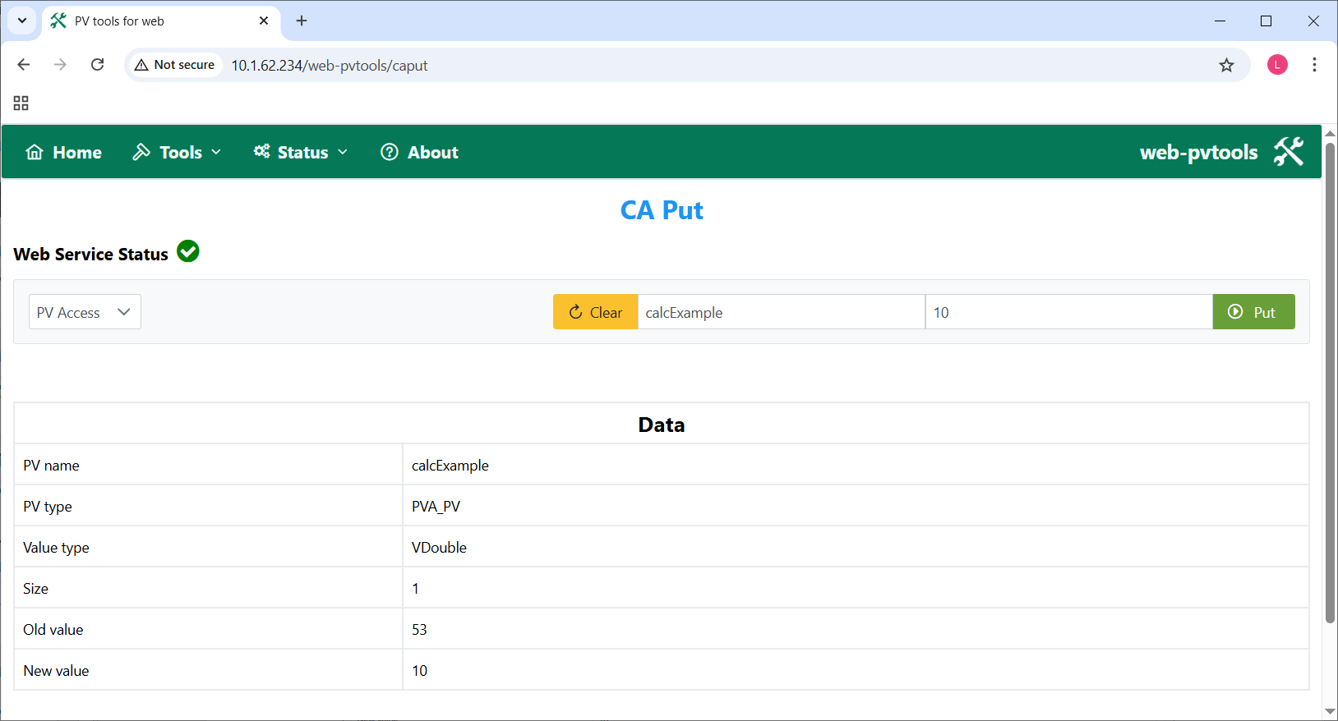
Frontend implementation: caput
Write PV value using REST API

Slide 18
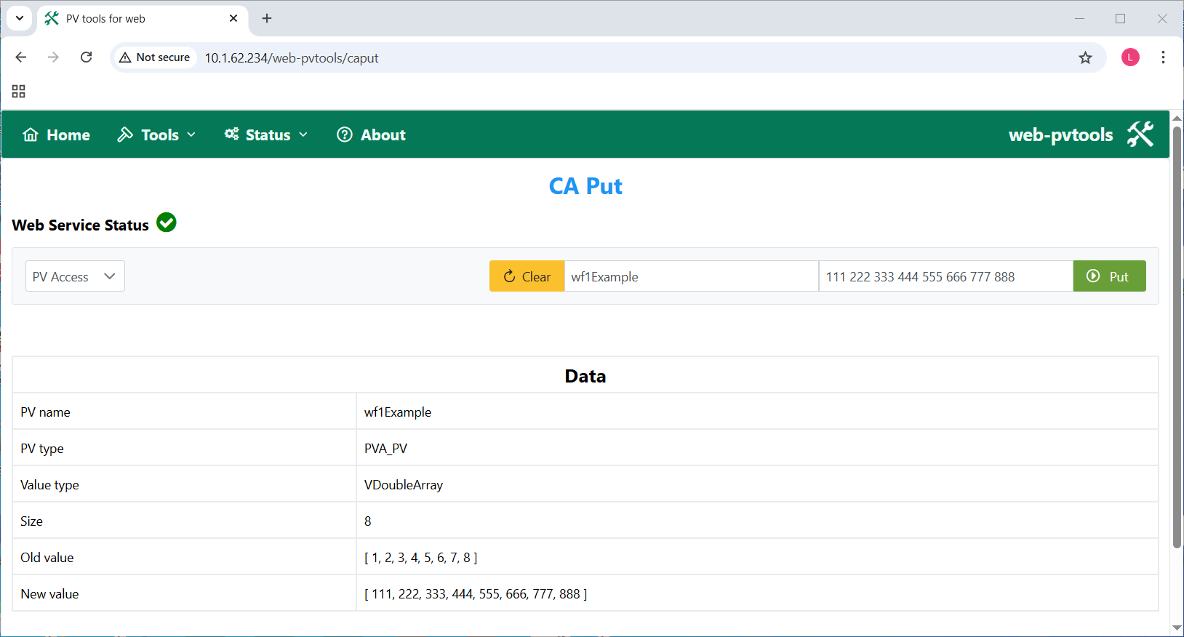
Frontend implementation: caput
Support array data separated by commas or spaces

Slide 19
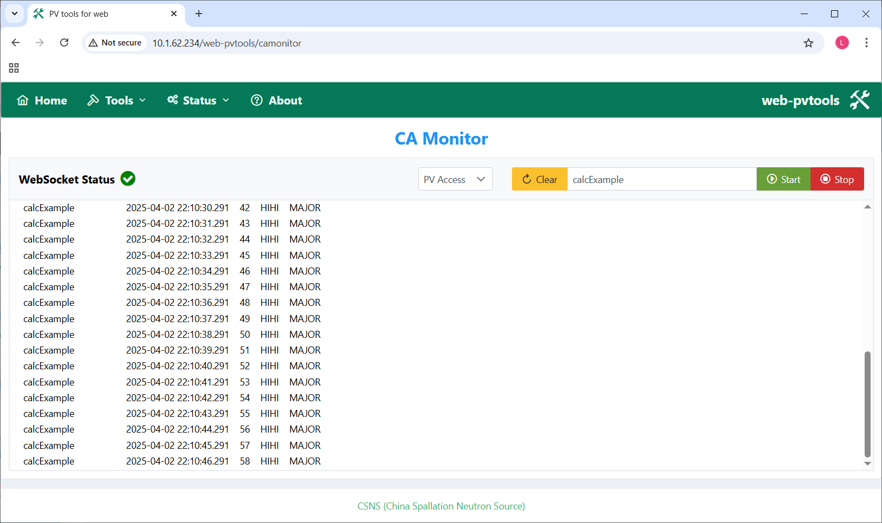
Frontend implementation: camonitor
Implementation
  Behaves like camonitor CLI using WebSocket.
  Uses a string array to store the data to display.
  A key point: ensure the data display updated, then move the scrollbar to the bottom.
Usage
  CA and PVA can be selected
  Click “Start” to start monitor
  Click “Stop” to stop monitor

Slide 20
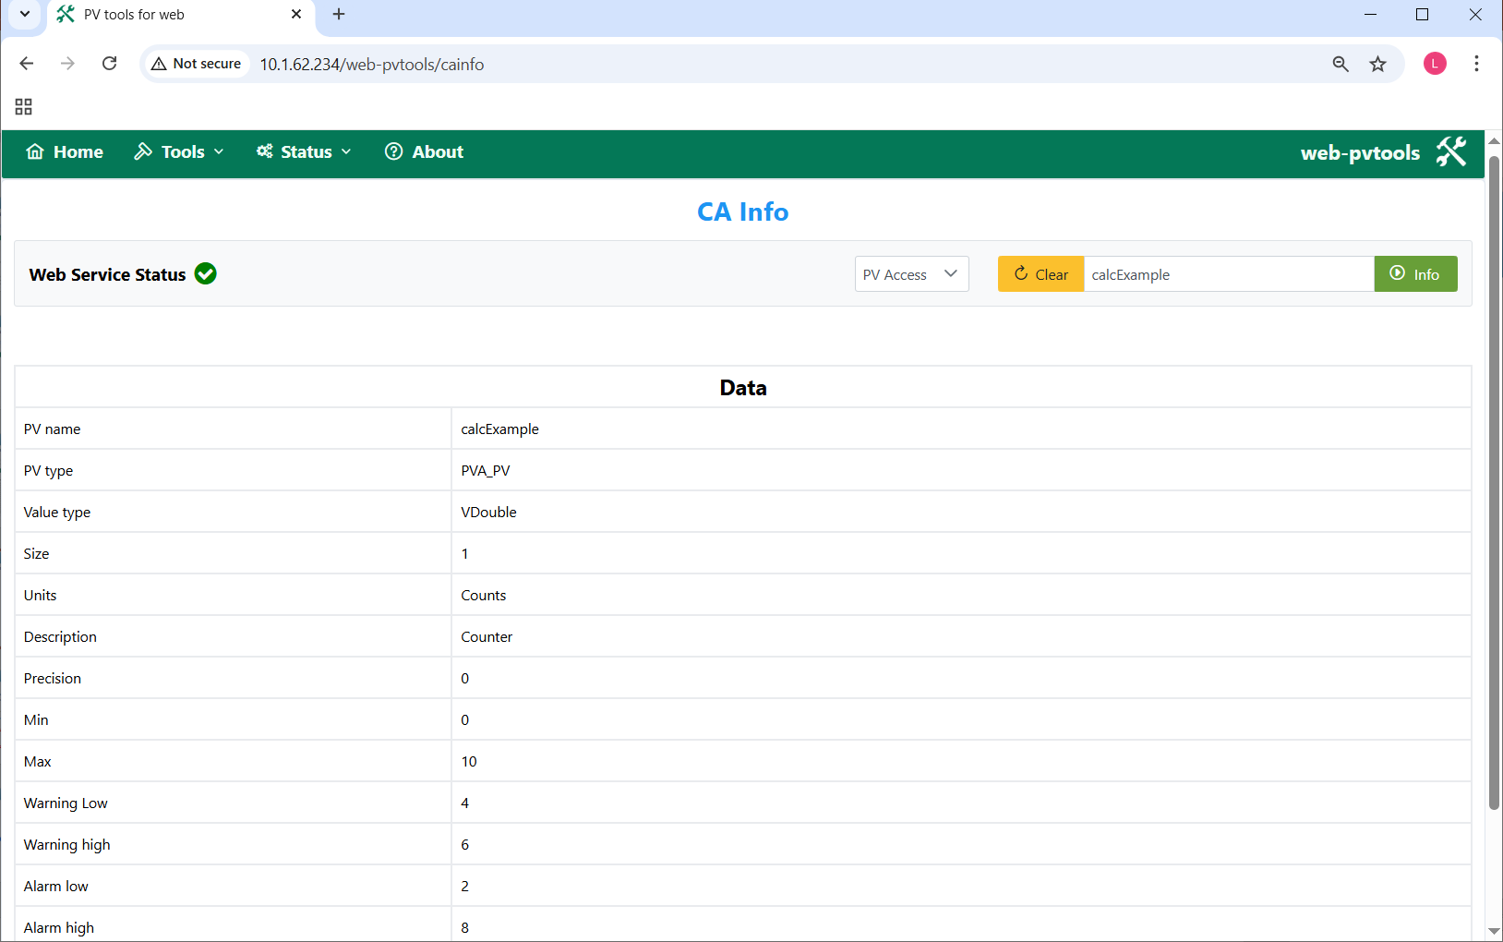
Frontend implementation: cainfo
Fetch PV info using REST API

Slide 21
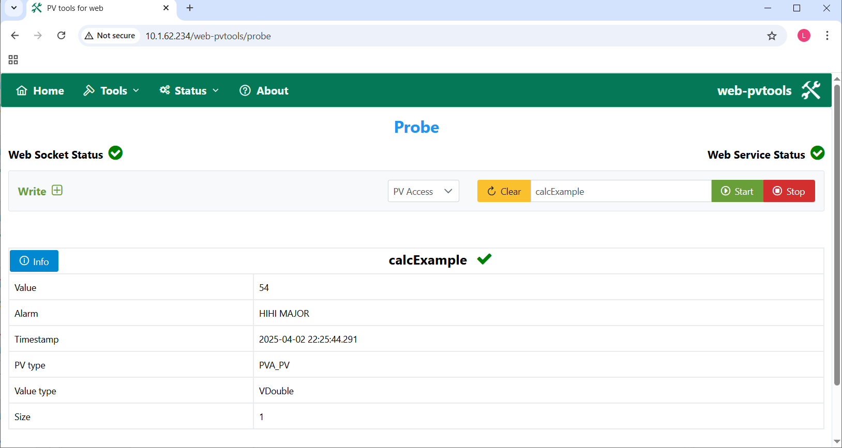
Frontend implementation: probe
Implementation
  Fetch PV value using REST API
  Fetch PV info using REST API
  Write to PV using REST API
  Monitor PV value using WebSocket
Usage
  CA and PVA can be selected
  Press “Enter ” to fetch PV value
  Click “Start” to start monitor
  Click “Stop” to stop monitor

Slide 22
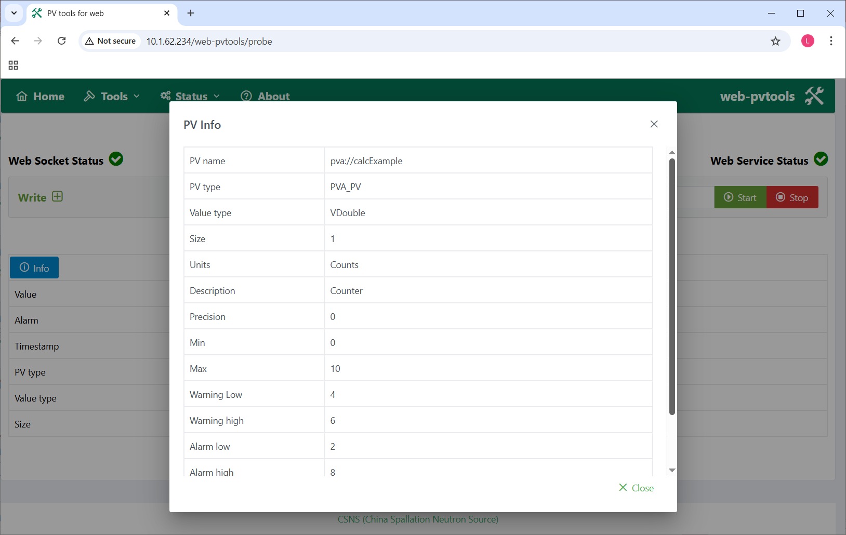
Frontend implementation: probe
Click “Info” button to fetch PV info and display

Slide 23
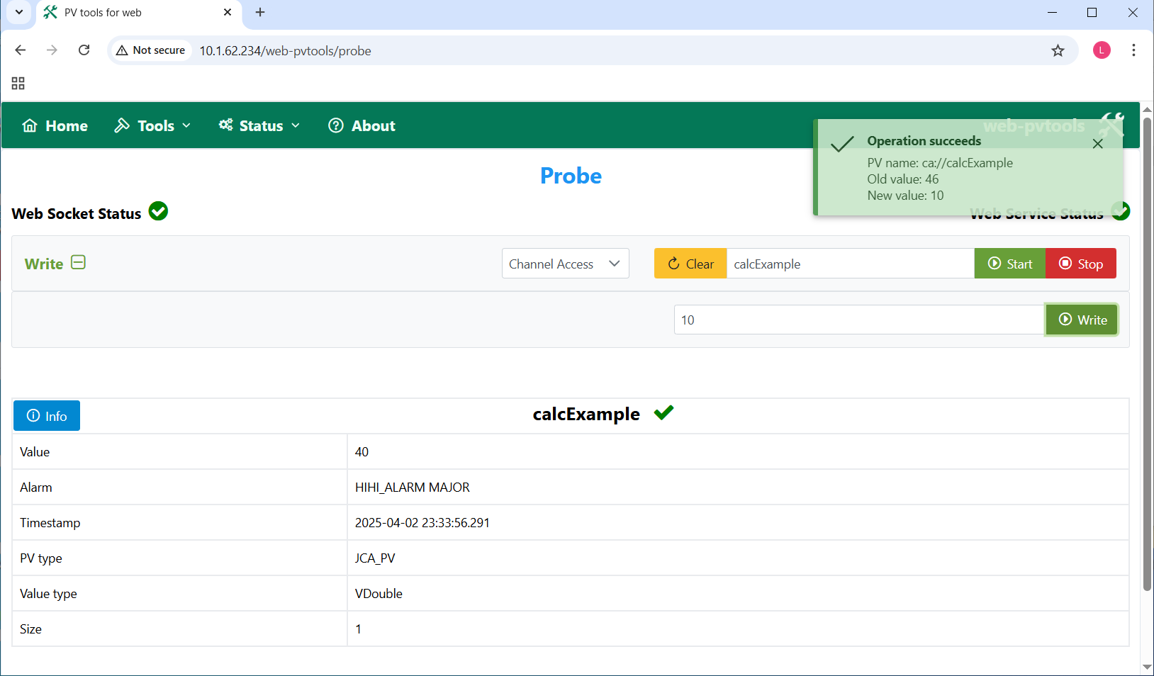
Frontend implementation: probe
Open “Write” panel to perform write operation

Slide 24
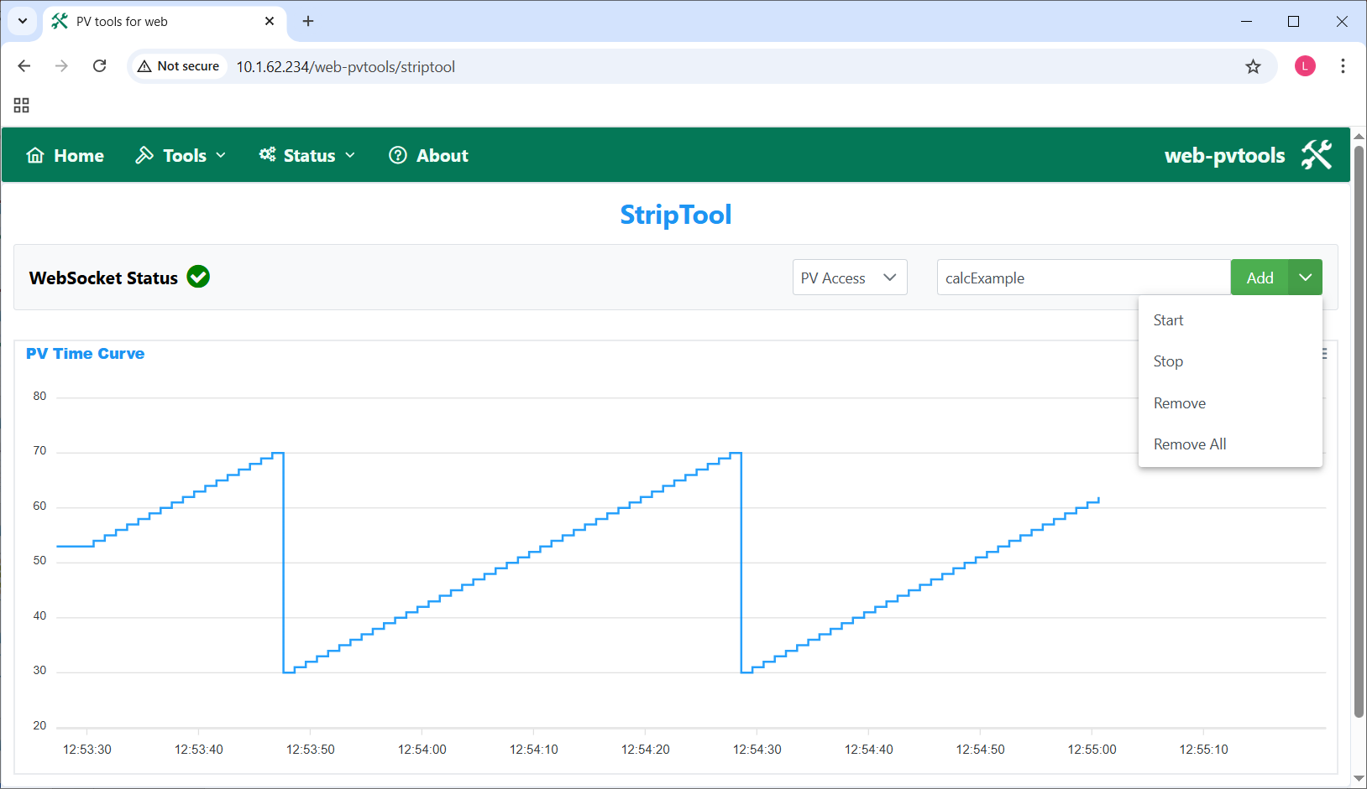
Frontend implementation: StripTool
Implementation
  Monitor the curve of PV changes over time
  Uses ApexCharts charting library
  Set type field of xaxis to “datetime” to represent timestamp
  Updates the curve and extend the x-axis if needed when new data arrives
Usage
  CA and PVA can be selected
  PVs can be added, removed, started, stopped

Slide 25
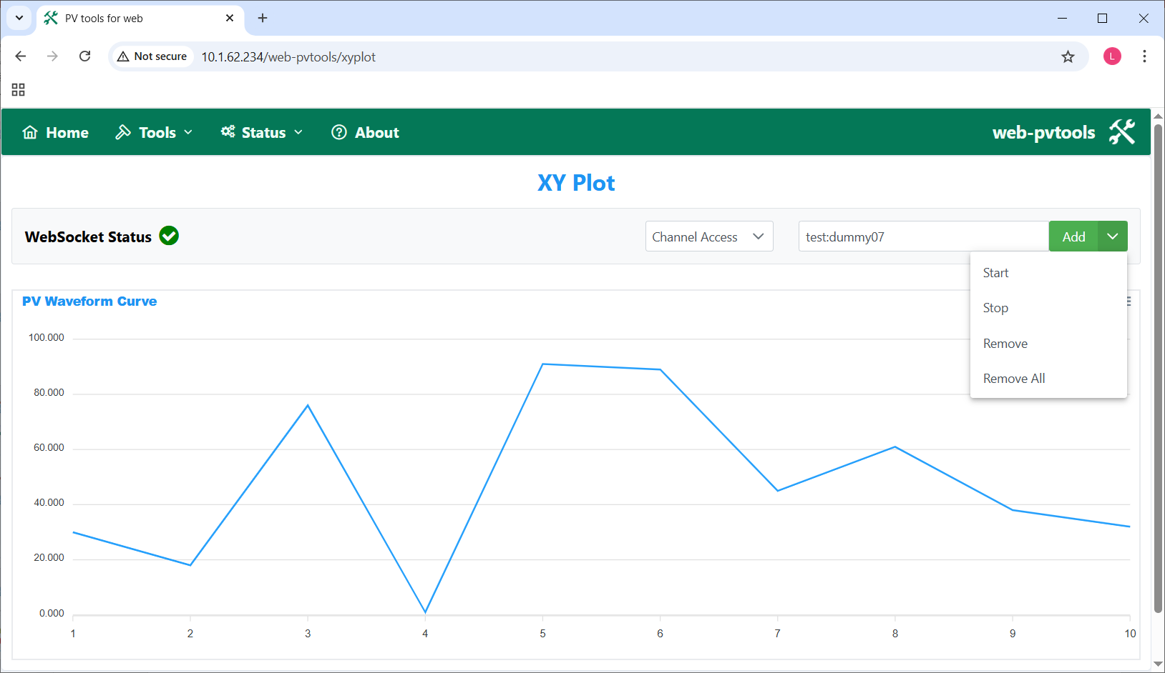
Frontend implementation: X/Y Plot
Implementation
  Monitor the curve of waveform PV using WebSocket
  Uses ApexCharts charting library
  Set categories field of xaxis to represent the number of points in the waveform
  Updates the curve and the x-axis when new data arrives
Usage
  CA and PVA can be selected
  PVs can be added, removed, started, stopped

Slide 26
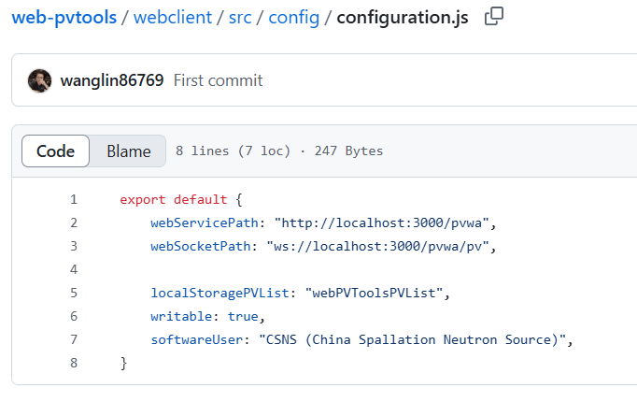
Deployment
Deployment with Apache http server and Oracle JDK
$ cd webclient
$ npm ci
$ npm run build
$ cp -r dist/* /var/www/html
$ cd pvwa
$ mvn clean install
$ java -jar target/pvwa-0.0.1-SNAPSHOT.jar
Deployment with Docker
$ cd web-pvtools
# docker compose build --no-cache
# docker compose up
Configurations
  If writable is false, caput page and write panel inside probe page are not available.

Slide 27
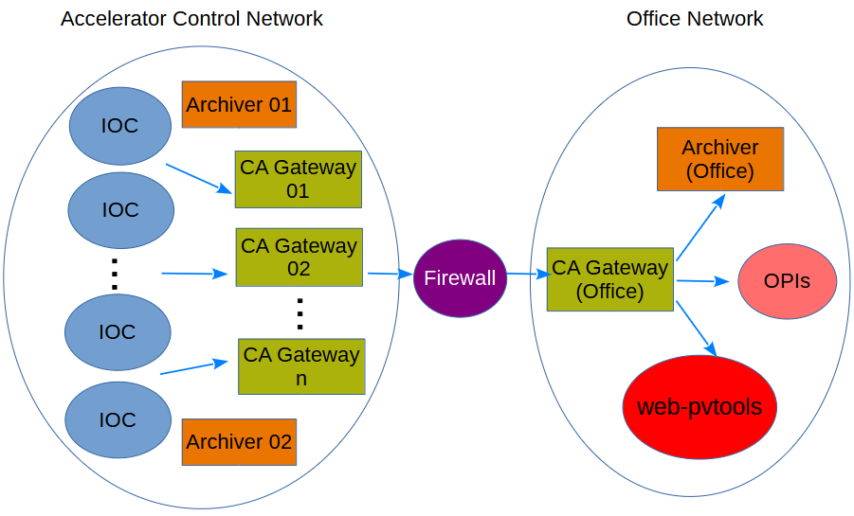
Use cases
web-pvtools has been deployed at CSNS office network
Use case #1
  Archiver users provide PV list to archive
  Check the status of multiple PVs at once before archiving
Use case #2
  Other high level applications want to fetch current PV value via one HTTP request
  REST API is more straightforward and easy-to-use compared to WebSocket
web-pvtools deployment at CSNS

Slide 28
Summary
web-pvtools includes a series of PV client tools that can access IOCs via web browsers.
This work is inspired by epics2web and pvws.
It was developed in 2024.
It supports both Channel Access and PV Access.
Deployed at CSNS to check PV status before archiving and provide REST API to other applications.
Github link
  https://github.com/wanglin86769/web-pvtools
Development team
  Design & Implementation: Lin Wang wanglin@ihep.ac.cn
  Line Manager: Yuliang Zhang zhangyl@ihep.ac.cn

Slide 29
Thanks for your attention!

