Slide 1
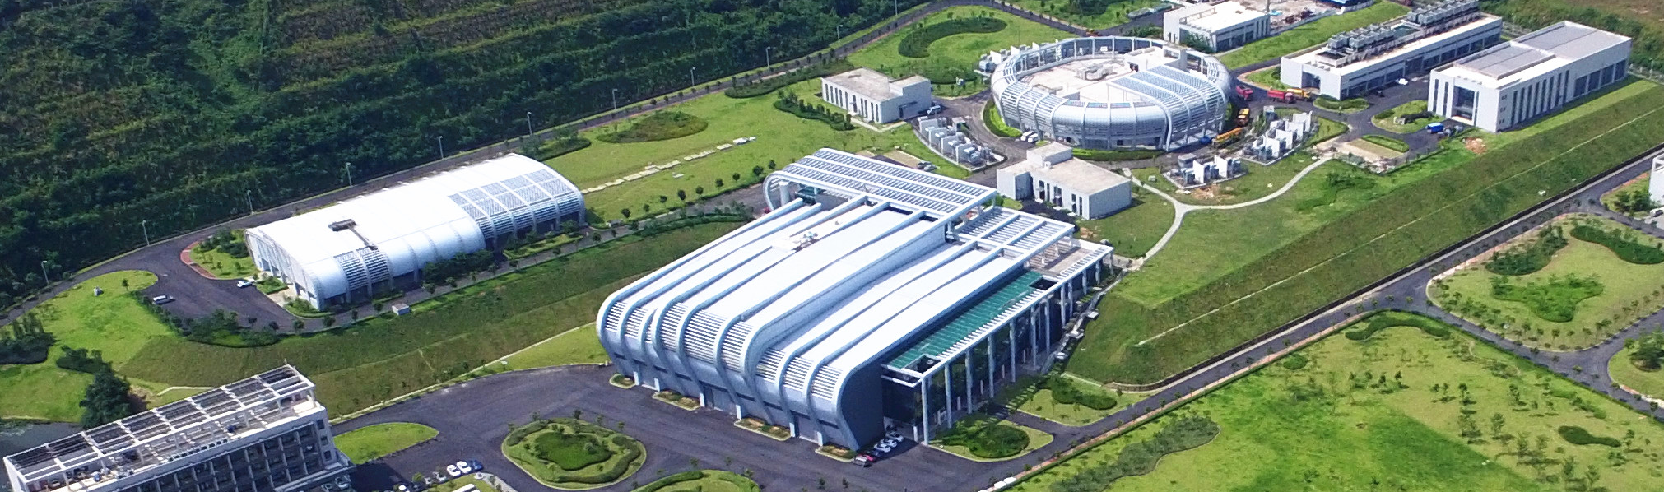

Phoebus Customization at China Spallation Neutron Source
Mingtao Li
China Spallation Neutron Source
April 8th, 2025
2025 Spring EPICS Collaboration Meeting, Oxford

Slide 2
Outline
Introduction to our facility
Current Progress of Phoebus Migration
Site Specific Customization of Phoebus
Summary

Slide 3
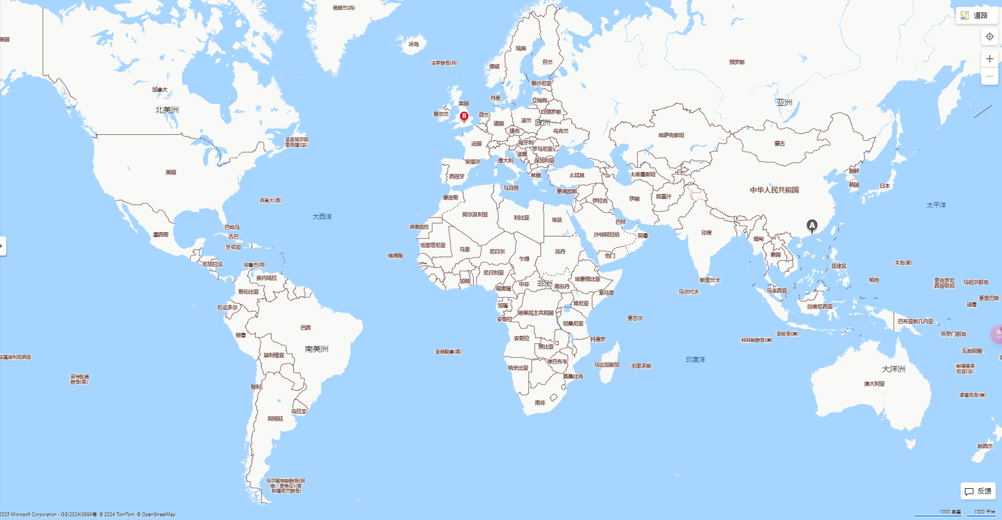
Introduction of China Spallation Neutron Source(CSNS)
CSNS: a pulsed neutron source facility with a repetition rate 25Hz
Site Location: Guangdong Province – China

Slide 4
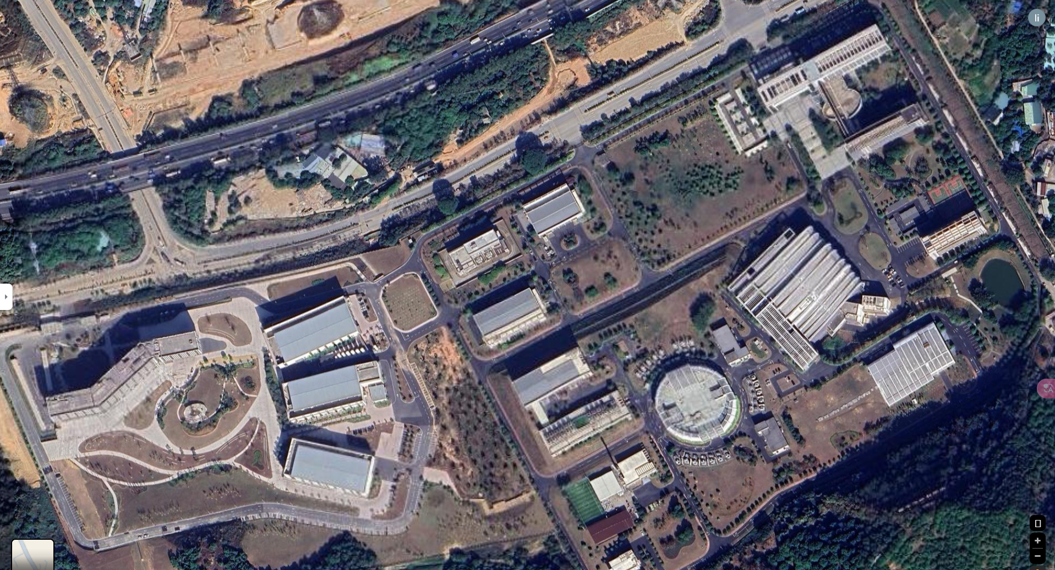
Brief Introduction of CSNS
Satellite map of our facility

Slide 5
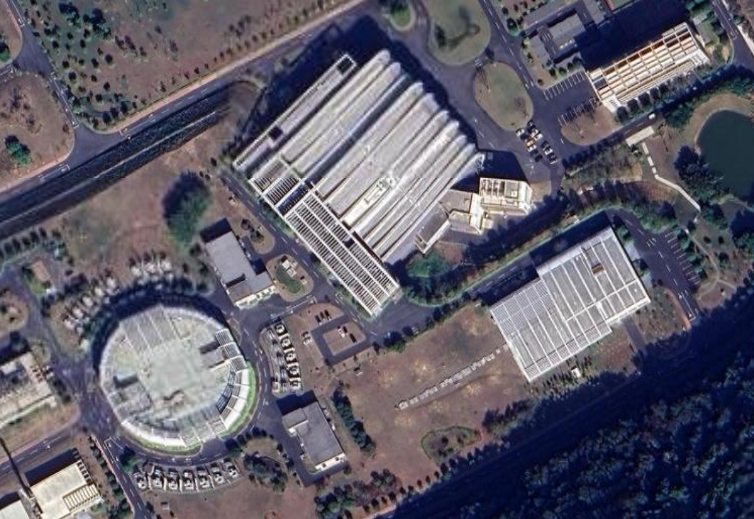
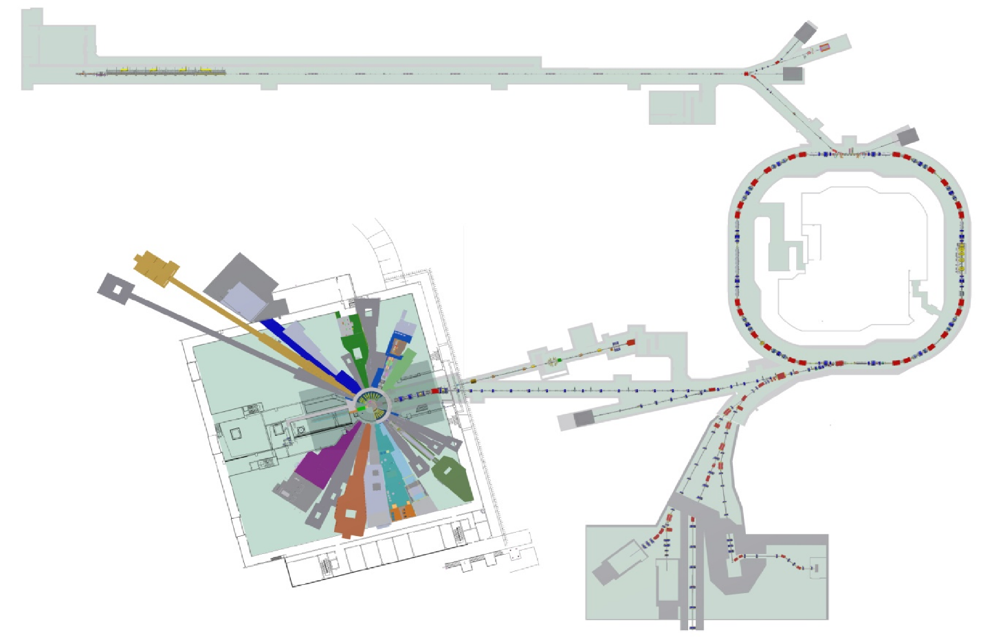
Brief Introduction of CSNS
Satellite map of our facility
Layout of the ongoing upgrade project
New Injection System
Target Station
8 beam lines
SSC, 80MeV->300MeV
LINAC, 80MeV
RCS
1.6GeV
Notes:
Our facility have one 80mev linac and a 1.6gev rapid cycling synchrotron.
This is the Layout of the ongoing upgrade project
some superconduct cavities would be installed in the linac to increase the energy form 80mev to 300mev.The beam power would be increased to 500Kw
More than 10 new beamlines will be built.

Slide 6
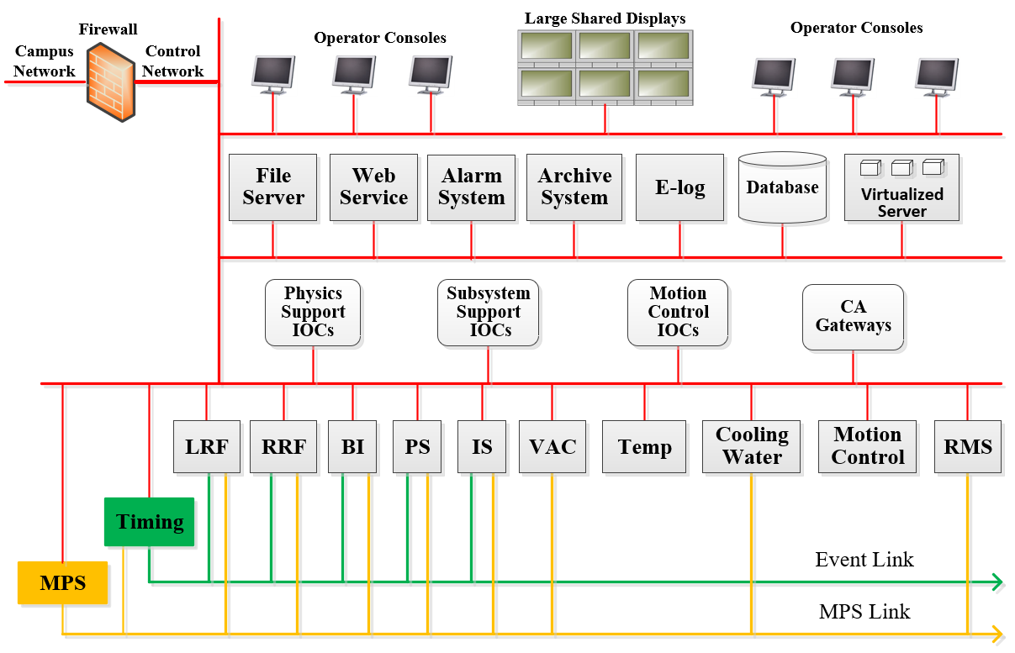
Introduction of Accelerator Control System
EPICS V3 and V7 mixed control system
Software Transition:
  CSS → Phoebus
  Channel Archiver → Archiver Appliance
Notes:
From 2022, we began Software Transition.
the css began to be replaced by phoebus.
Channel archiver is replaced by Archiver Appliance

Slide 7
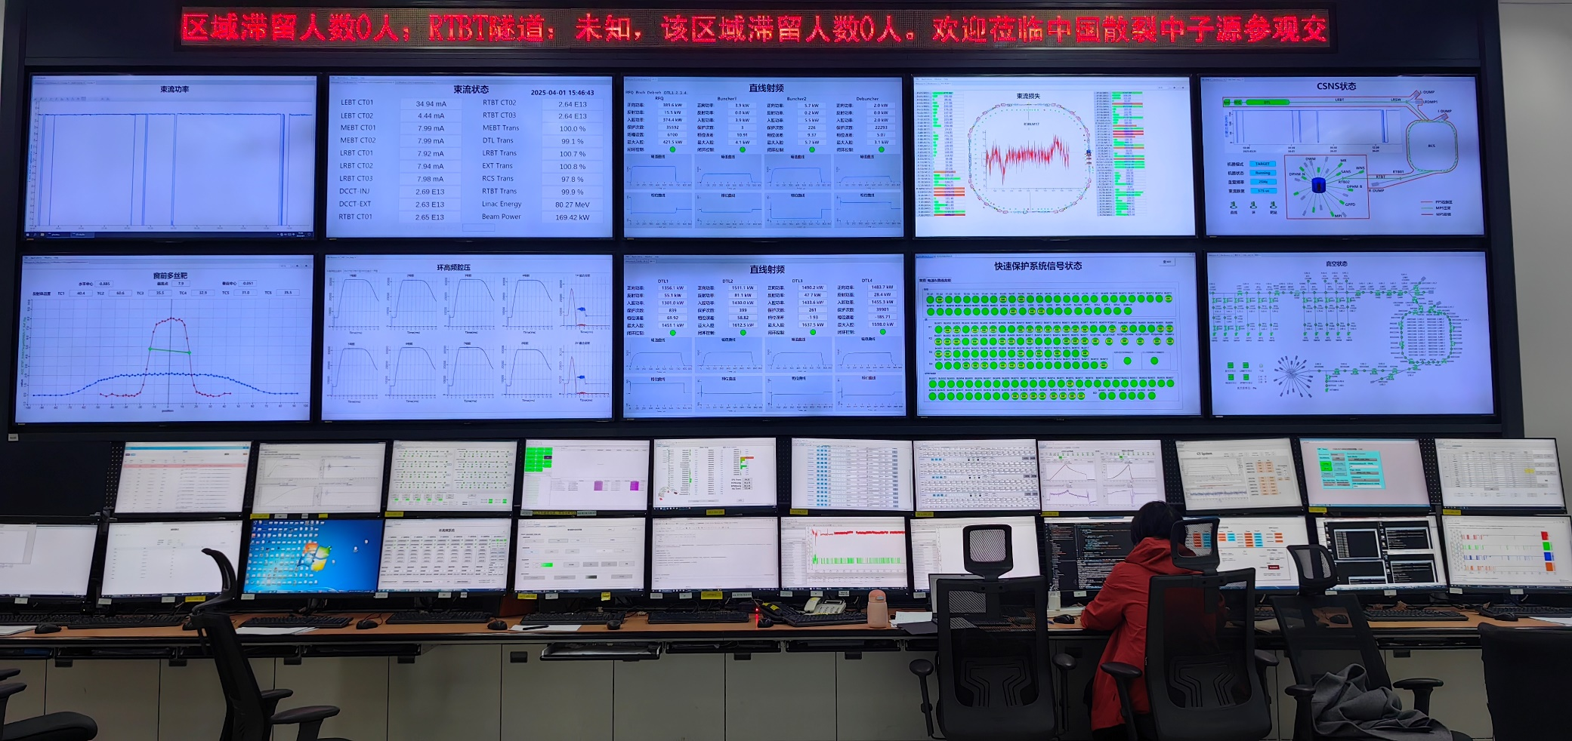
Current Progress of Phoebus Migration Since 2022
Phoebus
Phoebus or CSS
Video wall：Phoebus
PC screen：Phoebus in combination with CSS
Alarm system: Phoebus

Slide 8
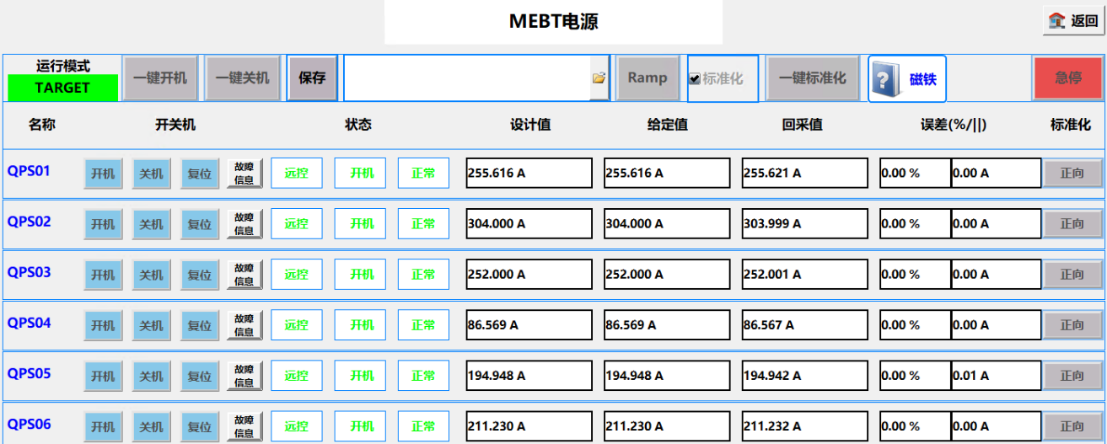
Current Progress of Phoebus Migration
Why not use Phoebus thoroughly?
Some OPIs loaded from template with Macros using JavaScript: cannot be opened and saved as .bob by Phoebus.
Some OPIs converted into .bob look difference in the interface styles.
Migration is time-consuming with large workload
lack of human resources

Slide 9
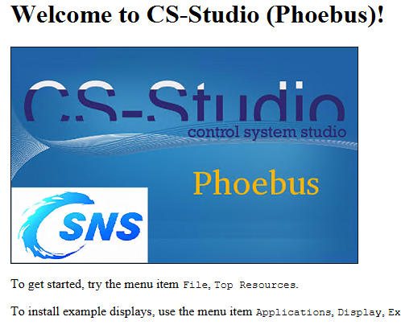
Site Specific Customization of Phoebus
Development based on product-4.7.2
Customization items:
  Alarm System
  Alarm Logger
  DataBrowser
  Snapshot management

Slide 10
Modification of Alarm System: Annunciator
Motivation：to support the Chinese text-to speech(TTS)
  FreeTTS→ Jacob: a bridge between Java programs and COM components in the Windows system
    <dependency>
      <groupId>com.hynnet</groupId>
      <artifactId>jacob</artifactId>
      <version>1.20</version>
    </dependency>
    jacob-1.20-x64.dll put in the system directory path
Disadvantages：
  Jacob seriously undermines the cross-platform nature of Java
  Chinese TTS is bound to Windows，unavailable in Linux and Mac.
  For CSNS, not serious.
Future:
  Based on AI, the models FastSpeech 2/ TensorFlowTTS are considered to replace Jacob.
  Improve the naturalness and fluency of TTS
Notes:
We have difficulty in Chinese tts with freetts
Based on the fast development of AI,
Speech Application Programming Interface SAPI
. It uses the Java Native Interface (JNI) technology to enable Java programs to call COM components
The Chinese Text - to - Speech (TTS) technology, which mainly leverages Windows - only components, is intrinsically bound to the Windows operating system. Therefore, it cannot be deployed on Linux or macOS systems. This restricts the cross - platform flexibility of TTS applications, limiting their reach to Windows - only environments.

Slide 11

Modification of Alarm System: Annunciator
In central control room, Annunciator is running on three different terminals.
2
3
1
1: Beam operation terminal
2 & 3:
Make sure all faults are addressed promptly by operators
Notes:
Alarm UIs are running in this machine.
Other bobs are running on these two machines.
We use three annunciators to make sure sure all faults are addressed promptly by operators

Slide 12
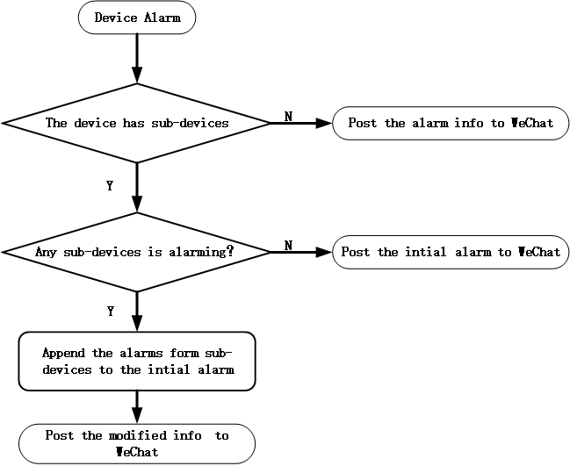
Modification of Alarm System: post Alarms to IM
Motivation：Directly inform the O&M personnel the specific cause of the failure immediately when the failure occurs.
PV of one Device: Alarm | Sub-Device PV 1: None
 | Sub-Device PV 2:Alarm
 | Sub-Device PV 3:Alarm
 | …
 | Sub-Device PV N: None
Post Alarm PV
and PV2 & PV 3
If one alarming device has sub-devices broken down, then post the detailed fault information to relevant personnel
Save the time for fault diagnosis and relay of information.
Notes:
WeChat WhatsApp Instant messaging software
operation and maintenance O&M
Save the time for fault diagnosis and relay of information from operation personnel to the maintenance personnel

Slide 13
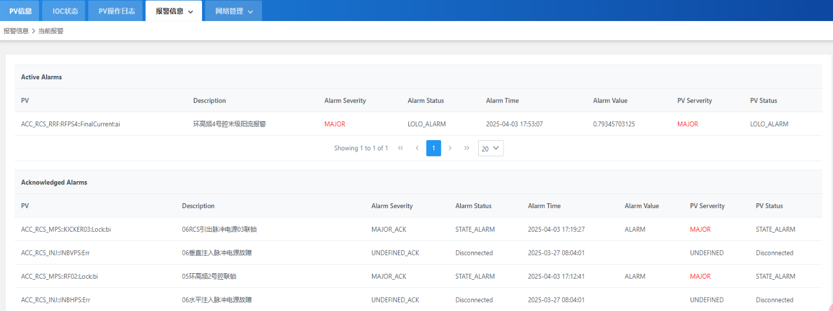
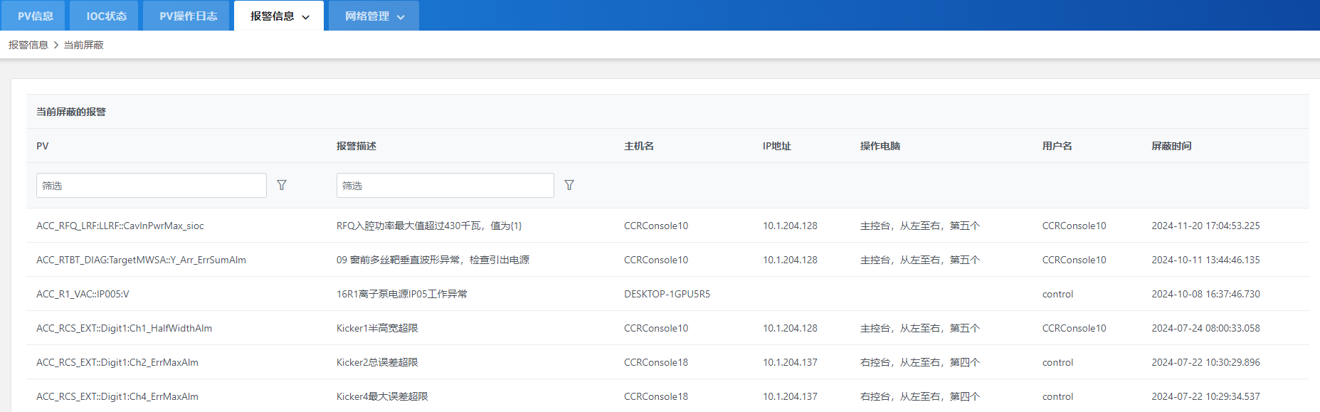
Modification of Alarm System: Web UI
Web page get the alarm info from Kafka using RESTful API
A
B
A. Active & Acknowledged Alarms
B. Disabled Alarms

Slide 14
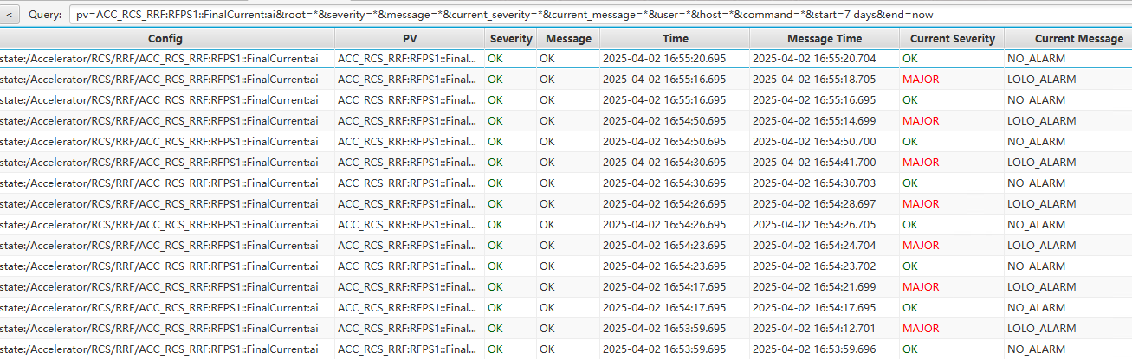
Modification of Alarm Logger
Motivation:
  The state of some PV switches between normal and alarming continuously
  Cannot delete or disable in alarm tree

Slide 15
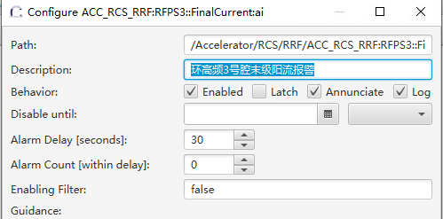

Modification of Alarm System: Alarm Logger
Solution:
Add a new configurable property logging to AlarmClientLeaf
Use alarm client to inform the Kstream in AlarmMessageLogger whether one alarm record in Kafka should be recored into Elasticsearch or not.
Alarm
Logging?
YES

Slide 16
Modification of DataBrowser
Modification Items:
  Compatibility with Channel Archiver
  Moving Avg of archived data
  Histogram of archived data
  Overlap of archived data of waveform PV
Notes:
DataBrowser has some Modification Items including

Slide 17
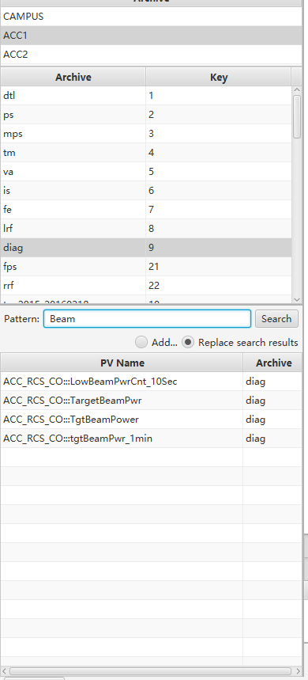
Compatibility with Channel Archiver
Motivation:
  Channel Archiver began at 2016, and was replaced by Archiver Appliance in 2022.
  Our Channel Archiver have 51 different engines, cannot be opened in Phoebus
  How to view them?
Solution:
When one Channel Archiver is selected in the ArchiveListPane, its engines are listed in a new Table. Once one engine is selected, then the PVs matching the pattern are listed in the channel_table
When one Archiver Appliance is selected, the Table is hidden.
Notes:
In some cases, We still want to view the data of channel archiver. The question is how to view them in phoebus.

Slide 18
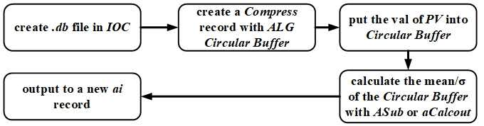
Moving Avg of archived data
Motivation:
Data fluctuations in high-repetition-frequency accelerator Interfere with the judgment of the data trend. Moving avg of PV value is needed in physical analysis to suppress noise.
Previous approach:
Create a series of PVs and calculate the mean value in IOC
Add PV to Archiver Appliance and observe it in Databrowser
Disadvantages:
Such process is complicated and repetitive for each PV
not instantaneous, and the data needs to be accumulated in Databrowser or Archiver Appliance.
Just as that in Steven Hunt‘s presentation ” Using compress records in the real world”

Slide 19
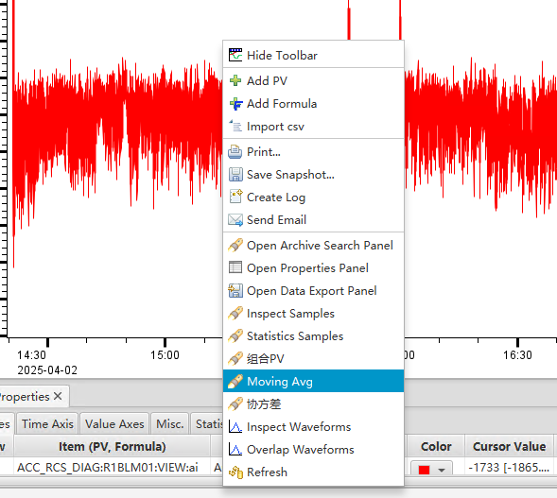
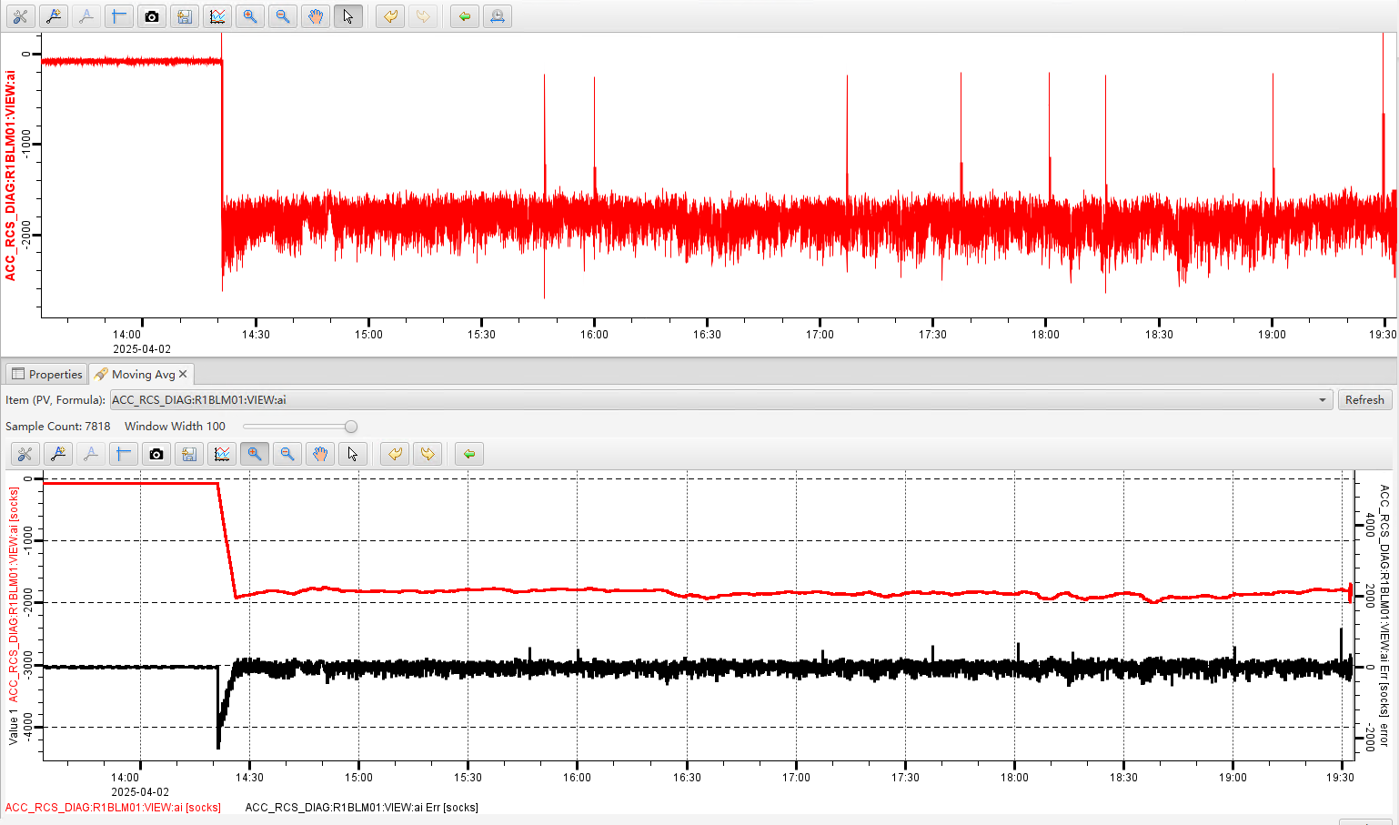
Moving Avg of archived data
New approach:
  Add a new MenuItem MovingAvg to the ContextMenu of DataBrowser.
Moving avg of the archived data of one PV is directly shown as a Tab in DataBrowser: Red curve：Moving Avg；black curve：noise.
Window width range 1~100
Moving Avg
Noise
Notes:
The archived data subtracted by the moving avg would result in the noise

Slide 20
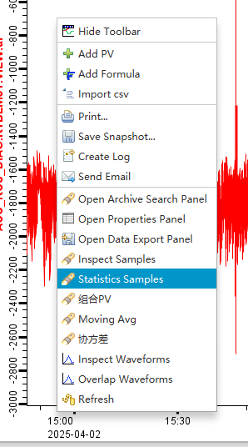
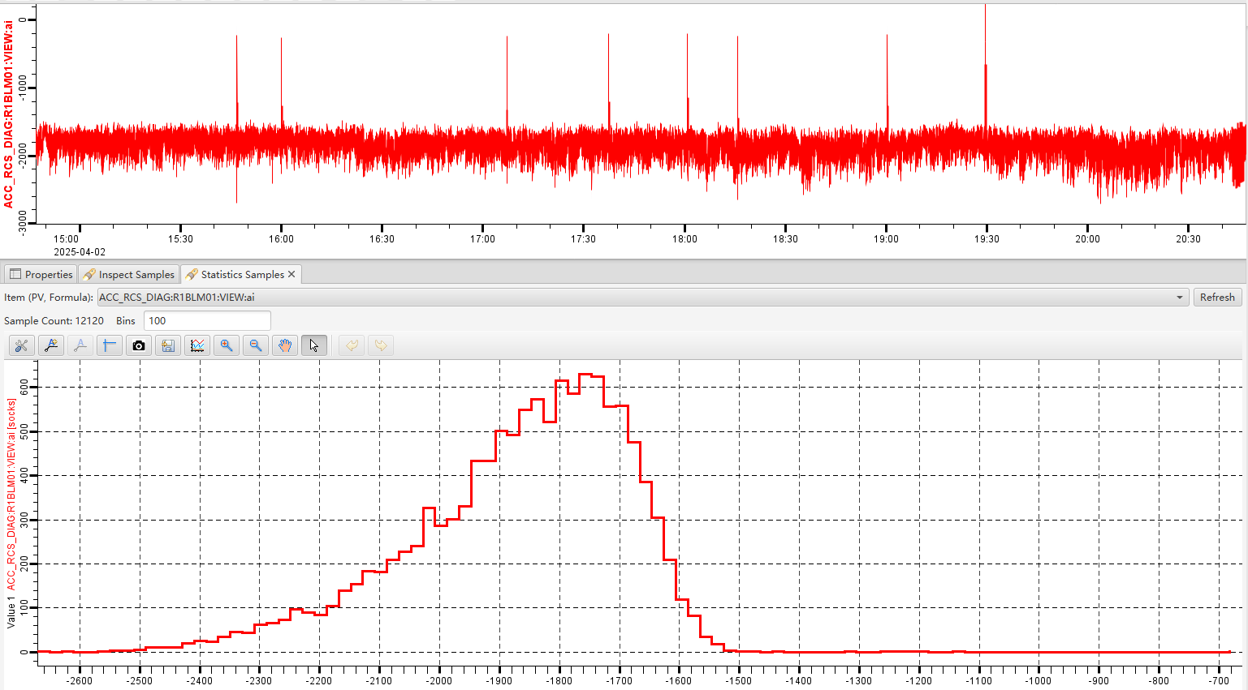
Histogram of archived data
Motivation:
  Statistics tools in DataBrowser (mean/Median/σ/Min/Max ) not fully meet the physical analysis requirements: Limitations in information; Vulnerability to extreme values
Add a new MenuItem Statistics Samples
Notes:
Statistics tools mean/Median/σ/Min/Max in
Limitations in information: They can only provide partial characteristics of the data and are unable to display the distribution pattern of the data. For instance, just knowing the mean and the standard deviation, it is impossible to understand whether the data follows a uniform distribution, a normal distribution, or a skewed distribution, and so on.
skewed /skjuːd/
Vulnerability to extreme values: The mean, in particular, is highly influencd by extreme values, which leads to insufficient representativeness of the central tendency of the data. For example, when there are a few extremely large or small values in the dataset, the mean may be pulled towards these extreme values and fail to accurately reflect the true level of the majority of the data.
Lack of intuitiveness /ɪnˈtʃuː.ɪ.tɪv.nəs/: For non-professionals, these statistical measures may be rather abstract, making it difficult to iunderstand the distribution of the data. In contrast, graphical presentation methods such as distribution histograms can enable people to more intuitively feel the distribution characteristics of the data.
If we press this menuitem, the histogram of the distribution of the crchivered data of the pv is shown in this plot. We know it is a shewed distribution

Slide 21
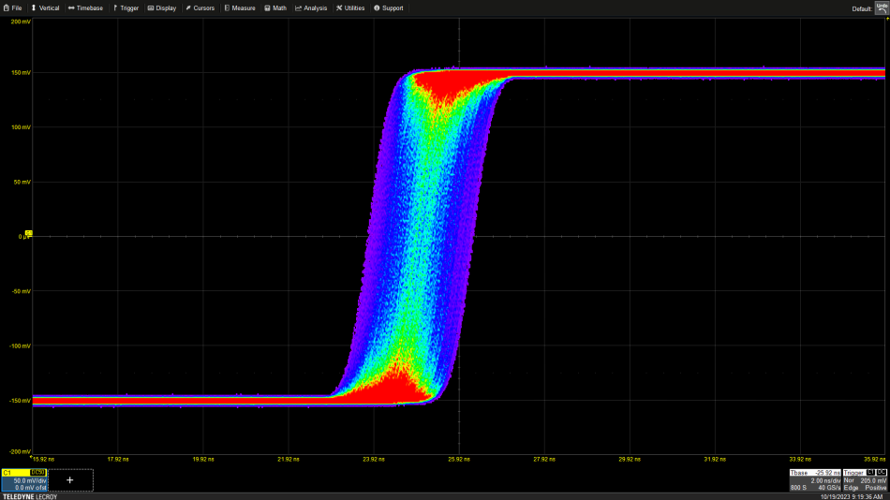
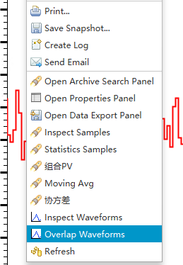
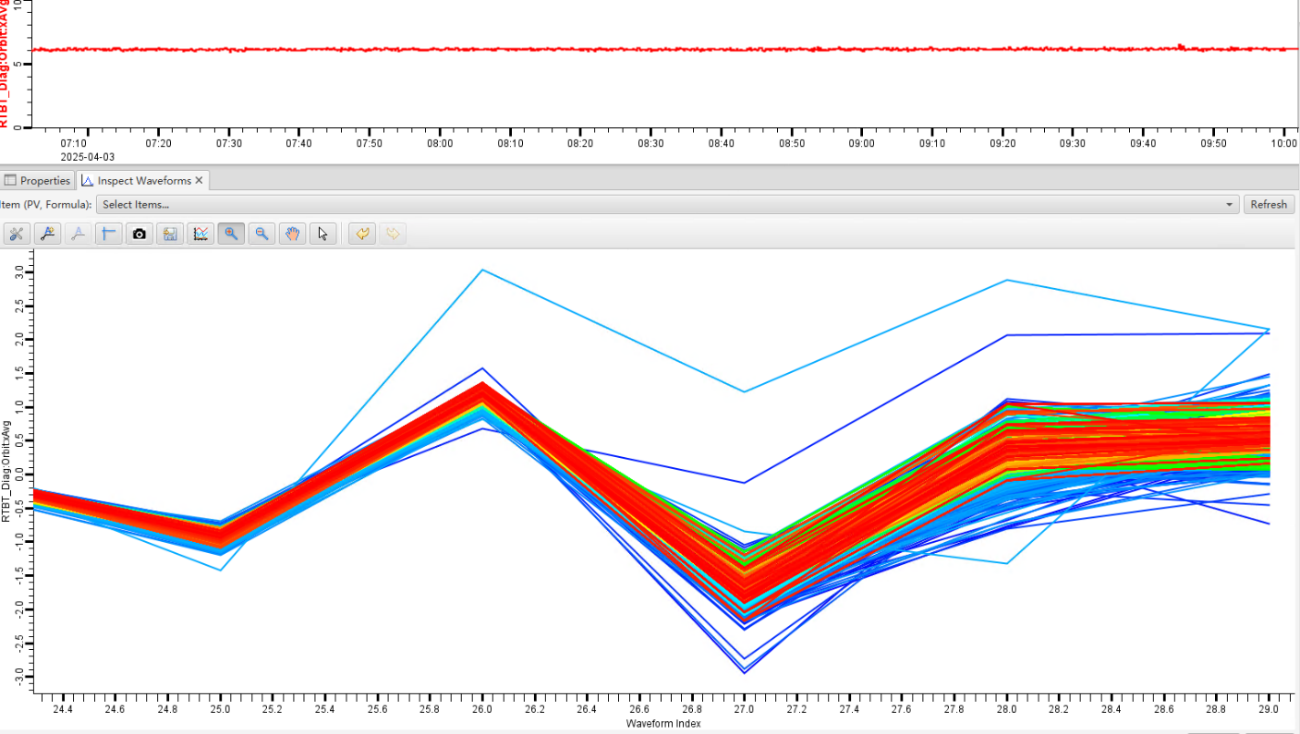

Overlap of archived data of waveform PV
Motivation:
  To facilitate the comparison of archived data of waveform PVs, an infinite persistence function similar to an oscilloscope is needed, in addition to the Inspect Waveforms.
Add a new MenuItem Overlap.
Use jet colormap to indicate the temporal sequence of data
Notes:
[əˈsɪləˌskəʊp]
we know, In Databrowser, for waveform pvs, the first point is shown in databrowser.
In the Inspect Waveforms, we drag the slider to show the archived data of waveform pv at different time.

Slide 22

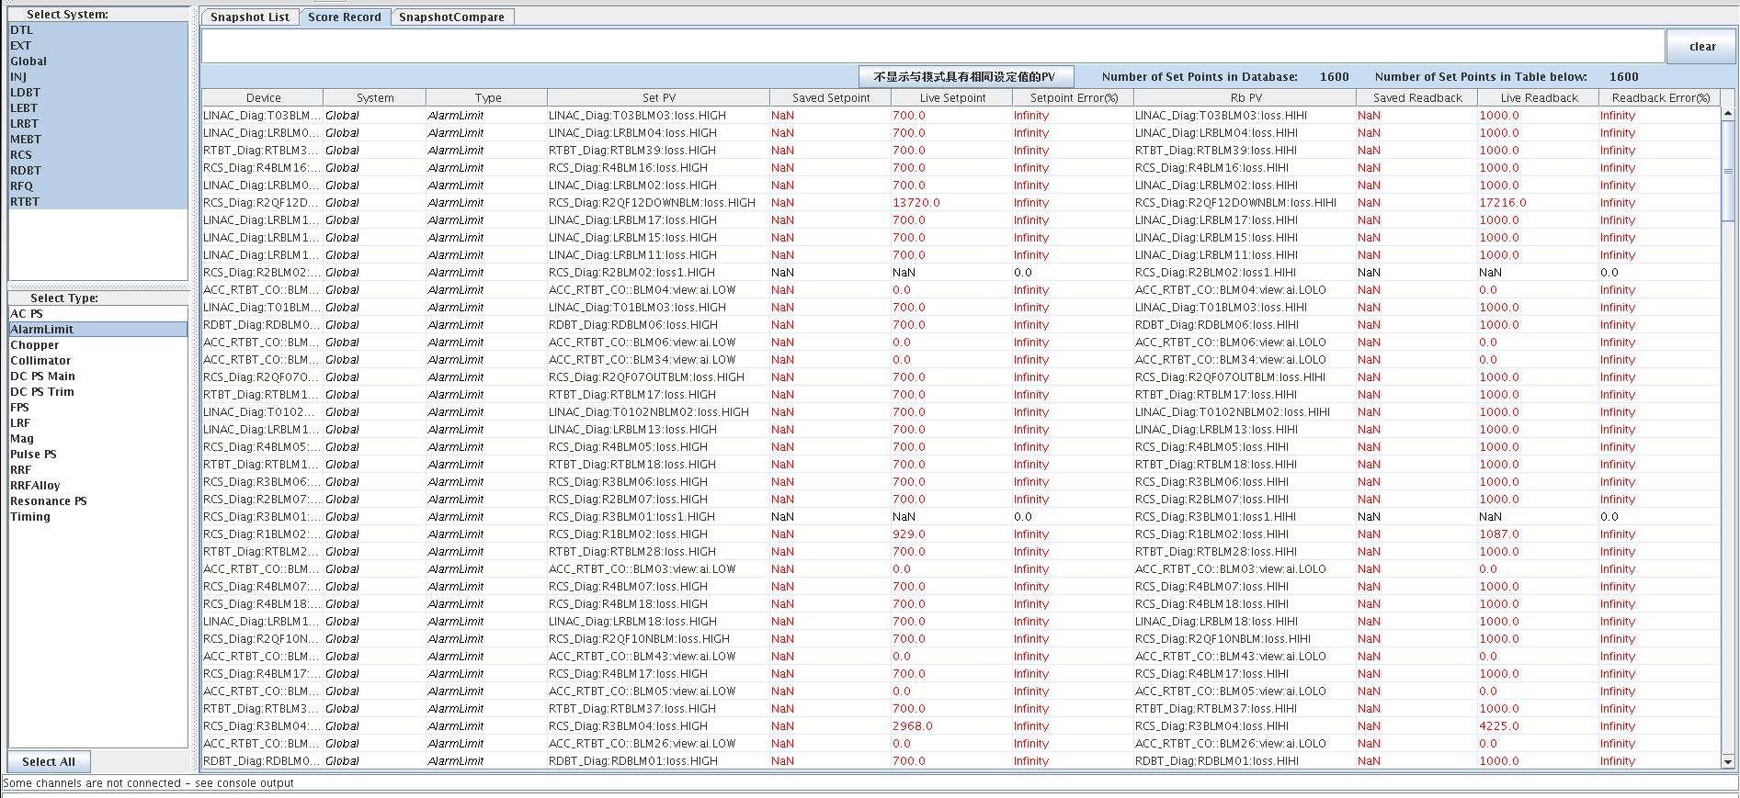
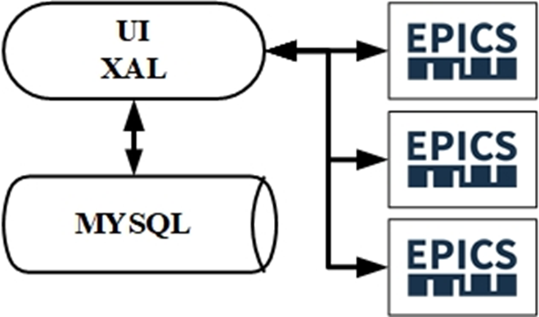
Snapshot Management in CSNS
Current situation of Snapshot Management in CSNS:
  SCORE(Save&Compare%Restore) in XAL used since 2015.
  2000+ snapshots recorded in MySQL.
  Save & Restore in Phoebus is not used in CSNS.
Most obvious characteristics of SCORE: All tasks executed in one program
Notes:
Beam commissioning and operation at CSNS began at 2015.
XAL is utilized as a flexible application framework for developing accelerator physics applications
two thousand plus snapshots
All functions are executed [ˈeksɪkjuːtɪd] in one program, including
Database operations with JDBC
PVs connection, read and written.
UI display, refresh, and operations

Slide 23
Snapshot Management in CSNS
Drawbacks:
The architecture of score antiquated, devoid of advanced technologies and frameworks
Very slow in loading and saving snapshots.
Connection and updating of PVs are time-consuming.
CRUD of database is time-consuming.
the contents in a snapshot:
PV Length | Number
1 | 4668
21 | 391
8448 | 4
16896 | 5
32768 | 4
Notes:
Socre has some drawcacks
There are 5000 PVs in a snapshot.
CRUD Create, Read, Update, Delete
The architecture of score is antiquated, devoid of advanced technologies and frameworks

Slide 24
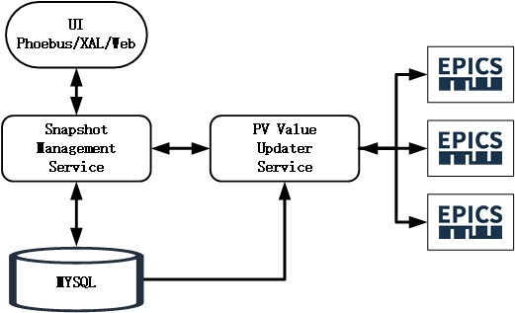
Snapshot Management in CSNS
Solution: Frontend-Backend-Separation architecture
PV Value Updater Service： Performs batch updating of PV values
Snapshot Management Service：gets snapshot list; gets PV values in a snapshot and from PV Value Updater Service; saves snapshot into MySQL; restores PV value
UI: interface layout; Data presentation; User interaction
Difference from Save & Restore in Phoebus:
ES vs. MySQL
PV connection & operation is in backend.
Springboot2.7.3
Notes:
Motivated by save & restore in phoebus
Its perpose is to reduce network connections
UI: focus solely on interface
In Save & Restore in Phoebus, PV connection & operation is in frontend

Slide 25
Snapshot Management in CSNS
Progress:
UI embedded in Phoebus’ Application/Utility menu and XAL
UI Inherits from SCROE to respect users' operation habits
Filter with:
  Accelerator sections
  Device types
  Key words
Notes:
Respecting users' habits is crucial for improving user satisfaction.

Slide 26
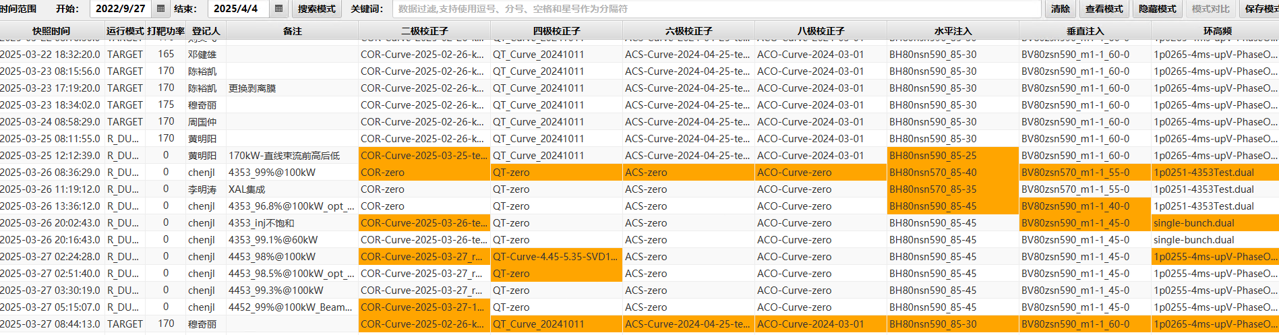
Snapshot Management in CSNS
Snapshot list:

Slide 27
Snapshot Management in CSNS
The content of one snapshot:

Slide 28
Snapshot Management in CSNS
Comparison of two snapshots:
Notes:
Difference from save & restore in phoebus, We show the data from two snapshots in one table, and also show the differences by percent

Slide 29
Snapshot Management in CSNS
Running performance:
  Fast in loading
  Fast to save/compare/restore snapshots
  Hardly observed waiting time
  tested for three months, but there are still some bugs
Key point:
  Bulk updating of PV values
  Long PV is connected when updating value, then released, to save bandwidth
  Use Caffeine to cache the responses to requests sent from the UI.
Special features:
  The Snapshot Management Service needs the R/W access in IOCs;
  Each Phoebus/XAL client in control system can restore snapshots.
  Operation is logged.
  Undesired Snapshots can be hidden in UI.
  The values of waveform PVs are represented by their sums, for convenient comparison.

Slide 30
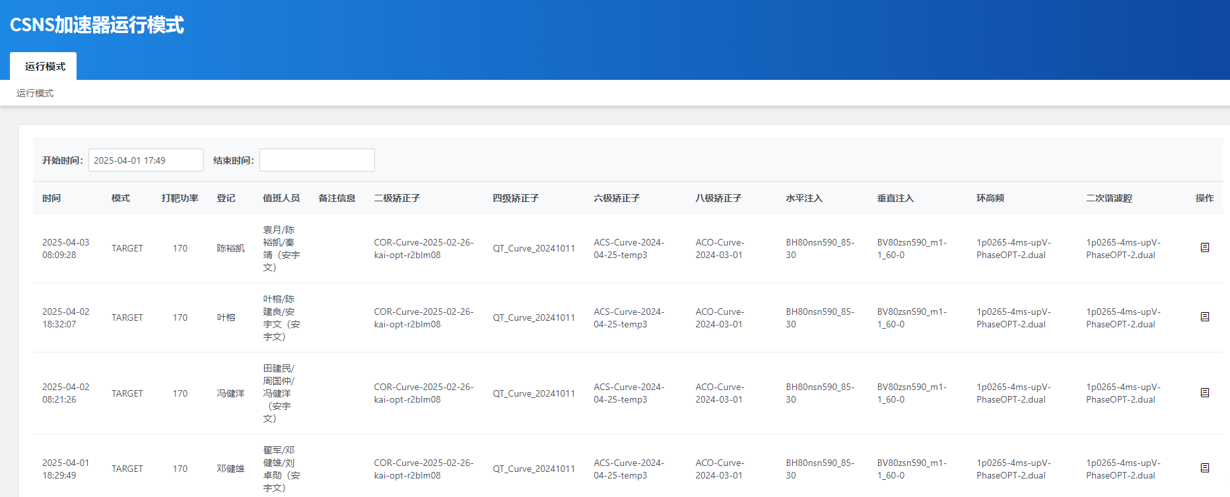
Snapshot Management in CSNS: Web UI
Web page get the snapshot info from MySQL using RESTful API

Slide 31
Summary
CSS OPIs planed to be migrated to Phoebus version in the coming years.
Lots of customization performed in Phoebus since 2020 to satisfy site-specific requirements, including Alarm System, Alarm Logger, DataBrowser, Snapshot management and so on.
Phoebus is running well in CSNS.
31

Slide 32

Thank you for your attention!

Slide 33
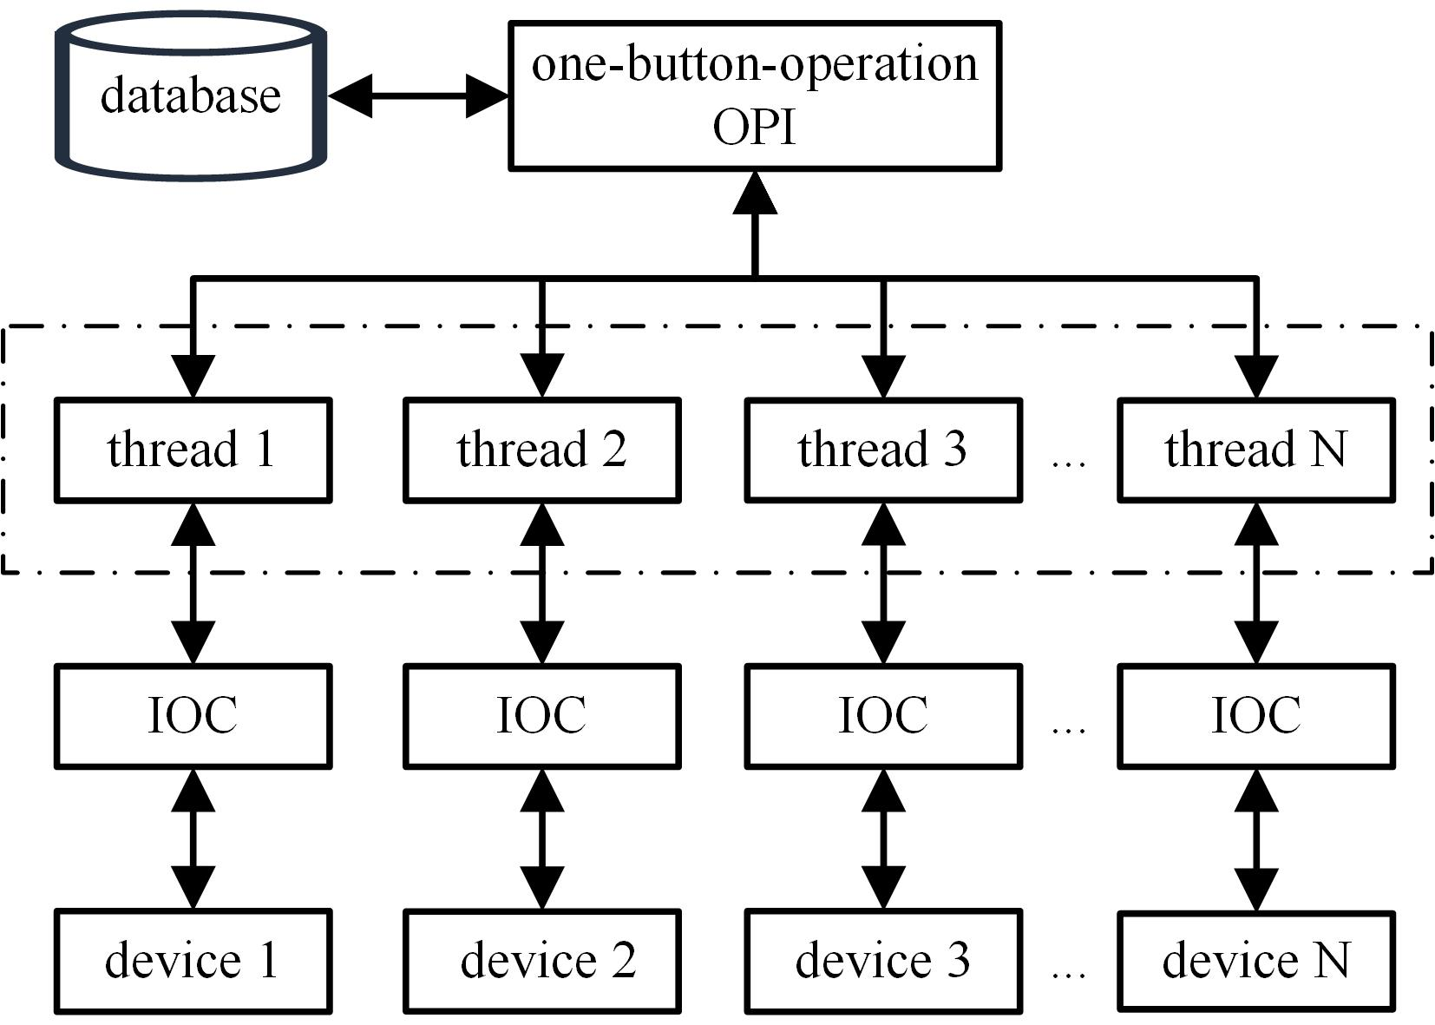
Information we care about PV

Slide 34
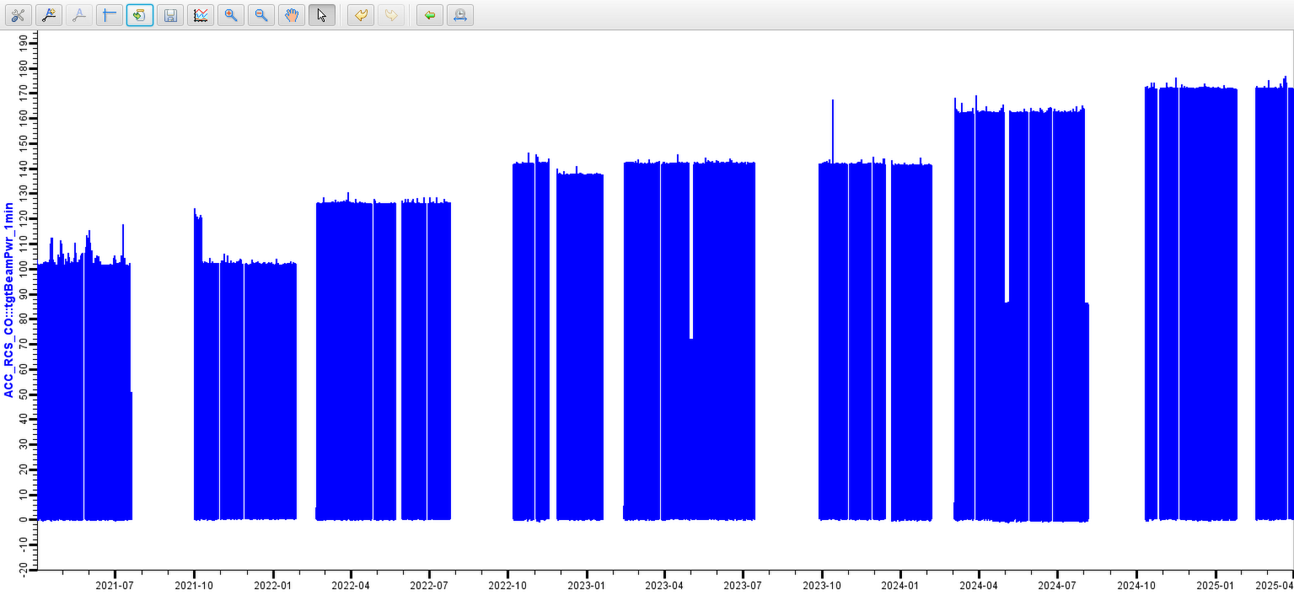
Brief Introduction of CSNS Operation and CSNS-II
CSNS is operating at 170kW beam power since October 2024
Beam power ramp history

Slide 35
Accelerator Control System Upgrade Towards CSNS-II
EPICS V3 and V7 mixed control system
Total number of V3 and V7 IOCs will be more than 200
Notes:
new features in V7 are not commonly used

Slide 36
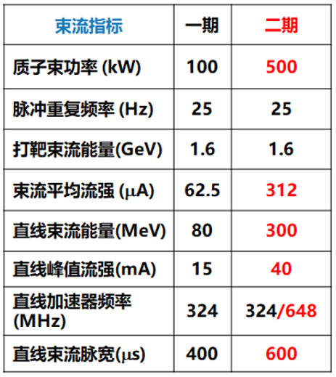
Brief Introduction of upgrade project of CSNS-II
Beam power will be upgraded from 170kW to 500kW
LINAC Energy will be upgraded from 80MeV to 300MeV
10+ new beam lines
New Injection System
Parameters
CSNS
CSNS-II
Beam Power（KW）
SSC, 80MeV->300MeV
Rep-Rate（Hz）
Beam Energy（GeV）
Avg Current (µA)
Linac Energy(MeV)
Linac Pk Current (mA)
Linac RF Frequency（MHz）
Linac Beam Width(µS）
Notes:
Upgrade of CSNS is undergone
Superconducting Accelerating Cavity

