Slide 1
Control System Upgrades at SNS
April 8, 2025
Karen S. White
Control Systems Section Head
Spallation Neutron Source

Slide 2
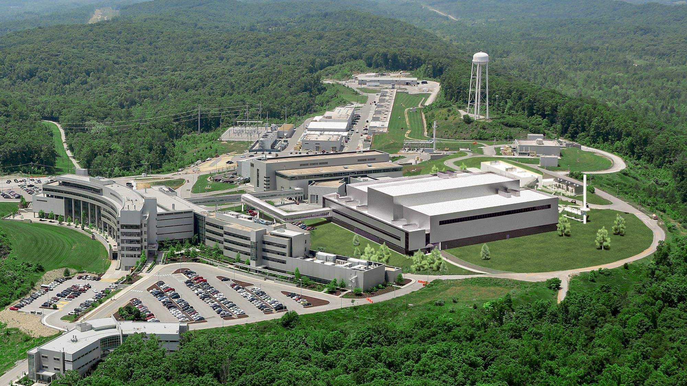
SNS EPICS based control system in operation since 2006
Sustaining Operations
  Obsolescence
  Growth
  New requirements
Upgrades
  $300M Proton Power Upgrade project (doubles machine power) completed in 2024
  $2B Second Target Station Project in progress

Slide 3
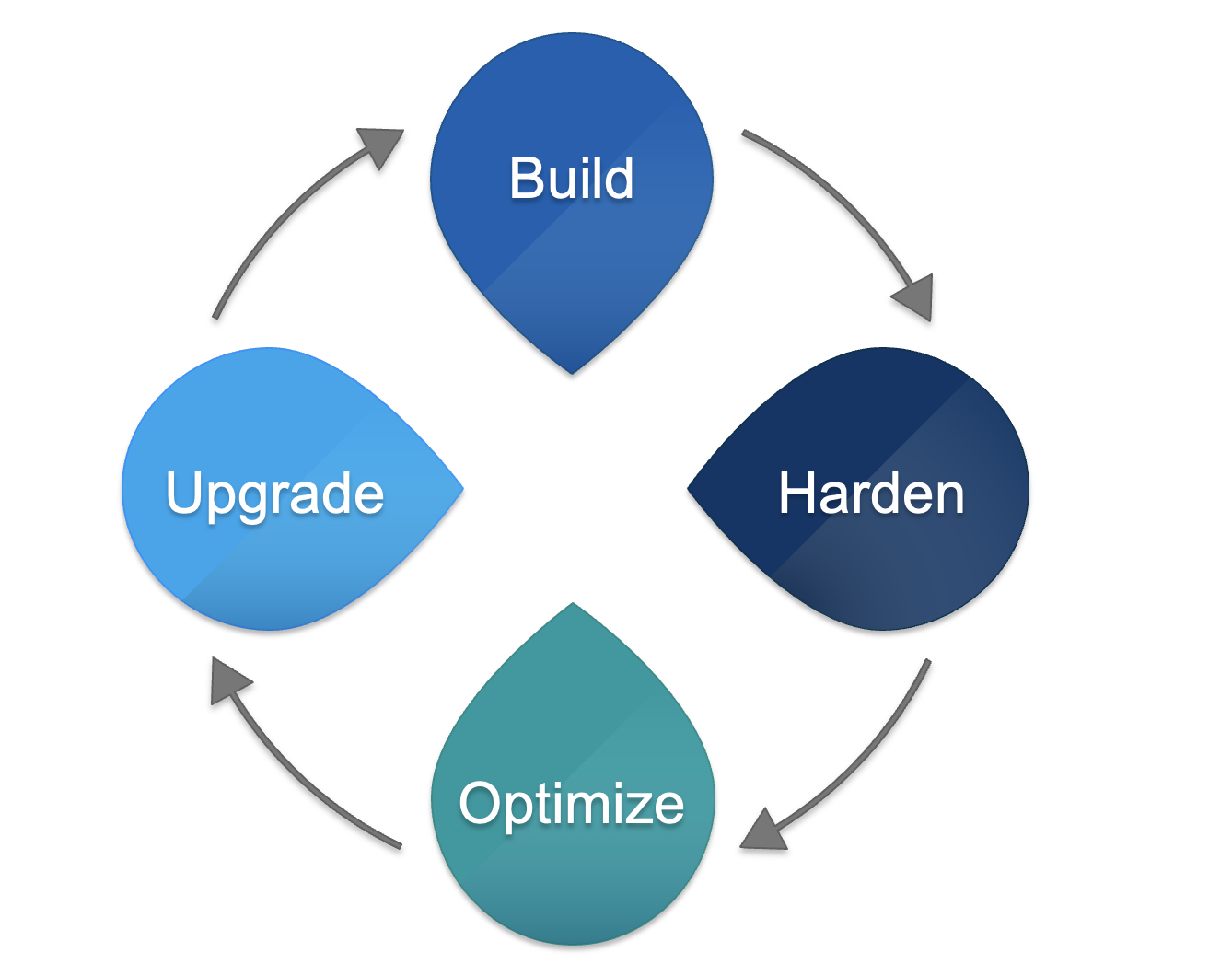
Sustaining Operations - lifecycle
Control system is built, but never finished
Some controls elements turnout to be unreliable
May need optimization
Emergent scope; customers want more diagnostics, new features, capacity may be challenged
Maintenance
Maintenance; parts of the control system start to become obsolete right away
Machine or facility upgrade projects

Slide 4
Challenges
System capacity
  System growth Demand for new devices/features and upgrade projects means more infrastructure us needed
Obsolescence/Reliability
  Older equipment more likely to fail in-situ
  Older software also needs upgrades for future compatibility
Cyber Security
  Increasing requirement for additional cyber security protections
  Following enterprise model not always good for our control systems
Capacity
Obsolescence
Cyber Security

Slide 5
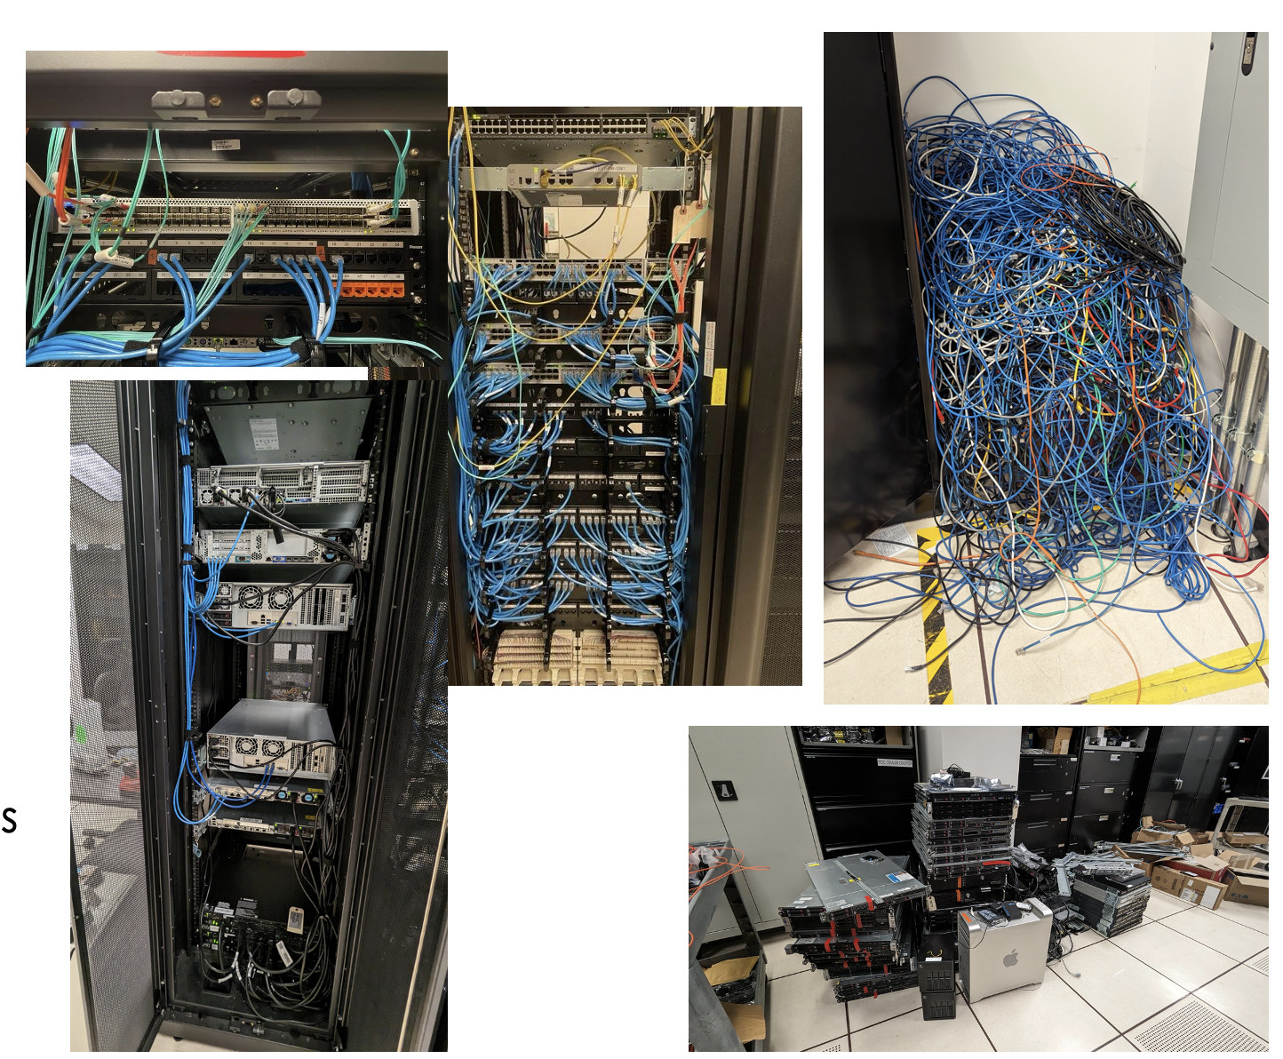
Capacity - Infrastructure
Network upgraded from 1Gbps to 25Gbps, upgraded firewalls
Added a virtual machine cluster
All network connections fully redundant down to servers
Improved cable management and rack cleanup
Replaced Power Distribution Units (PDU)
Added a Virtual Cluster and virtualized over 10 servers
Removed obsolete servers (about 35) and network switches (9) for reduced power load

Slide 6
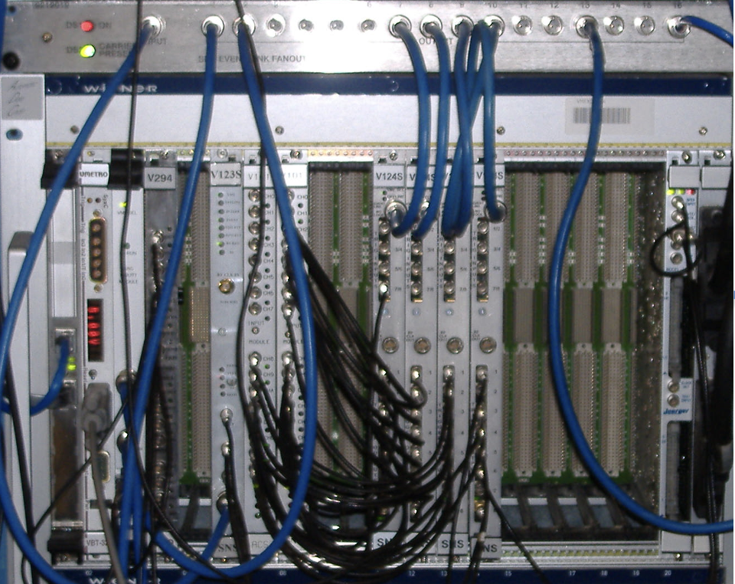
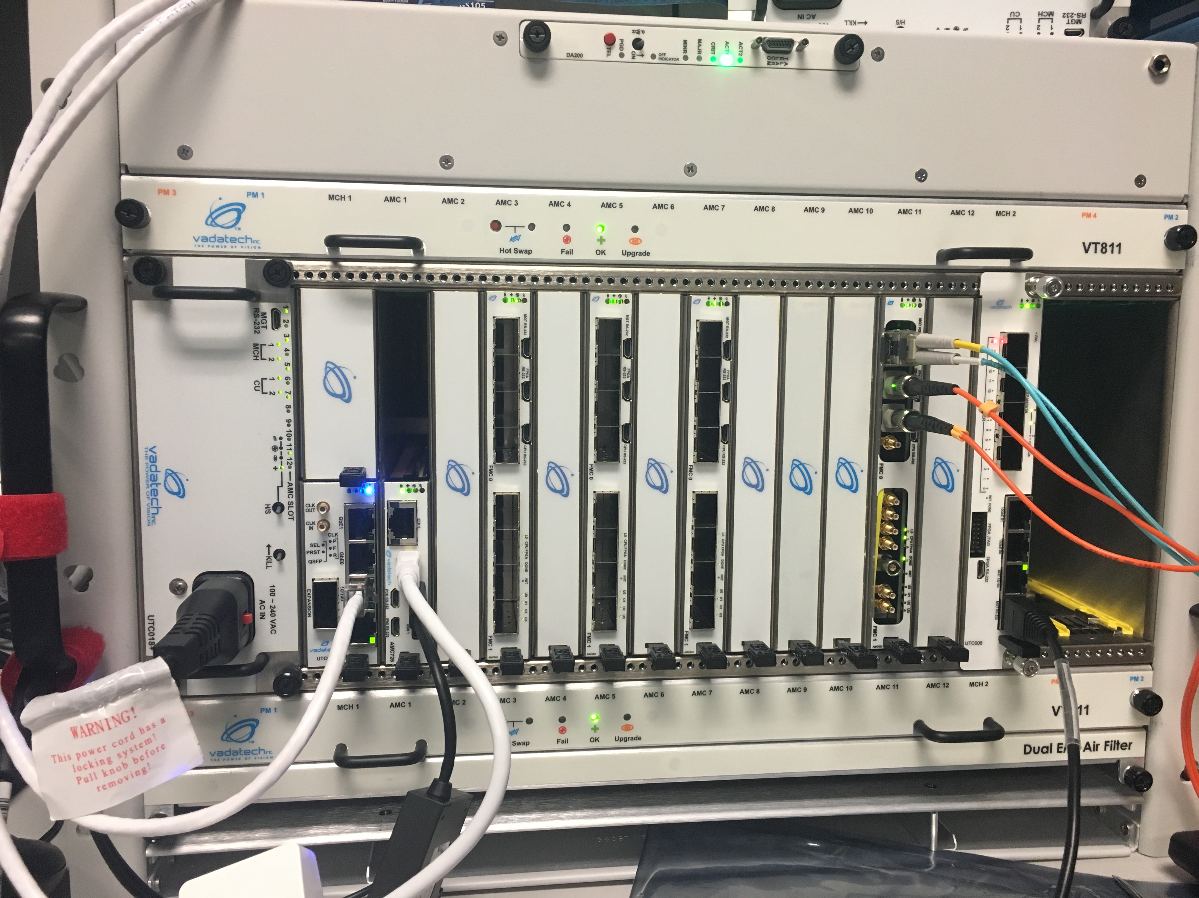
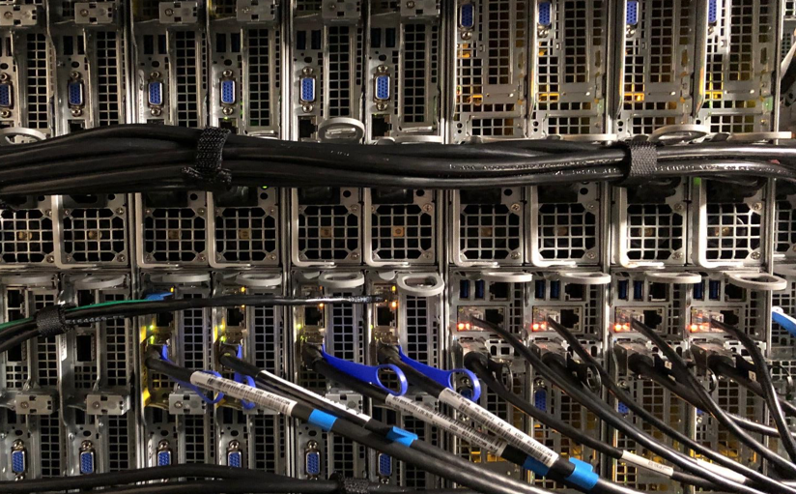
Hardware Obsolescence
Hardware - estimate lifetime of hardware models and plan for replacement before failure.
Ensure new designs are as standard as possible
Start replacement design well ahead of when you I think the changes should be deployed
We replaced
  Network (switches, core router, firewalls
  Timing and machine protection system hardware
We are working on
  New LLRF design, used for PPU; retrofit remaining cryomodules
  Kicker waveform monitoring
  VME => µTCA, Soft IOC or PLCs
  EPICS IOCS => EPICS 7 55% complete

Slide 7

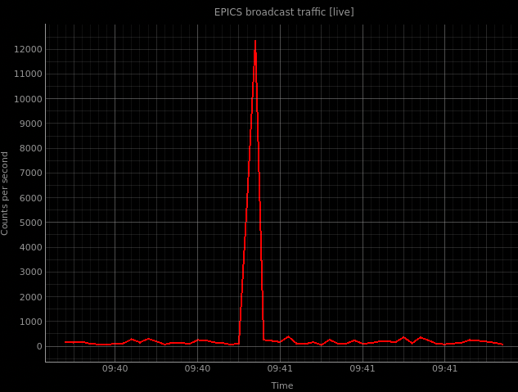
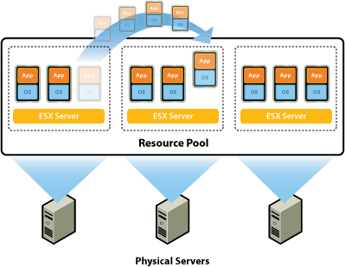

Software Obsolescence
Obsolete software will eventually provide serious limitation
We replaced
  RedHat Linux 6 => RedHat Linux 9
  EPICS 3.X => EPICS 82% complete
  VxWorks 6.9
  VME => µTCA
Start replacement design well ahead of when you I think the changes should be deployed
We replaced
  Network (switches, core router, firewalls
  Timing and machine protection remaining cryomodules

Slide 8

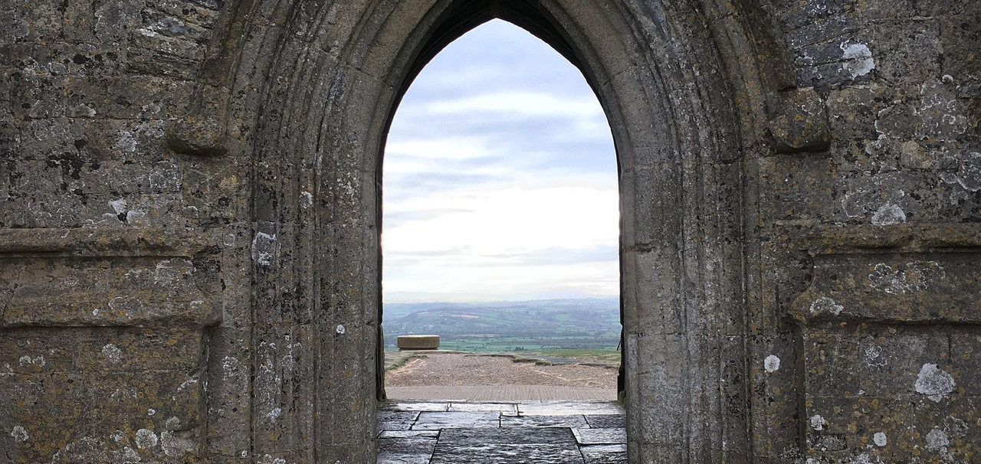
Performance upgrades
Increased network bandwidth
Introduced operational Nameserver to reduce spikes of broadcast traffic on the network
Gateway performance impacted by many requests for PVs that do not exists; working to reduce this condition, quickly exhaust memory
Working on a design for network segregation to further isolate risky (but not quickly) replaceable devices
Working to better manage CA traffic within the network

Slide 9

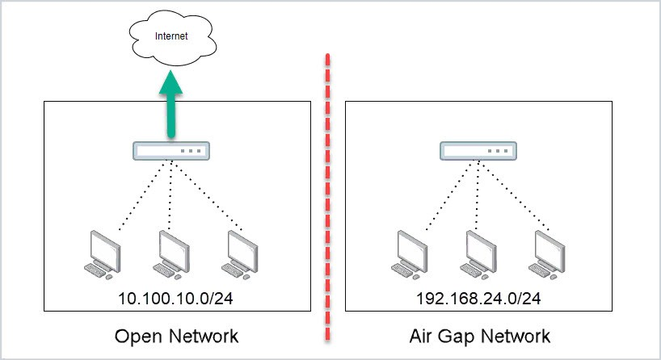

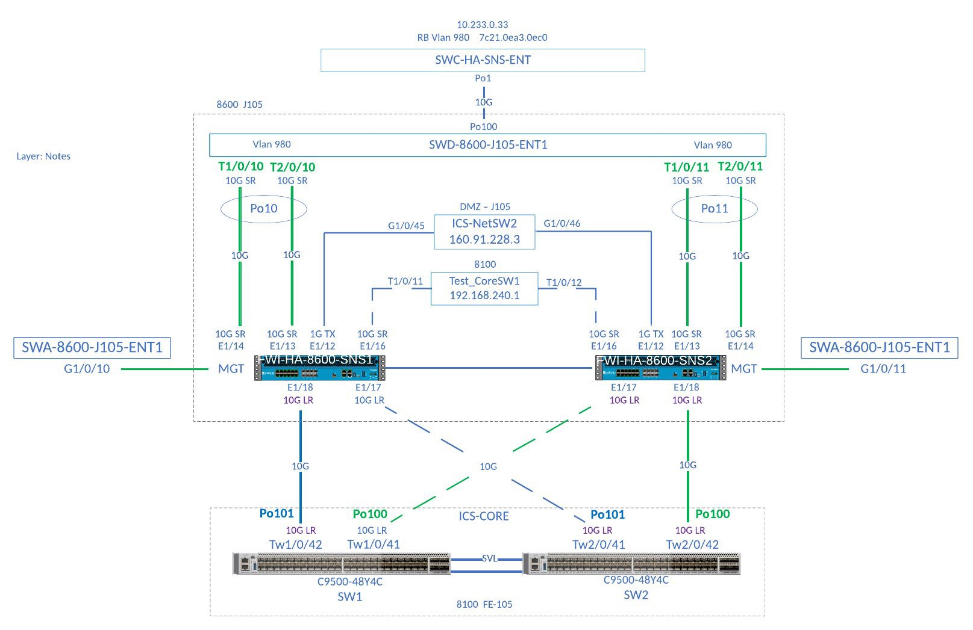
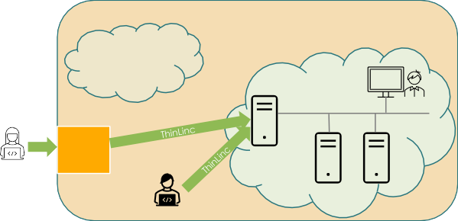

Improving Cyber Security requires collaboration
Virtualization provides encapsulation, partitioning, HW independence
Staff in office
Managed, monitored and audited MFA-enabled remote access
Meeting DOE requirements for cyber security is increasingly challenging, poses substantial risk to secure operations and machine availability, required DMZ upgrades are complete
Requires significant changes to our control systems
Add zero-trust and transport layer security to EPICS
Plan to work with the EPICS cyber security working group to provide a realistic test environment for Secure EPICS
Working with ITSD on a new network architecture (slow progress)
Adding resources to control system infrastructure team (2 FTE)
Staff in office
Managed, monitored, audited MFA-enabled remote access
Device, link, power source redundancy
Updated cyber security assessment and practices

Slide 10
Controls system work is never done!
Maintenance

