Slide 1
Implementing a P4P-Based Serial Driver for MOXA TCP Communication with ISIS Serial Devices
Nadir Bouhelali
ISIS Neutron and Muon Source, Rutherford Appleton Laboratory
EPICS Collaboration Meeting Spring 2025
Monday 07 April

Slide 2
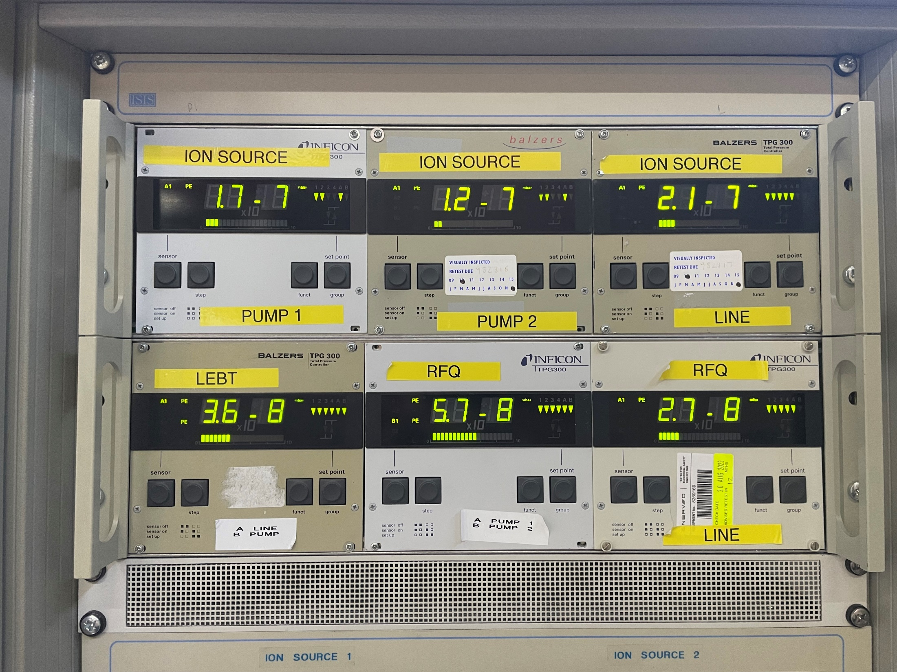
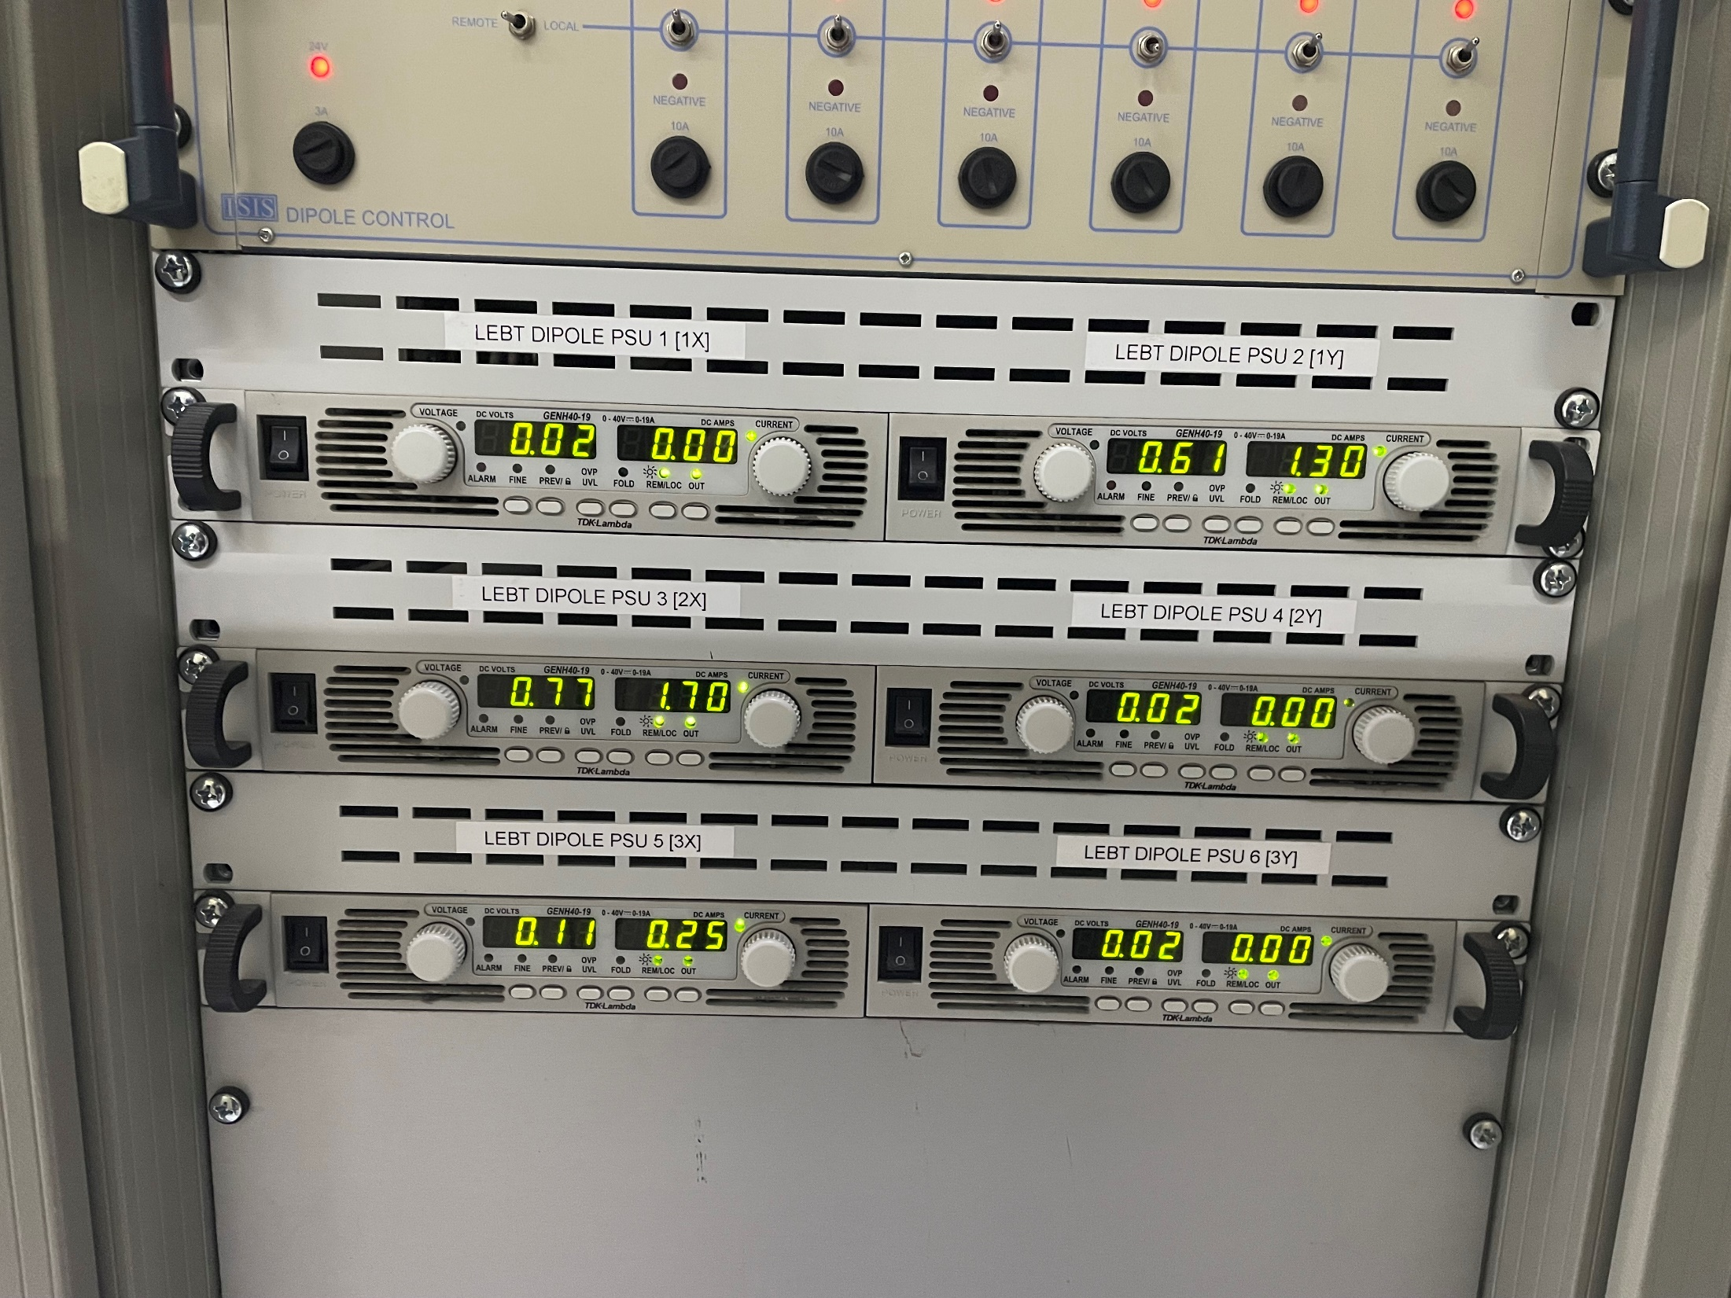
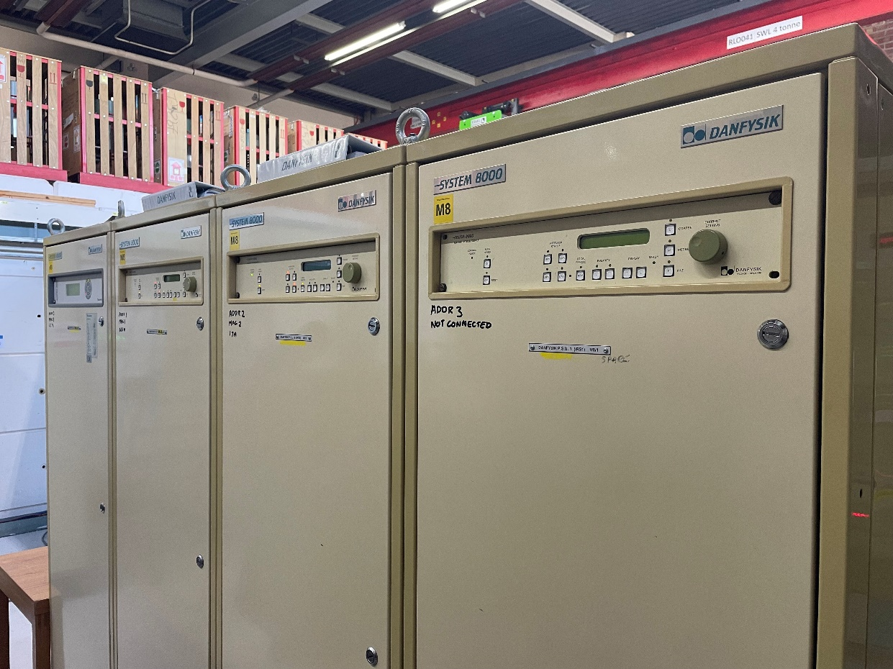
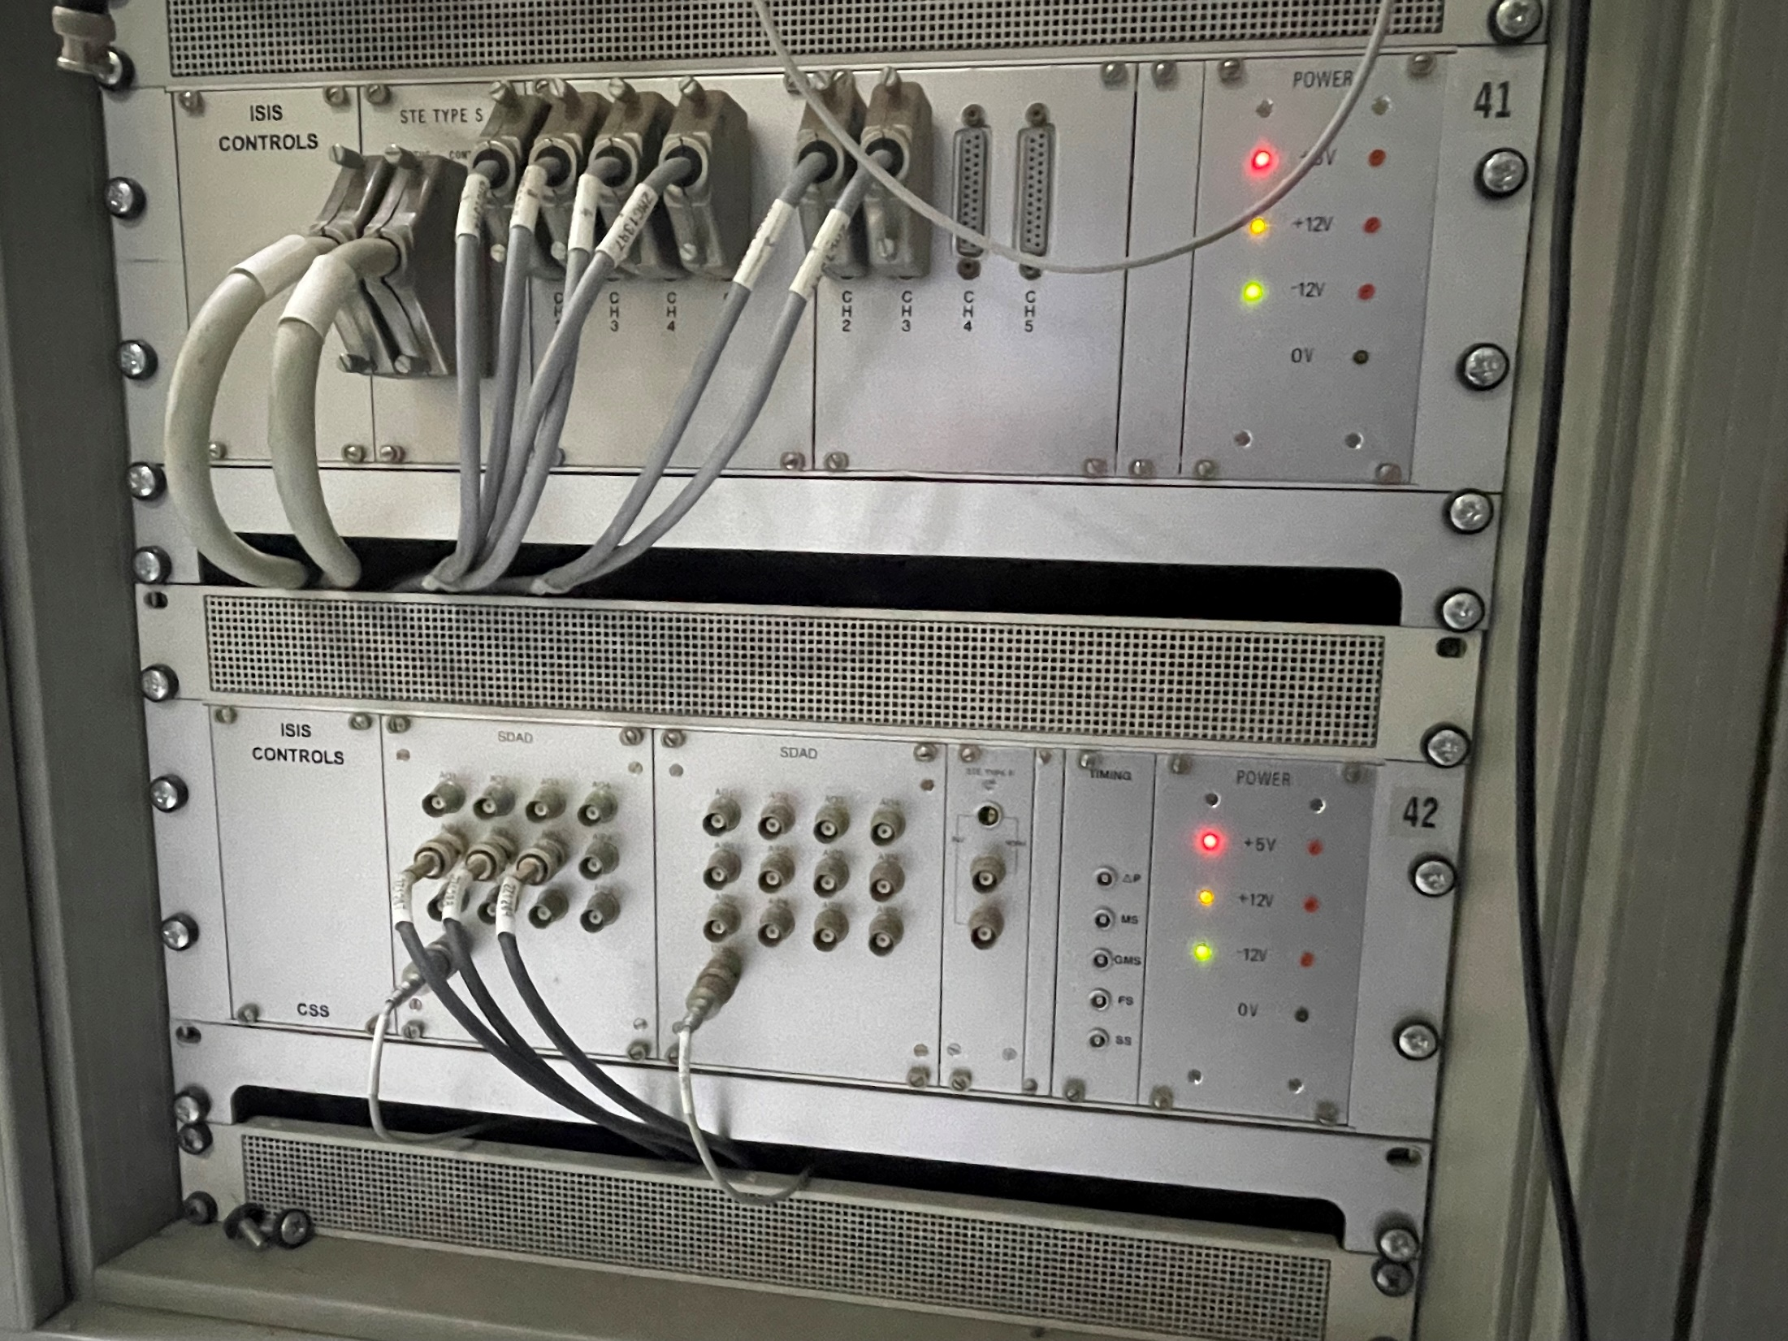
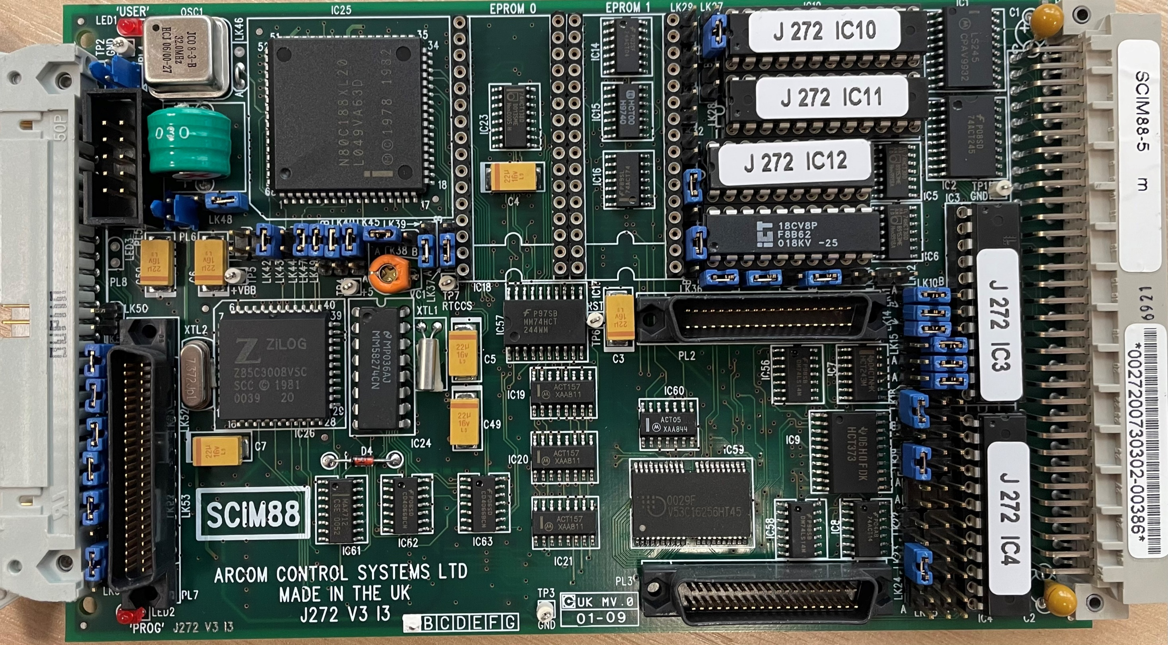
Context
R232, RS422, RS485

Slide 3

So what’s the problem?
Reliance on Vsystem
  But we want EPICS!
Legacy Hardware, harder to maintain, limited spares
Hard to maintain software
  We want maintainability and stability
No monitoring / Remote management
  We definitely want those!
CPS option exists but has limited scalability
  We want to scale up
It works … I guess

Slide 4
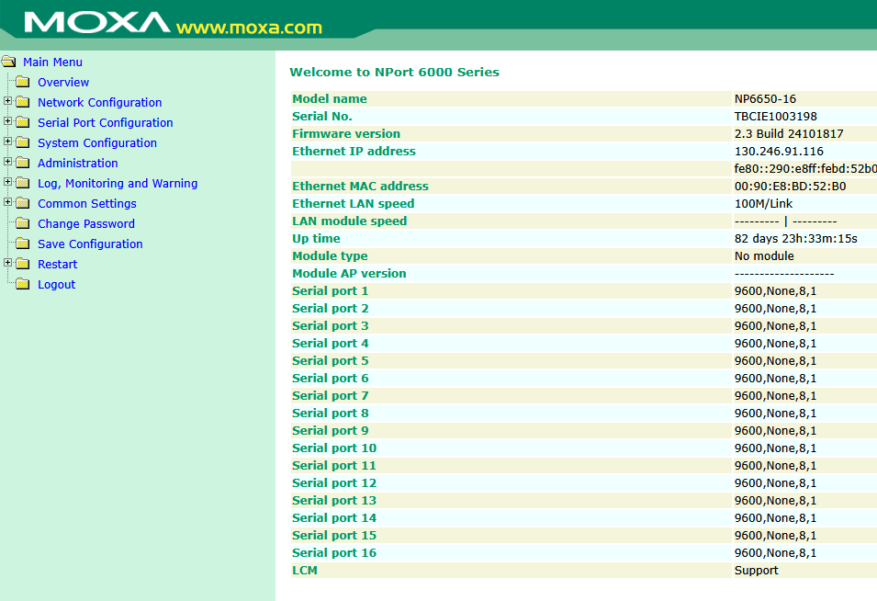
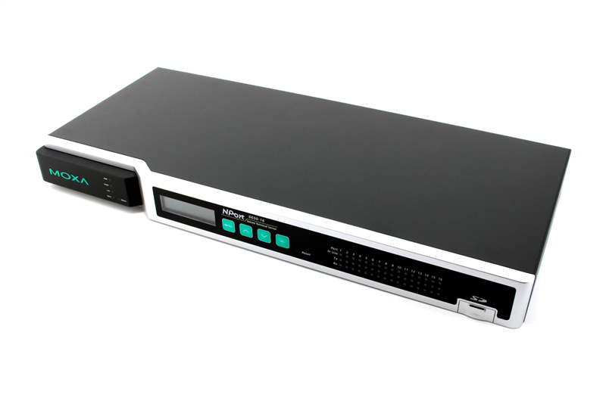

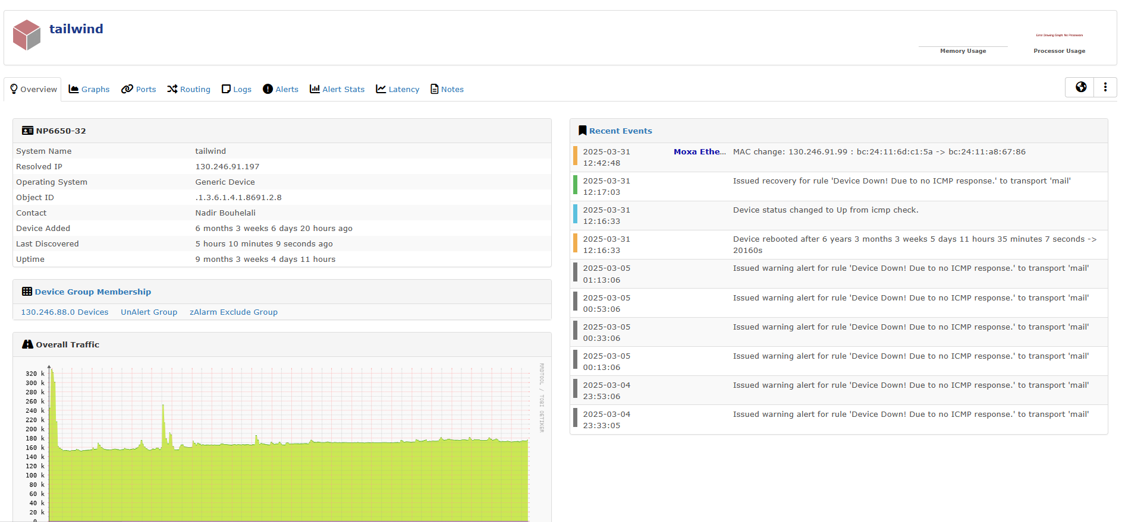

What are we doing about it?
Terminal Server from MOXA
Easy to procure, scalable
Remote management and monitoring
Updated & documented serial software
EPICS-Compatible
MOXA NPort 6000 series
SNMP Monitoring

Slide 5
YES!

Slide 6




Solution overview
P4P
PVA Server
Controller
Serial Handler #1
PV types
PV structure
Operation handlers
Serial port initialization
Command queue
Serial Handler #2
Commands via TCP
Serial Handler ##
And syslog!
I’m a PSU

Slide 7
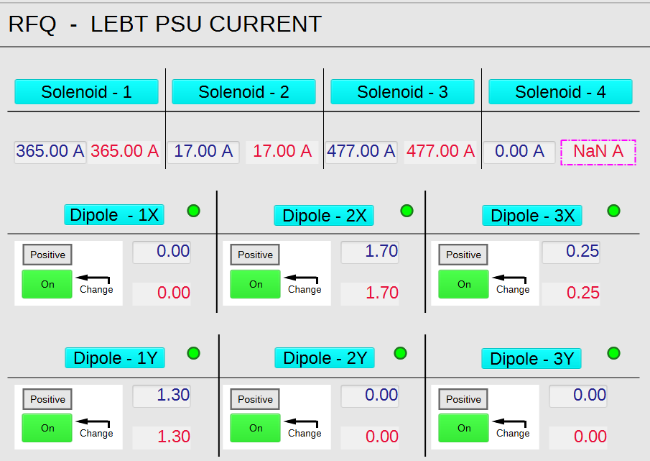
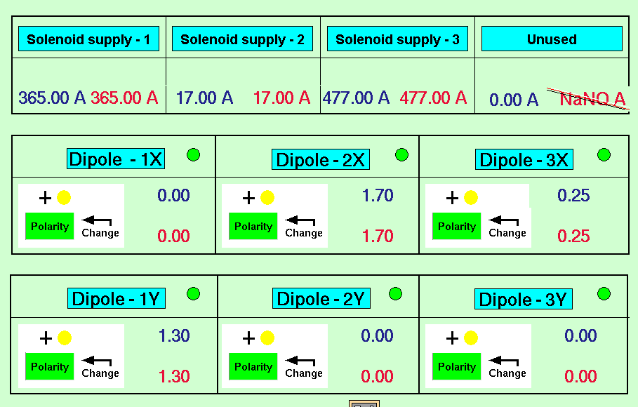
EPICS with a Vsystem flavour with PVecho
This doesn’t cause any issues at all !!!

Slide 8
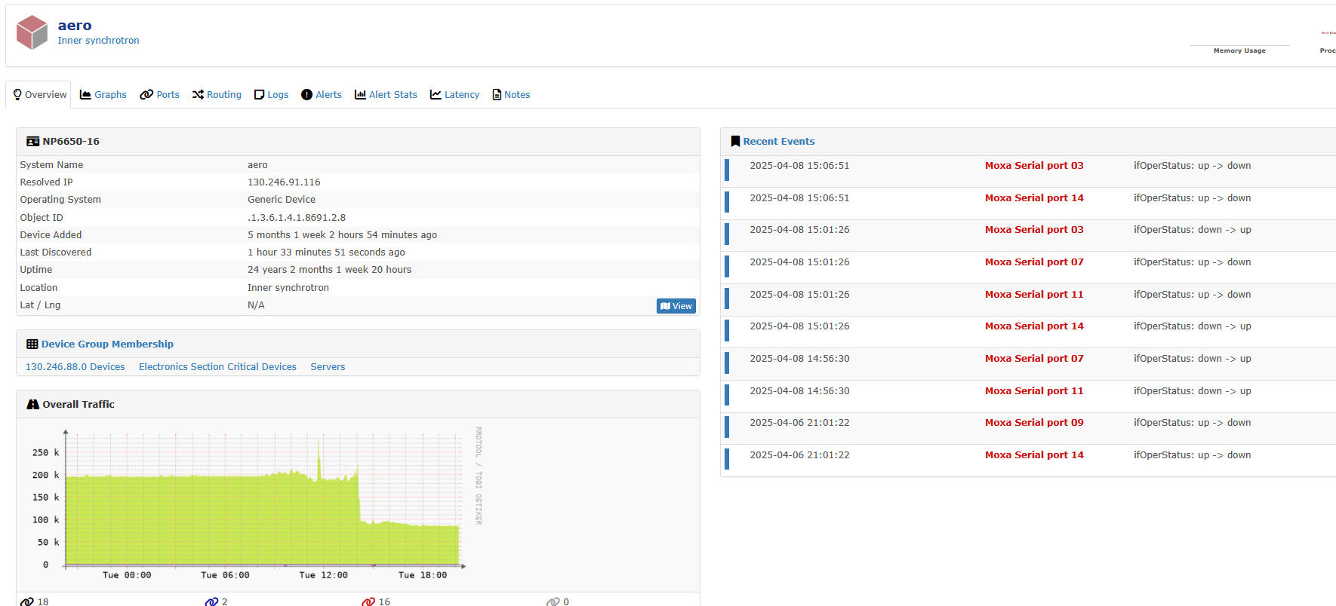
Impact & Benefit
Improved operational performance
Improved logging – finally on syslog!
Hardware monitoring through SNMP
Remote management
Automatic value restore
Maintainability/Future proofing
Surprisingly easy to implement!

Slide 9
Looking ahead
Expanding support for serial devices
Adding TLS layer over TCP
P4P for ISIS integration
Fully EPICS
THANK YOU!

