Slide 1

EPICS & Phoebus web tools survey
Martin Gaughran,
Diamond Light Source

Slide 2
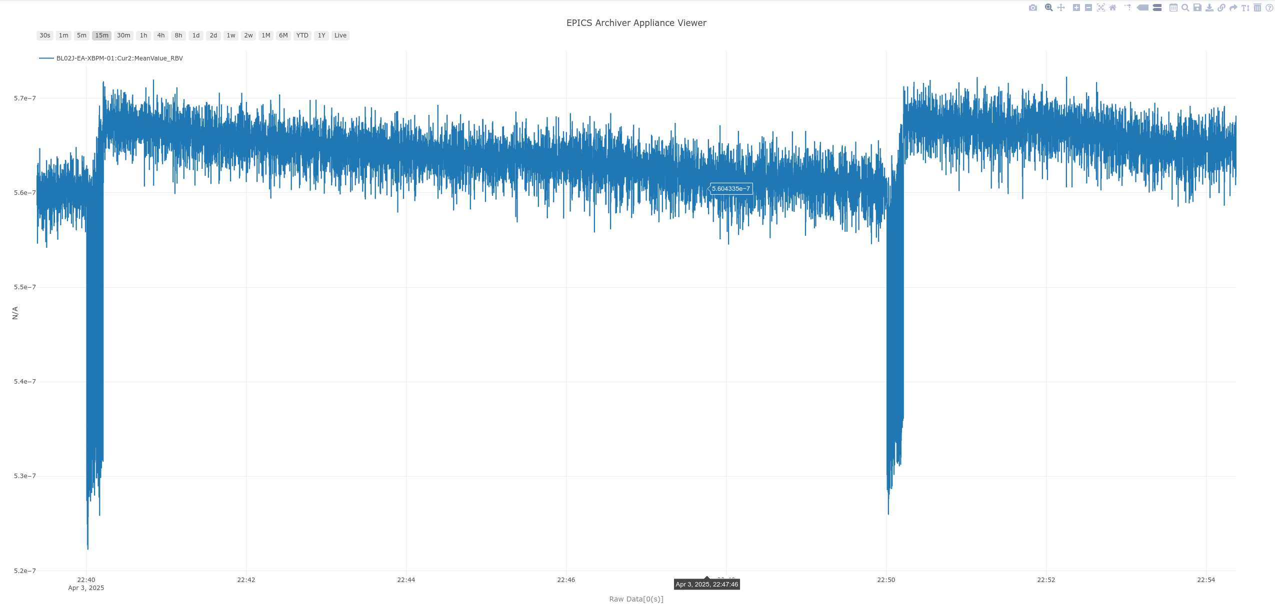
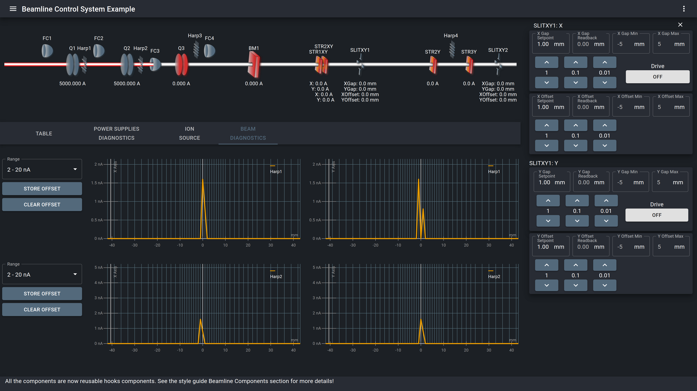
EPICS & Phoebus Web Tools
React Automation Studio
Archiver Appliance
Copyright (c) 2019, iThemba LABS, National Research Foundation, South Africa

Slide 3
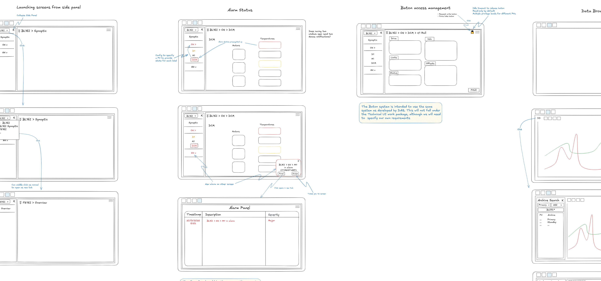
Diamond Controls Web UI

Slide 4
Problems
Not always clear what tools are in development or actively maintained
Several tools being announced only in workshops and conferences
  Difficult to find material – have had to send emails requesting info

Slide 5
Web Tools Survey
Accessible on the left-hand banner on Indico, under Surveys
Working with the CSS collaboration
Survey of people and web tools
Follow-up discussion 11am Friday, Phoebus Developers session
Survey will remain live after this meeting until 30th April

Slide 6
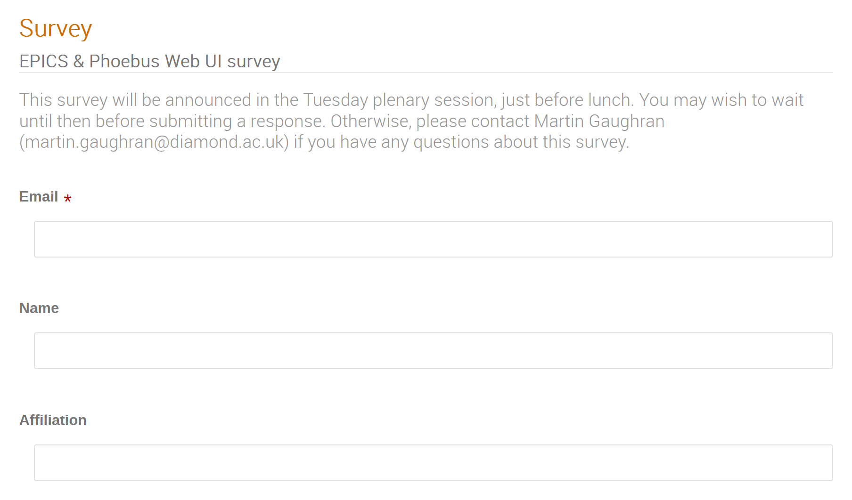
Survey (contact info)
Information only shared if you wish to be added to relevant mailing lists or added as project contact
Survey organisers may also contact you directly if we need to know more about one of your responses

Slide 7
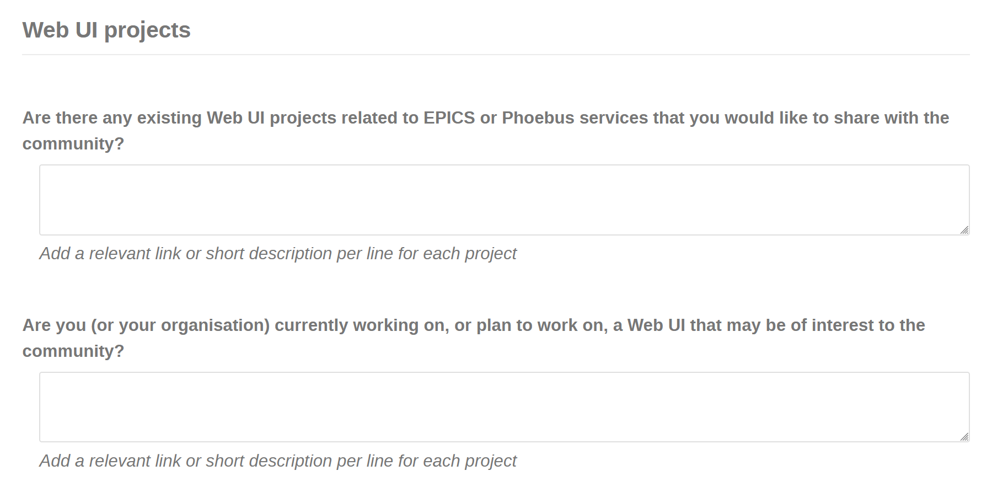
Survey (projects, pt.1)
Interested in projects at all stages of development

Slide 8
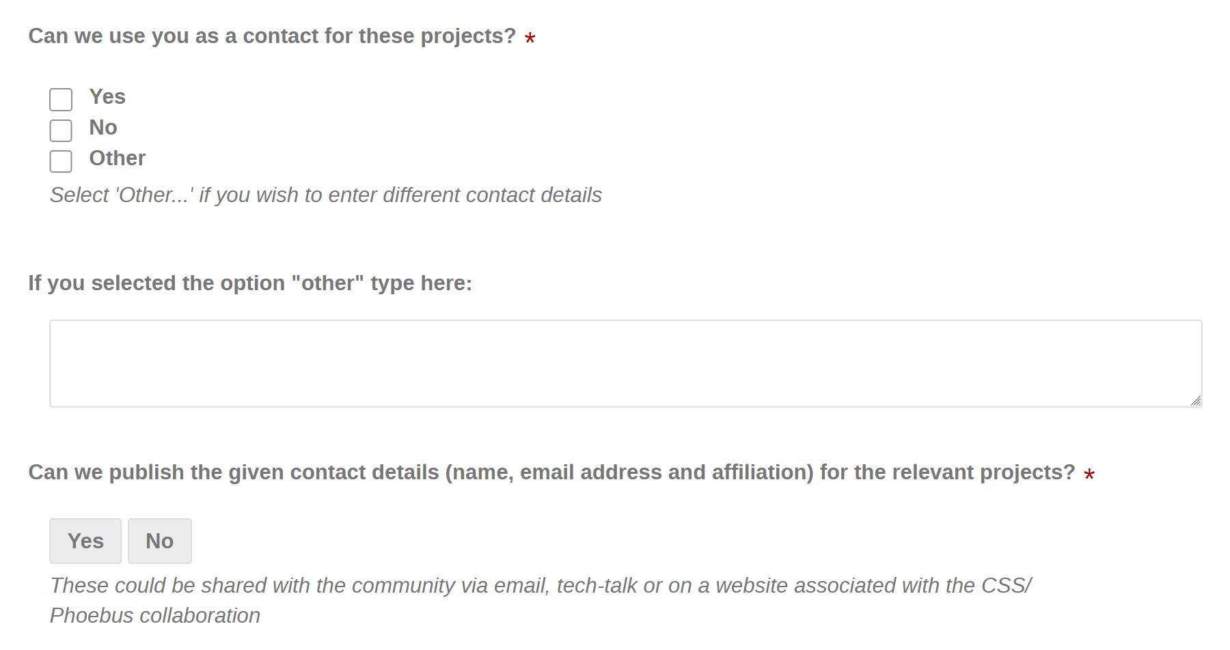
Survey (projects, pt.2)
Feel free to add more information in the ‘Other’ box if you have multiple project contacts etc.

Slide 9
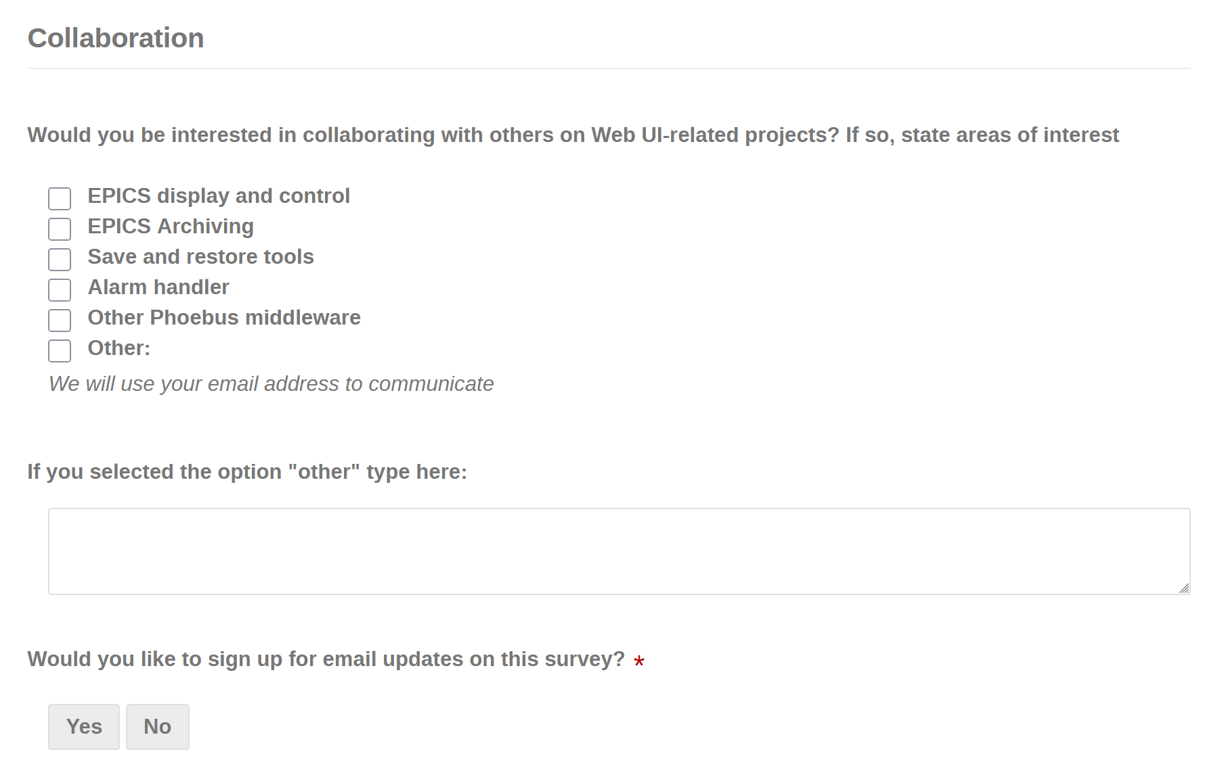
Survey (collaboration)
Indicate interest in collaboration for the given areas
Sign up for the Web UI survey mailing list

Slide 10
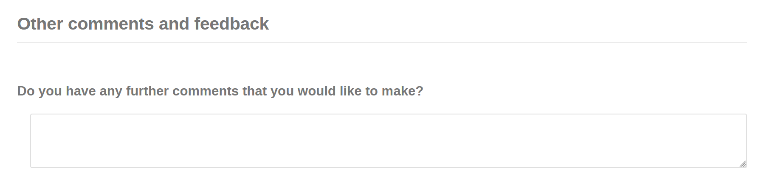
Survey (comments)
Anything else you wish to add

Slide 11
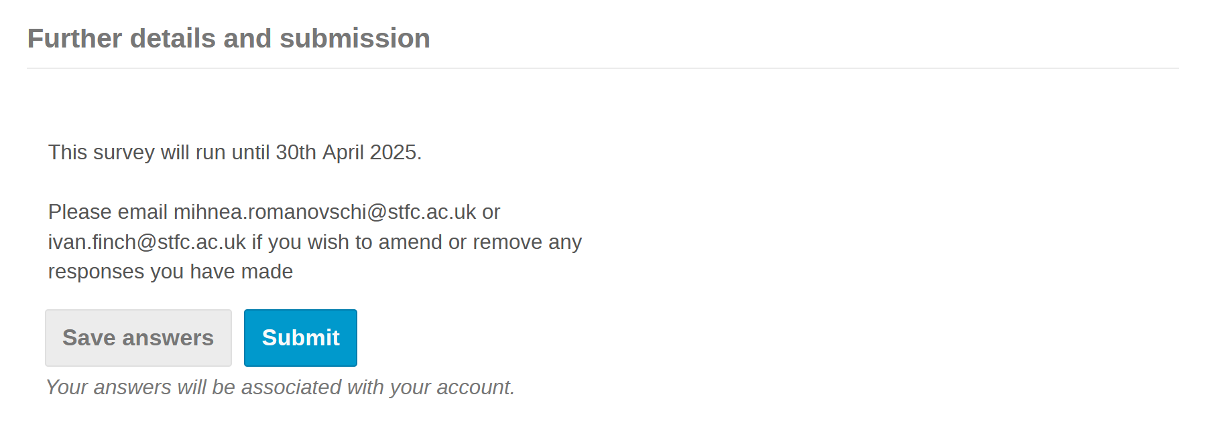
Survey (details)
Survey will run until 30th April
Contact myself, Mihnea or Ivan if you wish to amend or delete a response
Survey is available from the left-hand menu on Indico

Slide 12
Thanks for Listening!

