Slide 1

Python Accelerator Middle Layer
Martin Gaughran,
On behalf of the pyAML Collaboration

Slide 2
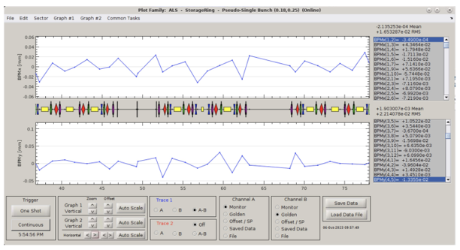
Matlab Middle Layer (MML)
Developed in the 90s, originally by SLAC and ALS
Sits between high-level accelerator applications and the low-level control system (e.g. EPICS)
Accelerator and control system-agnostic
Large suite of (well-tested) measurements and high-level applications available
  E.g. chromaticity, slow orbit feedback
  Includes more complex tools such as LOCO
https://indico.desy.de/event/43233/contributions/169040/attachments/90944/122729/OperationML_nadolski.pdf

Slide 3
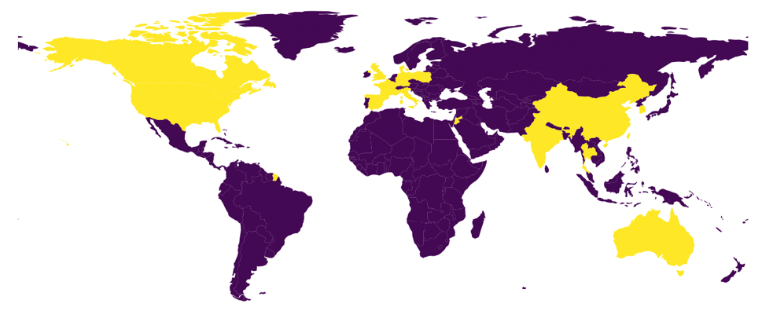
MML (cont.)
Integration with accelerator simulation
  Accelerator Toolbox
Allows direct control and simulation from Matlab
Reasonably easy to set up and use
MML has come to refer to both the ‘middle layer’ interface, and the suite of generic tools
https://cloud.esrf.fr/s/dZtJ27cc7rGL72b/download/LEAPS_PhotonSource_WG_23Oct2024_updated.pptx
Partial list of users:
USA: ALS, Stanford (Spear3), Duke FEL, Brookhaven (VUV), B-Factory
Canada: CLS
Europe: SOLEIL (France), Diamond (UK), ALBA (Spain), Solaris (Poland), MAX-IV (Sweden)
Asia: PLS2 (Korea), SLS (Thailand), SSRF (Shanghai), NSRRC (Taiwan)
Middle East: SESAME (Jordan)
Australia: ASP

Slide 4
MML Problems
Matlab is a proprietary programming language
Collaborative development is difficult
  Last release in 2018
  Many facilities use local forks, often due to limitations with abstractions
Does not benefit from advancements in computing
Will soon become obsolete

Slide 5
Python Accelerator Middle Layer (pyAML)

Slide 6
pyAML Project
Equivalent of MML in Python, but including several improvements
Maintain the strong benefits of MML:
  Accelerator & control-system agnostic
  Ease of set up and use
  Robust and reliable suite of applications
  Integration with simulations
Integrate developments in accelerator controls and high-level applications
Provide an interface to e.g. advanced commissioning simulations or AI/ML
Provide support for virtual accelerators and digital twins

Slide 7
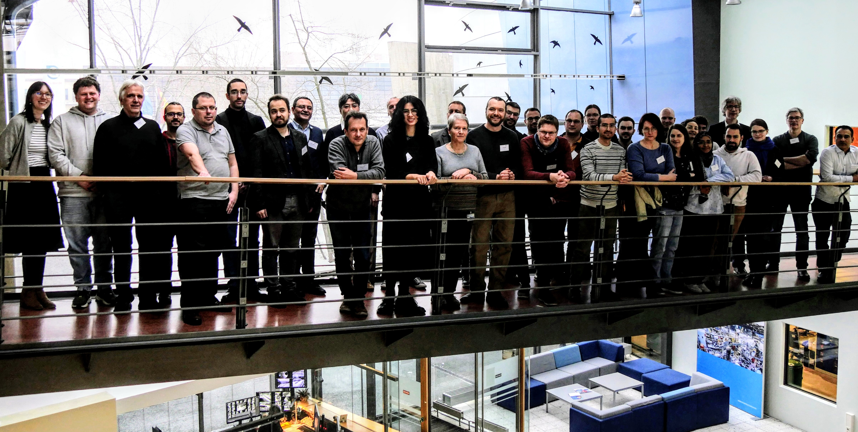
pyAML Workshops
Have now held a couple workshops on the pyAML project
  Defining scope of the project
  Gathering effort for software development
  Updates from accelerator physicists, controls engineers and software developers on related work
Now have dedicated resources from several facilities
  HZB, SOLEIL, ESRF, MAX IV, & more
Second Accelerator Middle Layer Workshop, HZB

Slide 8
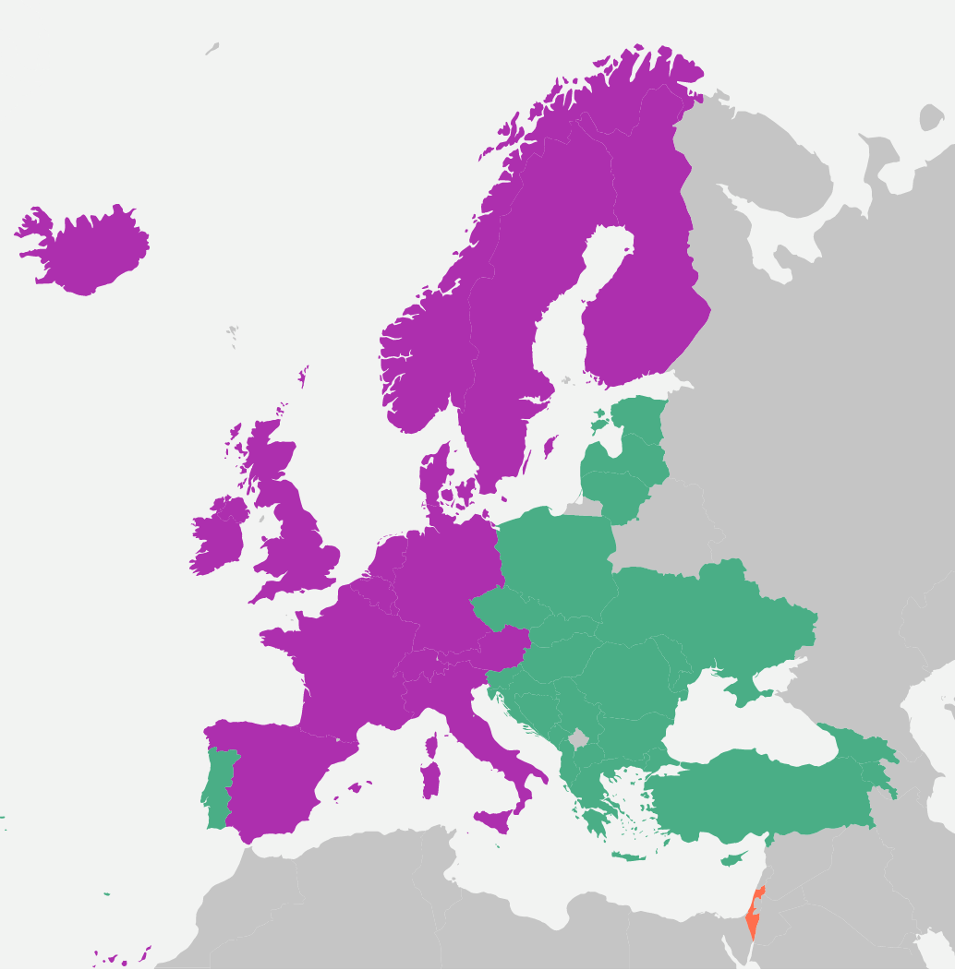
COST Action Proposal
Green: ICT (inclusiveness target country)
Purple: non-ICT member
COoperation for Science and Technology
Funds collaborative activities and organisation
Must involve 50% ITC countries
Pays for:
  Conferences
  Training sessions
  Codeathons
  Management activities
  Etc.
Collaborators from countries that aren’t COST members can be paid for presentations/training
Waiting for reply in June 2025
MAX IV
Diamond
DESY
HZB
KIT
Solaris
ESRF
Soleil
ELI-beamlines
KIPT
PSI
Cosy lab
Elettra
Univ. Of Sarajevo
Alba
Candle
Turkish Light Source
www.cost.eu

Slide 9
pyAML and Controls
Controls already worked on a tool called ‘pytac’, that was similar to the middle layer component of MML
  Written in Python
  Handles several high-level applications at Diamond, e.g. slow orbit feedback
We would like to migrate to pyAML, and:
  Allow operations to use pyAML-based high-level applications
  Reduce friction between accelerator physics and accelerator controls groups
  Take advantage of features such as for machine learning or virtual accelerator (simulation with EPICS interface) integration
S01.get_value('b2’, pytac.RB)
S03.set_value('b2', value)
CA
CA
IOC
IOC
Machine hardware

Slide 10
Collaboration Details
Any questions: martin.gaughran@diamond.ac.uk
GitHub orgs:
  https://github.com/atcollab
  https://github.com/python-accelerator-middle-layer
Workshops:
  https://indico.esrf.fr/event/93/
  https://indico.desy.de/event/43233/overview
  https://events.hifis.net/event/1997/overview
Exploratory work (IPAC’25): https://indico.jacow.org/event/81/contributions/7483/
Can email Simone to be added to mailing list: simone.liuzzo@esrf.fr

Slide 11
Thanks for Listening!

