Slide 1
Phoebus Archiver Datasources
Kunal Shroff – NSLS2
Georg Weiss – ESS

Slide 2
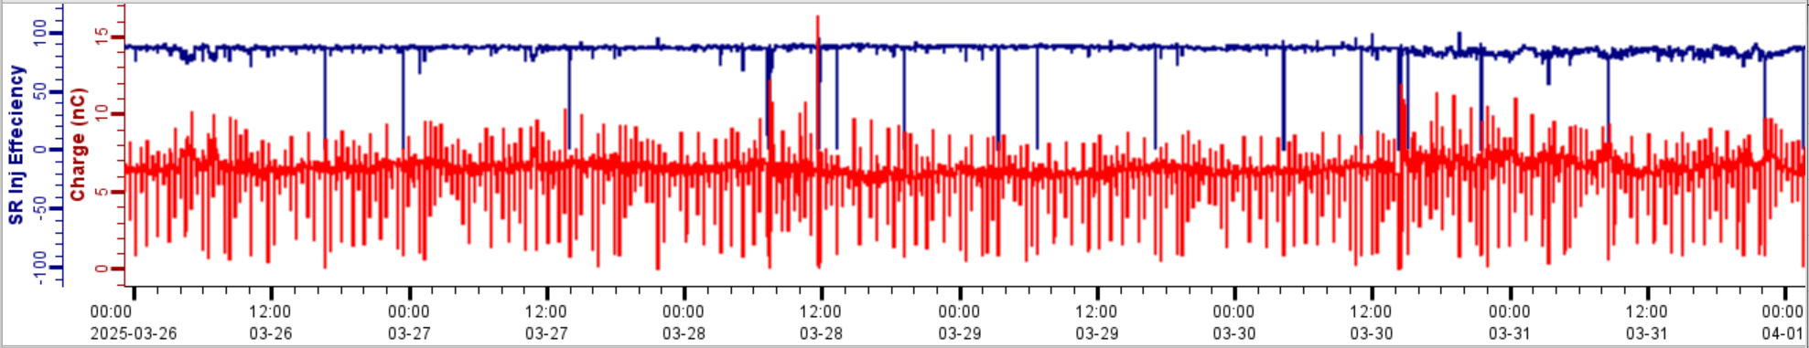
EPICS Archiver
EPICS Archiver Appliance
  A scalable, distributed system for archiving time-series data from EPICS PVs (Process Variables).
  Captures historical data for analysis, diagnostics, and replay
Query the archiver
  To obtain PV/s values at a point in time.
  Extract time-series data to study variations and trends.
Notes:
Query the archive to obtain PV values at precise points in time.
Extract time-series data to study variations and long-term trends.

Slide 3
Phoebus DataSources
core-pv
  Provides a pluggable/extendable interface for accessing data as Process Variables (PVs) across multiple data sources and control protocols.
Existing Data Sources:
  Channel Access (ca://) & PVAccess (pva://) → Connect to live EPICS PVs.
  Simulated (sim://) → Generate test signals (sine, noise, ramp, etc.).
  System (sys://) → Represent system attributes like time.
  MQTT (mqtt://) & Tango (tga://, tgc://) → Access MQTT & Tango control system data.
Extending Core-PV: New Data Sources
  Archive Data Source (archive://)
  Replay Data Source (replay://)
  These new data sources make archived data available as PVs to all Phoebus applications.
Notes:
Existing Data Sources:
✔ Channel Access (ca://) & PVAccess (pva://) → Connect to live EPICS PVs.
✔ Simulated (sim://) → Generate test signals (sine, noise, ramp, etc.).
✔ System (sys://) → Represent system attributes like time.
✔ Local (loc://) → Share values between Phoebus applications.
✔ MQTT (mqtt://) → Subscribe to external data sources via MQTT.
✔ Tango (tga://, tgc://) → Access Tango control system data.
These new data sources make archived data available as PVs to all Phoebus applications, enabling seamless access to historical and replayed data just like live PVs.

Slide 4
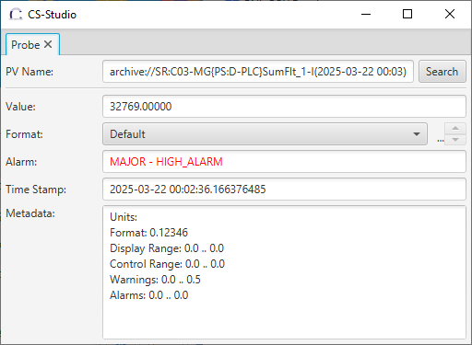
Archive DataSource
Get me the value of <pv_name> on 22nd March at 00:03
archive://
Retrieves an archived value at a particular instant of time.
archive://pv_name
  Retrieves the latest value in the archiver.
archive://pv_name(time)
  Retrieves the last value at or before the specified "time".

Slide 5
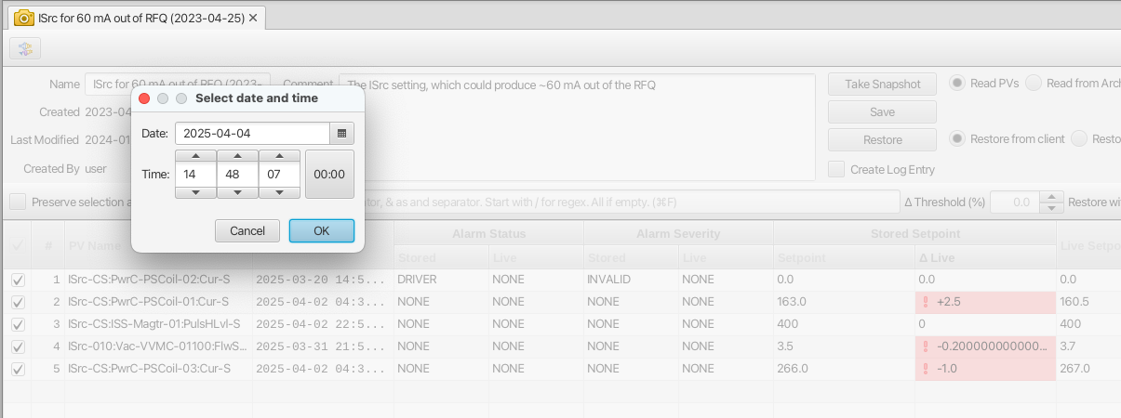
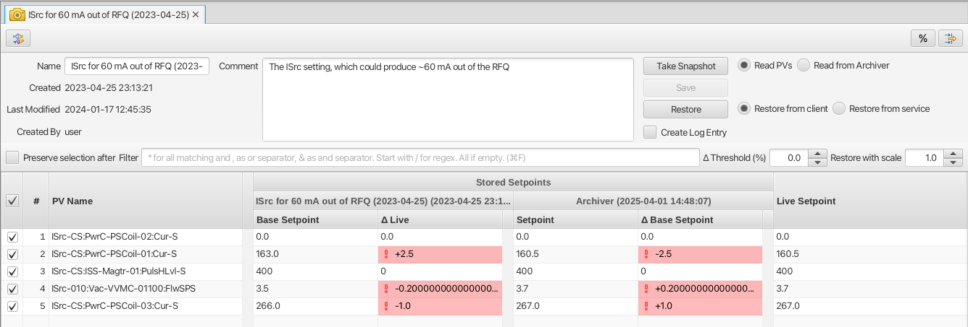
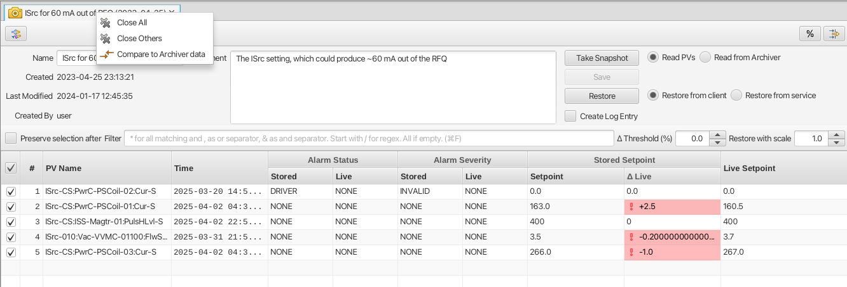
Archive DataSource

Slide 6
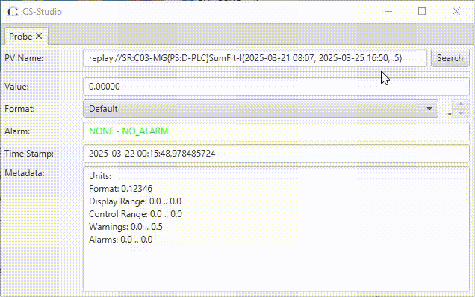
Replay DataSource
Simulate how <pv_name> changed between 21st Mar and 25th Mar
replay://
Creates a PV that recreates changes in values based on data from the archive.
replay://pv_name
(start, end, update_rate)
Recreates the PV value changes using the data from the archiver between the specified start and end times. Updates occur at the rate specified by `update_rate` (a value defined in seconds).
Notes:
"I want to simulate how <pv_name> changed between 22nd March 00:00 and 02:00 at a 1-second interval."

Slide 7
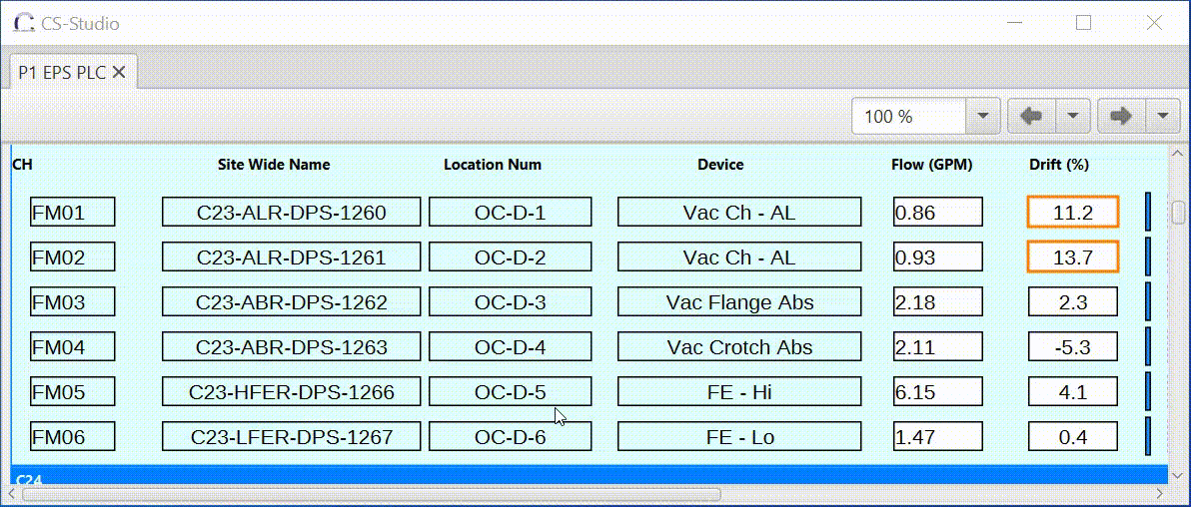
Replay DataSource
A Phoebus OPI using replay PVs to simulate the behavior of the Screen using historic data for those PVs

Slide 8
Useful links
http://phoebus.org
Fork us on github
https://github.com/ControlSystemStudio

