Slide 1
LhARA FFA magnet design
26/02/25
Ta-Jen Kuo
Supervisor: Jaroslaw Pasternak, Jean-Baptiste Lagrange
Imperial College London, STFC

Slide 2
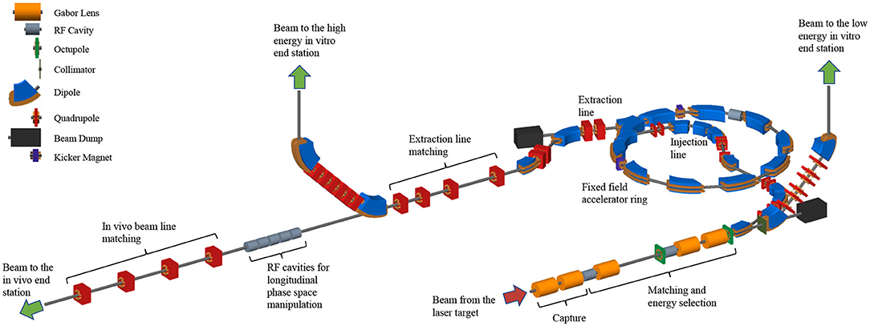
Aim
LhARA FFA
Radiobiological purposes
Working point in tune stays the same
while scaling B field to accelerate
different energy ranges (constant K)
Variable extraction energy from FFA
(15-127.4 MeV)
Notes:
for the studies of beam optics at different tune points

Slide 3
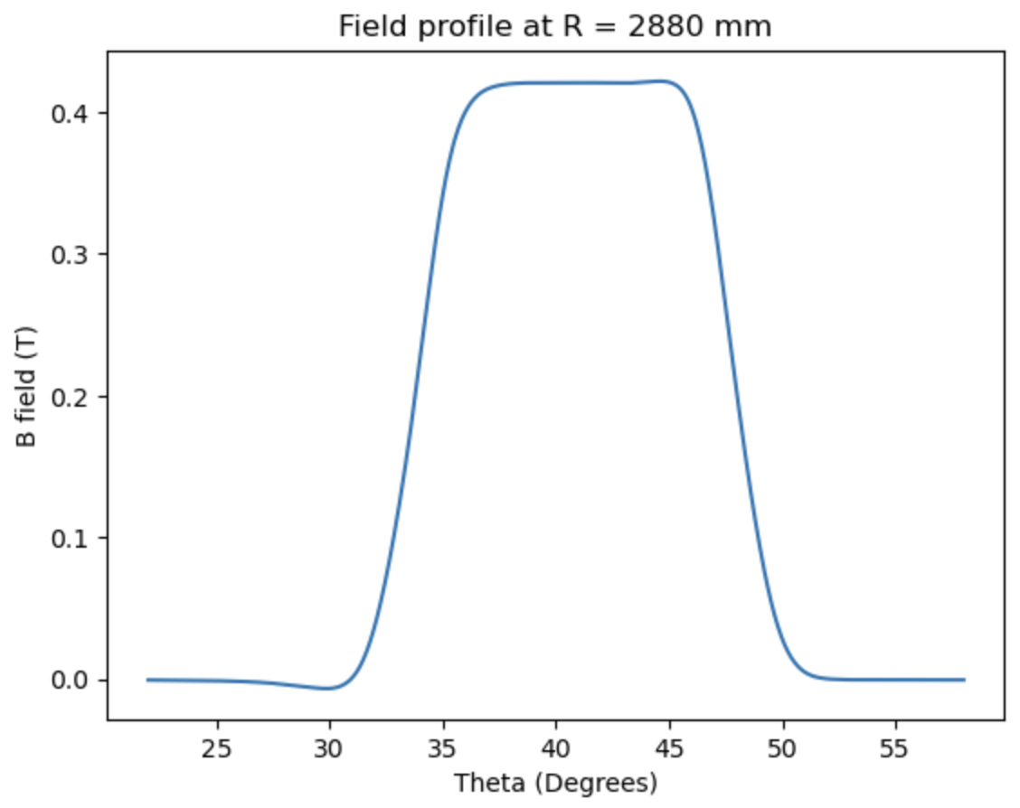
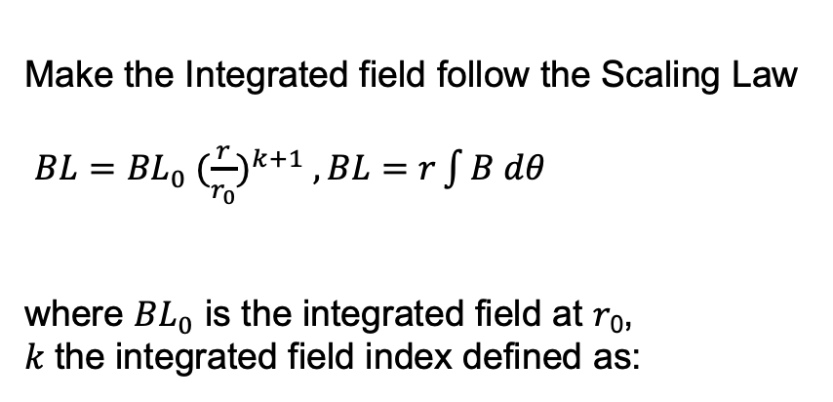
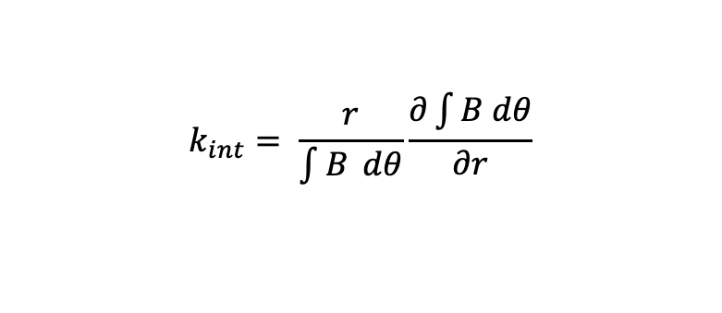
Magnetic field required
Make the Integrated field follow the Scaling Law
$BL={BL}_{0} {(\frac{r}{r_{0}})}^{k+1} , BL=r\int{B dθ }$
where ${BL}_{0}$ is the integrated field at 𝑟₀,
𝑘 the integrated field index defined as:
$$k_{int}= \frac{r}{\int{B} dθ}\frac{∂\int{B dθ}}{∂r}$$

Slide 4
Current optimisation Procedure
The process of modelling and optimizing is similar for both projects
with slight variation due to the doublet structure of FETS-FFA
Create 3D opera model with ‘Metaopera ¹’, a python script that created Opera
3D models through command line
2. Vary current in each trim coil individually to obtain a Jacobian in change in
current vs integrated field at different radii
3. Solve the Opera model and analysis with my own python script.
4. Using the Jacobian and a Scipy optimisation routine, obtain new estimate of
currents to reach closer to scaling law
5. Repeat until termination condition reached
1 Developed by Thomas Planche, Hui Wen Koay, Ta-Jen Kuo and Jean-Baptiste Lagrange

Slide 5
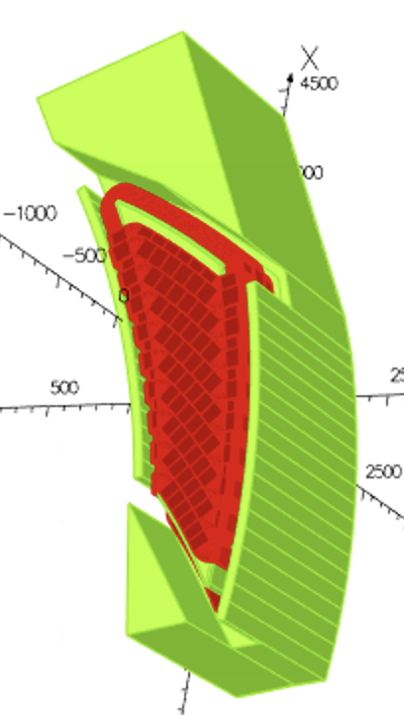
Magnet parameters
LhARA FFA
H shape magnet
10 fold symmetry
F singlet spiral
spiral angle:53.9 deg
k-value range 5.23
Maximum injection proton energy 15 MeV
Maximum extraction proton energy 127 MeV
Opening angle 12.24 deg
Full gap size 96mm
Coils in red wrapped around the pole
Field clamps connected to pole magnetically

Slide 6
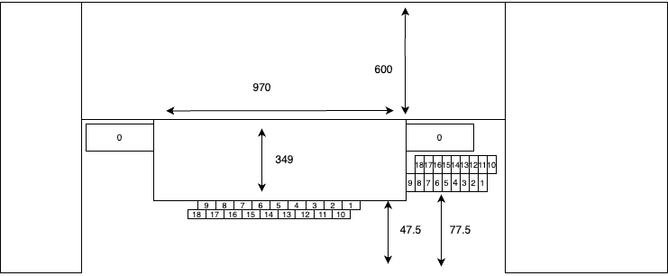
Cross section view of magnet
Trim coils wrapped in two height layers to reduce thickness and opening angle
All return towards the outside of the pole and add towards the main coil,
most energy efficient in terms of current
On the pole face, the trim coils are wrapped in two overlapping layers (with the same set of
currents), this reduces the field error comparing to without overlapping
The dimensions of the magnet are labelled in millimetres and the
conductors are labelled from 0-18.

Slide 7
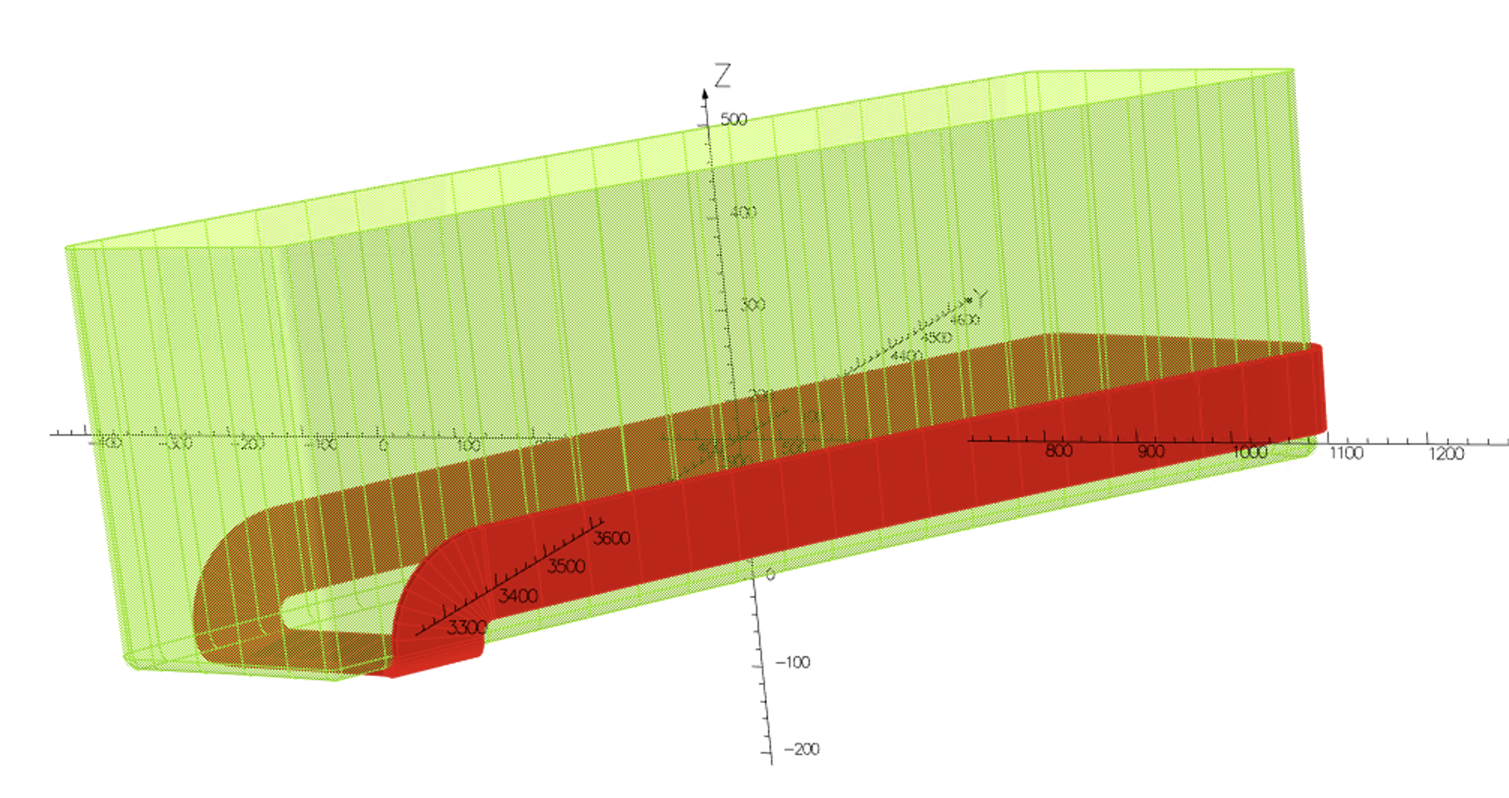
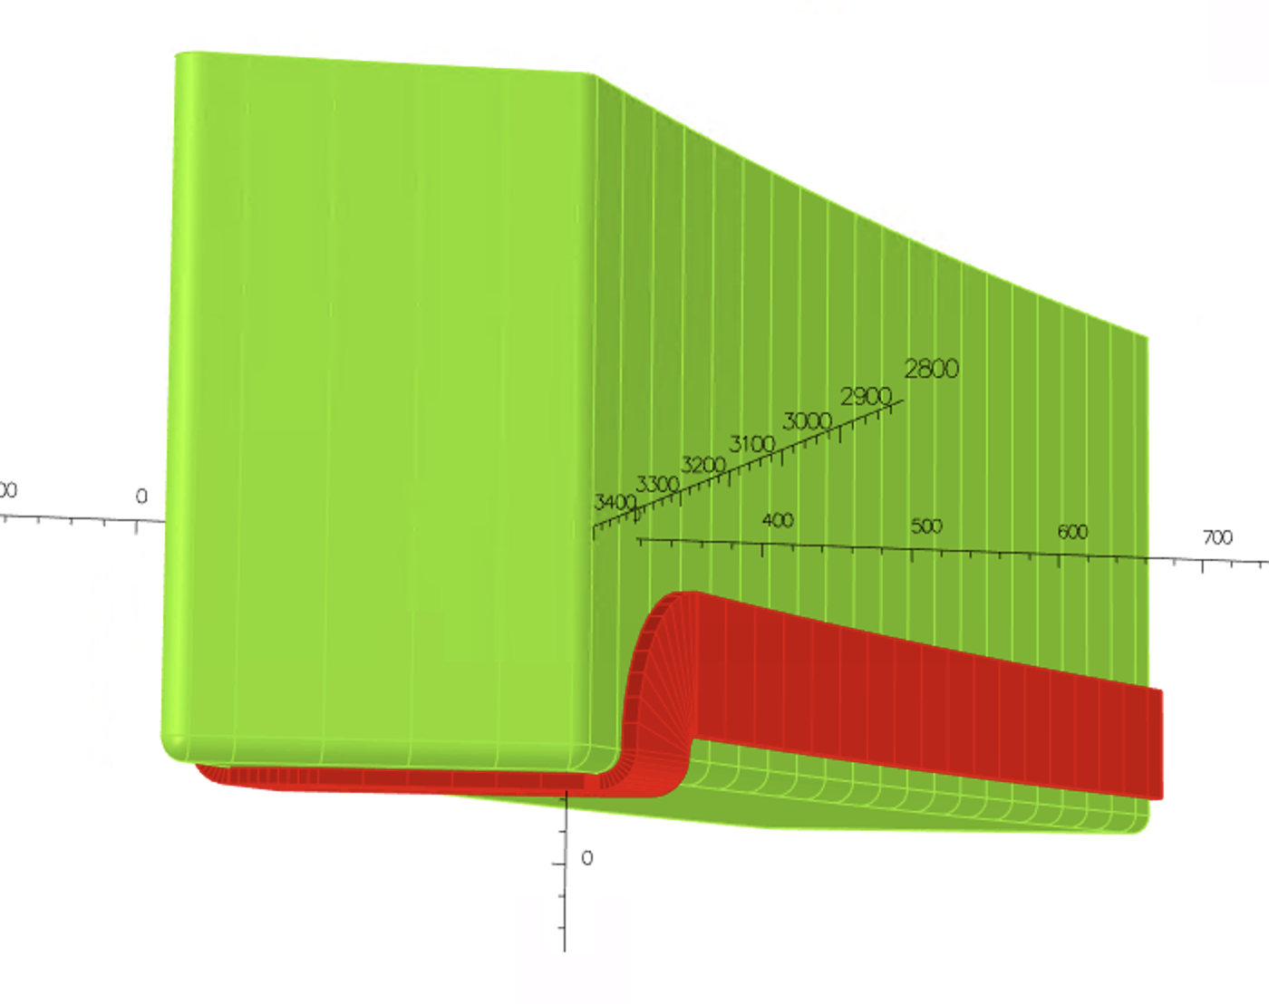
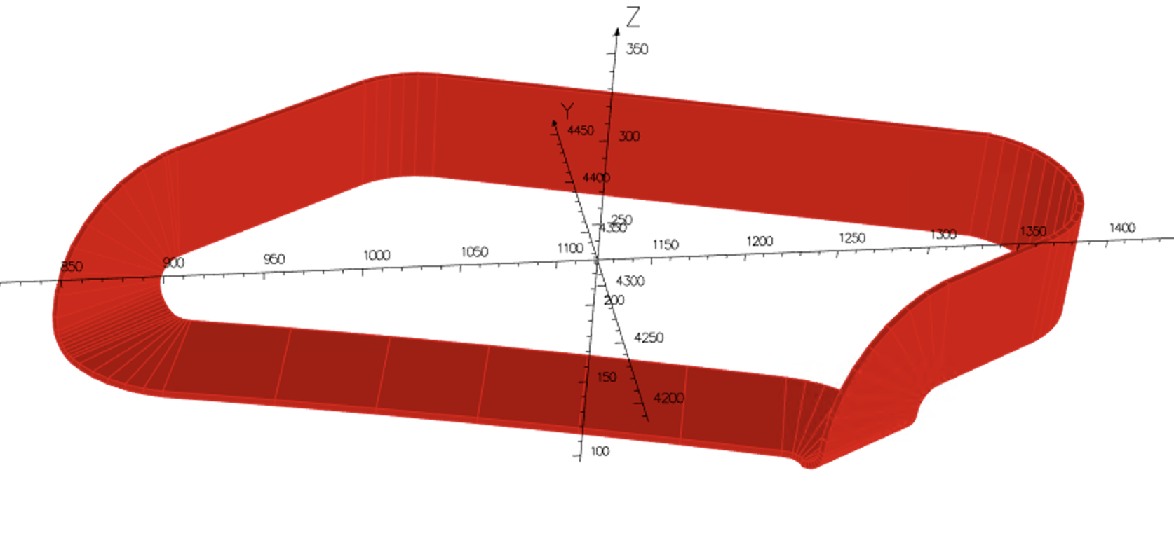
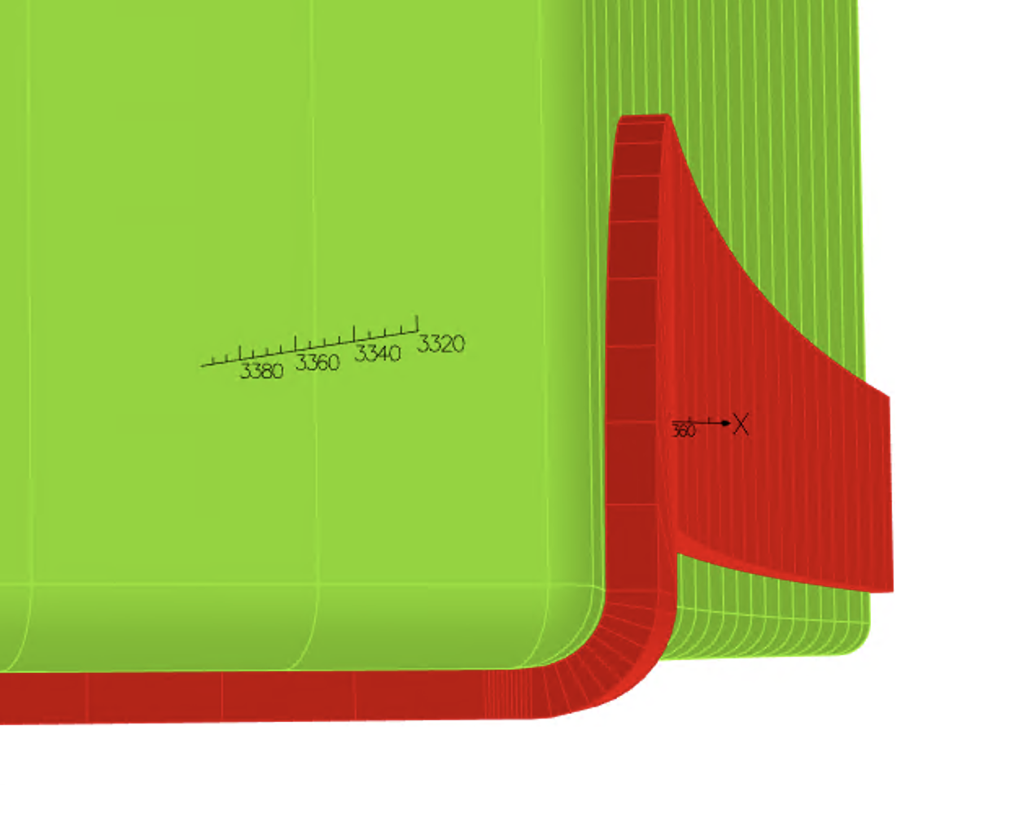
Modelling the trim coils

Slide 8
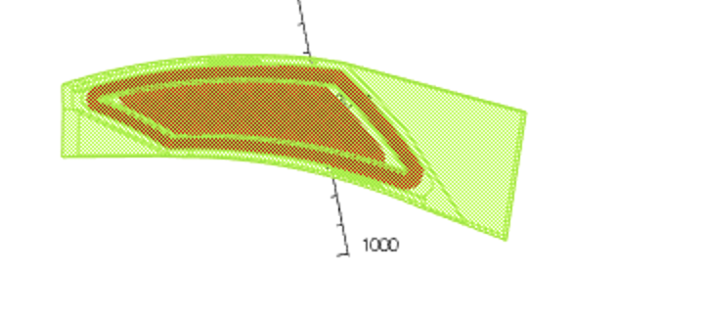

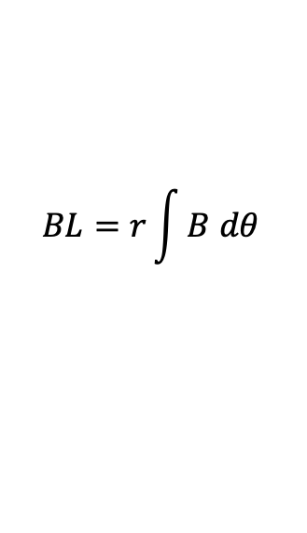
Integrated B field
$$BL=r\int{B dθ }$$
In the 3D Opera model, sweeping through theta obtain Bz on midplane at a particular radius
Repeat of different radius to obtain integrated B field at different radii

Slide 9
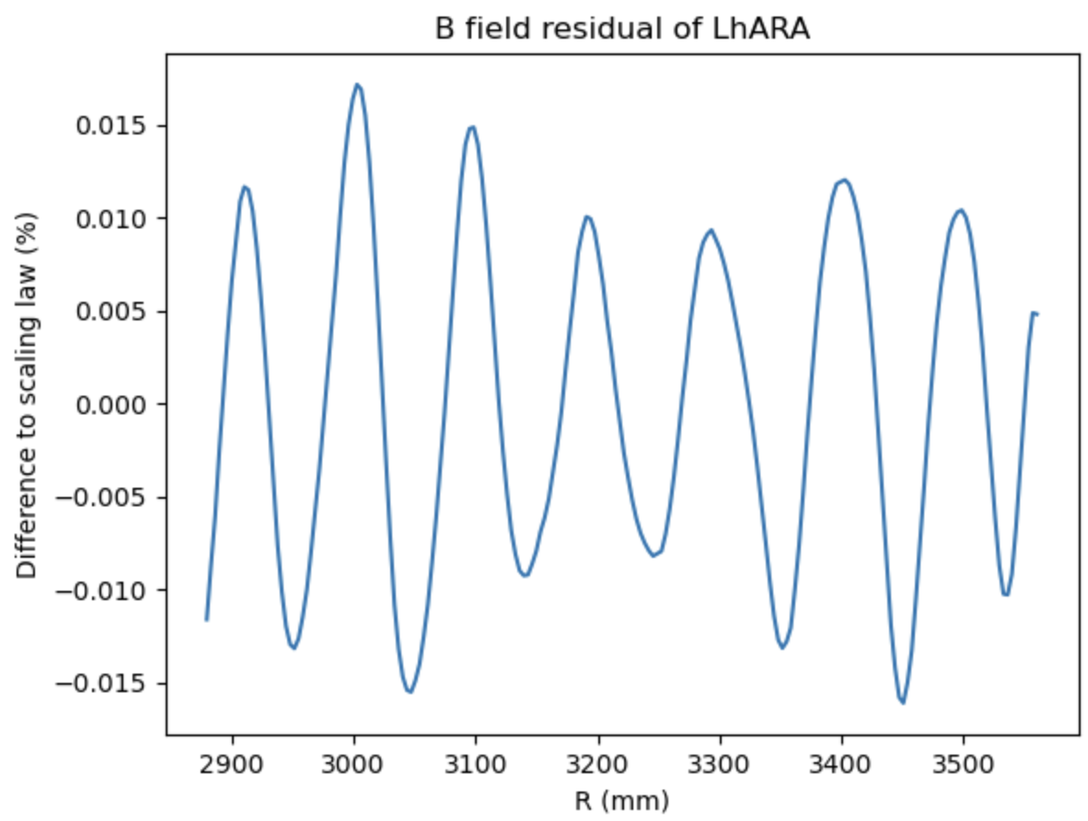
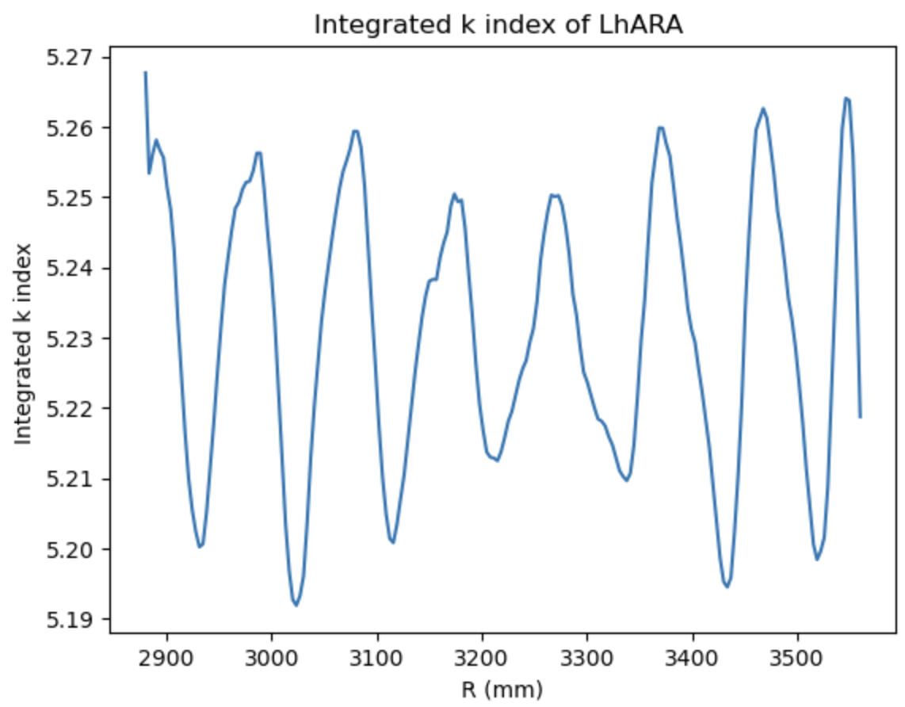

Field residual after optimization
$$BL={BL}_{0} {(\frac{r}{r_{0}})}^{k}$$
Central scenario: BL₀ : 1.44 Tm , r₀ :3.477m, k : 5.23 (15 – 127 MeV)
Oscillation in residuals due to the discretization of trim coils

Slide 10
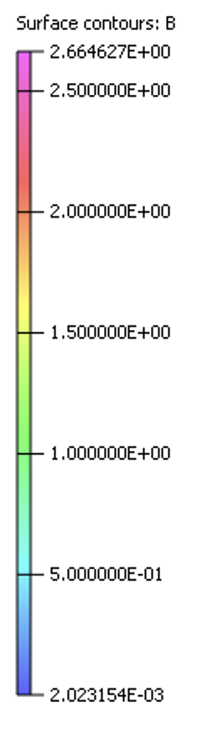
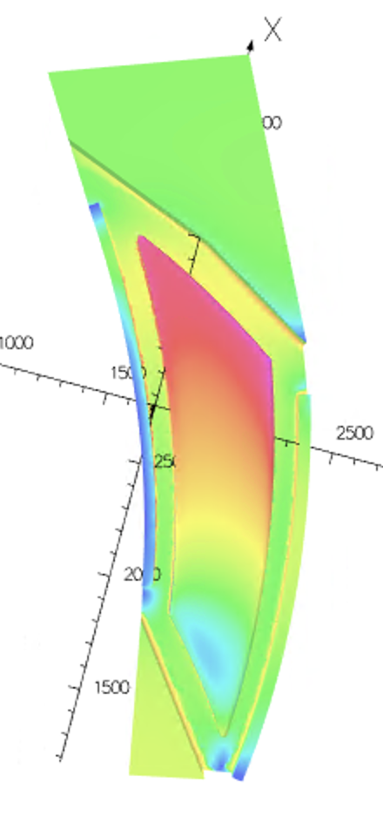
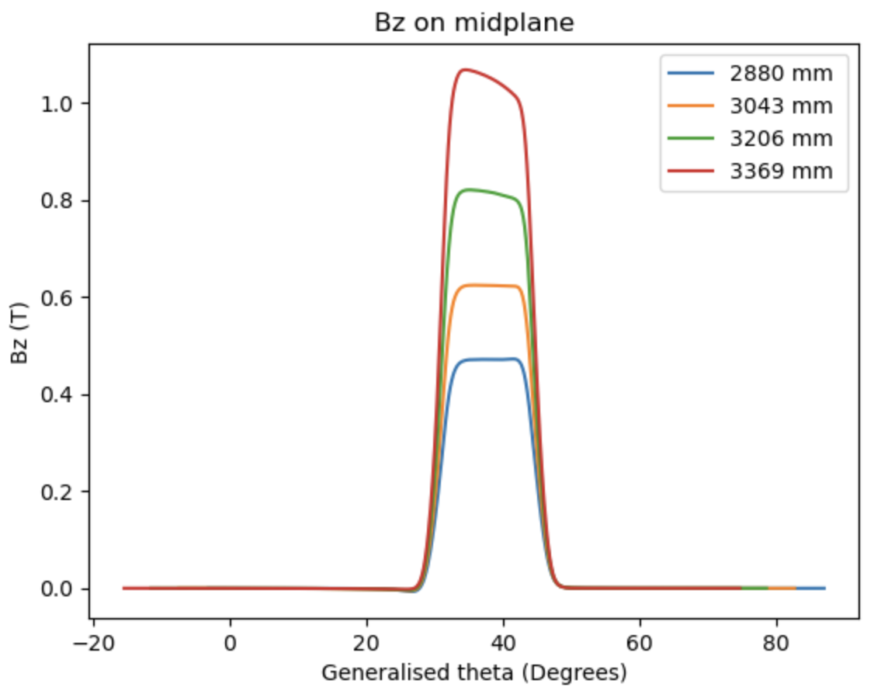
Saturation level and field profile
Part of the pole reaching 2.66T
Flat top of field distorted at higher radii due to
Saturation and will have an impact to the tune

Slide 11
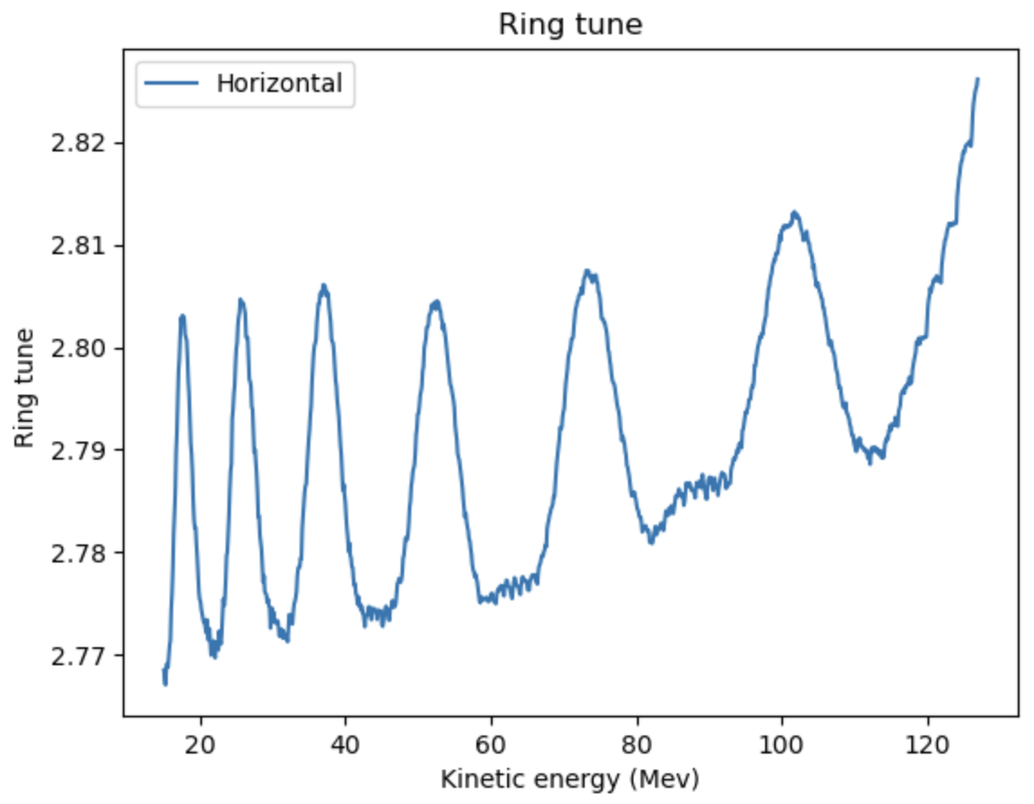
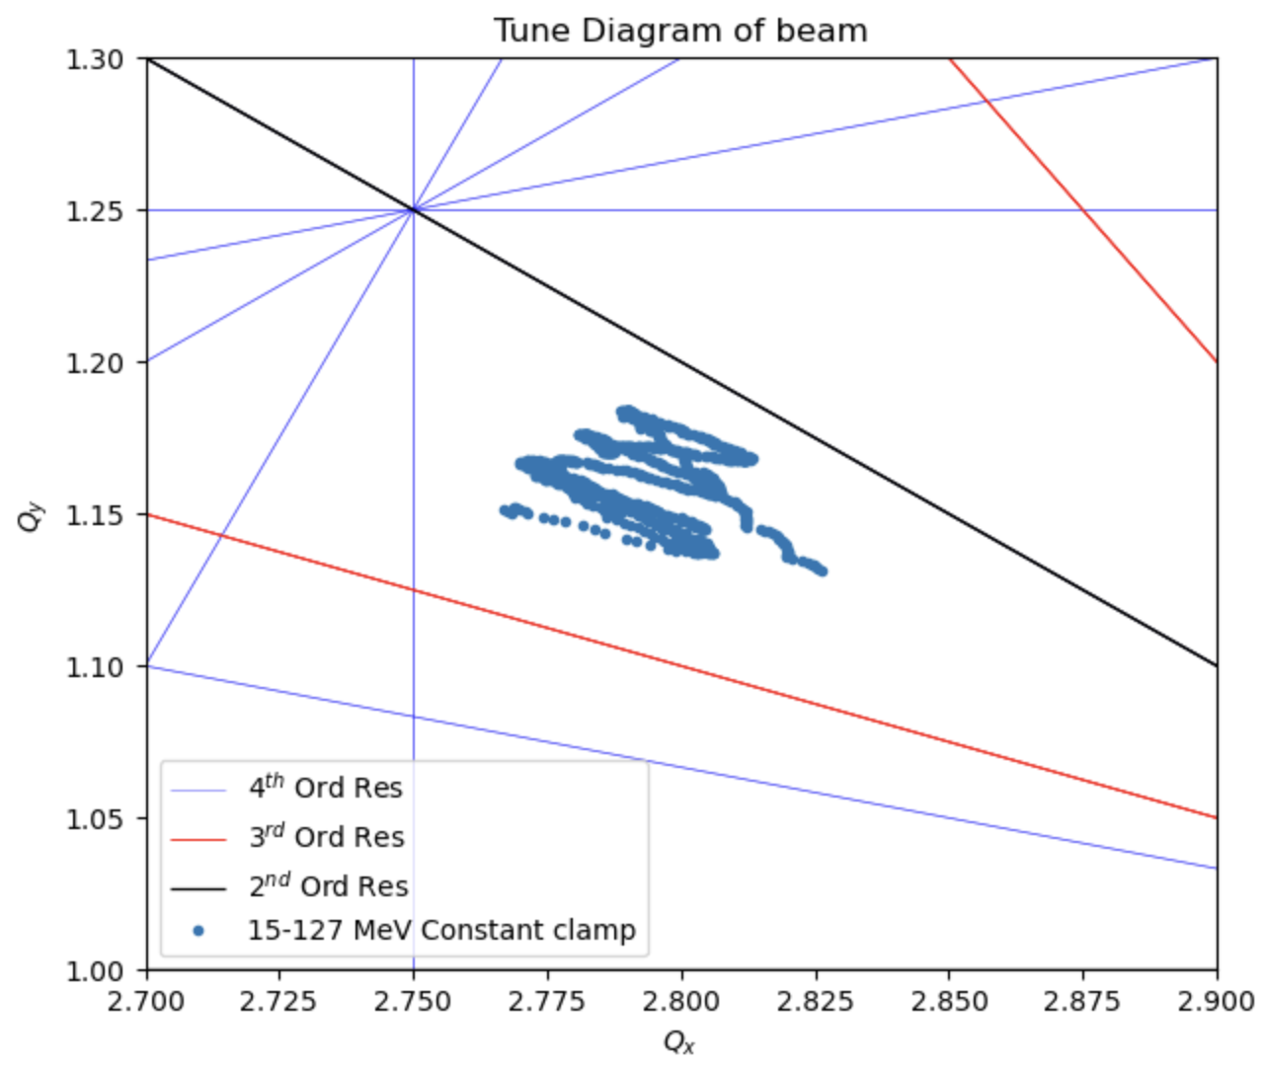
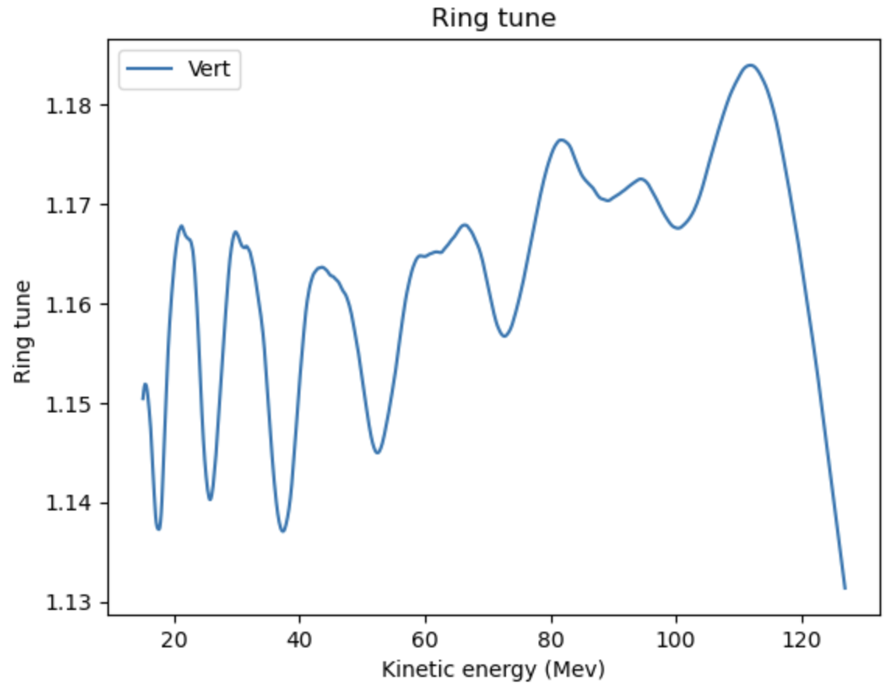
Plotting the ring tune against resonance up the
4th order

Slide 12
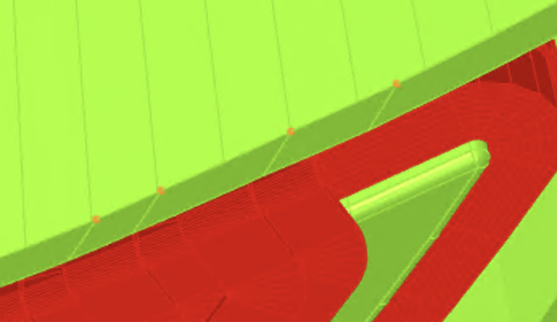
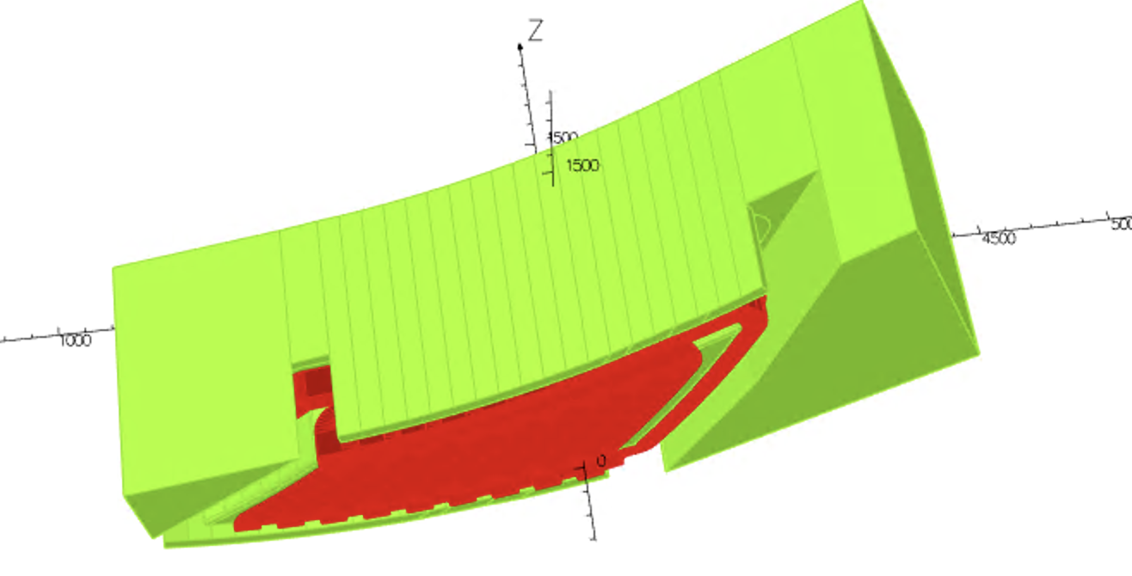
The vertical tune can be further controlled by
adjusting the vertical aperture of the clamps
Clamp height varies
Between 52mm to 56.5 mm off the midplane

Slide 13
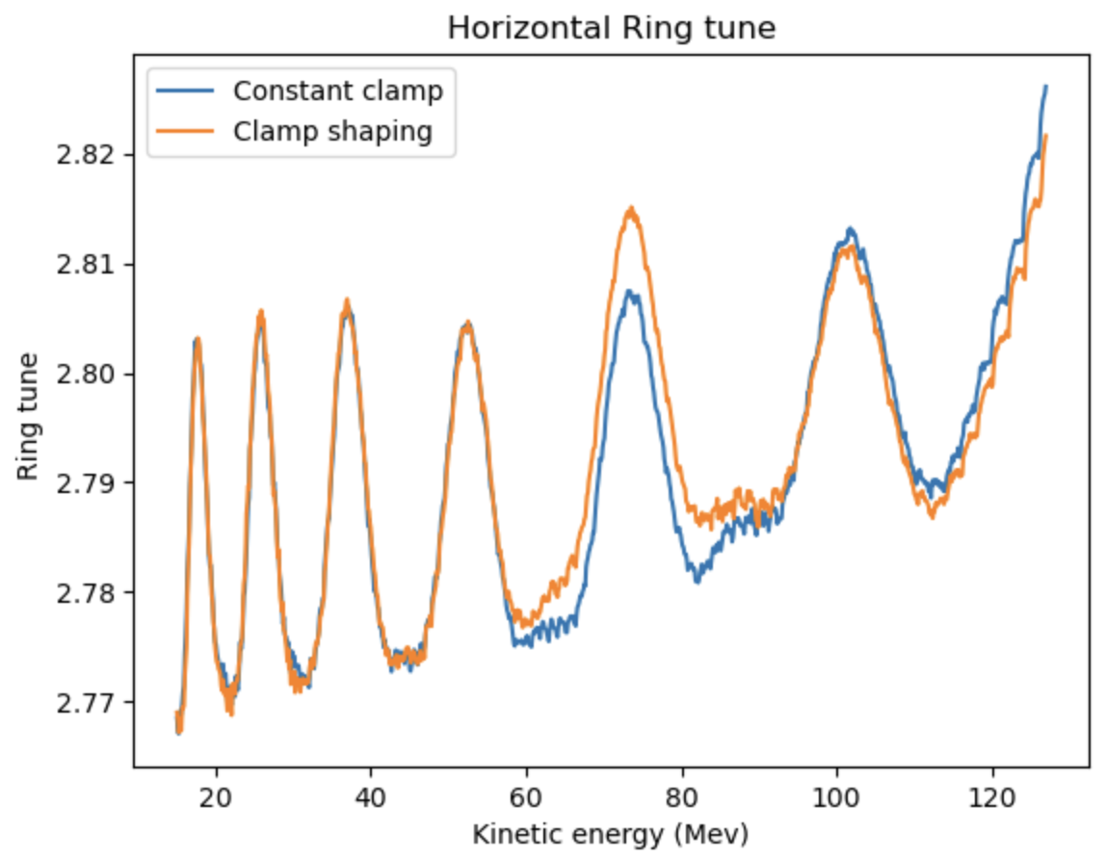
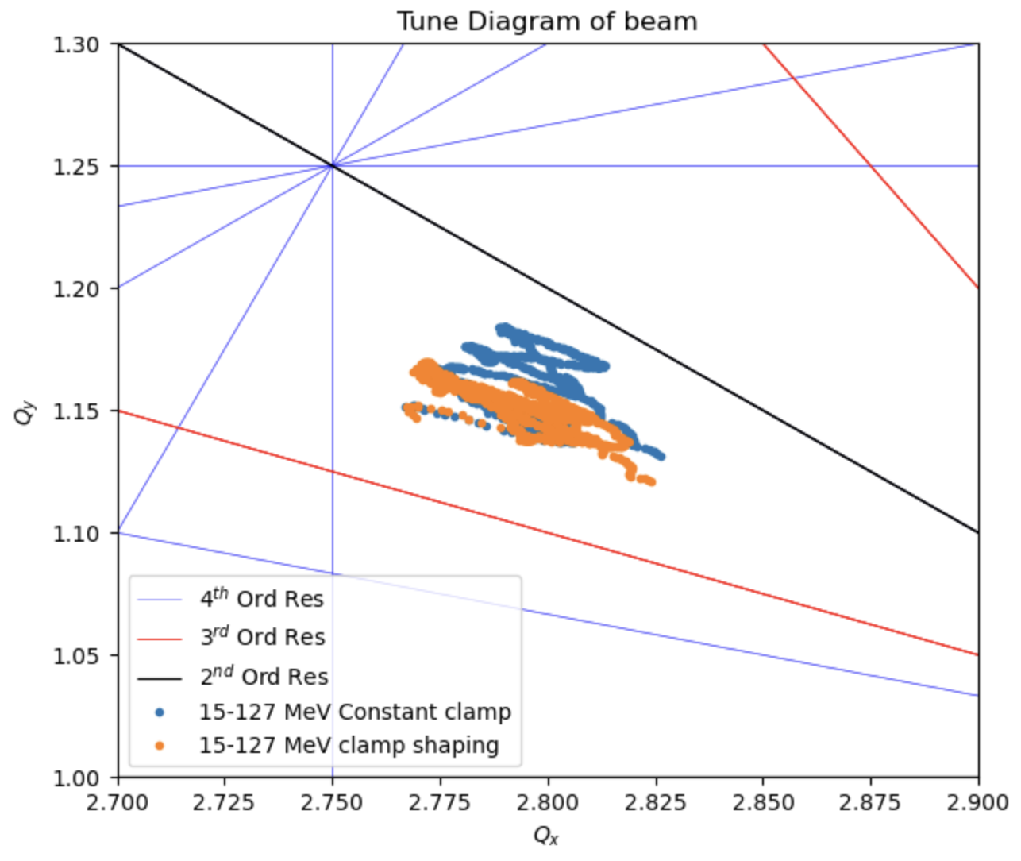
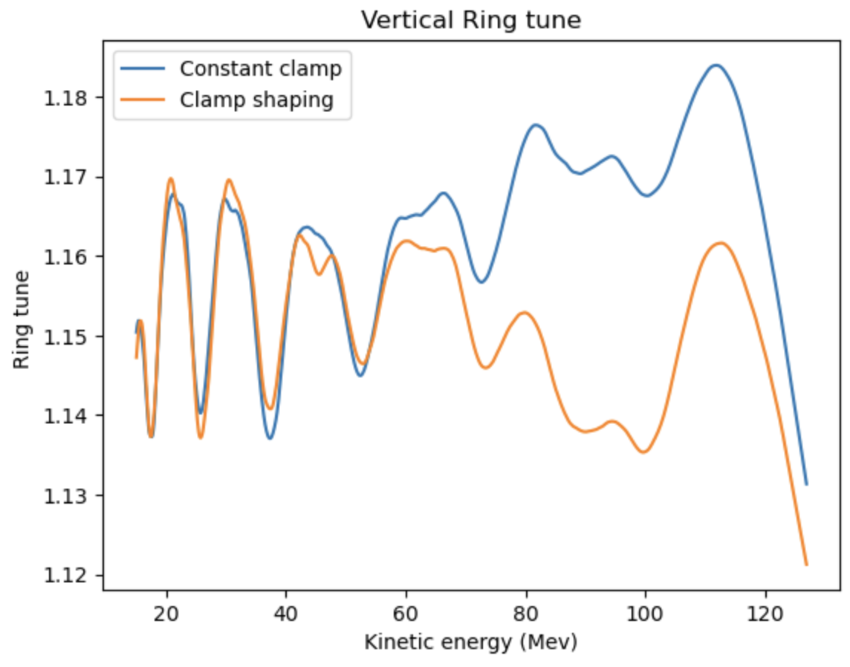
Tune after changing aperture of clamps

Slide 14
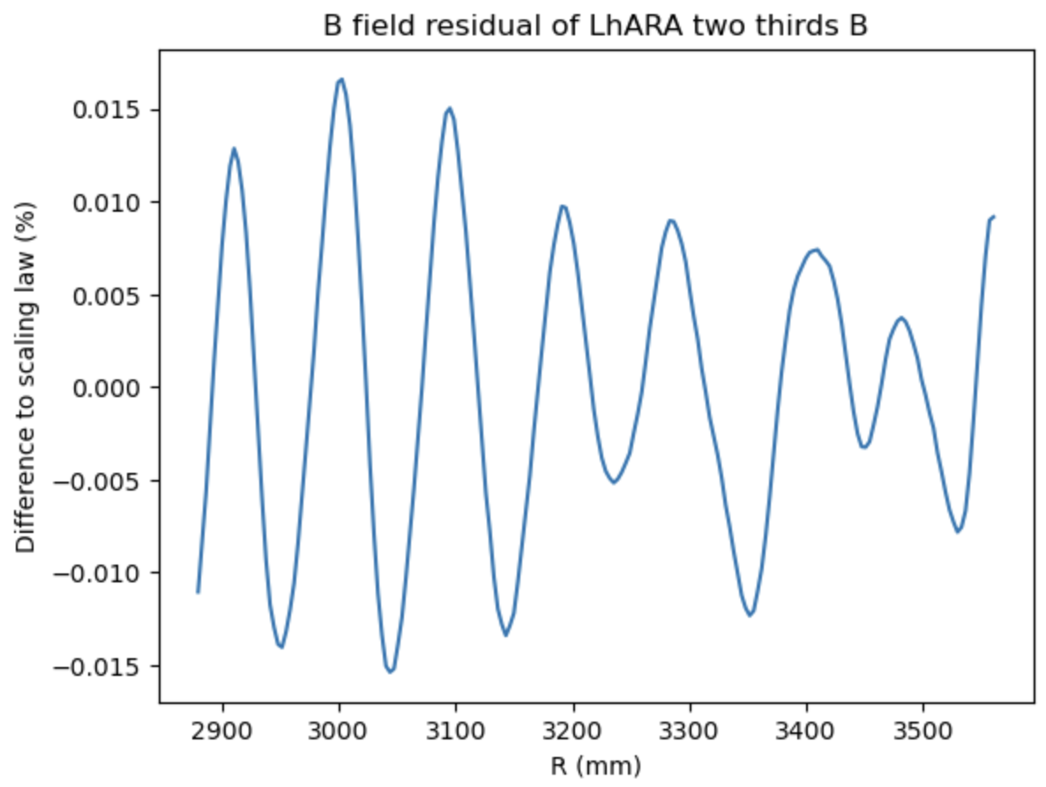
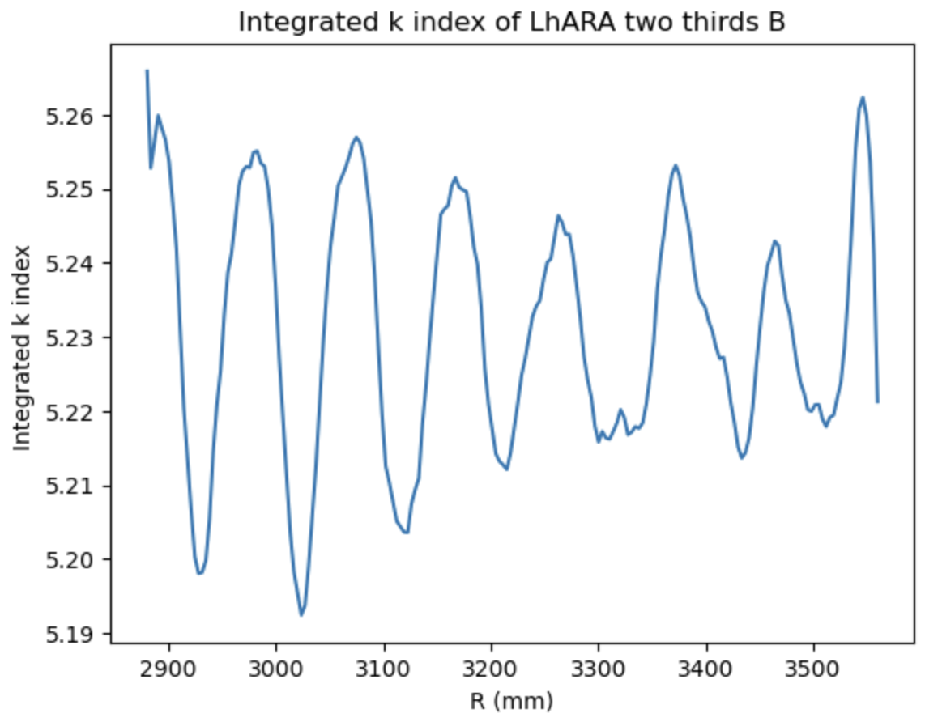
Performance at lower energy range
For the LhARA machine, we would like to accelerate beams at different energy while
being at the same tune point.
This can be done by scaling the BL₀ value in the integrated field
Setting BL₀ to $\frac{2}{3}$ of the original value, 7- 57 MeV energy range

Slide 15
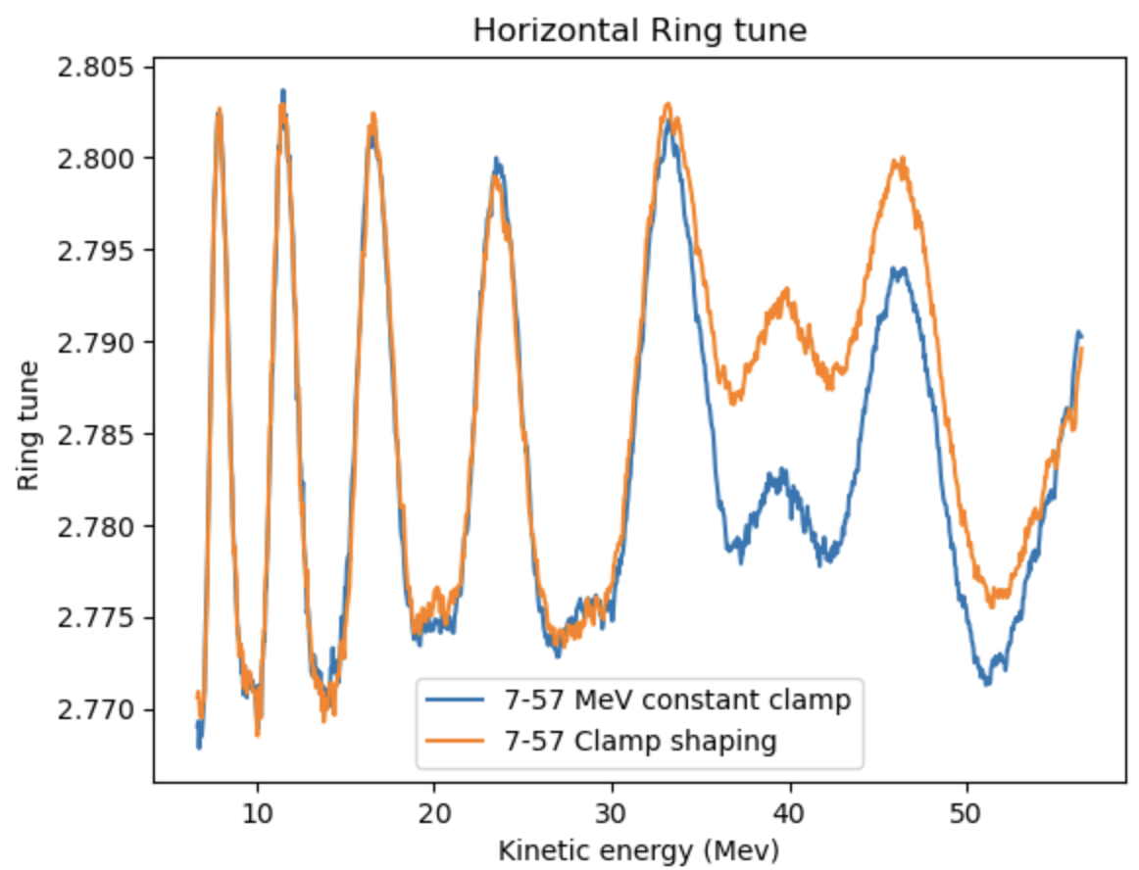
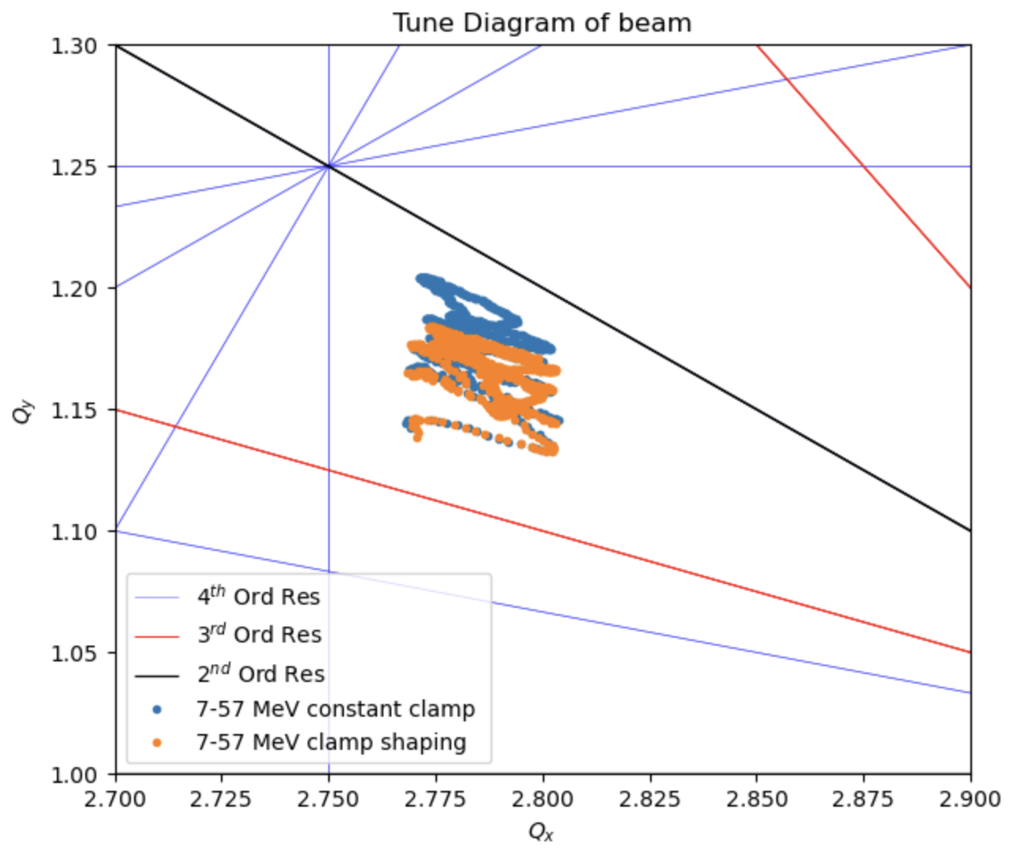
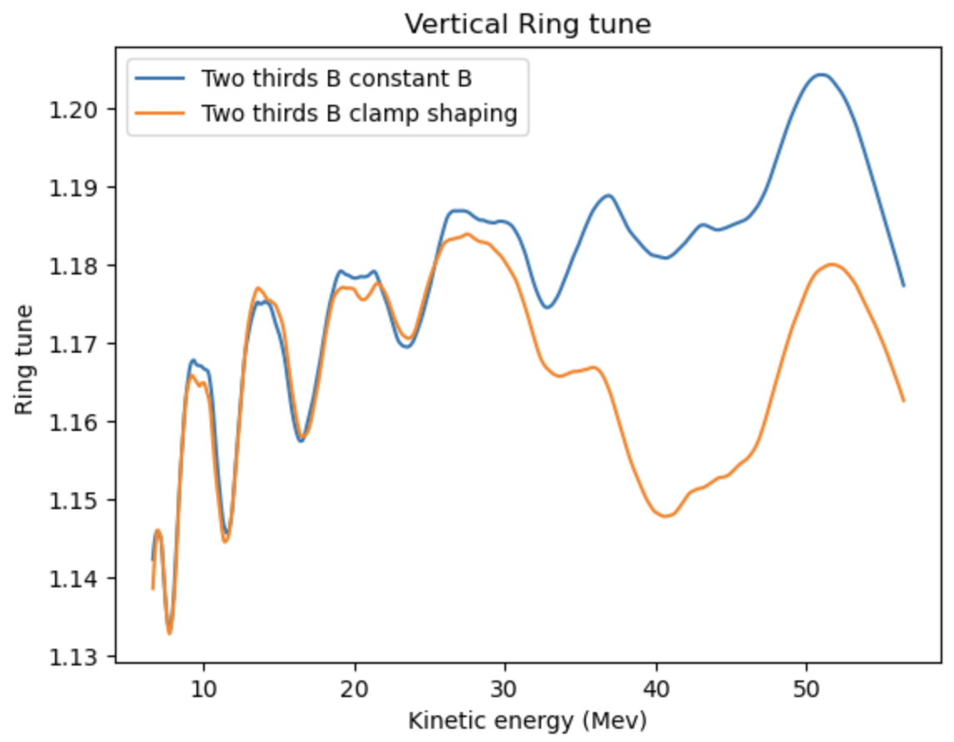
Tune from optimizing integrated B field at two thirds B

Slide 16
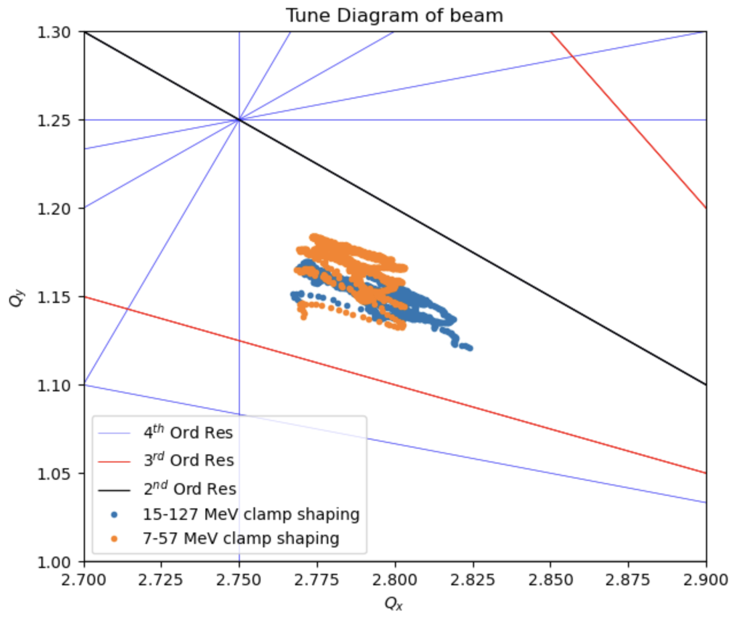
Tune at different energy ranges

Slide 17
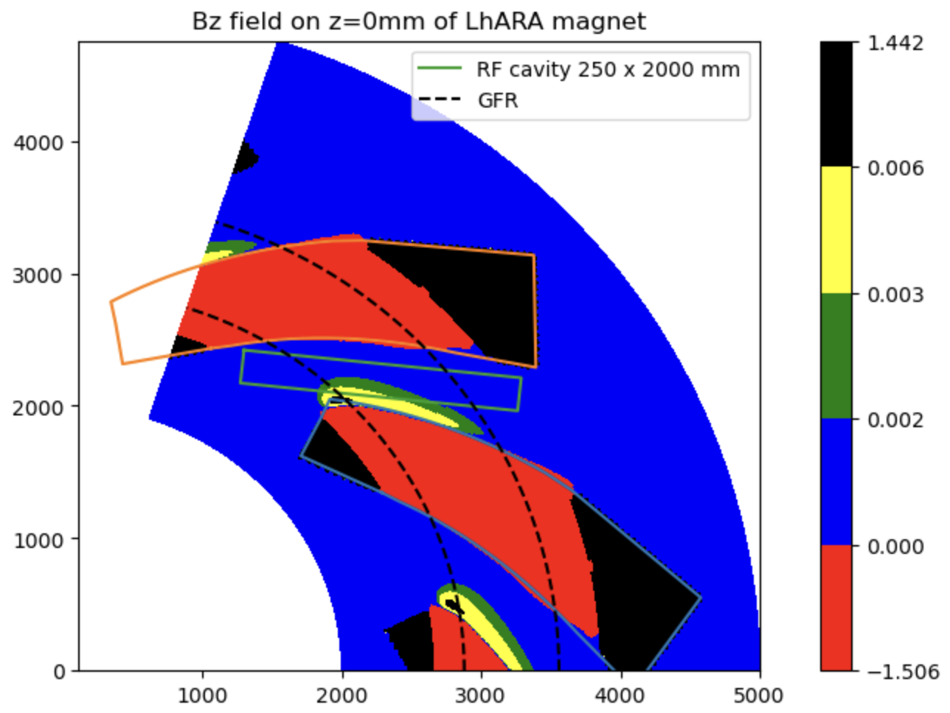
Field in the straight section
Showing the B field on
the midplane within the GFR
Highest field in straight section
is 60 Gauss
Centre of the machine towards
The origin

Slide 18
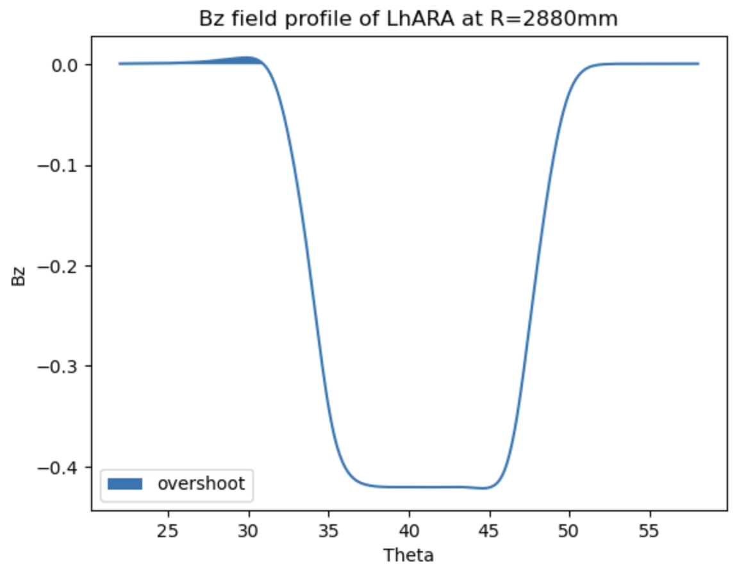
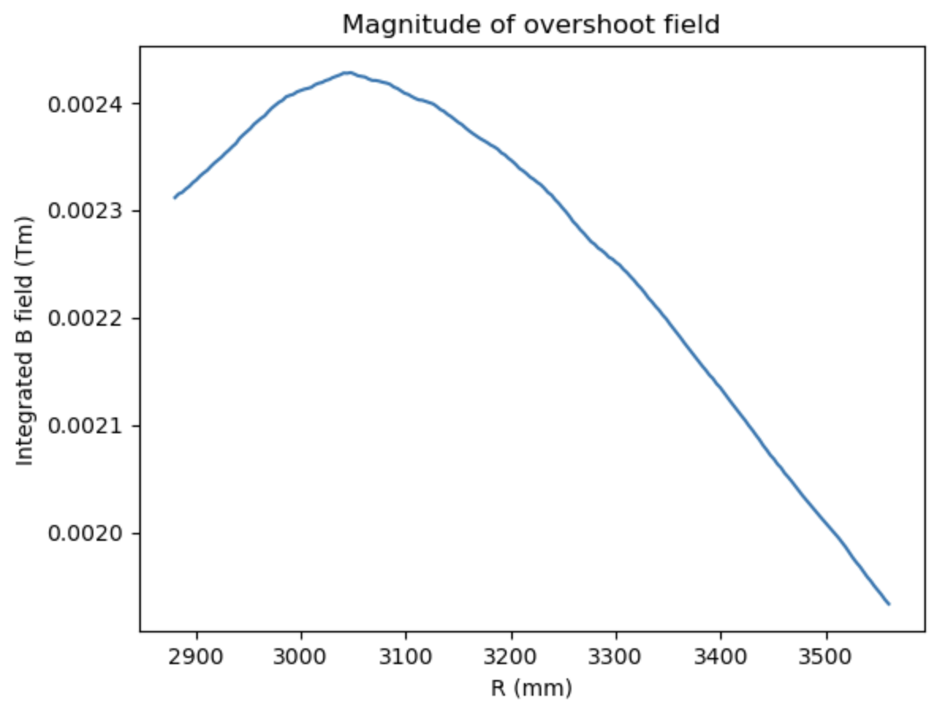
Why does the amount of overshoot matter
Could affect the performance of the RF cavity
Has an impact of tune that is not well understood

Slide 19
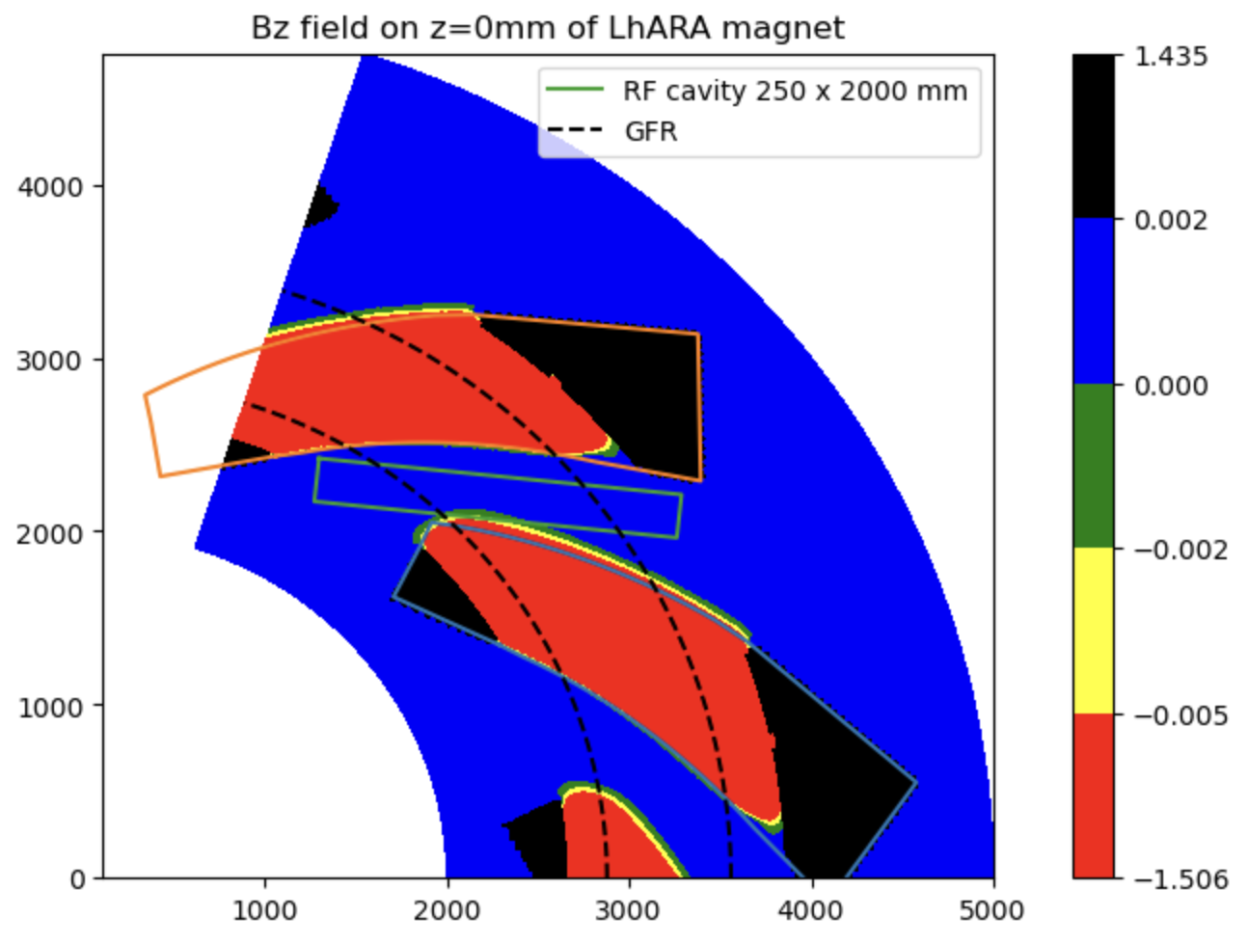
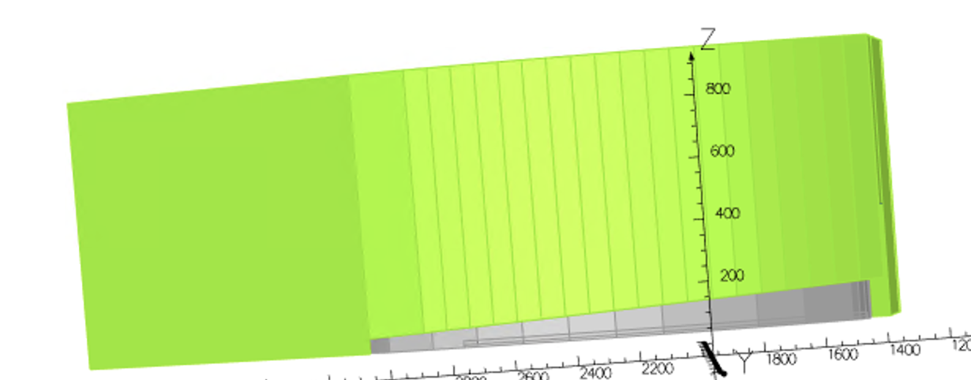
Vary aperture of clamp
Good effect on the overshoot, but fringe field extend could be scaling in
The wrong way?

Slide 20
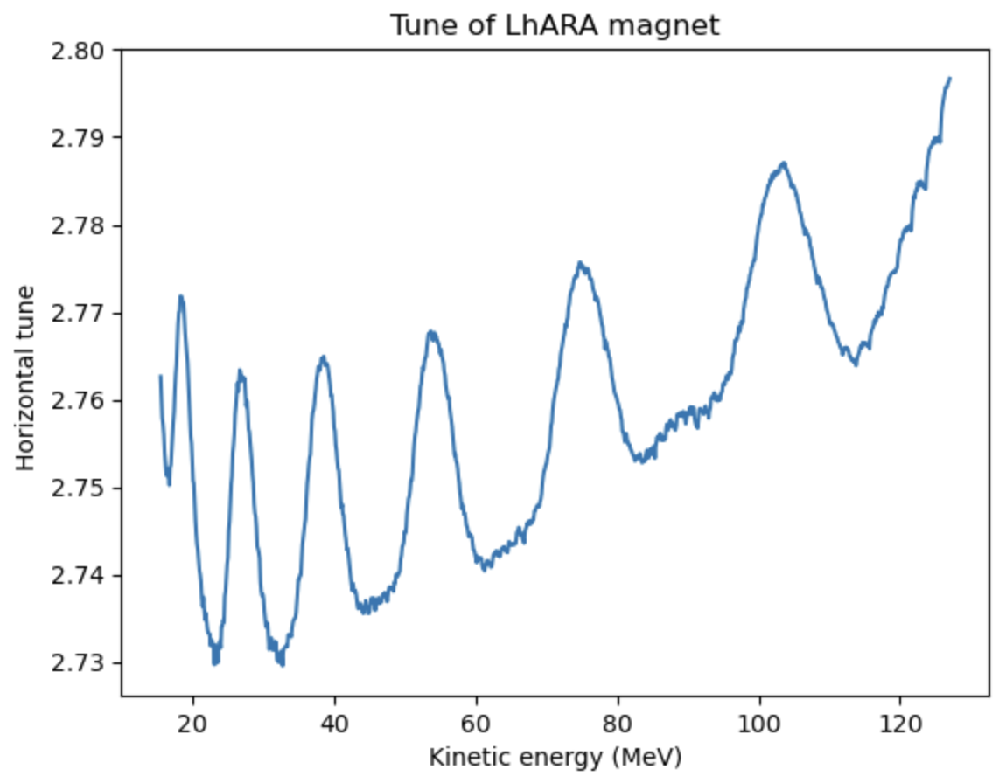
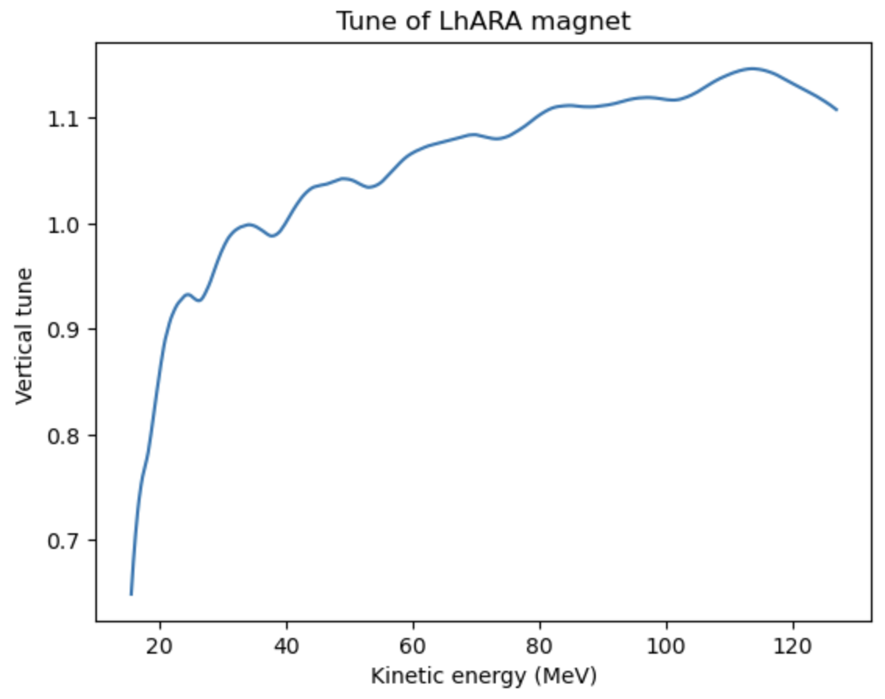
Tune from tracking
Currents would need to be reoptimized to obtain constant k index, but vertical
Tune spread increases significantly

Slide 21
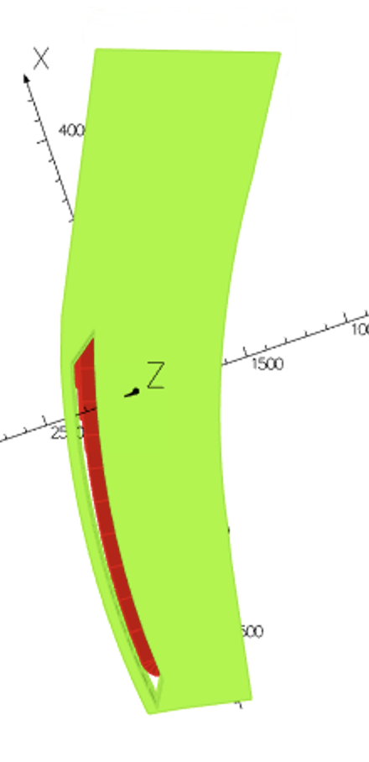
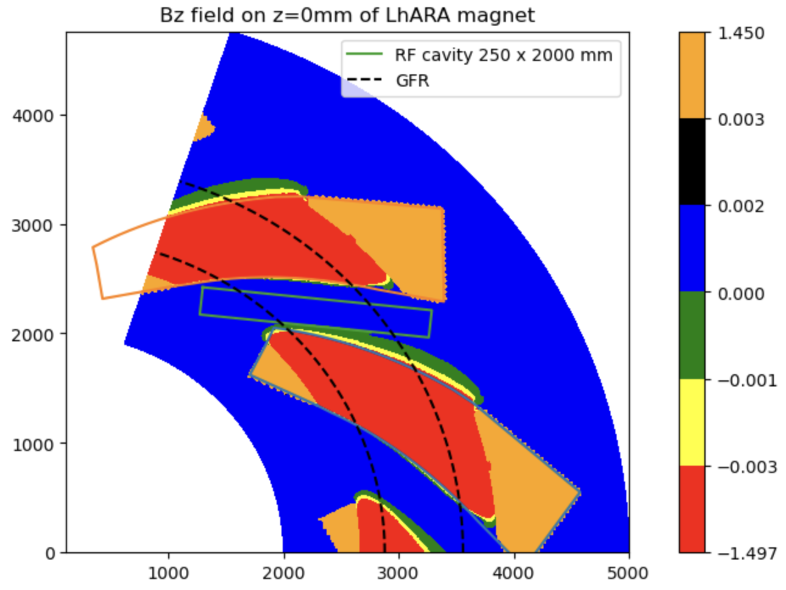
Cut a hole between pole and entry clamp to make it less efficient

Slide 22
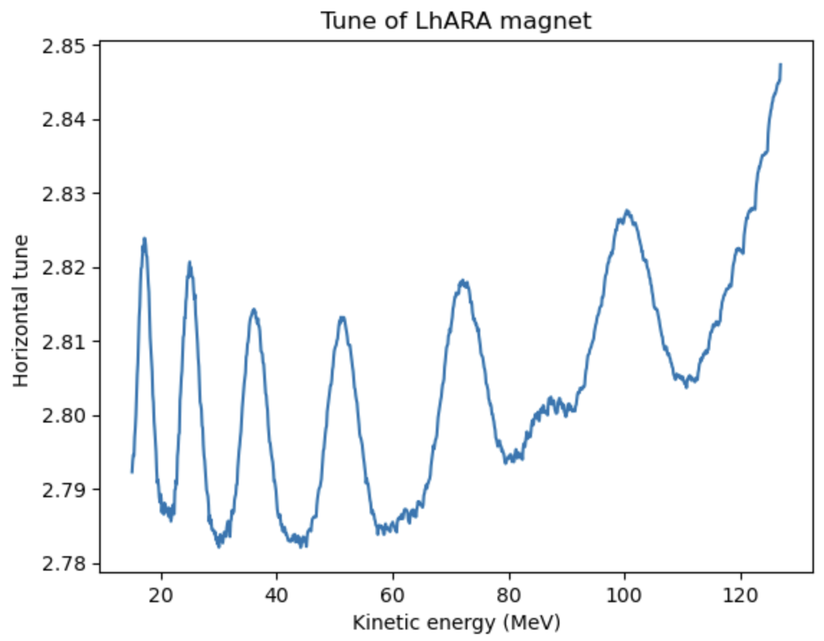
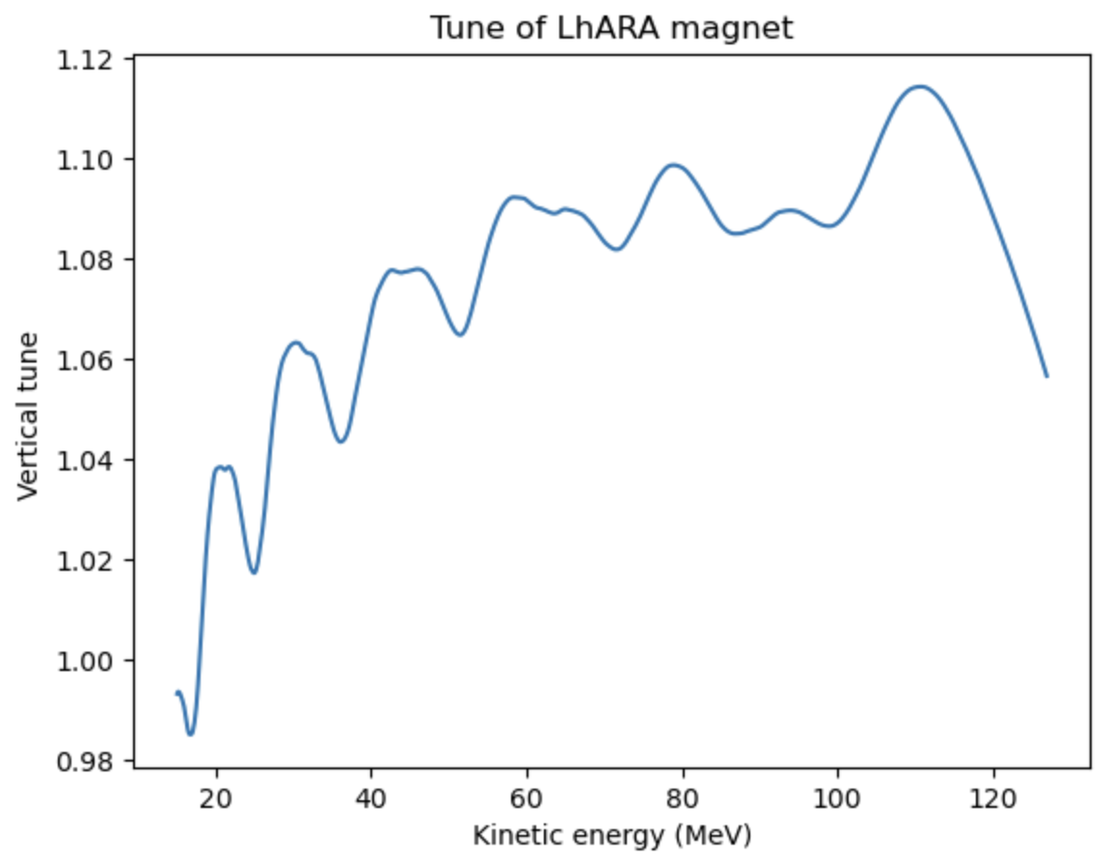
Tune from tracking
Vertical tune spread has also increased but can be flattened by shaping the aperture
Of the clamps accordingly
Another option to try: decreasing the thickness of the entry clamp

Slide 23
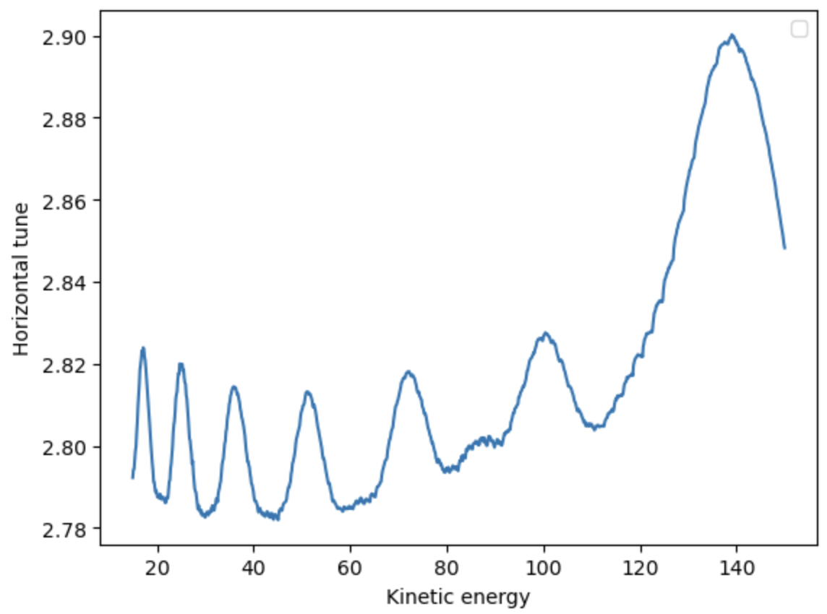
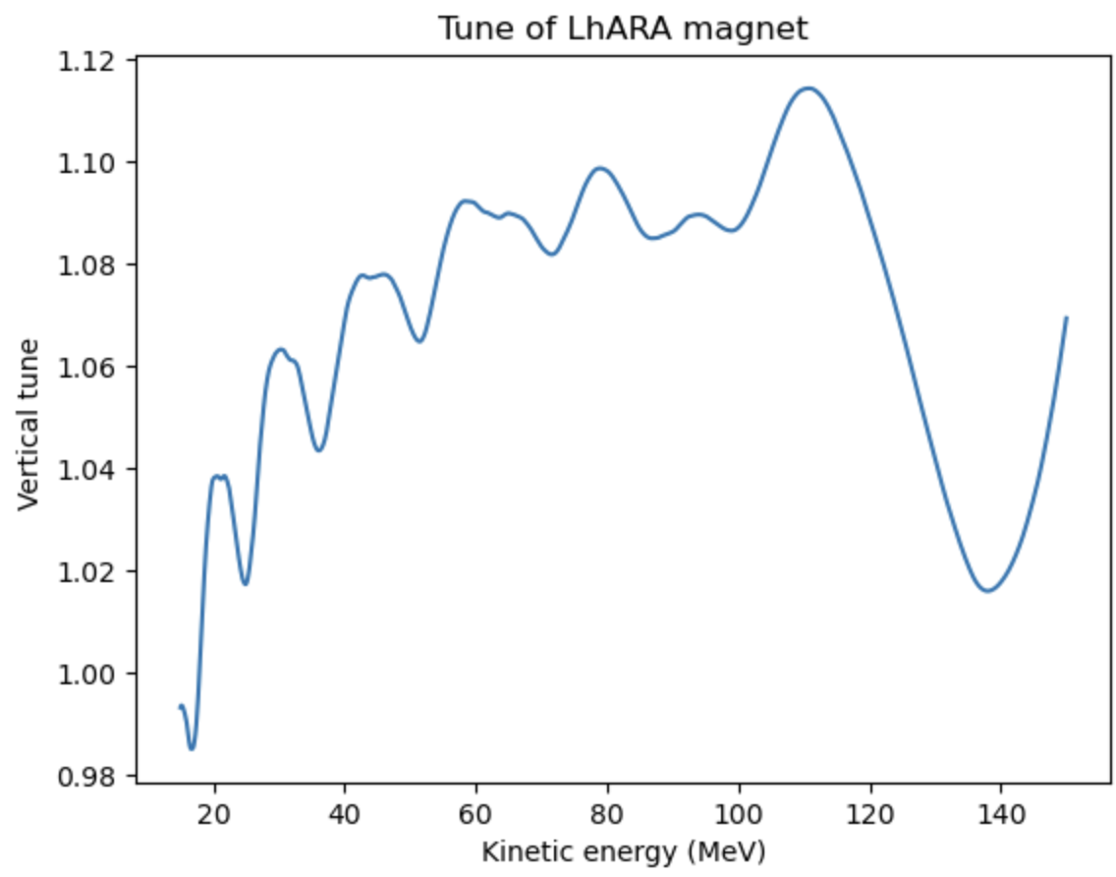
Larger energy range tracking

Slide 24
Conclusion
Latest tracking results show tune of the beam at both highest and lowest energy
are away from resonances up to forth order
Field in straight section reaches 60 gauss due to overshoot of the field caused by
the entry clamp
Methods of avoiding the overshoot is being investigated in case it affects the RF
cavity performance (Also to better understand the behaviour of the tune from a
theoretical point of view)

Slide 25
Extra slides

Slide 26
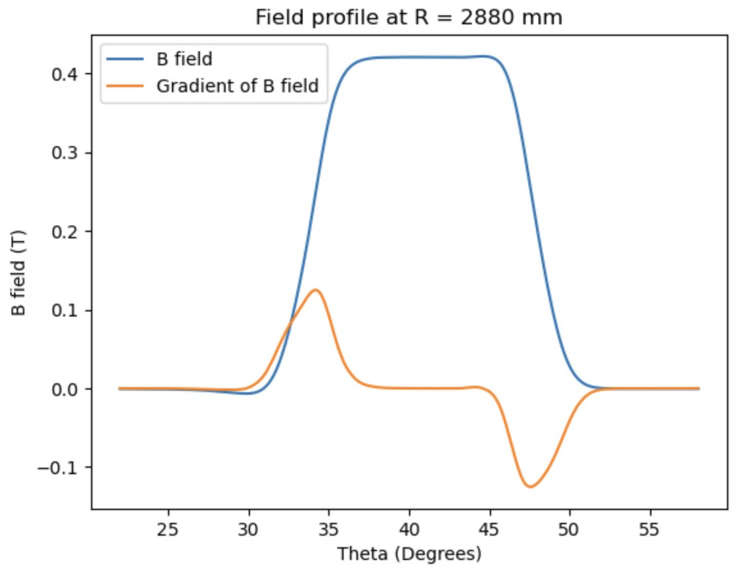
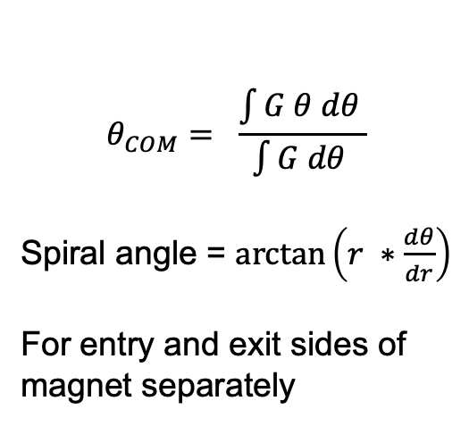
Vertical tune considerations
Spiral Angle
$$θ_{COM}= \frac{\int{G θ dθ }}{\int{G dθ }}$$
Spiral angle = $\arctan\left(r ∗\frac{dθ}{dr}\right)$
For entry and exit sides of magnet separately

Slide 27
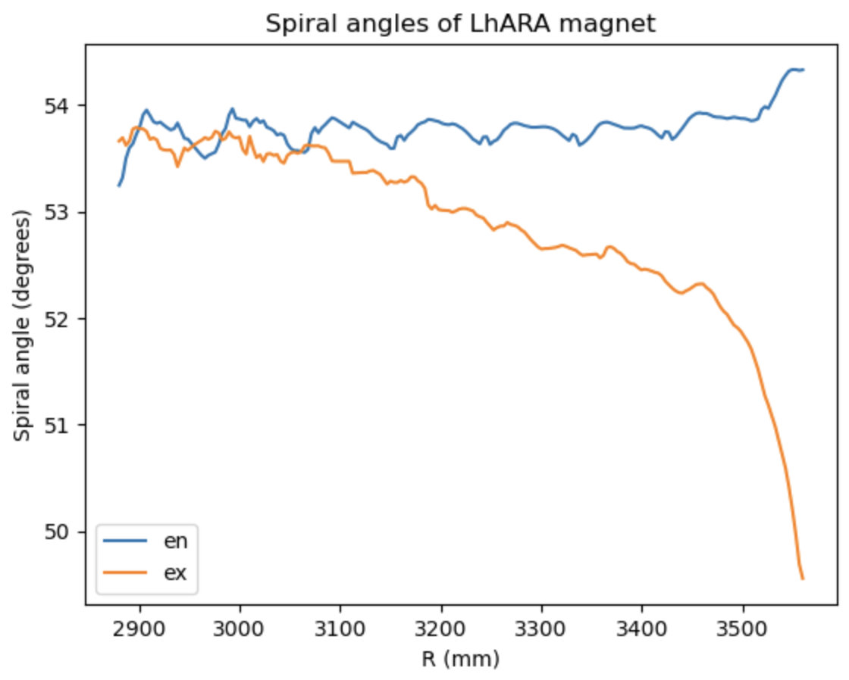
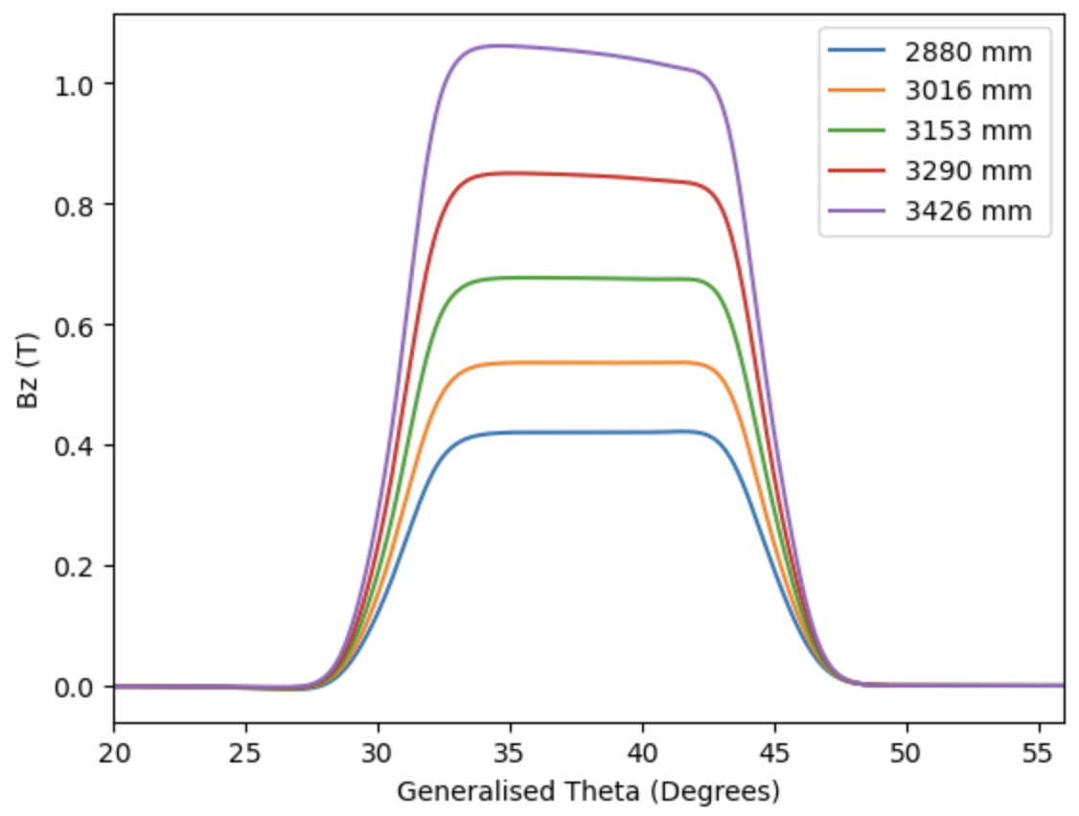
Spiral angle on the exit side decreases as the flat top of the B field gets affected
By saturation

Slide 28
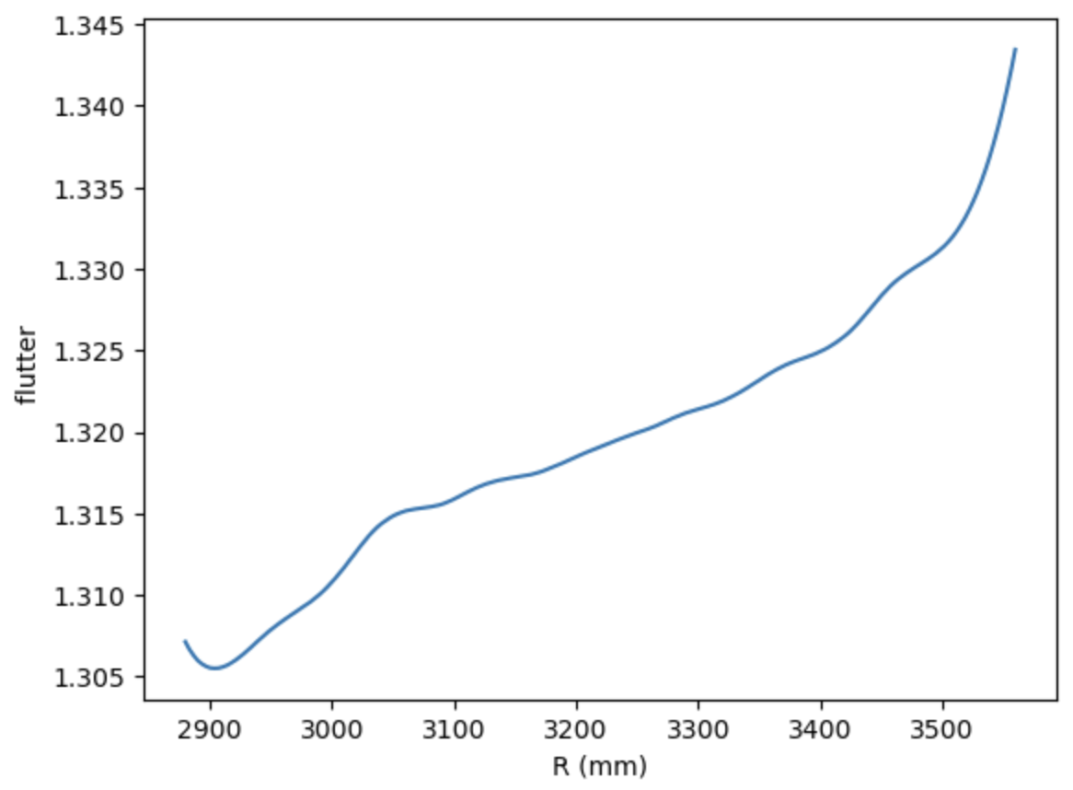
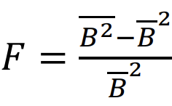
Flutter calculation
We can also calculate the flutter
By using the formula above and we
Have most of the variables needed
To predict vertical tune

Slide 29

Comparing results to approximate tune equations
One problem with the equation is that it assumes
the field profile is symmetric and there is only one
spiral angle, not separately for entry and exit
Using the average of entry and exit for now

Slide 30

Goal
To understand what is causing the change in vertical tune
Therefore understand better how to shape the clamps to further
Decrease vertical tune spread
Questions
May need to include other terms in equation
Is using average spiral angle the best idea?

Slide 31


Disconnect entry clamp completely

