Slide 1
Introduction and goals

Slide 2
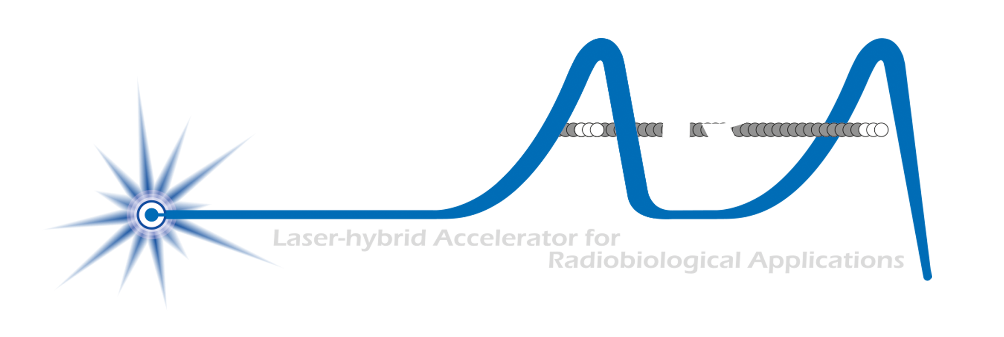
The LhARA initiative:
Deliver a systematic and definitive radiation biology programme
Prove the feasibility of laser-driven hybrid acceleration
  Spin into curiosity-driven science
Lay the technological foundations for the transformation of PBT
  automated, patient-specific proton and ion beam therapy

Slide 3
Structuring the initiative
Define programme to optimise delivery of:
Biology/proof-of-principle programme
R&D programme to address key project risks
Strategic partnerships

Slide 4
LhARA project; vision
International facility based in the UK
£225M investment (present “fully loaded” estimate)
Transform radiation biology & transform clinical practice in PBT

Slide 5
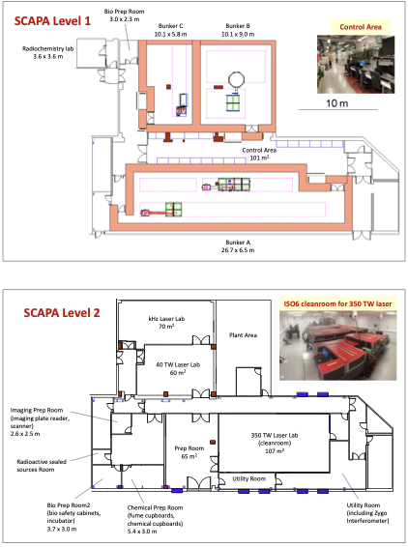
PoPLaR
Summer 2025 …

Slide 6

Science, technology, R&D:
Our programme:
  Radiation biology:
    PoPLaR and measurements at conventional facilities
  Source:
    Developments for LhARA and for PoPLaR
  Capture:
    Development of trapping technique @ Swansea
    Numerical modelling in support
  Ion-acoustic dose-profile measurement:
    Measurements at MC40 in Brm and LION on CALA at LMU
    Simulation/numerical modelling to predict performance
  End-station development and consultation
    Peer-group consultation
    Beam-line diagnostics
  Design and integration
    Source/beam line simulation
    Engineering integration

Slide 7
ITRF/LhARA conceptual design report
Need ion acoustic chapter!
Update introduction etc.

Slide 8
Our science, technology, R&D programme:
Radiation biology:
  PoPLaR and measurements at conventional facilities
Source:
  Developments for LhARA and for PoPLaR
Capture:
  Development of trapping technique @ Swansea
  Numerical modelling in support
Ion-acoustic dose-profile measurement:
  Measurements at MC40 in Brm and LION on CALA at LMU
  Simulation/numerical modelling to predict performance
End-station development and consultation
  Peer-group consultation
  Beam-line diagnostics
Design and integration
  Source/beam line simulation
  Engineering integration
Publications:
Radiation biology:
  Source: design, performance, simulation
  Radiobological measurement!
Source:
  Work specific to LhARA
Capture:
  Measurement and interpretation
Ion-acoustic dose-profile measurement:
  Measurement and interpretation
End-station development and consultation
  Peer-group consultation
Design and integration
  Detailed publication extracted from CDR

Slide 9
Raising the resources:
UKRI:
  Meeting with STFC postponed to 16Apr25 (from 10Apr25)
  Goal:
    Partner to bring LhARA forward as multidisciplinary, cross council, initiative championed by STFC
  Responsive mode proposals:
    Radiation biology programme
    Source/capture
    Ion-acoustic
    Novel instrumentation, end-station automation …
    Public, peer-group, pre-clinical/clinical researcher engagement
EU/ERC:
  Immediate priority; partnership with CNRS
  Build towards EU/ERC proposals
Through our instututions:
  Impact/industrial
  Philanthropic
Session before lunch tomorrow

Slide 10


