Slide 1
Taking stock and preparing the future of the LhARA initiative

Slide 2

Raising the resources:
UKRI:
  Meeting with STFC postponed to 16Apr25 (from 10Apr25)
  Goal:
    Partner to bring LhARA forward as multidisciplinary, cross council, initiative championed by STFC
  Responsive mode proposals:
    Radiation biology programme
    Source/capture
    Ion-acoustic
    Novel instrumentation, end-station automation …
    Public, peer-group, pre-clinical/clinical researcher engagement
EU/ERC:
  Immediate priority; partnership with CNRS
  Build towards EU/ERC proposals
Through our instututions:
  Impact/industrial
  Philanthropic

Slide 3
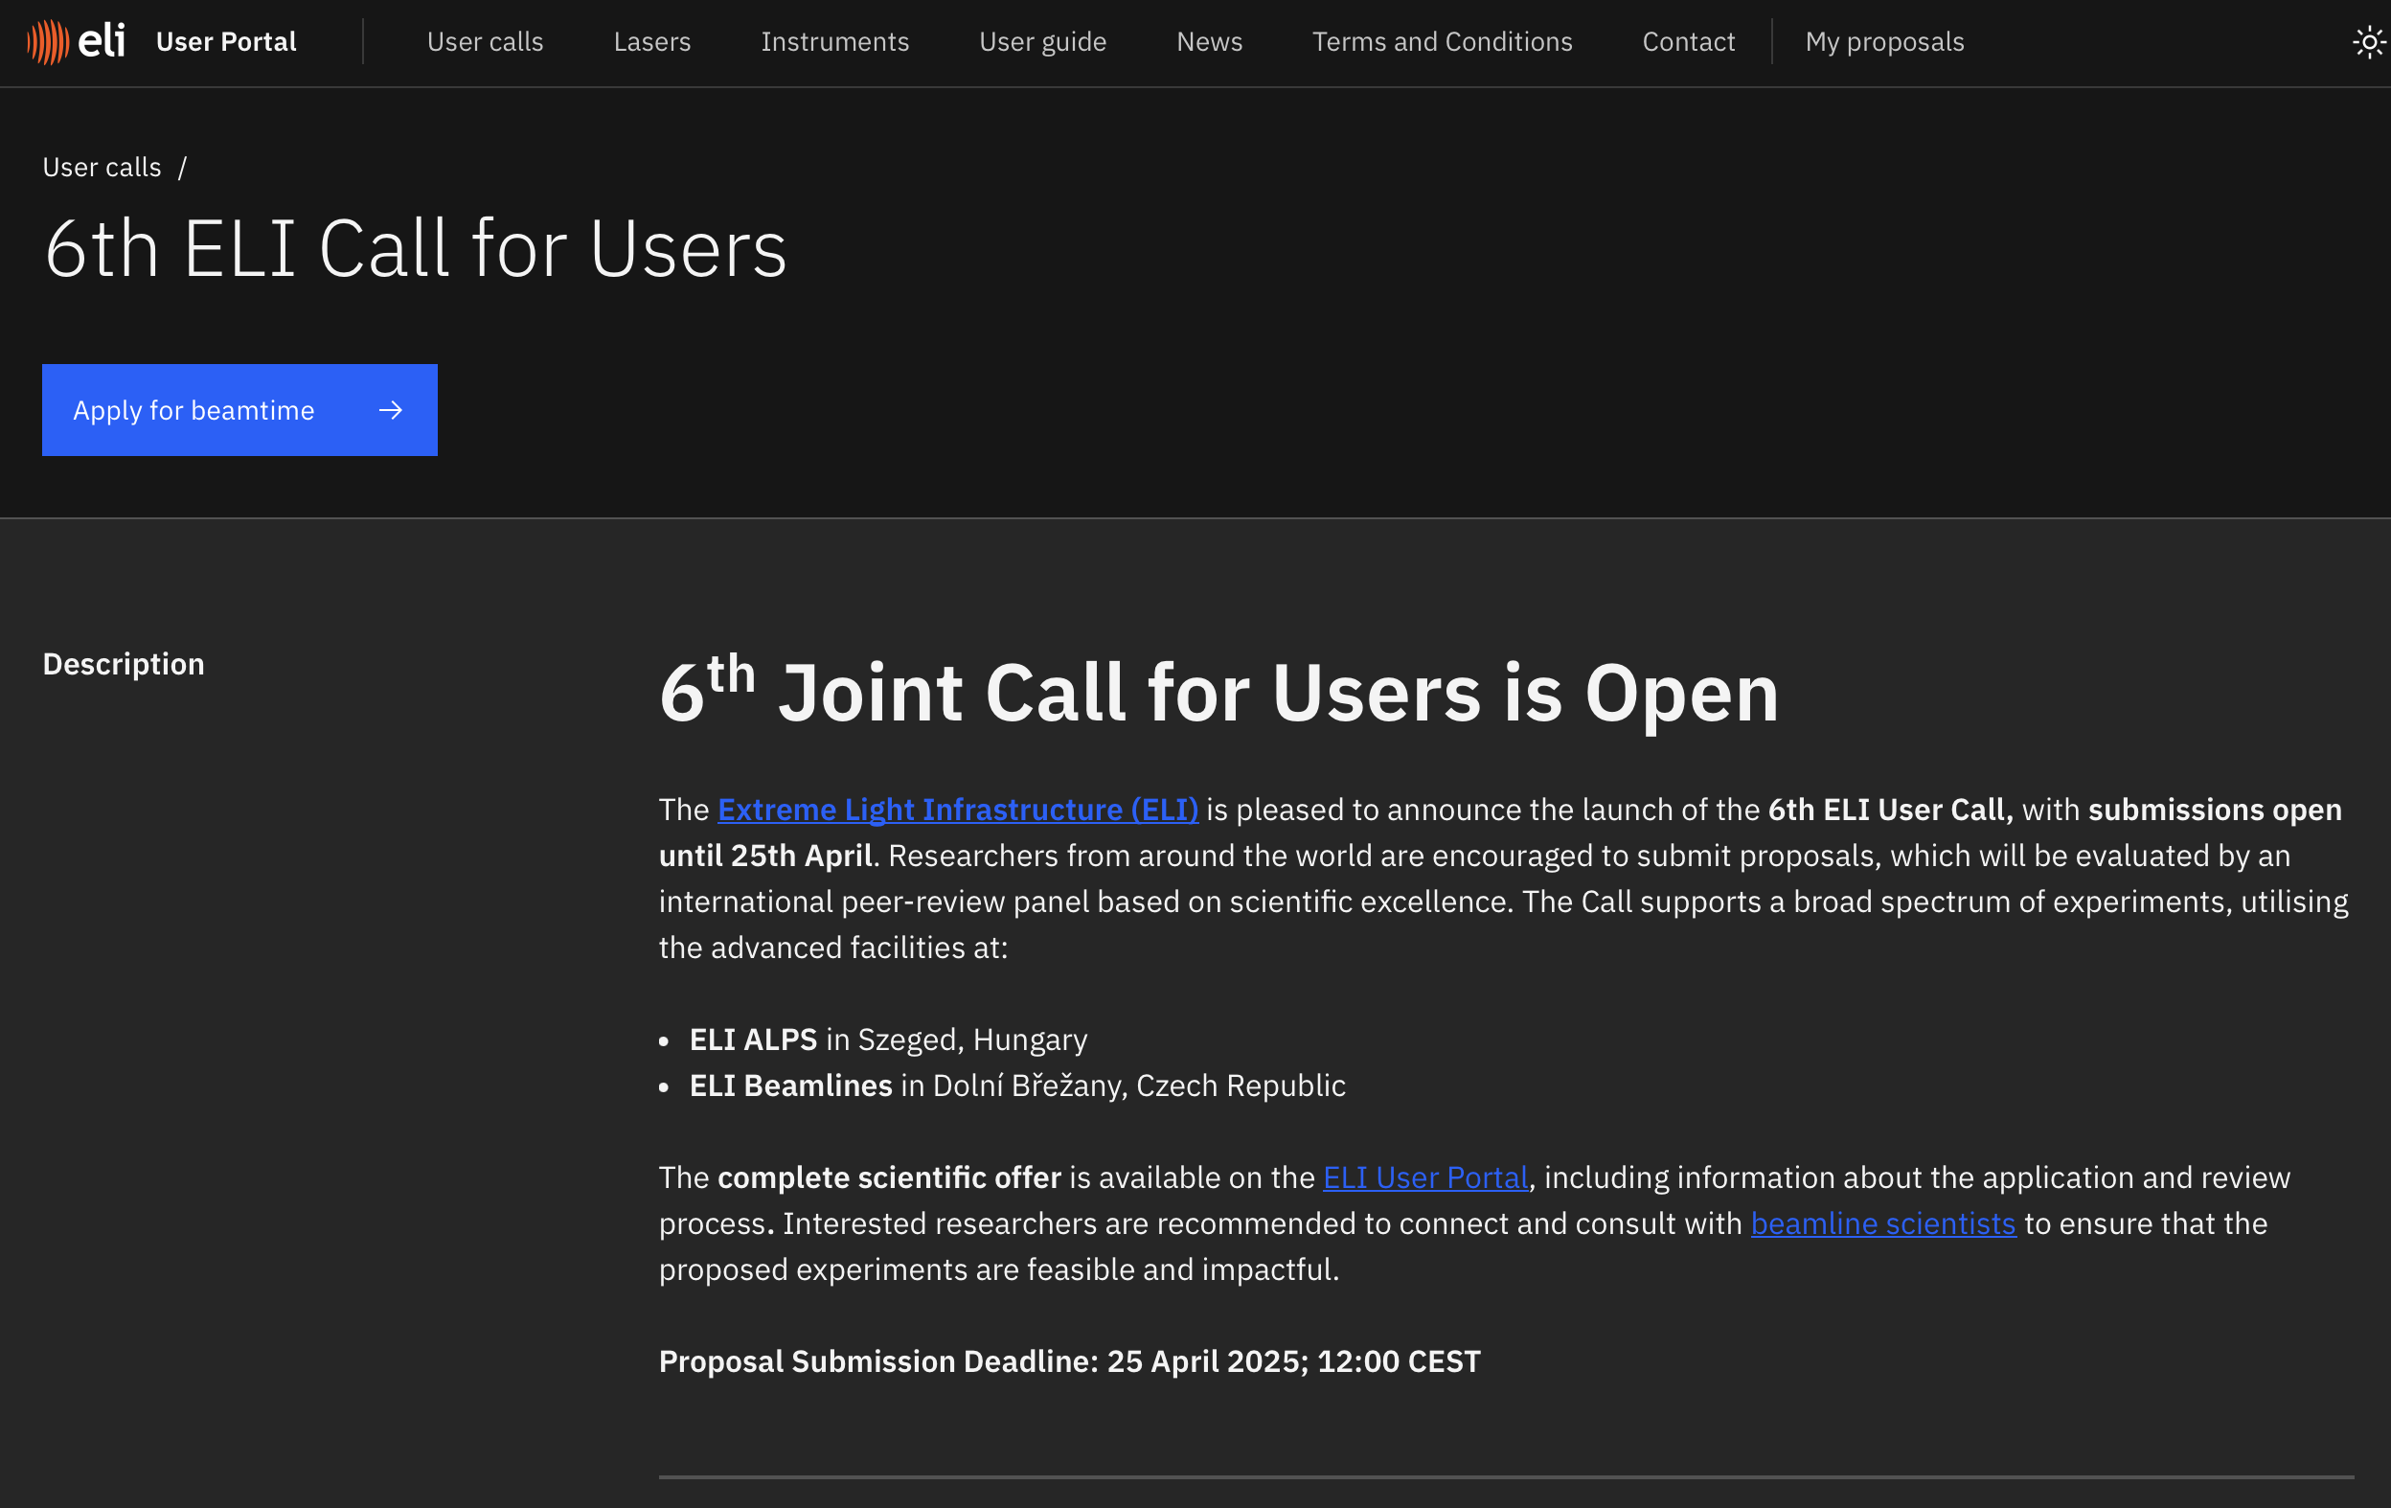

Extreme Light Infrastructure

Slide 4

Multidisciplinary

Slide 5

Modelling
Interpretation of radiobiology
Source
Capture
Ion-acoustic
Space-charge and collective effects

Slide 6


Making the case for large infrastructure

Slide 7

Ad hominem

Slide 8
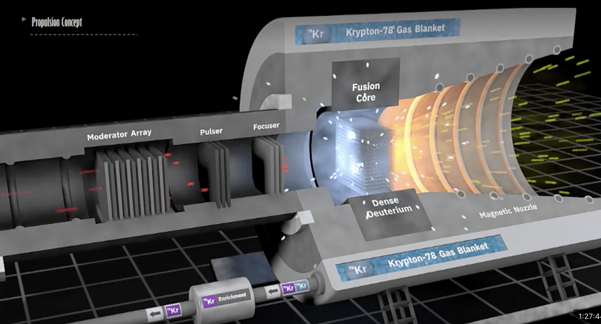



Programmes and projects
Source/capture
Ionacoustic/scintillator
Automation/instrumentation(?)

Slide 9

Creating links with industry …

Slide 10
Also …

Slide 11
Conclusions
“Don’t have to apply for everying!” …
But, …
  Creative:
    Seek partnerships that don’t dilute our mission
    Create approach to identifying multiple applications
  Time to prepare:
    Build for future
Also:
  Build collaborations in Europe to target EU/ERC
Non-RC/traditional funders ...
  … Pat …

