Slide 1
Preliminar dosimetric simulations of PoPLaR
Alfredo Fernandez Rodriguez
07/04/2025

Slide 2
Simulation pipeline
Python beamline optimisation by Josie McGarrigle
Beamline and setup reproduction in TOPAS¹
Scoring at simplified target
¹Topas Tool For Particle Simulation:
J Perl, J Shin, J Schümann, B Faddegon, H Paganetti. "TOPAS: an innovative proton Monte Carlo platform for research and clinical applications." Med Phys. 2012 Nov; 39(11):6818-37.
B Faddegon, J Ramos-Méndez, J Schümann, A McNamara, J Shin, J Perl, H Paganetti. "The TOPAS Tool for Particle Simulation, a Monte Carlo Simulation Tool for Physics, Biology and Clinical Research." Phys Med. 2020 Apr 02; 72:114-121. PMID: 32247964. PMCID: PMC7192305

Slide 3
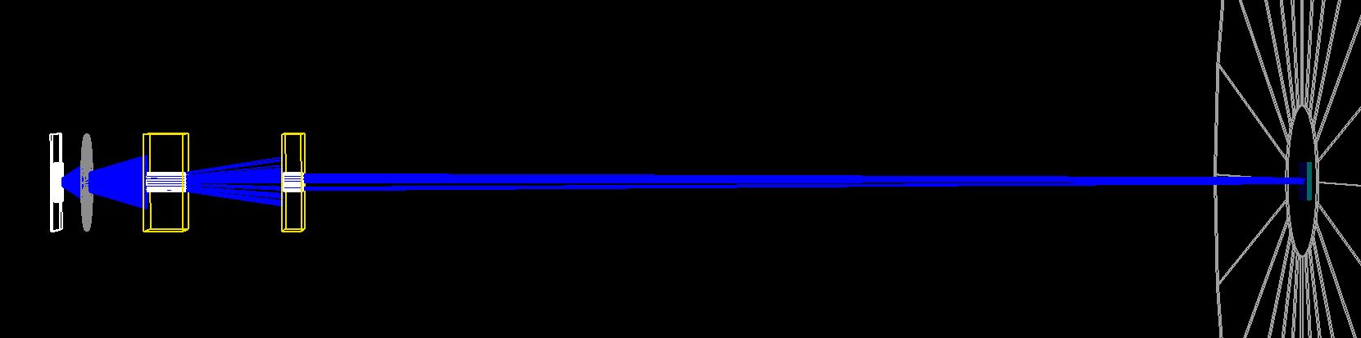
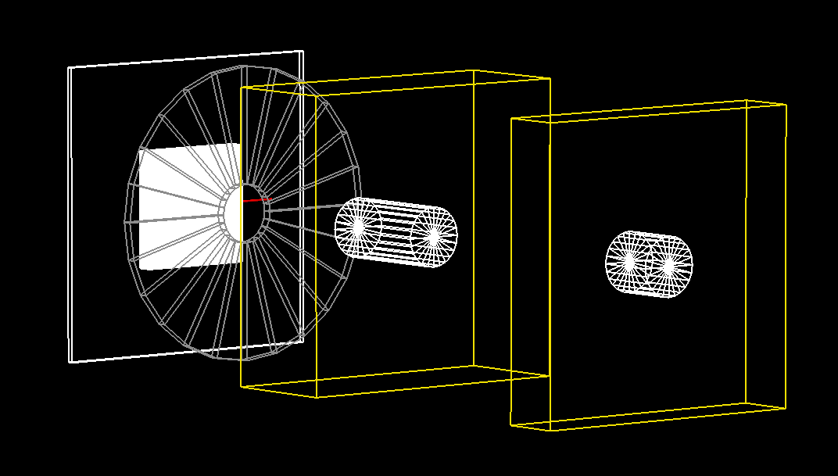
Setup desing
3.15cm
13.1cm
8.15cm
105.6cm
First Collimator: R=1cm
First approximation:
Gaussian source, peak at 10MeV
Target at exit of vacuum chamber (d=130cm)
No vacuum-air interface
No final collimator
150T/m
150T/m

Slide 4
Setup desing
3.15cm
13.1cm
8.15cm
105.6cm
First Collimator: R=1cm
Next approximation:
Parametrization of SCAPA laser source
Target at 5-10cm from exit of vacuum chamber (d=135-140cm)
18m radius, 10um mylar window
150T/m
150T/m

Slide 5
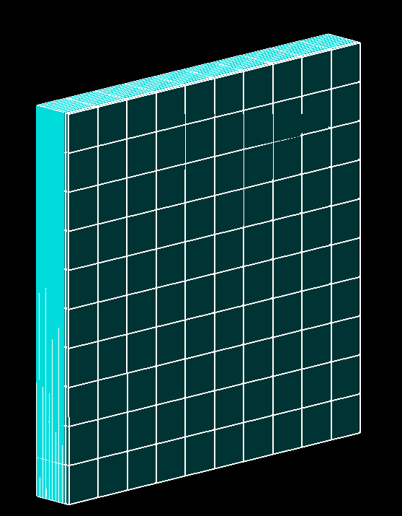
Scoring
Phantom:
4cmx4cm surface
2.5um mylar
2mm water
Phase Space scorer: Whole recording of all particles crossing mylar front surface
Dose and LET scoring:
400x400x80 bins
0.1mmx0.1mmx25um

Slide 6
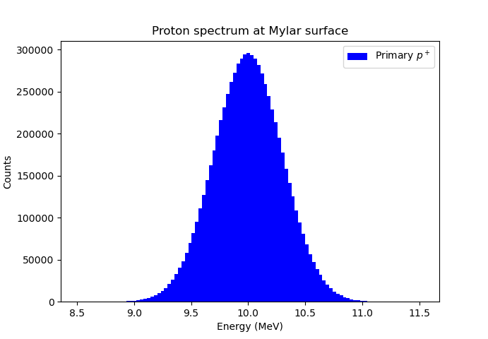
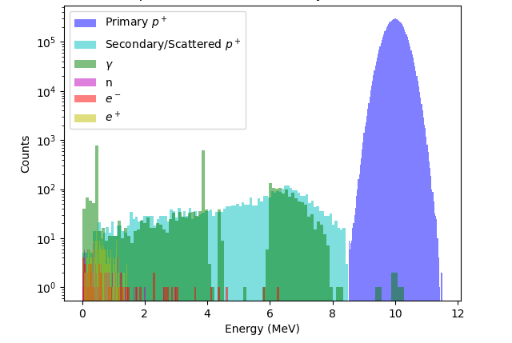
Spectra at target

Slide 7
Phase space and beam profile: Primary protons

Slide 8
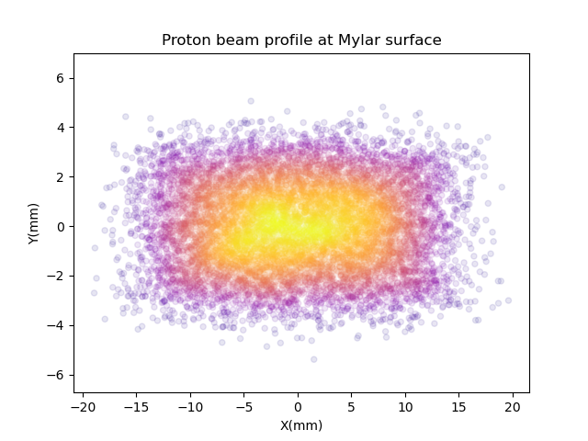
Phase space and beam profile: primary protons

Slide 9
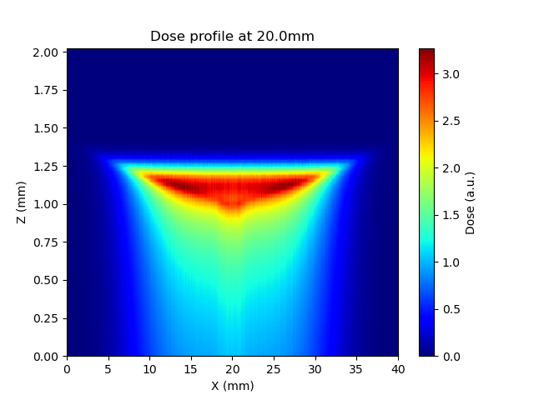
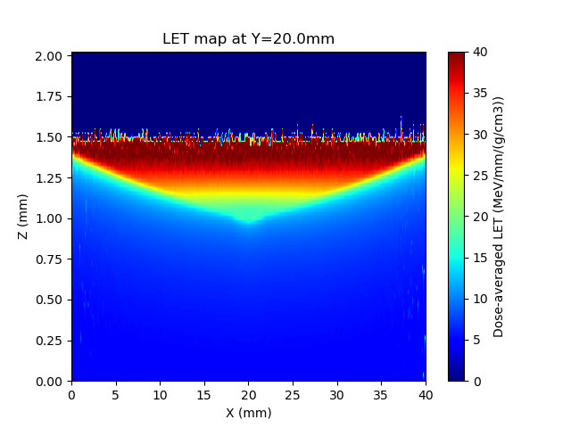
Dose and LET distributions
p+

Slide 10
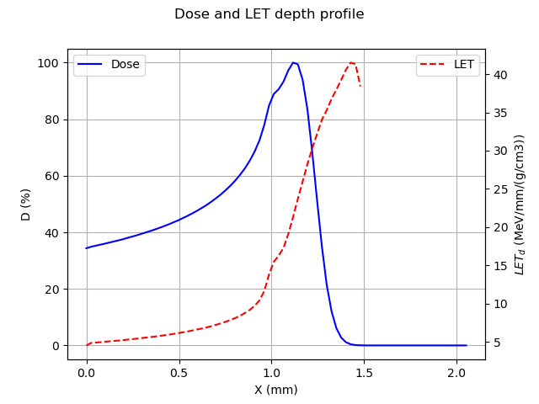
Dose and LET distributions

Slide 11
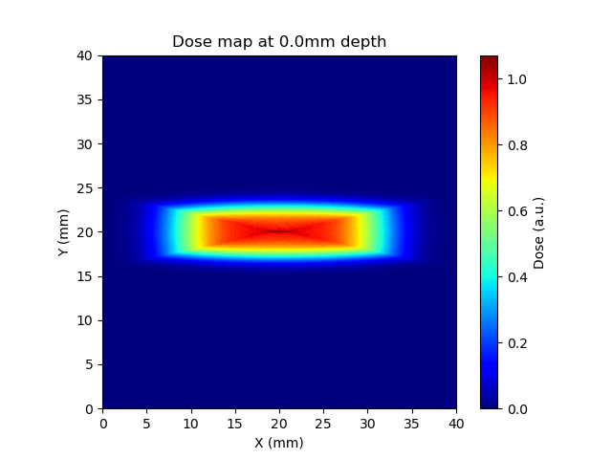
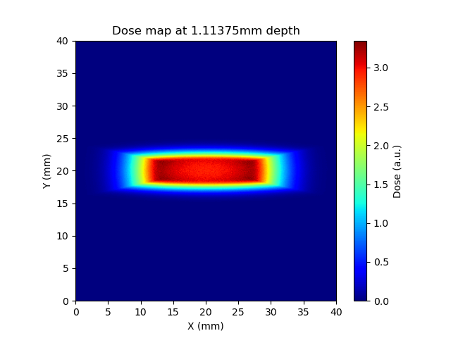
Dose and LET distributions

Slide 12
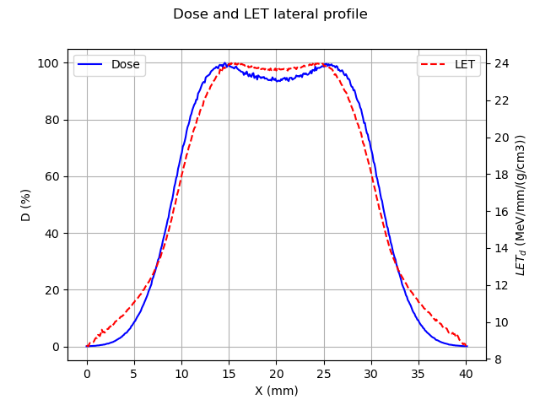
Dose and LET distributions

Slide 13
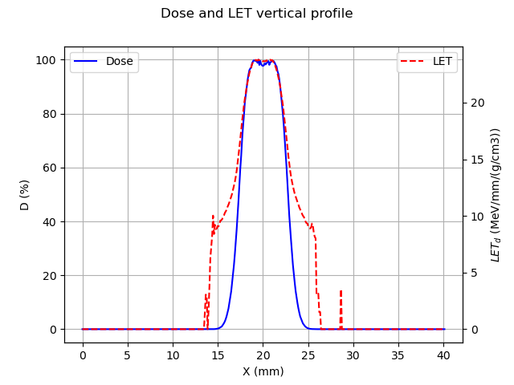
Does and LET distributions

Slide 14
Conclusions and next steps
We can expect a (not pristine) Bragg peak at ~1.1mm depth for a focus at 10MeV
FWHM around 6mm in the vertical direction and 20mm in the horizontal direction
Not important yield of secondaries in beam transport
Simulations will be improved to better resemble the actual setup

Slide 15
Preliminar dosimetric simulations of PoPLaR
Alfredo Fernandez Rodriguez
07/04/2025

