Slide 1


PoPLAR PMQs and Measurements
Hywel Owen, Thomas Smith, Ben Shepherd, Neil Thompson
STFC Daresbury Laboratory
Accelerator Science and Technology Centre
7th April 2025
LhARA 7th Collaboration Meeting, https://indico.stfc.ac.uk/event/1438/

Slide 2
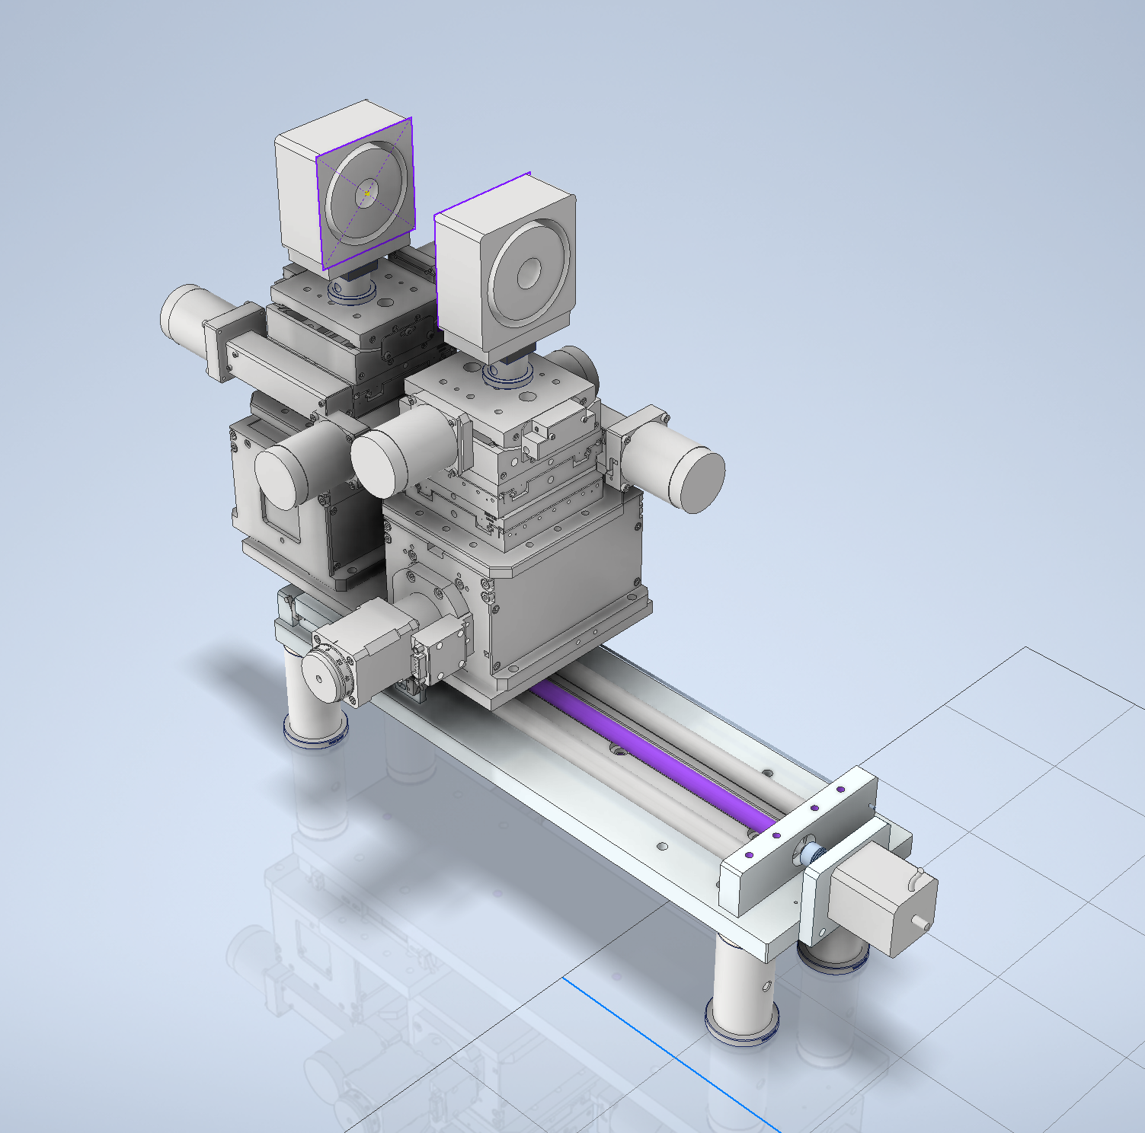
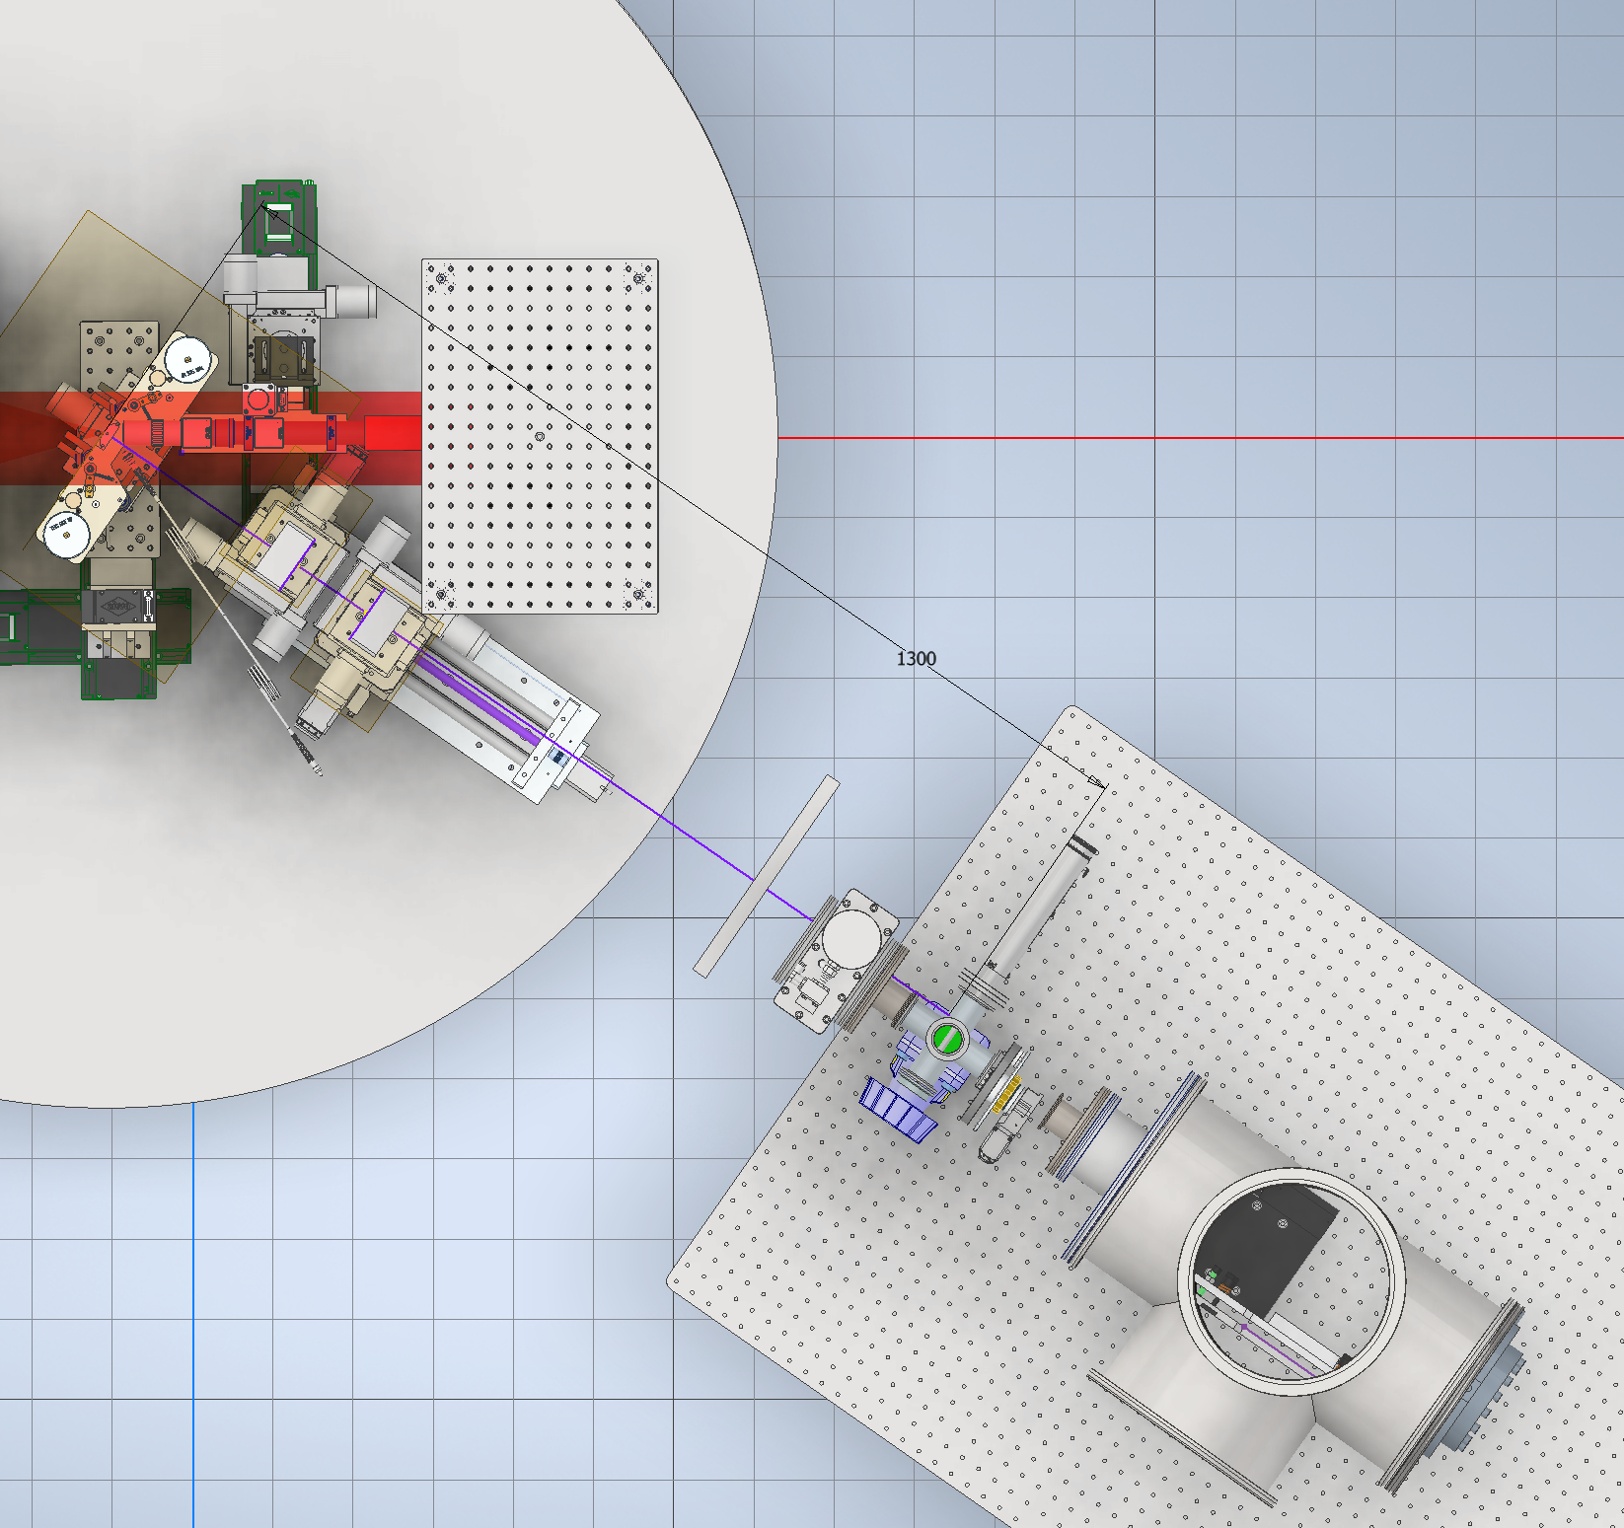
Beamline Layout

Slide 3
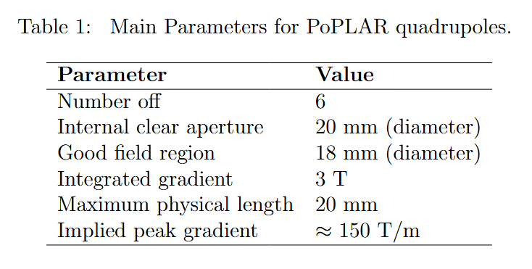
Specification
Pure PPM design
Four mounting faces to enable F/D in both orientations
Serial number and reference marks to reference against field maps
Ni-coated for vacuum compatibility

Slide 4
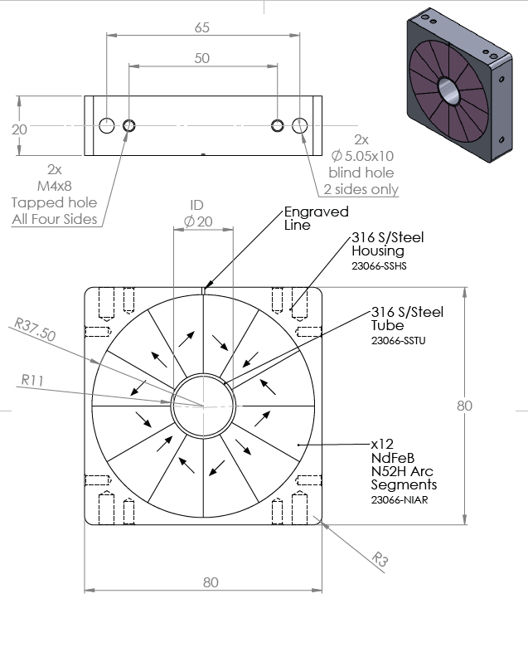
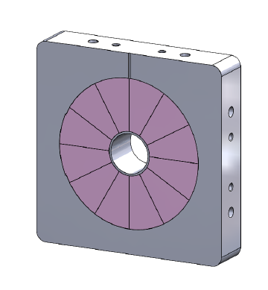
MagnetSales models

Slide 5
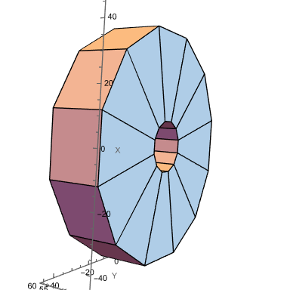
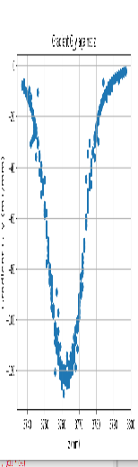
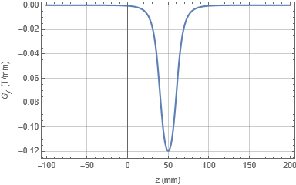
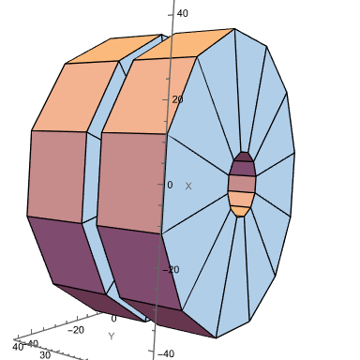
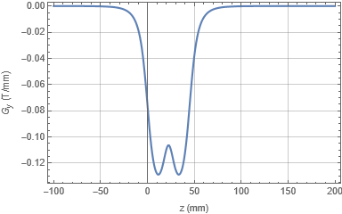
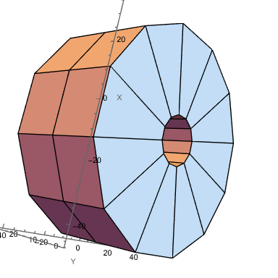
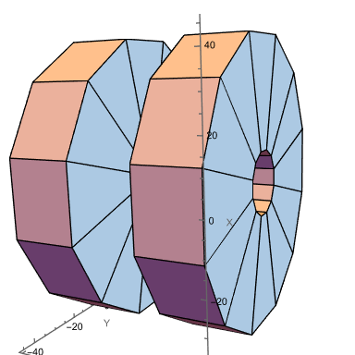
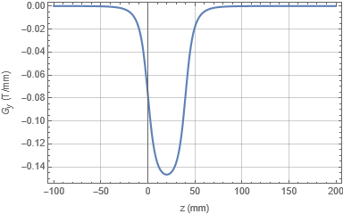
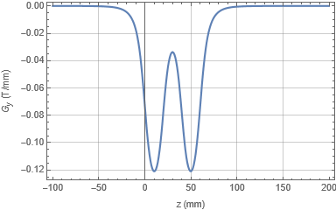
Measurement
(same scale)
ONE QUAD
TWO QUADS, 5mm GAP
Integrated Gradient G1 = -3.12883 T
Integrated Gradient = -6.26385 T = G1*2.002
TWO QUADS, NO GAP
TWO QUADS, 20mm GAP
Integrated Gradient = -6.25824 T = G1*2.0002
Integrated Gradient = -6.25036 T = G1*1.9997

Slide 6
Issue: Magnetic Forces
Can’t let 2 PMQs get this close without mechanical control
Need to be >20mm apart

Slide 7
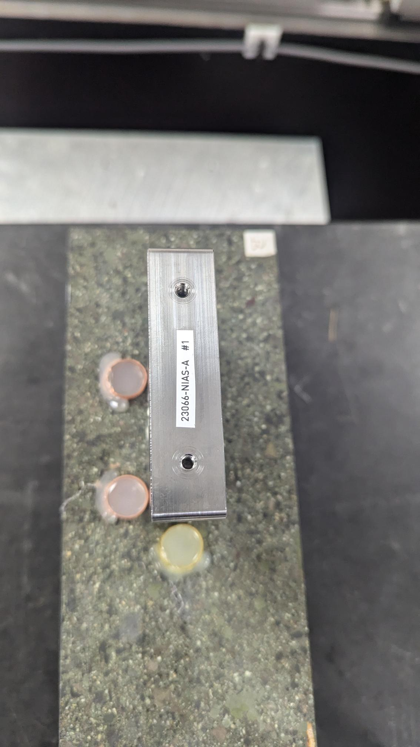
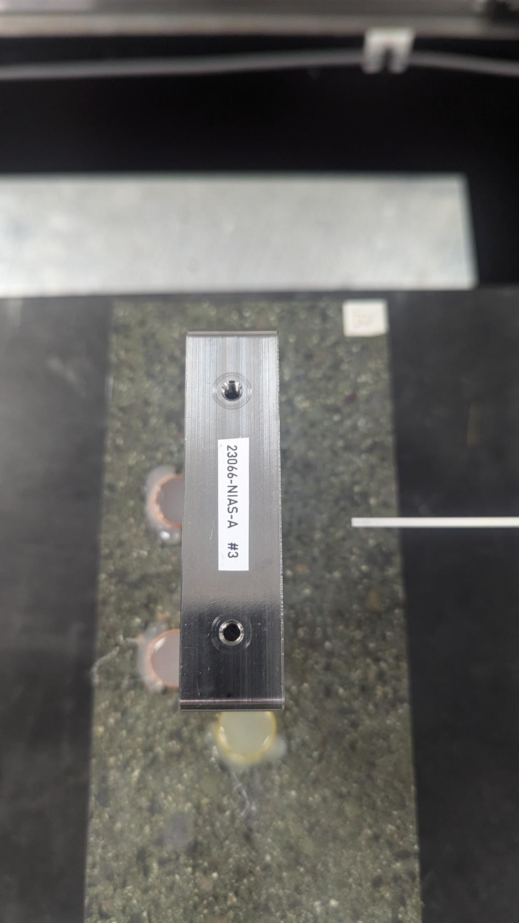
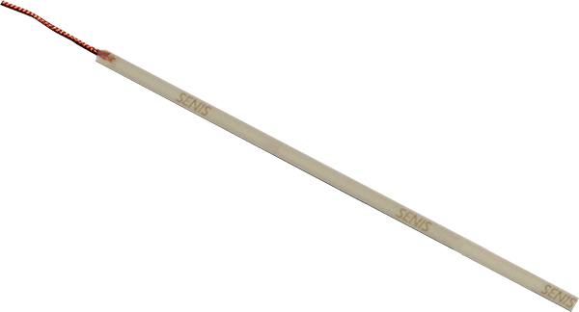
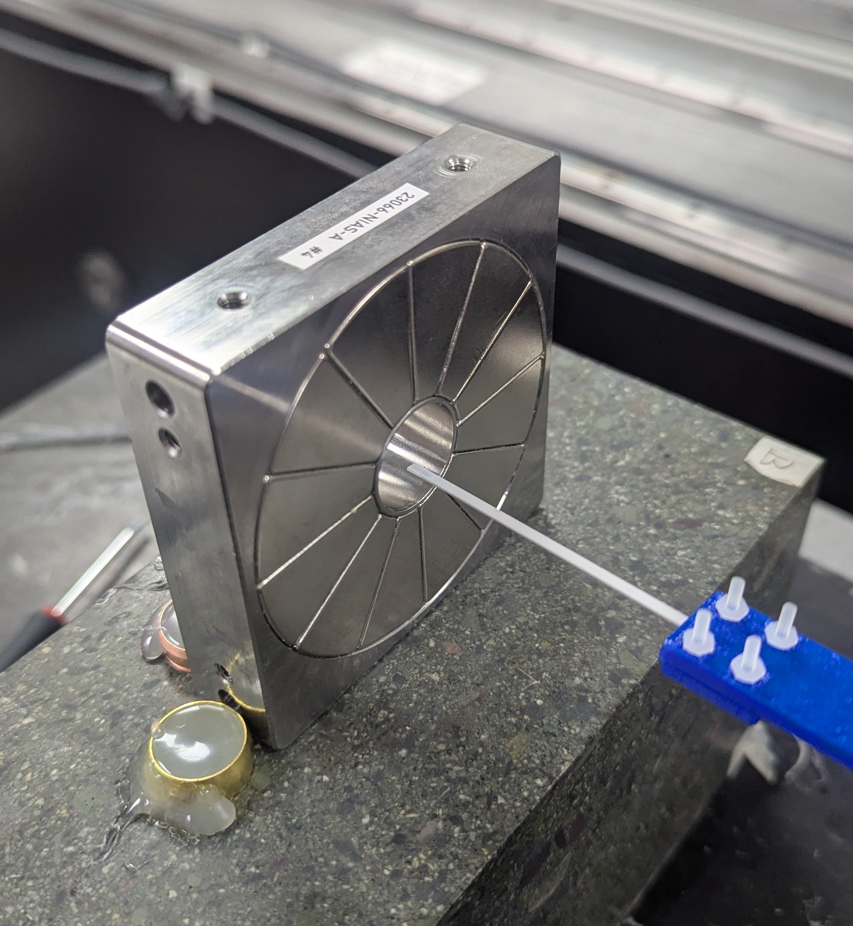
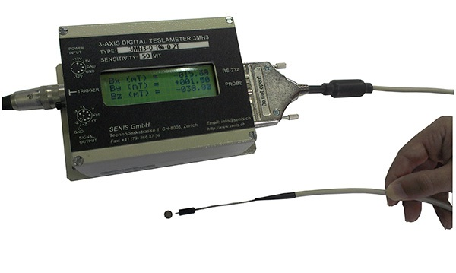
Bench measurements
Hall probe has a finite size and length
Can only scan +/-4mm in x/y
Can’t map full z field fall-off in one go
Measured all 6 quads from both sides
Senis H probe
(spot the difference!)
https://www.senis.swiss/magnetometers/teslameter-digital/3mh3-teslameter-gaussmeter-for-industrial-application/

Slide 8
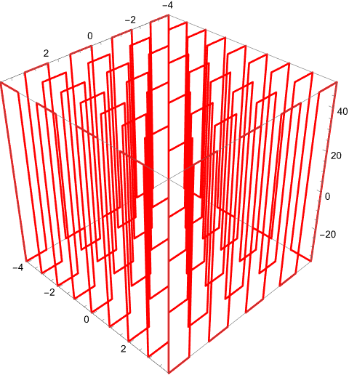
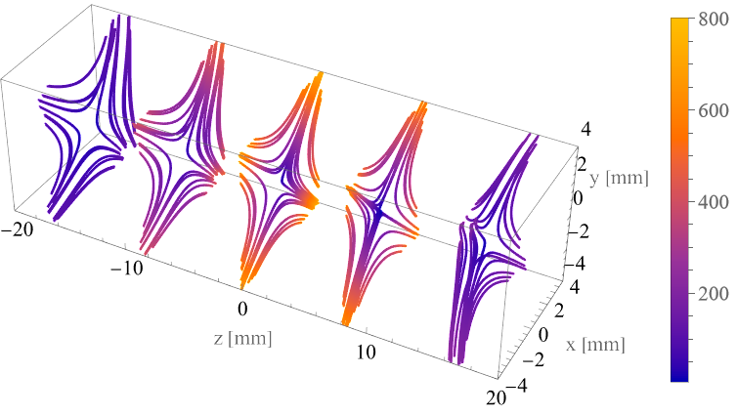
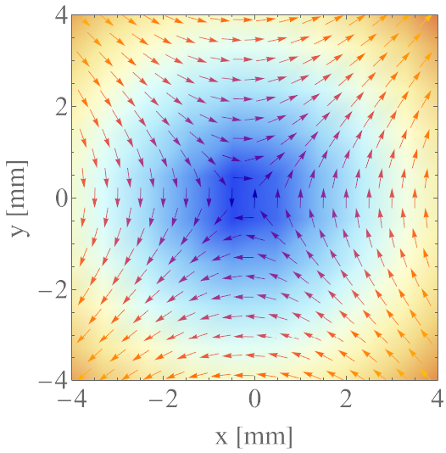
Probe toolpath
8 mm
8 mm
Sequential points over x,y,z
1st-order interpolation from points (could do 2nd-order but haven’t yet)
89 mm
Parametric reconstruction from linear interpolation (Mathematica)

Slide 9
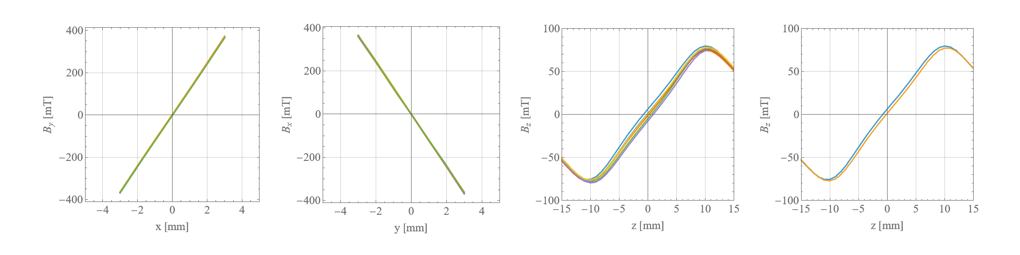
Matching the magnet positions
Least-squares fit in z,x,y fields:
Finds magnetic centre
Matches ‘Forward’ and ‘Backward’ field maps to each other
z-field fitting
x/y-field fitting
These are each 18 lines overlying each other.
Some spread of 8 z fields;
indicates some discretization error in measurements
Comparing ‘FWD’ and ‘BWD’ for one offset location; indicates how well we can match the two field maps together.
Q1

Slide 10
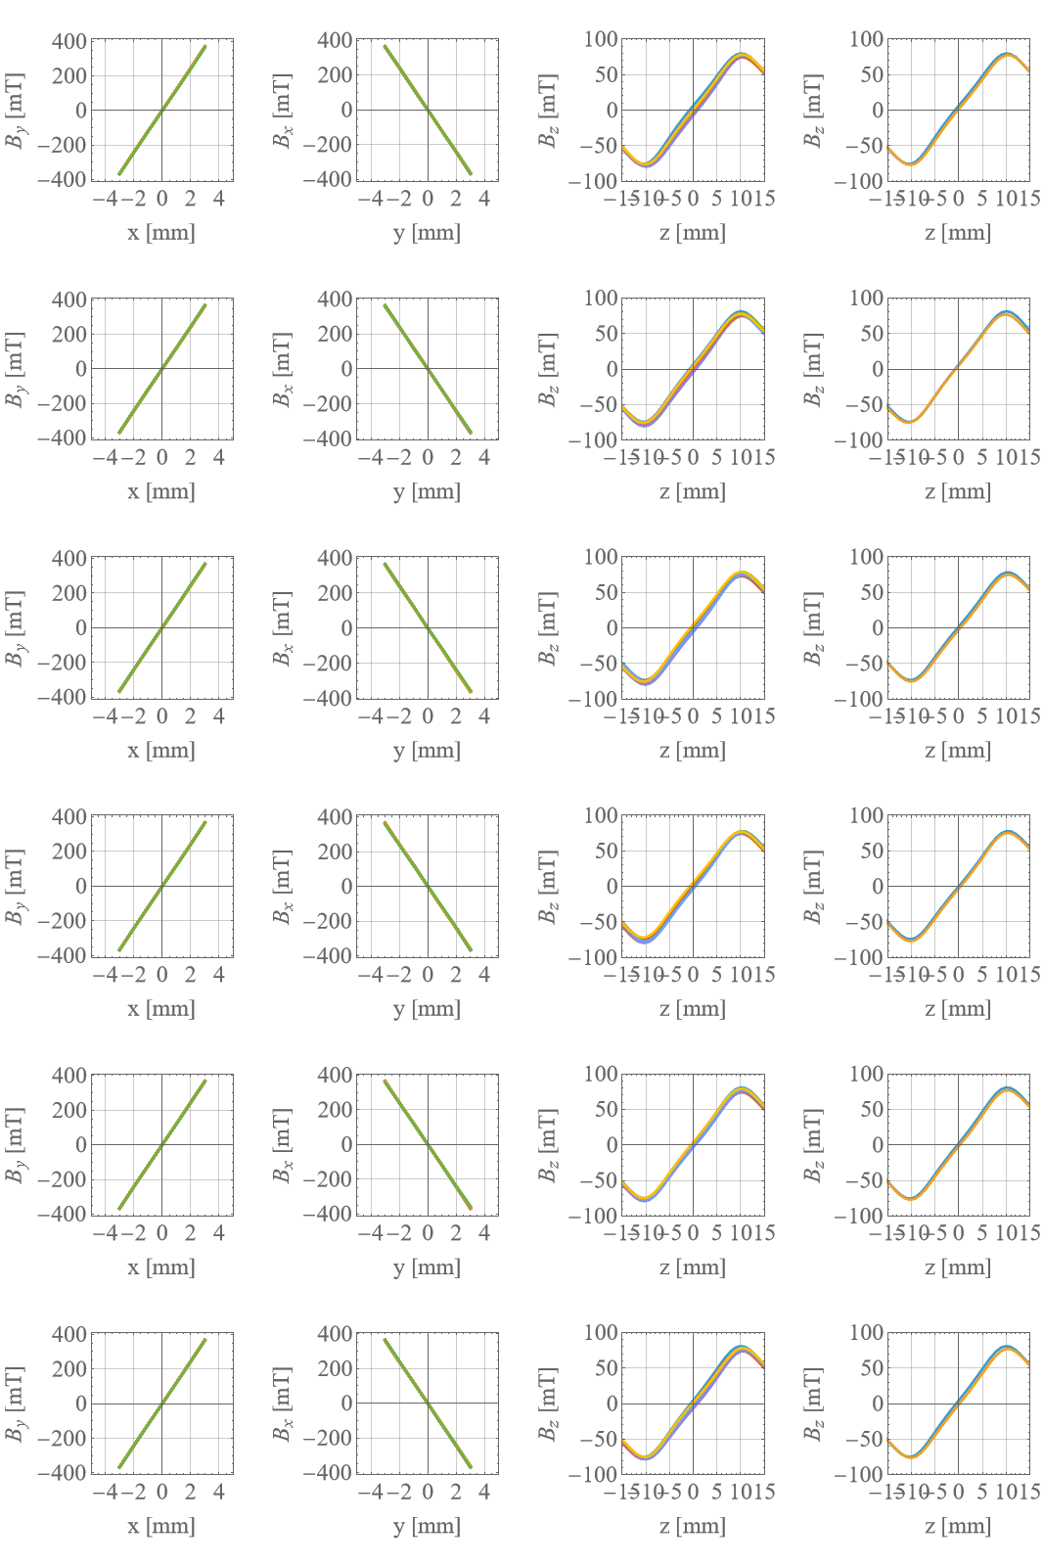
Q1 to Q6
Q1
Q2
Q3
Q4
Q5
Q6

Slide 11
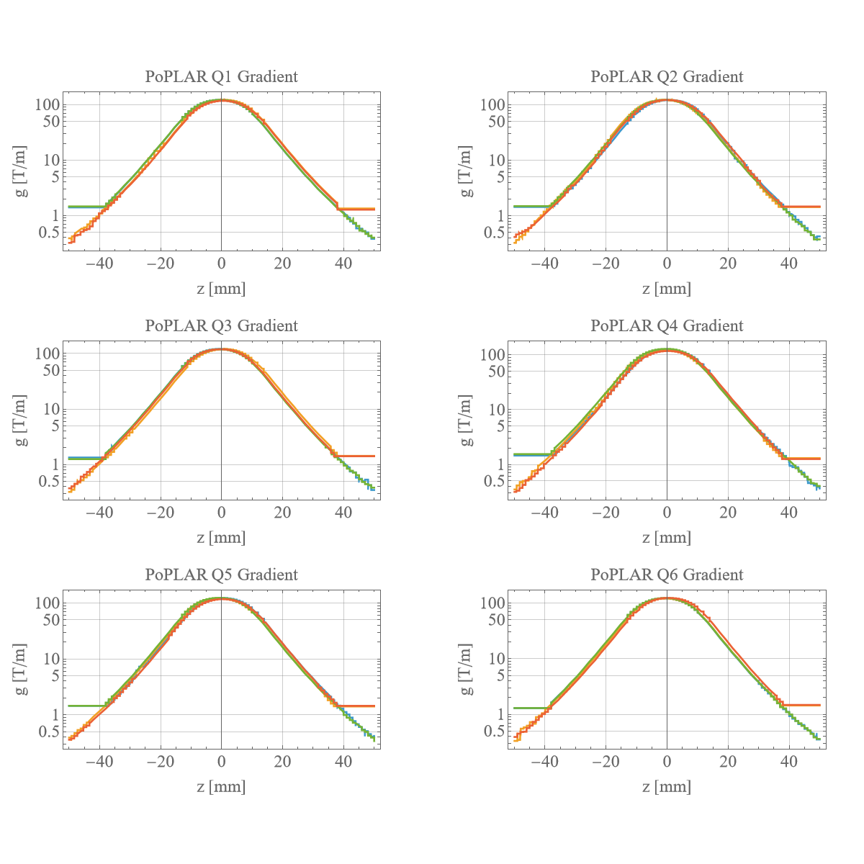
Longitudinal Gradient
Probe doesn’t reach on one side
Can obtain gradient by differentiating the field map
Do either for the (Bx,y) field or the (By,x) field
Can clearly see where the probe ‘can’t go’ on the ‘Forward’ and ‘Backward’ orientations
Gradients all agree
Can extract integrated gradient
4 lines on each plot: (Bx,y) & (By,x), FWD and BWD

Slide 12
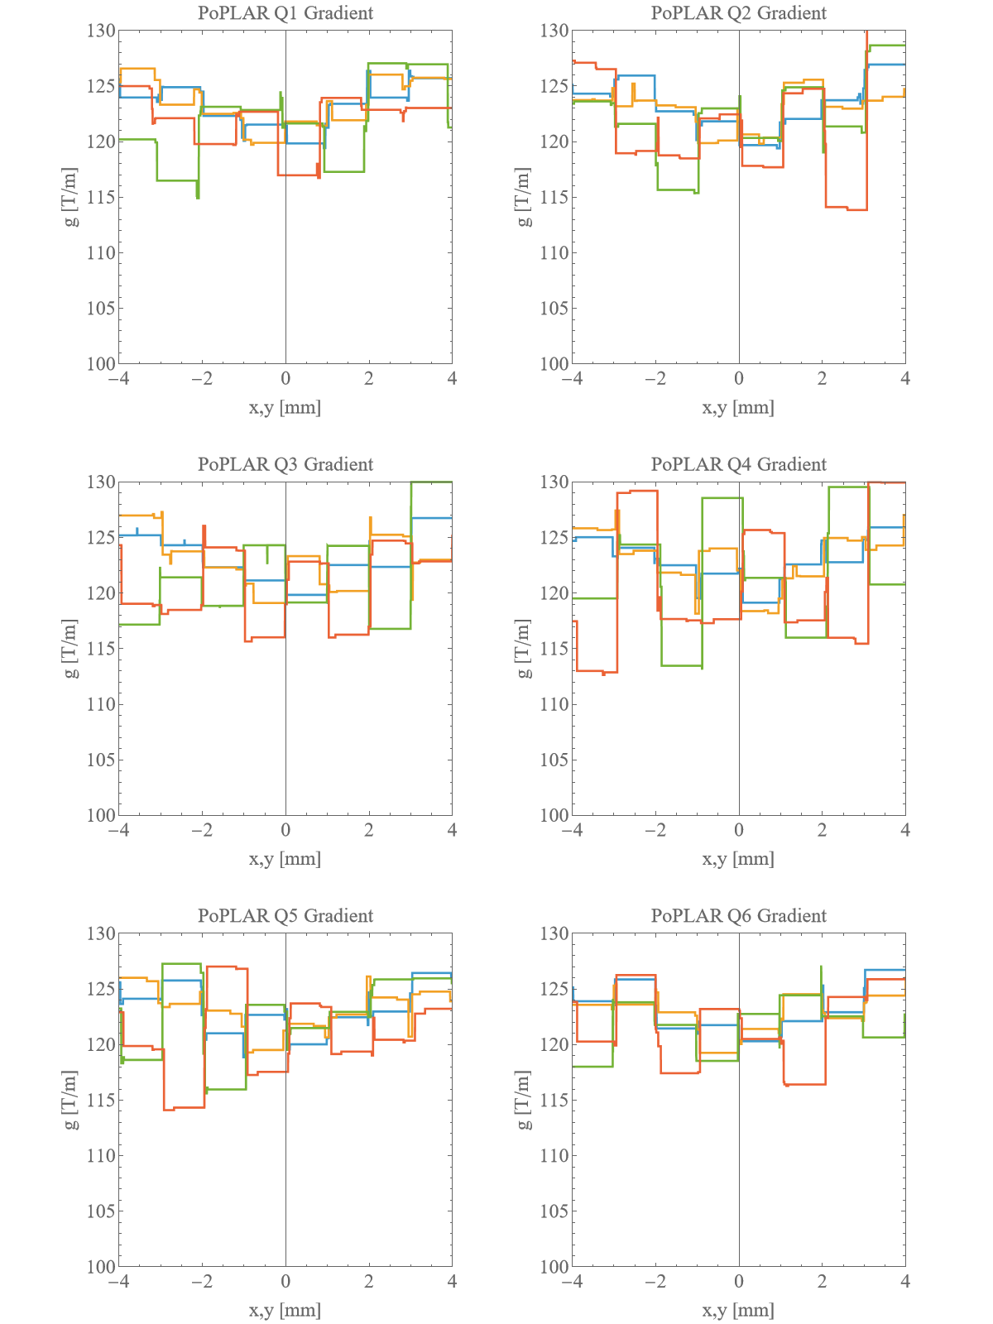
Gradient variation with x & y
Limitation here is that measurements are on a 1mm grid spacing
Linear interpolation gives numerical artefacts when differentiated (expected)
Underlying field map is fine!
Looks fine

Slide 13
Summary of Measurements
Variation and quality as expected for this type of quad/price:
Achieves central gradient
5% variation in integrated gradient (but we know which is which)
Can determine centre position to around 60um
Roll error <0.5 deg
Serial Number | Int. Norm. Skew. * | Roll error (mRad) | Roll error (deg)
23066-NIAS-A #1 | 146 | 7.3 | 0.418
23066-NIAS-A #2 | -79 | -3.95 | -0.226
23066-NIAS-A #3 | -64 | -3.2 | -0.183
23066-NIAS-A #4 | 29 | -1.45 | 0.083
23066-NIAS-A #5 | 13 | -6.5 | 0.037
23066-NIAS-A #6 | 61 | 3.04 | 0.174
Comparison of survey and field map data
(Forward only) |  | Q1 |  | Q2 |  | Q3 |  | Q4 |  | Q5 |  | Q6
x Difference |  | 13 | um | 9 | um | 10 | um | -5 | um | -4 | um | 16 | um
y Difference |  | -68 | um | -30 | um | -34 | um | 40 | um | 49 | um | 10 | um
z Difference |  | 39 | um | 100 | um | 1 | um | 8 | um | -65 | um | 1 | um
Field Integrals Along Beam Axis | (T)
(from fieldmapping) |  | Q1 |  | Q2 |  | Q3 |  | Q4 |  | Q5 |  | Q6
Forward By |  | 3.06 |  | 3.31 |  | 3.06 |  | 3.30 |  | 3.32 |  | 3.05
Forward Bx |  | 3.08 |  | 3.11 |  | 3.00 |  | 3.25 |  | 3.09 |  | 3.08
Backward By |  | 3.05 |  | 3.38 |  | 3.01 |  | 3.30 |  | 3.31 |  | 3.24
Backward Bx |  | 2.95 |  | 3.19 |  | 3.23 |  | 3.00 |  | 3.00 |  | 3.10
Average |  | 3.04 | 0.06 | 3.25 | 0.12 | 3.08 | 0.11 | 3.21 | 0.14 | 3.18 | 0.16 | 3.12 | 0.08

Slide 14
Recommendations
Can’t really rely on external surfaces to determine magnetic centre
Proven difficult to get matched field map that includes all the fringe field (probe limitation)
Field maps can be generated from measured data, but have interpolation limitation due to map size and range
However, field maps confirm that the quads are as originally modelled
Should probably use field maps generated from simulation if tracking is to be done.

