Slide 1

Simulation of LION Beam
Presenter: Calvin Dyson
Work in collaboration with Professor Kenneth Long, Nicholas Dover, Zaynab Sadur & Nadirah Zakhir
7th April 2025
LhARA 7th Collaboration Meeting, https://indico.stfc.ac.uk/event/1438/
Notes:
Welcome to the simulation of the LION beam with LLO
Calvin Dyson and work completed with

Slide 2
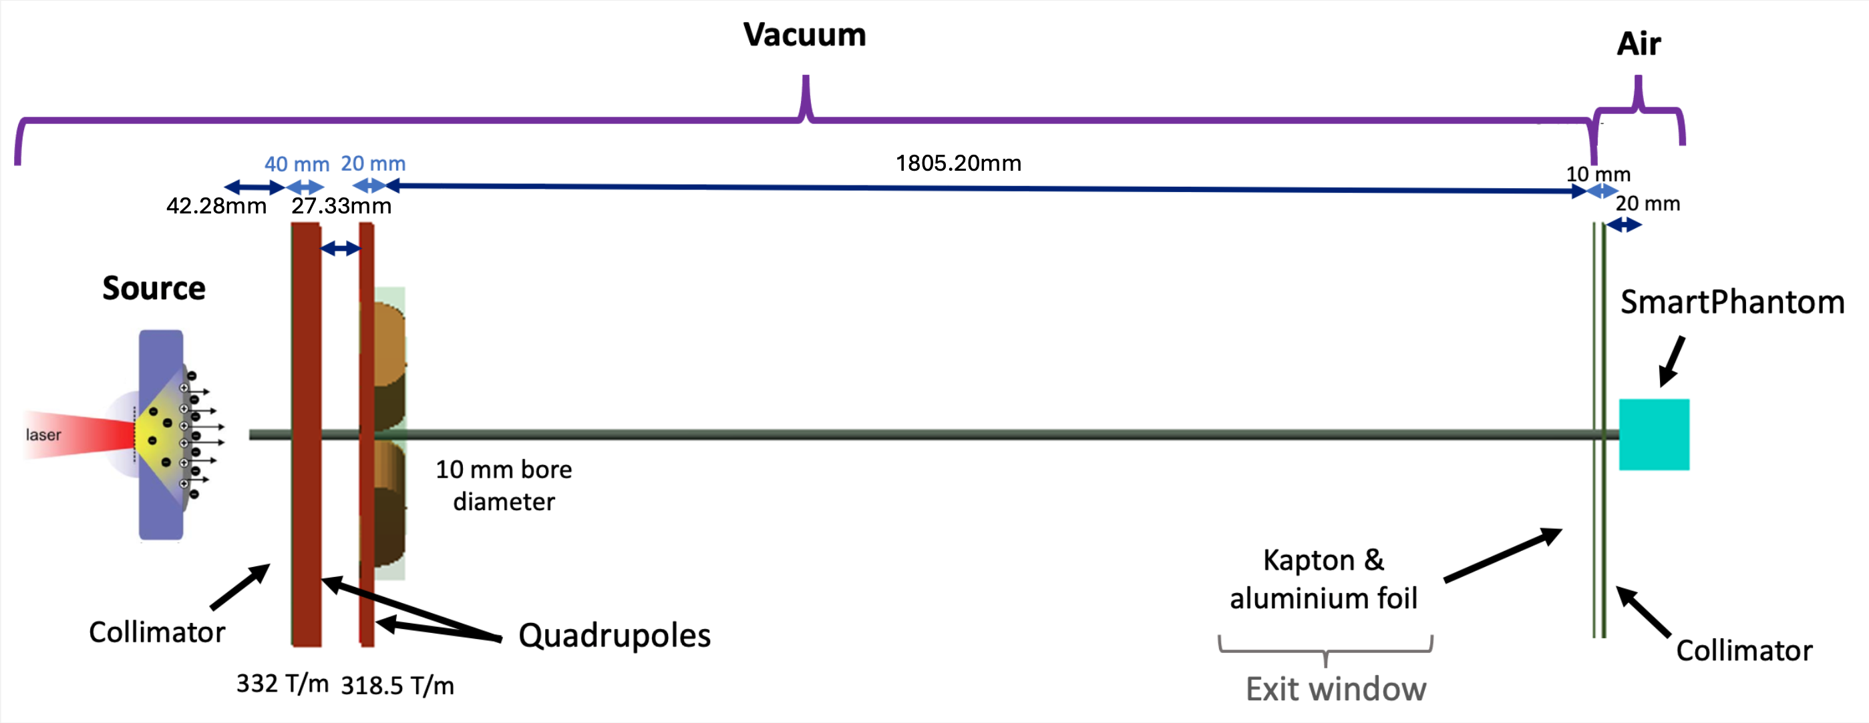



LION Beamline
1775.20mm
46.94mm
32.33mm
$$y$$
32.33mm
$$x$$
$$z$$
Laser Parameter | Value
Wavelength | 0.8 um
Pulse Duration | 28 fs
Intensity | 4 x 10²⁰ Wcm⁻²
Energy | 70 J
Calvin Dyson - LhARA Collaboration Meeting
07/04/2025
2
06/04/2025
Notes:
LION stands for Laser-driven ION at CALA (Centra for Advanced Laser Applications)
Proton beam with protons from a laser driven source using sheath acceleration
Quad doublet and then a Kapton window and a smart phantom

Slide 3
Research Objectives
1775.20mm
46.94mm
32.33mm
32.33mm
Laser-Driven Source Simulation
01
Verification of LhARA Linear Optics (LLO)
02
Investigate Quadrupole-induced beam shaping and energy deposition
03
Calvin Dyson - LhARA Collaboration Meeting
Notes:
The first aim was to obtain a realistic simulation of the protons from the laser-driven source
Then verify the tracking and full beamline simulation by comparison with BDSim
Finally to reproduce experimental results and to investigate the quadrupole offsets and tilts

Slide 4
Project Part 1
Source Proton Energy Spectra
LhARA Collaboration Meeting
Calvin Dyson - LhARA Collaboration Meeting
4
Notes:
Wanted to verify the sim by comparison of proton energy spectra with experimental results

Slide 5
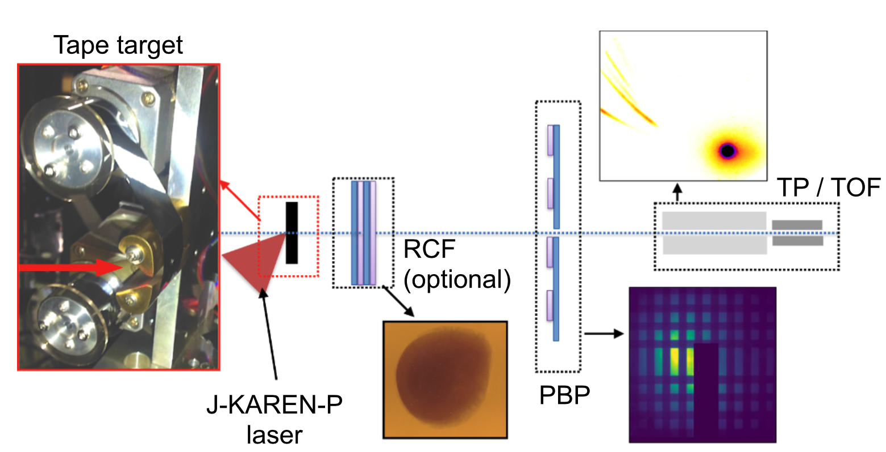
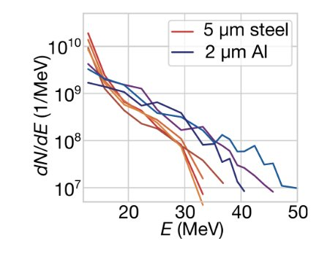

Experiment Overview
Nick Dover’s experiment conducted in 2020 uses J-KAREN-P laser
Laser Parameter | Value
Wavelength | 800 um
Pulse Duration | 40 fs
Intensity | 5 x 10²¹ Wcm⁻²
Energy | 10 J
Setup
Targets: 5$μ$m Steel, 2$μ$m Aluminium
Measurement technique: Radiochromic Film (RCF) used to record energy deposition
N. P. Dover et al., “Demonstration of repetitive energetic proton generation by ultra-intense laser interaction with a tape target,” High Energy Density Physics, vol. 37, p. 100847, Jun. 2020, doi: 10.1016/j.hedp.2020.100847.
LhARA Collaboration Meeting
Calvin Dyson - LhARA Collaboration Meeting
5
07/04/2025
06/04/2025
Notes:
The experiment was completed by Nick Dover at J-Karen-P
The experiment had two targets Steel and Aluminium to compare
These are the laser parameters with specific focus on the intensity greater than 10^20

Slide 6
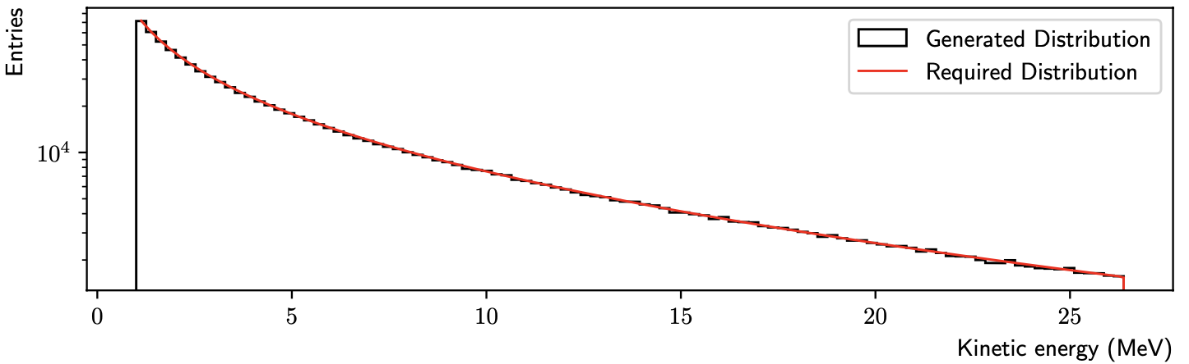
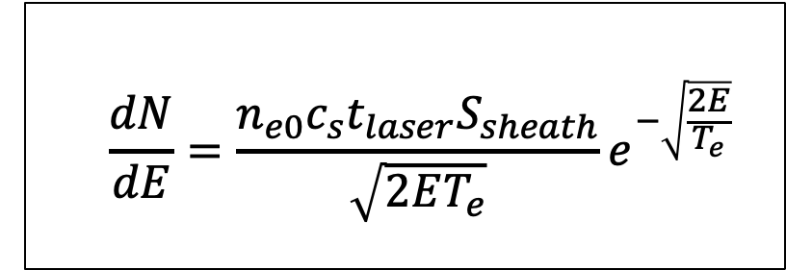
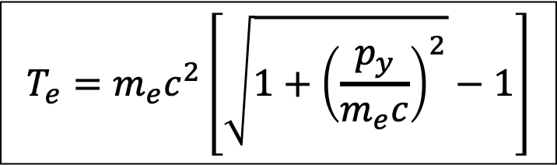
Original Source Simulation Model
$$\frac{dN}{dE}=\frac{n_{e0}c_{s}t_{laser}S_{sheath}}{\sqrt{2ET_{e}}}e^{−\sqrt{\frac{2E}{T_{e}}}}$$
$$T_{e}=m_{e}c^{2}\left[\sqrt{1+{\left(\frac{p_{y}}{m_{e}c}\right)}^{2}}−1\right]$$
K. Long et al., “LhARA linear optics documentation,” 2024.
LhARA Collaboration Meeting
Calvin Dyson - LhARA Collaboration Meeting
6
07/04/2025
06/04/2025
Notes:
Typical TNSA energy spectrum looks like so with a rapid decrease with energy and then a cut-off at a max kinetic energy
The slope is given by this equation here, which is using a time-limited fluid-dynamical model
And the cut-off is given by considering laser pulse duration and other factors
Then uses inverse transform sampling to obtain the random energies in the spectra
This model requires the calculation of the electron temperature and that equation is given here
Symbols:
n_e0 – hot electron density
c_s – ion-acoustic velocity
t_laser – laser pulse duration
S_sheath – electron acceleration area
T_e – electron temp

Slide 7
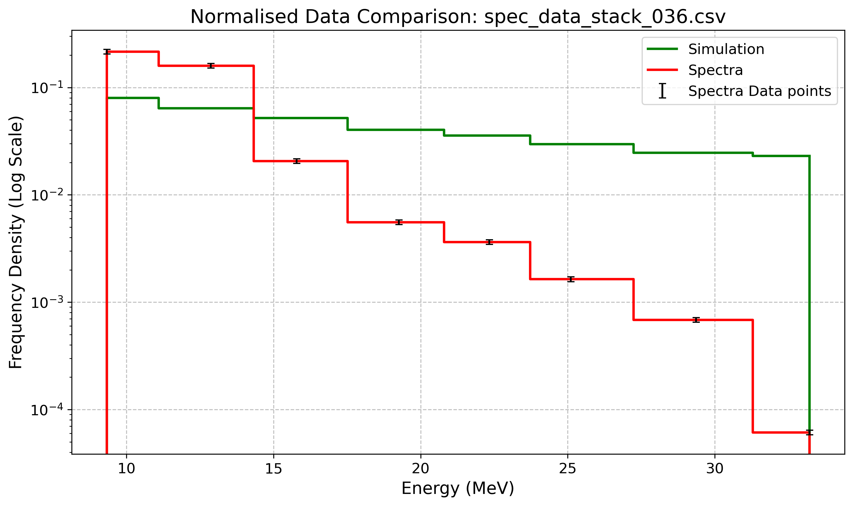
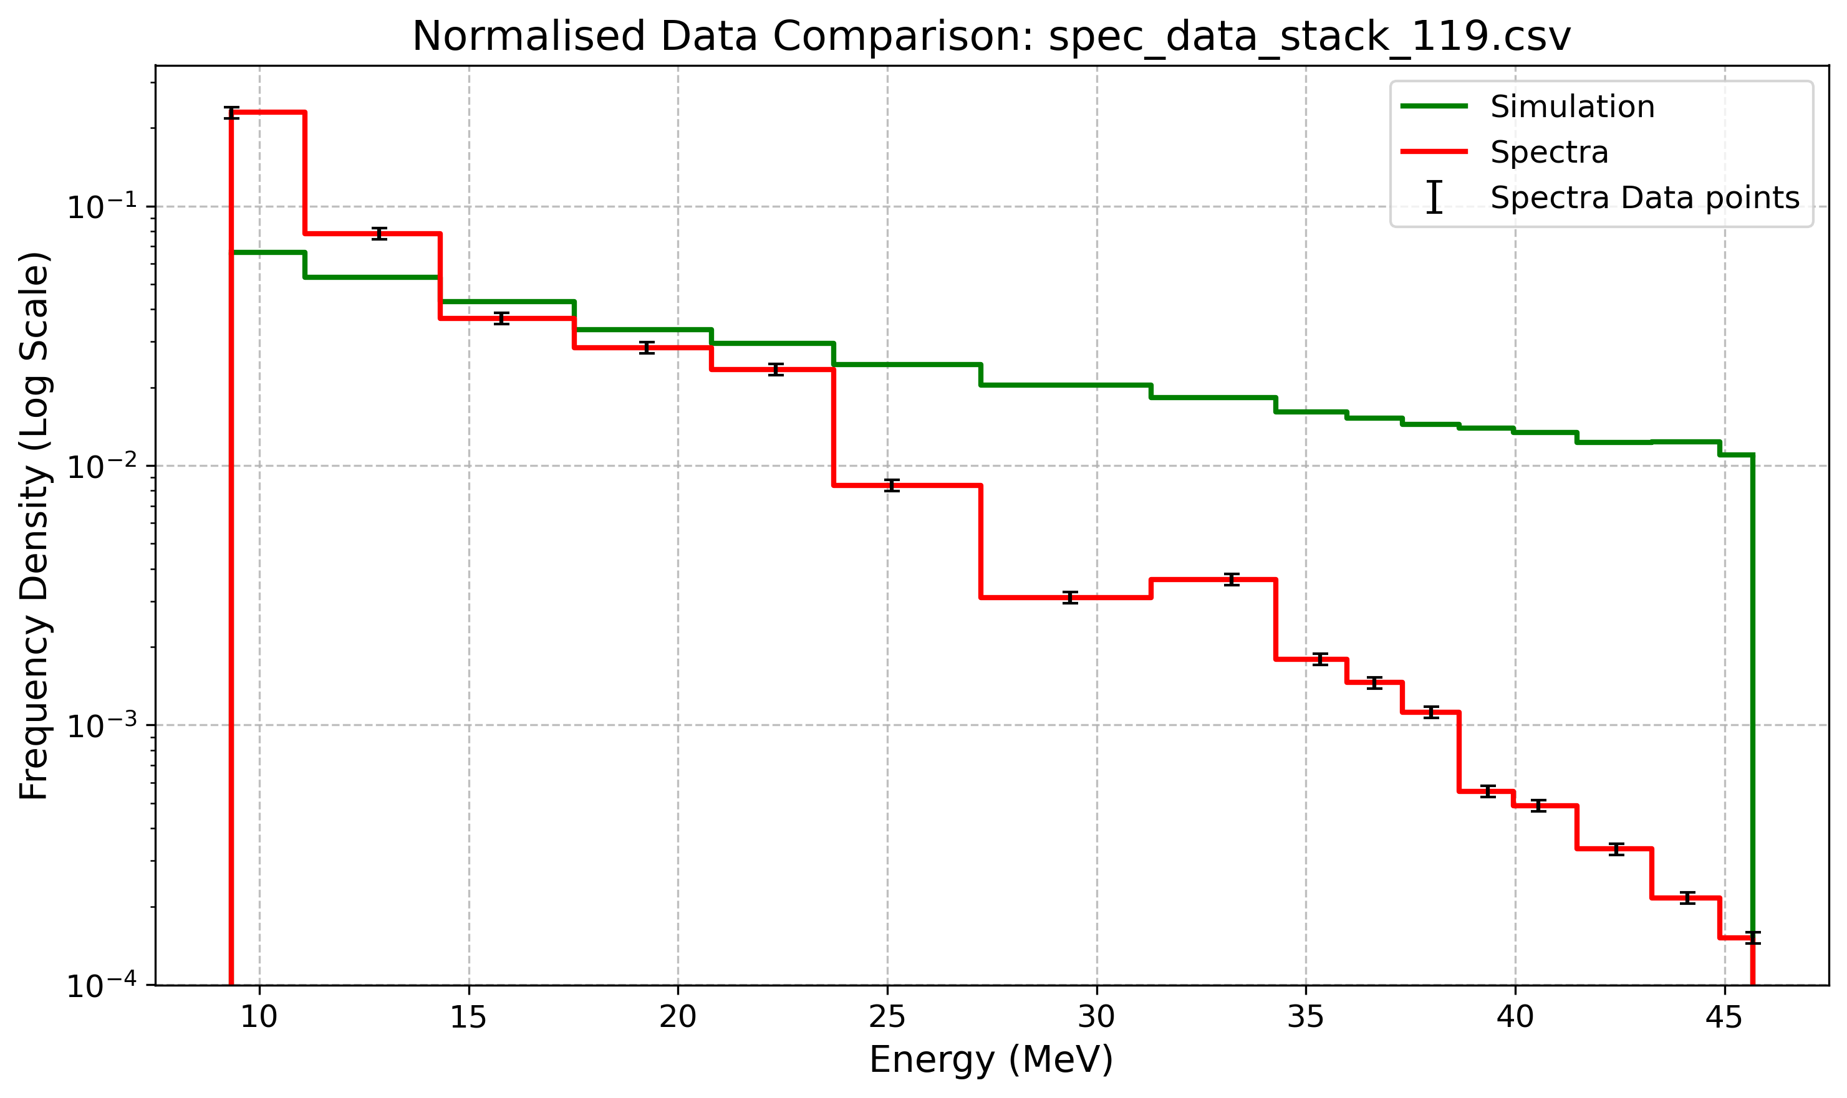


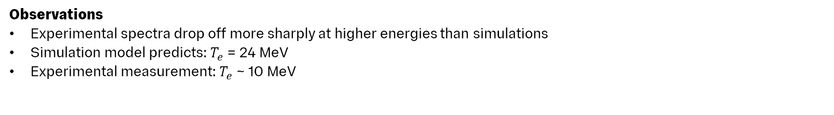
Preliminary Results
Stack 036: 5 $μ$m Steel Target
Stack 119: 2 $μ$m Al Target
Observations
Experimental spectra drop off more sharply at higher energies than simulations
Simulation model predicts: $T_{e}$ = 24 MeV
Experimental measurement: $T_{e}$ ~ 10 MeV
LhARA Collaboration Meeting
Calvin Dyson - LhARA Collaboration Meeting
7
07/04/2025
06/04/2025
Notes:
Talk about how the electron temperature influences the energy distribution – hotter electrons lead to higher energy protons
In their early attempts the simulation did not match the drop-off from experiment
Model also calculates an incorrect electron temperature
• • This is important as a higher electron temperature will lead to higher energy protons

Slide 8

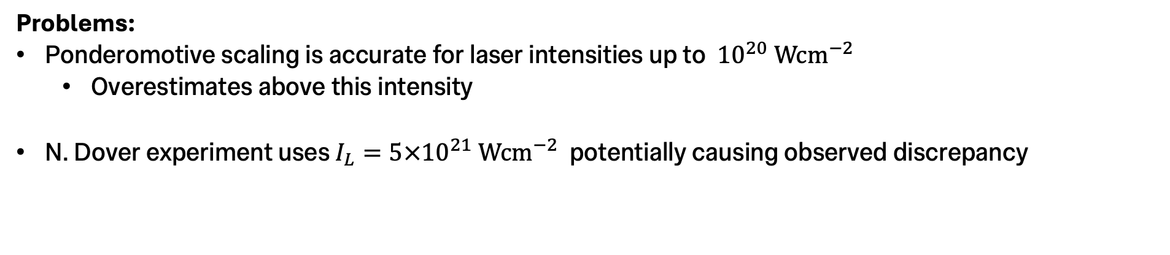
1. Simulation Model
Laser Intensity
LLO uses the ponderomotive scaling to determine the electron temperature:
            $$T_{e}=m_{e}c^{2}\left[\sqrt{1+\frac{{Iλ}^{2}}{1.37×{10}^{18} }}−1\right] =m_{e}c^{2}\left[\sqrt{1+{\left(\frac{p_{y}}{m_{e}c}\right)}^{2}}−1\right]$$
Problems:
Ponderomotive scaling is accurate for laser intensities up to ${10}^{20} \text{Wc}{\text{m}}^{−2}$
  Overestimates above this intensity
N. Dover experiment uses $I_{L}=5×{10}^{21} \text{Wc}{\text{m}}^{−2}$ potentially causing observed discrepancy
Calvin Dyson - LhARA Collaboration Meeting
K. Long et al., “LhARA linear optics documentation,” 2024.
8
07/04/2025
06/04/2025
Notes:
Uses ponderomotive scaling to get Te
Which is a way of scaling the electron temp with the laser intensity
Shown to be accurate up to 10^20
Symbols
I – Laser Intensity
Lambda – laser wavelength

Slide 9
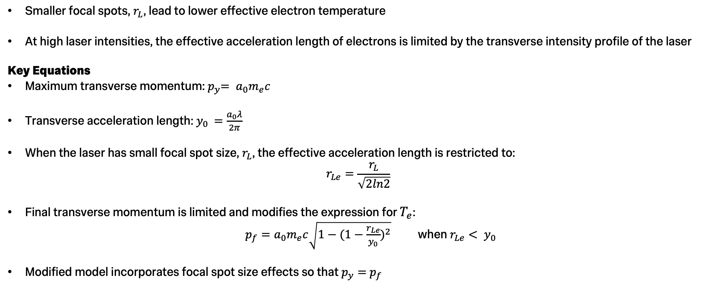
2. Focal Spot Size Dependence
Smaller focal spots, $r_{L}$, lead to lower effective electron temperature
At high laser intensities, the effective acceleration length of electrons is limited by the transverse intensity profile of the laser
Key Equations
Maximum transverse momentum:${ p}_{y}= a_{0}m_{e}c$
Transverse acceleration length: $y_{0 }=\frac{a_{0}λ}{2π}$
When the laser has small focal spot size, $r_{L}$, the effective acceleration length is restricted to:
$$r_{Le}=\frac{r_{L}}{\sqrt{2ln2}}$$
Final transverse momentum is limited and modifies the expression for $T_{e}$:
$p_{f}=a_{0}m_{e}c\sqrt{1−{(1−\frac{r_{Le}}{y_{0}})}^{2}}$ when $r_{Le}< y_{0 }$
Modified model incorporates focal spot size effects so that $p_{y}=$ $p_{f}$
N. P. Dover et al., “Effect of small focus on electron heating and proton acceleration in ultrarelativistic Laser-Solid interactions,” Physical Review Letters, vol. 124, no. 8, Feb. 2020, doi: 10.1103/physrevlett.124.084802.
LhARA Collaboration Meeting
Calvin Dyson - LhARA Collaboration Meeting
9
07/04/2025
06/04/2025
Notes:
In 2020 Nick suggested a way for the ponderomotive scaling model to be used in a higher intensity regime
By considering the effect of focal spot size
The maximum transverse momentum of an electron is given by py, where a_0 is the normalized vector potential and me is the electron mass
To achieve this momentum the electron must travel a distance of y_0 given here, where lambda is the laser wavelength
However, if the laser’s spot size is smaller than y0 the electron will not reach this max transverse momentum
Furthermore, the effective acceleration length is the radius of the laser outside of which the laser intensity has fallen by 1/e
Therefore, when the required length y0 is greater than the effective acceleration length the final transverse momentum is affected by this factor
Since the electron temperature depends on the transverse momentum, this reduction will cause a reduction in Te
Symbols
a_0 – normalized vector potential – kinda quantifies the strength of a laser pulse = I*lambda / 1.37*10^18

Slide 10
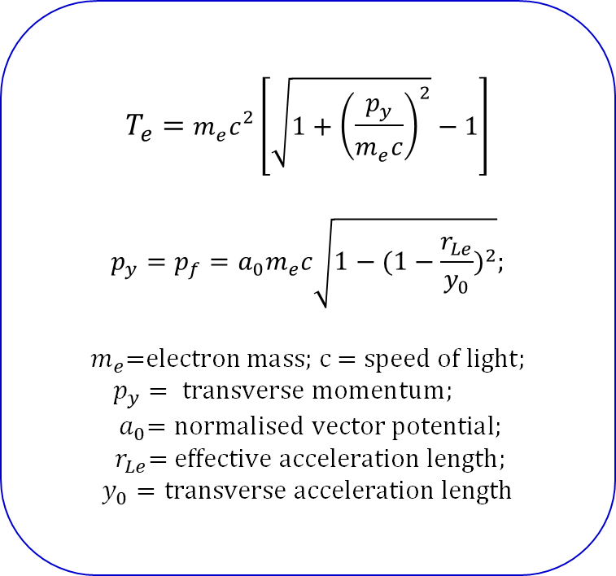
3. Implemented Model
$$T_{e}=m_{e}c^{2}\left[\sqrt{1+{\left(\frac{p_{y}}{m_{e}c}\right)}^{2}}−1\right]$$
$$p_{y}=p_{f}=a_{0}m_{e}c\sqrt{1−{(1−\frac{r_{Le}}{y_{0}})}^{2}};$$
$$m_{e}\text{=}\text{electron} \text{mass}\text{; }\text{c}\text{ = }\text{speed} \text{of} \text{light};$$
$$p_{y}= \text{transverse} \text{momentum}\text{;} \\ { a}_{0}=\text{normalised} \text{vector} \text{potential}\text{;}$$
$$r_{Le}\text{= }\text{effective} \text{acceleration} \text{length}\text{;}$$
$y_{0}=\text{transverse} \text{acceleration} \text{length}$
LLO model now correctly calculates electron temperature as 10 MeV
LhARA Collaboration Meeting
Calvin Dyson - LhARA Collaboration Meeting
10
07/04/2025
06/04/2025
Notes:
The new model implements this
LLO now correctly calculates the electron temperature

Slide 11
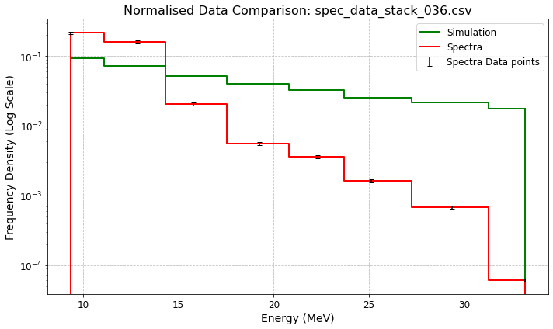
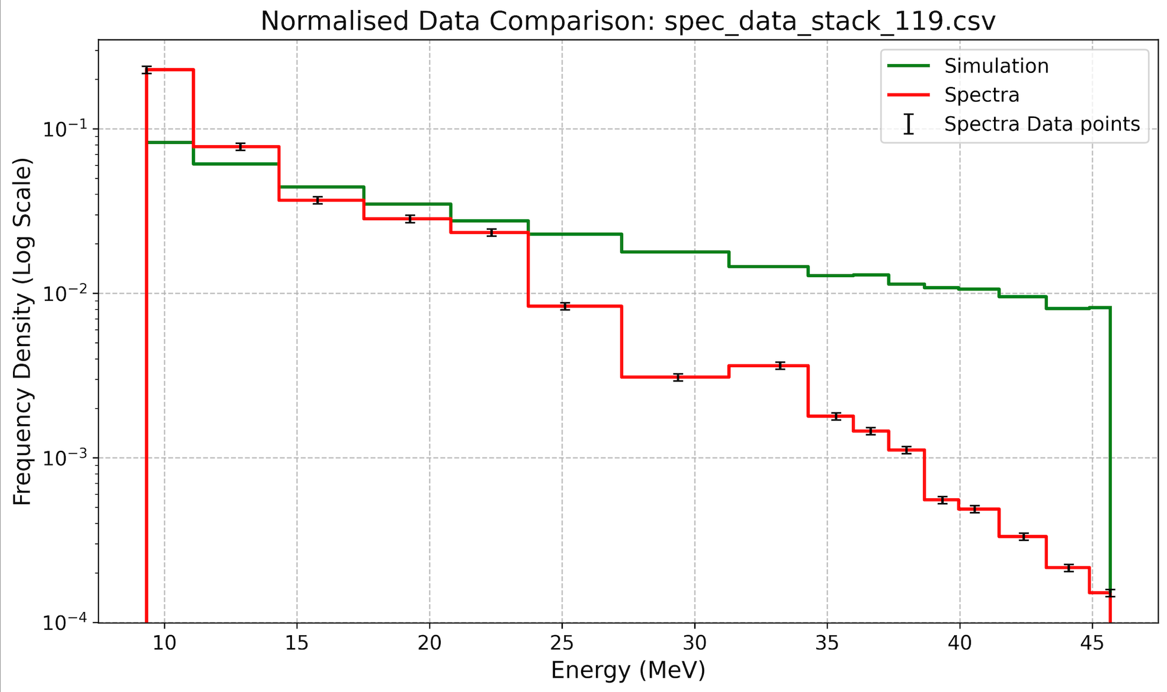


Plots with implemented Electron Temperature Model
$$T_{e}=10 \text{MeV}$$
Stack 036: 5 $μ$m Steel Target
Stack 119: 2 $μ$m Al Target
Key observation:
Discrepancy still persists
LhARA Collaboration Meeting
Calvin Dyson - LhARA Collaboration Meeting
11
07/04/2025
06/04/2025
Notes:
• However still see a discrepancy in the energy distributions
Therefore, it was decided to find the Te that best matched these spectra

Slide 12
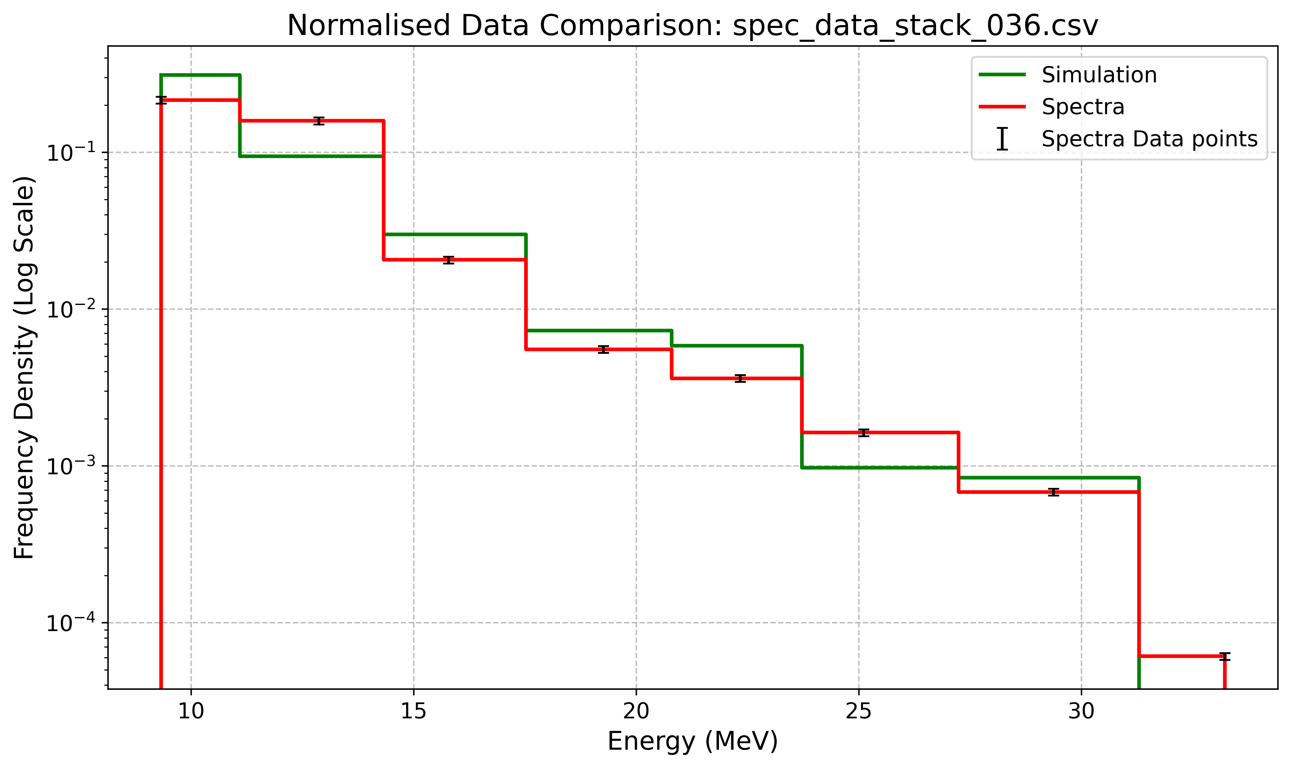
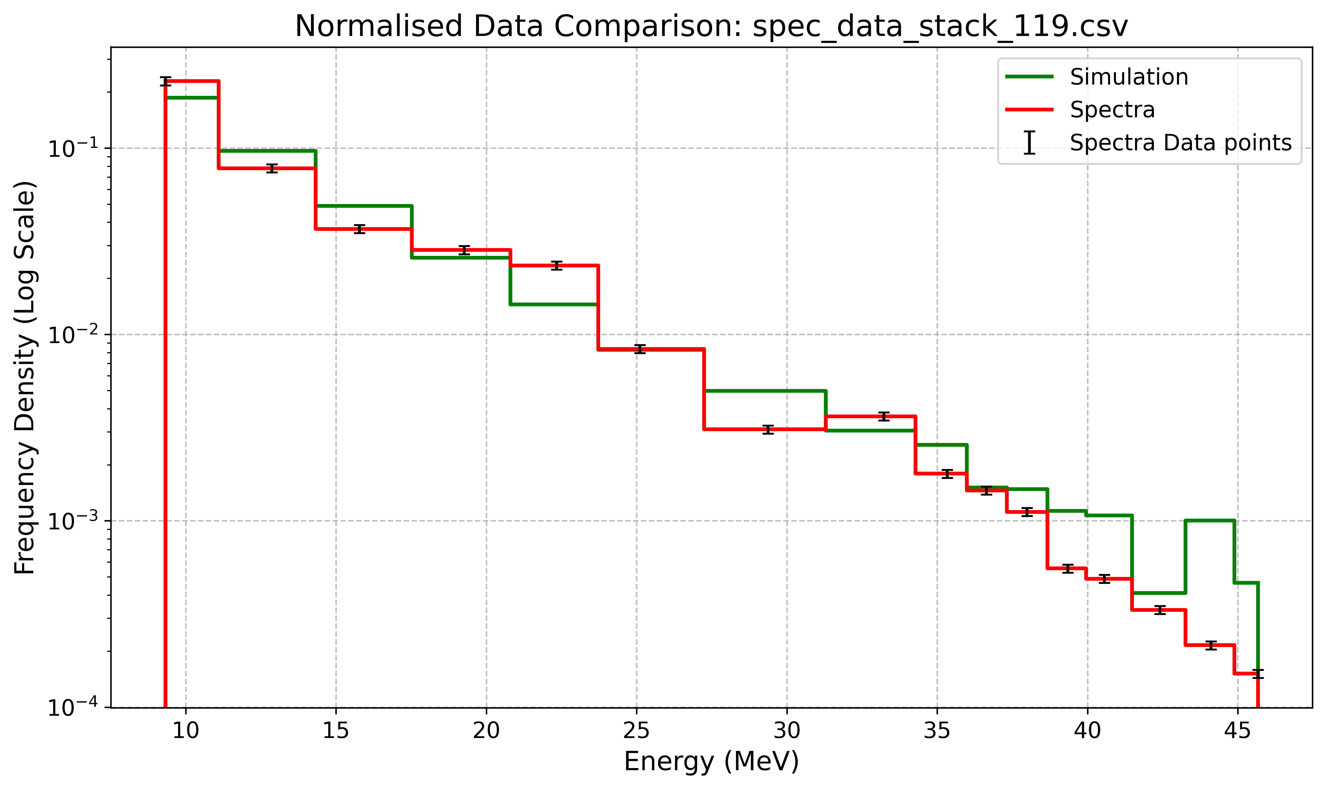
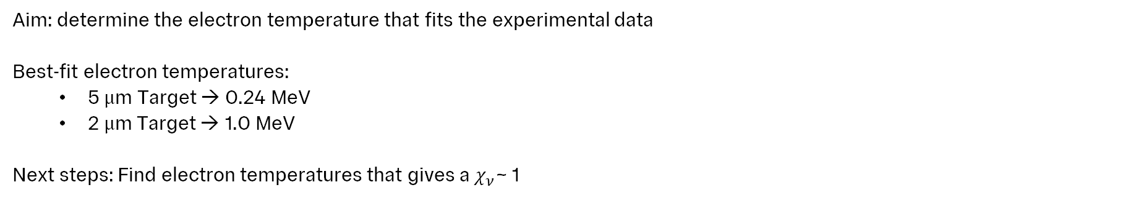


Electron Temperature
Matched Plots
Stack 036: 5 $μ$m Target
Stack 119: 2 $μ$m Target
Aim: determine the electron temperature that fits the experimental data
Best-fit electron temperatures:
  5 $μ$m Target → 0.24 MeV
  2 $μ$m Target → 1.0 MeV
Next steps: Find electron temperatures that gives a $χ_{ν}$~ 1
LhARA Collaboration Meeting
Calvin Dyson - LhARA Collaboration Meeting
12
07/04/2025
06/04/2025
Notes:
This was found to be 0.24MeV and 1 MeV for the respective plots
Roughly an order of magnitude away from experimentally measured value
Consider Te as a non-physical parameter
• Utilise a reduced chi-squared to investigate what a range of acceptable electron temperatures would look like in a more quantitative way

Slide 13
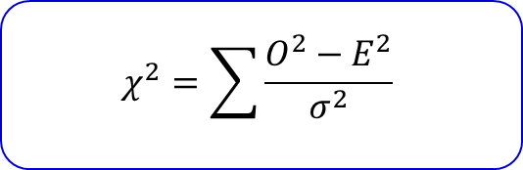

Statistical Analysis
$$χ^{2}=\sum{\frac{O^{2}−E^{2}}{σ^{2}}}$$
$$σ_{total}^{2}=σ_{data}^{2}+σ_{bin}^{2}+σ_{residual}^{2}$$
3 sources of uncertainty:
5% uncertainty in data points
Binning uncertainty from binomial statistics
Residual analysis
LhARA Collaboration Meeting
Calvin Dyson - LhARA Collaboration Meeting
13
07/04/2025
06/04/2025
Notes:
There were three sources of ucnertainty
Nick gave an experimental uncertainty of 5% on the data points
Get an ucnertainty from binning which can be judged via binomial stats
Binomial binning uncertainty
• • Uncertainty on residual?

Slide 14
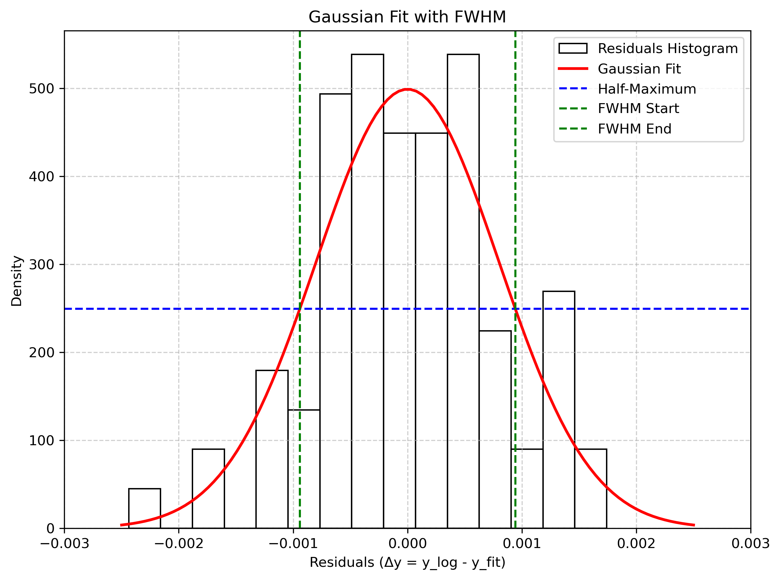
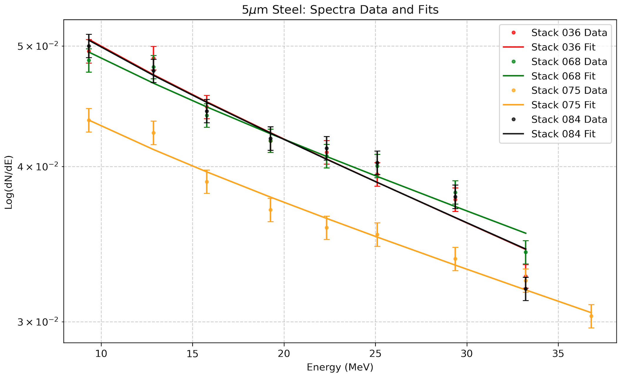
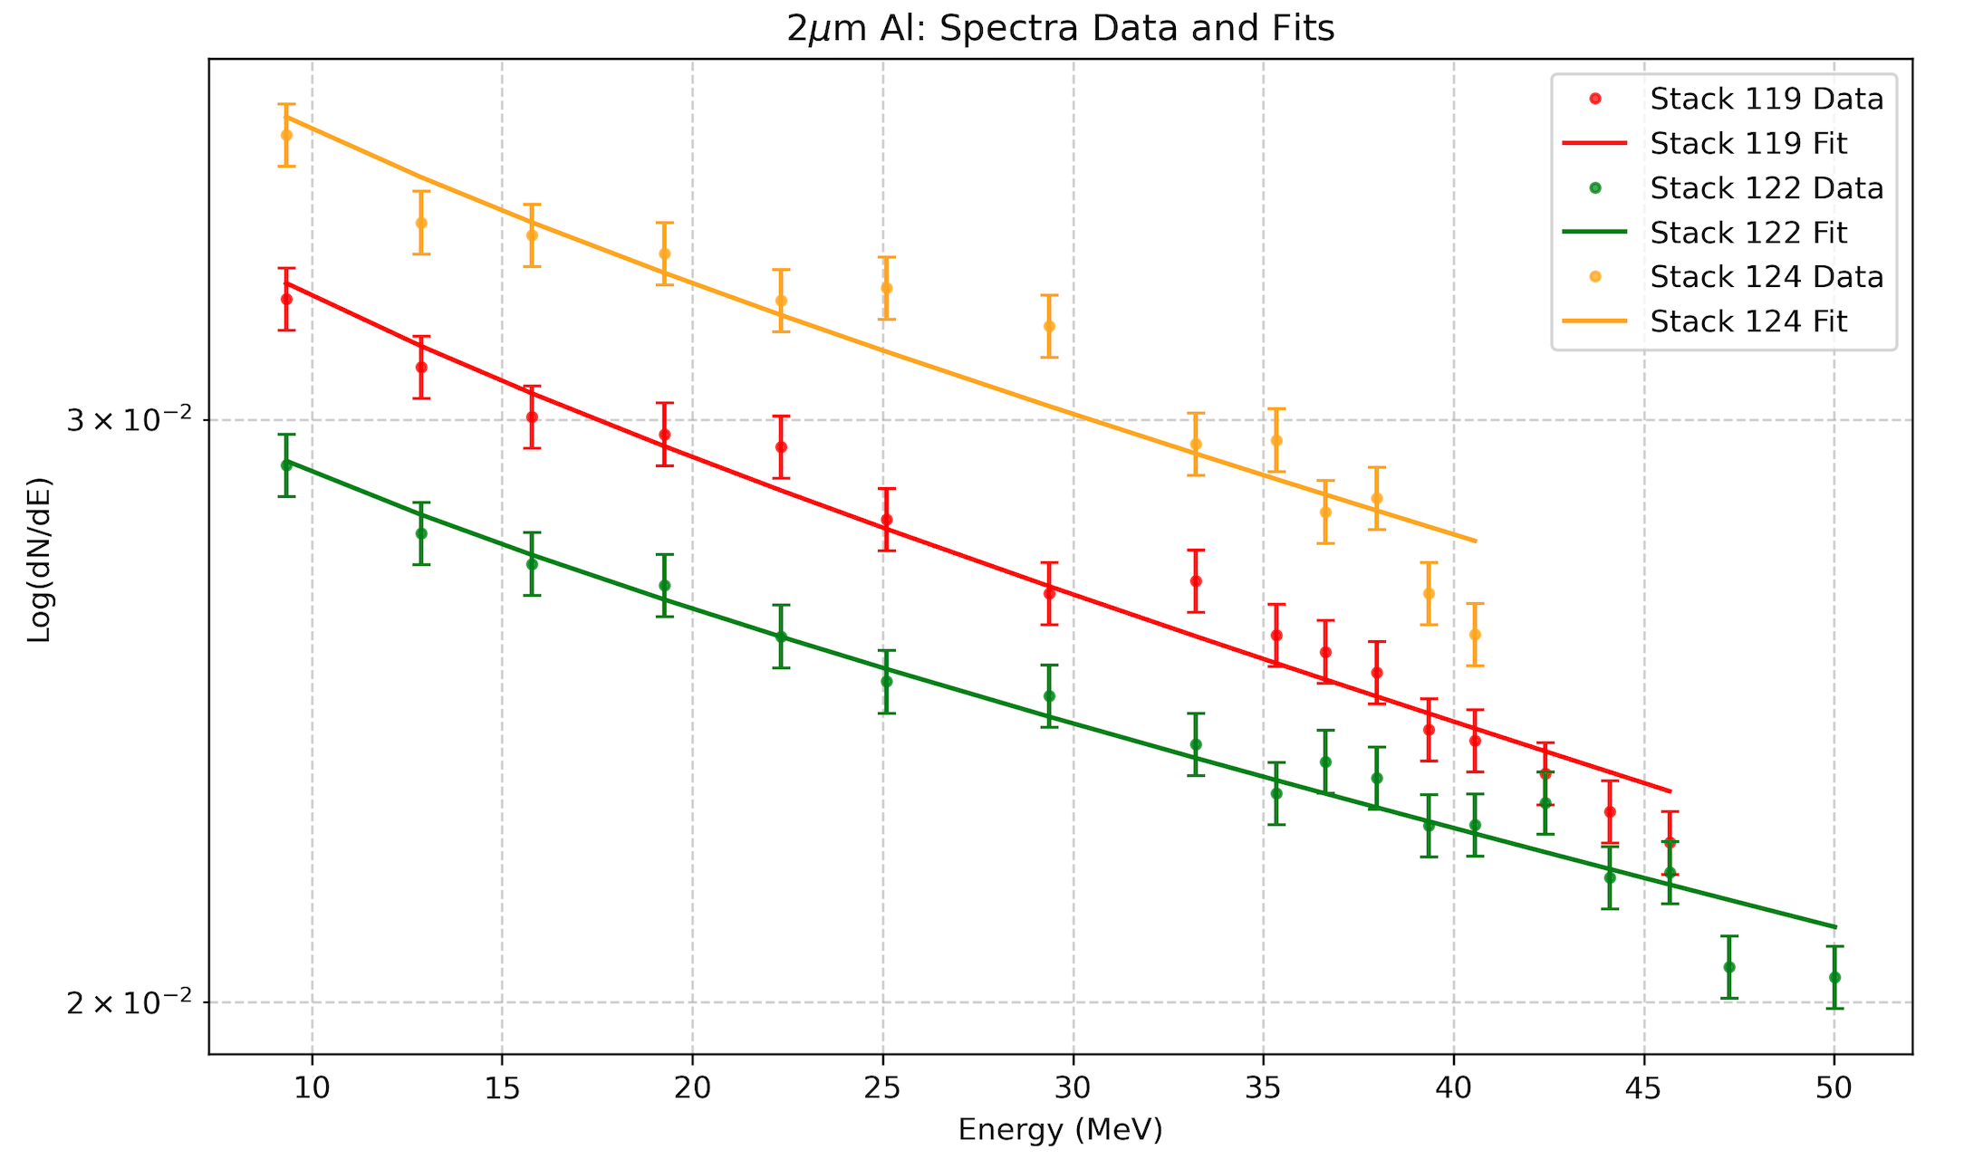
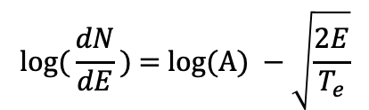
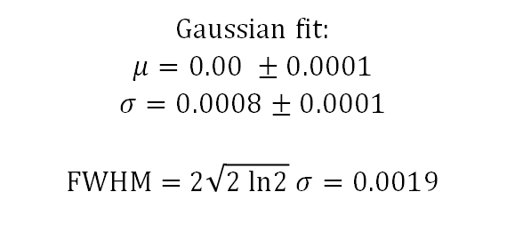
Statistical Analysis
Residual Analysis
Residual analysis assesses the deviations between the simulated and experimental data
$$l\text{og}\text{(}\frac{dN}{dE}\text{) = }\text{log}\text{(}\text{A}\text{) }−\sqrt{\frac{2E}{T_{e}}}$$
Gaussian fit:
$$μ=0.00 ±0.0001$$
$$σ=0.0008±0.0001$$
$$\text{FWHM}\text{ = 2}\sqrt{2 \text{ln}2} σ=0.0019$$
Fitted a logarithmic function of the form:
LhARA Collaboration Meeting
Calvin Dyson - LhARA Collaboration Meeting
14
07/04/2025
06/04/2025
Notes:
Fitted the spectrum for other stacks
Used the distribution of the residuals to calculate the uncertainty as shown

Slide 15
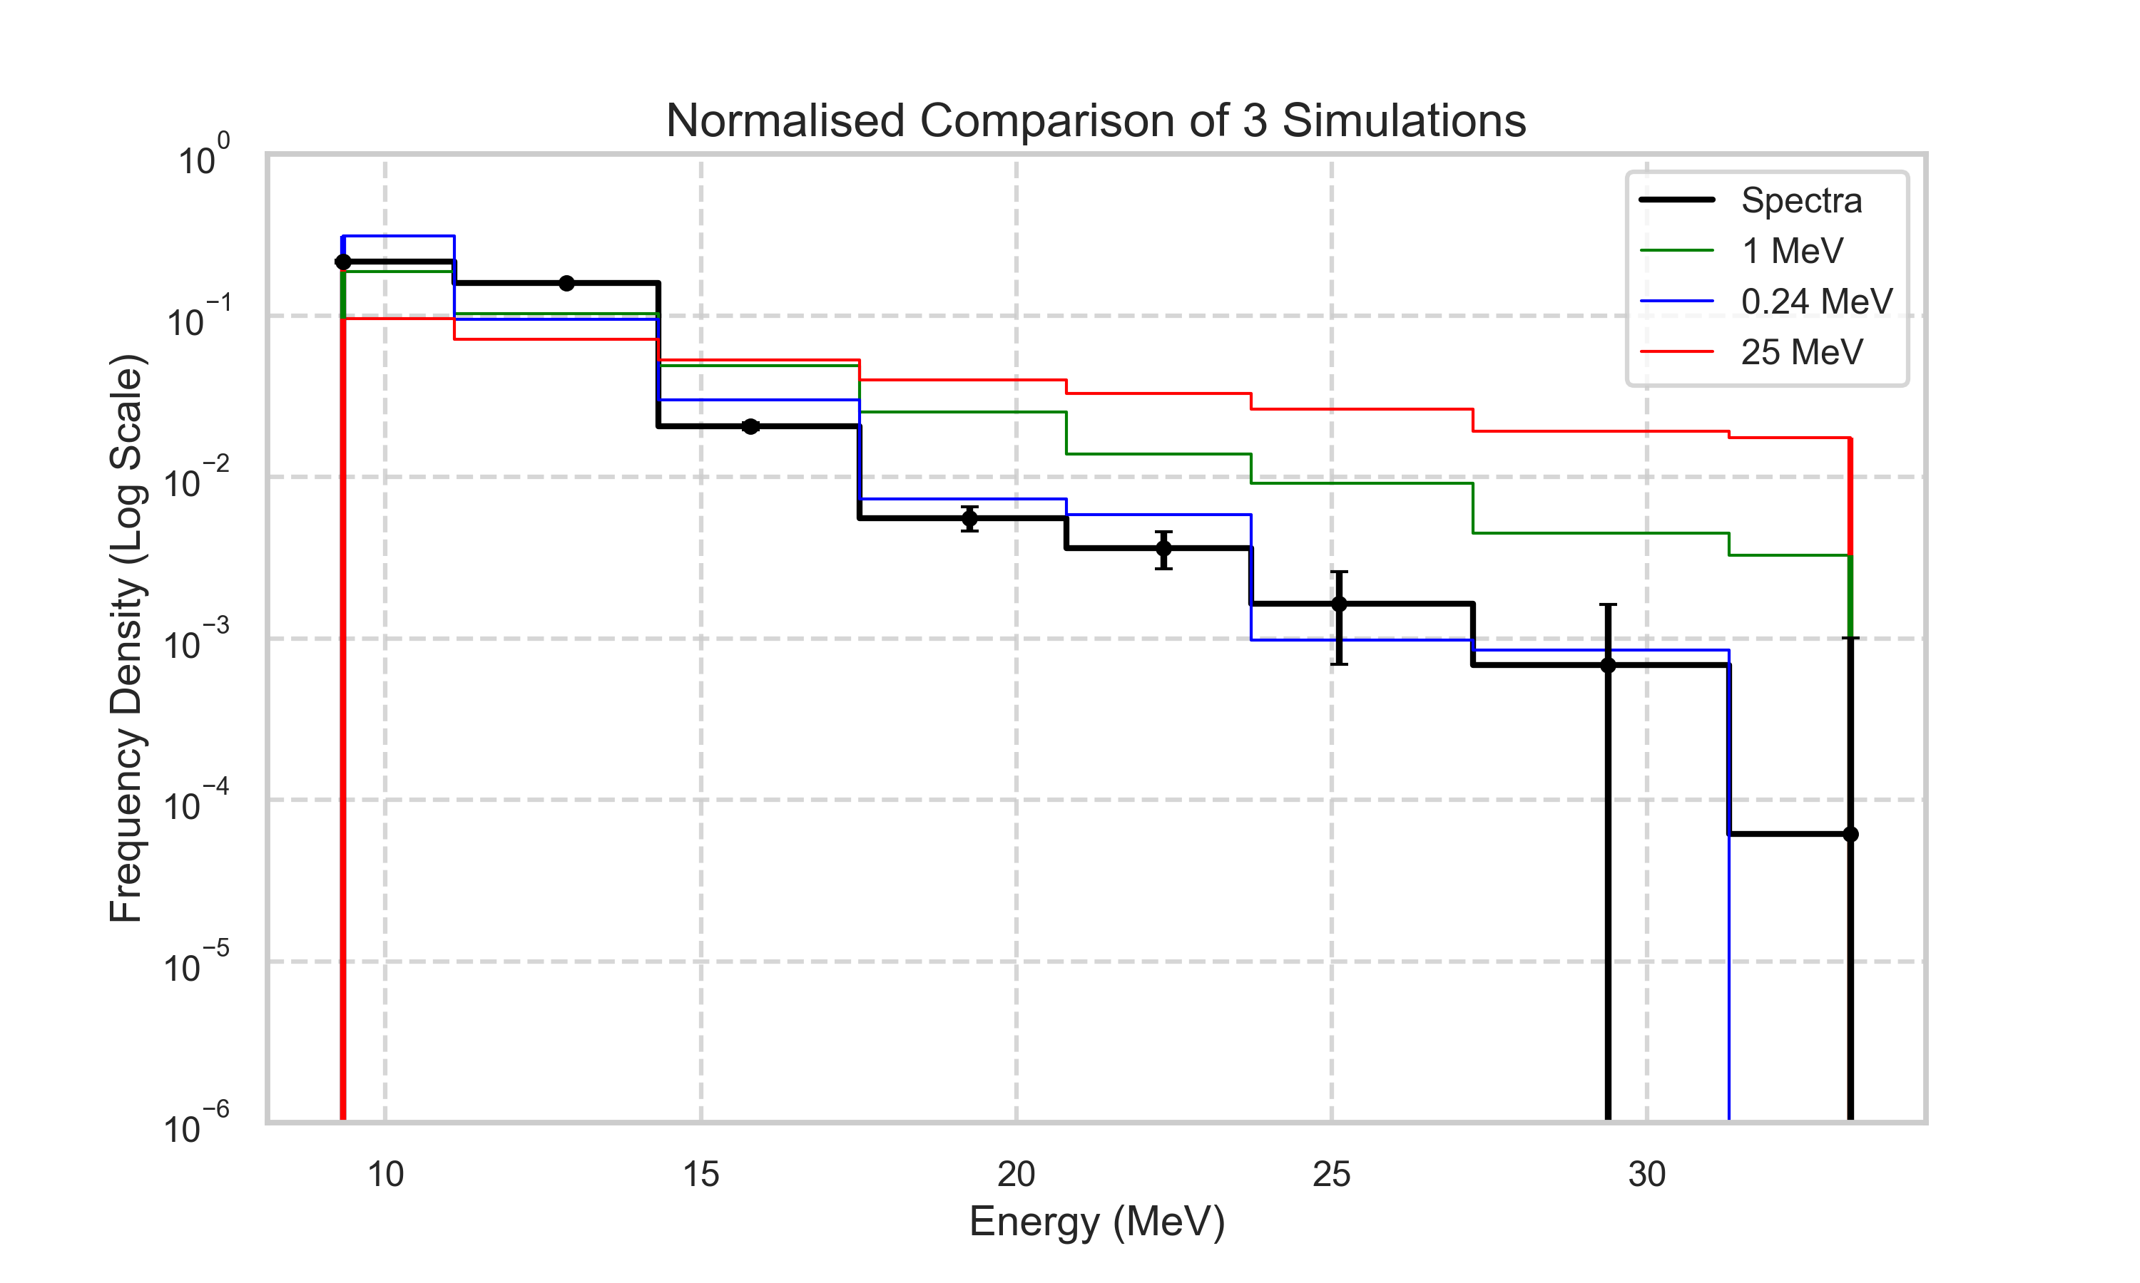
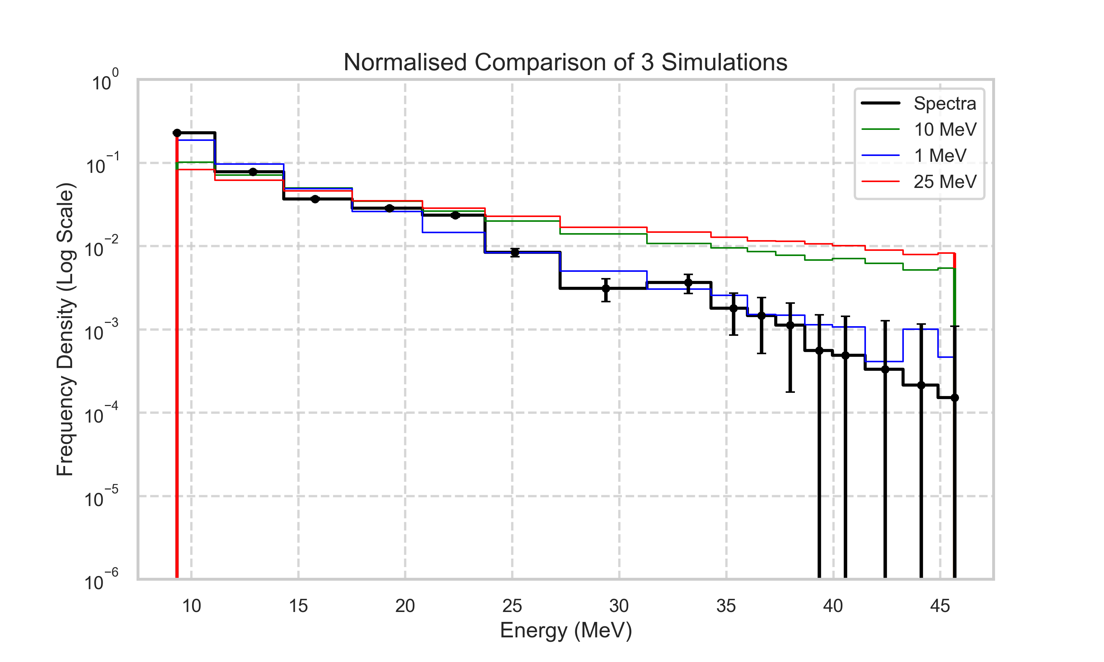




Statistical Analysis
Methodology and Final Plots
Stack 036: 5 $μ$m Target
Stack 119: 2 $μ$m Target
Conclusions:
Proton acceleration is a very complex and dynamic process, making it difficult to describe it fully analytically
The simulation does not model energy spectra accurately with the correct T_{e}
Quantitative assessment of T_{e} as a non-physical parameter started
Further work is required for the impact of T_{e} on final kinematic distributions
$$χ_{ν}^{2}=32.8$$
$$χ_{ν}^{2}=8.17$$
LhARA Collaboration Meeting
Calvin Dyson - LhARA Collaboration Meeting
15
07/04/2025
06/04/2025
Notes:
Students found that the 0.24MeV and 1MeV the best again
They did not test lower since they found that lower electron temperatures the reduced the max kinetic energy
This should not cause a large impact because the max energy is still far greater than 10-15MeV beam required for LhARA
Reduce the Te further and get a range of acceptable electron temperatures
The aim is to then show that the kinematic distributions at the end of the beamline do not vary across this range of electron temperatures

Slide 16
Project Part 2
Simulation verification with BDSim
LhARA Collaboration Meeting
Calvin Dyson - LhARA Collaboration Meeting
16
07/04/2025
06/04/2025
Notes:
The next step was to investigate the tracking and full beam simulation of LLO with BDSim
This was done by investigating the energy spectra at the end of the beam line
Then seeing the effects of offsets and tilts of the quads on the simulations

Slide 17
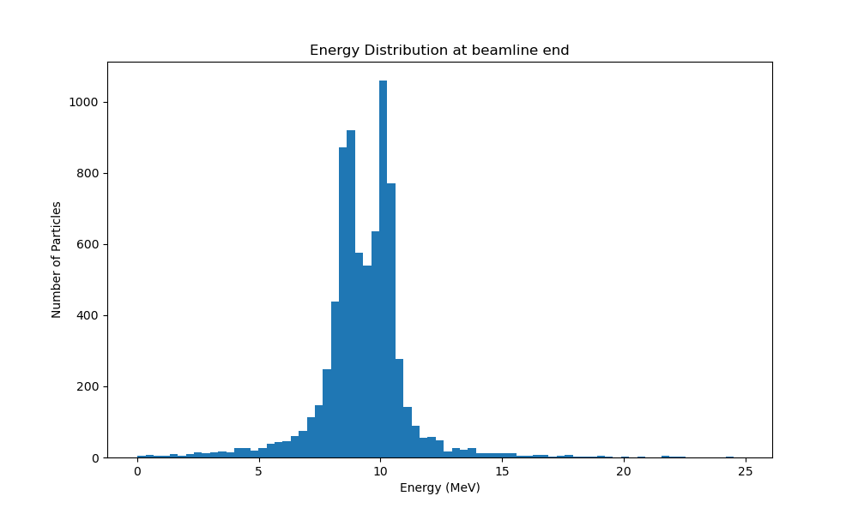

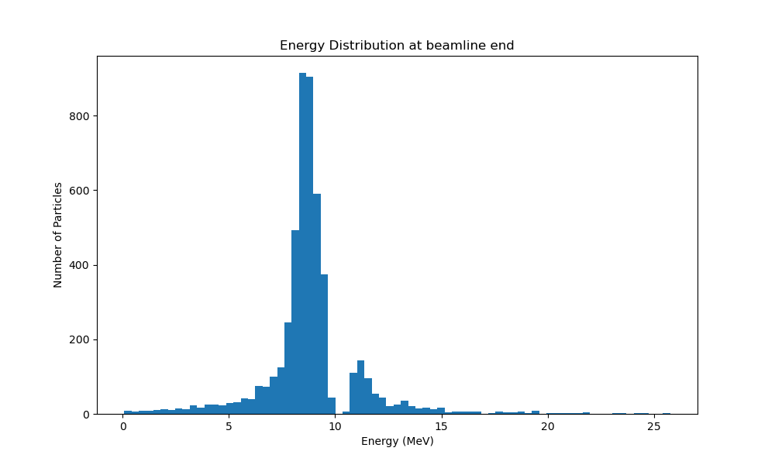
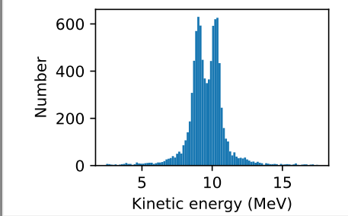
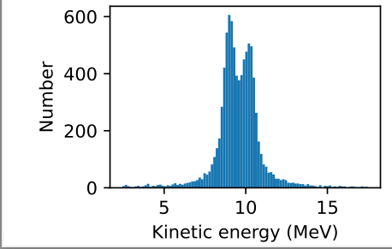
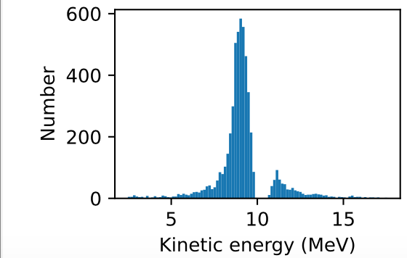
10MeV Beam Energy Distributions
Horizontal Offsets
Q1: x = 0, y = 0
Q2: x = 0, y = 0
Q1: x = + 0.01 mm, y = 0
Q2: x = 0, y = 0
Q1: x = + 0.05 mm, y = 0
Q2: x = 0, y = 0
BDSim:
LLO:
LhARA Collaboration Meeting
Calvin Dyson - LhARA Collaboration Meeting
17
07/04/2025
06/04/2025
Notes:
These are a sample of the horizontal offsets in the first quad, which is a focusing quad in the x-axes
On the left is the default with no offsets
The gap seen in the energy spectra at default is believed to be caused by an incorrect drift and a small aperture in the collimator
However, since this error was done in both simulations, the results can still be used to verify the performance of LLO

Slide 18
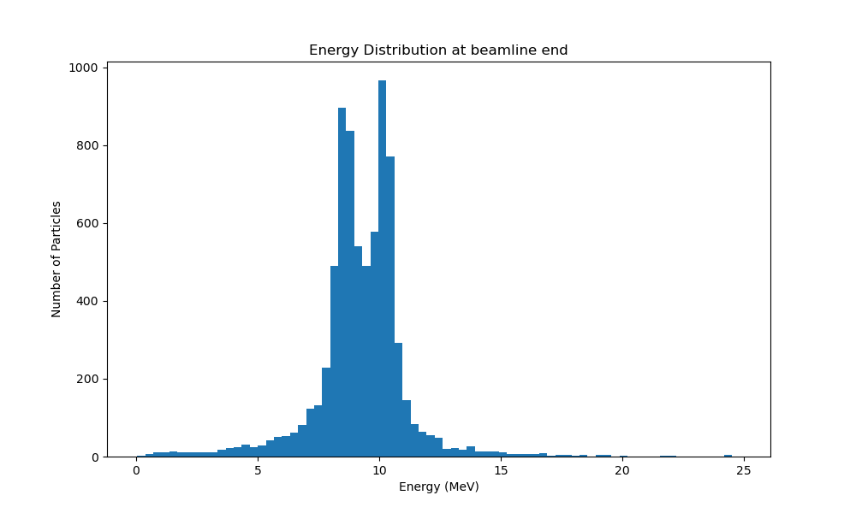
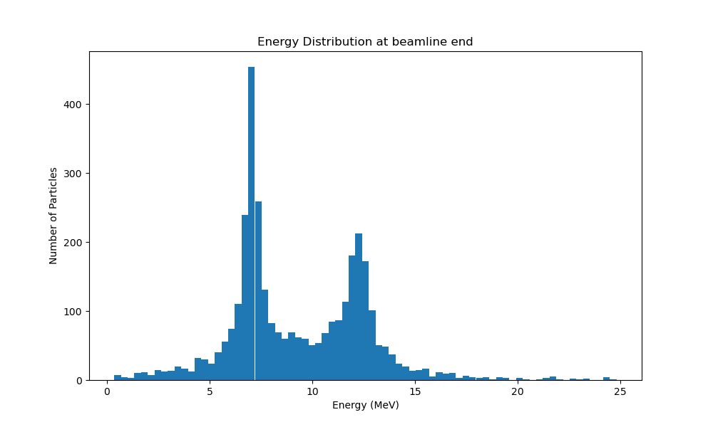
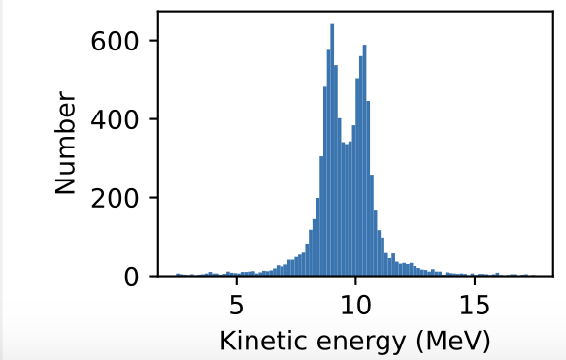
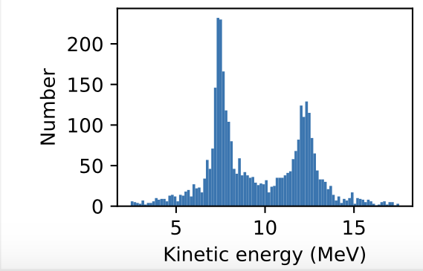
10MeV Beam Energy Distributions
Tilts around z-axis
Q1: tilt = 0
Q2: tilt = pi/2
Q1: tilt = + 0.01
Q2: tilt = pi/2
Q1: tilt = + 0.1
Q2: tilt = pi/2
BDSim:
LLO:
LhARA Collaboration Meeting
Calvin Dyson - LhARA Collaboration Meeting
18
07/04/2025
06/04/2025
Notes:
These are a sample of the horizontal offsets in the first quad, which is a focusing quad in the x-axes
On the left is the default with no offsets
The gap seen in the energy spectra at default is believed to be caused by an incorrect drift and a small aperture in the collimator
However, since this error was done in both simulations, the results can still be used to verify the performance of LLO

Slide 19
Project Part 3
RCF Stack Recreation
LhARA Collaboration Meeting
Calvin Dyson - LhARA Collaboration Meeting
19
07/04/2025
06/04/2025
Notes:
The final part was to compare the simulation with experimental results achieved at LION

Slide 20
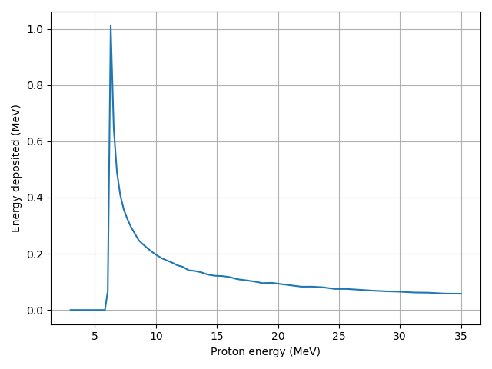
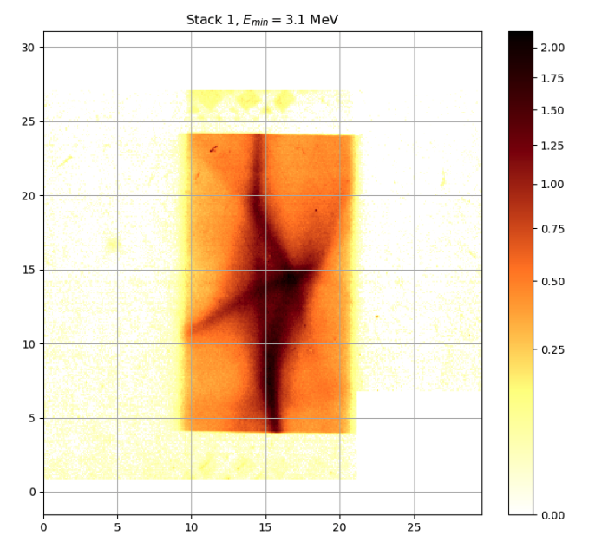
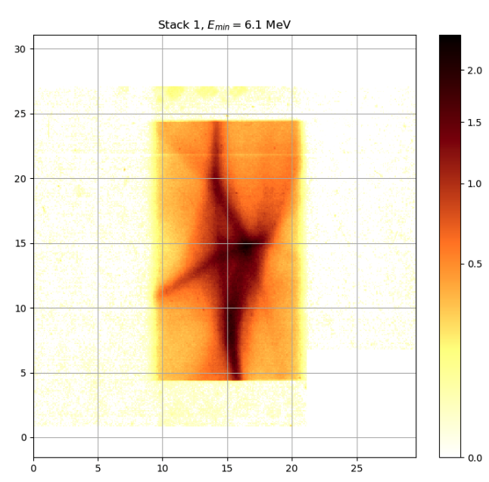
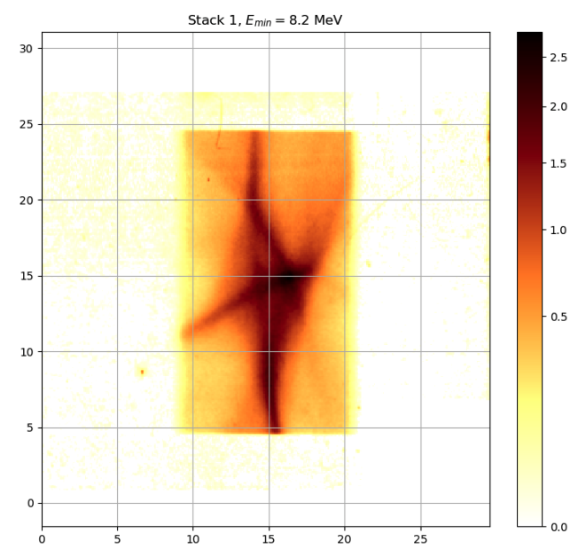
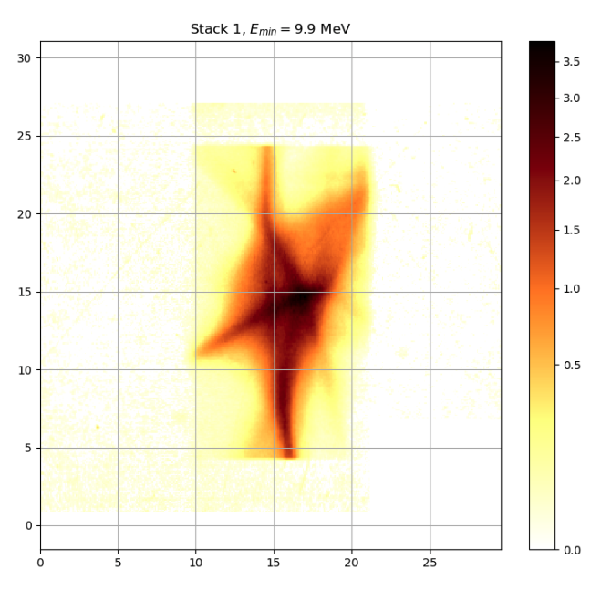
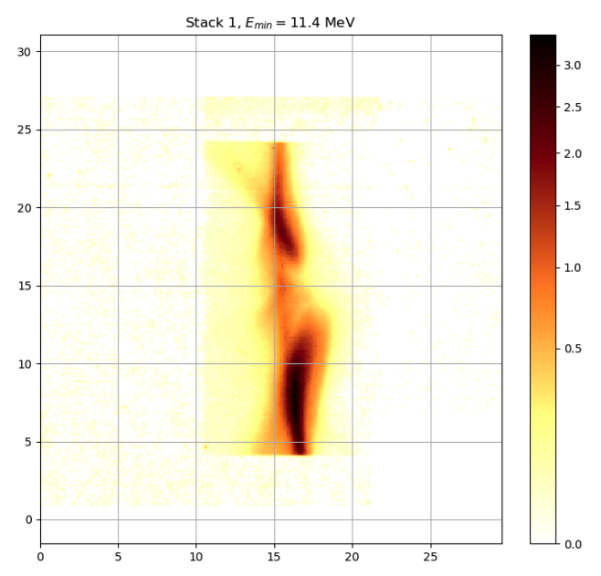
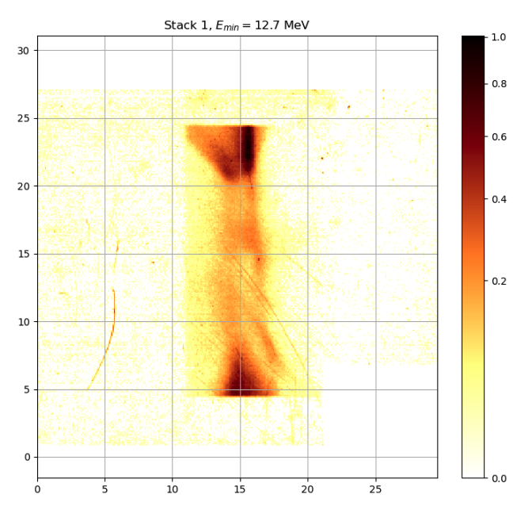
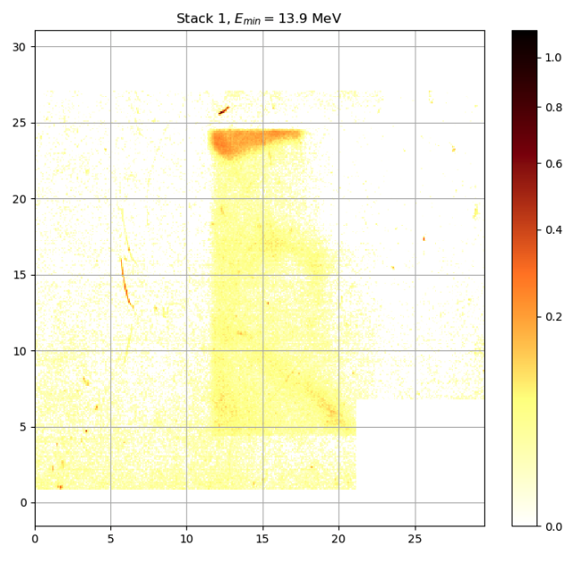







LION Beamline for RCF stack
Response Curve for Stack 2
1775.20mm
46.94mm
32.33mm
32.33mm
RCF Stacks
${\text{E}}_{\text{min}} \text{=} \text{3.1 }\text{MeV}$
${\text{E}}_{\text{min}} \text{=}\text{ 6}\text{.1 }\text{MeV}$
${\text{E}}_{\text{min}} \text{=} \text{8.2} \text{MeV}$
${\text{E}}_{\text{min}} \text{=}\text{ 9.9} \text{MeV}$
${\text{E}}_{\text{min}} \text{=}\text{ 11.4} \text{MeV}$
${\text{E}}_{\text{min}} \text{=} \text{12.7 }\text{MeV}$
${\text{E}}_{\text{min}} \text{=}\text{ 13.9} \text{MeV}$
LhARA Collaboration Meeting
Calvin Dyson - LhARA Collaboration Meeting
20
07/04/2025
06/04/2025
Notes:
At LION, RCF stacks were placed at the end of the beamline
An exaggerated version is shown here
As the particle travels through the stacks it deposits energy before coming to a stop
The stacks are designed so all the protons will eventually be absorbed by one of the stacks
The stacks then change colour with the colour intensity dependent on the energy deposited at that position
The experimental results are shown at the bottom where the min energy is the minimum energy a proton needed to have to reach that stack
To recreate the photos, the stack response functions, generated by Nick, were used.
An example is in the top left and shows how a particle with an intial energy before entering the RCF stacks would deposit energy in the second stack
The response curve is from a SRIM simulation of the stack assuming particle angle of incidence is zero
SRIM is stopping and range of Ions in Matter
Uses physical models like Bethe-Bloch
Note: There is evidence that there may be a small dE/dx dependence on the RCF response. The group at Birmingham did some nice work on this many years ago. It only really affects protons very close to their Bragg peak
Could be because particles at low energy deposit more energy and the turning it into colour process gets saturated

Slide 21
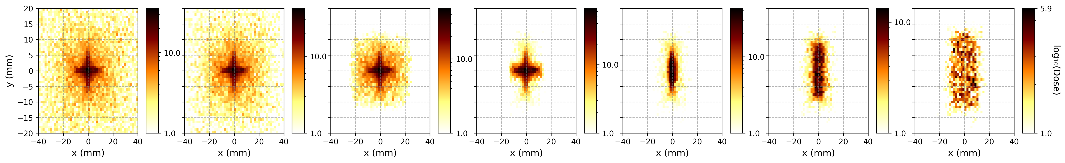







Data and Key Observations
Preliminary Simulation Results
Simulation of 1x10⁵ particles with no shifts or tilts of quadrupoles
${\text{E}}_{\text{min}} \text{=} \text{3.1 }\text{MeV}$
${\text{E}}_{\text{min}} \text{=}\text{ 6}\text{.1 }\text{MeV}$
${\text{E}}_{\text{min}} \text{=}\text{8.2} \text{MeV}$
${\text{E}}_{\text{min}} \text{=}\text{ 9.9} \text{MeV}$
${\text{E}}_{\text{min}} \text{=}\text{ 11.4} \text{MeV}$
${\text{E}}_{\text{min}} \text{=} \text{12.7 }\text{MeV}$
${\text{E}}_{\text{min}} \text{=}\text{ 13.9} \text{MeV}$
Key Observations
  Rectangular-shaped distribution seen in the simulation
  Notable shape change between layers 4 and 5,
LhARA Collaboration Meeting
Calvin Dyson - LhARA Collaboration Meeting
21
07/04/2025
06/04/2025
Notes:
These are the preliminary results of the beam
Key details to point out are the roughly rectangular shaped distribution and the shape change between layers 4 and 5

Slide 22




Focusing Quadrupole Shift
Shift: x = +0.1mm
Simulation of 1x10⁵ particles
${\text{E}}_{\text{min}} \text{=} \text{3.1 }\text{MeV}$
${\text{E}}_{\text{min}} \text{=}\text{ 6}\text{.1 }\text{MeV}$
${\text{E}}_{\text{min}} \text{=}\text{8.2} \text{MeV}$
${\text{E}}_{\text{min}} \text{=}\text{ 9.9} \text{MeV}$
${\text{E}}_{\text{min}} \text{=}\text{ 11.4} \text{MeV}$
${\text{E}}_{\text{min}} \text{=} \text{12.7 }\text{MeV}$
${\text{E}}_{\text{min}} \text{=}\text{ 13.9} \text{MeV}$
Key Observations:
Asymmetry in the focusing effect – lateral shift
Lower energy particles are more susceptible to small deviations
LhARA Collaboration Meeting
Calvin Dyson - LhARA Collaboration Meeting
22
07/04/2025
06/04/2025
Notes:
The aim was then to try and reproduce the star-shapes by introducing offsets and tilts in the quad doublet
This is for a shift of 0.1mm in the first quadrupole
Introduces a dipole effect which bends the beam and causes an offset in the beam centre

Slide 23
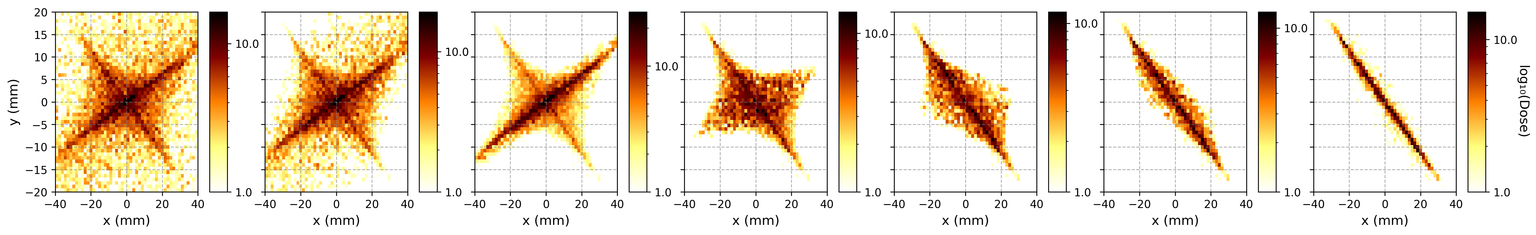
Focusing Quadrupole Tilt
Tilt: $α$= +0.1 rad
Simulation of 1x10⁵ particles
${\text{E}}_{\text{min}} \text{=} \text{3.1 }\text{MeV}$
${\text{E}}_{\text{min}} \text{=}\text{ 6}\text{.1 }\text{MeV}$
${\text{E}}_{\text{min}} \text{=}\text{8.2} \text{MeV}$
${\text{E}}_{\text{min}} \text{=}\text{ 9.9} \text{MeV}$
${\text{E}}_{\text{min}} \text{=}\text{ 11.4} \text{MeV}$
${\text{E}}_{\text{min}} \text{=} \text{12.7 }\text{MeV}$
${\text{E}}_{\text{min}} \text{=}\text{ 13.9} \text{MeV}$
Tilt changes angle at which proton enters the quadrupole field
Results in uneven focusing effect – some particles experiences stronger focusing while other are deflected in unintended
directions
LhARA Collaboration Meeting
Calvin Dyson - LhARA Collaboration Meeting
23
07/04/2025
06/04/2025
Notes:
This is a tilt around the z-axis
Causes a tilt in the transverse profile too
Starting to produce a similar star shape
• Causes quite a significant spread in the particles as well

Slide 24

Focusing and Defocusing Quadrupole Combination Tilt
FQ: $β$ = -0.005 rad, $γ$ = 0.005 rad;
DQ: $β$ = -0.005 rad, $γ$ = 0.005 rad
Simulation of 1x10⁵ particles
${\text{E}}_{\text{min}} \text{=} \text{3.1 }\text{MeV}$
${\text{E}}_{\text{min}} \text{=}\text{ 6}\text{.1 }\text{MeV}$
${\text{E}}_{\text{min}} \text{=}\text{8.2} \text{MeV}$
${\text{E}}_{\text{min}} \text{=}\text{ 9.9} \text{MeV}$
${\text{E}}_{\text{min}} \text{=}\text{ 11.4} \text{MeV}$
${\text{E}}_{\text{min}} \text{=} \text{12.7 }\text{MeV}$
${\text{E}}_{\text{min}} \text{=}\text{ 13.9} \text{MeV}$
Key Observations:
Vertical, curved section of star-shaped arm can be seen in the simulation
LhARA Collaboration Meeting
Calvin Dyson - LhARA Collaboration Meeting
24
07/04/2025
06/04/2025
Notes:
By combining a tilt in both quads the curve on the LHS of the star can be recreated
See the curved arm on the LHS
• • Just for calrity, the rotation axis here are euler angles following the intrinsic Z-Y-Z convention

Slide 25

Focusing and Defocusing Quadrupole Combination Tilt
FQ: x = +0.1mm, $α$ = +0.004 rad, $β$ = 0.004 rad, $γ$ = -0.003 rad;
DQ: x = +0.1mm, $α$ = -0.004 rad,$β$ = 0.004 rad, $γ$ = -0.003 rad
Simulation of 1x10⁵ particles
${\text{E}}_{\text{min}} \text{=} \text{3.1 }\text{MeV}$
${\text{E}}_{\text{min}} \text{=}\text{ 6}\text{.1 }\text{MeV}$
${\text{E}}_{\text{min}} \text{=}\text{8.2} \text{MeV}$
${\text{E}}_{\text{min}} \text{=}\text{ 9.9} \text{MeV}$
${\text{E}}_{\text{min}} \text{=}\text{ 11.4} \text{MeV}$
${\text{E}}_{\text{min}} \text{=} \text{12.7 }\text{MeV}$
${\text{E}}_{\text{min}} \text{=}\text{ 13.9} \text{MeV}$
Key Observations:
Vertical central line visible
Vertical, curved section of star-shaped arm can be seen in the simulation
LhARA Collaboration Meeting
Calvin Dyson - LhARA Collaboration Meeting
25
07/04/2025
06/04/2025
Notes:
Finally after searching many different orientations and combinations, this combination appeared to recreate the RCF stack profile the best
Get the almost vertical line down the centre
Slight curve or bulge on the left
And conversion to rectangular shape for higher energies
To take this further we are considering employing Bayseian optimisation to search the parameter space more effectively
It is worth noting that these shifts and tilts are generally within the machine precision expected
Though it should be noted that these quads at a strength of 332T/m and 318.5T/m are much stronger than the ones employed at SCAPA

Slide 26
Discussion on Fringe Fields
Realistic vs. Hard-Edge model in quadrupole magnets:
Hard-edge model assumes the magnetic field abruptly starts and stops at the quadrupole boundaries
Realistic model accounts for gradual field decay
Need for better magnetic field modelling:
Second-order aberrations arise from nonlinear variations in the magnetic field
Fringe fields can introduce unexpected focusing shifts
Source Variance
Potential for location of source origin to shift across the target
      Equivalent to a shift of both quadrupoles
LhARA Collaboration Meeting
Calvin Dyson - LhARA Collaboration Meeting
26
07/04/2025
06/04/2025
Notes:
There are also other potential sources of the star-like shapes, including variance in the source and fringe field effects in the quadrupoles
The source variance could be implemented by examining the response from multiple beams
Fringe fields will require the proper implementation of the quadrupole field, maybe an experimentally collected quadrupole field, though I understand there are reservations with this so a theoretical model may be more appropriate

Slide 27
Conclusions and Future
Successfully investigated proton acceleration using a laser-driven source
      Found that the analytical model does not accurately describe the experimental data due with correct T_{e} due to the complexity of the acceleration process
      Can be employed phenomenologically
      Further work is required to investigate T_{e} as a non-physical parameter
    Found agreement between simulations of LhARA Linear Optics code and BDSim
      Analysed quadrupole effects on beam transport, demonstrating their impact on spatial energy deposition patterns
Reproduced features of RCF stack energy distributions
      Bayesian optimisation could improve the search of the parameter space
      Consideration of other factors that could impact the beam, such as fringe fields in quadrupoles, is required
LhARA Collaboration Meeting
Calvin Dyson - LhARA Collaboration Meeting
27
07/04/2025
06/04/2025

Slide 28
Thank you
Simulation of LION Beam
20/03/2025

Slide 29
Additional Slides
LhARA Collaboration Meeting
Calvin Dyson - LhARA Collaboration Meeting
29
07/04/2025

Slide 30
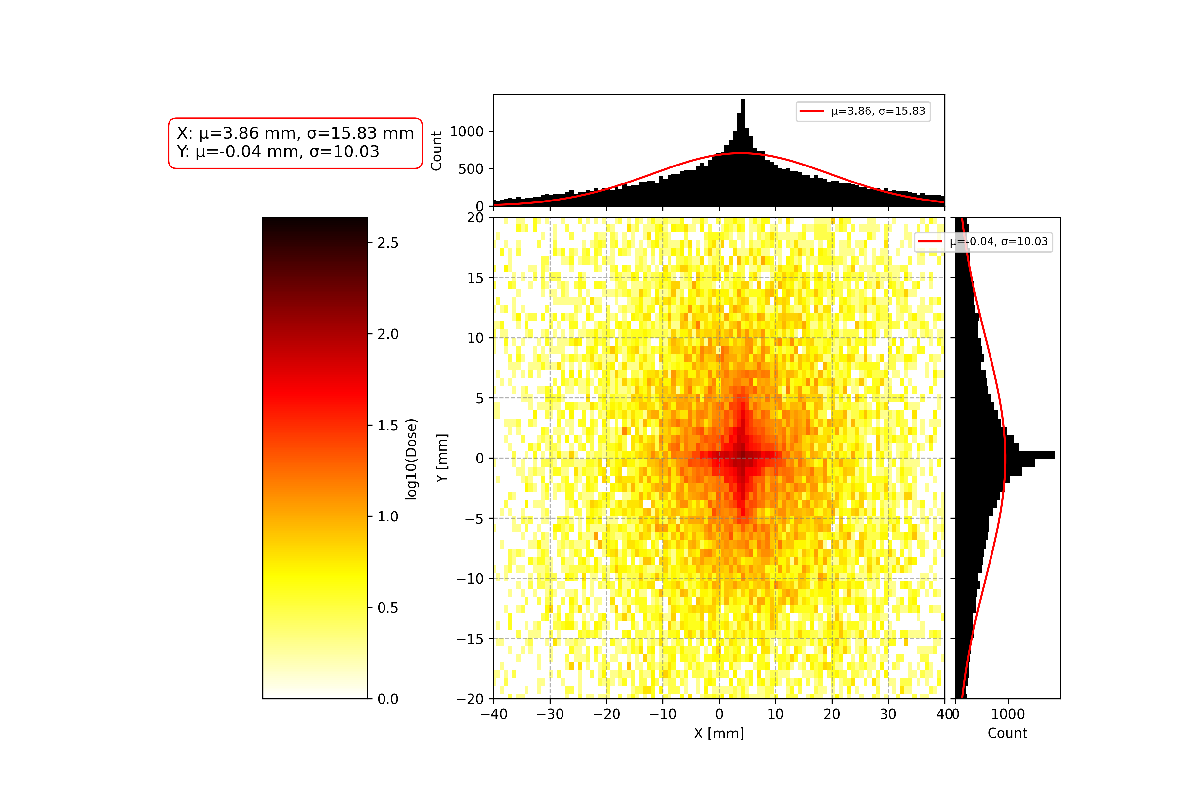
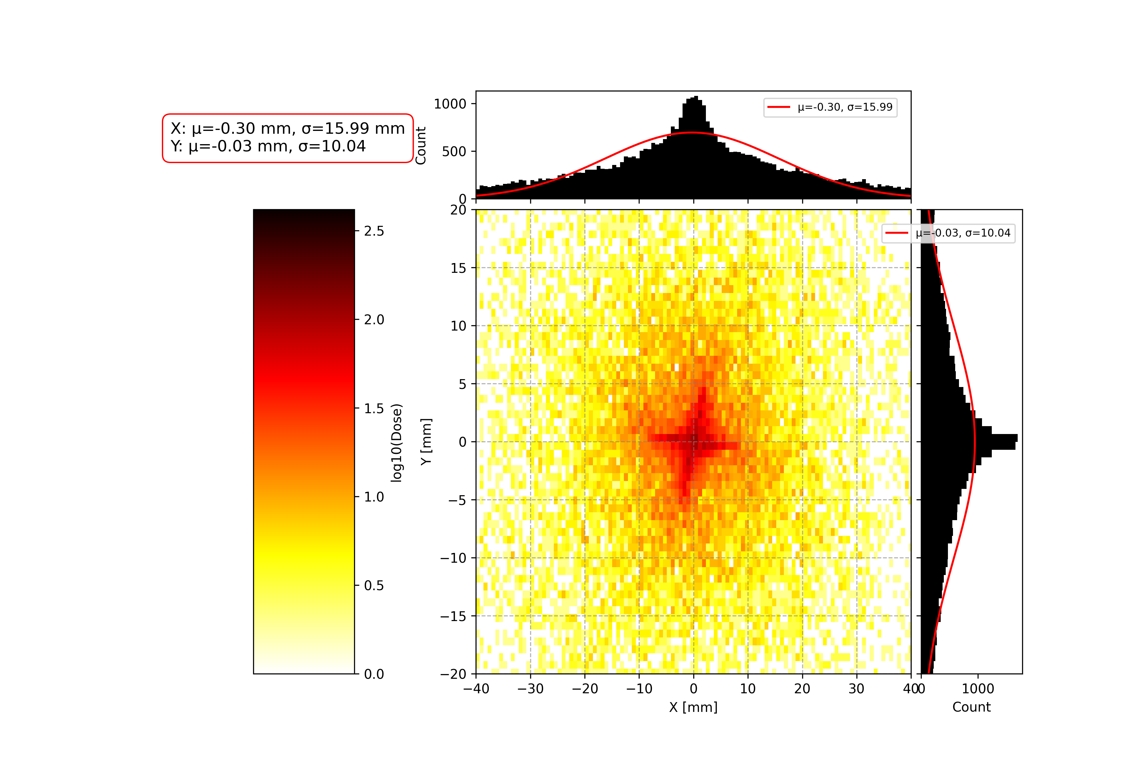
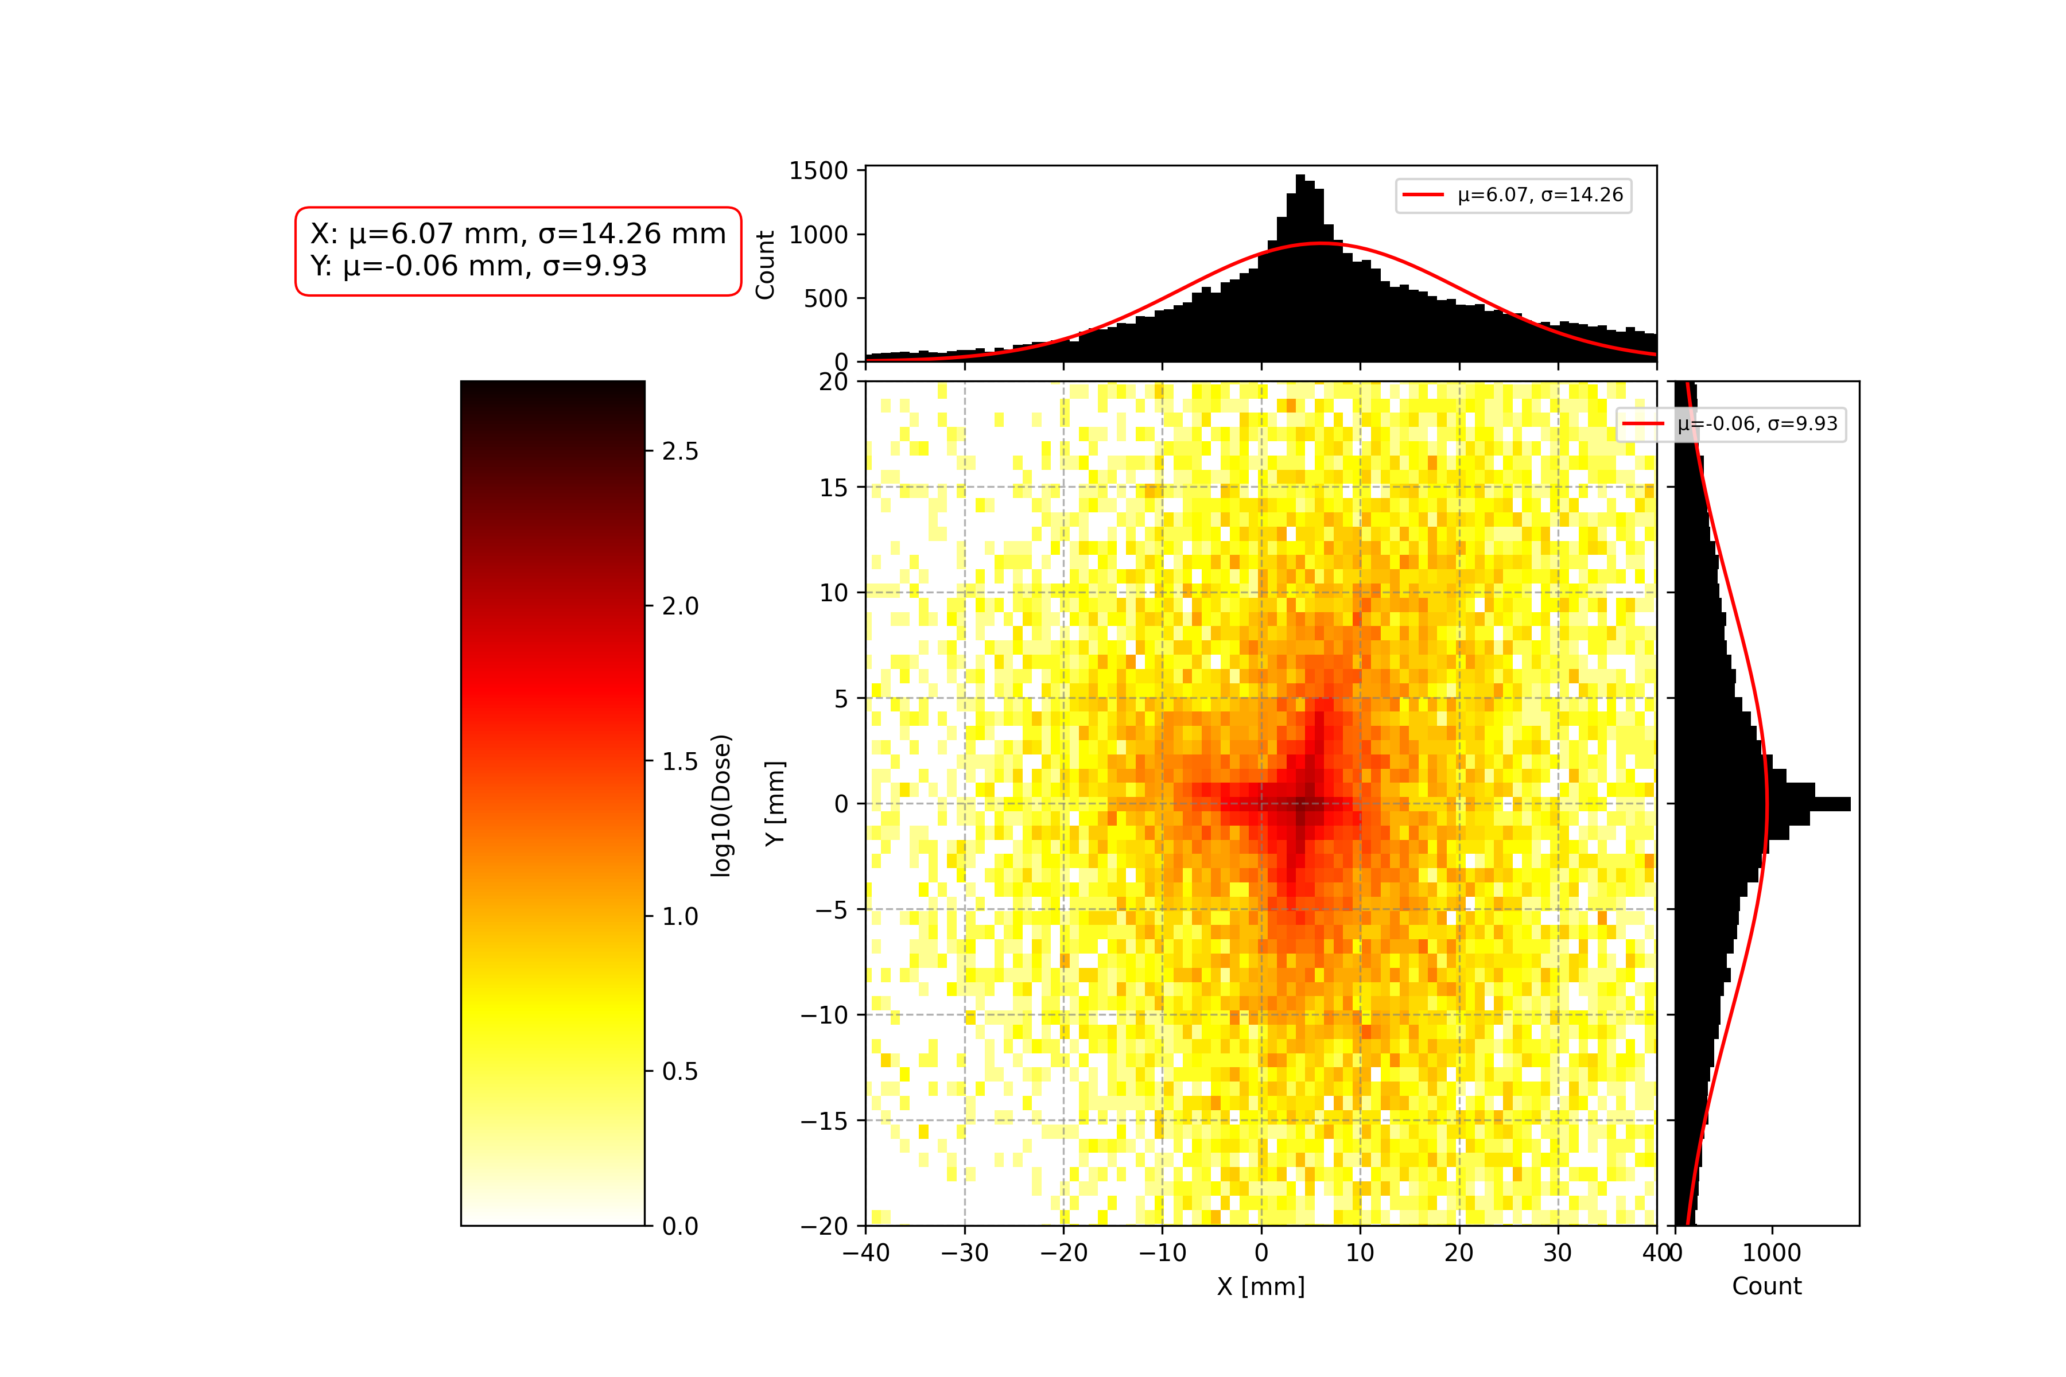
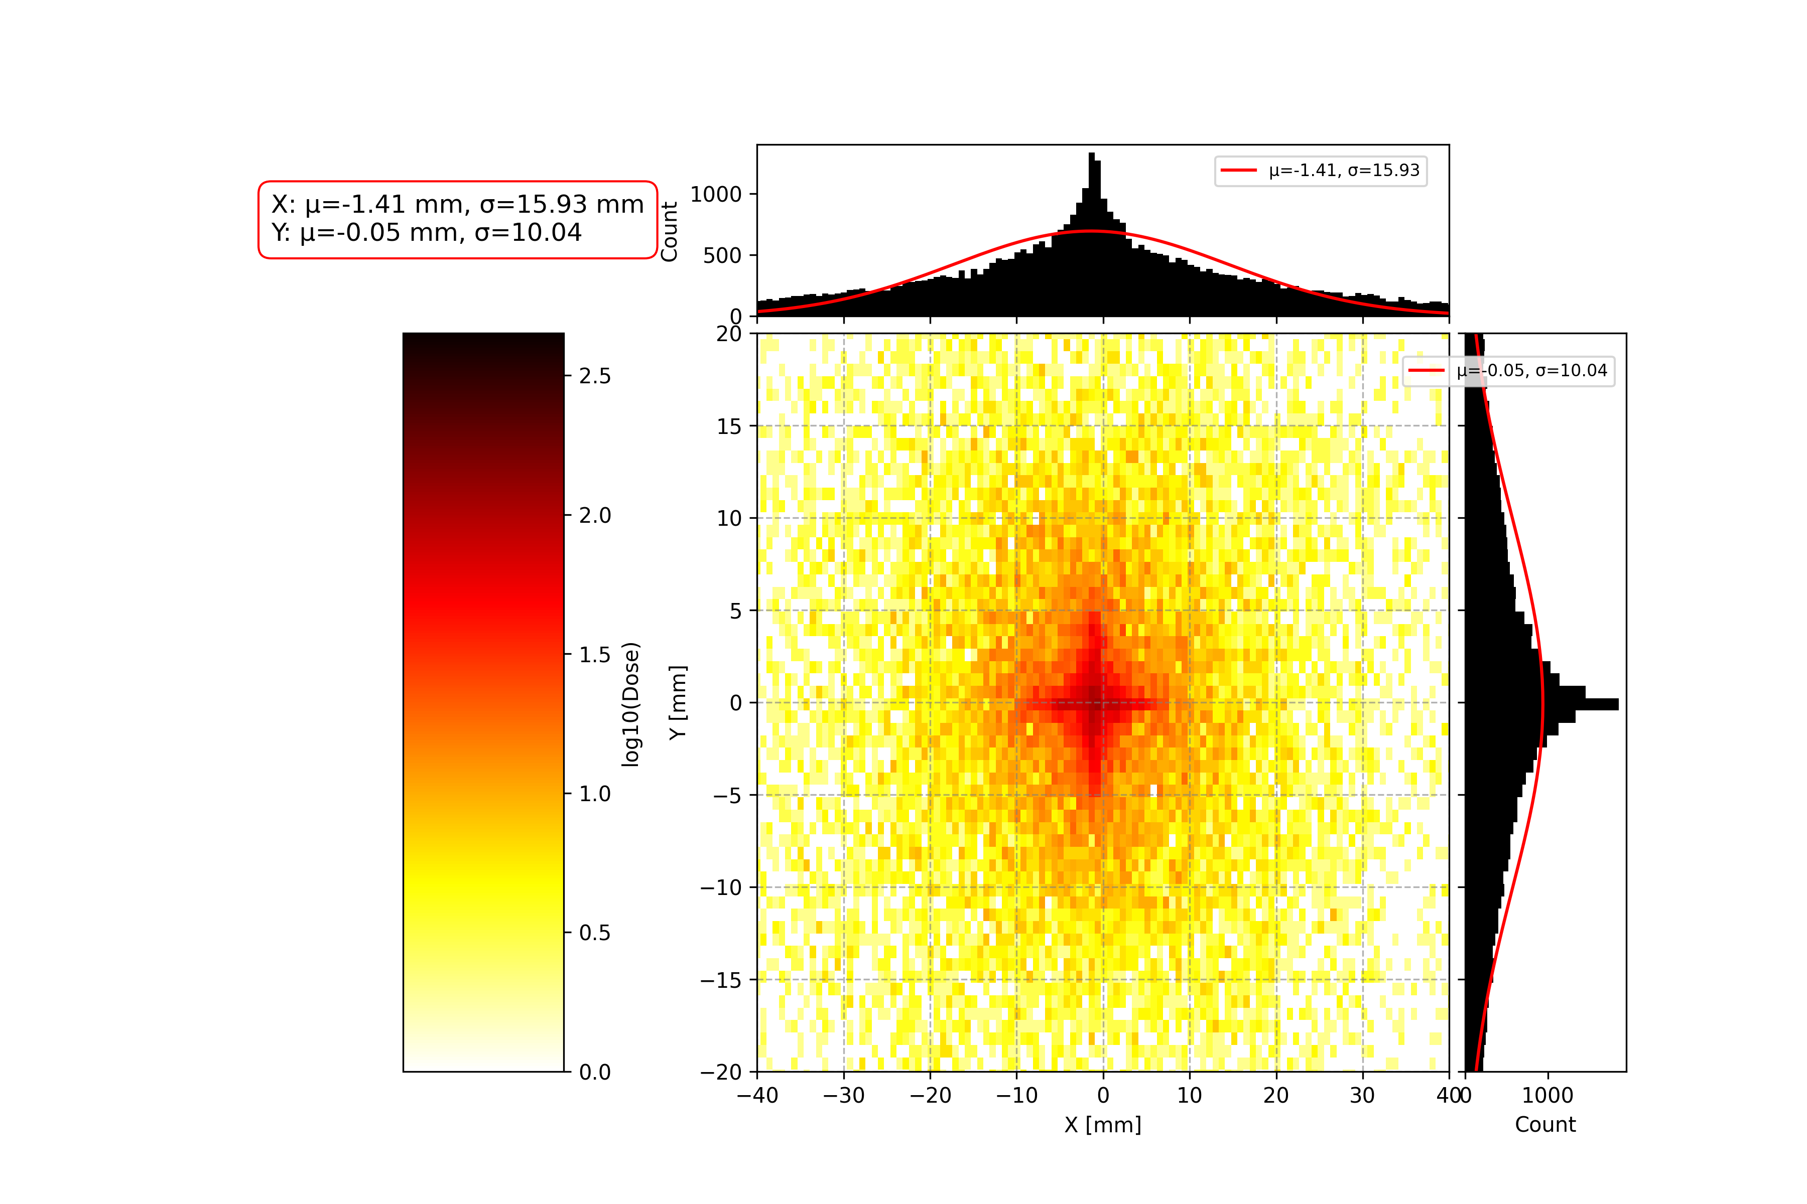




Discussion for SCAPA
FQ: x+0.1mm
FQ: $α$+ 0.01rad
FQ: x+0.1mm, $α$+0.004 rad, $β+$0.004 rad, $γ$-0.003 rad
DQ: x+0.1mm, $α$-0.004 rad,$β+$0.004 rad, $γ$-0.003 rad
DQ: x+0.1mm
DQ: $α$+ 0.01rad
Calvin Dyson - LhARA Collaboration Meeting
30
07/04/2025
Notes:
• I also used their simulations on the beamline at SCAPA to see the results
• The tilts and shifts produce the same distributions
• The final distribution they found that best suited the RCF stack so far reproduced similar results
Possibly do not expect as sensitive a set-up in SCAPA due to the reduced quadrupole strengths employed
• • Josie did a sensitivity study with a gaussian beam previously and found that the set up is more sensitive to movements in the first quad.

Slide 31

Explanation of Hole in energy distribution
LhARA Collaboration Meeting
Calvin Dyson - LhARA Collaboration Meeting
31
07/04/2025
06/04/2025
Notes:
The students successfully evaluated the simulation model of the laser driven source
Began to reconstruct the profiles seen in the RCF stacks by making adjustments to quadrupoles
Avenues for future work are numerous with considerations needed in:
Fringe field effects
Potential variance in the source and movement of the emittance position
Finally, there was a realisation that the students had been plotting the x and y distributions of the particles
• • A Bayesian Optimisation approach is planned with a loss function required before further progress can be made

Slide 32


Equations for Determining kinetic energy cut-off
$$K_{max}= X^{2}K_{i,∞}$$
$$\frac{t_{laser}}{t_{0}}=X\left(1+\frac{1}{2}\frac{1}{(1−X^{2})}\right)+\frac{1}{4}ln\left(\frac{1+X}{1−X}\right)$$
LhARA Collaboration Meeting
Calvin Dyson - LhARA Collaboration Meeting
32
07/04/2025
06/04/2025

