Slide 1
Proton and ion capture
Proton and ion capture progress (11th February 2025)

Slide 2
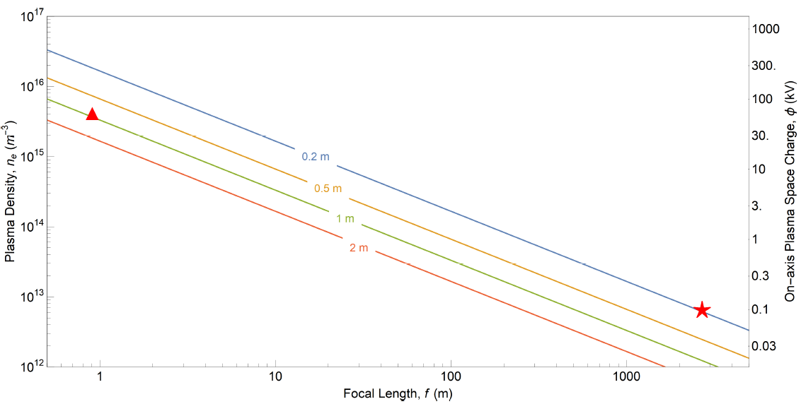
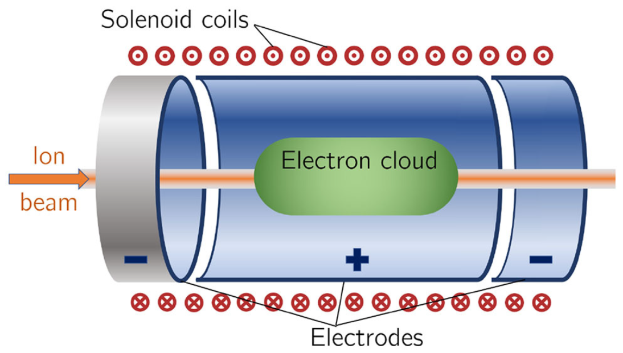
Gabor lens
The focal length $(f)$ of the Gabor lens:
$\frac{1}{f}=\frac{e^{2}n_{e}l}{4ε_{0}U}$
where $e$ is electric charge of the electron
$n_{e}$ is the plasma density
$l$ is the length of the plasma
$ε_{0}$ is the permittivity of free space
$U$ is the kinetic energy of the positively charge particle.
Penning-Malmberg trap
Plasma density: 4×10¹⁵ m⁻³
Radius: 3.65 cm
Length: 1 m
Aymar, G., Becker, T., Boogert, S., Borghesi, M., Bingham, R., Brenner, C., ... & Xiao, R. (2020). LhARA: the laser-hybrid accelerator for radiobiological applications. Frontiers in Physics, 8, 567738.
Proton and ion capture progress (11th February 2025)

Slide 3
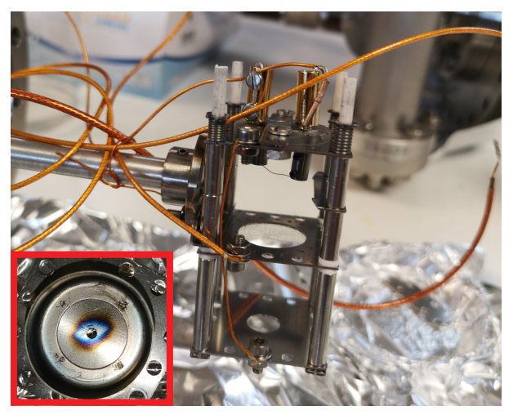
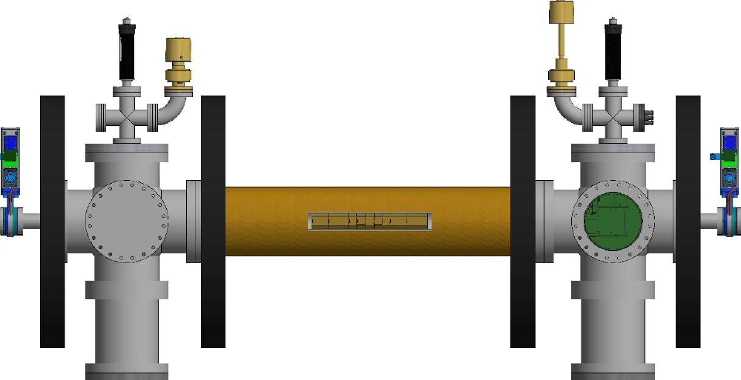
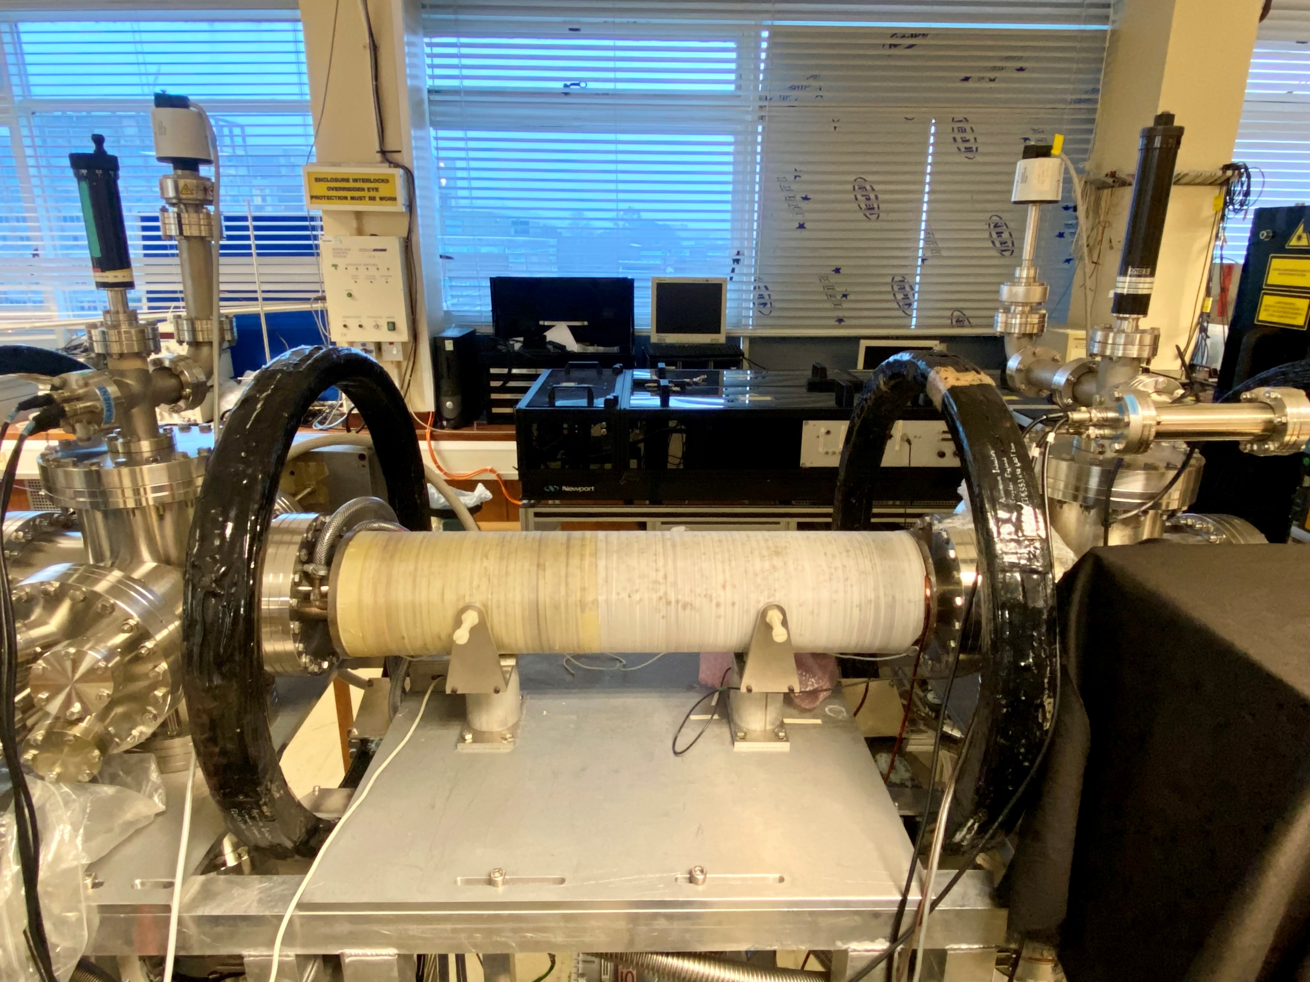
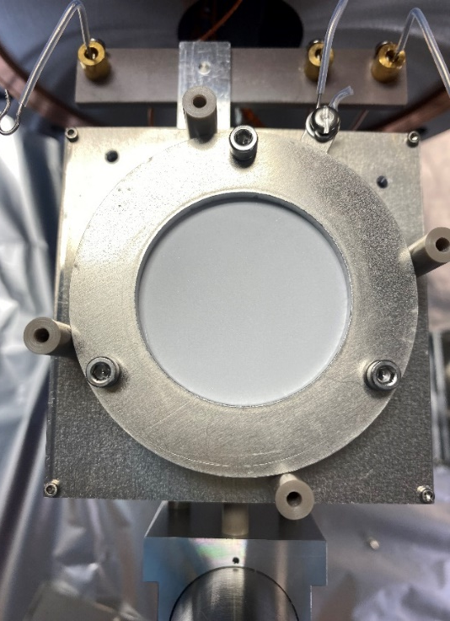
Experimental setup
Electron source
Solenoid: B$\sim 40$ mT
Brillouin density limit: $n_{B}=$ 7.8×10¹⁵ m⁻³
Phosphor screen
4.1cm
28.1cm
Proton and ion capture progress (11th February 2025)

Slide 4
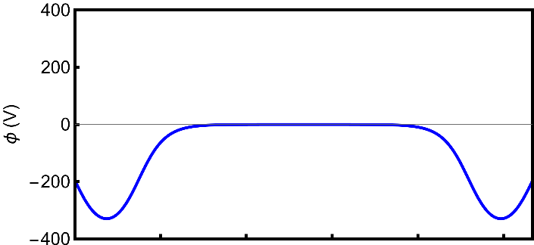
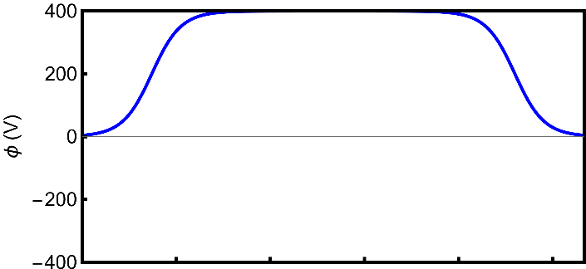
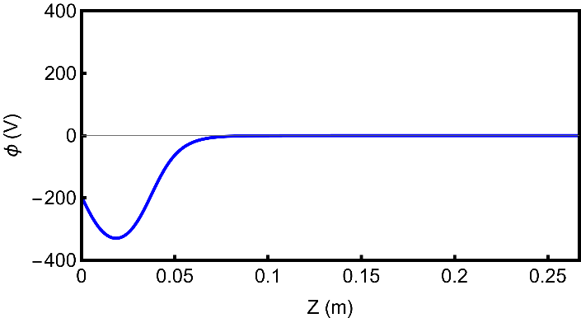
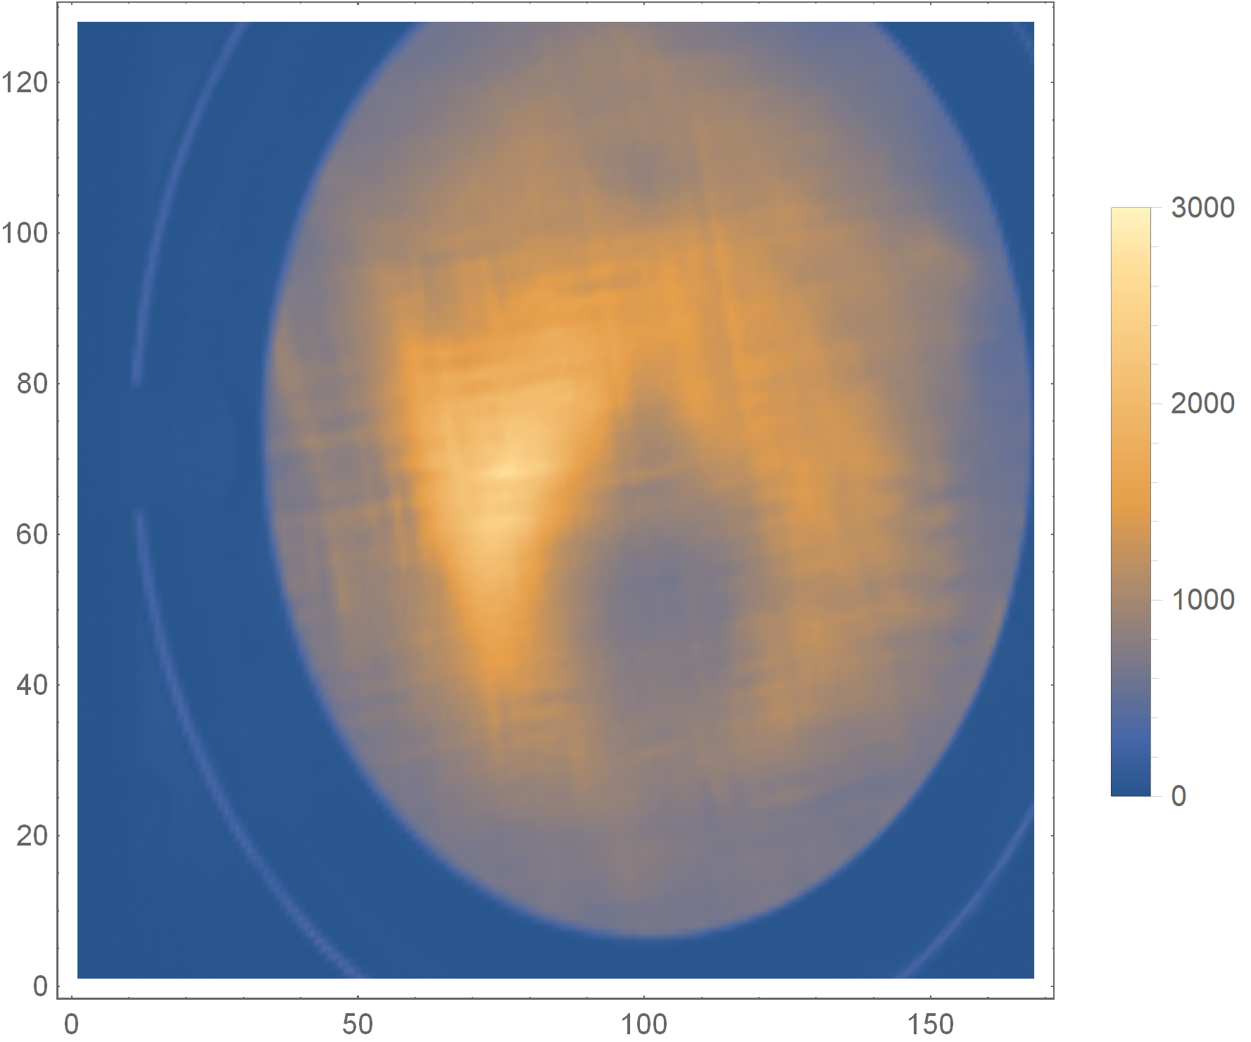
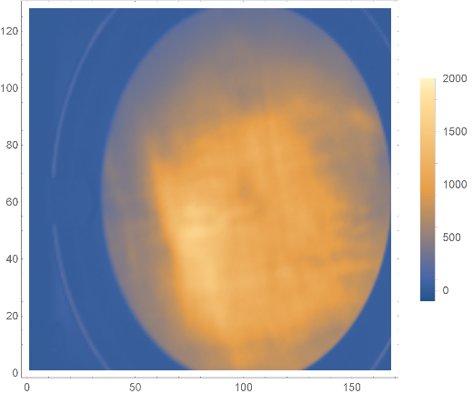
Previous results
Rotating wall (RW) + Cooling gas (CO₂)
37
49
18
19
21
19
18
49
37
mm
1s
e⁻
beam
E19
E18
E17
E16
-
E12
E11
E10
-
E4
E3
E2
E1
To
detector
RW
Investigate the energy distribution of ions within the trap
Phosphor
screen
Electrons
1s
Ions
RW
Electrons
Electrons
30ms
Ions
Ions
RW
5ms
Electrons
10ms
Electrons
Ions
Peak density: 1×10¹⁵ m⁻³
5ms
Electrons

Slide 5
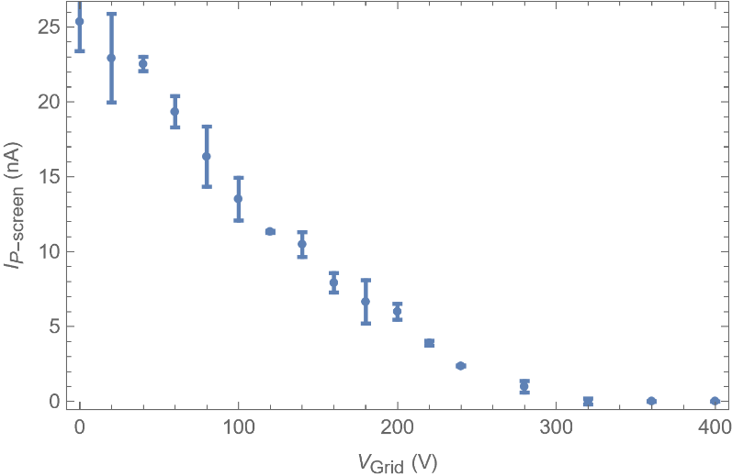
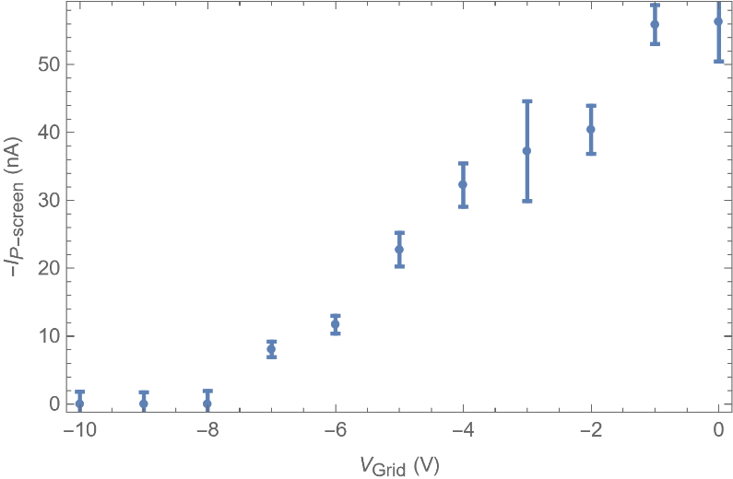
Investigate energy distribution of the ions and e⁻
Experimental sequence (Trap depth: -400V)
1) Load: 1s
2) Hold: 17us
3) RW: 13 MHz, 2.95 V_{pp}, 1 s
4) Lift the trap + RW: 10ms
5) RW: 30ms + Trigger Picoammeter
6) Turn off RW: 10ms
7) Drop the trap + Dump + Trigger digitizer + Trigger CAM: 5ms
Grid (0 V to 400V)
Grid (0 V to -10V)
Electrons
Electrons
Ions
RW
-27V
RW
e-
+27V
A
A

Slide 6
Previous results
Rotating wall (RW) + Cooling gas (CO₂)
37
49
18
19
21
19
18
49
37
mm
1s
e⁻
beam
E19
E18
E17
E16
-
E12
E11
E10
-
E4
E3
E2
E1
To
detector
RW
Investigate the energy distribution of ions within the trap
Phosphor
screen
Electrons
1s
Ions
RW
Electrons
Electrons
30ms
Ions
Ions
RW
5ms
Electrons
10ms
2) Investigate the plasma profile
Electrons
Ions
5ms
Electrons

Slide 7
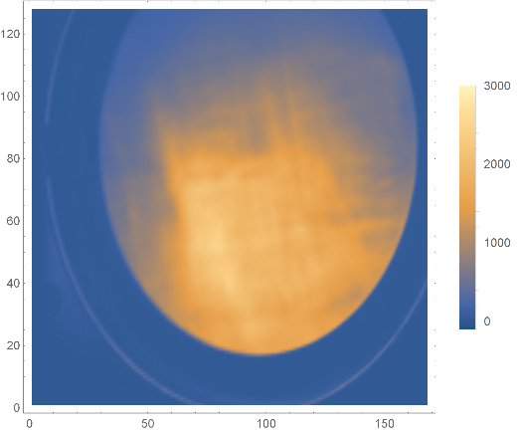
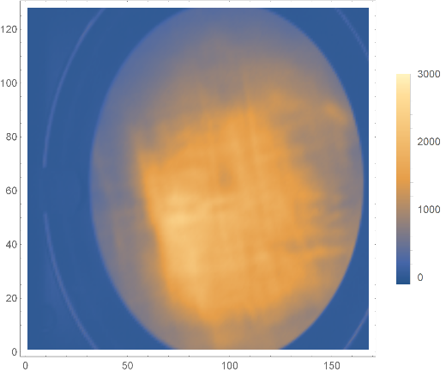
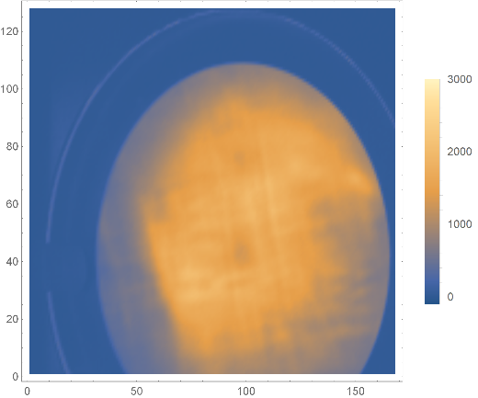
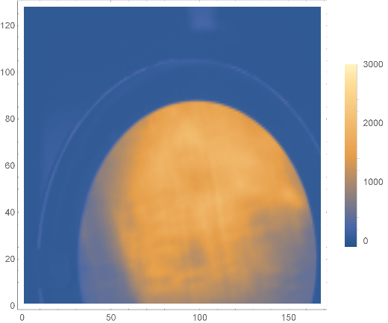
Scan the P-screen position (to check the plasma profile and
damaged areas on the p-screen)
13/11/1124 (Wed)
100.75mm: 20241113115748
94.5mm: 20241113112925
88.25mm: 20241113113550
82mm: 20241113114529
Experimental sequence (Trap depth: -400V)
1) Load: 1s
2) Hold: 17us
3) RW: 13 MHz, 2.95 V_{pp}, 1s
4) Lift the trap + RW: 10ms
5) Turn off RW: 10ms
6) Drop the trap + Dump + Trigger digitizer + Trigger CAM: 5ms
+6.25 mm
15.734×10⁹ e⁻
original position
16.032×10⁹ e⁻
-6.25 mm
15.758×10⁹ e⁻
-12.5 mm
15.652×10⁹ e⁻

Slide 8
Previous results
1s
RW
Investigate the energy distribution of ions within the trap
Electron source
Electrons
Ions
Electrons
30ms
Ions
RW
Proton/
Ion beam
10ms
2) Investigate the plasma profile
Electrons
5ms
3) Effect of E-gun position on the plasma
Electrons

Slide 9
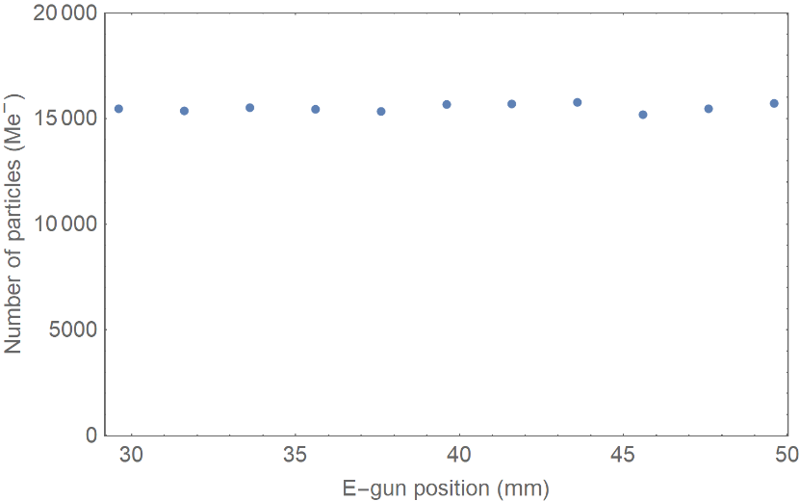
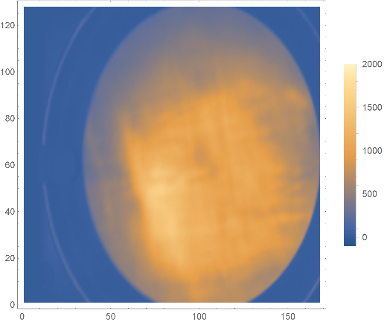
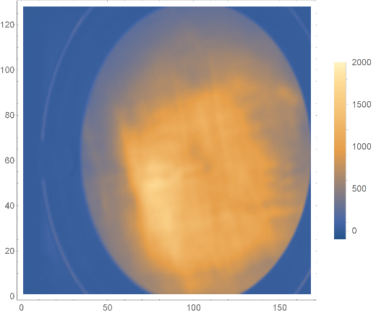
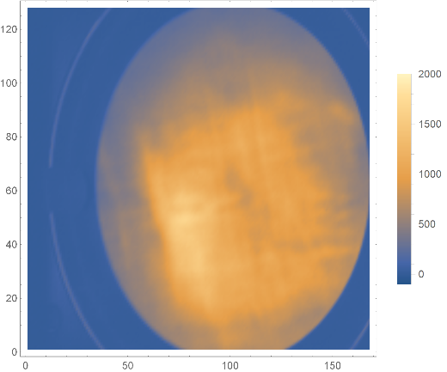
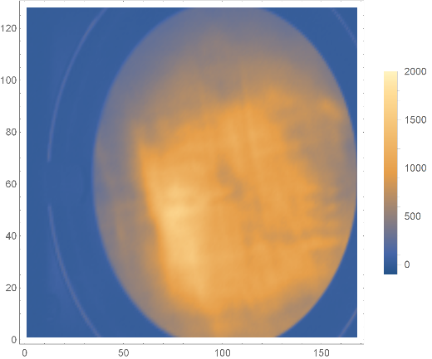
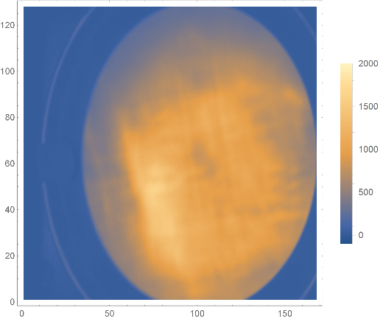
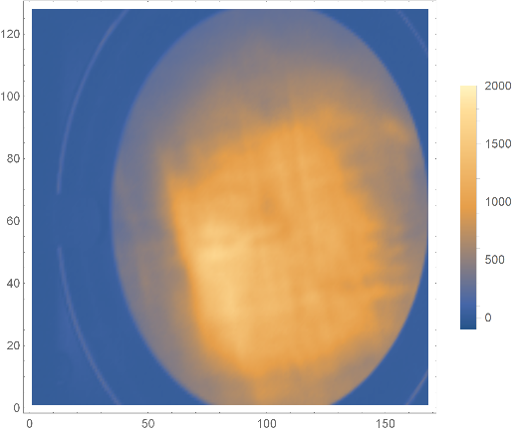
Deliberately misalign the E-gun
29.6mm: 20250128160814
31.6mm: 20250128160318
33.6mm: 20250128160126
35.6mm: 20250128155910
37.6mm: 20250128155602
39.6mm: 20250128153015
41.6mm: 20250128153252
43.6mm: 20250128153502
45.6mm: 20250128154818
47.6mm: 20250128155139
49.6mm: 20250128155357
Experimental sequence (Trap depth: -400V)
1) Load: 1s
2) Hold: 17us
3) RW: 13 MHz, 2.95 V_{pp}, 1 s
4) Lift the trap + RW: 40ms
5) Turn off RW: 10ms
6) Drop the trap + Dump + Trigger digitizer + Trigger CAM: 5ms
29.6 mm
31.6 mm
33.6 mm
35.6 mm
37.6 mm
39.6 mm (original position)
41.6 mm
43.6 mm
45.6 mm
47.6 mm
49.6 mm

Slide 10
Conclusion and outlook
Density
The peak density of the plasma is ~ 1×10¹⁵ m⁻³.
Radius
~5 mm.
Length
~19 cm.
Lifetime
As long as the RW is applied, the plasma remain stable.
Next steps …
Vary the pressure of the cooling gas.
Increase the electrode length to extend the plasma length, which will reduce the focal length.
Use numerical simulation to verify our diagnostics and
predict the behaviour of positively charge particles when sending them through the plasma.
Proton and ion capture progress (11th February 2025)

Slide 11
WP3 Personnel
W. Bertsche
M. Charlton
S. Eriksson
D. P. van der Werf
C. A. Isaac
C. Baker
P. Ruksasakchai
T. Dascalu
J. Fajans
J. Wurtele
B. Bingham
R. Hugtenburg
J. Purden
A. Knoll
E. Bennet
Proton and ion capture progress (11th February 2025)

Slide 13
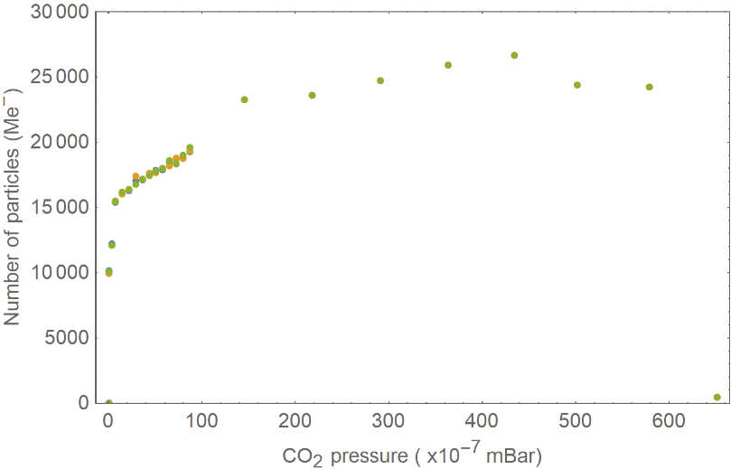
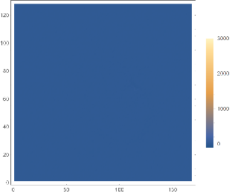
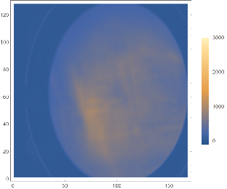
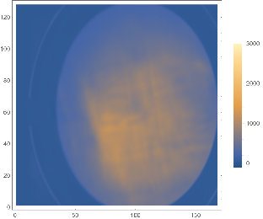
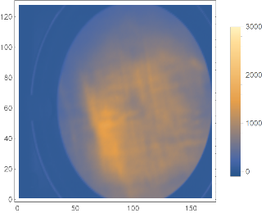
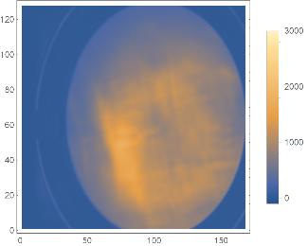
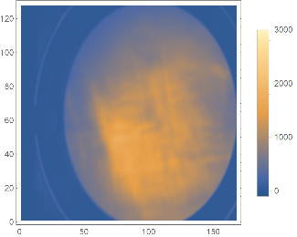
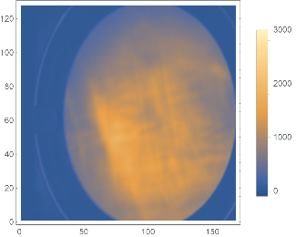
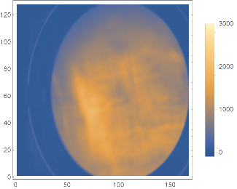
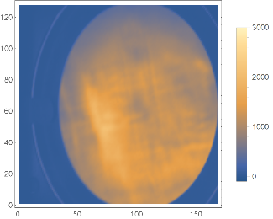
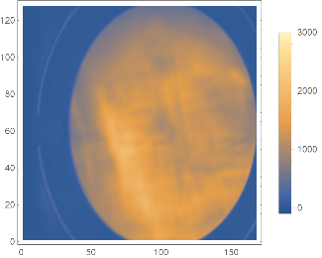
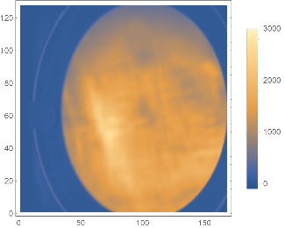
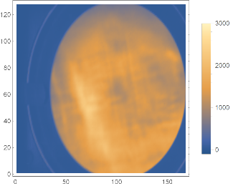
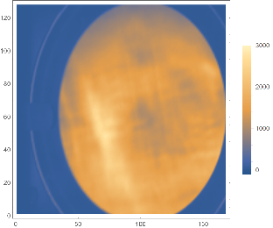
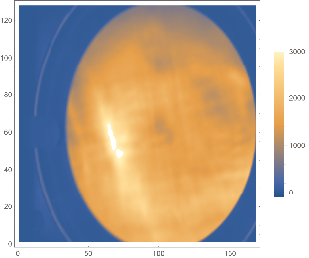
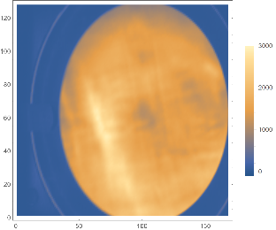
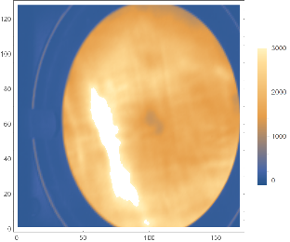
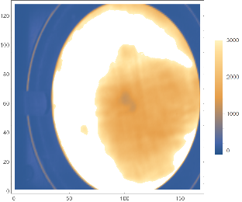
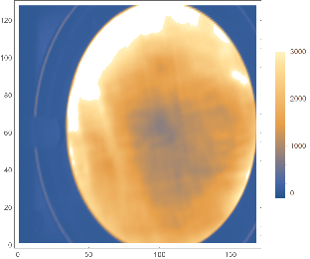
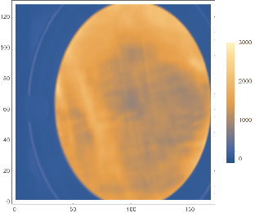
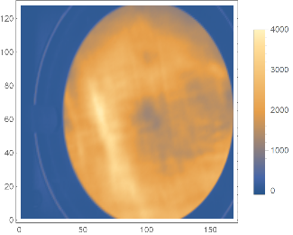
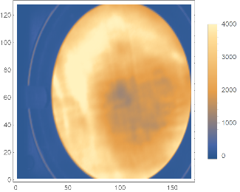
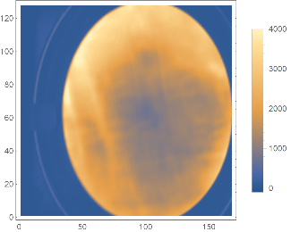
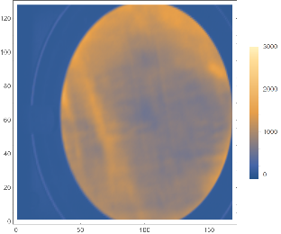
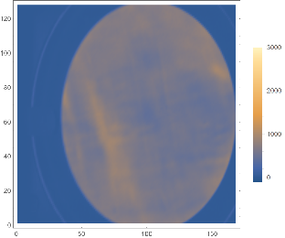
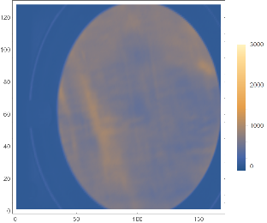
Vary the CO₂ pressure
3.87×10⁻⁸: 20250131174331
6.34×10⁻⁸: 20250131184621
7.57×10⁻⁸: 20250131165125
3.62×10⁻⁷: 20250131153255
7.35×10⁻⁷: 20250130102248
1.46×10⁻⁶: 20250130110911
2.18×10⁻⁶: 20250130115658
2.91×10⁻⁶: 20250130132503
3.63×10⁻⁶: 20250130140932
4.36×10⁻⁶: 20250130145213
5.08×10⁻⁶: 20250130153710
5.81×10⁻⁶: 20250130163338
6.54×10⁻⁶: 20250130172432
7.27×10⁻⁶: 20250131110244
7.99×10⁻⁶: 20250131115913
8.71×10⁻⁶: 20250131132143
1.45×10⁻⁵: 20250131201844
2.18×10⁻⁵: 20250131192734
2.91×10⁻⁵: 20250131203136
3.64×10⁻⁵: 20250131191610
4.35×10⁻⁵: 20250131204322
5.02×10⁻⁵: 20250131195451
5.79×10⁻⁵: 20250131205615
6.51×10⁻⁵: 20250131194322
Experimental sequence (Trap depth: -400V)
1) Load: 1s
2) Hold: 17us
3) RW: 13 MHz, 2.95 V_{pp}, 1 s
4) Lift the trap + RW: 40ms
5) Turn off RW: 10ms
6) Drop the trap + Dump + Trigger digitizer + Trigger CAM: 5ms
3.87×10⁻⁸
6.34×10⁻⁸
7.57×10⁻⁸
3.62×10⁻⁷
7.35×10⁻⁷
1.46×10⁻⁶
2.18×10⁻⁶
2.91×10⁻⁶
3.63×10⁻⁶
4.36×10⁻⁶
5.08×10⁻⁶
5.81×10⁻⁶
6.54×10⁻⁶
7.27×10⁻⁶
7.99×10⁻⁶
8.71×10⁻⁶
1.45×10⁻⁵
2.18×10⁻⁵
2.91×10⁻⁵
3.64×10⁻⁵
4.35×10⁻⁵
5.02×10⁻⁵
5.79×10⁻⁵
6.51×10⁻⁵

