Slide 1



Updates on the Pion Yield Studies
William Bishop (University of Warwick)
John Back (University of Warwick)
Chris Densham (RAL STFC UKRI)
30th April 2025

Slide 2
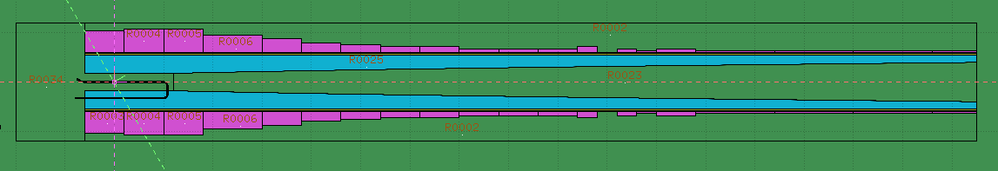
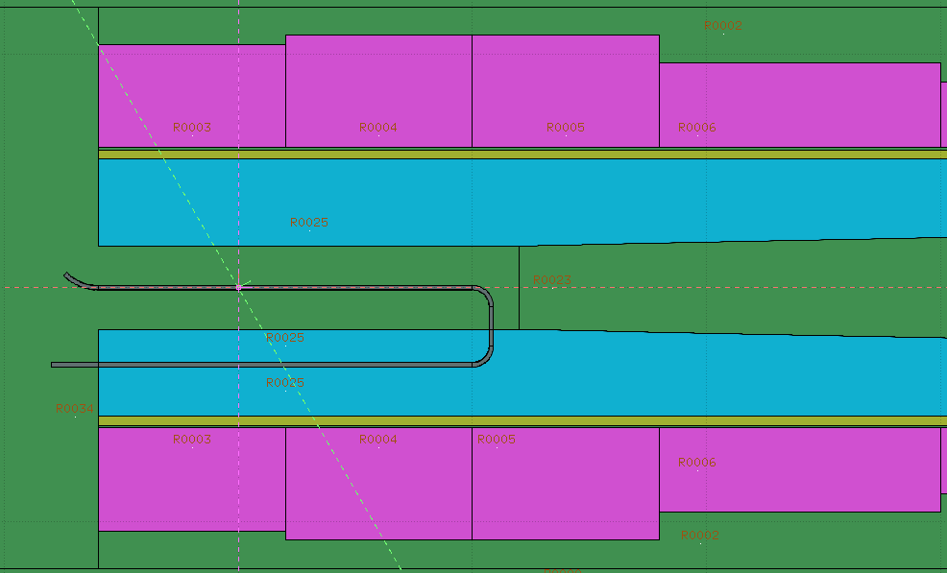
Pyg4ometry FLUKA design
Adaptation of the CERN Graphite target geometry to implement proposed WJet design
Failed due to the conversion between pyg4ometry to FLUKA causing parenthesis expansion errors
Will use the original design to get preliminary results
Zoomed view of WJet target region

Slide 3
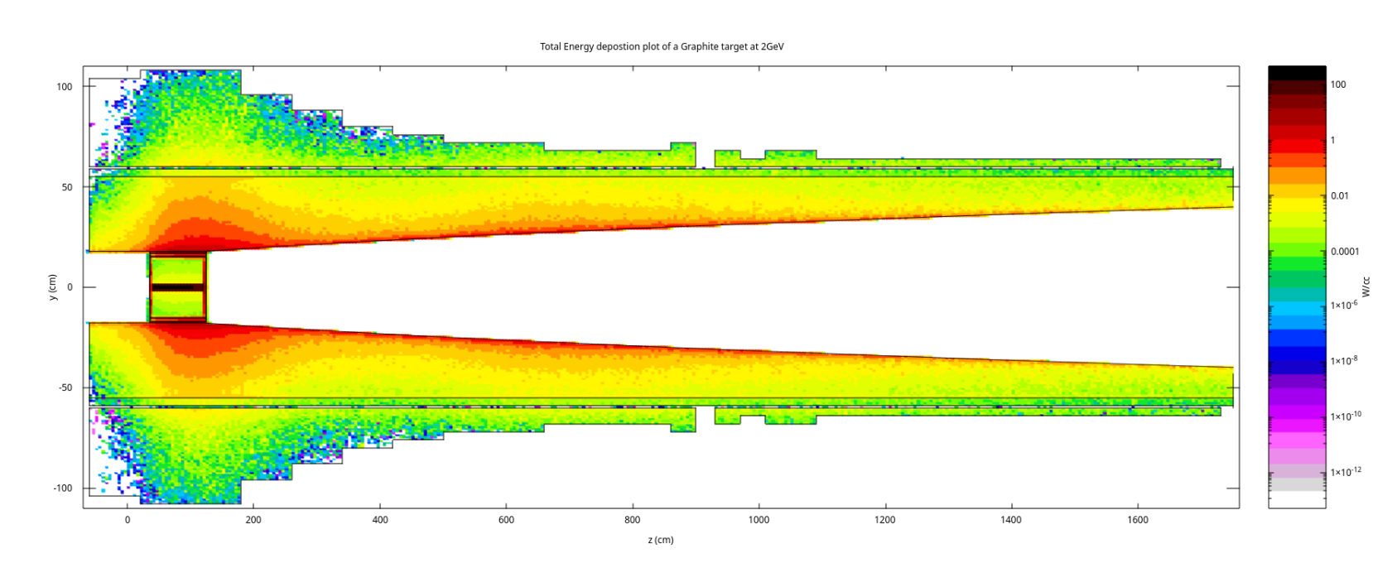
CERN Graphite target (2GeV beam) FLUKA energy deposition
Graphite
target
Notes:
- Prelim simulations done using the CERN github graphite setup, for early results, the material will be swapped with various Wjet densities to allow for comparison
- Able to produce Edep plots of the various regions, allowing for future comparison between graphite and WJet setups once we have the Wjet results
- It will allow for system adjustments which could be implemented prior to finalizing a Wjet design
- EDep will be different to previous results due to 4MW being used instead of 1.5MW and 2GeV instead of 5GeV
- No Edep in the middle due to vacuum
- Shielding is doing its job – Edep in various regions consistent down the beamline
- High Edep near the target, tapering off down the beamline
Colour bar in the units of W cm⁻³ instead of GeV/cc/proton (GeV (cm³*proton)⁻¹)
Divide by material density to get W g^-1 which allows comparison to the max EDep for operation.
cc = cm^-3
Deposited power for 2GeV beam = 2e6 W/cc or 200kW/cc
Total muon collider beam power PTot = 4 MW (mega watts) = 4e6 W = N Eb, where N = number of protons per second (proton rate) and Eb = beam energy (Joules).
N = PTot/E = 4e6 J per sec /[2GeV * 1.6e-19 * 1e9 J ] = 1.25e16 protons per sec / Eb(GeV), where Eb is the beam energy in GeV and the denominator factor does the GeV to Joules scaling.
---- For a 2 GeV beam, we have N = 1.25e16 protons per second. (more protons are needed for the lower energy to give the same power).
Fluka deposited usrbin power Pdep = Edep (GeV/cc/proton) * N (proton/sec) = Edep * (1.6e-19 * 1e9 J/cc/proton) * 1.25e16 (protons per sec)/ 2(Eb(GeV)) = 4e6/2 W/cc.
So for a beam energy Eb = 2 GeV, the scale factor would be 2e6, giving the deposited power in units of W/cc. You can then scale by another 1e-3 factor to use kW if the numbers are too high etc.

Slide 4
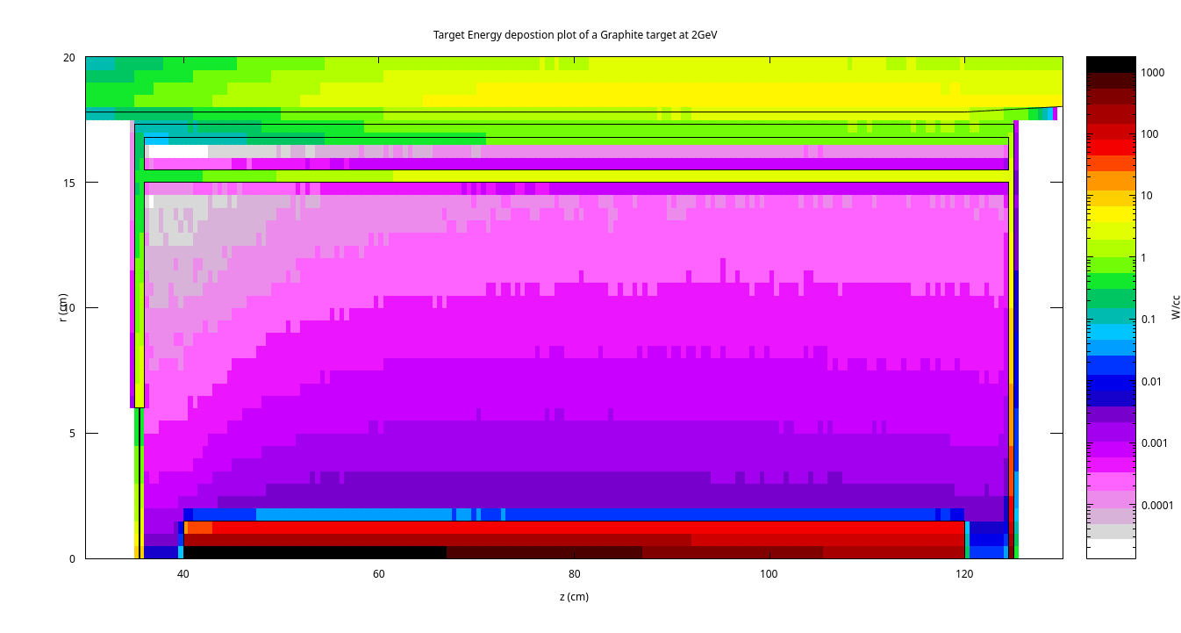
CERN Graphite Target E_{dep} (2GeV)
Target vessel
He cooling region
Graphite target, r = 15mm
Notes:
~ 1000 w/cc at the target core
Concerning due to graphite failure limits being ~ 100W/cc when pulsed causes degradation over time, creating thermal stress, sublimation risks, structural failure risks
L = 80cm
~ 1.78 interaction lengths
- Ask Ben if ideal Wjet target length has changed? May be comparable to new Wjet ideals

Slide 5
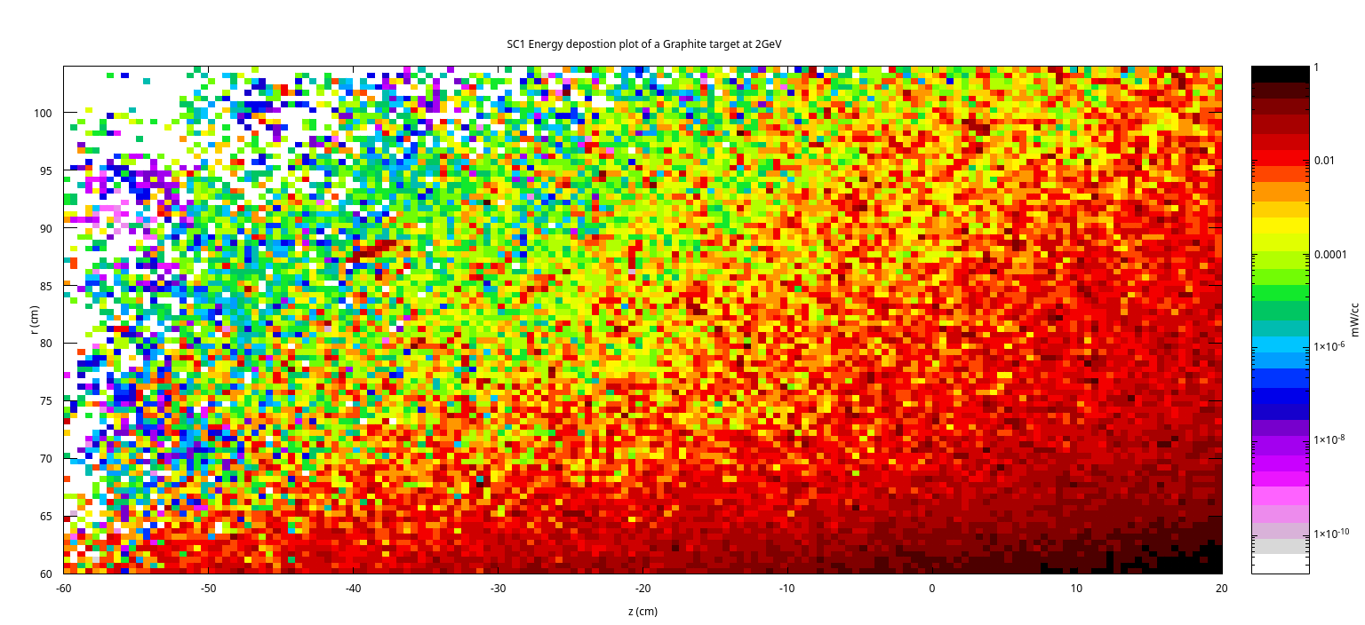
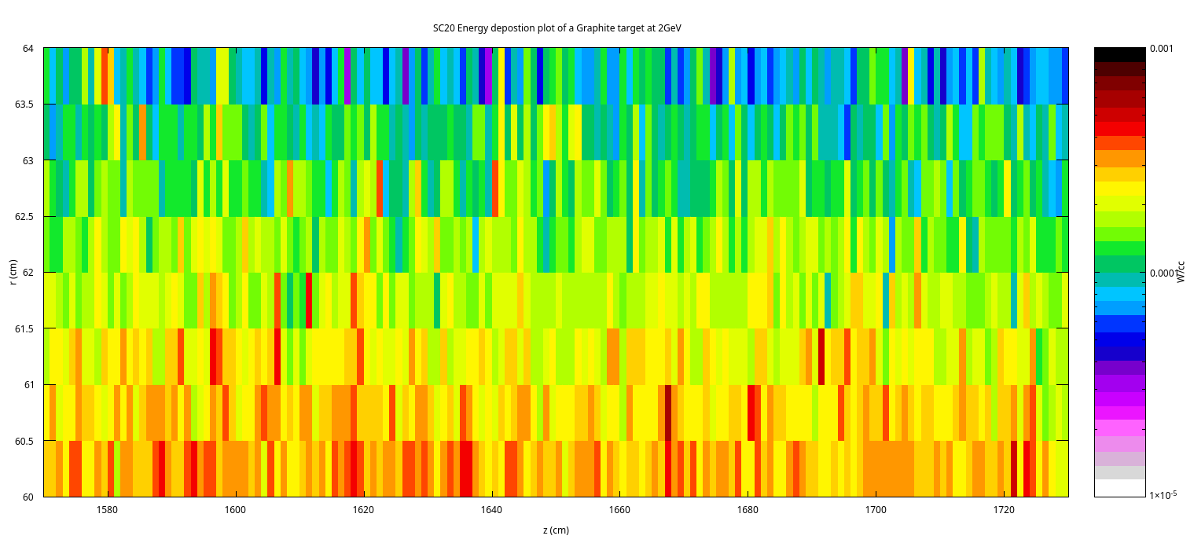
Superconducting Coils 1 & 12 E_{dep} (2GeV)
Chicane shape keeps the energy deposition load on the SC magnets consistent
Data is less populated, lower interactions with SC20 compared to SC1
Peak energy deposition is ~50% more at SC20 due to less shielding
What is the power deposition limit for VIPER?
Notes:
More energy at the final SC due to less shielding
R-PHI-Z projections observed around phi
Zero angle causes more Edep in chicane region, further testing for angled targets will cause more Edep in shielding
EuNu paper reference for SC limits (include EuNu Ref – 0.1 MW g^-1)
VIPER density is 7.89
VIPER SC limit is (____100000W/g) x 7.89
If you divided by the density of the material (g/cc), W/cc will convert to W/gram. If the total beam power was 2 MW, then the scale would be reduced by a factor of 2 (4 MW to 2 MW).

Slide 6
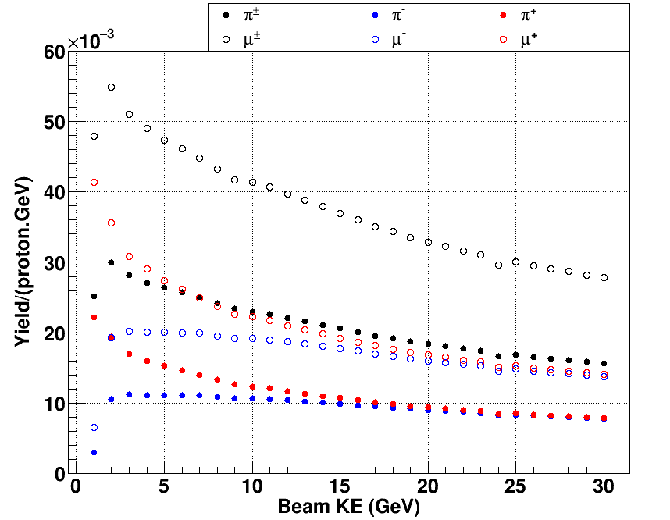
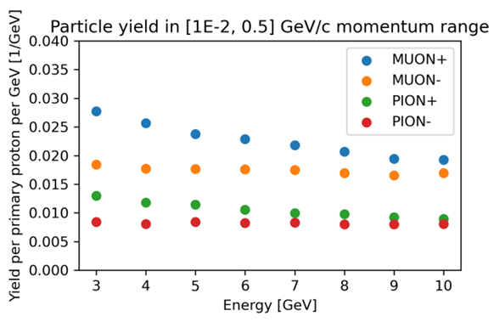
Yield plot results comparison
Current Simulated data
Previous Simulated data
2GeV yield spike
Both data sets are from a 17.5m Beam Window
1 Million events for all GeV, KE acceptance range: 10 to 500MeV
The results for 3GeV are comparable between the plots
Muon yields dominate with reduced pion yields due to distance
Notes:
Pion yields reduced but still existent going into the chicane
Spike due to pion increase

Slide 7
Future Plans
May 2025 - June 2025:
  Get a preliminary spread of data for a range of WJet densities (0-50%) within the current design
    Create fractional yield plots between the Graphite and WJet data to determine the differences
June 2025 - August 2025:
  Adjust the current FLUKA Geometry to implement the proposed WJet design
    Produce results for a range of WJet densities and other target parameters, allowing for accurate yield comparisons between the designs to determine the optimal parameter combination
August 2025 – October 2025:
  Reintroduce the previous pyg4ometry design to allow for BDSIM simulations
    Compare the results from BDSIM to FLUKA
Are there any future changes to the FLUKA geometry being considered?
  Will the chicane change?
    If so, will the geometry be updated accordingly?
Has the KE acceptance range been decided yet?

