Slide 1
A Tungsten Target for the Muon Collider
B Suitters, D Wilcox, C Densham, W Bishop, J Back
Muon Collider UK Meeting
30 April 2025

Slide 2
Agenda
Target Options
Motivation
Development work from previous studies
Application to the Muon Collider
Current status of target concept
Challenges
Plans

Slide 3
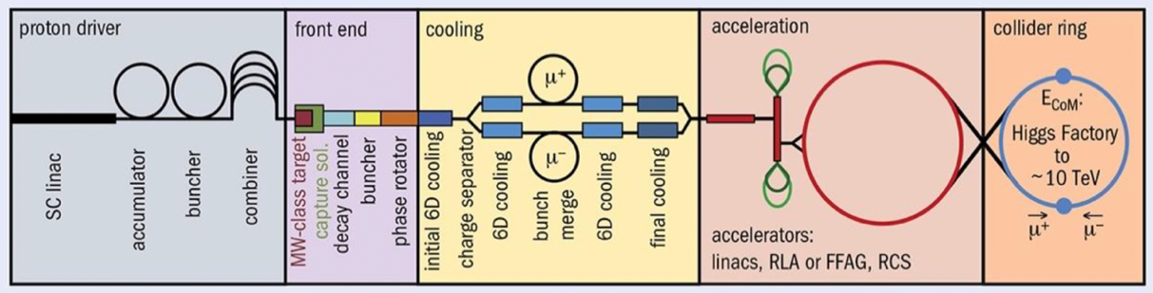
Muon Production Target

Slide 4
Target Requirements
Among the highest power on target ever proposed
Short, intense pulse
Space constraints
Power deposition on solenoids

Slide 5
Target Options
Carbon Target (CERN, S. Candido et al.)
Liquid Lead (ENEA/CERN, C. Carelli et al.)
Fluidized Tungsten (RAL/Warwick University, this talk)

Slide 6
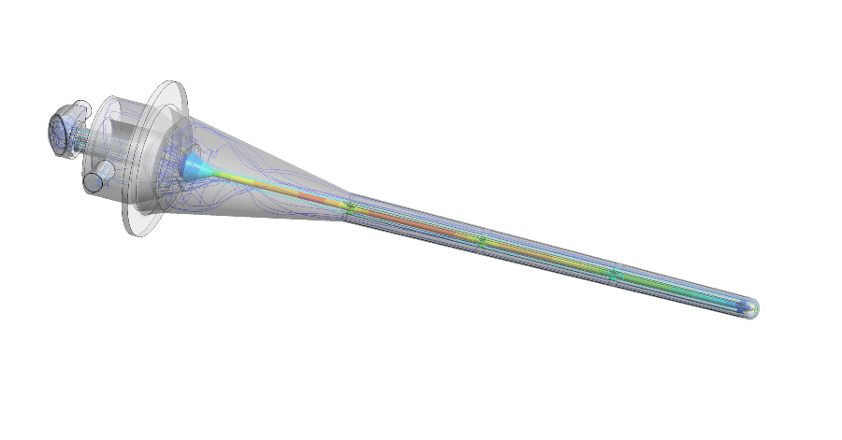
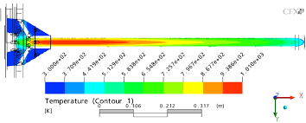
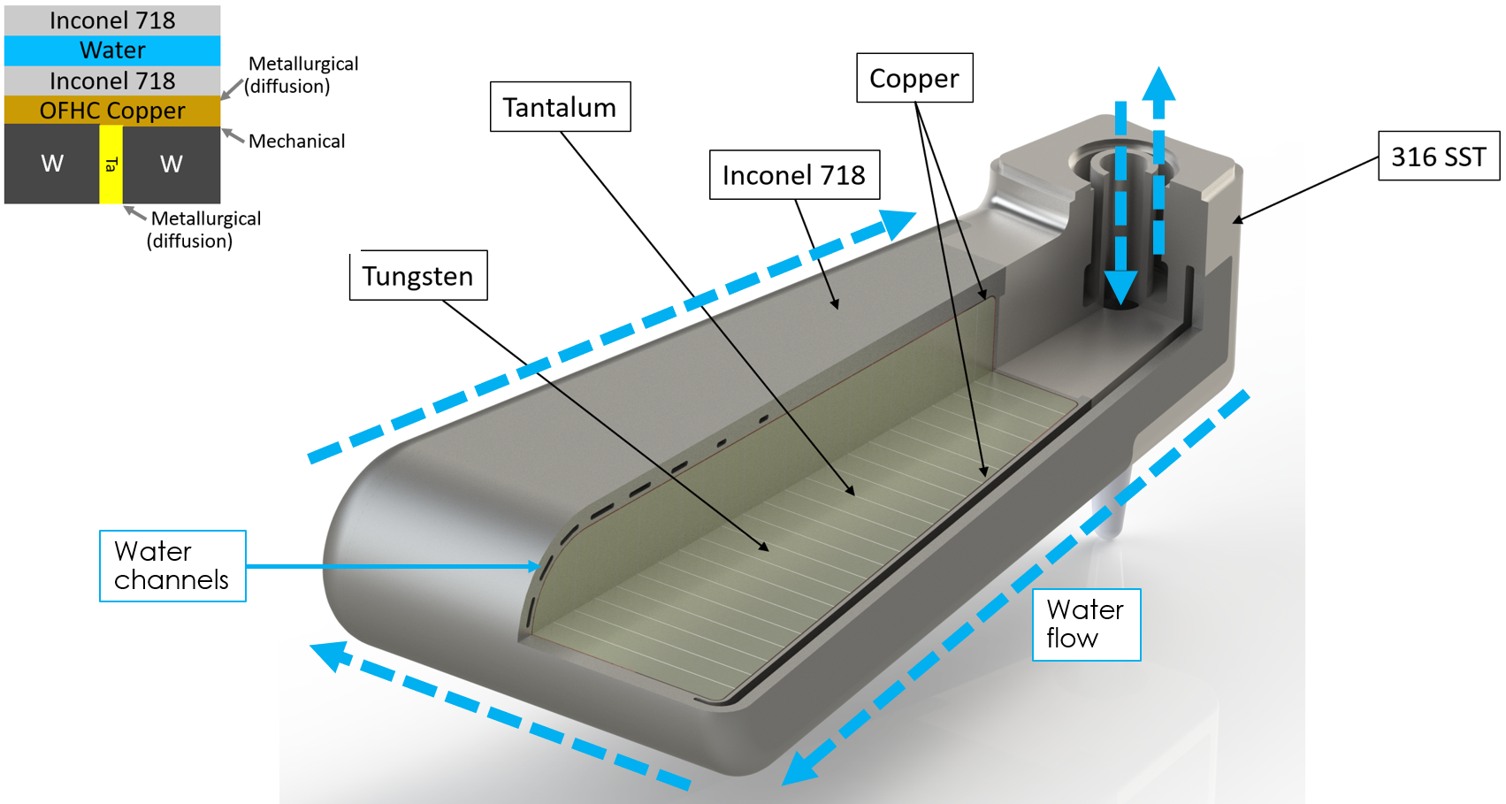
Target Options
Solid Materials
Tungsten
Graphite
Beryllium
Tantalum
Simpler, known construction
Limited by thermal properties. Fragile.

Slide 7
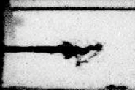
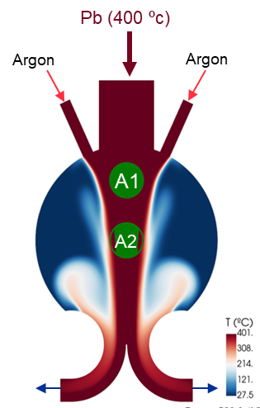
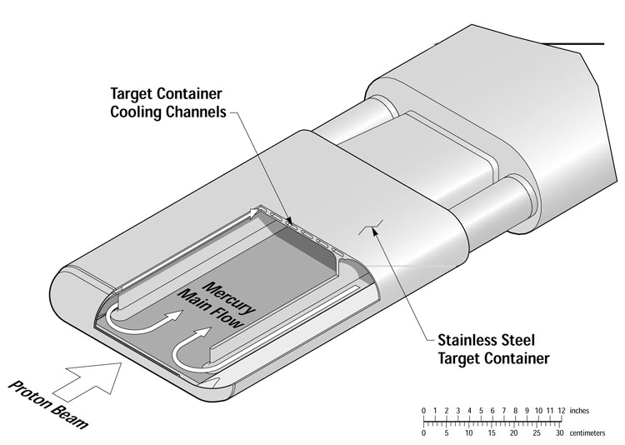
Target Options
Solid Materials
Tungsten
Graphite
Beryllium
Tantalum
Simpler, known construction
Limited by thermal properties. Fragile.
Liquid Materials
Mercury
Lead
Lead-Bismuth
Gallium
Power spread out across a larger volume
Cavitation, Corrosion, plant complexity

Slide 8
Target Options
Solid Materials
Tungsten
Graphite
Beryllium
Tantalum
Simpler, known construction
Limited by thermal properties. Fragile.
Fluidized Powder Targets
Liquid Materials
Mercury
Lead
Lead-Bismuth
Gallium
Power spread out across a larger volume
Cavitation, Corrosion, plant complexity
Spreads power like liquids
Resistant to shock
No corrosion
Reliability and Erosion
Plant Complexity

Slide 9
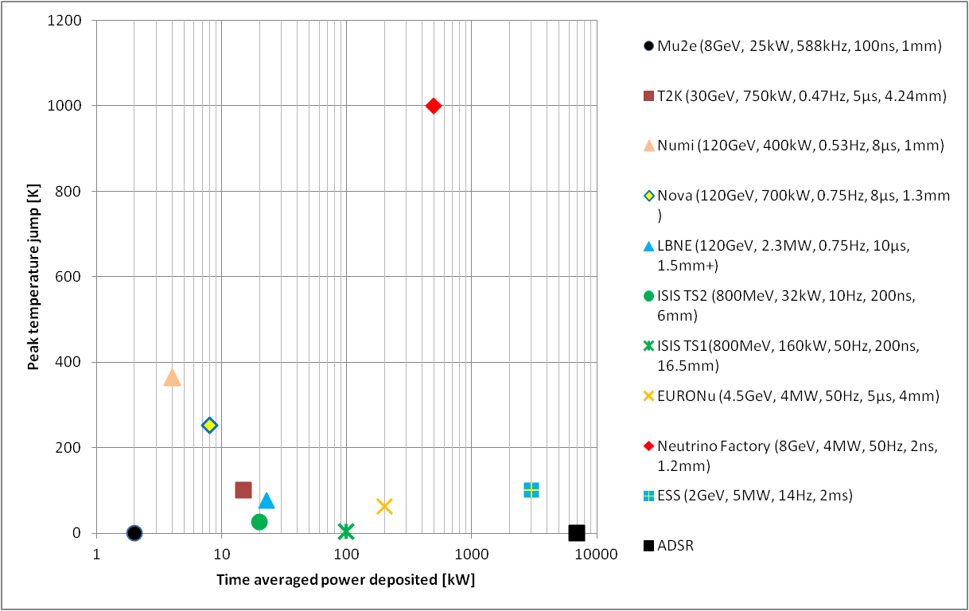
Flowing or rotating targets
Segmented
Peripherally cooled monolith
LHC Beam Dump Run 3, 540MJ/beam

Slide 10
Figure For Reference Only
MuCol W Powder
Flowing or rotating targets
Segmented
MuCol C Target
Peripherally cooled monolith
LHC Beam Dump Run 3, 540MJ/beam

Slide 11
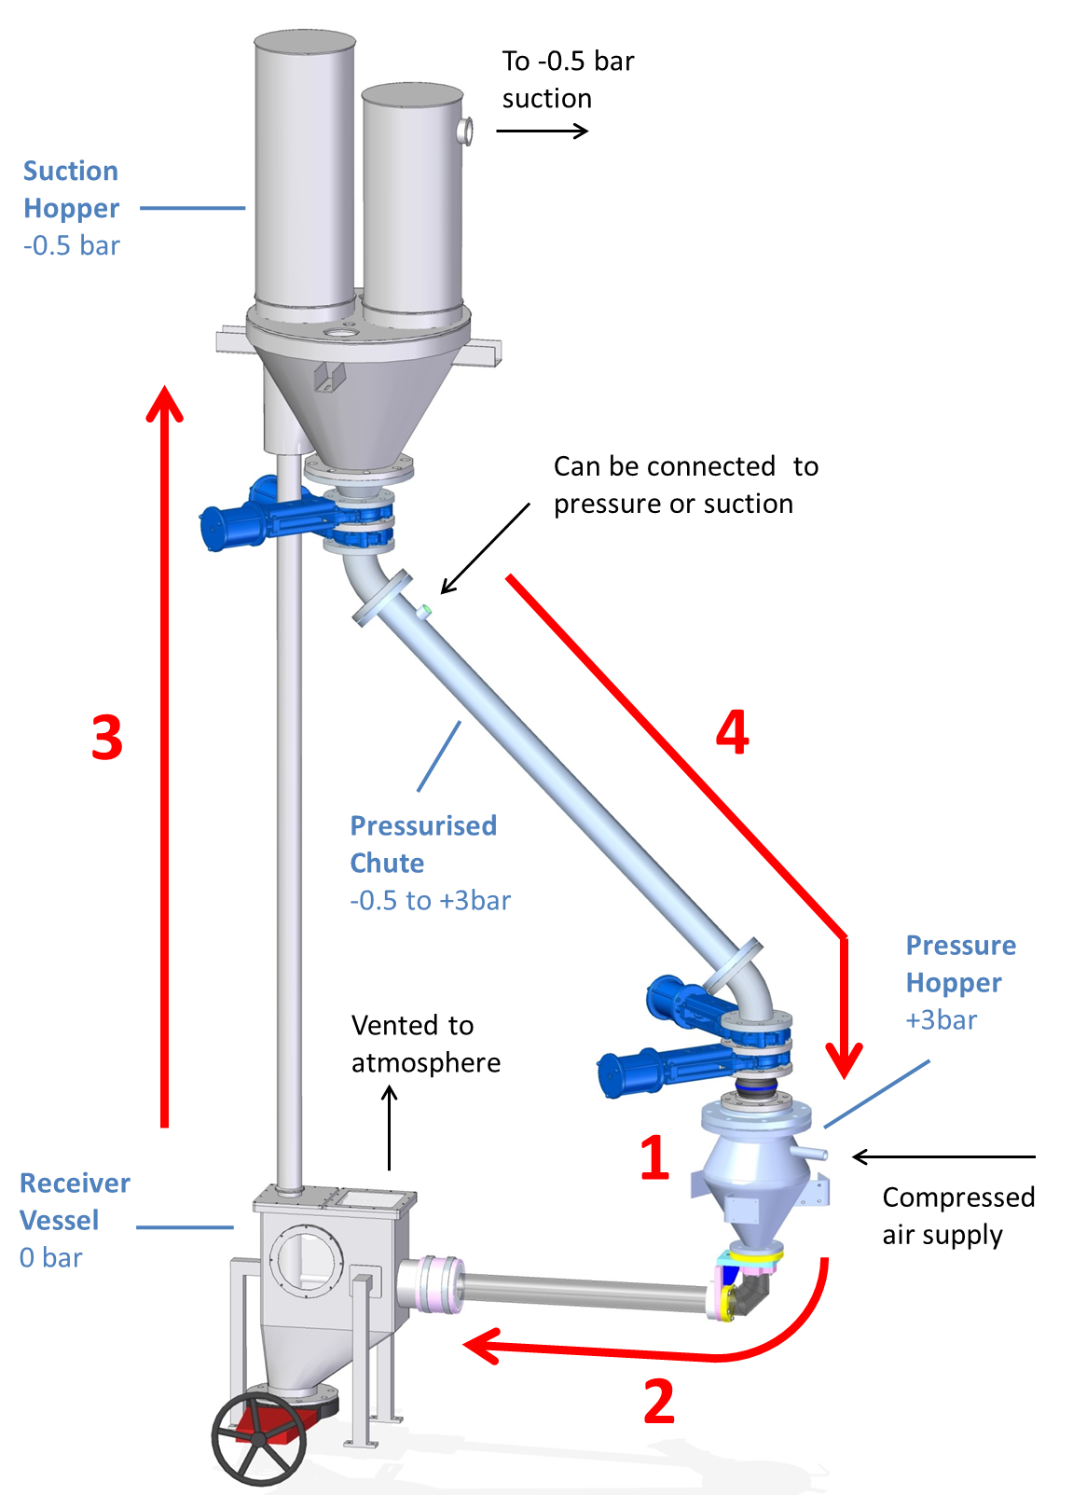
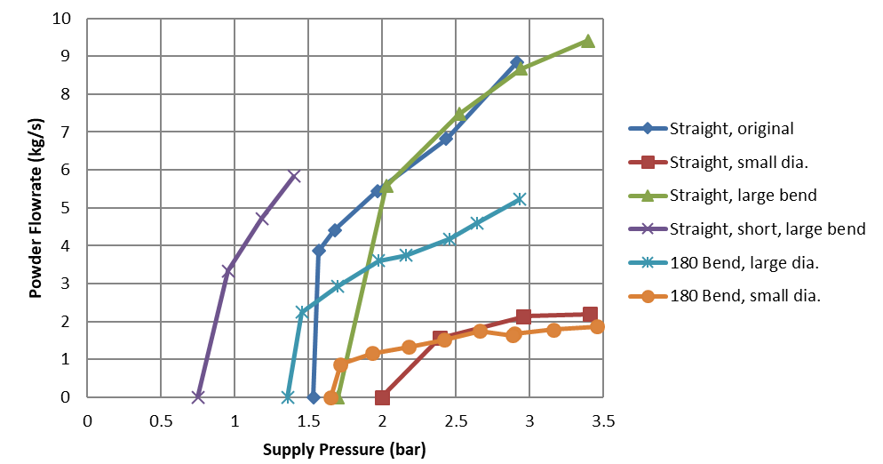
Previous Studies
Batched process flow in air, quasi-continuous flow possible with buffer chute pressurisation
~25-250μm tungsten powder
Showed flow regimes can be manipulated with driving pressure
Active test section ~1m in length
Novel data collected for conveying tungsten powder (publication pending)

Slide 12
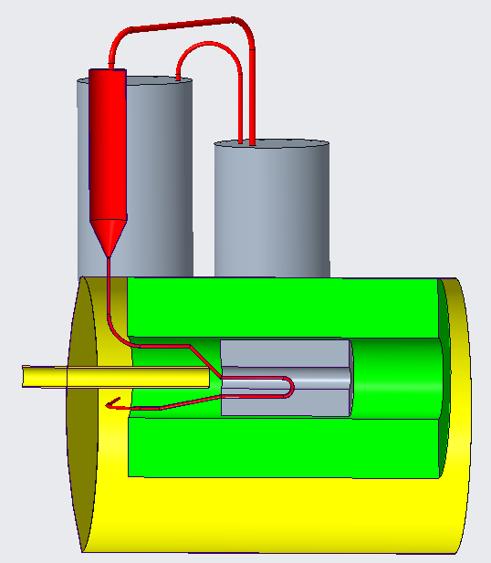
Layout
Target pipe drops in from above
Heat exchangers, compressors, etc all external
Approximately 10m pipe length- determines pressure requirements

Slide 13
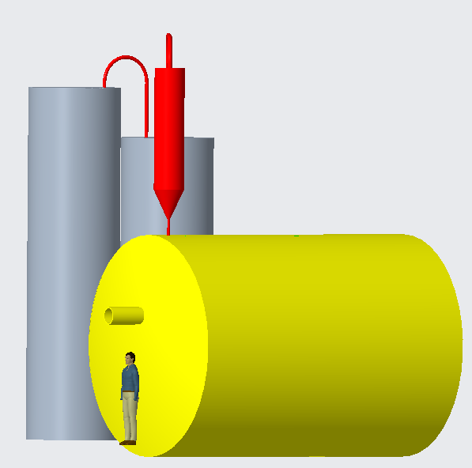

Slide 14
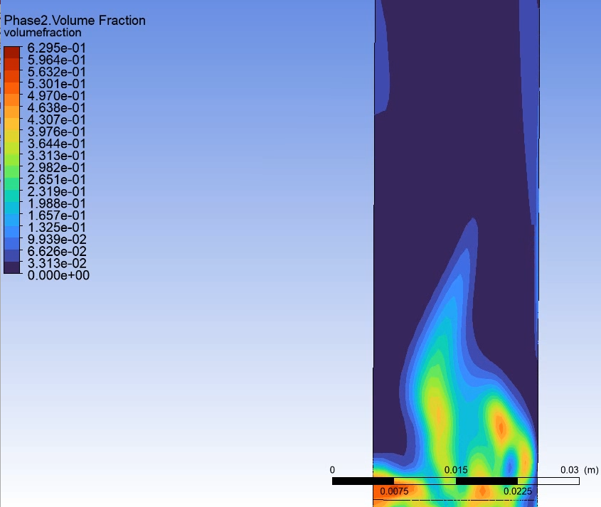
Current Status
Gas flow out
Previous work reimagined in a Muon Collider context
Rough layout devised
Feasibility of key components being assessed
  Contact made with UK academic centre
First approximations made of target heating and flow requirements
Target performance optimisation effort underway (see W Bishop)
Simulating fluidization is difficult, and hard to validate!
WRONG!
Gas flow in

Slide 15
Challenges
Heat deposition
Pressure
Erosion
Process design

Slide 16
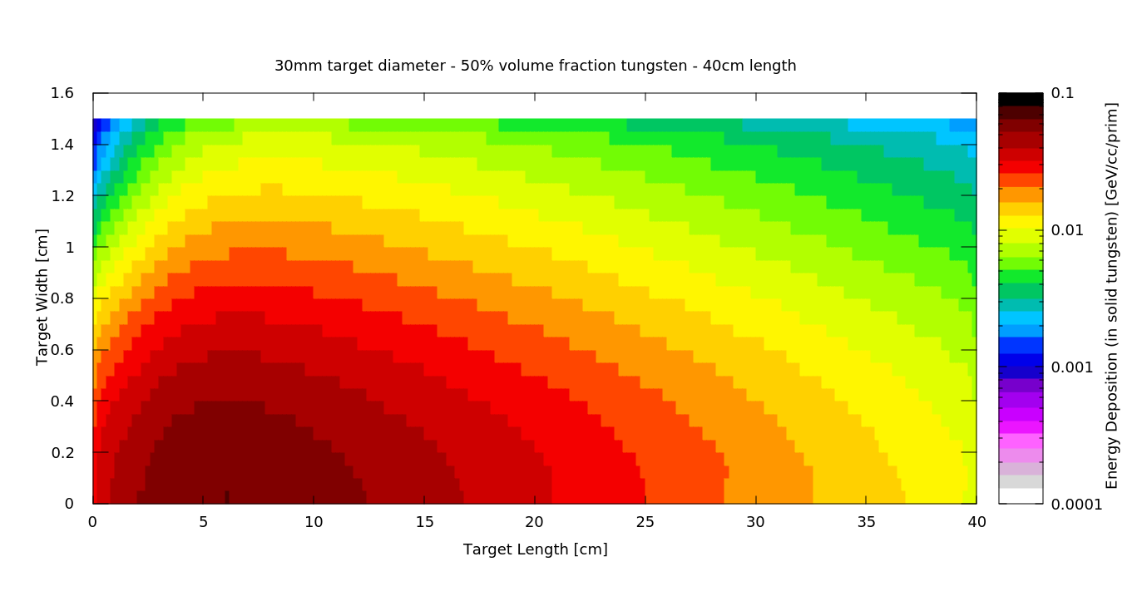
Heat Deposition
Intense heating on beam pulse
~5 J/mm³.pulse possible
  This must be reduced to 1.5-2 J/mm3.pulse max
Can control heating with either beam parameters or target density
Figure For Reference Only

Slide 17
Heat Deposition
Figure For Reference Only

Slide 18
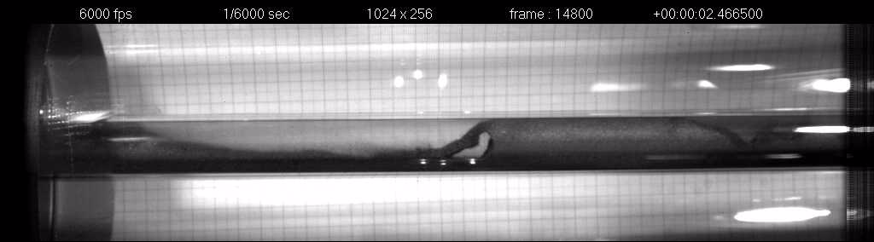
Pressure
Minimising total circuit length reduces pressure
Flow properties should scale well from previous test rig
  High, but manageable pressures ~1.5 bar/m
  Optimisation should improve this
Offline tests of each section will highlight areas of interest

Slide 19
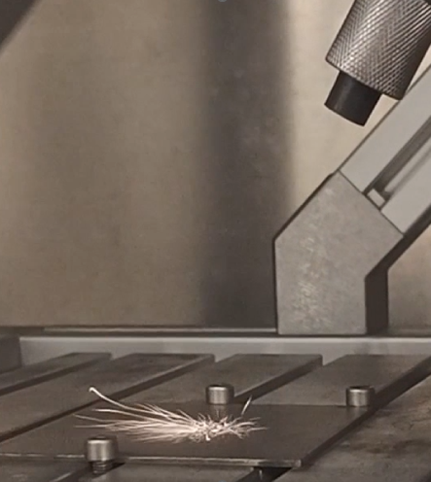
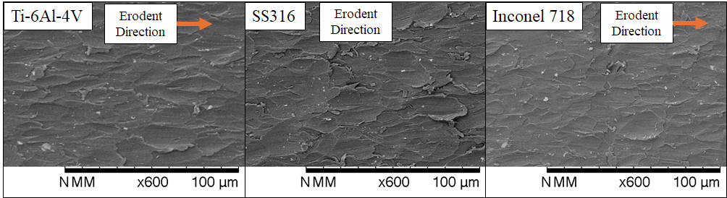
Erosion
University of Sheffield masters project to develop an erosion test capability
Second masters project next year to gather data
Erosion expert visiting researcher will work on this project
SiC-SiC Composite material samples on my desk ready to test!

Slide 20
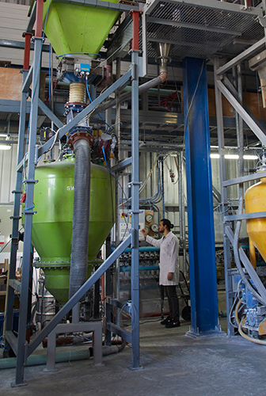

Process Design
Pneumatic conveying is a mature technology!
Only novelty is helium driving gas and high-density tungsten
UK has significant expertise in this area
  University of Greenwich Wolfson Centre
  UK Industry
Current Industrial interest in dense fluidization
  Nuclear and catalyst applications

Slide 21
Challenges
Opportunities
Heat deposition
  Design in parallel with Physics optimisation
Pressure
  Minimise piping length, test with off-line rig
Erosion
  Ongoing work to assess at University of Sheffield
Process design
  Use STFC expertise in facility design
  Industrial expertise pneumatic conveying and powder handling plant
  Offline Testing!

Slide 22
Summary
Fluidized Tungsten is a promising target material for higher beam powers
Focus on R&D plan
  Prioritising problem components
  Versatile, cost-efficient test rig in the future?
Increase confidence in key components through theoretical studies
Add detail to the target concept as more becomes known
Exploit opportunities for academic and industrial collaboration

Slide 23



Questions?
Notes:
The abstract pattern can be removed or repositioned if required. Be careful to ‘Send to Back’ so that it does not obscure any important information.

Slide 24
Backup
Notes:
The abstract pattern can be removed or repositioned if required. Be careful to ‘Send to Back’ so that it does not obscure any important information.

Slide 25
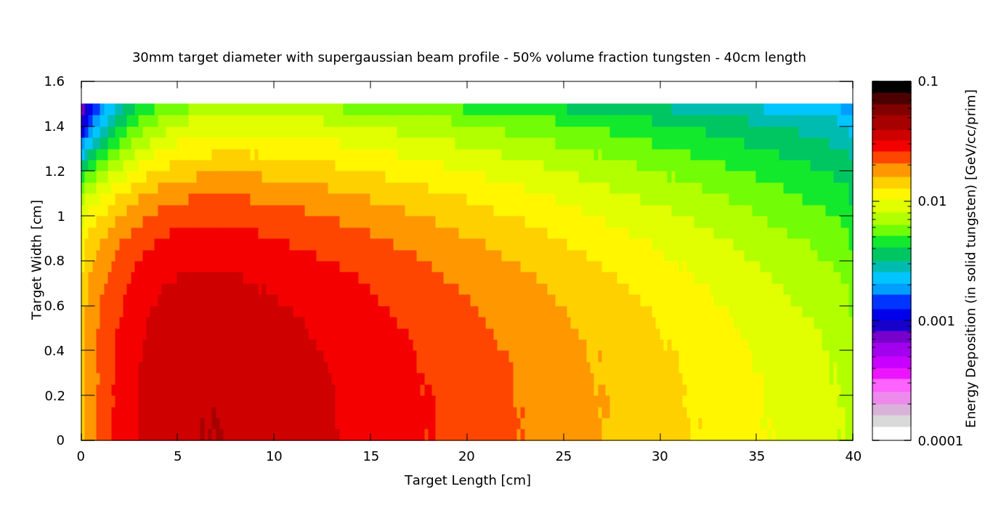
Flat Topping Beam
Gaussian Ø30mm
Allowable Beam Power 1.17MW
Supergaussian Ø30mm
Allowable Beam Power 1.85MW
Allowable Power → ΔT < 600K

Slide 26
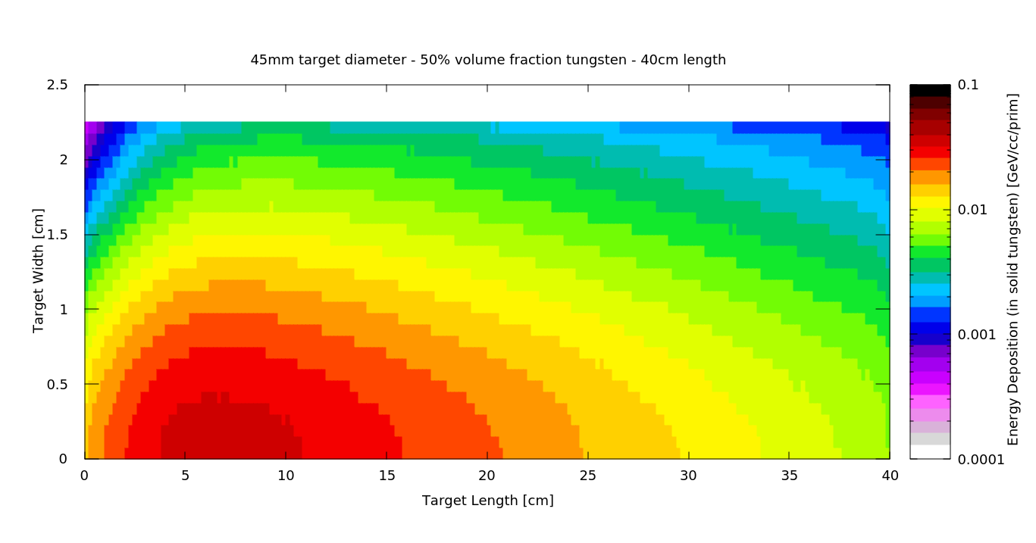
Changing Diameter
Gaussian Ø45mm
Allowable Beam power 2.04MW
Supergaussian Ø30mm
Allowable Beam Power 1.85MW
Allowable Power → ΔT < 600K

Slide 27
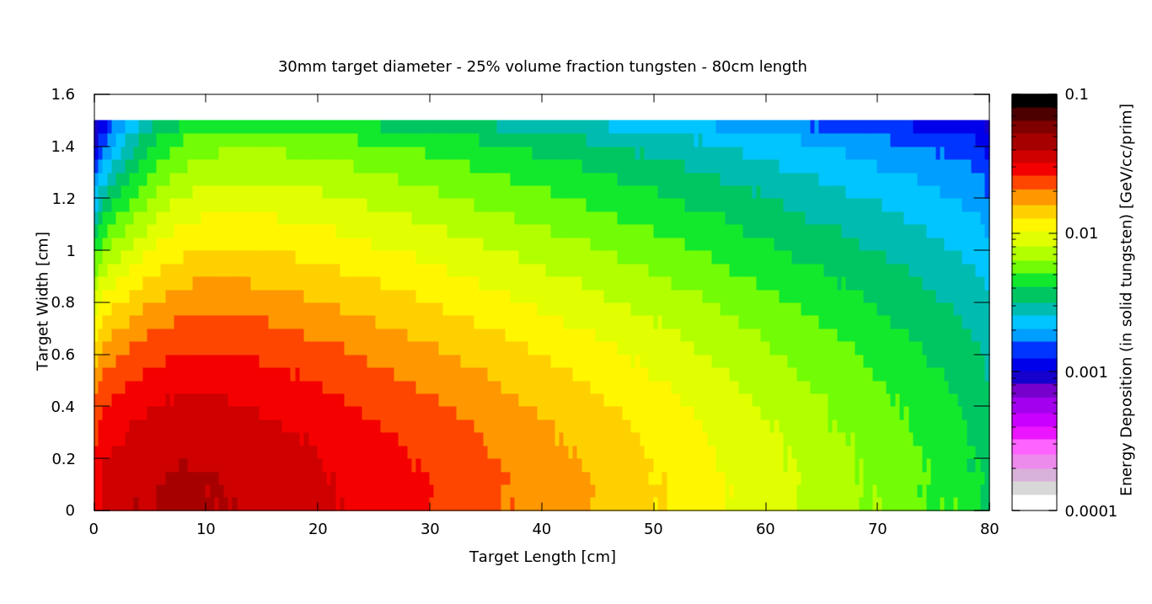
Changing Density
Gaussian Ø30mm, 25%
Allowable Beam power 1.69MW
Supergaussian Ø30mm, 50%
Allowable Beam Power 1.85MW
Allowable Power → ΔT < 600K

Slide 28
Power on Target, Varied Parameters

Slide 29
Potential with Supergaussian?

