Slide 1




RF Power Sources for Muon Collider
Alexander Spelling

Slide 2
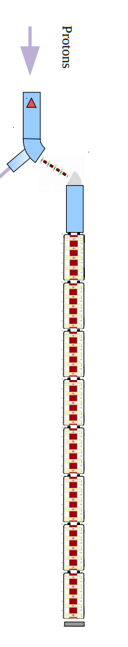
Muon Cooling Demonstrator Layout:
A. Grudiev and R. Losito
MC RF WG meeting #5: Sept 21
Requirement is a 24MW peak power Klystron for each station of 8 cavities at 704MHz and 352MHz.
modulator
RF for cooling: Max. gradient 30 MV/m
klystron
24MW
WG distribution with phase adjustment to feed 2 x 4 cavities
RF for 144 cavities at
~30 MV/m
30m x 14m
18 RF stations
Building -> Gallery :
(underground might be possible)
30m x 15m
Height: 8-10 m
32m
WG
WG
cavity
cavity
cavity
cavity
cavity
cavity
cavity
cavity
14m

Slide 3
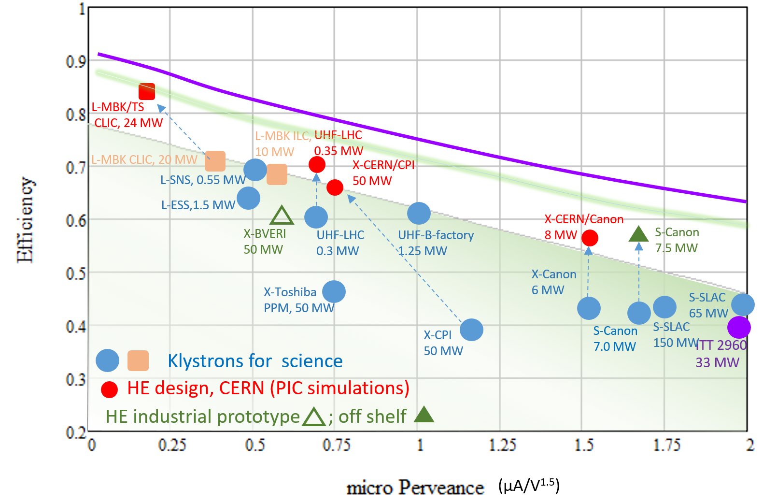
Klystrons for RF Power
Klystron efficiency is typically limited by space charge.
The effect is quantified simply as "perveance"
The perveance is expressed simply by : I / V^{3/2}
High perveance shortens bunching length but decreases the maximum attainable efficiency.
Ultimate limit?
Notes:
-Klystrons typically are represented as microperveance as the beam voltage is in the tens or hundreds of kV whereas the current is usually in the order of tens of amps.

Slide 4
Existing Klystron Tubes
Existing high peak power Klystrons are predominantly at high frequency.
CLIC tube at 20MW 1GHz is within scaling range to 704MHz*
Interaction length is inversely proportional to drive frequency.
Scaling is not always viable.
*352MHz is the focus of Graeme Burt
704MHz is the focus of Alexander Spelling

Slide 5

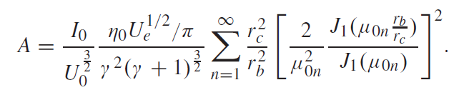

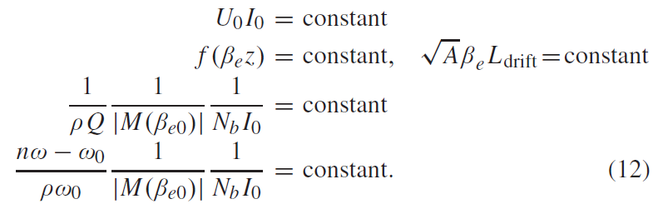
Parametric Scaling Principle (PSP)
Key numbers in klystron scaling are the electron wavelength, Beta, and the bunching parameter, A,
If we scale a klystrons voltage, current, or frequency certain relationships need be maintained
Scaling the frequency down the 1GHz CSM based CLIC tube to 704MHz would result in an increase in length of ~1.4x.
Notes:
Bunching Parameter A contains the filling factor, beam perveance, gamma factor, bessel function terms etc.
1.4x Length increase isn't terrible, the 352MHz equivalent would be ~3x in length.

Slide 6
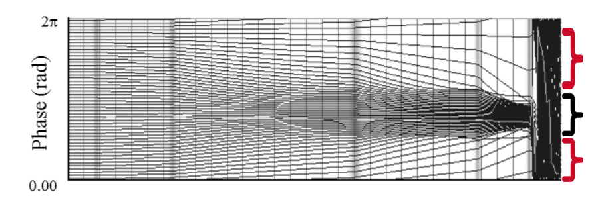
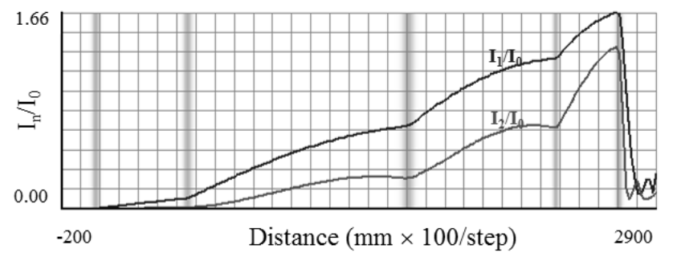
Standard Klystron Bunching Scheme
"Applegate Diagram"
An applegate diagram is a moving window showing the phase relationship between particles.
The standard bunching technique is to add cavities at local maxima.
The output cavity is placed at the point where the harmonic current saturates.
The anti-bunch describes the particles which are not in the useful phase bucket – negative contribution to power extraction
Antibunch
Bunch
Antibunch
[Baikov et al, 2019]
This technique provides moderate efficiencies ~(>70%).
Ideal bunch saturation is not achieved, anti-bunch still populated
Notes:
[1] "Toward High-Power Klystrons With RF Power Conversion Efficiency on the Order of 90%". Andrey Yu. Baikov, Chiara Marrelli, and Igor Syratchev

Slide 7
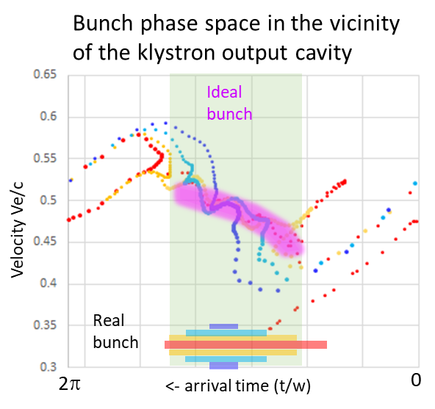
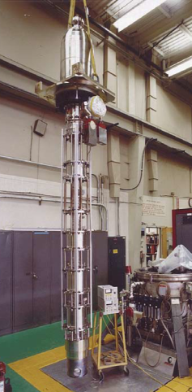
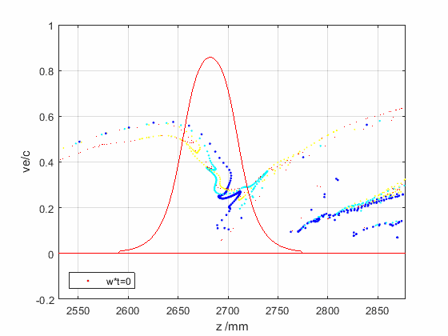
Factors limiting efficient RF power extraction
E field expansion in the drift tubes causes beam reacceleration when it leaves the output cavity.
Ohmic loses are proportional to the operating frequency.
Space charge depression is a partial conversion of the beam kinetic energy into the potential DC energy of beam traveling in the drift tube.
Bunch saturation is optimal, when all the electrons populate only the useful RF phase bucket leaving the anti-bunch empty.
Bunch congregation is a normalized elections velocity spread along the bunch. It has an optimal value for every given bunch length.
Bunch stratification is a radial dependence of the bunch length and congregation. The ideal bunch should not have such a dependency.
Radial bunch expansion happens during beam deceleration in the output cavity in the presence of external solenoidal magnetic field.
Reflected electrons could be generated if some of the above effects are not balanced.
SLAC B-factory CW
0.478GHz, 1.25 MW
Arrival plane
Efficiency 61%
Driven by klystron general parameters.
Driven by RF design and space charge effects.

Slide 8
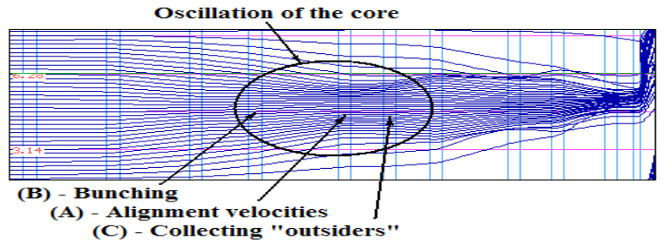
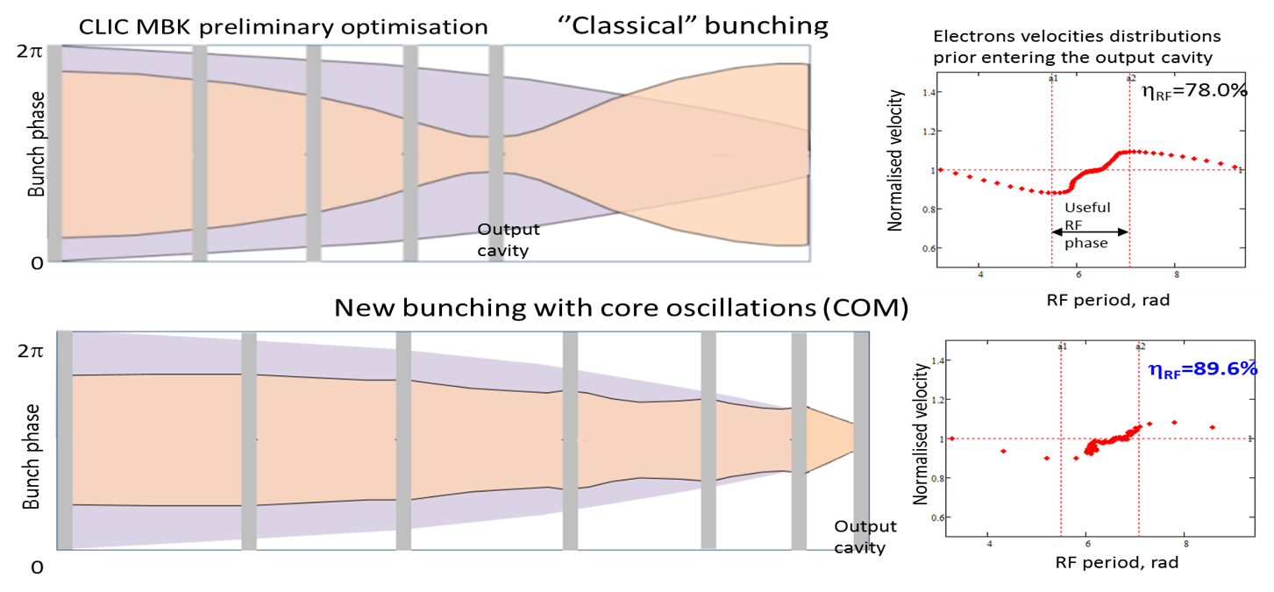
Methods to Enhance Bunch Saturation
New bunching techniques have been recently developed to improve bunching efficiency.
Bunch-Align-Collect (BAC): use of a large number of RF cavities in closely spaced cavity triplets which perform direct oscillations of the bunch core.
2.
Core Oscillation Method (COM): alternating forces of de-bunching from the space-
charge and the bunching from the cavities oscillate the bunch core whilst collecting the anti-bunch.

Slide 9
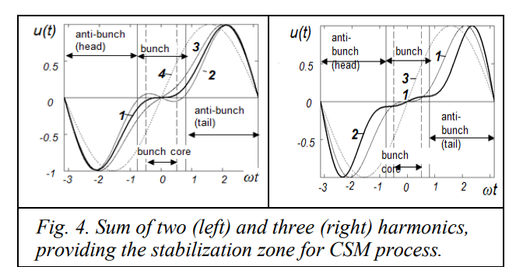
Methods to Enhance Bunch Saturation
New bunching techniques have been recently developed to improve bunching efficiency.
3.
Core Stabilisation Method (CSM): utilises higher order harmonics (2nd and 3rd) to provide a stabilised region for electrons in the bunch core whilst enabling the periphery to continue bunching.
CSM Tube appears ideal for single stage at this frequency as:
Bunching Circuit can be shortened.
Achievable efficiencies >80%
[A Baikov, O Baikova, IVEC 2019]
Notes:
[2] "Simulation of High-Efficiency Klystrons with the COM and CSM bunching" by Andrei Bakov and Olga Baikova for IVEC Busan 2019
+ Allows for a shorter bunching interaction circuit than BAC and COM whilst maintaining reasonably high efficiency.
+ Requires fewer cavities to implement.
- Increased complexity in design due to the higher order harmonic cavities.

Slide 10
Scaling FCC CSM Klystron to Multi-Beam Klystron
The most suitable scaling candidate was the 6 Cavity FCC 800MHz single beam tube.
Scaling and modifying the beam properties to be more conservative gave a single beam baseline at 704MHz
With the assumption that each beam would provide ~1.1MW.
24 MW would require 22 of these beams.
CSM 704MHz, Filling Factor: 0.65
Beam Voltage: 125kV
Beam Current: 11A
Interaction Length: 2.1m
µPerveance: 0.247
Output Power: 1.1MW (per beam)
Efficiency: ~80.9%*
*Each beam in a multi-beam cavity contributes to the shunt impedance.
Approximation is only sufficient to determine the cavity beam count.
Notes:
Each beam in a multi-beam cavity contributes to the shunt impedance.
Therefore, scaling linearly only works as a beam count approximation.

Slide 11
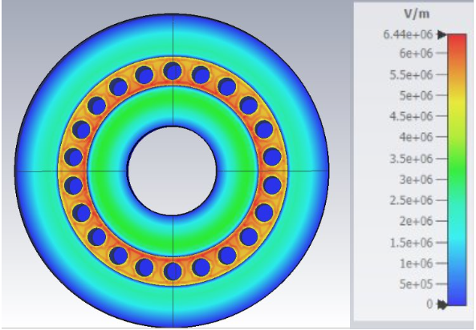
Design of 22-Beam Cavities
Desirable to maximise the effective shunt impedance R x M^2 of Klystron cavities
(where R is the shunt impedance of the cavity and M is the gap coupling factor).
Frequency of cavity can be tuned to vary the impedance the bunch experiences.
Fundamental_100_85_10
R/Q = 40.8095
Q = 19198
M = 0.783
*RTh is the Re-entrant Thickness
Notes:
M is transit time factor for Klystrons. T for particle accelerators.
Cavities share a radius to give each beam equivalent shunt impedance.

Slide 12
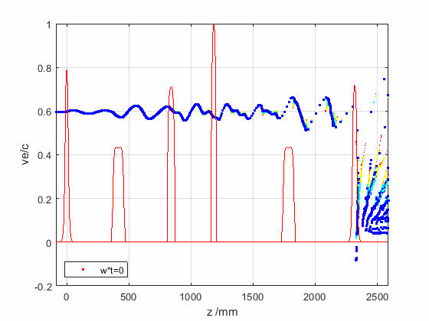
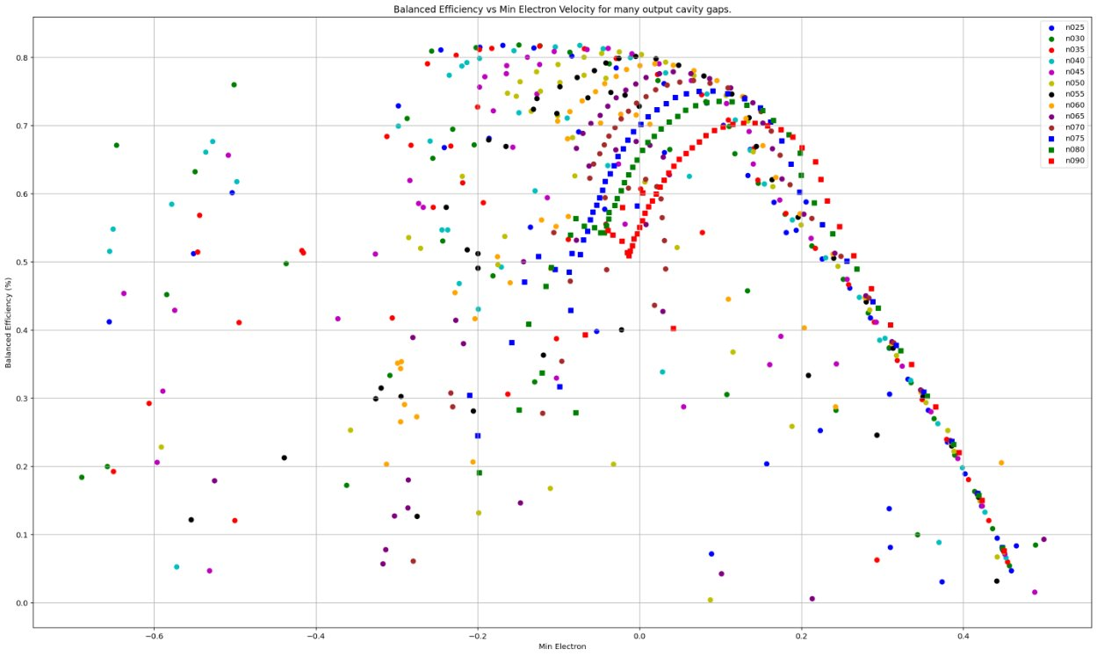
Maximisation of Power Extraction at the Output Cavity
Maximum power extraction occurs when the "bouncing" effect is maximised.
As the bunch decelerates, the minimum electron velocity is negative but is re-accelerated at the output gap.
If the beam is decelerated too significantly - this may lead to reflected electrons or an accumulation of space charge.
Output Cavity Bouncing

Slide 13
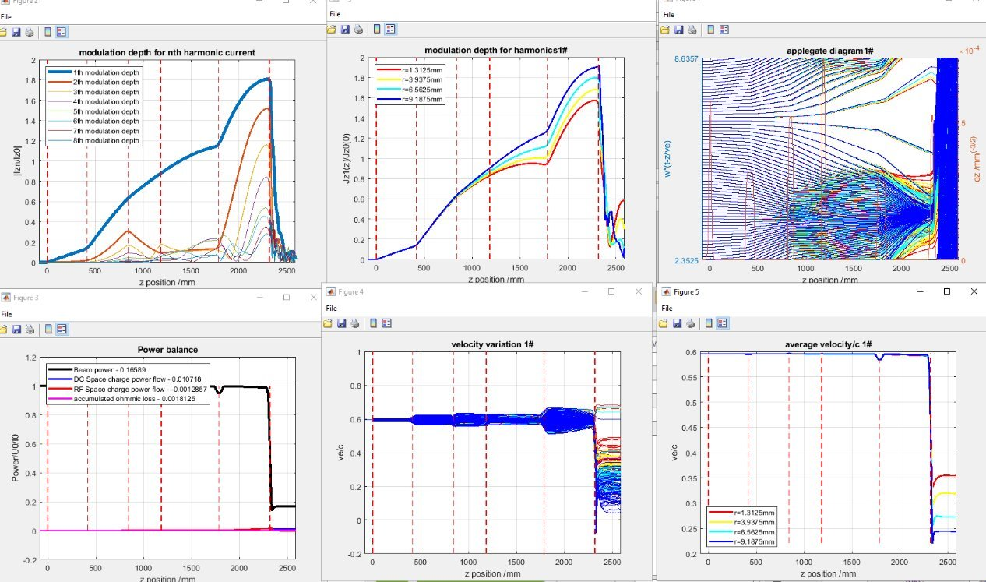
Klystron with Actual Cavity Field Data
Optimisation of the Klystron in KlyC using the cavity field data increases the efficiency to 82.29% but results a slight increase to the interaction length from 2.1m to 2.3m
2nd Harmonic
3rd Harmonic
The best efficiency of 82.29% is present with an RF drive power of 1300W
Notes:
Radial Stratification visible at the modulation depth and applegate.

Slide 14
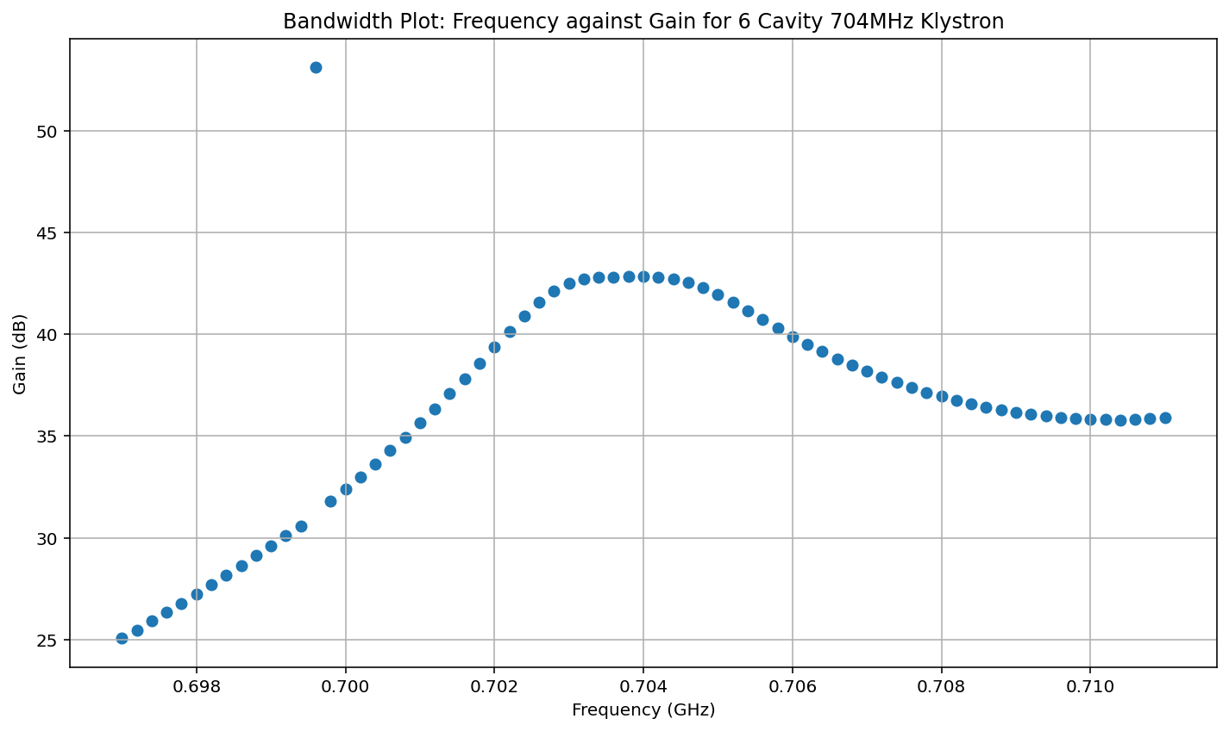
Bandwidth Curve for 6 Cavity Klystron Design
Input Cavity QExt was set to 484 where highest gain was present.
A high Input QExt increases the gain, but decreases the bandwidth
Ideally, QExt should be as low as possible (~150 as target).
Losses in gain need to be restored.
Solution – add another buncher
-3dB Bandwidth of 4MHz – far too narrow
Notes:
Bandwidth of 1% is about 7MHz
FCC tube had an extremely high external Q factor at the input cavity (484 was lower than the FCC example) – this tube inherited in part that problem.

Slide 15
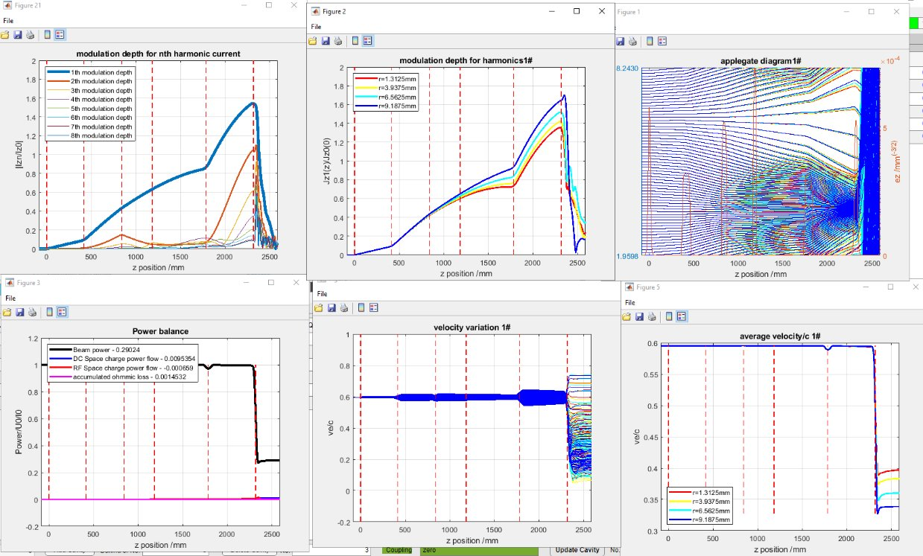
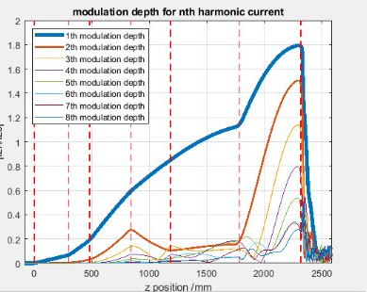
Additional Cavity to Recoup Performance
An additional bunching before the 2nd harmonic restores the efficiency lost from the drop in QExt.
6 Cavity, QExt = 484
6 Cavity, QExt = 150
7 Cavity, QExt = 150
Eff. 82.29%
Eff. 69.94%
Eff. 82.05%
Additional cavity added before 2nd harmonic

Slide 16
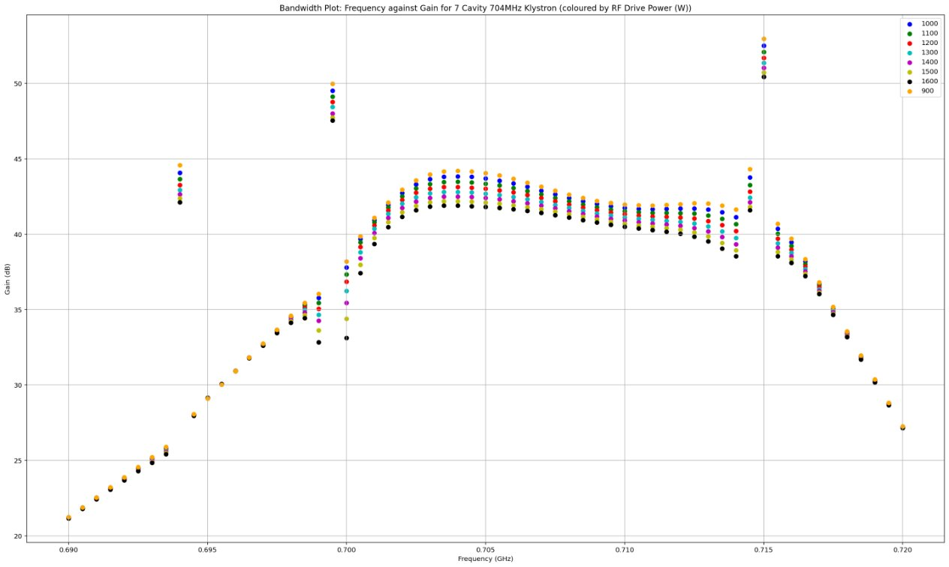
Bandwidth Curve for 7 Cavity Klystron Design
-3dB Bandwidth has increased by ~3 times.
Erroneous points show reflected electrons.
These occur where a bunching cavity is tuned close to a harmonic of the drive frequency.
Removing these from the flat top could get a –3dB bandwidth of ~14MHz
Retuning bunchers frequencies will allow a wider usable bandwidth.
Notes:
14MHz is just shy of 2% bandwidth.

Slide 17
Conclusion
24MW 704MHz Klystron is viable, would substantially reduce the number of required Klystrons for the Muon Collider.
Viable design is proposed with wide bandwidth in KlyC at ~82% Efficiency.
Need to move onto full scale PIC simulations.
22 Beams was based on the approximation of 1.1MW per beam, other beam count Klystrons may be more efficient – need to verify.
Two-Stage Klystron may be viable at this frequency – is the increased complexity worth the size / efficiency improvements?

