Slide 1
Muon Cooling for ISIS:
Towards bright <100keV muon beams
Rhea Stewart, ISIS Muon Group
UK Muon Beams Meeting, RAL
30th April 2025

Slide 2
Muon Cooling for ISIS
Muon Spectroscopy experiments and important beam characteristics
The motivation for low energy experiments on thin films and interfaces
Existing facilities and how they produce low energy muons
LEM beamline @PSI and some examples and limitations
Slow muons @J-PARC
The muCool experiment
A slow muon beam at ISIS
Important considerations compared to PSI and J-PARC Frictional cooling
Possible schemes and test experiments

Slide 3
Muon Cooling for ISIS
Muon Spectroscopy experiments and important beam characteristics
The motivation for low energy experiments on thin films and interfaces
Existing facilities and how they produce low energy muons
LEM beamline @PSI
Slow muons @J-PARC
The muCool experiment
A slow muon beam at ISIS
Important considerations compared to PSI and J-PARC Frictional cooling
Possible schemes and test experiments
Rhea Stewart
Peter Baker
Chris Rogers
Henry Pentz
Adrian Hillier
Alan Letchford
Yu Bao
Yang Li
Wu Chen

Slide 4
Muon Spectroscopy Technique
Spin polarised µ⁺ are implanted into a sample (Implantation, surface muons -> 0.1-1mm and low energy ->10-100nm.)
Muon spins interact with the local magnetic environment.
Decay lifetime 2.2µs: μ⁺ → e⁺ + ν_{e} + ν_{μ} positrons are preferentially emitted along the momentary muon spin direction and collected by arrays of detectors either side of the sample.
Measure the positron distribution to determine the muons’ polarisation in time. Learn about the muons’ local environment or the muon behaviour itself.
Backward Detector
Forward Detector
positrons
W(θ) = 1+ a cos θ

Slide 5
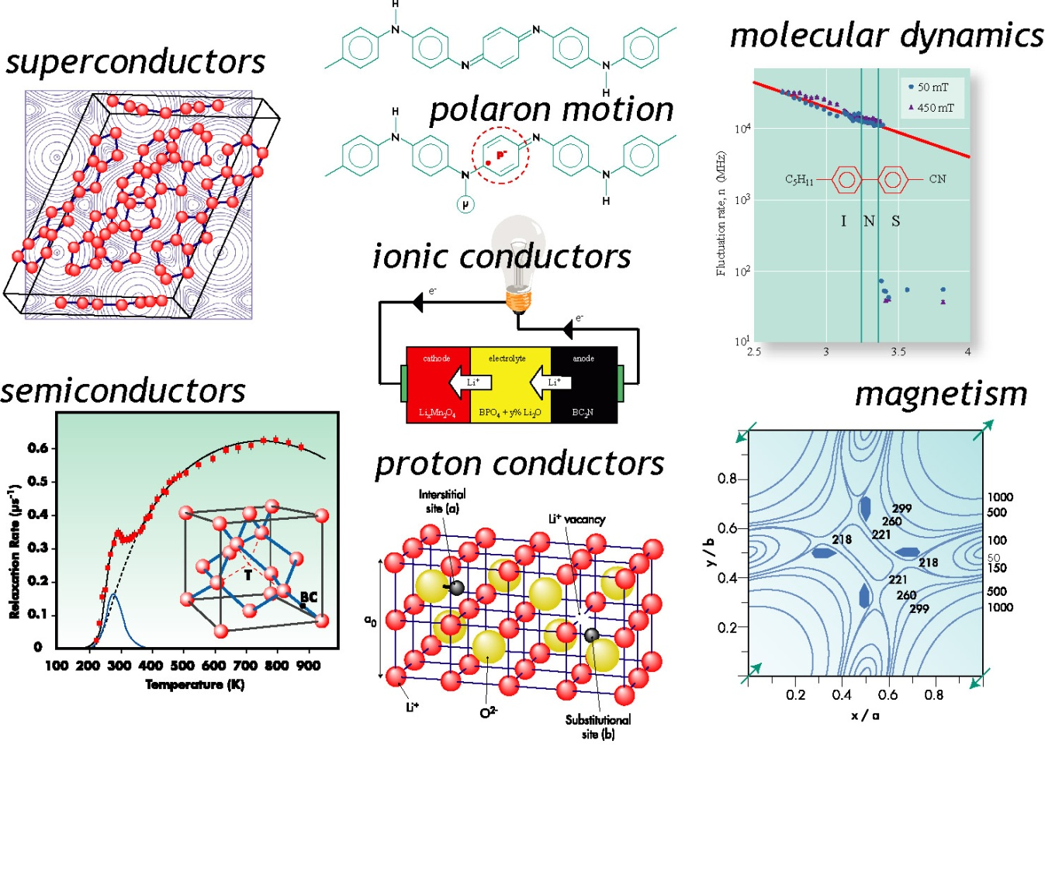
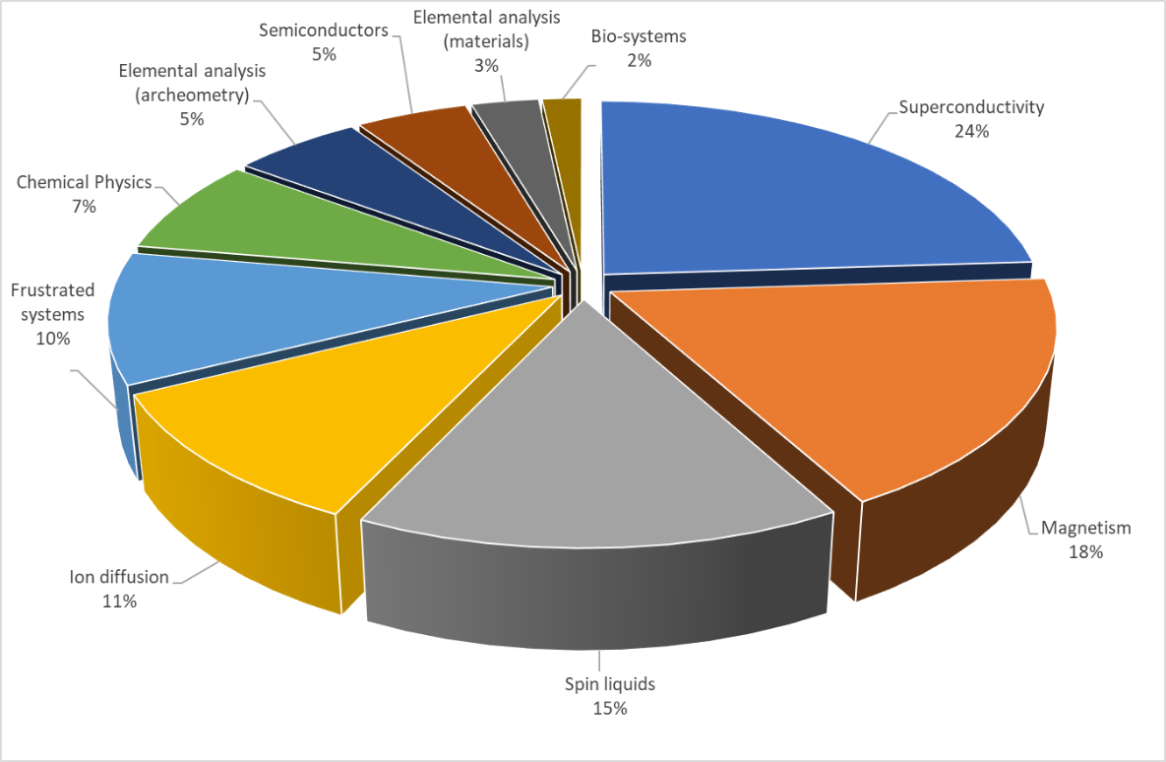
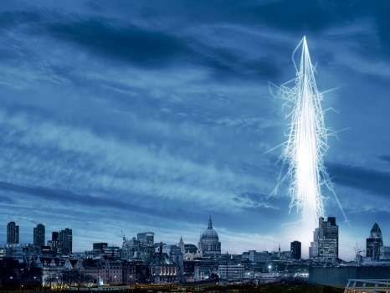
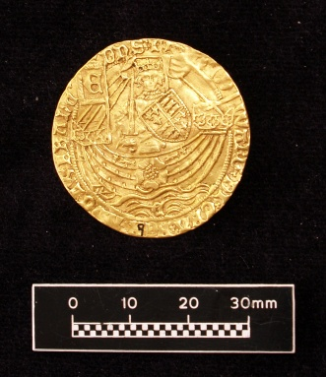
Muon Spectroscopy Applications
Electronics Irradiation
Elemental Analysis
Science areas of ISIS Muon proposals from the last few rounds.

Slide 6
Motivation for Low Energy Muon Beams
Depth of implantation controlled via selection of the momentum of the incoming muons
Muons
Layer 1
Layer 2
Stopping distribution
Implantation depth
7keV, <x>=21 nm
27keV, <x>=82 nm
Sample local magnetism as a function of depth in the ~10-100 nm range.

Slide 7
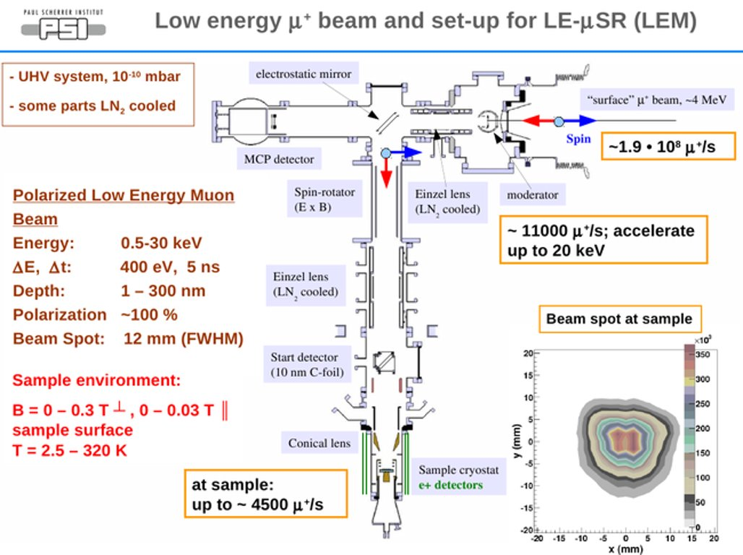
The LEM instrument at PSI (operational since 2000s)
Surface muons at 4MeV stopped in a cryogenic noble gas moderator
Stopped muons extracted from the moderator using ~15kV transport voltage
Muons delivered to sample point, where final energy set by HV applied to the sample plate. 1 – 30keV accessible.

Slide 8
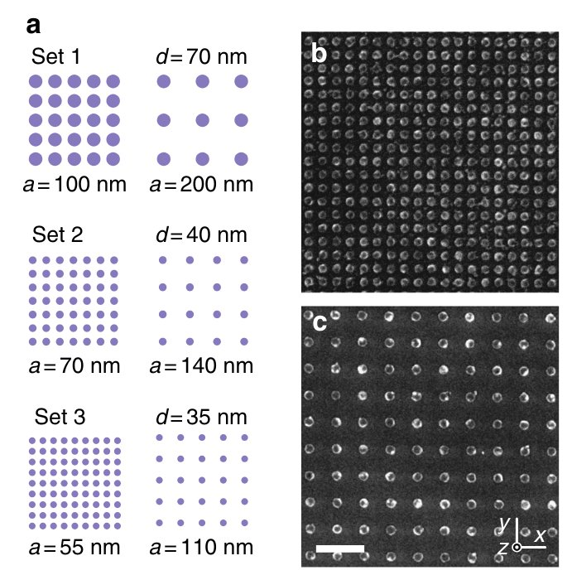
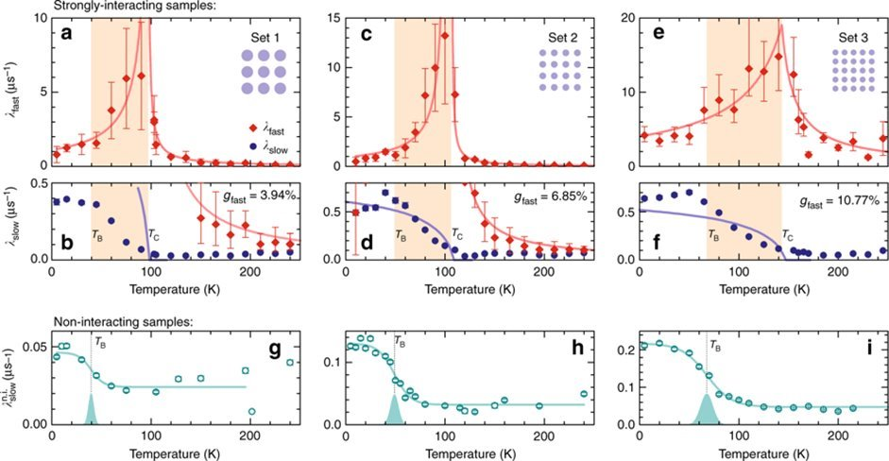
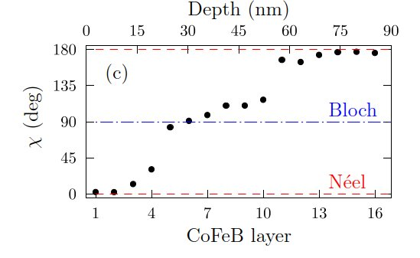
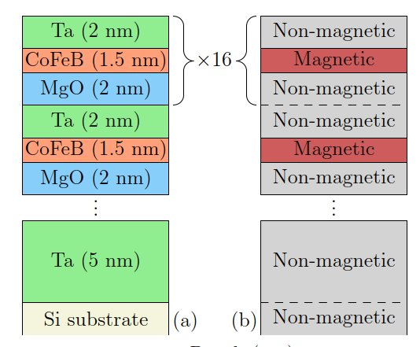
Applications of Low Energy Muon Beams
A wealth of applications in Physics, Chemistry and materials science!
Behaviour of (classical) spins in nanomagnetic systems.
Unconventional superconductivity at buried interfaces
Leo, N.et al., Nat Commun 9, 2850 (2018)
Depth resolved studies of magnetic textures
T. J. Hicken et al., Phys. Rev. B 109, 134423 (2024)
Nature Communications volume 14, Article number: 5081 (2023)

Slide 9
Applications of Low Energy Muon Beams
A wealth of applications in Physics, Chemistry and materials science!
Behaviour of (classical) spins in nanomagnetic systems.
Unconventional superconductivity at buried interfaces
A typical measurement needs 10s of millions of positron events and experiments are often limited by both count rate and beam spot size vs available sample size. significant benefit from higher brightness beams.
Leo, N.et al., Nat Commun 9, 2850 (2018)
Depth resolved studies of magnetic textures
T. J. Hicken et al., Phys. Rev. B 109, 134423 (2024)
Nature Communications volume 14, Article number: 5081 (2023)

Slide 10
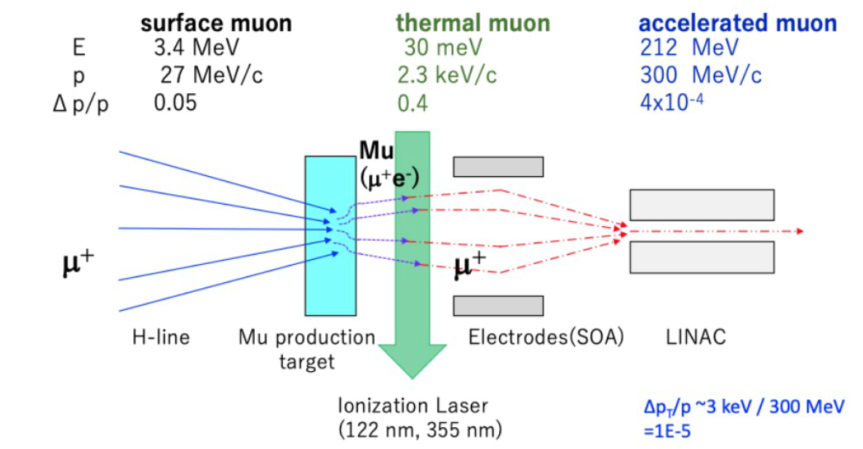
Ultra Slow Muons at J-PARC (in development)
Surface muons captured by a muonium production target (tungsten or aerogel).
Thermal muons liberated from muonium
muons reaccelerated: U-line: keV H-line: 100s MeV
S. Kamioka et. al., PoS Muon4Future2023, 2024
Beam spot as small at 5mm

Slide 11
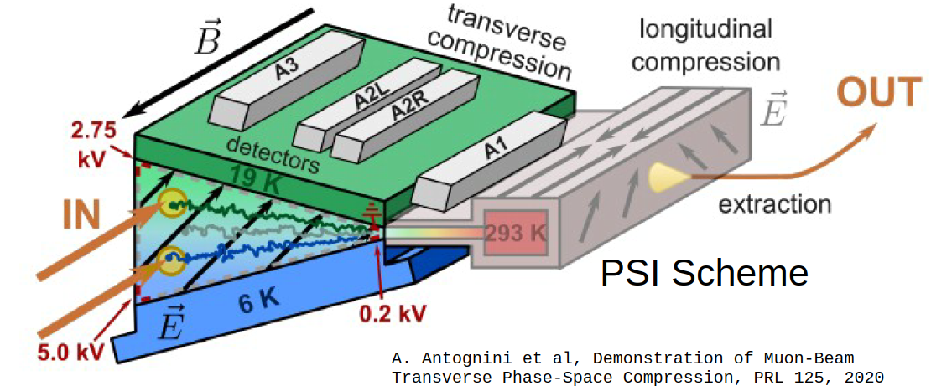
The muCool experiment
Surface muons undergo frictional cooling and transverse compression in cryogenic He gas.
Slowed muons reach the transverse compression stage and are extracted as a bright beam at keV energies.
A. Antognini et al, PRL 125, 2020
Combined longitudinal and transverse compression has now been demonstrated. Expected cooling efficiency is ~10⁻³, giving a 5mm beam at ~10⁵ muons/s.

Slide 12
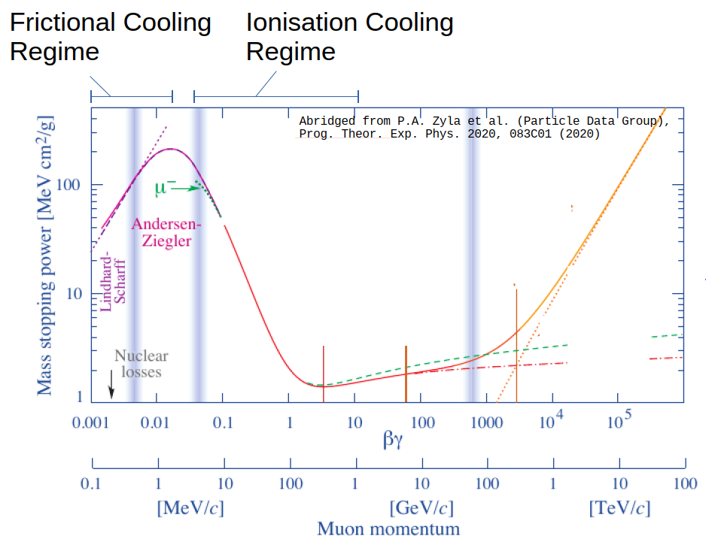
A slow muon beam at ISIS
Wishlist:
Cooling from MeV keV energies
Need to retain a short pulse beam (vs PSI)
Need good efficiency (vs J-PARC)
Need to retain close to 100% spin polarisation
Ideal beam spot of ~ 5mmx5mm

Slide 13
A slow muon beam at ISIS
Wishlist:
Cooling from MeV keV energies
Need to retain a short pulse beam (vs PSI)
Need good efficiency (vs J-PARC)
Need to retain close to 100% spin polarisation
Ideal beam spot of ~ 5mmx5mm
Plan to use frictional cooling in high purity He gas
High energy muons lose more energy
Low energy muons lose less energy
Achieve energy compression
Slowed muons extracted with a short pulse HV
Courtesy of Chris Rogers

Slide 14
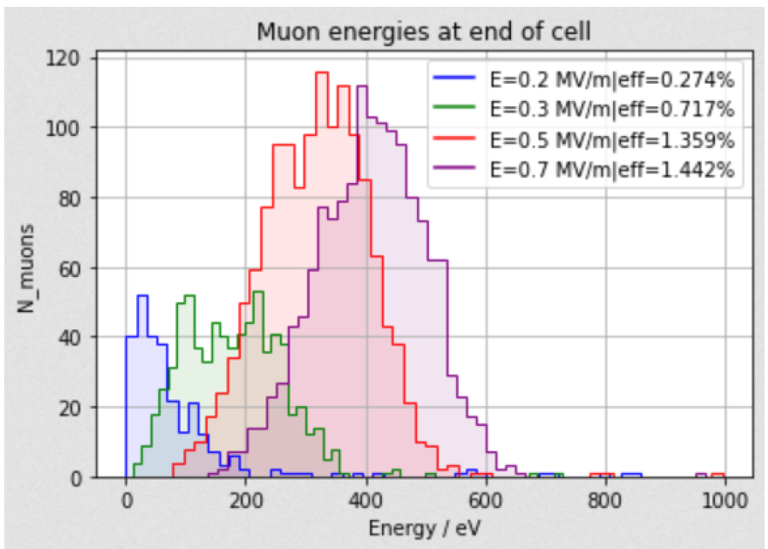
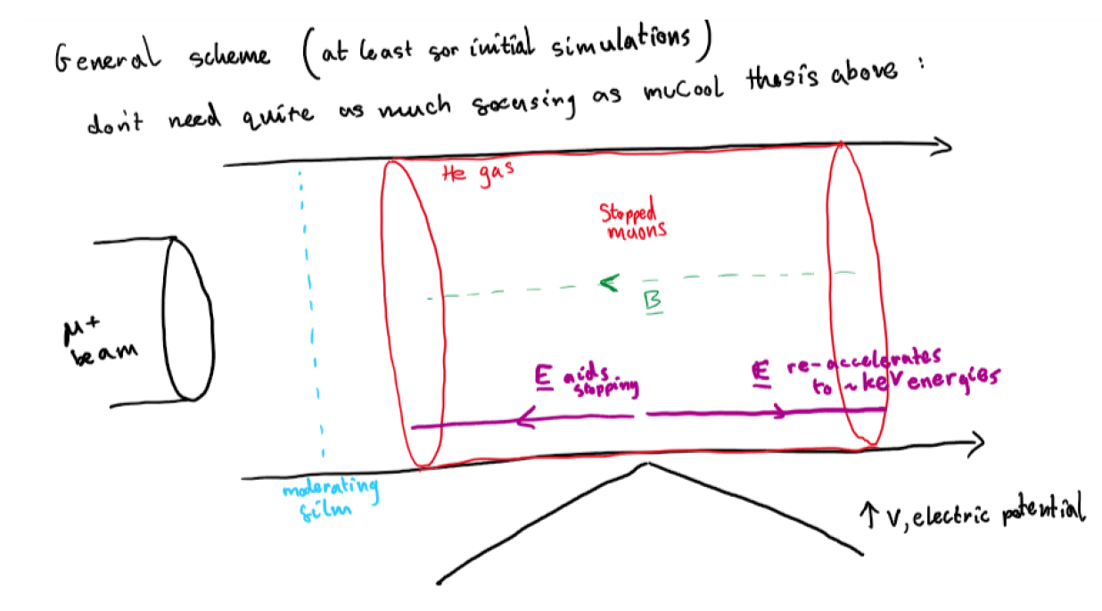
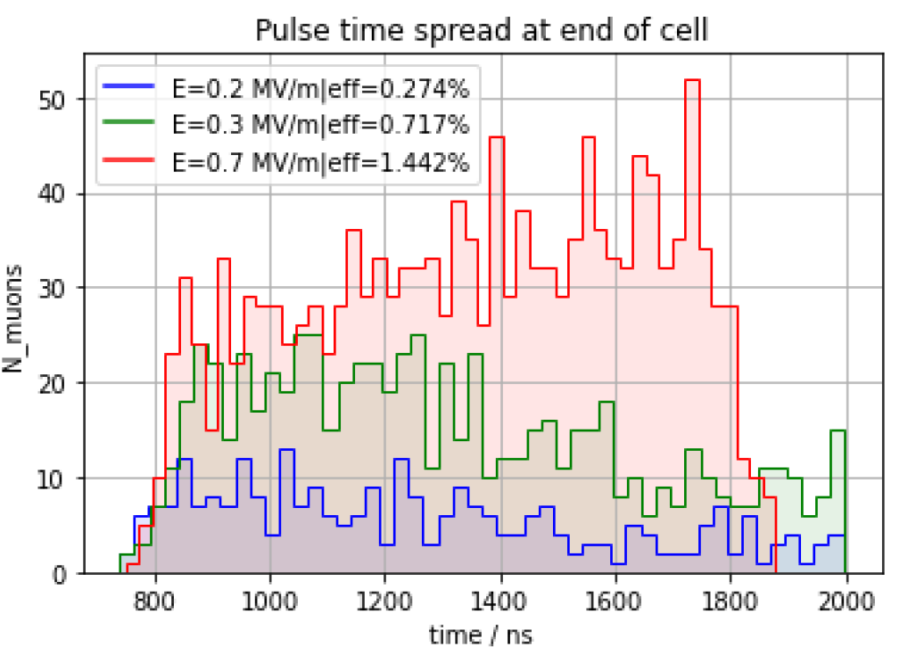
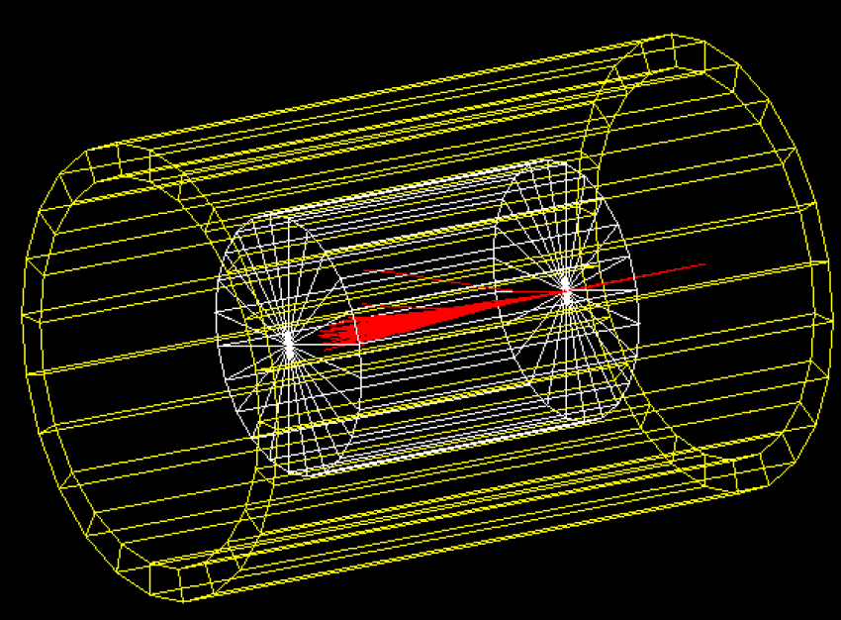
Possible Cooling Schemes for ISIS
Initial simulations focused on a simple system with static E field:
Pulse broadened in time as it passes through cell!
Courtesy of Henry Pentz, ISIS summer student, now a PhD student at Berkeley

Slide 15
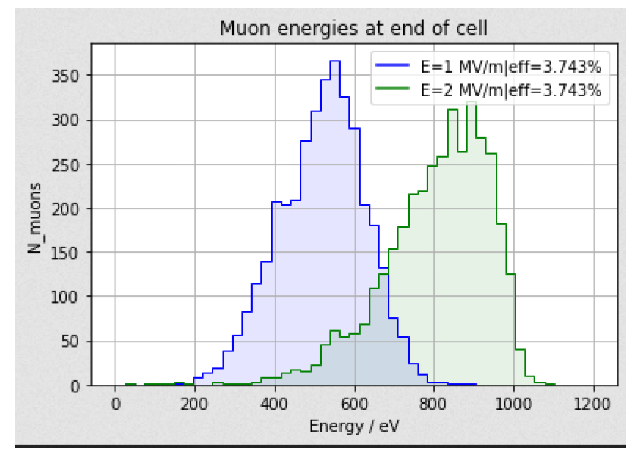
Possible Cooling Schemes for ISIS
Initial simulations focused on a simple system with static E field:
Initial tests with a pulsed E-field indicated a ~ 4-fold improvement in the number of muons stopped.
Courtesy of Henry Pentz, ISIS summer student, now a PhD student at Berkeley

Slide 16
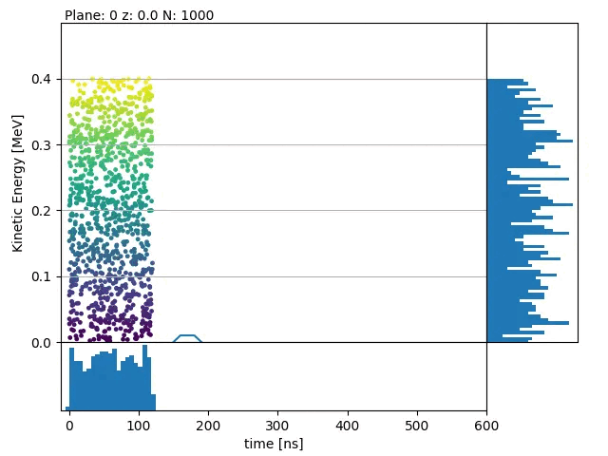
Possible Cooling Schemes for ISIS
Pre-moderated muons captured by an EM wave
Fast muons slowed more, slow muons slowed less
End bunch is sharp in time and energy
Fields longitudinal, so loss of spin polarisation expected to be minimised but needs to be checked.
A very interesting concept to explore further!
1MV/m peak gradient, He gas density 0.032*stp
Courtesy of Chris Rogers, STFC

Slide 17
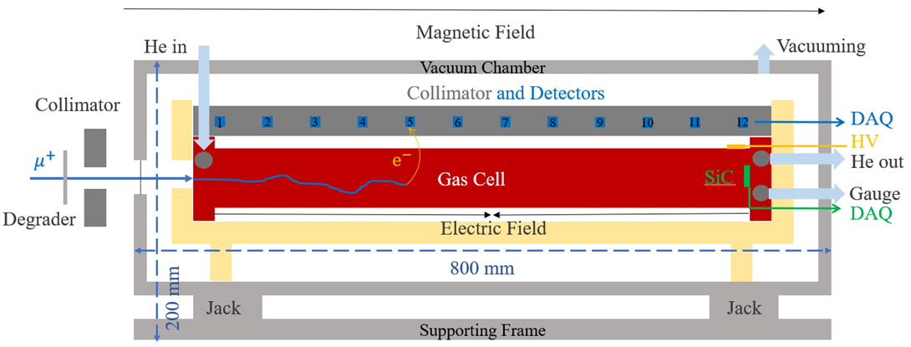
Test Experiments at ISIS
Upcoming (hopefully) experiment with the CSNS team, which will use the HiFi beamline and instrument at the ISIS muon facility:
A simplified muCool
E-field generated outside to reduce risk of HV breakdowns
Testing will allow simulation codes to be benchmarked and inform future designs.
Courtesy of Wu Chen, CSNS Muon Group
Follow up with future work to test Chris's RF concept – could be tested initially with a very simple RF-MuSR experiment.

Slide 18
Conclusions and Outlook
There is significant need to produce high brightness muon beams at keV energies. (Current experiments are limited by slow muon flux, the beam spot size and availability of facility time.)
Significant work in progress at J-PARC and ETH Zurich – PSI in this area, with different applications in mind.
At ISIS, an efficient frictional cooling scheme, with good muon acceptance is needed
Initial studies look promising, and some test experiments are planned
Many technical points to be considered e.g., RF limitations, muonium formation in He gas with impurities, etc...

