Slide 1
Introduction

Slide 2
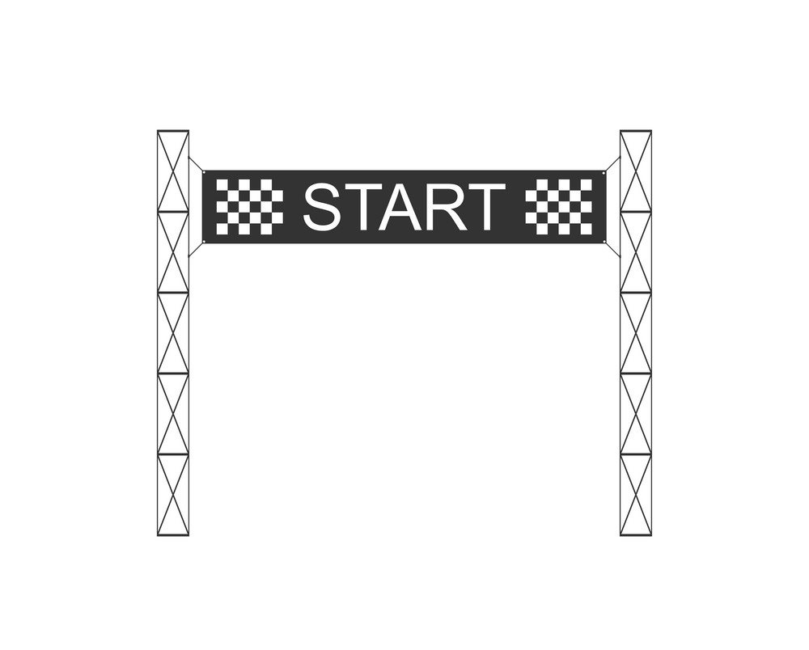

Slide 4
Third pillar must be
brought forward
Timely to develop this central aspect of our programme; so:
Reinitiate discussion of LhARA collaboration programme today
Short & medium term, exploit existing beams
Maintain vision for first measurements when LhARA comes on line

Slide 5
