Slide 1
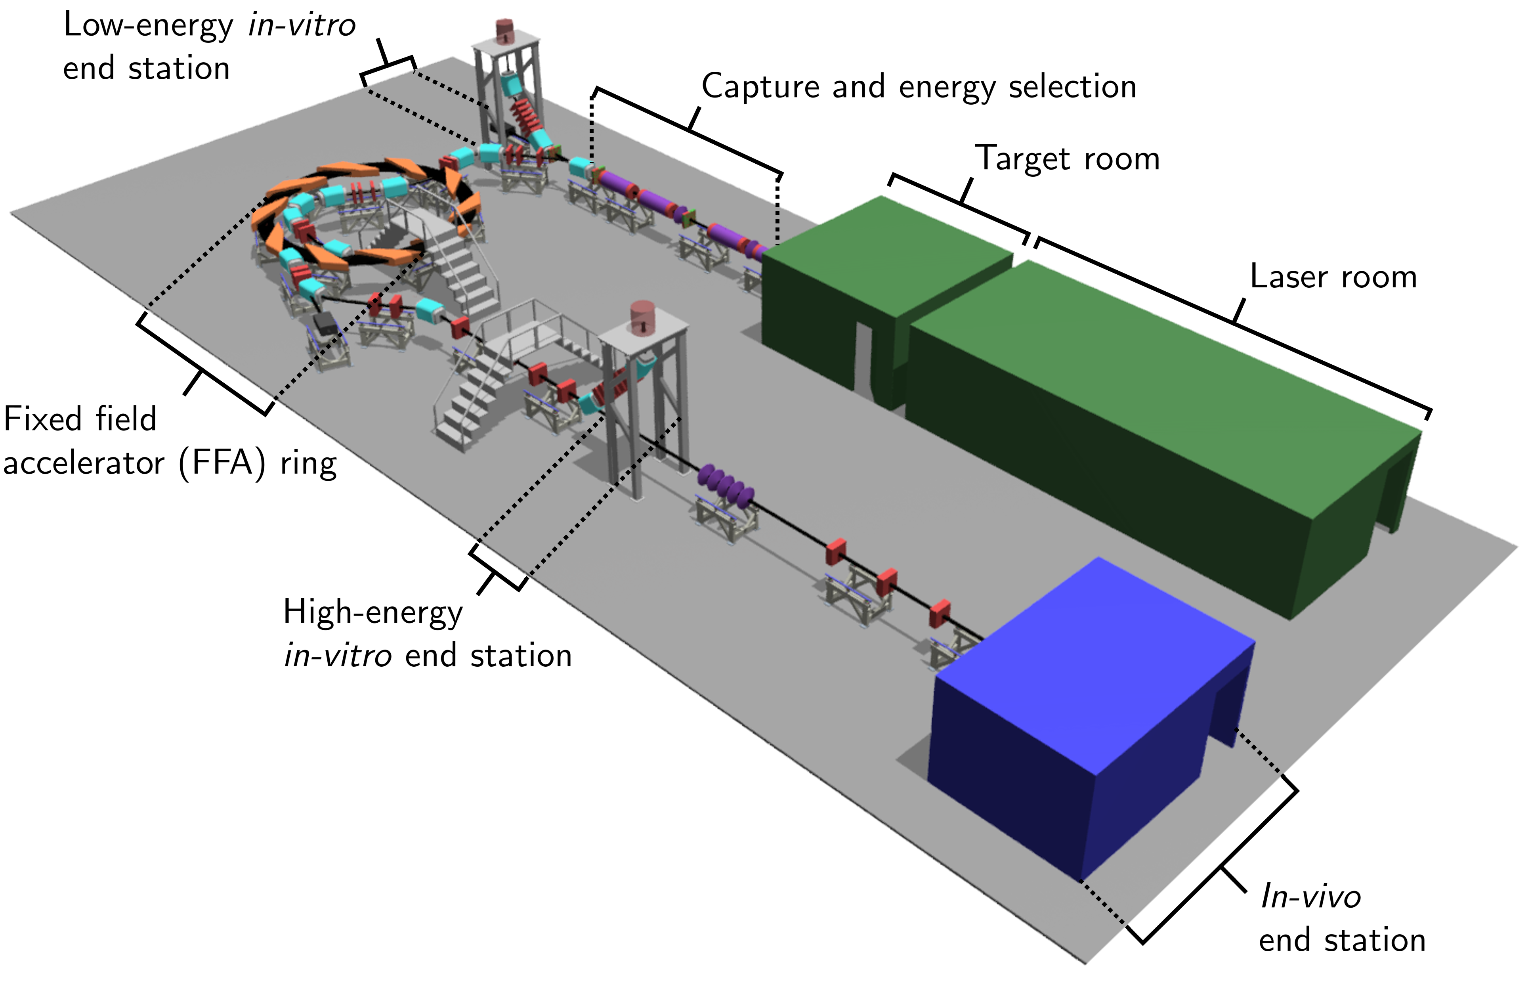

Slide 2
LhARA- Baseline
https://ccap.hep.ph.ic.ac.uk/trac/raw-attachment/wiki/Communication/Notes/CCAP-TN-11-LhARA-Design-Baseline.pdf
This document defines all LhARA parameters.
Variation/change occurs through discussion at Collaboration meetings

Slide 3
Deliverables
Task Name | Work Package | Start | Finish
Year 1&2 | WP1 | Thu 23/03/23 | Thu 19/09/24
Early Progress Review CDR | WP1 | Thu 23/03/23 | Thu 23/03/23
Interim Progress Review CDR | WP1 | Thu 21/09/23 | Thu 21/09/23
Pre-CDR Review | WP1 | Thu 21/03/24 | Thu 21/03/24
CDR | WP1 | Thu 19/09/24 | Thu 19/09/24

Slide 5
Collaboration meetings
Task Name | Work Package | Start | Finish
Years 1&2 |  | Fri 14/10/22 | Wed 11/09/24
Collaboration meeting 1 - Kick-off |  | Fri 14/10/22 | Fri 14/10/22
Collaboration Meeting 2 |  | Wed 15/03/23 | Wed 15/03/23
Collaboration Meeting 3 |  | Wed 13/09/23 | Wed 13/09/23
Collaboration Meeting 4 |  | Wed 13/03/24 | Wed 13/03/24
Collaboration Meeting 5 |  | Wed 11/09/24 | Wed 11/09/24

Slide 6
M5.1. Initial report on the user requirements for the in-vitro and in-vivo end stations. | WP5 | Fri 31/03/23 | Fri 31/03/23
M3.1 Validate plasma simulations with existing Swansea experimental set-up | WP3 | Mon 03/04/23 | Mon 03/04/23
M6.1: Early review of R&D work towards LhARA CDR (6 months) | WP6 | Mon 03/04/23 | Mon 03/04/23
M5.2. Report on the beam-monitoring technology for LhARA. | WP5 | Fri 29/09/23 | Fri 29/09/23
M2.1: Prediction of optimised proton source parameters for 100+ TW laser systems based on hydrodynamic and kinetic simulations | WP2 | Sun 01/10/23 | Sun 01/10/23
M6.2: Interim review of R&D work towards LhARA CDR (12 months) | WP6 | Mon 02/10/23 | Mon 02/10/23
M2.2: First SCAPA ion source simulations and experiment completed. | WP2 | Mon 01/04/24 | Mon 01/04/24
M5.3. Second report on the user requirements for the in-vitro and in-vivo end stations. | WP5 | Sat 30/03/24 | Sat 30/03/24
M3.2 Progress report of large diameter plasma experiments and simulations | WP3 | Mon 01/04/24 | Mon 01/04/24
M6.3: Final review of R&D work towards LhARA CDR (18 months) | WP6 | Tue 02/04/24 | Tue 02/04/24
M4.1 Geant4 simulations of beam energy deposition profile | WP4 | Mon 01/04/24 | Mon 01/04/24
M3.3 Next generation plasma lens testbench design | WP3 | Mon 30/09/24 | Mon 30/09/24
M4.2 Acoustic sensor array design | WP4 | Mon 30/09/24 | Mon 30/09/24

Slide 7
Monthly Report to PRC/IF
WPMs report to me
LhARA reports to ITRF
ITRF reports to DL
DL delivers overall report
One simple form addressing
progress to date highlights, upcoming tasks
Risk & Issues
Spend – this will be linear for almost all Unis. Those with equipment/facilities may need to present that spend.

Slide 8
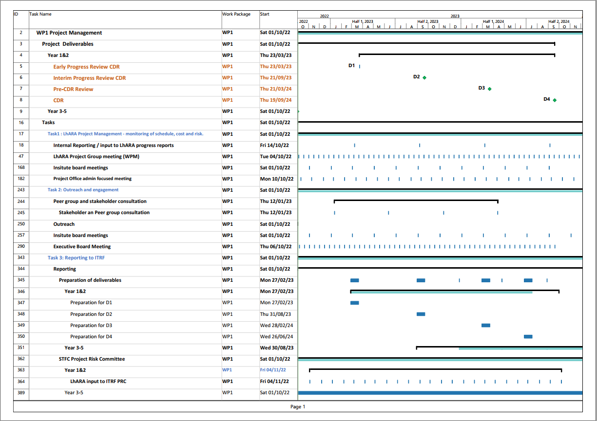

Slide 9
Project Structure
WP1 will organise
Collaboration meetings, project office.
Deliverables, reporting to ITRF
Outreach, Institute and Executive Board meetings
All goes on the Wiki.
Bi-weekly WPM meeting.
Bi-weekly Consortium meeting
WPMs to organise:
Meetings on 2 weekly basis (or more often if you need it)
Agenda on Wiki – advertise time and date to Collaboration
Minutes on Wiki

Slide 10
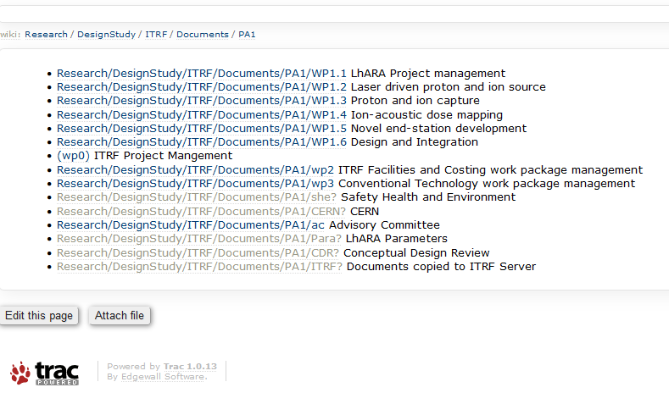
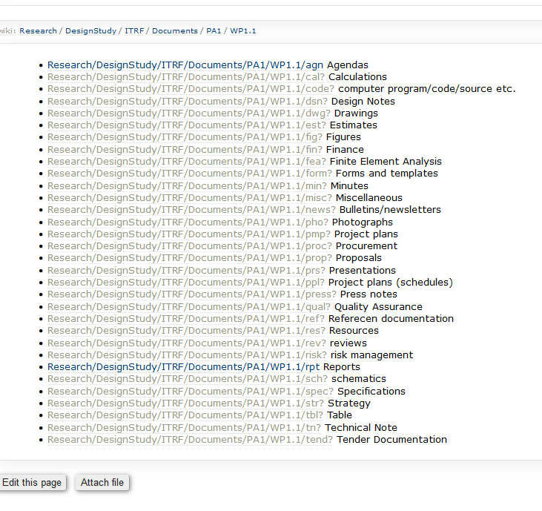
LhARA Wiki

Slide 11
2nd Stage – Preliminary Activity 2
Preparation ~ 18 month point
Match to known ‘bid opportunities’
Account for delay between proposal submission and receipt of funds

Slide 12
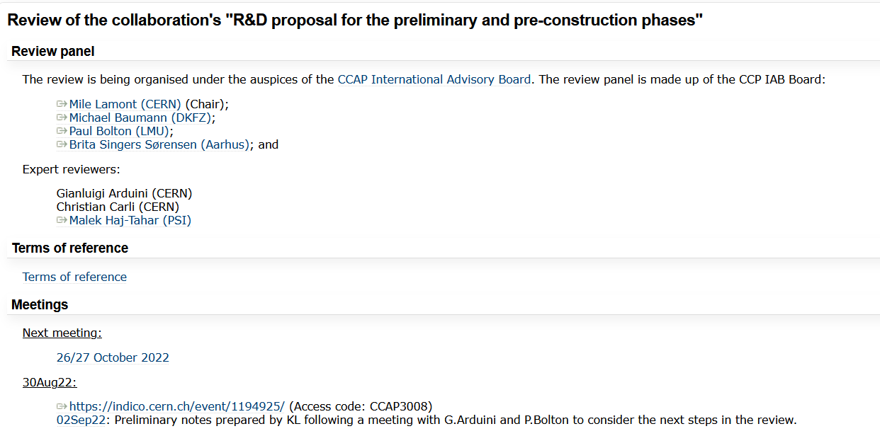
LhARA Review
1st session – 30th August 2022
2nd, 3rd sessions 26th and 27th October
https://ccap.hep.ph.ic.ac.uk/trac/wiki/Research/DesignStudy/Reviews/AugSep22/Review

