Slide 1

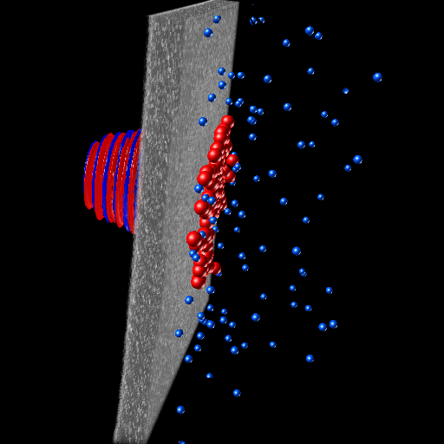
One-to-one simulations of the LhARA proton source
Notes:
I am going to share a study concerning fast ignition driven by ions accelerated via collisionless shocks in the corona of an ICF pellet

Slide 2

Acknowledgements
Nicholas Dover (Imperial College London)
Ross Gray and Paul McKenna (University of Strathclyde)
Simulations performed on Marenostrum (BSC, Spain) under PRACE allocation
and DiRAC (EPCC, UK) under STFC allocation
E. Boella | LhARA collaboration meeting | October 14th, 2022

Slide 3
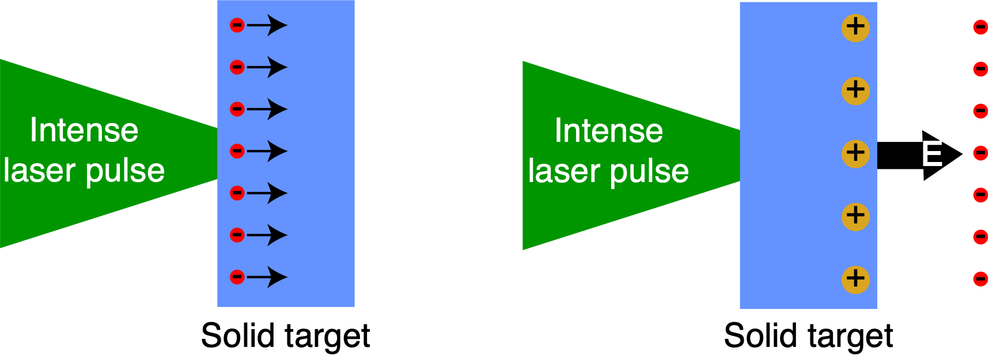
In LhARA,
a large flux of protons will be produced via Target Normal Sheath Acceleration
Features of TNSA accelerated ions
Features of TNSA ion source
Short particle bunches (~ps)
High currents (~kA)
Low transverse emittance (<10⁻² mm-mrad)
Broad energy spectrum (~100% energy spread)
10 Hz repetition rate
Reduced space-charge effects
A programme of simulations is needed to tune laser and target parameters
E. Boella | LhARA collaboration meeting | October 14th, 2022
Notes:
Electric field MV/micron vs 100 MV/m for traditional accelerators
Up to 10^13 pp/shot
ps bunches vs microsecond
kA vs milliAmpere

Slide 4
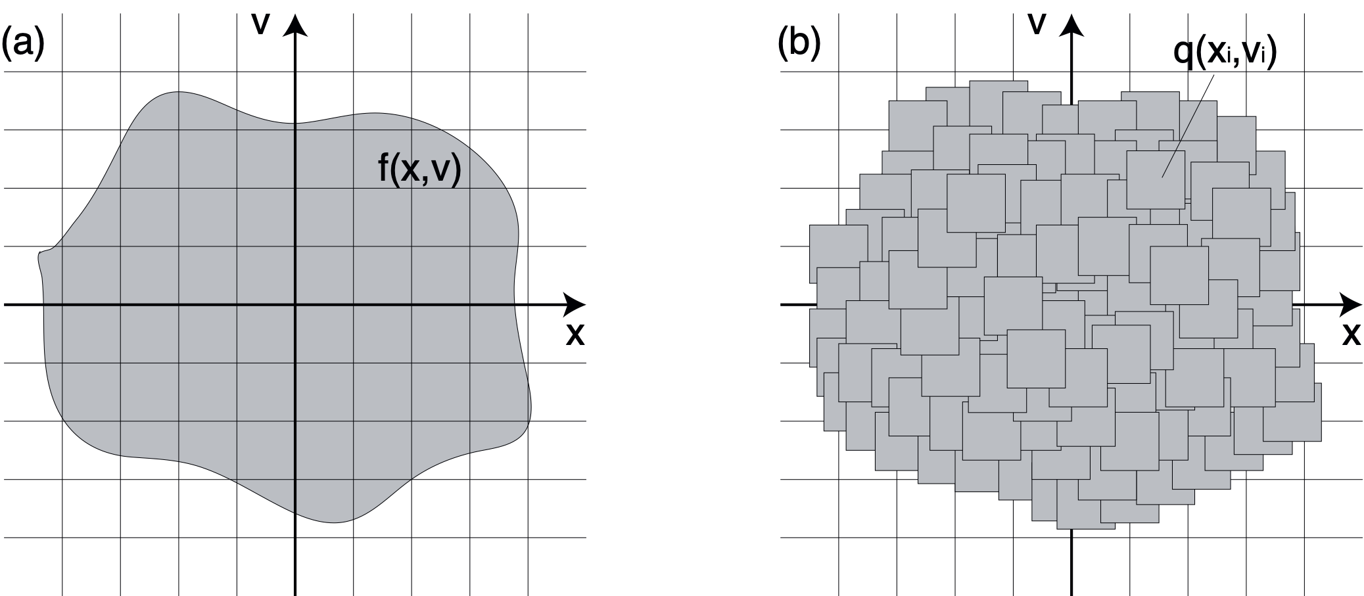
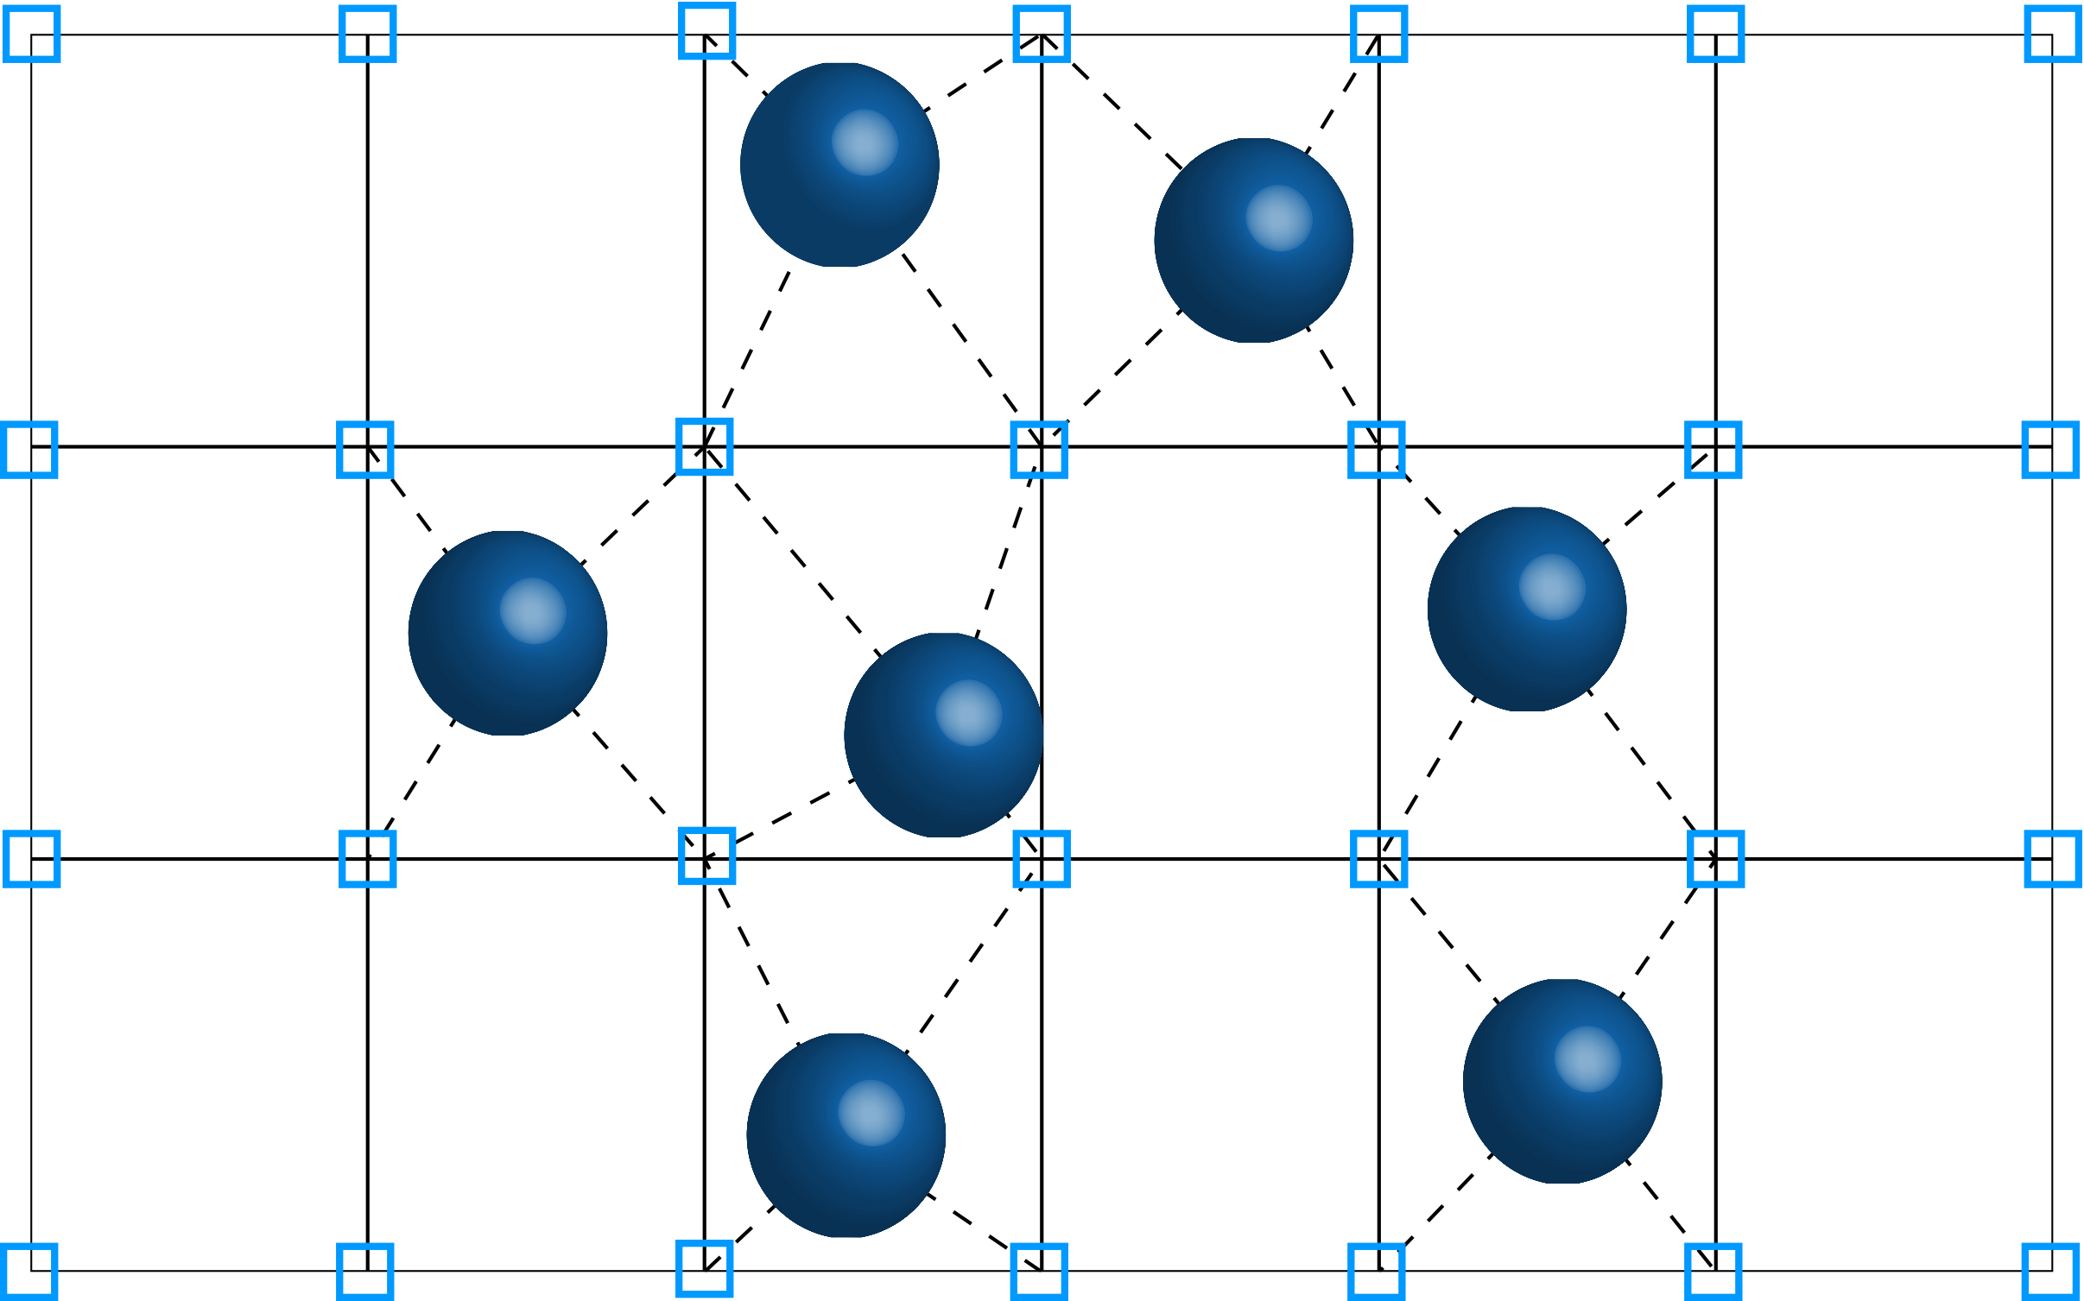
The Particle-In-Cell method allows
for modelling laser-driven plasmas from first principle
The continuum plasma distribution function is replaced by discrete macroparticles
Np computational particles, Ng grid cells
P. Gibbon “Short Pulse Laser Interactions with Matter” Imperial College Press (2007).
E. Boella | LhARA collaboration meeting | October 14th, 2022

Slide 5
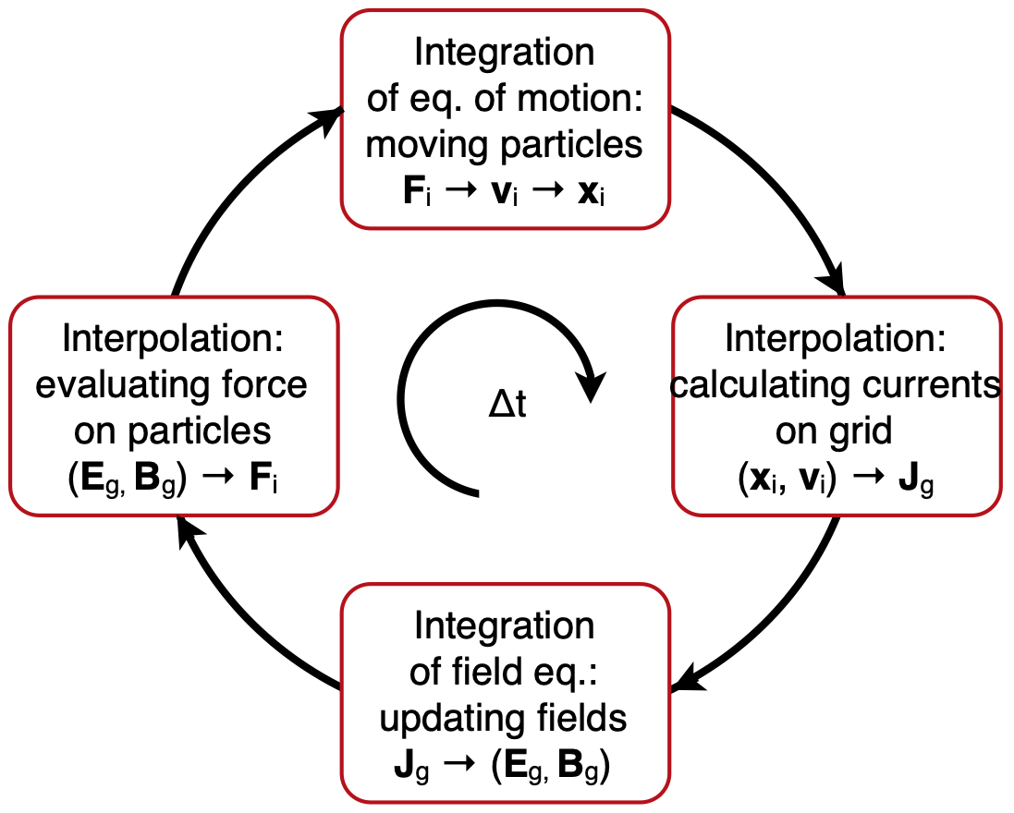
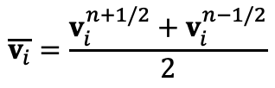




The PIC algorithm requires resolving the smallest plasma scales
$$v_{i}^{n+1/2}=v_{i}^{n−1/2}+Δt\frac{q_{i}}{m_{i}}\left[E^{n}(x_{i}^{n})+\frac{\overline{v_{i}}×B^{n}(x_{i}^{n})}{c}\right]$$
$$x_{i}^{n+1}=x_{i}^{n}+Δtv_{i}^{n+1/2}$$
$$\overline{v_{i}}=\frac{v_{i}^{n+1/2}+v_{i}^{n−1/2}}{2}$$
with
$$B_{g}^{n+1/2}=B_{g}^{n−1/2}−cΔt∇_{g}×E^{n}$$
$$E_{g}^{n+1}=E_{g}^{n}+cΔt\left(∇_{g}×B^{n+1/2}−\frac{4π}{c}J_{g}^{n+1/2}\right)$$
E. Boella | LhARA collaboration meeting | October 14th, 2022

Slide 6


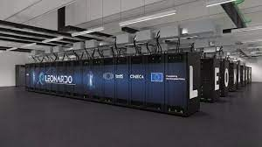
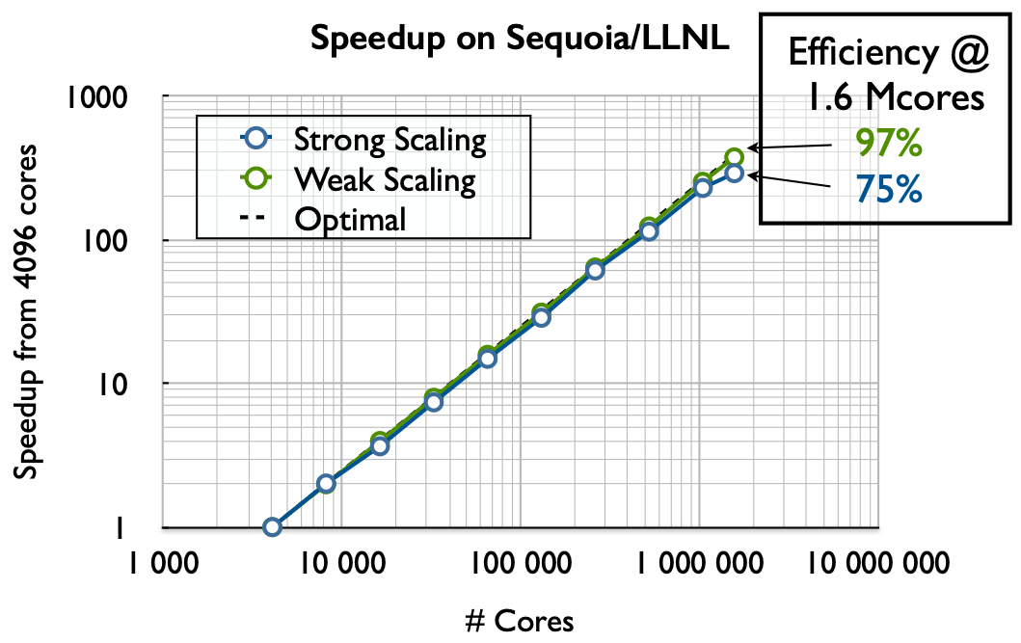
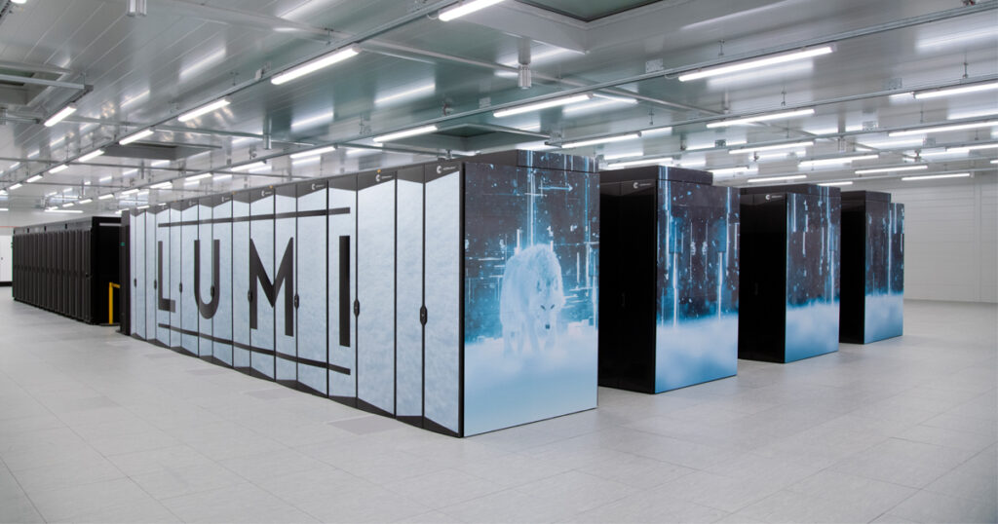
High-performance computing resources
are needed to carry out these simulations
leonardo-supercomputer.cineca.eu
lumi-supercomputer.eu
E. Boella | LhARA collaboration meeting | October 14th, 2022

Slide 7
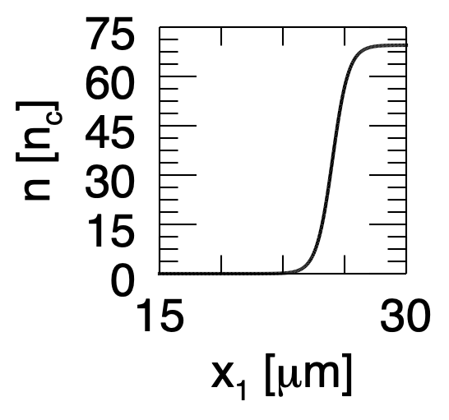
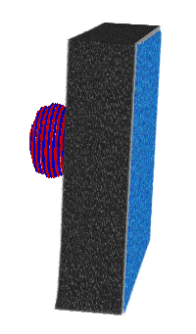
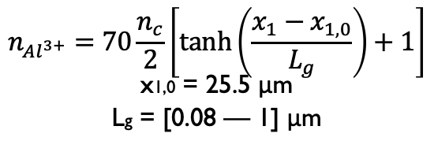
Modelling expected SCAPA conditions
using 3D Particle-In-Cell simulations
I = [8 — 10] x 10²⁰ W/cm²
λ0 = 800 nm
a0 = [19.32 — 21.60]
τFWHM = 25 fs
w0 = 1.5 μm
p - polarised
Initial density profile detail
H⁺ layer
nH+ = 1.15 nc
LH+ = 31.83 nm
$$n_{Al^{3+}}=70\frac{n_{c}}{2}\left[tanh\left(\frac{x_{1}−x_{1,0}}{L_{g}}\right)+1\right]$$
x1,0 = 25.5 μm
Lg = [0.08 — 1] μm
Al³⁺ foil
nAl3+ = 70 nc
LAl3+ = [2 — 6] μm
E. Boella | LhARA collaboration meeting | October 14th, 2022
Notes:
The simulations modelled the interaction of an intense laser pulse with the plasma corona.
The laser pulse had an intensity of 10^20 W/cm2, an a0 of 6.8 and a duration of approximately 3 ps.
The laser illuminated a plasma composed of hydrogen and carbon ions.
The longitudinal plasma density profile was provided by hydro simulations modelling NIF indirect drive implosion and can be seen in this plot.
The density increases exponentially from 0 to 146 nc.

Slide 8
Bulk target ions and contaminants are accelerated by the charge separation field triggered by the escaping hot electrons
I = 9 x 10²⁰ W/cm²,
2 μm thick target, Lg = 0.08 μm
Electron longitudinal
phase space
H⁺ longitudinal
phase space
Laser electric field
and plasma density
Al³⁺ longitudinal
phase space
Longitudinal electric field
E. Boella | LhARA collaboration meeting | October 14th, 2022

Slide 9
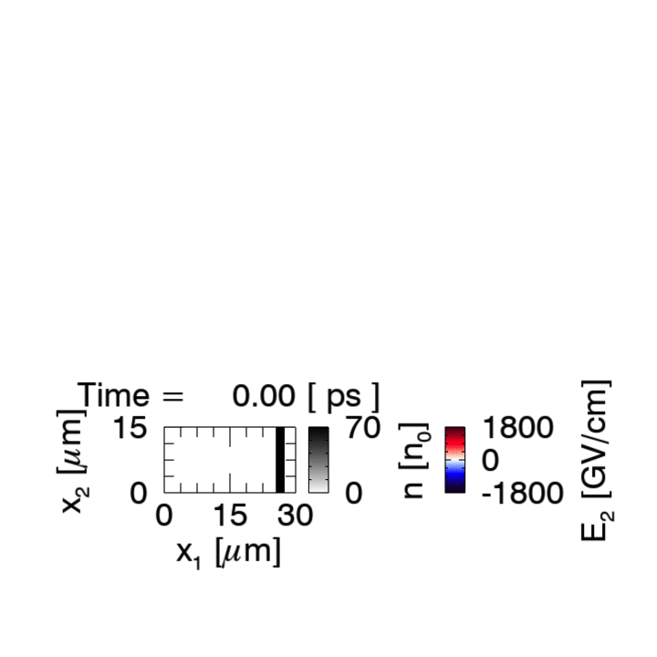
Bulk target ions and contaminants are accelerated by the charge separation field triggered by the escaping hot electrons
I = 9 x 10²⁰ W/cm²,
2 μm thick target, Lg = 0.08 μm
Electron longitudinal
phase space
H⁺ longitudinal
phase space
Al³⁺ longitudinal
phase space
Longitudinal electric field
E. Boella | LhARA collaboration meeting | October 14th, 2022

Slide 10
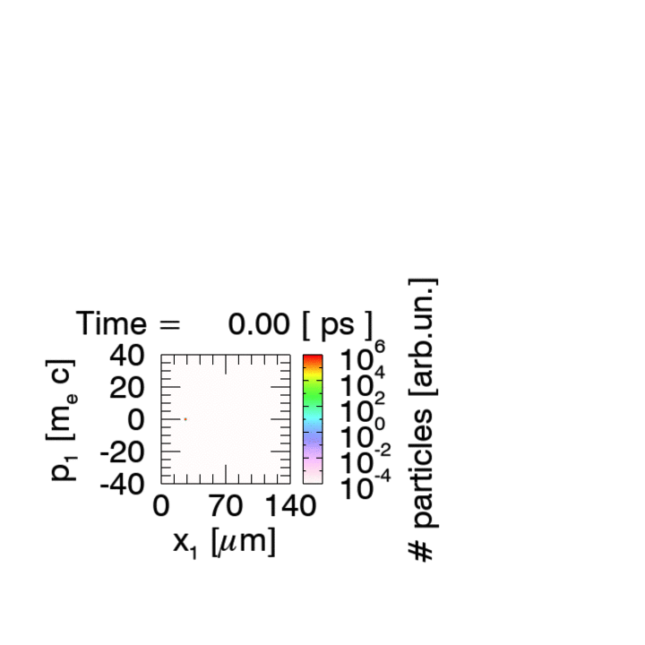
Bulk target ions and contaminants are accelerated by the charge separation field triggered by the escaping hot electrons
I = 9 x 10²⁰ W/cm²,
2 μm thick target, Lg = 0.08 μm
H⁺ longitudinal
phase space
Laser electric field
and plasma density
Al³⁺ longitudinal
phase space
Longitudinal electric field
E. Boella | LhARA collaboration meeting | October 14th, 2022

Slide 11
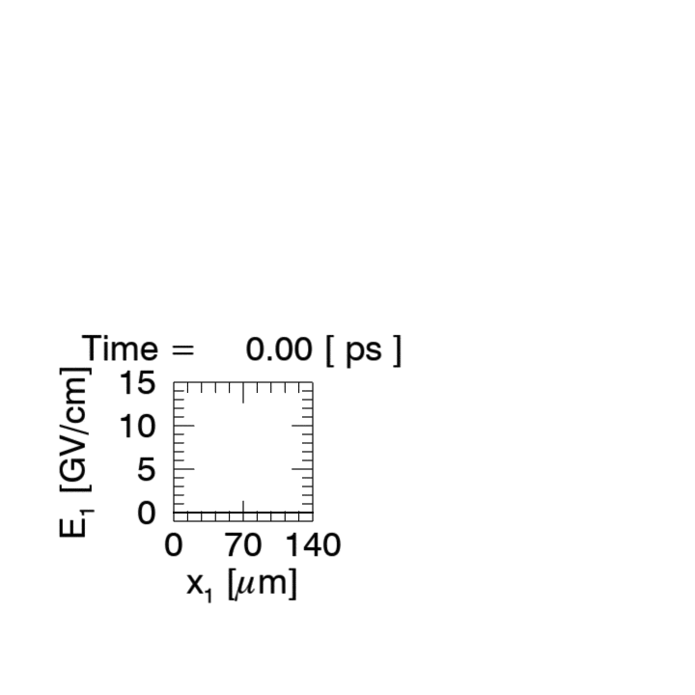
Bulk target ions and contaminants are accelerated by the charge separation field triggered by the escaping hot electrons
I = 9 x 10²⁰ W/cm²,
2 μm thick target, Lg = 0.08 μm
Electron longitudinal
phase space
H⁺ longitudinal
phase space
Laser electric field
and plasma density
Al³⁺ longitudinal
phase space
E. Boella | LhARA collaboration meeting | October 14th, 2022

Slide 12
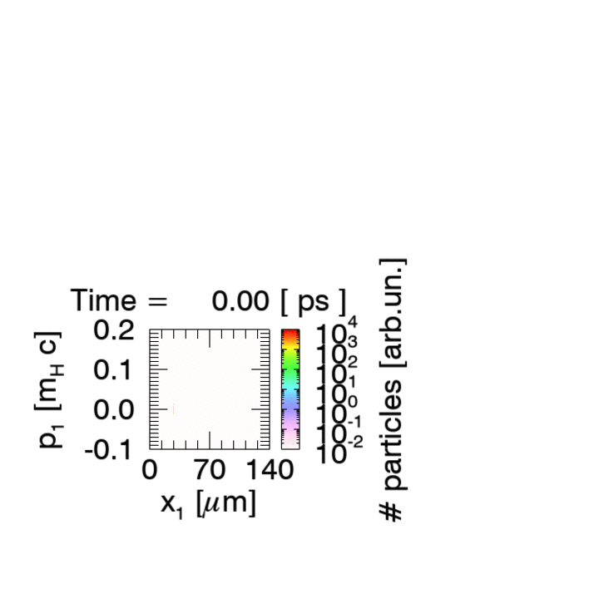
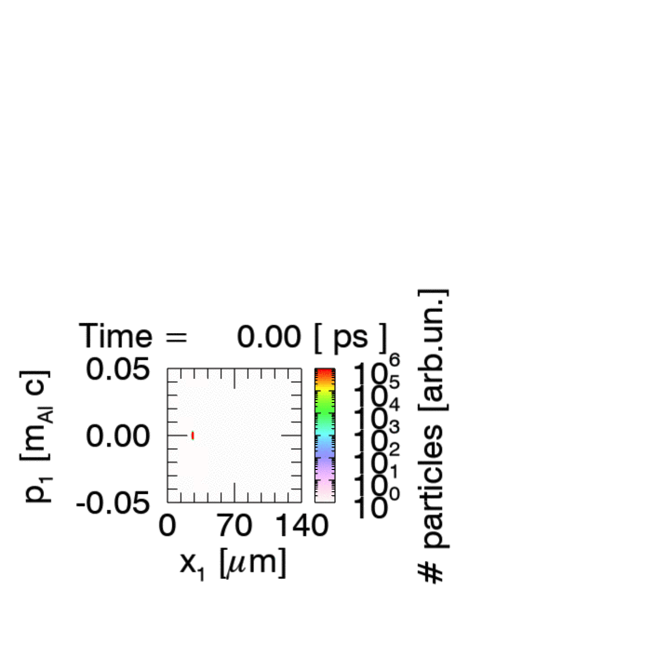
Bulk target ions and contaminants are accelerated by the charge separation field triggered by the escaping hot electrons
I = 9 x 10²⁰ W/cm²,
2 μm thick target, Lg = 0.08 μm
Electron longitudinal
phase space
Laser electric field
and plasma density
Longitudinal electric field
E. Boella | LhARA collaboration meeting | October 14th, 2022

Slide 13
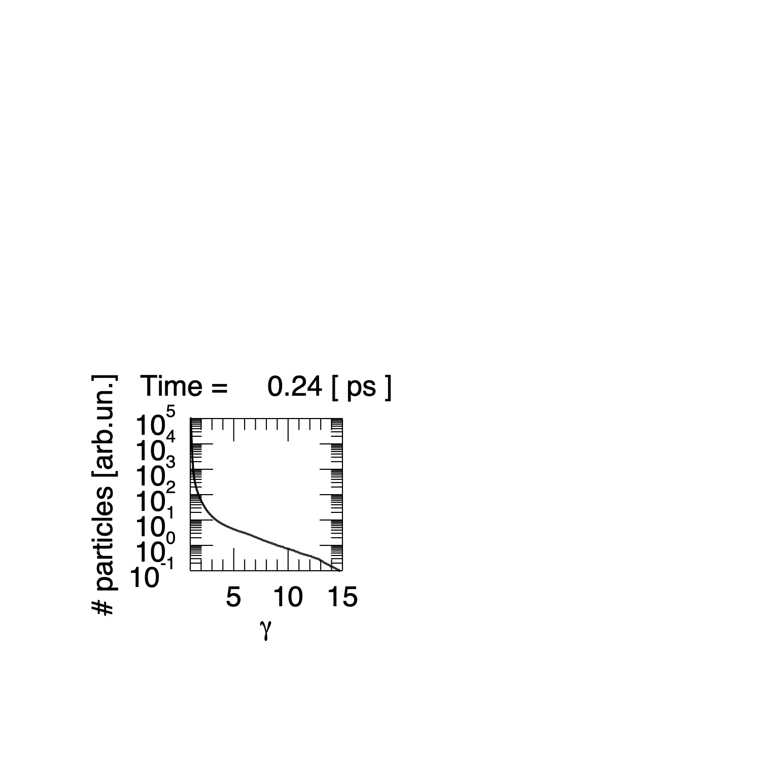
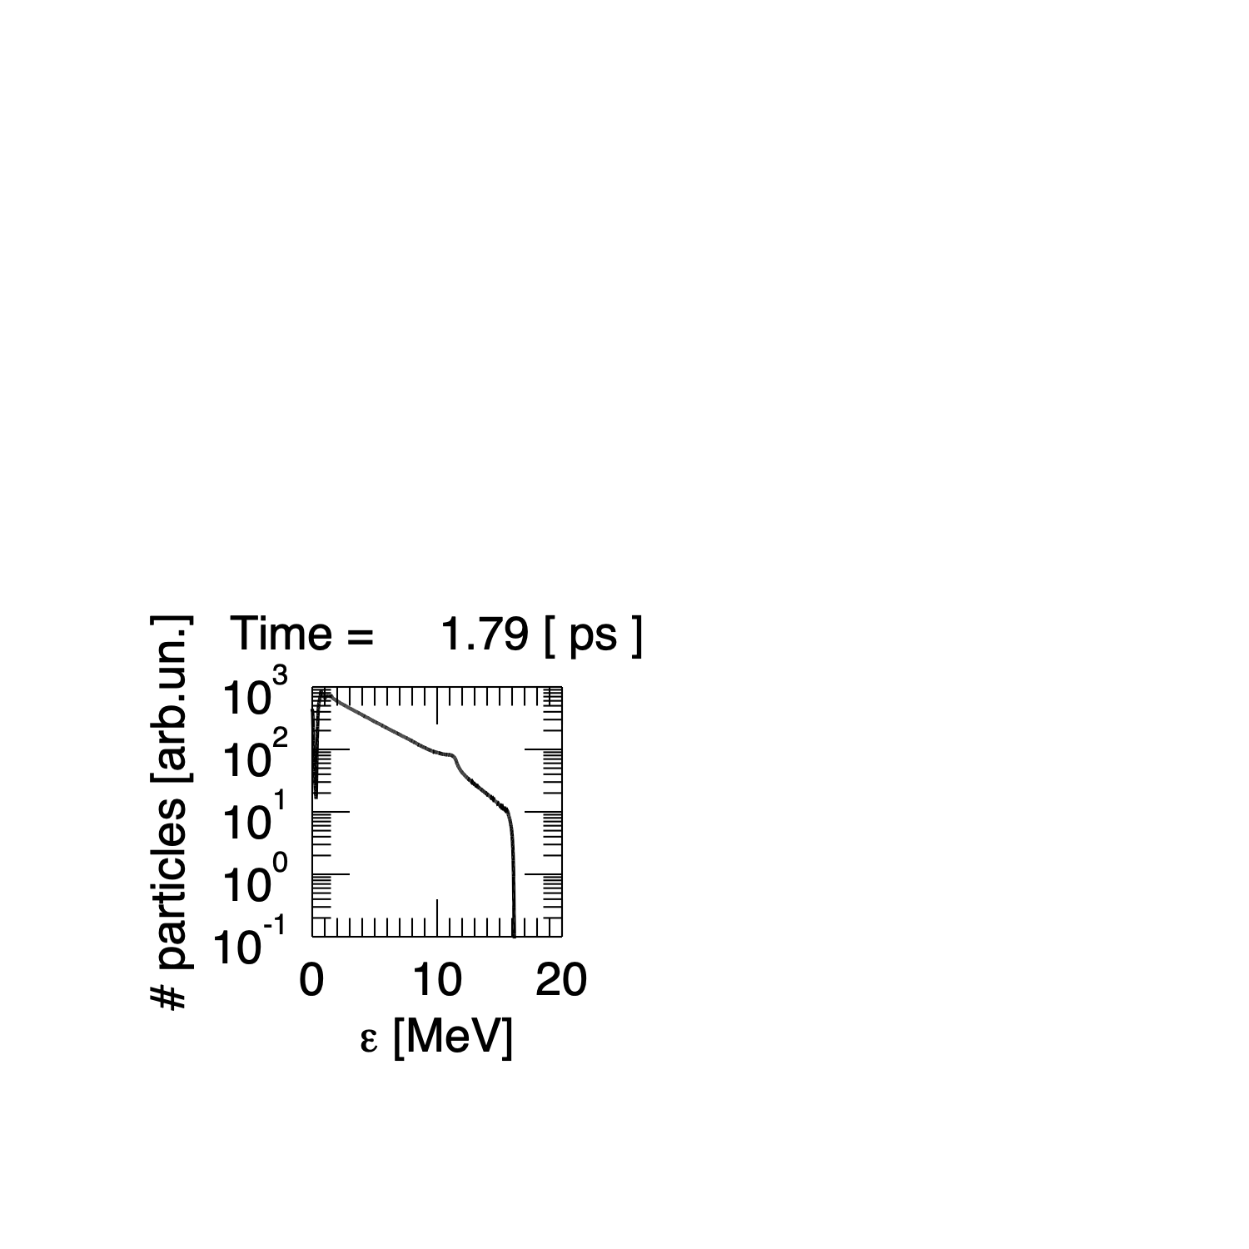
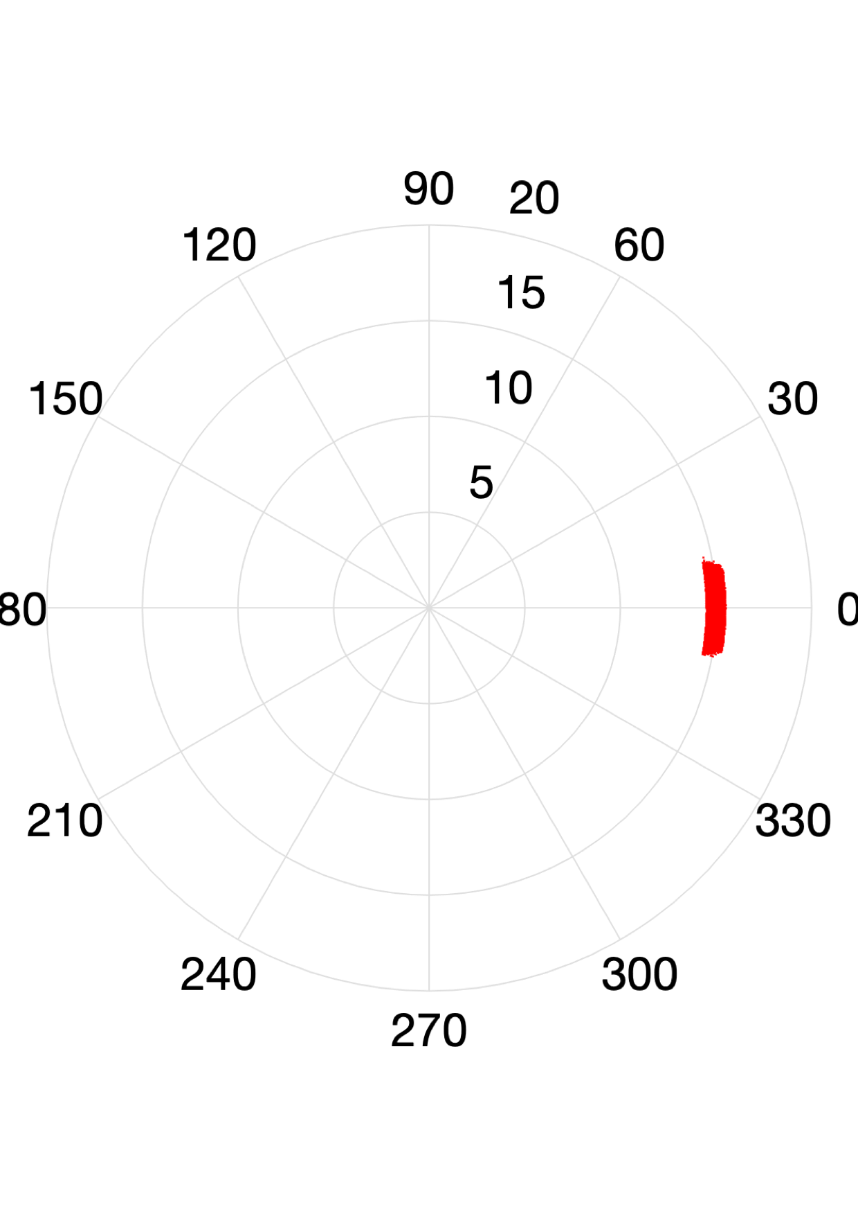
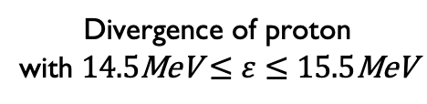
Selected protons are collimated
I = 9 x 10²⁰ W/cm², 2 μm thick target, Lg = 0.08 μm
Divergence of proton
with $14.5\text{MeV}≤ε≤15.5\text{MeV}$
Electron distribution function
Proton spectrum
Te,hot ~ 0.88 MeV
8.7 pC
Te,pond = 6.93 MeV
θrms ~ 4º
E. Boella | LhARA collaboration meeting | October 14th, 2022

Slide 14
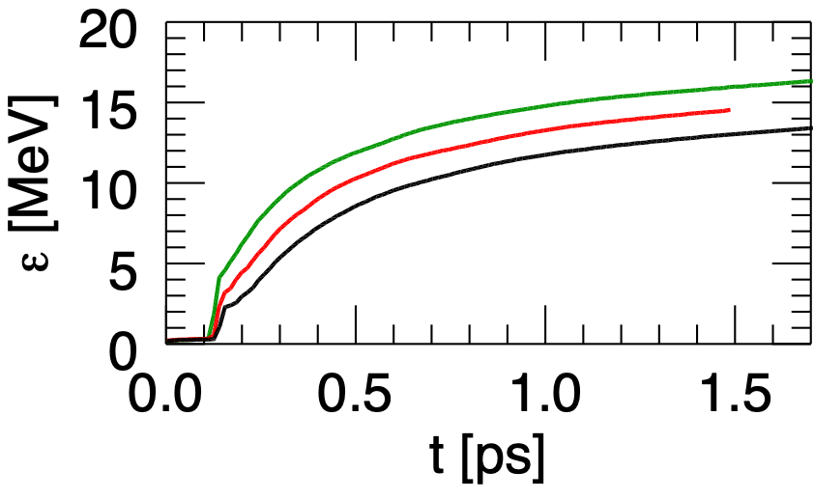
In the case of almost abrupt plasma-to-vacuum transition,
only the 2 μm Aluminium target allows for achieving LhARA target goals
I = 9 x 10²⁰ W/cm², Lg = 0.08 μm
Proton cutoff energy vs time
— 6 μm — 4 μm — 2 μm
E. Boella | LhARA collaboration meeting | October 14th, 2022

Slide 15
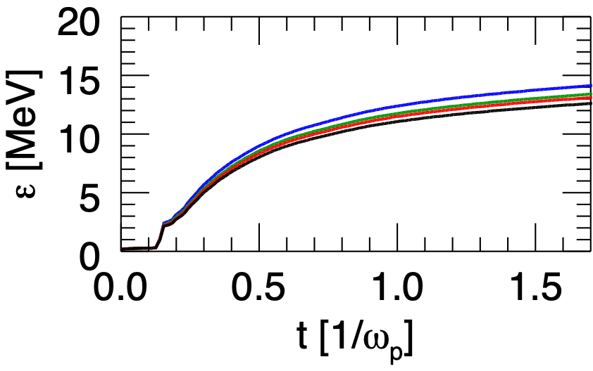
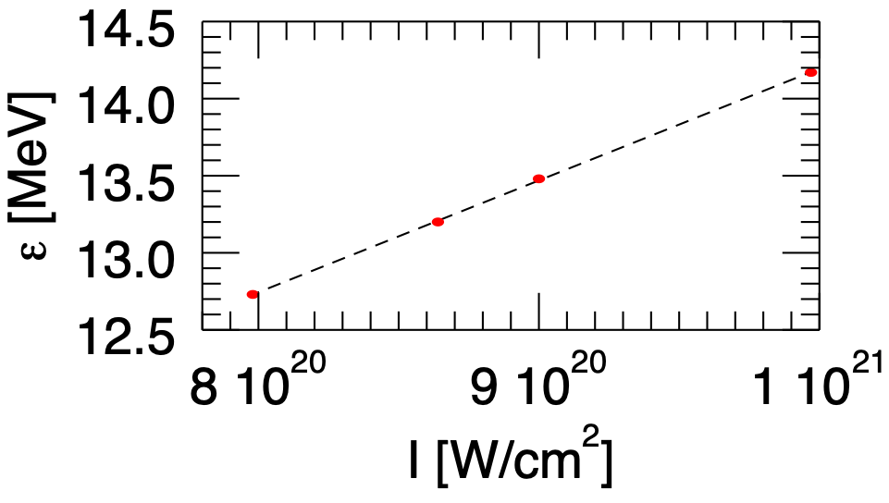
A laser intensity ~ 10²¹ W/cm² would be required
to accelerate protons to15 MeV
6 μm thick target, Lg = 0.08 μm
Proton cutoff energy vs time
Proton cutoff energy vs laser intensity
— 8.0 x10²⁰ W/cm² — 8.6 x10²⁰ W/cm²
— 9.0 x 10²⁰ W/cm² — 10.0 x 10²⁰ W/cm²
E. Boella | LhARA collaboration meeting | October 14th, 2022

Slide 16
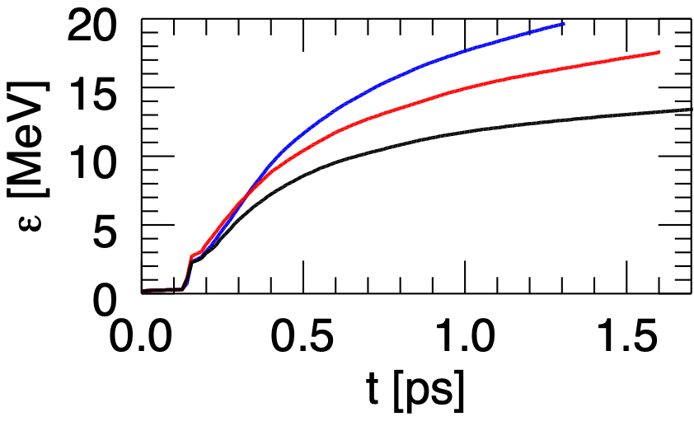
A short pre-plasma allows for accelerating protons to ε > 15 MeV
using thicker targets
I = 10 x 10²⁰ W/cm², 6 μm thick target
Proton cutoff energy vs time
— 0.08 μm — 0.3 μm — 0.5 μm
E. Boella | LhARA collaboration meeting | October 14th, 2022

Slide 17
Summary
We explored via 3D Particle-In-Cell simulations the interaction of the SCAPA laser with Aluminium foils.
We investigated the effect of target thickness, laser intensity and pre-plasma scale-length.
In the case of almost abrupt plasma-vacuum transition, very thin Aluminium targets (~2 μm) will be necessary to exceed proton energies of 15 MeV.
For thicker targets (~ 6 μm), higher laser intensities will be necessary to exceed proton energies of 15 MeV.
The presence of a pre-plasma allows for accelerating protons to energies >> 15 MeV with thicker targets.
E. Boella | LhARA collaboration meeting | October 14th, 2022

