Slide 1
Ionacoustic Work Package
LhARA Collaboration Meeting
8th February 2023

Slide 2
Online dose monitoring system
LhARA: protons / light-ions
Minimize damage on healthy cells: on-the-fly, non-invasive, range verification system
Real-time exact dose deposition profile
Bragg peak localization
Solution: ion-acoustic imaging

Slide 3
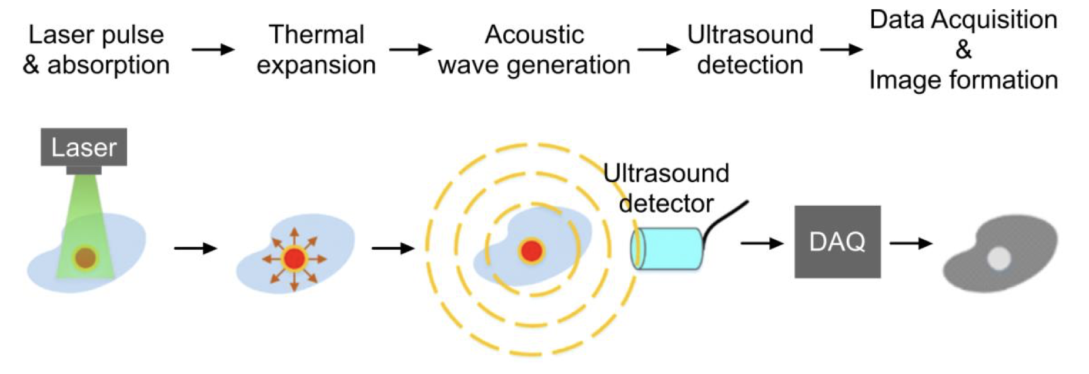
Ionacoustic imaging
As the beam penetrates the tissue, it is scattered & absorbed
Increase in temperature -Thermoelastic expansion
Increase in pressure - Acoustic wave emitted (thermoacoustic effect)
Detected by ultrasound detector
Image reconstruction
Figure 1: Schematic of photo-acoustic imaging

Slide 4
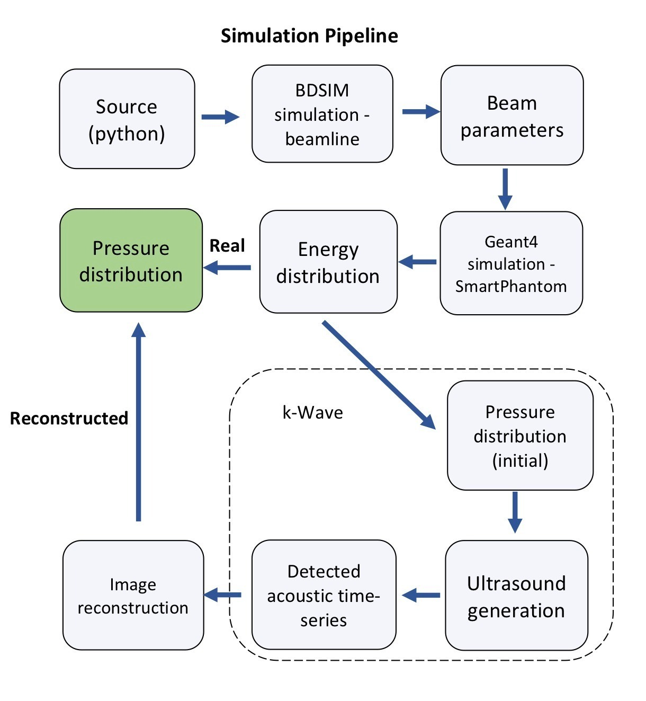



Simulation pipeline

Slide 5

BDSIM

Slide 6
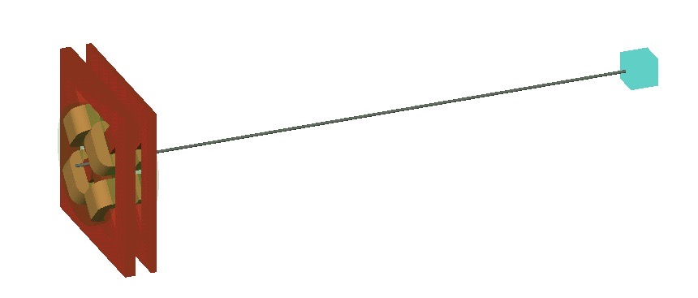
LION beamline - BDSIM
2x quadropole magnets for focusing
SmartPhantom
source
(python file)
Figure 2: Render of LION beamline at Ludwig-Maximillian University Munich in BDSIM

Slide 7
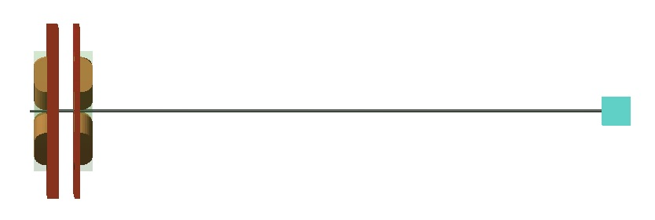
LION beamline - BDSIM
60.34 mm
1844.7 mm
100 mm
55.77 mm
10 mm bore diameter
2x quadropole magnets for focusing
332 T/m
318.5 T/m
Figure 3: Side-on view of LION beamline in BDSIM

Slide 8
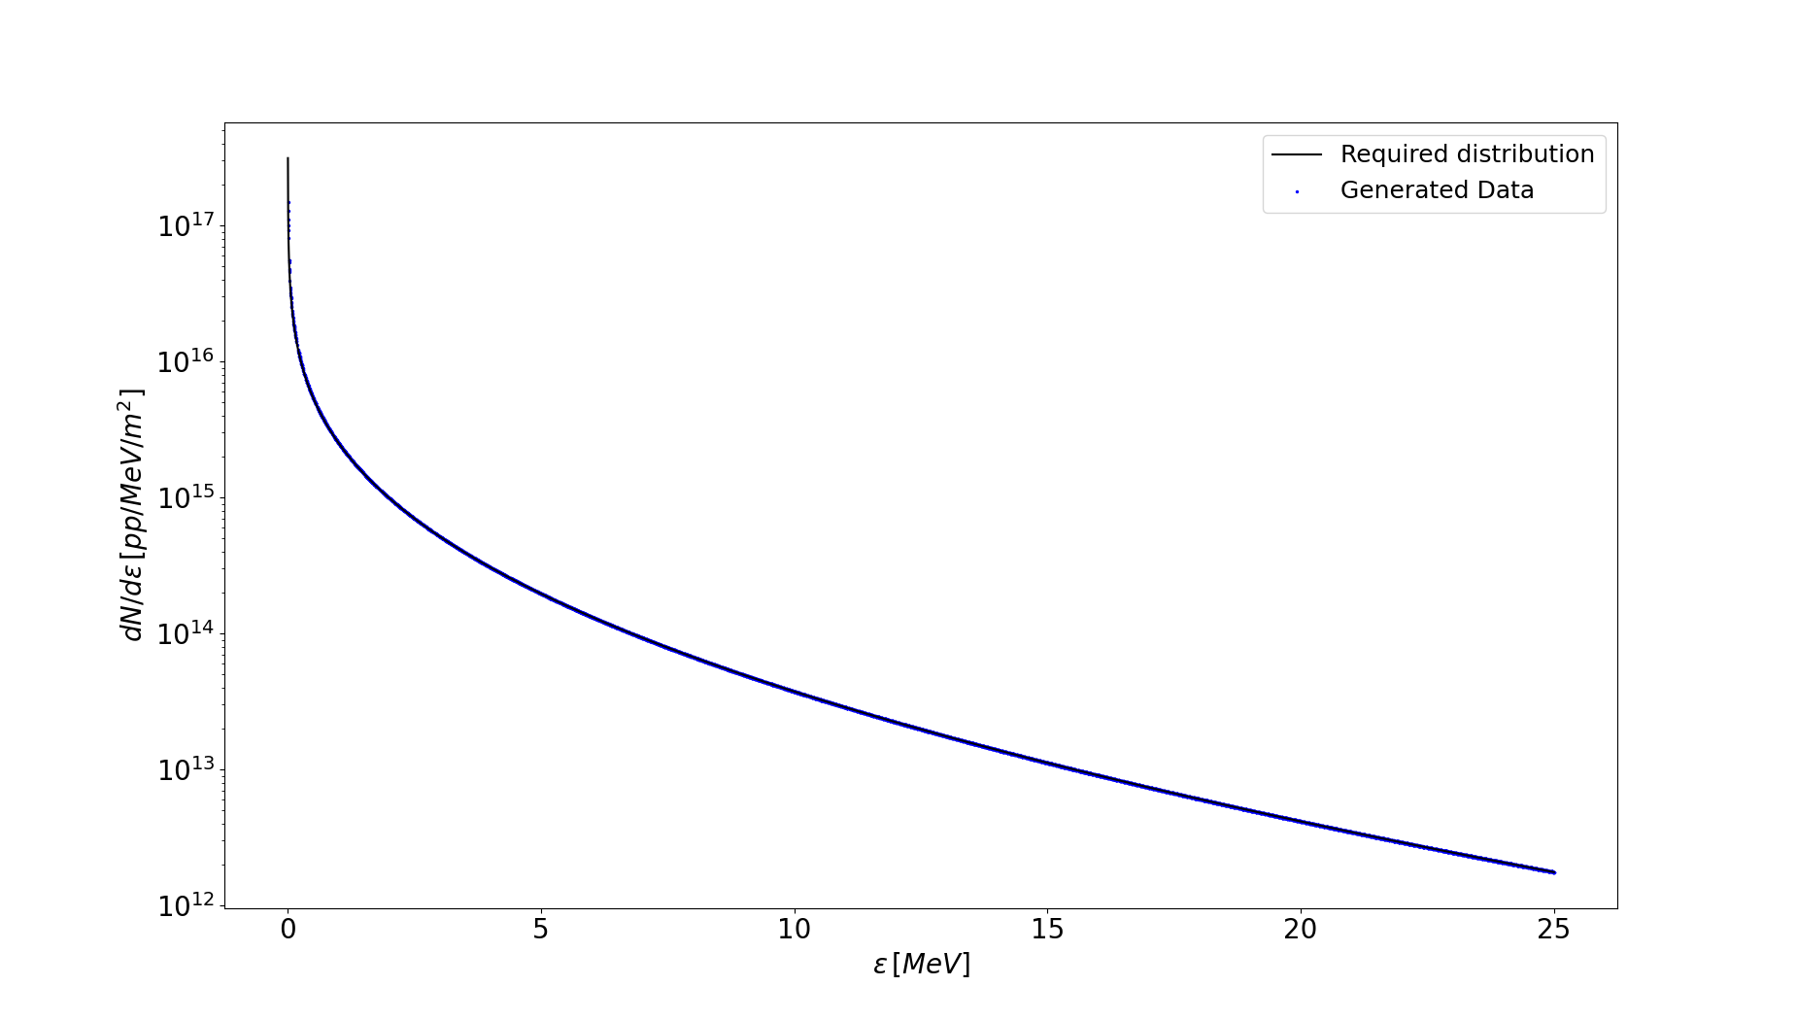


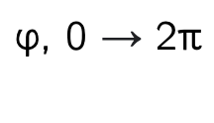
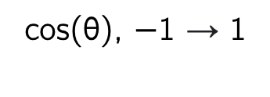
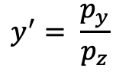
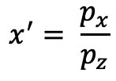
Source
Generate angular distribution
$$\text{cos}\text{(}\text{θ}\text{), −1 }\text{→}\text{ 1}$$
$$\text{φ}\text{, 0 }\text{→}\text{ 2}\text{π}$$
$$p_{x}=psin\left(θ\right)cos⁡(φ)$$
source.txt
$$p_{x}=psin\left(θ\right)sin⁡(φ)$$
$$x^{′}= \frac{p_{x}}{p_{z}}$$
$$y^{′}= \frac{p_{y}}{p_{z}}$$
Figure 4: Energy distribution of protons from source – simulated and analytic closely match

Slide 9
Running the simulation
Problems:
Simulating 1e7 particles is computationally heavy
Statistically low number of particles at around 20 MeV
Solution: selected only particles with +/- a few % around 20 MeV:
100 000 protons
Energy: 20±0.5 MeV
10 mrad acceptance angle

Slide 10
Simulated Bragg peak
Figure 5: Bragg peak in SmartPhantom, as simulated in BDSIM

Slide 11
Simulated particle depth
SmartPhantom
Quadropoles
Figure 6: Particle depletion through simulated beamline
∼1/84 particles enter phantom
1191

Slide 12
Set-up
test_file.dat
Figure 7: Side-on view of LION beamline in BDSIM

Slide 13

GEANT4

Slide 14
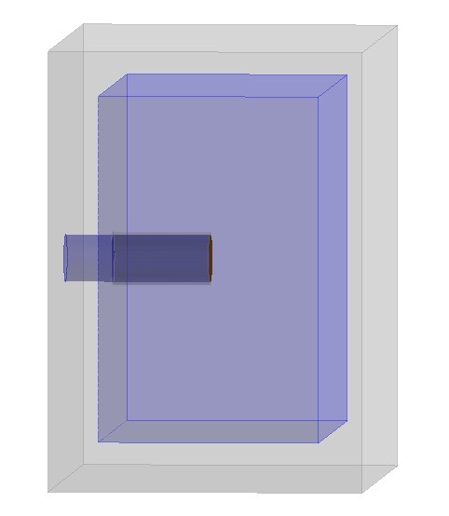
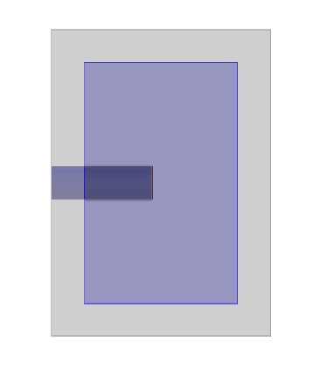
SmartPhantom in Geant4
Aluminium
Water
15 mm
Kapton entry window
Beam
(test_file.dat)
160 mm
15 mm
100 mm
140 mm
Figure 8: Geant4 simulation of the SmartPhantom. Angled view (left), cross-section view (right)

Slide 15
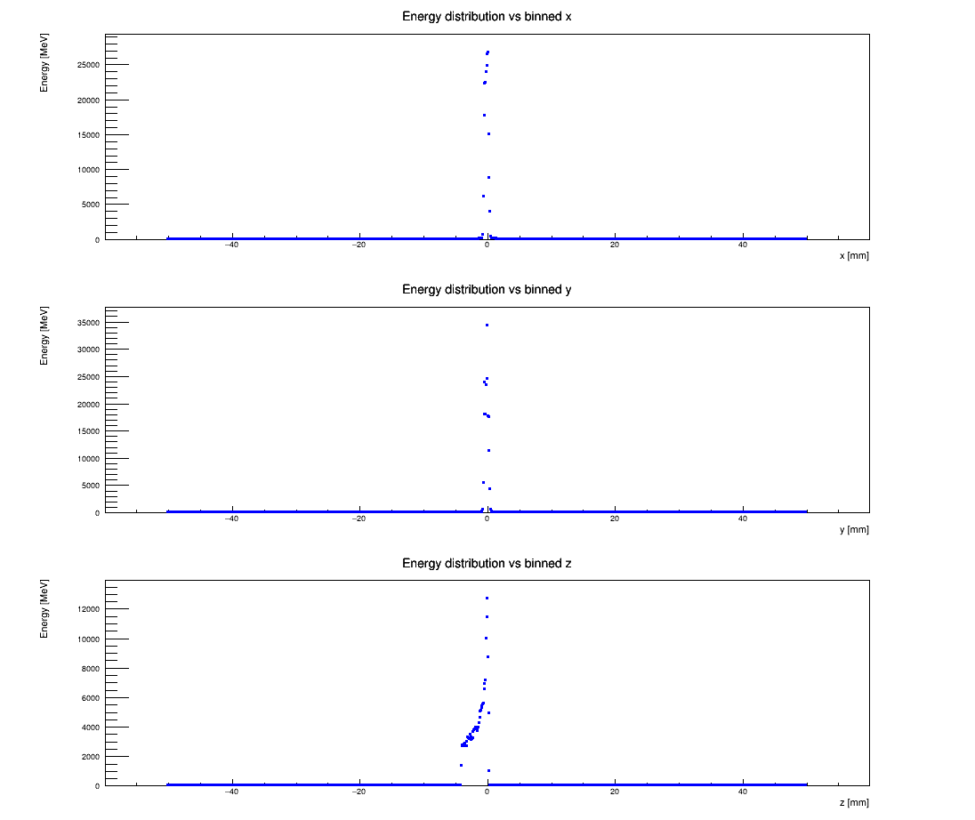
Energy distribution
Figure 9: Binned energy deposition along the three axis

Slide 16
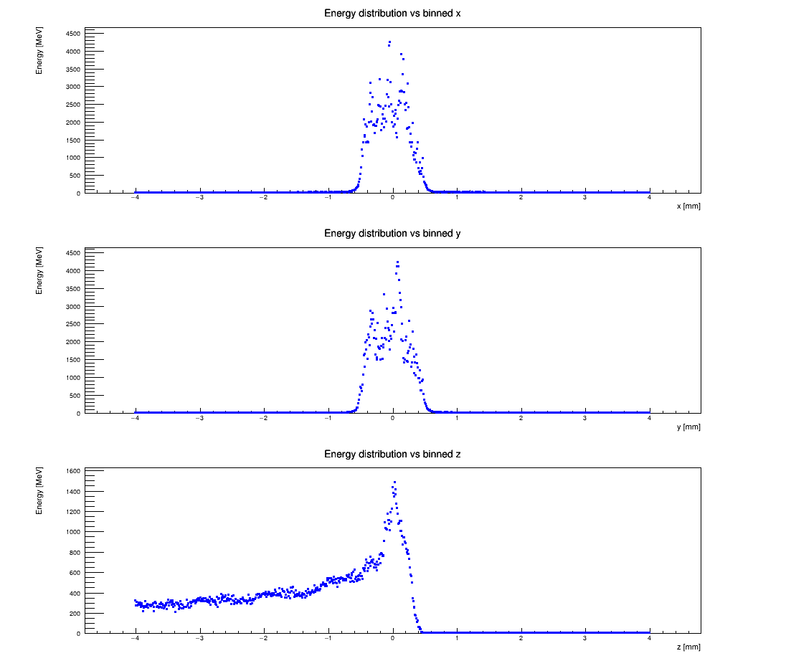
Energy distribution
Figure 10: Binned energy deposition along the three axis

Slide 17

k-Wave

Slide 18
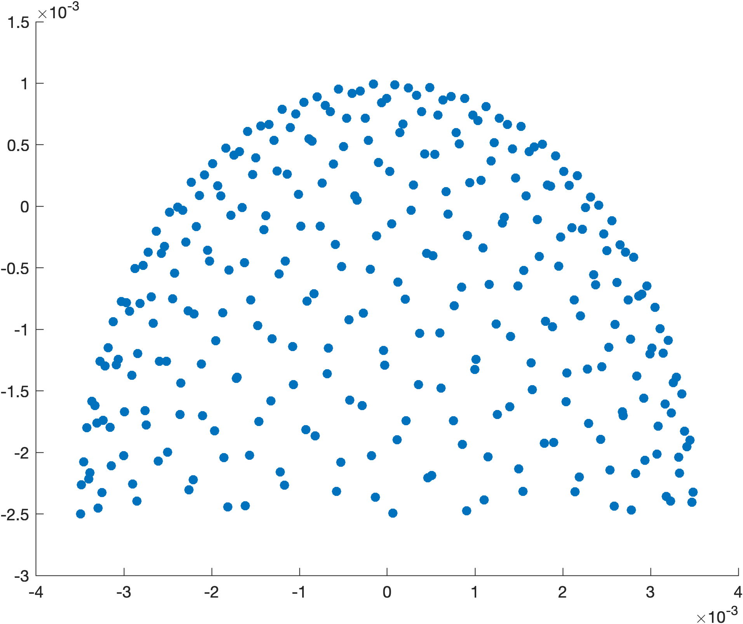
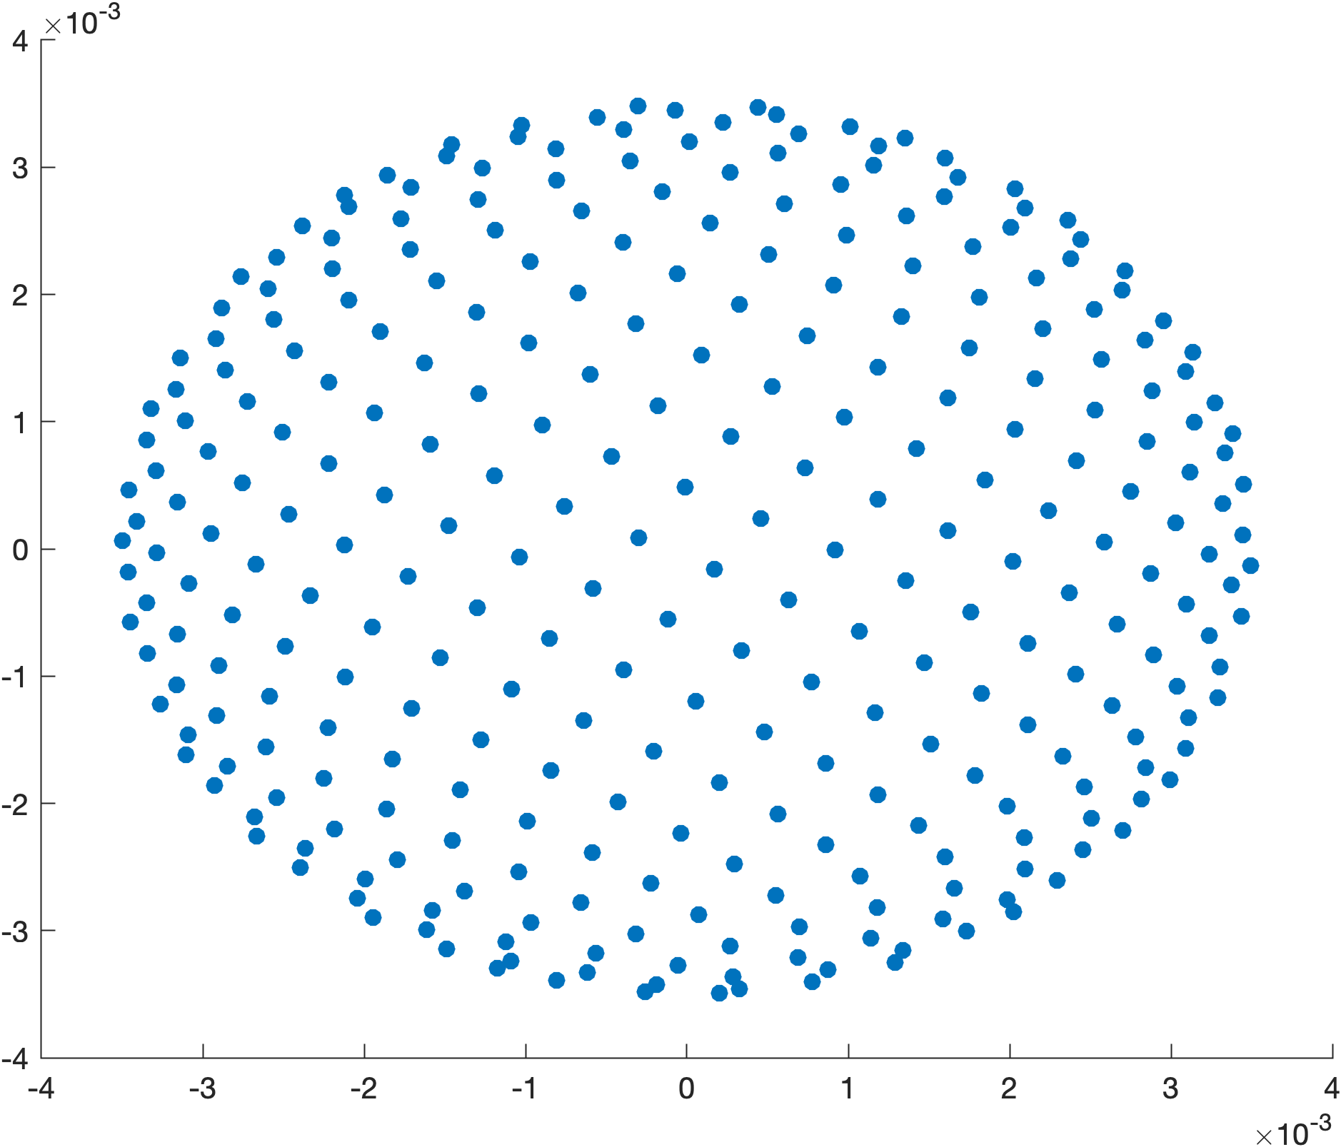
Acoustic detector array
Figure 11: 7mm diameter acoustic sensor with 300 disc elements each with 2mm diameter. Side view (left) and top view (right).

Slide 19
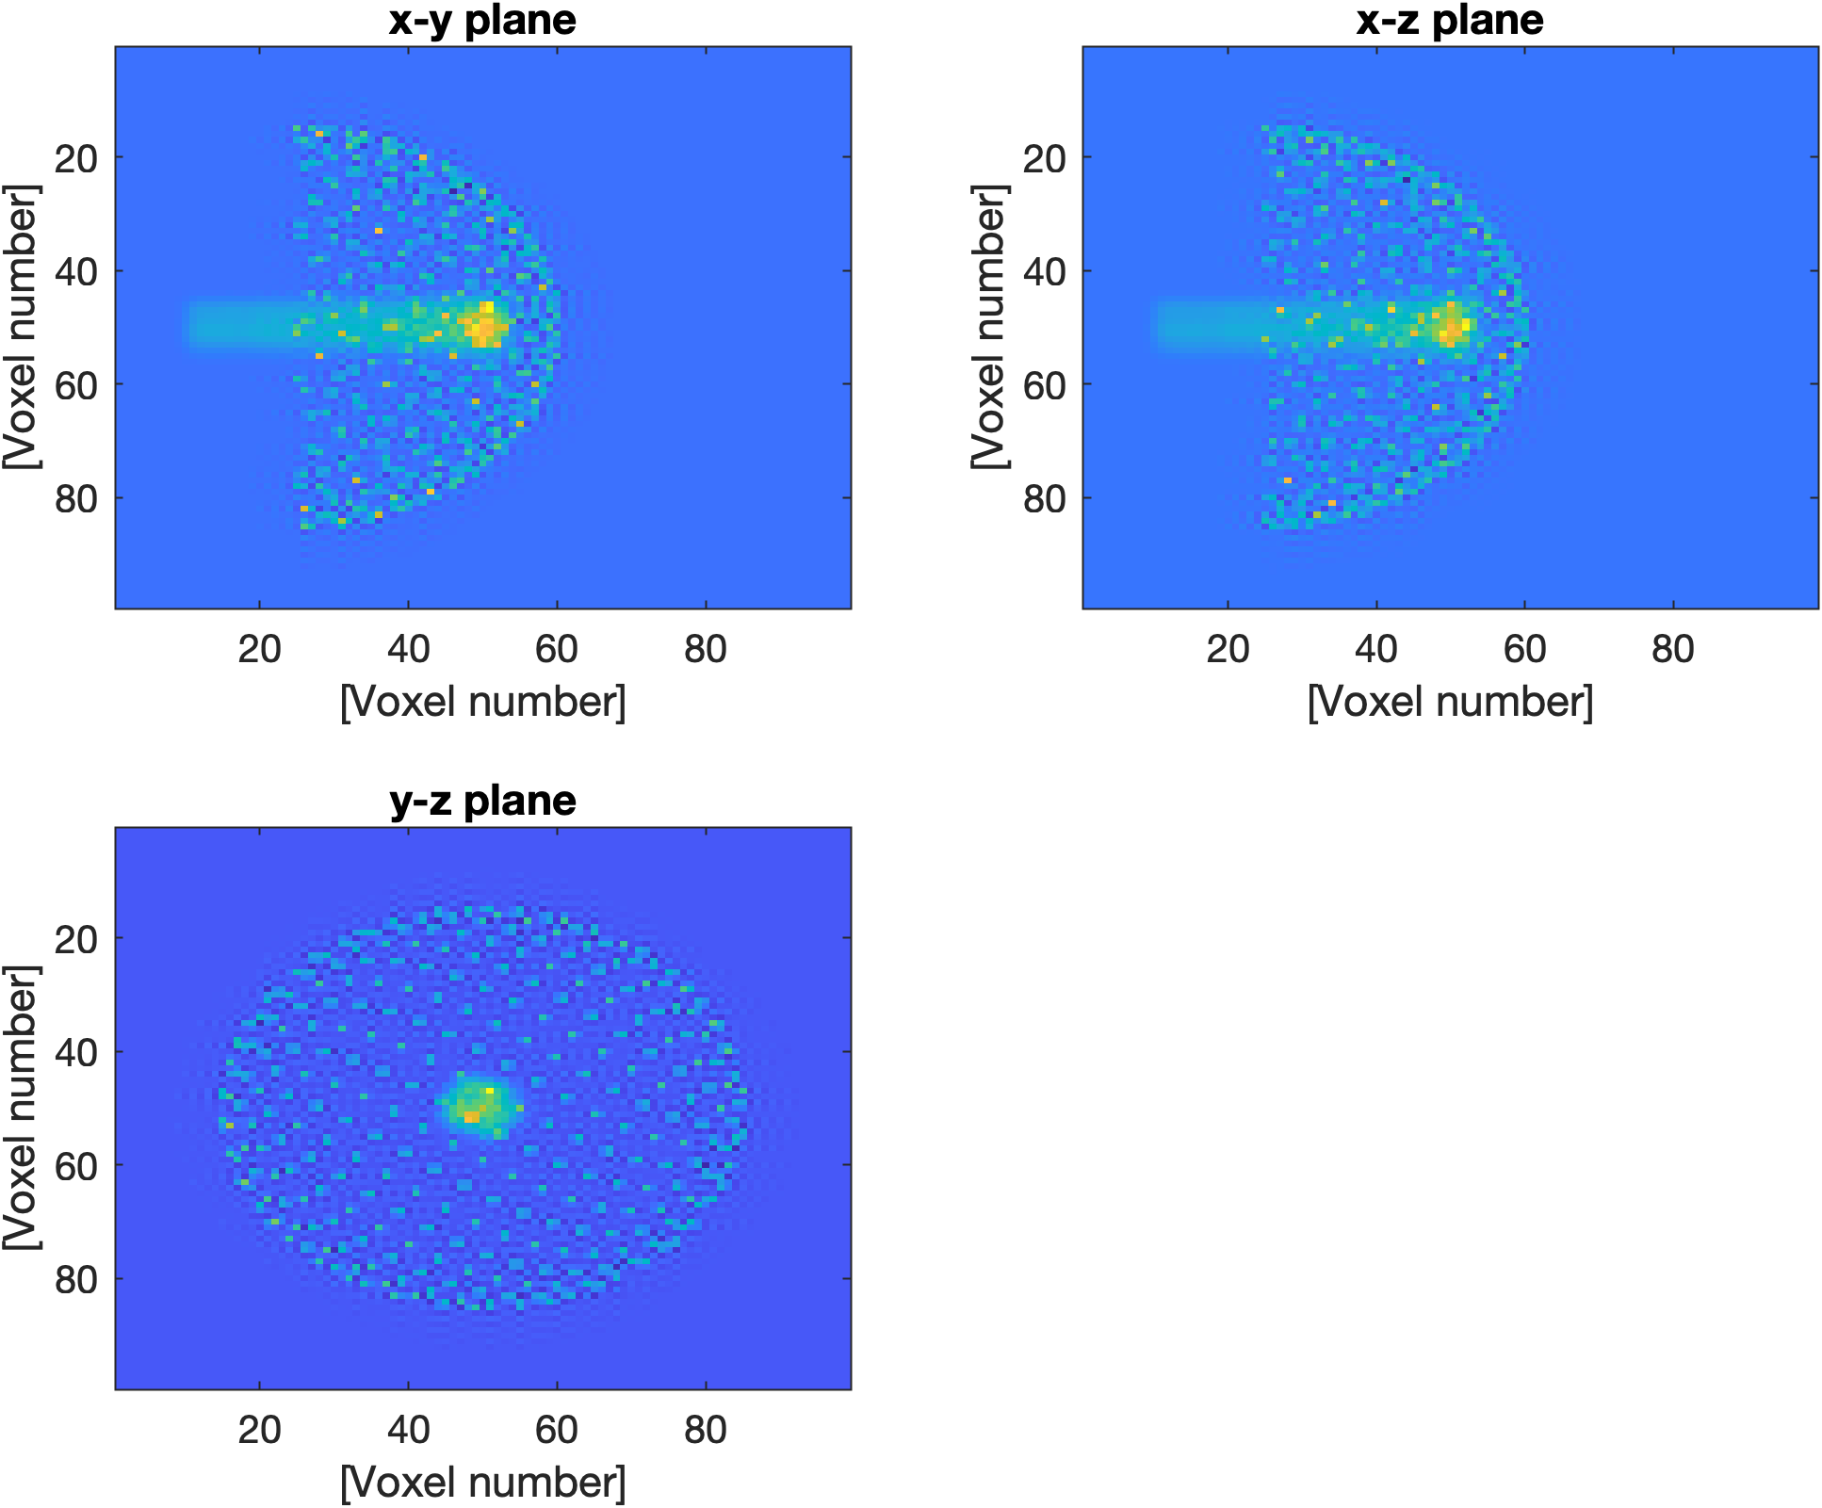
k-Wave set-up
proton beam
sensor array
Figure 12: Sensor geometry and proton beam energy deposition in k-Wave simulation with 0.1mm voxels

Slide 20
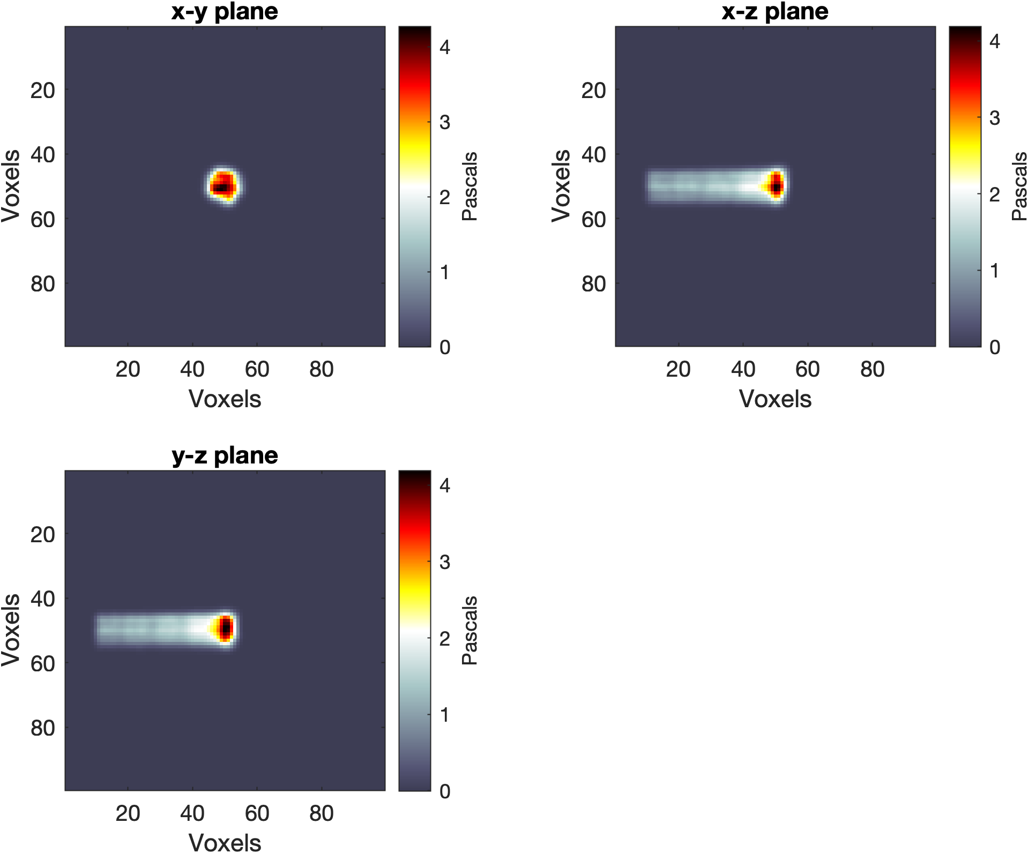
Initial distribution
Figure 13: Initial pressure distribution due to proton beam energy deposition

Slide 21
Image reconstruction

Slide 22
Image reconstruction methods
Iterative time-reversal
Model-based minimization
Back-projection

Slide 23
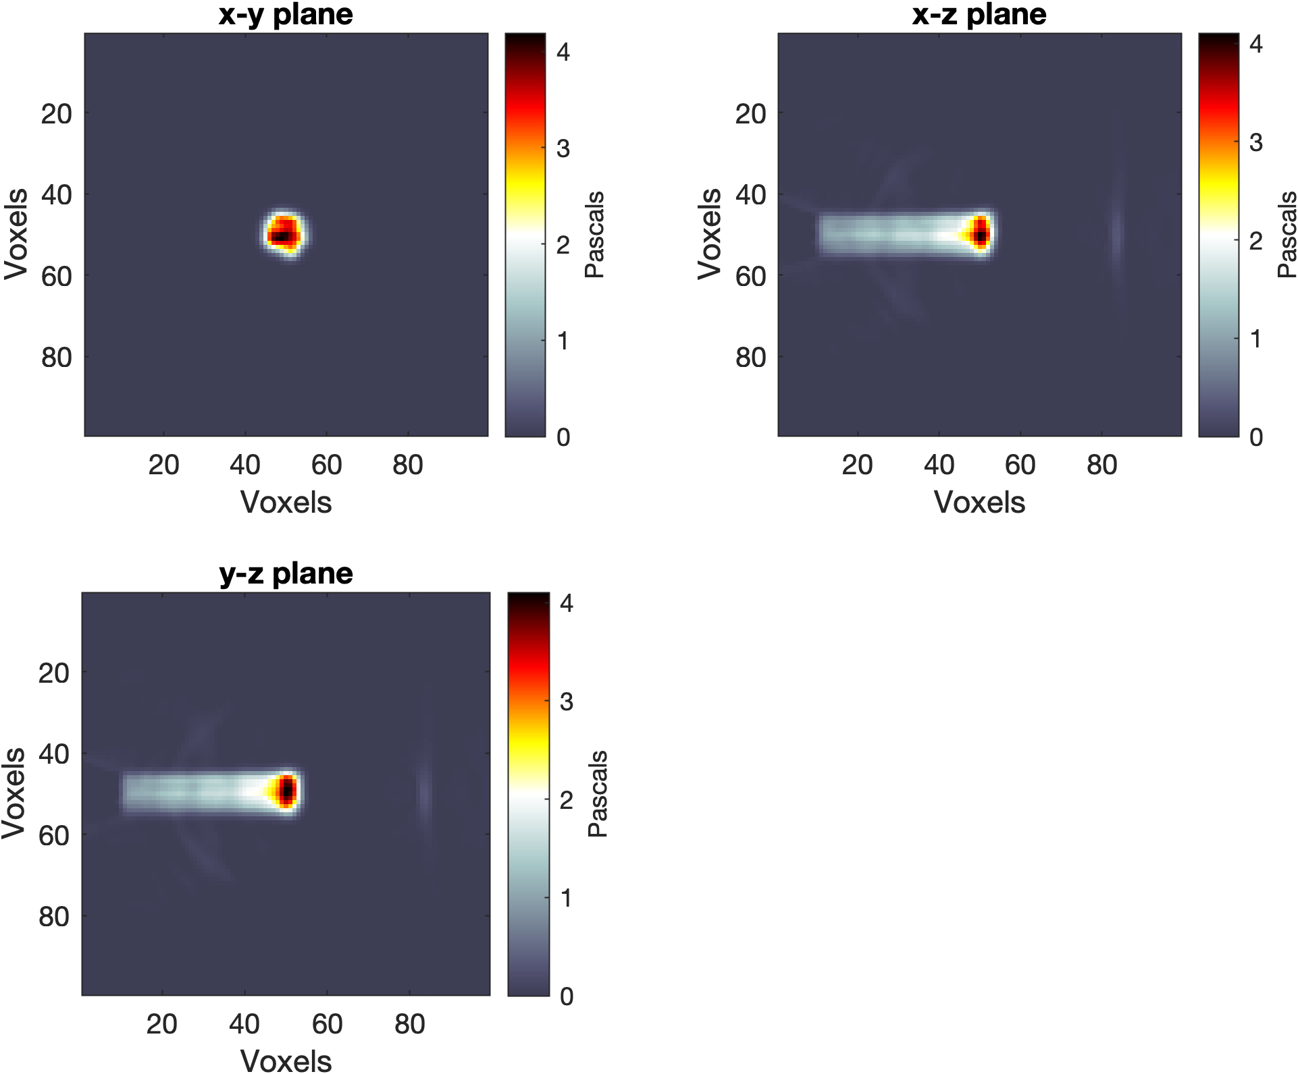
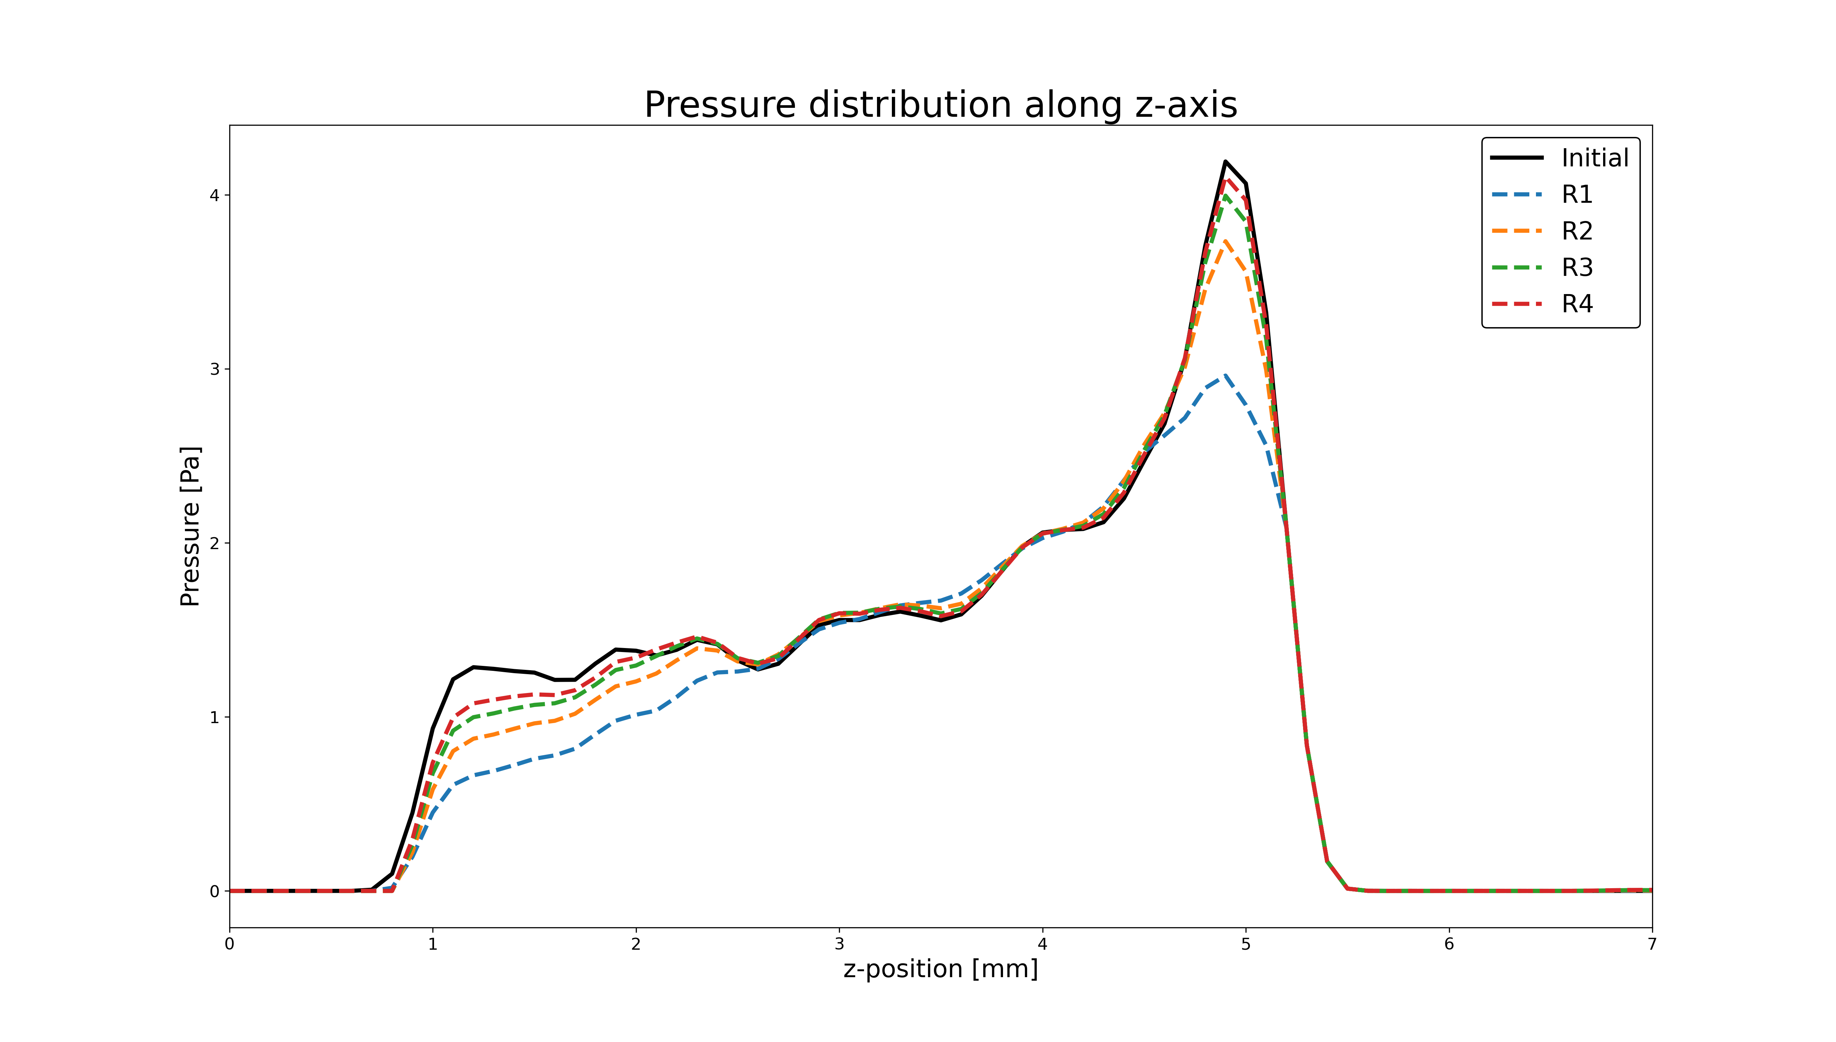
Iterative time-reversal
Figure 14: Reconstructed pressure distribution using an iterative time reversal algorithm

Slide 24
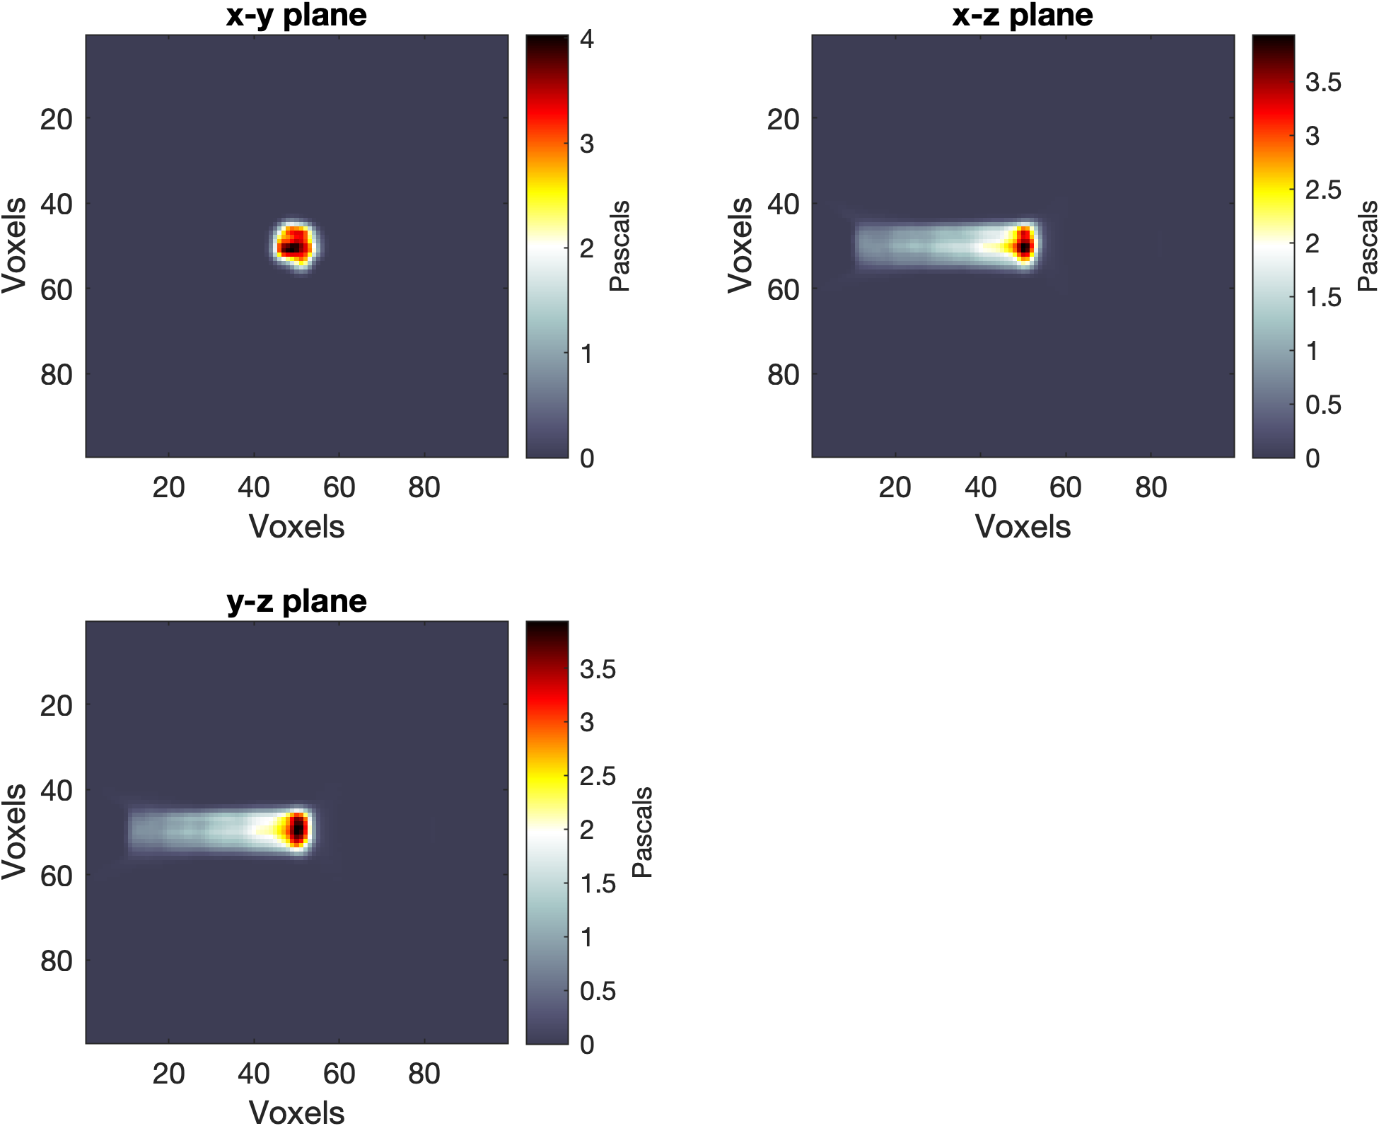
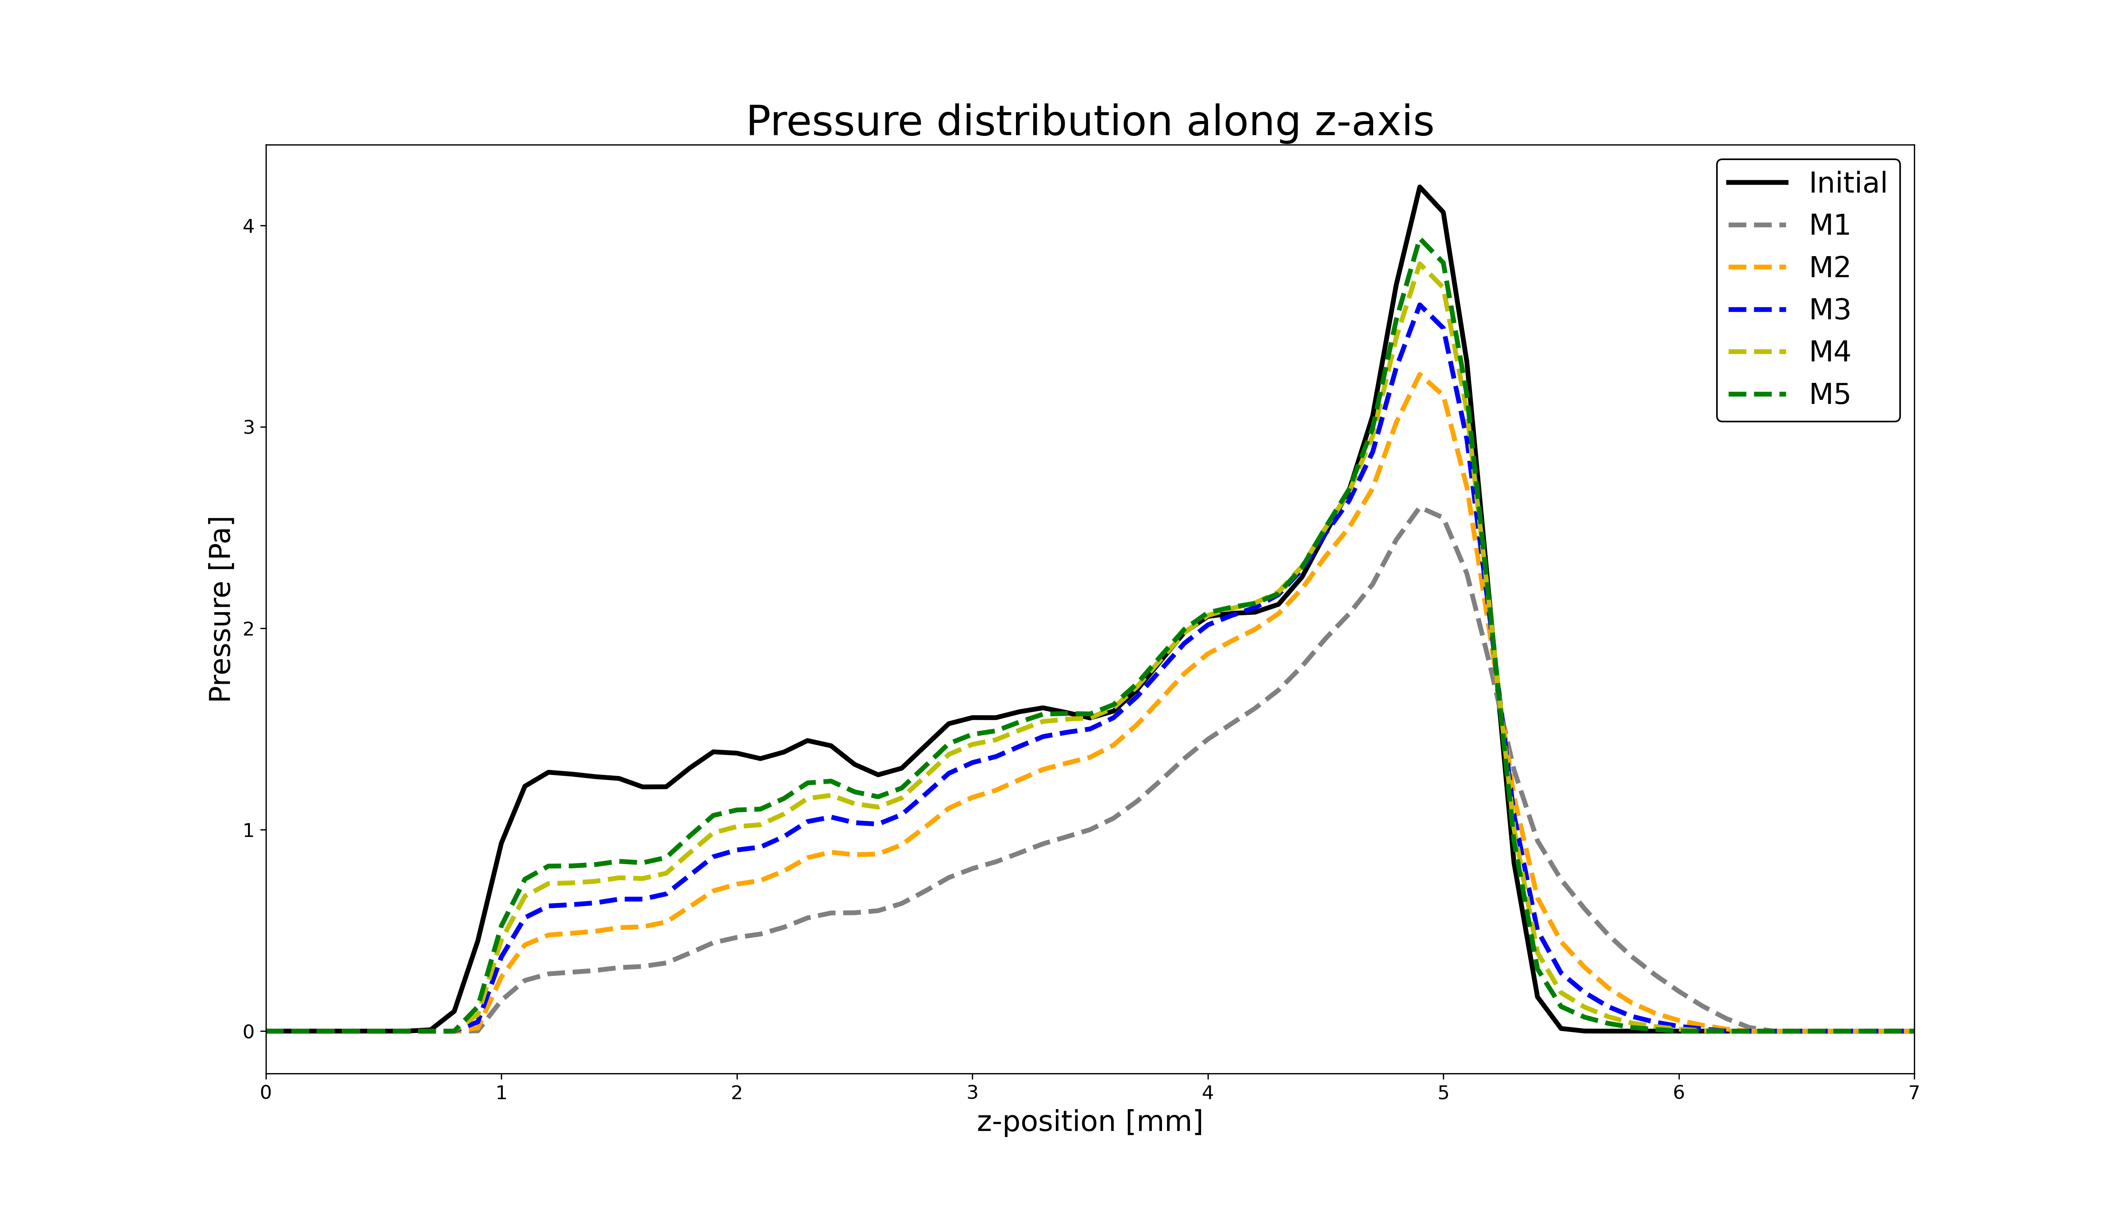
Model-based minimisation
Figure 15: Reconstructed pressure distribution using model-based minimisation: uses gradient descent to minimise error function consisting of the difference between the data (measured time-series) and the simulation output

Slide 25
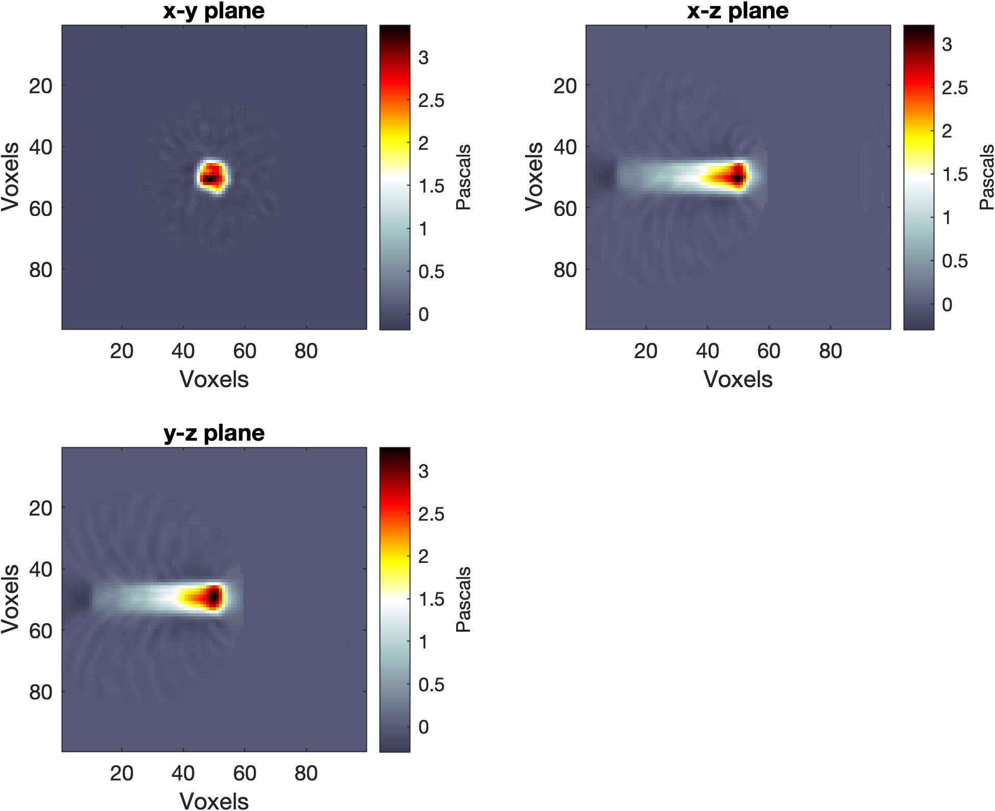
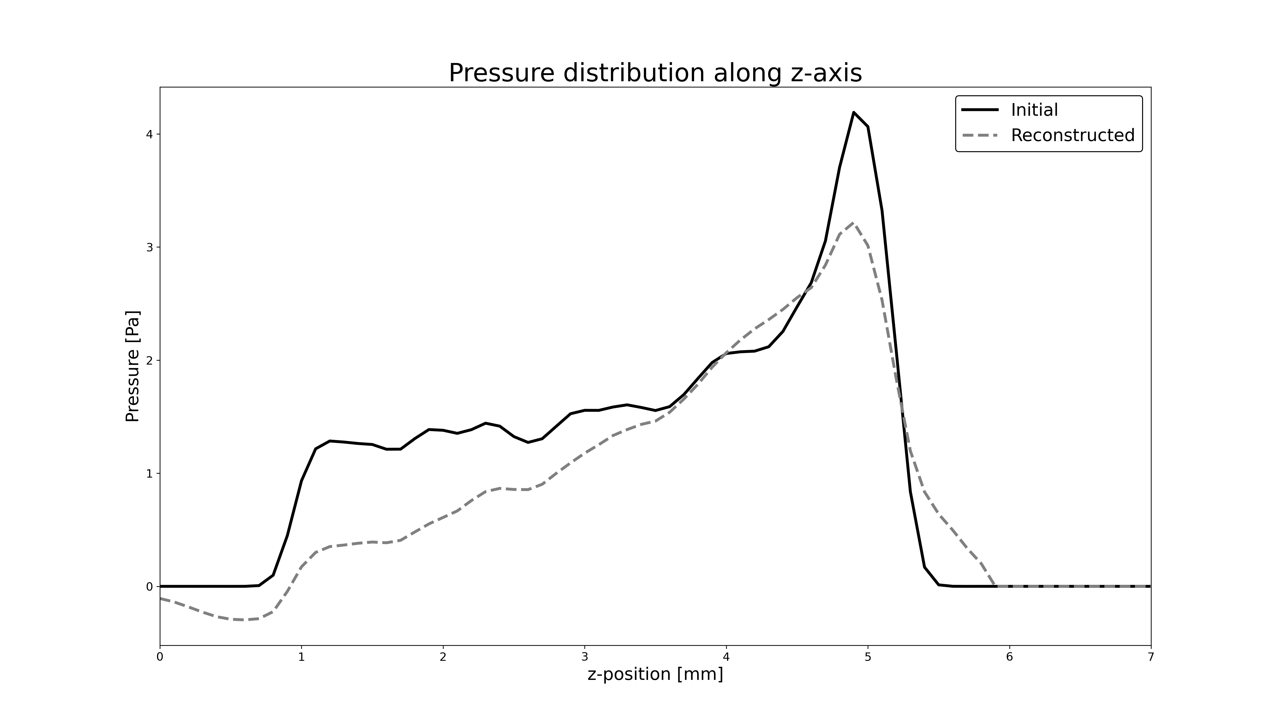
Back-projection
Figure 16: Reconstructed pressure distribution using back-projection

Slide 26
SciFi Planes

Slide 27

Scintillating fibre planes
250 μm
50 μm
33 polystyrene fibres
10 mm
300 μm
10 mm
Figure 17: Scintillating fibre plane diagram (not to scale). Off-axis view of a few fibres (left) top-down view of fibres

Slide 28
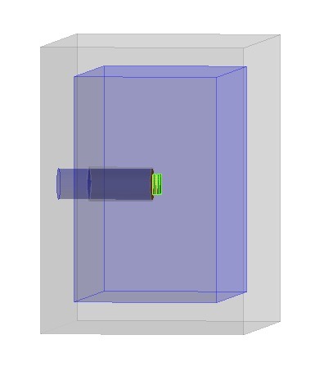
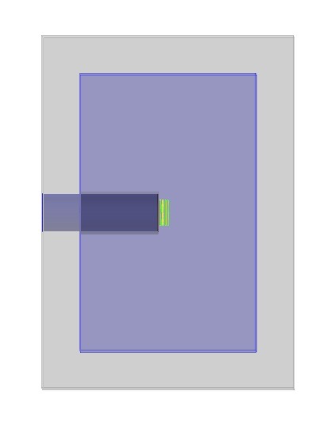
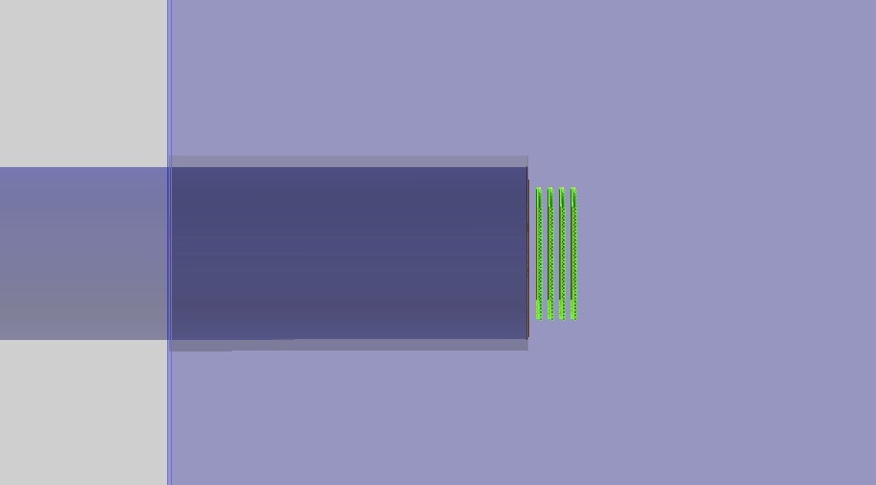
Scintillating fibre planes
4x fibre planes
Figure 18: Scintillating fibre planes (green) in the Geant4 simulation geometry. Off-axis view (left), side-on view (right).

Slide 29
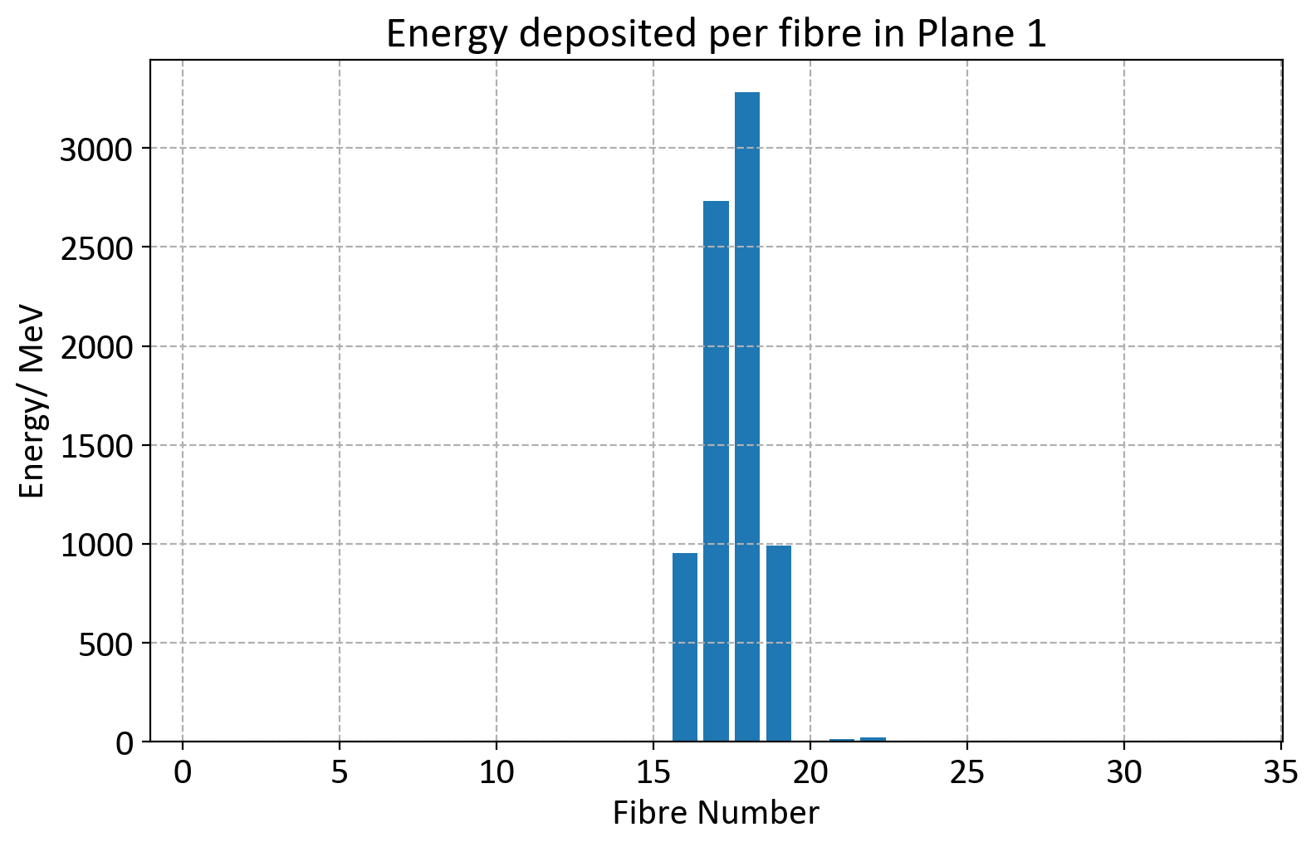
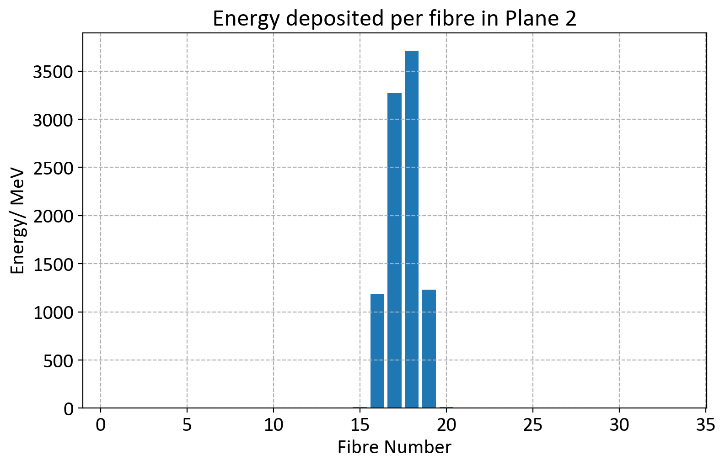
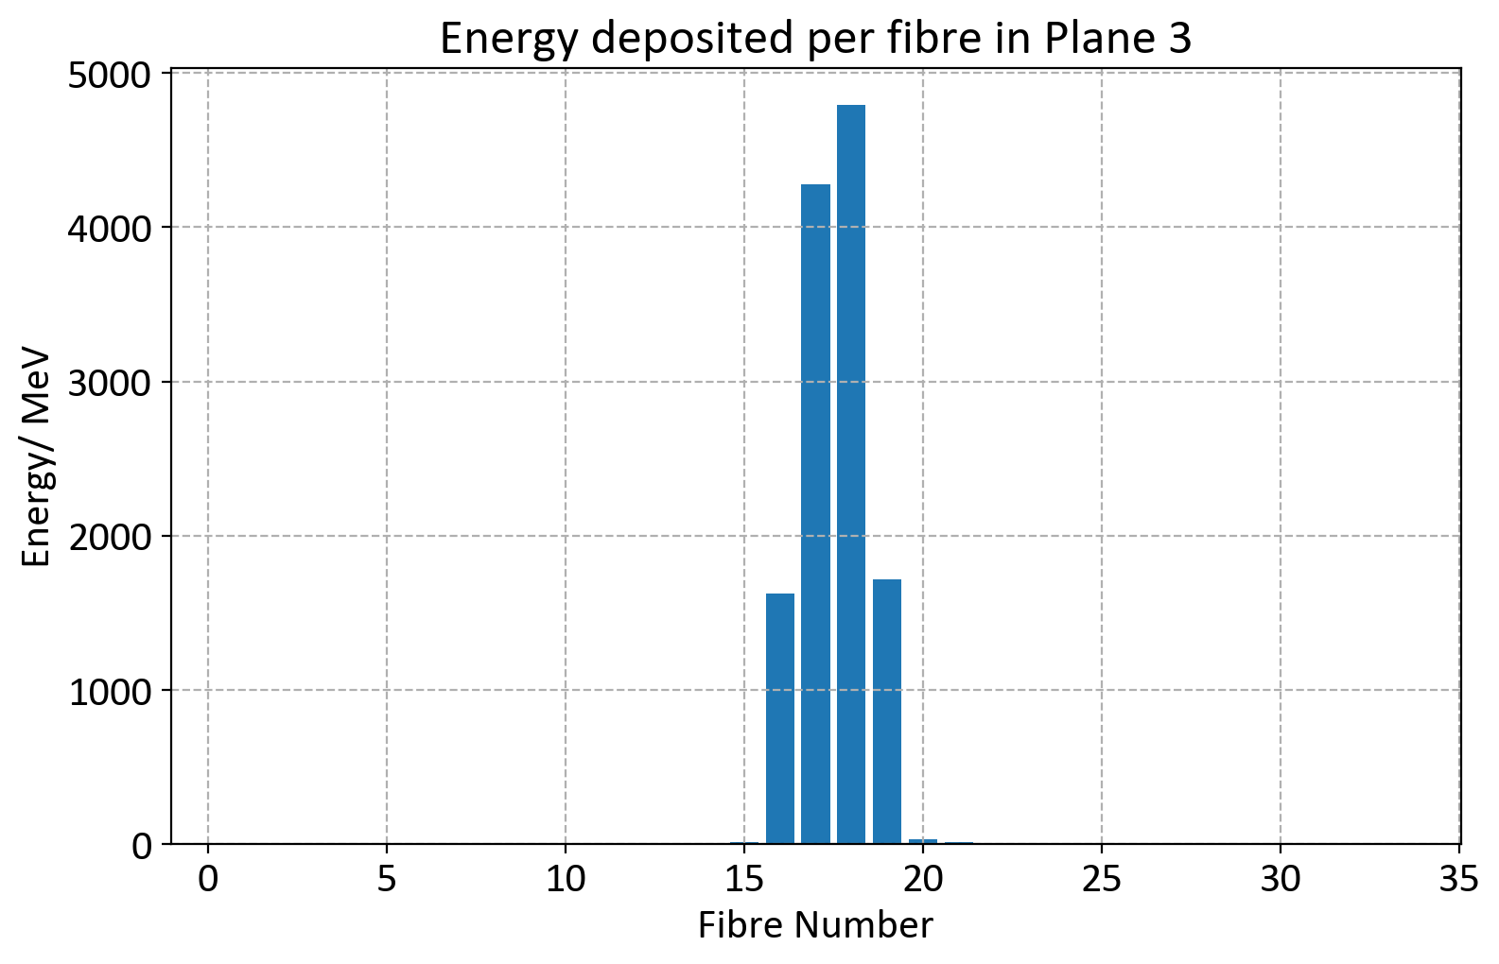
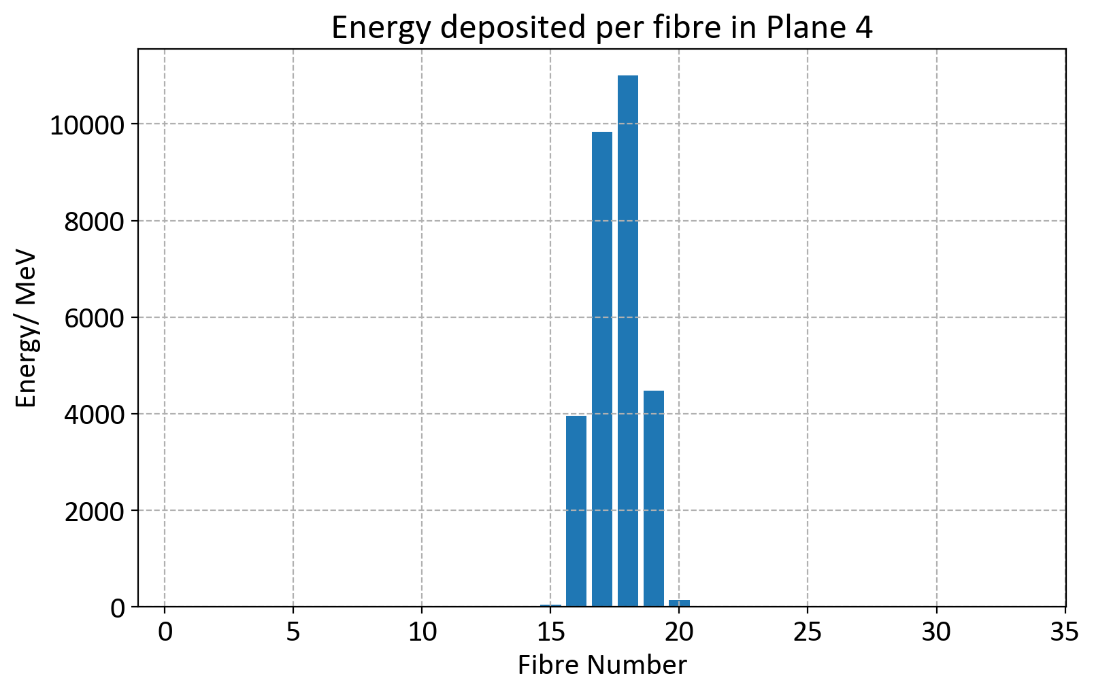
Figure 19: Simulated energy deposited in each fibre in the four planes

Slide 30
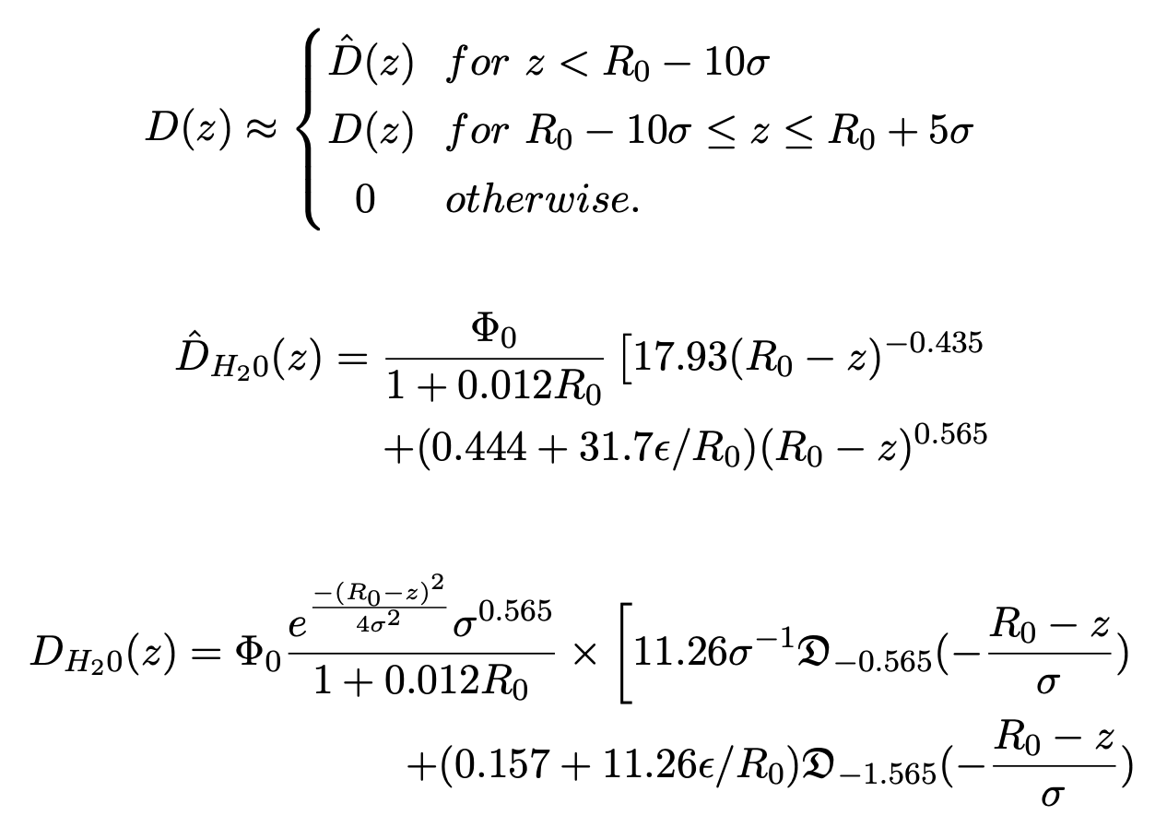
Analy
Bortfeld equation
Analytical approximation of dose D as function of depth in the phantom z

Slide 31
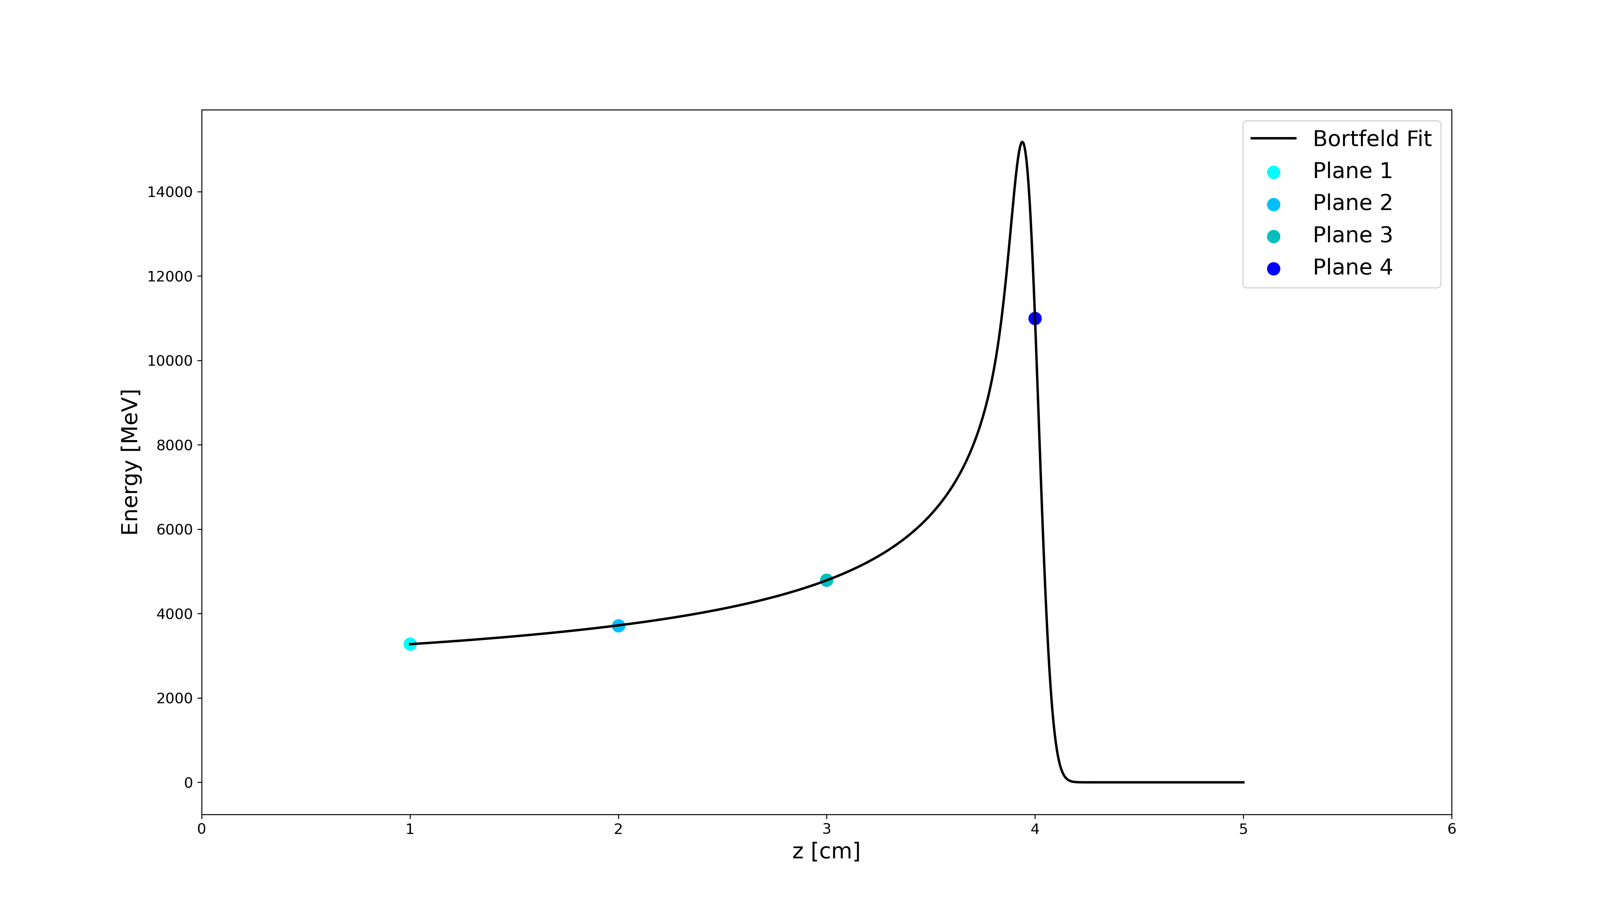
Bortfeld fit
Use energy deposition in each plane to provide an estimate of the Bragg peak
Figure 20: Fitting Bortfeld equation to the simulated energy deposition in the 4 planes

Slide 32
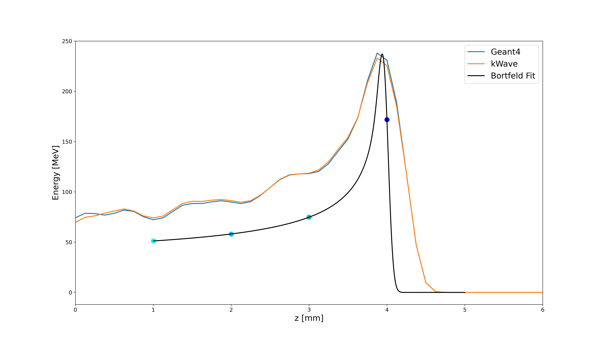
Comparison
Do the planes sample the dose distribution well enough to accurately provide a measure of the peak?
Figure 21: Bortfeld fit using the fibre planes (black), kWave reconstructed distribution (orange), “real” proton energy distribution (blue)

Slide 33
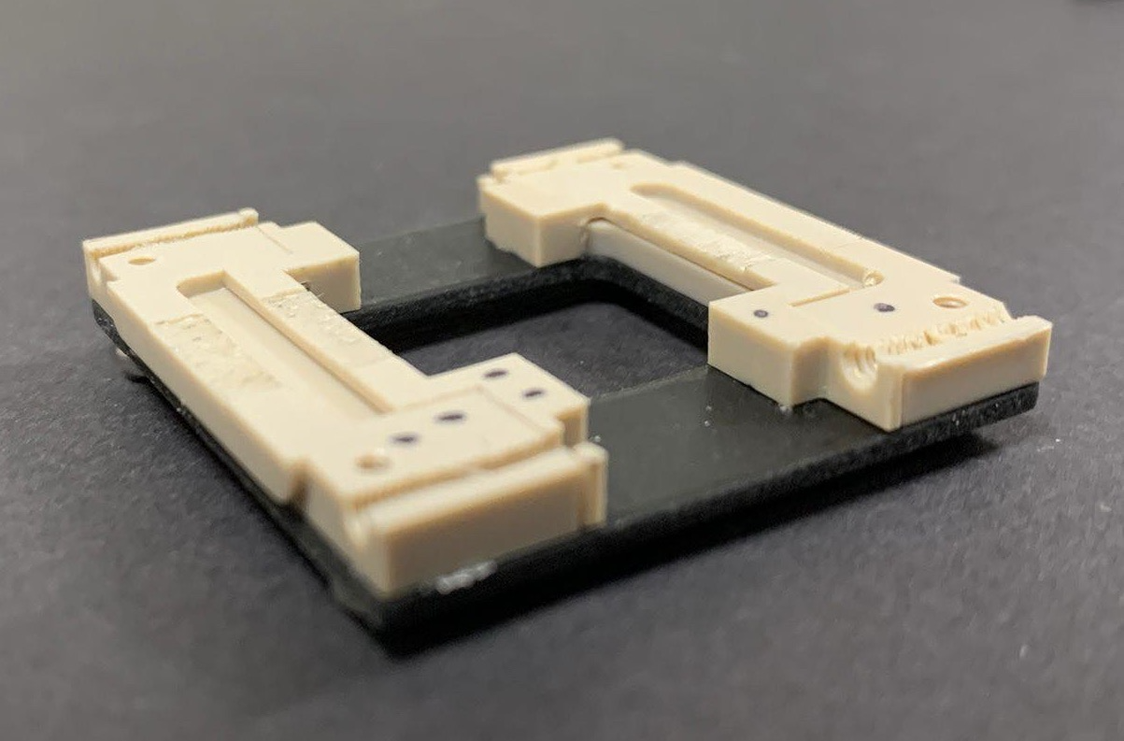
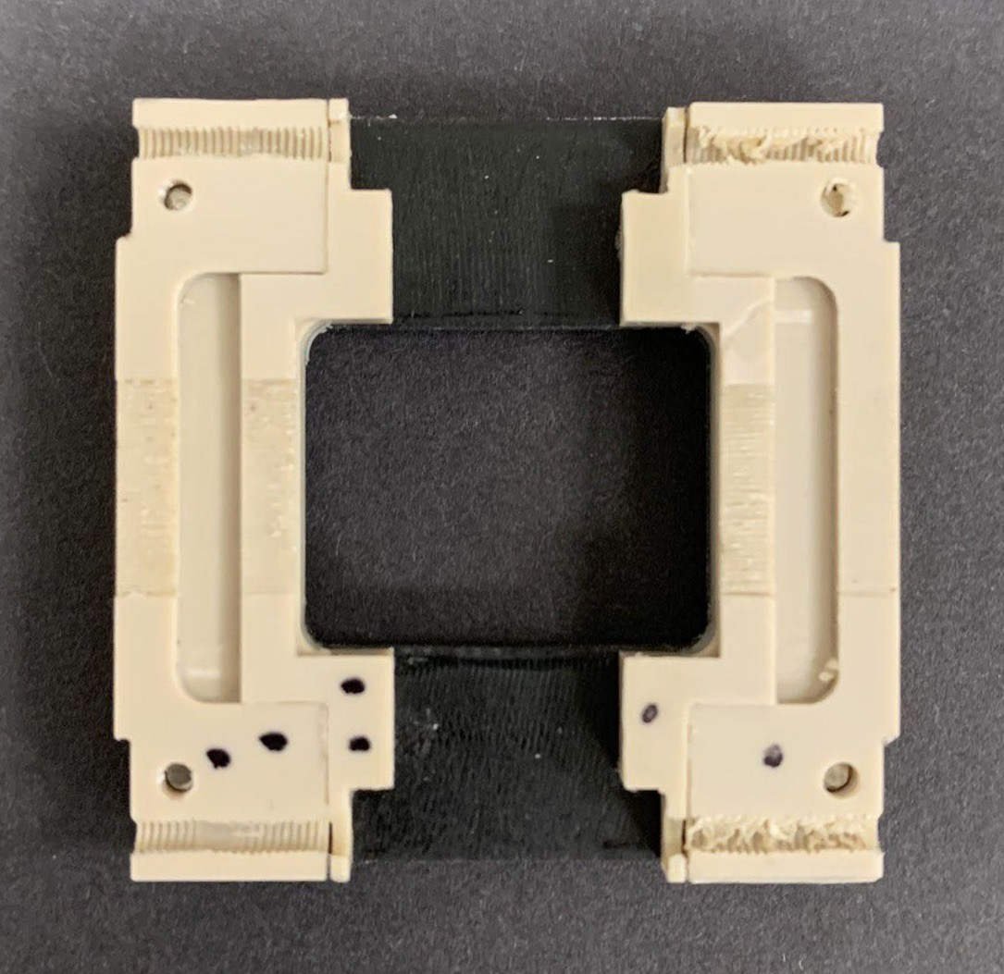
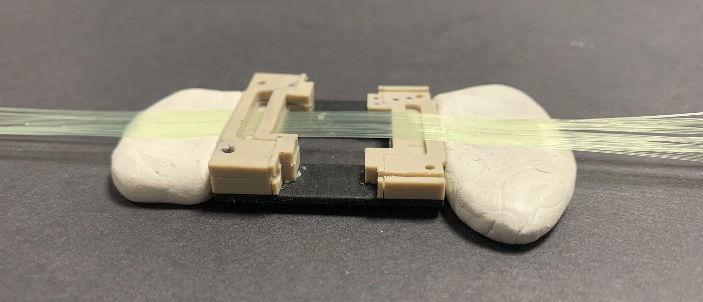
Fibre plane construction
Cavities for epoxy resin
Plastic frame
Figure 23: Fibre plane mid-construction side-view
Grooves for fibres
1 ”top frame” attached to secure fibres
Scintillating fibres
Blu-tack to hold fibres during construction
10mm
Backing plate
Figure 22: Fibre plane mid-construction
Figure 24: Plane mid-construction with 33 fibres in place

Slide 34
Future work
Finish scintillating fibre plane construction and quality assurance tests
Test the planes with a beam
Validate the simulations with experimental data
Alternative option: liquid scintillators
Topas: acoustic signals for bone, tissue, blood etc.

