Slide 1
LhARA the Laser-hybrid Accelerator for Radiobiological Applications

Slide 2
The LhARA initiative
Vision:
Transform clinical practice of proton/ion-beam therapy by creating a fully automated, highly flexible system to harness the unique properties of laser-driven ion beams

Slide 3
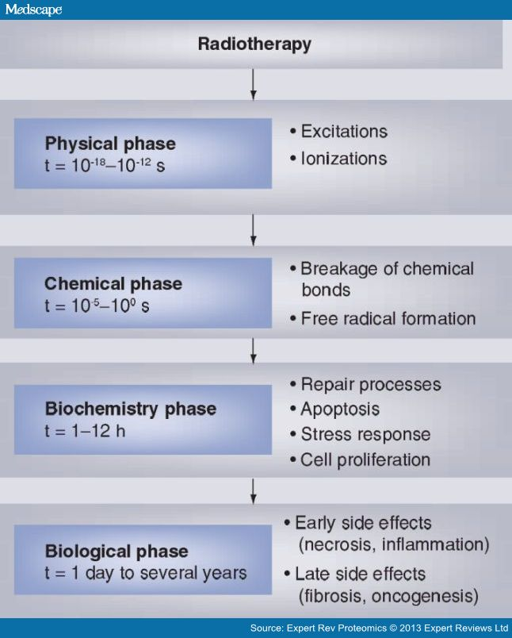
The case for fundamental radiobiology
Relative biological effectiveness:
  Known to depend on:
    Energy, ion species
    Dose, dose rate, spatial fractionation
    Tissue type
    Biological endpoint
Yet:
  p-treatment planning uses 1.1
  Effective values are used for C⁶⁺
Maximise the efficacy of PBT

Slide 4
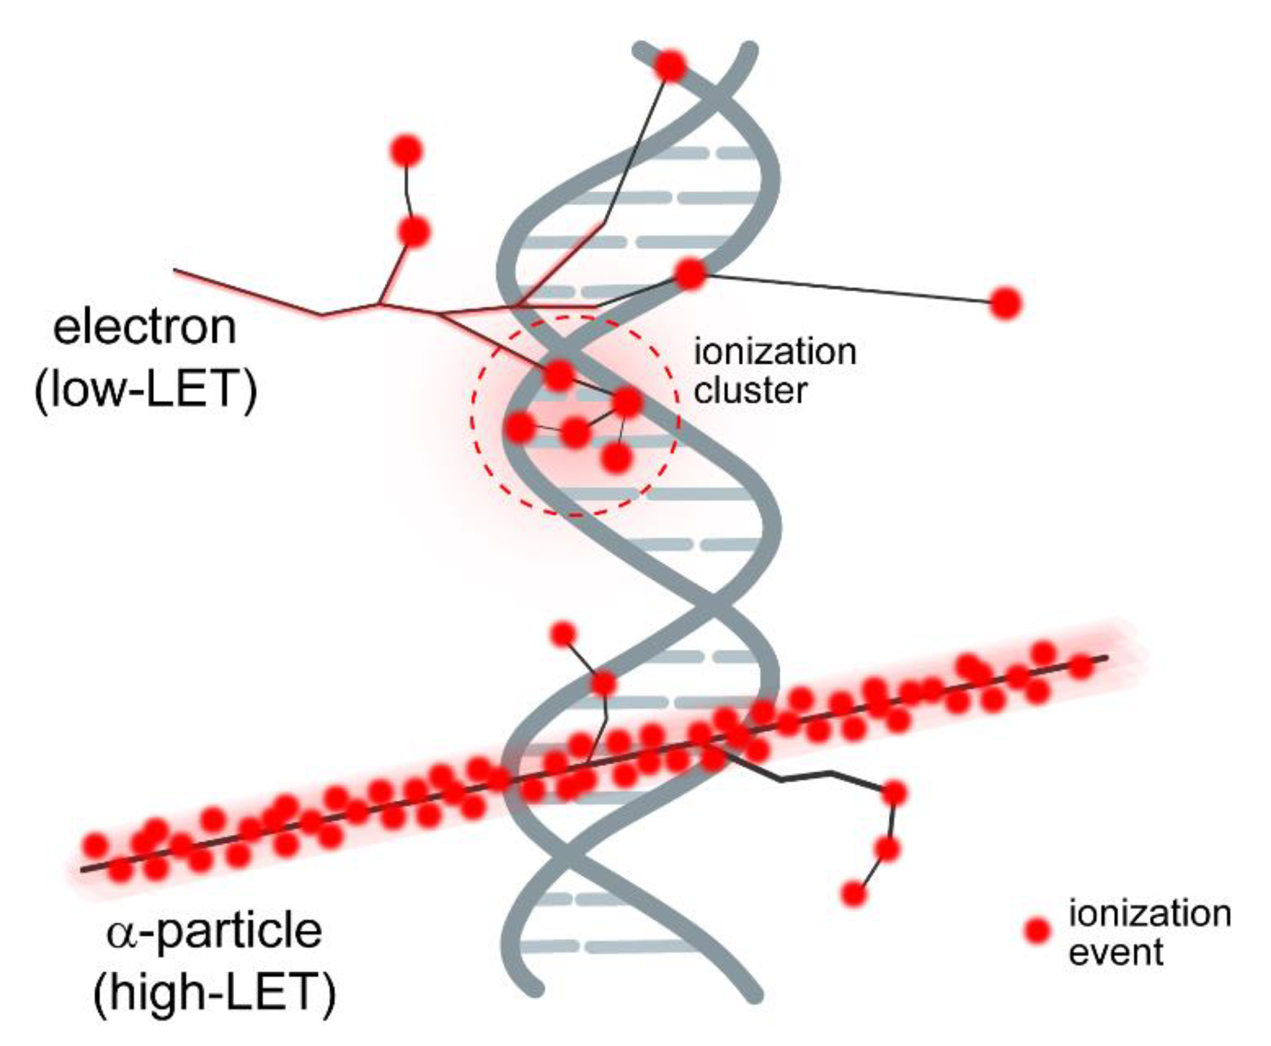
Radiobiology in new regimens
Time
domain
Space
domain
The ideally
flexible beam facility
can deliver it all!
⇒ substantial
opportunity for a
step-change in
understanding!
Multidisciplinary approach essential
Ion
species
Energy
In combination
and with chemo/immuno therapies

Slide 5
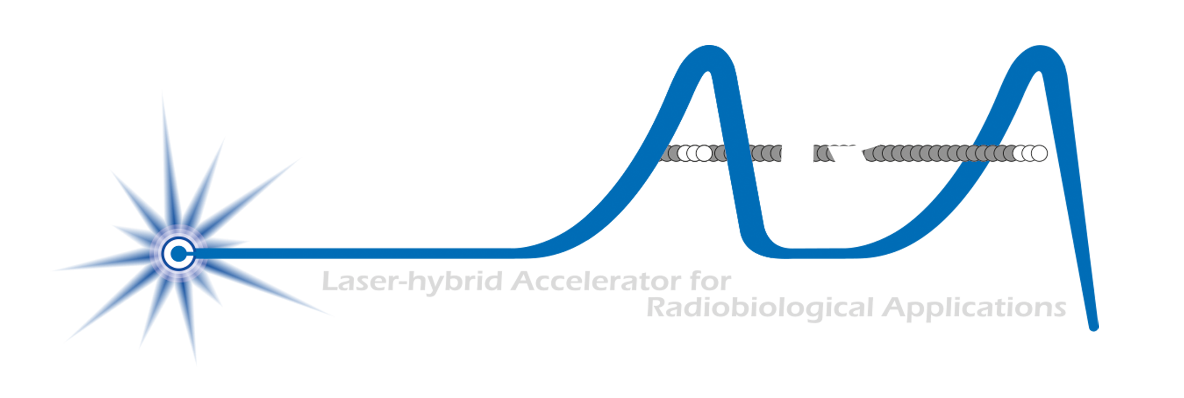
Laser-hybrid Accelerator for Radiobiological Applications
A novel, hybrid, approach:
Laser-driven, high-flux proton/ion source
  Overcome instantaneous dose-rate limitation
    Capture at >10 MeV
  Delivers protons or ions in very short pulses
    Bunches as short as 10—40 ns
  Triggerable; arbitrary pulse structure
Novel “electron-plasma-lens” capture & focusing
  Strong focusing (short focal length) without the use of high-field solenoid
Fast, flexible, fixed-field post acceleration
  Variable energy
    Protons: 15—127 MeV
    Ions: 5—34 MeV/u
Front. Phys., 29 September 2020; DOI: 10.3389/fphy.2020.567738

Slide 6
LhARA to serve the Ion Therapy Research Facility
2-year Preliminary Activity – Project start 01Oct22: CCAP-TN-10
To serve ITRF: 2 + 3-year project
in 6 work packages:
  Project Management
  Laser-driven proton and ion source
  Proton and ion capture
  Real-time dose-deposition profiling
  Novel, automated, end-station development
  Facility design and integration
First two years of
“Full five-year proposal”
CCAP-TN-10
2-year preliminary phase;
Flagged need for further 3-year preconstruction phase

Slide 7
N. Bliss (DL)
N. Bliss et al
Front. Phys., 29 September 2020; DOI: 10.3389/fphy.2020.567738
Draft
⇒ compact, uniquely flexible facility

Slide 8
Low-energy in-vitro end station
Maximum rep rate 10 Hz
  With current specification
Realisation of full scientific
potential requires:
  Automation
  Novel instrumentation:
    High dose rate
    Spatial fractionation
    “Readout” in < 0.1s

Slide 9

Conclusions
Laser-driven sources are disruptive technologies …
  With the potential to drive a step-change in clinical capability
Laser-hybrid approach has potential to:
  Overcome dose-rate limitations of present PBT sources
  Deliver uniquely flexible facility:
    Range of: ion species; energy; dose; dose-rate; time; and spatial distribution
  Be used in automated, triggerable system → reduce requirement for large gantry
    Disruptive/transformative approach to “distributed PBT for 2050”
Peer-group consultation critical:
  Maximise scientific potential through:
    Automation
    Novel techniques, instrumentation, operation, procedures …

Slide 10

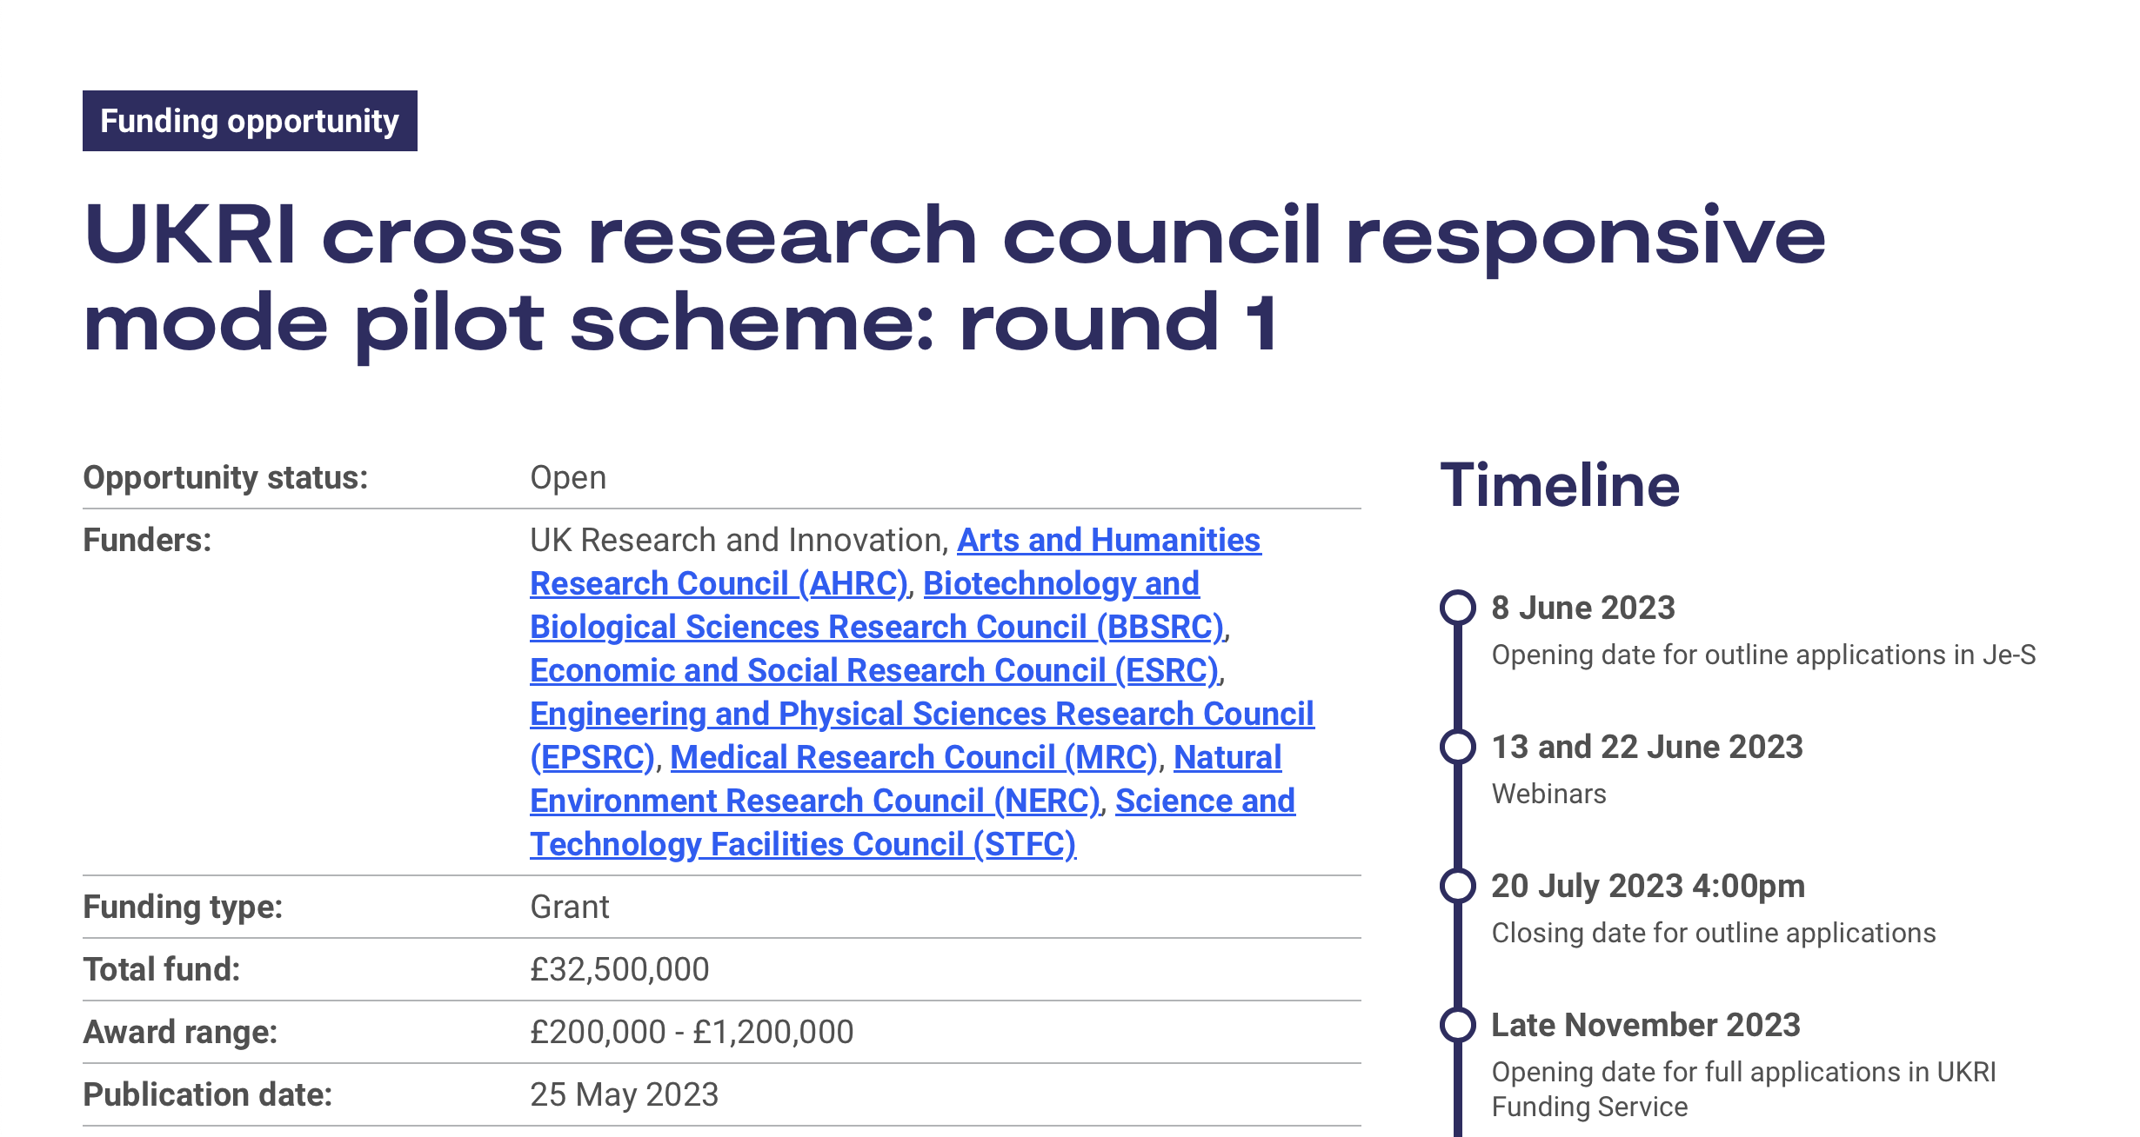
Beyond today
Peer-group essential preparation for bid for continuation:
  Start from and extend:
    Full five-year proposal
Target UKRI cross-council call to secure resource for multidisciplinary end-station development activity
Wave 4:
Call opens: 02Oct23
Decision. : 01Mar24
Funding : 01Oct24

