Slide 1
WP2: Update on first LhARA beamtime on SCAPA
Ross Gray
University of Strathclyde, Glasgow, UK
20th September 2023

Slide 2
SCAPA Experiment Team….
University of Strathclyde
R. Wilson, T. Frazer, E. Dolier, C. McQueen, B. Torrance, R. Nayli and P.McKenna
Imperial College
O. Ettlinger, G. Casati and N.P. Dover
Queens University Belfast
P. Parsons and C. Palmer
SCAPA, University of Strathclyde
M. Wiggins, E. Brunetti, G. Manahan, W. Li
Central Laser Facility
J. Green, C. Armstrong, C. Spindloe, W. Robins, S. Astbury

Slide 3
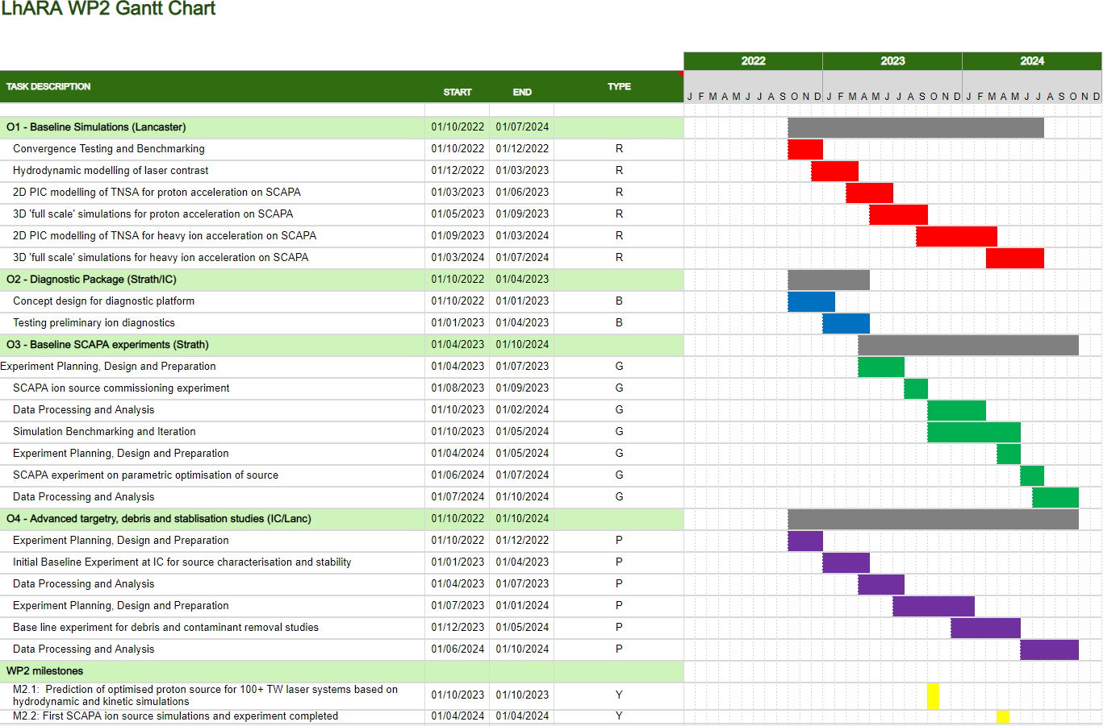
WP2 project plan…
Deliverables for the first two years are focused on early experiments and source benchmarking in simulations, as well as initial technology development in diagnostics and targetry.
For the initial experiments we would ideally like to perform detailed, statistically significant parameter scans to establish and optimise the source performance.

Slide 4
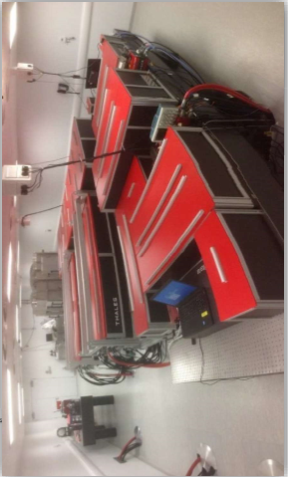
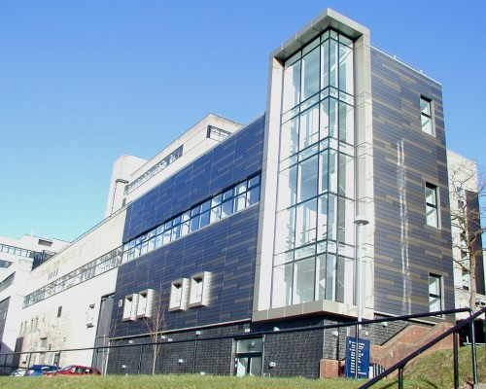
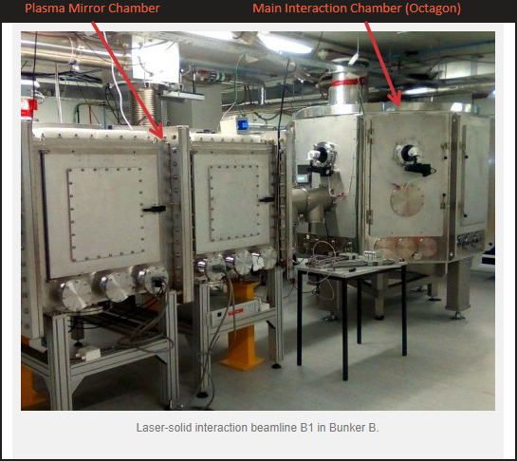
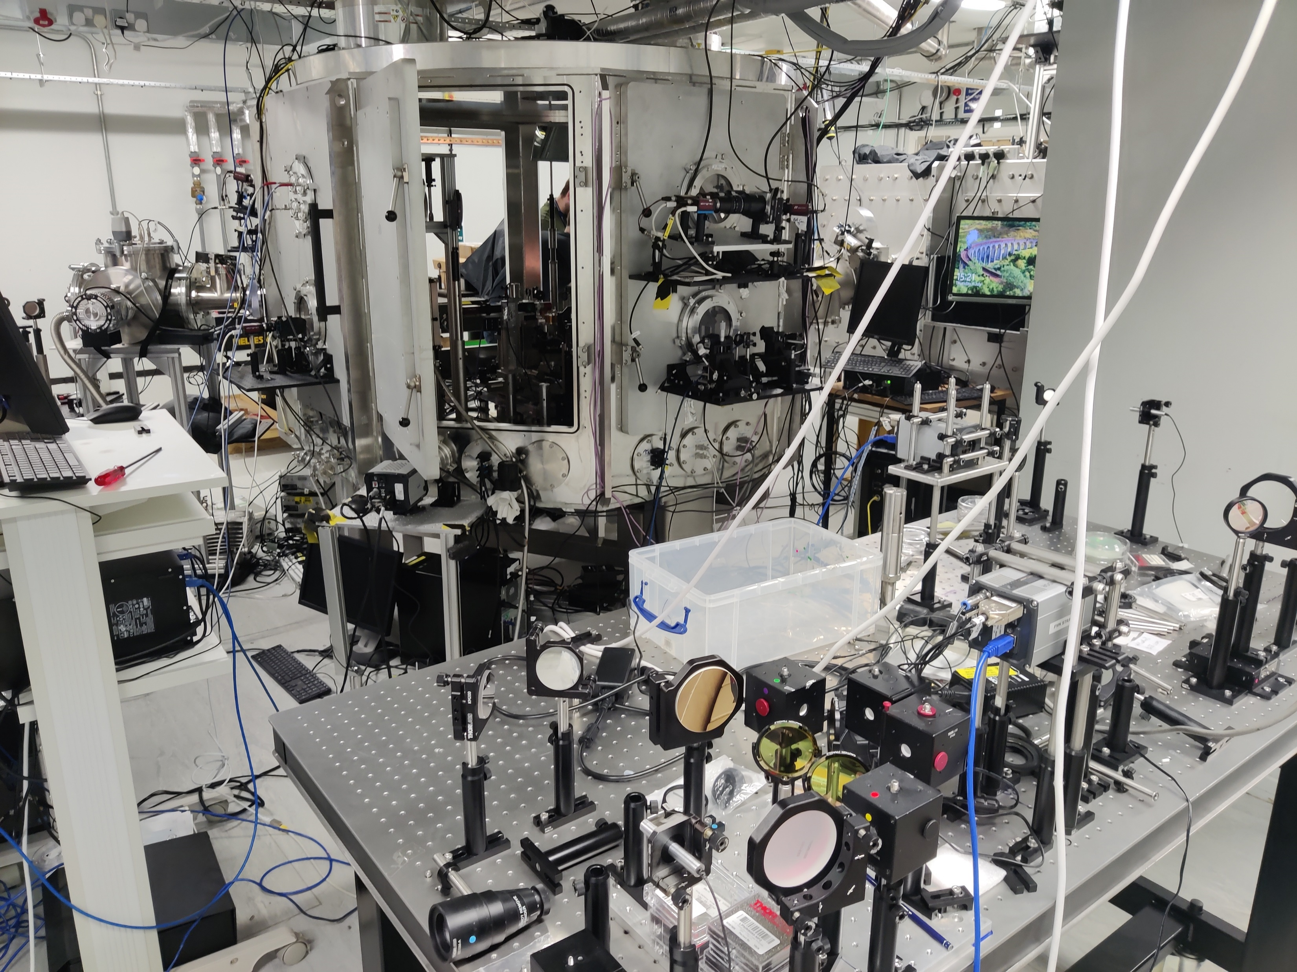
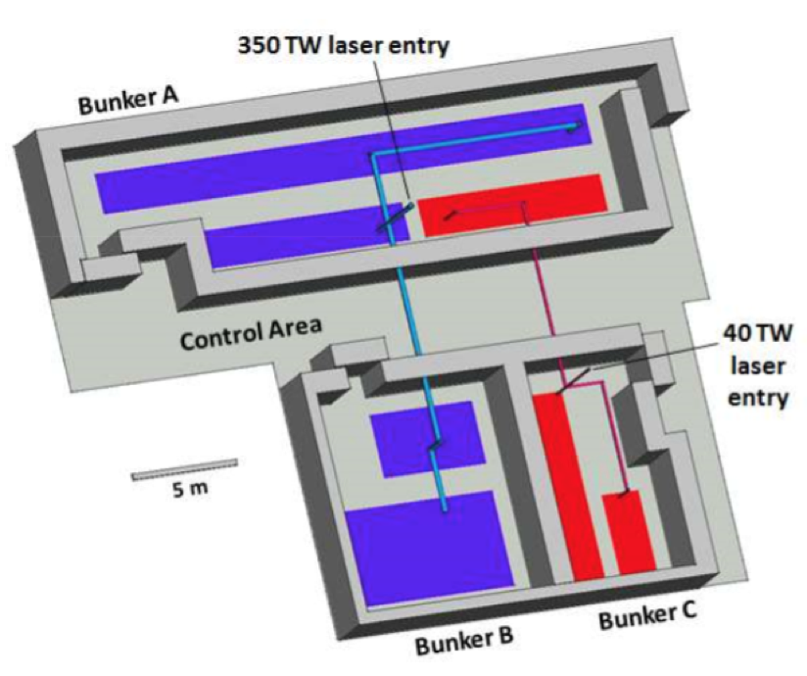
Scapa: Scottish Centre for the Application of Plasma-based Accelerators
Parameters
Peak Power | $≥$350 TW
FWHM pulse duration | $≤$25 fs
Energy per pulse (on target) | $≥$ 6.5 J
Pulse repetition rate | Up to 5 Hz
Temporal intensity contrast | 10¹⁰:1 @ 100 ps 10⁸:1 @ 30 ps 10⁴:1 @ 2 ps ASE contrast 10¹⁰:1
Central wavelength | 800 nm
Beam quality Strehl ratio | $≥$0.85
Attenuator | 10-100%

Slide 5
Developments in Targets, Diagnostics and Data Handling….

Slide 6
Diagnostics Development for SCAPA experiment
Ion Diagnostics –
Online proton beam footprint monitor
RCF Stack
Thomson Parabola ion spectrometer
Optical Diagnostics –
Specular reflection scatter screen (imaging 1w and 2w) and optical spectrometer
Backscatter scatter screen (imaging 1w and 2w) and optical spectrometer
Transmission scatter screen (imaging 1w and 2w) and optical spectrometer
Transverse optical probe, operating in an interferometry configuration
Electron Diagnostics –
Lanex beam imager
Compact electron spectrometer
Debris Diagnostics–
Witness plates (glass slides with section covered with Kapton tape, to be post-characterised by target fab (CLF))
Witness optics (optical setup with a laser reflection from optics exposed to debris. Gives real time optic degradation measure.)

Slide 7
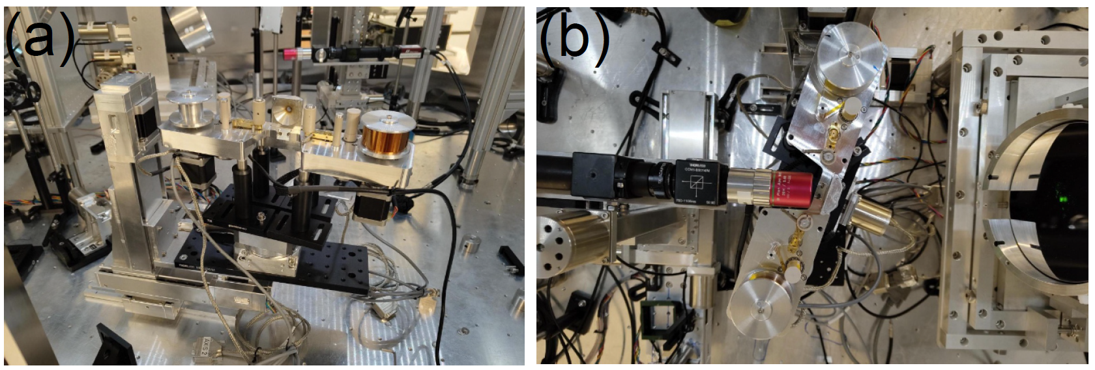
Wider tape drive mount for 35 degree angle of incidence…
Rear view of Tape Drive
Top view of tape drive with focal spot camera in place

Slide 8
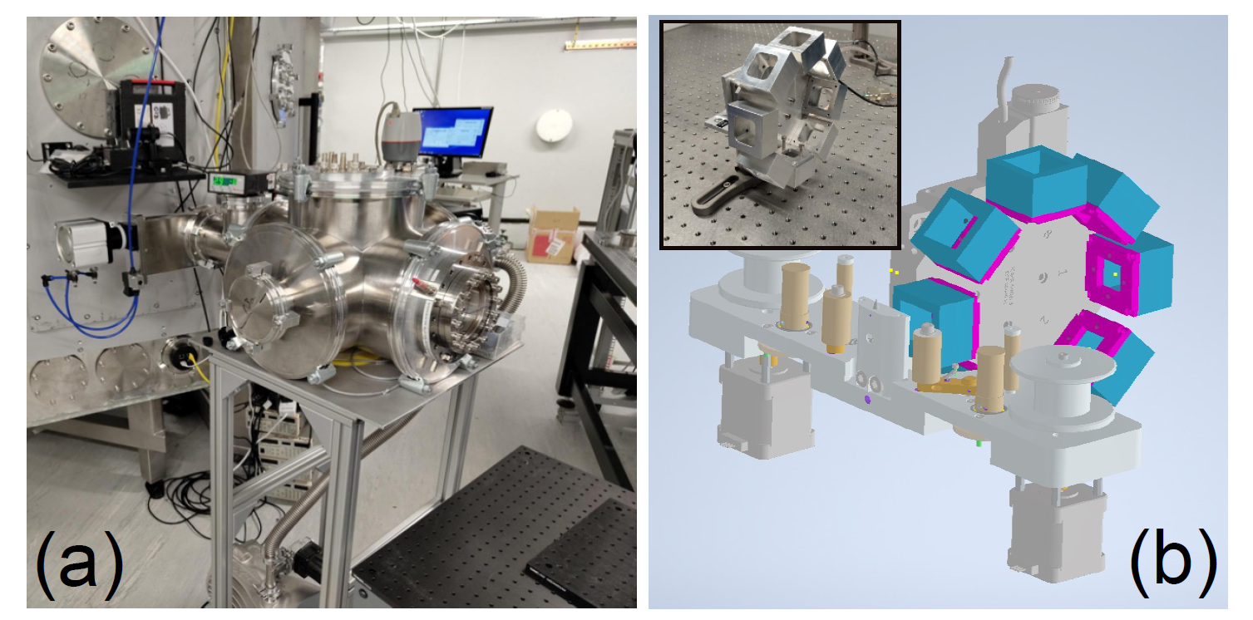
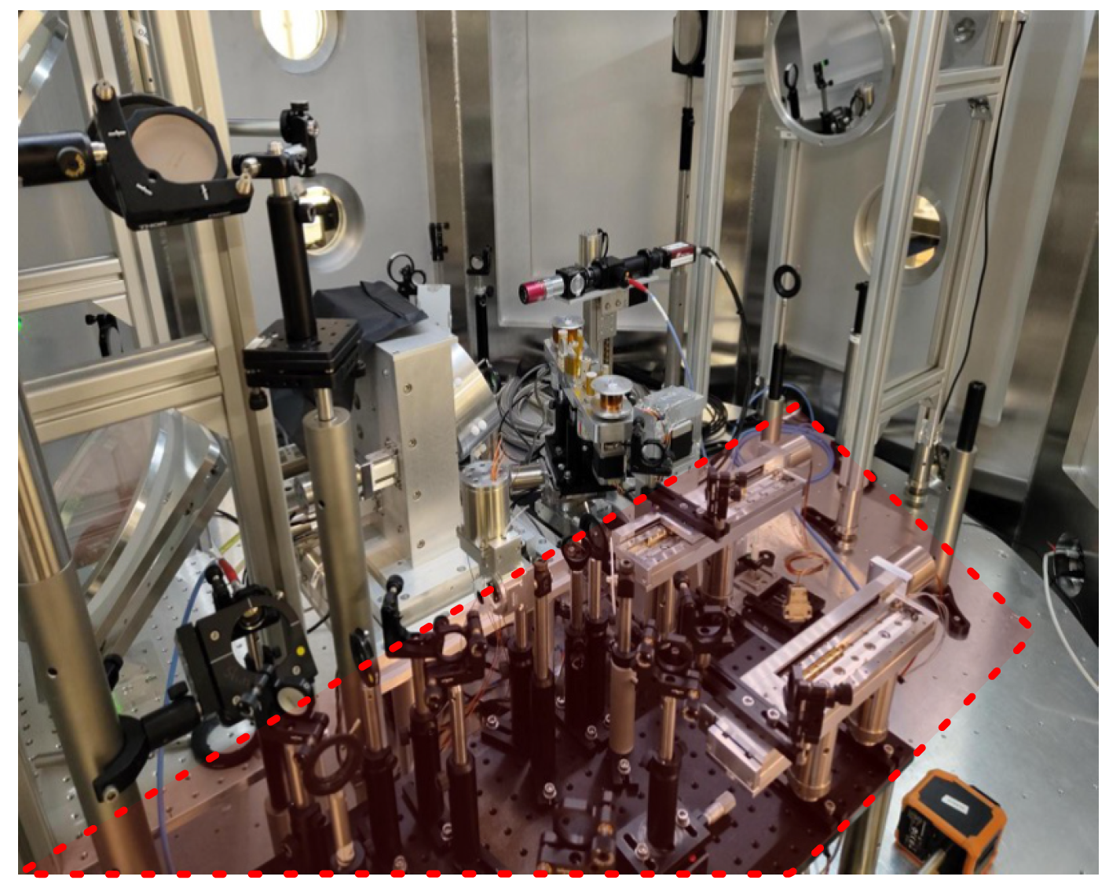
New ion and optical diagnostics….
Thomson Parabola Spectrometer
Chamber
Multi-shot RCF wheel
Combined prepulse and optical probe beamline

Slide 9
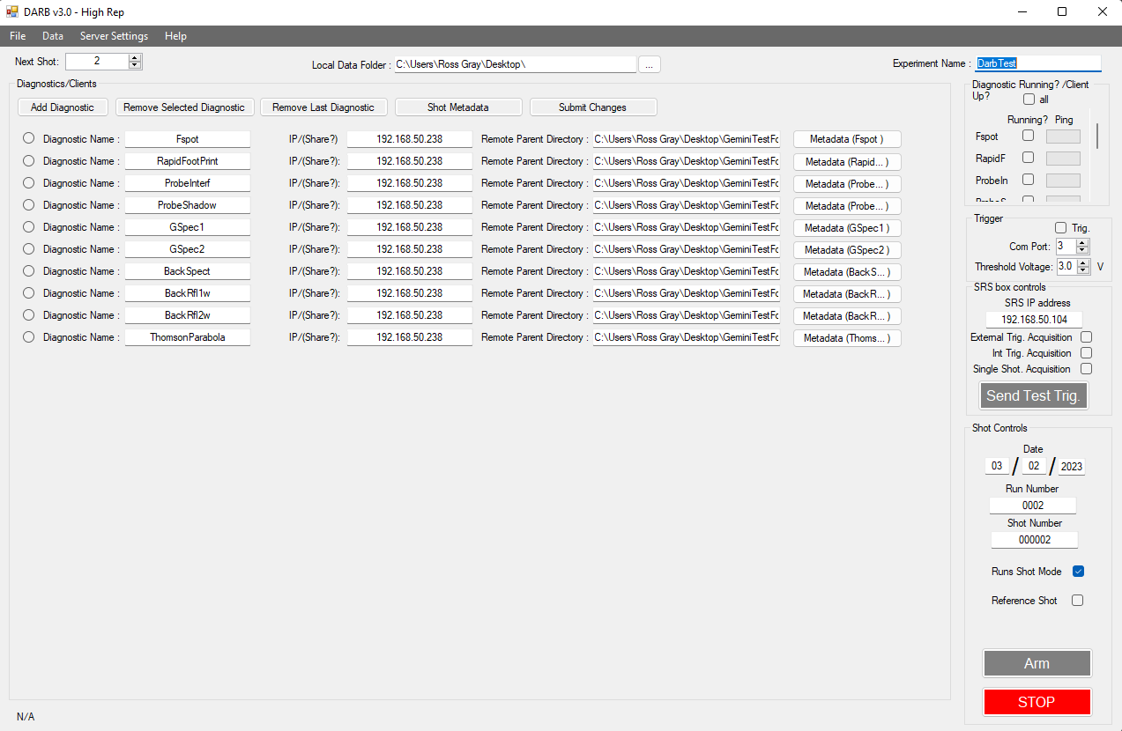
Data collection at Hz repetition rates – DARB V3.0
Data collection system we developed at Strathclyde ~10 years go and have used on many different laser systems.
Initially designed for high energy, low rep systems with a client-server model
Complete rewrite of the backend and data transfer changed to “publisher-subscriber” model with data transfer that is asynchronous with shot.
Up to 1 Hz data collection demonstrated on recent SCAPA run

Slide 10
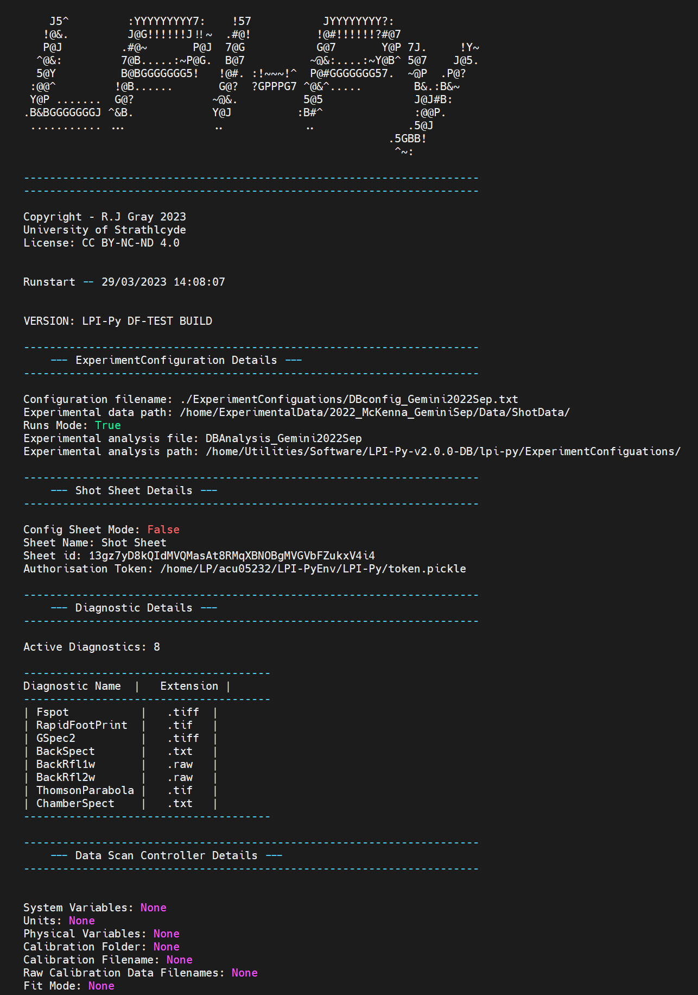
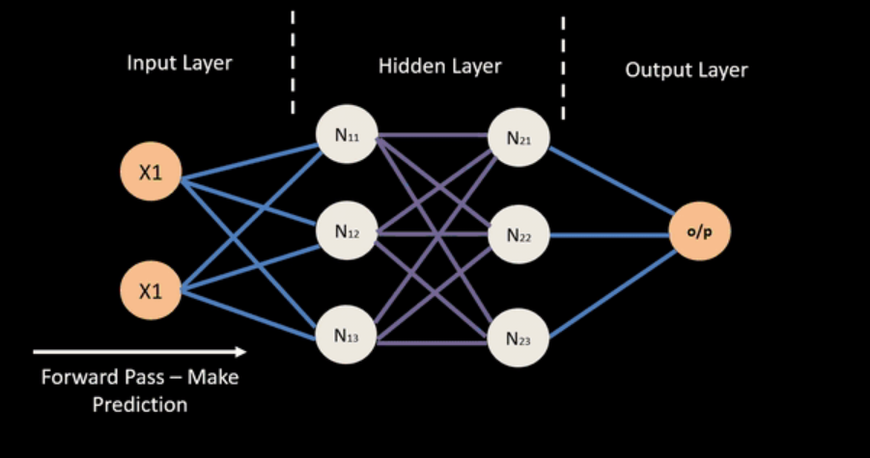
LPI-Py DB – Custom configurable analysis of experimental data and storage in a live database
Configuration profile defined for a specific experiment
Custom analysis class that make use of in-built fileloaders, analysis functions and calibrations
Actively updates on new data
applies user-defined analysis class
makes use of inbuilt file loaders, analysis functions and calibrations
Pushes processed data to a live, searchable database
Data Visualisation
Model Training

Slide 11
ML Model/Supervisor/Human Operator
LPI-Py: Database
LPI-Py: Analysis
DARB Data Capture
Shot Database
Laser Diagnostics
Online Plasma/Radiation Diagnostics
Lab monitoring (drive values, shutters, interlocks, filters)
Target System
Parabola, beamline, AO and waveplates
Plasma mirror System
Focal spot camera
Drive System
SCAPA Laser
LPI-Py: Experimental Calibrations
Data Visualization
Trigger System
LPI-Py: Physics Models
BISHOP
Vacuum System
LPI-Py: Experiment Configuration
Automated/Feedback driven data capture runs….
Control Feedback
HPC modelling
Data Storage & Handling
Data Processing & Analysis
Beamline Diagnostics
Beamline Systems
Lasers
Control Systems
Our ambition is to develop a highly integrated command and control system with high levels of automation

Slide 12
First results from the LhARA beamtime on SCAPA….

Slide 13
Objectives
Objective 1: Ion acceleration characterisation
High resolution parameter scans: varying focal spot size, laser pulse energy and pulse length
Characterisation of generated proton beam stability over a large number of shots, at high repetition rates
Objective 2: Debris characterisation
Characterisation of generated debris from tape drive target system over several shots
Objective 3: Diagnostic development
Testing of PROBIES Lanex detector lifetime over a series of fixed parameter shots

Slide 14
Outcomes:
Demonstration of ion source at 1Hz operation using tape drive configuration.
>2000 shots, covering wide ranging data sets, varying key parameters related to source optimisation.
Demonstration of both proton and carbon ion acceleration.
Demonstration of data capture and live analysis at Hz repetition rates.
Issues:
Debris build up/ coating damage of F/1.5 OAP.
Turbo film pellicle burning/20% loss in energy (see next slides).
Maximum proton energy (~9 MeV) currently < 15 MeV but plans in place to push it higher

Slide 15
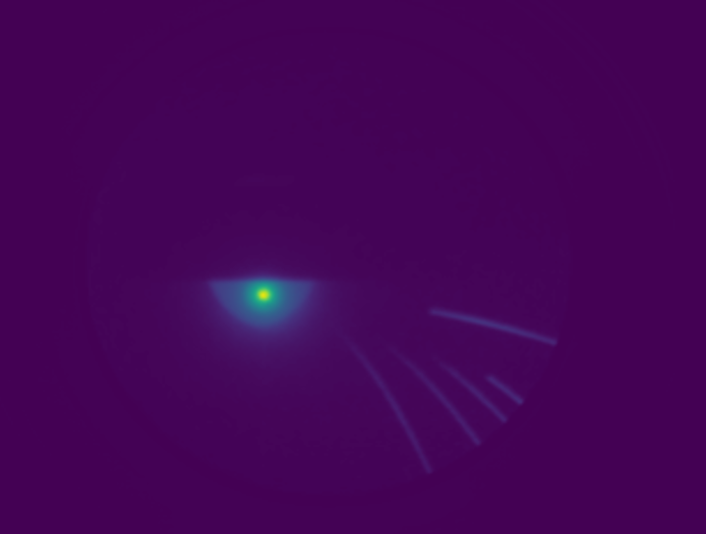
Laser energy, defocus and pulse duration parameter scans…
The heatmaps show the proton spectrum as measured by the Thomson parabola ion spectrometer
We also have extensive data for Carbon acceleration but prioritised analysis of protons for this report….
Maximum proton energy measured is ~9 MeV, currently < 15 MeV.
We have more optimisation to do in target thickness and preplasma scalength!

Slide 16
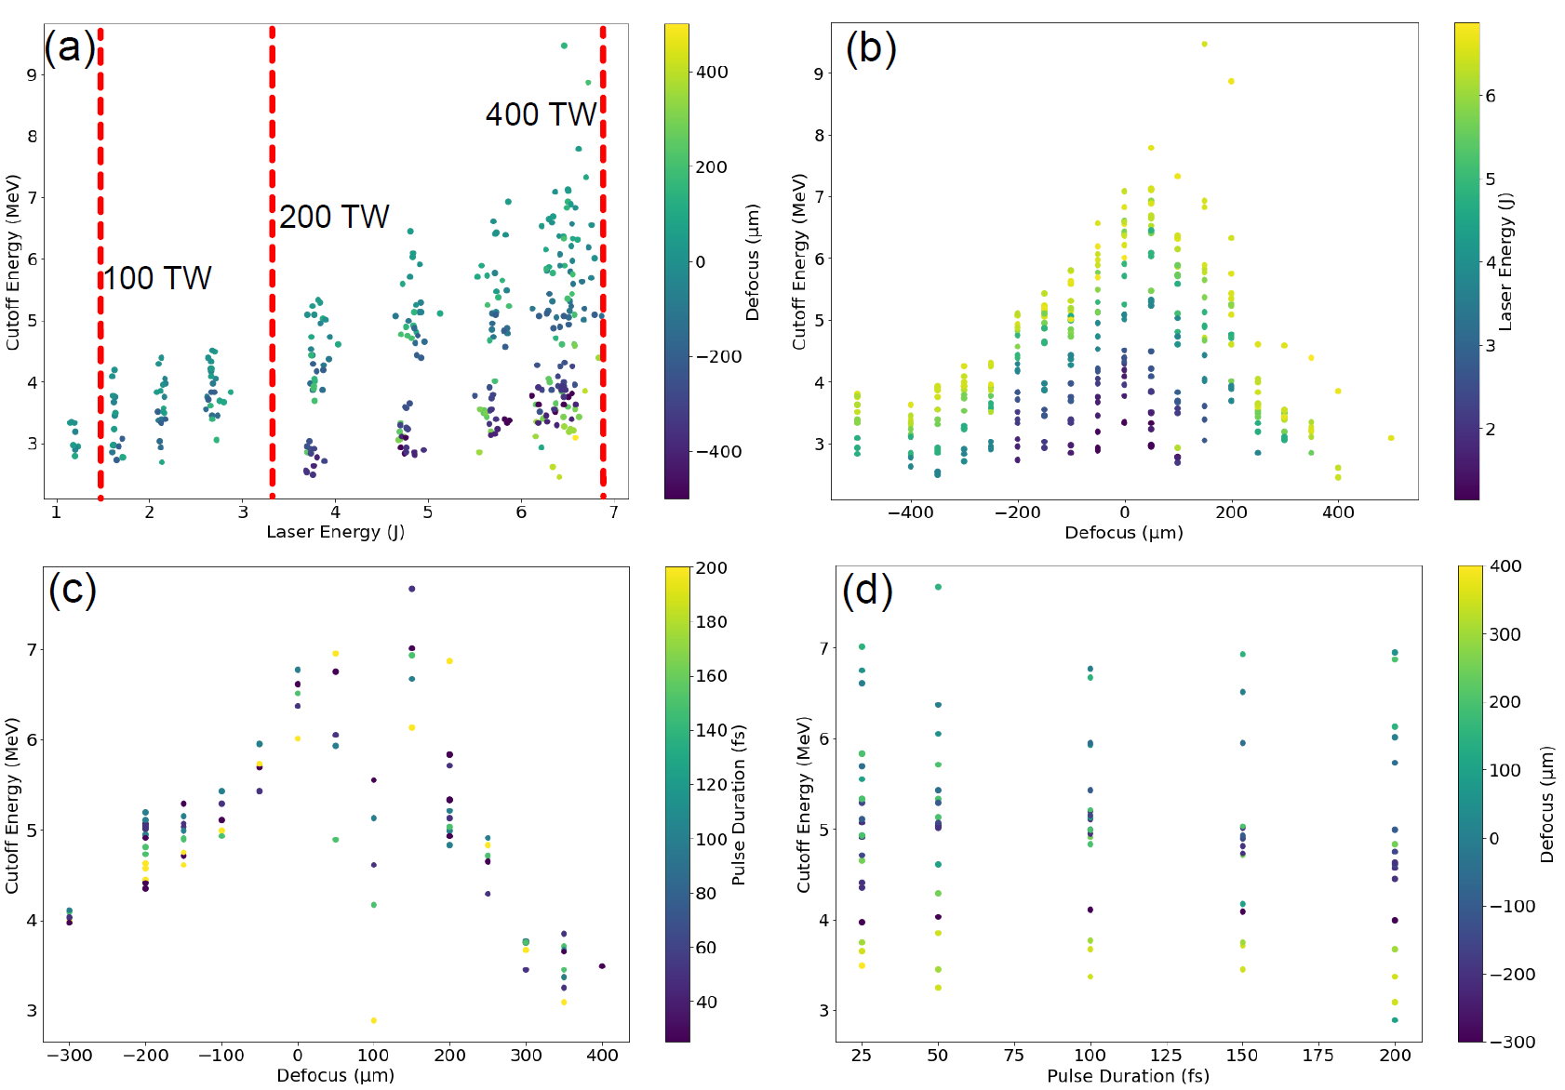
Proton Max Energy: Laser energy, defocus and pulse duration parameter scans…
We confirm previously demonstrated strong dependency with laser energy and defocus
Proton max energy dependence on pulse duration is much weaker
The laser baseline spec should prioritise maximising the available laser energy and focus….even at the cost of pulse duration
We expect to push these energies further with preplasma and target thickness optimisation

Slide 17
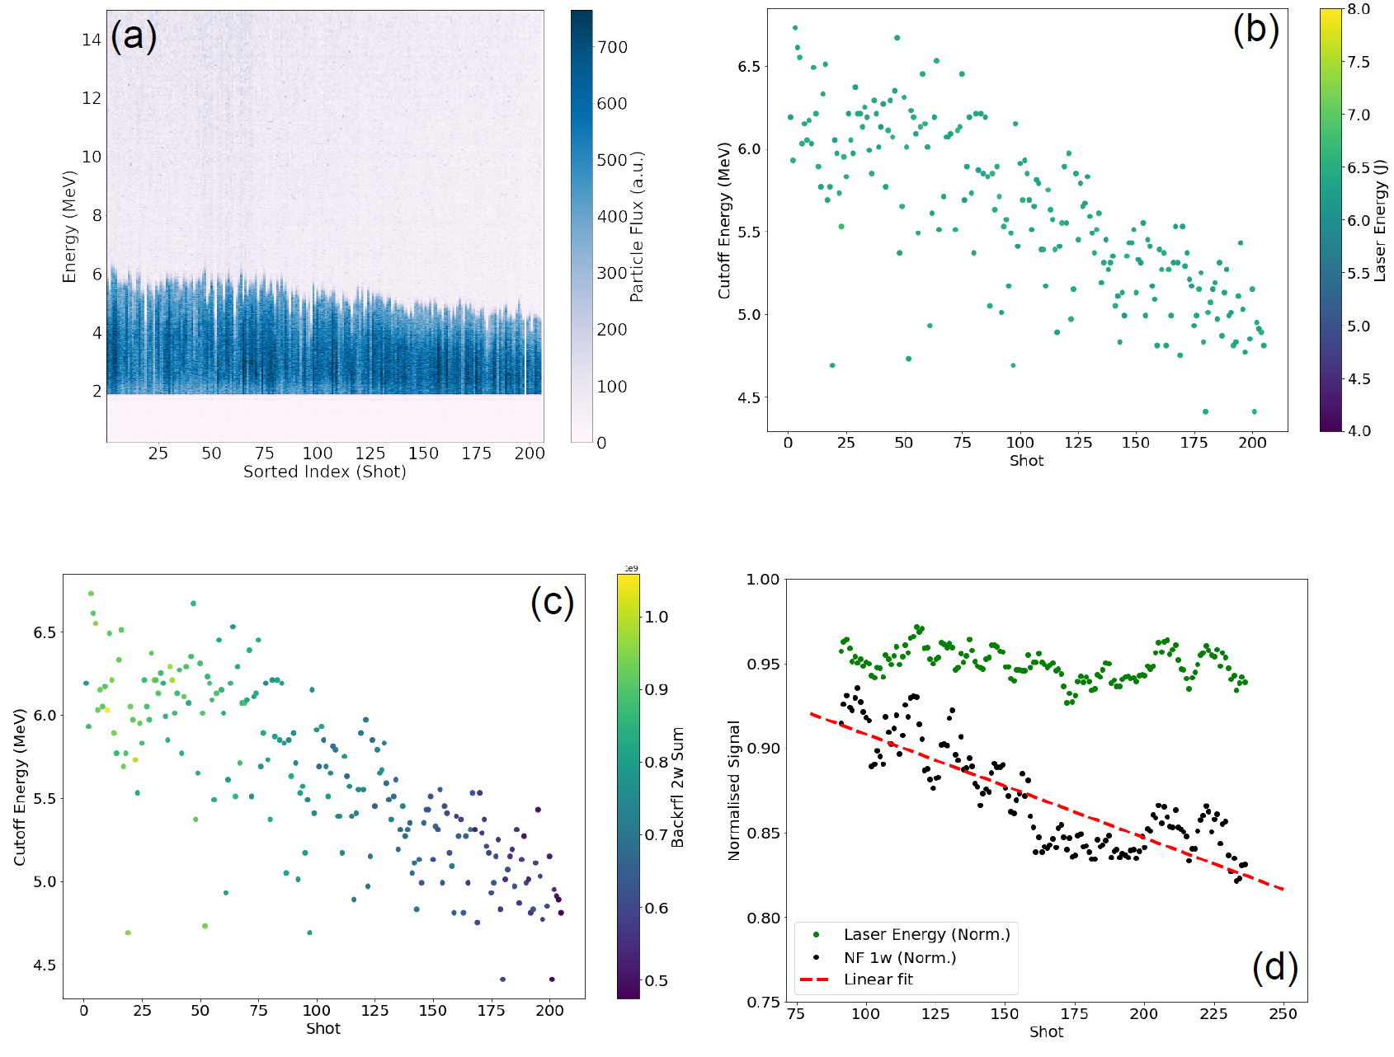
Proton max energy stability……and a problem with the pellicle…

Slide 18
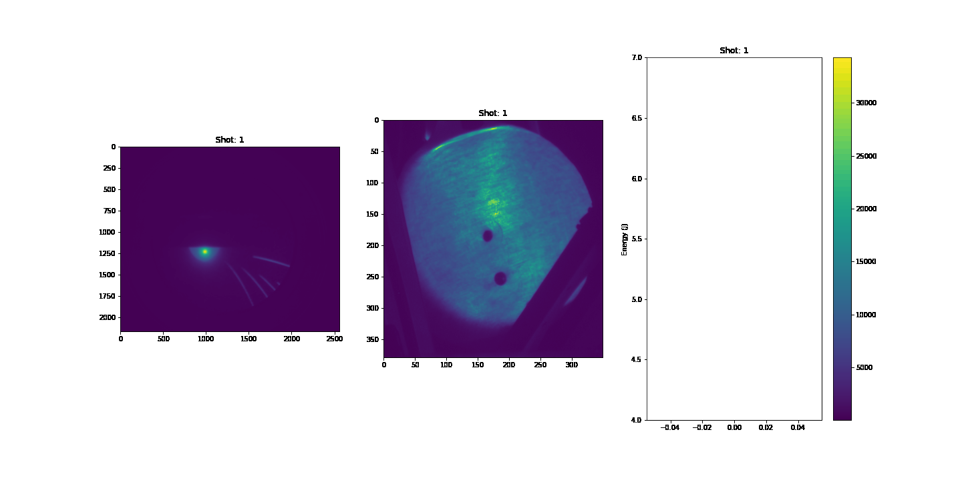
Proton max energy stability……and a problem with the pellicle…
Thomson Parabola Spectrometer
Back Scatter (2ω) NF
Laser Energy

Slide 19
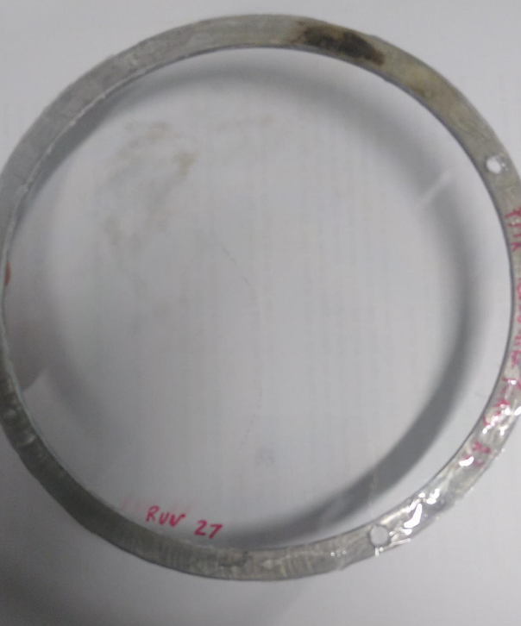
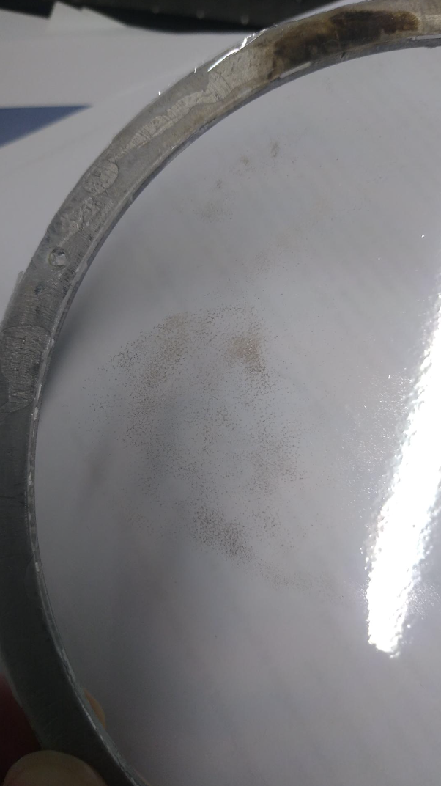
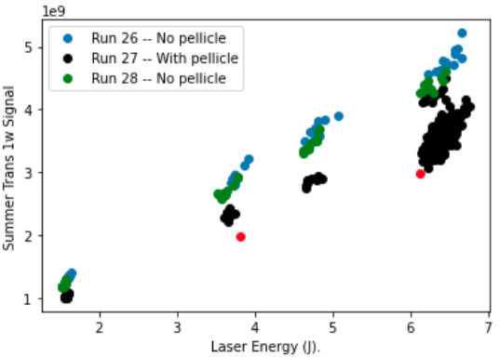
Proton max energy stability……and a problem with the pellicle…
We are observing attenuation of the of the incoming beam by the pellicle and rapid burning over 100 full power shots
We have an alternative material which is AR coated and should survive much longer (although considerably more expensive)
We are aiming to investigate this during commissioning work in November 2023

Slide 20
July SCAPA experiment…main lessons
Issue | Action
1. Maximum proton energy measured up to 9 MeV (2x since last beamtime) | We need > 15 MeV. Thinner targets and contrast control required
2. High repetition rate (1 Hz +) now possible but long term operation challenging | We need to investigate the pellicle and beamline damage issues
3. Tape drive is now operating well but a new (even wider) design would help alignment | Further updates to the base plate with the CLF
4. Laser contrast control required | Further development of plasma mirror and prepulser beamline
5. The probies detector needs further development and testing for our proton energies/flux | Calibration and testing of various scintillators at Birmingham accelerator will help (due in November).

Slide 21
Upcoming Beamtime……Scheduling
Further test runs on the pellicle and plasma mirror system. Alongside further development on probe and preheater. This is likely in November.
W/B 15th January is scheduled for the next LhARA run

Slide 22
SCAPA Experiment Team….
University of Strathclyde
R. Wilson, T. Frazer, E. Dolier, C. McQueen, B. Torrance, R. Nayli and P.McKenna
Imperial College
O. Ettlinger, G. Casati and N.P. Dover
Queens University Belfast
P. Parsons and C. Palmer
SCAPA, University of Strathclyde
M. Wiggins, E. Brunetti, G. Manahan, W. Li
Central Laser Facility
J. Green, C. Armstrong, C. Spindloe, W. Robins, S. Astbury

Slide 23
PA2: PoP experiment in SCAPA..?
Ross Gray
University of Strathclyde, Glasgow, UK
20th September 2023

Slide 24
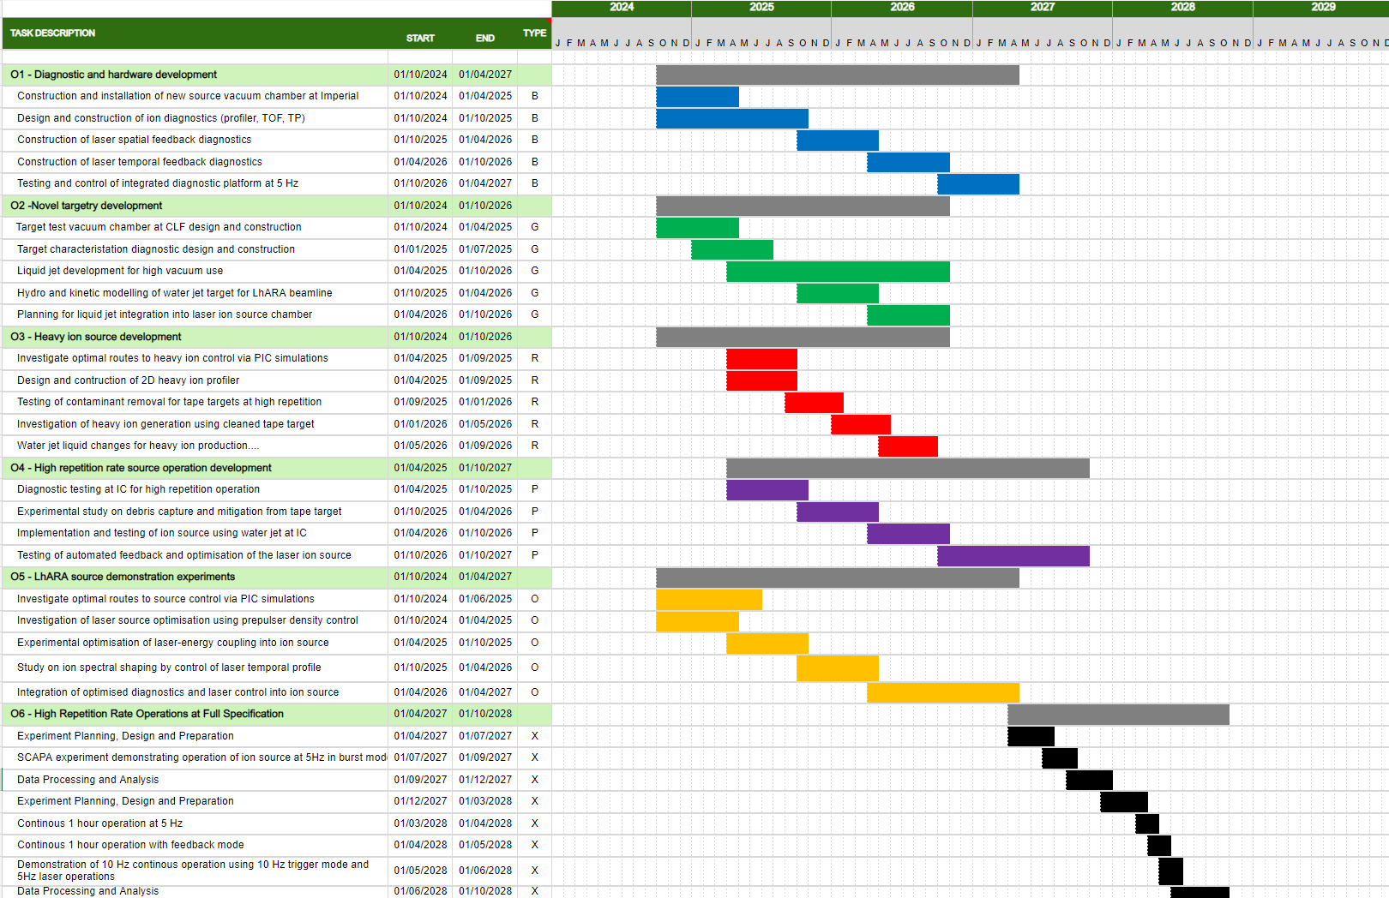

Slide 25
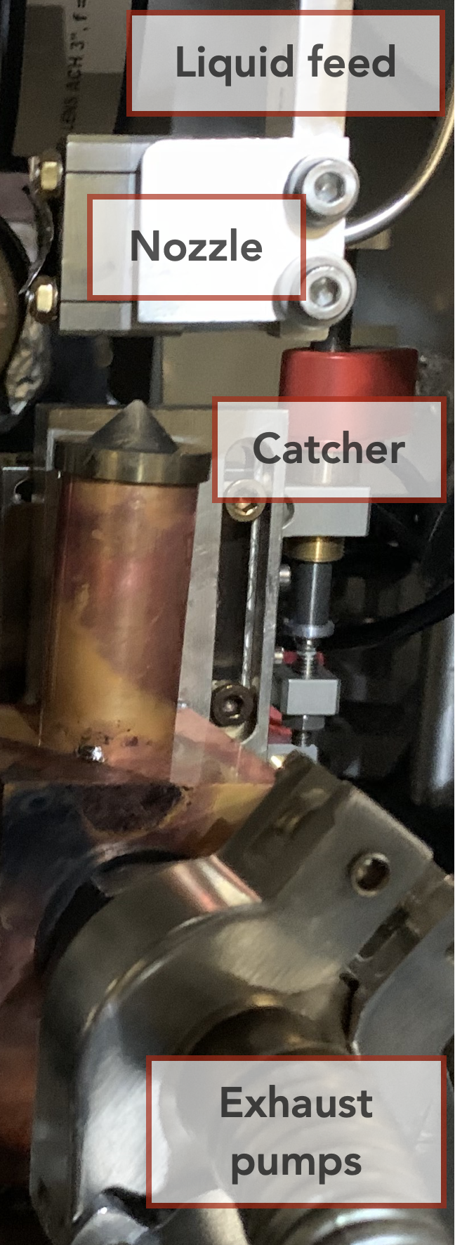
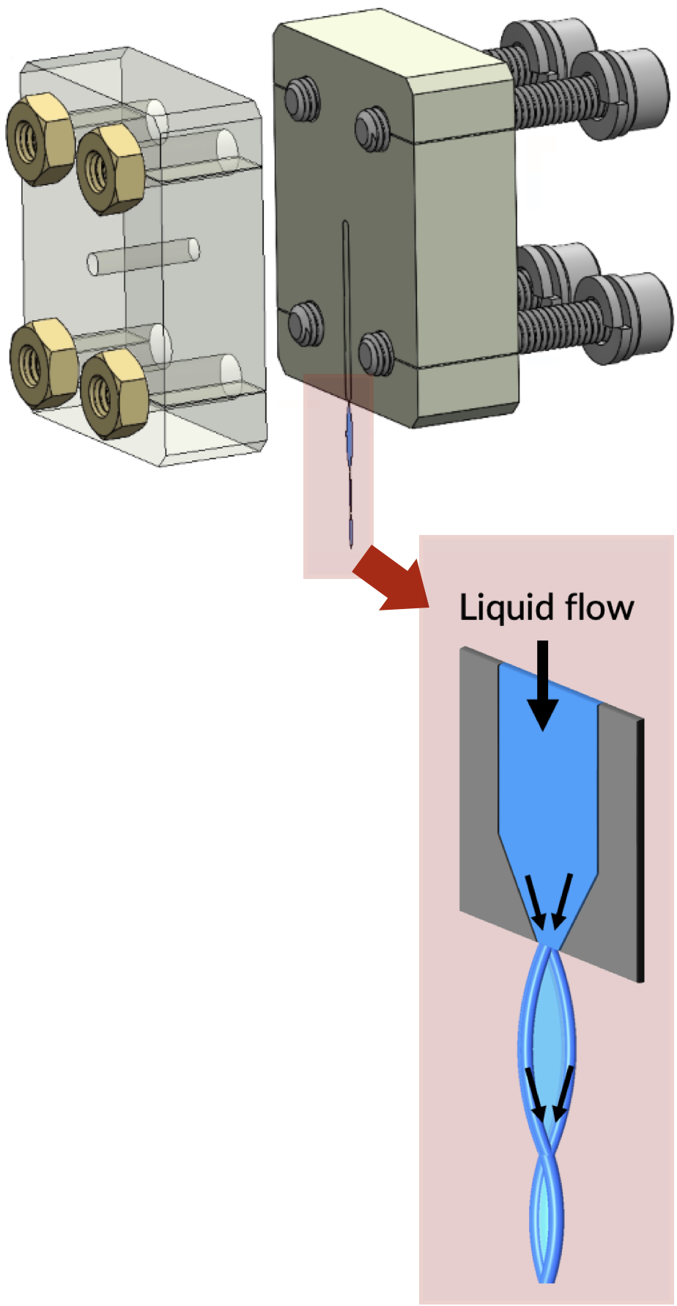
Liquid sheets targets for high-rep, low-debris ion acceleration
High-purity mm-scale liquid sheet with variable thickness down to 200 nm, compatible with kHz operation (Morrison et al., NJP (2018)) and Joule-class lasers (Treffert et al., APL (2022)).
Vacuum conditions challenging but may provide unforeseen benefits in terms of shot-to-shot stability and proton flux.

Slide 26
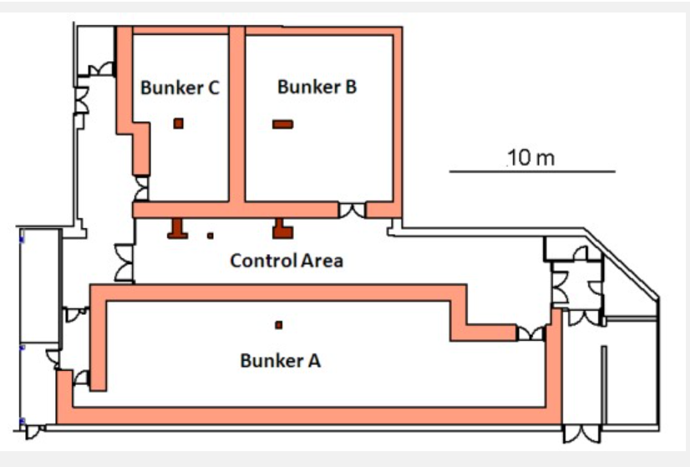
Ground Floor Labs
Ion/gamma Source Bunker
Authorised animal housing during the day,
overnight storage in SIPBS
Electron/gamma Source Bunker

Slide 27
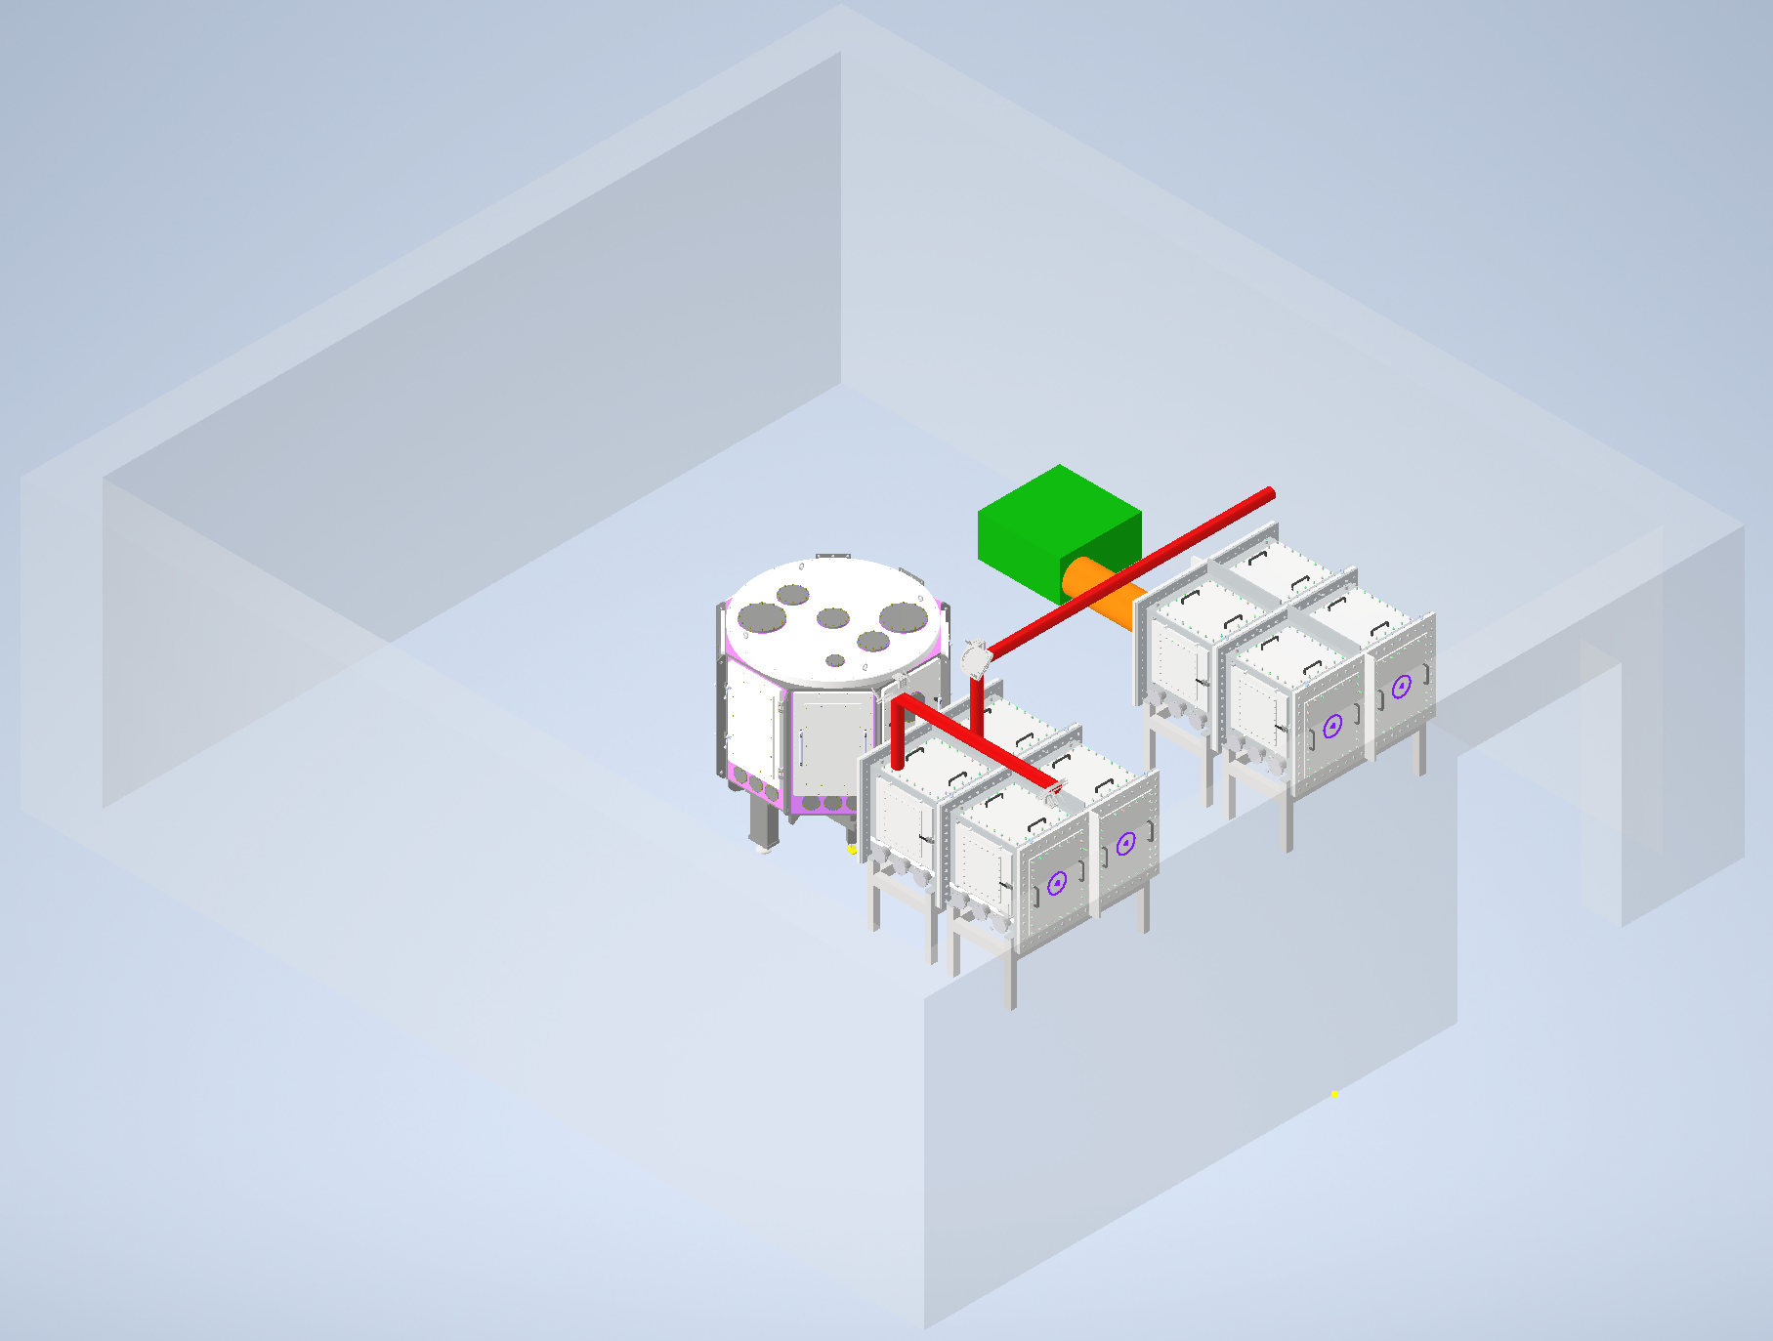
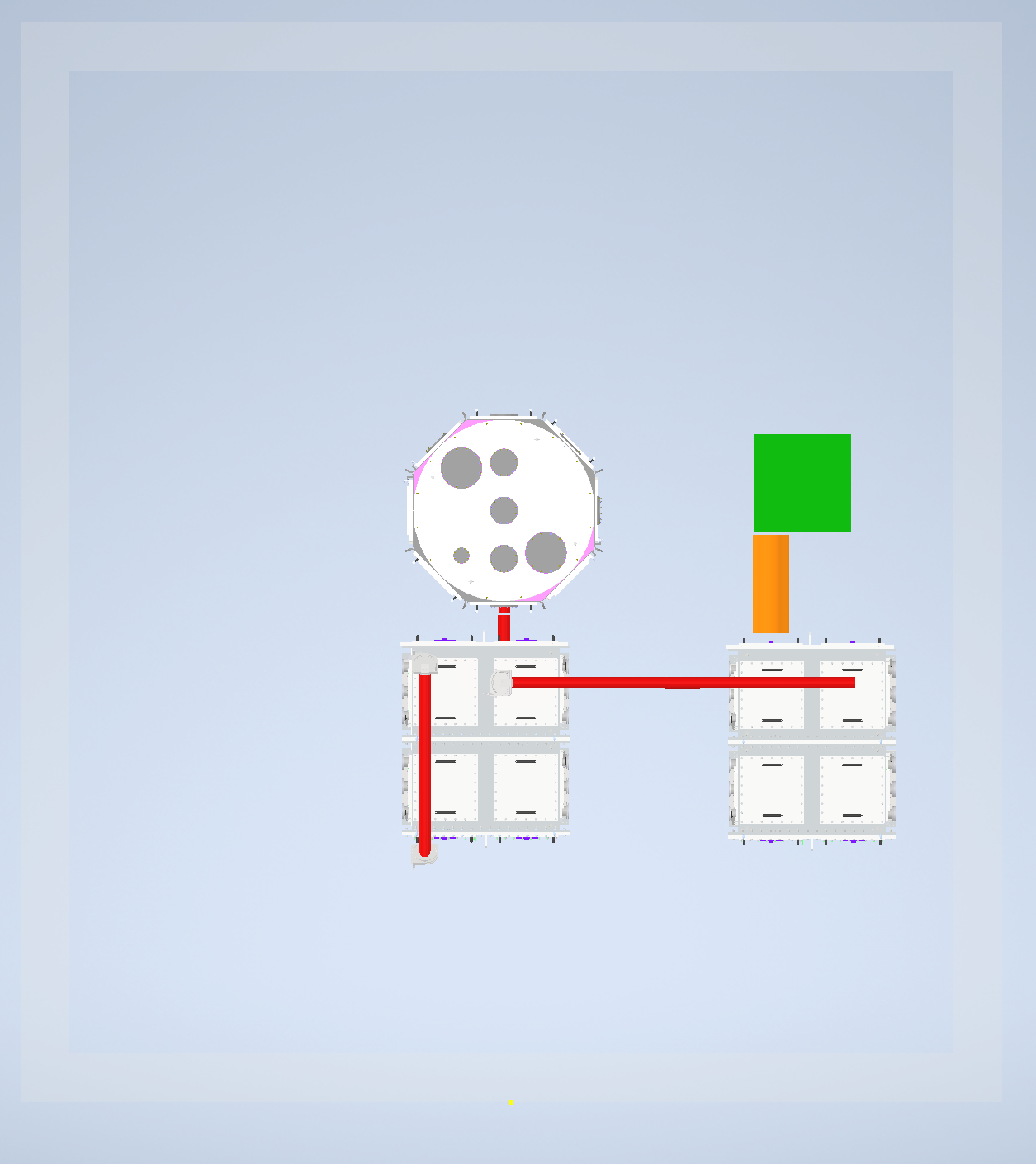
Proof of Principle Experiment Concept in Bunker B
Modular Capture Chamber
Liquid Jet Chamber
Automated Cell Holder
Reuses AO/PM Beamline
Dedicated Beamline for extended experiments

Slide 28
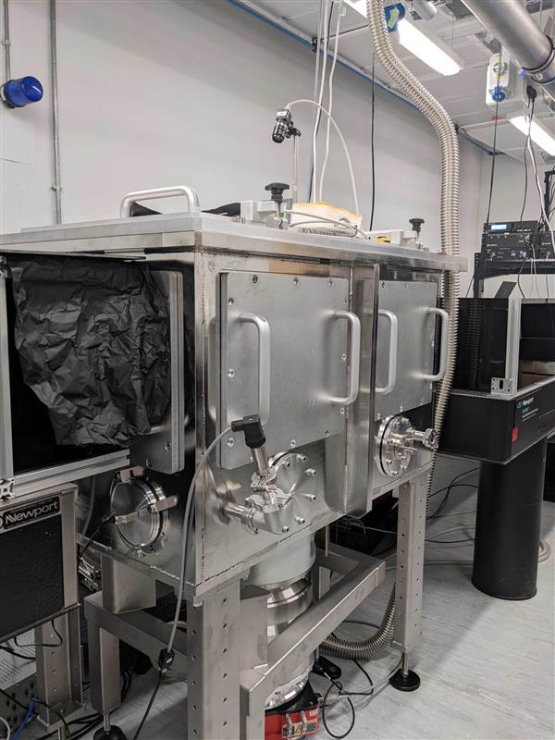
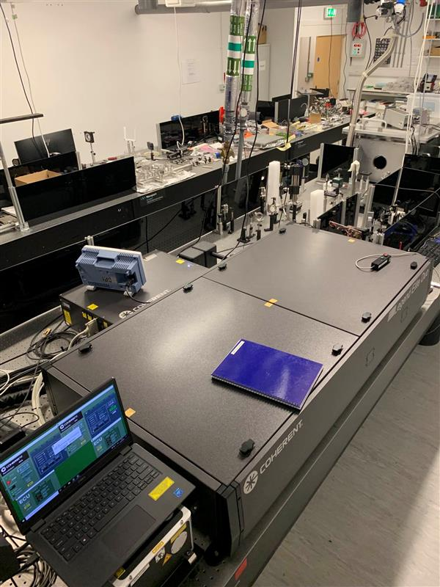
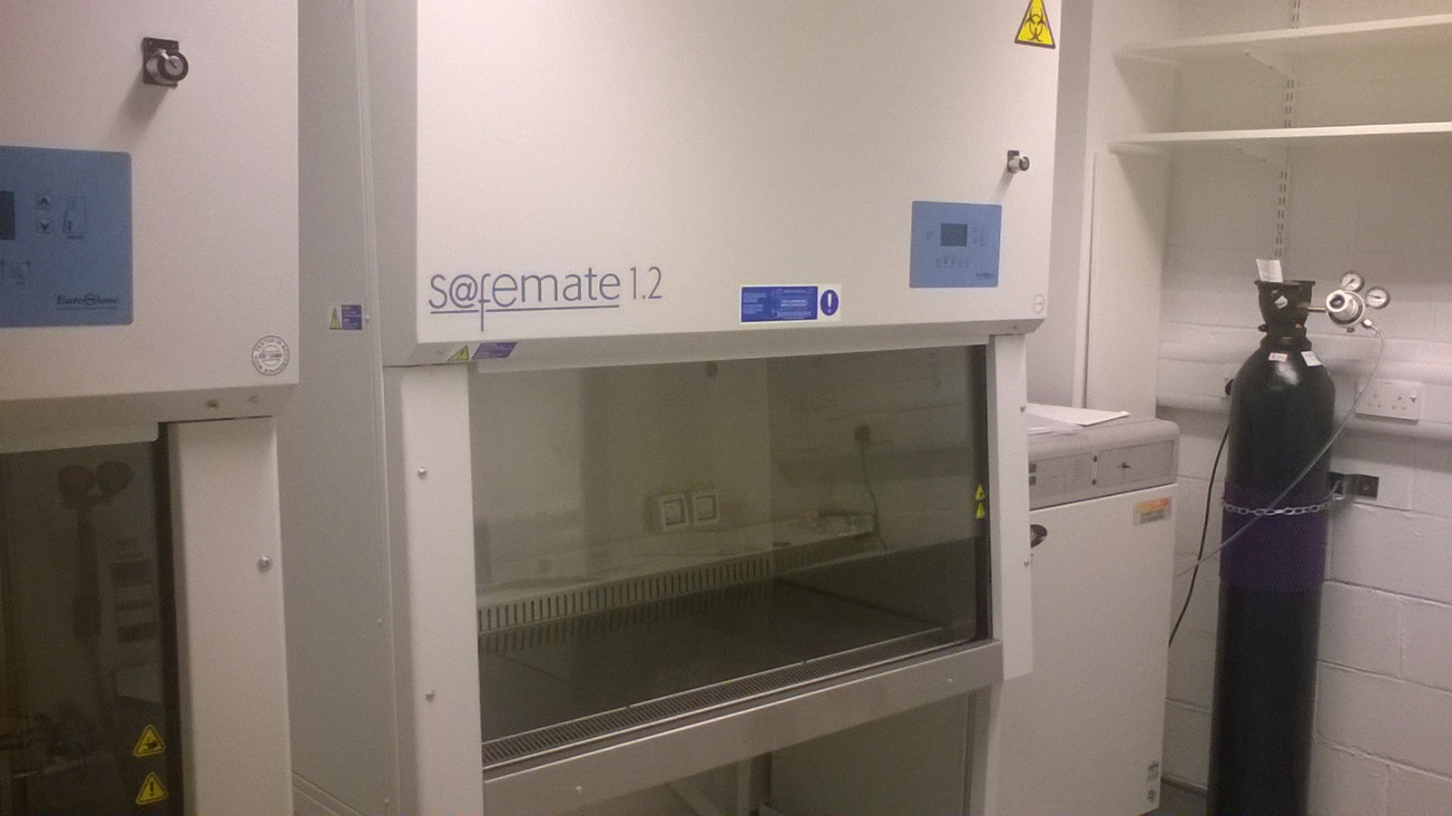
1st Floor Labs
Bio prep room for off-line cell work
kHz lab for high-repetition rate target testing

Slide 30
