Slide 1
WP4: Ion-acoustic dose mapping
Maria Maxouti, Josie McGarrigle, Anthea MacIntosh-LaRocque, Vania Lay, Yu Hu, Ben Cox, Ben Smart, Colin Whyte, Kenneth Long, Emma Harris, Jeff Bamber

Slide 2
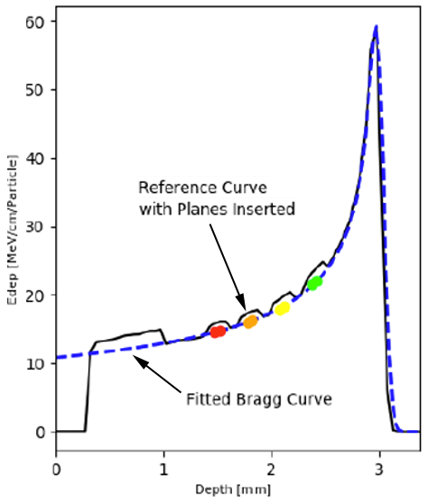
WP4: Ion-acoustic dose mapping
2 Years
5 years
Validated models for the simulation of dose and ion-acoustic signals
Multi-element part spherical array
Biological sample holder designed for high throughput
Dose map
Ioacoustic signal (Pa)
Scintillator signal (mV)
simulation
experiment
Lhara beams
Lhara beam
Dose (J/kg)
Ion-acoustic system for dose mapping on a pulse-by-pulse basis
Smart phantom system for cross-calibration of dose/range estimation
Signal (Pa)
Validated models for the simulation of dose and ion-acoustic signals for LhARA
Results from initial biology experiments
Angle from beam direction (deg)
Experimental testing/evaluation of initial components for ion-acoustic and scintillation systems.

Slide 3
2-year Objectives,Tasks, Milestones
Objectives:
The development of a Geant4 MC simulation of the forward model
The development of a k-wave acoustic forward model
Tasks:
The detailed design of a proof of principle experiment to be executed during the Preconstruction Phase of the project, identifying potential suppliers for components.
Reports on progress towards above objectives.
Milestones:
18-month report: forward simulation of energy deposited in a water phantom (SmartPhantom) and deposited energy resolved in 4D.
24-month report: results of forward simulation and its use to optimise SmartPhantom performance to provide the power density spectrum as input to the acoustic model.

Slide 4
Agenda
Jeff - Introduction, aims and objectives
Maria - Python ➔BDSIM ➔ Geant4 ➔k-Wave simulation and plans for future validation experiment at LMU
Jeff - Photoacoustic simulation experiment (work of MRes student, Yu Hu)
Jeff – Summing up of status

Slide 5
Preliminary photoacoustic “experimental simulation” – Yu Hu (MRes project)
Monte Carlo simulation
3-D dose distribution
Threshold and tessellate 3-D surface
3-D printer to produce mould
Optically absorbing gel phantom in the shape of the deposited dose distribution
Image using the photoacoustic system (part-spherical cup, and part-circular ring, arrays) at ICR
Evaluate received acoustic frequencies and reconstructed images in terms of analytical predictions and compare with k-Wave predictions

Slide 6
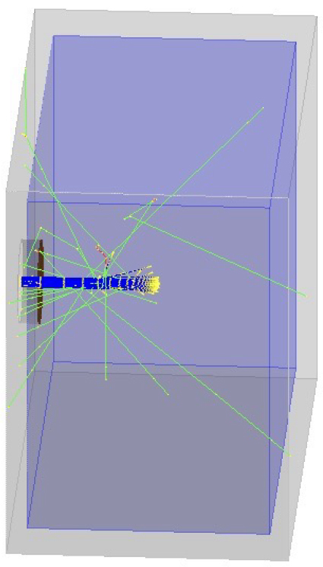
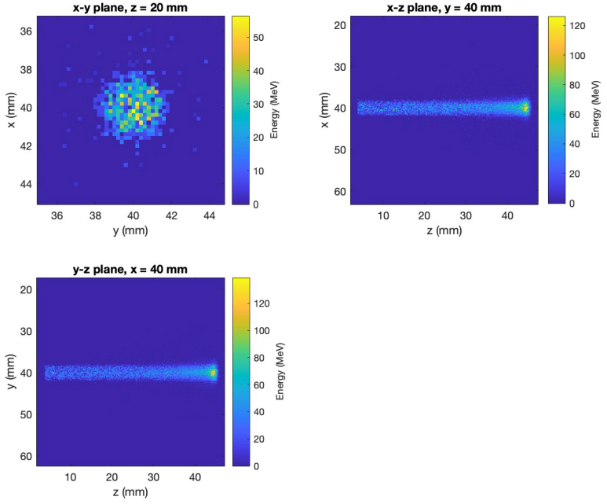
Geant4 – 20000 protons, 40 ns, 70 MeV
water
Kapton window
y
4 mm
protons
x
secondary particles
z

Slide 7
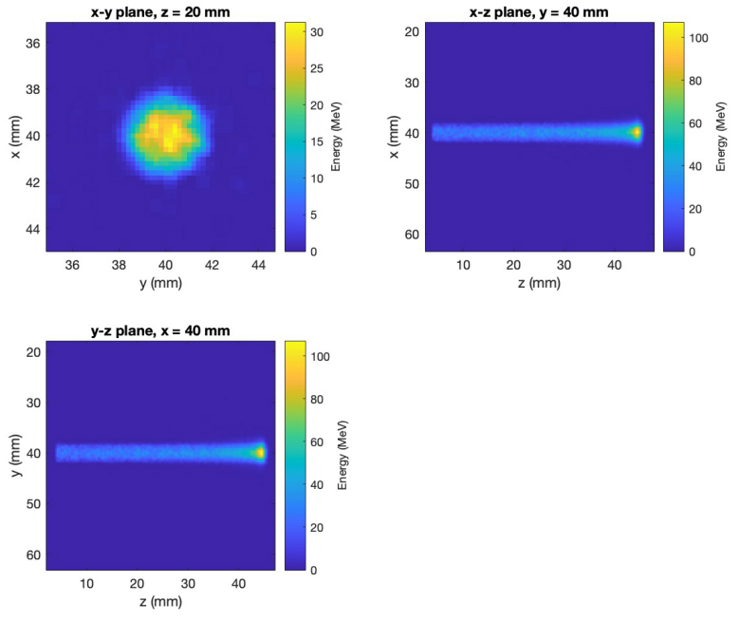
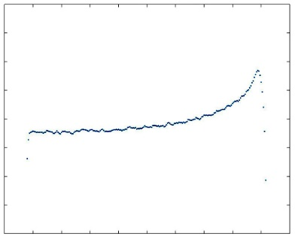
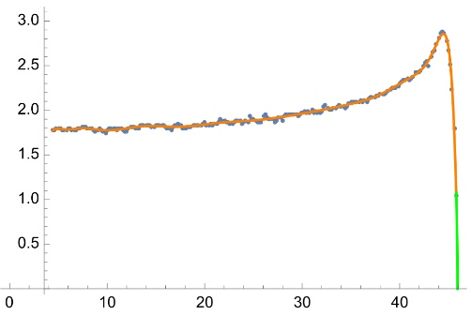
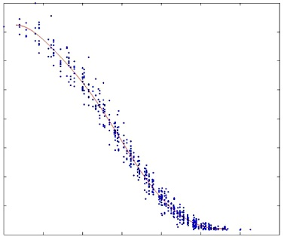
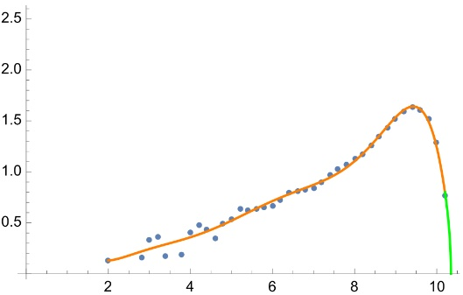
Further processing of deposited energy distribution
Threshold = 5% global peak
Radius (mm)
0 1 2 3 4
0 10 20 30 40 50
z (mm)
z (mm)
Threshold = 40% global peak
Energy (MeV)
Radius (mm)
0 10 20 30 40
0 0.5 1.0 1.5 2.0 2.5 3.0
Radius (mm)
Relative z (mm)

Slide 8
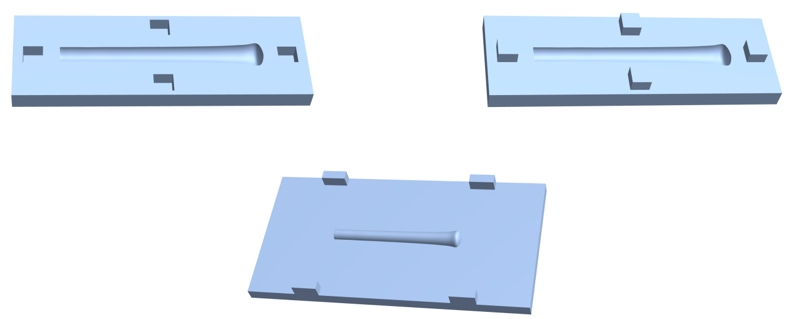
Mould designs for beam insert and background impression, from surface of revolution from radius-depth plots
Two halves of beam insert
Mould to create a hollow impression in the background

Slide 9
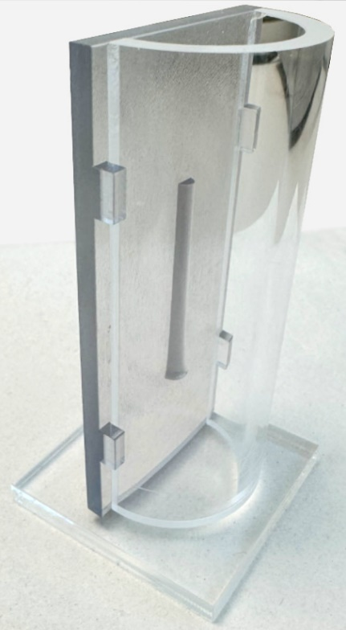
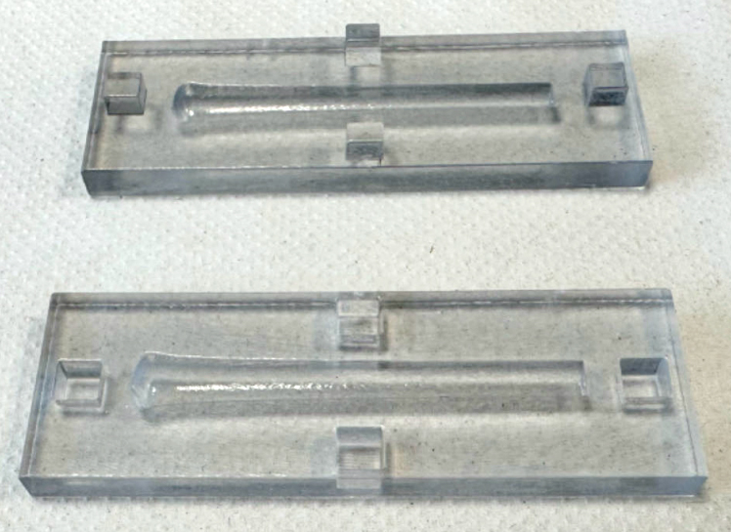
3D printed mould examples (5%)
Two halves of beam insert
Half the beam hollow impression in half the cylindrical background

Slide 10
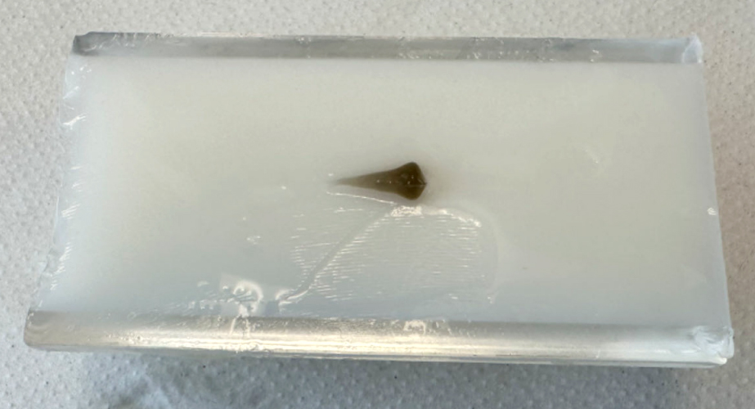
Half phantom example (40%)
Background (TiO² in gelatine)
Beam insert at 40% threshold (India ink pigmented)

Slide 11
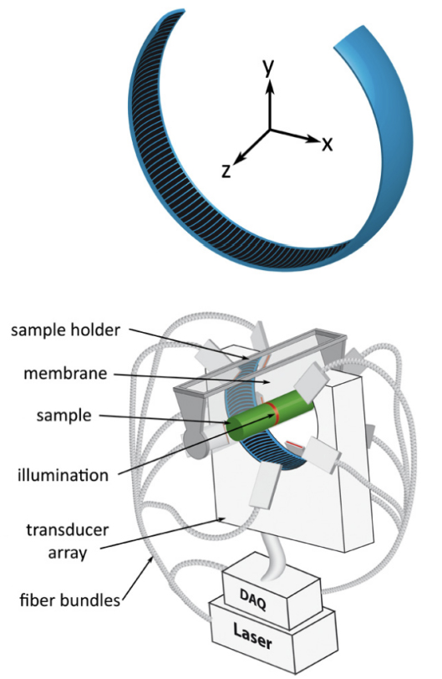
Photoacoustic imaging system
256
1
Acoustic sensor elements
128

Slide 12
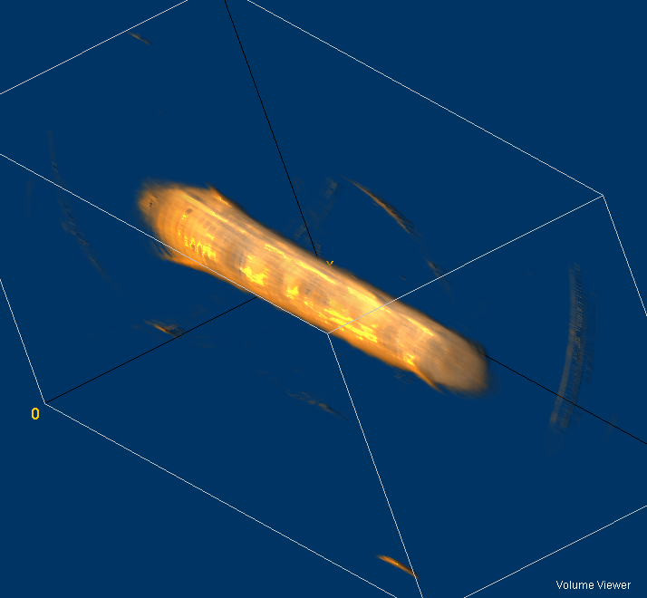
Example photoacoustic images (5%)

Slide 13
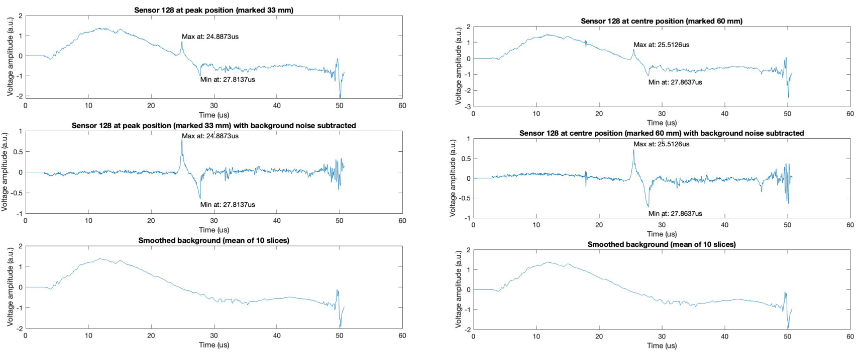
Acoustic signals received at sensor element 128

Slide 14
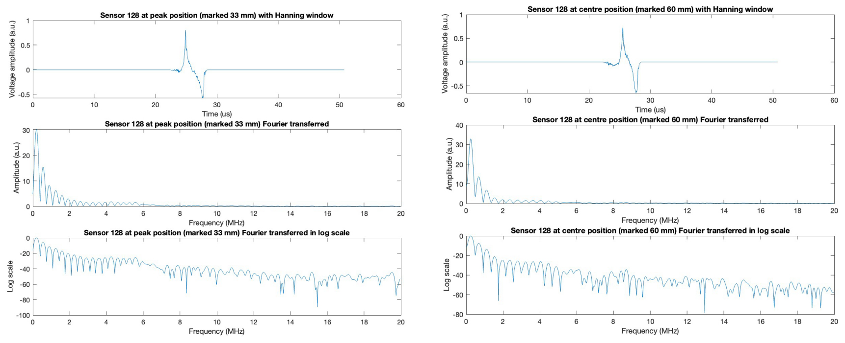
Acoustic signals received at sensor element 128

Slide 15
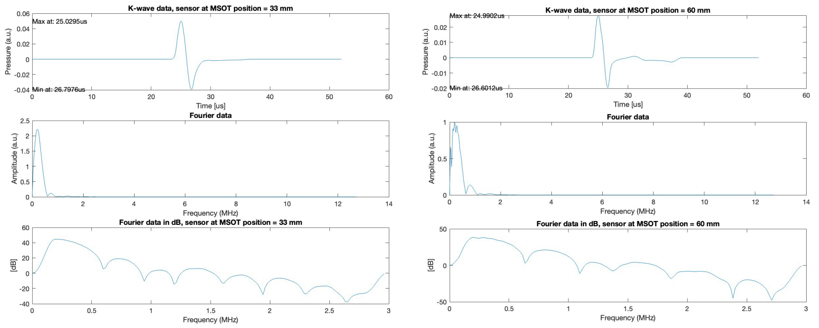
Simulated acoustic signals received at sensor element 128

Slide 16
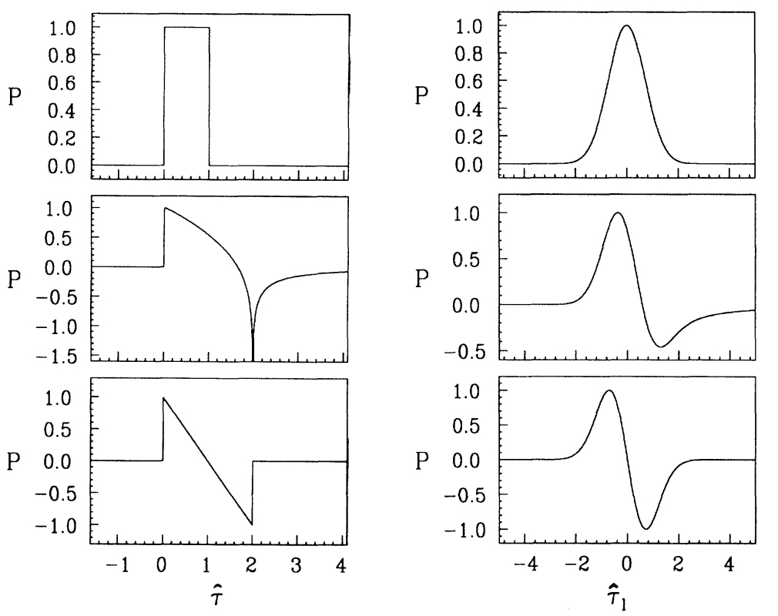
Analytical (and experimentally confirmed) predictions of pressure-time waveforms
Energy long Gaussian pulse
Energy delta function
c.f. simulation radial profile
Parallel-sided slab
Cylinder
c.f. simulation results
Sphere
c.f. experimental results
Diebold et al, Phys Rev Let (1991)

Slide 17
