Slide 1
ITRF WP3
Conventional Technologies
1272-pa1-wp3-prs-0006-v0.1-twelve-month-review
Mark Johnson, Karen Kirkby and Hywel Owen ITRF 12-Month Review
20/09/2023
Mark Johnson | Accelerator Physicist (ASTeC)
Office A50 | STFC Daresbury Laboratory | Warrington WA4 4AD
mark.johnson@stfc.ac.uk

Slide 2
Introduction
Synchrotron Design
End Stations
Conclusions

Slide 3
Introduction
ITRF WP3 Context
ITRF WP3 aims to compare options based on conventional
technologies against the baseline LhARA facility design
This includes the evaluation of a synchrotron, with an injector based on
established ion sources and pre-acceleration methods
Currently parameterising a small synchrotron design, adapted from
work published by the CERN NIMMS project
At present, we are not considering the
synchrotron as a drop-in replacement for the LhARA FFA

Slide 4
Design Basis
A Compact, Room Temperature Synchrotron
Key Requirements:
  Synchrotron is primarily designed for the most likely radiotherapy ions
  (H⁺, ⁴He²⁺ and ¹²C⁶⁺), without excluding heavier ions in future
  Aim for stored intensities compatible with FLASH regimes,
  of order 10¹⁰ ions per spill
  Machine fits within the circumference of the LhARA FFA
  (21.86 m) with similar beam energies
  Use accessible, conventional technologies
  e.g. room temperature magnets

Slide 5
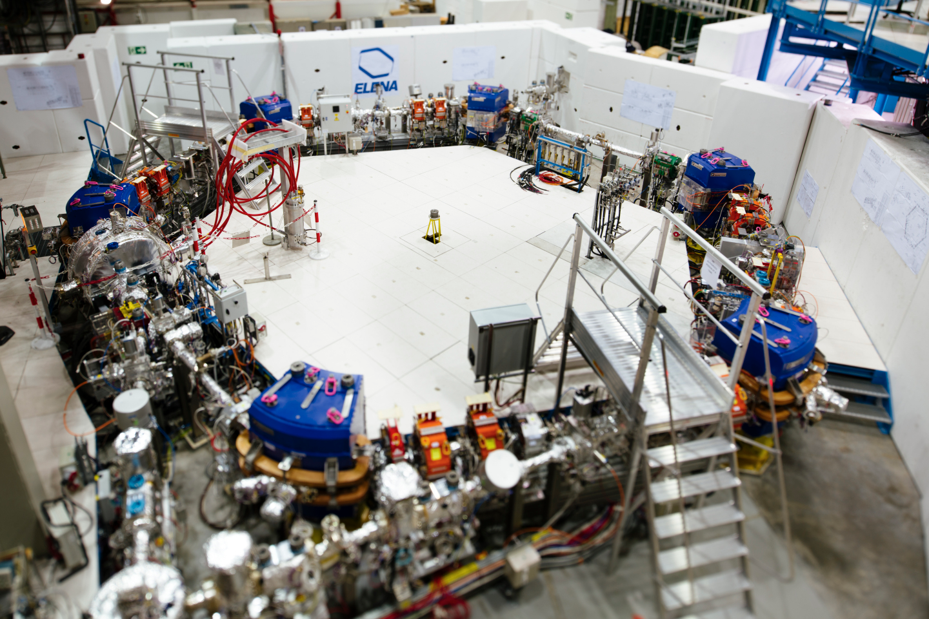
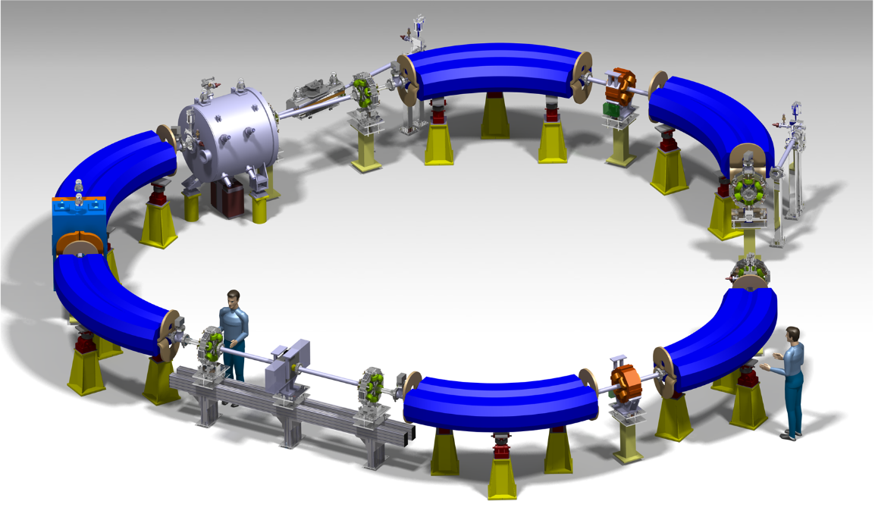
Examples
[1] H.X.Q. Norman et al., Proc. IPAC ‘22, THPOMS028 (2022)
[2] M. Vretenar et al., J. Phys.: Conf. Ser. 2420 012103 (2023)
[3] V. Chohan et al., Extra Low Energy Antiproton Ring (ELENA) and its Transfer Lines – Design Report, CERN-2014-002 (2014)
CERN NIMMS and ELENA
NIMMS have proposed compact synchrotron designs
for ¹²C⁶⁺ and ⁴He²⁺ ions ^{[1,2]}
Designs target FLASH dose rates, at relatively high energies
(430 MeV/u for ¹²C⁶⁺) relevant to clinical treatment
NIMMS designs build on CERN experience with
small hadron synchrotrons like ELENA ^{[3]}
Slow-cycling synchrotron designs (~1 Hz)
Above: ELENA decelerator at the CERN AD
Below: Render of the NIMMS ⁴He²⁺ synchrotron design

Slide 6
Introduction
Synchrotron Design
End Stations
Conclusions

Slide 7
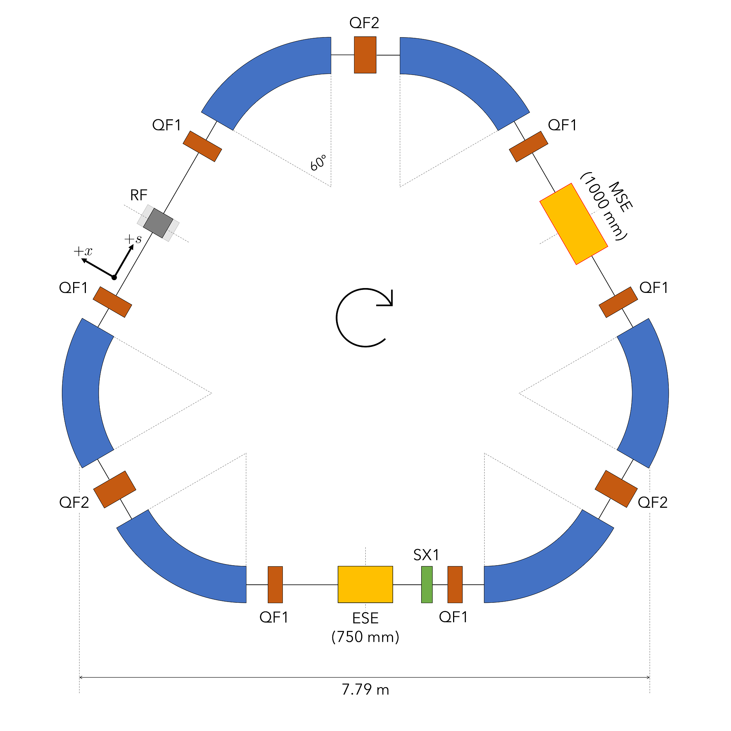
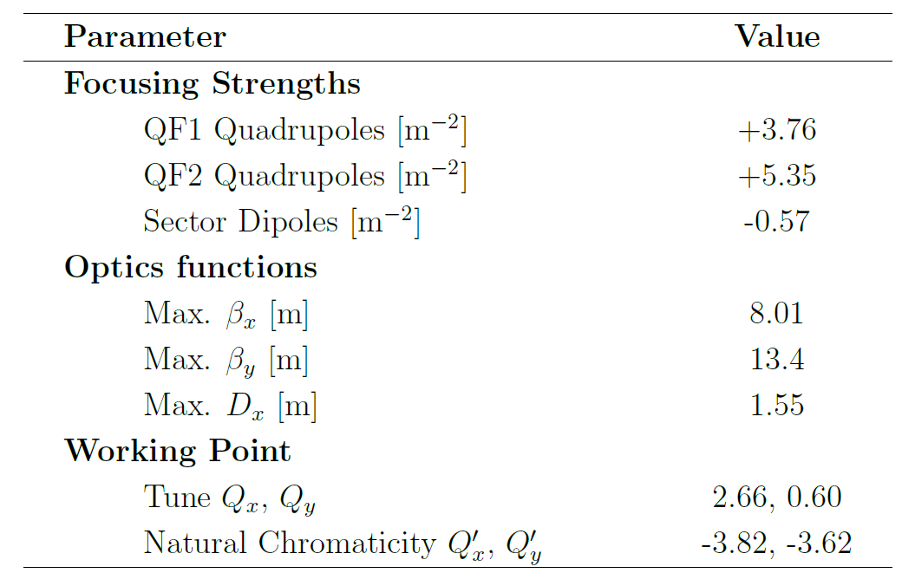
ITRF Synchrotron Design
[1] M. Vretenar et al., J. Phys.: Conf. Ser. 2420 012103 (2023)
[2] X. Zhang, arXiv:2007.11787 [physics.acc-ph] (2020)
Overview
Small (~23.88 m circumference) synchrotron based on a scaled
version of the NIMMS ⁴He²⁺ synchrotron design ^{[1]}
Ring comprised of three achromat lattice cells ^{[2]}
Room temperature 1.50 T sector dipoles allow
¹²C⁶⁺ acceleration up to 83.5 MeV/u
Dispersion-free straights accommodate injection,
extraction and RF hardware
Parameter | Value
Dipole radius [m] | 1.80
Max. Dipole Field [T] | 1.50
Max. Beam Rigidity [T·m] | 2.70
Ion Species | H⁺ | ⁴He²⁺, ¹²C⁶⁺
Max. Beam Energy [MeV/u] | 105.5† | 83.5
Orbital Frequency [MHz] | 5.50 | 4.97
† Limited by assumed RF cavity bandwidth (1.5 – 5.5 MHz)
Dipoles can accommodate protons up to 155 MeV

Slide 8
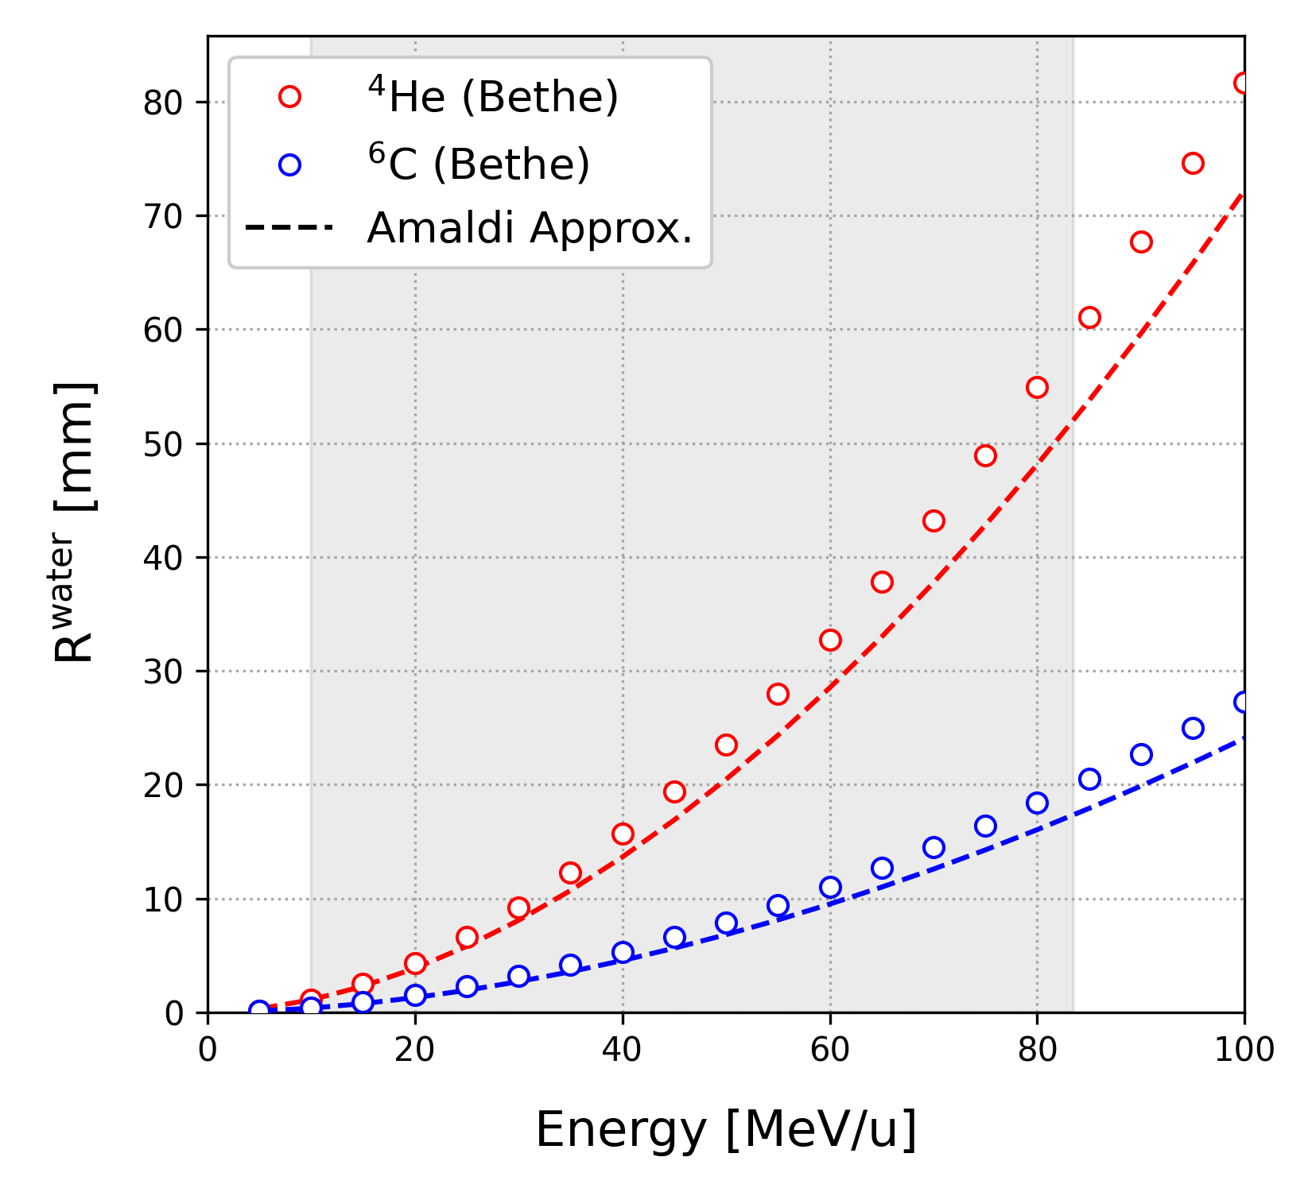
ITRF Synchrotron Design
Choice of Beam Energy
Making the synchrotron slightly larger than the LhARA FFA* facilitates higher ¹²C⁶⁺ extraction energies
  Synchrotron: 83.5 MeV/u
  LhARA FFA: 33.4 MeV/u
Higher-energy synchrotron has now been
adopted as the baseline WP3 machine design
Extraction energy chosen to provide a maximum
irradiation depth of ~20 mm
* Original pre-CDR FFA design, circumference ~21.9 m

Slide 9
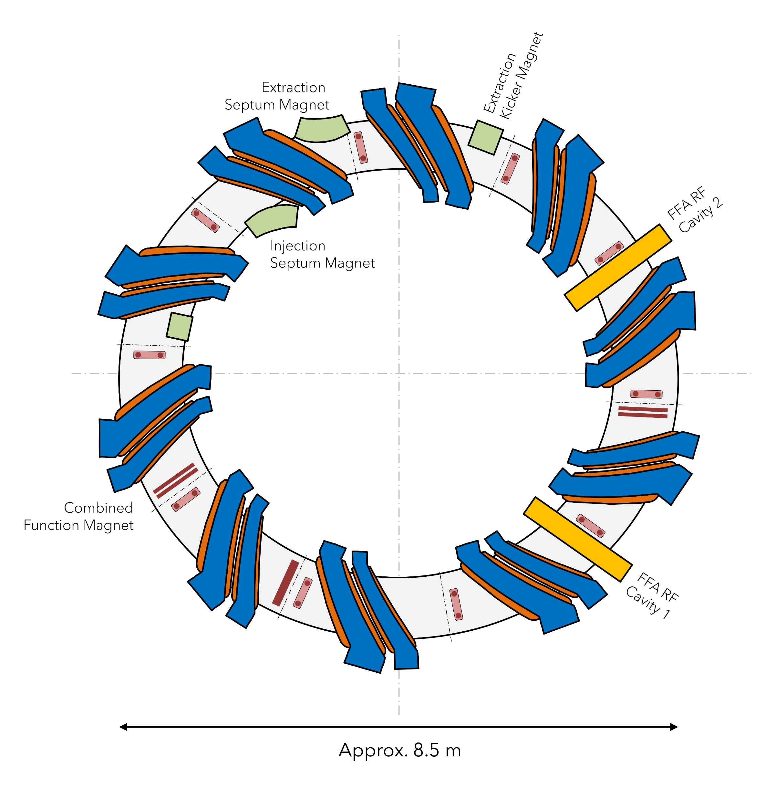
Machine Footprints
* FFA design presented to WP1.6 meeting 01/08/2023
Approximately to Scale
Left: ITRF WP3 synchrotron (~23.9 m)
Right: LhARA FFA* (~26.7 m)

Slide 10
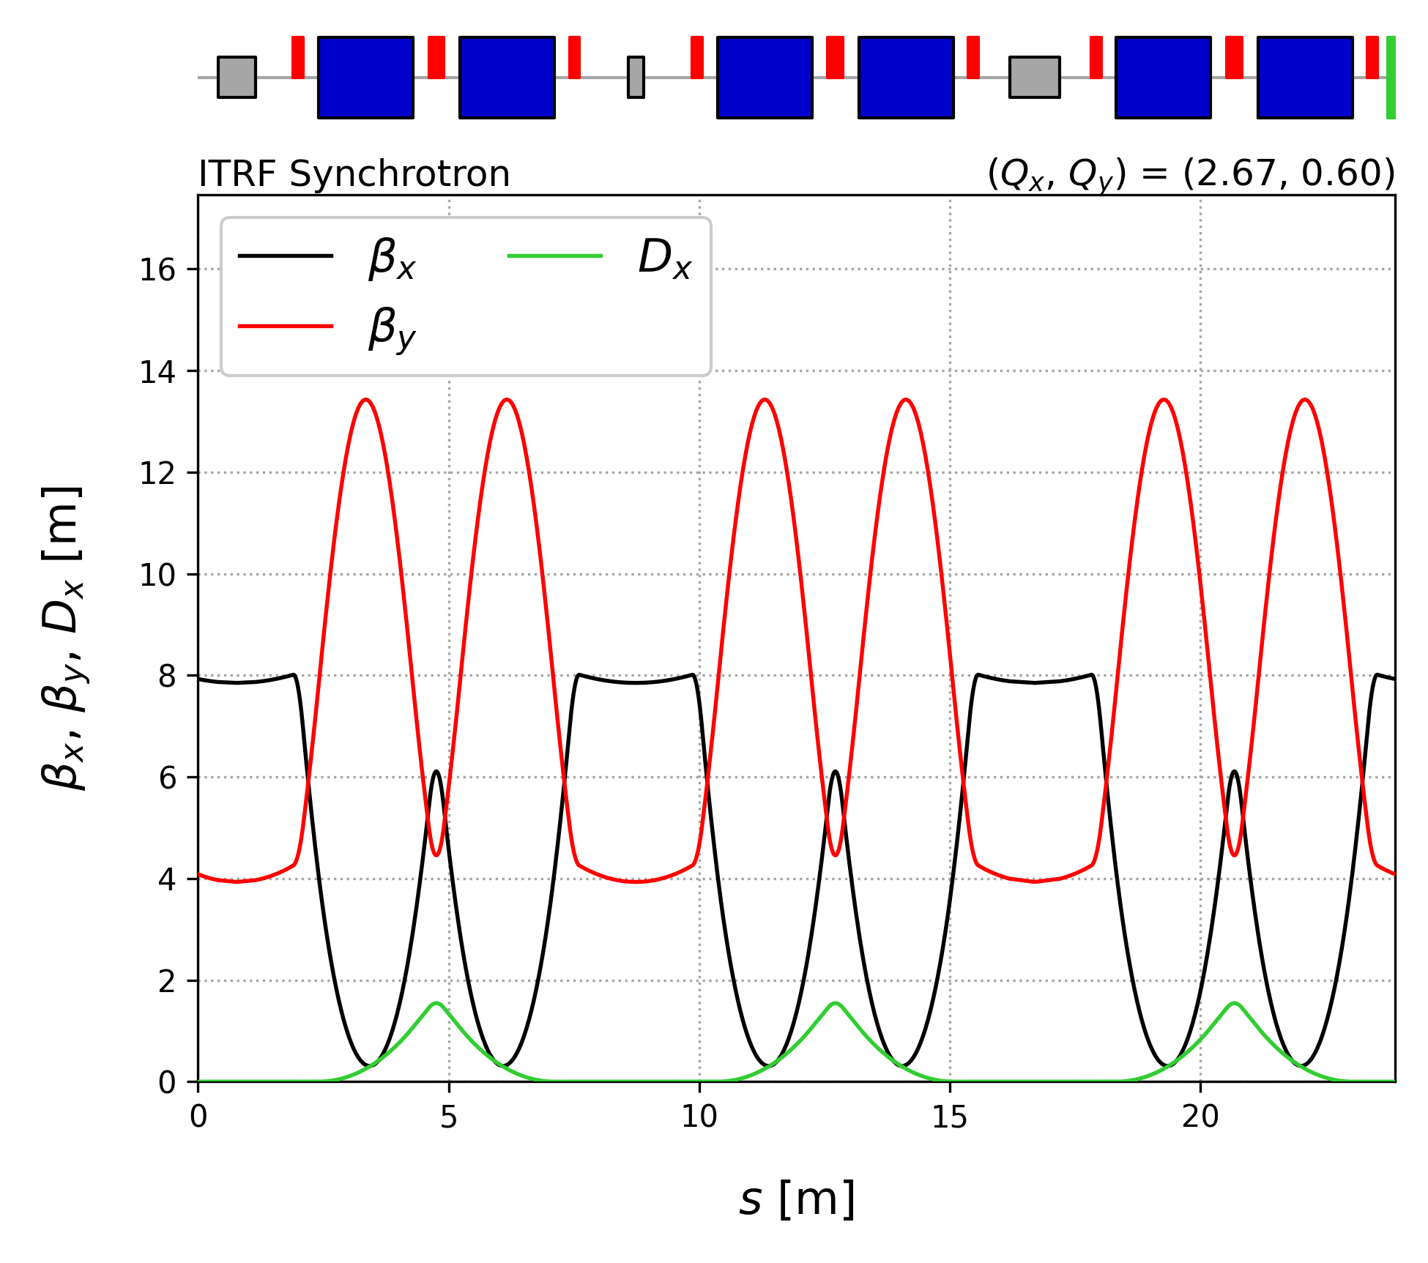
ITRF Synchrotron Design
[1] R. Taylor et al., J. Phys.: Conf. Ser 2420 012101 (2023)
Beam Optics
The synchrotron design was optimised to
maximise the accessible range of working points
Optics are tuned near a third-order resonance (Q_{x} = 2.66) for compatibility with slow, resonant beam extraction ^{[1]}
Parameter | Value
Optics Functions
Max. β_{x} [m] | 8.01
Max. β_{y} [m] | 13.4
Max. D_{x} [m] | 1.55
Working Point
Tune Q_{x}, Q_{y} | 2.66, 0.60
Chromaticity Q’_{x}, Q’_{y} | -3.82, -3.62

Slide 11
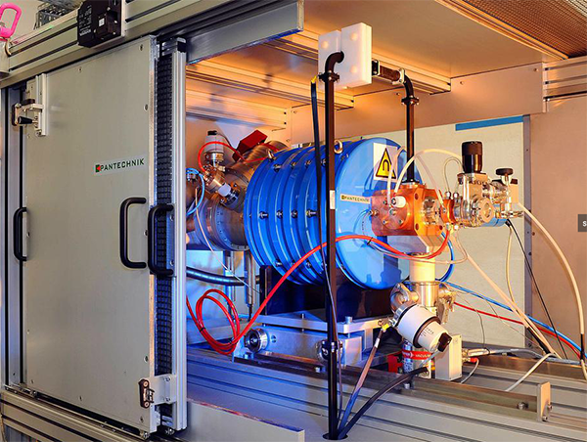
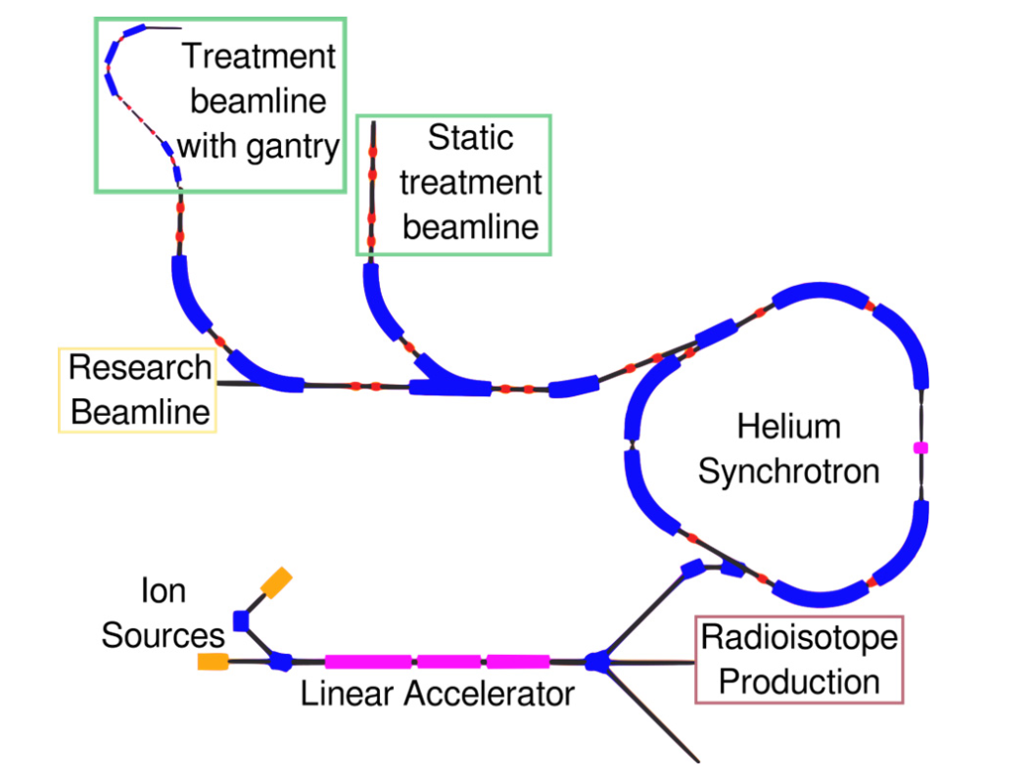
Beam Injection
[1] M. Vretenar et al., J. Phys.: Conf. Ser. 2420 012103 (2023)
[2] U. Amaldi et al., A Facility for Tumour Therapy and Biomedical
Research in South-Eastern Europe, Vol. 2 (2019)
[3] E. Benedetto, CERN-NIMMS-Note-008 (2022)
Injector Chain
NIMMS propose ^{[1]} a conventional injector chain based on CERN Linac 4
  Multiple ECR sources are envisioned, based on the
  SEEIST ^{[2]} injector and commercial Supernanogan source
  RFQ followed by one (two) DTL tanks to inject ions
  (protons) at 5 MeV/u (10 MeV)
Injection energies are primarily influenced by ^{[3]}
  Multi turn injection dynamics
  Space charge tune shift
  Stripping foil efficiency
Above: Commercial Supernanogan ECR source
generating up to 2 mA H⁺ or 200 µA C⁴⁺
Left: Schematic layout of NIMMS He
synchrotron and injector

Slide 12
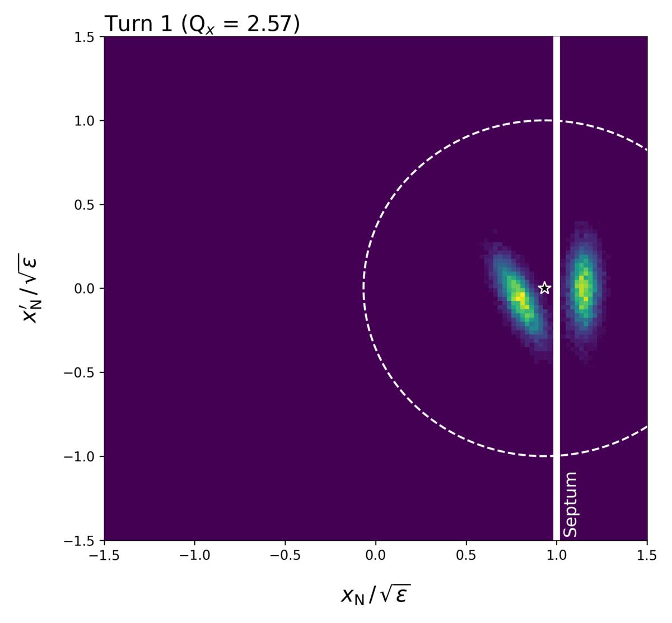
Beam Injection
[1] U. Amaldi et al., A Facility for Tumour Therapy and Biomedical
Research in South-Eastern Europe, Vol. 2 (2019)
Multi-Turn Injection
Ions are accumulated over several turns via MT injection
or “phase space painting”.
Injection is typically limited to 15 – 20 turns, with ~60% efficiency
Estimate the maximum stored intensity based on the SEEIST
injector parameters ^{[1]} and Supernanogan ECR source.
Parameter | Values
 | H⁺ | ⁴He²⁺ | ¹²C⁶⁺
Linac Current [mA] | 2.0 | 1.0 | 0.2
Injection Energy [MeV/u] | 10 | 5 | 5
Orbital Period [MHz] | 1.82 | 1.29 | 1.29
Ions after 15 Turns [10¹⁰] | 6.19 | 2.18 | 0.15
Max. Space Charge Tune Shift | -0.18 | -0.02 | < 0.01

Slide 13
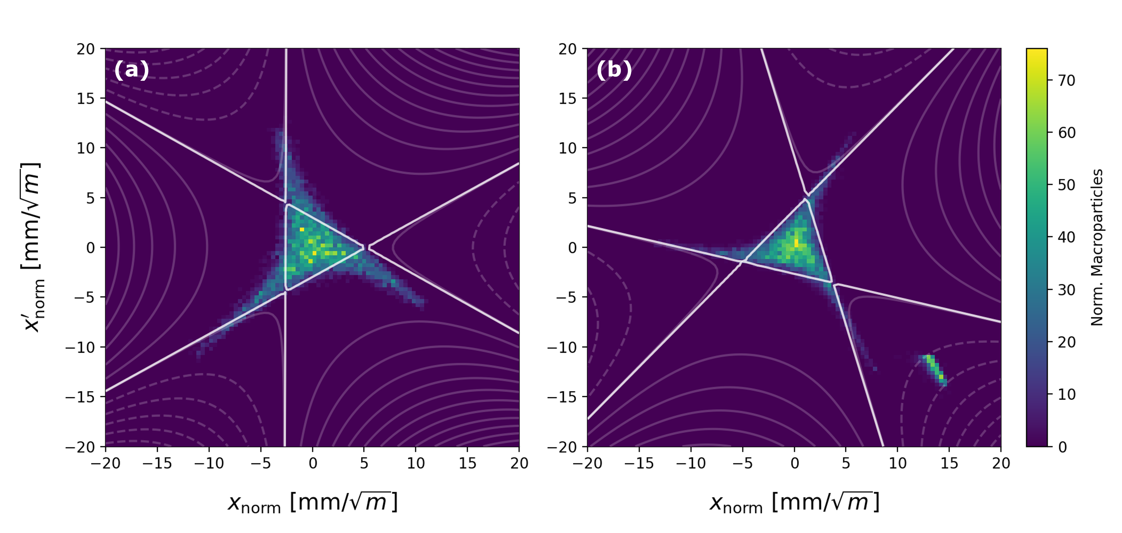
Beam Extraction
[1] M. Vretenar et al., J. Phys.: Conf. Ser. 2420 012103 (2023)
[2] R. Taylor et al., J. Phys.: Conf. Ser 2420 012101 (2023)
Particle Tracking Simulations
Like NIMMS ^{[1]}, we expect to use slow resonant extraction
using RF knockout at the third-order resonance
Extensive extraction simulations have been carried out
for the CERN PIMMS designs (e.g. CNAO, MedAustron) ^{[2]}
Typical extraction timescale of ~100 ms to 1 s
Extraction scheme for the WP3 synchrotron is being validated using MAD-X particle tracking:
Locations of extraction hardware
Preliminary specifications for septa
Septum
Figure: Normalised beam phase space
(a) after excitation of the resonance, and
(b) with “extracted” ions at the magnetic septum

Slide 14
Dose Rates
[1] H.L. Owen et al., Contemporary Physics 55:2, 55-74 (2014)
Preliminary Estimates
Indicative dose rates were calculated ^{[1]} for a
9 cm³ irradiation volume:
  3 x 3 cm field size
  Depth from 0 – 1 cm
We assume a uniform irradiation using a Spread-Out
Bragg Peak (SOBP) approach, and neglect lateral
scattering.
Dose rate estimated from the energy deposited
during a typical 100 ms slow extraction.
Parameter | Value
 | H⁺ | ⁴He²⁺ | ¹²C⁶⁺
Ions per Spill [10¹⁰] | 5.0 | 2.0 | 0.15
Median Energy [MeV/u] | 23.1 | 23.1 | 42.2
Dose per Spill [Gy] | 20.5 | 32.8 | 13.5
Instantaneous Dose Rate [Gy/s] | 205 | 328 | 135
Average Dose Rate [Gy/s] | 20.5 | 32.8 | 13.5
Equivalent LhARA Calculation
10⁹ protons per pulse
7 ns bunches at 10 Hz
Instantaneous : 6 x 10⁷ Gy/s
Average: 4.1 Gy/s

Slide 15
Introduction
Synchrotron Design
End Stations
Conclusions
Slides from
Karen Kirkby

Slide 16


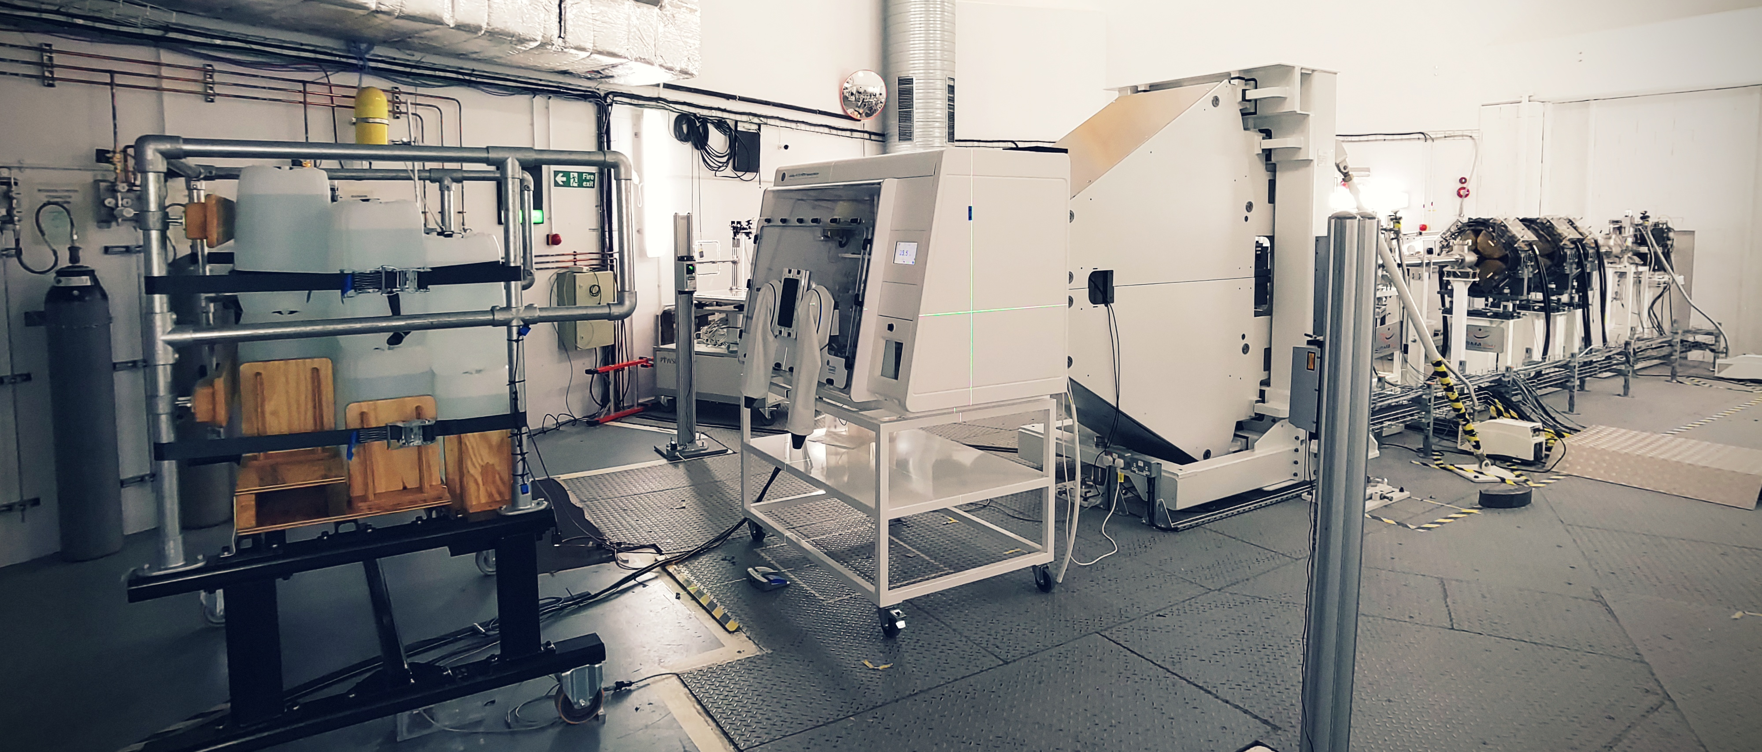




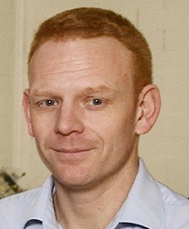


End Stations
Research Room at The Christie, Manchester
Prof. Ranald Mackay
Dr Helena Kondryn

Slide 17
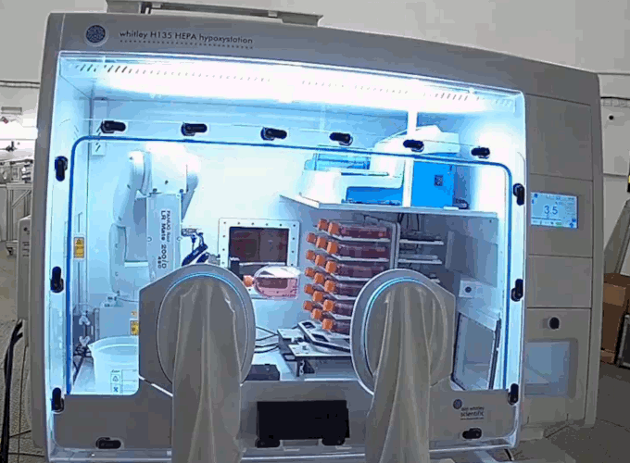
End Stations
Research Room at The Christie, Manchester
Research Room End Station
O₂: 0.1% - ambient
CO₂: 0% - 20%
Temperature: Ambient +4 ºC – 45 ºC
Humidity: Ambient – 100 %
Scanning Area: 20 x 20 cm
6-Axis Robot: 30s between samples
Hotel: 36 samples (54/night)
Automated liquid handling for
96-well plates
Scattered dose to hotel at worst
1.27 mGy/Gy

Slide 18
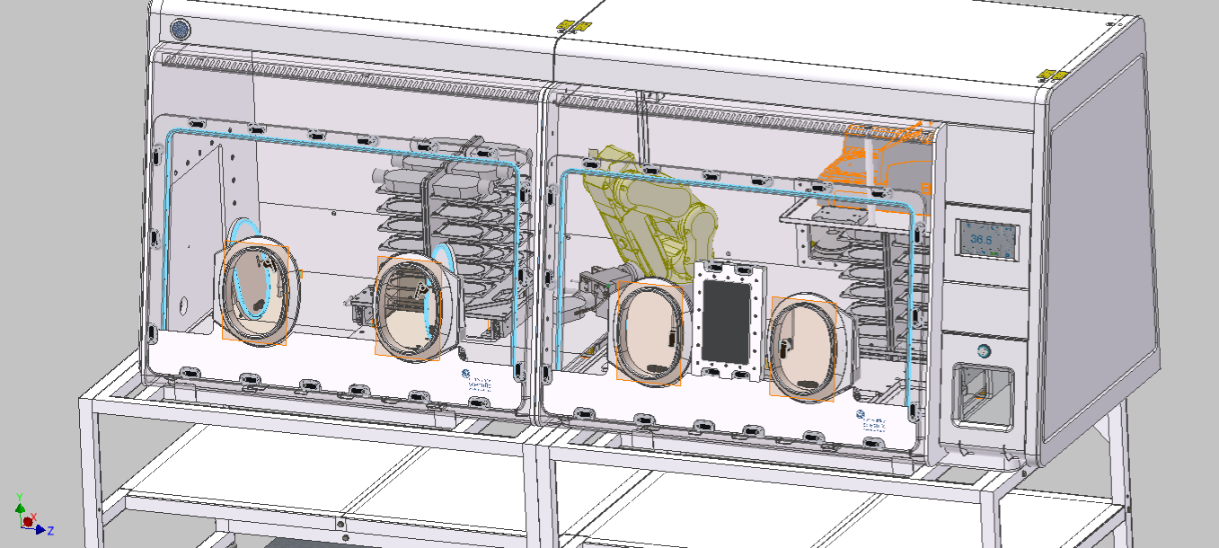
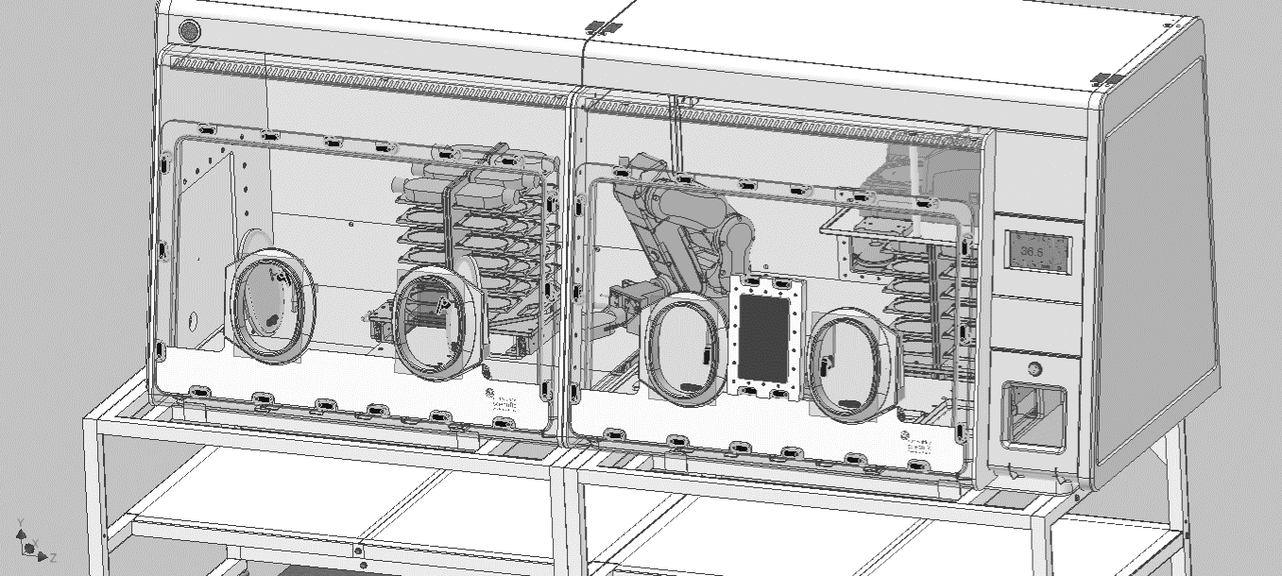
New End Station
Working with Don Whitley Scientific
Now fully funded
Second Hotel of Samples
Increased throughput
Cooled stage
DNA repair
FLASH studies
Online microscopy
Utilises same robot
And much more…
New Microscope Fits Here
Can be accessed by robot
Online live imaging
New End Station
Existing End Station

Slide 19

Conclusions
A baseline synchrotron option for ITRF WP3 has been
established, based on designs proposed by CERN NIMMS
The synchrotron achieves a higher ¹²C⁶⁺ extraction
energy than the LhARA FFA (83.5 MeV/u)
MAD-X particle tracking simulations are being developed
to explore and refine the scheme for slow extraction
Instantaneous dose rates expected to be
of order ~100 Gy/s
WP3 REPORT

Slide 20
Bonus Slides
Mark Johnson | Accelerator Physicist (ASTeC)
Office A50 | STFC Daresbury Laboratory | Warrington WA4 4AD
mark.johnson@stfc.ac.uk

Slide 21
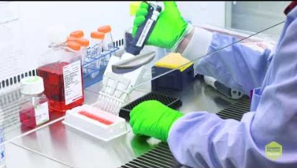
Christie Research Room
Video
https://www.youtube.com/watch?v=j2QR4PQvaeI

