Slide 1




Advancing laser accelerated proton beam performance
- for dose controlled irradiation studies
- and beyond the 100 MeV frontier
U. Schramm
Institute for Radiation Physics and Oncoray
Helmholtz-Zentrum Dresden-Rossendorf
Advancing Radiobiology Technology, IOP, London, 2023

Slide 2
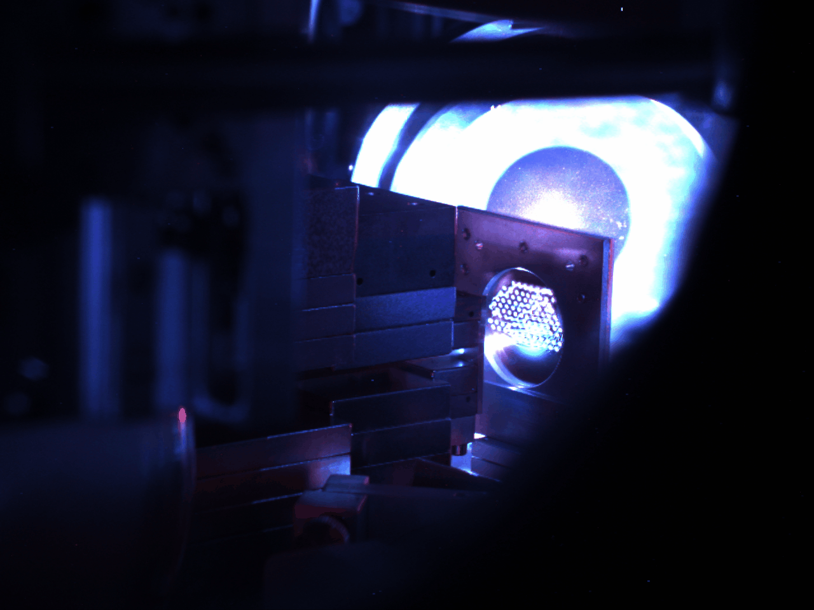
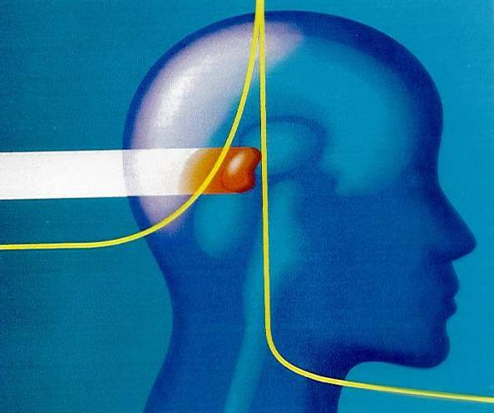
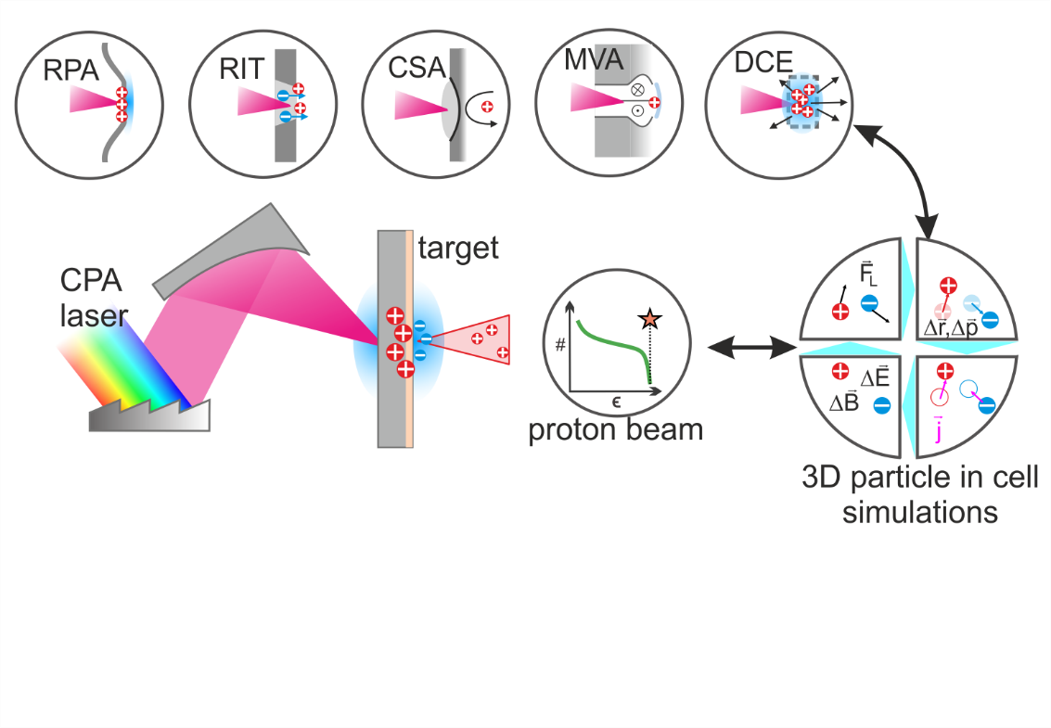
Motivation
(in the early times of laser plasma acceleration)
compact (cheap) accelerator to replace clinical proton therapy source
TNSA
exploit unique beam properties for high dose rate irradiation studies

Slide 3
Requirements (application ready laser ion accelerators)
application specific beam parameters
  energy to penetrate matter
  spectral yield (high dose rate)
beam transport (additional control) parameter monitoring
pulse repetition rate not target limited
reproducible conditions on demand
TNSA

Slide 4
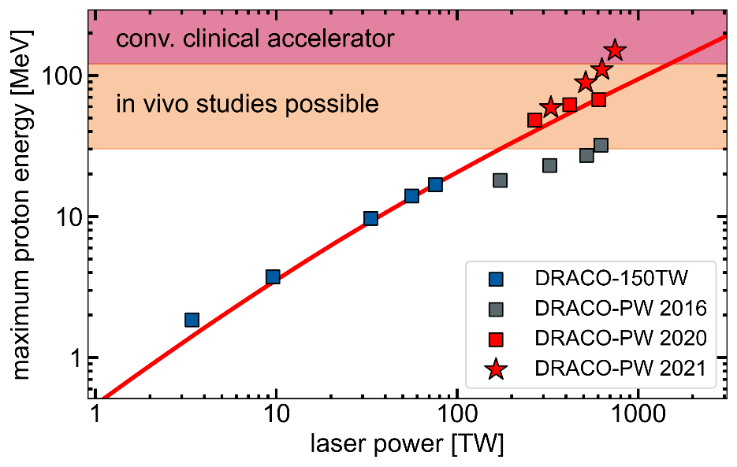
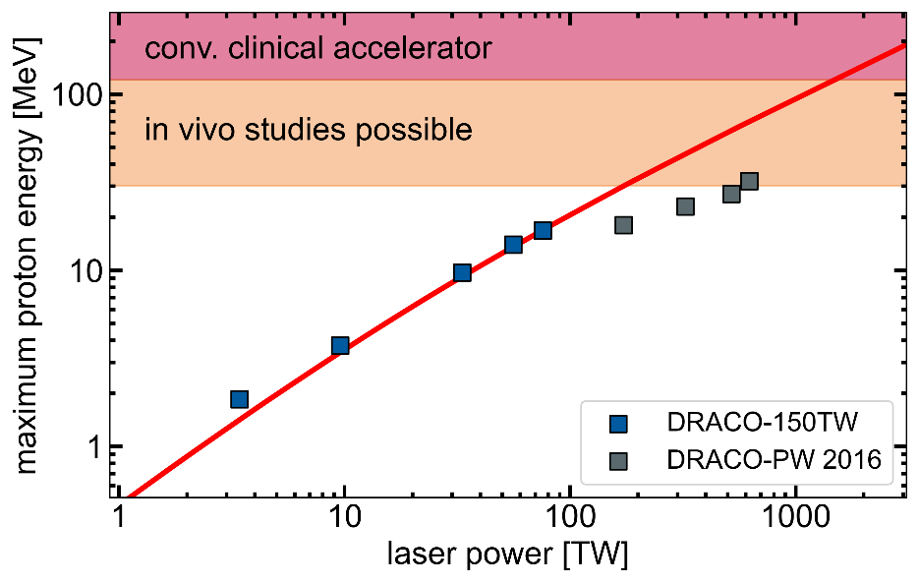
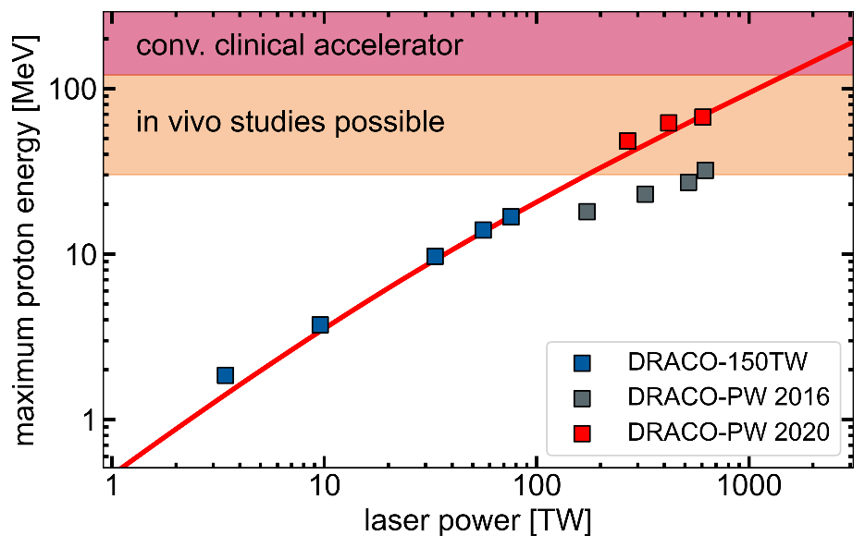
Requirements (application ready laser ion accelerators)
TNSA energy scaling
-> increase laser energy (power)
-> increase interaction efficiency

Slide 5
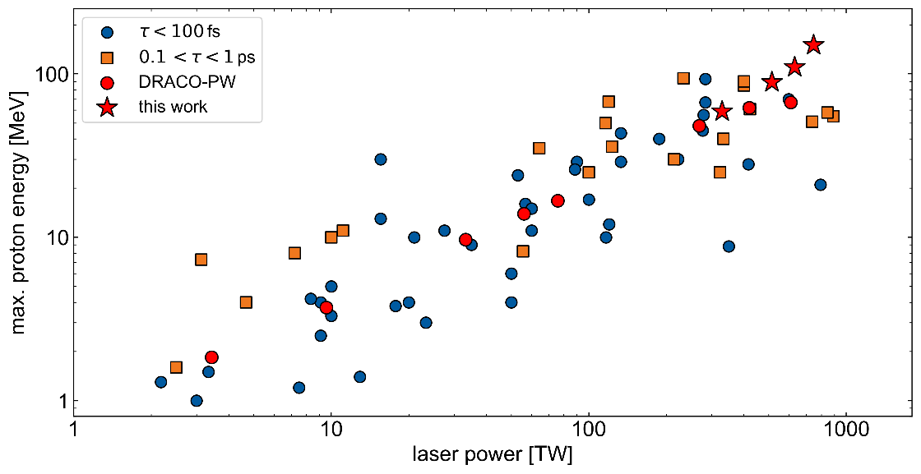
Requirements (application ready laser ion accelerators)
TNSA energy scaling
-> short pulse lasers competitive
-> long pulse diode pumped …

Slide 6
Upscaling of laser accelerated proton beam energies …
from surface to efficient volumetric interaction
microscopic understanding (instabilities, …)
links between simulation and experiment, predictive capability, diagnostics
control (and knowledge) of laser parameters on target
2020 Roadmap on plasma accelerators
New Journal of Physics 23, 031101 (2021)

Slide 7
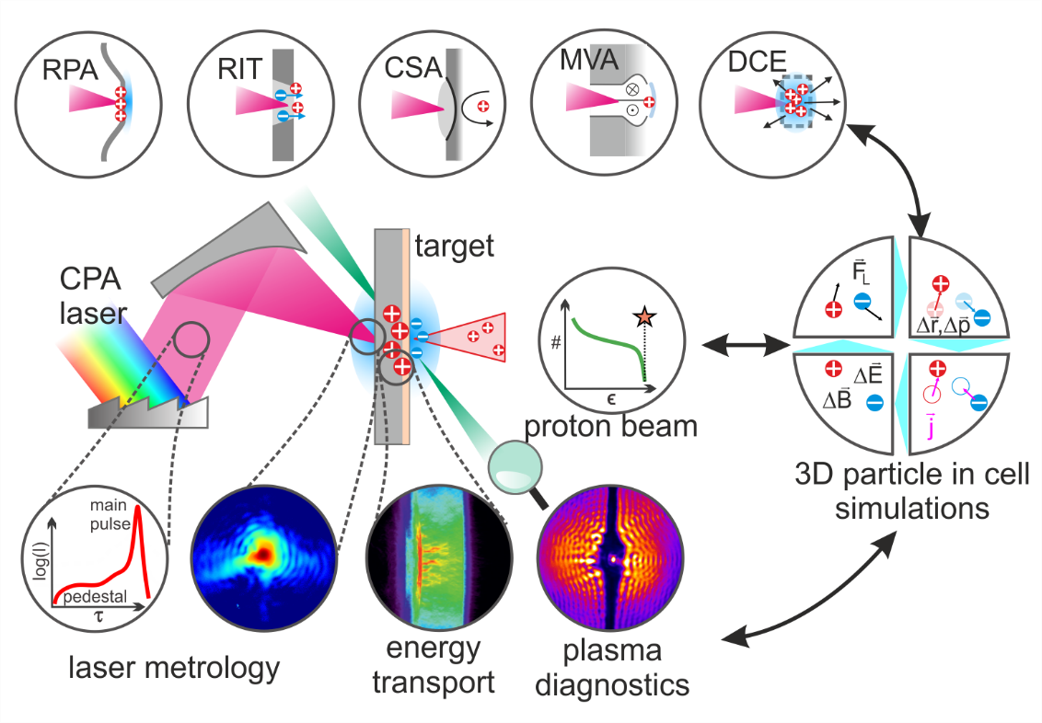
Upscaling of laser accelerated proton beam energies …
from surface to efficient volumetric interaction
microscopic understanding (instabilities, …)
links between simulation and experiment, predictive capability, diagnostics
control (and knowledge) of laser parameters on target,
pulse contrast (!)

Slide 8
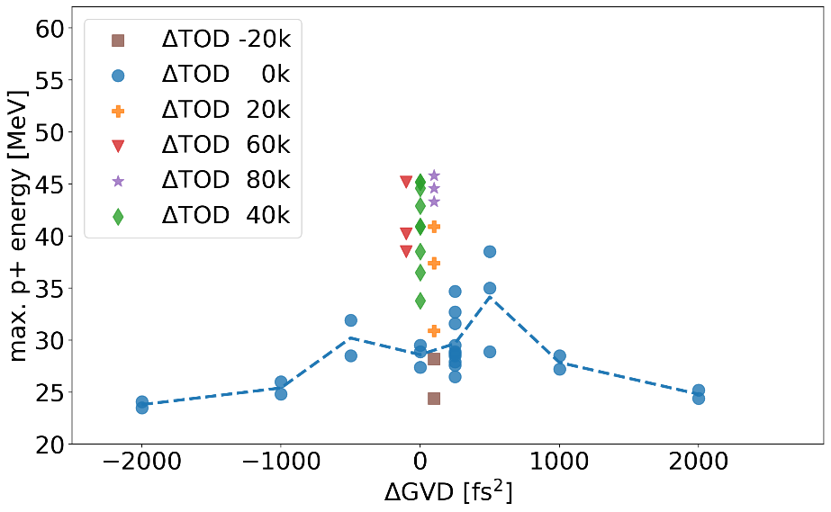
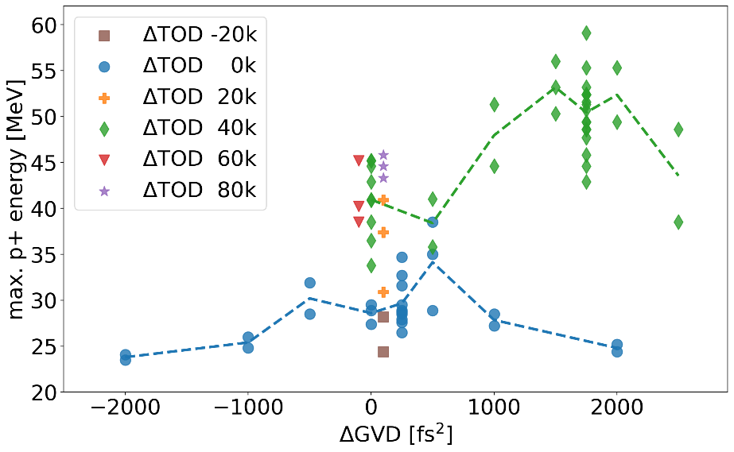
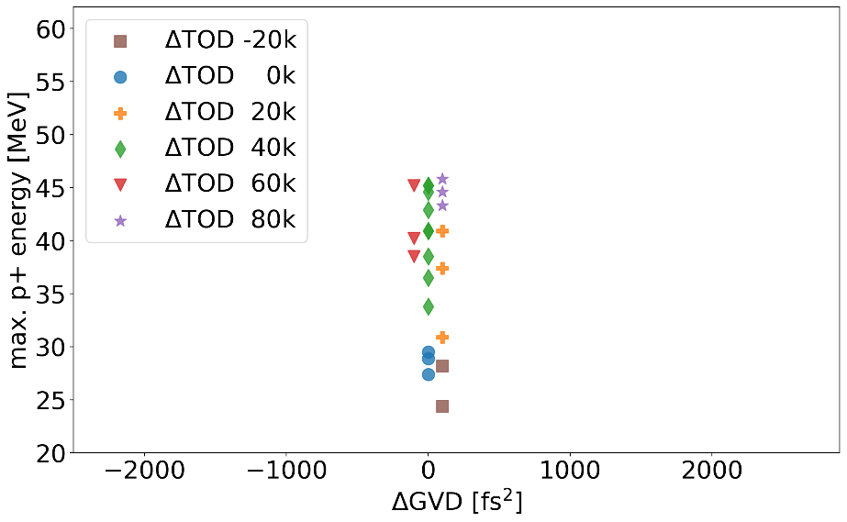
… through active dispersion (compression) management
(typically 15J (PM cleaned) on few 100nm plastic / formvar targets)
shift energy from pre- to
post-pulse side by TOD
T. Ziegler, et al., Scientific Reports 11, 7338 (2021)

Slide 9
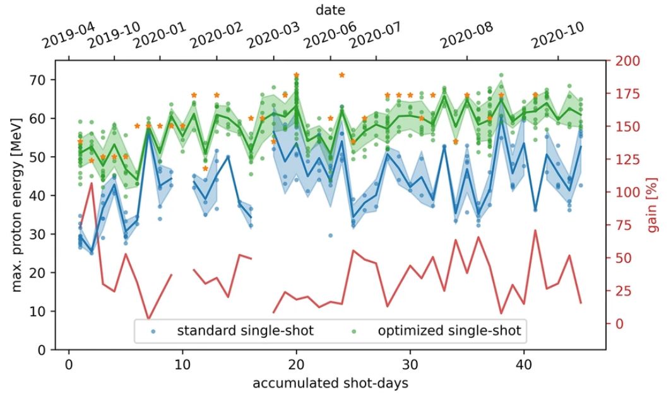
Stable laser proton accelerator operation over months @ >60 MeV
empirical GVD and TOD optimization improves and stabilizes TNSA performance
measured / cross-checked with RCF stacks,
TP spectromter, TOF
ready for applications
T. Ziegler, et al., Scientific Reports 11, 7338 (2021)

Slide 10
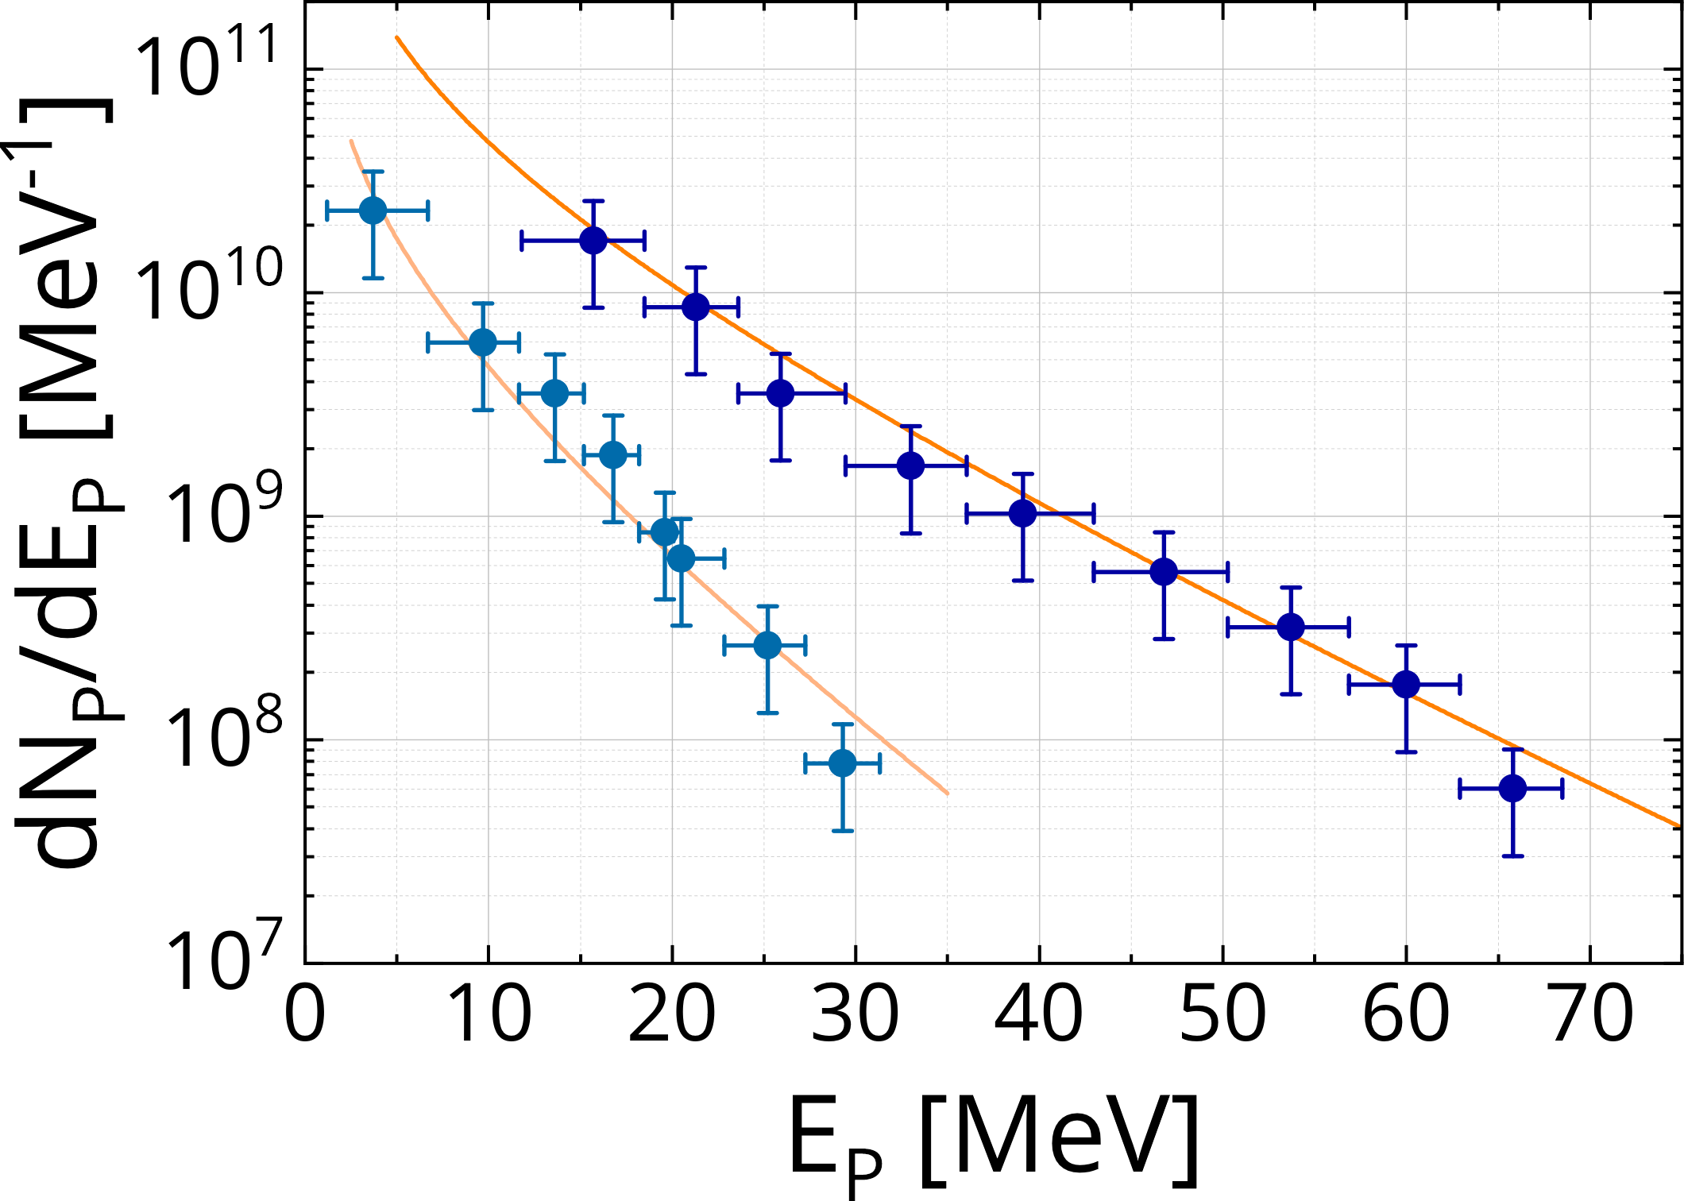
Stable laser proton accelerator operation over months @ >60 MeV
empirical GVD and TOD optimization improves and stabilizes TNSA performance
measured / cross-checked with RCF stacks,
TP spectromter, TOF
ready for applications
irradiation of 5mm
deep volume
T. Ziegler, et al., Scientific Reports 11, 7338 (2021)

Slide 11
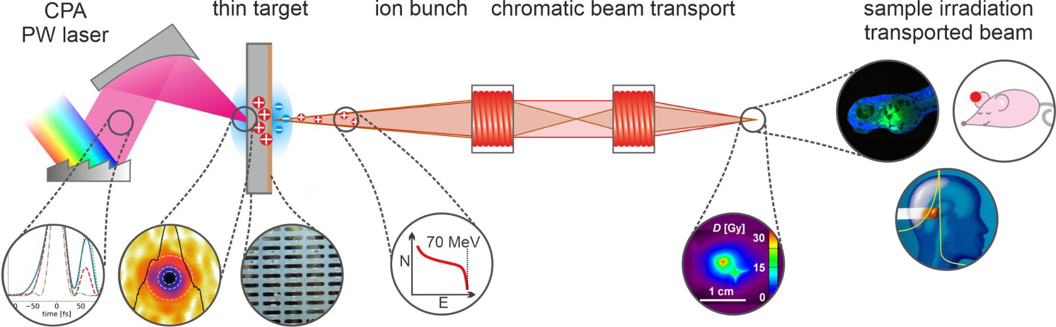
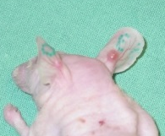
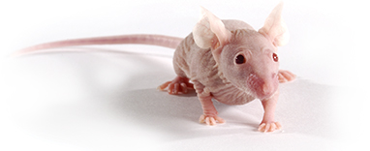
Controlled dose delivery with pulsed solenoids
in vivo 3D irradiation (mouse ear tumor)
proof-of-concept study
F. Brack, et al., Scientific Reports 10, 9118 (2020)
S. Busold, et al., (LIGHT), Sci. Rep. 5, 12459 (2015)
D. Haffa, et al., Sci. Rep. 9, 6714 (2019)
U. Masood, et al., Phys. Med. Biol. 62, 5531 (2017)
E. Beyreuther et al., PLOS ONE 12 (2017)
homogeneous dose
within 5×5×5 mm³
< 10% dose fluctuation
4 Gy in ~minute
criver.com

Slide 12
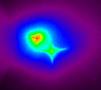
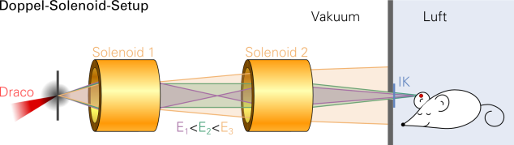
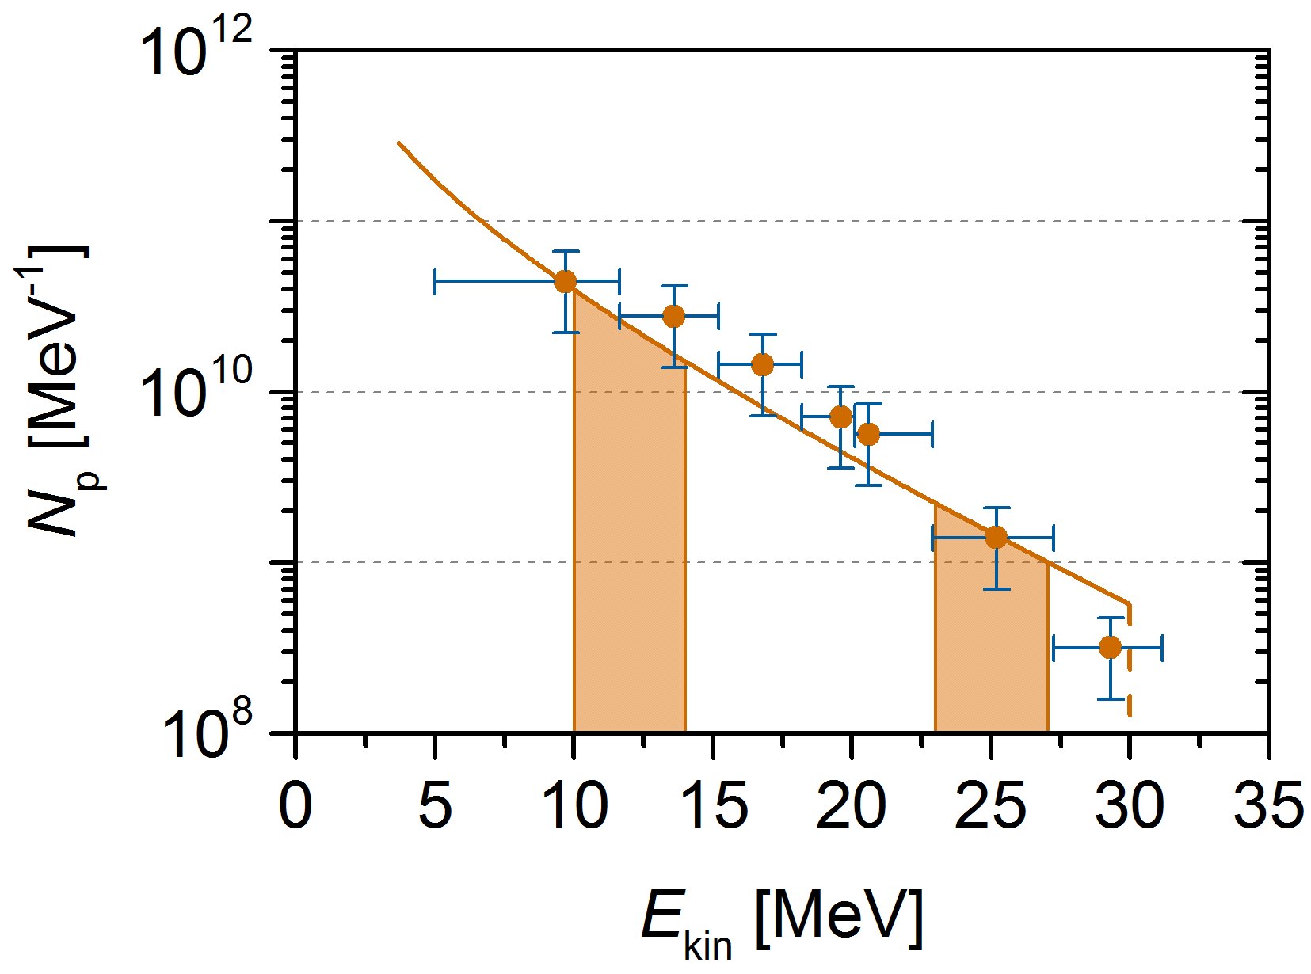
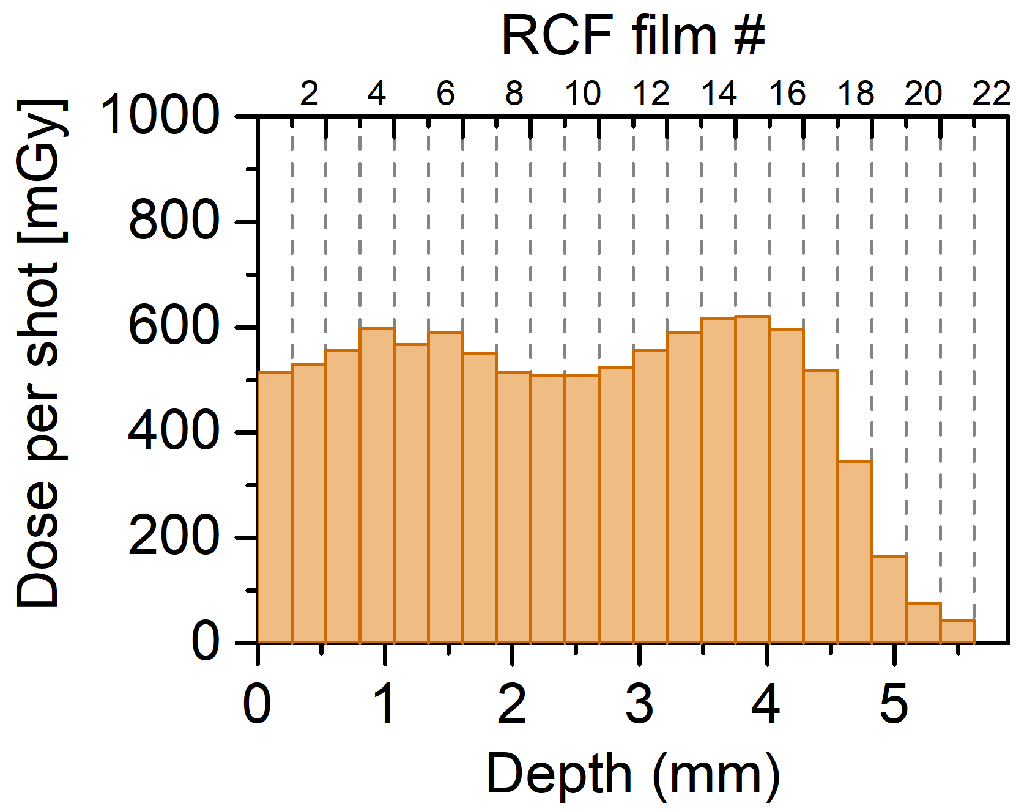
Single pulse depth dose control through polychromatic beams
2-solenoid Setup
vacuum
air
1 cm
18,6 MeV
12,3 MeV
RCF #
D_{pulse} [mGy]
F. Brack, et al., Scientific
Reports 10, 9118 (2020)
d [mm]

Slide 13
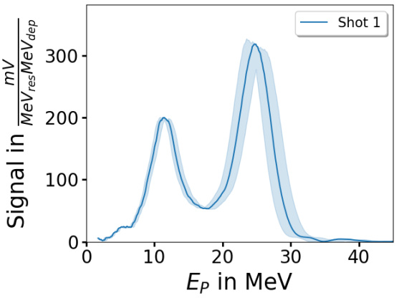
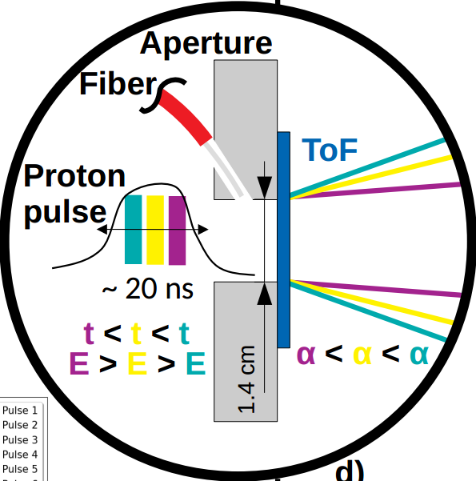
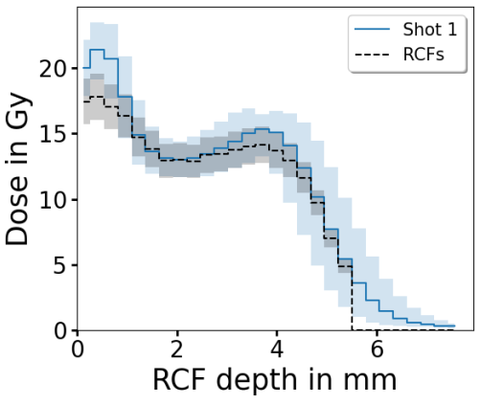
Single pulse depth dose control through on-shot metrology
2-solenoid Setup
vacuum
air
M. Reimold, et al, Scientific Reports 12, 21488 (2022)

Slide 14
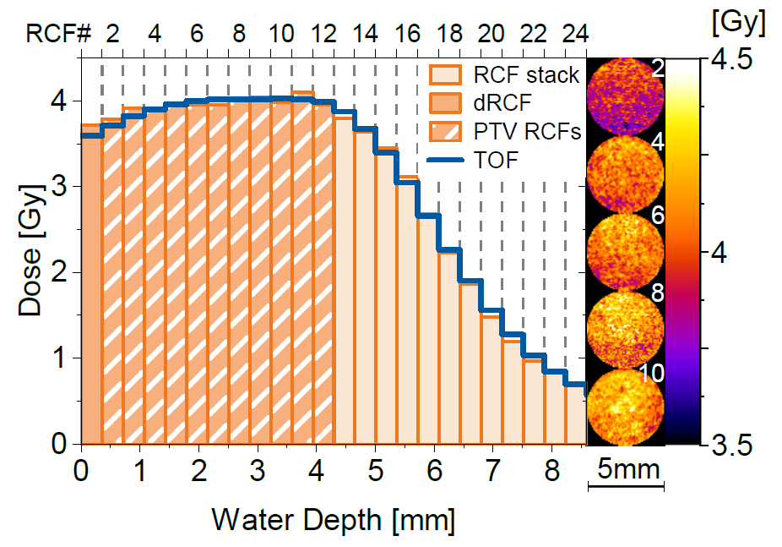
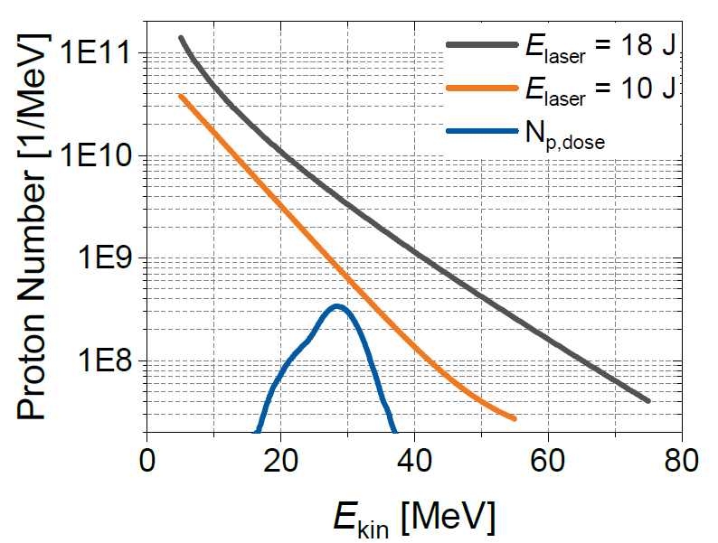
Single pulse depth dose control through on-shot metrology
2-solenoid Setup
vacuum
air
    Enabling a full-scale pilot study in a small animal model with a laser proton beam
F. Kroll, et al., Nature Physics 18, 316 (2022)

Slide 15
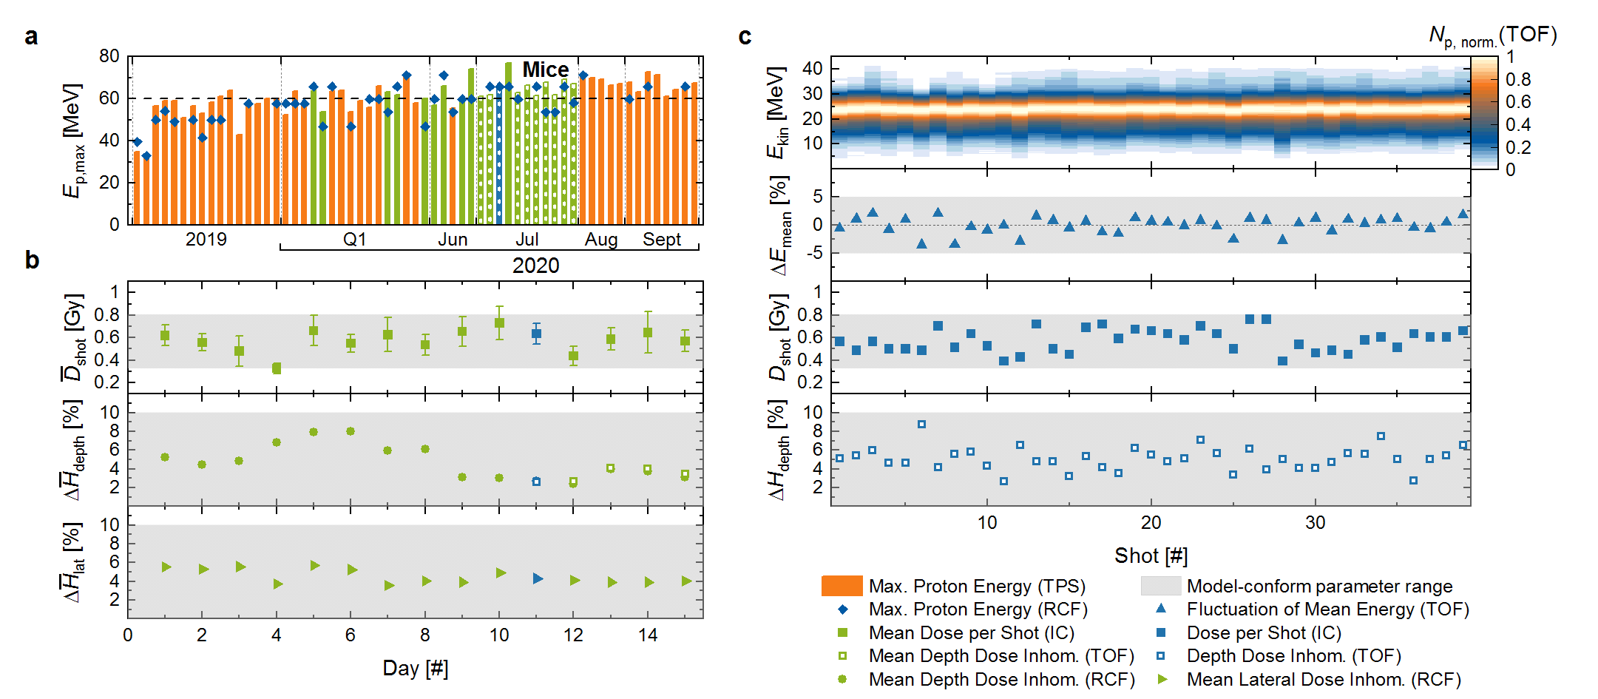
Accelerator readiness and stability benchmarked
    Enabling a full-scale pilot study in a small animal model with a laser proton beam
F. Kroll, et al., Nature Physics 18, 316 (2022)
Notes:
Setup presented → now accelerator readiness/stability
Standard fig of merit in proton LPA and also precondition for exp.: cut-off/max. energy → stably > 60 MeV for many month → already unique performance in LPA
But to show readiness for radiobiological study: need to verify stability/readiness via model/application-specific parameters, here chosen e.g. pulse dose/homogeneity shown for days marked in green → grey areas mark targeted values → all within → first of its kind achievement
Next step: single shot resolution for one day (blue) → spectral stability from tof and depth dose homogeneity derived → all ok!!!
But: single shot dose fluctuates → inherent property of LPA source → mititigated via dose accumulation

Slide 16
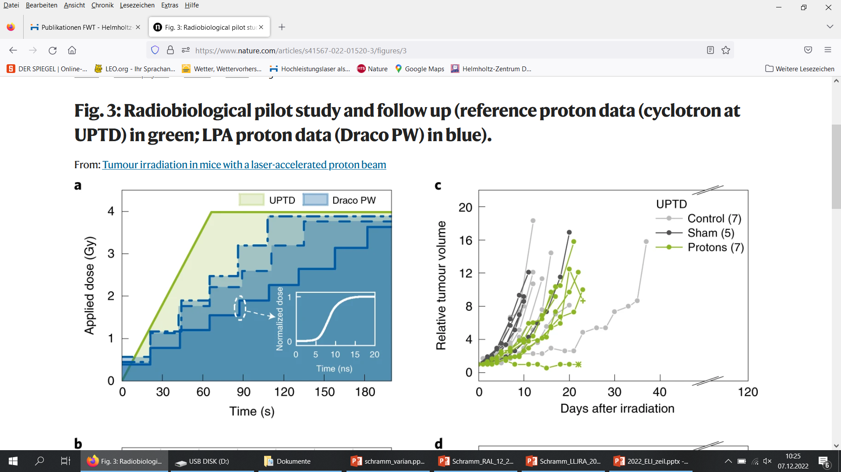
First in-vivo proton irradiation study with laser accelerated protons
Monitor tumor growth control
(i.e. delayed tumor growth)
for different radiation sources
 | Draco PW | UPTD
mean dose | 3.9 | 3.9
single dose accuracy (2σ) | 8% | 14%
dose homogeneity lateral/depth (2σ) | 9%/< 9% | 9%/2%
mean dose rate | 1.2 – 2.2 Gy/min | 3.6 Gy/min
peak dose rate | 10⁸ Gy/s | -
F. Kroll, et al., Nature Physics 18, 316 (2022)

Slide 17
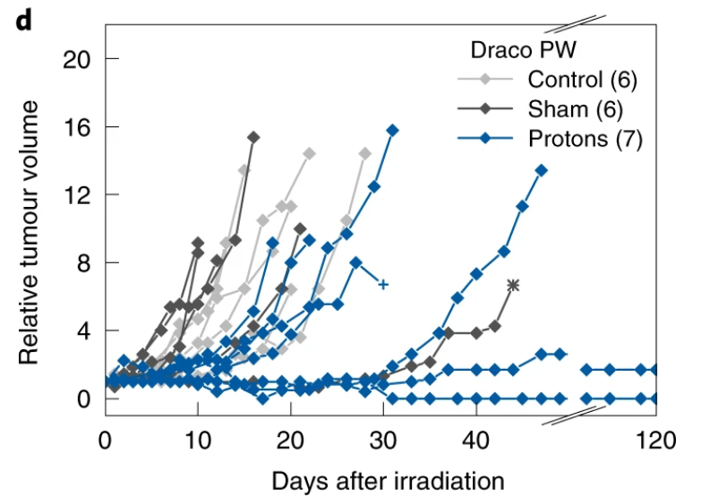
First in-vivo proton irradiation study with laser accelerated protons
F. Kroll, et al., Nature Physics 18, 316 (2022)

Slide 18
First in-vivo proton irradiation study with laser accelerated protons
    Full-scale pilot study in a small animal model with a laser proton beam
    Radiation induced (4 Gy) effect observed
    In total 47 mice at HZDR (Draco 4 Gy | Draco 0 Gy | X-ray 4 Gy | X-ray 0 Gy | Controll) + same number for reference at clinical beam
    Long-term survival unexpected, yet requiring higher statistics …
    Not a FLASH study
F. Kroll, et al., Nature Physics 18, 316 (2022)

Slide 19
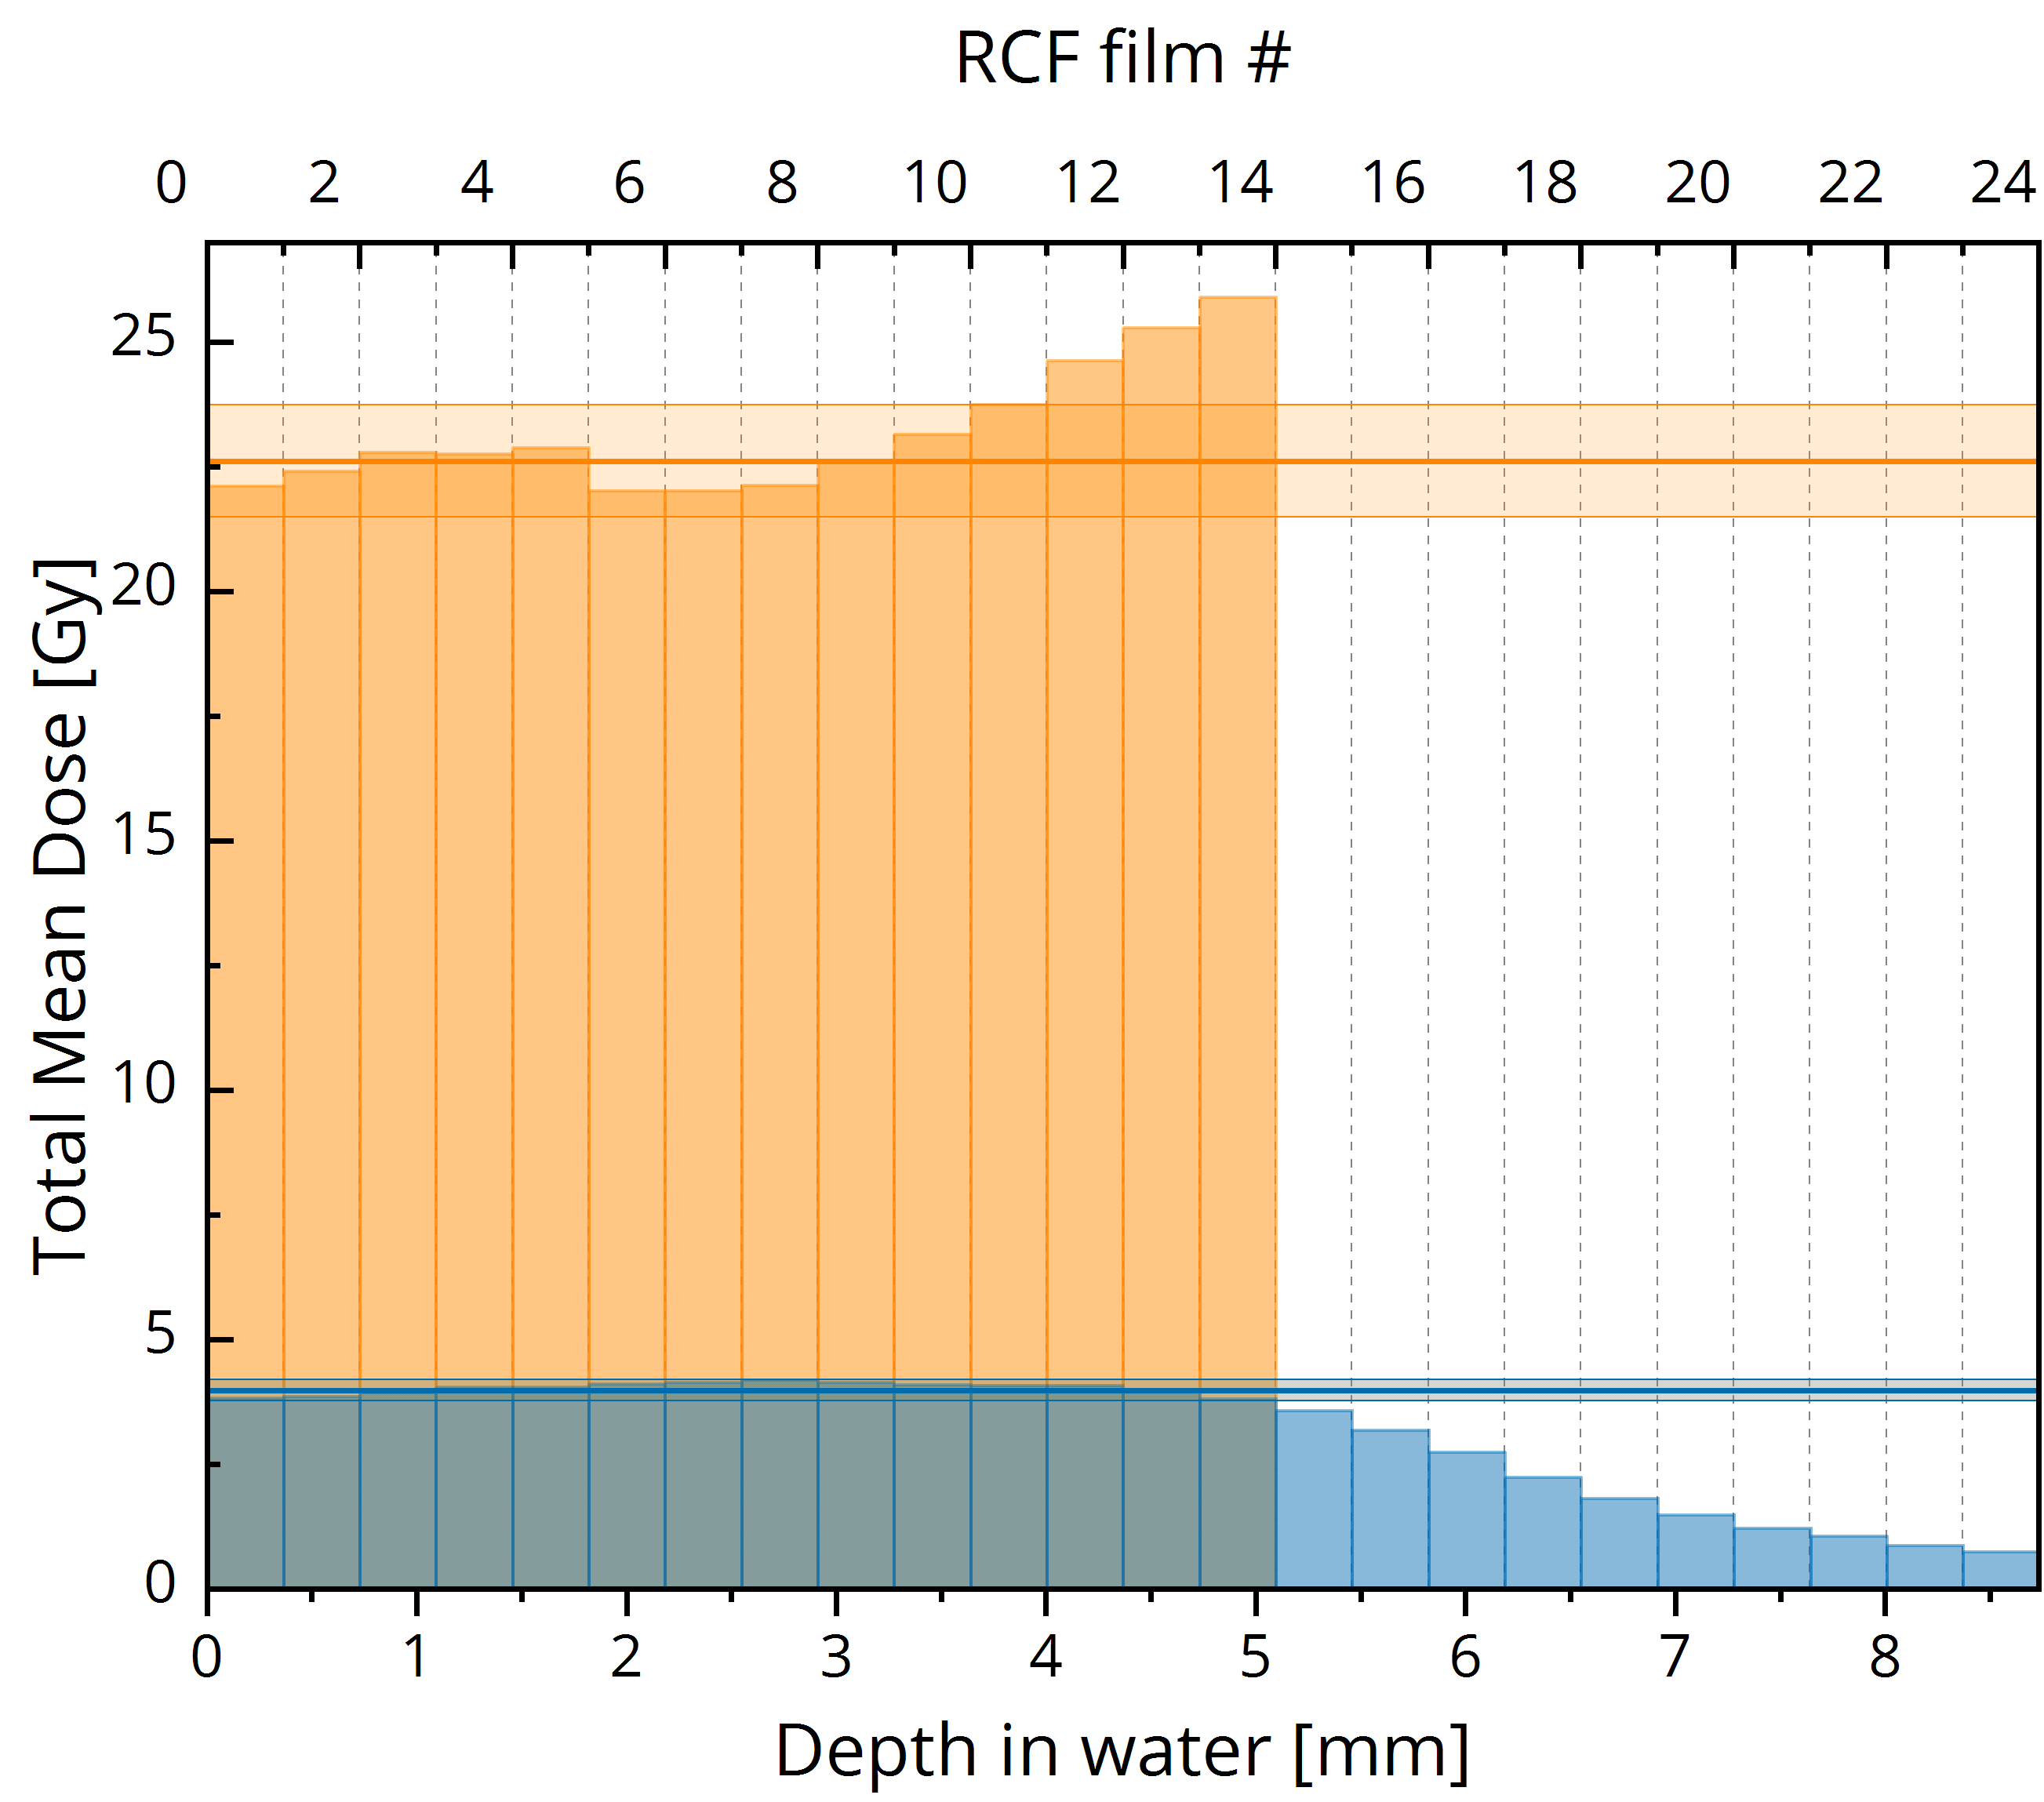
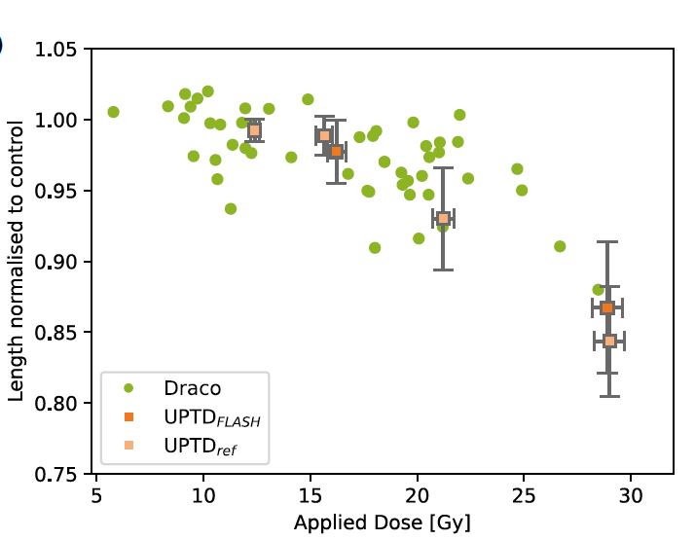
High dose rate effects (zebra-fish) ?
Controlled dose at highest precision
(mouse experiment, accumulated shots)
Maximum dose rate (up to 25 Gy/shot)
enabling FLASH irradiation studies
Draco laser system: single shot proton dose rate of 10⁹ Gy/s
Reference study at UPTD using conventional proton dose rate

Slide 20
Coming back to physics …
TNSA proton performance ready for demanding applications
But how to optimize volumetric interaction ?
How to tailor near-critical density targets ?
And serve repetition rate (self-replenishing target, without need for plasma mirrors)
-> Expanding foils and cryogenic hydrogen

Slide 21
Coming back to physics …
Dense, opaque target
mirror-like behaviour
pulse mostly reflected
Transparent target
pulse mostly transmitted

Slide 22



Coming back to physics …
foil
typ. > 10²³ cm⁻³
over-critical
Near critical density target
solid
pre-expansion
1.7 x 10²¹ cm⁻³
n_{critical}[800nm]
hydrogen (jet)
near-critical
pulse mostly absorbed
typ. < 10²⁰ cm⁻³
under-critical

Slide 23
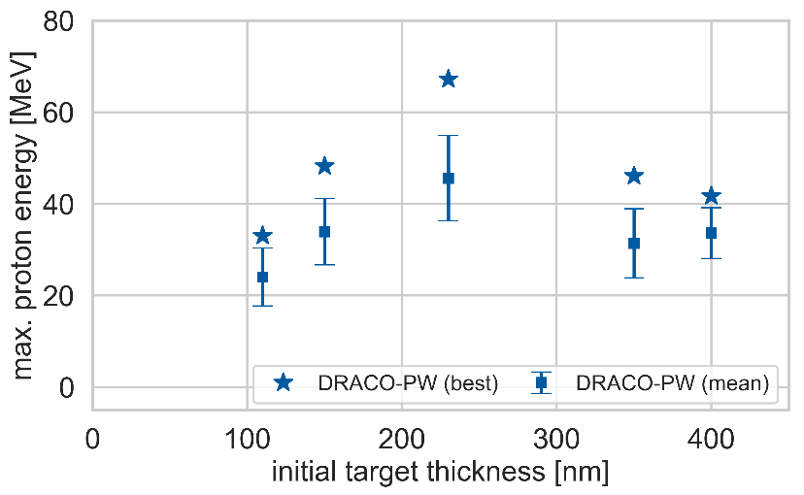
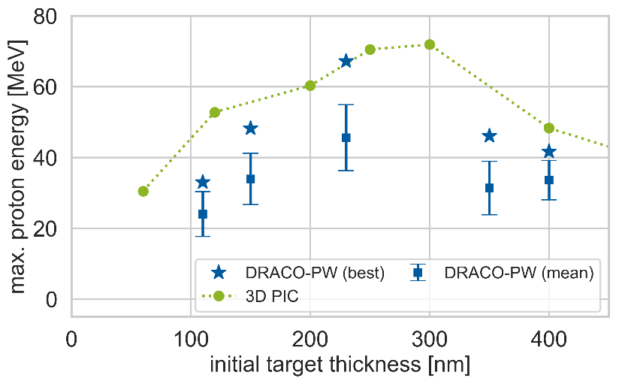
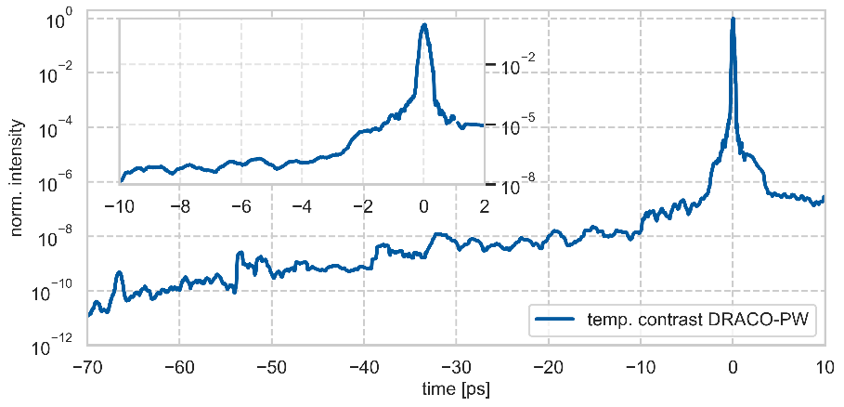
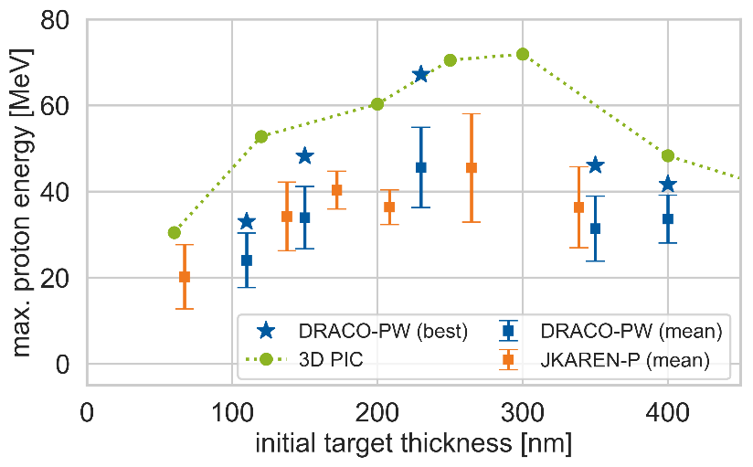
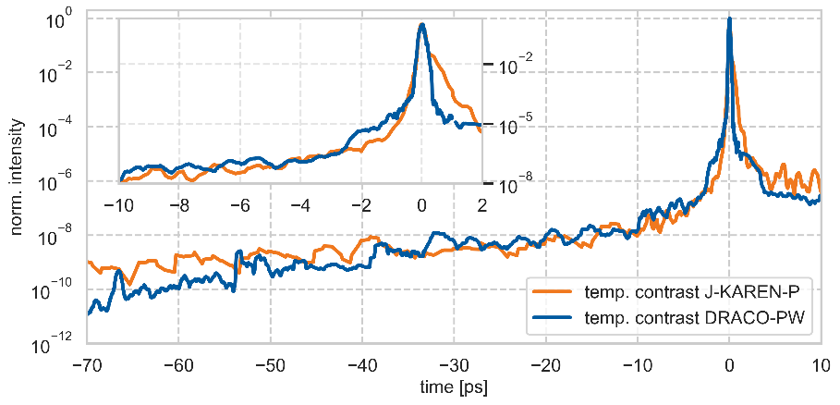
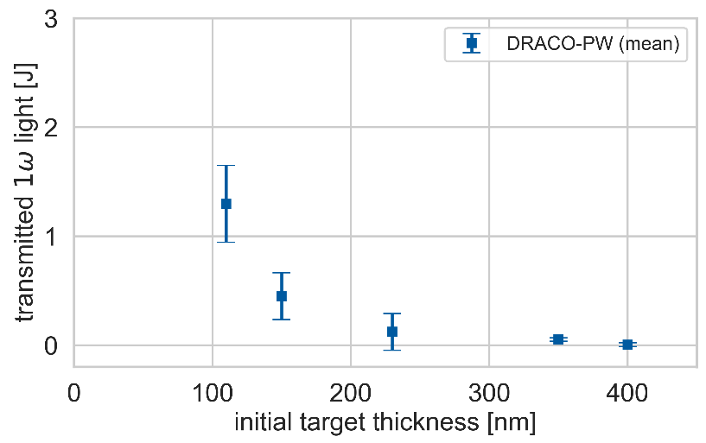
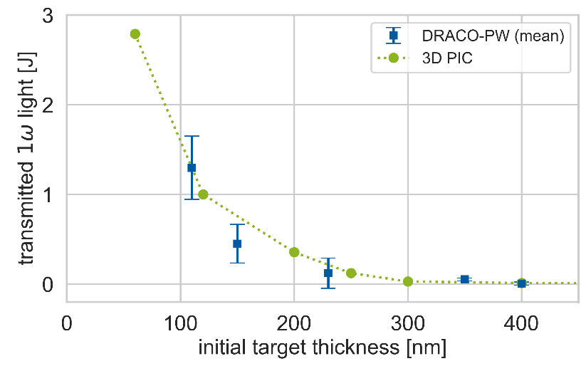
Pre-expanded thin foil studies at two laser systems w/o PM
intrinsic target pre-expansion
enhanced proton energies at optimal thickness
onset of transparency at optimal thickness
comparison to other high-power laser systems
N. Dover, T. Ziegler, et al.
Nature Light: Science and Appl. 12, 71 (2023)

Slide 24
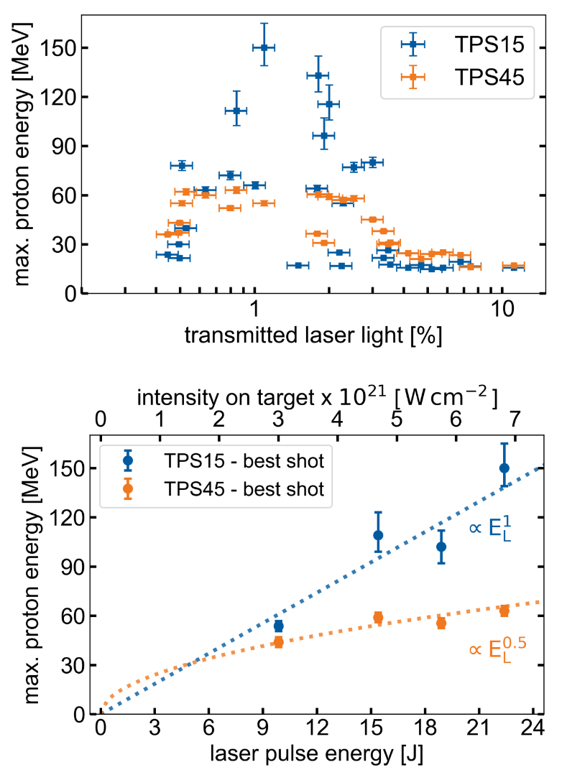
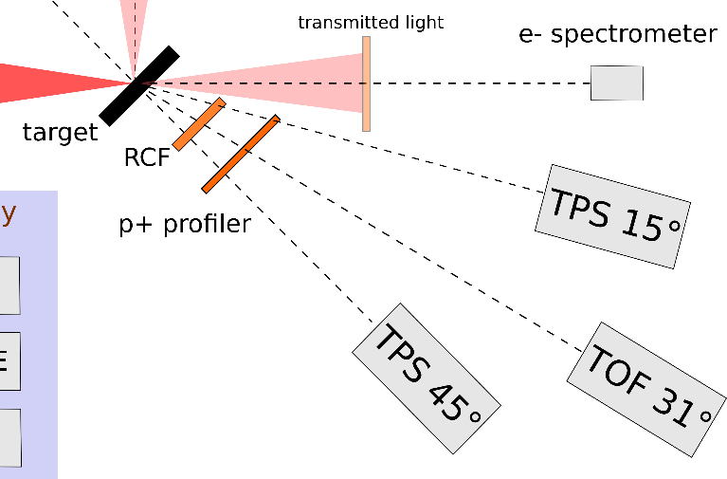
Proton emission characteristics
sorting by transmitted light
T. Ziegler, et al. unpublished

Slide 25
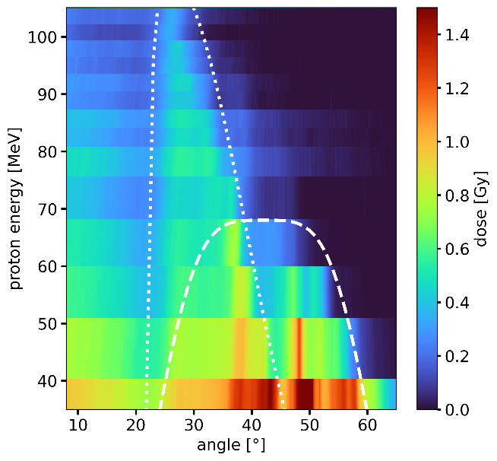
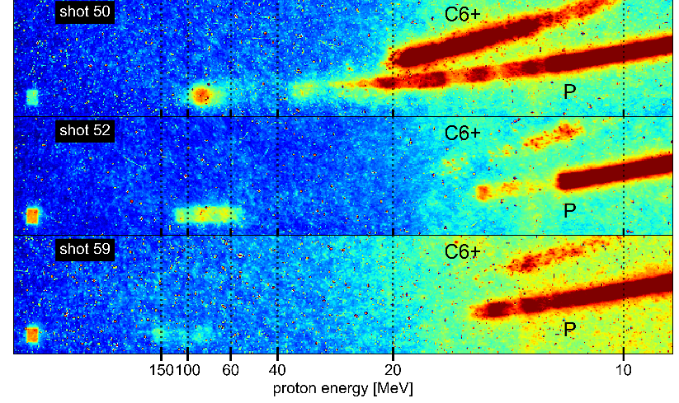
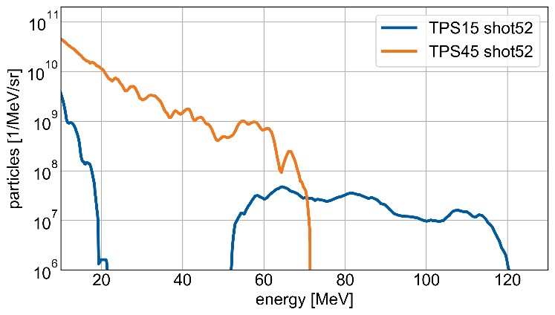
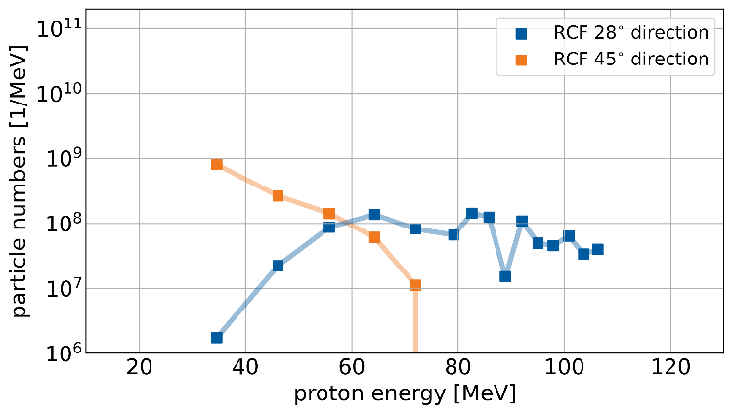
Sample spectra (TPS and RCF data)
T. Ziegler, et al. unpublished

Slide 26
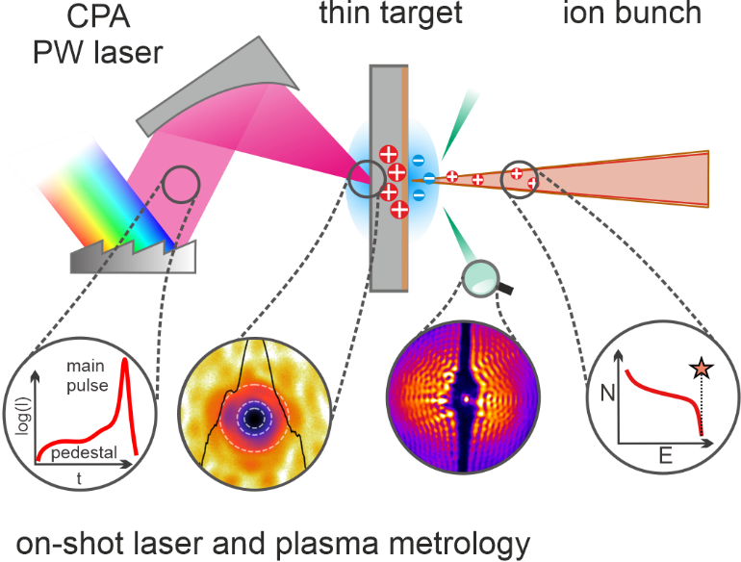
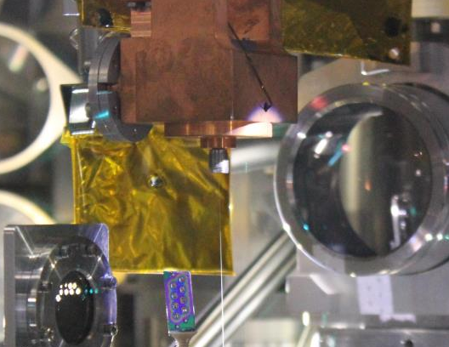
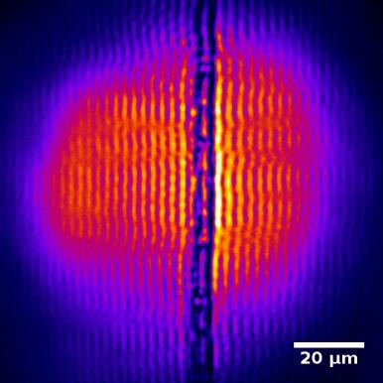
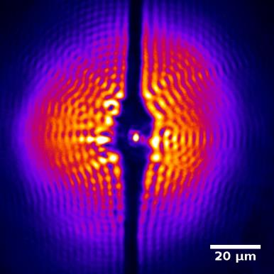

Proton acceleration in near critical density targets
cryogenic hydrogen jet targets
with off-harmonic probing
S. Goede et al., PRL 118, 194801 (2017)
L. Obst et al., Sci. Rep. 7, 10248 (2017)
M. Gauthier, et al., APL 111, 114102 (2017)
L. Obst, et al., Nat. Comun. 9, 5292 (2018)
M. Loeser, et al, Optics Express 29, 9199 (2021)
T. Ziegler, et al., PPCF 60, 074003 (2018)
C. Bernert, et al., Sci. Rep. 12, 7287 (2022)
C. Bernert, et al., Phys. Rev. Appl. 19, 014070 (2023)

Slide 27
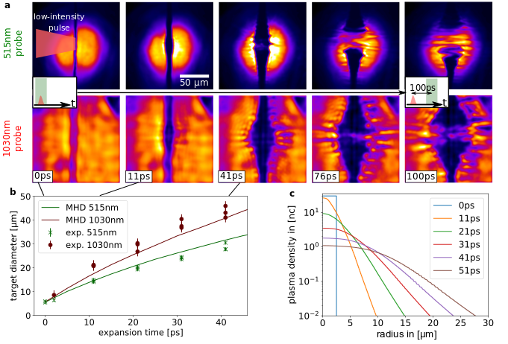
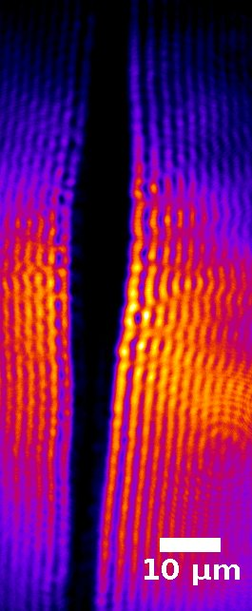
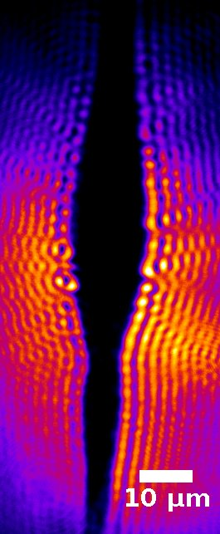
On-shot plasma characterization by bi-colour high resolution probing
enabling controlled plasma density tailoring and predictive simulation input
20 ps
Pre-pulse
delay
30 ps
10µm
15µm
M. Rehwald, C. Bernert, et al.,
Nat. Commun. 14, 4009 (2023)

Slide 28



On-shot hydrogen target density tailoring (with pre-pulse)
- enabling quantitative simulation suggesting transition from TNSA via RTF-RPA to MVA
- supporting up to 80 MeV with debris-free and rep-rated target
MVA
RTF-RPA
TNSA
M. Rehwald, C. Bernert, et al.,
Nat. Commun. 14, 4009 (2023)

Slide 29

On-shot hydrogen target density tailoring
- enabling quantitative simulation suggesting transition from TNSA via RTF-RPA to MVA
- supporting up to 80 MeV with debris-free and rep-rated target
RTF-RPA = Relativistic Transparency
Front - RPA
synchronized acceleration of ions at the moving (intensity dependent) relativistic critical density front
I. Goethel, et al., PPCF 64, 044010 (2022)

Slide 30



Repetition rate demonstration (at 1J / 5 Hz @ HIBEF)
Comprehensive set of diagnostics for target position (optical probing), laser-target overlap (p+ spectrometer, TOF, transmission screen), and laser pointing -> ready for machine learning applications
optical probing
p-spectrometer (first 300 shots):
online target position monitor
Relax beam
1J, 5Hz, 800nm
1.8 x 10²⁰W/cm²
PS
TS
H₂ cryojet target
Proton cut-off distribution
(60% hits)

Slide 31


Proton acceleration take away message – pilot study demonstrates
system readiness – TNSA beaten with intrinsic laser setting – rep. rate
energy to penetrate volume
cryogenic hydrogen
serving target rep rate
stability
stability
long term and short term
directed beam well exceeding 120 MeV

Slide 32



Laser radiooncology
Laser particle acceleration
reference beams
beam transport/
dose delivery
laser-driven ion acceleration
high power lasers Draco
and PENELOPE
biological infrastructure
beam monitoring/
dosimetry
computational radiation physics
biological models
J. Pawelke, E. Beyreuther, K. Brüchner, E. Bodenstein, L. Karsch, E. Lessmann, M. Krause, E. Troost, N. Cordes, C. Richter, et al.
K. Zeil, J. Metzkes-Ng, F. Kroll, C. Bernert, E. Beyreuther, L. Gaus, S. Kraft, A. Nossula, M.E.P. Umlandt, M. Rehwald, M. Reimold,
H.-P. Schlenvoigt, M. Sobiella, T. Ziegler, S. Bock, R. Gebhardt, U. Helbig, T. Püschel, U. Schramm, T. Cowan, et al.
High-field laboratory Dresden (HLD) and HZDR workshop; R. Szabo, et al. (ELI-ALPS); J. Jansen, et al. (DKFZ)

Slide 33


K. Zeil, J. Metzkes-Ng, F. Kroll, S. Assenbaum, C. Bernert, F. Brack, M. Rehwald, M. Reimold, H.P. Schlenvoigt, T. Ziegler, et al.
A. Irman, J. Couperus, V. Chang, A. Ghaith, M. Laberge, et al.,
T. Kluge, A. Debus, M. Bussmann, R. Pausch, K. Steiniger, I. Göthel, M. Garten, et al.
J. Pawelke, E. Beyreuther, L. Karsch, M. Krause, et al.,
M. Siebold, D. Albach, S. Bock, R. Gebhardt, U. Helbig, M. Löser, T. Püschel, et al.
U. Schramm, T. Cowan, R. Sauerbrey
N. Dover, M. Nishiuchi, A. Kon, H. Kyriama et al. / M. Gauthier, F. Fiuza, S. Glenzer, et al. /
S. Goede, et al. / V. Malka, et al.

Slide 35


Dresden (accelerator) platform (investigating FLASH requirements)
Near arbitrary bunch sequence
at SRF accelerator ELBE (13 MHz bunch rate)
Total dose applied ~ 30 Gy
(laser accelerated protons reach 30 Gy / pulse)
164 ms
100 ms
Electron Linac/ Synchrocyclotron
like Flash
~ 164 ms
200 Gy/s
~10⁹ Gy/s
5 x 800
Isochronous cyclotron like Flash
~ 100 ms
320 Gy/s
~10⁶ Gy/s
~10⁶
Maximum
Flash
~ 300 µs
10⁵ Gy/s
~10⁹ Gy/s
~4000
Irradiation time
Mean dose rate
Pulse dose rate
Number of pulses
Reference
~ 4 min
0.13 Gy/s
~10³ Gy/s
~10⁹
Ref
UHDR_{cyclo}
UHDR_{synclo}
UHDR_{Max}
J. Pawelke, et al., Radiother. Oncol. 158, P7 (2021), L. Karsch et al. Radiother Oncol 173, 49 (2022)

Slide 36

Dresden (accelerator) platform (investigating FLASH requirements)
Comparison of mean vs peak dose rate effects irradiating zebra-fish embryos at ELBE
same mean dose rate
different peak dose rate
J. Metzkes-Ng, E. Beyreuther, et al., The Dresden platform, in preparation

