Slide 1

Machine Learning For Accelerators
Dr Amelia Pollard
ASTeC/STFC
Notes:
Hi I'm Amelia Pollard, I'm the resident machine learning researcher at ASTeC, and I'd first just like to thank you for inviting me to speak here. My talk today concerns the application of machine learning techniques to particle accelerators, and will hopefully engender some ideas for how machine learning can be applied to the LhARA project. I'm going to preface my whole talk with a little disclaimer: I'm not a physicist, I'm a computer scientist. I've gathered a basic understanding of accelerators over the last few years but it's far from complete

Slide 2
Contents
What is Machine Learning?
Applications on CLARA
Future work on CLARA
FAQ
Questions
Notes:
So to start I'm going to give a brief overview of what machine learning actually is, then show you some of the things we've been doing with it at Daresbury. Following that I'll discuss our plans for future work. Finally I'll end with some frequently asked questions, and then open the floor for your questions.

Slide 3
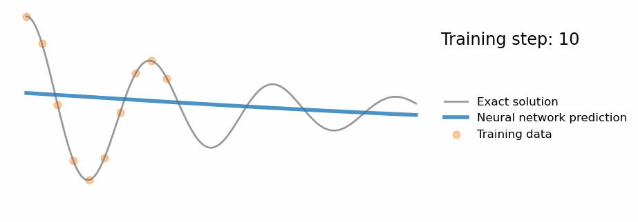
What is Machine Learning?
At its core, machine learning is about creating models that approximate functions by learning from data
Attribution: So, what is a physics-informed neural network? - Ben Moseley. https://benmoseley.blog/my-research/so-what-is-a-physics-informed-neural-network/
Notes:
So first – what is machine learning?
At it's core, machine learning is about creating models that approximate functions by learning from data. You have some ground truth function parameterised by your data's features, and a your machine learning system which takes those features and attempts to approximate that ground truth function. How that function approximation is done is what separates the different techniques from each other.
Here I show an animation taken from Ben Mosely's blog on physics informed neural networks, which demonstrates the wonders and pitfalls of this function approximation very nicely.
This is showing the predictions of a neural network as it learns to fit data taken from a ground truth function. The blue line is the output of the neural network, the grey line is the ground truth (which in reality is rarely known), and the yellow spots are the training data.
You can see that the training data covers only a part of the underlying ground truth function, and so the neural network learns to approximate only that section. We would say that this model generalises poorly.
To get a more general approximation more training data would be needed, or alternatively you could incorporate more information into the model by using a technique such as a physics informed neural network, where you incorporate physical constraints into your loss function.

Slide 4
What is Machine Learning?
Machine learning is a huge field encompassing many techniques
For applied sciences, we generally want to focus on control systems, diagnostics, and anomaly detection.
Lots of complex math under the hood
… but you don't need to understand the math to use it!
Notes:
Machine Learning is a huge field. I just showed an example using a simple neural network, but there's a great many more techniques from clustering to random forests. I'd likely need the full day to just summarise them all, and I've only got 20 minutes, so I'm afraid we'll have to skim!
Fortunately in the applied sciences, and particularly in accelerator work, we are primarily concerned with augmenting control systems, speeding up simulations, and preventing faults. As such we can somewhat narrow the field to a few major areas. For control systems: predictive models, for diagnostics: generative models, and for anomaly detection: auto-regressive models. These aren't small areas of research, each one could easily be the focus of a career, but at least we don't need to know everything.
On the topic of knowing everything, there's rather a lot of math under the hood of most of these systems – but thanks to the excellent frameworks that have been created you don't need to know most of it to use it!

Slide 5
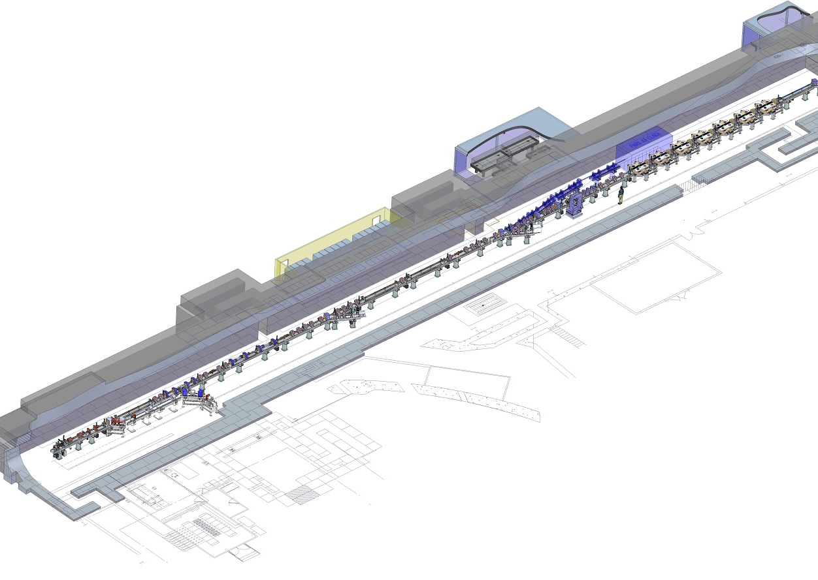
What is CLARA?
CLARA is a unique facility hosted at Daresbury Labatory and designed to provide a high-quality electron beams to test novel concepts and ideas in a wide range of disciplines and to function as a technology demonstrator
Notes:
I should probably let you know a little about CLARA. CLARA, the Compact Linear Accelerator for Research and Applications, is an advanced electron accelerator test facility hosted at Daresbury Labatory. It's currently operating at 10Hz at 50 MeV, with a nearly complete project to expand to 250 MeV at 100Hz and incorporate a high power laser system, beamline, and experimental area called FEBE. In addition to its primary goal of demonstrating novel accelerator technologies, it also provides high quality electron beams for user experiments from a wide range of disciplines.

Slide 6
Applications to CLARA
Virtual Diagnostics
RF Breakdown detection & prediction
Laser pulse shaping
Notes:
The team working on Machine Learning at Daresbury largely consists of me and David Dunning, with occasional collaborations from across the Cockroft Institute. However Machine Learning has been identified as one of ASTeC's key focuses, and discussions are underway to expand our team significantly.
I have only been doing this for a couple of years, but in that time I and others in the Cockroft Institute have researched and implemented a number of projects, which fall into three main categories: virtual diagnostics, RF anomaly detection, and laser pulse shaping
We've presented a number papers on these projects at various conferences, and I'll be giving a brief overview of each of them.

Slide 7
Publications
Maheshwari, Minerva, et al. "Prediction and Clustering of Longitudinal Phase Space Images and Machine Parameters Using Neural Networks and K-Means Algorithm." Proc. IPAC’21 (2021): 3417-3420.
Wolfenden, J et al. “Broadband Imaging of Coherent Radiation as a Single-Shot Bunch Length Monitor with Femtosecond Resolution”, Proc. IPAC’21 (2021): 2673-5490.
Pollard, A. E., D. J. Dunning, and M. Maheshwari. "Learning to Lase: Machine Learning Prediction of FEL Beam Properties." Proc. ICALEPCS'21 (2021).
Pollard, A. E., A. J. Gilfellon, and D. J. Dunning. "Machine Learning for RF Breakdown Detection at CLARA." Proc. ICALEPCS'21 (2021).
Pollard, A. E., et al. "Machine Learning Approach to Temporal Pulse Shaping for the Photoinjector Laser at CLARA." Proc. IPAC'22 (2022)
Dunning, D.J et al. “Machine Learning Developments for CLARA” Proc. FEL’22 (2022).
Wolfenden, J et al. “Application of Virtual Diagnostics in the FEBE CLARA User Area” Proc. LINAC’22 (2022).
Wolski, A et al. “Transverse phase space tomography in the CLARA accelerator test facility using image compression and machine learning” https://doi.org/10.48550/arXiv.2209.00814 (submitted to PRAB) (2022).
Pollard, A. E., et al. "Machine Learning for Laser Pulse Shaping" Proc. IPAC'23 (2023)
Notes:
These are the publications I'll be covering, for ease of reading when the slides are sent out.

Slide 8

Virtual Diagnostics
Notes:
Let's begin with virtual diagnostics. Virtual diagnostics as a field is focused on allowing us to observe those properties of the accelerator which are usually hidden, either because measuring them is destructive, requires specialised hardware, or is extremely difficult to measure directly. Essentially the idea is that a machine learning system takes some signal that is gathered parasitically, be that the machine parameters entered by the operator or the signals from a sensor, and uses it to predict something that is normally unobservable, such as the phase space distribution of the bunch.

Slide 9
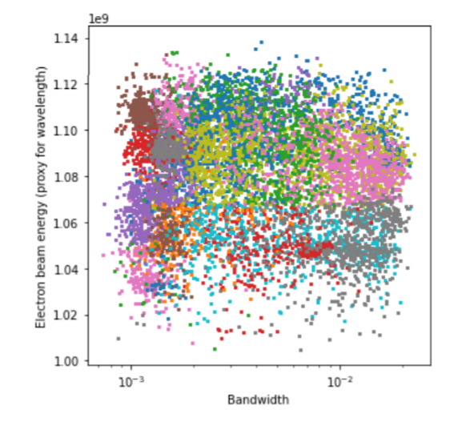
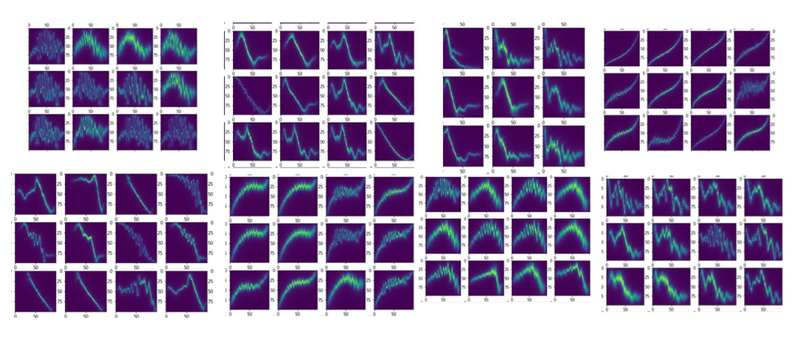
Prediction and Clustering of Longitudinal Phase Space Images and Machine Parameters Using Neural Networks and K-Means Algorithm
Clustering applied to a dataset of longitudinal phase space images presents an overview of potential operating conditions and can be linked back to the corresponding machine parameters
Maheshwari, Minerva, et al. "Prediction and Clustering of Longitudinal Phase Space Images and Machine Parameters Using Neural Networks and K-Means Algorithm." Proc. IPAC’21 (2021): 3417-3420.
Notes:
In one of ASTeC's earliest works on machine learning, a year-in-industry student, Minerva, presented this paper at IPAC 21. The paper explored clustering of longitudinal phase space images to predict machine parameters, and the reverse, predicting longitudinal phase space graphs from machine parameters. You can see here some of the LPS graphs organised by the cluster they're in, and on the right there, how those clusters align with measurables for an FEL, in this case electron beam energy.
Such a model allows an operator to target a specific phase space distribution by predicting control parameters that would achieve similar phase space distributions, or even potentially use the difference between the predicted and observed values to find sources of drift in the accelerator. This work used a relatively simple technique, and achieved very strong results, and really speaks to the accessibility and power of basic machine learning. All that was used here was a series of simulation codes to generate the longitudinal phase space graphs, and a simple clustering algorithm to predict machine parameters.

Slide 10
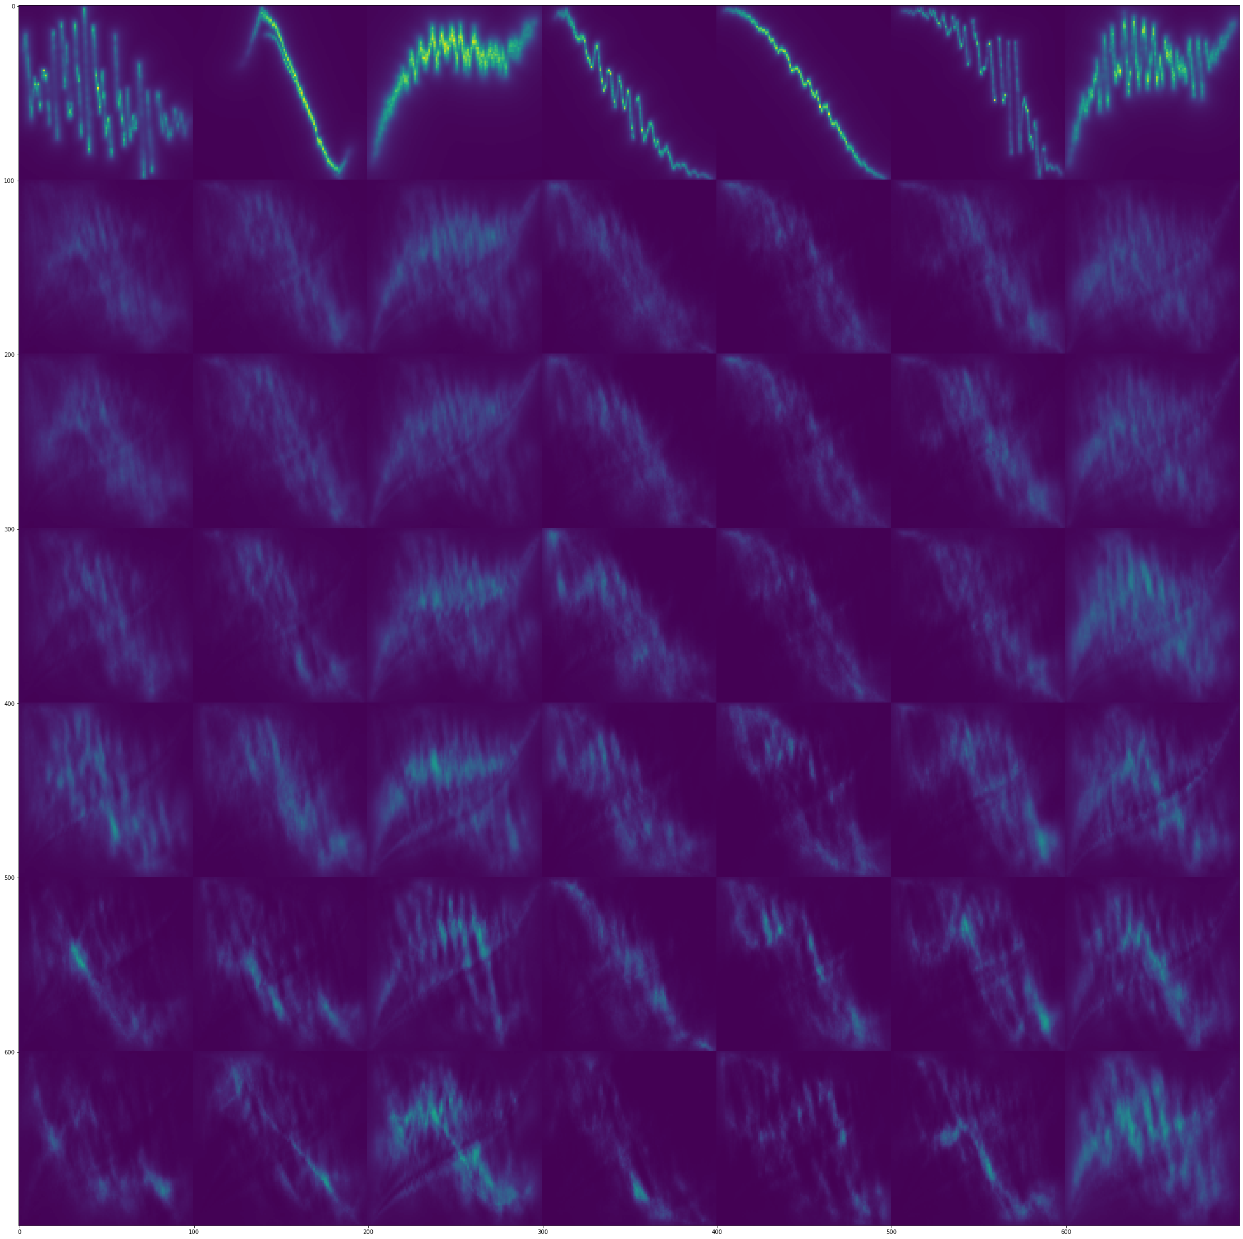
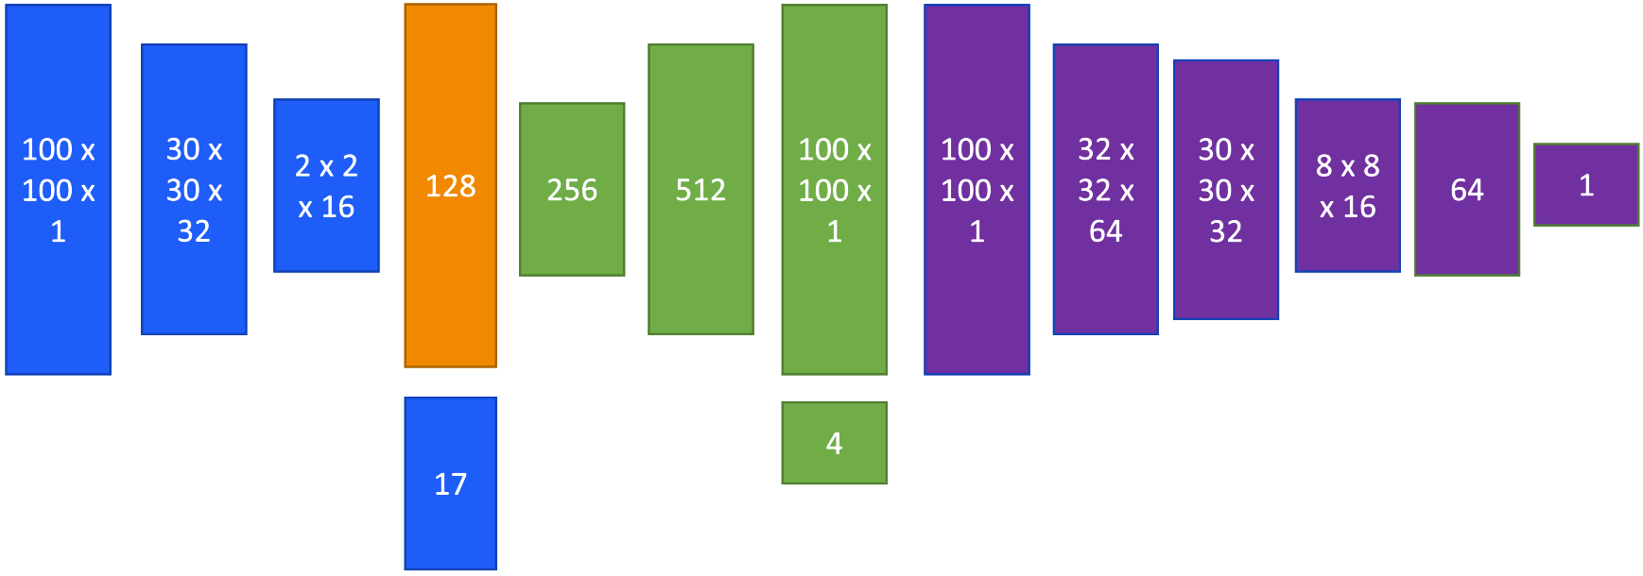
Learning to Lase: Machine Learning Prediction of FEL Beam Properties
Pollard, A. E., D. J. Dunning, and M. Maheshwari. "Learning to Lase: Machine Learning Prediction of FEL Beam Properties." Proc. ICALEPCS'21 (2021).
DNN autoencoder model produces better images, but blurred
Adversarial training leads to the generation of images which are almost indistinguishable from simulation.
Ground Truth
Encoder
Decoder
Prediction
Combining a conditional variational autoencoder with a generative adversarial network to build a CVAE-GAN by affixing a discriminator to a CVAE model and training the model adversarially.
Image © STFC John Dawson
Discriminator
Notes:
Minerva's work did highlight some shortfalls of basic machine learning for predicting the LPS graphs from machine parameters however, and so shortly after, we sought to improve the longitudinal phase space graph prediction to increase accuracy and detail in the resulting graphs. We approached this work using a complex neural network model called a CVAE-GAN, which is able to generate realistic, detailed, LPS graphs for a very wide range of possible accelerator configurations. This work was presented at ICALEPCS 21, a few months later.
By using a conditional variational autoencoder model, we were able to achieve some decent results that were a significant improvement over previous work but still lacked important details or contained artifacts as you can see from the images on the left.
You can see on the right here the network we developed to counter this issue. By combining the CVAE with a discriminator model which is trained solely on its ability to detect generated data versus real data, we significantly improved our results.

Slide 11
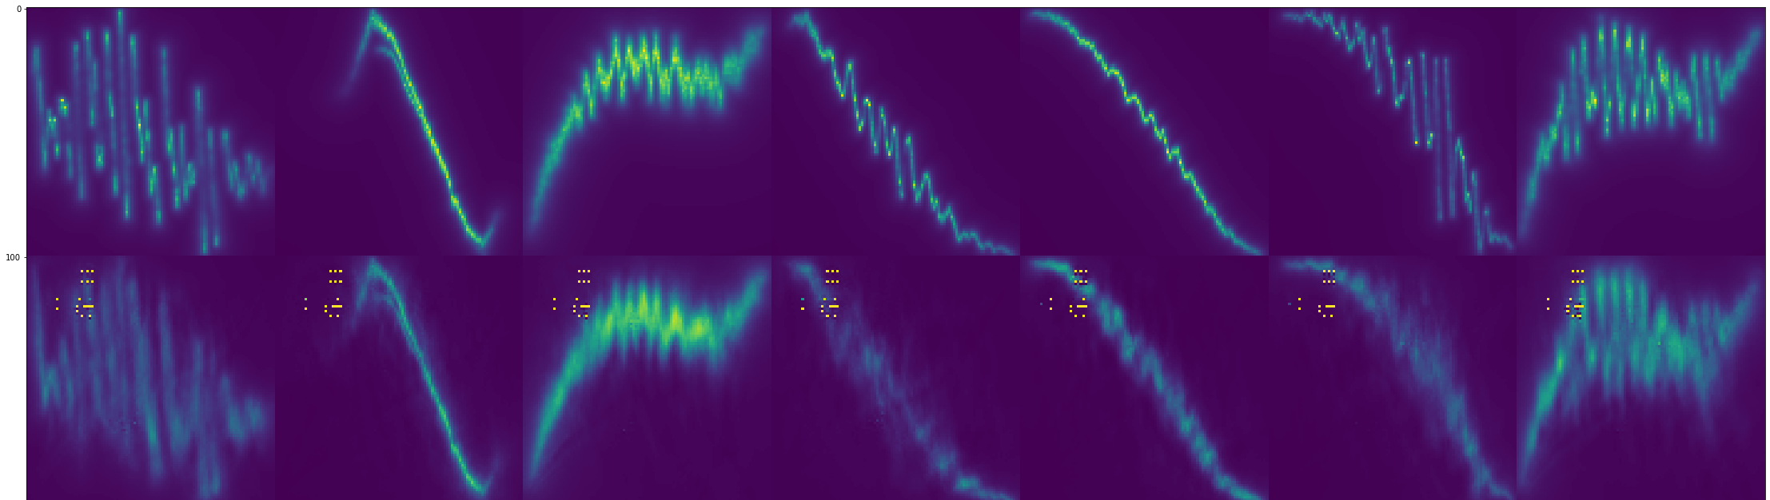
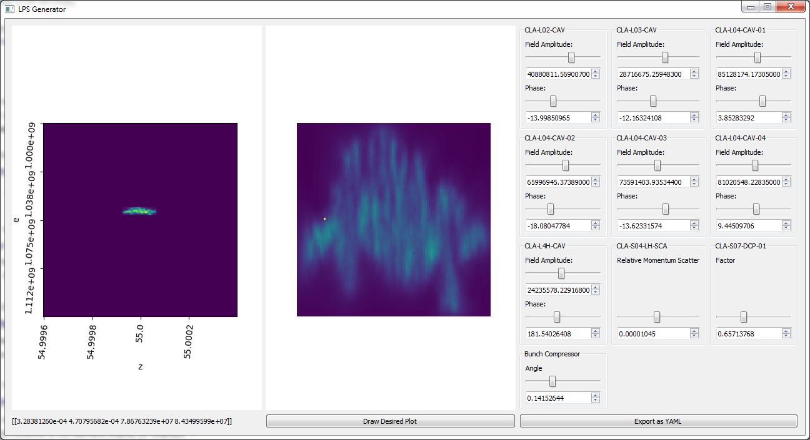
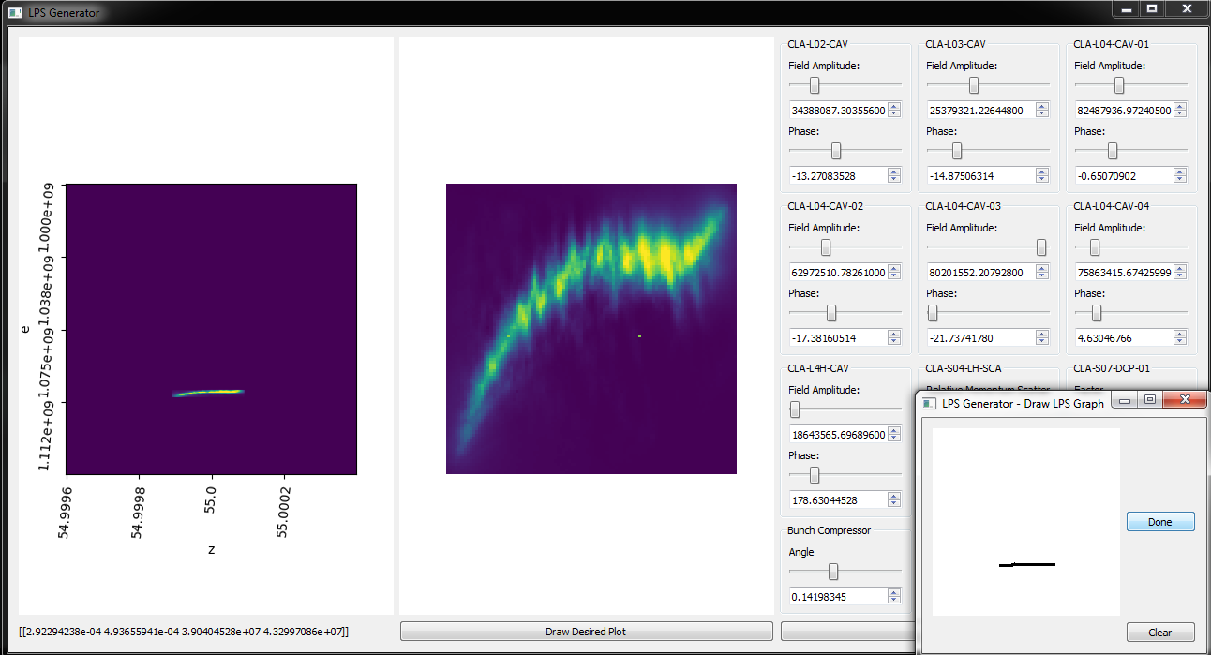
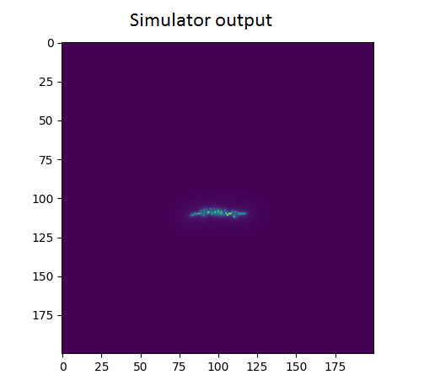
Results
Ground Truth
Real time generation of LPS graphs matching simulation. Milliseconds instead of minutes!
Prediction
Operators can draw their desired graph and get the parameters which closely match it within seconds.
Image © STFC John Dawson
Notes:
And here, you see those improved results. In the top right, you see a pair of rows – the ground truth row is made of samples from the dataset, LPS graphs generated by the ASTRA/ELegant simulation. The prediction row is the output of the neural network I just described, after being fed the same accelerator parameters as Elegant. In particular, note the high quality on the fine structure details, which are an almost perfect match to simulation. Each of these images took about 2 millliseconds to generate on a low power PC, while the simulator took approximately 2 minutes to achieve the same.
Because we can now generate these graphs in milliseconds, we can do things like putting the model in a nice graphical interface with slide bars, and drag those slide bars around to see how each parameter effects the output, allowing us to observe the longitudinal phase space of a beam in realtime as we vary parameters.

Slide 12
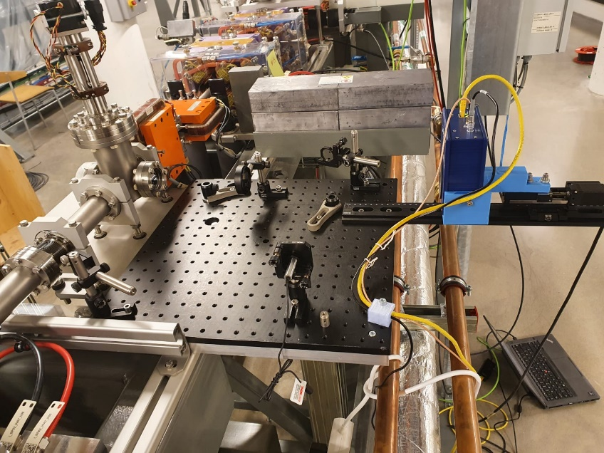
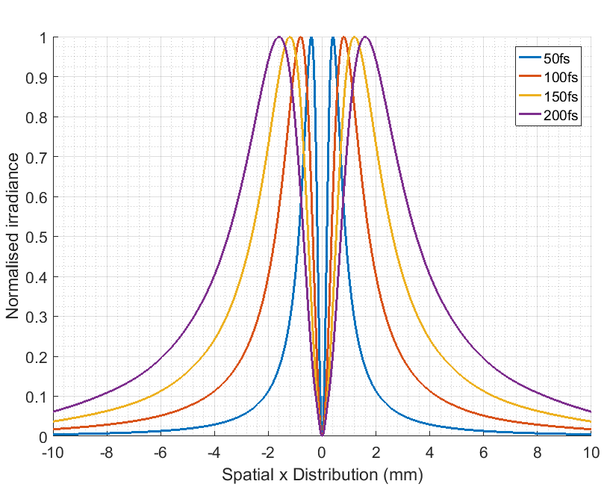
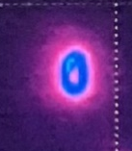
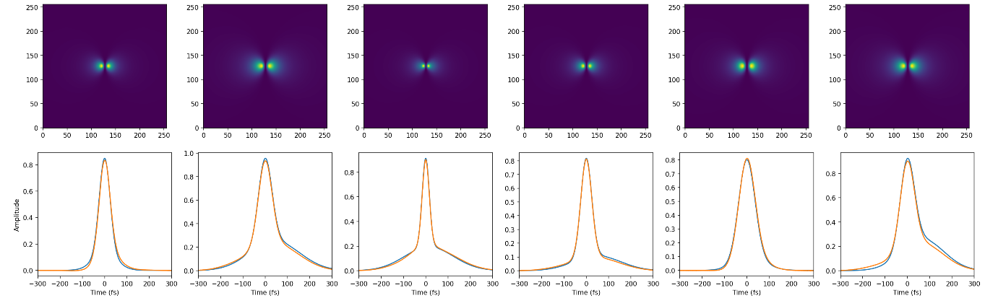
LPS extraction from CTR images @ MAX IV
Wolfenden, J et al. “Broadband Imaging of Coherent Radiation as a Single-Shot Bunch Length Monitor with Femtosecond Resolution”, Proc. IPAC’21 (2021): 2673-5490.
HRFZ Si Lens
Experiment
Standard analysis (σ only)
Blue – Truth
Orange - Prediction
Pyrocam
Notes:
For a diagnostic involving a more direct measurement, Joe Wolfenden has been working with MAX 4 on a Coherent Transition Radiation monitor and combining this with a machine learning approach to extract the temporal bunch profile.
Using a technique previously used for parasitic bunch length monitoring and augmenting it with a machine learning approach enables the extraction of the temporal bunch profile.
To train the system, he generated 100k examples from simulations of a double-Gaussian distribution, with six parameters randomised within a range which could be expected from the MAX 4 SPF. A simulated CTR image was then generated for each.
The ML model converts a 1D line profile of the CTR simulated images, to the six double-Gaussian variables, enabling prediction of the temporal bunch profile from the transition radiation monitor.

Slide 13
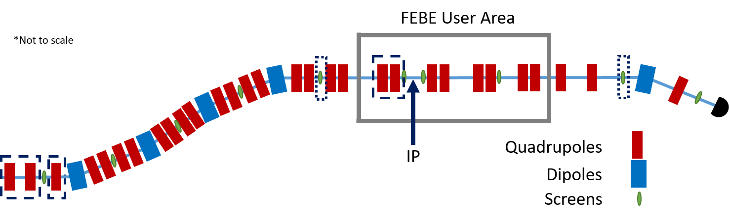
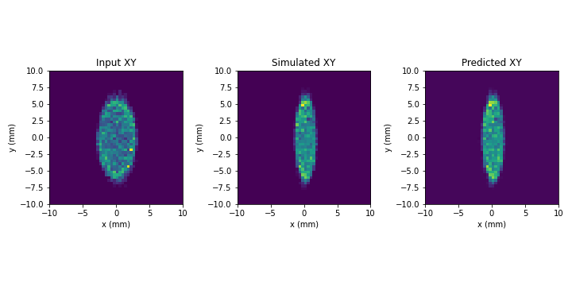
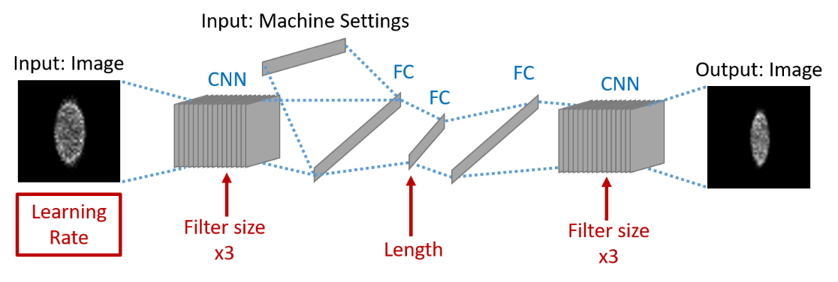
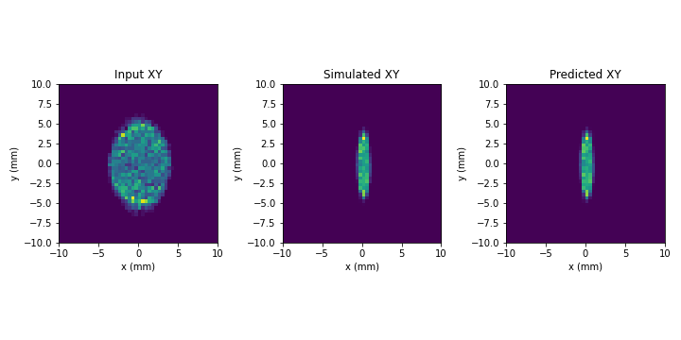
IP beam size virtual diagnostic @ FEBE CLARA
Wolfenden, J et al. “Application of Virtual Diagnostics in the FEBE CLARA User Area” Proc. LINAC’22 (2022).
FEBE CLARA IP – Screens/Quads used in study indicated
CNN/VAE architecture – red items optimised via Hyperband
Example VD output
Pre-IP measurement
Experiments planned at FEBE CLARA and at the ARES linac (DESY)
Post-IP measurement
Notes:
Another one by Joe: With the intent to provide virtual screens for areas of the accelerator where it is inconvenient to have a real one, he presented this work at LINAC22 where a pre-interaction point screen was used in combination with machine parameters to predict a post-interaction point screen that could, in theory, be entirely virtual.
By using a conditional variational auto encoder parameterised by the quadrupole strengths between the observation point and the prediction point, the model estimates how the beam will be affected by the magnets.
This work was again demonstrated on simulation data, but experiments are already planned for when FEBE comes online.

Slide 14
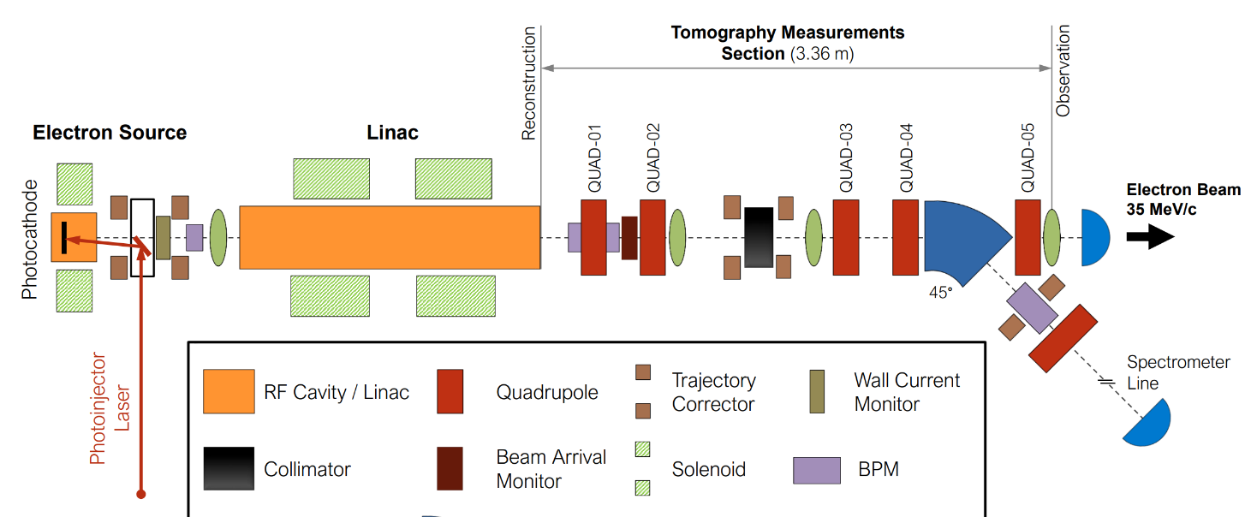
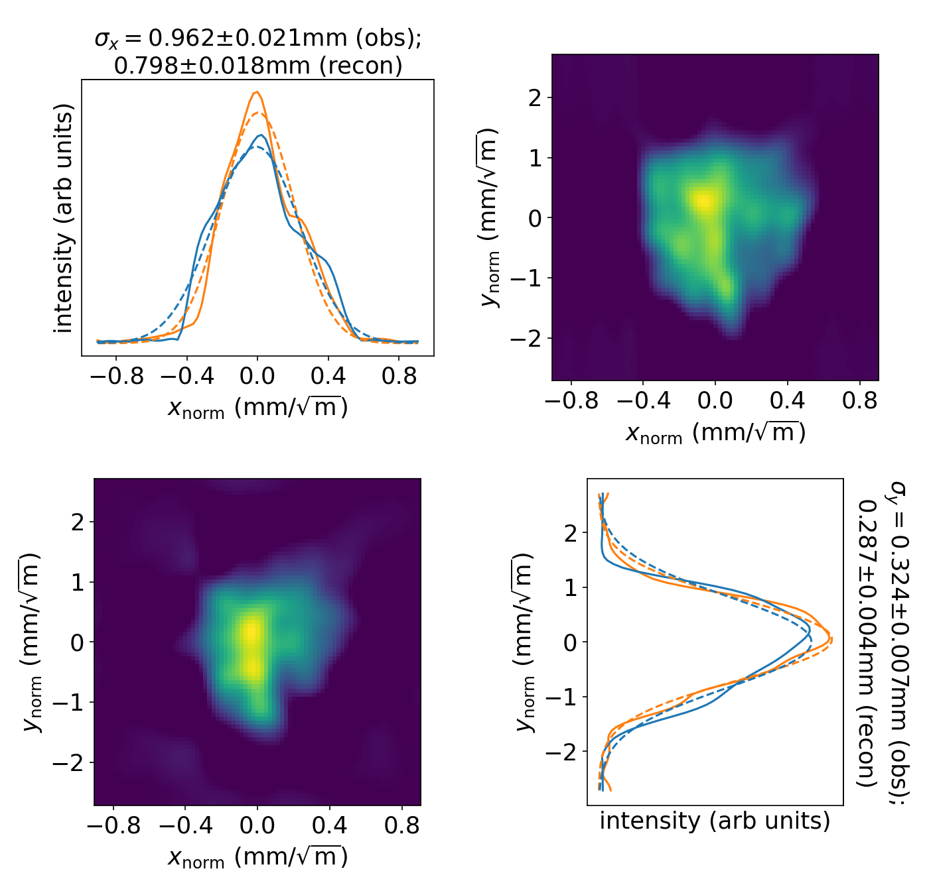
4D transverse phase space tomography on CLARA
Wolski, A et al. “Transverse phase space tomography in the CLARA accelerator test facility using image compression and machine learning” https://doi.org/10.48550/arXiv.2209.00814 (submitted to PRAB) (2022).​
The aim is to reconstruct 4D transverse phase space distribution from quad scan images.
Previous studies have demonstrated use of 4D phase space tomography using a “conventional” algorithm (ART)…
  https://doi.org/10.1103/
  PhysRevAccelBeams.23.032804
…but data processing is slow, computationally demanding, and results are prone to artefacts.
Recent studies investigate application of Machine Learning, with tomographic reconstruction performed using a neural network trained on simulated data.
reconstruction
point
observation
point
Top: 4D phase space at end of linac constructed from beam images at observation point for different quad strengths.
Right: Results validated by transporting phase space to the observation point, and projecting onto the x-y plane.
Andy Wolski et al.
Notes:
Andy Wolski recently presented work on predicting 4D transverse phase space from observations collected from quadrapole scanning.
A dataset was created with 3000 4D phase space distributions generated by superposing multiple 4D Gaussian distributions with random variations in position, shape and intensity. For each, sinograms are obtained by transforming the distribution using phase space rotations (corresponding to the 32 steps in a quadrupole scan), and then projecting the distribution onto the x–y plane at each step.
A deep neural net model then learns the relationship from sinogram to 4D phase space. Thus we can quickly and efficiently predict the 4D phase space tomography without significant compute time of the algorithmic approach.
(4d transverse phase space: x, y, x', y' (transverse dimensions and their rate of change, for immediate emmission and delta of emission)

Slide 15
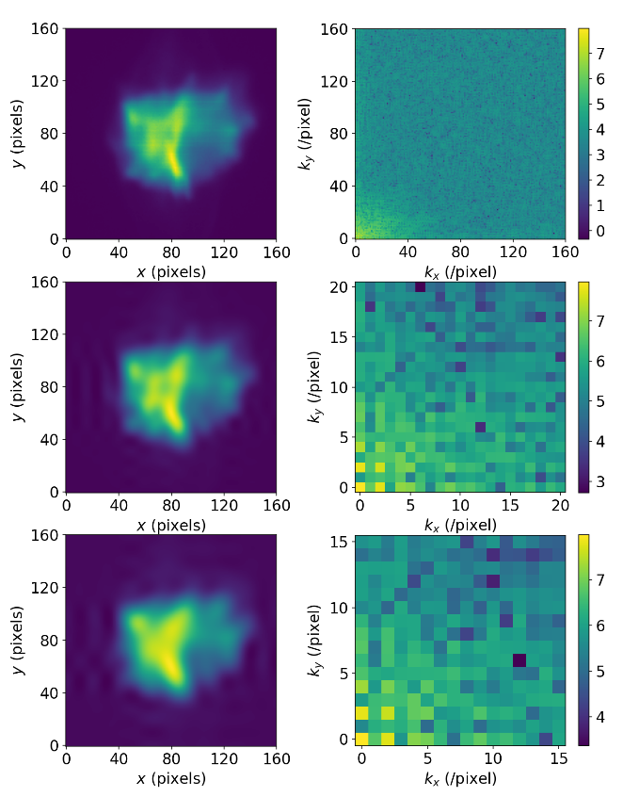
4D transverse phase space tomography on CLARA
Size of neural network reduced through use of image compression (using discrete cosine transforms).
Use of image compression would be very difficult with conventional tomography algorithms.
Decompressed Image
DCT
Collect quad scan images (32 steps)
Compress images using DCT
Provide compressed image as input to (trained) neural network
Compressed 4D phase space produced as output
Decompress 4D phase space using IDCT
Andy Wolski et al.
Notes:
And this is just a quick overview of how that's done

Slide 16
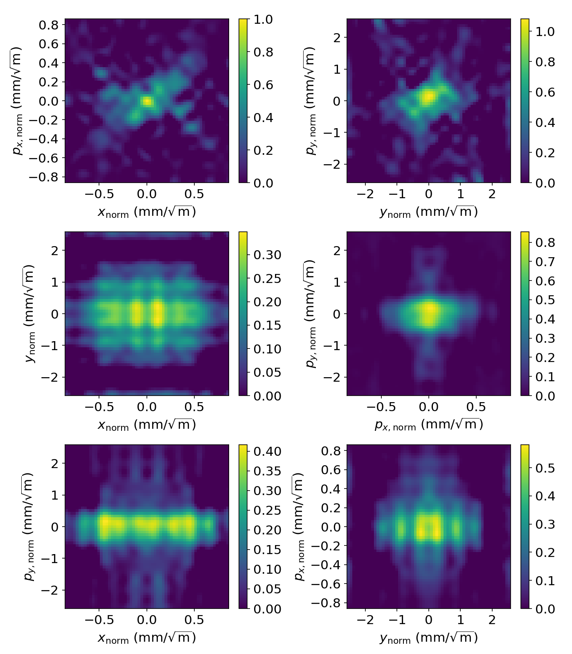
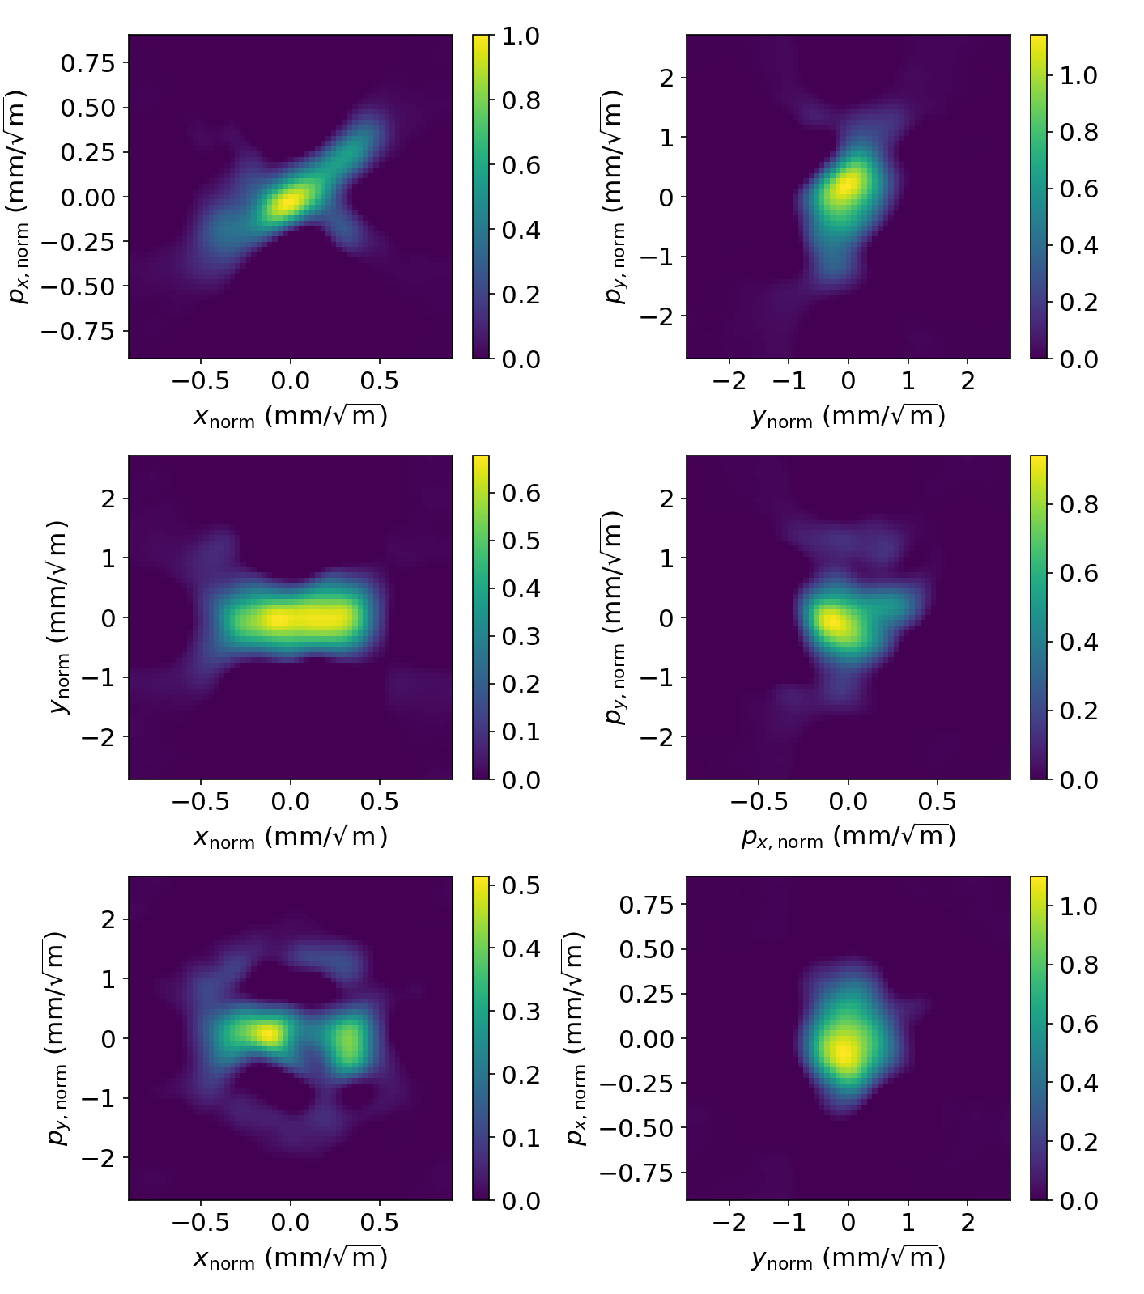
4D tomography: results for 100 pC bunch charge
Algebraic reconstruction tomography
Machine learning
https://doi.org/10.48550/arXiv.2209.00814 (submitted to PRAB)
Andy Wolski et al.
Notes:
You can see here how this approach performs in comparison to an algebraic reconstruction method, with the ML model producing significantly fewer artifacts and doing so much faster.

Slide 17

Anomaly Detection
Notes:
Anomaly detection – We haven't done much in the way of this at CLARA, but as you might imagine, detecting deviations from normal behaviour before they become a problem can have significant benefits. Machine learning is particularly well suited for this task.

Slide 18
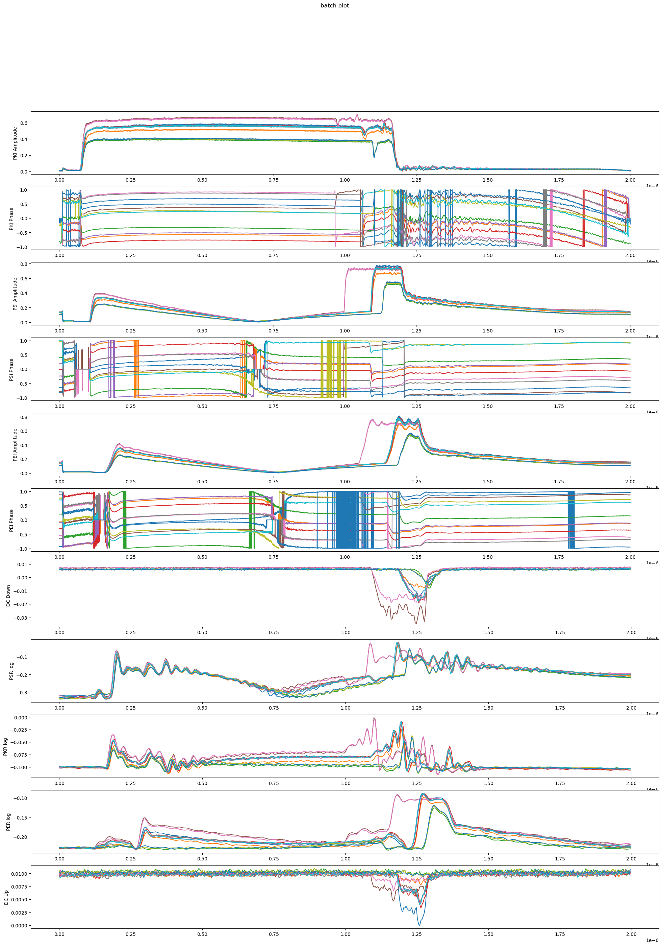
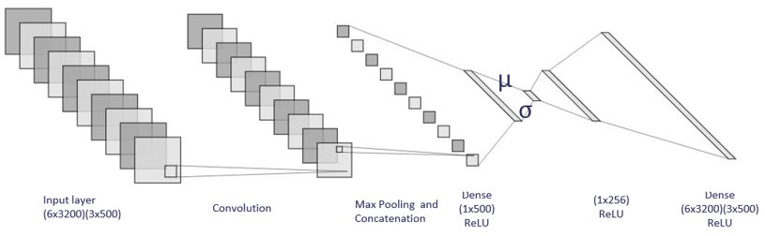
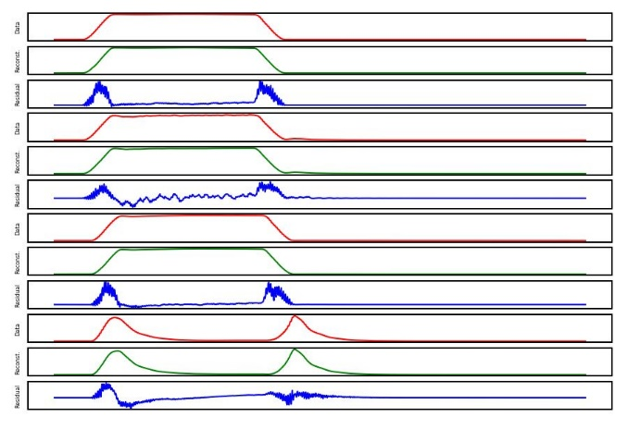
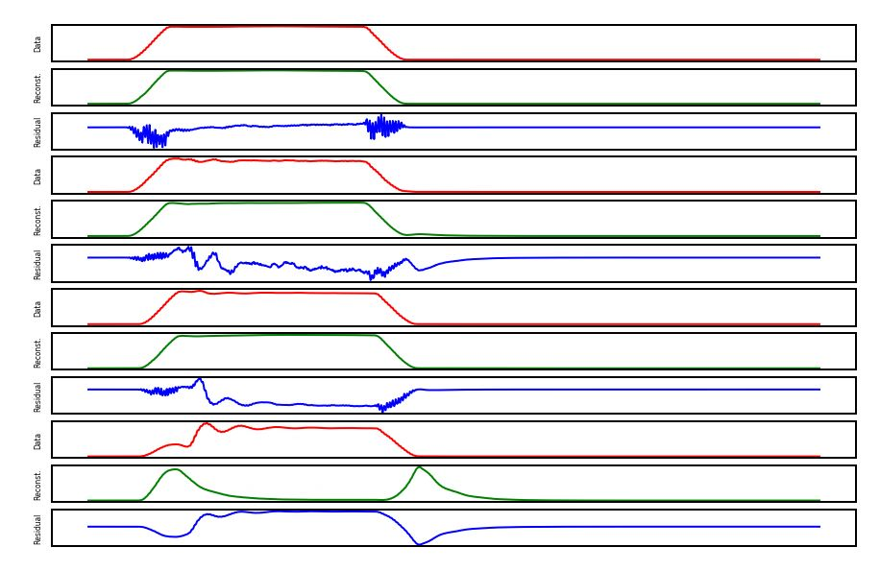
Machine Learning for RF Breakdown Detection at CLARA
Pollard, A. E., A. J. Gilfellon, and D. J. Dunning. "Machine Learning for RF Breakdown Detection at CLARA." Proc. ICALEPCS'21 (2021).
RF cavities experience occasional breakdowns which damage equipment and cause loss of beam time.
Detection and prediction of breakdown events is therefore critical.
Data – Reconstruction = Residual
We have recorded phase and amplitude traces from multiple points in the RF system, and seek to apply machine learning to detect, and hopefully predict, breakdowns.
Image © STFC John Dawson
Healthy Pulse
Breakdown Pulse
Notes:
This work was a collaboration with Tony Gilfellon and SciML on developing a better breakdown detection system using machine learning, with an eye to solving breakdown prediction.
RF systems are prone to occasional EM breakdowns which damage equipment, slow down conditioning, (and are generally to be avoided). The current method for detecting when this has happened is done by masking, and so performs poorly when the RF waveforms are changing for legitimate reasons, for example during conditioning, and fails to capture minor breakdowns which fall under the detection threshold.
For this project, we had two datasets to work with – one for the CLARA 10Hz gun which was collected in-house parasitically, and another for the XBOX test stand at CERN, which was produced by PSI. The model was a simple autoencoder, trained exclusively on healthy non-breakdown signals, with a secondary deep neural network to examine the reconstruction and detect deviations from those healthy signals

Slide 19
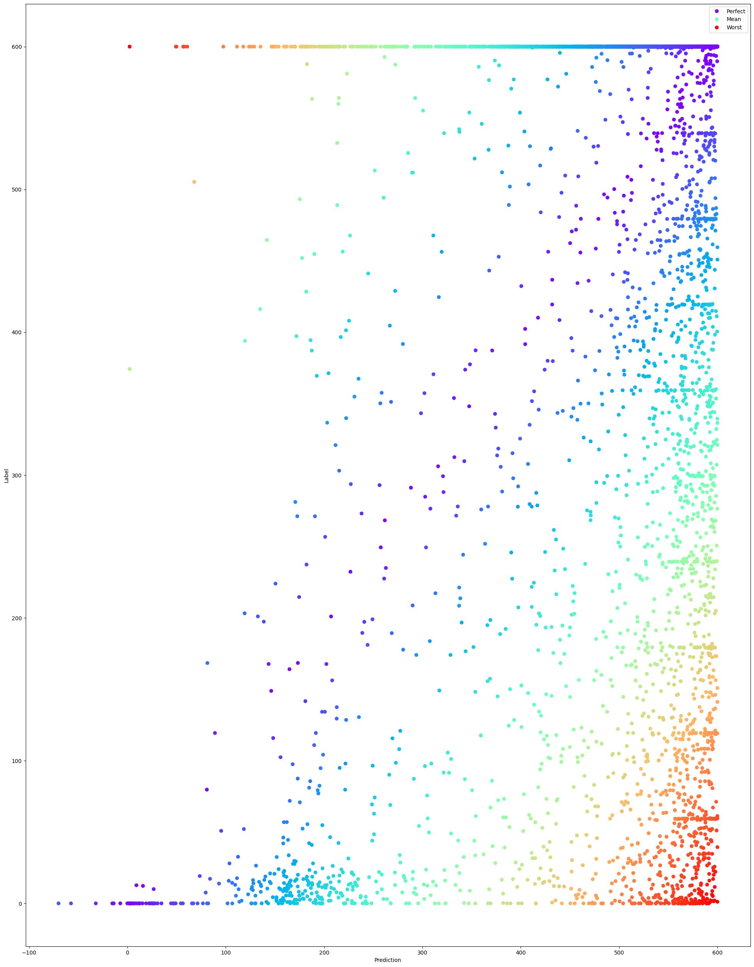
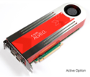
Results
Prediction
We achieve an almost perfect classifier demonstrated on both CLARA and CERN's XBOX2 test stand, with an exceptionally low false positive rate.
Training the network to instead predict time-until-breakdown resulted in overall poor accuracy. 73% prediction of time until breakdown within a 30 second window.
We believe this poor prediction performance is due to the low sampling frequency of the shot capture, and so have implemented a system to capture all shots for CLARA phase 2.
 | Positive | Negative
True | 95.8% | 98.0%
False | 4.2% | 2.0%
 | Positive | Negative
True | 97.9% | 99.6%
False | 2.1% | 0.4%
Time Until Breakdown
CLARA Breakdown Detection
CERN XBOX2 Breakdown Detection
Deployment
Work is currently ongoing to deploy this system to an FPGA for 400Hz operation in CLARA phase 2.
Predicted Time Until Breakdown
Notes:
As you can see, our results on detection are pretty great. Especially so when you factor in that approximately half of the false positives detected were actually true positives that were mislabeled. In fact, we are currently in the process of deploying this on an FPGA with the intent that it can run alongside the masking system in the CLARA phase 2 expansion. Unfortunately we're having some technical difficulties that are somewhat delaying the high-repetition rate deployment, but we have a working proof of concept at 10Hz. Hopefully, once it's proved, we can connect the ML system to our interlocks for better conditioning.
While we did achieve a 73% accuracy on predicting breakdowns within a 30 second window, we were not confident in the quality of those predictions. The graph in the bottom right is a scatter plot of predictions vs actual time until a shot results in a breakdown, and ideally that would be an x=y straight line, you can see that it's not. Our hypothesis was that too much information was lost by the low frequency of shot capture, where we captured only one shot per second.
In addition to the ML system deployment, we're also deploying another FPGA system which seeks to rectify that by recording every shot over a three month time window in order to establish a stronger dataset for this work.

Slide 20

Control Systems
Notes:
And finally we come to control systems. Here the idea is that we have some target that we want the machine to reach, and previously that meant operators using intuition and fiddling with the settings to get the desired output. With ML based control systems, we can instead simply tell the ML system what we want, and have it apply the settings required directly – vastly saving on operator time.

Slide 21
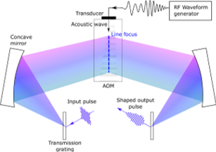
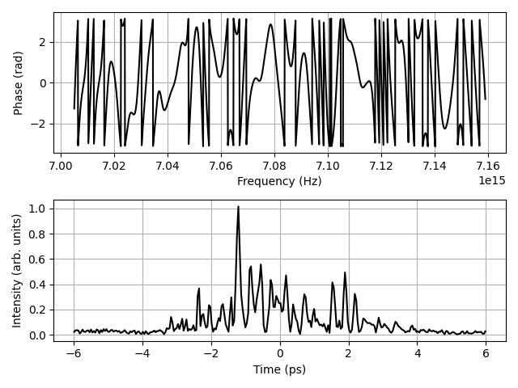
Temporal Laser Pulse Shaping
Pollard, A. E., et al. "Machine Learning for Laser Pulse Shaping" Proc. IPAC'23 (2023)
The shaping of the laser pulse affects the shaping of the electron bunches – another key parameter in FEL lasing
We can control the temporal intensity profile of the laser using an acousto-optic modulator.
The AOM receives a spectral phase profile and produces a corresponding temporal intensity profile.
A function exists to calculate temporal intensity profile from spectral phase, but not the other way around.
We applied machine learning to enable us to specify an arbitrary temporal intensity profile and generate a spectral phase profile which will generate it.
Notes:
Temporal Laser Pulse Shaping. This project is my major focus right now.
Currently, the only control an operator has over the electron bunch from the gun is the total charge. With this project, we sought to change that and enable highly customisable bunch profiles by modulating the temporal intensity profile of the photinjector laser. We can use an acousto-optic modulator for this purpose, however the algorithms to control these are either slow or inaccurate. We saw an opportunity to apply machine learning to fix this deficiency.
An AOM manipulates the pulse shape by splitting the incoming laser pulse into its component frequencies, which we can then phase shift with a signal to a transducer attached to an optical crystal, and recombine to form our final pulse. On the top right here you can see an overview diagram of the AOM, and below that, an example of a spectral phase profile with the corresponding temporal intensity profile shown below. This problem is quite ideal for machine learning because calculating the temporal intensity profile from the spectral phase profile is trivial, but the reverse is ill-posed. ML excels at problems like this.

Slide 22
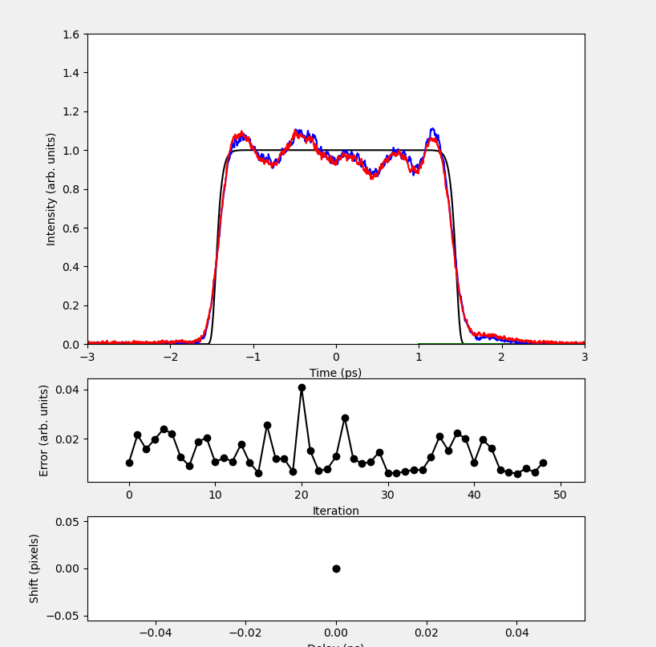
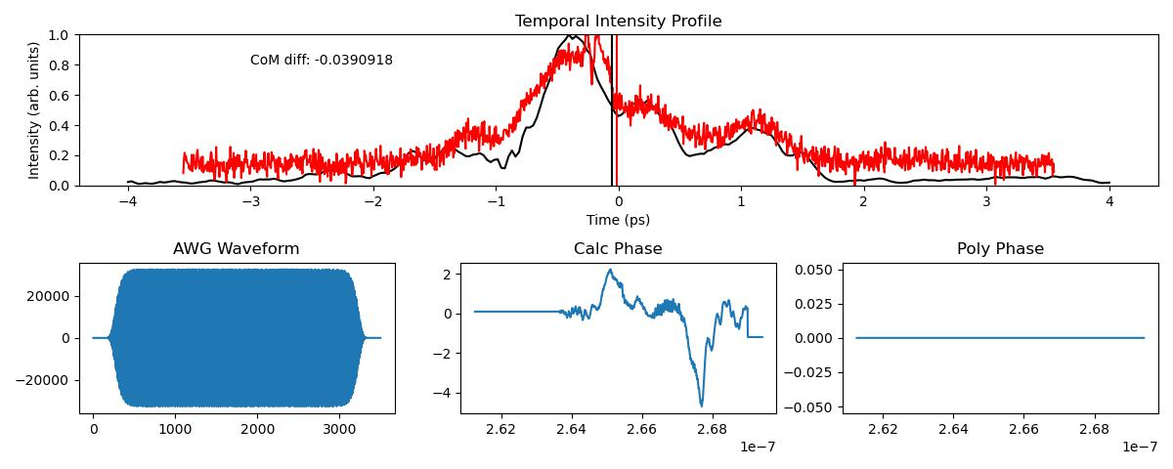
Temporal Laser Pulse Shaping
Using a physically informed neural network, we achieve physically realisable configurations with strong matching in milliseconds.
Deployment is underway, and nearly ready for user-facing work. We can ask for and receive arbitrary temporal intensity profiles within a 10th of a second.
Notes:
We implemented our control solution using a physically informed neural network model, which is a little complex to cover here, so I encourage you to take a look at the papers if you're interested in the finer details. However, the main takeaway is that this model incorporates the physical limits of the AOM and so provides shaping signals which are instantly applicable to the shaper, in contrast with previous methods which generally require many rounds of iteration to achieve results.
We are currently in the process of deploying this system, and we're quite far along with this. It is now possible for a user to specify an arbitrary temporal pulse profile for the PI laser and have it applied in a fraction of second.
Future work on this will involve tying the system in to a bunch shape monitor and having the ML system allow for the specification of arbitrary bunch shapes. I don't entirely understand all the implications of this, but the accelerator physics guys seem pretty excited about it.

Slide 23
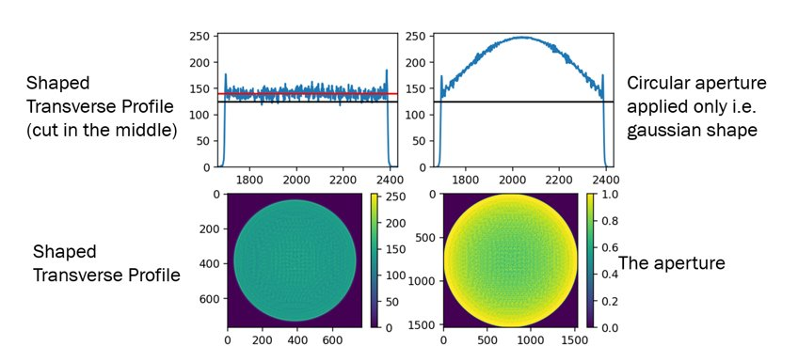
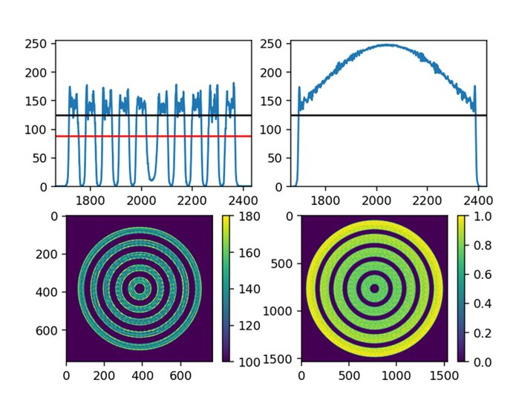
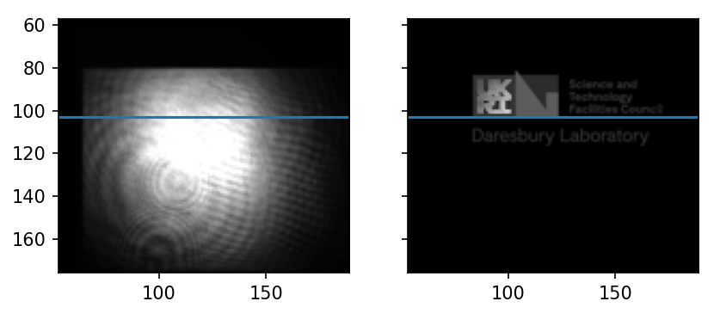
Transverse Laser Pulse Shaping
Using a DMD and a neural network control system to do transverse laser pulse shaping
Laser Pick-off
Shaped Laser Output
Notes:
As an addition to the longitudinal shaping, we also had a year-in-industry student, Ahmed Osman, who developed a machine learning system which interfaced with a digital mirror device to produce high quality 2D shaping and shading of the laser.
This system took as input the pick-off of the laser and the target pattern and produced a contol pattern for the DMD which smoothed out noise, corrected for laser breathing, and minimised artifacts from edge interference.
Once deployment is complete and combined with the temporal shaping, this gives CLARA a rather unique ability to have almost full 3D control of the photo-injector laser at femto-second scales. I say almost because the DMD can only change at 30Khz, which means that we can only change the transvserse shape per-shot rather than during shots.

Slide 24
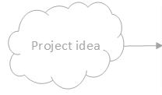
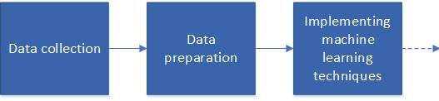
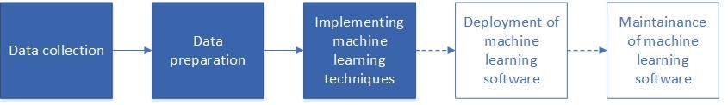
Future Works on CLARA
(in simulations, not always appropriate)
Magnet Hysterisis Prediction & Compensation
PI laser pulse shaping
Integrated model surrogate model
RF breakdown prediction
Integration of ML live RF breakdown classifier into NO-ARCv2 conditioning code
Longitudinal diagnostics for FEBE e.g. using CTR
PI laser pulse shaping -> electron bunch shaping
Broader RF fault detection/ correction system
Emittance measurement (tomography)
Electron diffraction artefact removal
Notes:
So to give a bit of perspective, we've got this lovely project timeline. As you can see, the laser pulse shaping is our most advanced project. It's practically ready for users.
RF breakdown detector is not far behind, along with Andy's tomography work.
We've got quite a few more projects lined up, and hopefully should be getting through most of those in a year or two, so look out for our papers on those!

Slide 25
Frequently Asked Questions
How do I get started?
How much data do I need?
How do I choose the right architecture?
Notes:
And finally, I'll cover a few frequently asked questions:
First – How do I get started? It depends on the problem you're trying to solve, but for a complete beginner I'd recommend following a TensorFlow tutorial on the MNIST numbers for a basic introduction to neural networks, and then perhaps encourage you to look into Bayesian Optimisation. These easy simple techniques will get you a long way qith very little investment!
Second – how much data do you need? Well there's no easy answer to this. I like to think of it in terms of information – how information dense is the underlying space – how many samples would it take to fully describe that space? As you saw on the first slide, distribution of the data is critically important as well.
Third – how do I choose the right architecture? Again I'm sorry to say there is no easy answer here either. In truth, once you've got your data and decided what you want to extract from it, the model you need to start with is the simplest one that meets those constraints. This won't give you your best results, but it does give you a strong starting off point. For me, model architecture tends to be the last thing I optimise.

Slide 26
Questions?
Thanks for listening!
Notes:
And that's all from me. I hope that's given you some thoughts on how these techniques could be applied to LhARA, and I'll take any questions you have!

