Slide 1
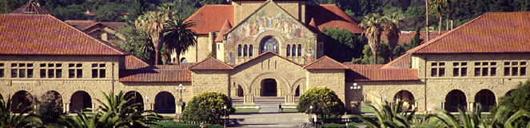

Hadron Therapy-UK
Stanford Oxford

Slide 2
  Objective: To Increase the Therapeutic Index of Radiotherapy
100
75
Tumor
Probability of Tumor Control
or Normal Tissue Damage (%)
Normal Tissue
50
25
0
A
B
C
Cumulative Dose
Hall and Giaccia, 2019

Slide 3
Hadron Therapy
Conventional radiation therapy
  = photons (x- or γ rays) + electrons
Hadron therapy = Particle radiation therapy (particles heavier than electrons)
  Protons
  Carbon ions
  Other ions (helium, neon, silicon, iron, etc)

Slide 4
There is a strong rationale for the clinical benefit of proton and carbon therapies, but current evidence is limited
Therapy
Rationale for clinical benefit
Proton
  Deliver a higher, targeted radiation dose with decreased toxicity to surrounding tissue compared with photon therapy, especially near critical structures
Carbon
  Further increase target tissue damage with decreased secondary tissue affected compared with protons
  Specific potential benefit with intractable radio-resistant tumors

Slide 5
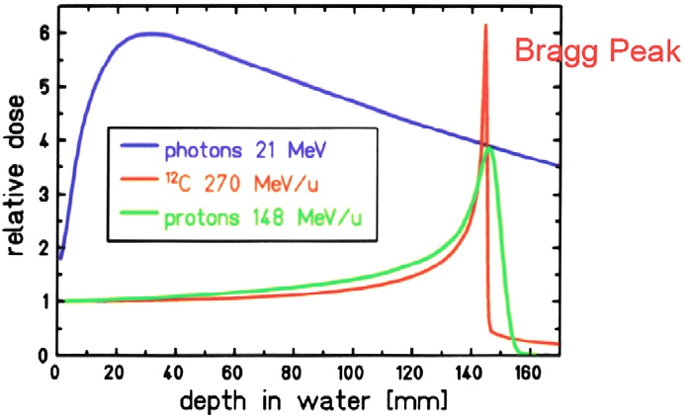

Dosimetry
Photons vs. Protons vs. Carbon

Slide 6
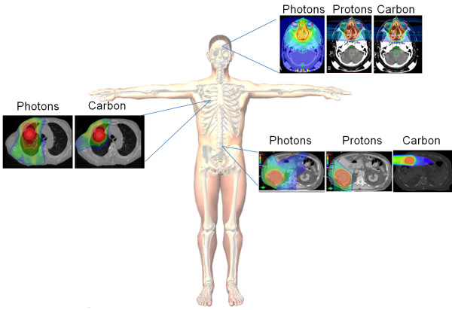
Superior Dose Distribution of Carbon Ions Compared to Protons and Photons

Slide 7
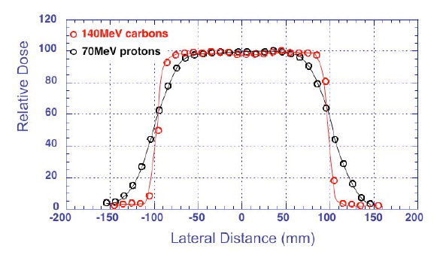
Carbon Ions Provide Highly Localized Tumor
Deposition of Dose (Sharper Transverse Edge)
Better Localization
  Tighter deposition in depth (Bragg peak is narrower)
  Transverse deposition is more narrowly collimated
  Less dose to the healthy tissue

Slide 8
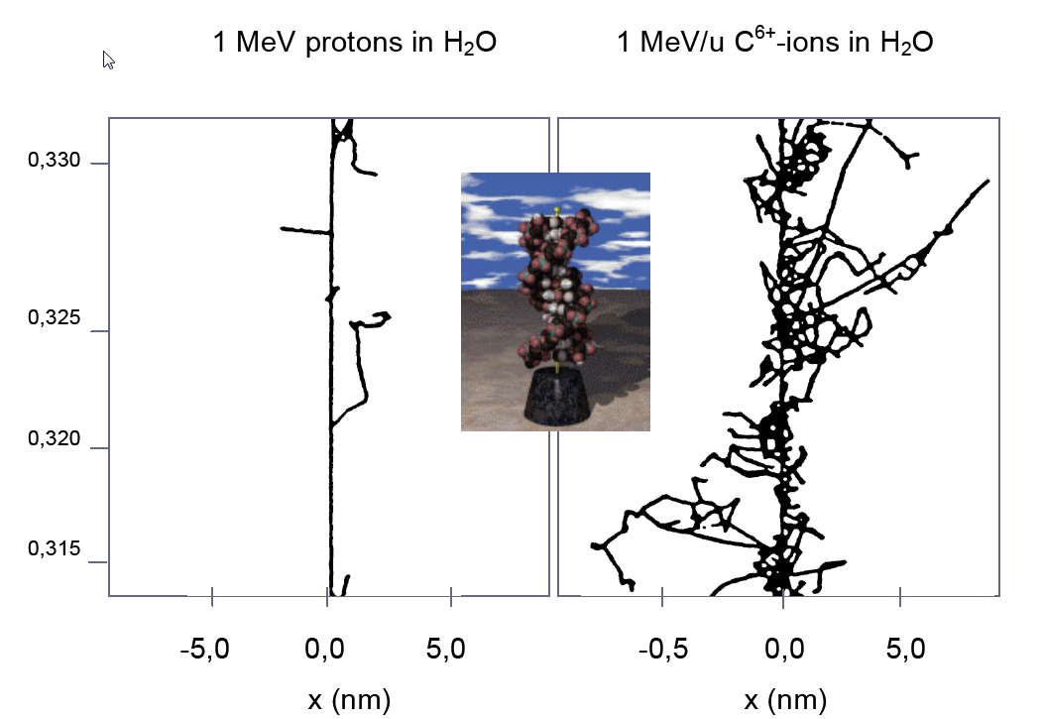
Carbon Ions Induce More Lethal Damage Per Unit Dose
than Photons or Protons
Increased Biological Effectiveness:
Relative Biological Effectiveness is 2-3 times protons
  Reduces # fractionations by ~ 2: greater patient throughput/compliance
  Countermands radio-resistance: non-repairable, double-strand breaks
Production of positrons permits active monitoring using PET

Slide 9
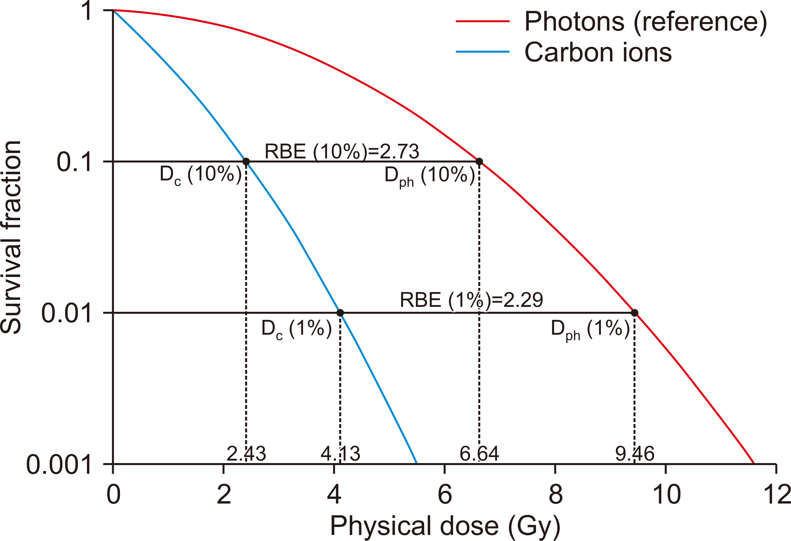
Cell Survival Based on the LQ model
Progress in Medical Physics 2020;31:1-7
Notes:
The photons and carbon ions are considered to be isoeffective when the survival fractions are identical. The ratio of isoeffective photon and ion dose is determined to be RBE. For instance, fixing the survival fraction to 10%, carbon ion RBE is 2.82 whereas fixing to 1%, respective RBE is 2.25. RBE, relative biological effectiveness; LQ, Linear Quadratic.

Slide 10
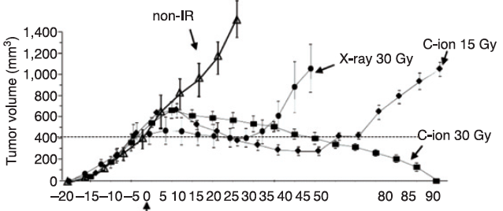
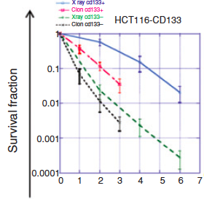
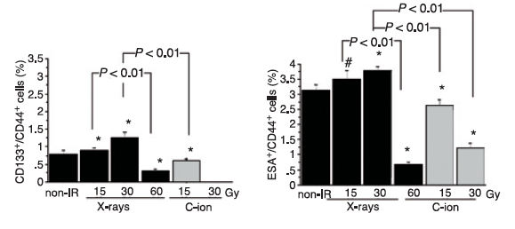
Carbon is More Effective In Killing Cancer Stem Cells
In vivo growth by beam type and dose
In vitro clonogenic survival
% putative CSC- like in vivo after RT
Cui X et al, Cancer Research 2011

Slide 11
  Objective: To Increase the Therapeutic Index of Radiotherapy
(Hadron Therapy)
100
75
Tumor
Probability of Tumor Control
or Normal Tissue Damage (%)
Normal Tissue
50
(Decreasing Lymphopenia)
(Hadron Therapy)
25
0
A
B
C
Cumulative Dose
Hall and Giaccia, 2019

Slide 12
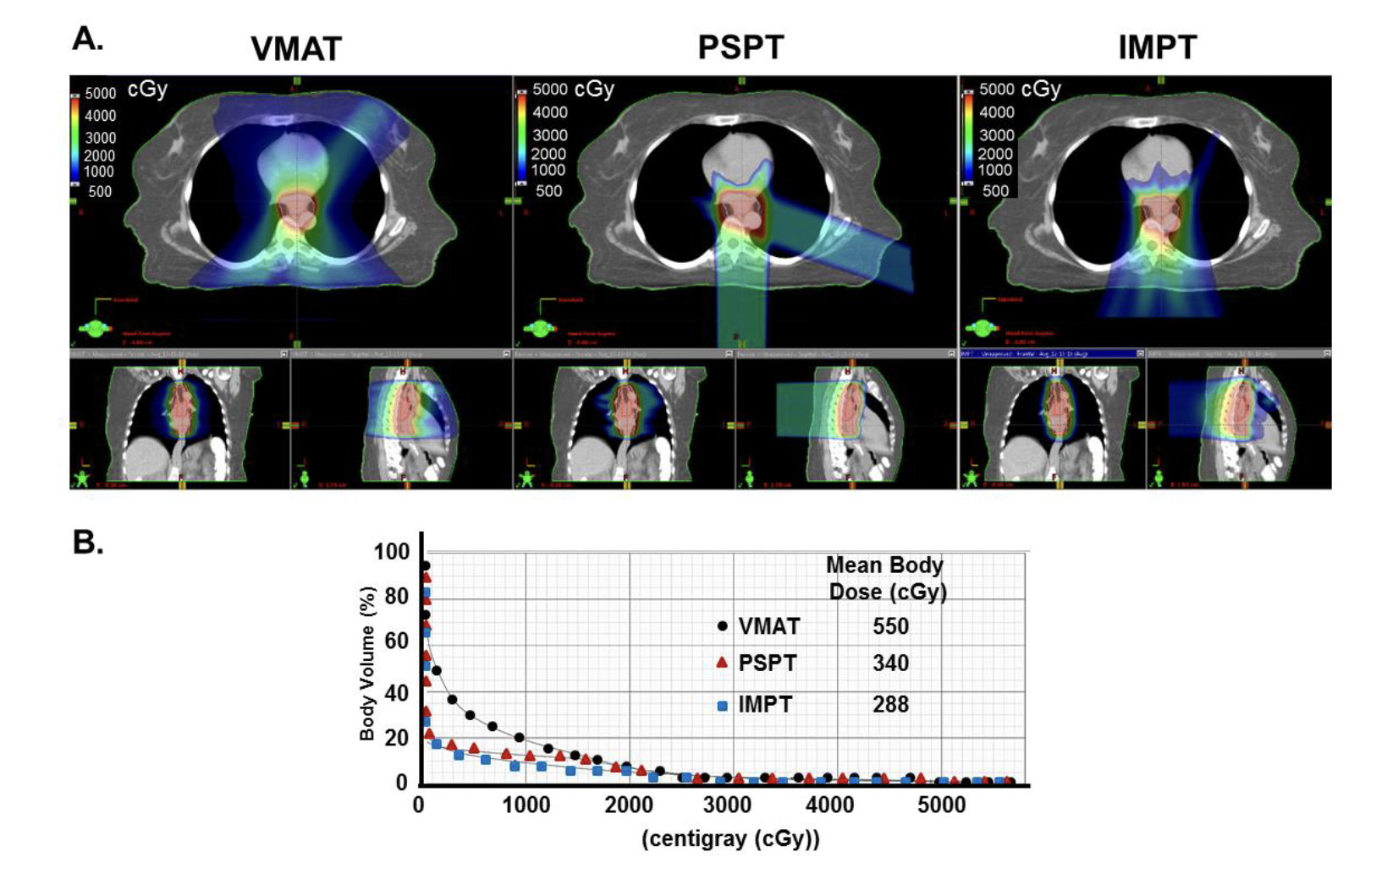
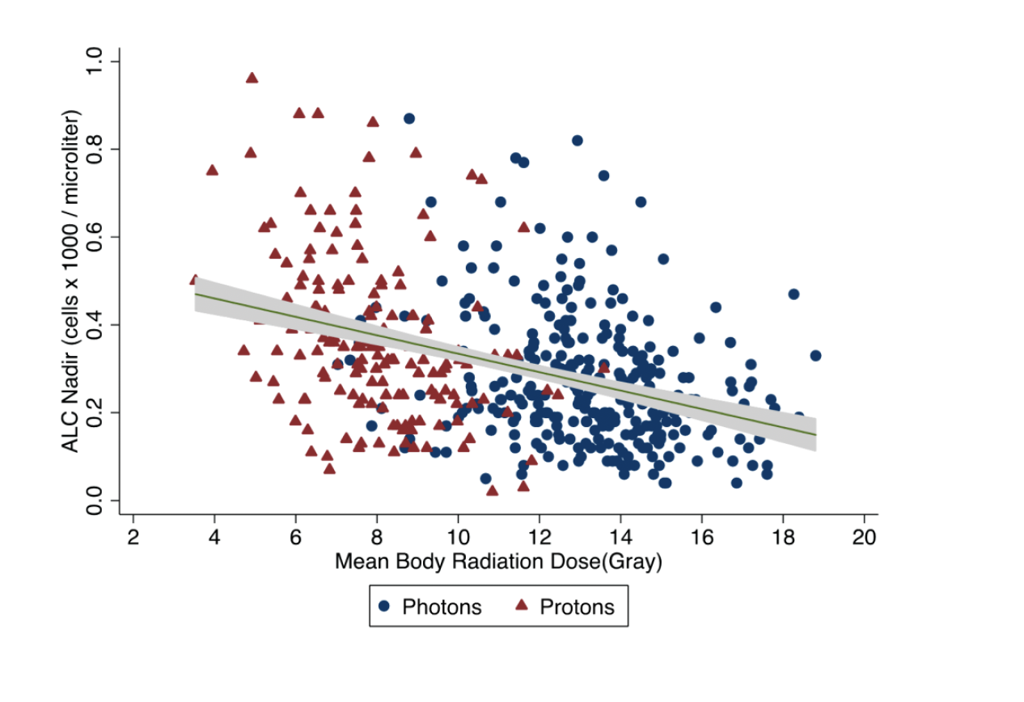
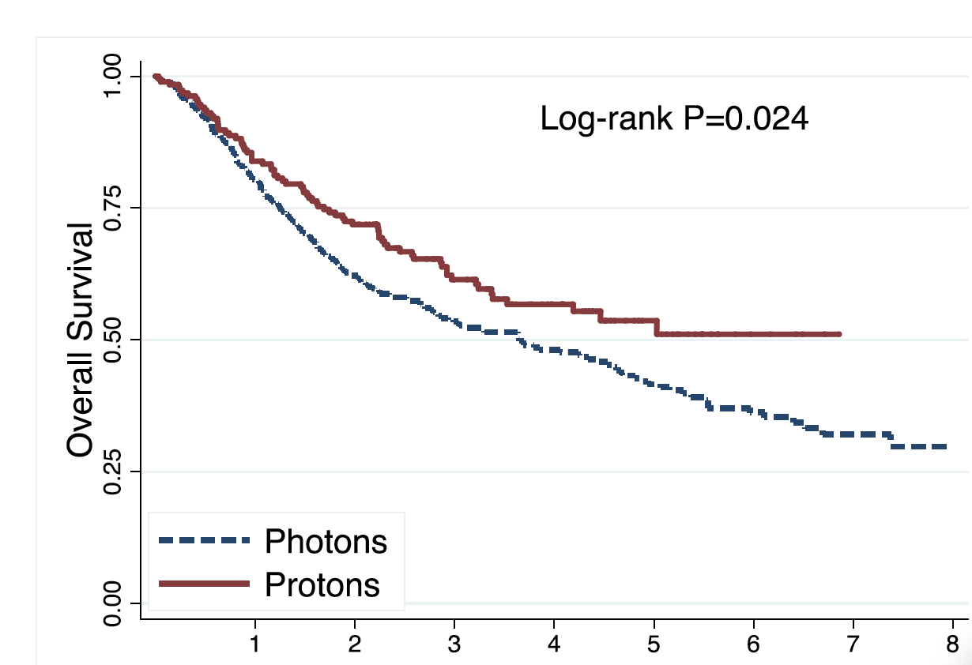
Effect of Different Therapies on Mean Body Dose and Survival
Davuluri et al, IJROBP, 2017

Slide 13
  Objective: To Increase the Therapeutic Index of Radiotherapy
100
(Hadron Therapy)
75
Tumor
Probability of Tumor Control
or Normal Tissue Damage (%)
Normal Tissue
50
(Decreasing Lymphopenia)
(Hadron Therapy)
(FLASH)
25
0
A
B
C
Cumulative Dose
Hall and Giaccia, 2019

Slide 14
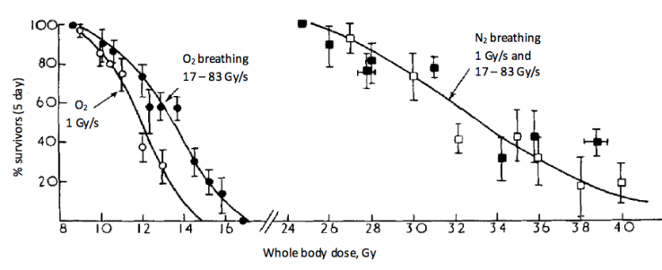
Hornsey S, Bewley DK. Hypoxia in mouse intestine induced by electron irradiation at high dose-rates. Int J Radiat Biol Relat Stud Phys Chem Med. 1971;19(5):479-483.
The Origins of FLASH Radiotherapy
Notes:
Fraction of mice surviving 5 days after whole-body irradiation delivered at different dose rates while animals breathing oxygen or nitrogen.

Slide 15
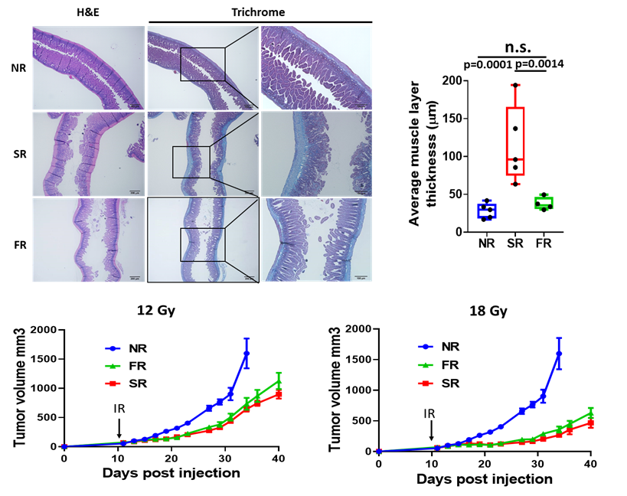
Flash-Proton Radiotherapy Highly Effective in Controlling Pancreatic Tumor Growth and Reduces Normal Tissue Toxicity
Koumenis et al, 2022

Slide 16
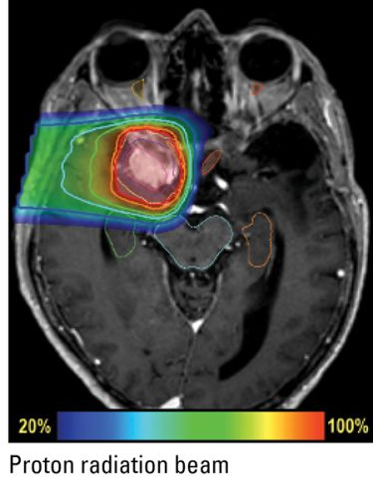
Treating Deep-Seated Tumours with Proton-FLASH
Problems/challenges:
    Scanning/scattering needed to cover the target volume
      Dose rate decreases!
    Several beam energies needed to cover the target volume in depth
      Dose rate decreases!
    Several beams needed for dose conformity
      Dose rate decreases!
      Takes time to change beam angle.

Slide 17
  Objective: To Increase the Therapeutic Index of Radiotherapy
(Overcoming Hypoxia)
(Hadron Therapy)
100
75
Tumor
Probability of Tumor Control
or Normal Tissue Damage (%)
Normal Tissue
50
(Decreasing Lymphopenia)
(Hadron Therapy)
(FLASH)
25
0
A
B
C
Cumulative Dose
Hall and Giaccia, 2019

Slide 18
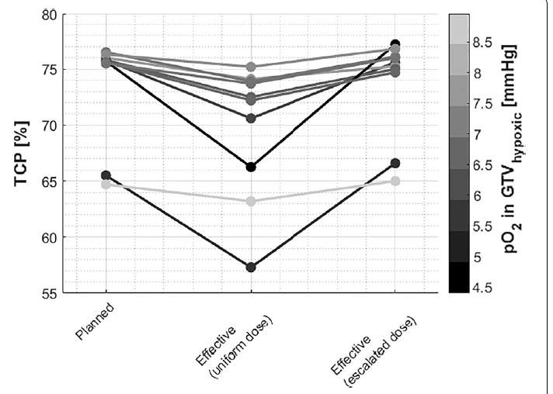
TCP for Individual Patients Treated
with Protons
Kothe et al, Radiat Oncol, 2021

Slide 19
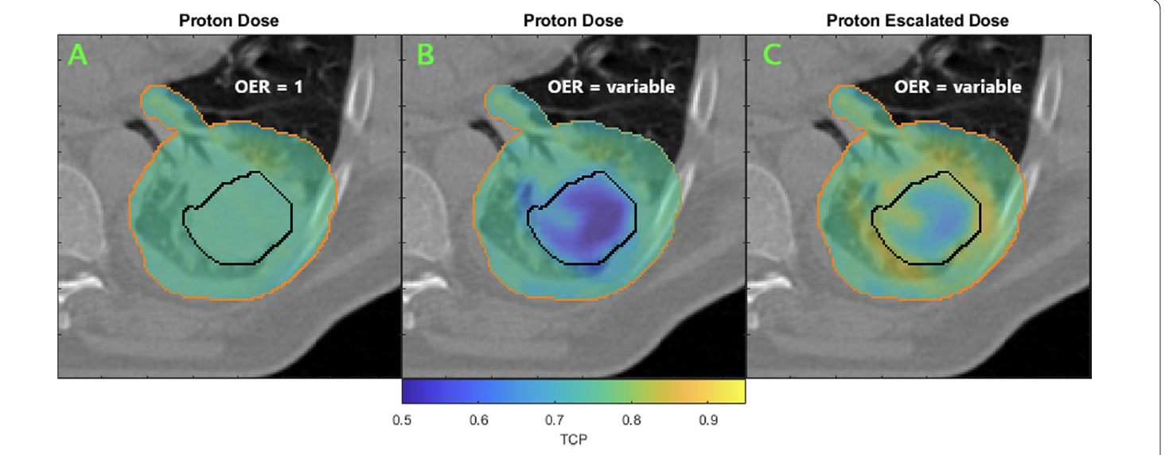
Voxel-wise TCP Calculation and Overcoming
Hypoxia with Proton Escalation
Kothe et al, Radiat Oncol, 2021

Slide 20
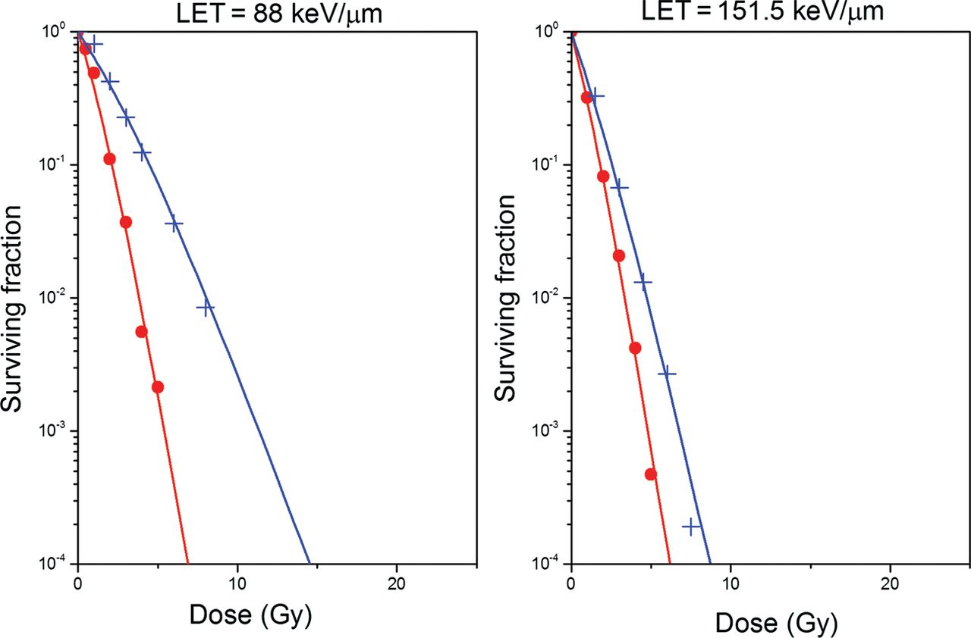
Survival of Cells Irradiated with Carbon Ions
in Oxic (red curves) and Hypoxic conditions (blue curves)
for Two Different LETs
Antonovic L et al. J Radiat Res 2013;54:18-26
Notes:
Survival curves for V79 cells irradiated with carbon ions in oxic (red curves) and hypoxic conditions (blue curves) for two different LETs predicted by the RCR parameterized model described by Equations 2–7.

Slide 21
  Objective: To Increase the Therapeutic Index of Radiotherapy
(Overcoming Hypoxia)
(Hadron Therapy)
(Targeting Therapeutic Resistance)
100
75
Tumor
Probability of Tumor Control
or Normal Tissue Damage (%)
Normal Tissue
50
(Decreasing Lymphopenia)
(Hadron Therapy)
(FLASH)
25
0
A
B
C
Cumulative Dose
Hall and Giaccia, 2019

Slide 22
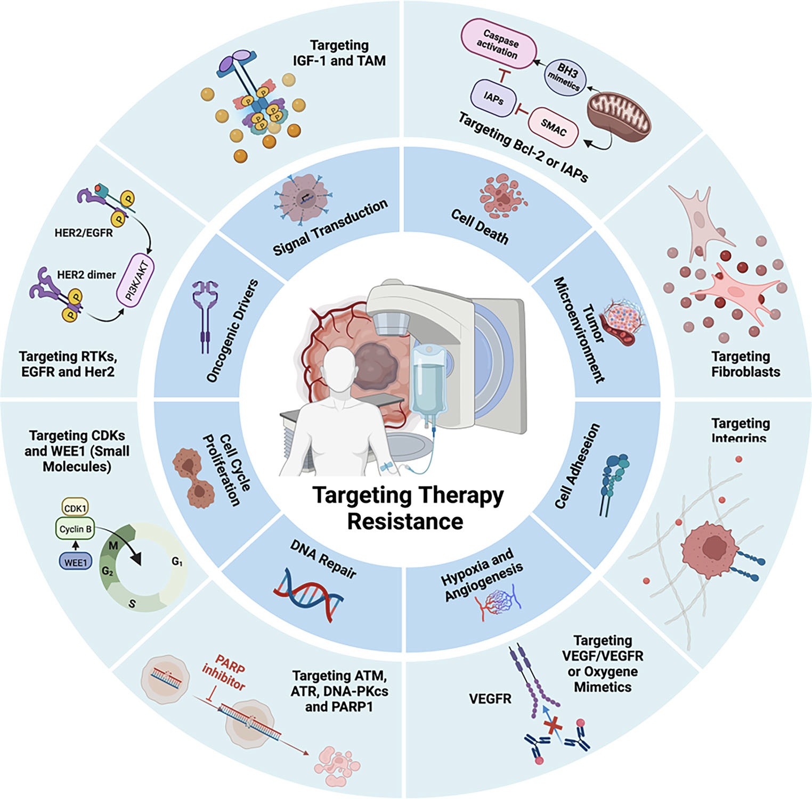
Schematic representation
of molecular mechanisms associated
with treatment resistance
in solid tumors and molecular
targeting approaches for cancer
chemo- and radiation sensitization.
Modified from Viktorsson et al, Strahlenther Onkol, 2023

Slide 23
Keap-Nrf2 Pathway
Notes:
Nrf2/Keap1 signaling pathway. Under basal conditions, Nrf2 binds to Keap1 by its two motifs (ETGE and DLG) and activates Cul3‐mediated ubiquitination followed by proteasomal degradation. Under stress conditions, due to the modification of Keap1 cysteine residues, Nrf2 dissociates from Keap1 and translocates into the nucleus. Nrf2 then forms a heterodimer with sMaf protein and binds to ARE to initiate the transcription of various downstream genes

Slide 24
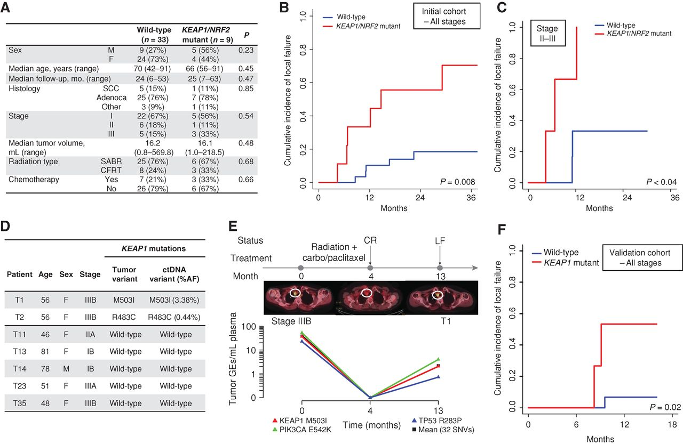
KEAP1/NRF2 Mutation Status Predicts Local Failure after Radiotherapy in Human NSCLC
Youngtae Jeong et al. Cancer Discov 2017;7:86-101
Notes:
KEAP1/NRF2 mutation status predicts local failure after radiotherapy in human NSCLC. A, Clinical characteristics of a cohort of patients with stage I–III NSCLC treated with curative intent RT and analyzed for KEAP1/NRF2 mutation status using targeted next-generation sequencing. B and C, Association of KEAP1/NRF2 mutations with local failure in patients with NSCLC treated with RT. B, Entire cohort. C, Stage II–III patients treated with conventionally fractionated radiotherapy or chemoradiotherapy. D, Noninvasive identification of KEAP1 mutation status in ctDNA isolated from pretreatment plasma samples of 7 patients from the cohort in A using CAPP-Seq. E, Monitoring of ctDNA in a KEAP1-mutant patient from D treated with chemoradiation. CR, complete response; LF, local failure; carbo, carboplatin. F, Clinical characteristics of a validation cohort of patients with stage I–III NSCLC treated with curative intent RT and analyzed for KEAP1/NRF2 mutation status using targeted next-generation sequencing.

Slide 25
Combining Ion Therapy with Immune Checkpoint Inhibitors
Notes:
Ionizing radiation increases the release of cytokines and pro-inflammatory molecules from tumor cells that recruit antigen presenting cells and immune effector cells to the tumor microenvironment. In addition, ionizing radiation increases the release and presentation of tumor antigens that can trigger tumor-specific immune responses. Immune checkpoint inhibitors such as anti-PD-1 and anti-CTLA-4 antibodies synergize with radiation by blocking T cell inhibitory signals. Immune cells can help to kill tumors at the site of radiation, and radiation may trigger systemic tumor-specific immune responses that could lead to regression of metastatic disease outside of the radiation field.

Slide 26
  Objective: To Increase the Therapeutic Index of Radiotherapy
(Overcoming Hypoxia)
(Hadron Therapy)
(Targeting Therapeutic Resistance)
100
75
Tumor
Probability of Tumor Control
or Normal Tissue Damage (%)
Normal Tissue
50
(Decreasing Lymphopenia)
(Hadron Therapy)
(FLASH)
25
0
A
B
C
Cumulative Dose
Hall and Giaccia, 2019

Slide 27
Clinical Data for Carbon
Tumor Site | # Studies | # Pts | Results
Occular | 2 | 114 | Similar to proton
CNS | 4 | 218 | Similar to proton
Prostate | 3 | 1384 | Excellent results for high risk, less toxicity than proton/photon
HCC | 1 | 64 | High local control
Lung (NSCLC) | 2 | 129 | Maybe better than proton
HNC | 1 | 236 | High LC – ACC, melanoma
Chordomas | 3 | 38 | Similar to proton

Slide 28
Ongoing Trials for Carbon
Tumor | Phase | N | Design | Endpoint | Site
Prostate | II | 90 | Carbon vs. Proton | Toxicity | Heidelberg
Skullbase Chondrosarc | III | 154 | Carbon vs. Proton | LPFS | Heidelberg
Skullbase Chrodoma | III | 319 | Carbon vs. Proton | LPFS | Heidelberg
Salivary Gland CA | I | 54 | IMRT + Carbon boost | Safety | Heidelberg
HCC | I | 33 | Carbon | MTD | Heidelberg
GBM | II | 150 | CRT + Carbon vs. Proton boost | 1 yr OS | Heidelberg, RTOG
HNC | II | 50 | TPF + RT + Cetux + Carbon Boost | LRC | Heidelberg

Slide 29
Summary: Clinical Data for Hadron Therapy
For most tumors, carbon ion therapy results in improved local control and decreased toxicity in comparison to photons or protons.
In some intermediate- and high-risk cancers, the clinical data suggests a survival advantage for carbon ion.

Slide 30
What Does Hadron Mean to UK
UK is a unique place that could lead by bringing a laser driven technology to produce ions to the clinic: strengths in physics, engineering, science, and medicine
Hadrons can solve the problem of how to deliver a higher RBE particle, increase tumor control & spare normal tissue at the same time
If we don’t embark on this opportunity now, we risk missing the opportunity to be leaders in the revolution of particle therapy for solid tumors & will struggle to be passengers
Strategically, we would be in a more advantageous position than relying solely on protons, which may ultimately may be best suited for pediatric and certain tumors

Slide 31
Superior Dose Depth Distribution
& Physical Beam Characteristics
Increasing the
Patient Experience
-Higher LET
-Superior RBE
-Low OER
-Narrow penumbra
-New Lhara Ion therapy
-Less toxicity
-Given in short period of time
-Cost effectiveness research
Physics
Clinical Biology Research
-Beam characterization
-Beam heterogeneity
-Dose limitations
-Toxicity
-Which tumor histologies benefit most
-Does it overcome tumor microenvironment
-Development of new clinical trial design
Multidisciplinary
UK
Lhara- Ion
Therapy
Program
Radiobiological Research
-Development of radioprotectors
-Carbon ion interaction with diff tissues
-Metabolism
-Microenvironment
-CSCs
Clinical Physics Research
-Dose and treatment planning
-Development of New Treatment Plans
-Absorbed Dose Calculations
-Modeling RBE
Engineering
-Gantry design
-Miniaturization
STFC/UKRI/ITRF
Material Science
Radiology
-Beam Production
-Beam Delivery
-Accelerator miniaturization
-Active and Passive Beam Shaping
-Target Production
-Substance lighter than
concrete, but just as effective
-Ionacoustic Imaging
-Positron imaging
-Dose distribution

