Slide 1



Investigating the radiobiology of protons with increasing LET in head and neck tumour models
Professor Jason Parsons
Institute of Cancer and Genomic Sciences
School of Physics and Astronomy

Slide 2
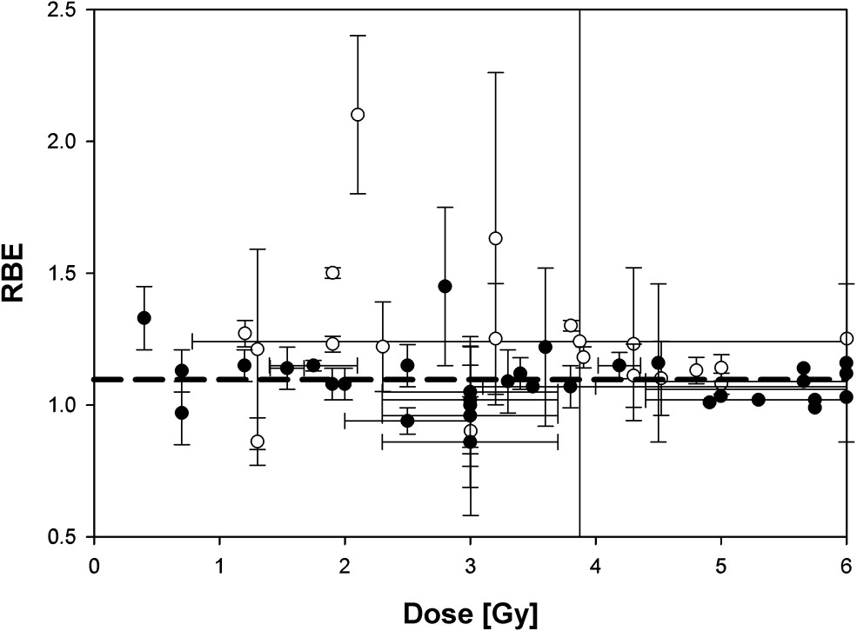
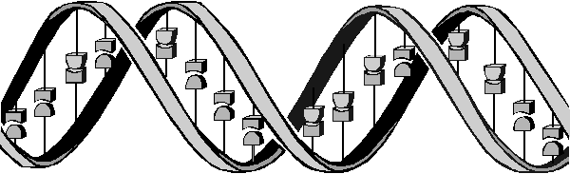
The advantages but also biological uncertainties following proton beam therapy (PBT)
-in vitro
-in vivo
Tumour
X-rays
Bragg peak
Distal fall-off
Low-LET radiation tracks
Relative dose
High-LET radiation tracks
protons
LET (protons)
Depth in tissue
Taken from Paganetti and van Luijk (2013) Sem Rad Oncol
  Further research exploiting the biological impact of PBT is vital for establishing RBE and optimal clinical treatment for tumours.
Vitti and Parsons (2019) Cancers

Slide 3
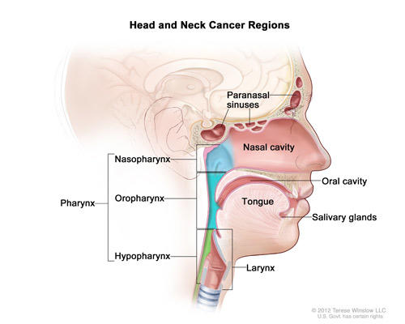
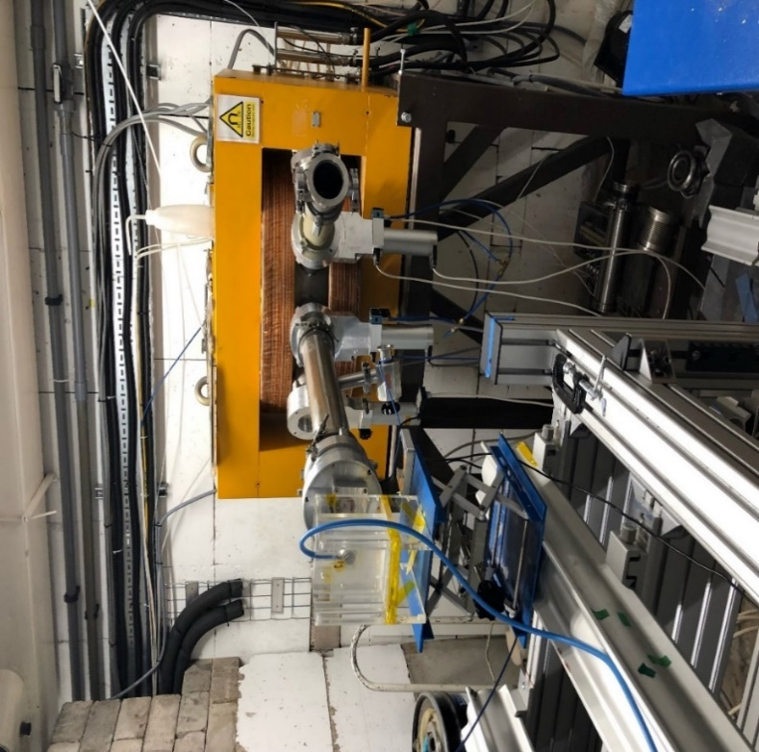
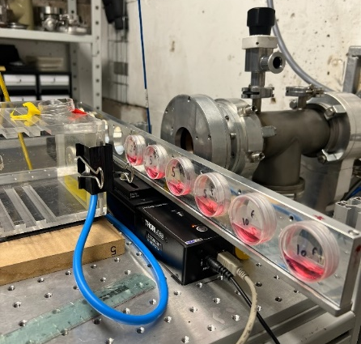
Head and neck squamous cell carcinoma (HNSCC) and glioblastoma (GBM)
HNSCC
6th most common cancer worldwide (~800,000 cases/year).
Major contributory factors are smoking and drinking.
Rapid rise in incidence of human papillomavirus (HPV-16) associated cancers of the oropharynx (~60 % of OPSCC and ~40 % of HNSCC combined).
HPV-positive tumours are more sensitive to radiotherapy and chemotherapy, thus improved prognosis, than HPV-negative tumours.
GBM
The most common primary brain tumour in adults.
Survival rates are extremely poor (median of ~12 months).
Conventional radiotherapy has limited effectiveness.
Zhou and Parsons (2020) Expert Rev Mol Med; Aiyappa-Maudsley et al (2022) Neuro Oncol Adv

Slide 4
Major research questions/aims
Do protons, particularly at increasing LET, lead to changes in the molecular (DNA) and cellular (survival/RBE) profiles.
Can the effectiveness of protons (particularly at high-LET) be further exacerbated using drugs/inhibitors.
What is the impact of reduced oxygen (hypoxia) on photon versus proton efficacy.
What is the effect of dose rate (FLASH) on proton radiobiology.
R01CA256854-01

Slide 5
Major research questions/aims
Do protons, particularly at increasing LET, lead to changes in the molecular (DNA) and cellular (survival/RBE) profiles.
Can the effectiveness of protons (particularly at high-LET) be further exacerbated using drugs/inhibitors.
What is the impact of reduced oxygen (hypoxia) on photon versus proton efficacy.
What is the effect of dose rate (FLASH) on proton radiobiology.
R01CA256854-01

Slide 6
  “Relatively” high-LET protons cause a decrease in cell survival due to CDD formation compared to low-LET protons
  UMSCC74A
Alkaline (SSB)
Tumour
  UMSCC74A
Neutral (DSB)
160
Bragg peak
Enzyme-modified (DSB+CDD)
X-rays
120
140
*
****
*
100
120
Distal fall-off
100
***
80
CDD
80
**
60
*
  SF2, p<0.02; RBE=1.7
Relative dose
***
60
40
**
  UMSCC6
40
protons
20
20
LET (protons)
0
0
  *p<0.005, **p<0.002, ***p<0.001
Depth in tissue
  *p<0.02, **p<0.01, ***p<0.005, ****p<0.001
  SF2, p<0.01; RBE=1.9
  58 MeV (1 keV/μm); 11 MeV (12 keV/μm)
  Carter et al., (2018) Int J Rad Oncol Biol Phys
  Fabbrizi et al., (2021) Methods Protoc

Slide 7
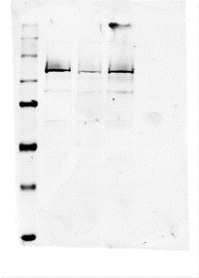
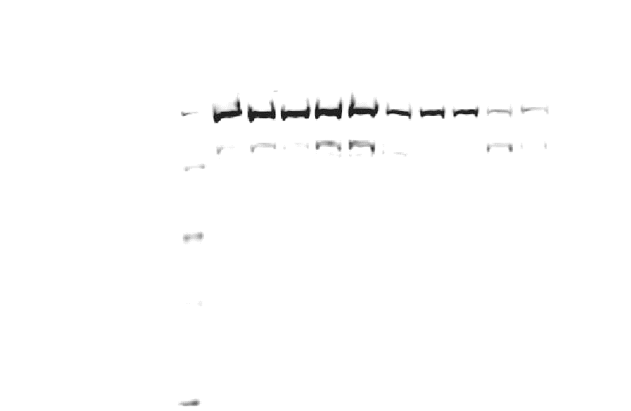
Modulation of proton-induced cellular sensitivity following DUB siRNA knockdown
  HeLa
  *p<0.01, **p<0.005, ***p<0.002, ****p<0.001
11 MeV protons
USP6 siRNA
NT siRNA
NT siRNA
USP6 siRNA
USP6
Hours post-CHX
PARP-1
0
0.5
1
2
4
0
0.5
1
2
4
XRCC1
PARP-1
APE1
Actin
Actin
1.0 0.3
PARP-1/actin ratio
  *p<0.01, **p<0.005, ***p<0.001
11 MeV
58 MeV
  Carter et al., (2019) Int J Rad Oncol Biol Phys
  Nickson, Fabbrizi et al., (2021) Front Oncol

Slide 8
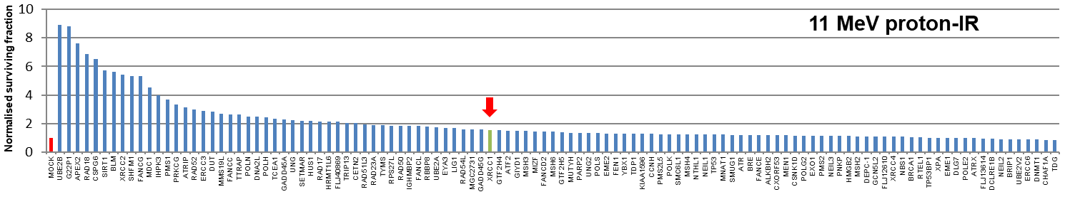
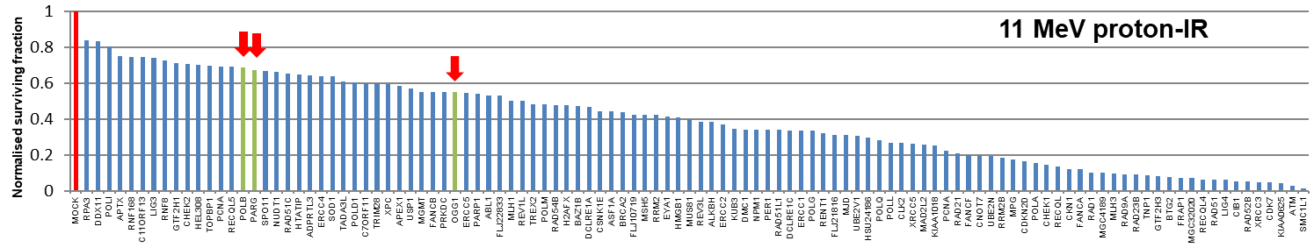
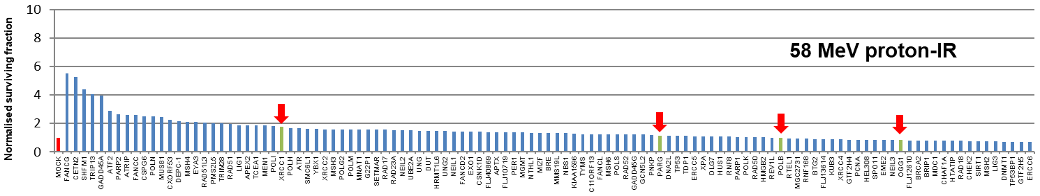
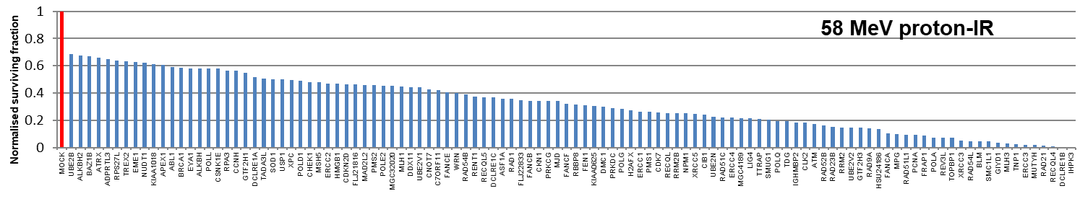
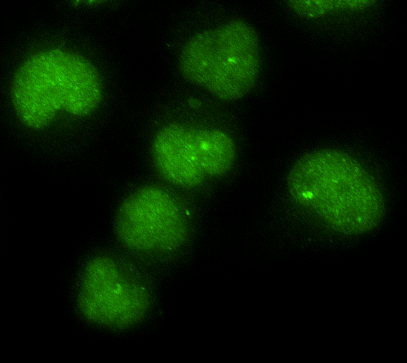
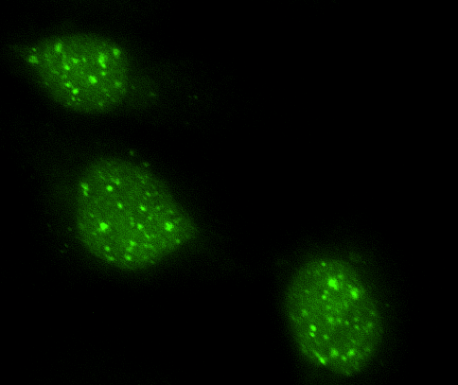
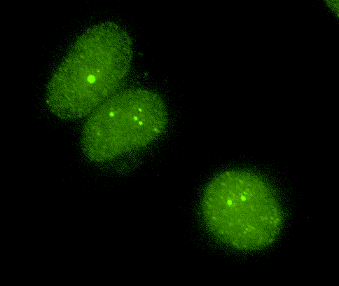
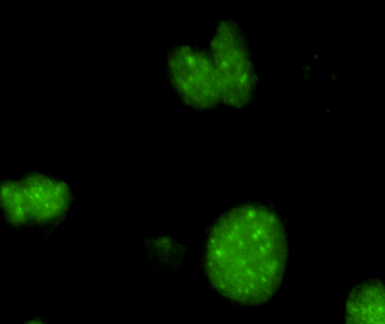
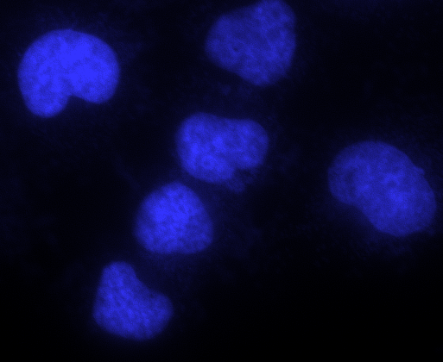
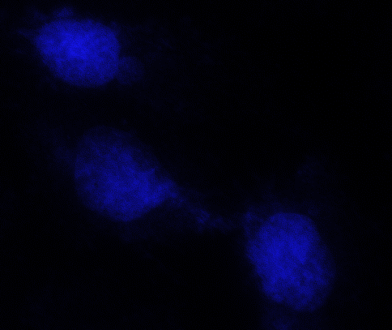
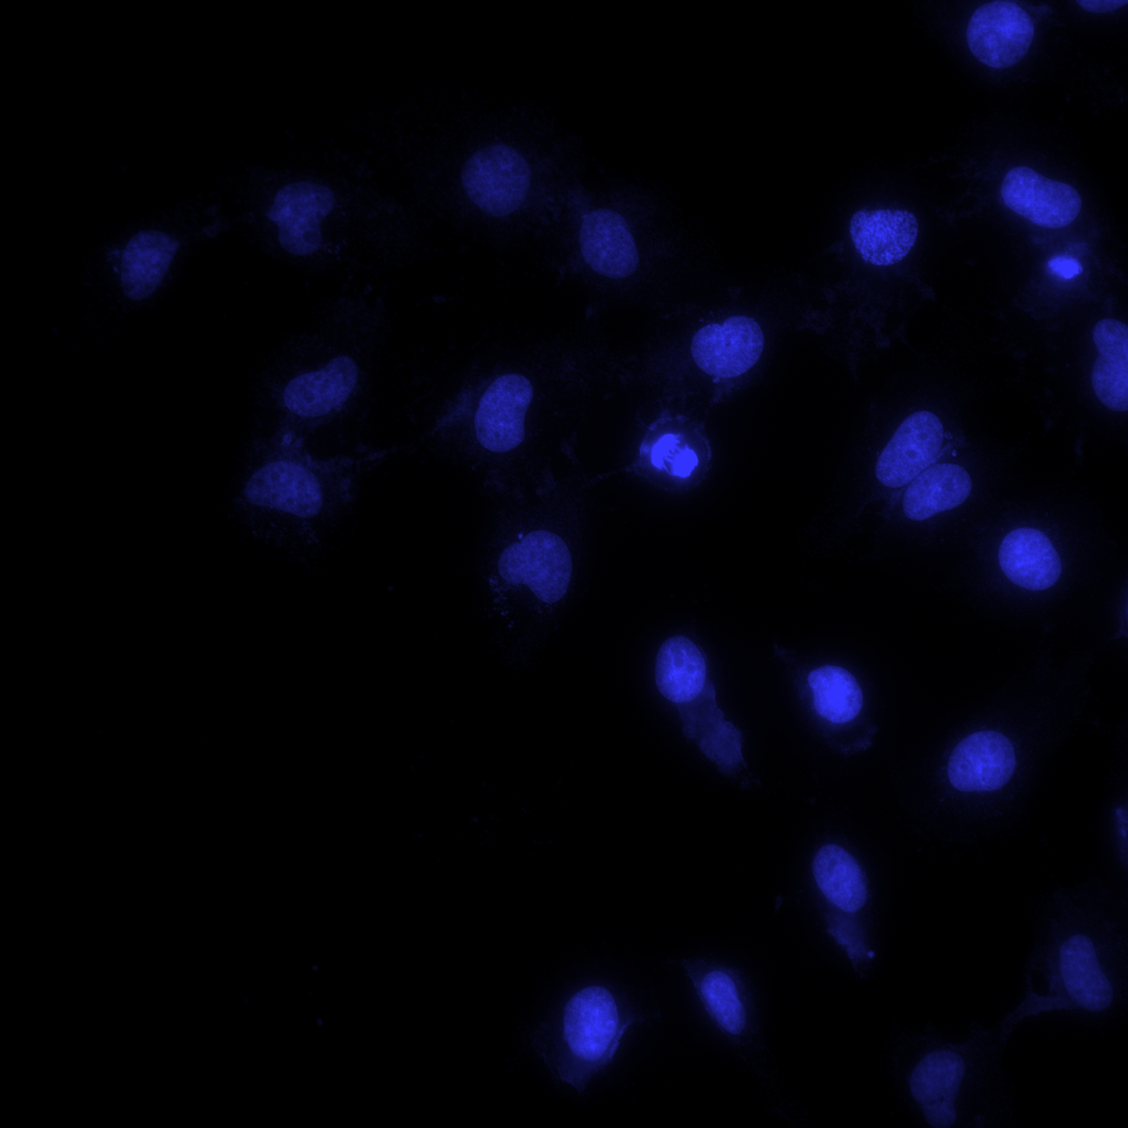
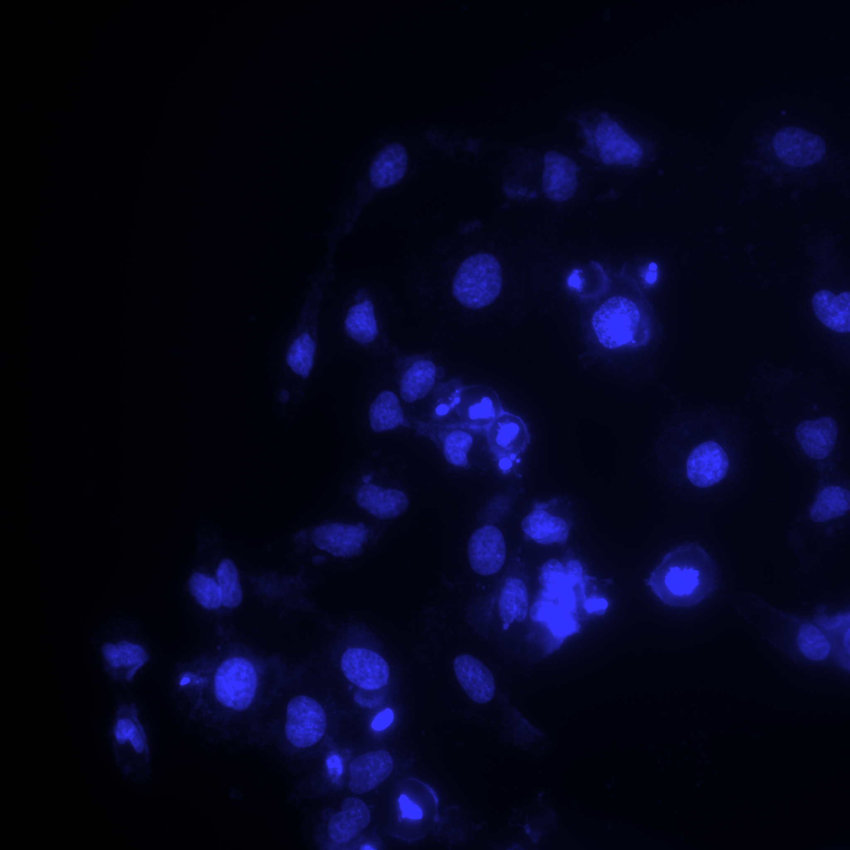
Modulation of proton-induced cellular sensitivity following DDR siRNA
11 MeV
11 MeV
58 MeV
58 MeV
Control
24 h
Control
24 h
OGG1
DAPI
  Fabbrizi, Nickson et al., (in review)

Slide 9
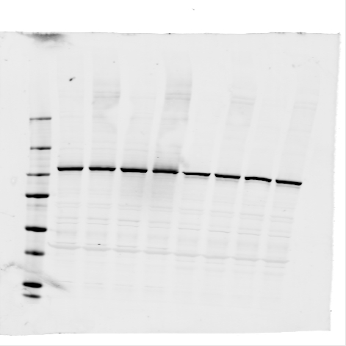
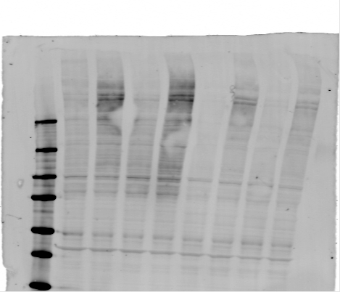
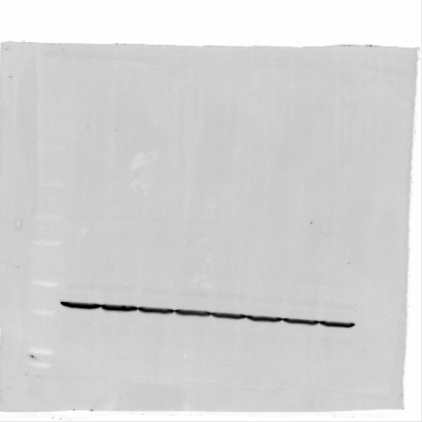
Targeting OGG1 and PARG sensitises cells to high-LET protons
PARGi
PARGi (+IR)
DMSO
DMSO (+IR)
11 MeV
PARP-1
250
PAR
150
100
75
Actin
58 MeV
  *p<0.05, **p<0.02
  ***p<0.005
  Fabbrizi, Nickson et al., (unpublished)
  Collaborations with Thomas Helleday and Helen Bryant

Slide 10
Major research questions/aims
Do protons, particularly at increasing LET, lead to changes in the molecular (DNA) and cellular (survival/RBE) profiles.
Can the effectiveness of protons (particularly at high-LET) be further exacerbated using drugs/inhibitors.
What is the impact of reduced oxygen (hypoxia) on photon versus proton efficacy.
What is the effect of dose rate (FLASH) on proton radiobiology.
R01CA256854-01

Slide 11
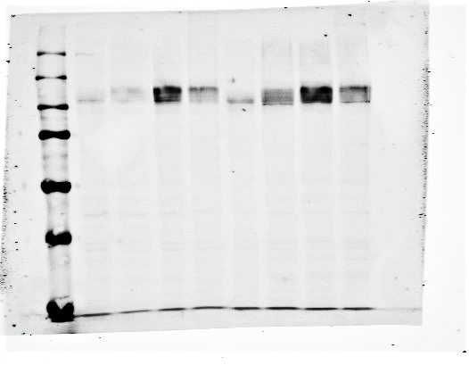
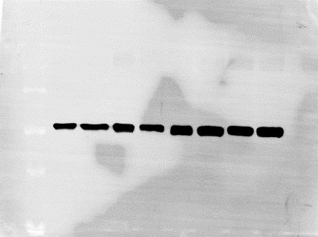
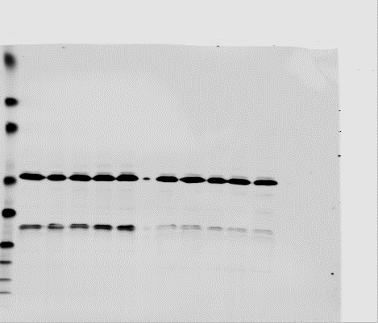
Hypoxia-induced radioresistance and identifying strategies to overcome this.
UMSCC6
Hours in hypoxia
N
3
6
24
UMSCC6
UMSCC74A
HIF-1α
FaDu
Actin
**
*
***
UMSCC74A
Hours in hypoxia
N
3
6
24
HIF-1α
Actin
UMSCC74A
UMSCC74A
UMSCC74A
Normoxia
Hypoxia
Time post-IR
C
1
4
8
24
C
1
4
8
24
p62
**
LC3B I
LC3B II
Actin
R01CA256854-01
  Hill, Rocha et al., (in review)

Slide 12
Major research questions/aims
Do protons, particularly at increasing LET, lead to changes in the molecular (DNA) and cellular (survival/RBE) profiles.
Can the effectiveness of protons (particularly at high-LET) be further exacerbated using drugs/inhibitors.
What is the impact of reduced oxygen (hypoxia) on photon versus proton efficacy.
What is the effect of dose rate (FLASH) on proton radiobiology.
R01CA256854-01

Slide 13
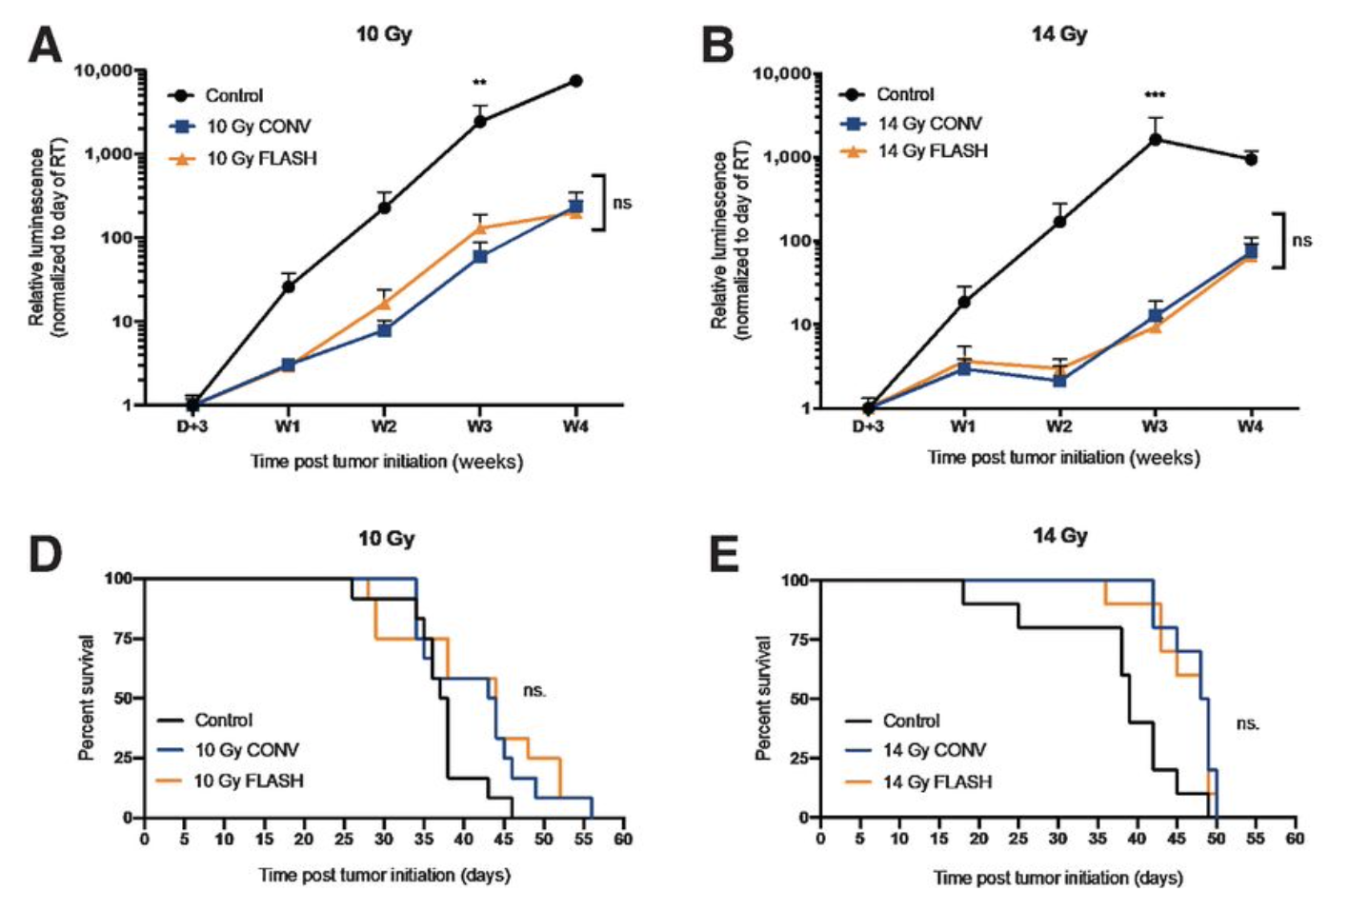
Examine the radiobiology of FLASH high-LET radiation.
Using high-dose rates (>40 Gy/s; versus ~5 Gy/min).
FLASH stimulates normal tissue sparing.
Glioblastoma
  Vozenin et al (2018) Clin Cancer Res
  Bourhis et al (2019) Radiother Oncol
  Montay-Gruel et al (2021) Clin Cancer Res

Slide 14
Comparison of FLASH and conventional dose rate proton beam therapy in vivo
Model | Dose (Gy) | FLASH Dose-Rate (Gy/s) | Outcome | Reference
Zebrafish embryo | 0–43 | 100 | No survival difference | Beyreuther et al., 2019
Mice (thorax) | 15/17.5/20 | 40 | Normal tissue protection with FLASH | Abel et al., 2017
Mice (thorax) | 15/17.5/20 | 40 | Normal tissue protection with FLASH | Girdhani et al., 2019
Mice (abdomen) | 15 | 78 | Normal tissue protection with FLASH | Diffenderfer et al., 2020
Mice (local intestinal) | 18 | 78 | Normal tissue protection with FLASH | Diffenderfer et al., 2020
Mice, orthotopic engrafted Lewis lung carcinoma (thorax) | 18 | 40 | Improved tumor control with FLASH, increased T-lymphocyte tumor infiltration | Rama et al., 2019
Mice, pancreatic MH641905 flank tumor | 12/15 | 78 | No difference in tumor control | Diffenderfer et al., 2020
Mice, FaDu HNSCC transplantation | 17.4 | >10⁹ | No difference in tumor control | Zlobinskaya et al., 2014
Evidence of tumour cell killing effect of FLASH required.
Mechanism of action unclear (oxygen, radicals, metabolism, DNA damage/repair?).
Opportunity for utilisation of FLASH protons/particles and influence of LET.
  Hughes and Parsons (2020) Int J Mol Sci

Slide 15
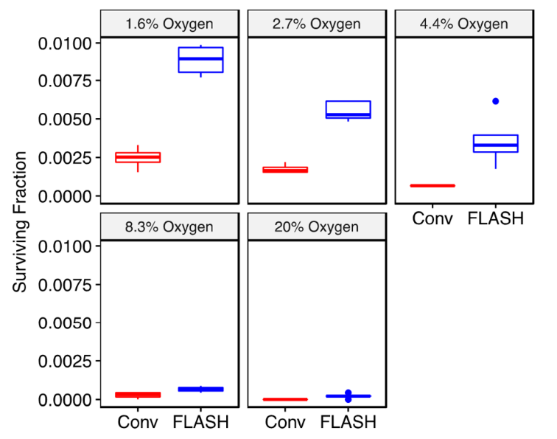
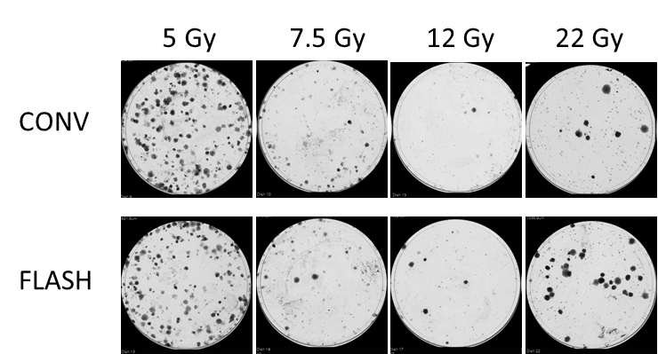
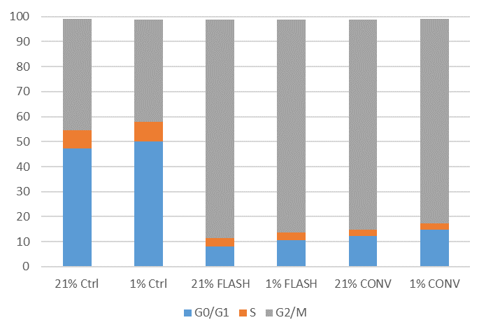
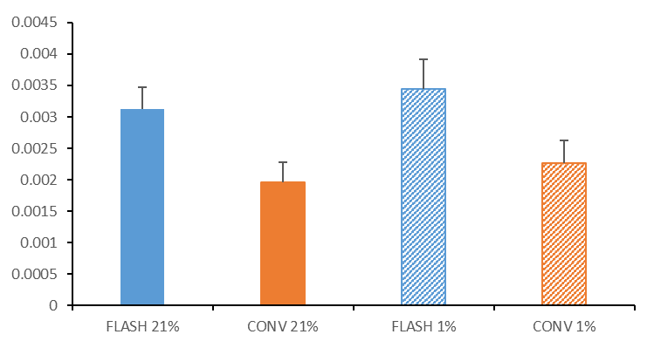
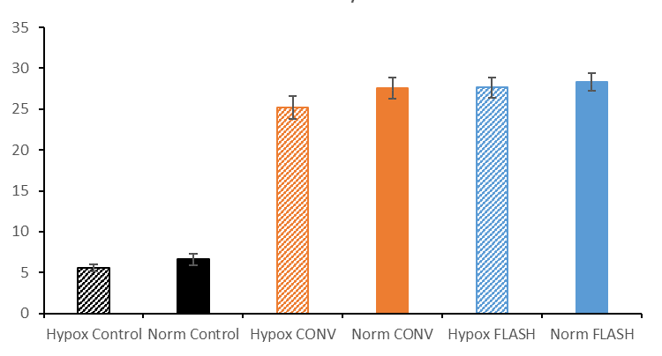
Examining the radiobiology of FLASH high-LET radiation
DU145 prostate cancer cells (18 Gy electrons)
HeLa cells (protons)
Courtesy of Kristoffer Petersson
FaDu cells (cell cycle)
HeLa cells (survival)
FaDu cells (γH2AX)
  Collaborations with Stuart Green, Tzany Wheldon, Tony Price, Ben Phoenix and Kristoffer Petersson

Slide 16
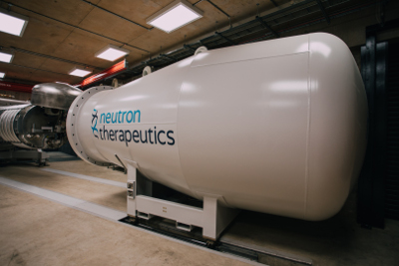
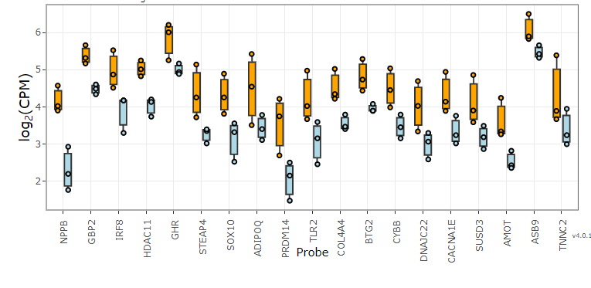
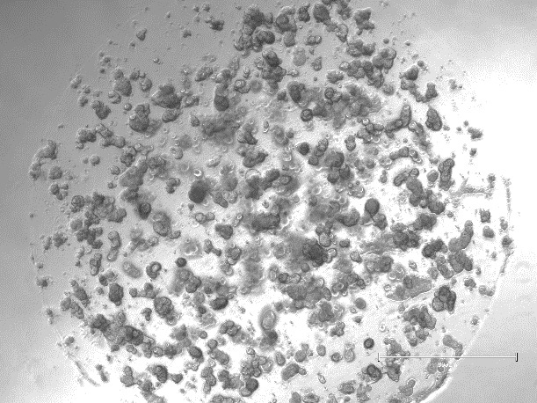
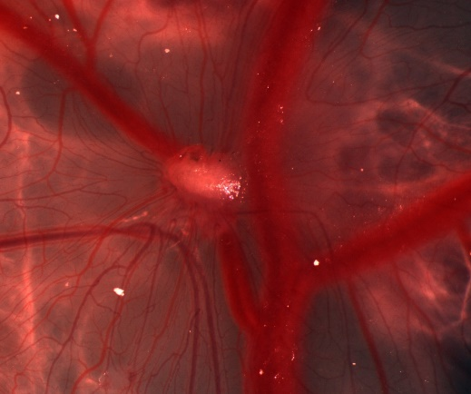
Current radiobiology research focus
Thermal neutrons
¹⁰B
Tumour cell
⁴He
⁷Li
Normal cell
Transcriptomic and proteomic analysis post-irradiation
11 MeV
59 MeV
High flux accelerator neutron source for BNCT
Development of chick embryo model
Development of patient-derived organoids (Inge Tinhofer-Keilholz – Charité Berlin)
R01CA256854-01

Slide 17
Summary and key points
High-LET protons (at Bragg peak distal end), in contrast to low-LET protons, can generate complex DNA complex that contributes to increased cellular radiosensitivity.
Repair of complex DNA damage induced by high-LET protons is co-ordinated through a specific cellular DNA damage response involving PARP-1, PARG and OGG1.
Opportunities for exacerbating HNSCC cell killing effects of photons and protons (both low and high-LET) through specific DNA repair inhibitors.
Other biological factors (hypoxia) and physical factors (dose rate/FLASH) require further investigation.

Slide 18
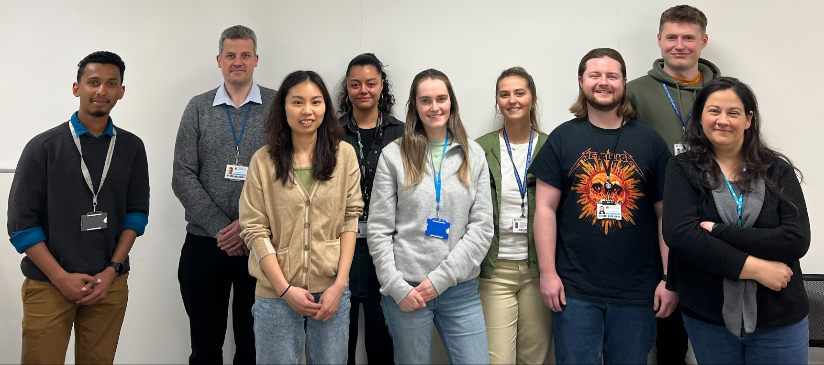



Acknowledgements
Parsons Group
Rachel Carter
Katie Nickson
Terpsi Vitti
Maria Rita Fabbrizi
Jonathan Hughes
Alice Ormrod
Chun Li
Lizzie Duffacy
Amalia Goula
Karthik Vaidya
Rhianna Hill
George Duffield
Emma Melia
Leah Punshon
Laura Hawkins
Alex Bembridge
Stuart Green
Tzany Kokalova-Wheldon
Ben Phoenix
Tony Price
Hisham Mehanna
Colin Watts
Oxford Institute for Radiation Oncology
Imperial College London
University of Glasgow
Ken Long
Anthony Chalmers
Mark Hill
James Thompson
Kristoffer Petersson
AstraZeneca
Clatterbridge Cancer Centre
Stephen Durant
Alan Lau
Andrzej Kacperek
Charité, Berlin
University of Liverpool
Thanks to
Inge Tinhofer-Keilholz
Mike Clague, Sylvie Urbe
Sonia Rocha, Terry Jones
Helen Bryant
Thomas Helleday

