Slide 1







Ionacoustic imaging for eventual in-vitro and in-vivo dose mapping
Jeff Bamber (Institute of Cancer Research) and
Maria Maxouti (Imperial College London), with
Josie McGarrigle, Anthea MacIntosh-LaRocque, Vania Lay, Yu Hu, Ben Cox, Ben Smart, Emma Harris, Colin Whyte, Kenneth Long
Notes:
Jeff starts off and talks to slides 1-5.

Slide 2
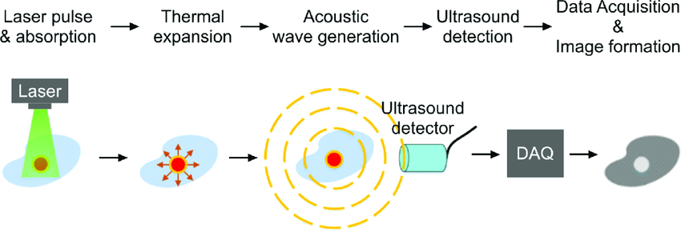
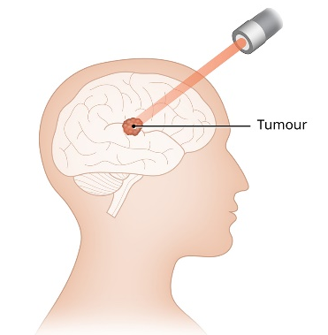
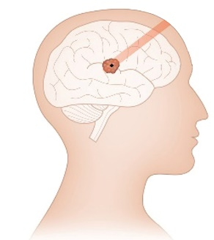
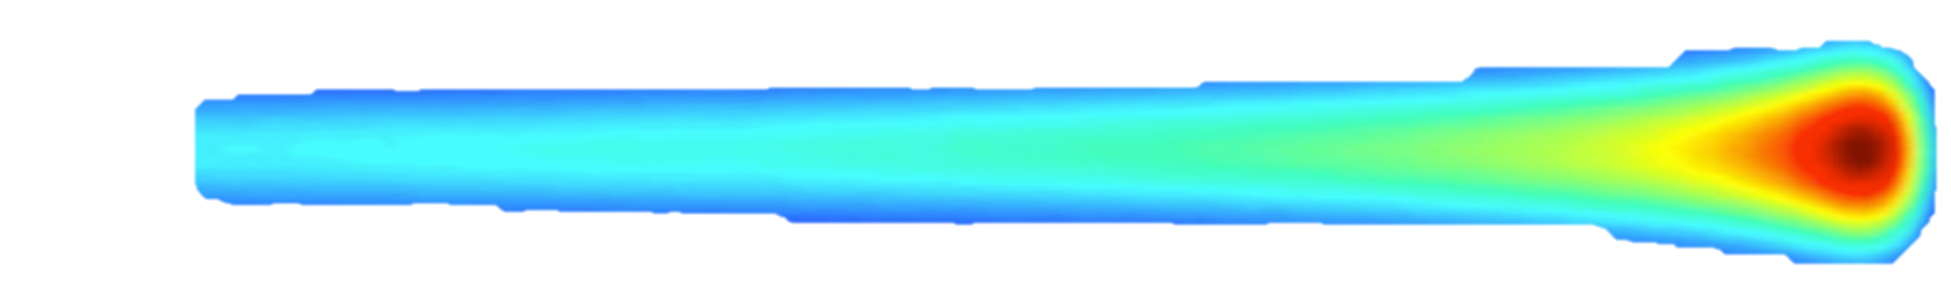


Ionacoustic Process
Transient pressure rise
Acoustic wave detection
Data acquisition and image reconstruction
Proton/ion pulse energy absorption
Acoustic wave propagation
$$p_{0}=Γ\frac{∂H}{∂t}$$
$$∇^{2}p−\frac{1}{c^{2}}\frac{∂^{2}p}{∂t^{2}}=p_{0}$$
Proton/ion beam
Dose map
Tumour
Pulses are needed. A constant energy deposition produces no acoustic wave.
High resolution demands short pulses, e.g., 150 μm requires 100 ns (10 MHz)
Nearly homogenous dose regions produce very low acoustic frequencies (kHz)
Nevertheless, success obtained in vitro and in vivo, by various groups
Extremely wide bandwidth acoustic sensors required

Slide 3
Our ion-acoustic ambition
In-vivo real-time 3D dose localisation and quantitative mapping, for real-time pulse-to-pulse adaptive treatment as the beam is moved around
  Localise the Bragg peak (submillimetre accuracy possible), to avoid damage to healthy tissue and under-dosing of the tumour.
  Measure the deposited-energy distribution in the tissue, preferably on a pulse-by-pulse basis.
  Simultaneously image with ultrasound and photoacoustics, registered to planning CT/MRI - track tissue motion, image anatomy, perfusion, microvasculature, hypoxia, tissue stiffness, speed of sound, molecular biomarkers and dose enhancement distribution from molecularly targeted dose enhancers.
  Suitable for organs with acoustic access: breast, prostate, liver, pancreas, pelvic, head and neck, etc. (perhaps eventually brain).
  Enable preclinical radiobiology research to provide the knowledge needed to take full advantage of the new accelerator, and for its optimal clinical use.
  Especially applicable to mini/micro-beam and FLASH irradiation.

Slide 4
Our main challenges
Very weak signals
  LhARA technology generates 10 - 40 ns pulses
  Massively parallel ultrasound electronics and transducer arrays, and front-end compressive sensing
  Techniques described below will also enhance signal to noise ratio
Matching signal frequency content to ultrasound transducers
  Novel acoustic beamforming and transducer arrays take advantage of LhARA to adjust the beam size
  Prior knowledge of expected dose distribution
Ultrasound transducers must permit imaging and PB access, without an operator
  For some organs (e.g. breast, thyroid, prostate), suitable 3D automated scanning is already used clinically
  Current work around the world to develop conformable arrays in the form of inter-communicating patches
The acoustic properties for which compensation is needed, for spatially accurate and quantitative dose, are patient specific
  Speed of sound, attenuation and Grüneisen coefficient imaging are being developed for diagnostic imaging
  Ultrasound contrast microbubbles can act as beacon signals for aberration and attenuation correction
Notes:
I deleted “Dose-enhancing nanoparticles providing self-adaptive ion-acoustic dose mapping” from the last item because it is too complex to explain (and novel).

Slide 5
Our approach
Smart phantom system for verifying the simulation and dose/range estimates
Modelling of proton/ion beam, transport, energy deposition, thermoacoustic generation, acoustic propagation, sensing and dose-map reconstruction
- study variables (e.g., beam size, pulse length, kinetic energy, particle type, dose per pulse, ultrasound sensor positions and characteristics, reconstruction method)
=> predict dose imaging capabilities
=> define ultrasound sensor and system requirements
Early experiments to validate the modelling – existing source
Build prototype preclinical demonstrator system
Bring together with LhARA prototype
Conduct preclinical experiments to generate radiobiological knowledge
Refine and repeat, translate to clinical scale, …
Beam
Acoustic sensor array
High-throughput biological sample holder
Dose maps
LhARA beams

Slide 6
Digital simulation studies
Notes:
Jeff hands over to Maria who speaks to slides 6-13

Slide 7

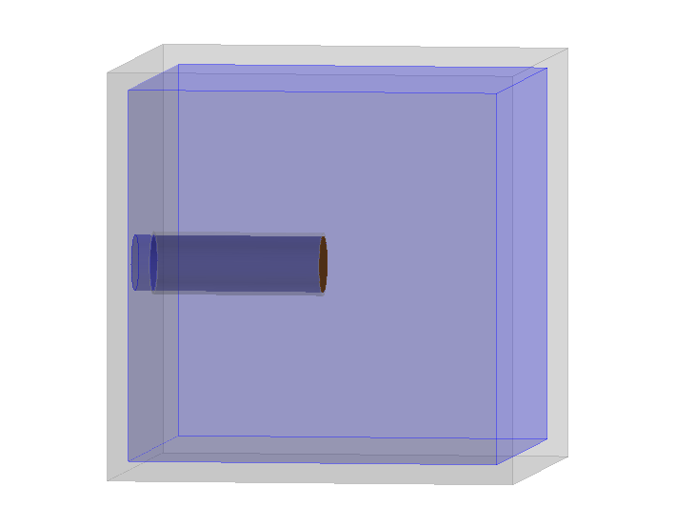
simulation of the water phantom
Aluminium housing
5 mm
Kapton entry window
Air
15 mm
Y
110 mm
Beam
Water
X
110 mm
Z
110 mm

Slide 8
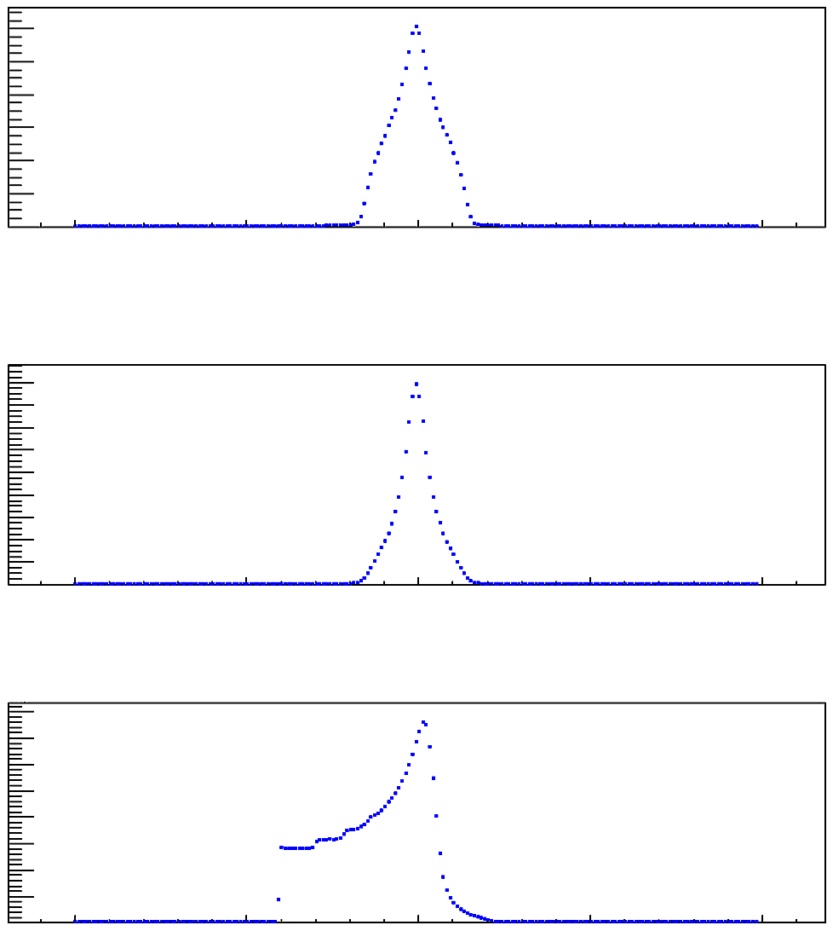
Binned energy deposition profiles
1200
800
Energy (MeV x10³)
400
-10
-5
0
5
10
X distance (mm)
1600
1200
Energy (MeV x10³)
800
400
-10
-5
0
5
10
Y distance (mm)
800
600
Energy (MeV x10³)
400
200
-10
-5
0
5
10
Z distance (mm)

Slide 9
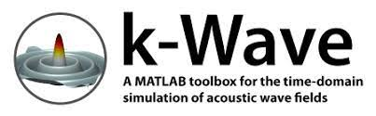
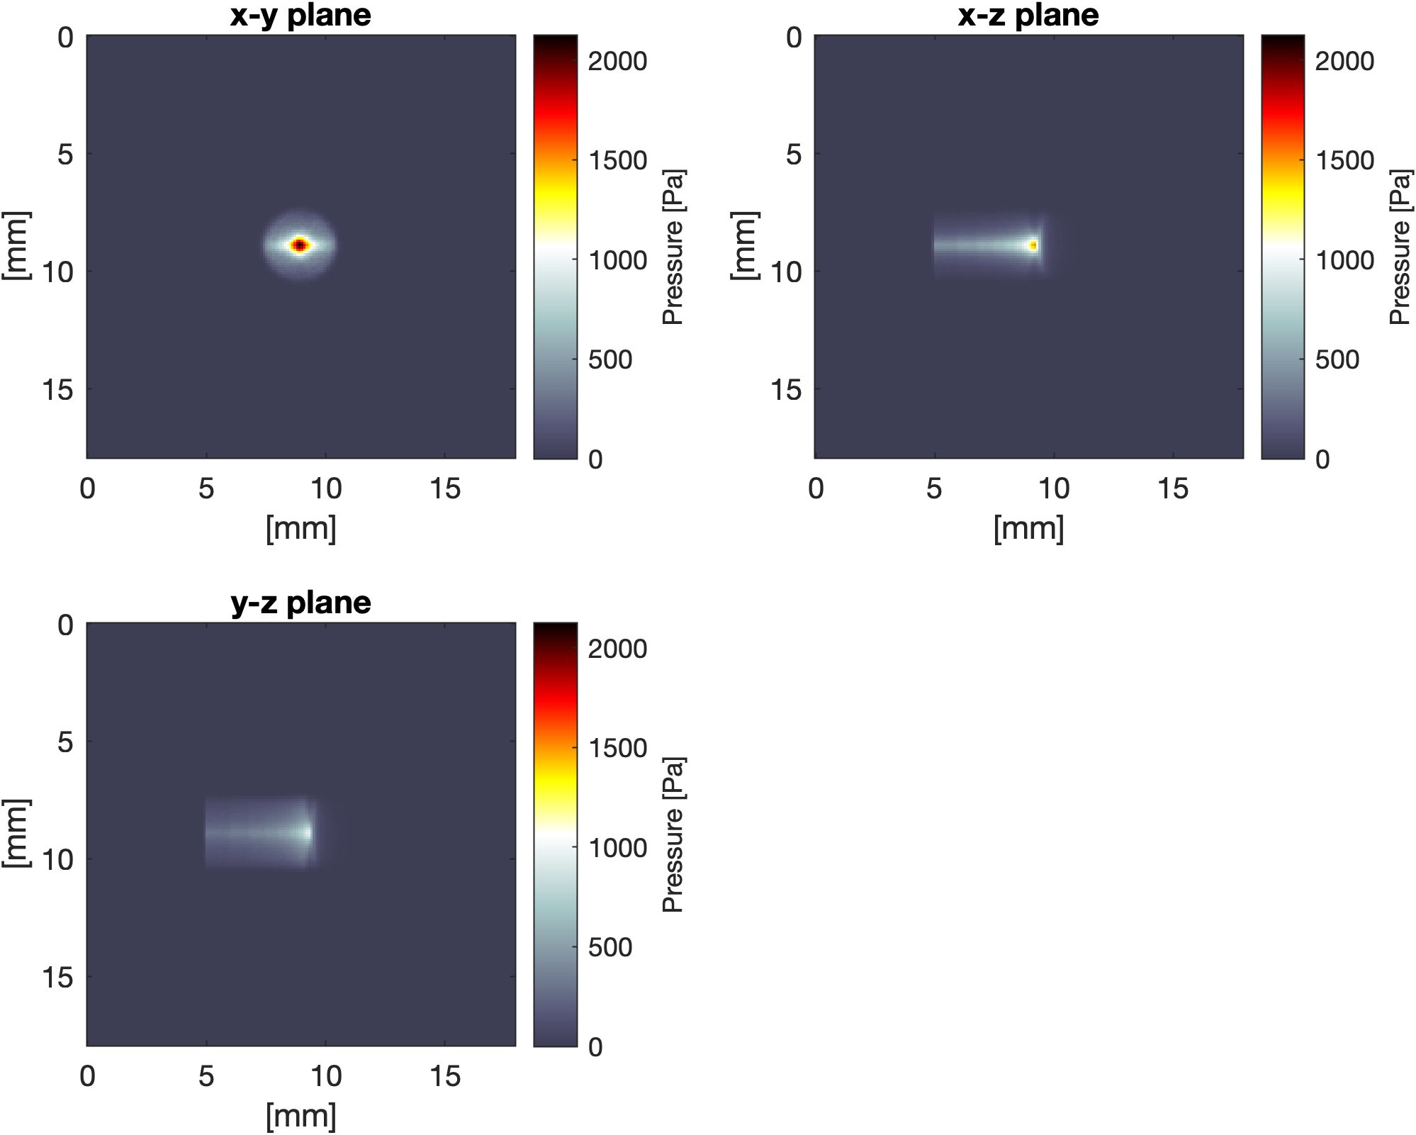
simulation - source pressure
distribution due to deposited proton energy

Slide 10
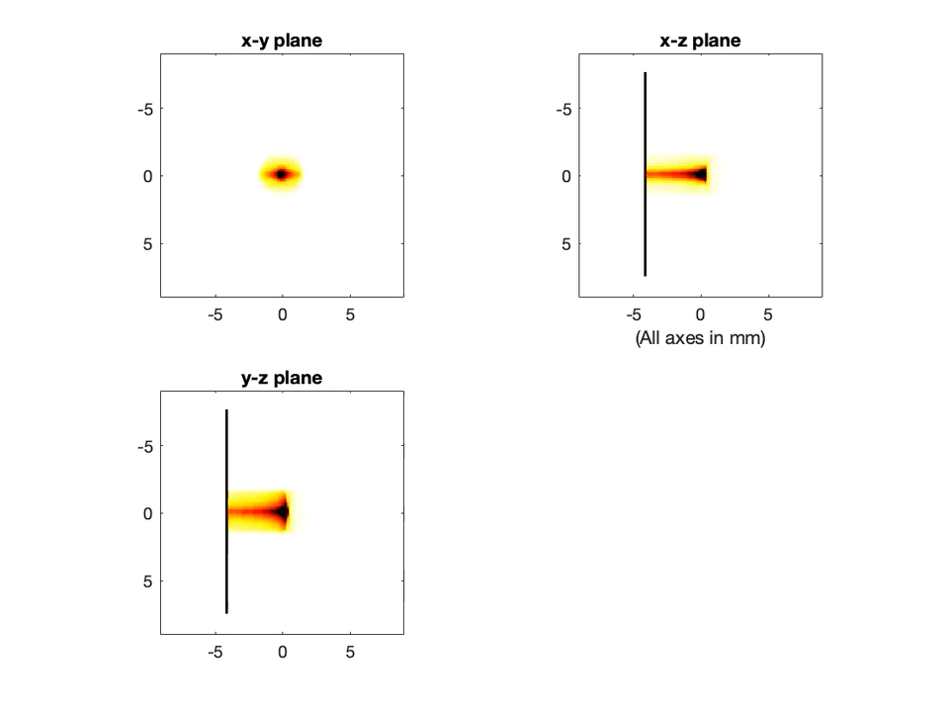
Acoustic Wave Propagation
Kapton foil
Air
Water

Slide 11
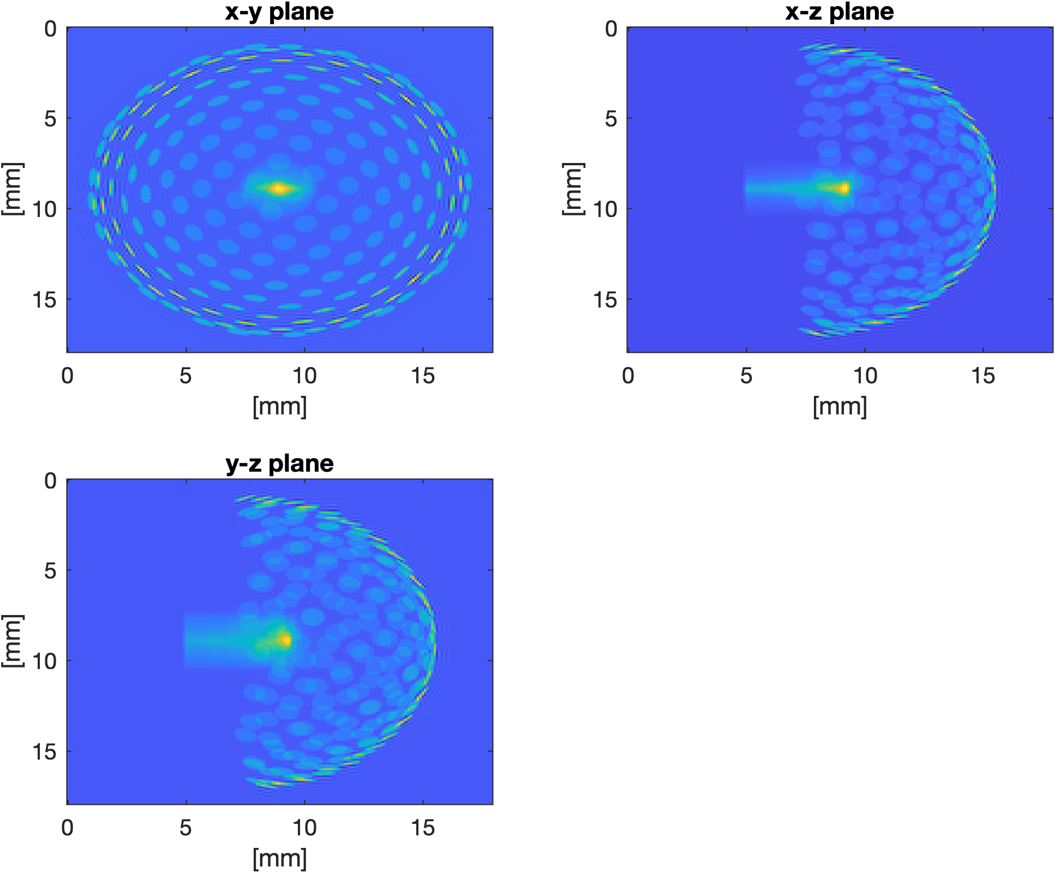
Acoustic sensor geometry and location in relation to the proton energy deposition
proton beam deposited energy distribution
hemispherical array of disc shaped sensor elements

Slide 12
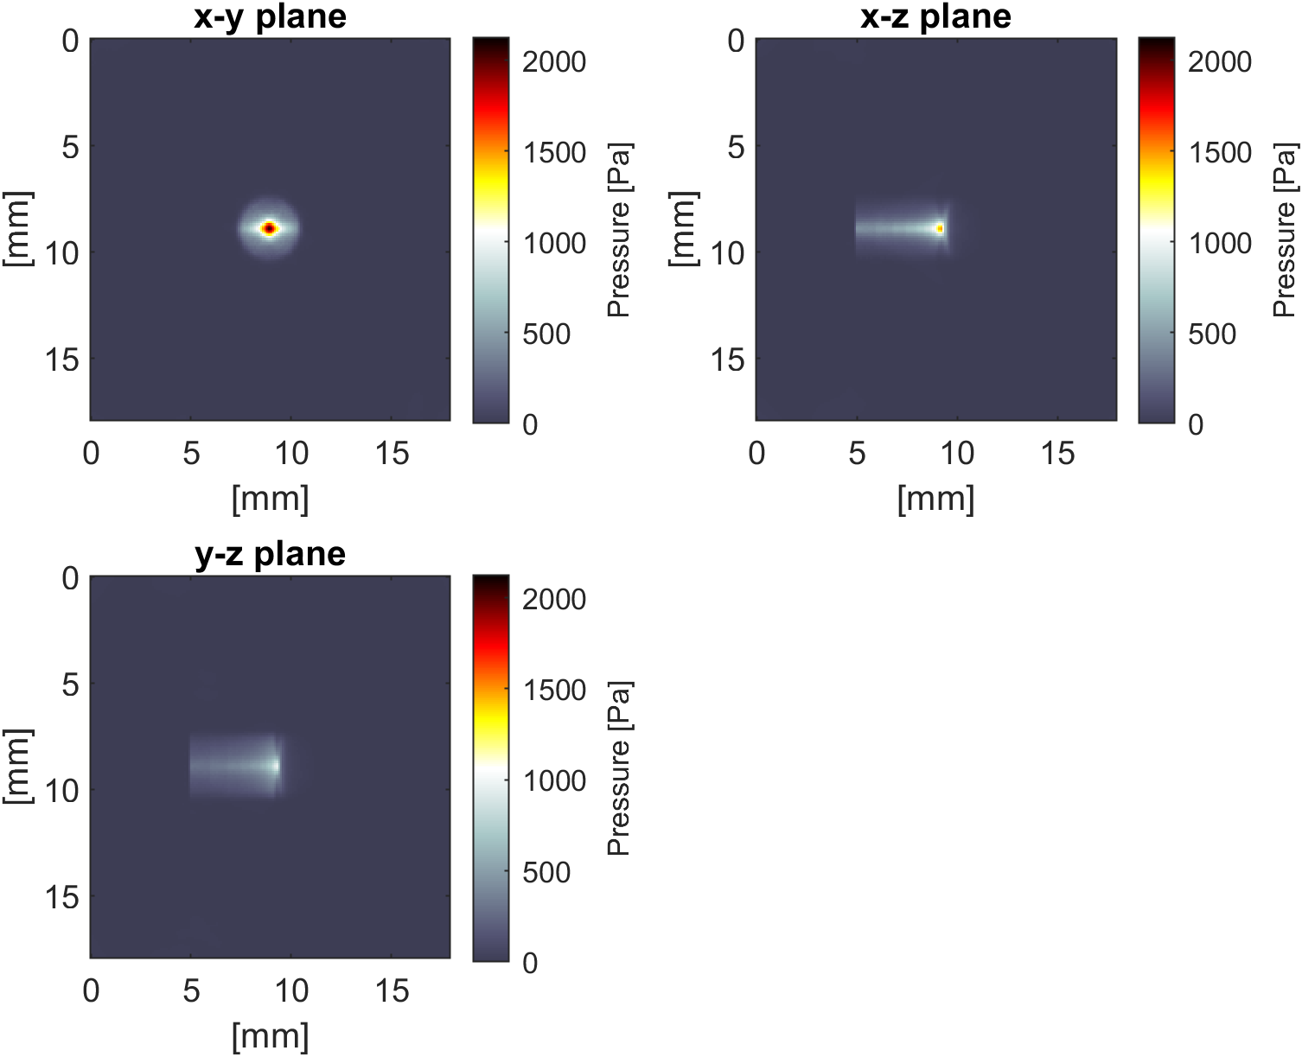
Pressure distribution reconstructed using iterative time reversal – comparison with the source pressure
Reconstruction
Source pressure

Slide 13
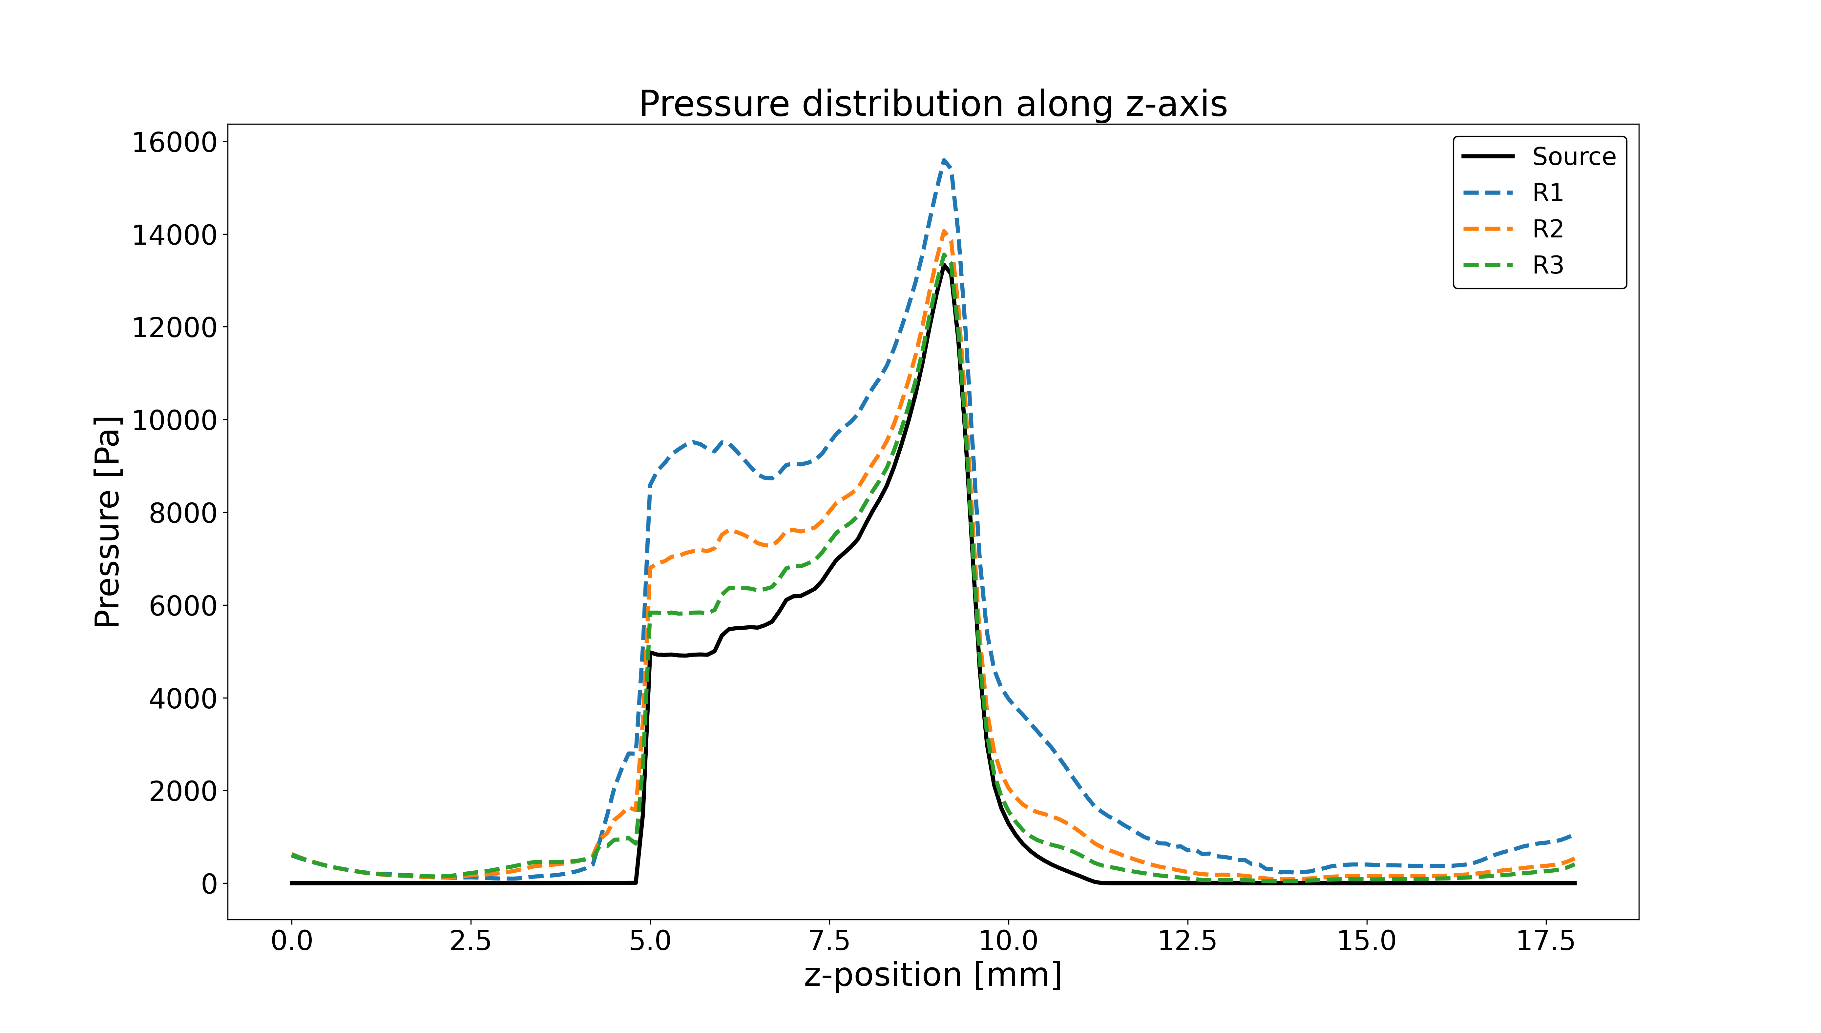
Axial profile through the reconstructed pressure distribution – iterative time reversal convergence

Slide 14
Experimental simulation studies
Notes:
Maria hands back to Jeff who speaks to the end, slides 15-20

Slide 15
Preliminary photoacoustic “experimental simulation”
Monte Carlo simulation
3-D dose distribution
Threshold and tessellate 3-D surface
3-D print to produce mould
Optically absorbing gel phantom in the shape of the deposited dose distribution
Image using a photoacoustic system
Evaluate received acoustic frequencies and reconstructed images in terms of analytical predictions and compare with k-Wave predictions

Slide 16
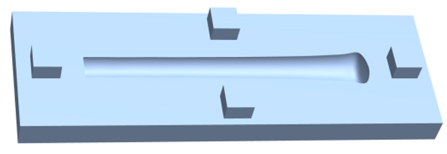
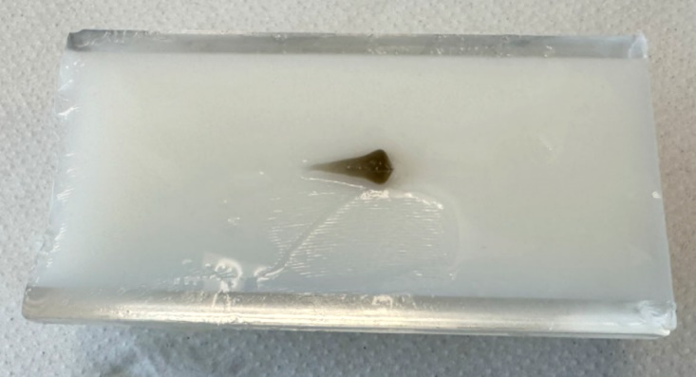
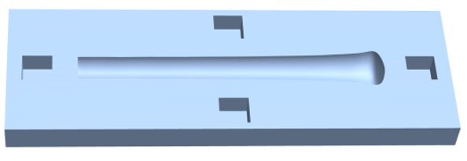
Example mould design and final photoacoustic phantom of thresholded simulated dose distribution (70 MeV)
Two halves of mould for deposited dose distribution at 5% threshold
Halve the phantom for deposited dose distribution at 40% threshold
Background (TiO² in gelatine)
Beam insert (India ink pigmented)

Slide 17
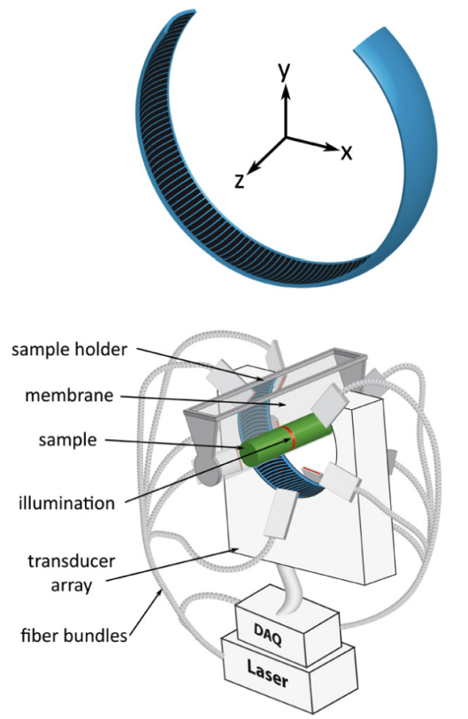
Photoacoustic imaging system
256
1
Acoustic sensor elements
128

Slide 18
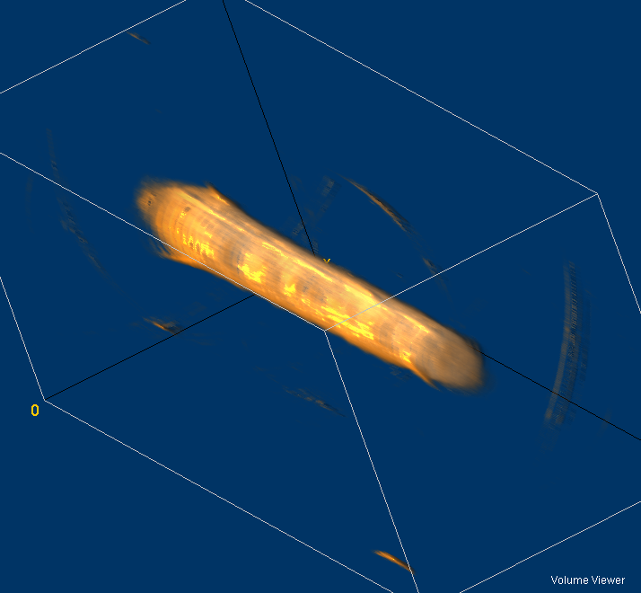
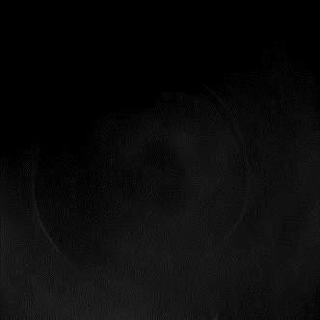
Example photoacoustic images (5%)
Surface rendering of 3D reconstruction
Stack of cross-sectional reconstructions

Slide 19
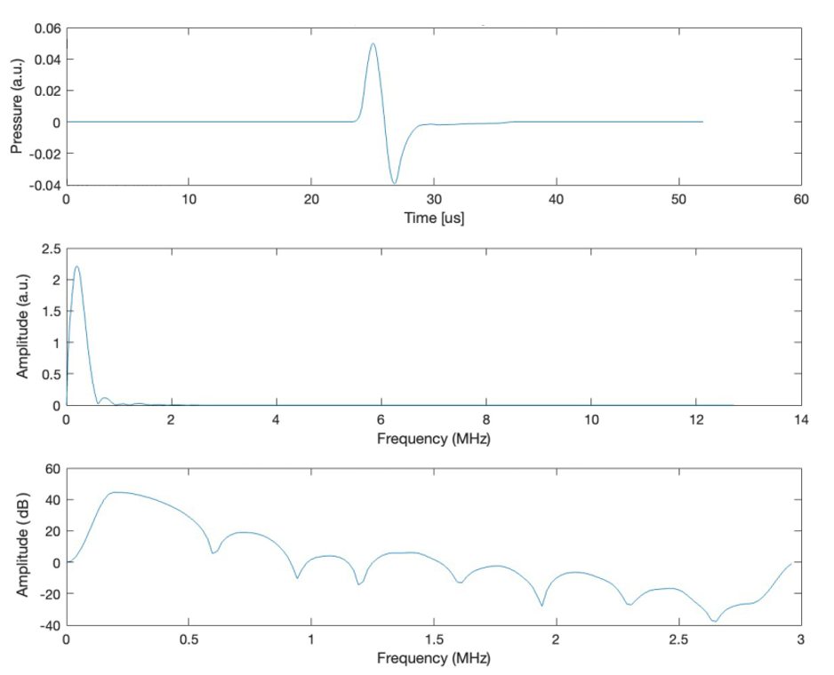
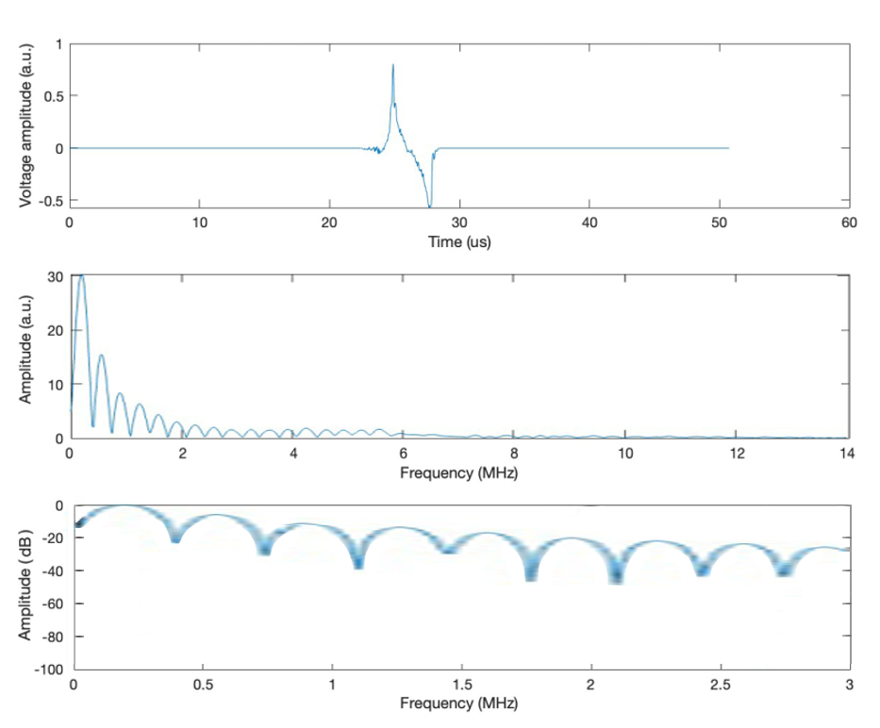
Radial acoustic signals received from position of the Bragg peak by sensor element 128
Computer (IO) simulation
Experimental (PA) simulation

Slide 20
Conclusion
Simulation appears to be behaving well (analysis ongoing)
The next steps:
1) Validate the simulation against an ionacoustic (rather than photoacoustic) experiment with a pulsed proton source
2) Use the simulation to design the ionacoustic system for preclinical LhARA experiments
3) Build the ionacoustic system, test and demonstrate in a
proof-of-principle radiobiological experiment

