Slide 1

Advancing Radiobiology Technology
Investigating chemical structure at high spatial resolution.
Dr James Ingham

Slide 2




Microbeam radiation therapy
IR-SNOM
FTIR
Machine learning

Slide 3
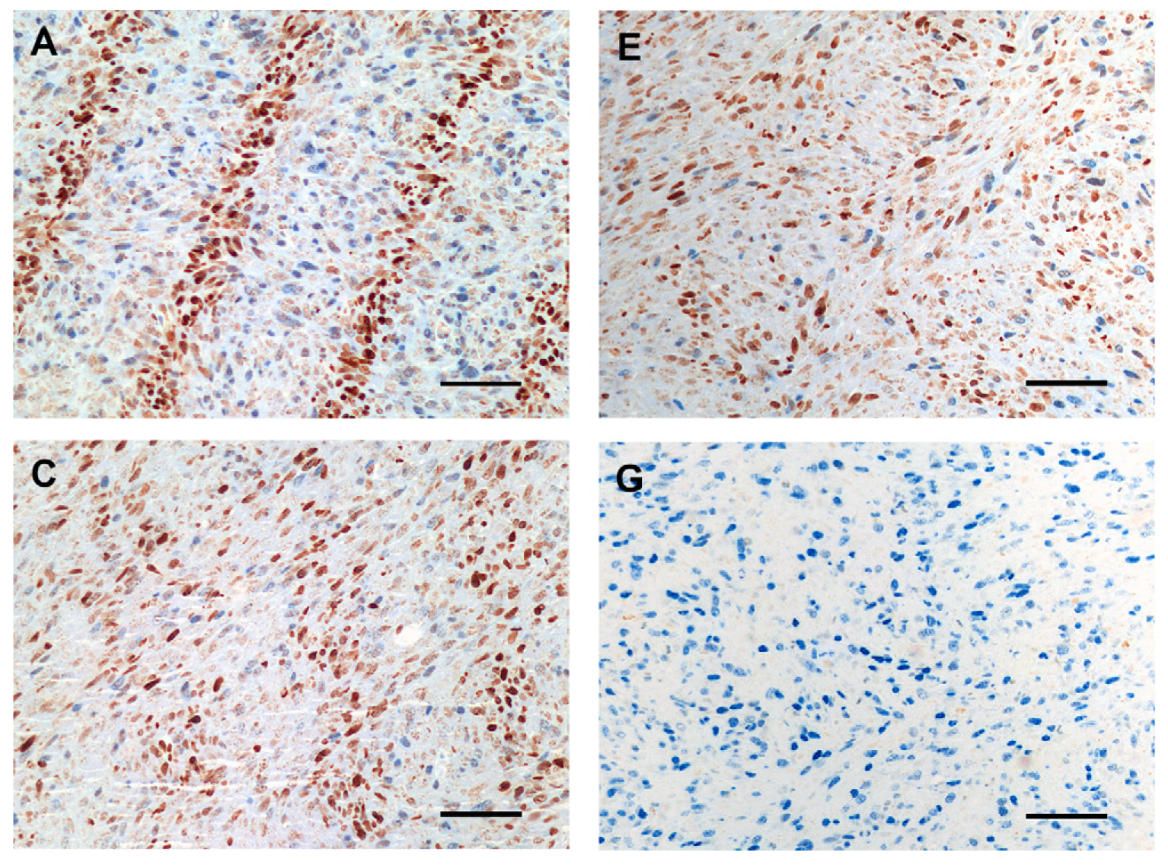
Microbeam radiation therapy
High dose X-ray MRT on mammary tumour-inoculated mice.
4 Hours
24 Hours
12 Hours
Control
Crosbie et. al. Int. J. Radiation Oncology Biol. Phys., Vol. 77, No. 3, pp. 886–894, 2010

Slide 4
Microbeam radiation therapy
4 Hours
24 Hours
MRT significantly reduced tumour cell proliferation by 24 h post-irradiation.
Extensive cell migration in tumours, not expected.
MRT elicited an increase in median survival times of tumour-inoculated mice similar to that achieved with conventional radiotherapy, while causing markedly less normal tissue damage.
12 Hours
Control
Prof. Peter Weightman - Collaborative Research Programme with Australia
“Development of Infrared Diagnostics of Cancer”
(EU Fellowship 2017) Peter Weightman (Liverpool) Jeff. Crosbie and Ewan Blanch (RMIT University, Melbourne), Mark Tobin and Bruce Cowie (Australian Synchrotron).

Slide 5
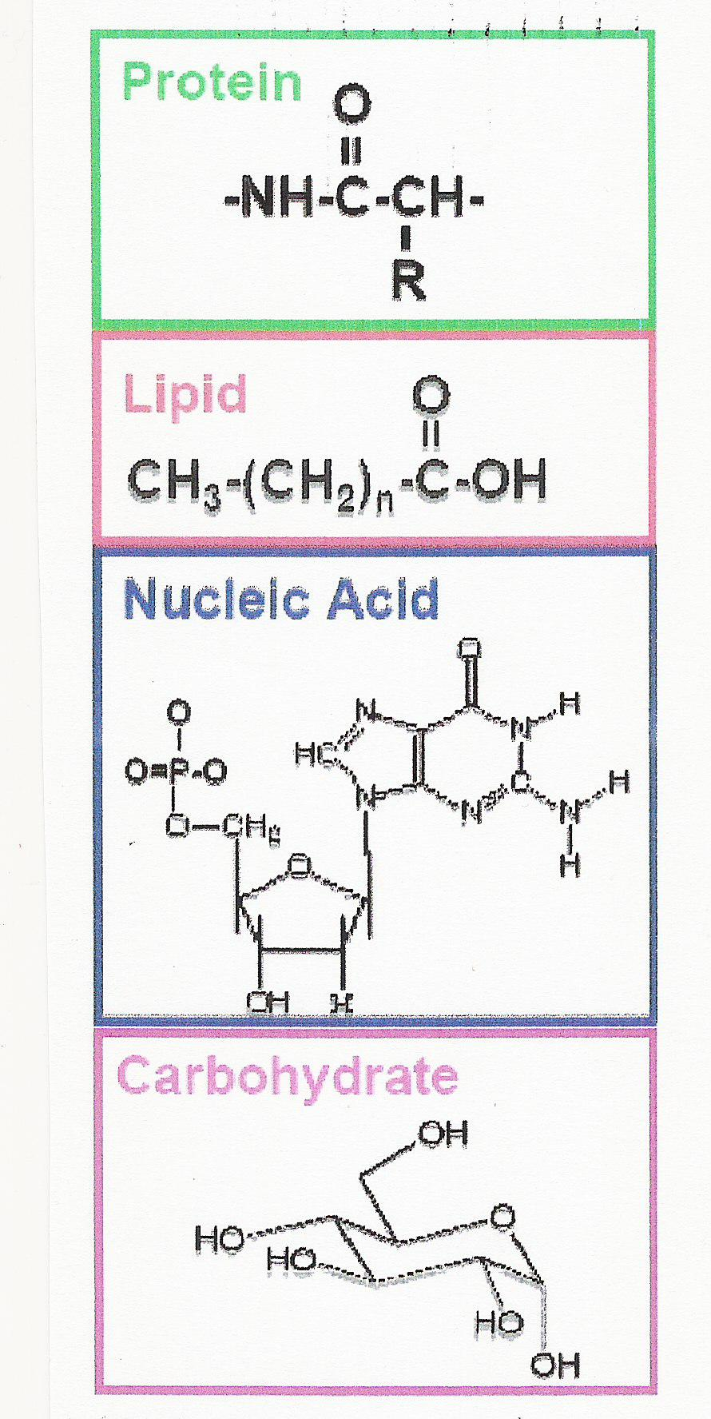
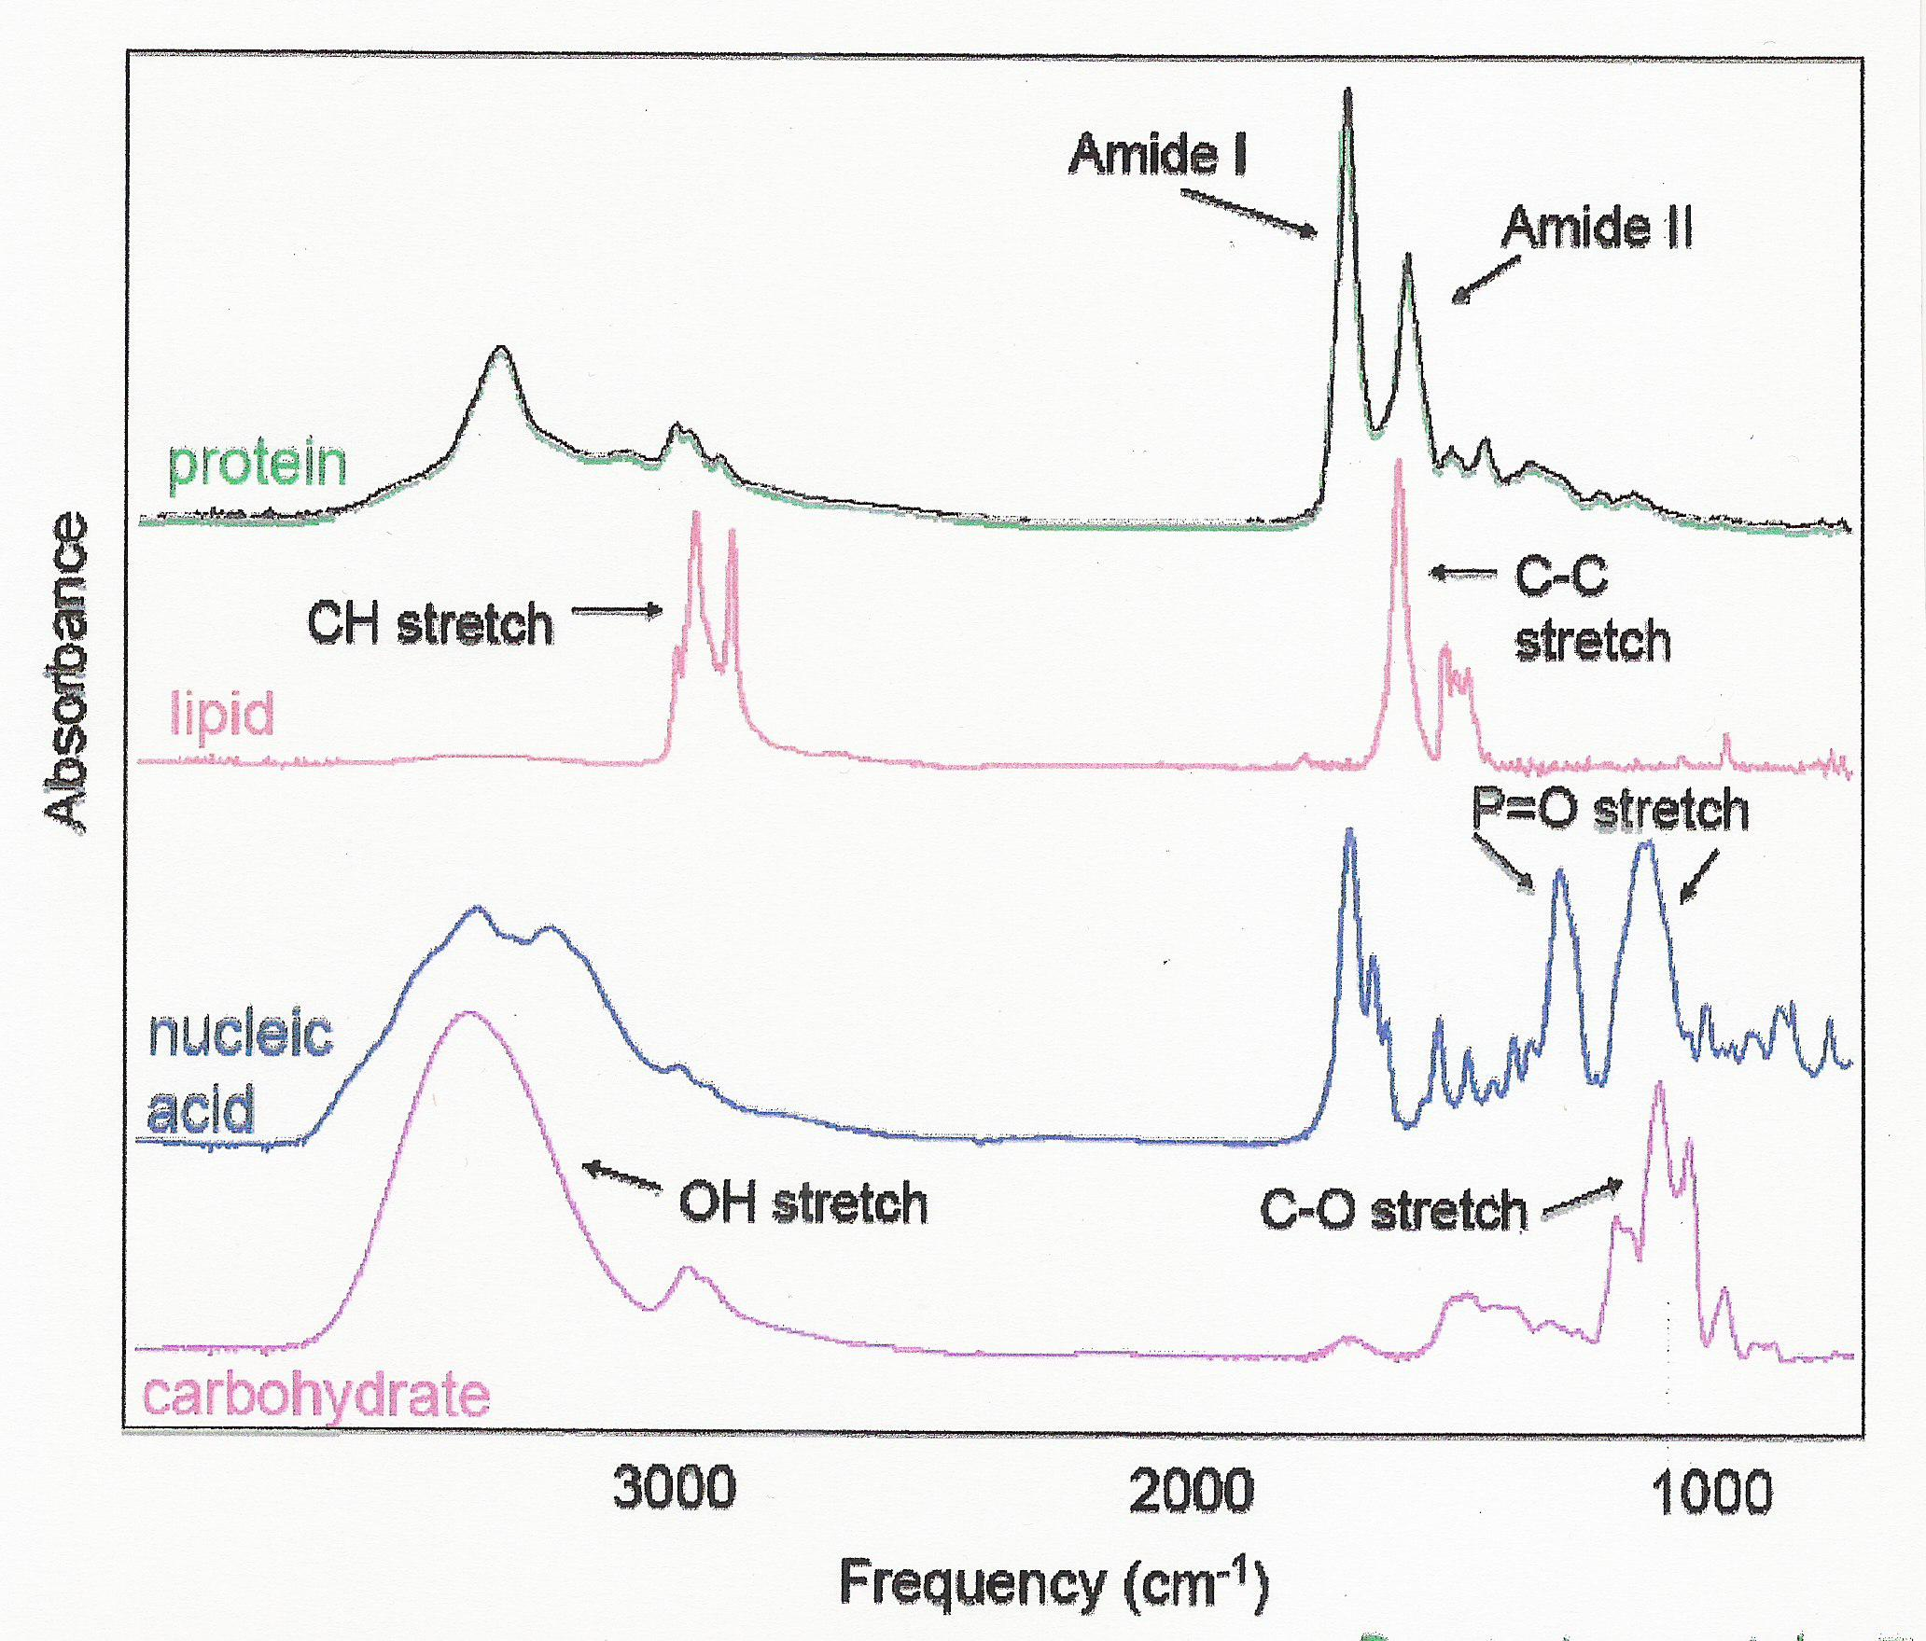
IR-SNOM
Infra-red spectroscopy
Spectral fingerprints of key biological molecules
Longer IR wavelengths limits spatial resolution to ~ λ/2

Slide 6

IR-SNOM
Scanning Near-field Optical Microscopy
Aperture
Aperture-less
Pokémon
Near-field

Slide 7
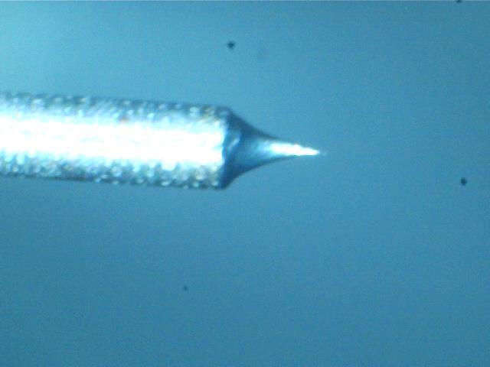
IR-SNOM
Aperture Scanning Near-field Optical Microscopy
Near-field

Slide 8
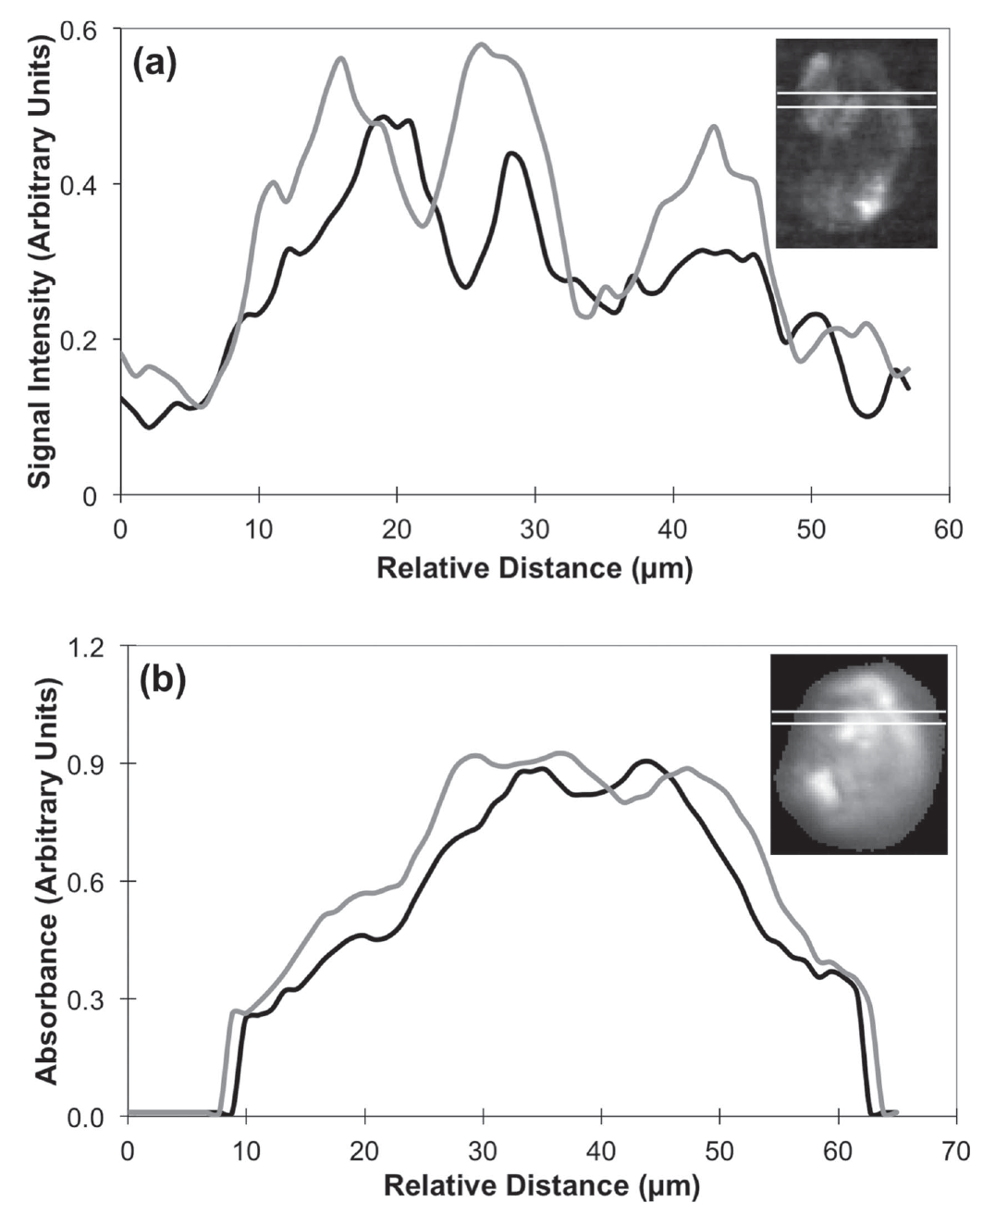
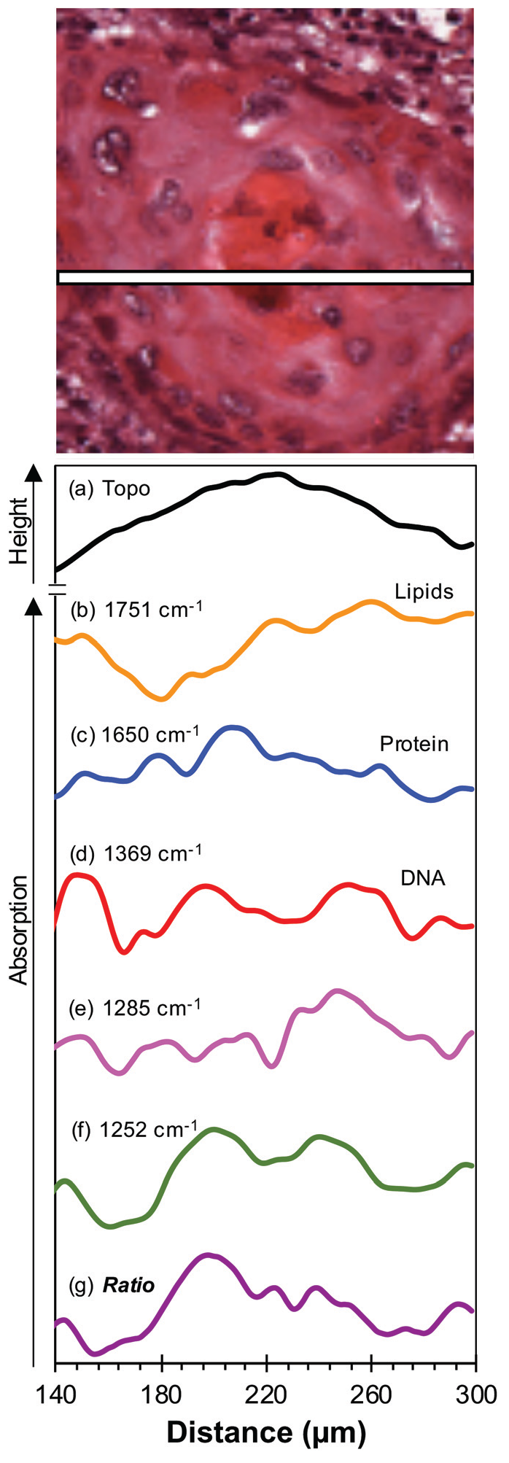
IR-SNOM
SNOM
@1242 cm⁻¹
FTIR
@1242 cm⁻¹
Ingham et. al. Biomed. Phys. Eng. Express 4 (2018) 025011
Ellis et. al. Analyst, 2021, 146, 4895–4904

Slide 9
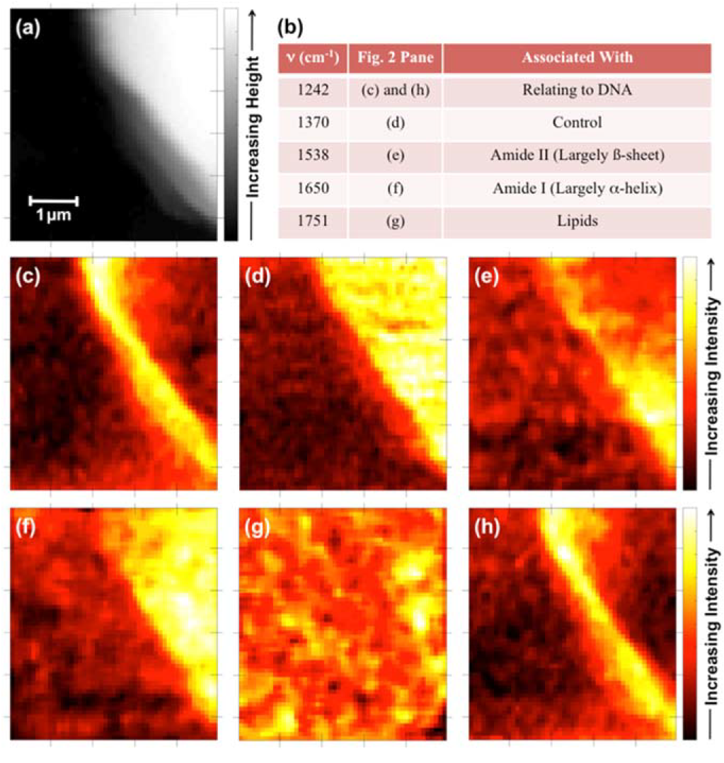
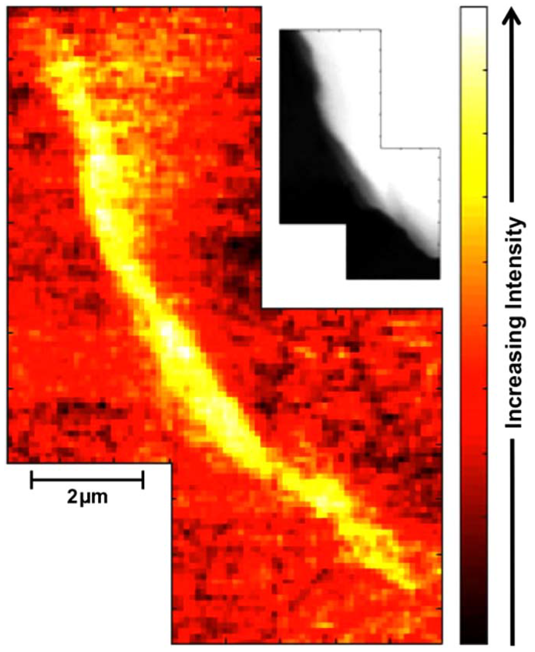
IR-SNOM
Ingham et. al. Biomed. Phys. Eng. Express 5 (2019) 015009

Slide 10
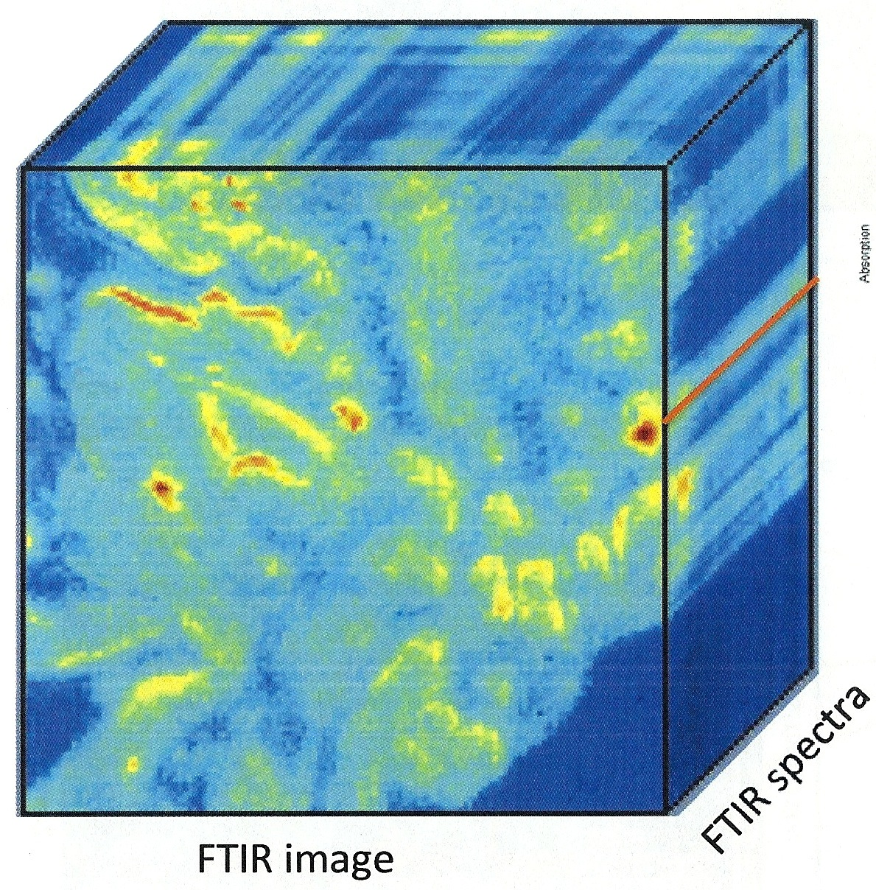
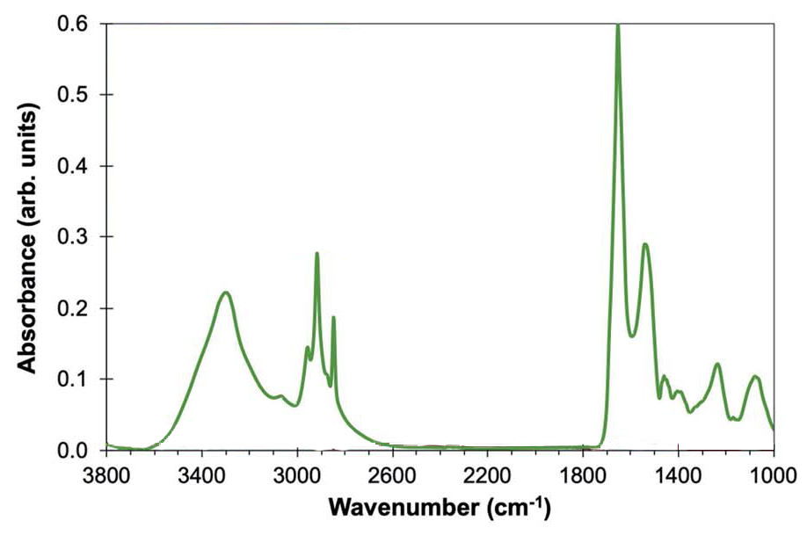
FTIR
Fourier Transform Infra-Red microscopy
Large amount of chemically sensitive information

Slide 11
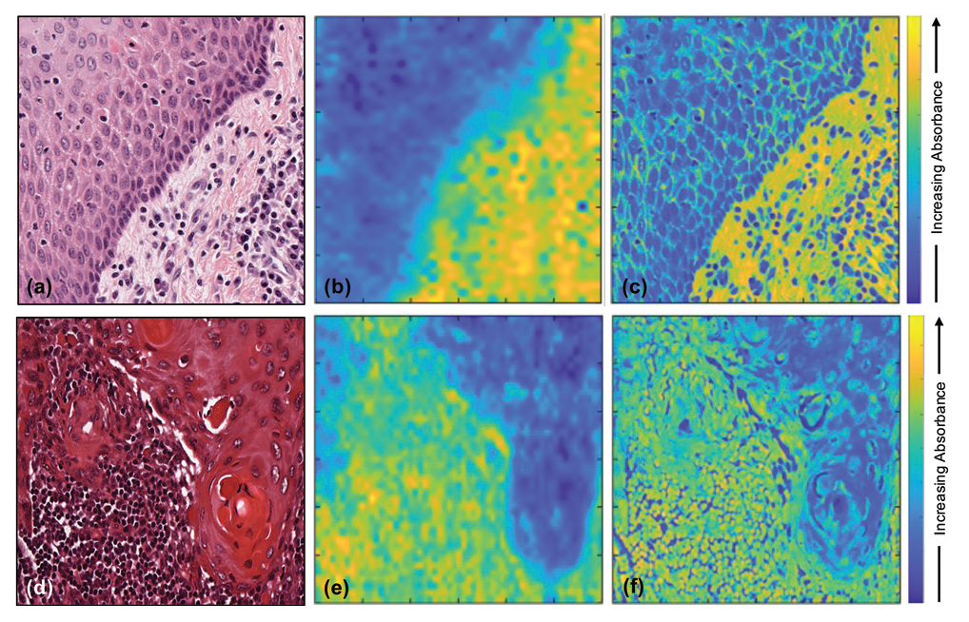
FTIR
Image fusion
Al Jedani et. al. Analyst, 2021, 146, 5848–5854
Combination the spatial resolution of optical microscopy images with FTIR images using a weighted linear regression model.

Slide 12
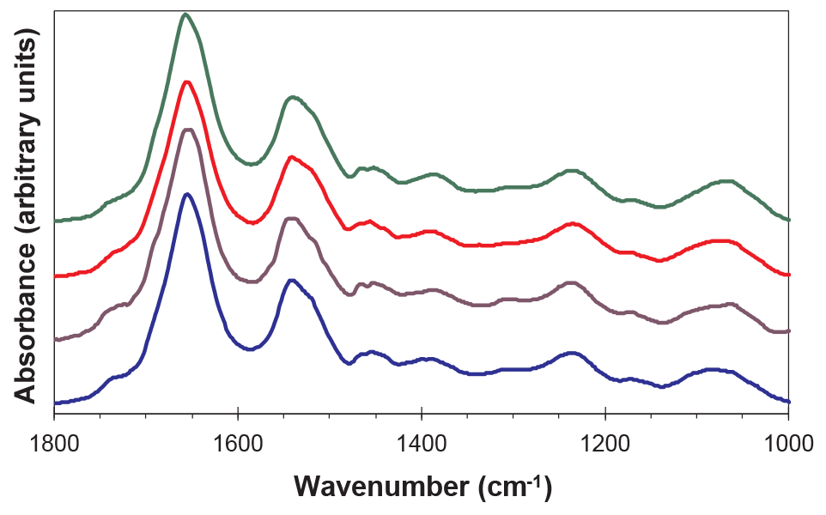
FTIR
Fourier Transform Infra-Red microscopy - Problems
Ingham et. al. Infrared Phys and Tech 102 (2019) 103007
Small variations in spectra
Unwieldy when working with 100,000’s of spectra

Slide 13




Machine learning
Sample
Collection
Sample
Preparation
Histological
Analysis
FTIR
Imaging
Supervised Analysis*
*WO 2019/197806 A1

Slide 14
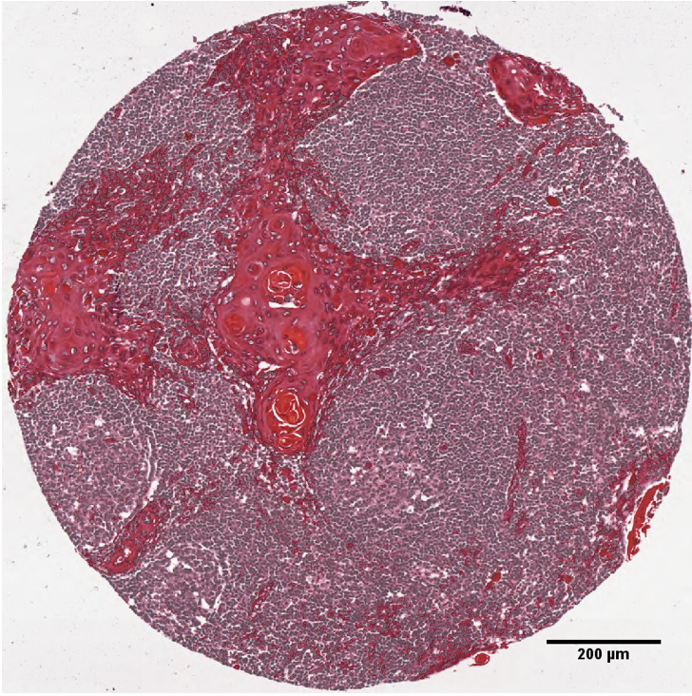
Machine learning
Our approach for analysing FTIR datasets looks at the relationship between pairs of wavenumbers and scores them based on their ability to provide information.
1252 cm⁻¹
1285 cm⁻¹
1252 cm⁻¹/1285 cm⁻¹
Ellis et. al. Analyst, 2021, 146, 4895–4904

Slide 15
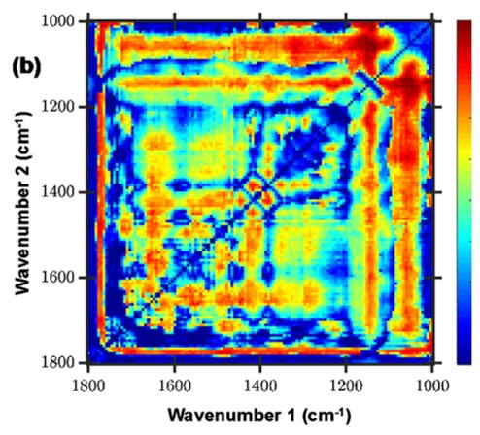
Machine learning

Slide 16
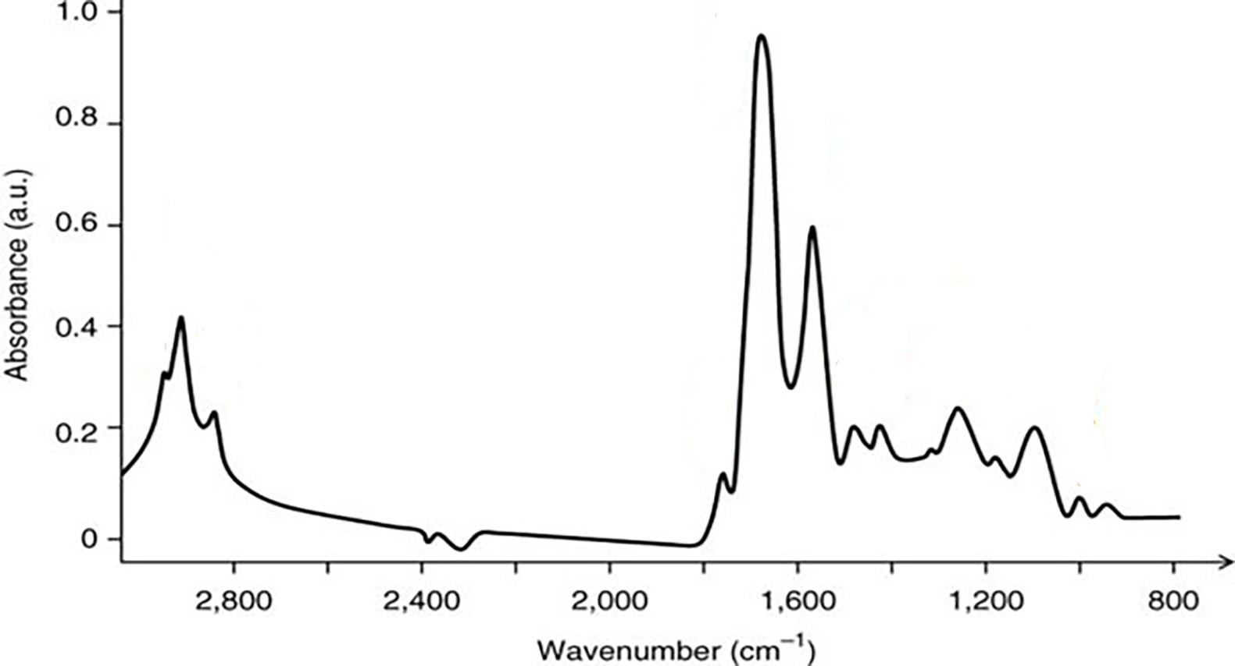
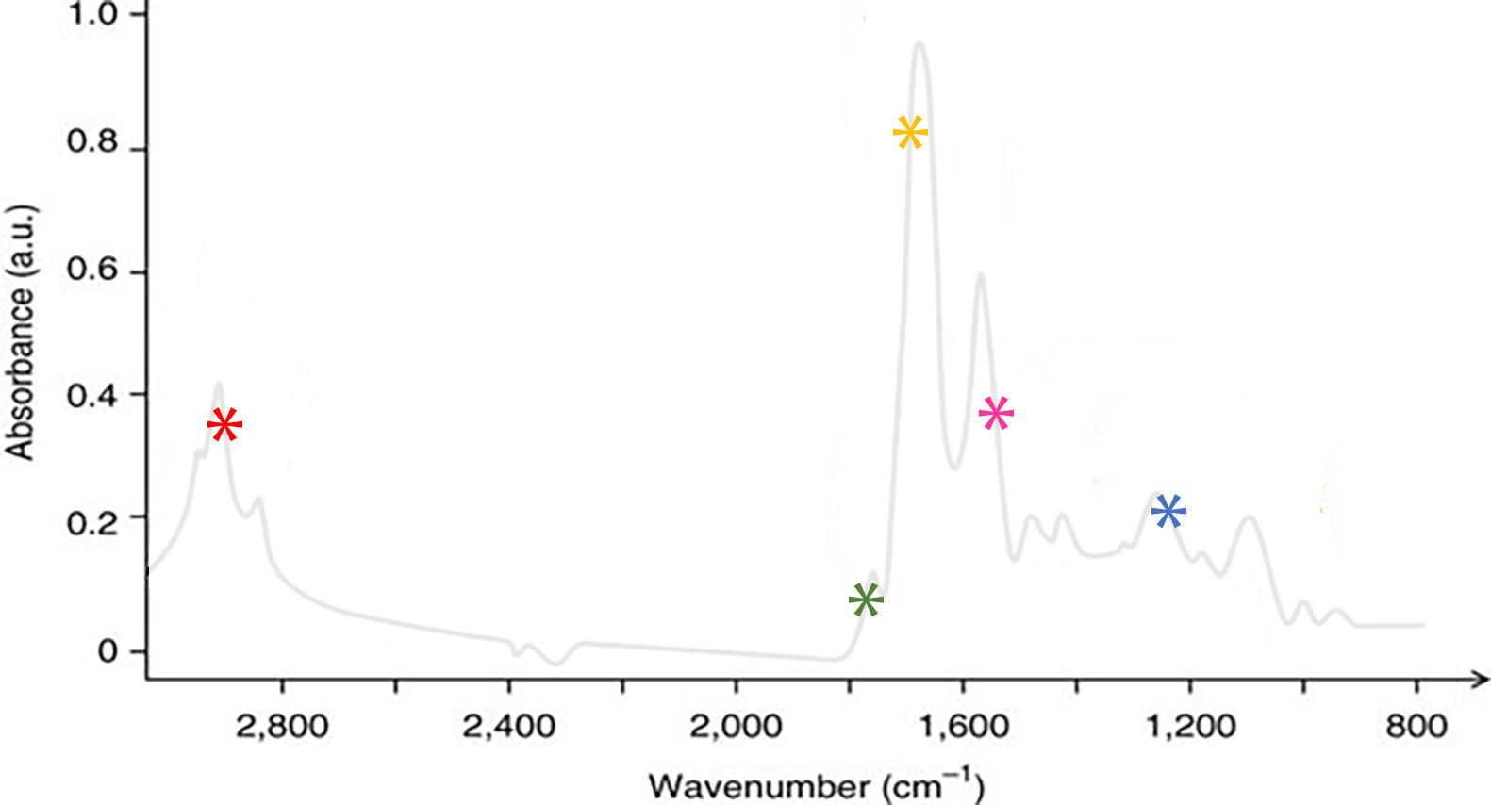
Machine learning
Reduction of data required for classification
Wavenumbers give insight into key biological components involved in cancer development

Slide 17
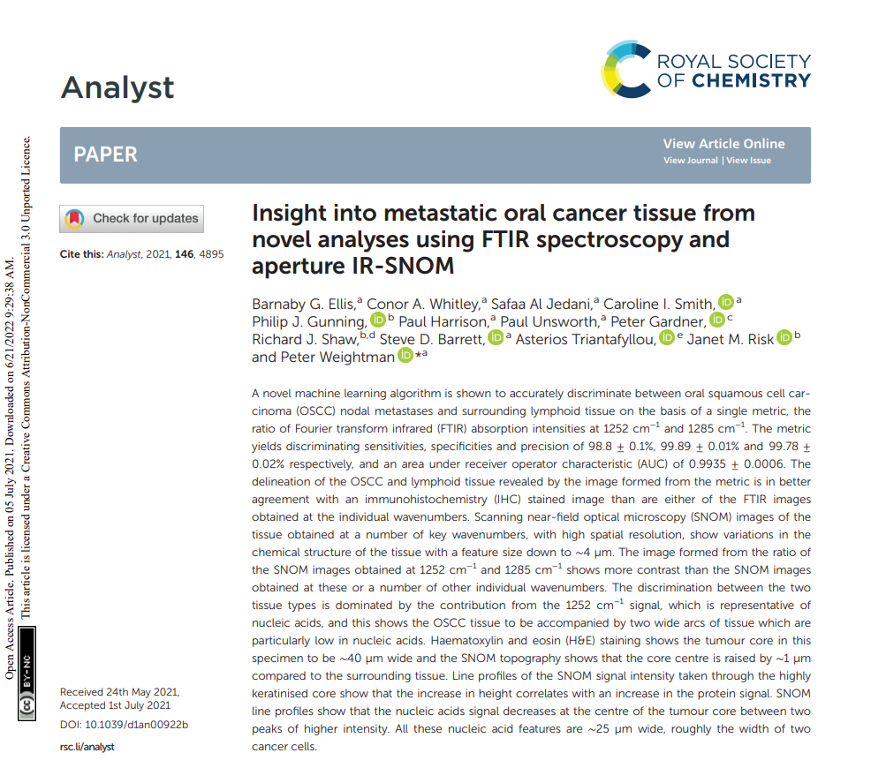
Machine learning
Oral squamous cell carcinoma (OSCC) nodal metastases and surrounding lymphoid tissue
Sensitivity | 98.8 ± 0.1%
Specificity | 99.89 ± 0.01%

Slide 18
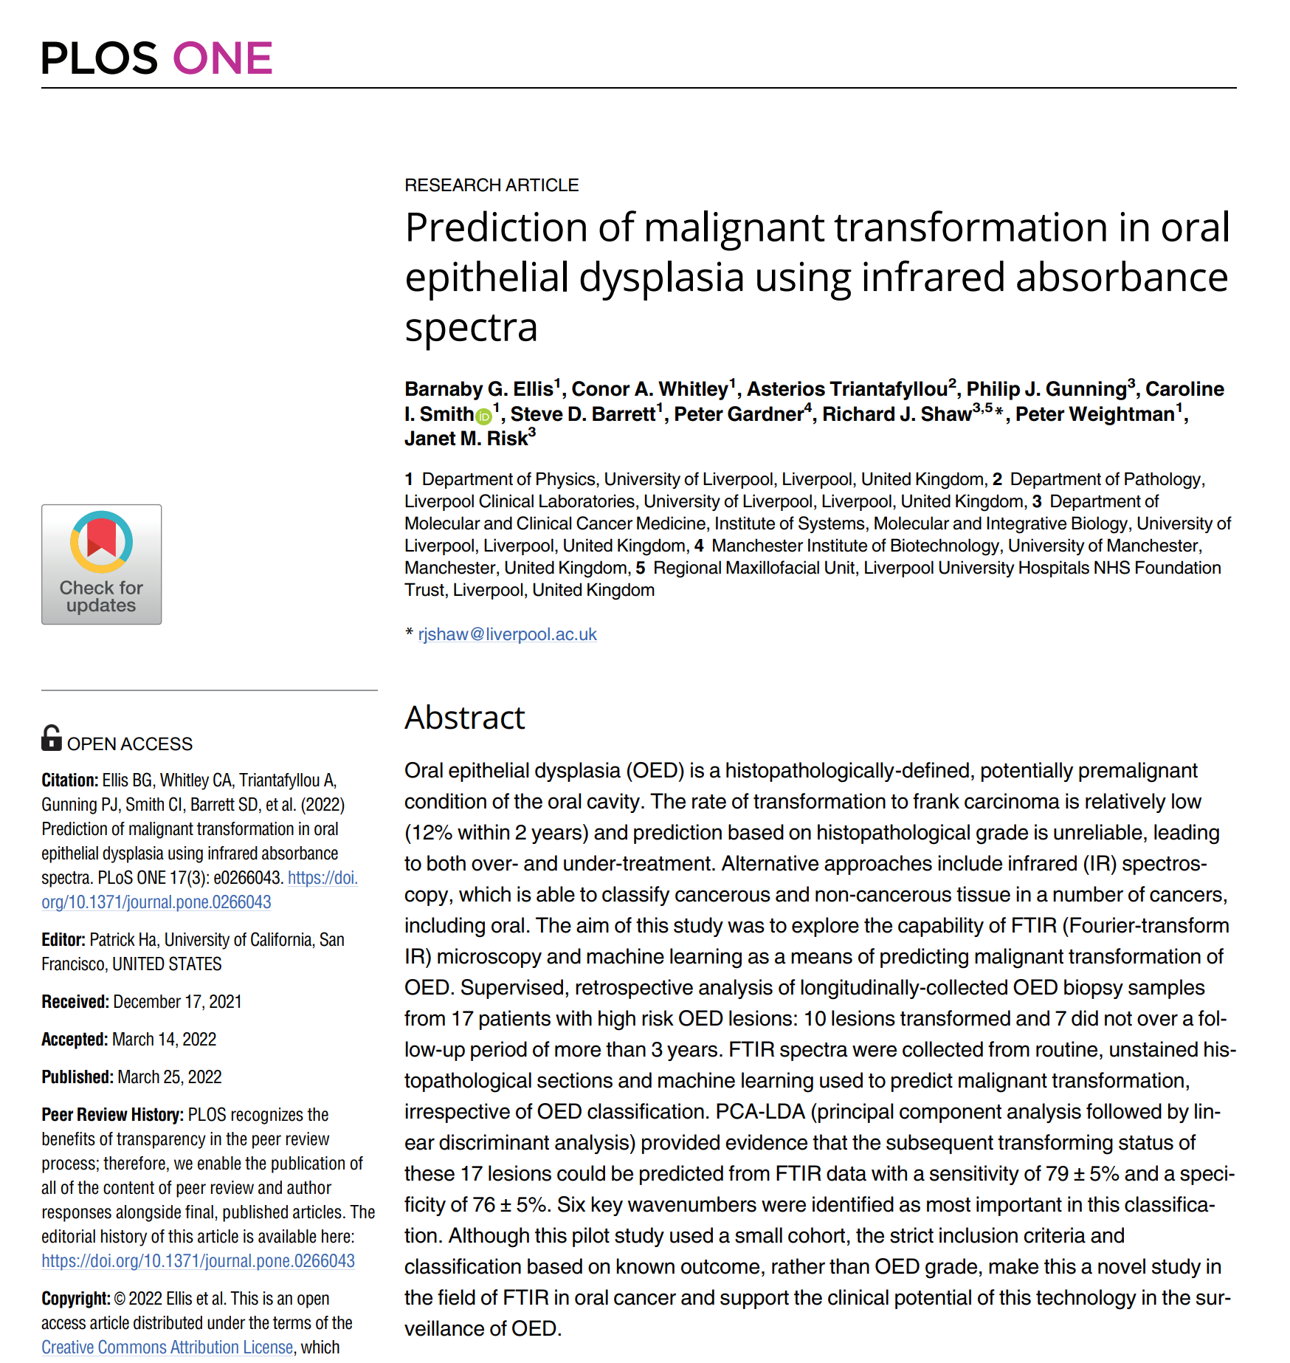
Machine learning
Prediction of progression of oral epithelial dysplasia lesions into cancer
 | Our MLA | PCA-LDA
Sensitivity | 84 ± 3% | 79 ± 5%
Specificity | 79 ± 3% | 76 ± 5%
‘Current histopathological grade approaches are able to make this predication ~ 25-40%’.*
*Mehanna et. al. Curr Oncol Rep (2011) 13:145–152

Slide 19
Pathway
FTIR
Imaging
Machine learning
SNOM
Imaging

Slide 20




Thanks!
Team
Professor Peter Weightman
Professor Richard Shaw
Dr Janet Risk
Dr Asterios Triantafyllou
Dr Steve Barrett
Dr Caroline Smith
Dr Paul Harrison
Dr Barnaby Ellis
Dr Conner Whitley
Dr Safaa Al Jedani
Mr Thiazzi Anakrazia

