Slide 1


Exploration of distinct spatiotemporal dose distributions at LhARA
Yolanda Prezado
Notes:
Lo de las perspectivas

Slide 2
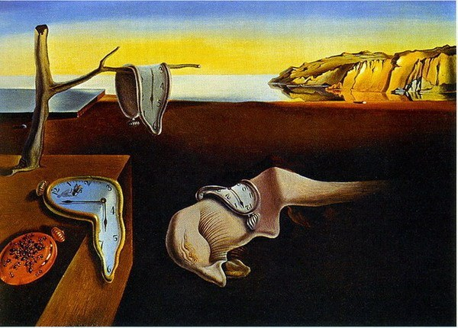
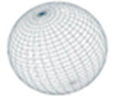
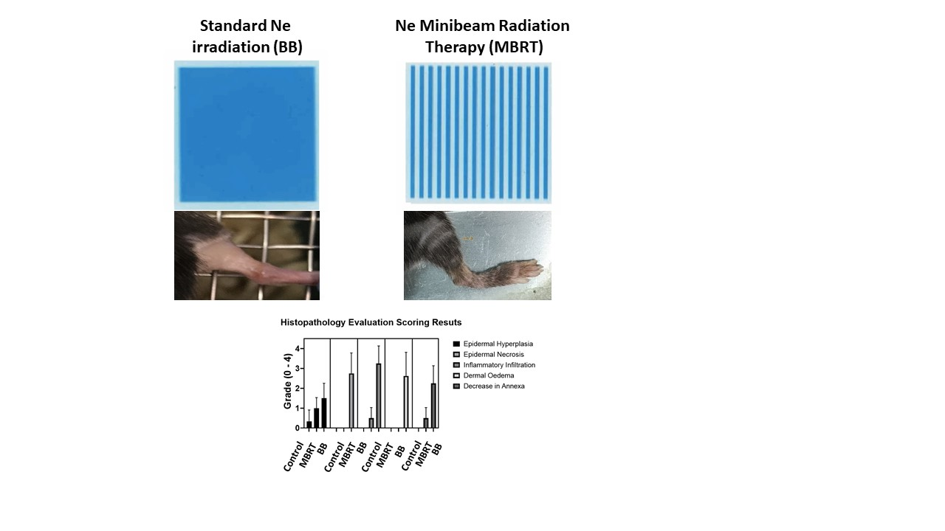
Radiotherapy: a paradigm shift in the 21th century
Fractionation
Dose rate
Pulse structure
Photons
Protons
Heavy ions
TIME
PARTICLE
Standard RT
SPACE
ENERGY

Slide 3

Exploration of the influence of the different parameters on the biological response
TIME
PARTICLE
Clinical accelerators = non-flexible
Protons/heavy ions facilities= low accessibility
New flexible accelerators are needed
SPACE
ENERGY

Slide 4
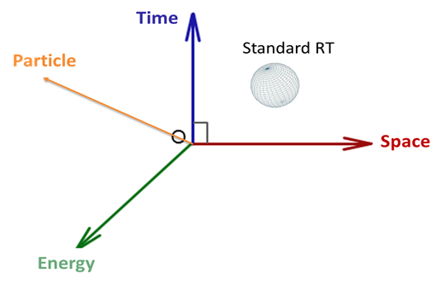
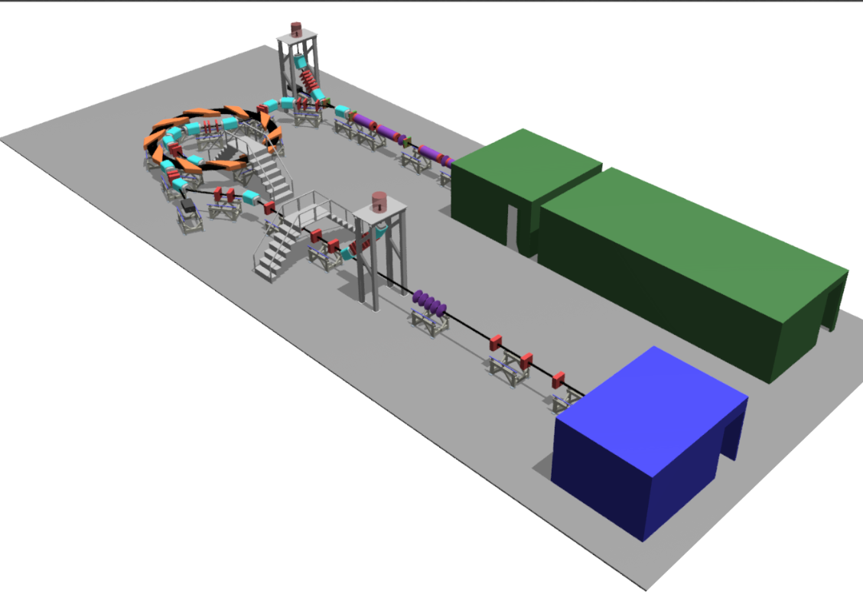
Laser Hybrid Accelerator for radiobiology applications
G. Aymar et al. Frontiers in Physics
Notes:
Nanorain

Slide 5
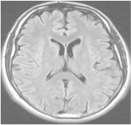
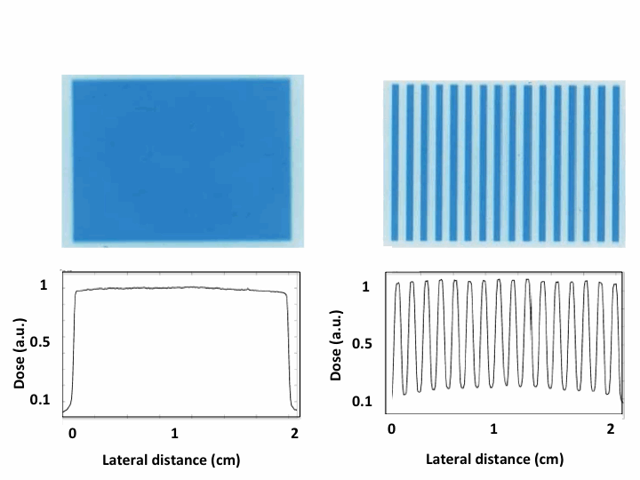
Spatially Fractionated Radiation Therapy (SFRT)
large fields (≥ 1 cm)
laterally homogeneous dose distributions
field composed of smaller beamlets
laterally heterogeneous dose distributions
(peaks and valleys)
➜ increase of normal
tissue tolerance
Standard RT
≥ 1 cm
beamlet
peak valley
SFRT

Slide 6
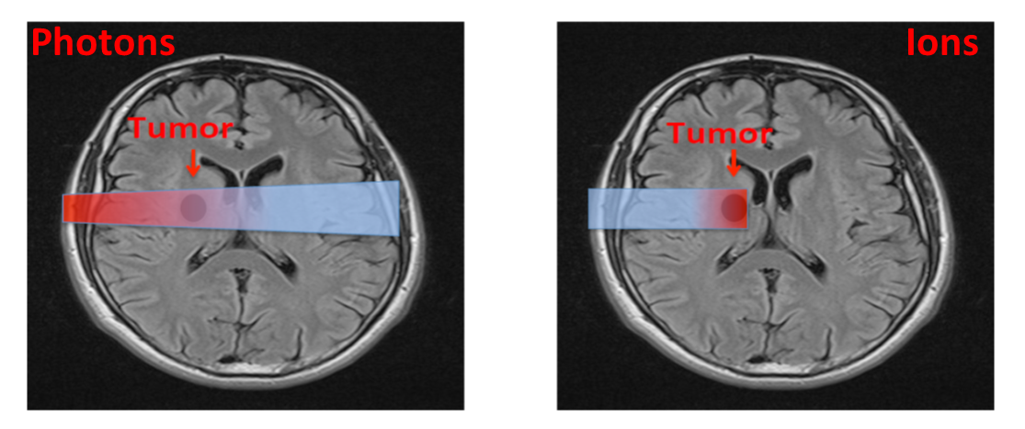
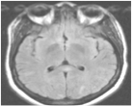

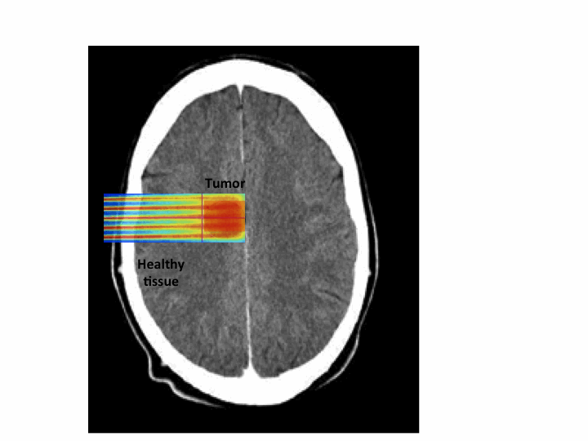
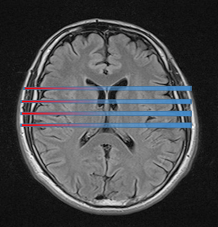
PROTONMBRT: an innovative therapeutic approach
Proton MBRT
Charged particles
Tumor
Prezado et al. 2013
ERC consolidator grant
Beam width < 1 mm
Minibeam radiation therapy (MBRT)

Slide 7
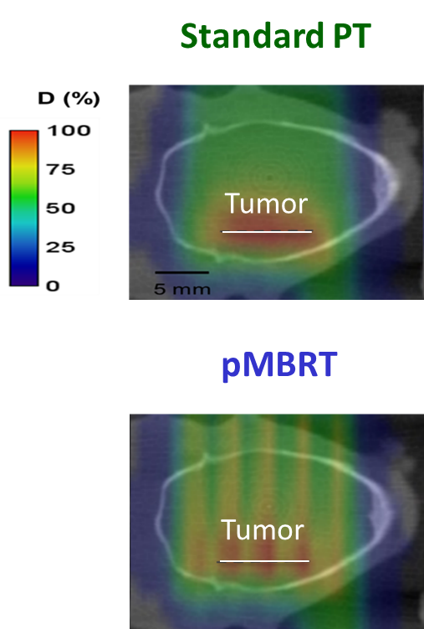
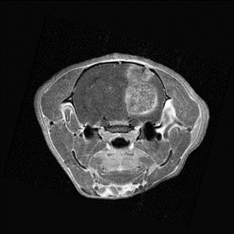
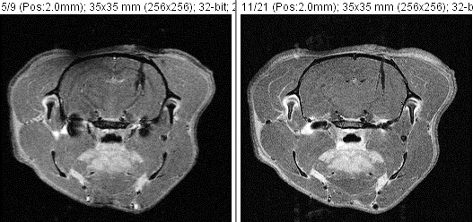
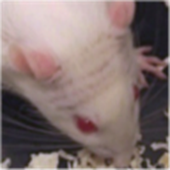
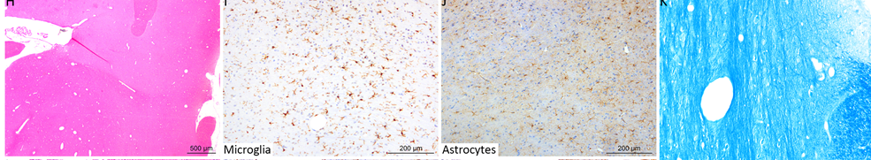
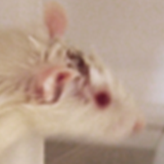
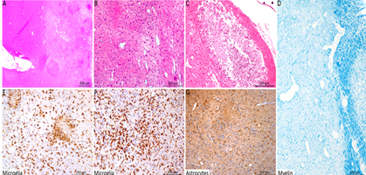
pMBRT increases the therapeutic index for high-grade gliomas
Equivalent or superior tumor (rat glioma) control than standard proton therapy
25 Gy/one fraction
5 days after IR
26 days after IR
Prezado et al. IJROP 2019
Net reduction of neurotoxicity
pMBRT
Standard
PT
necrosis
Inflammation
astrogliosis
demyelination
Prezado et al. Scie Reports 2017; Lamirault et al. Scie Reports 2020

Slide 8
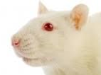
pMBRT a promising alternative for re-irradiations
Day 0
Conv RT (BB)
20 Gy
Day 60
Conv RT 20 Gy
OR
pMBRT 20 Gy mean dose
Behavioural tests
@ 3 and 6 months after the first IR
Naive Rat’s brain irradiations
N=8/group
 | Incidence/mean
Main Finding | CTRL | BB+pMBRT | BB+BB | BB
Thalamus: Vacuolation | 0 | 0 | 2/1.0 | 0
Necrosis, fimbria | 0 | 4/1.3 | 5/1.6 | 0
Necrosis, alveus | 0 | 0 | 2/1.5 | 0
Necrosis CA1 to CA4, gyrus denta-tus | 0 | 0 | 3/1.7 | 0
Microthrombi/ossification, plexus | 0 | 0 | 3/1.0 | 0

Slide 9
PROTONMBRT
Net reduction of normal tissue toxicities
Equivalent or superior tumor control as in conventional RT even with highly heterogenous dose distributions
WHY?

Slide 10
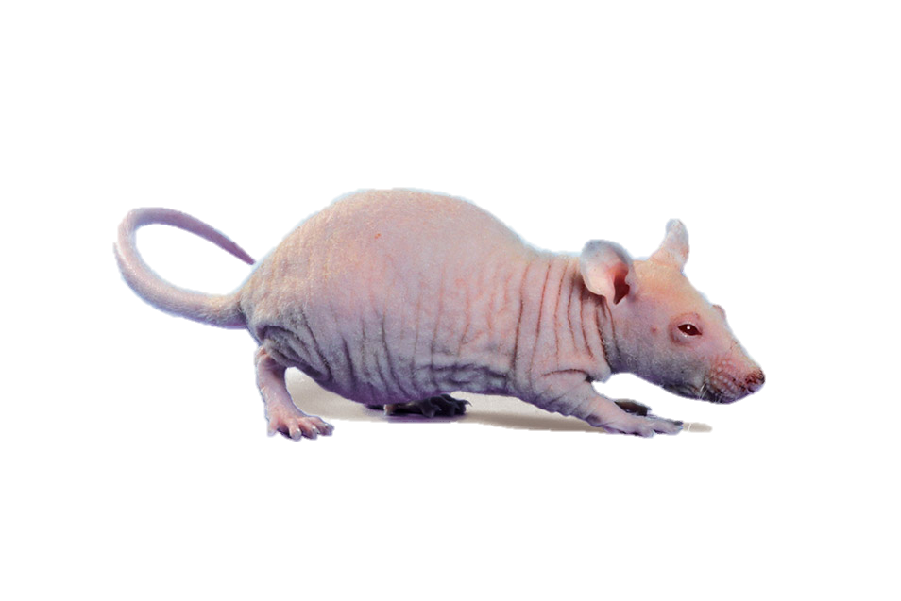
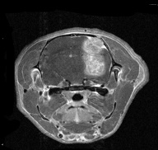
Immune response generated in (orthotopic) glioblastoma model after pMBRT
1 fraction of 25 Gy average in pMBRT
Athymic rats (Nude)
→ Lack T lymphocytes
Rats Fischer (immunocompetent)
Rats Nude (immunodeficient)
Glioblastoma (RG2)
Catherine Sébrié, IR4M
T cells are key in pMBRT mechanism
Bertho, Iturri et al. IJROBP 2022

Slide 11
Lymphocytes in pMBRT
Flow cytometry analysis
Control
ConvPT 7dpi
pMBRT 7dpi
Infiltration of tumor-associated lymphocytes (TRM T cells and B cells)
Notes:
In order to do so, we started by a quantification of the overall immune infiltration in the tumor microenvironment by a flow cytometry analysis. Among 11 different immune cell types analysed, we observed that tumor associated lymphocytes were highly recruited both after conventional protontherapy here in red, and pMBRT in blue. Although specifically CD4 T cells and in the case of pMBRT TRM T cells and B cells)

Slide 12
Lymphocytes in pMBRT
Flow cytometry analysis
Control
ConvPT 7dpi
pMBRT 7dpi
Infiltration of tumor-associated lymphocytes (TRM T cells and B cells)
RADIOBIOLOGY
Notes:
In order to do so, we started by a quantification of the overall immune infiltration in the tumor microenvironment by a flow cytometry analysis. Among 11 different immune cell types analysed, we observed that tumor associated lymphocytes were highly recruited both after conventional protontherapy here in red, and pMBRT in blue. Although specifically CD4 T cells and in the case of pMBRT TRM T cells and B cells)

Slide 13
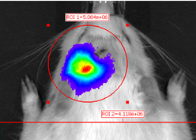
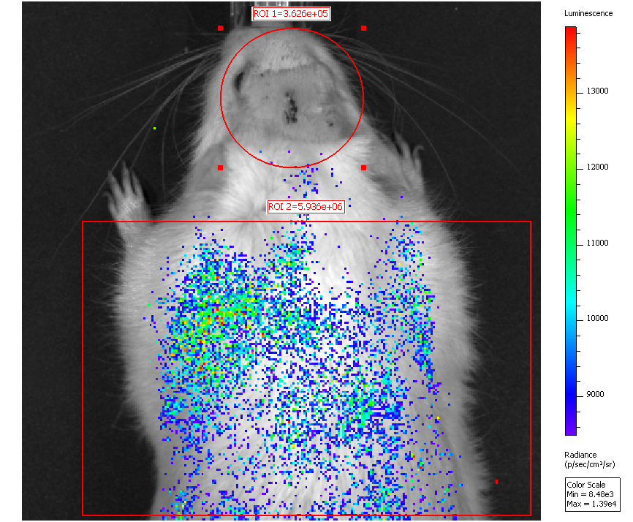

Minibeam radiation therapy could provide long-term anti-tumor immunity
Irradiated and cured immunocompetent RG2-bearing rats were rechallenged with RG2 tumor cells 3 to 6 months after irradiation
CTRL
MBRT

Slide 14
Minibeam radiation therapy leads to a different spatio-temporal recruitment
Spatial distribution of immune cells
Immunofluorescence
Center
Adjacent
Periphery
T cells
Periphery
Adjacent
Center
B cells
pMBRT induces the recruitment of T cells in the center of the tumor
and B cells in the adjacent tissue and the periphery of GB
RADIOBIOLOGY

Slide 15
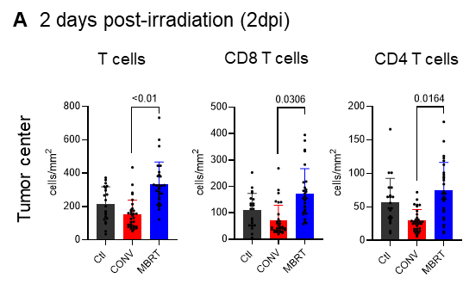
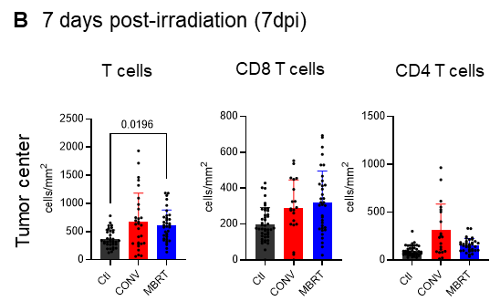
MBRT induces a faster recruitment of T cells in the center of the tumor
Notes:
These results were similar to a previous publication from our lab, in which we studied in a similar way the immune response after x-ray minibeam radiation therapy.
In this study, not only T cells were more recruited in the center, but the difference was more striking 2 days after the irradiation. Therefore, MBRT induced a faster recruitment of T cells in the center. This suggests that in spatial fractionation immune response is related to a different spatio-temporal recruitment
Although for the sake of comparison, the doses given in the conventional group are

Slide 16
Immune infiltration of tumors irradiated by MBRT seems to be characterized by increased (and fast) intratumoral T and B cells.
MBRT leads to a distinct spatio-temporal immune recruitment.

Slide 17
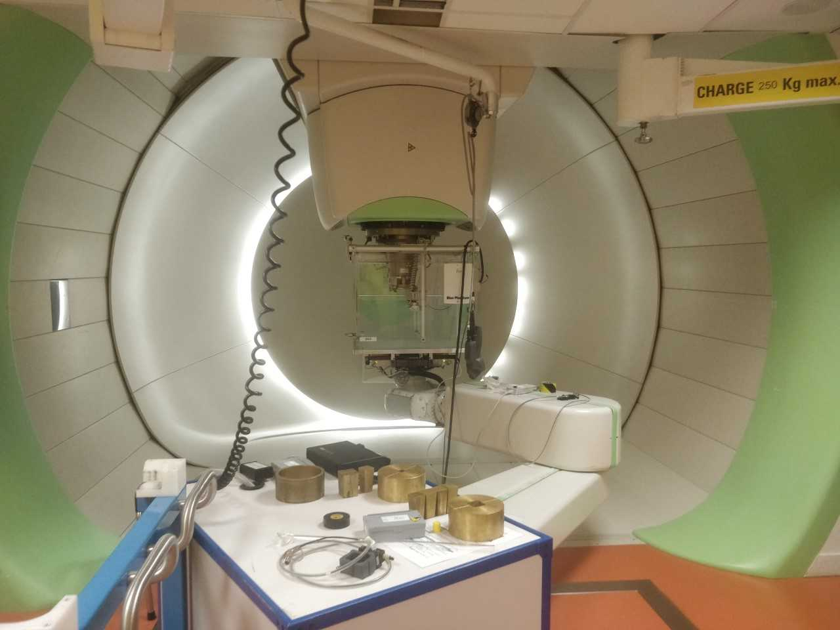
Implementation at a clinical pencil beam scanning systemBS
MC (TOPAS) versus IBA nano RAZOR diode
6 Gy/min
L. De Marzi et al. Med. Phys 2018

Slide 18
Beam characterics LhARA
Ideal beam features
Low divergence
Small emittance
Magnetically focussed minibeams
LhARA → FWHM < 0.5 mm
T. Schneider et al. Scientific Reports 2020
can pave the way towards combination of pMBRT + FLASH

Slide 19
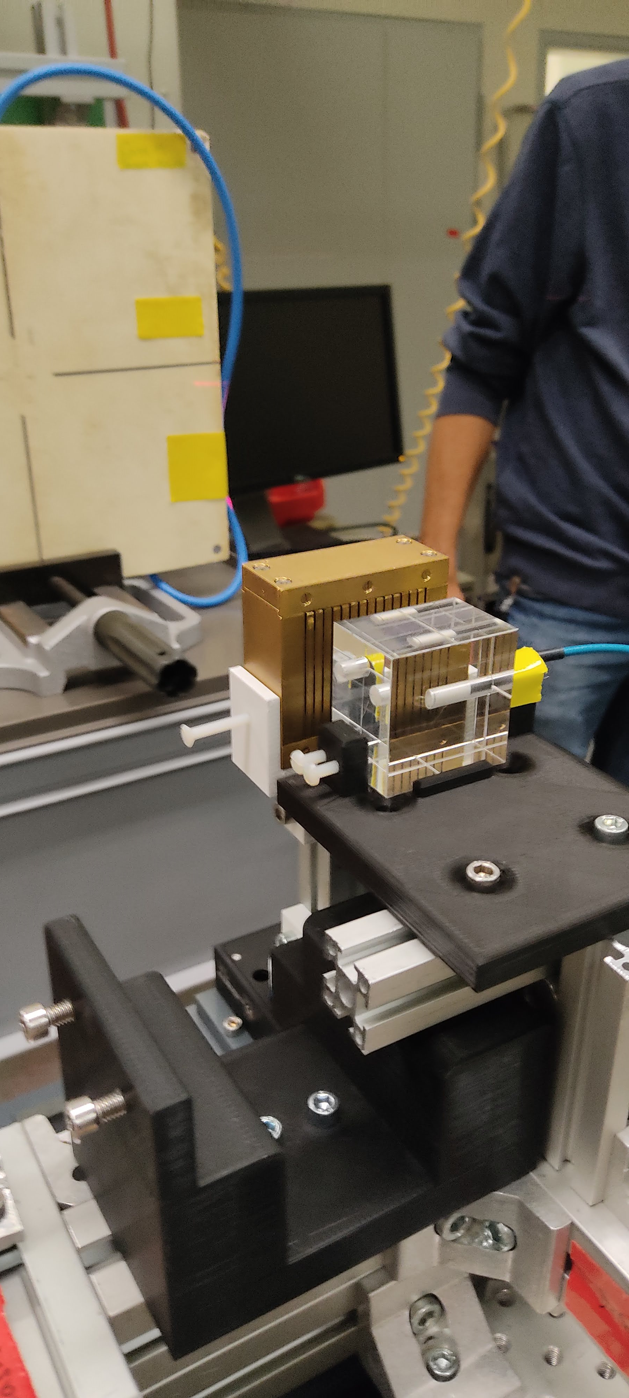
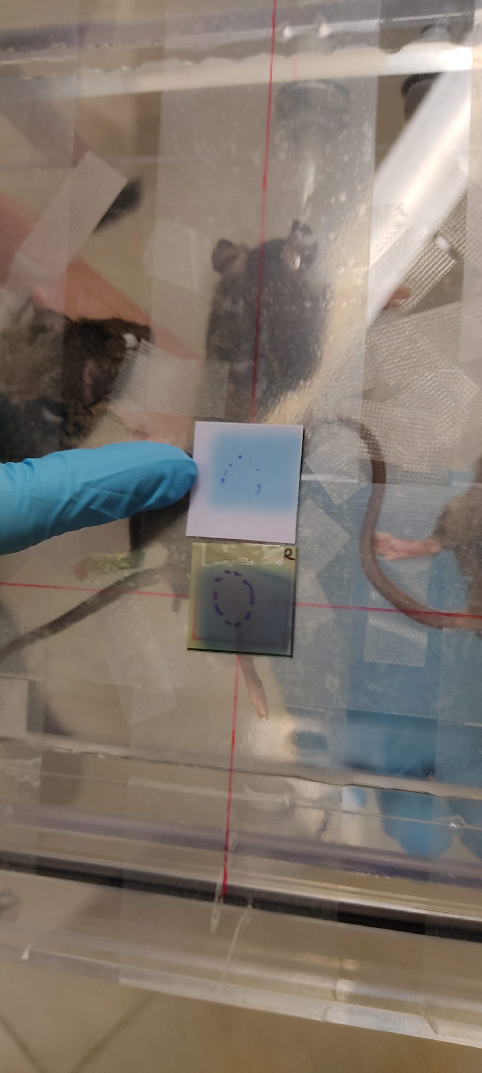
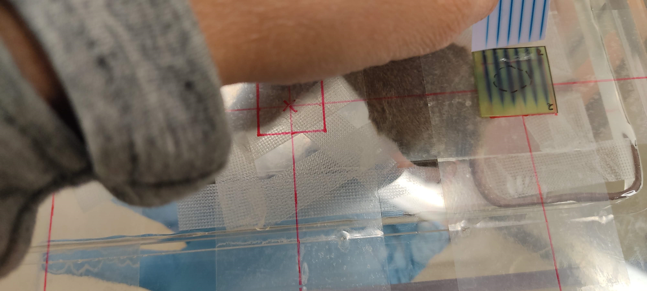
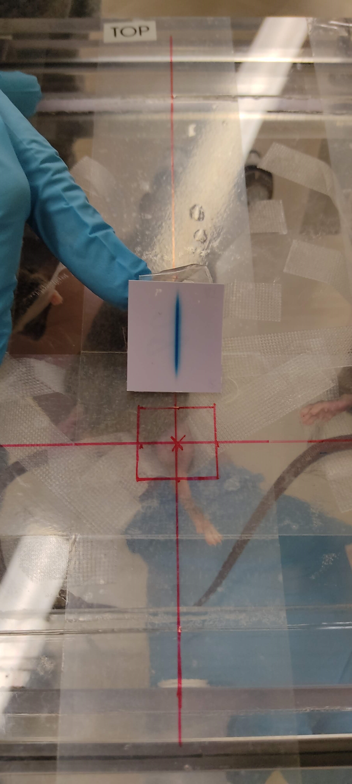
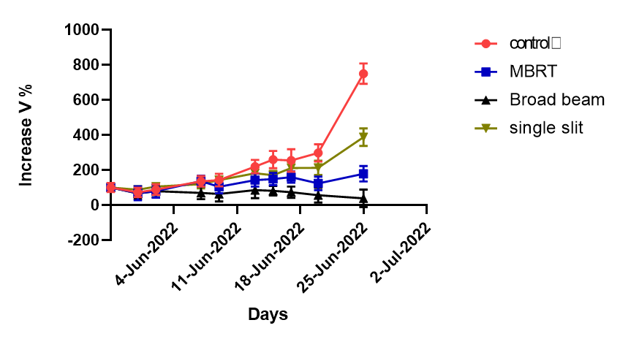
Carbon minibeam radiation therapy @ GSI
180 MeV/A C ions
550 µm width
Conv. IR
MBRT
Single slit
Dose prescription: 20 Gy average
Dose peak = 121 ± 6 Gy,
D valley = 1.5 ± 0.1 Gy
LM8 mice osteosarcoma
Less lung metastasis with Conv.RT and MBRT

Slide 20
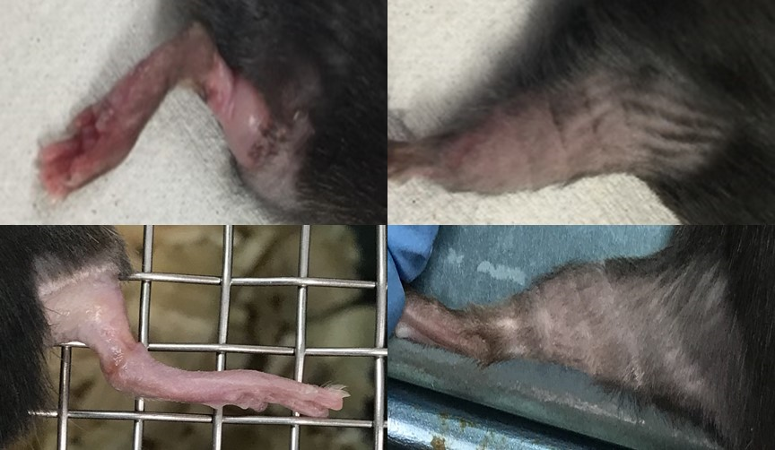
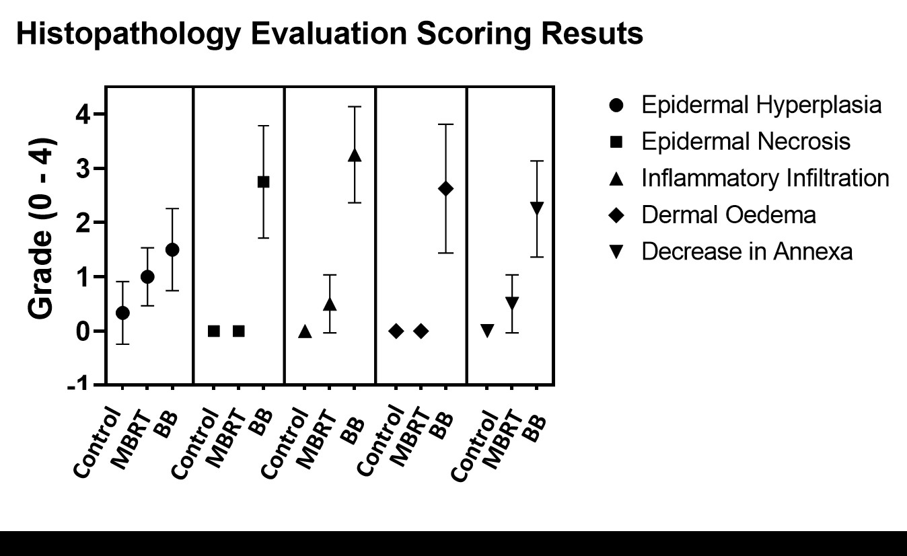

Very heavy ions MBRT
Ne, Si and Ar ions used in the past, extremely efficient for the treatment of hypoxic tumors (Castro 1994). HOWEVER, abandoned due to important side effects in normal tissues
Ne MBRT @ HIMAC, mice’s legs irradiation
Conv RT
MBRT
MBRT leads to a net reduction of toxicity as compared to BB
Potential renewed use of very heavy ions for therapy!
Prezado et al Cancers 2021

Slide 21
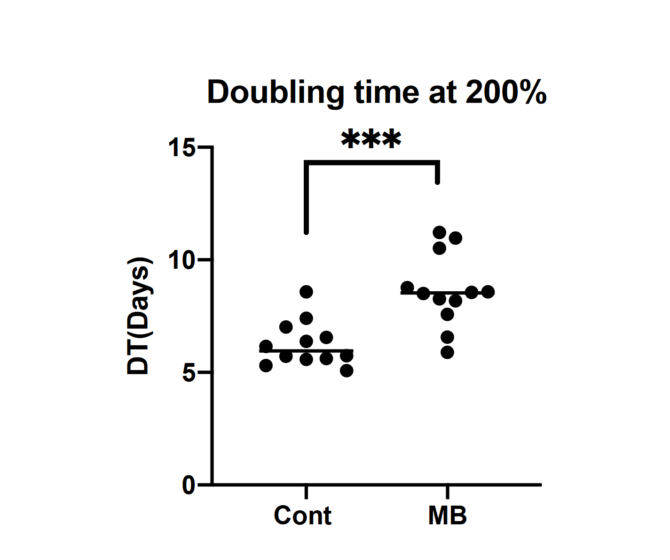
NeMBRT: tumor control delay
SCVii bearing mice, advanced tumors
20 Gy mean dose, 1 Gy valley dose
Broad beam animals reached toxicity endpoints.
Significant tumor growth delay after NeMBRT

Slide 22

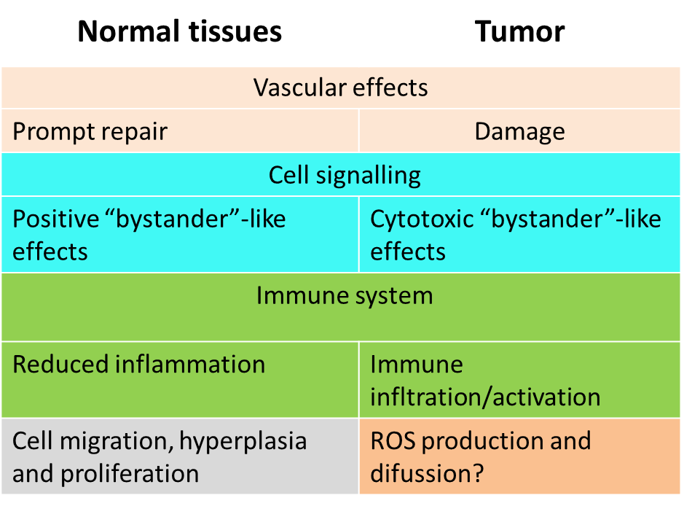
Missing the full picture

Slide 23
LhARA
Notes:
Nanorain

Slide 24
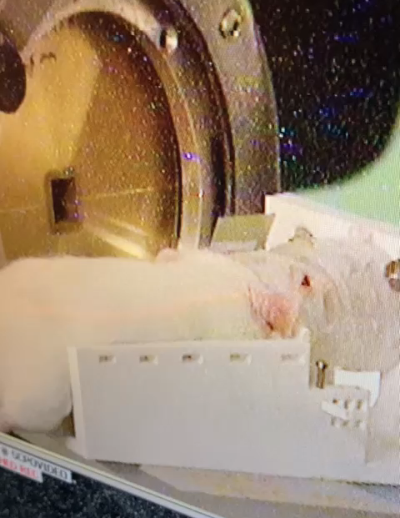
FLASH radiation therapy (FLASH-RT)
Ultra-fast delivery of radiation
  > 40 Gy/s
  High dose given in milliseconds
Protective effect in healthy tissue: FLASH effect
  Neurocognitive sparing of memory Montay-Gruel 2017
  Reduction in pulmonary fibrosis Favaudon 2014
  Skin, intestine, muscle Diffenderfer 2020 & Cunningham 2021 & Tinganelli 2022
Observed with low energy electrons (mostly), photons, protons and carbon ions
R. Ortiz (NARA)
Most direct traslation

Slide 25
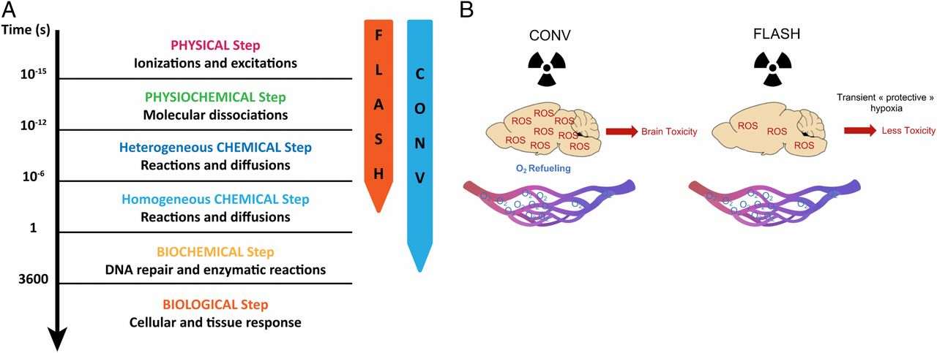
Mechanisms?
From Montay-Gruel 2019
Oxygen depletion: significant intracellular O2 drop→controversial
ROS and free radical from peroxidation reduced in normal cells
Modulation of immune response

Slide 26
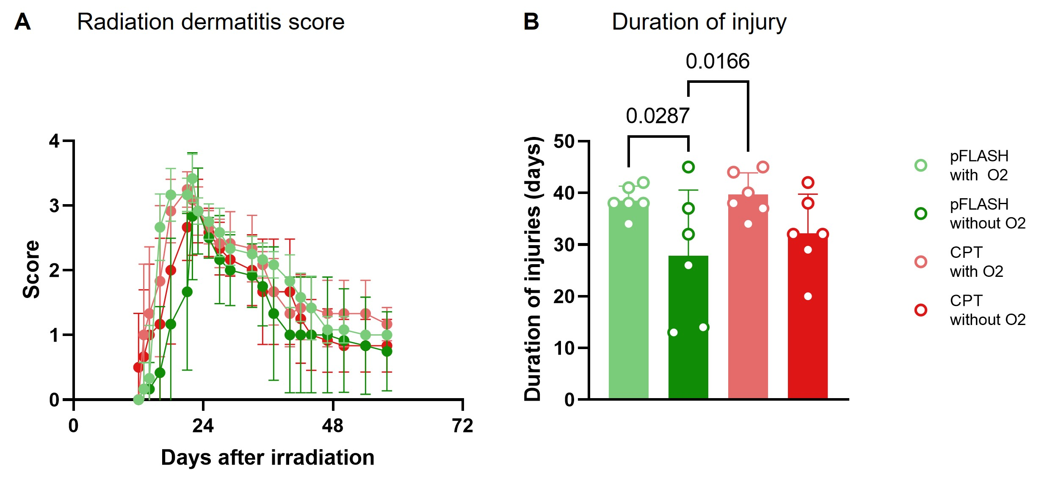
On the impact of anesthesia’s O₂
Adolescent Fischer rats, brain irradiation, 25 Gy
Important open question in brain radiotherapy: the impact of oxygen content in gas anaesthesia and radiation dose rate on normal tissue tolerance of brain radiotherapy.
This is a particularly relevant clinical question in paediatric oncology.
Notes:
Nature Comm. Under revision

Slide 27
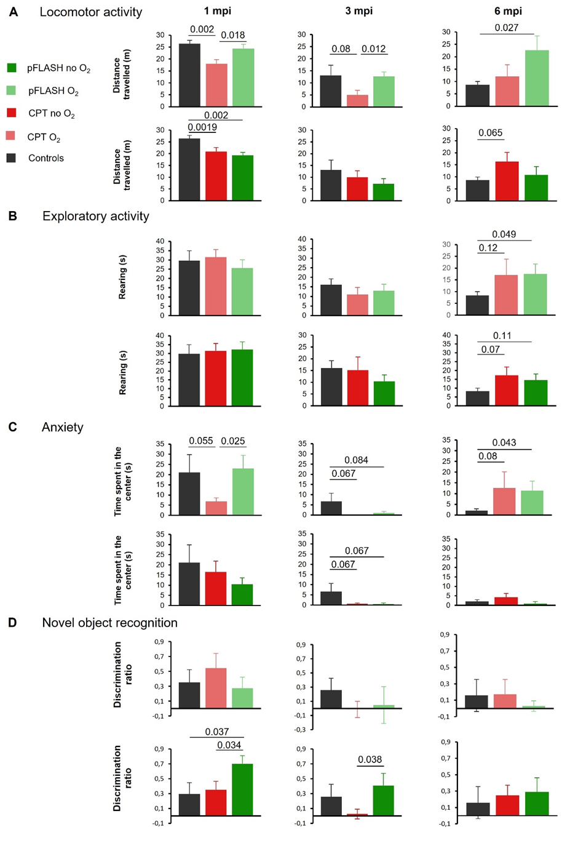
On the impact of anesthesia’s O₂
Detrimental effect of anesthesia’s O₂ in both CPT and pFLASH irradiations, being in the latter case where the most extensive brain damage is observed. →the benefit/risk strategy of high or low dose oxygen administration will need to be discussed and a balance struck between issues of safety and therapeutic outcome /toxicity of radiation therapy.
Iturri et al. Nature Comm. accepted

Slide 28
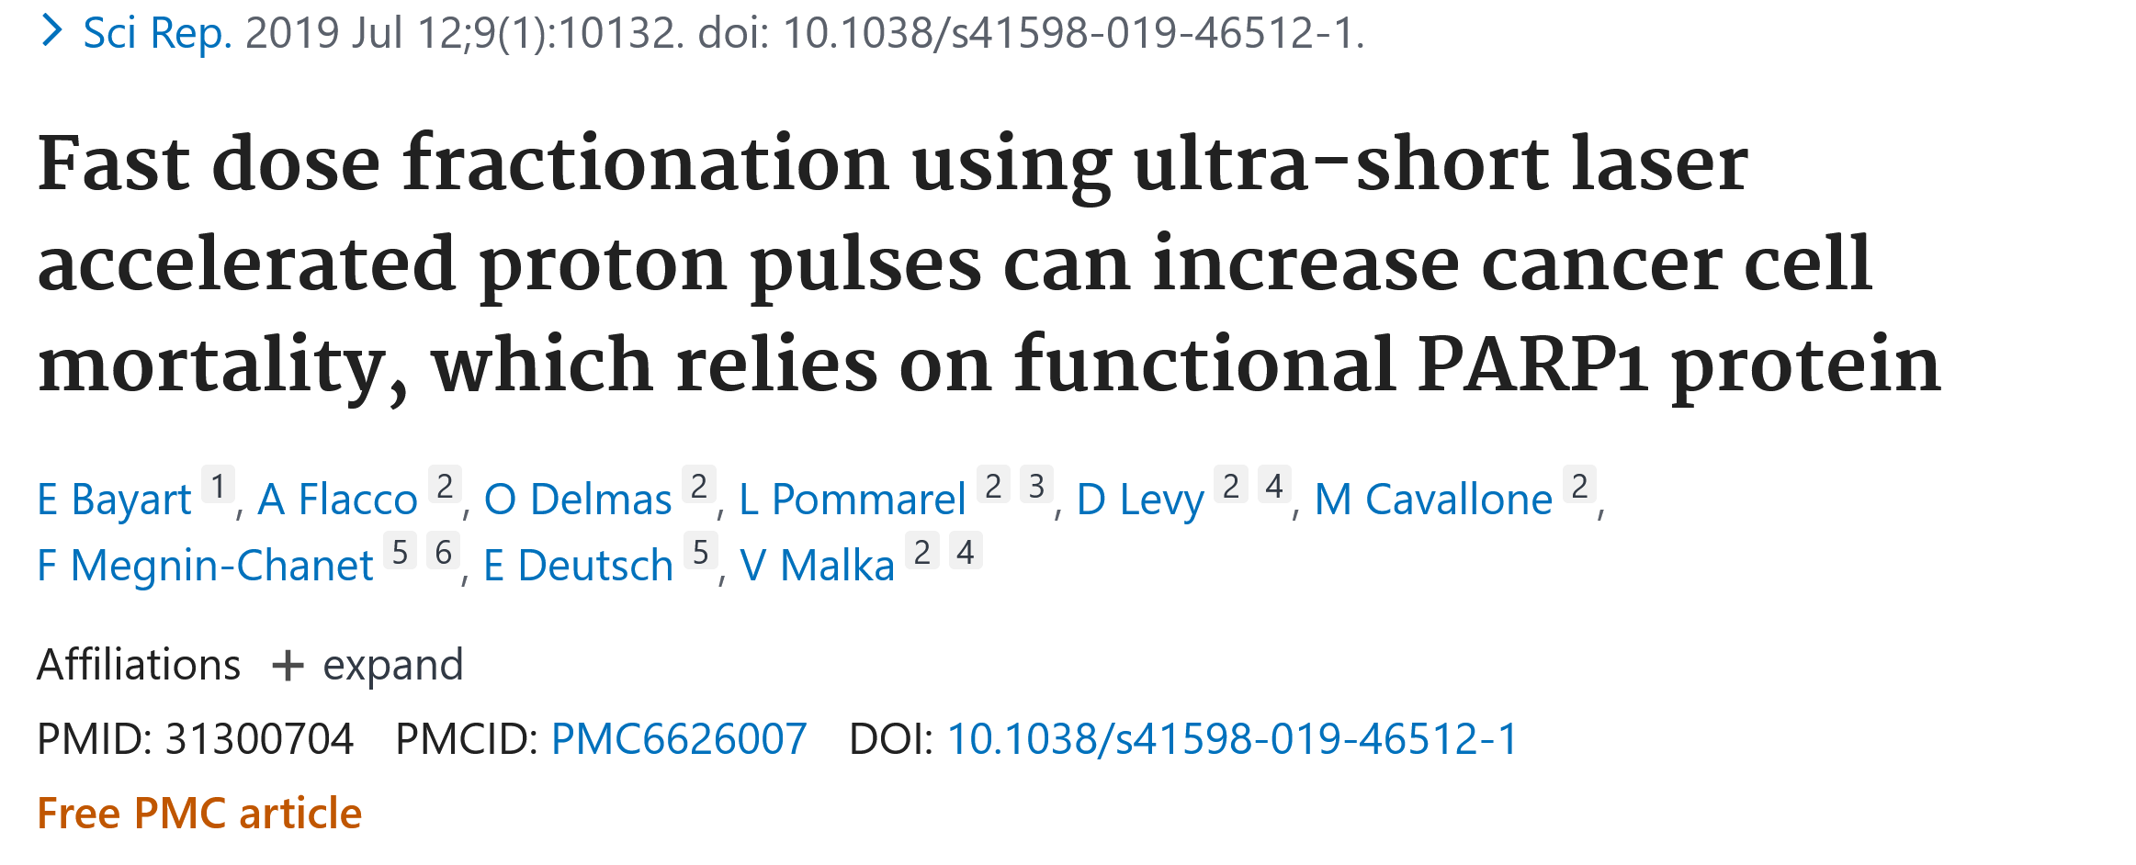
Pulsed Radiobiology

Slide 29
LhARA will open new a wide range of possibilities for exploration
Evaluation of the influence of different fractionation schemes in SFRT
Optimised spatiotemporal dose distributions
Influence of the particle type
Assessment on the (ultra high) dose-rate dependance in SFRT
Set of irradiation parameters to achieve a robust FLASH effect

Slide 30
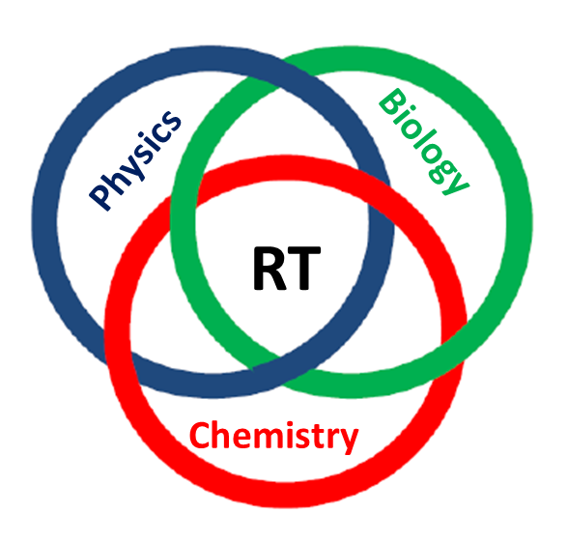
Thank you very much for your attention!
yolanda.prezado@curie.fr

