Slide 1


A context for the clinical use of heavy Ion therapy
Professor Adrian Crellin
24th October 2023

Slide 2
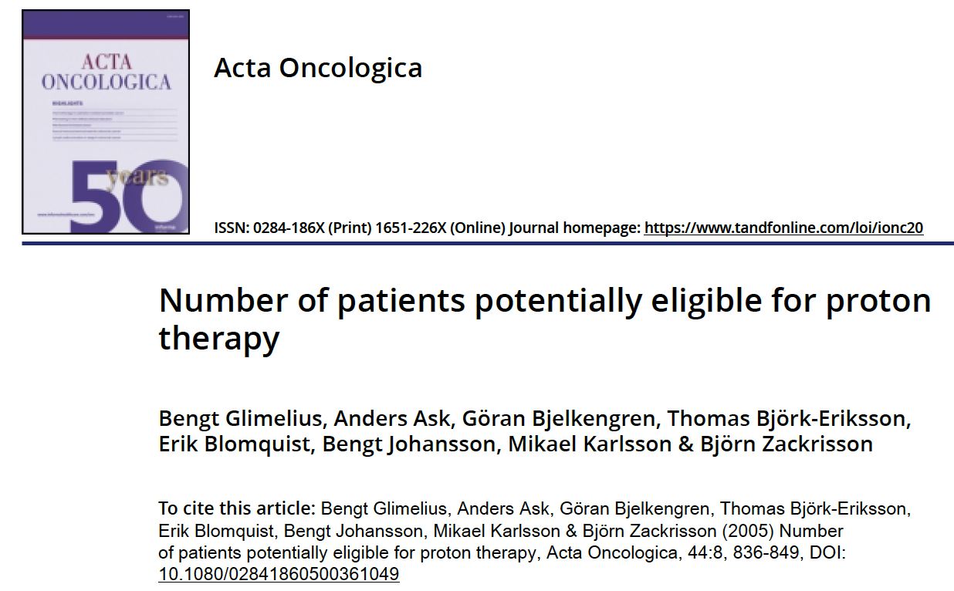
Is there a convincing Gap (Clinical Need) for It?
Where would Clinical Ion Facility fit with Conventional RT, SABR, PBT, Molecular RT, Brachytherapy?
Rehashed quote of 10-15% Potential advantage for Protons
Since then dramatic improvement Conventional RT
  IMRT/IGRT
  SABR
  Image based planning and QA
  Hypofractionation schedules
  Pre-rectal Spacers
Successful case for PBT and £260M capital and £55.5M revenue
including 40-50% use for trials - only just!!
NHS methodology for innovative therapies
Paediatric caseload critical political / leverage factor
So for Ions – Need to look for failure of range of current NHS RT options

Slide 3
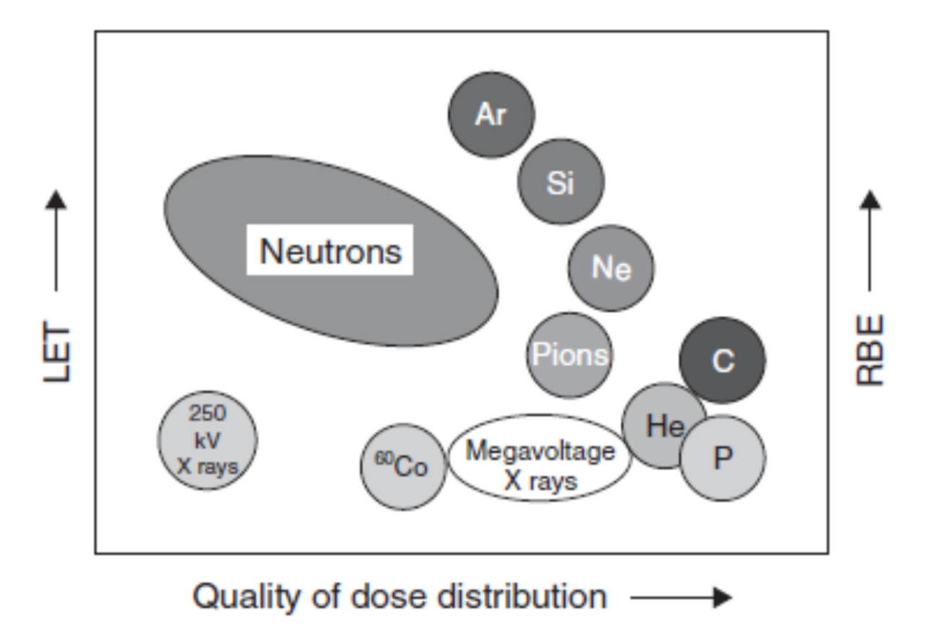
Uncertainties and Fundamentals
What is optimum particle?
What energy?
What is biological gain? Hypoxia?
Individualised gain of same cell type?
Marginal dosimetry benefit vs PBT
Technical challenges
  Gantry Size
  Accelerator designs
Cost $250-300M One room Carbon
Cheaper & smaller Helium?
Who and how many patients will benefit c.f. PBT
  Cost per case
From : Hall E. Radiobiology for the Radiologist

Slide 4
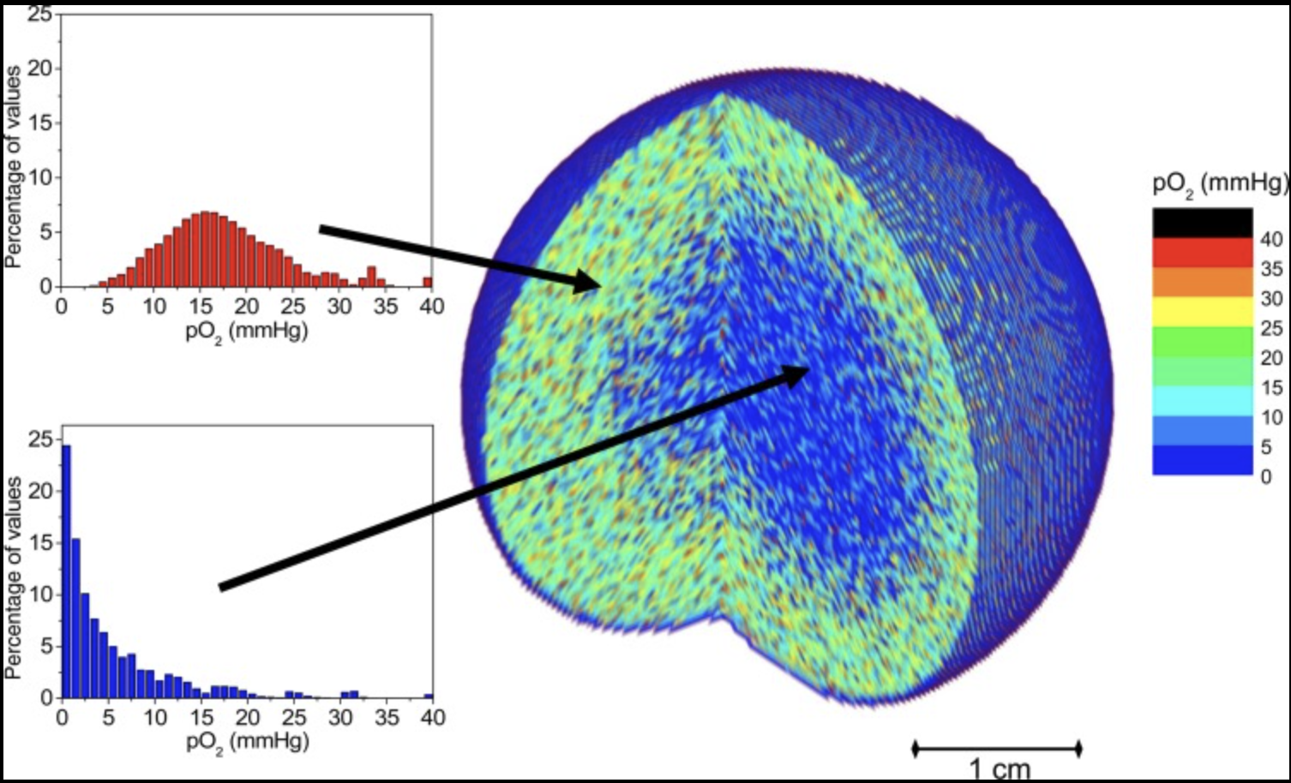

What is the clinical context and exam question?
Local control is sole cause failure
  Inoperable or unresected advanced disease with low/no metastatic potential?
  Conventional RT and PBT has very poor curative potential results
  Locally recurrent tumours?
  Re-irradiation normal tissue?
  Numbers and identification of cases up front?
Can use it but is it superior to Protons / Photons
  ? Evidence base – case series – Japan et. al
Inoperable Sacral Chordoma
Advanced Inoperable Head and Neck Cancer
Recurrent and advanced Non Small Cell Lung Cancer?
Salivary Gland tumours?
Boost to anoxia – mixed modality?
Niche dosimetry indications?
Immune response modification due to high LET?
Competition and increased uncertainty - FLASH –
Application to photon/proton/helium/carbon
Relative clinical effectiveness of carbon
ion radiotherapy: theoretical modelling for H&N tumours. Antonovic et al. J Rad Research 2015
Mary Meredith

Slide 5
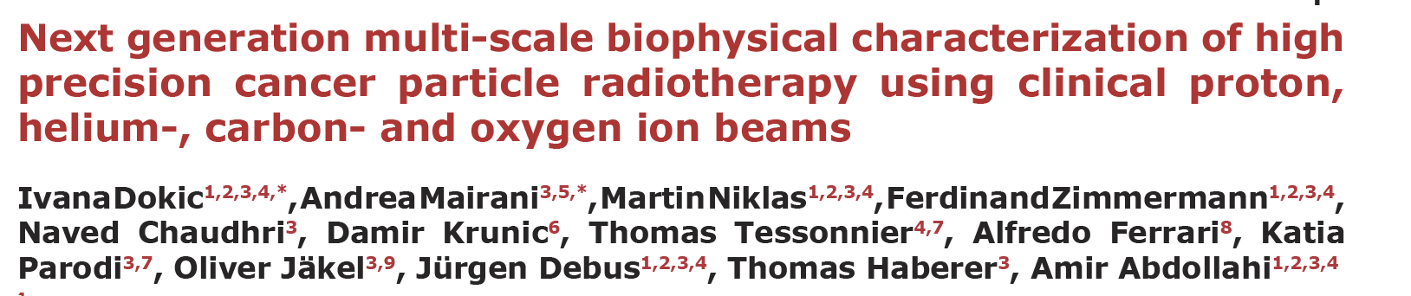
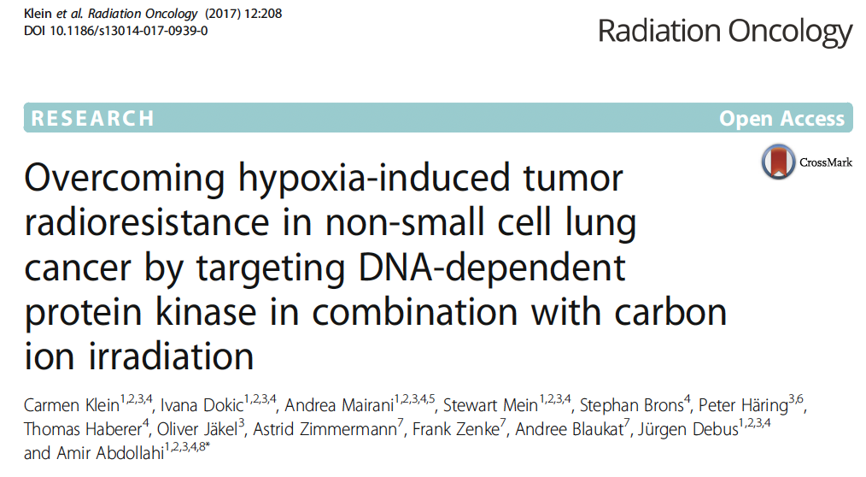
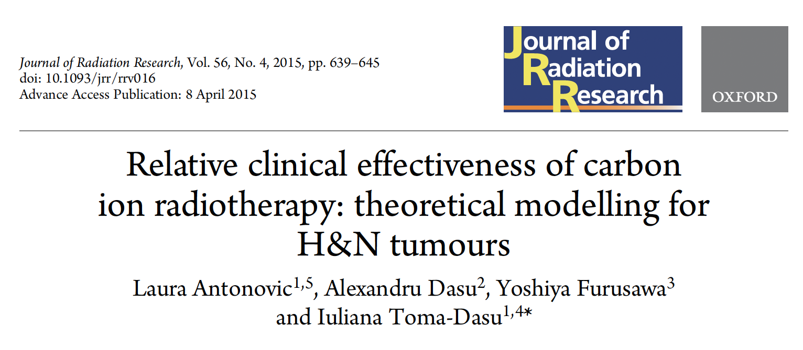
Review UK PBT clinical outcomes
NHS England Fatigue
Disease control as intent not cure
  Into clinical trial abroad
  hypofractionation / hyperthermia
  Can still link to 2 – 5 year survival and QOL
Develop closer links with EU centres?
Good starting point science

Slide 6
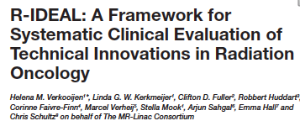
More questions
Why such variation with Clinical Strategy of USA / EU/ Japan / Germany / Austria if any of them is so good?
When and how can we deliver a simple answer framed that a Minister (SPAD) and NHSE Clinical Panel could understand framed based on superiority to Conventional (including PBT) treatment
Frontiers in Oncology 2017

Slide 7
ITRF Concept
Excellent plan
Has all the elements
  How do we find our Cindarella and turn her into a princess?
Avoids many risks - but not all
Time frame sensible
  Bearing in mind PBT took 2008-2018

Slide 8
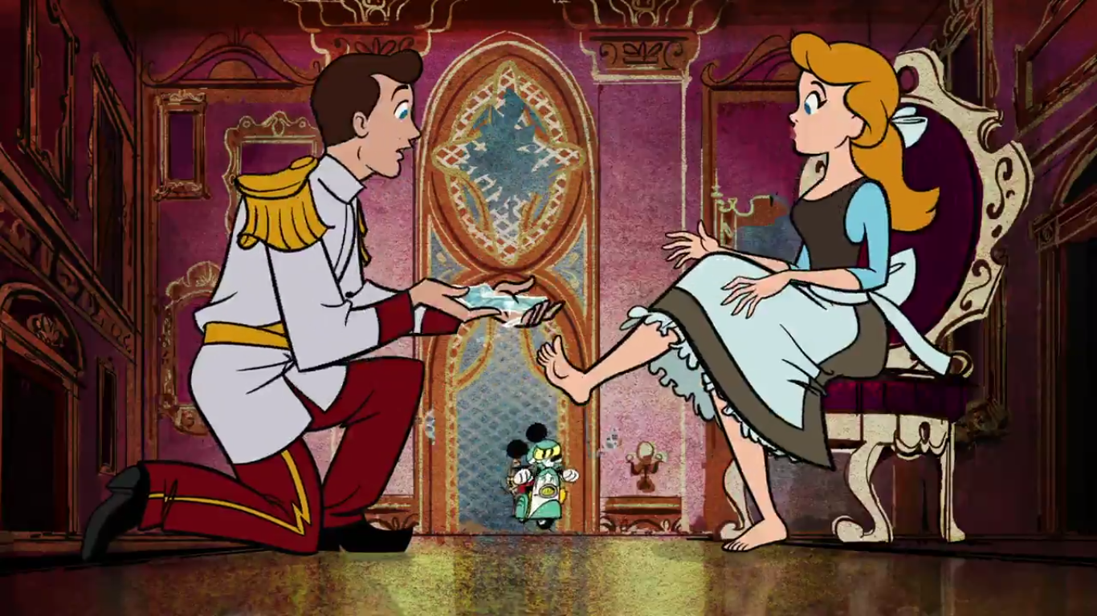
We need to develop and refine a coherent and attractive clinical story

Slide 9
Who are the candidates?

Slide 10
Conclusions
Research focus for now
Innovative questions and endpoints
Accelerator developments and engineering
Fundamental understanding biology to justify investment in clinical facility
  Aligned to Major Cancer Centre with full supportive infrastructure and experience
Develop clear subgroups patients and mechanism for improving outcomes for each?
Not undermine PBT
Early communication is key and clinical context in face of major drive to early diagnosis

